Slide 1
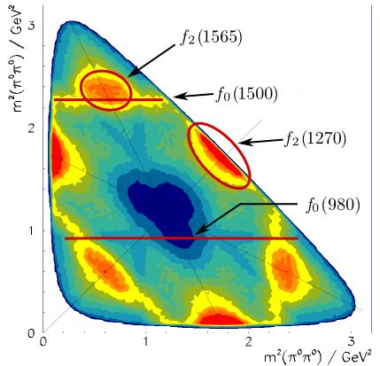
Physics Analysis Concepts with PandaRoot (1)
PANDA Lecture Week 2017
GSI, Dec 11 - 15, 2017
Klaus Götzen GSI Darmstadt

Slide 2
Topics
Data Levels
Data Access (PndAnalysis)
Analysis Basics
Particle Candidates (RhoCandidate, PndPidCandidate)
Combinatorics (RhoCandList)

Slide 3
Wiki Tutorial Page
A all times up-to-date tutorial can be found here: http://panda-wiki.gsi.de/cgi-bin/view/Computing/PandaRootRhoTutorial

Slide 4
Wiki Rho Documentation
http://panda-wiki.gsi.de/cgi-bin/view/Computing/PandaRootAnalysisJuly13

Slide 5
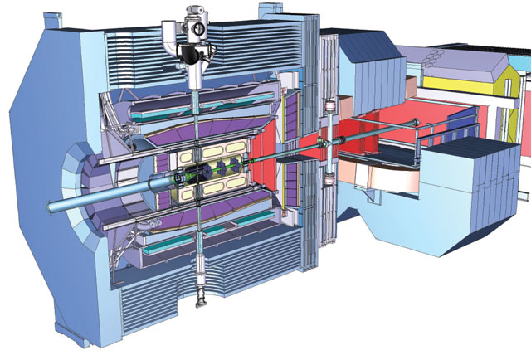
The Aim
Data Analysis
Publication
What do you want to analyse/investigate?
How can it be measured (what are the observables)?
Reconstruct the corresponding signal channels!
Determine the needed quantities!
Estimate the errors (statistic & systematic)!
Write paper
Get invited to Stockholm

Slide 6
The Aim
Data Analysis
Publication
What do you want to analyse/investigate?
How can it be measured (what are the observables)?
Reconstruct the corresponding signal channels!
Determine the needed quantities!
Estimate the errors (statistic & systematic)!
Write paper
Get invited to Stockholm
Gonna talk
about that one!

Slide 7
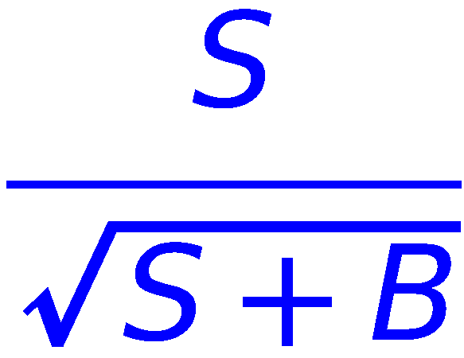
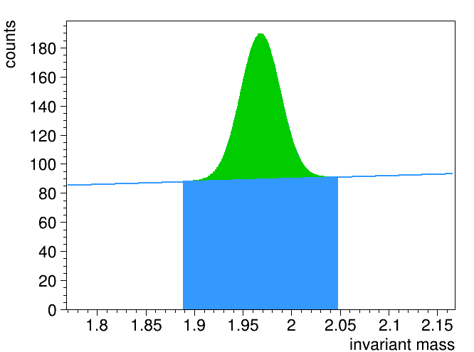
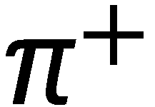
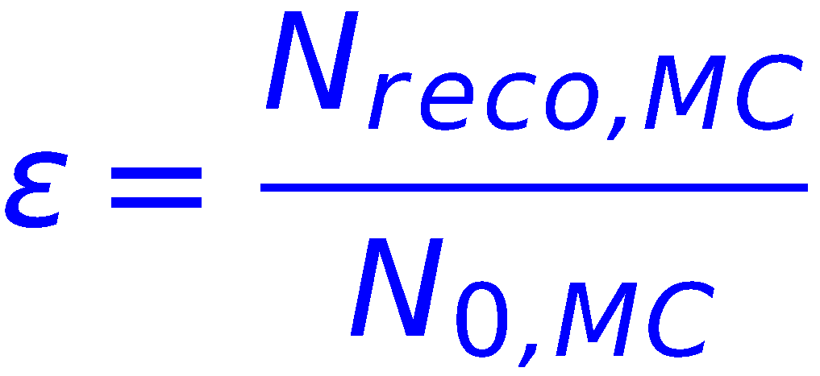
Example: Count Number of D_{s} in Data
Reconstruct signal in data; maximize e.g. significance
Reconstruct signal in dedicated signal Monte Carlo events; number of MC truth matched signals give efficiency
Number of D_{s} in data is (taking into account BR‘s)
S
S = entries in signal peak
B = entries below peak
B

Slide 8
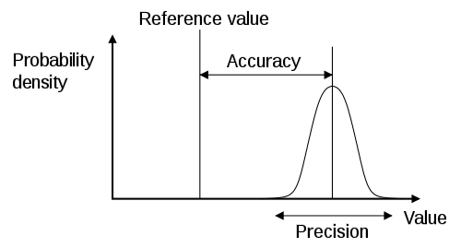
Goal for Experimentalist
Theoreticians: interested in measured value
M_{Higgs} ≈ 125 GeV
Experimentalists: interested in precision/accuracy (error)
M_{Higgs} = X ± 2 GeV
High accuracy
(low systematic error)
High precision
(low statistic error)

Slide 9
BASICS

Slide 10
Reactions in PANDA
There are two different kinds of principle reactions in PANDA
Formation reactions The p system transforms into single resonance state R, which decays afterwards
Production reactions The p system transforms into more than one resonance
p
 beam momentum (→ √s)
is fixed by mass of R
R

p
R₁
 beam momentum can vary
due to kinematic recoil R₂
R₂ (recoil)


Slide 11
Data Levels
What kind of data (levels) do we have in an experiment?
Raw data The stream of digitized hits from the detectors Basis for track/neutral cluster/PID reconstruction
Analysis Object Data (AOD) / Data Summary Tape (DST) Reconstructed objects like tracks and neutrals with associated PID information, bundled to event based data packages Basis for physics analysis
Tag level data Condensed information of events like total energy or momentum, multiplicities (tracks, gammas, kaons, etc.) Fast data filtering

Slide 12
Data Levels
RAW data
AOD data
0
ch 1
+
ch 2
-
ch n-1
0
ch n
-
0
0
+
TAG data
2 positive charged (+)
2 negative charged (-)
4 neutral (0)
...

Slide 13
Data Access in PandaRoot
PandaRoot object: PndAnalysis
Features:
Simple access to reco candidates and McTruth objects
Various PID algorithms directly accessible
FairRunAna *fRun = new FairRunAna();
fRun->SetInputFile("pid_complete.root");
PndAnalysis *ana = new PndAnalysis();
RhoCandList eplus, eminus, muplus, muminus, mct;
TString myPidAlgosElectron = "PidAlgoEmcBayes;PidAlgoDrc"
TString myPidAlgosMuon = "PidAlgoMdtHardCuts"
...
while ( ana->GetEvent() )
{
ana->FillList( eplus, "ElectronTightPlus", myPidAlgosElectron );
ana->FillList( eminus, "ElectronTightMinus", myPidAlgosElectron );
ana->FillList( muplus, "MuonTightPlus", myPidAlgosMuon );
ana->FillList( muminus, "MuonTightMinus", myPidAlgosMuon );
ana->FillList( mct, "McTruth" );
...
}

Slide 14
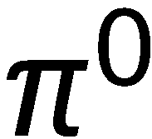
The basis for Analysis: Invariant masses
Q: How do we detect a certain resonance decay?
A: Estimate the 4-vectors of the final states (FS), sum up and compute the invariant mass It should be ‚close‘ to the resonance rest mass. Why did I write estimate? Usually only momentum (charged) or energy (neutrals) from FS particles is measured; the so-called mass hypothesis has to be set during analysis, typically based on PID detector information.

Slide 15
How 4-vectors are reconstructed
Charged particles
Reconstruction of trajectory with tracking/vertex detector
Curvature in magnetic field → momentum p
Assume position on trajectory → 3-vector (p_{x},p_{y},p_{z})
Assume mass hypothesis m →
Neutral particles (gammas)
Reconstruction of cluster in EM-calorimeter
Cluster energy → particle energy E
Assume gamma mass m=0 → p = E
Assume gamma comes from IP → 3-vector (p_{x},p_{y},p_{z})
⇒ Determination of 4-vectors is not an unbiased process!

Slide 16
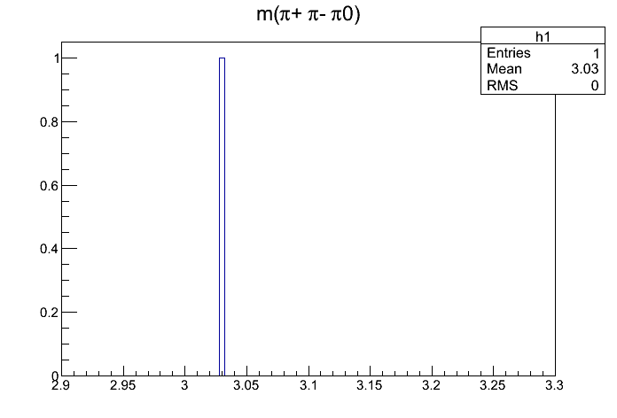
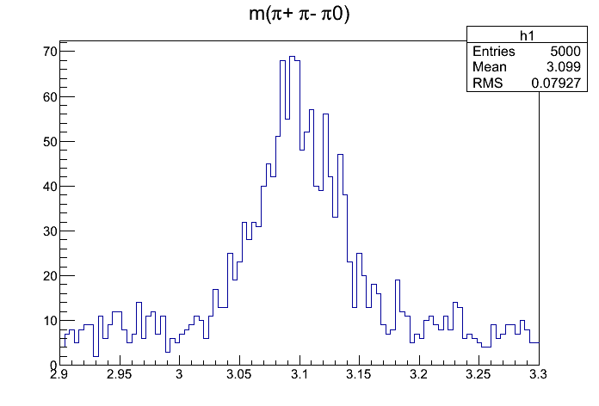
The basis for Analysis: Invariant masses
Q: How do we detect a certain resonance decay?
A2: Not at all (in principle) for a single decay!
Here might
be some
though ...
mass [GeV/c²]
mass [GeV/c²]

Slide 17
Particle Candidate in PandaRoot
PandaRoot object: RhoCandidate
Some important accessors:
Return type | Method | Information
TLorentzVector | P4() | 4-vector
TVector3 | P3() | Momentum vector
TVector3 | Pos() | Origin
Double_t | Charge() | Charge
Double_t | M(), P(), E() | Mass, Momentum, Energy
Int_t | NDaughters() | Number of daughters
RhoCandidate* | Daughter(i) | i-th daughter in decay tree
RhoCandidate* | TheMother() | Mother in decay tree
RhoCandidate* | Combine(TCandidate &c,...) | Creates composite candidate
Bool_t | Overlaps(TCandidate &c) | Checks for collision in tree
RhoCandidate* | GetMcTruth() | MC truth object
Int_t | PdgCode() | PDG code
FairRecoCandidate* | GetRecoCandidate() | Access to reco information

Slide 18
Micro Candidate in PandaRoot
PandaRoot object: PndPidCandidate (FairRecoCandidate)
Some accessors:
Return type | Method | Information
Int_t | GetMvdHits() | Number of MVD hits
Float_t | GetMvdDEDX() | dE/dx measurm. from MVD
Int_t | GetSttHits() | Number of STT hits
Float_t | GetSttMeanDEDX() | dE/dx measurm. from STT
Float_t | GetDrcThetaC() | θ_{C} measurement from DIRC
Int_t | GetDrcNumberOfPhotons() | Number Photons in DIRC
Float_t | GetEmcCalEnergy() | Calibrated EMC cluster energy
Int_t | GetEmcNumberOfCrystals() | Number of crystals in cluster
Int_t | GetMuoNumberOfLayers() | Number of layers hit in MUO det
Float_t | GetMuoProbability() | Probability for being a muon

Slide 19
Work with RhoCandidate/PndPidCandidate
Using PndPidCandidate
...
PndAnalysis *pndana= new PndAnalysis();
RhoCandList piplus, piminus, goodpiplus, goodpiminus;
while (pndana->GetEvent())
{
pndana->FillList(piplus, "PionAllPlus"); // access to reco candidates
pndana->FillList(piminus, "PionAllMinus");
goodpiplus.Cleanup();
for (int i=0; i<piplus.GetLength(); ++i)
{
// get micro candidate and use it for selection
PndPidCandidate *mic = (PndPidCandidate*) piplus[i]->GetRecoCandidate();
if (mic->GetSttHits()>5) goodpiplus.Add(piplus[i]);
}
...
}

Slide 20
General handling of RhoCandidate
RhoCandidate = basic analysis object, many instances needed
RhoFactory does the book-keeping of instances
Creation of new RhoCandidates (when done by hand): RhoCandidate *c = RhoFactory::Instance()->NewCandidate(); RhoCandidate *c = new RhoCandidate();
Delete RhoCandidates: Not necessary!! RhoFactory takes care of it! delete c;


Never!!
actually, it‘s not
super-bad, but
life is easier w/o
☺

Never!!

Slide 21
COMBINATORICS

Slide 22
Combining Candidates
Remember the example event shown above
Question: How do we find out, whether there was a decay
n₁
t⁺₁
t⁻₁
n₂
t⁻₂
t⁺₂
n₄
n₃

Slide 23
Combinatorics
Answer: Create all combinations of FS particles, which match the decay pattern and create histogram of inv. mass.
Our example: 2 positive (t⁺₁, t⁺₂), 2 negative tracks (t⁻₁, t⁻₂), 4 neutrals (n_{k})
π⁰ candidates → 6 combinations π⁰₁=(n₁+n₂), (n₁+n₃), (n₁+n₄), (n₂+n₃), (n₂+n₄), π⁰₆=(n₃+n₄)
J/ψ candidates → 24 combinations J/ψ₁ = (t⁺₁ + t⁻₁ + π⁰₁), J/ψ₂ = (t⁺₁ + t⁻₁ + π⁰₂), ... ... J/ψ₂₄ = (t⁺₂ + t⁻₂ + π⁰₆)

Slide 24
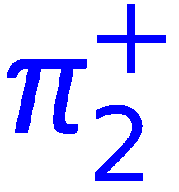
Caveat: Double counting
Double counting = erroneous creation of identical combinations leading to multiple entries in spectra/lists
Can happen in wrong coded nested loops
Examples for double counting:
=
=

Slide 25
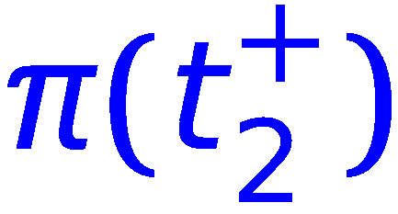
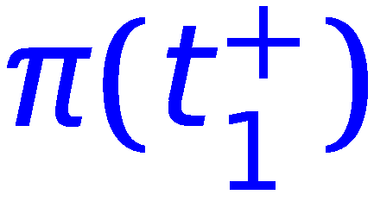
Caveat: Double counting
No double counting here (decay trees have different topology!):
≠
≠
≠

Slide 26
Caveat: Double counting
But be aware:
If cut applied to K_{S}⁰ → only one of (1) and (2) might be selected.
If both selected → two different decay trees with identical 4-vector of the D⁺
If K_{S}⁰ fit → probably will have two different 4-vectors
Is this now double counting?
Simple recipe: Just keep one (the best) solution per event
1
2

Slide 27
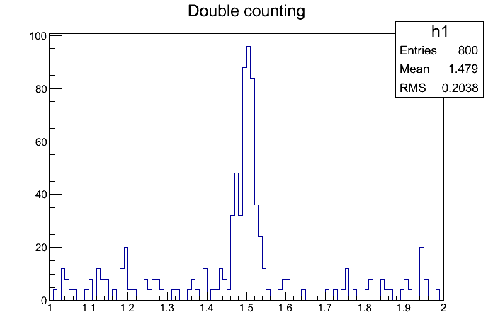
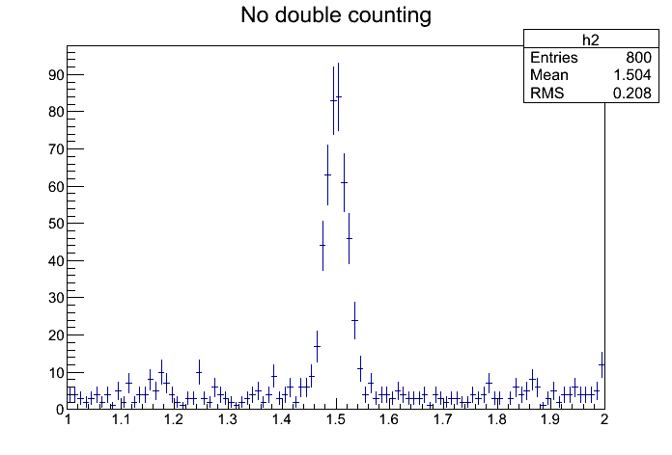
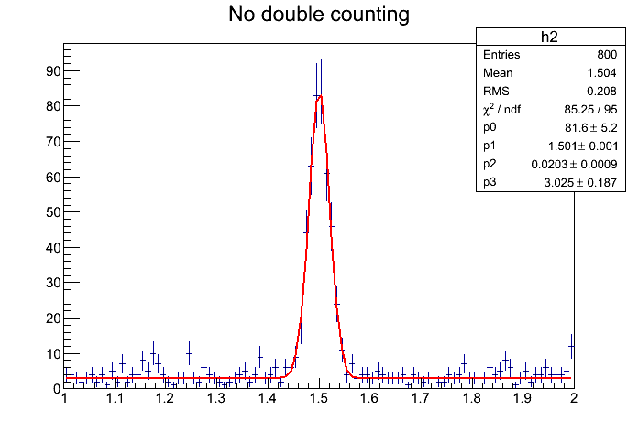
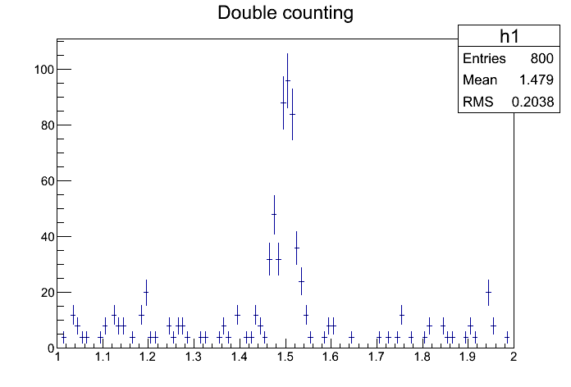
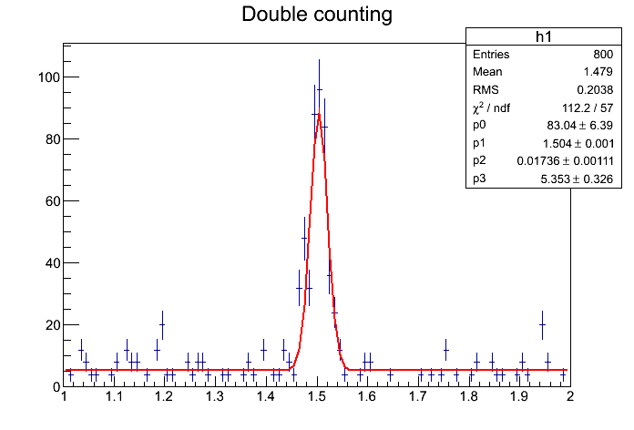
Double counting: How it might look like
errors too small
compared with
fluctuations

Slide 28
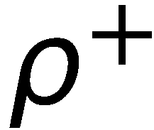
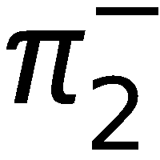
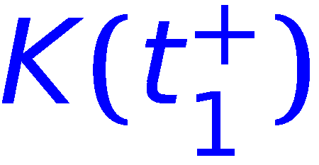
Caveat: Overlaps
Overlap = erroneous multiple use of the same reco object in a decay tree
Can happen when working with composite candidates or different mass hypotheses

Slide 29
Particle List in PandaROOT
PandaROOT object: RhoCandList
Some important accessors:
Method | Information
Int_t GetLength() | number of particles in list
void Add(RhoCandidate*) | Appends candidate to list
void Remove(RhoCandidate*) | Removes candidate from list
RhoCandidate* operator[](Int_t) | Returns a candidate
void Append(RhoCandList&) | Appends candidates from another list
void Combine(RhoCandList&,...) | Combinatorics with other RhoCandList(s)
void Select(VAbsPidSelector*) | Selects (=modifies) list
void Select(RhoCandList &, VAbsPid...) | Selects from another list
void Cleanup() | Empties list

Slide 30
Combinatorics in PandaROOT
PandaROOT objects: RhoCandList & RhoCandidate
Example channel:
RhoCandList piplus, piminus, gamma, pi0, jpsi, psip; // define RhoCandList‘s
pndana->FillList(piplus, "PionAllPlus"); // positive chrg trks with pion hypo
pndana->FillList(piminus, "PionAllMinus"); // negative chrg trks with pion hypo
pndana->FillList(gamma, "Neutral"); // neutral particle candidates
pi0.Combine(gamma, gamma); // cares about double counting
jpsi.Combine(piplus, piminus, pi0);
psip.Combine(jpsi, piplus, piminus); // cares about overlaps
for (int j=0; j<psip.GetLength(); ++j) // loop over candidates in TCandList
{
masshisto.Fill( psip[j]->M() ); // and fill e.g. a mass histo
}

Slide 31
Combinatorics in PandaROOT (by hand)
Example channel:
RhoCandList piplus, piminus, gamma, pi0, jpsi; // define TCandList‘s
...
pi0.Cleanup(); jpsi.Cleanup(); // clean lists !!
for (int i=0; i<gamma.GetLength()-1; i++) { // nested loops
for (int j=i+1; j<gamma.GetLength(); j++) {
if (gamma[i]->E()>Emin || gamma[j]->E()>Emin) { // do e.g. some check
RhoCandidate *comb = gamma[i]->Combine(gamma[j]); // create comb. candidate
pi0.Add(comb); // add it to list
}
}
}
for (int i=0; i<piplus.GetLength(); i++) { // and the same for
for (int j=0; j<piminus.GetLength(); j++) { // the J/psi candidates
for (int k=0; k<pi0.GetLength(); k++) {
RhoCandidate *comb = piplus[i]->Combine(piminus[j], pi0[k]);
jpsi.Add(comb);
}
}
}
...

Slide 32
Combinatorics in PandaROOT (by hand)
Example channel (overlap check):
RhoCandList pipm, kplus, kminus, ds; // define RhoCandList‘s
...
ds.Cleanup(); // clean list
for (int i=0; i<kplus.GetLength(); i++) // nested loops
{
for (int j=0; j<kminus.GetLength(); j++)
{
RhoCandidate *phi = kplus[i]->Combine(kminus[j]); // create phi candidate
for (int k=0; k<pipm.GetLength(); k++)
{
if (!pipm[k]->Overlaps(phi)) // check for overlap
{
RhoCandidate *comb = phi->Combine(pipm[k]);
ds.Add(comb);
}
}
}
}
...

Slide 33
Access to Genealogy
PandaROOT object: RhoCandidate
Example channel:
pi0.Combine(gamma, gamma); // create pi0 candidates
jpsi.Combine(piplus, piminus, pi0); // create J/psi candidates
...
cout << jpsi[i]->NDaughters() <<endl; // prints number of daughters (3, not 4!)
RhoCandidate *pip = jpsi[i]->Daughter(0); // the pi+ candidate
RhoCandidate *pim = jpsi[i]->Daughter(1); // the pi- candidate
RhoCandidate *pi0 = jpsi[i]->Daughter(2); // the pi0 candidate (composite!)
RhoCandidate *gam1 = pi0->Daughter(0); // the 1st gamma
RhoCandidate *gam2 = pi0->Daughter(1); // the 2nd gamma

Slide 34
Combinatoric Exercises
Particles in event: 3t⁺, 3t⁻, 6n; no PID information used
How many combinations for
J/ψ → γη_{c} → γγγ?
D_{s}± → K⁺ K⁻ π±?
J/ψ → γη_{c} → γωω → γ π⁺π⁻π⁰ π⁰γ → γ π⁺π⁻ γγ γγγ?
60
36
/
1620

Slide 35
EXERCISES

Slide 36
Exercises Preparation
Preparation/hints in tutorials/thailand2017/README
FIRST setup environment: source ~/workshop/build/PandaRoot_trunk.../config.sh
To have some data for tutorial macros, do one of the following a) . ./tut_runall.sh 1000 # sim/reco 1000 events pbarp -> J/psi pi+ pi- b) cp data/signal_p*root . # preproduced default data
Macros named 'tut_ana...C' are stubs and should be completed by you.
At places marked with ' #### EXERCISE: ...' some code needs to be added; Run macros (default or different input data) with > root -l tut_ana...C # signal_pid.root, signal_par.root > root -l 'tut_ana...C(0,"mydata")' # mydata_pid.root, mydata_par.root
If getting stuck, sample solutions are in the subfolder 'solution' Run solution macros directly (default or different input data) with > root -l solution/tut_ana...C > root -l 'solution/tut_ana...C(0,"mydata")'

Slide 37
Exercises Suggestions
Rho Tutorial website: http://panda-wiki.gsi.de/cgi-bin/view/Computing/PandaRootRhoTutorial
Take a look to tutorials/thailand2017/README Exercise: #1
Write macro to reconstruct (combinatorics) one/some of the channels in ./data
Compare results with nested loop to RhoCandList combinatorics

