Slide 1
git Introduction

Slide 2
Short Introduction

Slide 3
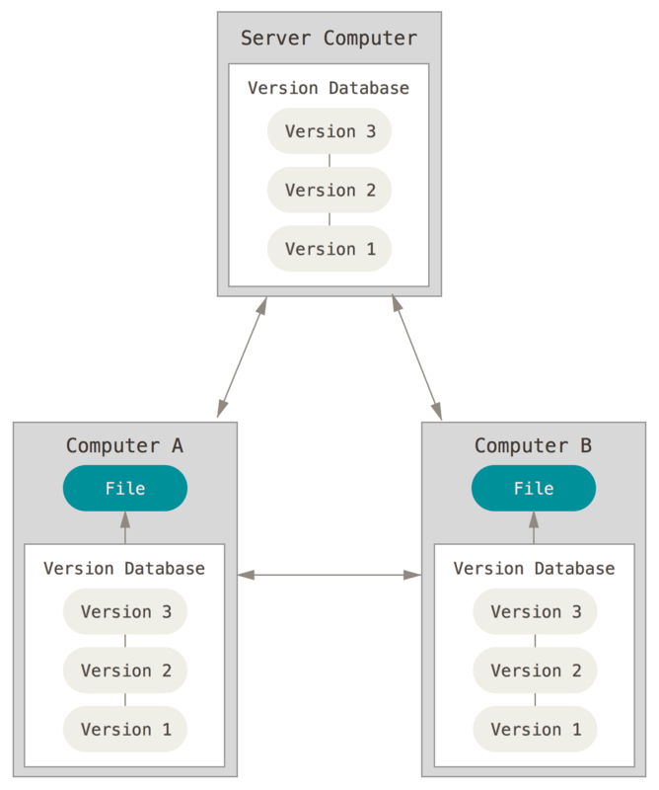
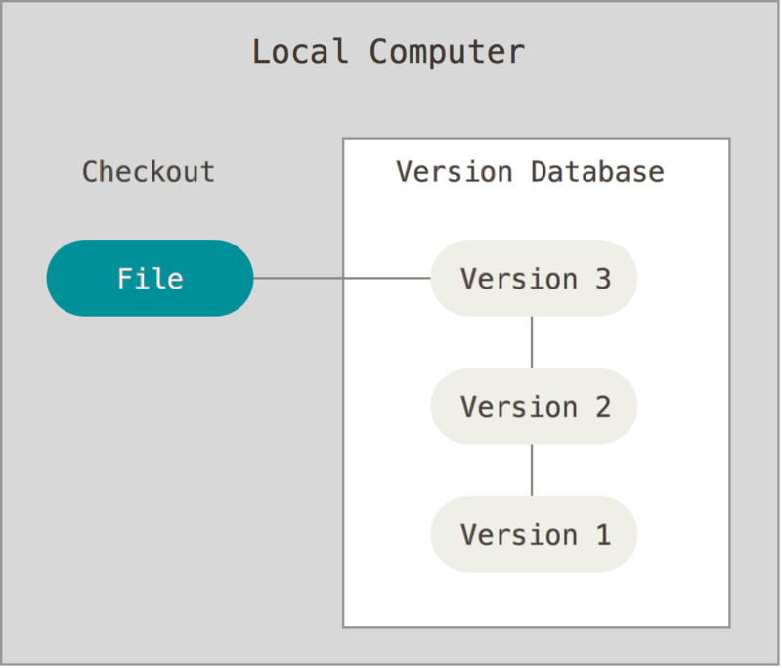
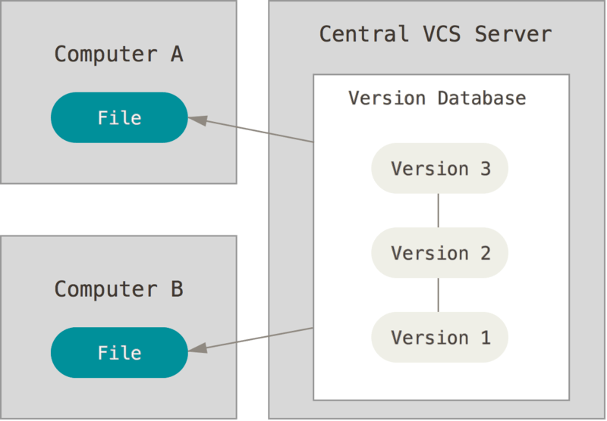
About Version Control
Local VCS
E.g. RCS
Centralized VCS
E.g. CVS, SVN
Distributed VCS
E.g. CVS, SVN
Records deltas for each file on disk
Less error prone than manually copying files to separate directories
Collaboration of developers
Fine-grained access control
Each computer has a copy of the repository

Slide 4
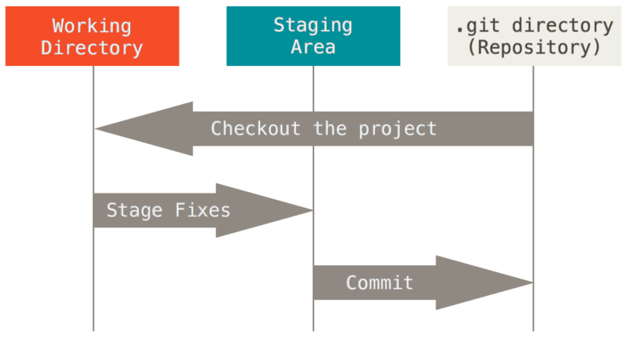
3 Areas in git

Slide 5
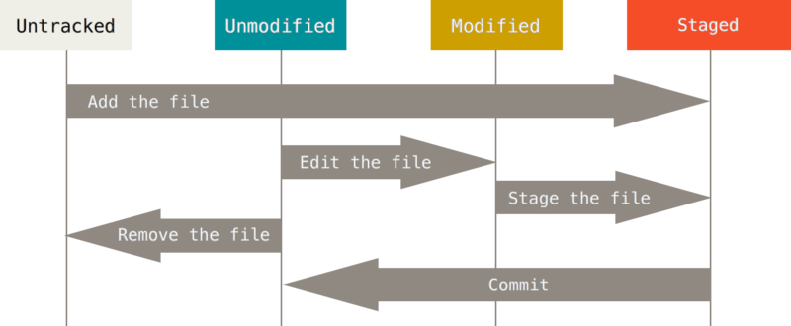
Status of Files
New file
File in repo
Not changed
File in repo
Changed
Marked for commit

Slide 6
Status of Files
git status
On branch dev
Your branch is up-to-date with 'mainrepo/dev'.
Changes to be committed:
(use "git reset HEAD <file>..." to unstage)
modified: README.md
Changes not staged for commit:
(use "git add <file>..." to update what will be committed)
(use "git checkout -- <file>..." to discard changes in working directory)
modified: LICENSE
Untracked files:
(use "git add <file>..." to include in what will be committed)
.project
examples/MQ/9-PixelDetector/run/scripts/startFairMQEx9NewTS.sh.in
examples/advanced/Tutorial3/macro/MyLog.log
examples/advanced/Tutorial3/macro/PrintLinks_complete.C
examples/advanced/Tutorial3/macro/PrintLinks_timeBased.C
examples/advanced/Tutorial3/macro/TST.root

Slide 7
What has changed?
git diff
index 1a024283..b1268102 100644
--- a/README.md
+++ b/README.md
@@ -55,7 +55,6 @@ echo 'treename=name_you_chose' > config/rootmanager.dat
# path: ~/fair_install/FairSoftInst
```
-
2. Install [FairRoot](http://fairroot.gsi.de/?q=node/82)
```bash
git diff --staged
diff --git a/LICENSE b/LICENSE
index 5b746838..3152e29c 100644
--- a/LICENSE
+++ b/LICENSE
@@ -7,7 +7,6 @@ GPL text after LGPL text in this file:
Everyone is permitted to copy and distribute verbatim copies
of this license document, but changing it is not allowed.
-
This version of the GNU Lesser General Public License incorporates
the terms and conditions of version 3 of the GNU General Public
License, supplemented by the additional permissions listed below.

Slide 8
Committing
git commit
# Please enter the commit message for your changes. Lines starting # with '#' will be ignored, and an empty message aborts the commit. # On branch master # Your branch is up-to-date with 'origin/master'. # # Changes to be committed: # new file: README # modified: CONTRIBUTING.md # ~ ~ ~ ".git/COMMIT_EDITMSG" 9L, 283C
git commit -m "Short commit"
git commit –a -m “Skipping staging area"
git commit –-amend

Slide 9
Branches

Slide 10
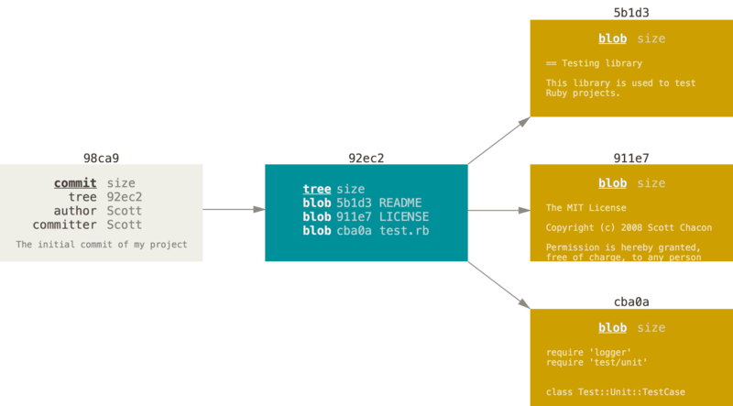
Initial Commit
$ git add README test.rb LICENSE $ git commit -m 'The initial commit of my project'

Slide 11
Sequence of Commits

Slide 12
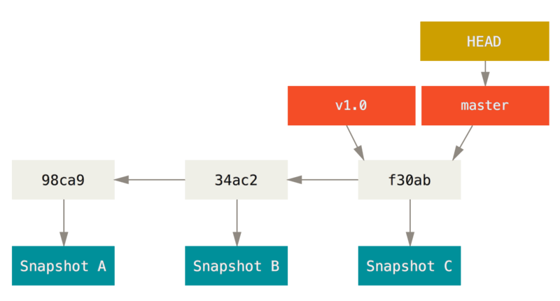
Branch
A branch is just a pointer to a Snapshot
Default branch is called ‘master‘

Slide 13
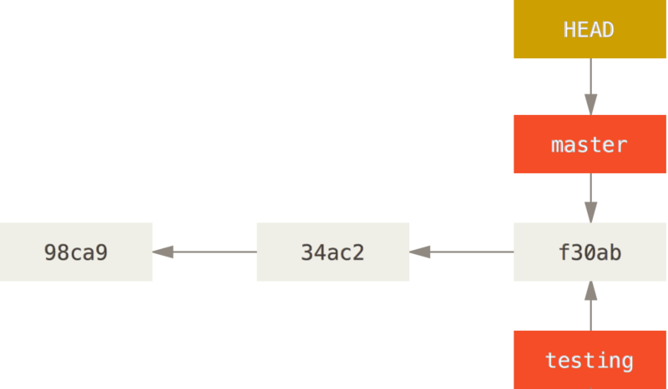
Branch
$ git branch testing

Slide 14
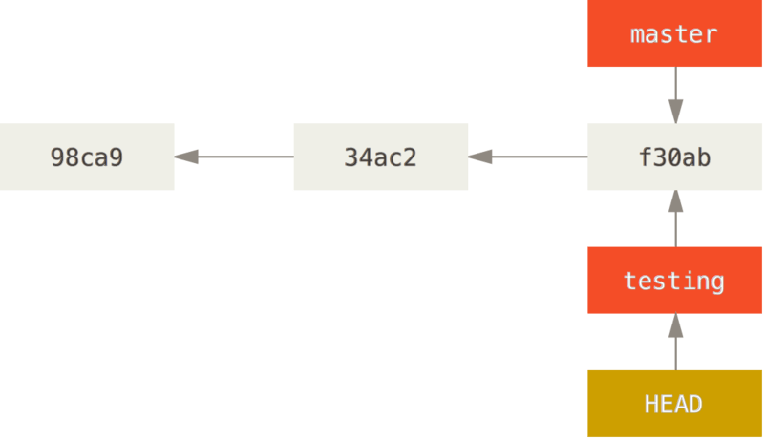
Branch
$ git checkout testing

Slide 15
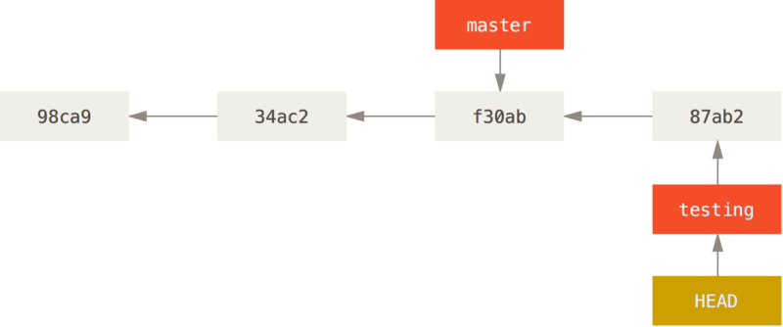
Branch
$ vim test.rb
$ git commit –a –m “made a change“

Slide 16
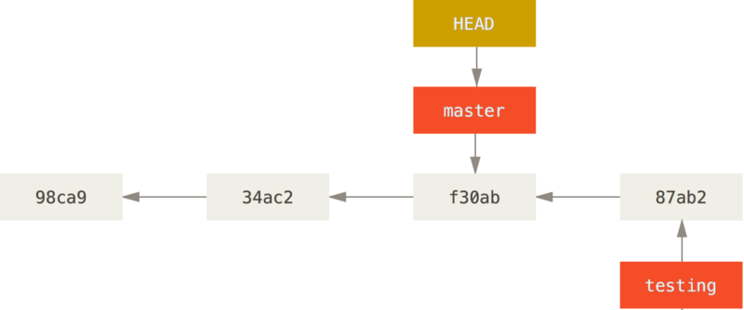
Branch
$ git checkout master

Slide 17
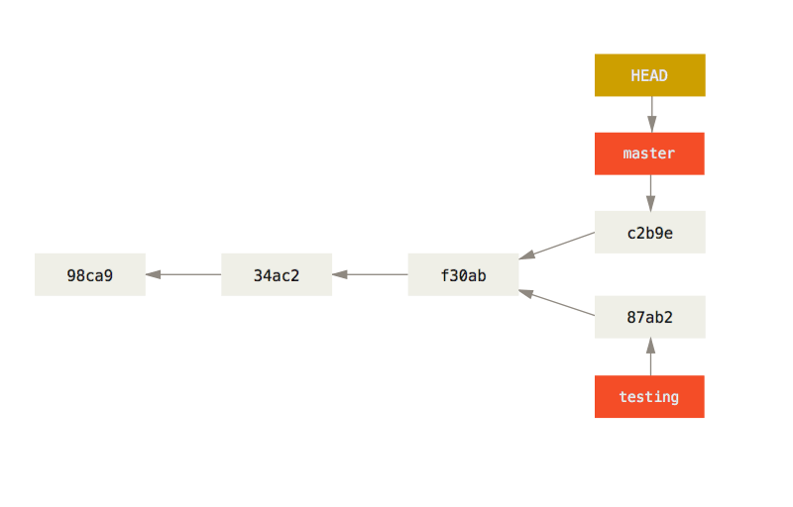
Branch
$ vim test.rb
$ git commit –a –m „made other changes"

Slide 18
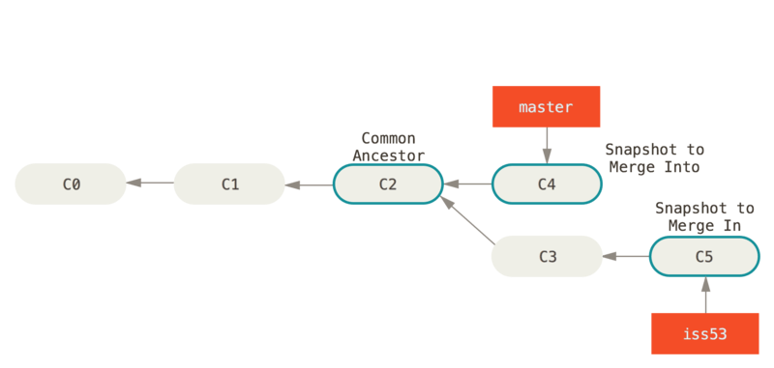
Merging

Slide 19
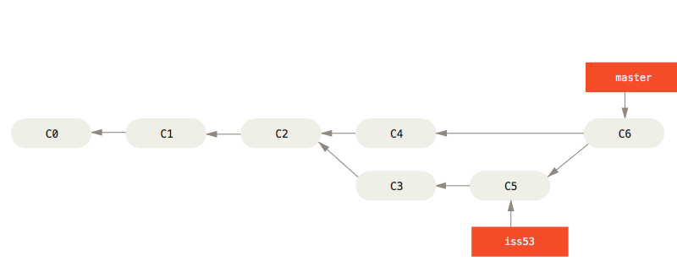
Merging
$ git checkout master
Switched to branch ‘master‘
$ git merge iss53
Merge made by the ‘recursive‘ strategy.

Slide 20
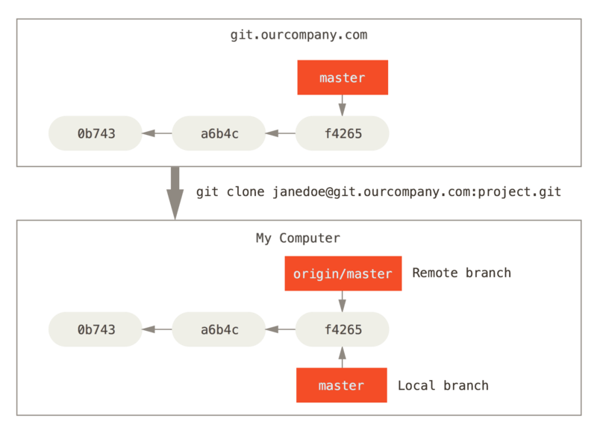
Remote Branch

Slide 21
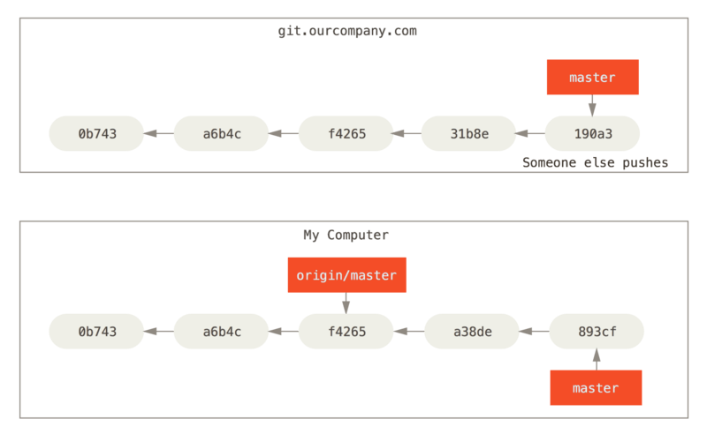
Remote Branch

Slide 22
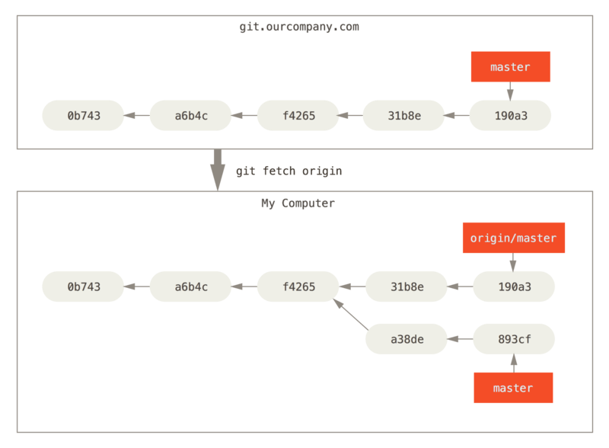
Remote Branch

Slide 23
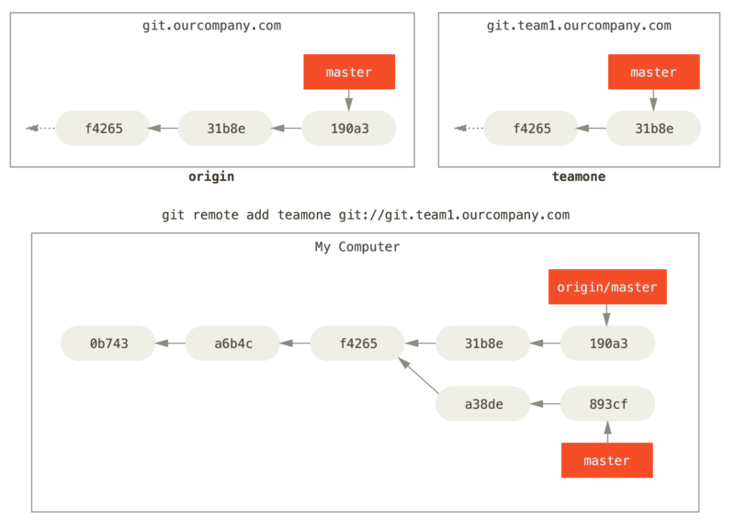
Remote Branch

Slide 24
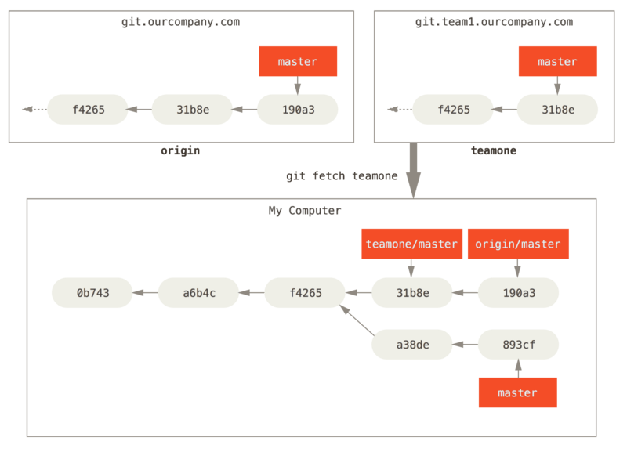
Remote Branch

Slide 25
Remote Branch
$ git push origin <branchname>
Counting objects: 24, done.
Delta compression using up to 8 threads.
Compressing objects: 100% (15/15), done.
Writing objects: 100% (24/24), 1.91 KiB | 0 bytes/s, done.
Total 24 (delta 2), reused 0 (delta 0)
To https://github.com/schacon/simplegit
* [new branch] serverfix -> serverfix
In addition: pull request A pull request is the managed process of a git merge (usually via a webbased software tool) into a restricted repository.
Use case PandaRoot (and FairRoot): The main repository of PandaRoot is restricted for writing
If you want to get a new feature into PandaRoot you have to create a pull request on the gitlab server of PandaRoot → more at the end.

Slide 26
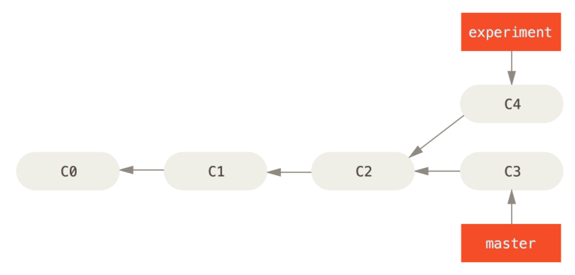
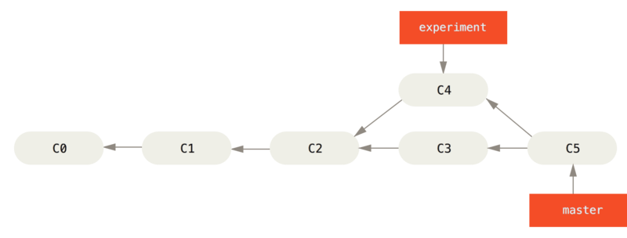
Rebasing

Slide 27
Rebasing
$ git checkout experiment
$ git rebase master
First, rewinding head to replay your work on top of it...
Applying: added staged command
C4‘ does not point to C2 as C4 but to C3. It was rebased.

Slide 28
PandaRoot
Local/PandaRoot
User/PandaRoot „origin“
PandaRootGroup/PandaRoot
„mainrepo“
Branches: dev, master
Only read access to user
Releases are tags to the master branches
Master:
Ready to build at any moment
No development
Only HotFix allowed
No history changes allowed
Dev:
Inherited from latest master
Development mainstream
Rebased from master
Clone of User/PandaRoot
Actual source code plus complete copy of repository
Create feature branch git checkout –b featureName mainrepo/dev
Update via git fetch mainrepo
Rebase via git rebase mainrepo/dev
Upload changes via git push origin
Fork of PandaRootGroup/PandaRoot
Writeable by user
Often rebase from mainrepo
Branches: dev, master, feature branches
Feature Branches:
Each new feature gets a new branch
Tracks dev branch
After developm. finished → rebase from dev, pull request
Local Repository
MyPC
Private Remote Repository
pandaatfair.githost.io
Restricted Remote Repository
pandaatfair.githost.io

Slide 29
Summary
Excellent description of git: https://git-scm.com/book/en/v2
Description of workflow in PandaRoot (and FairRoot) with useful use cases https://github.com/AnarManafov/GitWorkflow/blob/master/GitWorkflow.markdown

