Slide 1
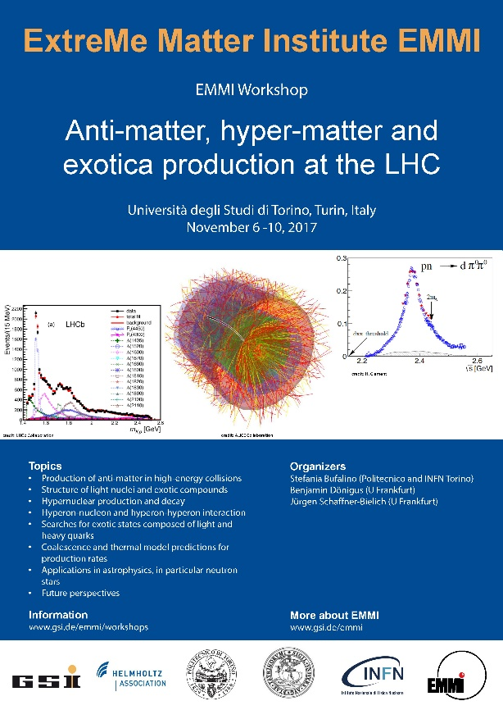
Overview of hypernuclear physics
n
p
p
n
n
p
p
p
n
Λ
p
n
p
n
n
Λ
p
n
n
Tullio Bressani

Slide 2
Outline
Hypernuclear Physics at the border between Particle and Nuclear Physics
Achievements and Perspectives in Nuclear Physics
textbook evidence of the shell model
nuclear compression due to the glue-role of the Λ
neutron-rich Hypernuclear systems
Achievements and Perspectives in Particle Physics
Charge Symmetry Breaking in the strong Λ-N interaction
Spin Dependent Terms in the strong Λ-N interaction
Towards a quantitative determination of the ΛN → NN weak interaction?
Summary

Slide 3
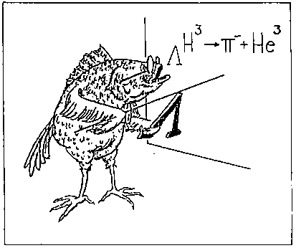
Hypernuclear Physics at the border between Particle and Nuclear Physics
Since the discovery of the first Hyperfragment (1953) several slogans and drawings were invented to describe Hypernuclear Physics as a bridge between Particle and Nuclear Physics
Main advantages (in principle):
Bound systems composed by 3 baryons (p,n,Λ)
Only way to obtain experimental information on the ΛN-NN interaction(strong and weak)
The results which will be presented come nearly exclusively from counter experiments carried out by using magnetic spectrometers designed to prepare and to select Hypernuclei in their ground or excited states

Slide 4
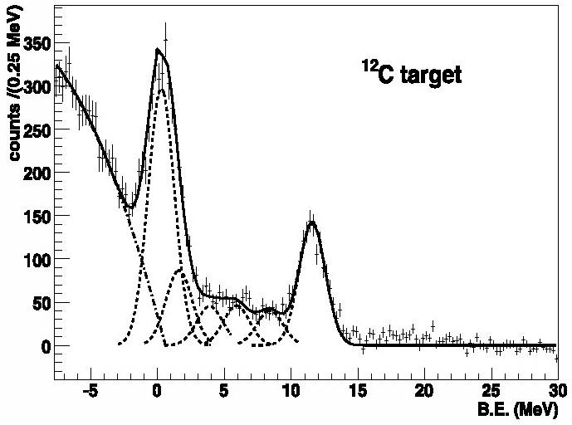
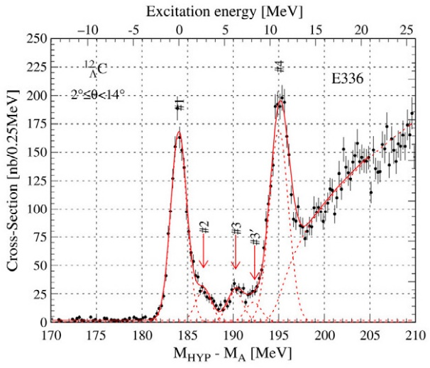
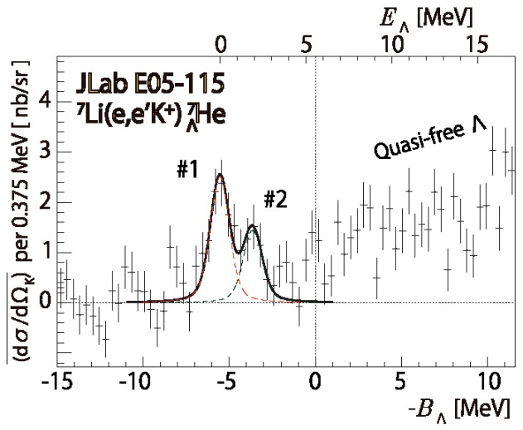
Production reactions
1) Strangeness exchange (CERN, BNL, KEK, LNF, J-PARC)
esothermic
absolute scale of energies only with stopped K⁻
FINUDA Coll., PLB 681 (2009) 139
2) Associate production (BNL, KEK, J-PARC)
endothermic
no absolute scale of energies
O. Hashimoto, H. Tamura, PPNP 57 (2006) 564
3) Electroproduction (JLab, MAMI)
endothermic
absolute scale of energies
T. Gogami et al., PRC 94 (2016) 021302

Slide 5
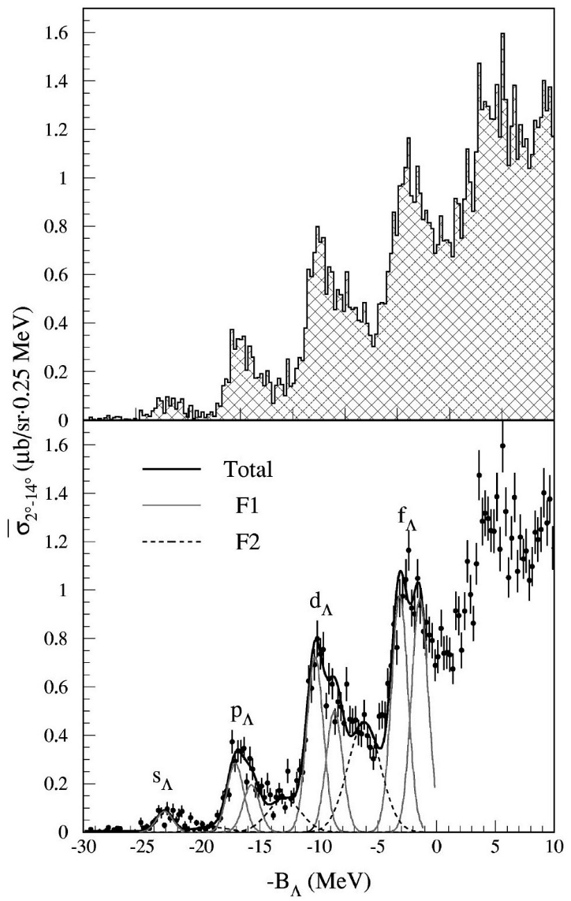
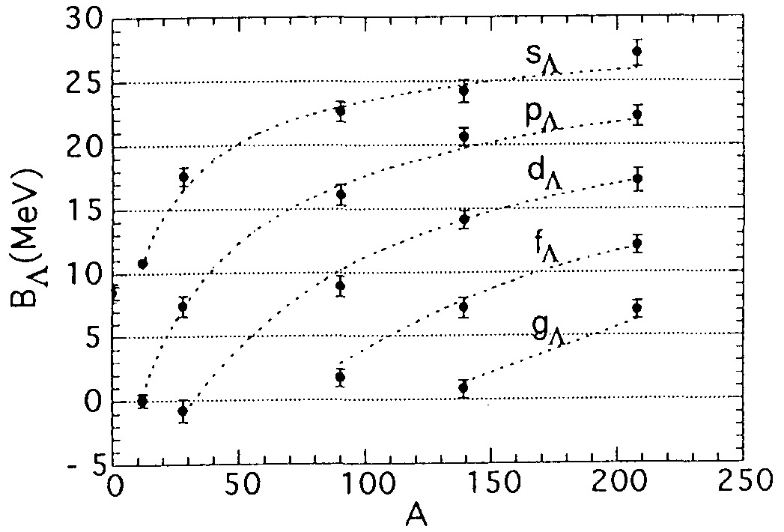
Achievements and Perspectives in Nuclear Physics
textbook evidence of the shell model!
H. Hotchi et al., PRC 64 (2001) 044302
A. Ajimura et al., NPA 585 (1995) 173c
Caution!
Ordinates scale should be shifted by 0.6 MeV
(see later)

Slide 6
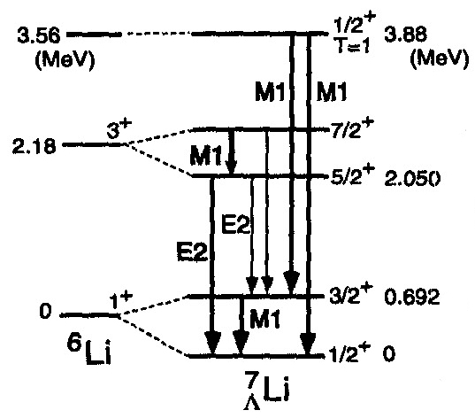
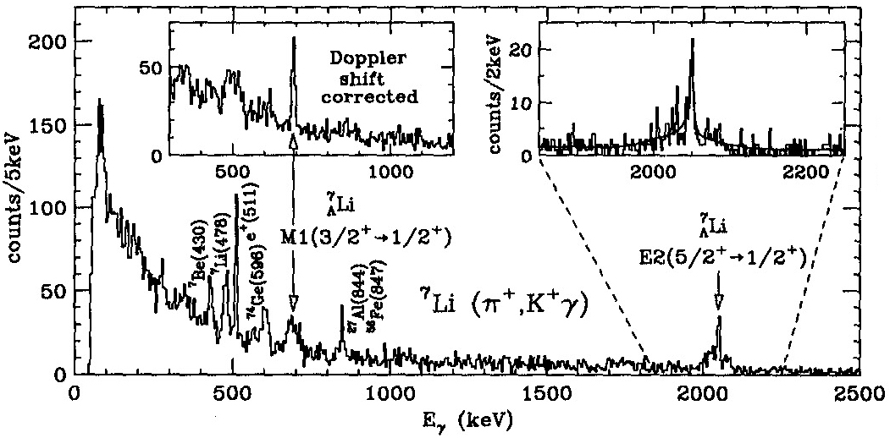
Achievements and Perspectives in Nuclear Physics (cont’d)
nuclear core compression due to the glue role of the Λ
H. Tamura et al., NPA 691 (2001) 86c
Interesting result achieved with the first example of high resolution γ-spectroscopy of Hypernuclei (⁷Li_{Λ})
(combination of the state-of art technologies of MM magnetic spectrometry and large HPGe arrays)
Determination of the excited states energies
with a precision 3 orders of magnitudes better than
with MM reaction spectroscopy (see later)
Determination of the lifetimes of
hypernuclear excited states
by the Doppler shift attenuation method
B(E2) ∝ r⁴ ⇒ shrinkage of ⁶Li core by ~20%

Slide 7
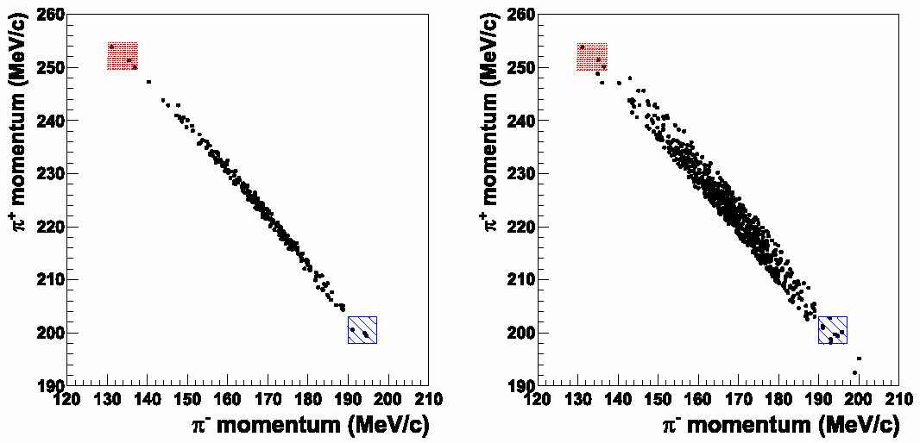
Achievements and Perspectives in Nuclear Physics (cont’d)
neutron-rich Hypernuclear systems
The glue-like role of the Λ-hyperon could stabilize nuclear cores, like ⁵H,
leading to neutron-rich Hypernuclei like ⁶H_{Λ}
((N+Y)/Z) = 5 to be compared with (N/Z) = 3 for ⁸He)
Searches with (K⁻,π⁺) and (π⁻,K⁺)reactions
first positive result with π⁻ + ¹⁰B → ¹⁰Li _{Λ} + K⁺ (lower background)
bump seen, corresponding to ((N+Y)/Z) = 2.3
P.K. Saha et al., PRL 94 (2005) 052502
3 events corresponding to ⁶H_{Λ} were observed by FINUDA
following interactions of K⁻ stopped in ⁶Li targets
background suppressed by requiring a coincidence with the π⁻ from ⁶H_{Λ} weak decay
FINUDA Coll., PRL 108 (2012) 042501
FINUDA Coll., NPA 881 (2012) 269

Slide 8
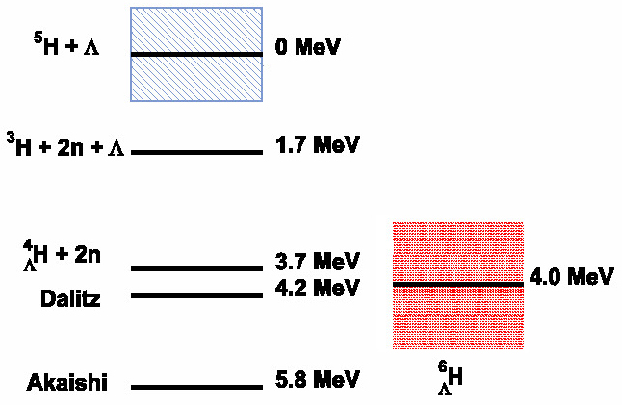
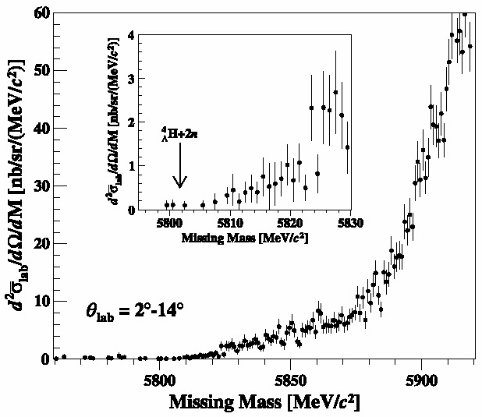
Achievements and Perspectives in Nuclear Physics (cont’d)
neutron-rich Hypernuclear systems
FINUDA Coll., NPA 881 (2012) 269
H. Sugimura et al., PLB 729 (2014) 39
A subsequent measurement of the
π⁻ + ⁶Li → ⁶H_{Λ} + K⁺ reaction at J-PARC
did not find excess events
corresponding to the formation of ⁶H_{Λ}
Different reaction mechanisms involved?
More theoretical insight needed!
Very helpful new measurements
with other experimental techniques:
high resolution pion decay spectroscopy (?)
relativistic ions fragmentation (?)

Slide 9
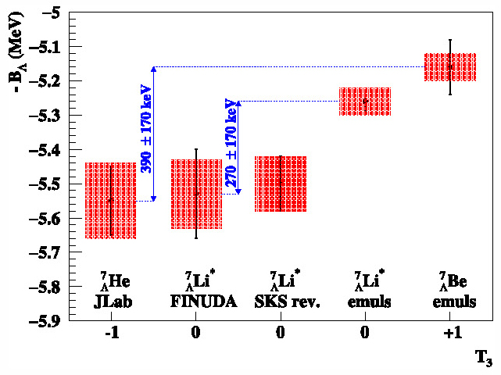
Achievements and Perspectives in Particle Physics
Charge Simmetry Breaking (CSB) in the strong ΛN interaction
before the operation of CEBAF @ JLab only old emulsion data were available for comparison
issue in comparing new data from JLab and from SKS
(normalization to B_{Λ}(¹²C _{Λ}) provided by emulsion experiments not reliable)
Criticism by several authors:
F. Cusanno et al., PRL 103 (2009) 202501 → ΔB_{Λ}(16,8) too high
T. Gogami et al., PRC 93 (2016) 034314 → SKS vs. emulsions, SKS shift +540 ± 50 keV
A. Gal et al., RMP 88 (2016) 035004 → B_{Λ}(¹²C _{Λ}) , SKS shift +600 keV
E. Botta et al., NPA 960 (2017) 165 → SKS vs. FINUDA, SKS shift +600 ± 80 keV
interesting results obtained after
the shift of the SKS data by
+600 ± 80 keV
complete analysis of
the A = 7, T = 1
Hypernuclear systems
differential shrink of
⁷He_{Λ} and ⁷Be_{Λ} cores
(~150 keV)
due to Coulomb force
E. Hiyama et al., PRC 80 (2009) 054321
E. Botta et al., NPA 960 (2017) 165

Slide 10
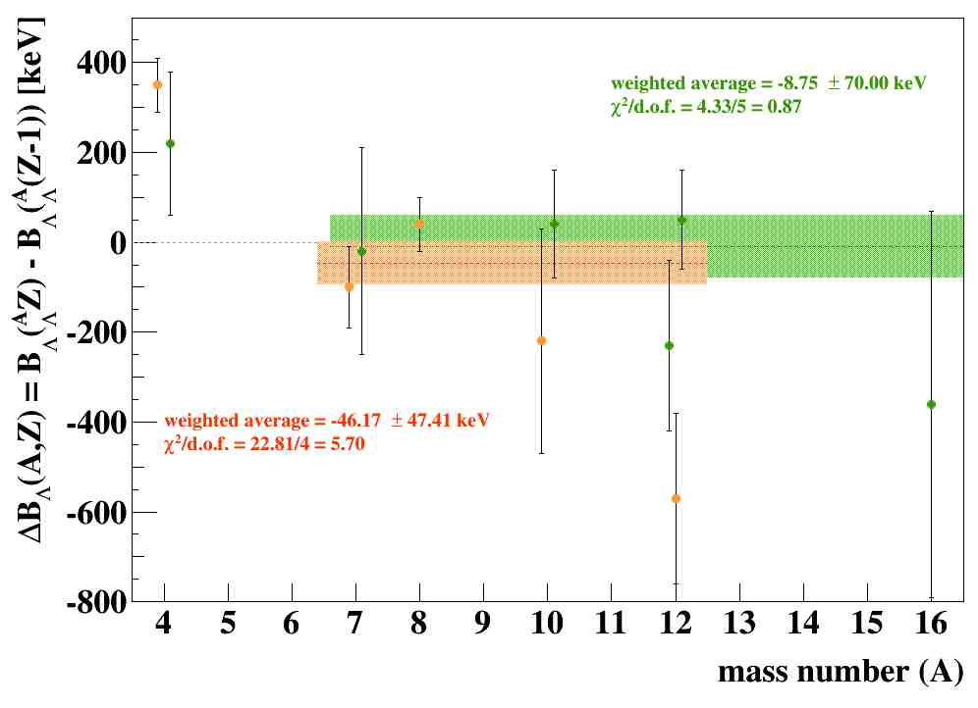
Achievements and Perspectives in Particle Physics (cont’d)
comparison of ΔB_{Λ}(A,Z) among homogeneous sets of data (emulsion, counters)
CSB
photographic emulsions
counter experiments
A. Feliciello, invited talk at the 103° SIF National Congress,
Trento, September 11-15, 2017
The w.a. of both sets of data for p-shell Hypernuclei is small, compatible with zero
(in agreement with the prediction of A. Gal, PLB 744 (2015) 352)

Slide 11
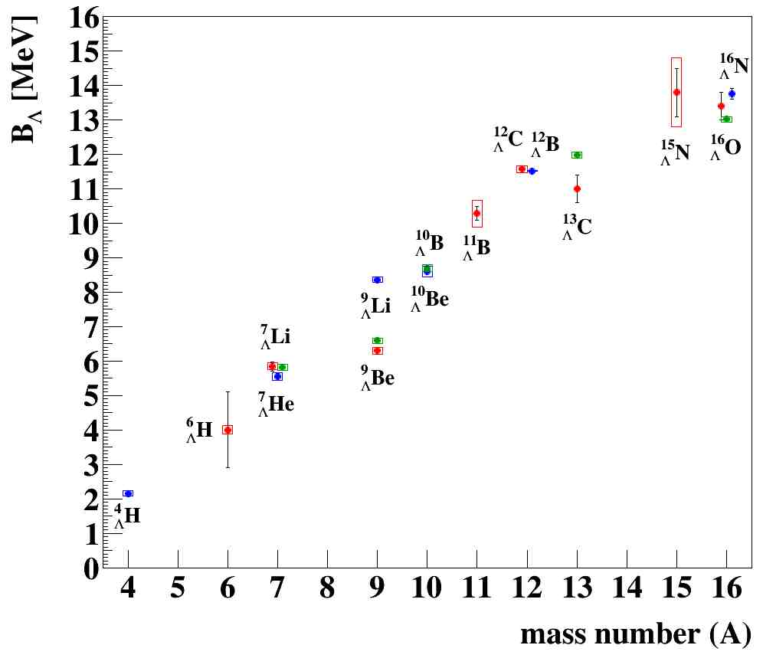
Achievements and Perspectives in Particle Physics (cont’d)
Charge Simmetry Breaking (CSB) in the strong ΛN interaction
JLAB, MAMI
FINUDA
SKS
May be better to use the new sets of data of B_{Λ} available for A ≤ 16 hypernuclei provided by JLab, FINUDA and (corrected) SKS?
Mandatory measurements for the future:
B_{Λ}(⁴He_{Λ}) and B_{Λ}(⁷Li_{Λ})
to a precision better than 50 keV
E. Botta et al., NPA 960 (2017) 165

Slide 12
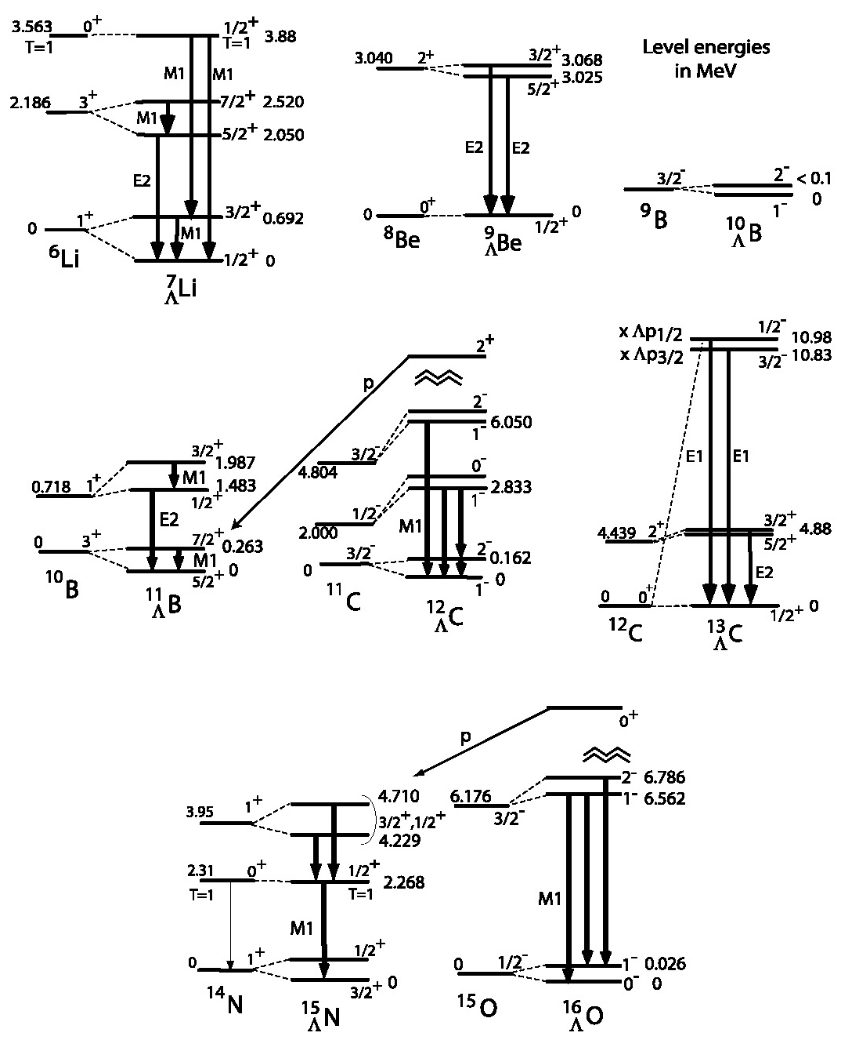
Achievements and Perspectives in Particle Physics (cont’d)
spin dependent terms in the
strong ΛN → NN interaction
following the first successful experiment
on the γ-ray spectrum from ⁷Li_{Λ},
a series of measurements was carried out
on all the p-shell Hypernuclei at
KEK (π⁺,K⁺ reaction)
BNL (K⁻,π⁻ reaction)
with more performing arrays of
HPGe detectors
H. Tamura et al., NPA 914 (2013) 99

Slide 13
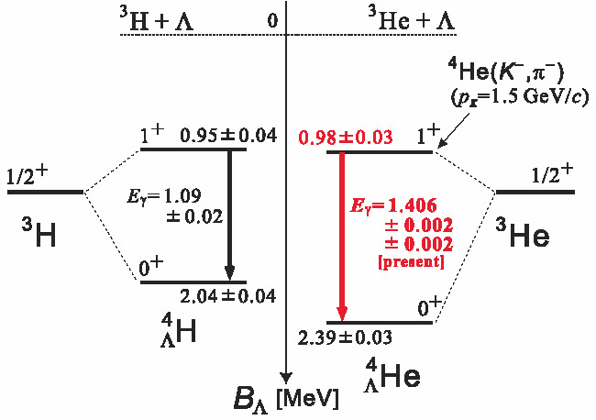
Achievements and Perspectives in Particle Physics (cont’d)
spin dependent terms in the strong ΛN → NN interaction
the y-rays spectra of p-shell Hypernuclei are compared and well interpreted within
shell model calculations by means of an effective ΛN potential of the form:
Δ
S_{Λ}
S_{N}
D.J. Millener, NPA 914 (2013) 109
T
Δ = 0.330 MeV (0.43 MeV for A = 7)
S_{Λ} = -0.015 MeV
S_{N} = -0.350 MeV
T = 0.024 MeV
recently y-rays spectroscopy has been done at J-PARC
on the ⁴He_{Λ} s-shell Hypernucleus,
confirming the CSB effect in the A = 4 system,
and for the first time on the ¹⁹F _{Λ} sd-shell one
T.O. Yamamoto et al., PRL 115 (2015) 222501

Slide 14
Achievements and Perspectives in Particle Physics (cont’d)
towards a quantitative determination of the ΛN → NN weak interaction
the importance of the weak decay of Hypernuclei as unique source of information
about the four baryons ΛN → NN vertex was stressed from the early days of Hypernuclar Physics
validity of the ΔI = 1/2 rule?
five decay channels (at least!) may occur → difficult task!
p_{N} ≤ 100 MeV/c
ß
p_{N} ≈ 400 MeV/c
All Γ’s are given in units of Γ_{Λ} = ß/ τ_{Λ}
when compared each other
p_{N} ≈ 330 MeV/c
the nuclear medium hosting the Λ is quite hostile since:
the Pauli principle inhibits MWD for A > 30
FSI strongly affects the nucleons from NMWD, which lose the kinematical signature of the bare process and it may induce interference effect

Slide 15
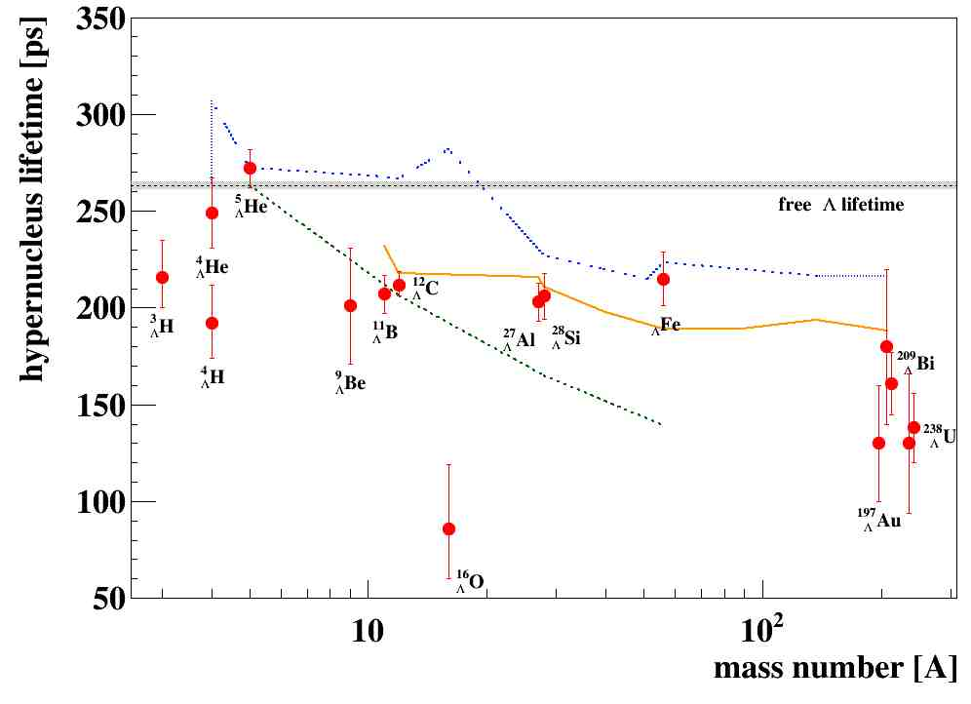
Achievements and Perspectives in Particle Physics (cont’d)
lifetime of Hypernuclei
τ = 208.8 ps
for heavy systems τ was obtained indirectly from delayed fission
induced by the energy release in NMWD of Hypernuclei produced
with p (CERN) or p (COSY) beam.
results strongly dependent
on theoretical calculations!

Slide 16
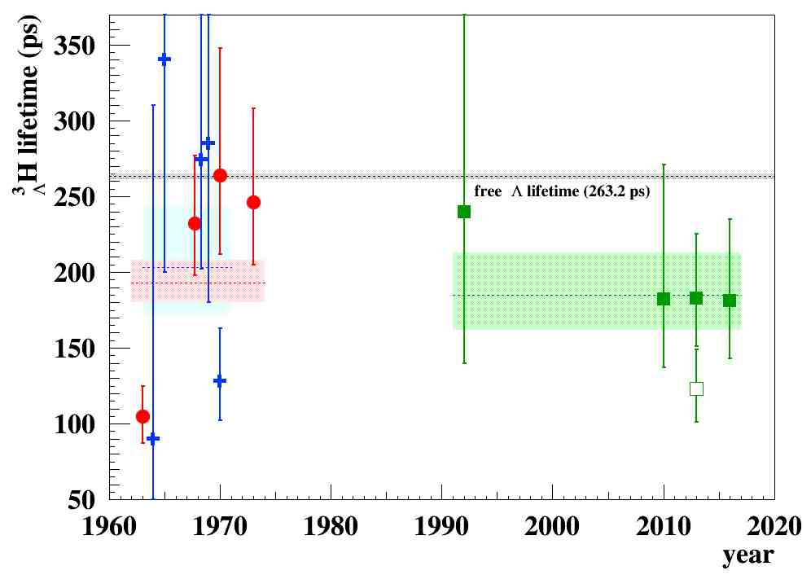
Achievements and Perspectives in Particle Physics (cont’d)
lifetime of Hydrogen Hyperisotopes
He bubble
chambers
(heavy) ions
collisions
STAR
HypHI
ALICE
~20 years
STAR
photographic
emulsions
M. Agnello et al., NPA 954 (2016) 176
Interest raised in the last few years
thanks to results from STAR, HypHI and ALICE
hot topic in this Workshop!

Slide 17
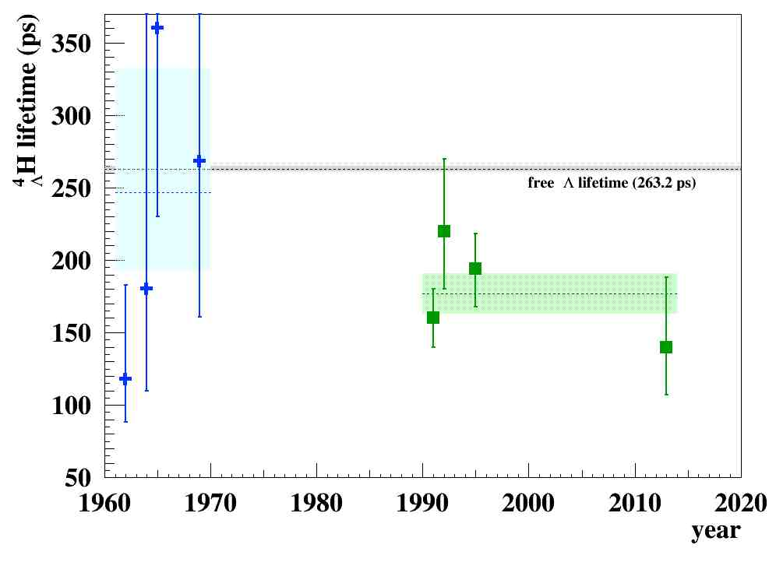
Achievements and Perspectives in Particle Physics (cont’d)
lifetime of Hydrogen Hyperisotopes
photographic
emulsions
M. Agnello et al., NPA 954 (2016) 176
HypHI
counter
experiments
Waiting for results from future
data takings/analyses
from ALICE and STAR
Plans for future measurements with the delay spectra technique:
J-PARC: use of the (π⁻,Kº) reaction → Letter of Intent submitted
ELPH: (γ,Λ,K⁺) reaction l Jlab: ³H target!

Slide 18
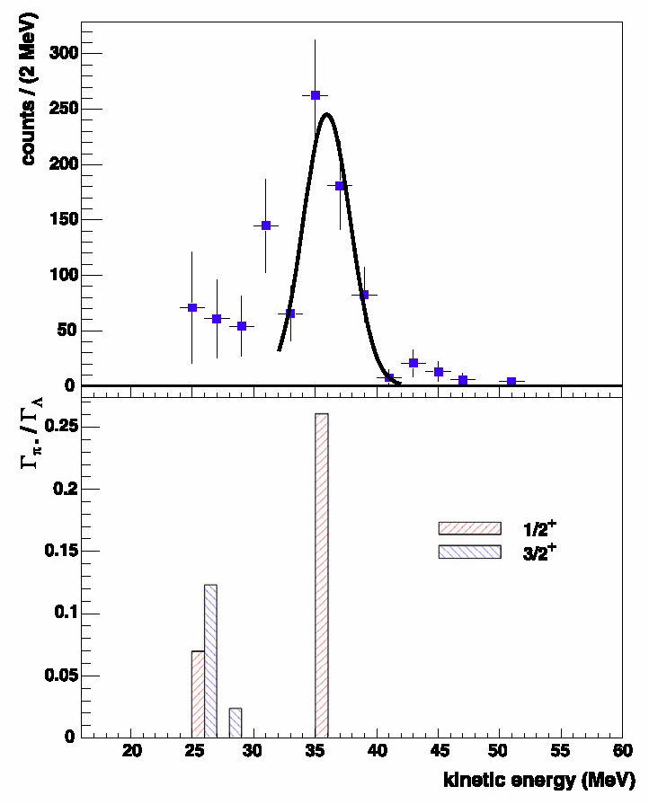
Achievements and Perspectives in Particle Physics (cont’d)
mesonic weak decay
dominant in s-shell Hypernuclei
decreasing from 30% to 5% for p- and sd- shells (Pauli blocking effect, see later)
⁷Li_{Λ}
results for s-shell:
existence of an inner repulsive core
in the Λ-nucleus potential
results for p-shell:
very nice proof of the full capability of the theory
to perform detailed predictions
FINUDA Coll., NPA 681 (2009) 139

Slide 19
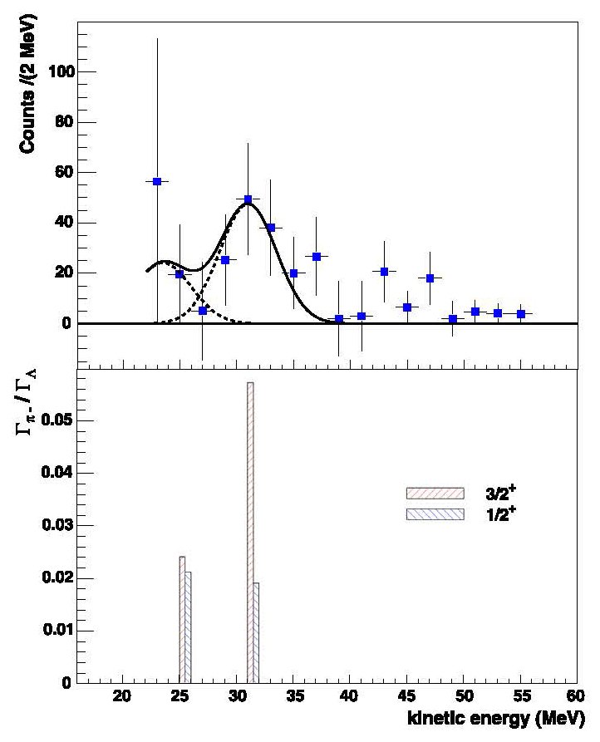
Achievements and Perspectives in Particle Physics (cont’d)
mesonic weak decay
¹⁵N_{Λ}
the MWD spectrum allowed the determination
of the spin-parity of the g.s. of ¹⁵N_{Λ} (3/2⁺)
Γ_{π0}/Γ_{Λ} were measured only for
⁴He_{Λ}, ⁵He_{Λ}, ¹¹B_{Λ} and ¹²C_{Λ},
using arrays of NaI(Tl) or plastic scintillators
FINUDA Coll., NPA 681 (2009) 139

Slide 20
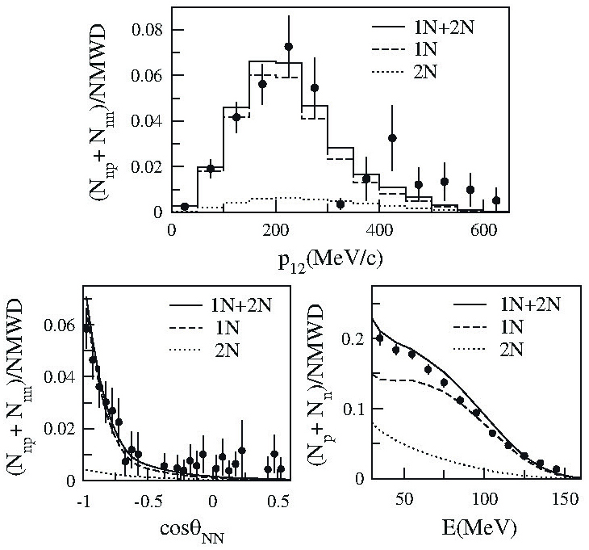
Achievements and Perspectives in Particle Physics (cont’d)
non-mesonic weak decay
hard task for:
intrinsic (FSI) and
experimental (neutron detection) difficulties
long-standing Γ_{n}/Γ_{p} puzzle
important improvement in theory about Γ_{2N}/Γ_{Λ}
two experimental approaches:
1) KEK
high statistics spectra for a single target (¹²C),
correlations, ad-hoc INC code…
but…
high (30 MeV) threshold for protons,
thick targets
M.J. Kim et al., PRL 103 (2009) 182502
results:
Γ_{p}/Γ_{Λ} = 0.45 ± 0.10
Γ_{n}/Γ_{Λ} = 0.23 ± 0.08 l first full mapping of the Weak Decay Widths of ¹²C_{Λ}
Γ_{2N}/Γ_{Λ} = 0.27 ± 0.13

Slide 21
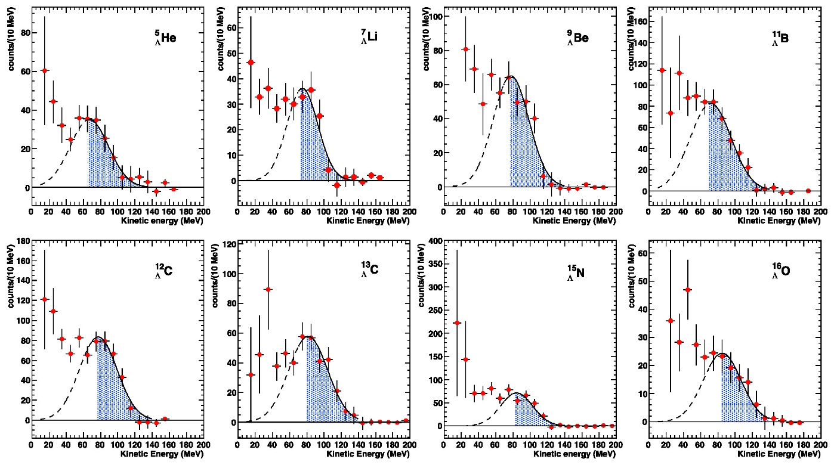
Achievements and Perspectives in Particle Physics (cont’d)
non-mesonic weak decay
FINUDA Coll., PLB 738 (2014) 499
2) LNF
8 p-shell Hypernuclei measured in a time, thin targets,
magnetic analysis of the proton spectra with low threshold (15 MeV),
FSI determined by the data…
but…
limited statistics

Slide 22
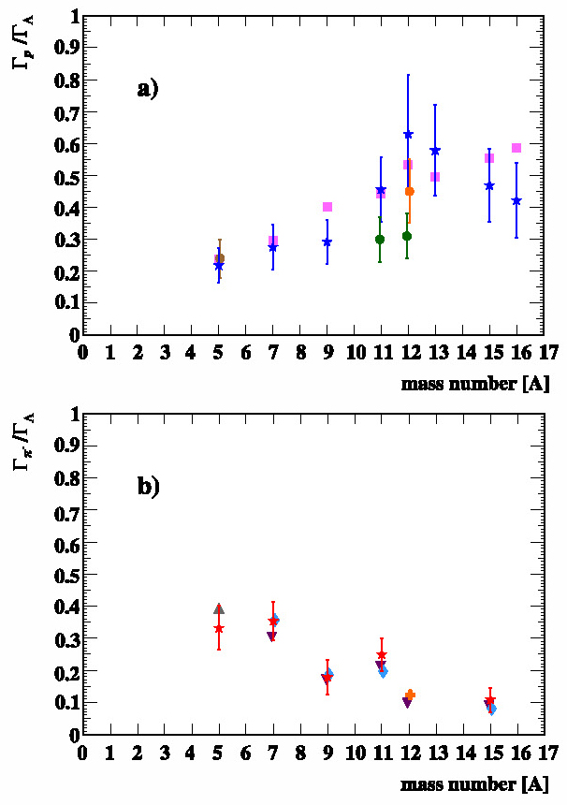
Achievements and Perspectives in Particle Physics (cont’d)
non-mesonic weak decay
from the analysis of the high energy part
of the proton spectra
it was possible to determine for the first time Γ_{p}/Γ_{Λ} for 8 Hypernuclei in the 5 ≤ A ≤ 16 range
FINUDA Coll., PLB 738 (2014) 499
first experimental confirmation of
the complementarity between Γ_{p}/Γ_{Λ} and Γ_{π-} / Γ_{Λ}, long time advocated

Slide 23
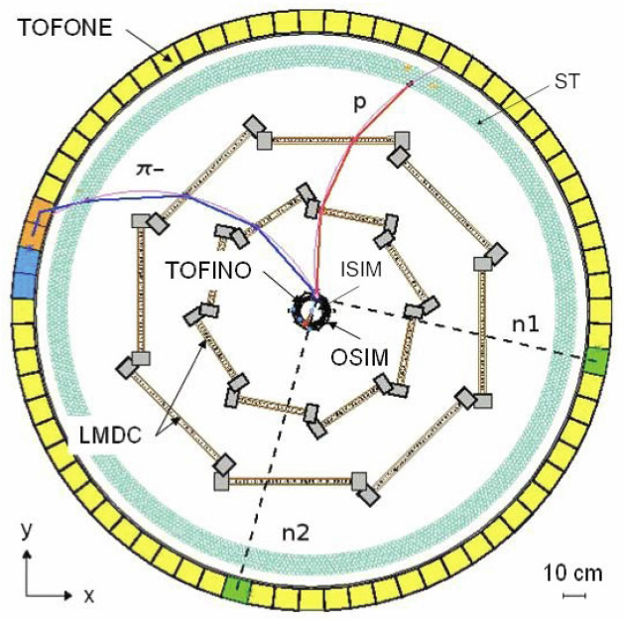
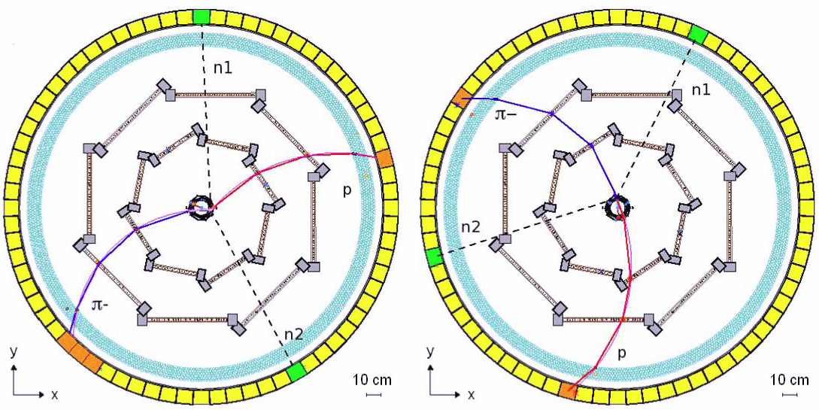
Achievements and Perspectives in Particle Physics (cont’d)
non-mesonic weak decay
from the analysis of the low-energy part of
the proton spectra (threshold at 15 MeV!)
it was found that Γ_{2N} / Γ_{NMWD} = 0.20 ± 0.08 (stat) ^{+0.04}_{-0.03} (sys)
for all the Hypernuclei in the 5 ≤ A ≤ 16 range,
in agreement, within the errors,
with the theoretical evaluations
and the KEK result for ¹²C_{Λ}
very significant the
“smoking gun” evidence of
3 events unambiguously
attributed to the
2N-induced NMWD
E. Botta et al., RNC 38 (2015) 387

Slide 24
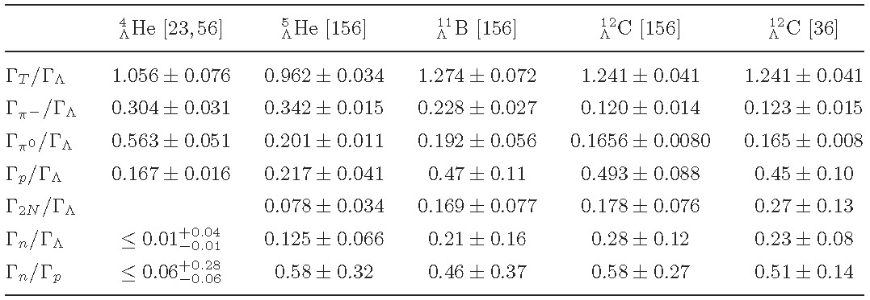
Achievements and Perspectives in Particle Physics (cont’d)
non-mesonic weak decay
from the FINUDA data a full mapping of WD widths of ⁵He_{Λ}, ¹¹B_{Λ} and ¹²C_{Λ} could be done
E. Botta et al., PLB 748 (2015) 86
E. Botta et al., RNC 38 (2015) 387
some data are affected by large errors; however a consistent picture of the process emerges

Slide 25
Summary
Hypernuclear Physics has fulfilled the task of providing unique information for Nuclear and Particle Physics. The effort must be maintained and improved
Topics of particular interest are:
CSB effect → precise measurements of B_{Λ}(⁴He_{Λ}) and B_{Λ}(⁷Li_{Λ})
To confirm the existence of bound ⁶H_{Λ}
To measure lifetimes of ³H_{Λ} (⁴H_{Λ}) and heavy systems
To continue γ-ray spectroscopy for medium-heavy systems
To assess whether ΔI=1/2 rule is valid in NMWD?
Effort for a quantitative study of ΛN → NN weak interaction

