Slide 1
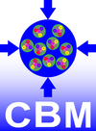
CBM detector and electronics tests at COSY in 2017
Johann M. Heuser
GSI Helmholtz Center for Heavy Ion Research GmbH, Darmstadt, Germany
for the CBM Collaboration
5th COSY Beamtime Advisory Committee Meeting, Bad Honnef, 19 December 2016

Slide 2
Outline
Results from in-beam tests, August 2016
Application for beamtime in 2017:
Electronics tests: Feb. 2017 (1 week)
Detector tests: May 2017 (2 weeks)

Slide 3
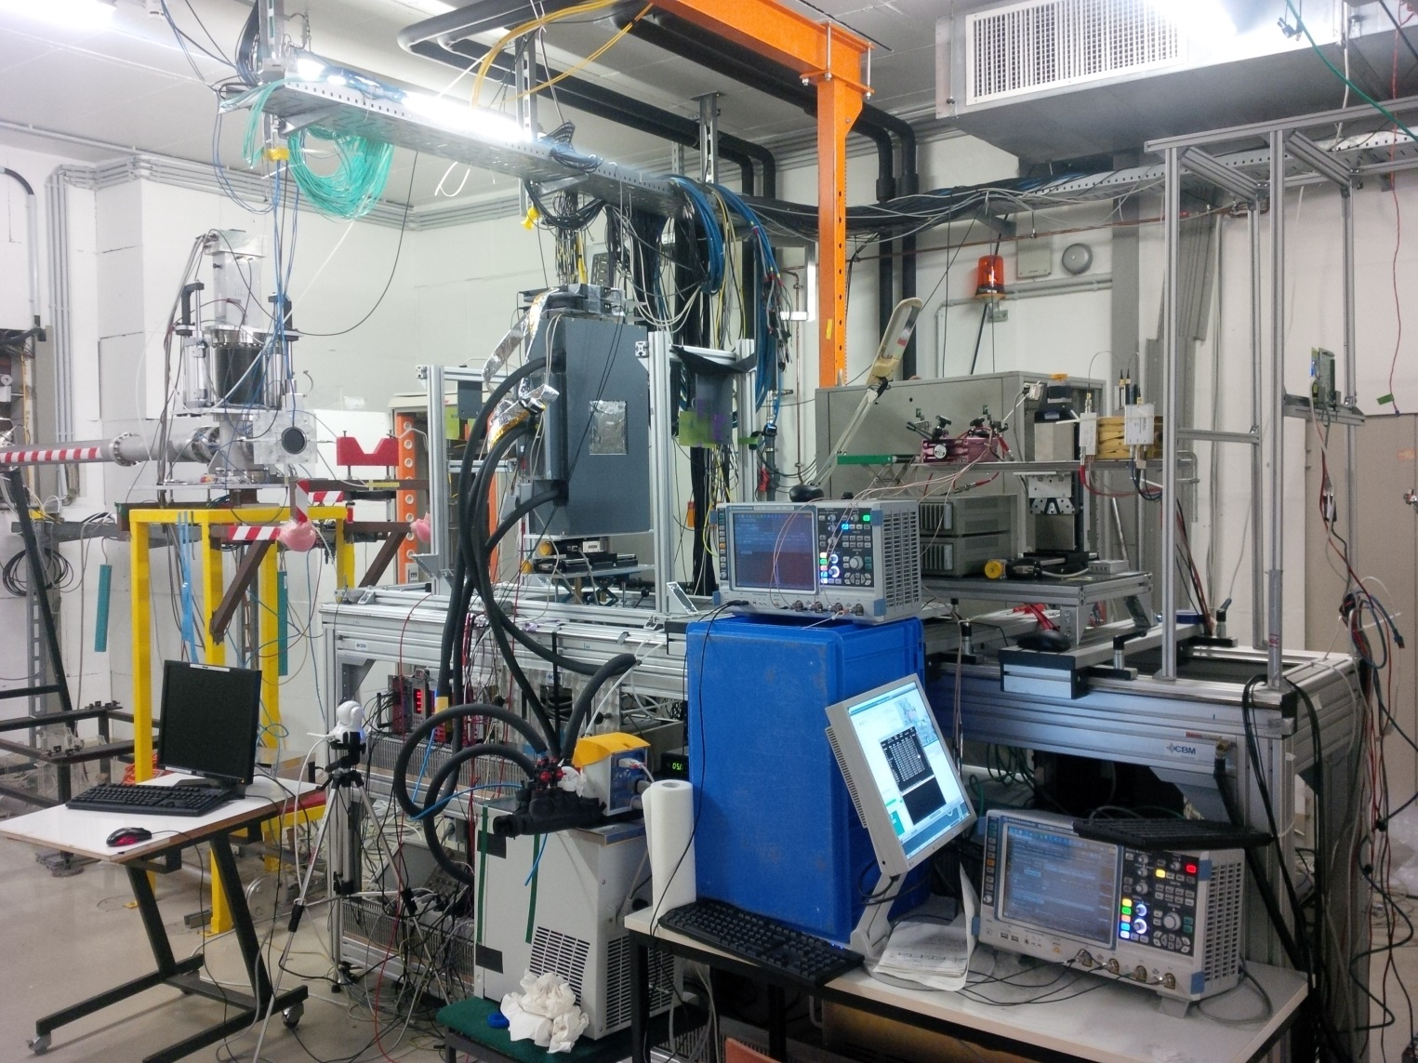
1) Results from the in-beam test, August 2016
STS
T0
µC
Set-up in JESSICA Cave

Slide 4
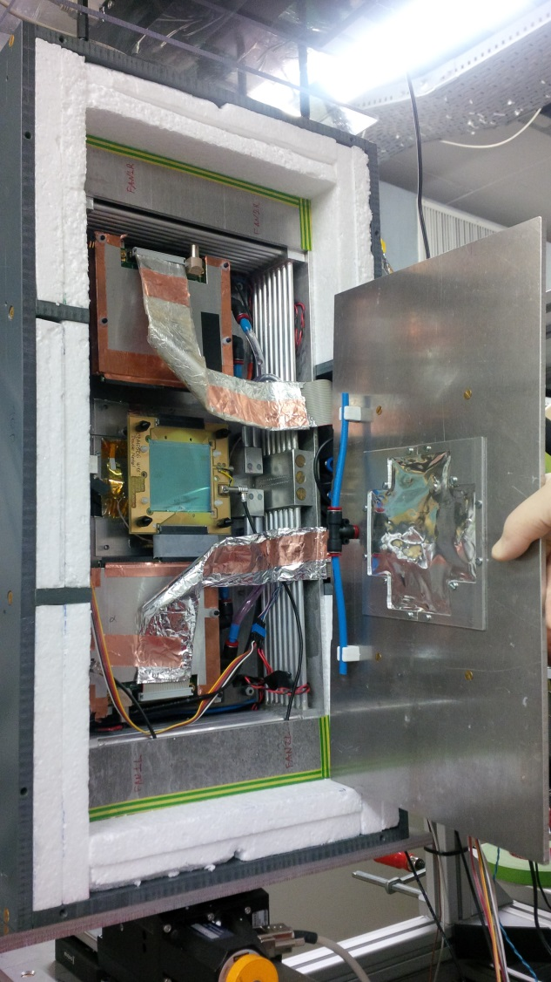
I. Microstrip sensor studies for CBM-STS
Prototype silicon microstrip sensors:
non-irradiated (“non-aged”)
operated under anticipated conditions: bias voltages > 120 V, T ≤ -5 °C
read out with standalone front-end ASIC and DAQ: Beetle chip/Alibava system
simple trigger: two scintillators in coincidence
Proton beam from COSY:
Ekin = 1 GeV ± 0.01% in August 2016
≅ 5% higher energy loss in Si than MIP → taken into account in data analysis
Enabled us to measure:
charge collection
signal dependence on beam incidence angle
cross talk etc.

Slide 5
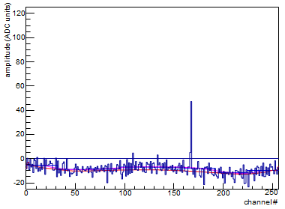
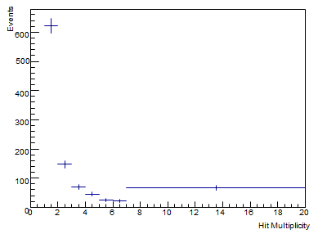
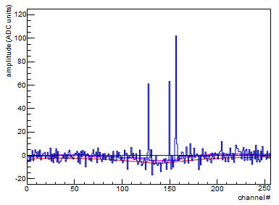
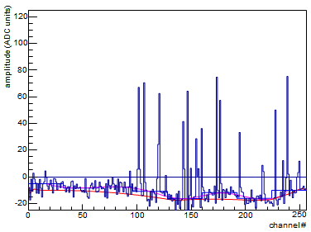
STS results on charge collection
three event classes, probably related to beam spill structure:
beam intensity time structure:
sharp spike: 7 × 10⁷
bulk extraction: 2 × 10⁸
spill/inter-spill: 20 s/10 s
I
single hits
t
Hit multiplicity
ca. 50% of the events recorded are “analyzable” (i.e. of low hit multiplicity)
few hits
many hits
Aibava setup based on the Beetle chip:
2 × 128 r/o channels
40 MHz analog rate
128 per chip analog memory stack
4 μs digitization rate
data storage rate via USB to PC:
≈ 1 kHz

Slide 6
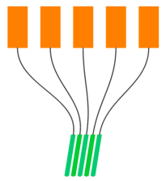
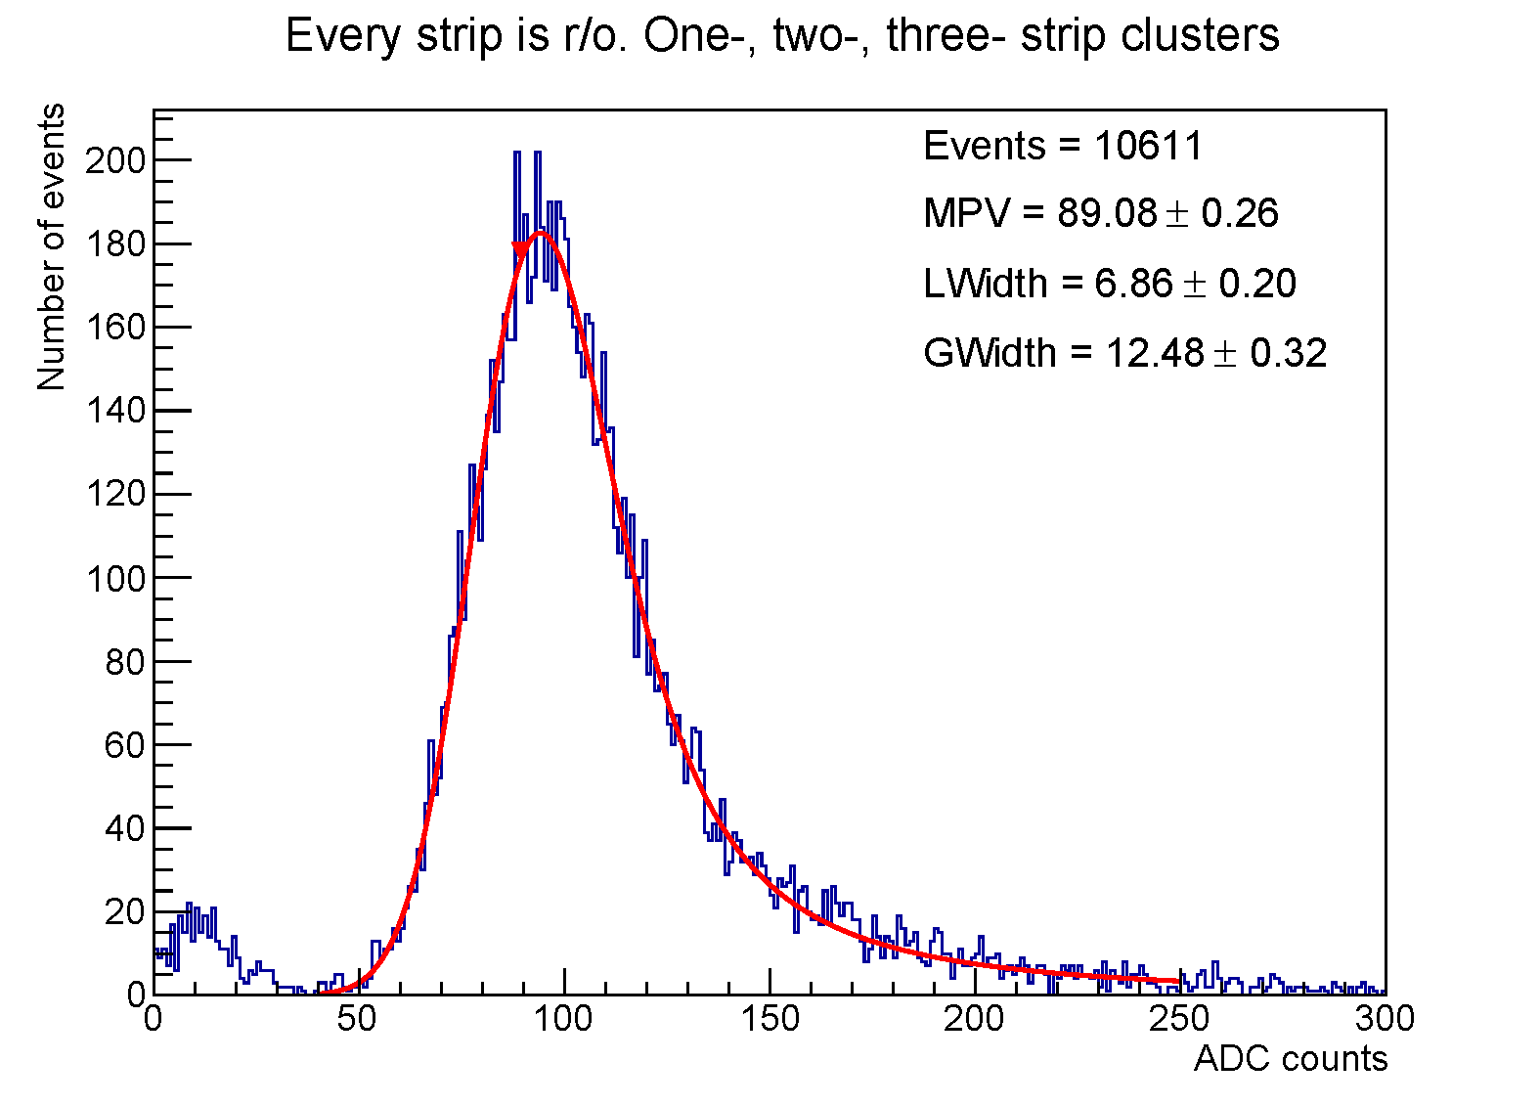
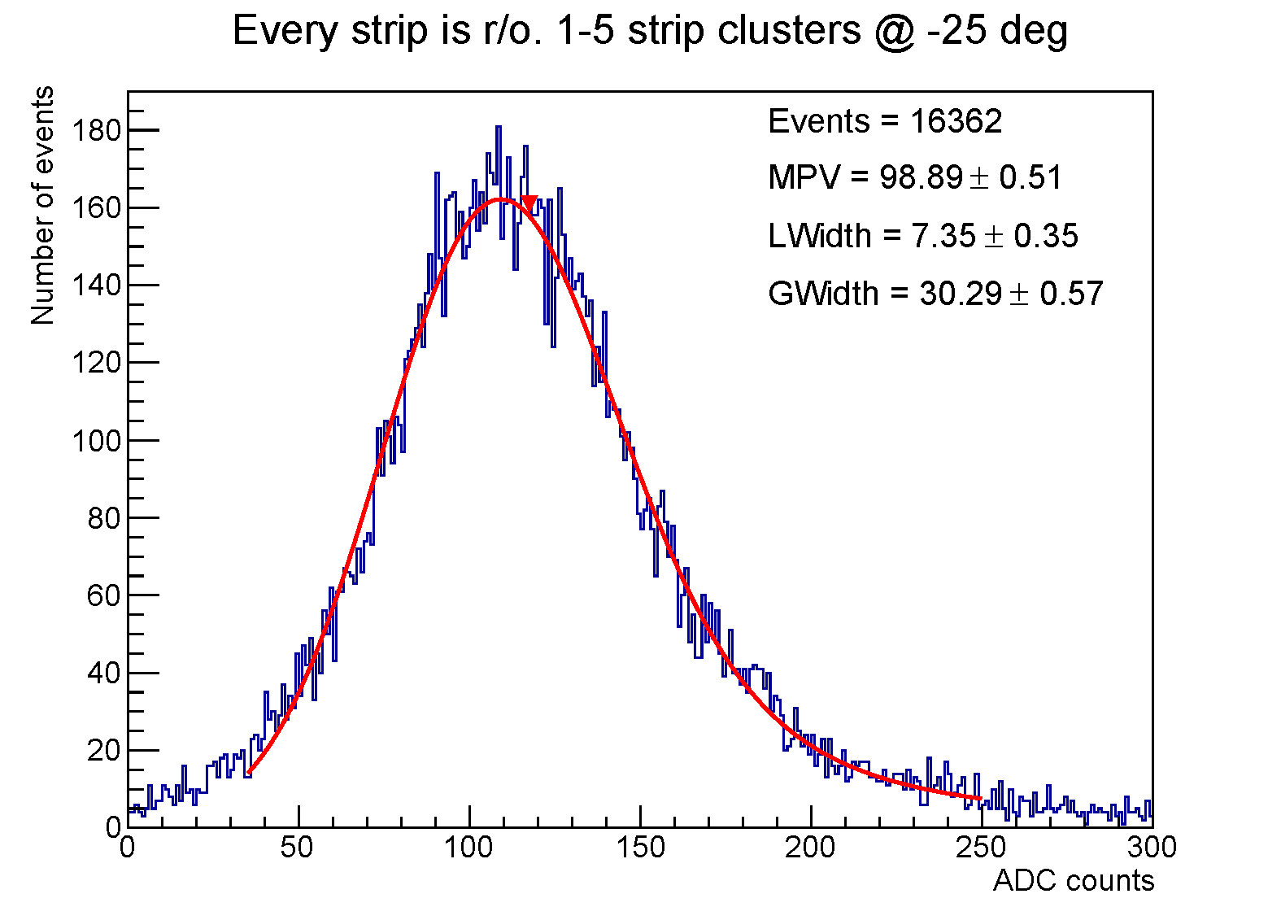
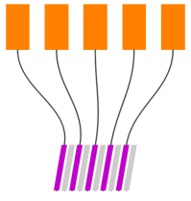
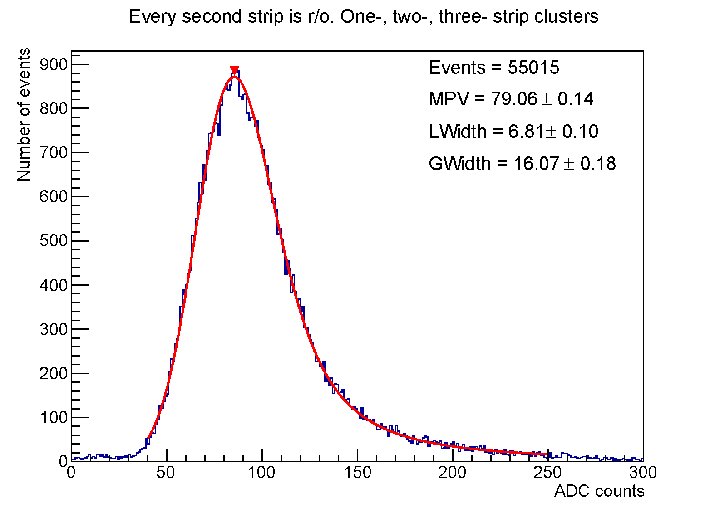
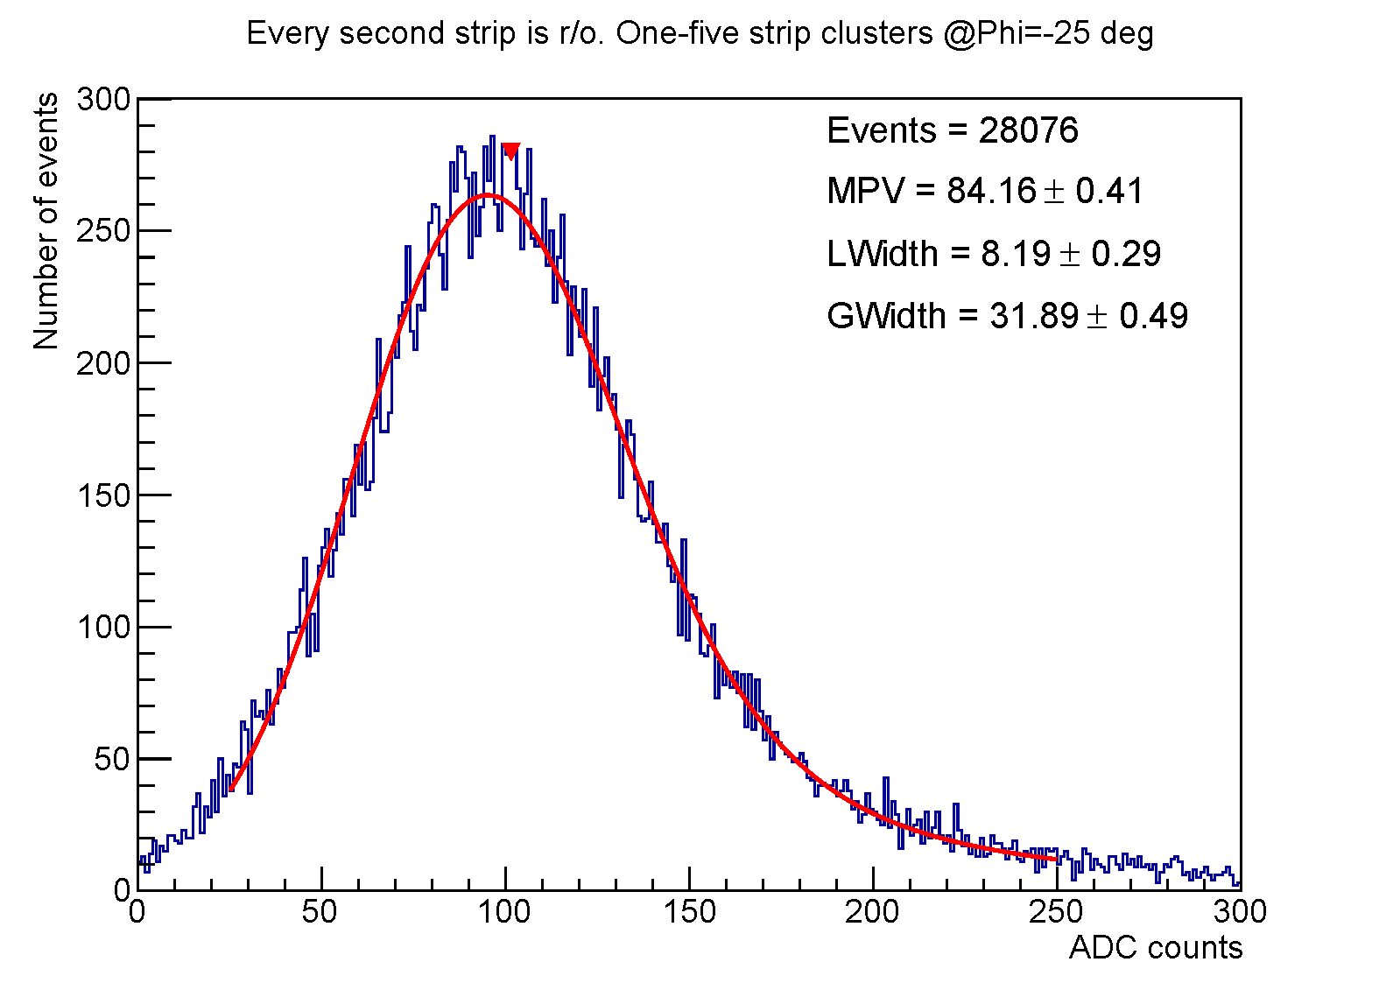
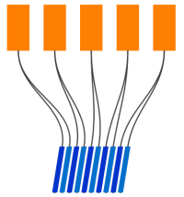
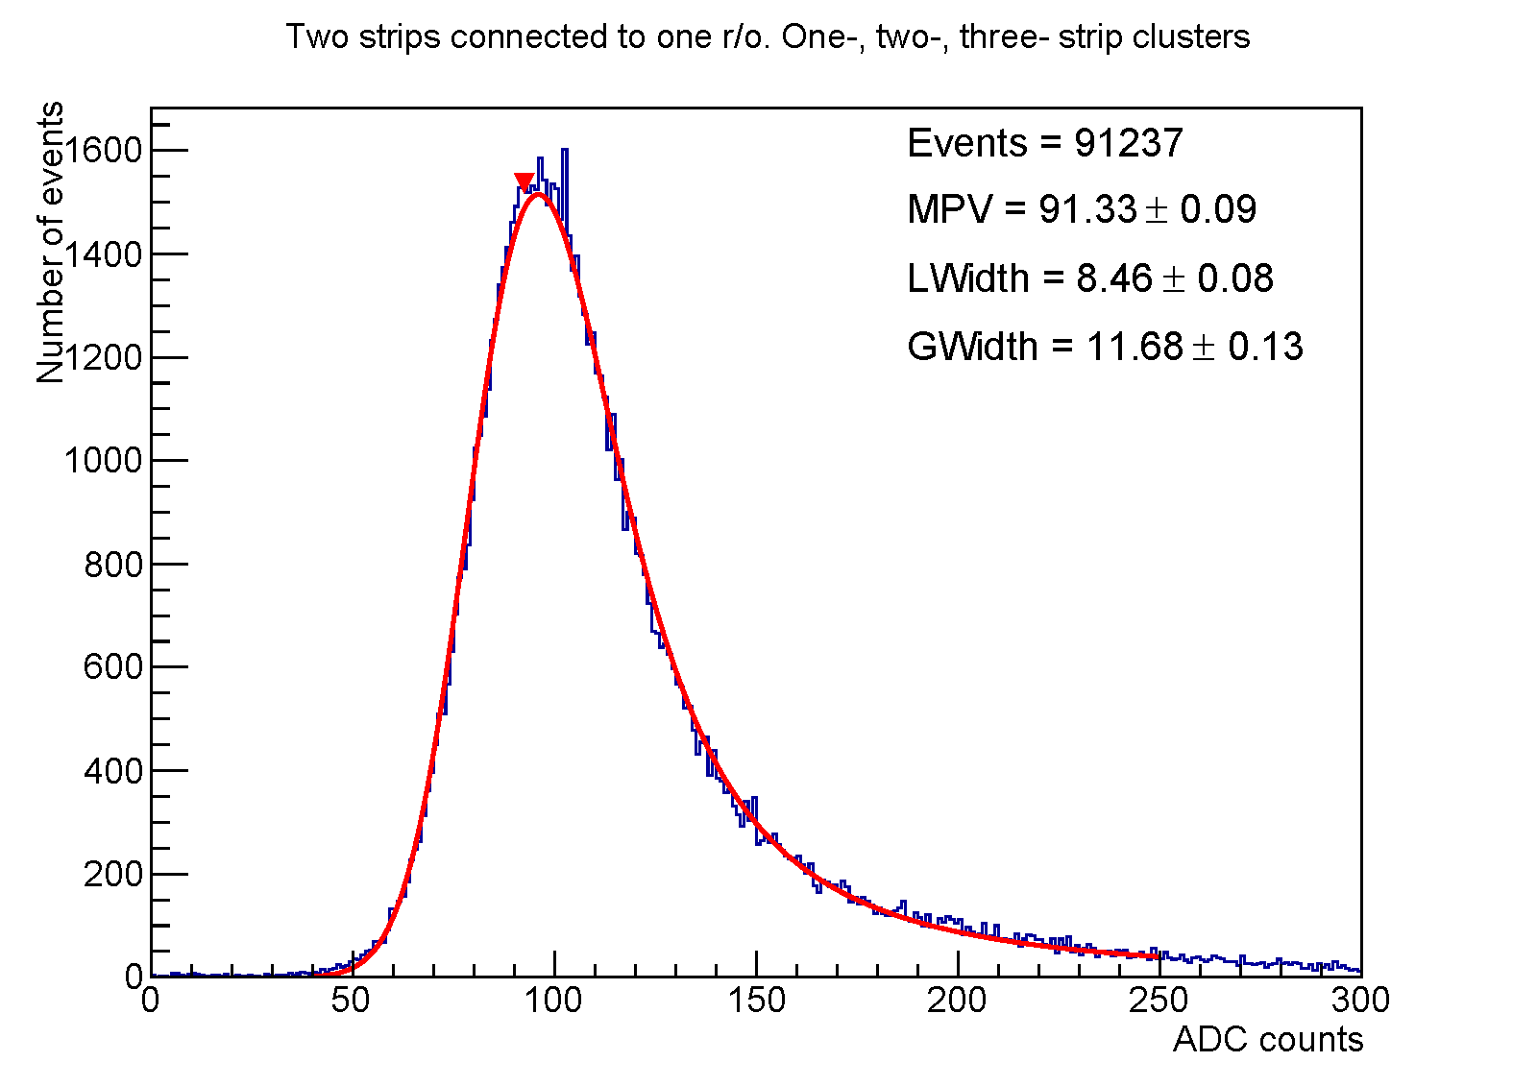
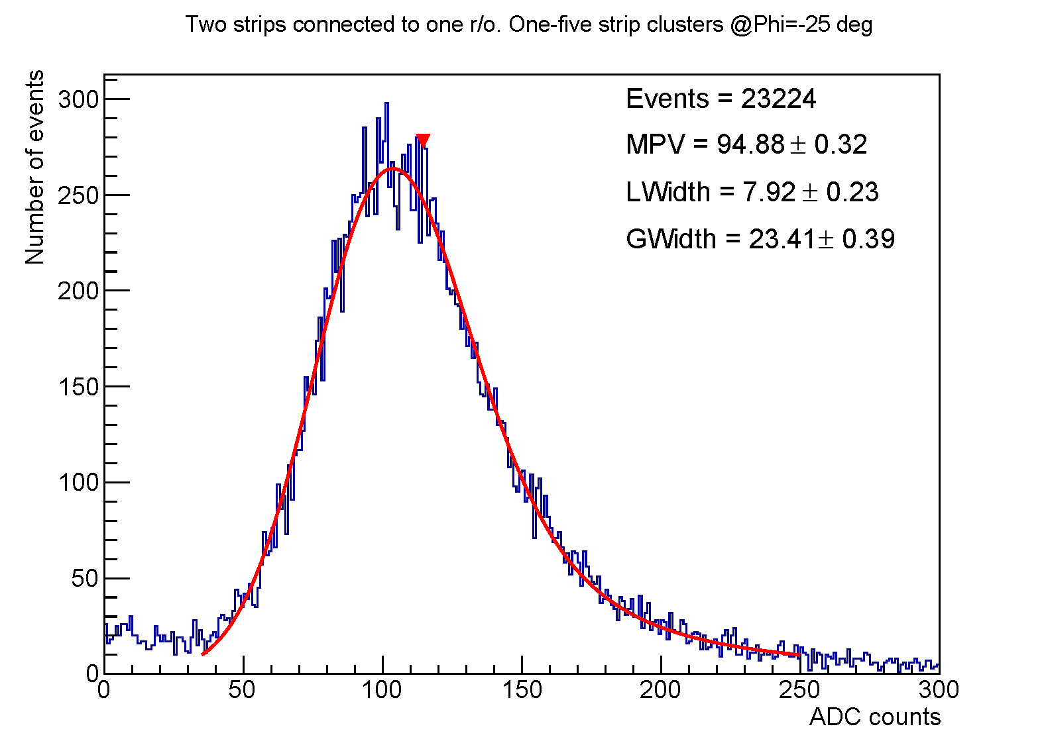
connection schemes: strip : r/o channel
Φ = 0 °
Φ = 25 °
Charge collection study:
Three connection schemes between sensor strips and ASIC channels
Beam incidence angle 0° ≤ Φ ≤ 25° (inclination corresponds to STS acceptance
Detailed charge collection study made
all cluster sizes
all cluster sizes
90 ADC
100 ADC
1 : 1
Findings:
Size of clusters increases with beam incidence angle as expected by geometry
For large clusters the noise increases (larger capacitive effect, as expected)
Spectra broaden with increasing angle
every second strip read out
2 : 1

Slide 7
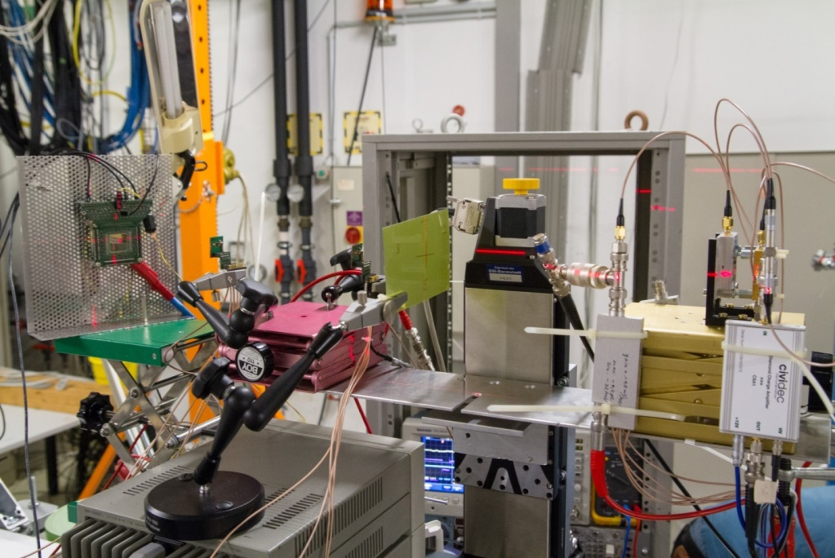
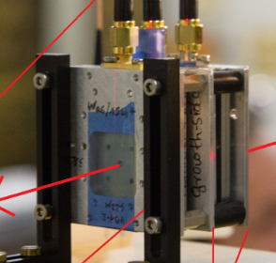
II. Diamond detector studies for TOF-T0
Main aim: Response of poly-crystalline CVD diamonds to MIPs
Detection efficiency for MIPs in pcCVD diamond material
Timing properties of pcCVD diamond material
Diamond detectors
(aligned via laser)
poly-crystalline
(pcCVD)
single-crystal- line (scCVD)
proton beam
1.7 GeV/c
quasi-single-crystalline (Diamond on Iridium, DoI)
Remote Oscilloscope as flexible read-out and DAQ
Movable platform (X/Y) with μm precision

Slide 8
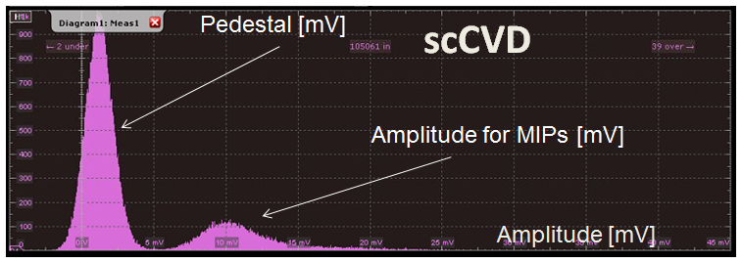
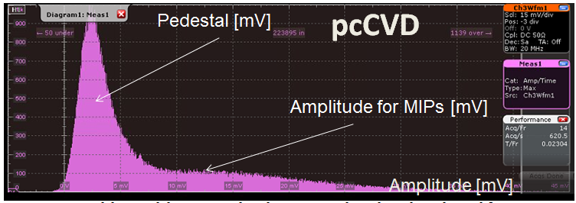
Results: scCVD/pcCVD amplitude spectra
clear separation between signal and pedestal for scCVD
problem with separation of signal and pedestal for pcCVD
further tests at higher bias voltage needed !

Slide 9
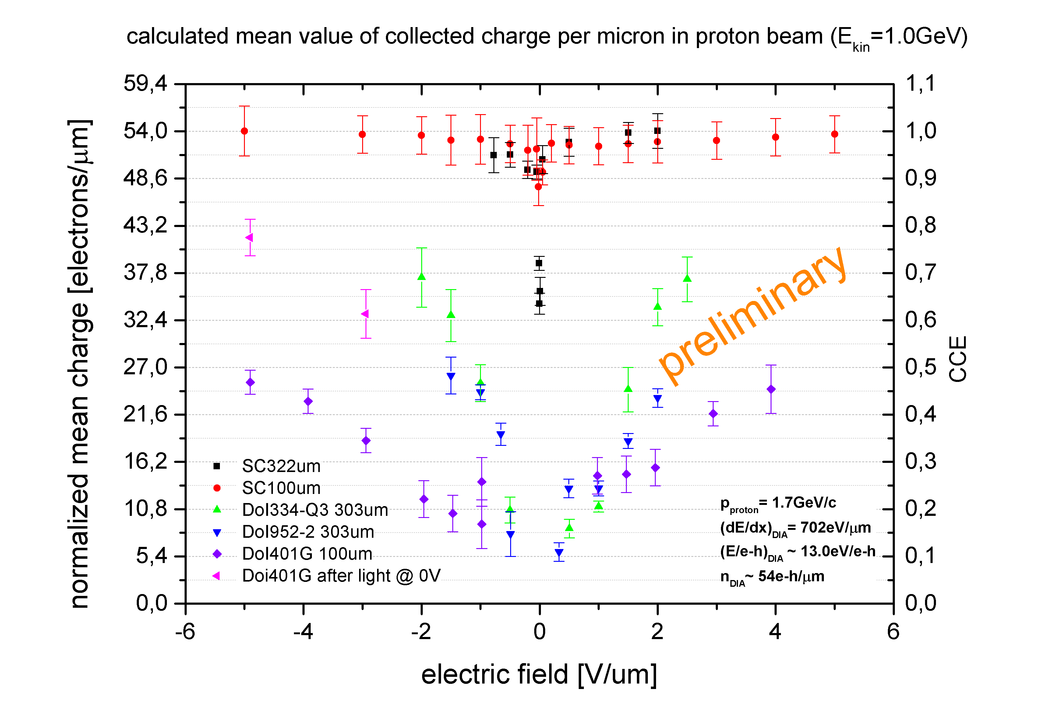
Results: DoI charge collection

Slide 10
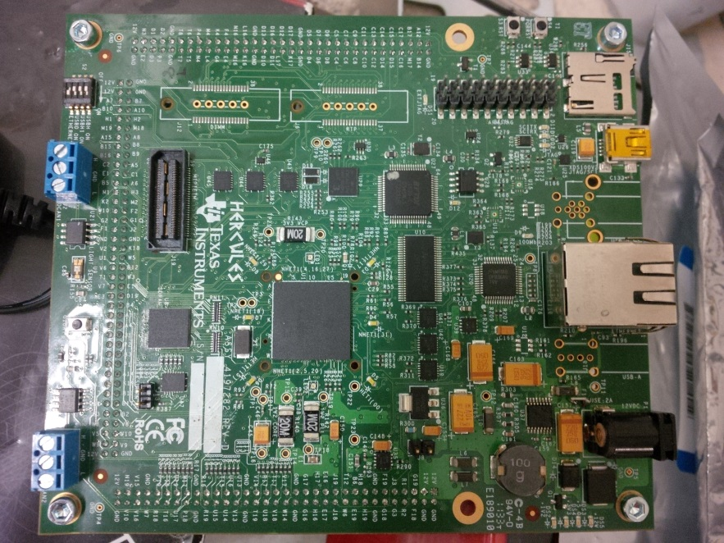
III. Micro Controller rad-tolerance study
Microcontroller TMS-570: Possible application in the CBM detector control system
External, non-error-correcting-code memory.
Determine with an algorithm its robustness for corrections.
EPICS monitors failure registers
mysql data base, every 2 seconds

Slide 11
Microcontroller SEU results
Total BeamTime: ~13 h
No failures detected during beam-off times
Single bit errors detected when beam was on
No Multiple-bit errors
Total detected and corrected SEUs:
in SRAM Bank A: 718
in SRAM Bank B: 686
Dosimetry foil evaluation pending (offered by O. Felden et al., FZJ-IKP)
Number of SEU's detected and corrected every 2 minutes
Bank A
Bank B

Slide 12
Team members from GSI, FAIR, Univ. Frankfurt, TU Darmstadt

Slide 13
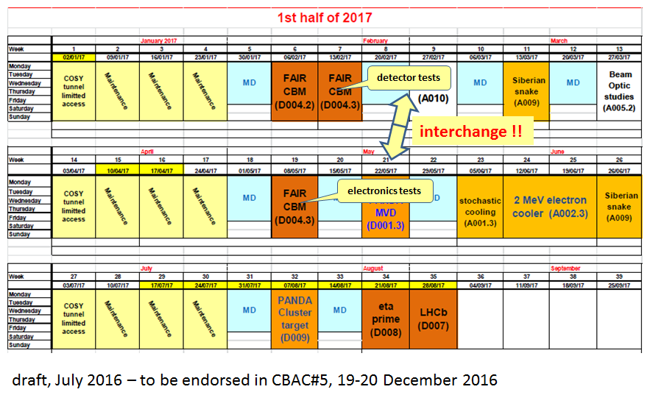
2) Application for beamtime in 2017

Slide 14
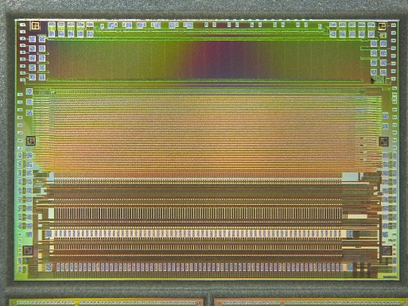
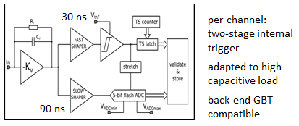
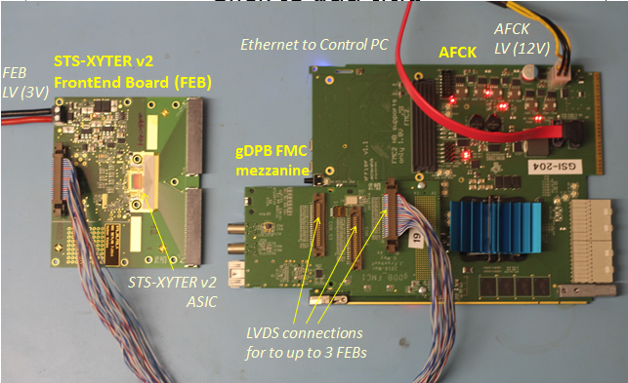
I. Tests of electronics
STS-XYTER v2 ASIC (front-end chip for CBM-STS and MUCH detector systems) produced in September 2016. Detailed tests ongoing, running set-ups in the laboratory. Ready for beam test!
Aim of in-beam test:
Qualification of the improved DICE cell architecture with respect to Single Event Effects (SEE) in the STS-XYTER v2 ASIC
Comparison with the cross section determined in the STS-XYTER v1 test, 9/2015 at COSY, using a similar setup.
Requirement: 1 week of highest possible beam intensities in JESSICA Cave to yield sufficient statistics of SEUs
128 channels
STS-XYTER v2

Slide 15
SEE results 9/2015 and expectation for 2017
Procedure:
comparison of 2-dimensional array (channels, discriminators) of registers implemented with DICE cells and regular flip flops
continuous readback of predefined pattern or – constant – random values
check for bit flips in register values
SEE Counts ~ 48 hours of effective irradiation (Sep. 2015 conditions)
 | STS-XYTER v1 (Sep. 2015) |  | STS-XYTER v2 (estimate)
Type | No. of bits | Total number of SEE | No. of bits | Total number of SEE
Flip Flop | 32240 | 3467 | 56420 | 6067
DICE cells | 32240 | 116 | 32240 | <48
Bit Flips in DICE Registers
Expectations for STS-XYTER v2 tests
better SEE statistics for regular flip flops - number increased by factor 1.75
SEE in DICE cells reduced by factor larger than 2 - improved cell layout (all DICE register bits)
Number of bit flips
0 1 2 3 4 5 6 7
bit number in DICE register

Slide 16
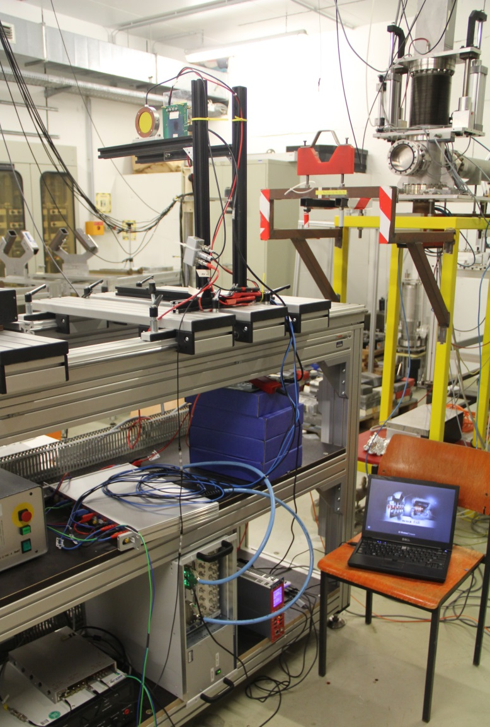
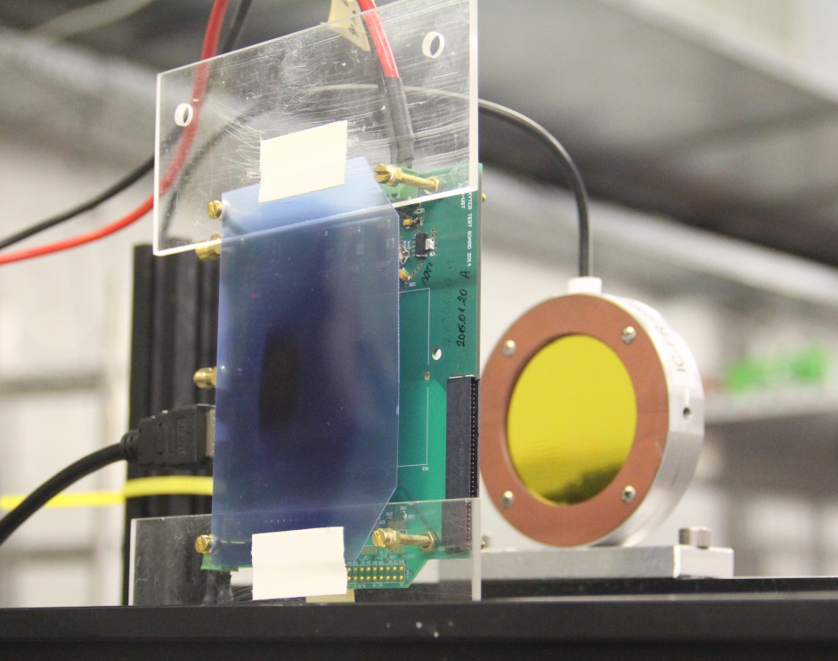
Setup will be similar to the one used in Fall 2015
08.-12.09.2015
FZ Jülich, COSY, JESSICA cave
~3×10⁹ p/spill on setup
STS-XYTER ASIC
bonded to FEB
FEB with STS-XYTER v1
Ionization Chamber with QFW based readout

Slide 17
Beamtime application for electronics test
Total number of particles and type of beam (p,d,polarization) | Momentum range (MeV/c) | Intensity or internal reaction rate (particles per second) minimum needed maximum useful
p, not polarized | p ~ 1700 MeV/c | 10⁸/s | 10⁹/s
Experimental area | Safety aspects (if any) | Earliest date of Installation | Total beam time (No.of shifts)
JESSICA Cave | none | week 6, 2/2017 focus: STS XYTER v2 SEU tests optional: FPGA SEU tests, power regulator TID tests | one week, 24/7

Slide 18
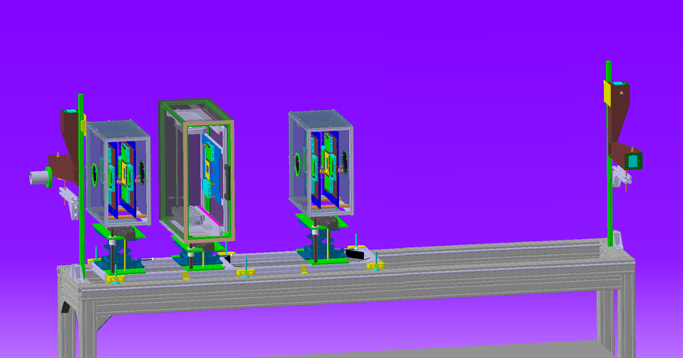
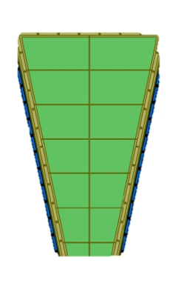
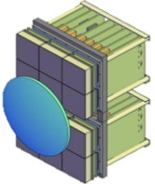
II. Tests of detectors
hodo1
STS
hodo2
ref1,2
ref3,4
RICH, GEM
T0 diamond
FPGA
beam
3 large set-ups (STS, RICH, GEM)
+ two smaller ones (T0, FPGA)
new FEE and DAQ (n-XYTER ASIC based, AFCK-FLIB/FLES)

Slide 19
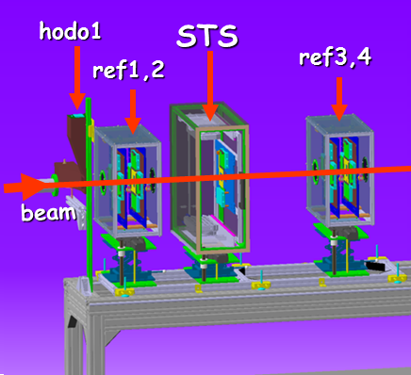
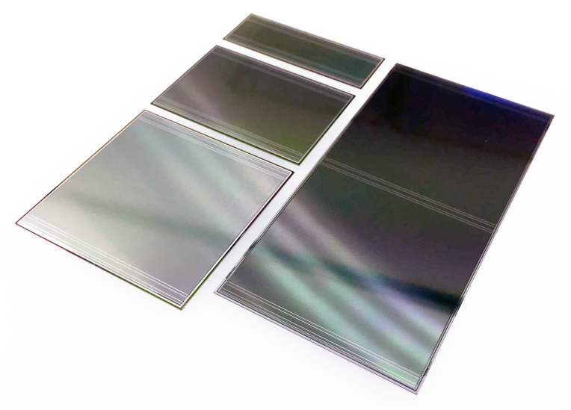
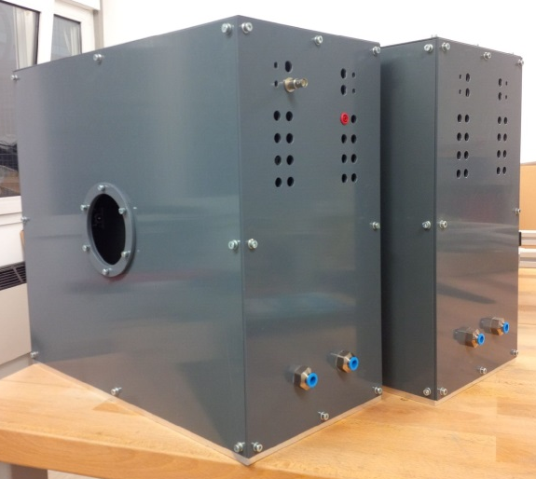
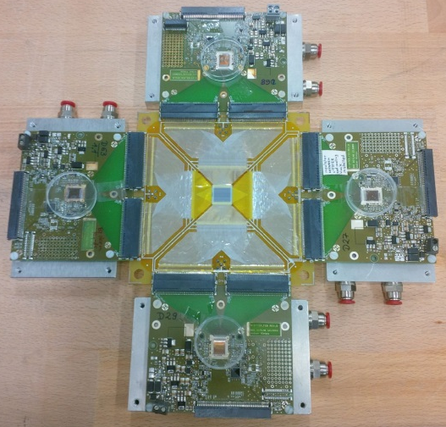
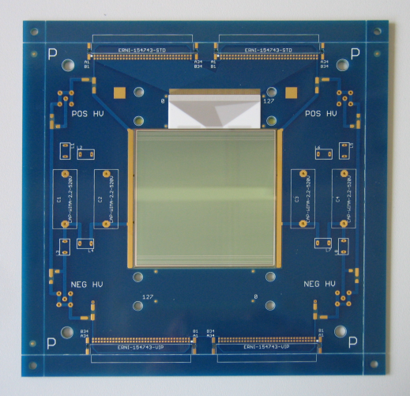
(a) Tracking efficiency test of STS sensors
Aim: Sensor efficiency study with reference tracks. Important to PRR in 2017.
Sensors irradiated up to CBM life-time fluence (10¹⁴ n/cm²) at KIT.
Operation at below -5 °C New thermal box under preparation.
prototype sensors from CiS and Hamamatsu
sensor boards
reference stations under construction
based on n-XYTER FEBs
(electronics/DAQ available to STS from Jan. 2017)

Slide 20
(b) Test of readout electronics for RICH-MAPMTs
Measure first Cherenkov photons with new DIRICH scheme; study rate behavior
First steps towards integration of DiRICH chain into CBM DAQ system
radiator lens with Aluminum coating
2x 3x2 PMT matrix
HADES RICH700 modules
Simulation of ring image on PMT plane at COSY:
beam: p = 1.7 GeV/c, 10⁵ protons/s, σ_{x,y} = 0.3 cm
up to 4·10⁴ hits/pixel/s
~ 20 hits/ring, ring radius: 5.4 cm
Electronics: ready
Set-up under construction

Slide 21
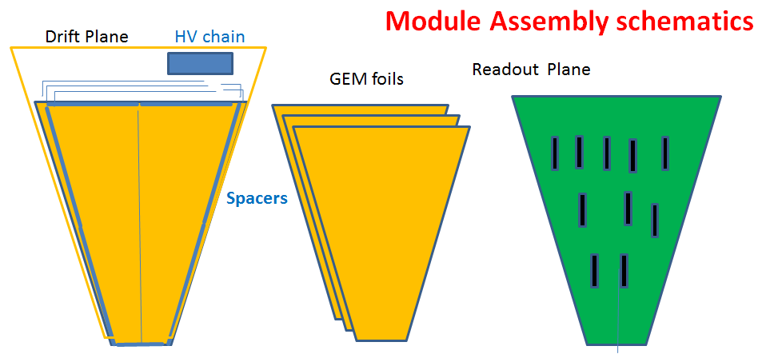
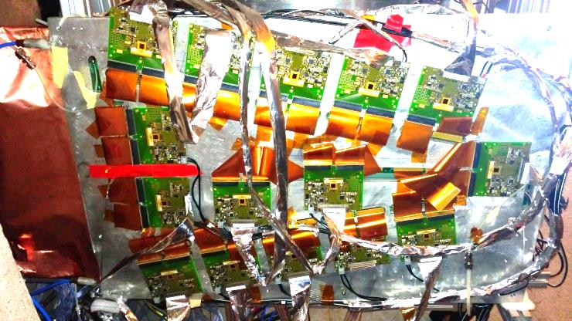
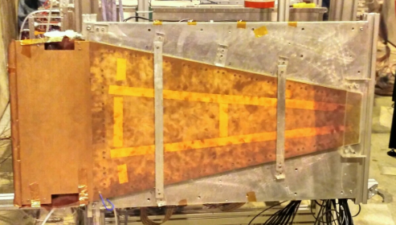
(c) Test of new GEM detectors for MuCH
Two prototypes will be tested:
1) Full-size prototype “M2”
CERN-made GEM foils
with new HV configuration, possibly involving opto-coupler switches
with full-fledged controlled cooling
with full 18 FEB –F read-out
and latest DAQ
2) Triple-GEM test detector
Indian-made GEM foils
10 cm x 10 cm and/or
30 cm x 30 cm
~ 120 cm
Prototype M1 under test at CERN-SPS, 12/2016

Slide 22
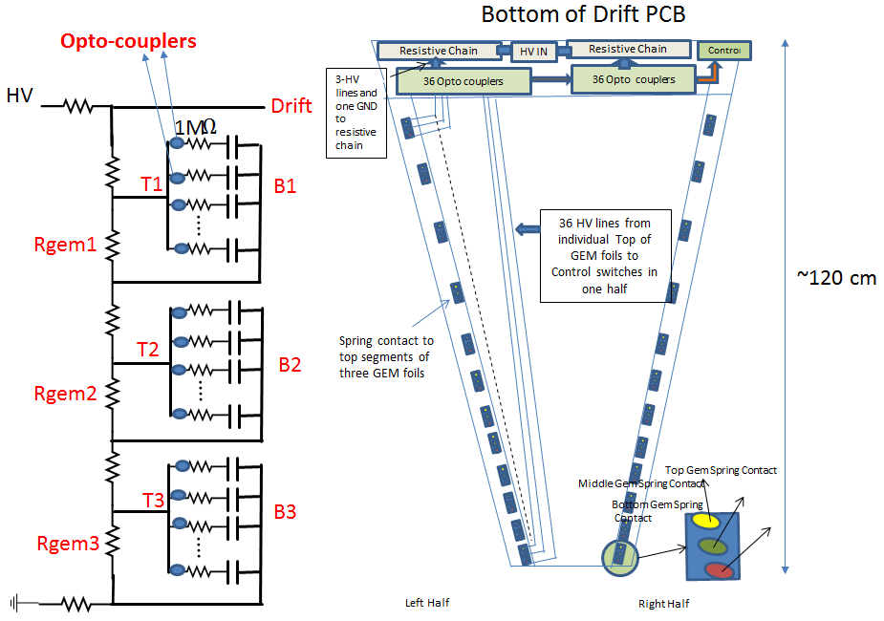
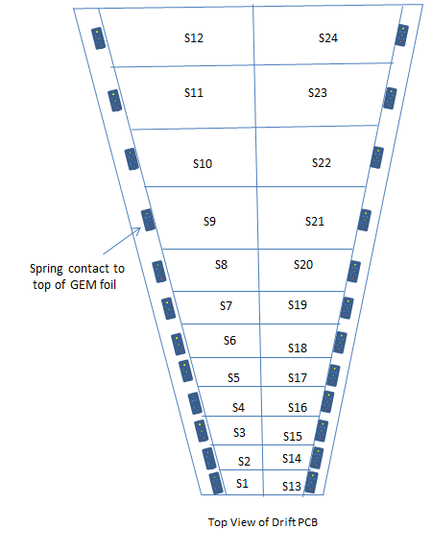
GEM – prototype M2 under construction
Opto-coupler switches
HV-Layout scheme
~ 120 cm
biasing network laid out for high stability under pulsed current

Slide 23
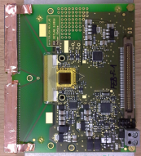
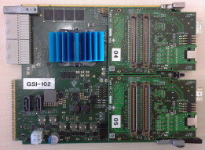
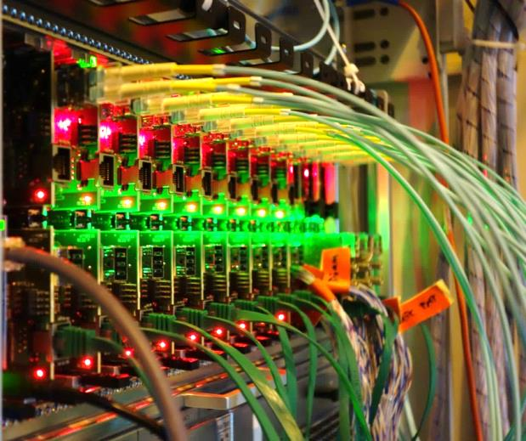
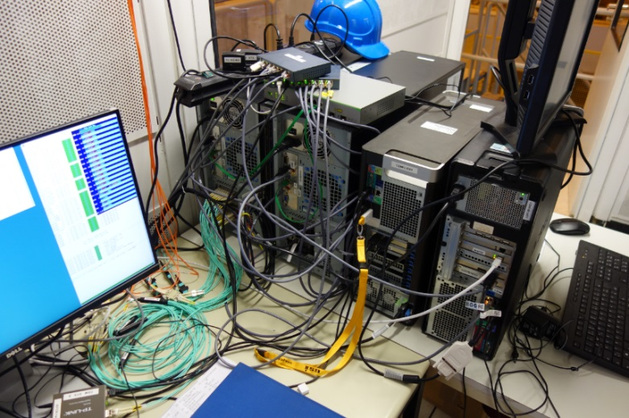
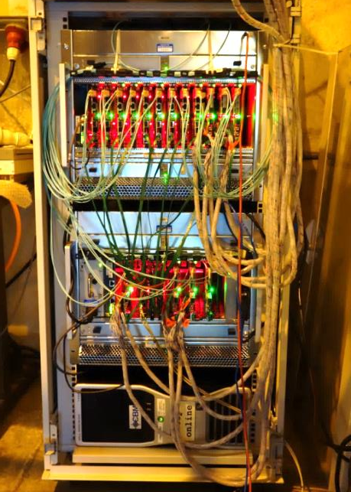
(d) New DAQ system for STS + GEM read-out
Ready: DAQ running at CBM Pb-beamtime (TOF, TRD, GEM), CERN-SPS, 12/2016. Will be used for STS, Hodoscope + GEM read-out at COSY.
on detector
on/near detector
in μTCA crates
mFLES
nDPB/MUCHgDPB
tDPB
PCs with FLIBs for time-slice building from the incoming data stream
n-XYTER FEBs
nDPB
μTCA crates
mFLES

Slide 24
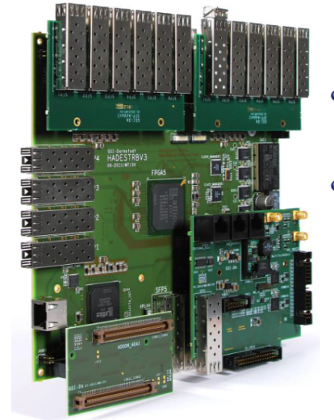
(e) Diamond T0 tests with TRB3 read-out
TRB3 System:
FPGA-based high precision TDC measurement and DAQ in one
Leading edge precision: 8-12ps (RMS)
Very flexible trigger functionality (FPGA)
Hitrates < 50 MHz (burst)
Used in many FAIR Projects:
HADES (diamond/trigger/RICH/ECAL),
CBM RICH,
PANDA (Barrel-DIRC/Straw)
and also outside of FAIR: MUSE, A1, ...

Slide 25
Beamtime application for detector tests
Total number of particles and type of beam (p,d,polarization) | Momentum range (MeV/c) | Intensity or internal reaction rate (particles per second) minimum needed maximum useful
p, not polarized | p ~ 1700 MeV/c | 10⁴/s | 10⁶/s
Experimental area | Safety aspects (if any) | Earliest date of Installation | Total beam time (No.of shifts)
Big Karl Cave + two “control rooms” for the large detector groups (GSI, Univ. Frankfurt, TU Darmstadt, Univ. Giessen Univ. Wuppertal, VECC Koktata): room at Big Karl, and Wasaquarium | none | weeks 19+20, 5/2017 * STS with DCS, DAQ, Online Analysis; * GEM prototypes; * RICH + DAQ; * diamond T0 detector. | two weeks, 24/7

Slide 26
The two CBM beamtimes summarized
Total number of particles and type of beam (p,d,polarization) | Momentum range (MeV/c) | Intensity or internal reaction rate (particles per second) minimum needed maximum useful
p, not polarized | p ~ 1700 MeV/c | 10⁴/s | 10⁶/s (detectors) 10⁹/s (electronics)
Experimental area | Safety aspects (if any) | Earliest date of Installation | Total beam time (No.of shifts)
JESSICA Cave | none | week 6, 2/2017 focus: STS XYTER v2 SEU tests optional: FPGA SEU tests, power regulator TID tests | one week, 24/7
Experimental area | Safety aspects (if any) | Earliest date of Installation | Total beam time (No.of shifts)
Big Karl Cave + two “control rooms” for the detector groups: room at Big Karl, and Wasaquarium | none | weeks 19+20, 5/2017 * STS with DCS, DAQ, Online Analysis; * GEM prototypes; * RICH + DAQ; * diamond T0 detector | two weeks, 24/7

Slide 27
Appendix

Slide 28
SEE Tests
slide from CBAC Meeting #2
Goal: first qualification of STS-XYTER DICE cell architecture with respect to Single Event Effects (SEE):
quantitative assessment of SEE cross sections for DICE cells and comparison to the regular flip flops in the design
dependency of SEE cross sections on incident angle
Expected SEE cross sections in the order of 10⁻¹³ to 10⁻¹⁴ cm²/bit for regular flip-flops and 10⁻¹⁴ to 10⁻¹⁵ cm²/bit for DICE cells
DICE cross section may be significantly increased in case of inadequate cell architecture
Depending on DICE architecture inclined incidence may increase cross section
Tests
Count SEEs ( readback of STS-XYTER registers )
Measure at perpendicular incidence: 90 (compatible with literature values)
Measure at inclined incidence: >≈ 25° typical incidence angle for ASIC installation in CBM-STS

Slide 29
SEE Rate Estimate for STS-XYTER v2
Compare
DICE cells: 32240 bits ( Trim DACs settings) – same number as with STS-XYTER v1 → test with any predefined bit pattern
Regular flip flops: 56420 bits ( ADC discriminator counters → 14bit instead of 8bit in STS-XYTER v1) → test with random bit pattern
1 week in JESSICA cave: compared to Sep. 2015
More DUTs
2 ASICs with perpendicular incidence (approx. compensates for lower expected SEE rate for DICE cells)
1 ASIC with ~25 degree incidence as in CBM-STS
Check for variations in SEE rate depending on incidence angle
Longer effective duration of irradiation (more robust and recoverable readout interface)
Higher beam intensity

