Slide 1
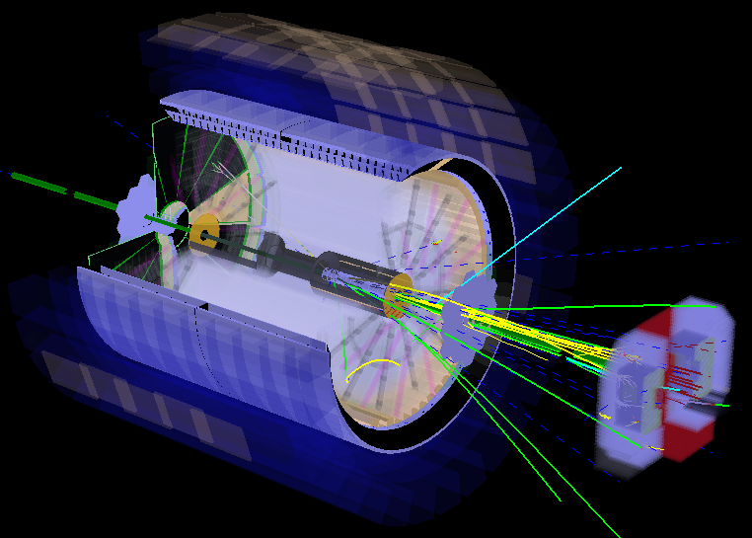

pp, pA & AA physics with
The STAR forward upgrade
https://drupal.star.bnl.gov/STAR/starnotes/public/sn0648
E.C. Aschenauer
Zhangbu Xu
& Elke Aschenauer

Slide 2

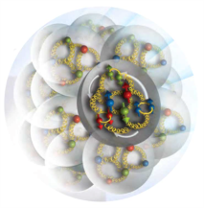
The objectives of the STAR Forward upgrade (I)
unique measurements to answer the hot questions in cold QCD
sea quarks and gluons and spins distributed in space and momentum inside the nucleon?
What is the properties of nucleons/nuclei emerge from those interactions?
How energetic color-charged quarks and gluons interact with a nuclear medium (formation time of colorless jet)?
How do the confined hadronic states emerge from these quarks and gluons?
What is the gluon density in nuclei?
How partons interact at high density?
Does it saturate at low-x?
Saturated gluonic matter with universal properties in all nuclei, even the proton?
gluon
emission
gluon recombination
?
=

Slide 3
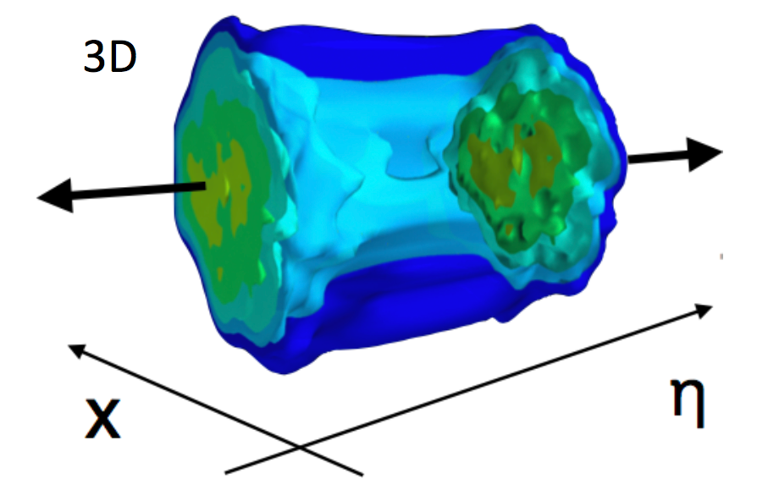
The objectives of the STAR Forward upgrade
pp and pA:
unique measurements to answer the hot questions in cold QCD
AA:
unique measurements to answer the cool questions in hot QCD
What is the longitudinal structure of initial condition?
Strengthen and Enhance the EIC physics program
  lay the groundwork for the EIC, both scientifically and by refining the experimental requirements
  Test EIC detector technologies under real conditions, i.e SiPMs

Slide 4
Transverse Momentum Distributions
Till today TMDs come only from fixed target data → high x @ low Q²
need to establish concept at high Q² and wide range in x
STAR unique kinematics with polarized pp at RHIC: from high to low x at high Q²

Slide 5
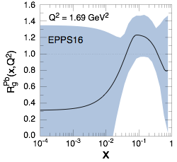
Initial State in Heavy-Ion Collisions
Current knowledge including
first LHC pA data
What are the nPDFs at low-x?
How saturated is the initial state of the nucleus?
What is the spatial transverse distributions
of nucleons and gluons?
pA@RHIC: unique kinematics
can measure nPDF in a x-Q² region
where nuclear effects are large
Observables free of final state effects
Scan A-dependence prediction by
saturation models
can access saturation regime at
forward rapidities
RHIC pA y≤4
direct photon
2.8 < η < 3.8
Saturation

Slide 6
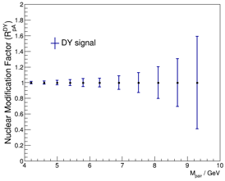
How Does The initial state IN AA Look?
pA: DY@2.5 < η < 4.5
pA: Direct Photon@2.5 < η < 4.5
DY: Q²: ~M²; Q²>16 GeV²
Uncertainties: 2023 pp & pA
direct photon: Q²: ~p_{t}²;Q²>5 GeV²
Uncertainties:2015 + 2023 pp&pA
Impact on
nPDFs:
→ gluons
Impact on
nPDFs:
→ sea quarks
Both DY and direct photon R_{pA} give significant constraints on nPDF
alternative observables and kinematics to EIC

Slide 7
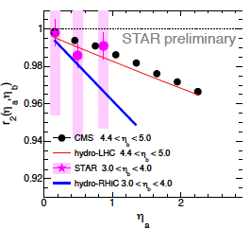
Rapidity (de)correlations
Hot QCD study 𝞰/s and dynamic evolution
Cold QCD γ-h correlation => saturation effect

Slide 8
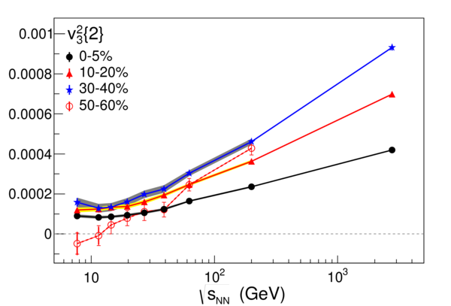
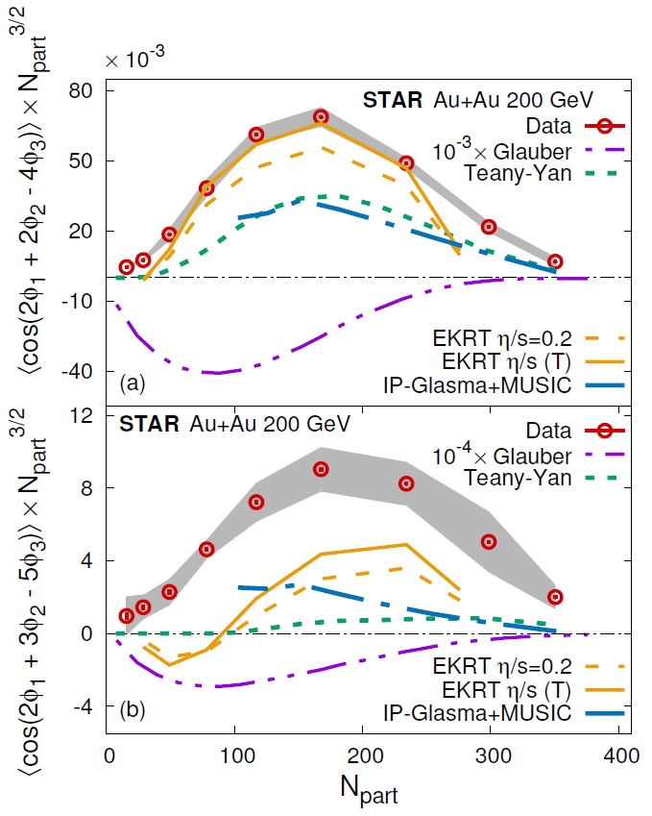
n^{th} order Flows in rapidity
PRL 116(2016)
STAR Preliminary
Higher harmonics sensitive to earlier stage
Study BES and small system size:
Turn OFF QGP?
Multiple-Harmonics sensitive to η/s
STAR
Preliminary

Slide 9
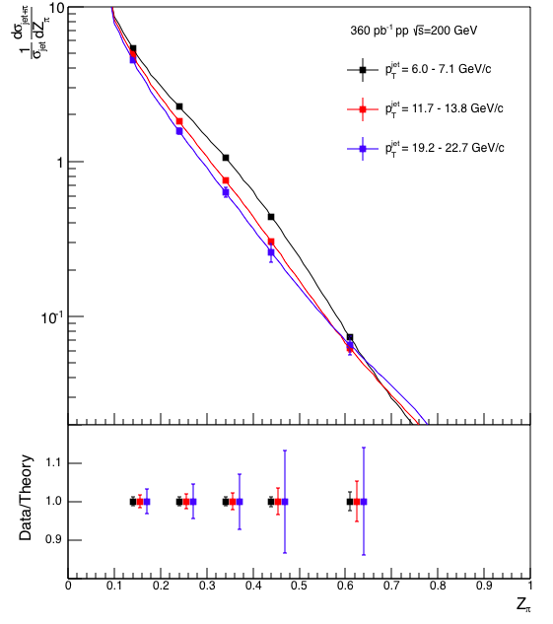
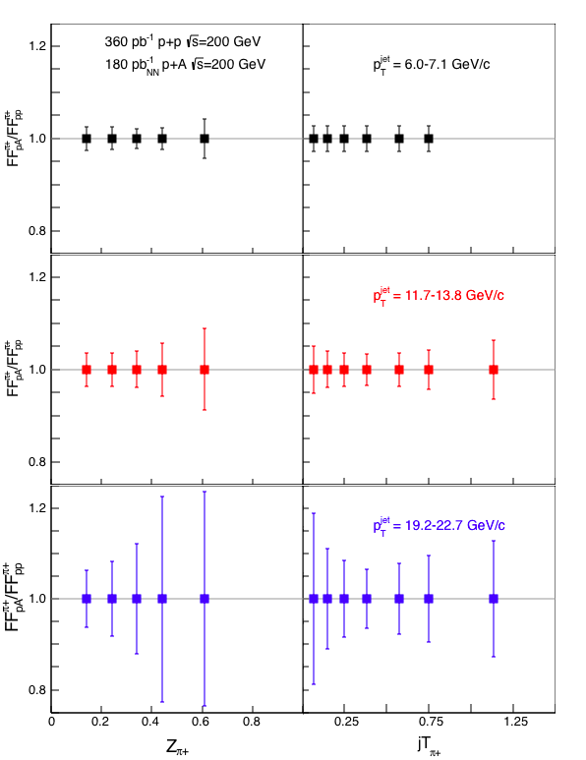
pp, pA, AA Physics At Midrapidity
Rich unique program building on the strength and high rate of STAR detector
measurements complement the forward physics program
  extending kinematics
  addressing complement physics topics
  diffractive & UPC program with Roman Pots, i.e. Wigner functions
pp:
Fragmentation functions
High precision TMD measurements
→ Universality test → EIC
pA:
nuclear Fragmentation functions
complement to nPDFs
only at RHIC p↑A:
→ spin effects in nFF → Collins FF
AA:
a deep look into the properties
of the QGP: γ & e+e- pairs
chiral symmetry restoration
thermal radiation of QGP

Slide 10
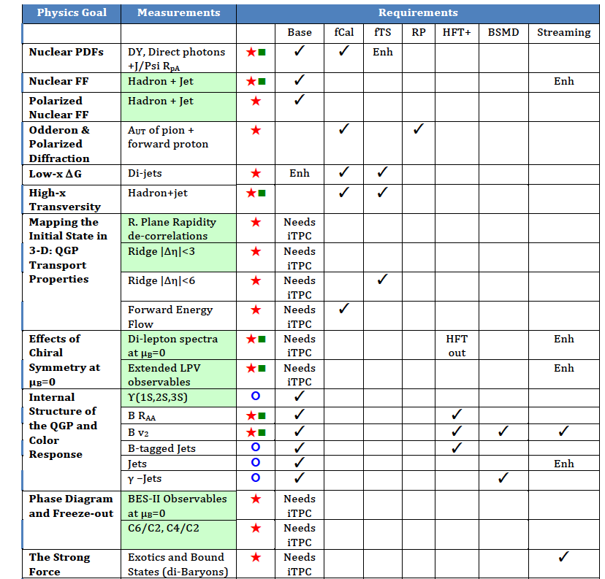
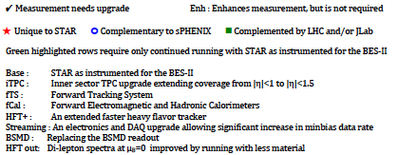
Physics Opportunities beyond BES-II (2020+)
Define QCD Phase Structure
Study Chiral Properties
Map T dependence of η/s
Test K_{T} factorization
and Universality
SN0648-
proposal for Forward upgrade
Submitted to BNL in May 2017
Extended coverage and
targeted upgrades open up
many opportunities
for a diverse scientific
program in 2020+

Slide 11
BNL Program Advisory Committee Report
6. Modest Forward Upgrades
The PAC commends both the sPHENIX and STAR collaborations for their considerable effort in preparation of detailed Letters of Intent that describe their forward detector upgrade plans. The PAC finds that the physics case for a forward upgrade at RHIC remains compelling. The importance of the proposed measurements for the future EIC is clear. The PAC is also impressed by the added benefit to the heavy-ion program of the increased rapidity range provided by the forward detector upgrades.
Recommendations:
• In view of the importance of DY reactions for the forward detector program, high
priority should be given to the analysis of the 2017 STAR DY data to demonstrate the
feasibility of such a measurement.
• As TMD physics is the major motivation for the forward detector upgrade program, it
is of crucial importance that the 2017 RHIC Spin run be analyzed quickly and as
completely as possible. This calls for an increase in the RHIC Spin effort rather than
the reduction that is being considered.
• As the physics program that is foreseen for forward physics is substantial, full
utilization of future polarized proton beam time must be made to realize the proposed
forward physics program.
• RHIC management is encouraged to find a way to enhance and include a forward physics
program at RHIC.

Slide 12
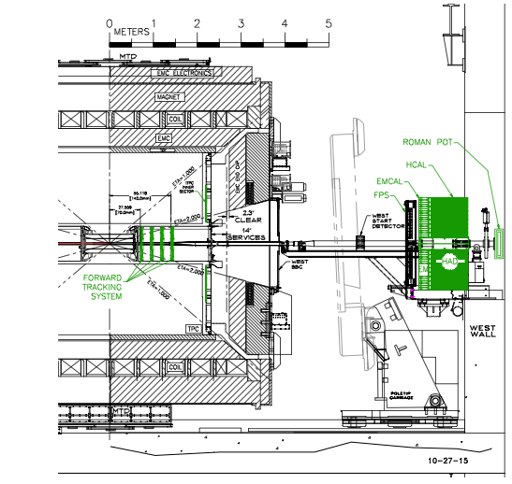
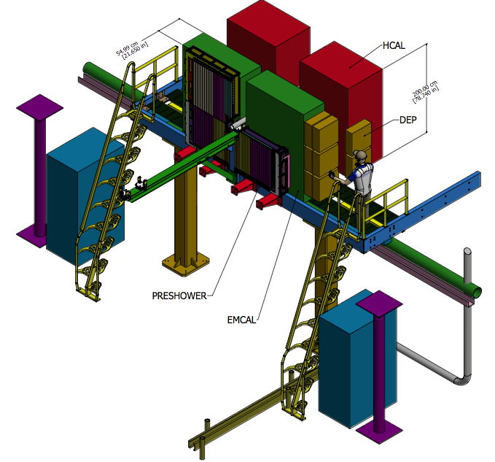
Possible Implementation
Cost 1-2M$
Forward Electromagnetic calorimeter and hadronic calorimeter
Complete energy measurement with high granularity.
https://drupal.star.bnl.gov/STAR/starnotes/public/sn0648
And
The RHIC Cold QCD Plan from 2017 to 2023: A portal to the EIC - Jan. 2016

Slide 13
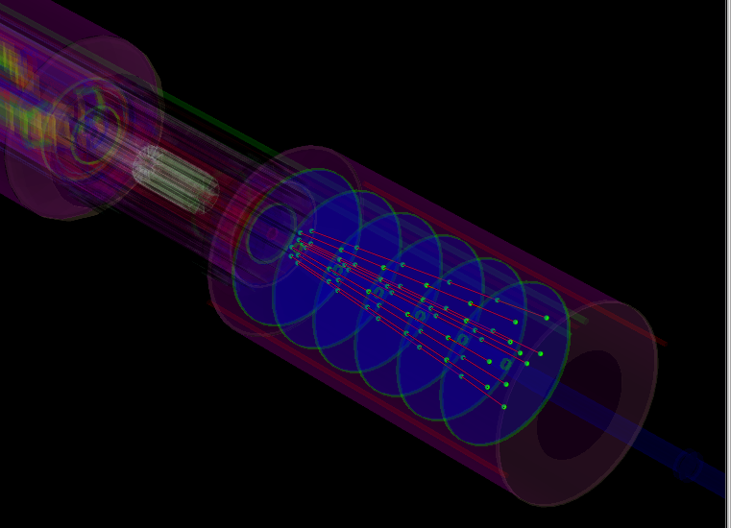
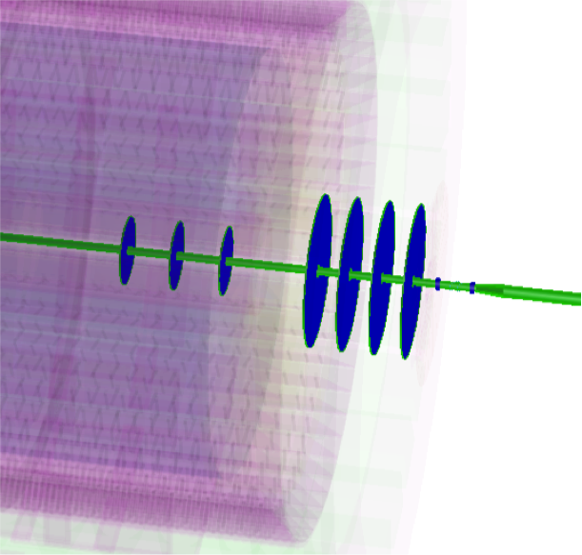
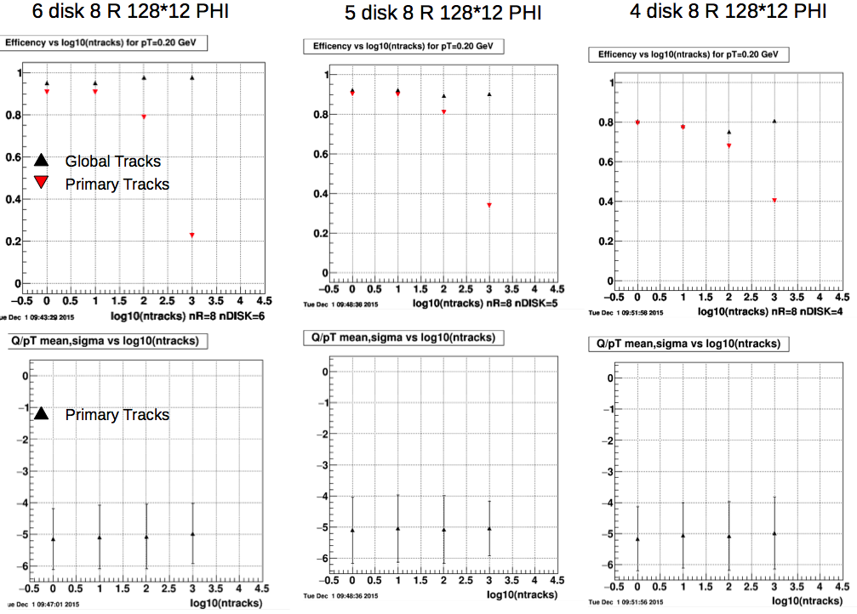
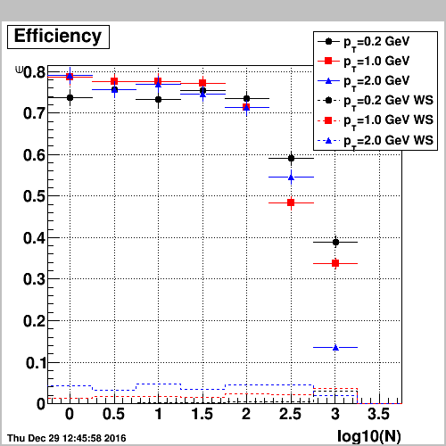
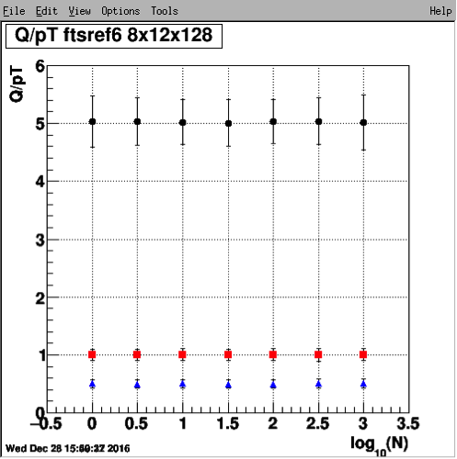
The STAR Forward Upgrade
Silicon mini-Strip Detectors only
Si + Small-strip Thin Gap Chambers
6 disks
12 wedges, each with
128 strips in ϕ at
fixed radius and 8
strips in the radial
direction at a fixed ϕ
60 – 180 cm from IP
3 Si disks + 4 sTGC
Si- disks:
90, 140, 187 cm from IP
sTGC:
270, 300, 330, 360 cm
from IP (outside Magnet)
Momentum resolution: 20-30%
for 0.2 < p_{T} < 2 GeV/c
track finding efficiency: 95%@100 tr/ev
Momentum resolution: 20-30%
for 0.2 < p_{T} < 2 GeV/c
track finding efficiency: 80%@100 tr/ev
0.2 GeV/c
pions
1 GeV/c
2 GeV/c
Cost: 4.1 M$
Cost: 3.3 M$

Slide 14
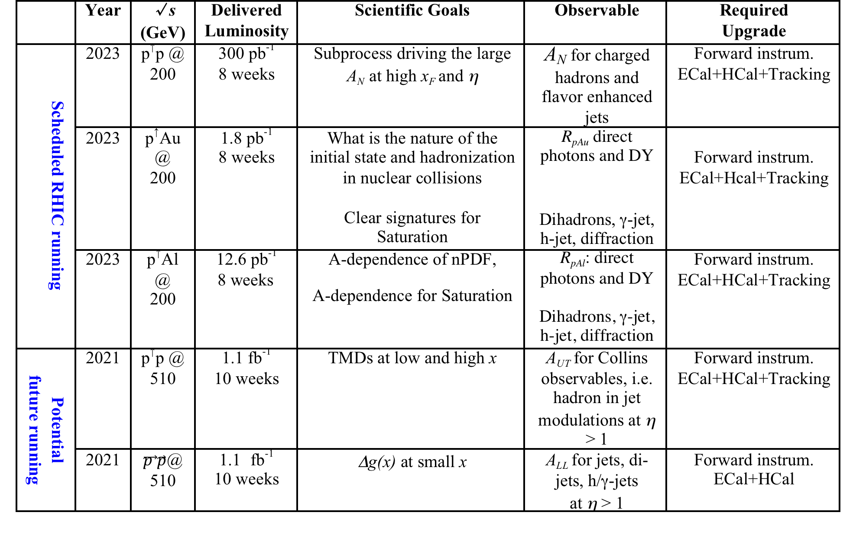
Summary of forward pp & pA measurements

Slide 15
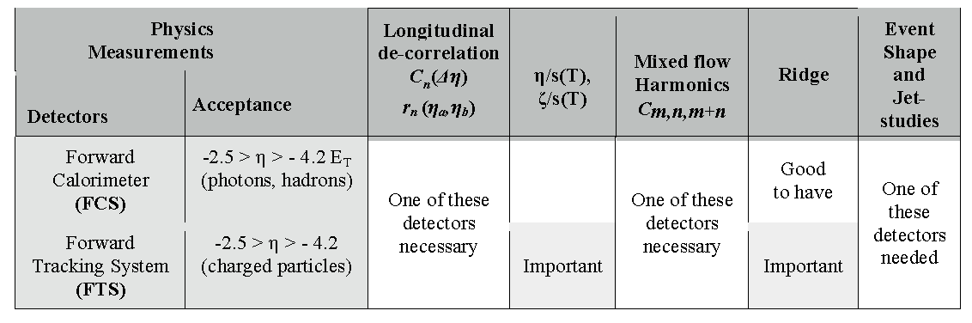
Summary of forward AA measurements
forward STAR upgrade unique opportunity to:
study the structure of the initial state that leads to breaking of boost invariance in heavy ion collisions and to explore of the transport properties of the hot and dense matter formed in heavy ion collisions near the region of perfect fluidity.

Slide 16
RHIC has been adaptable to science needs
2010-2013 | 2014 | 2015 | 2016 | 2017 | 2018 | 2019 | 2020 |  | 2022+
Au+Au p+p | Au+Au | p+p p+A | Au+Au d+Au | p+p Au+Au | Isobar Au+Au | Au+Au | Au+Au |  | Au+Au pp,pA
ΔG, QGP property | Charm flow | Ref. A_{N} | D_{c}, Λ_{c} ϒ, Jets | Fc sign | CME, Λ↑ | Critical Point, Phase Transition |  |  | Jets, ϒ forwardA_{N}
BES-I | 200, 14.5 | 200 | 200-19.6 | 500, 54.4 | 200, 27 | BES-II 11-20 | BES-II 7-11 |  | 200
BES-I
BES-II
Beam Energy Scan (BES)
Expand to include several programs:
p+A in run 15,
pp500 and 54.4GeV Au+Au in run17,
Isobar (Zr, Ru-96) and 27GeV Au+Au in run 18
BES-II more compelling, detector and machine upgrades in 2018
Future high-luminosity jets and Upsilon in 2020+
3+1D hydrodynamics and Unique Cold QCD (DY) portal to EIC

Slide 17
RHIC Energy nucleus low-x physics & QGP rapidity correlation
TMD and gluon saturation at Low-x using forward DY and γ-h correlations
Rapidity decorrelation and global polarization probing QGP properties
Exotic particle and jet production over large rapidity range
Adopting new detector concepts toward EIC (Electron-Ion Collider)

