Slide 1
Superconducting RF Photoelectron Source -
Research for a high-brightness & continuous wave photo injector
at ELBE/HZDR
Jochen Teichert
KfB Meeting Darmstadt
31 Aug. – 1 Sept. 2017
Verbundforschung in der Physik der kleinsten Teilchen

Slide 2
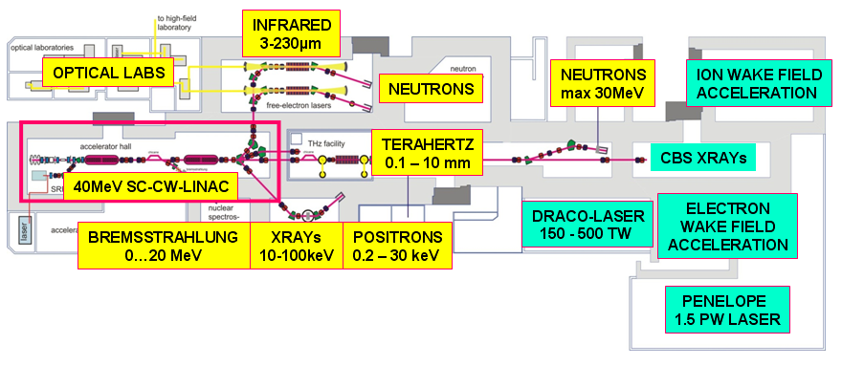
Radiation Source ELBE & SRF Gun
ELBE User Facility
thermionic injector
SRF gun
New applications require
high bunch charges (1 nC)
ultra short bunches (< 500 fs)
low transverse emittance (1 mm mrad)
Accelerator Research and Development at ELBE:
Superconducting RF Photoelectron Injector
BMBF Verbundforschung:
Erforschung kondensierter Materie
Physik der kleinsten Teilchen

Slide 3
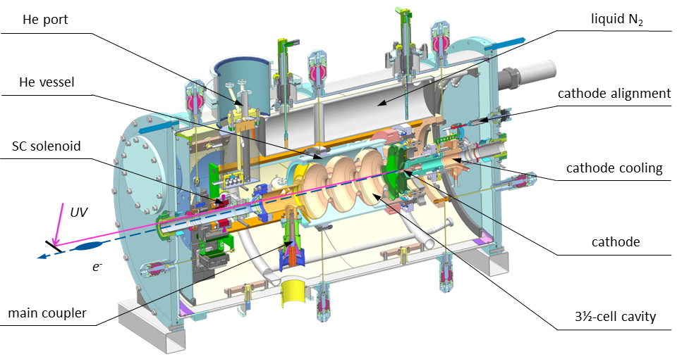
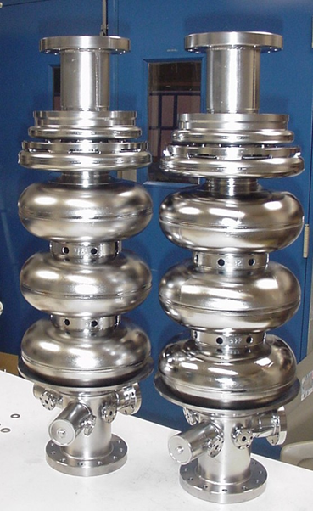
ELBE SRF Gun II Cryomodule
CInommissioning of SRF Gun II
RRR 300
Nb cavity
large grain
Nb cavity
New cavity - fine grain Nb,
produced, treated,
tested at JLab
New cryomodule
10 cm longer, fabricated and assembled at HZDR
Integration of a superconducting solenoid

Slide 4
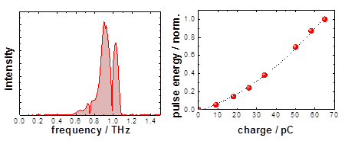
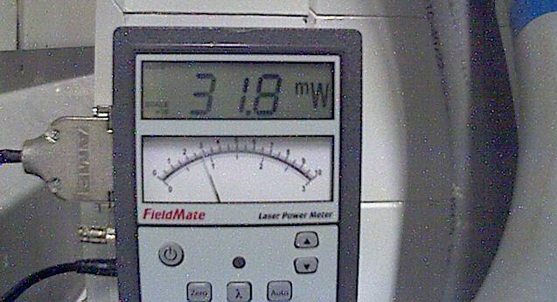
User operation with SRF gun II
Commissioning of SRF Gun II
4 x 12 h user shifts for THz radiation production
80 – 100 pC, E_{kin} = 4 MeV, 100 kHz
10 mW @ 1 THz
32 mW@ 0.5 THz
next: shorter bunches wanted
THz spectrum and charge dependence
first beam 3.12.2016!
ARD-ST3 test facility TELBE
ARD-ST1
MuT /ARD Subtopics ST1 „SRF“ & ST3 „ps-fs“

Slide 5
Research topics
Photocathodes
metallic, semiconductors PC
UV or green light, PCs for polarizes electrons
CW superconducting RF
high gradient and high current operation
LLRF, couplers, RF power sources
Production of ultra-short electron bunches
non-linear beam dynamics and compression
bunch-length measurements
RF superconducting cavity design
RF & beam dynamic design of gun cavities
multi-mode cavities
Beam diagnostic and simulation
space charge and wake fields
Beam loss, prevention of radiation damage, radiation hardness

