Slide 1
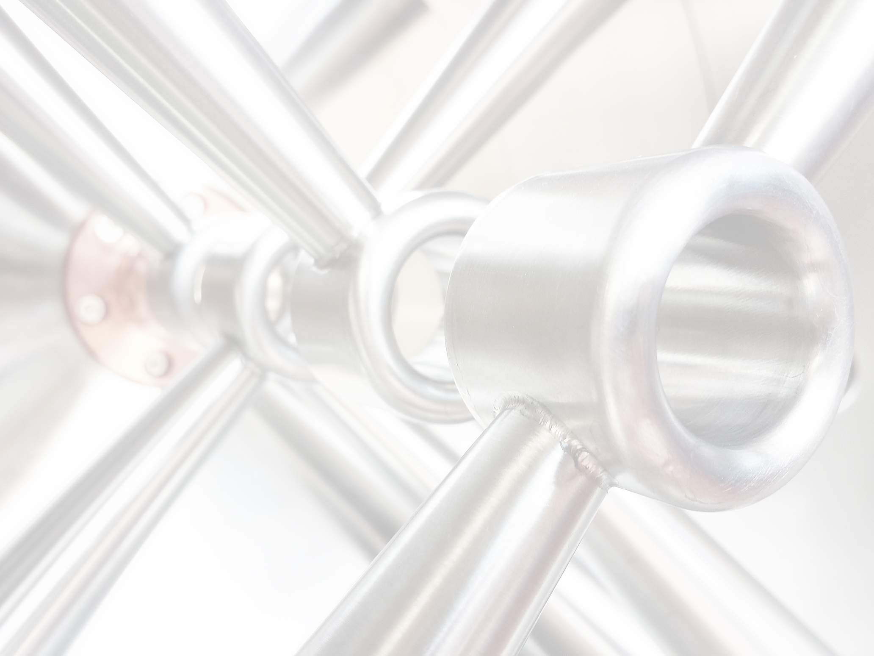


Development for Efficient Hadron Linear Accelerators for Low and Medium Energies
KfB Treffen zur Verbundforschung
31.8.2017
H. Podlech
Institut für Angewandte Physik
Goethe Universität Frankfurt

Slide 2
Upgrade HLI
High Charge Injector serves as one heavy ion injector
Future operation: cw@A/q=6, pulsed@A/q=8.5
Exisiting RFQ allows no stable operation → Mechanical vibrations
New mechanical and RF design under progress
Prototype under construction → Test campaign
Measured RF signals of HLI RFQ
Simulated mechanical modes of electrodes
New geometry of HLI RFQ
Optimized cooling for cw operation

Slide 3
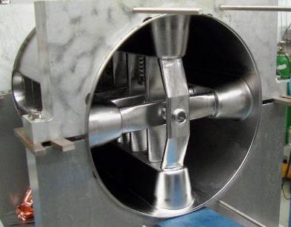
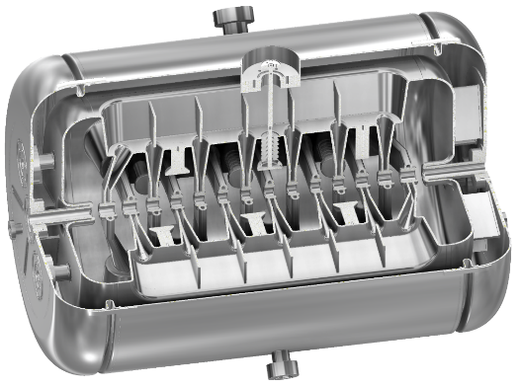
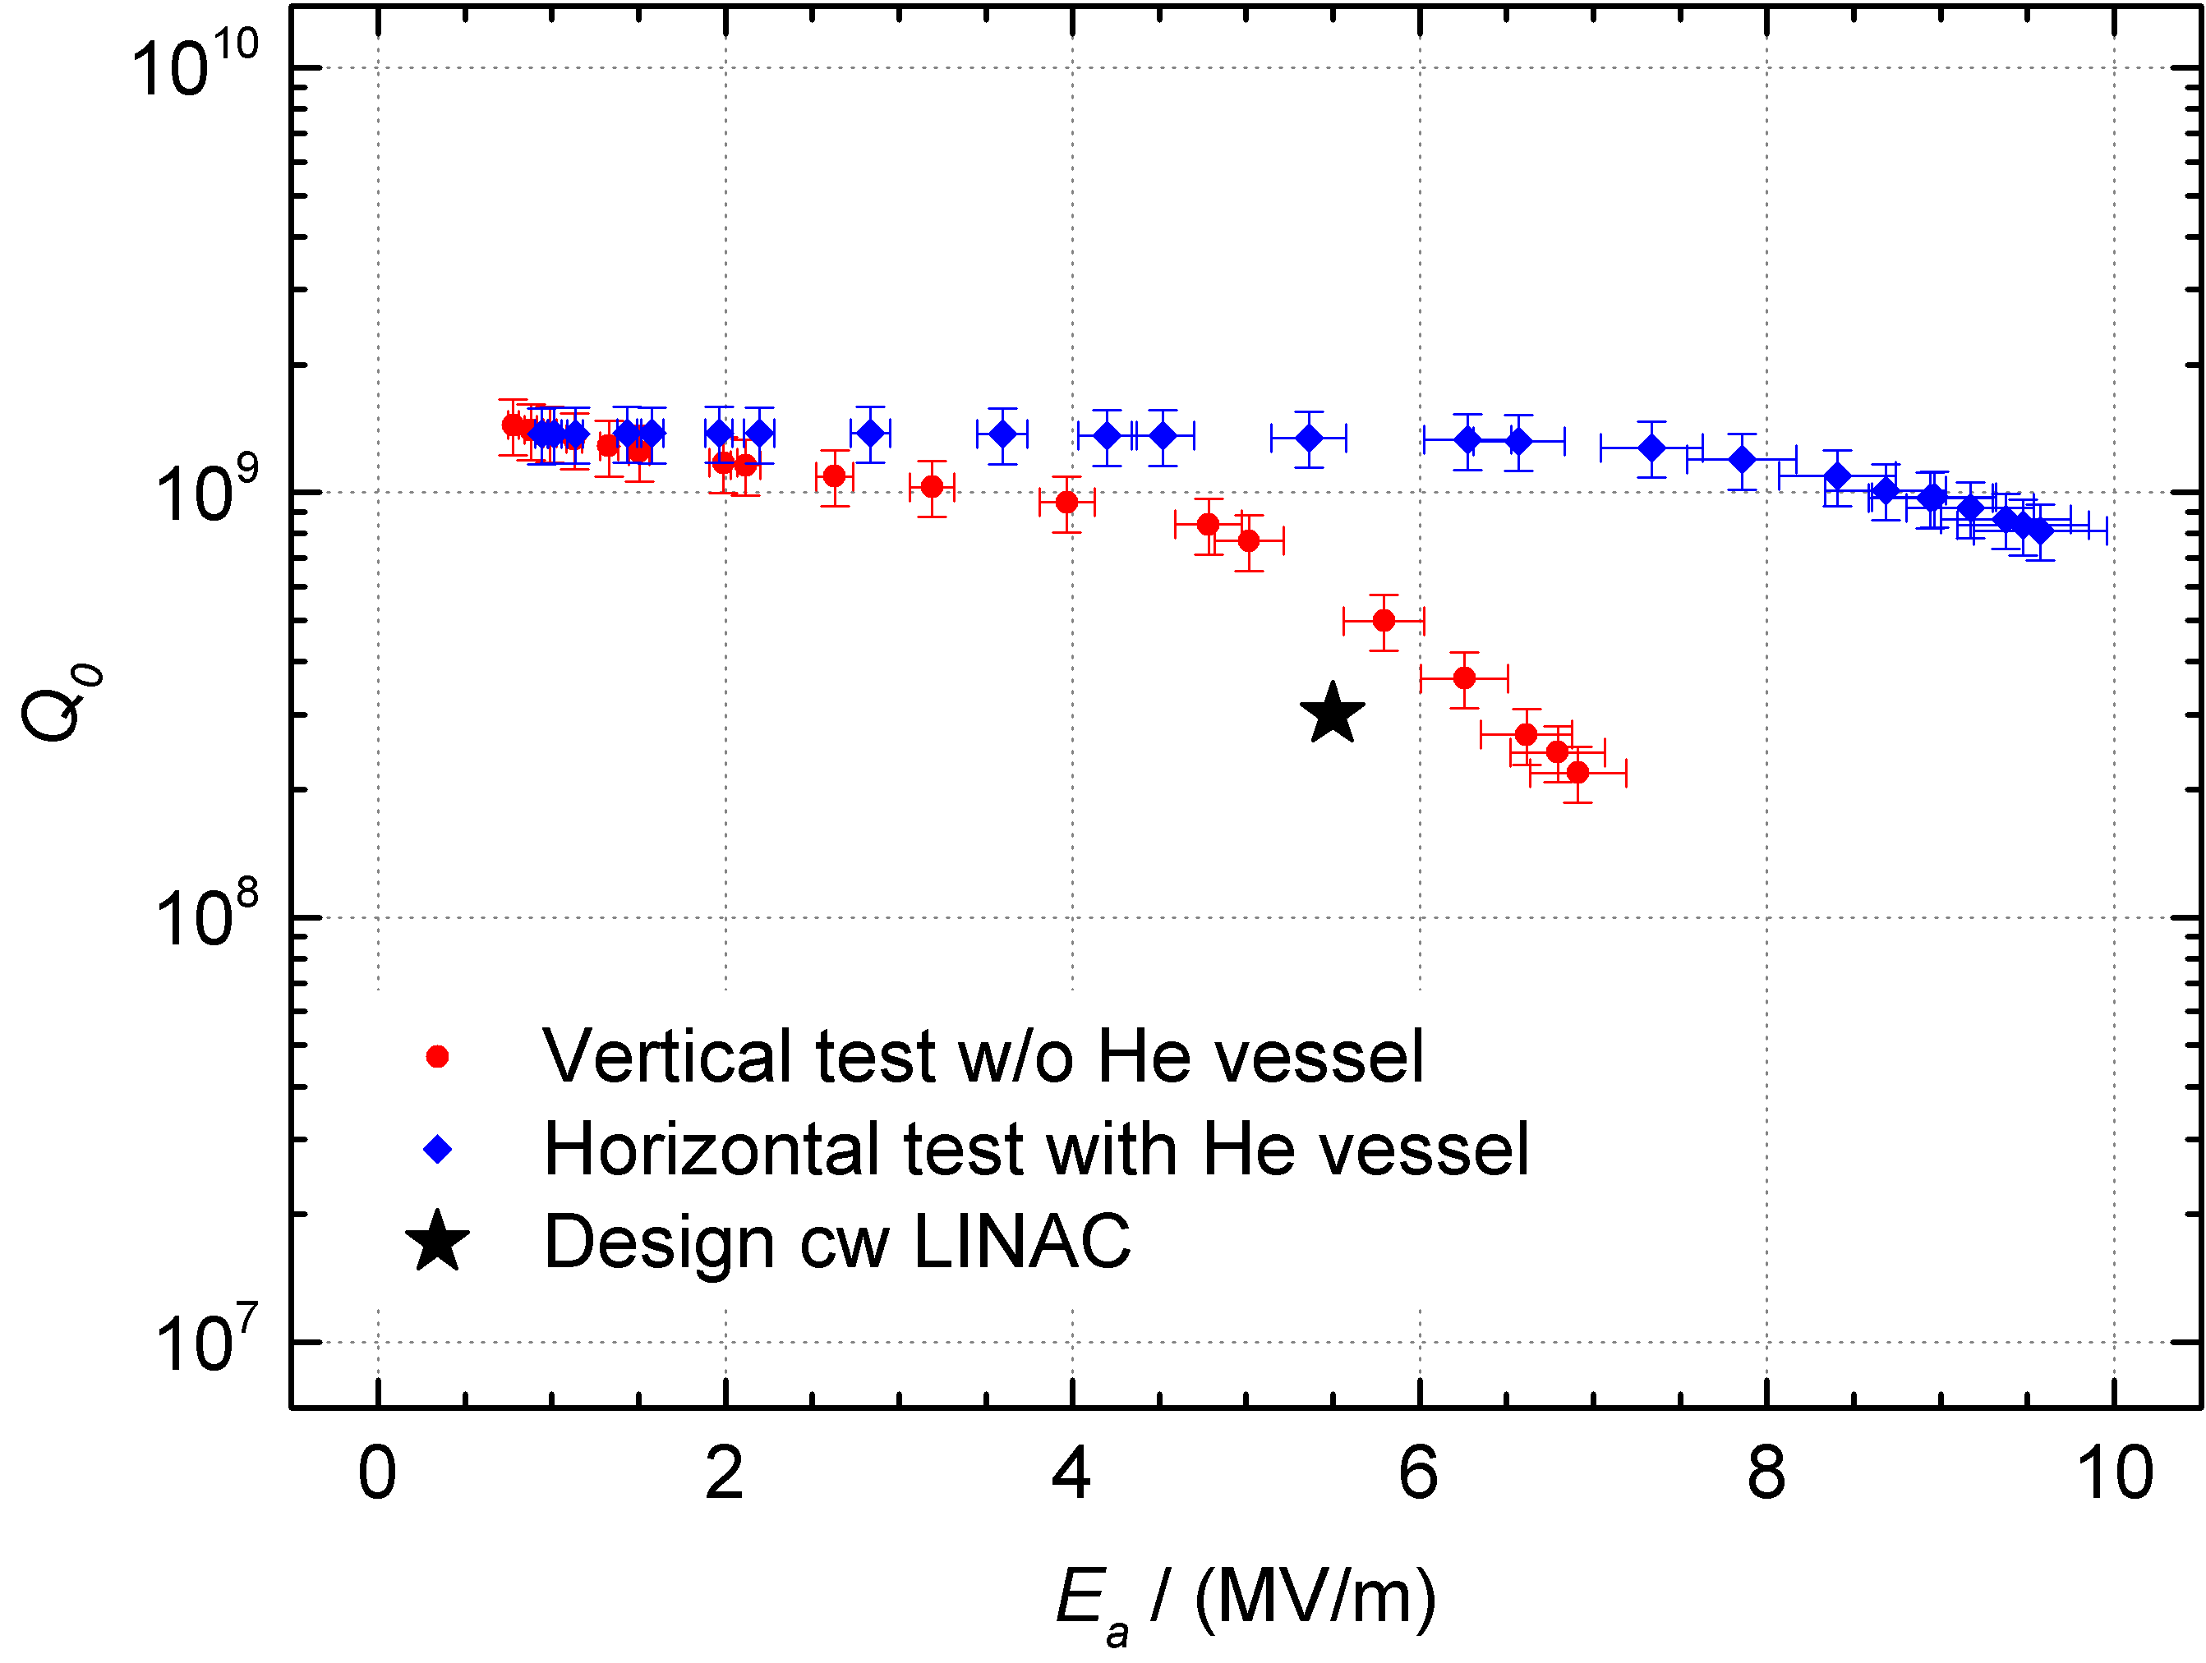
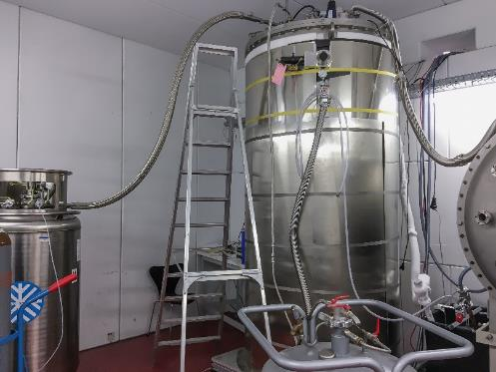


SRF Development for cw Linac
Inclined stem
Dynamic tuner
Static tuner
Sc CH-cavity development for a future cw HI linac based on 15 years experience at IAP
Power coupler, Tuner systems
Preparation
ports
Helium vessel
217 MHz Demonstrator cavity CH-0
Vertical test at IAP
Test results of CH-0

Slide 4
SRF Development for cw Linac
First beam test successfully performed at GSI in 2017
W. Barth et al.
Preliminary beam dynamics layout
Goal:
Realization and test of first complete cryo module
Finalization of beam dynamics
Design of following CH-cavities
CH1/2 presently under construction

Slide 5
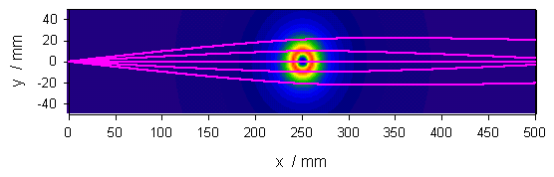

Electron Beam Probe – Non-destructive Beam Diagnostics
Beam instrumentation in synchrotrons (SPS @ CERN)
Case study for FCC
Independent of residual gas pressure
Time resolution given by CCD camera & scintilator
Reconstruction of ion density is possible
SCC processes are detectable

