Slide 1


MESA Linac Module @ bERLinPro
Joint Accelerator Research JGU & HZB
“SRF Cryomodule testing for electron
accelerators under beam conditions”

Slide 2
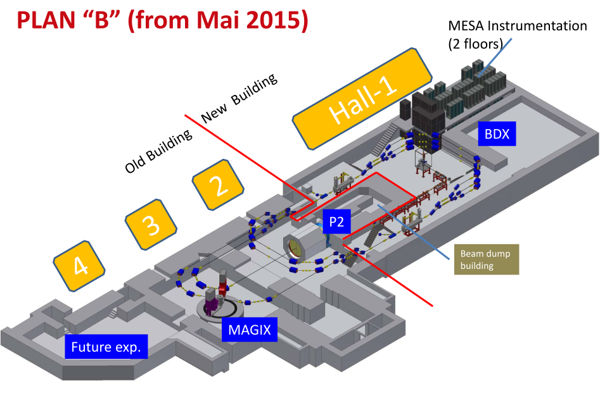
MESA – Mainz Energy Recovery Superconducting Accelerator
due to civil construction time accelerator construction can start end 2020
 | Basic Parameter
max. beam energy | 105 MeV (ERL mode) 155 MeV (external beam)
max. current in ERL operation | 1 mA (later 10 mA) (0.77-7.7 pC/bunch)
Number of recirculations | 2 (ERL mode) 3 (external beam)
Picture: D. Simon

Slide 3
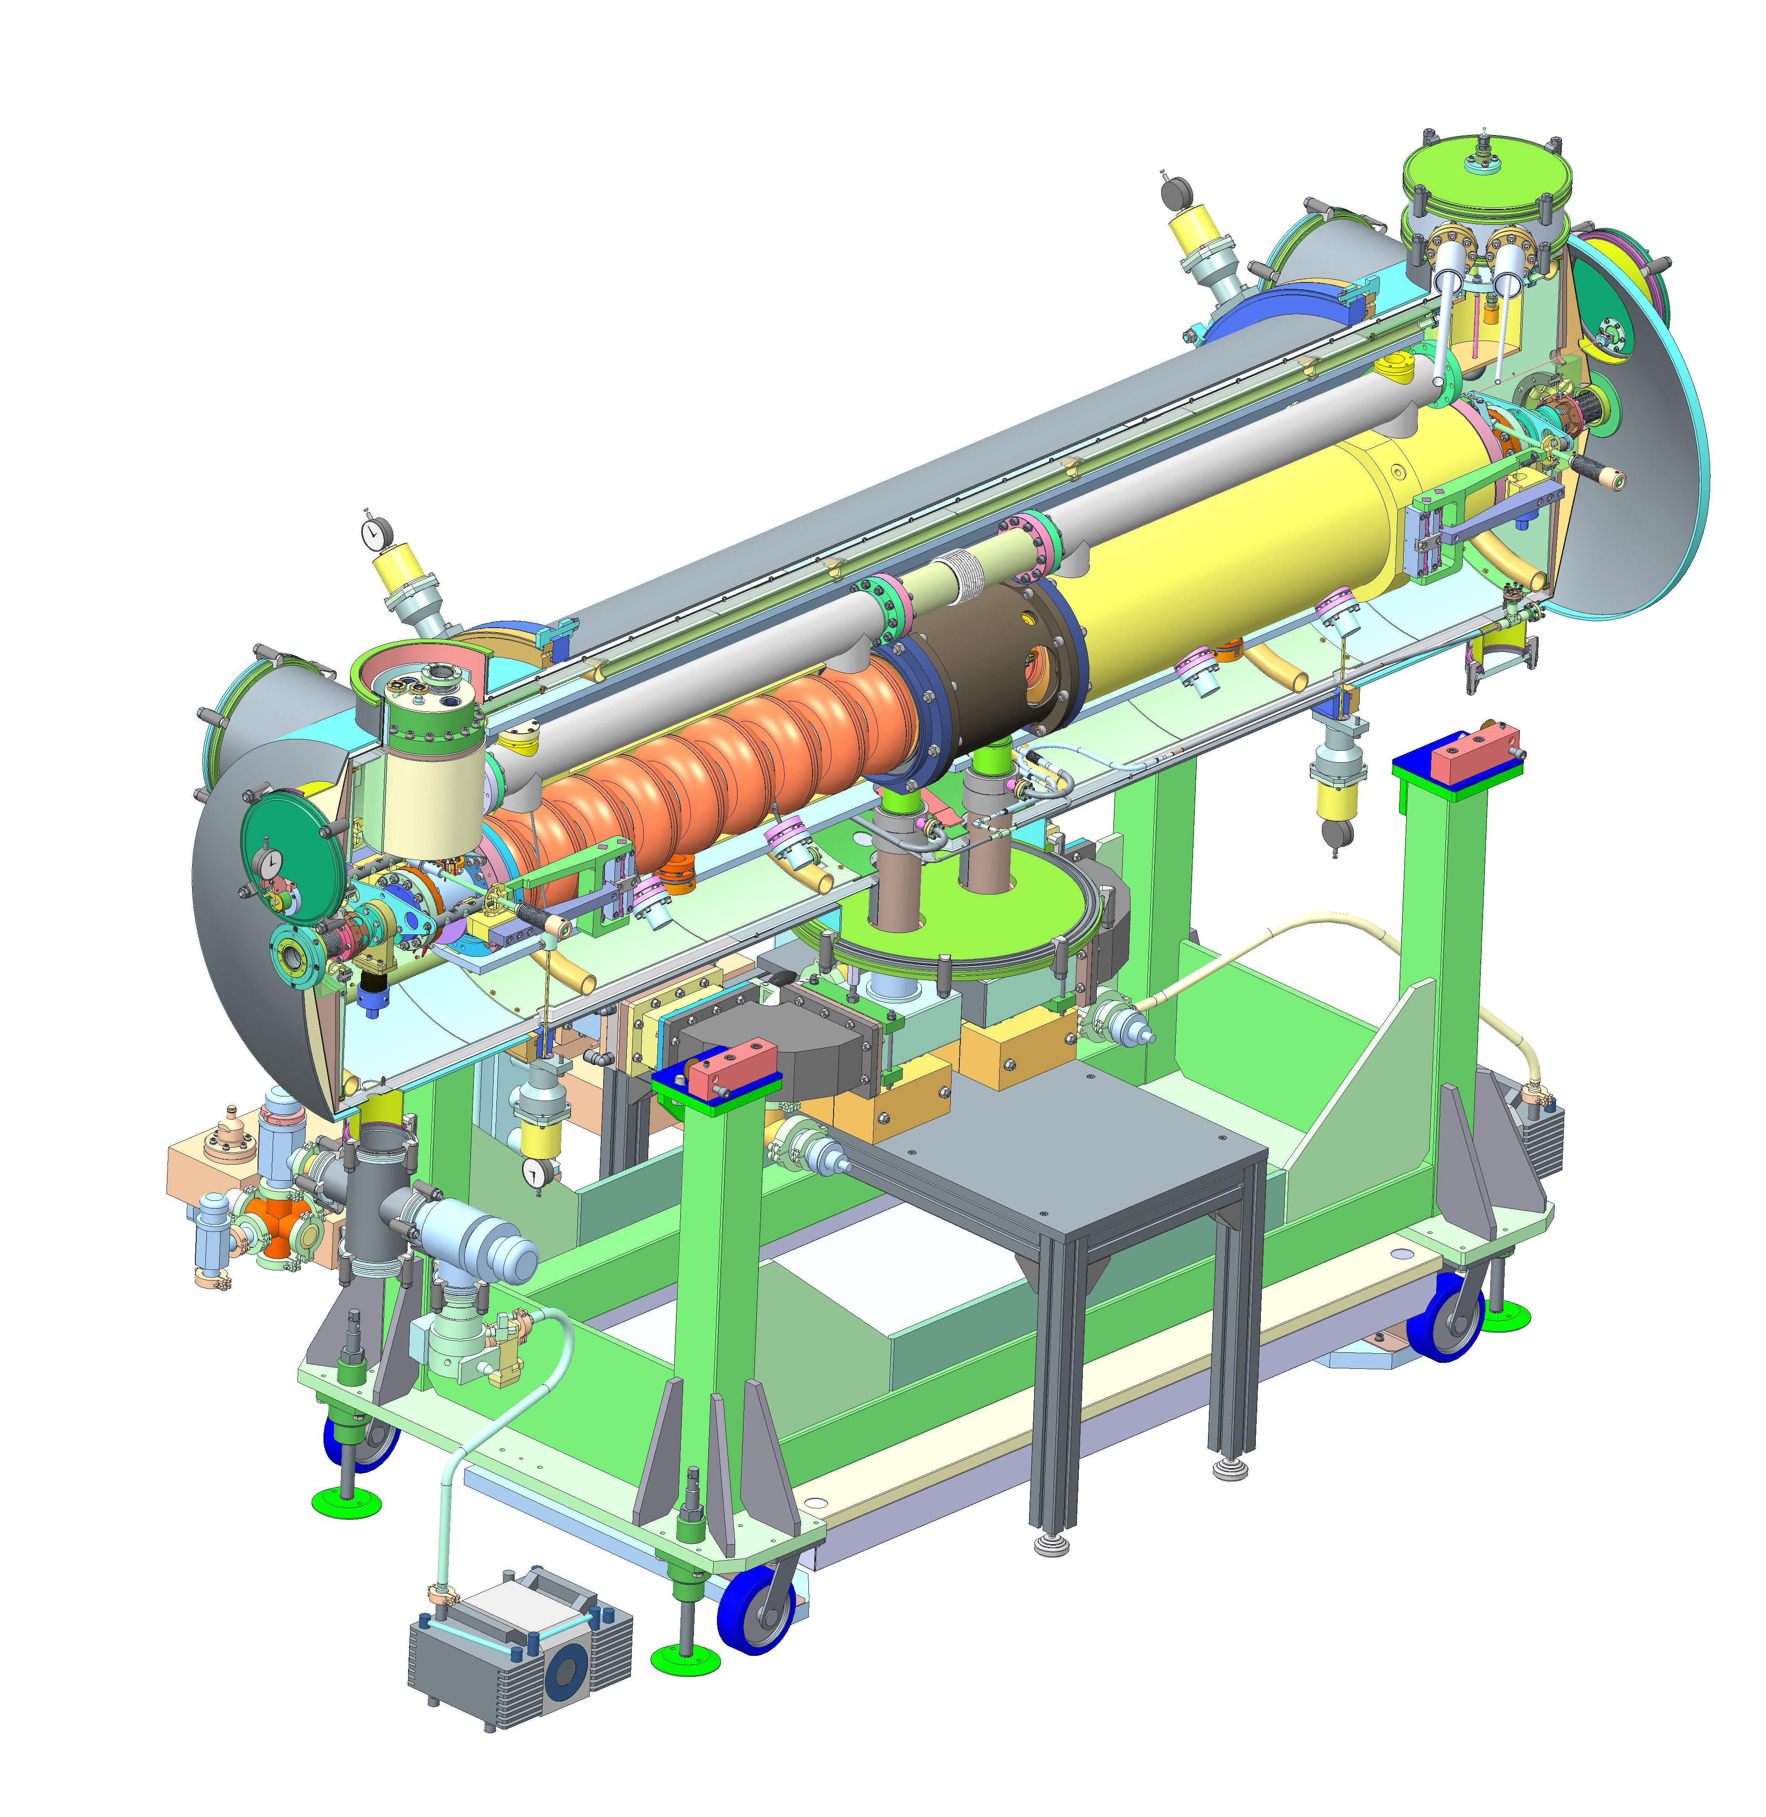
MESA Cryomodules
Cryomodules of the 'Rossendorf'-type
(2 x 9-cell TESLA/XFEL cavities), which are in use at ELBE
will be used for MESA
→ we applied some adaptations
in order to allow 1 mA ERL operation:
added tuners with piezo elements
(XFEL/Saclay-type)
used sapphire windows at HOM
feedthroughs
→ beam current of 10 mA may not be
achievable with that type of
cryomodule
Just today: String assembly
successfully completed
2 modules will be tested at Mainz
fall 2017 till spring 2018
Picture: HZDR

Slide 4
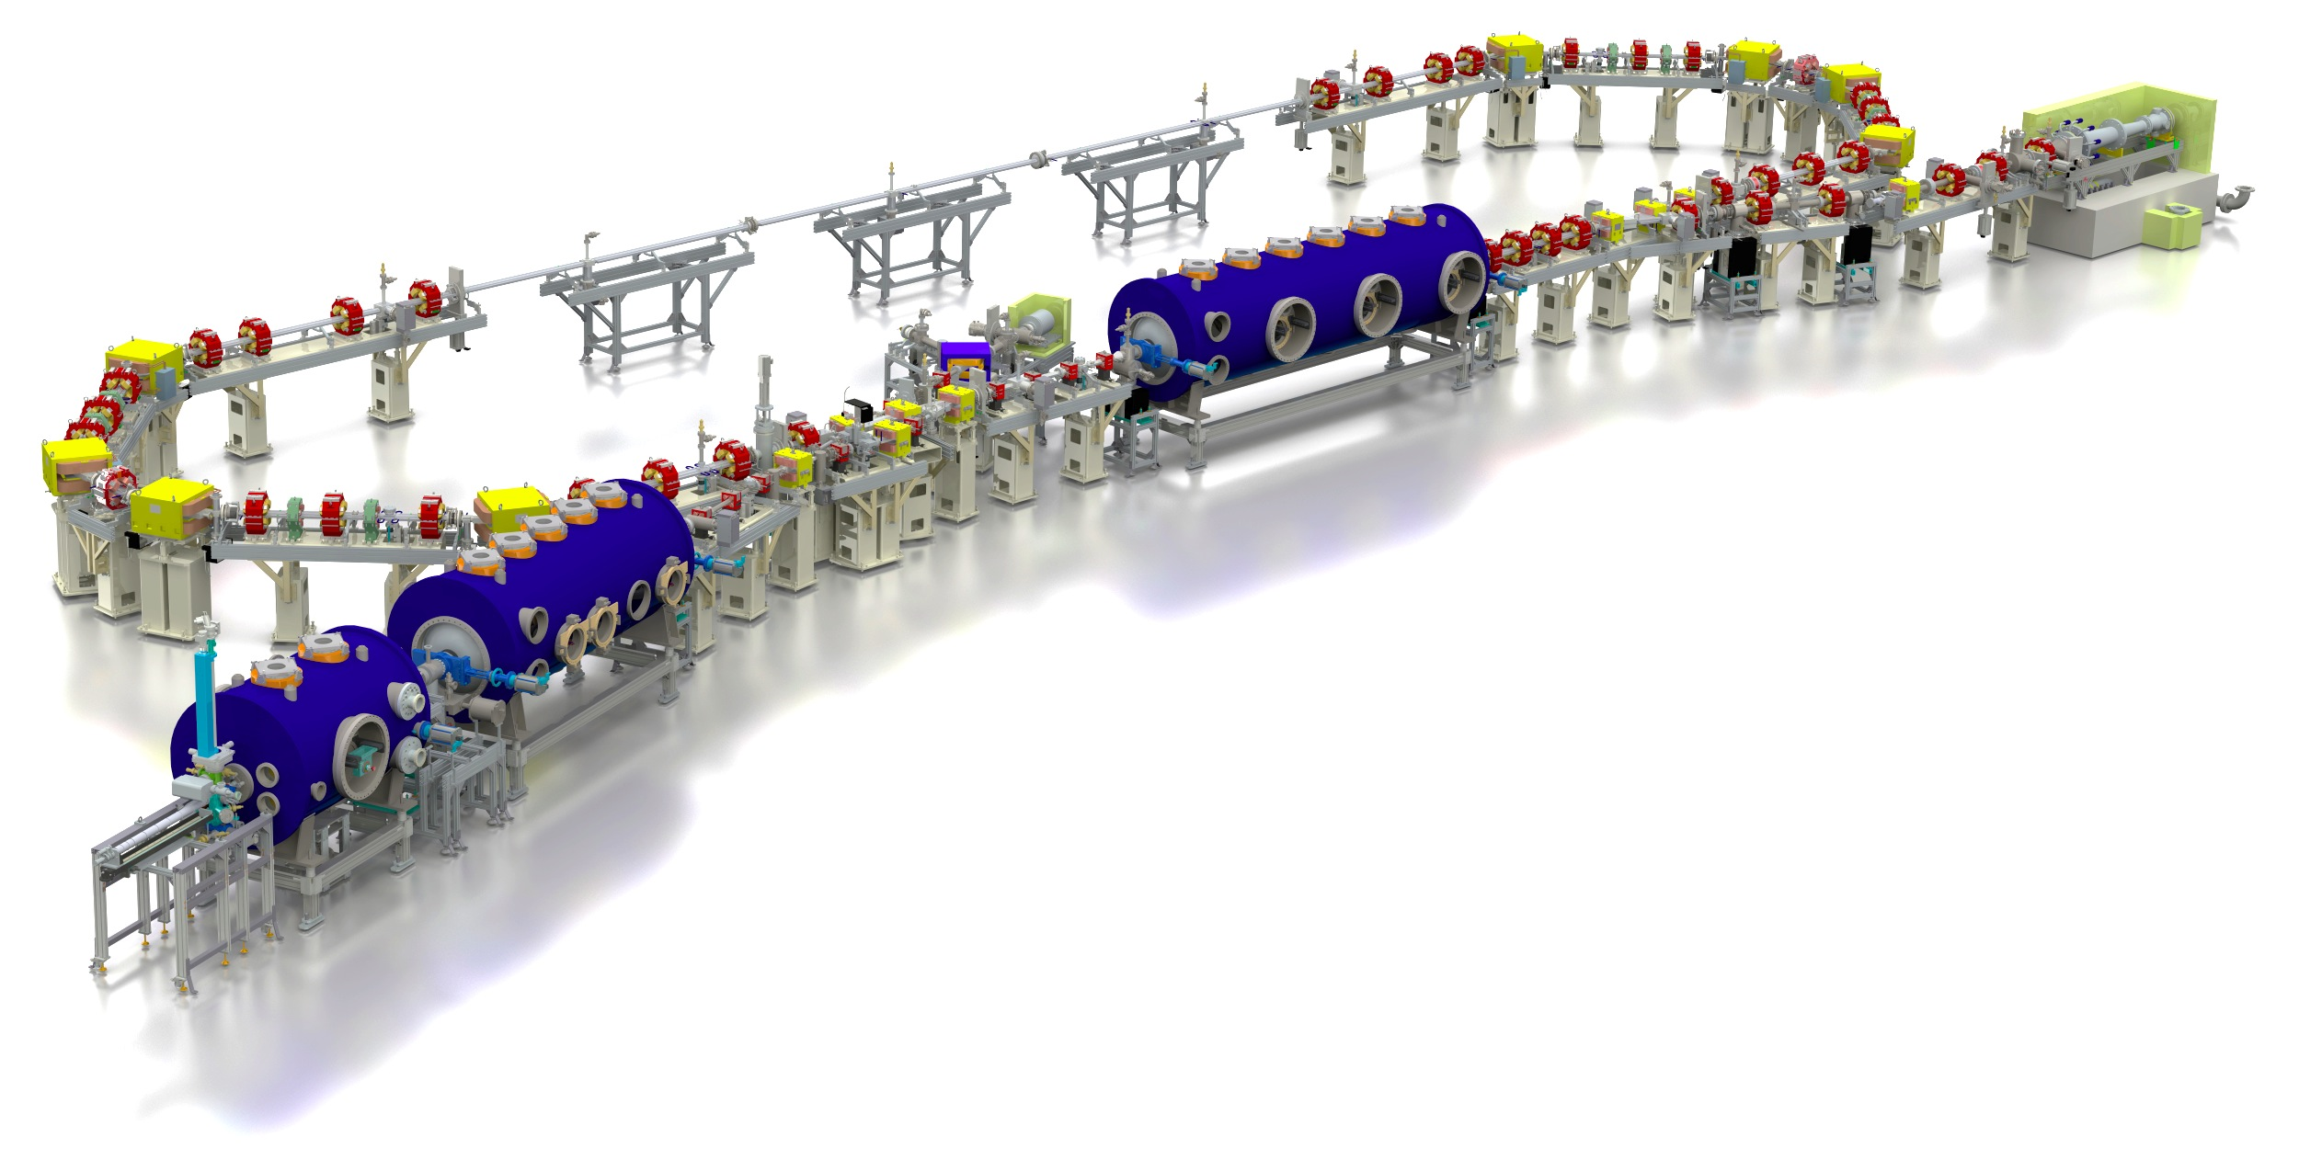

bERLinPro – Berlin Energy Recovery Linac Project
bERLinPro = Berlin Energy Recovery Linac Project
100 mA / low emittance technology demonstrator (covering key aspects of large scale ERL)
test and diagnostic line
(5mA@10MeV dump,
energy & slice diag.)
beam dump
6.5 MeV, 100 mA
= 650 kW
linac module
3 x 7 cell srf cavities
44 MeV
merger
dogleg
modified Cornell booster
3 x 2 cell srf cavities
4.5 MeV
srf-gun
1.4 cell srf cavities
1.5-2.3 MeV, single solenoid,
 | Basic Parameter
max. beam energy | 50 MeV
max. current | 100 mA (77 pC/bunch)
normalized emittance | 1 μm (0.5 μm)
bunch length (straight) | 2 ps or smaller (100 fs)
rep. rate | 1.3 GHz
losses | < 10⁻⁵
project started 2011, fully funded
building ready 2017
first electrons 2018
recirculation 2019/2020

Slide 5
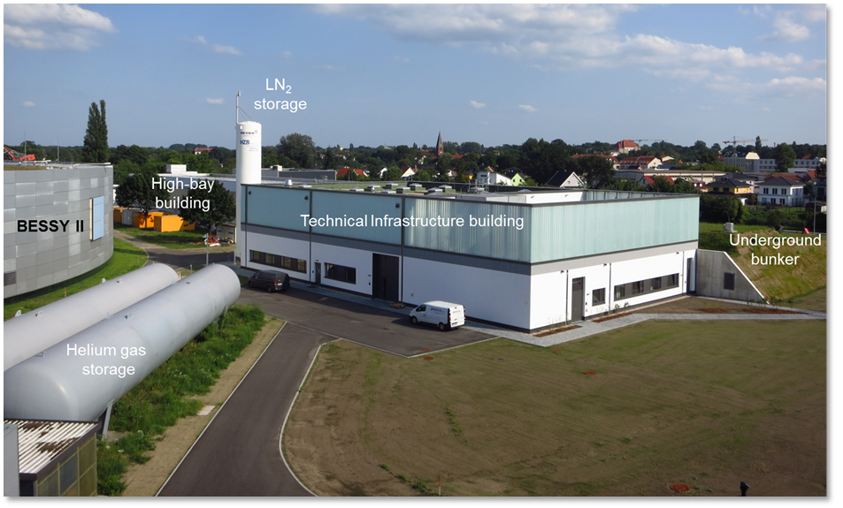
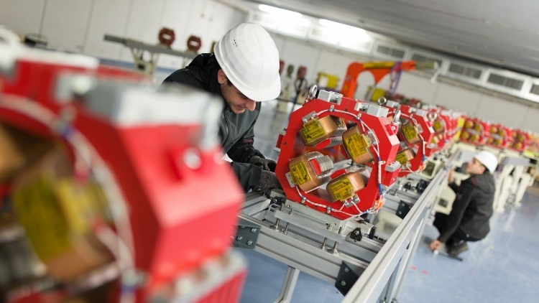
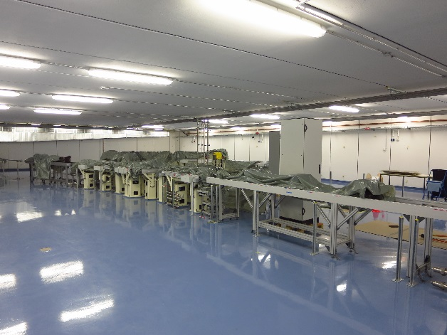
bERLinPro – Building / Infrastructure / Accelerator
MESA Cryomodule
(modified ELBE type)
Position to integrate
MESA Linac Module
(5m free space available)

Slide 6
MESA Cryo Module @ bERLinPro – Research Program
Cryo & RF Qualification without beam
Detailed HOM studies
Test and comparison of different LLRF systems (uTCA based bERLinPro ↔ MESA)
Study of BBU threshold currents in the mA range, comparison of simulations and beam tests)
Study of BBU mitigation techniques (phase advance tuning, chromaticity, …)
Verification of calculated / measured HOM spectra with beam driven spectra in a wide
range of parameters (average current, peak current, pulse length)
Beam tests of LLRF systems under different operation condition (cw, variable pulse trains,
transients, …)
Beam dynamics studies with respect to achievable parameters space in terms of
emittance, bunch charge, pulse length
Studies of beam halo and unwanted beam
Studies of Energy Recovery Efficiency at mA beam current level
Studies of Energy Recovery with “internal target” mock-ups
(energy width, emittance increase, …)

