Slide 1
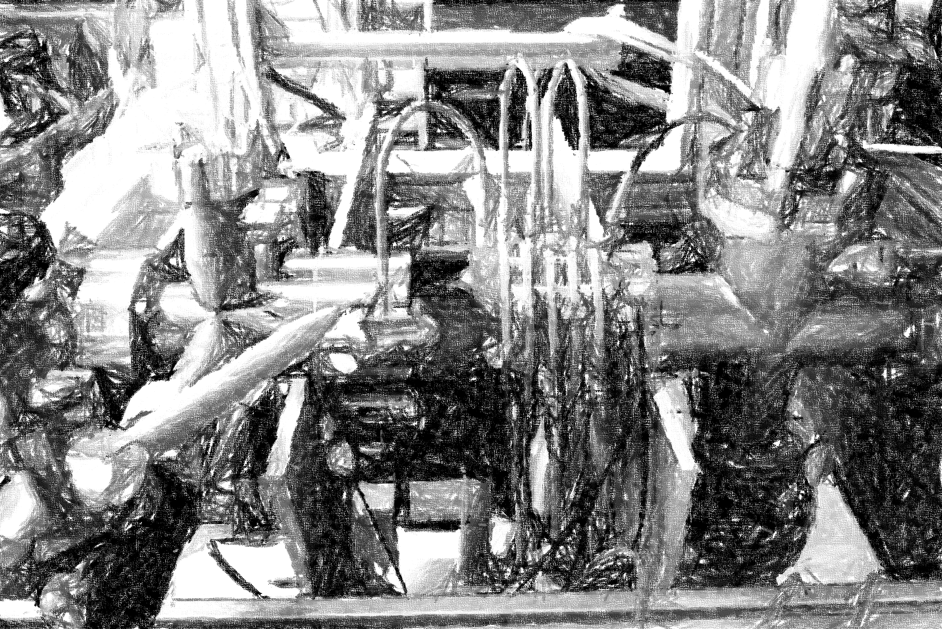
A plasma window for FAIR
BMBF-Verbund | TU Darmstadt
Bernhard Bohlender, Doktorand
M. Dehmer, A. Michel, M. Iberler, J. Jacoby

Slide 2
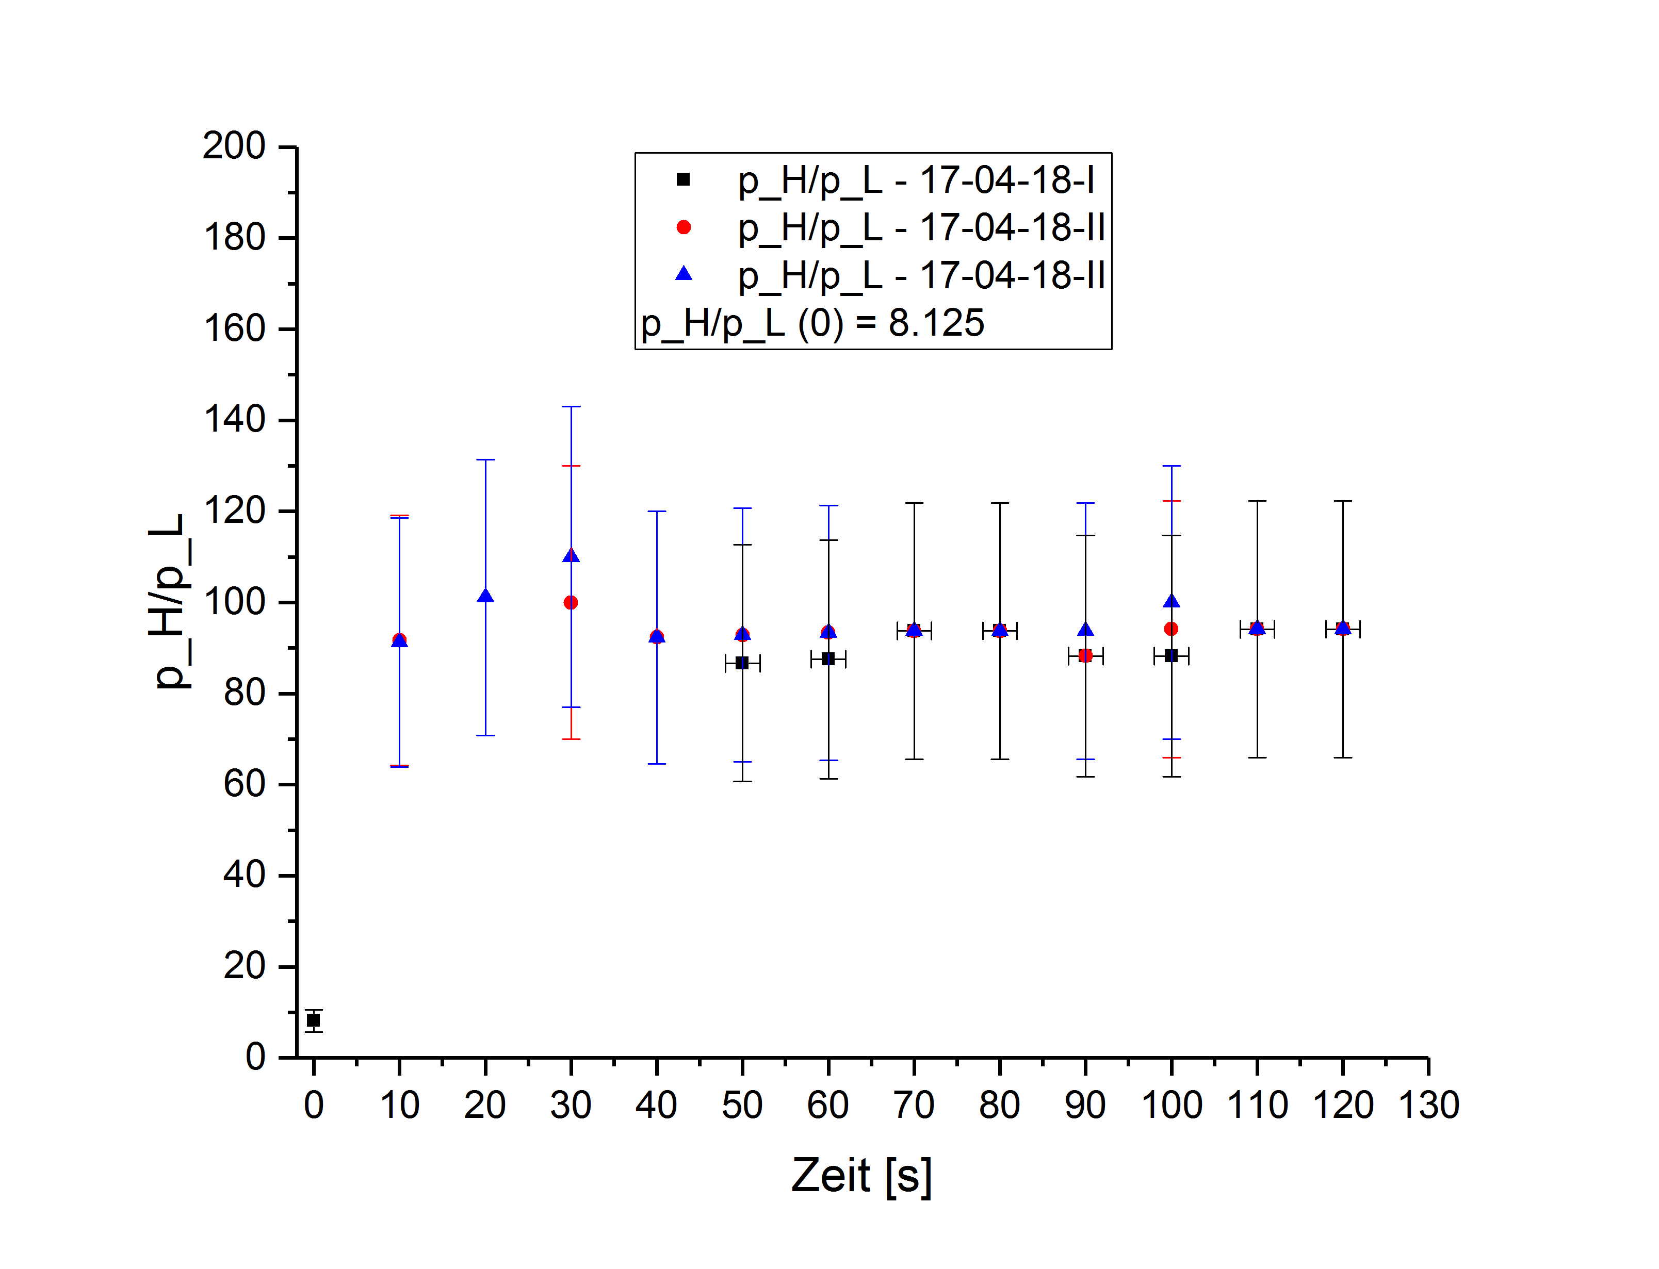
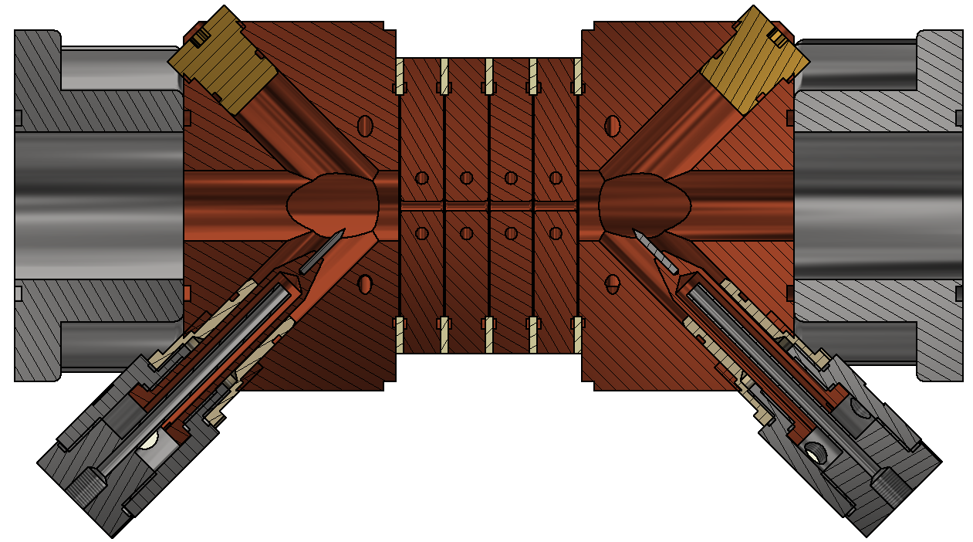
Plasma window | concept and results
Plasma window: destruction-free valve for beam transport from vacuum to regions with higher pressure
Parameter | Value
Canal length | 58$mm$
Canal diameter | 3$mm$
Working gas | 98% $Ar$, 2% $H_{2}$
Current | 60 $A$
Electrode material | W, Cu
Length overall | ~ 30 $cm$

Slide 3
Plasma window | status and outlook
Status:
Proof of principle
Suffering damage to electrodes and cascade
Pressure gradient $\frac{p_{H}}{p_{L}} >90$
Working with currents $≤60A$
Outlook:
Increased aperture $d \sim 25mm$
Increased current
Multiple cathodes and anodes
Long term tests (no publications until now)
Possible cooperation with TRIUMF

