Slide 1
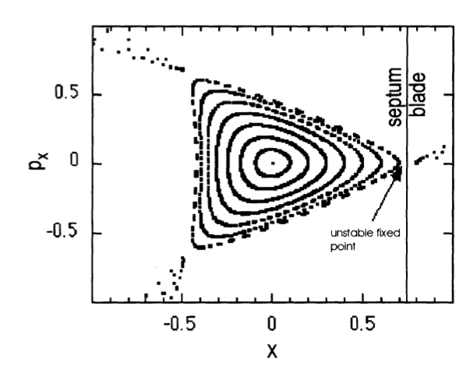
Simulation model for slow extraction from the FAIR synchrotrons
micro-spill structure from SIS-18
time (1 ms / div)
(J. Pietraszko, C. Sturm)
At present: Significant data quality loses because of micro-spill structure.
reduced data quality and rate capability !
load on detectors !
Not acceptable for CBM@SIS100 !
Macro/micro spill structure is a “universal” problem, also present at medical synchrotrons, for example.

Slide 2
The slow extraction workshop (Darmstadt, June 2016)

Slide 3
Simulation model for slow extraction from the FAIR synchrotrons
Project:
Development a fast (!) simulation model for the slow extraction with a focus on losses (septum) and spill strucure.
Validation of the simulation model at SIS, HIT and possibly COSY.
Analyze/optimize the „robustness“ of the spill structure against perturbations/ripples for different slow extraction schemes (quadrupole-, accel.-driven, rf knockout).
Optimize „novel“ operation modes (multi-energy slow extraction)
Profit from the experience gained at medical synchrotrons (macro spill structure) !
Project in close collaboration with GSI, FZJ and HIT.

