Slide 1
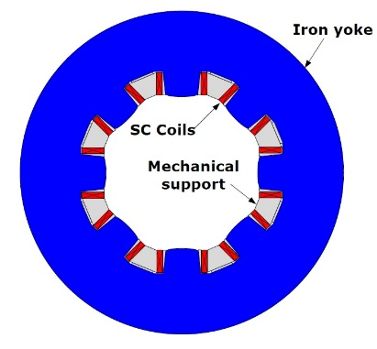
Advanced Landau damping for synchrotrons and colliders
Modern and future synchrotrons (SIS100) and colliders (LHC, FCC) employ
increasingly higher intensity and brighter hadron beams and become operationally limited
by coherent beam instabilities. Usual methods to control the instabilities, such as octupole
magnets, feedback dampers and chromatic effects, become less effective with
space charge or at higher energies.
Example stability plot for
LHC with octupoles
At low energies space charge will
modify/remove Landau damping

Slide 2
Landau damping for intense beams at low and high energies (synchrotrons and collider)
Project:
Implement a analytical/numerical models for the beam interaction with e-lenses, RFQ.
Identify optimum working parameters for electron lenses to provide Landau damping.
Detailed simulations and predictions for FAIR/CERN accelerators of Landau damping in intense beams with (combinations) of octupoles, e-lenses, RFQs.
Analyze undesired effects (optics perturbations, resonances)
Validation and experiments with octupoles, electron lenses, RFQs.
Tune spread induced by a
counter-propagating electron beam
(electron-lens):
Shiltsev et al PRL 2017
Radio-Frequency
Quadrupole (RFQ)
Grudiev PRAB 2014

