Slide 1
Rf-Cavity Design of the new FAIR post-Stripper Linac
Xiaonan Du, Linac-Department

Slide 2
Outline:
Introduction to UNILAC
Requirements to new post-stripper
Basics: shunt-impedance and time-transient factor
New drift tube shape design
Design of DTL cell lengths
Field stabilization

Slide 3
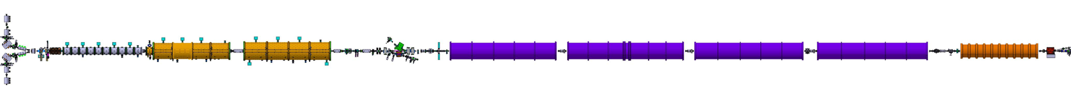
UNIversal Linear Accelerator UNILAC
pre-stripper HSI
(Hoch-Strom-Injektor)
acceleration to 1.4 MeV/u
stripper
increase q
post-stripper
acceleration up to 11.4 MeV/u
single-gap
resonators
energy fine tuning
RFQ
120 keV/u
IH-DTL
1.4 MeV/u
U⁴⁺ → U²⁸⁺
Alvarez-DTL
3.6 / 4.8 / 5.9 / 8.6 / 11.4 MeV/u
sources and LEBTs
2.2 keV/u
6 SGRs
|ΔE| ≤ 5*(q/A) MeV/u

Slide 4
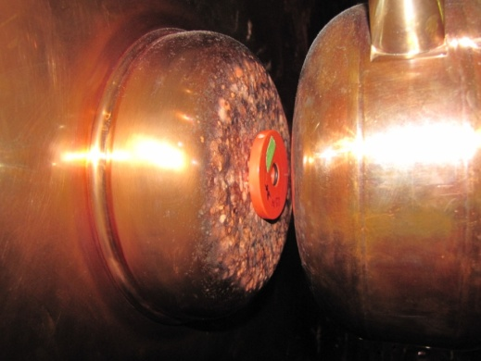
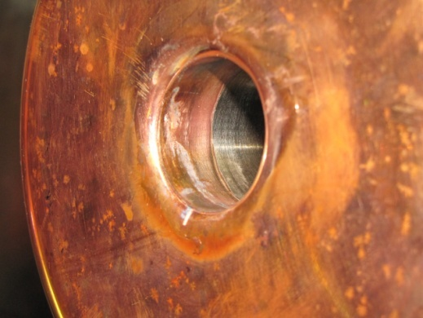
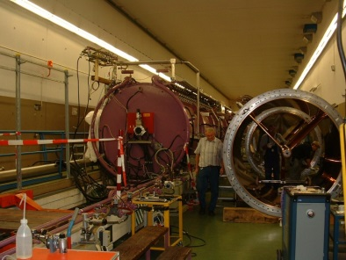
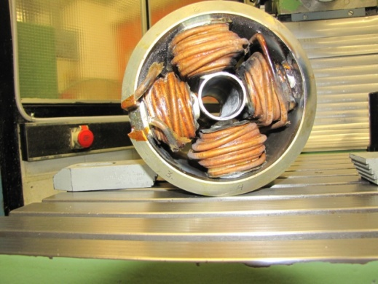
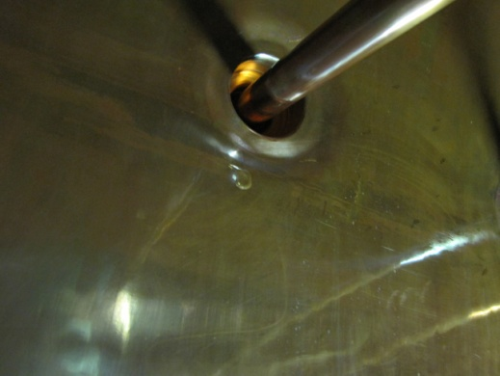
Today‘s post-Stripper DTL
Alvarez tanks A1, A2a, A2b in operation since > 40 years
25 years expected lifetime
drift tubes are obviously damaged
copper plating shows bubbles & bumps
resources for maintanance increase rapidly

Slide 5
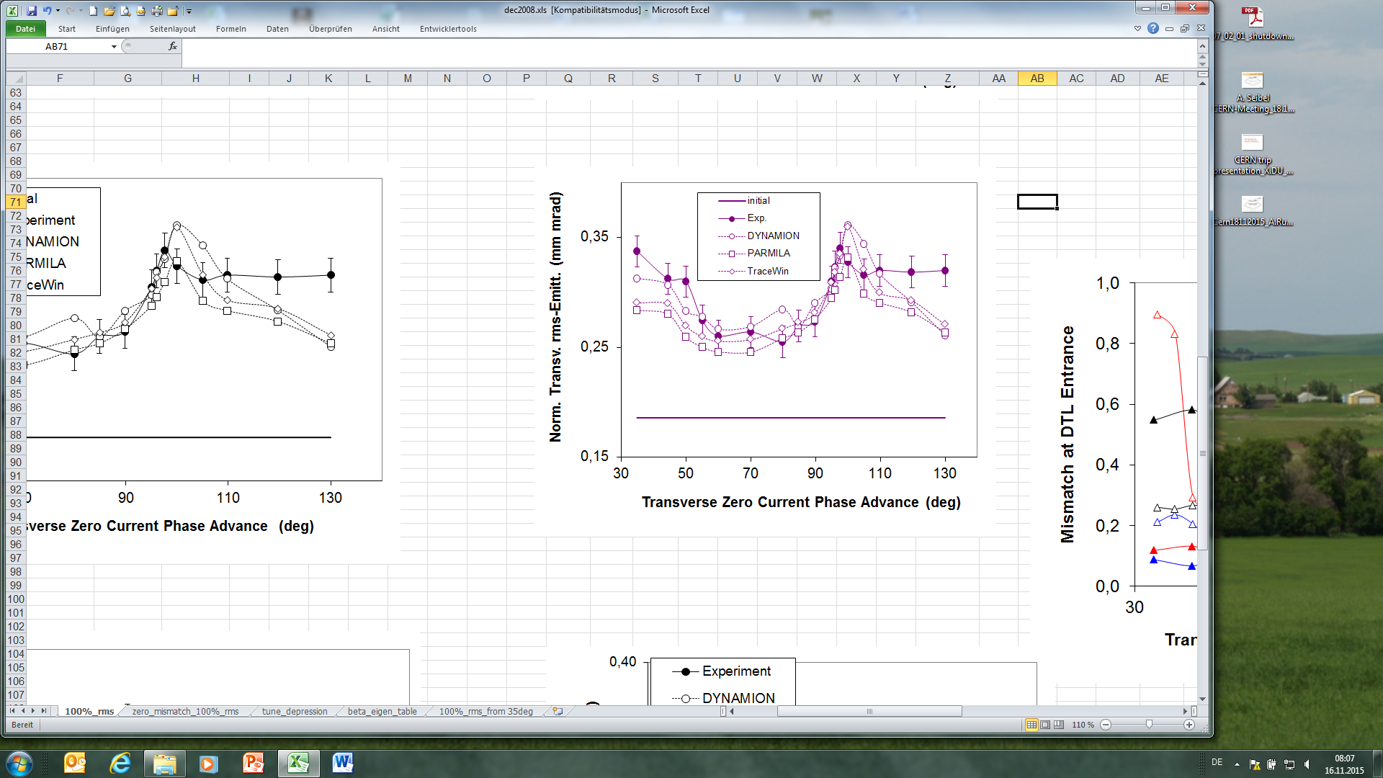
Today‘s post-Stripper DTL
DTL quadrupole strengths cannot deal with high intensity uranium beams for FAIR
To operate FAIR, the replacement of the post-stripper DTL is mandatory

Slide 6
Requirements to Upgraded UNILAC
design parameters after upgrade
ion A/q | ≤ 8.5, i.e. ²³⁸U²⁸⁺
beam current (pulse) * A/q | 1.76 (0.5% duty cycle) | mA
input beam energy | 2.2 | keV/u
output beam energy | 3.0 - 11.4 | MeV/u
normalized total output emittance, horizontal/vertical | 0.8 / 2.5 | mm mrad
beam pulse duration | ≤ 1000 | µs
beam repetition rate | ≤ 10 | Hz
operating frequency | 36.136 / 108.408 | MHz
length | ≈ 115 | m
main task of UNILAC is to serve as injector for FAIR
all ions with A>1 will pass the UNILAC`s post-stripper DTL

Slide 7
Choice of “Alvarez“ Technology
several design options were proposed
they were systematically evaluated and benchmarked
decision process was defined by directorate and accompanied by external Committees
the decision was taken to chose the “Alvarez“ technology
the other options did not meet FAIR requirements w.r.t. beam quality, budget restrictions, maturity of technology

Slide 8
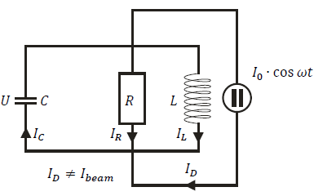
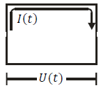
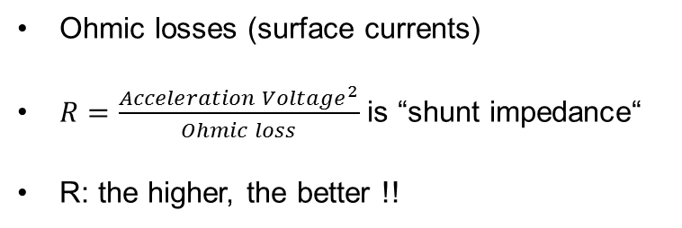
Basics I: Shunt Impedance
cavity modeled by “lumped circuit“
beam
inductivity
beam
external rf-power source providing:
compensation of Ohmic losses
energy gain of particle beam
Ohmic losses (surface currents)
$R=\frac{{Acceleration Voltage}^{2}}{Ohmic loss}$ is “shunt impedance“
R: the higher, the better !!

Slide 9
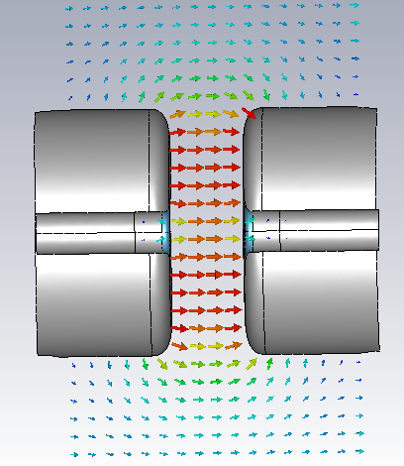
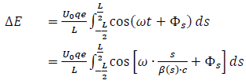

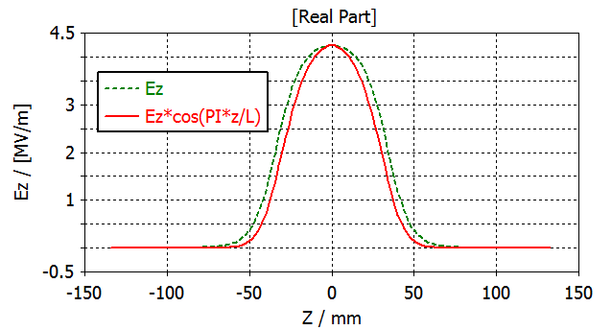
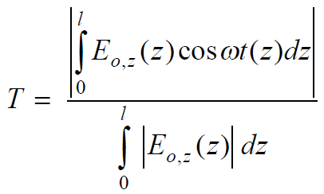


Basics II: Time-Transient-Factor TTF
TTF accounts for the finite time of particle transition through the gap
energy gain:
one “cell”
$$\vec{E}$$
Lg
Lc
TTF
Integral of red curve
(effective voltage)
Integral of green curve
(voltage)
Ez: the acceleration field
Ez*cos(PI*z/L): the effective acceleration field

Slide 10
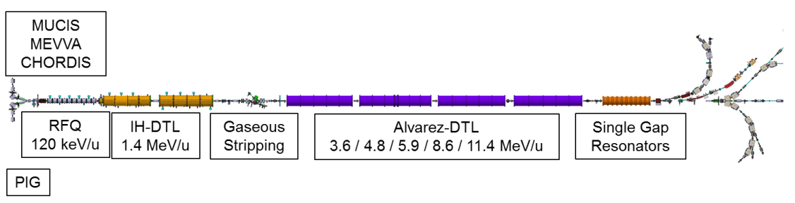
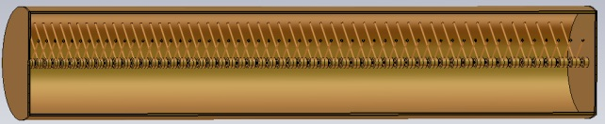
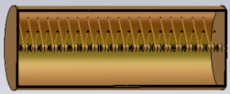
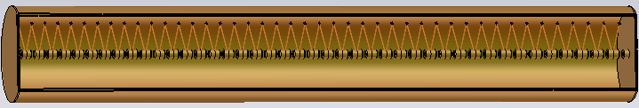
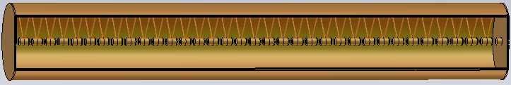
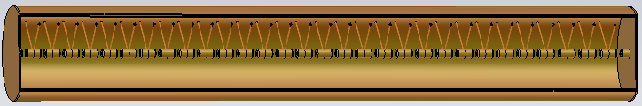
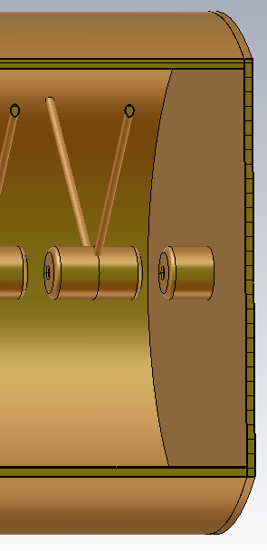
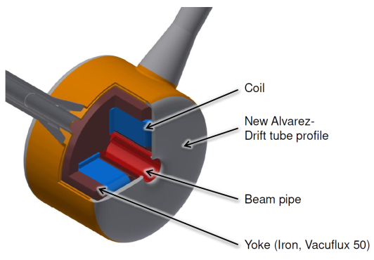
New Cavity Design
Compared with existing cavities
new & advanced design tools
optimized drift tube shape
novel field stabilization scheme
improved manufacturing technology

Slide 11
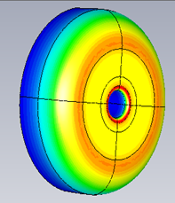
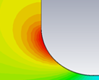
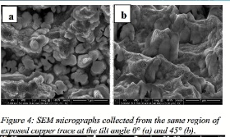
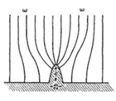
Drift Tube Shape Design
the tube must provide for sufficient gap voltage w/o dark currents and/or HV-sparking
→ optimized shape design with CST-MWS
at corners with large curvature of the surface,
the surface field is higher w.r.t. the nearby area
→ optimized shape design with CST-MWS
irregular surface of the copper under microscope, there are metal whiskers and protruding on which the surface field is much higher than at nearby surfaces
→ need high surface quality with Cu-plating

Slide 12
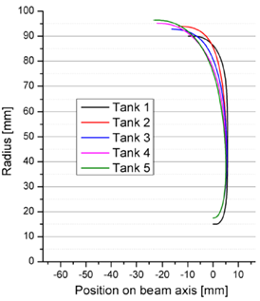
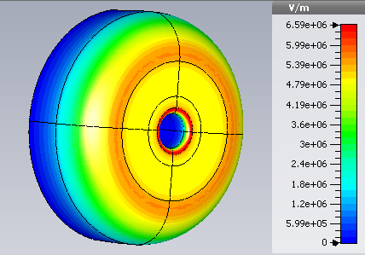
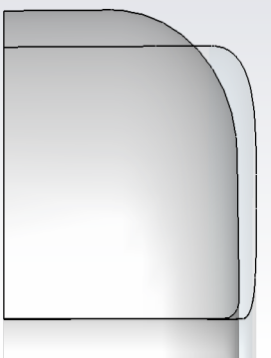
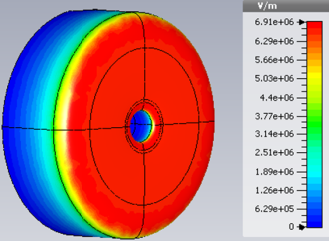
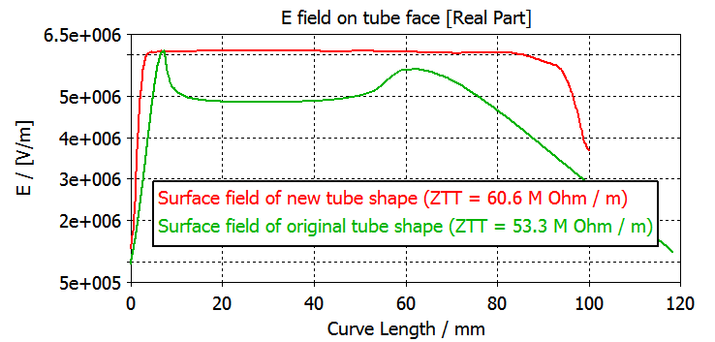
Shape Design
Former shape
new shape
the re-designed tube shape produces a homogeneous surface field
tube shape profile for the five tanks
It is possible to design an individual shaped curve for each tube, but it is not mandatory:
entrance cells have highest Epeak in one cavity
one tube shape is suitable for others with similar cell length
unified tube shapes reduce the fabrication cost

Slide 13
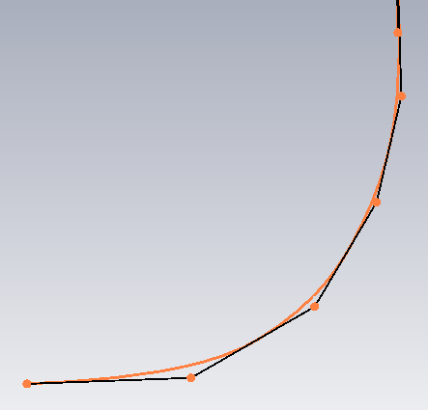
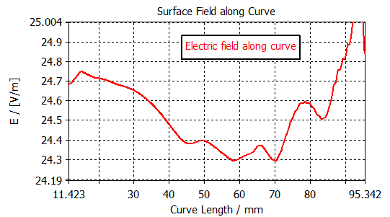
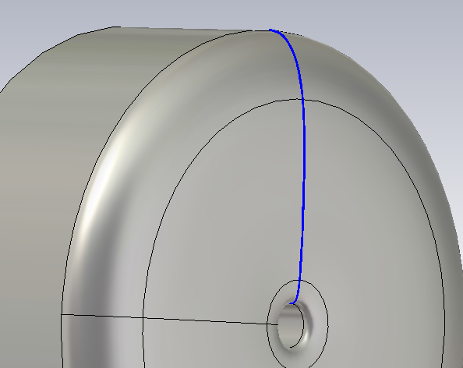

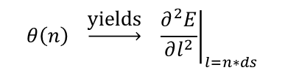
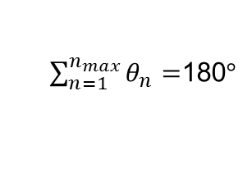
Shape Design: Curvature is the Key
create the curve that connects smoothly the inner and outer radii of the tube:
$$n_{max}=200$$
$\sum_{n=1}^{n_{max}}{θ_{n}}=$180$°$
build tube with this curve and evaluate the surface field along this curve.
adjust this curve according to the field.
θ(n)
ds
$$θ\left(n\right) \underset{→}{\text{yields}} { \left.\frac{∂^{2}E}{∂l^{2}}\right|}_{l=n∗ds}$$
θ(n-1)
θ to be reduced

Slide 14
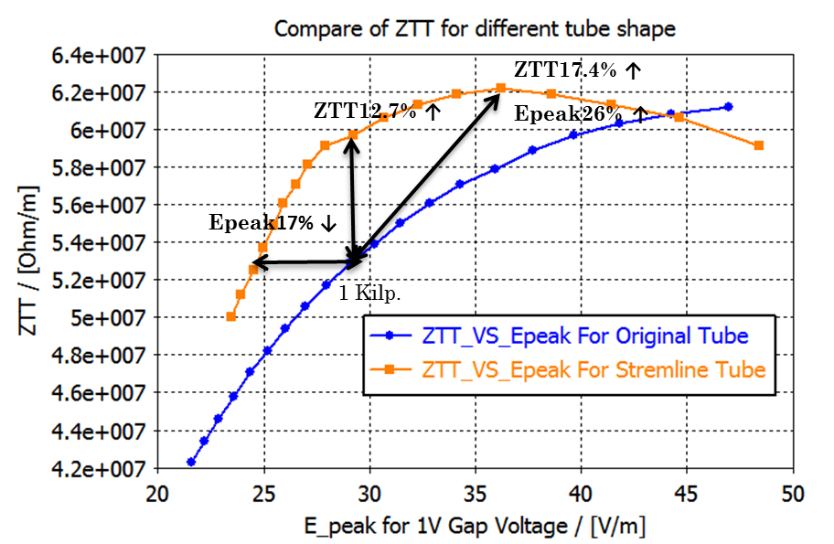
Two Options to Profit from new Shape
profit from this improvement: lower E_{peak} per shunt impedance
design options:
keep the peak surface field (E_{peak}) as today (1 Kilp.) and get 12% more shunt impedance (preferred)
keep shunt impedance as today and reduce E_{peak} by 17%, further reducing the break down probability

Slide 15
Beta Profiles design
Boundaries
Boundaries from Rf-Alimentation:
amplifiers reliably provide 1.35 MW (Pmax) power for every tank after few reflection and safety margin(1.8MW-1.35MW)
rf-power loss of the cavity from simulation : Ps ( 0.85 MW e.g.)
rf-power loss for real cavity with 20% lower Q factor w.r.t. simulated Q: Pr=Ps/0.8
beam power increase Pb (0.3 MW e.g.)
all cavities were designed with the boundary Pr + Pb ≤ Pmax
Other boundary conditions:
average accelerating field ( ≈ 2 MV/m )
maximum surface field ( ≈ 1 Kilp.)
input/output energy(1.4 /11.4 MeV)
total length (fit into existing tunnel, about 55 m)
constant tank diameter (1.8 m - 2 m)

Slide 16
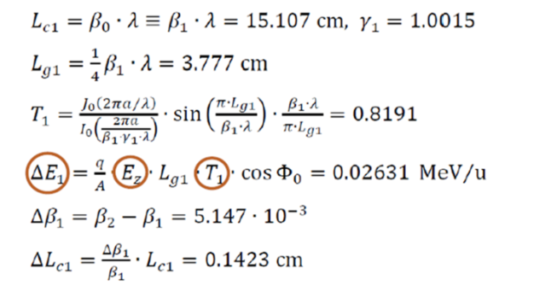
Beta Profiles
Basic beta profiles design by analytical approach:
input energy → first cell---------------
get TTF with approximate formula -
calculate energy gain -----------------
calculate speed increase ------------
info for second cell --------------------
......
Advanced design method is combined with rf simulation
design of beta profile using CST-MWS to:
obtain accurate TTF from simulation instead from approximate formula
plug rf-parameters into the design process

Slide 17
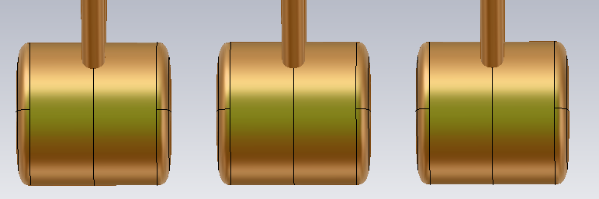
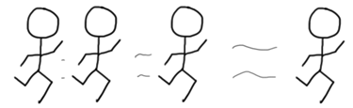
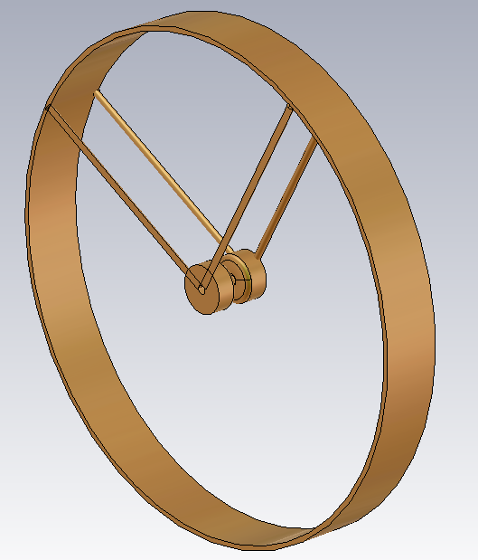
Beta Profiles
L_{g}
βλ
(β+Δβ)λ
prepare the universal flexible model of single cell (figure on right side).
loop>>>
assume the beta increase after this cell : Δβa(n)≈ Δβ(n-1)
calculate the cell length for this cell: Lc(n)=(β(n)+Δβa(n)/2)λ
  use average beta. could be more accurate if use particle tracing
  Δβ(n-1) is β increase of last cell, β(n) is input beta of this cell
update model with this cell length and guessed Lg/Lc
run the automatic optimization
  optimize Lg/Lc to get 108.4 MHz local frequency, the maximum E_{surf} will not be exceeded in first gap.
store results
  geometric and RF parameters of every cell is stored .
use output beta as input beta of next cell (β(n+1)).
end loop<<< If βmax or cell number or total power limit achieved.
model of single gap

Slide 18
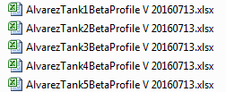
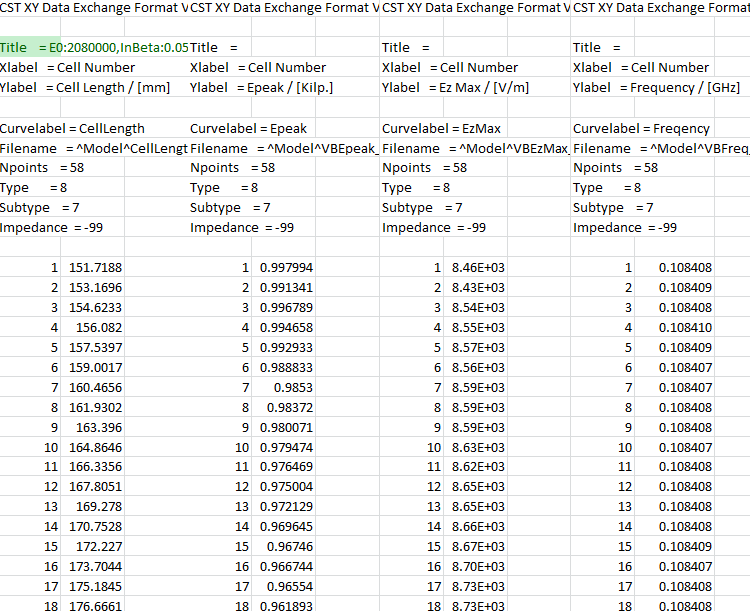
All beta Profiles available
parameter list:
cell number
cell lengths
input energy
input beta
Veff
Zeff
TTF
E_{peak}(surface)
local frequencies (108.408 MHz)
power loss
total power (include beam power)
Lg / Ltube
tube shape curve for this cavity
...

Slide 19
Summary of Latest Design
Design V5 | tank I 20160713 | tank II 20160713 | tank III 20160713 | tank IV 20160713 | tank V 20160713
energy [MeV/u] | 1.392 – 3.316 | 3.316 – 4.351 | 4.351 - 6.621 | 6.621 – 8.966 | 8.966 – 11.341
apperture radius [mm] | 15 | 17.5 | 17.5 | 17.5 | 17.5
rf-phase [deg] | -30 | -30 | -30 | -25 | -25
# cells | 55 | 20 | 43 | 35 | 31
L_{gap} / L_{cell} | 0.27 | 0.27 – 0.28 | 0.23 – 0.25 | 0.22 – 0.23 | 0.22 - 0.23
rf-length [m] | 10.54 | 4.99 | 12.78 | 12.41 | 12.53
E_{surf,max} [E_{K}] | 1.00 | 1.00 | 0.96 | 0.98 | 0.96
P_{loss,MWS} [MW] | 0.885 | 0.555 | 0.870 | 0.842 | 0.853
P_{beam} [MW] | 0.245 | 0.132 | 0.289 | 0.299 | 0.303
<Z_{eff}> [MΩ/m] | 28.67 | 27.95 | 33.48 | 38.02 | 38.13
E_{eff},_{mean} (MV/m) | 1.55 | 1.76 | 1.51 | 1.61 | 1.61
Q | 115968 | 113382 | 118403 | 116668 | 114150

Slide 20
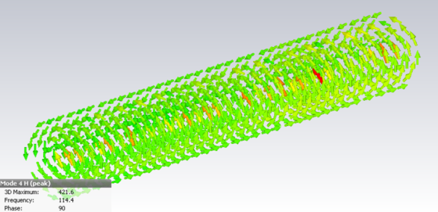
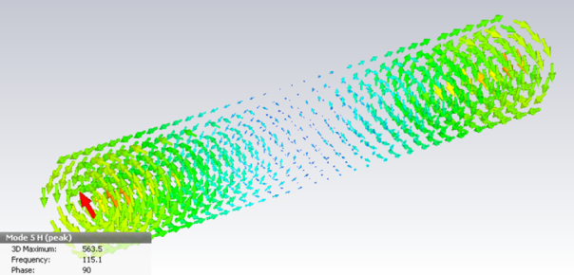
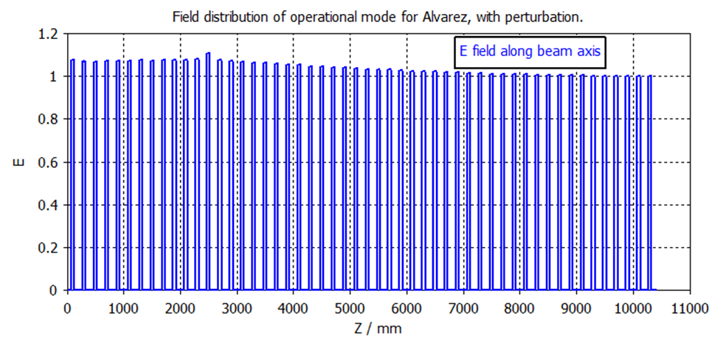
Need of Field Stabilization
The modes of Alvarez cavity in ideal case (simulation)
Magnetic field of TM010
TM011
TM012, TM013....
in the real cavity the accelerating field from the operational mode may be disturbed by different kind of perturbations
sources of perturbations:
mechanical errors
heat deformation
tuners, couplers
ports on the cavity wall
beam loading
dark current between gaps
alignment errors
...
if gap error occurs somewhere, the field of the entire cavity will be disturbed. The field deviation comprises fields from other modes

Slide 21
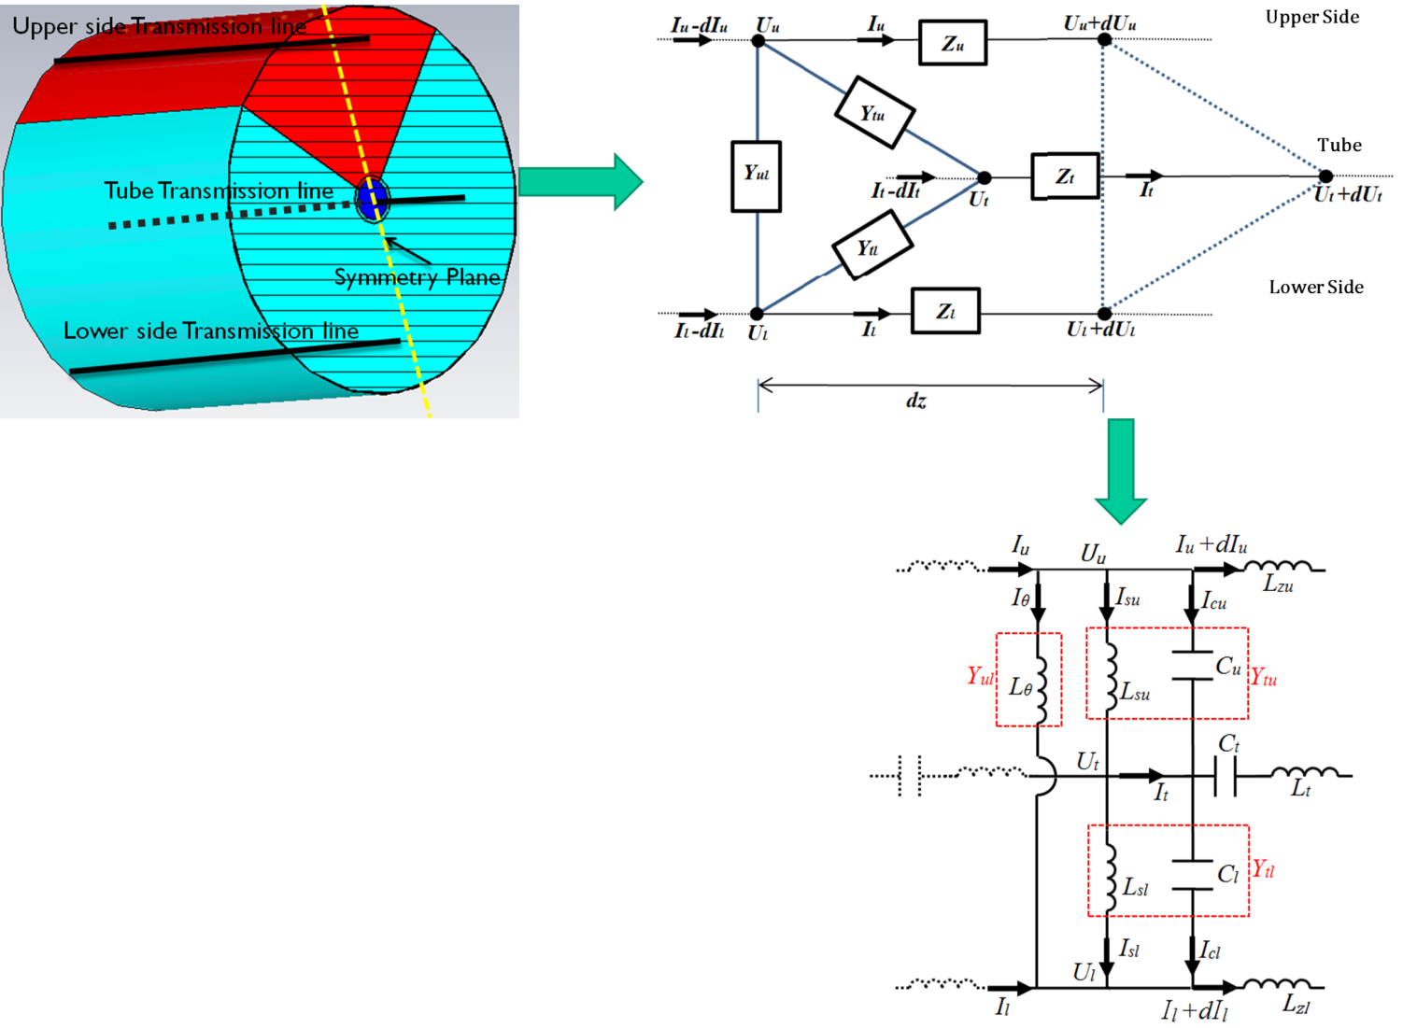
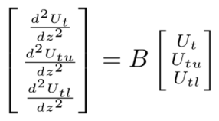


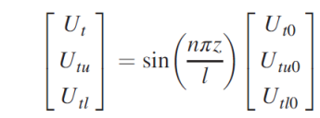
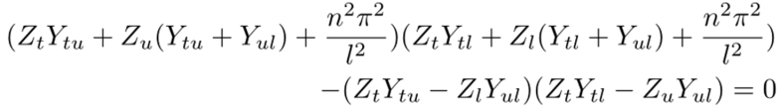
Stabilization: Equivalent Circuit
how does the current flows inside an Alvarez cavity? answer: along three transmission lines
differential equation for voltage:
standing wave solution:
about field
about frequencies
X. Du, et al., Phys. Rev. Accel. Beams 20, 032001 (2017)

Slide 22


Stabilization: Use Stem Orientation
The key is to locally adjust the stem configuration until
transverse admittance (Y) along z axis as small as possible
(a): current path inductance Ls; (b): capacitance C from the electric field between tank wall area (red) and drift tube area (blue)
section by section simulation and adjustment until
frequency of TE₀₁₀ mode is modified to 108.4 MHz.
designed stem configuration E with section by section simulation

Slide 23



Stabilization: Use Stem Orientation
for operational mode Y (f = 108.4 MHz) ≈ Y ( f= 109 MHz) ,
If we adjust the field distribution of TM₀₁₁(109MHz) mode to two flat sections (slope of field depends on Y) ,
Y (f = 109 MHz) could be minimized
Y (f = 108.4 MHz) may also be close to zero.
electric field map of original TM_011 field
rotating one of the stems towards the lower side of the cavity will reverse the field slope. Choice of specific stems to be rotated will change cosine-type field distribution towards step function.
→ slope is cancelled by small Y
designed stem configuration M with step function field

Slide 24



Stabilization Scheme verified by CST-MWS Simulations
not stabilized:
stabilized:
if the field is stabilized :
acceleration field is more stable
mode frequency of TM011 pushed away form operational mode (108.4 + 4 MHz)
slope of dispersion curve is increased
mode frequency of TE010 mode very close to 108.4 MHz

Slide 25




1:3 Scaled Model Cavity
model Alvarez-cavity was built to measure the novel stabilization scheme (A. Seibel)
1154 mm
A. Seibel et al., IPAC 2015, THPF027
X. Du, et al., Phys. Rev. Accel. Beams 20, 032001 (2017)

Slide 26
Summary and Outlook
rf-design of new post-stripper DTL available
all input for beam dynamics design available (see talk of A. Rubin on June 8th, this seminar)
new drift tube shape with improved shunt impedance
novel scheme of field stabilization
Alvarez-prototype with 11 drift tubes and a total cavity section length of 1.9 m will be manufactured and tested at nominal rf-power (talk of M. Heilmann on June 22nd, this seminar)
Thank you!

