Slide 1
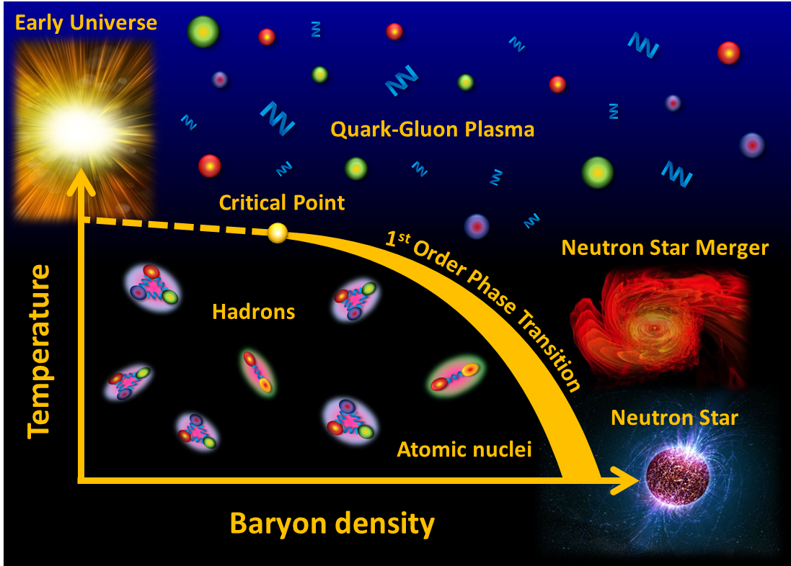
Cosmic Matter in the Laboratory –
The Compressed Baryonic Matter experiment at FAIR
Peter Senger GSI and Univ. Frankfurt
Outline:
➢ Cosmic matter
The Facility of Antiproton and Ion Research
The Compressed Baryonic Matter experiment
1
CBM School: Lectures on Dense Baryonic Matter, Sept. 22 – 23 2017, CCNU, Wuhan, China

Slide 2
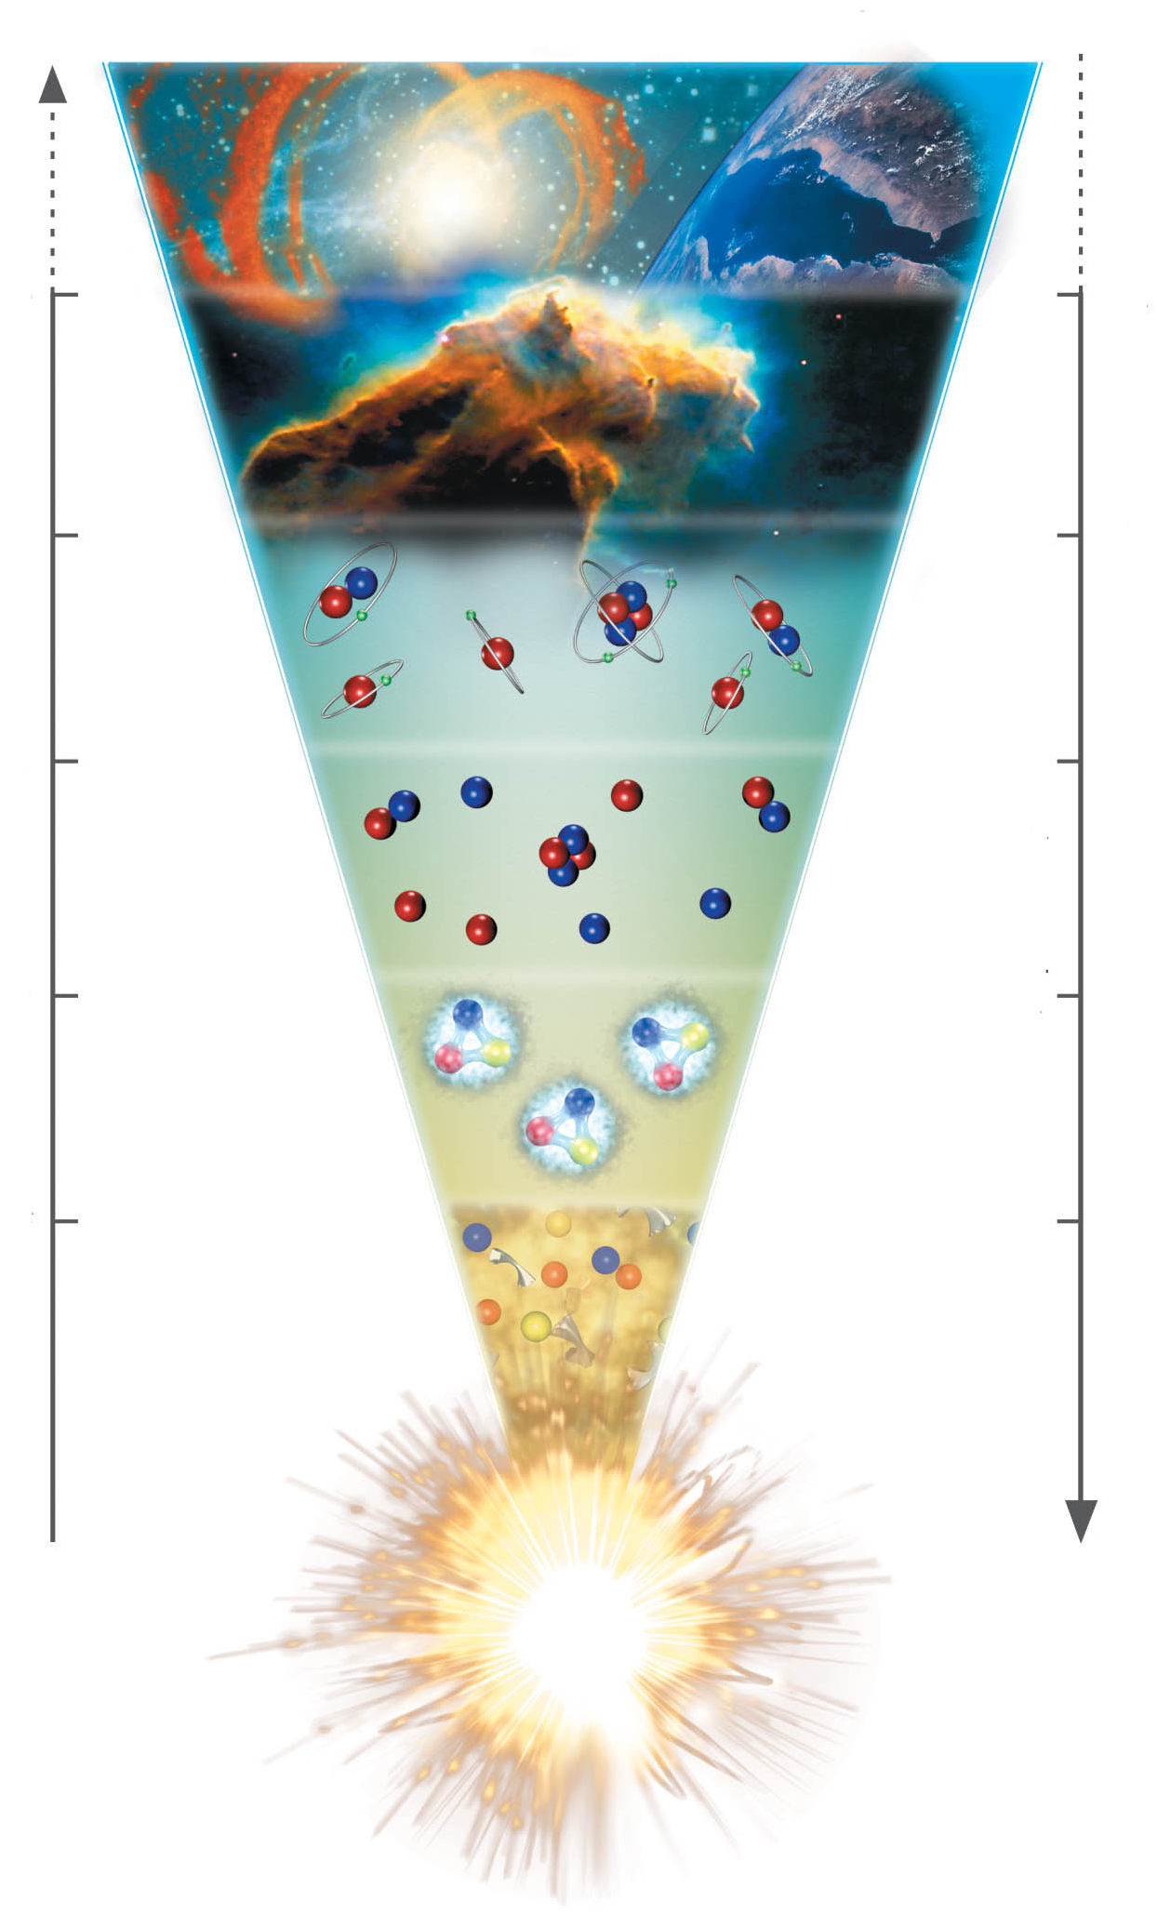
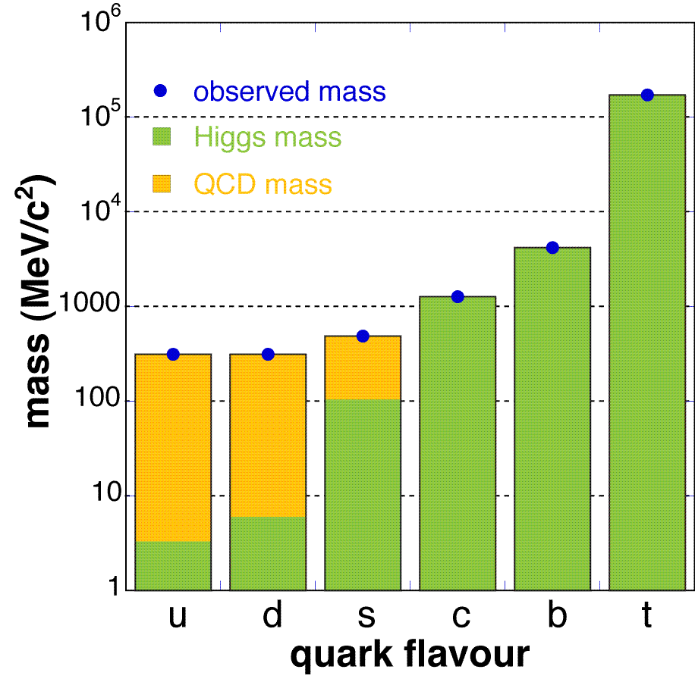
The evolution of matter in the universe
15 billion years
3 K
1 billion years
20 K
time
300.000 years
3000 K
temperature
3 minutes
10⁹ K
1 millisecond
10¹² K
1 microsecond
Explicit breaking
of Chiral Symmetry
(Higgs mechanism)
m_{u} ≈ 5 MeV,
m_{d} ≈ 10 MeV,
m_{s} ≈ 150 MeV
distance

Slide 3
The evolution of matter in the universe
15 billion years
3 K
1 billion years
20 K
time
300.000 years
3000 K
temperature
3 minutes
10⁹ K
1 millisecond
10¹² K
1 microsecond
The soup of the
first microsecond:
quarks, antiquarks,
electrons, positrons,
gluons, photons
distance

Slide 4
The evolution of matter in the universe
15 billion years
3 K
1 billion years
20 K
time
300.000 years
3000 K
temperature
3 minutes
10⁹ K
1 millisecond
10¹² K
1 microsecond
Spontaneous/dynamical
Chiral Symmetry breaking:
Hadrons acquire mass by
coupling to the virtual
quark-antiquark pairs
of the chiral condensate
distance

Slide 5
The evolution of matter in the universe
15 billion years
3 K
1 billion years
20 K
time
300.000 years
3000 K
temperature
3 minutes
10⁹ K
1 millisecond
10¹² K
1 microsecond
Annihilation of particles
and antiparticles, only
10⁻⁹ of particles survived
distance

Slide 6
The evolution of matter in the universe
15 billion years
3 K
Evolution of stars
1 billion years
20 K
time
300.000 years
3000 K
temperature
3 minutes
10⁹ K
1 millisecond
10¹² K
1 microsecond
distance

Slide 7
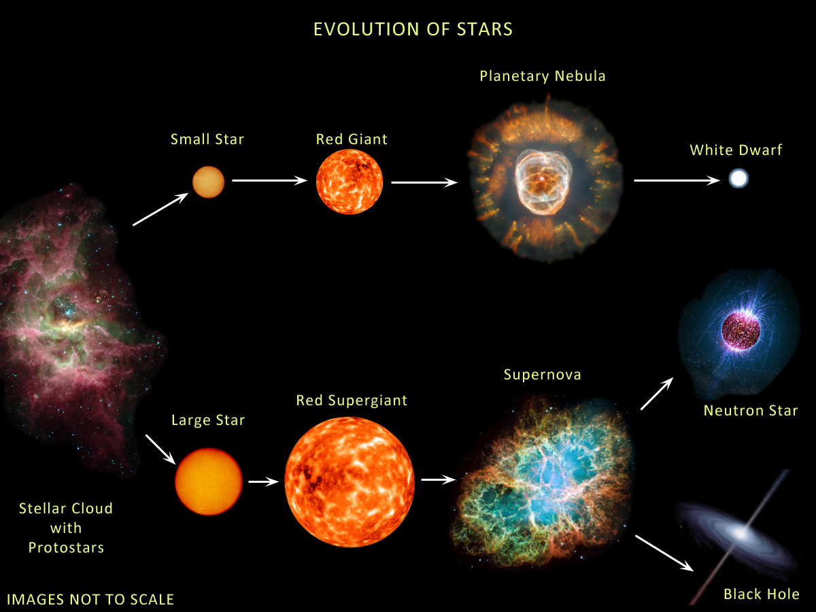
The evolution of stars
M < ≈ 8M → white dwarf
8M< M < 15M → neutron star: 1.4M< M_{core}< 2M
M >≈15M → black hole: M_{core} >≈ 2M
Courtesy of Anna Watts

Slide 8
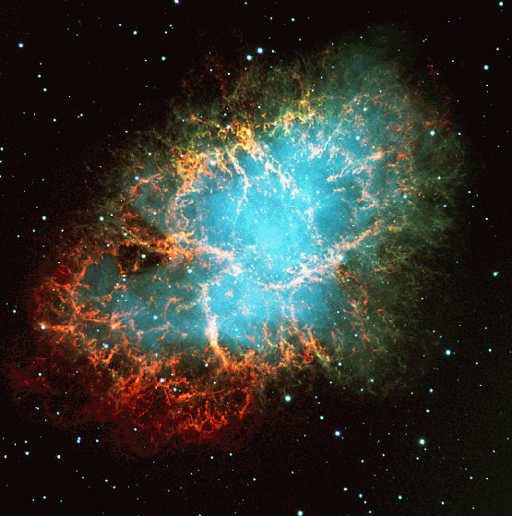
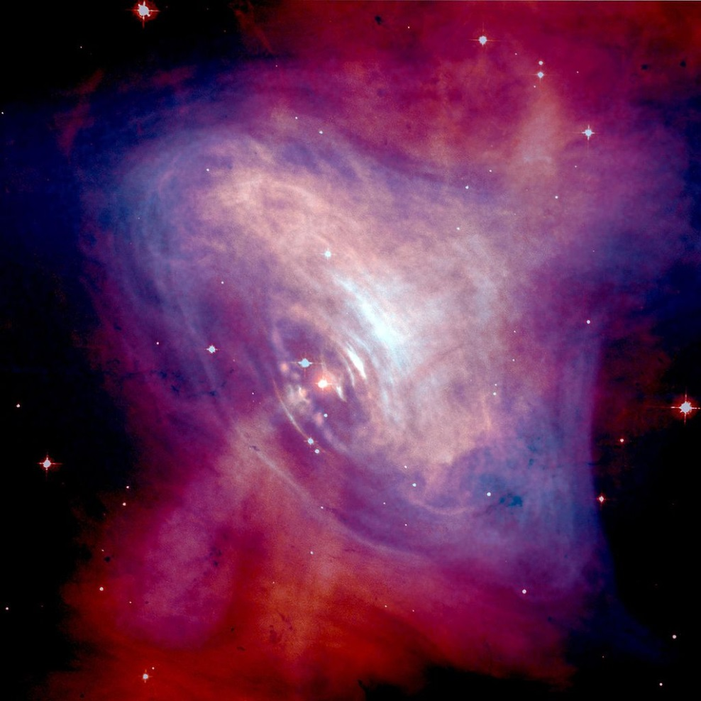
Discovery of the first pulsar in 1968
Crab nebula:
ashes of a core collapse supernova observed in 1054 by Chinese astronomers.
The “visiting star” was as bright as the Venus for more than 20 days.

Slide 9
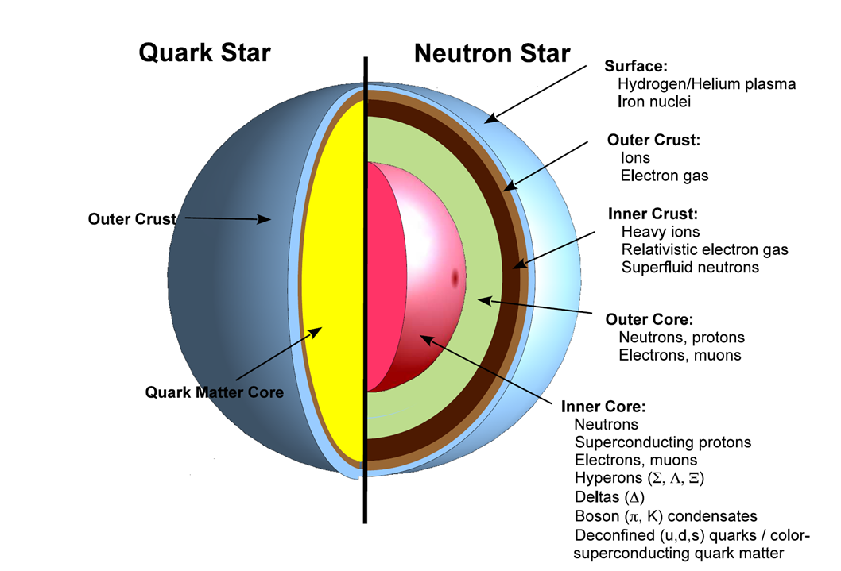
?

Slide 10
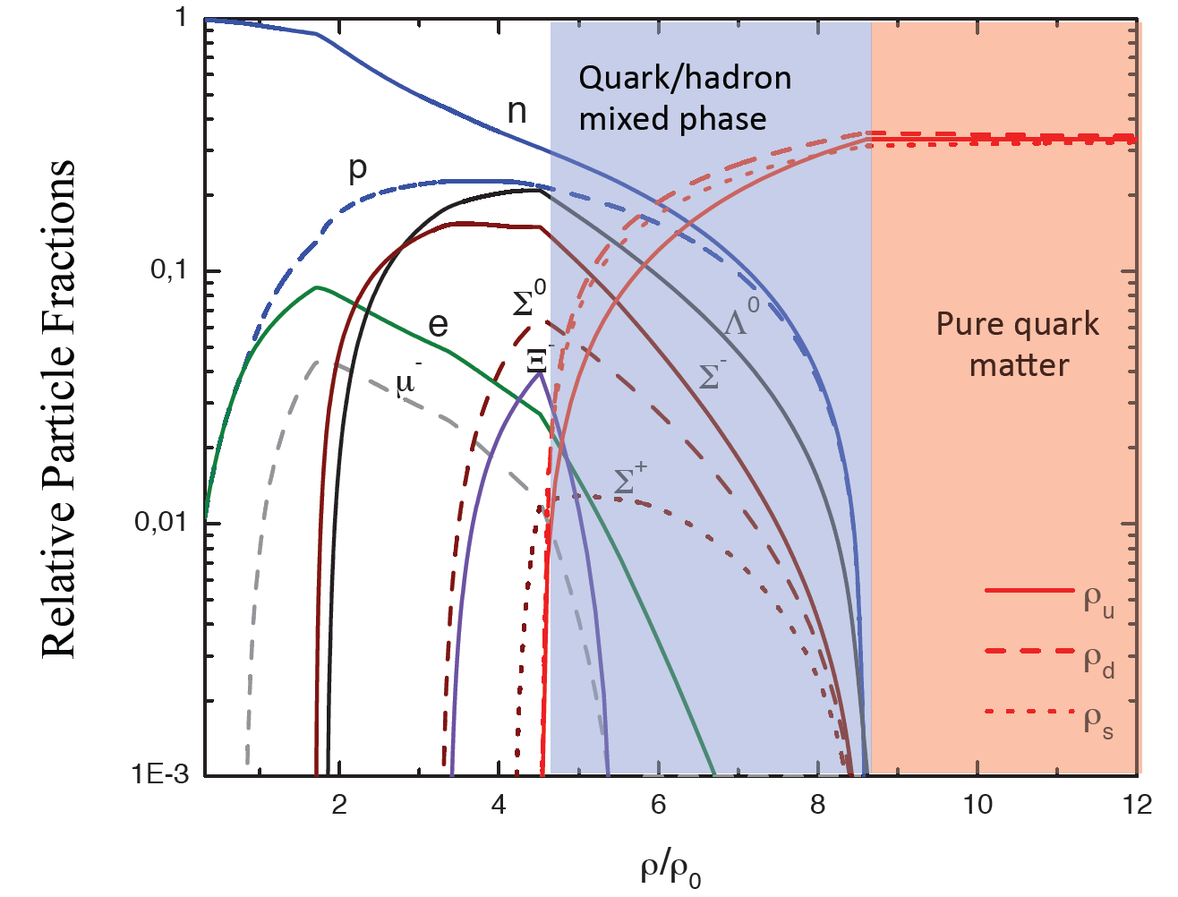
Quark matter in massive neutron stars?
M. Orsaria, H. Rodrigues, F. Weber, G.A. Contrera, arXiv:1308.1657
Phys. Rev. C 89, 015806, 2014

Slide 11
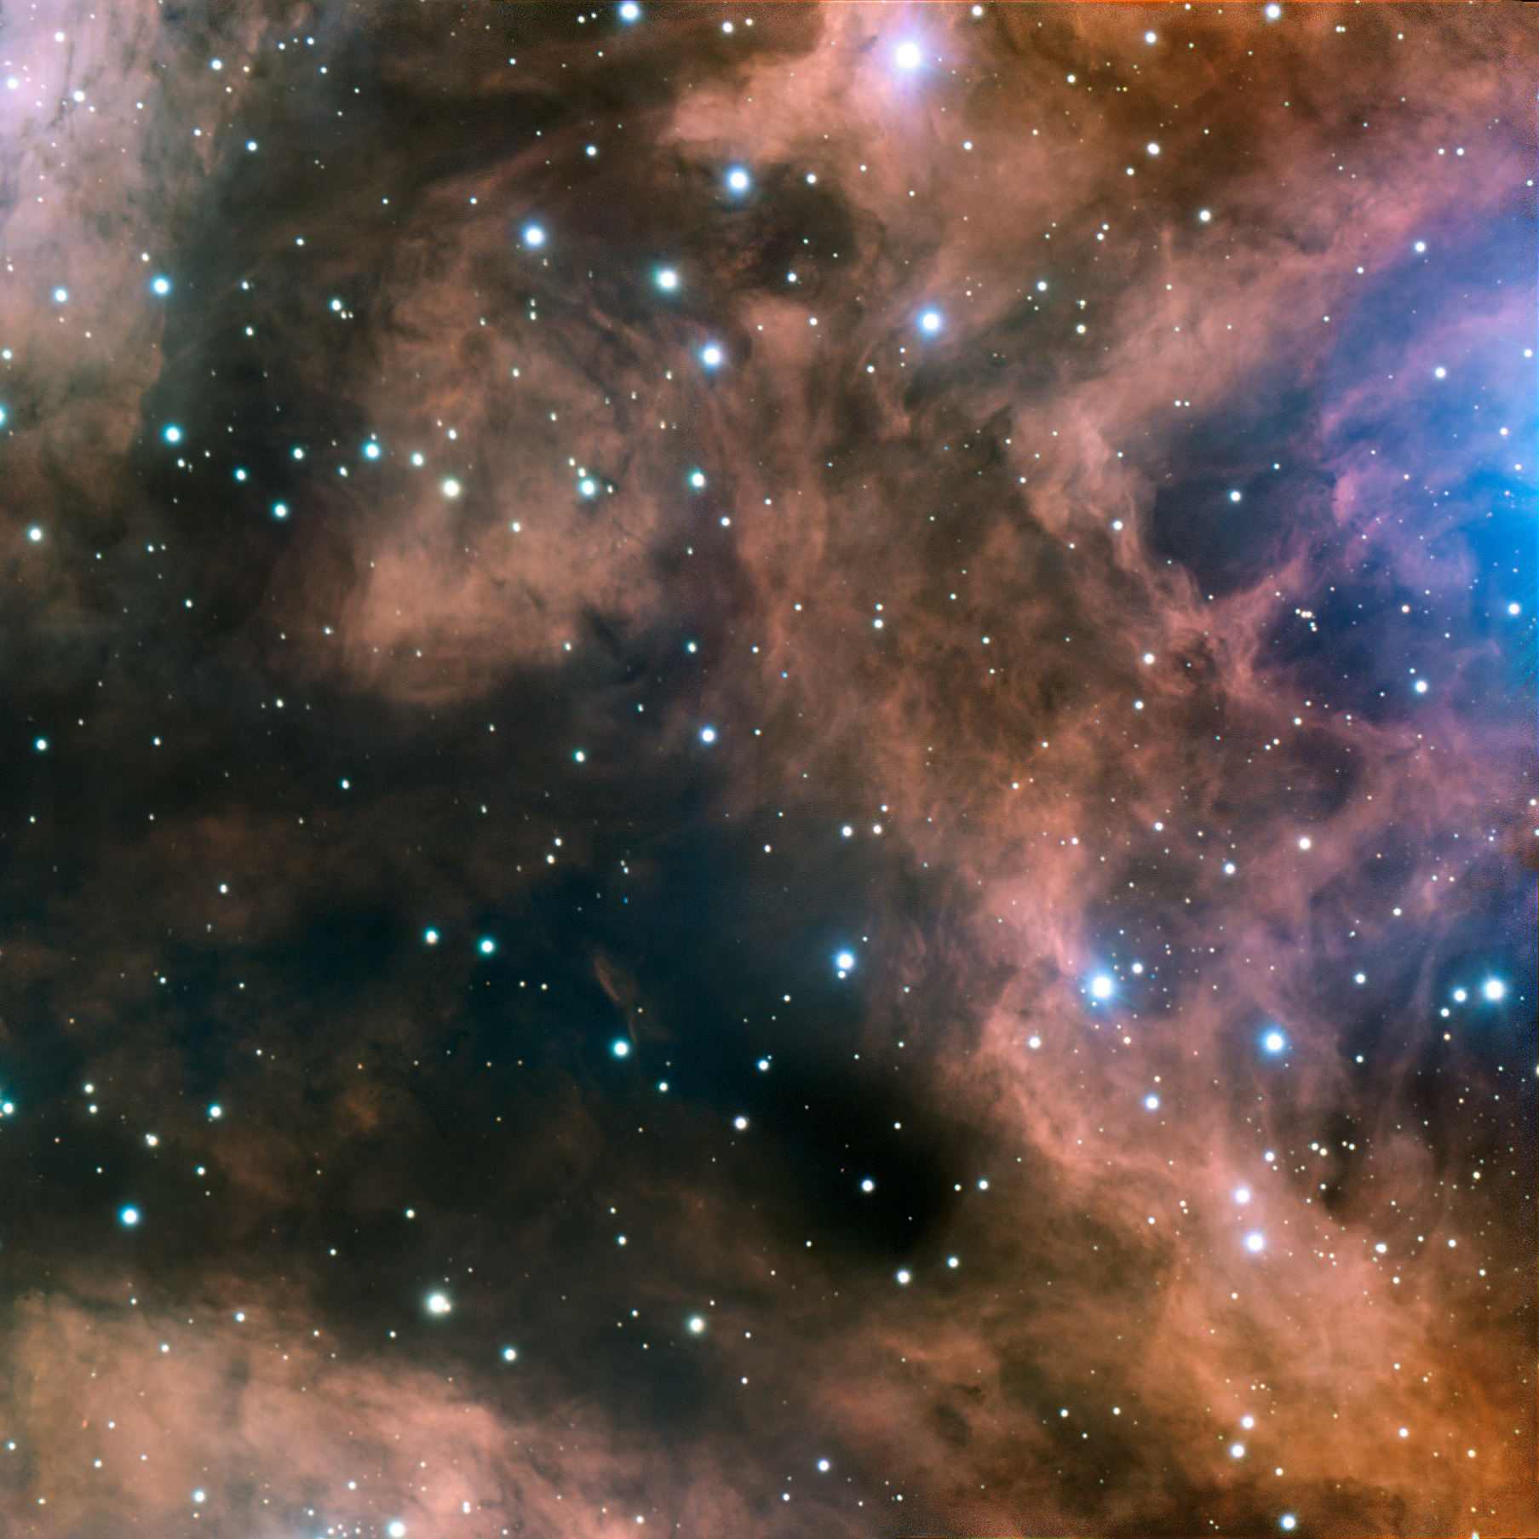
Fundamental questions
What is the origin of the mass of the universe?
What is the origin of the elements ?
What is the structure of neutron stars?
Can we ignite the solar fire on earth ?
Does matter differ from antimatter ?
Why do we not observe individual quarks ?
→ to be explored at the future international
Facility for Antiproton and Ion Research (FAIR)

Slide 12











Facility for Antiproton & Ion Research
SIS100/300
p-Linac
SIS18
Compressed Baryonic Matter
Primary Beams
10¹²/s; 1.5 GeV/u; ²³⁸U²⁸⁺
10¹⁰/s ²³⁸U⁹²⁺ up to 11 (35) GeV/u
3x10¹³/s 30 (90) GeV protons
Anti-Proton Physics
HESR
Super Fragment-Separator:
Nuclear Structure and Astrophysics
Secondary Beams
radioactive beams up to
1.5 - 2 GeV/u;
10¹¹ antiprotons 1.5 - 15 GeV/c
Technical Challenges
FAIR phase 1
FAIR phase 2
CR
rapid cycling superconducting magnets
dynamical vacuum
12
100 m

Slide 13
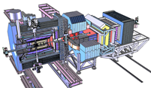
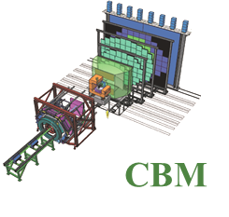
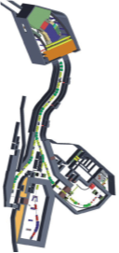
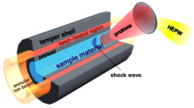
Facility for Antiproton & Ion Research
Experimental programs:
APPA: Atomic & Plasma Physics & Applications
➢ Highly charged atoms
➢ Plasma physics
➢ Radiobiology
➢ Material science
SIS18
SIS100/300
p-Linac
Compressed Baryonic Matter
HESR
CBM: Nucleus-nucleus collisions
➢ Nuclear matter at neutron
star core densities
➢ Phase transitions from
hadrons to quarks
Anti-Proton Physics
Super Fragment-Separator:
Nuclear Structure and Astrophysics
NUSTAR: Rare Isotope beams
➢ Nuclear structure far off stability
➢ Nucleosynthesis in stars and supernovae
CR
PANDA: Antiproton-proton collisions:
➢ Charmed hadrons (XYZ)
➢ Gluonic matter and hybrids
➢ Hadron structure
➢ Double Lambda hypernuclei
FAIR phase 1
FAIR phase 2
100 m
13

Slide 14
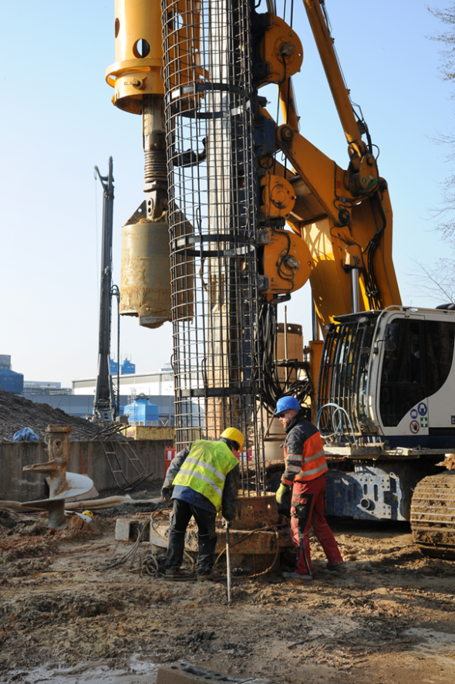
Status of FAIR
Construction started July 2017
Installation incl. commissioning of
the experiments is planned during 2021-2024
Full completion of FAIR by 2025
14

Slide 15
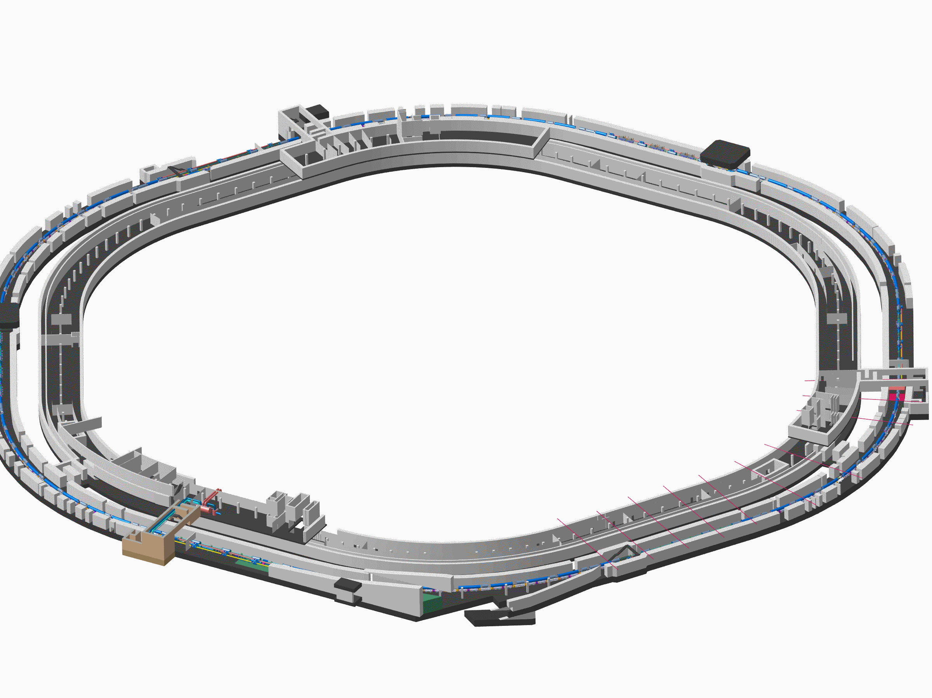
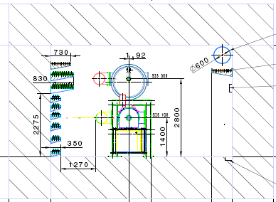
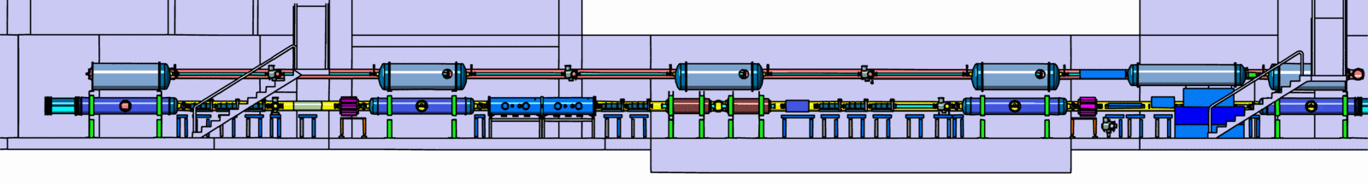
Tunnel for SIS100/300
15

Slide 16
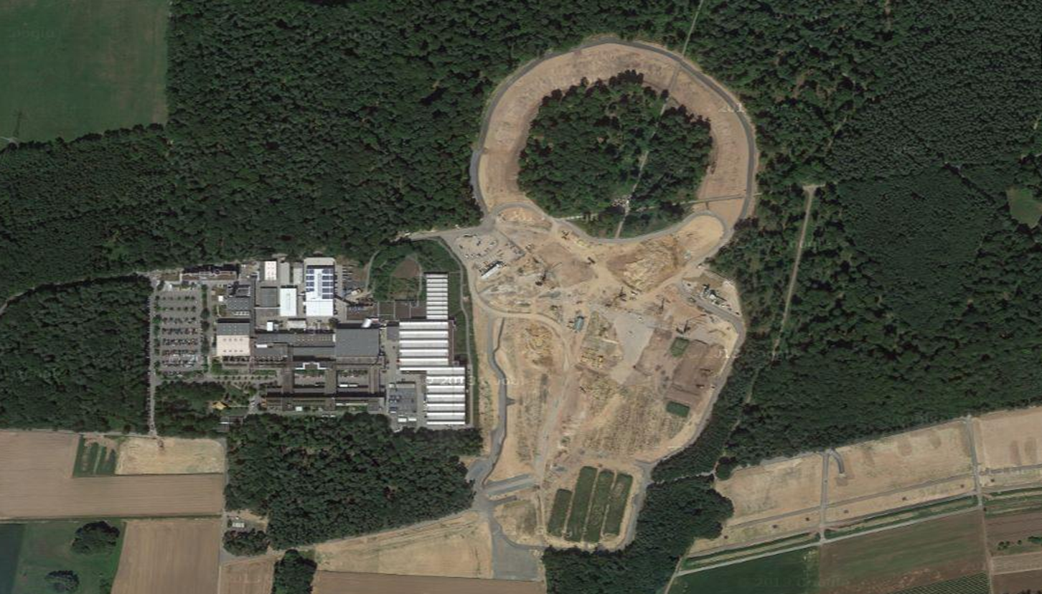
Facility for Antiproton & Ion Research
Experimental programs:
APPA: Atomic & Plasma Physics & Applications
➢ Highly charged atoms
➢ Plasma physics
➢ Radiobiology
➢ Material science
SIS18
SIS100/300
p-Linac
Compressed Baryonic Matter
HESR
CBM: Nucleus-nucleus collisions
➢ Nuclear matter at neutron
star core densities
➢ Phase transitions from
hadrons to quarks
Anti-Proton Physics
Super Fragment-Separator:
Nuclear Structure and Astrophysics
NUSTAR: Rare Isotope beams
➢ Nuclear structure far off stability
➢ Nucleosynthesis in stars and supernovae
CR
PANDA: Antiproton-proton collisions:
➢ Charmed hadrons (XYZ)
➢ Gluonic matter and hybrids
➢ Hadron structure
➢ Double Lambda hypernuclei
FAIR phase 1
FAIR phase 2
100 m
16

Slide 17
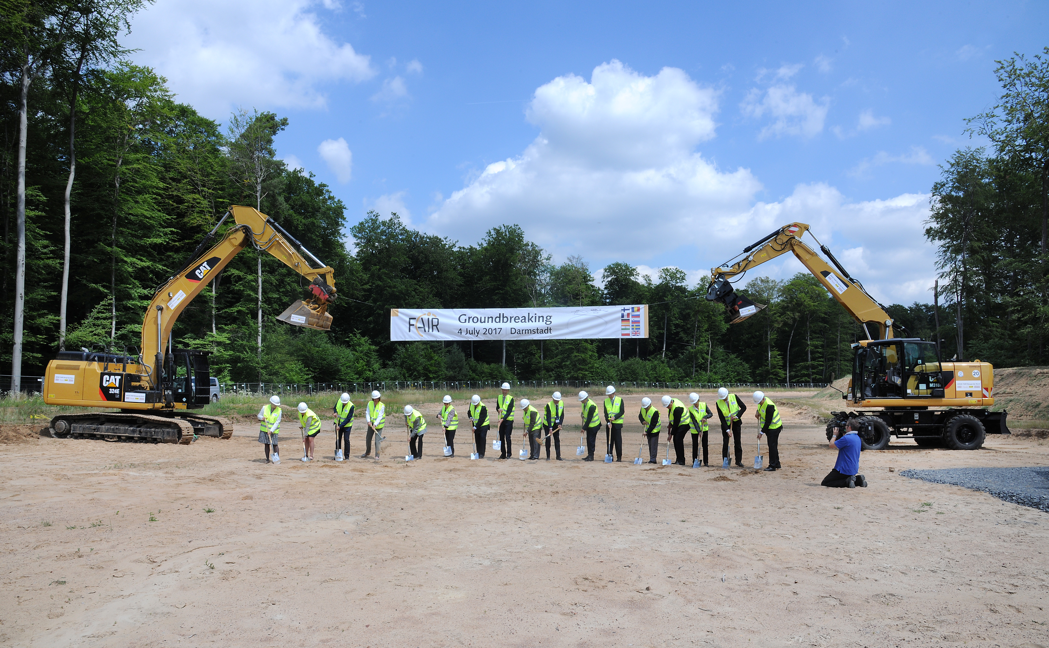

Slide 18
Status FAIR civil construction
as of August 25, 2017
SIS18 – adaptation works for FAIR

Slide 19
Status FAIR civil construction
as of August 25, 2017
SIS18 – adaptation works for FAIR

Slide 20
Status FAIR civil construction
as of August 25, 2017
Preparatory works for excavation

Slide 21
Status FAIR civil construction
as of August 25, 2017
Piping for ventilation and ground water lowering

Slide 22
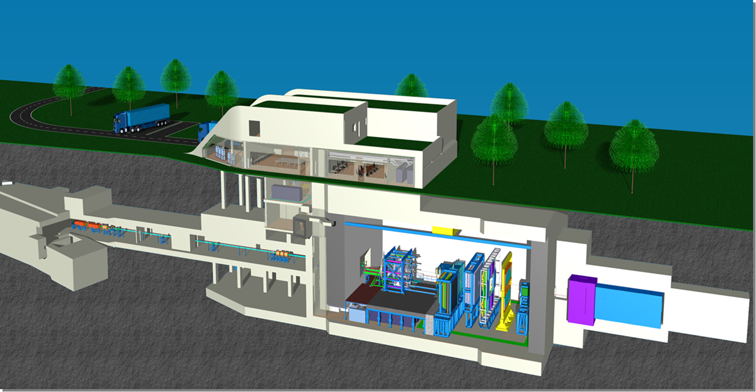
The Compressed Baryonic Matter (CBM)
experiment
22

Slide 23
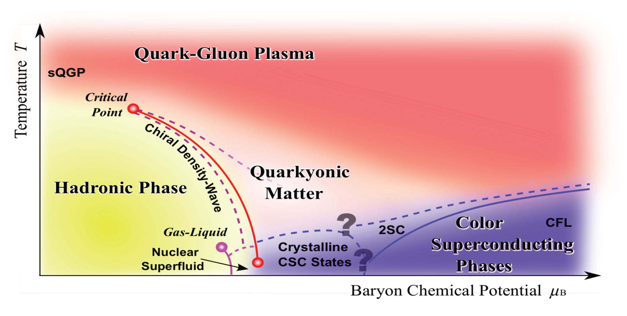
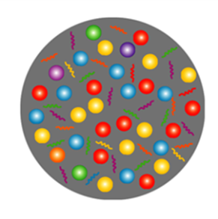
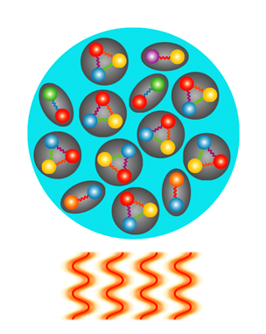
Exploring the QCD phase diagram
Courtesy of K. Fukushima & T. Hatsuda
At very high temperature:
➢ N of baryons ≈ N of antibaryons
Situation similar to early universe
➢ L-QCD finds crossover transition between
hadronic matter and Quark-Gluon Plasma
➢ Experiments: ALICE, ATLAS, CMS at LHC
STAR, PHENIX at RHIC

Slide 24
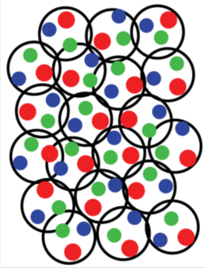
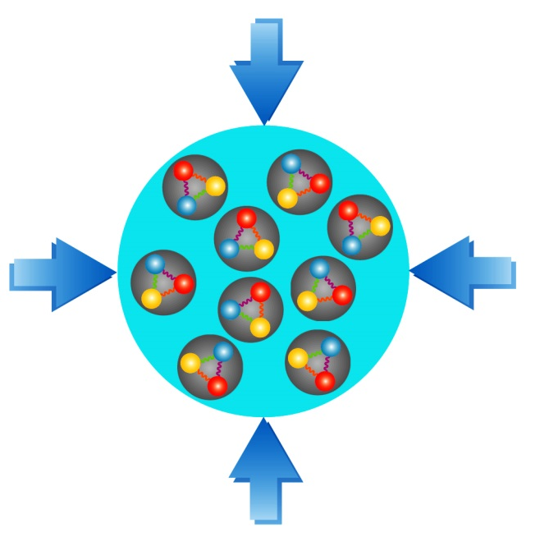
Exploring the QCD phase diagram
Courtesy of K. Fukushima & T. Hatsuda
At high baryon density:
➢ N of baryons >> N of antibaryons
Densities like in neutron star cores
➢ L-QCD not (yet) applicable
Models predict first order phase transition
with mixed or exotic phases
Experiments: BES at RHIC, NA61 at CERN SPS,
CBM at FAIR, NICA at JINR, J-PARC

Slide 25
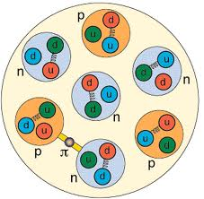
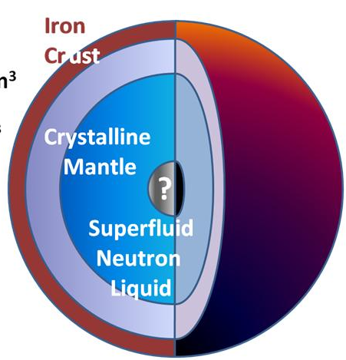
Density estimates
Atomic nucleus:
Radius R = 1.2 fm A^{1/3} (σ_{reac} = π R²)
Volume V = 4/3 π R³ = 4/3 π 1.2³ A fm³
Nucleon density ρ₀ = A/V = 3/ (4 π 1.2³) fm⁻³ ≈ 0.14 fm⁻³
Mass of nucleon m = 1.67 ⋅ 10⁻²⁴ g
Mass density of cold nuclear matter ρ₀ ⋅ m ≈ 270 Mio t/cm³
Limits of nucleon density:
Au-nucleus: R ≈ 7 fm, V ≈ 1400 fm³
Nucleon: R ≈ 0.8 fm, V ≈ 2 fm³
200 Nucleons: V ≈ 400 fm³
At 3 – 4 ρ⁰: nucleons overlap, Fermi see of quarks?
Neutron star:
Radius R ≈ 10 km,
Volume V ≈ 4200 km³
Mass M ≈ 2 solar masses = 2 ⋅ 2 ⋅ 10³³ g
Average mass density ρ = M/V ≈ 1000 Mio t/cm³ ≈ 3.6 ρ⁰ ⋅ m
Core density 5 – 10 times nuclear density

Slide 26


Baryon densities in central Au+Au collisions
I.C. Arsene et al., Phys. Rev. C 75, 24902 (2007)
5 A GeV
10 A GeV
8 ρ₀
5 ρ₀
∼ 2 ρ₀
∼ 5 ρ₀
26
courtesy Toru Kojo (CCNU)

Slide 27
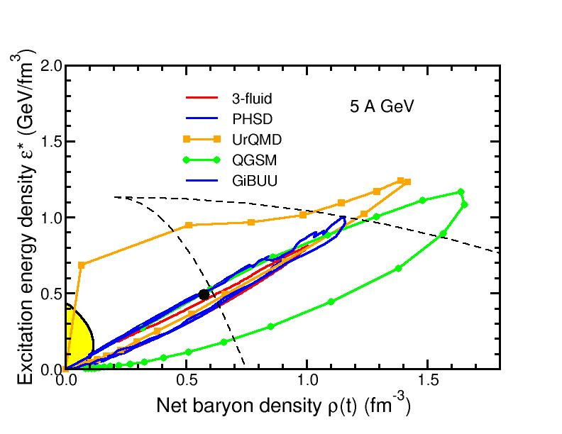
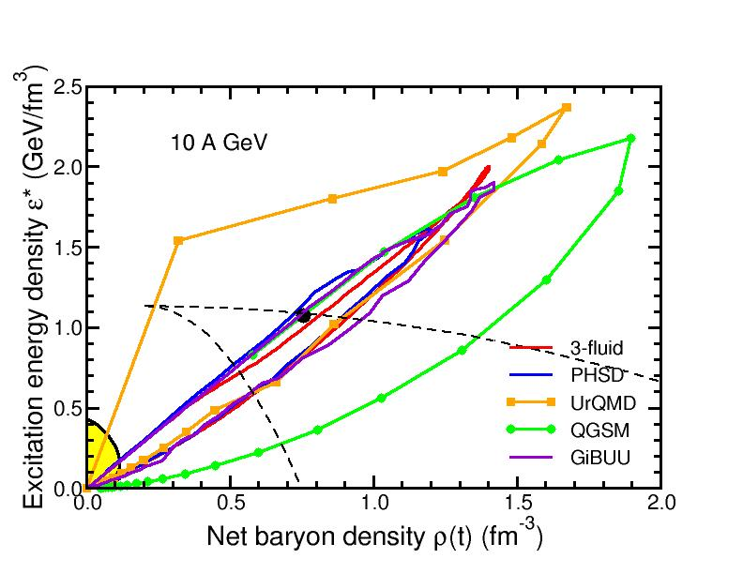
Baryon densities in central Au+Au collisions
I.C. Arsene et al., Phys. Rev. C 75, 24902 (2007)
5 A GeV
10 A GeV
8 ρ₀
5 ρ₀
phase
coexistence
phase
coexistence
27

Slide 28
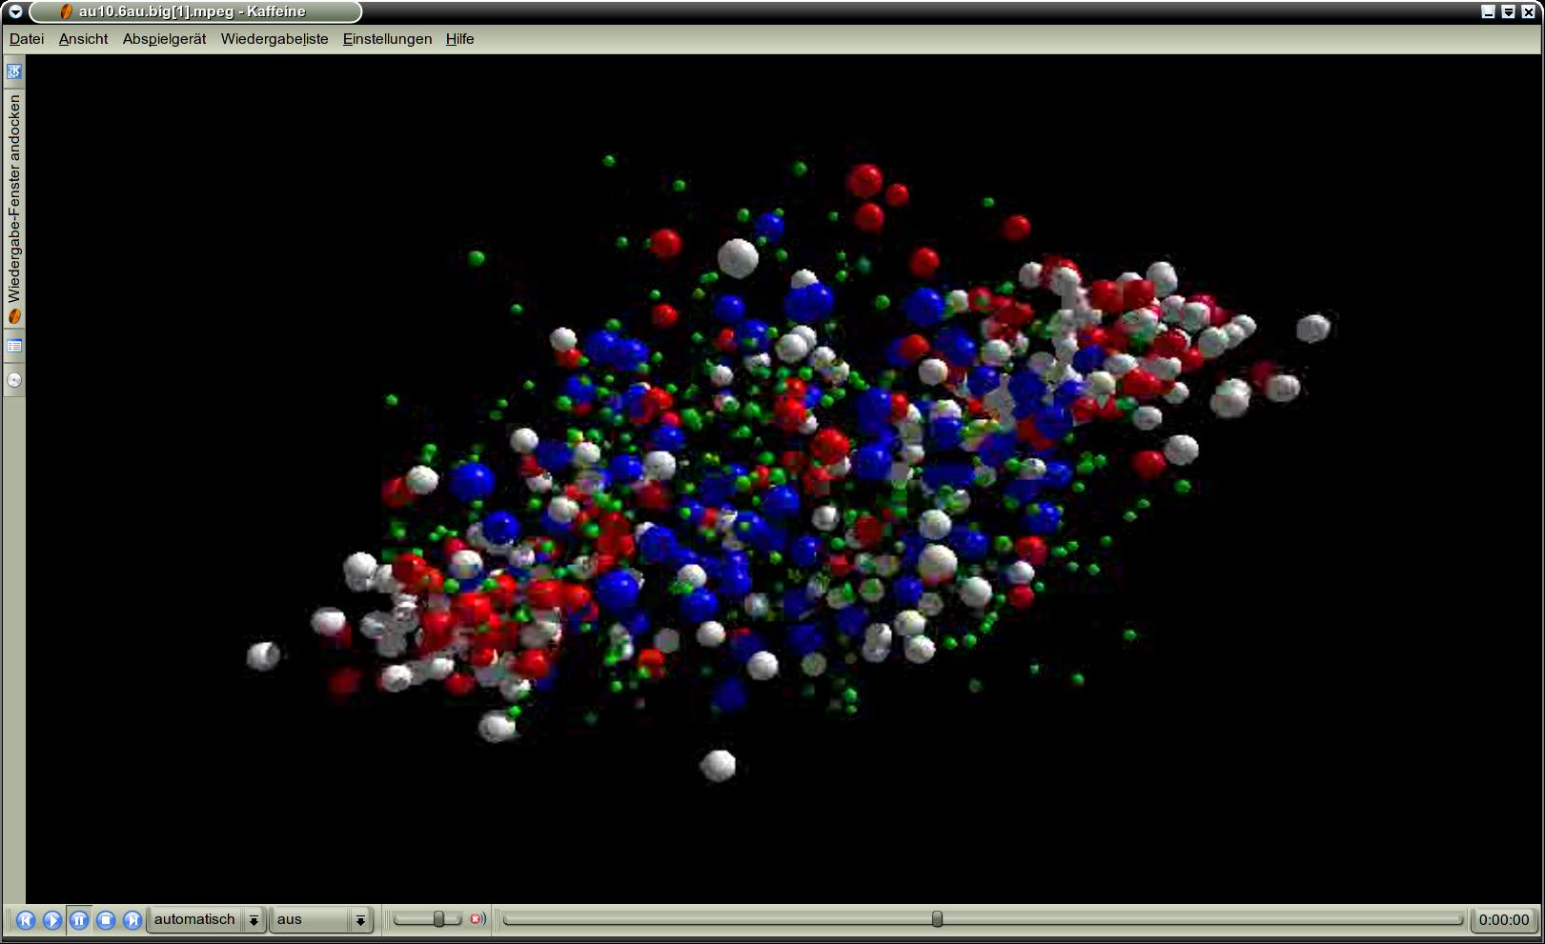
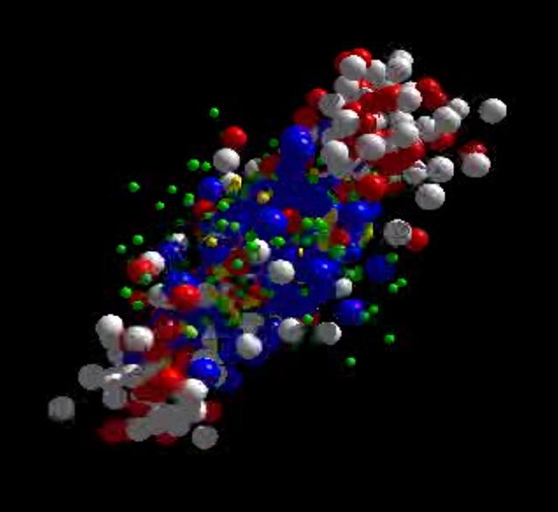
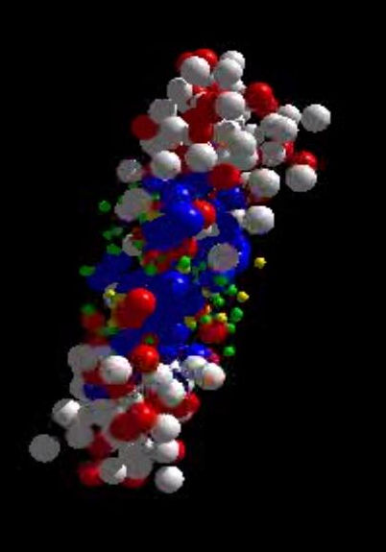
Messengers from the dense fireball:
CBM at FAIR
UrQMD transport calculation Au+Au 10.7 A GeV
Ξ⁻, Ω⁻, φ
π, K, Λ, ...
p, Λ, Ξ⁺, Ω⁺, J/ψ
ρ → e⁺e⁻, μ⁺μ⁻
resonance decays
ρ → e⁺e⁻, μ⁺μ⁻
ρ → e⁺e⁻, μ⁺μ⁻

Slide 29

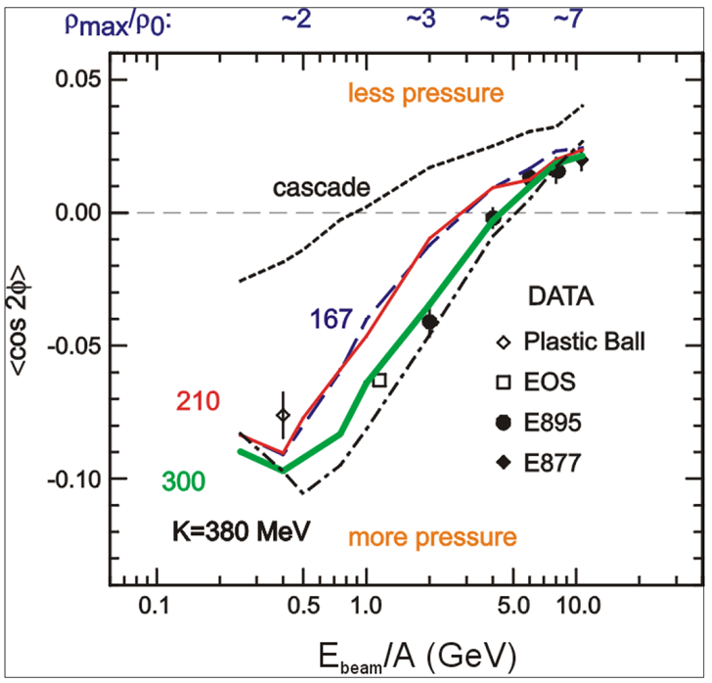
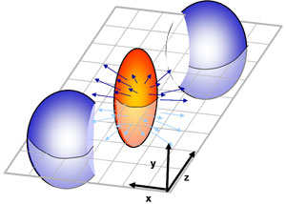
CBM physics case and observables
The QCD matter equation-of-state at neutron star core densities
➢ collective flow of identified particles (π,K,p,Λ,Ξ,Ω,...)
driven by the pressure gradient in the early fireball
AGS: proton flow in Au+Au collisions
Azimuthal angle distribution:
dN/dφ = C (1 + v₁ cos(φ) + v₂ cos(2φ) + ...)
P. Danielewicz, R. Lacey, W.G. Lynch, Science 298 (2002) 1592

Slide 30
CBM physics case and observables
The QCD matter equation-of-state at neutron star core densities
➢ collective flow of identified particles (π,K,p,Λ,Ξ,Ω,...)
driven by the pressure gradient in the early fireball
➢ particle production at (sub)threshold energies via
multi-step processes (multi-strange hyperons, charm)
Direct multi-strange hyperon production:
pp → Ξ⁻ K⁺K⁺p (E_{thr} = 3.7 GeV)
pp → Ω⁻ K⁺K⁺K⁺n (E_{thr} = 7.0 GeV)
pp → Λ⁰Λ⁰ pp (E_{thr} = 7.1 GeV)
pp → Ξ⁺ Ξ⁻ pp (E_{thr} = 9.0 GeV)
pp → Ω⁺ Ω⁻ pp (E_{thr} = 12.7 GeV
p
p
p
Λ⁰
p
p
(uds)
Hyperon production via multiple collisions
pp → K⁺Λ⁰p, pp → K⁺K⁻pp,
pΛ⁰→ K⁺ Ξ⁻ p, πΛ⁰→ K⁺ Ξ⁻ π,
Λ⁰Λ⁰→ Ξ⁻ p, Λ⁰K⁻ → Ξ⁻ π⁰
3 . Λ⁰ Ξ⁻ → Ω⁻ n, Ξ⁻K⁻ → Ω⁻ π⁻
Antihyperons
1. Λ⁰ K⁺ → Ξ⁺π⁰ ,
2. Ξ⁺ K⁺ → Ω⁺ π⁺.
K⁺
p
Λ⁰
Ξ⁻
(uds)
(dss)
Ω⁻
p
p
K⁺
(sss)
p
Λ⁰
(uds)
K⁺
p
n

Slide 31
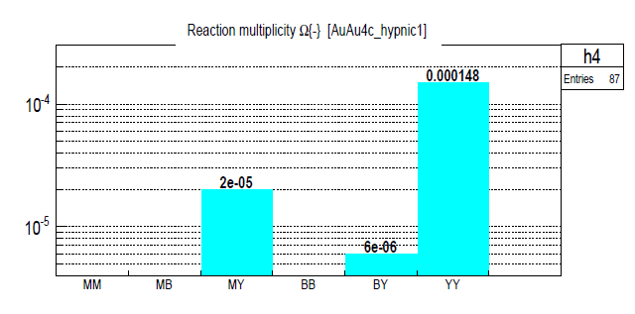
CBM physics case and observables
The QCD matter equation-of-state at neutron star core densities
➢ collective flow of identified particles (π,K,p,Λ,Ξ,Ω,...)
driven by the pressure gradient in the early fireball
➢ particle production at (sub)threshold energies via
multi-step processes (multi-strange hyperons, charm)
Direct multi-strange hyperon production:
pp → Ξ⁻ K⁺K⁺p (E_{thr} = 3.7 GeV)
pp → Ω⁻ K⁺K⁺K⁰p (E_{thr} = 7.0 GeV)
pp → Λ⁰Λ⁰ pp (E_{thr} = 7.1 GeV)
pp → Ξ⁺ Ξ⁻ pp (E_{thr} = 9.0 GeV)
pp → Ω⁺ Ω⁻ pp (E_{thr} = 12.7 GeV
Ω⁻ production in 4 A GeV Au+Au
Hyperon production via multiple collisions
pp → K⁺Λ⁰p, pp → K⁺K⁻pp,
pΛ⁰→ K⁺ Ξ⁻ p, πΛ⁰→ K⁺ Ξ⁻ π,
Λ⁰Λ⁰→ Ξ⁻ p, Λ⁰K⁻ → Ξ⁻ π⁰
3 . Λ⁰ Ξ⁻ → Ω⁻ n, Ξ⁻K⁻ → Ω⁻ π⁻
Antihyperons
1. Λ⁰ K⁺ → Ξ⁺π⁰ ,
2. Ξ⁺ K⁺ → Ω⁺ π⁺.
HYPQGSM calculations , K. Gudima et al.

Slide 32
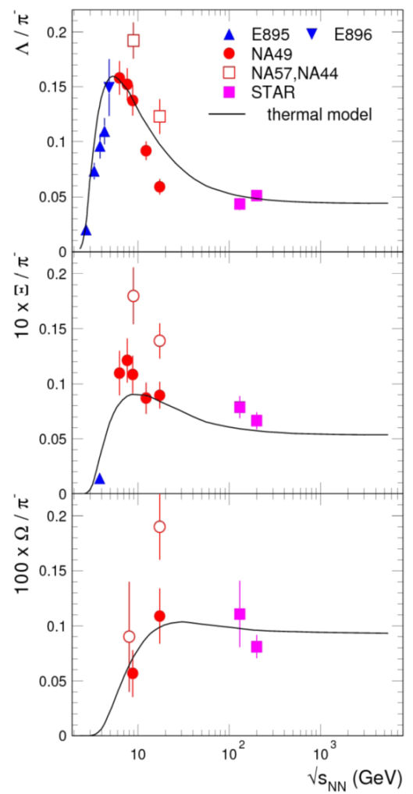
CBM physics case and observables
The QCD matter equation-of-state at neutron star core densities
➢ collective flow of identified particles (π,K,p,Λ,Ξ,Ω,...)
driven by the pressure gradient in the early fireball
➢ particle production at (sub)threshold energies via
multi-step processes (multi-strange hyperons, charm)
Direct multi-strange hyperon production:
pp → Ξ⁻ K⁺K⁺p (E_{thr} = 3.7 GeV)
pp → Ω⁻ K⁺K⁺K⁰p (E_{thr} = 7.0 GeV)
pp → Λ⁰Λ⁰ pp (E_{thr} = 7.1 GeV)
pp → Ξ⁺ Ξ⁻ pp (E_{thr} = 9.0 GeV)
pp → Ω⁺ Ω⁻ pp (E_{thr} = 12.7 GeV
Hyperon production via multiple collisions
pp → K⁺Λ⁰p, pp → K⁺K⁻pp,
pΛ⁰→ K⁺ Ξ⁻ p, πΛ⁰→ K⁺ Ξ⁻ π,
Λ⁰Λ⁰→ Ξ⁻ p, Λ⁰K⁻ → Ξ⁻ π⁰
3 . Λ⁰ Ξ⁻ → Ω⁻ n, Ξ⁻K⁻ → Ω⁻ π⁻
Antihyperons
1. Λ⁰ K⁺ → Ξ⁺π⁰ ,
2. Ξ⁺ K⁺ → Ω⁺ π⁺.
Very few data
at FAIR energies

Slide 33
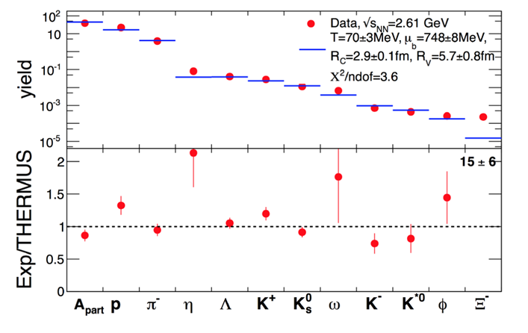
CBM physics case and observables
Phase transitions from partonic to hadronic matter
excitation function of strangeness: Ξ⁻(dss),Ξ⁺(dss),Ω⁻(sss),Ω⁺(sss)
→ chemical equilibration at the phase boundary
Particle yields and thermal model fits
Very few data
at FAIR energies
A. Andronic et al., Jour. Phys. G38 (2011)
HADES: Ar + KCl 1.76 A GeV
G. Agakishiev et al., arXiv:1512.07070

Slide 34
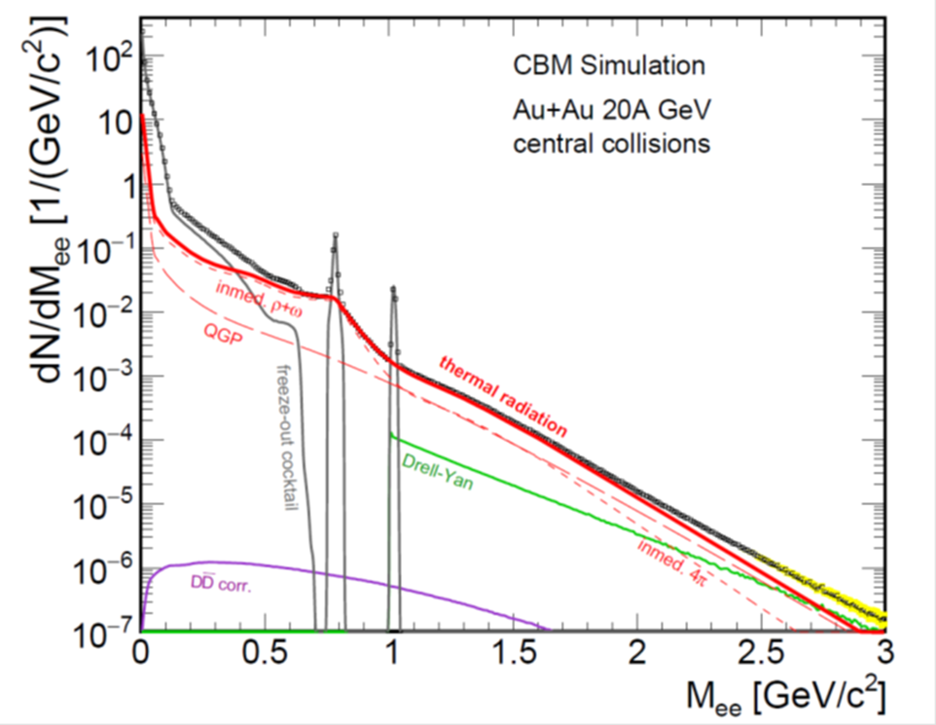
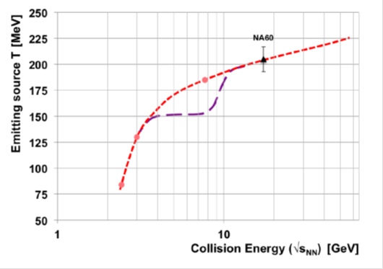
CBM physics case and observables
Phase transitions from partonic to hadronic matter
➢ excitation function of strangeness: Ξ⁻(dss),Ξ⁺(dss),Ω⁻(sss),Ω⁺(sss)
→ chemical equilibration at the phase boundary
Phase coexistence
excitation function (invariant mass) of lepton pairs:
thermal radiation from QGP, caloric curve
Invariant mass distribution of lepton pairs
Slope of dilepton invariant mass spectrum
1 GeV/c² < M_{inv} < 2.5 GeV/c²
No data
at FAIR energies
The CBM Collaboration, arXiv:1607.01487

Slide 35
CBM physics case and observables
Phase transitions from partonic to hadronic matter
➢ excitation function of strangeness: Ξ⁻(dss),Ξ⁺(dss),Ω⁻(sss),Ω⁺(sss)
→ chemical equilibration at the phase boundary
Phase coexistence
excitation function (invariant mass) of lepton pairs:
thermal radiation from QGP, caloric curve
➢ anisotropic azimuthal angle distributions: “spinodal decomposition”
Spinodal decomposition of the mixed phase: net baryon number density fluctuations
C. Herold, M. Nahrgang, I. Mishustin, M.Bleicher
Nuclear Physics A 925 (2014) 14
Jan Steinheimer, Jorgen Randrup
Phys. Rev. C 87, 054903 (2013)
Eur. Phys. J. A (2016) 52: 239

Slide 36
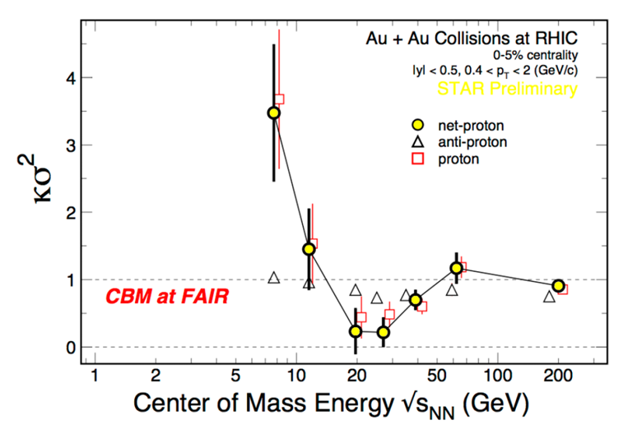
CBM physics case and observables
Phase transitions from partonic to hadronic matter
➢ excitation function of strangeness: Ξ⁻(dss),Ξ⁺(dss),Ω⁻(sss),Ω⁺(sss)
→ chemical equilibration at the phase boundary
Phase coexistence
excitation function (invariant mass) of lepton pairs:
thermal radiation from QGP, caloric curve
anisotropic azimuthal angle distributions: “spinodal decomposition”
Critical point
event-by-event fluctuations of conserved quantities (B,S,Q)
“critical opalescence”
4th moment of net-proton
multiplicity distribution:
critical fluctuations
STAR preliminary
No data
at FAIR energies

Slide 37
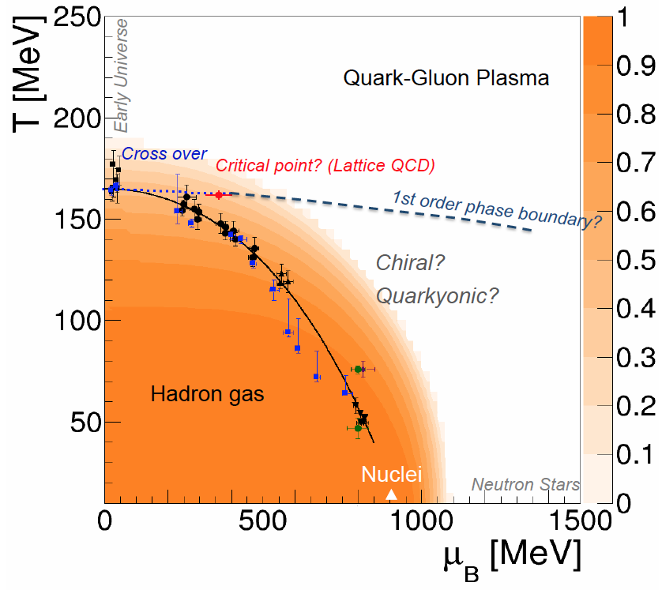
CBM physics case and observables
Onset of chiral symmetry restoration at high ρ_{B}
➢ in-medium modifications of hadrons: ρ,ω,φ →e⁺e⁻(μ⁺μ⁻)
➢ dileptons at intermediate invariant masses: 4 π → ρ-a₁ chiral mixing
Origin of quark masses
Orange region: Chiral condensate

Slide 38

CBM physics case and observables
Onset of chiral symmetry restoration at high ρ_{B}
➢ in-medium modifications of hadrons: ρ,ω,φ →e⁺e⁻(μ⁺μ⁻)
➢ dileptons at intermediate invariant masses: 4 π → ρ-a₁ chiral mixing
No data
at FAIR energies

Slide 39

CBM physics case and observables
N-Λ, Λ-Λ interaction, strange matter?
➢ (double-) lambda hypernuclei
➢ meta-stable objects (e.g. strange dibaryons)
No data
at FAIR energies
Double lambda hypernuclei production
in central Au+Au collisions at 10 A GeV:
 | Multiplicity | Yield in 1 week
⁵_{ΛΛ}H | 5 ⋅ 10⁻⁶ | 3000
⁶_{ΛΛ}He | 1 ⋅ 10⁻⁷ | 60
Assumption for yield calculation:
Reaction Rate 1 MHz
BR 10% (2 sequential weak decays)
Efficiency 1%
SIS100
A. Andronic et al., Phys. Lett. B697 (2011) 203

Slide 40
CBM physics case and observables
Charm production at threshold energies in cold and dense matter
➢ excitation function of charm production in p+A and A+A (J/ψ, D⁰, D±)
UrQMD calculation including subthreshold charm production via
N* → Λ_{c} + D and N* → N +J/ψ
No data
at FAIR energies
40
J. Steinheimer, A. Botvina, M. Bleicher, Phys. Rev. C 95, 014911 (2017), arXiv:1605.03439v1

Slide 41
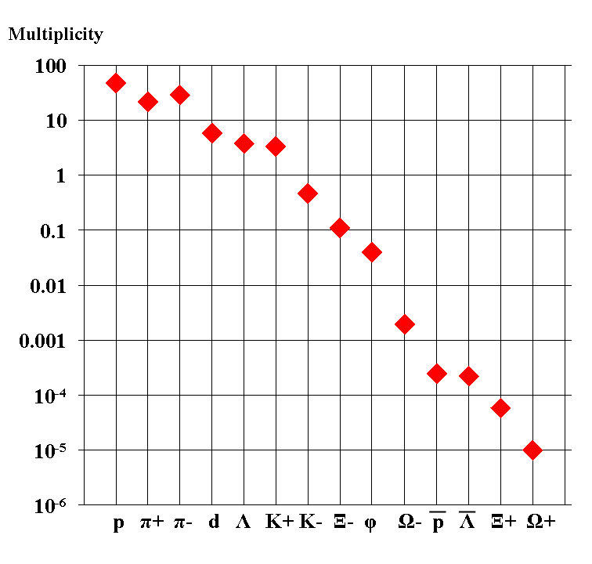
Experimental challenges
Particle yields in central Au+Au 4 A GeV
Statistical model, A. Andronic, priv. com.
AGS
extremely high
interaction rates
required !
e⁺e⁻
μ⁺μ⁻

Slide 42
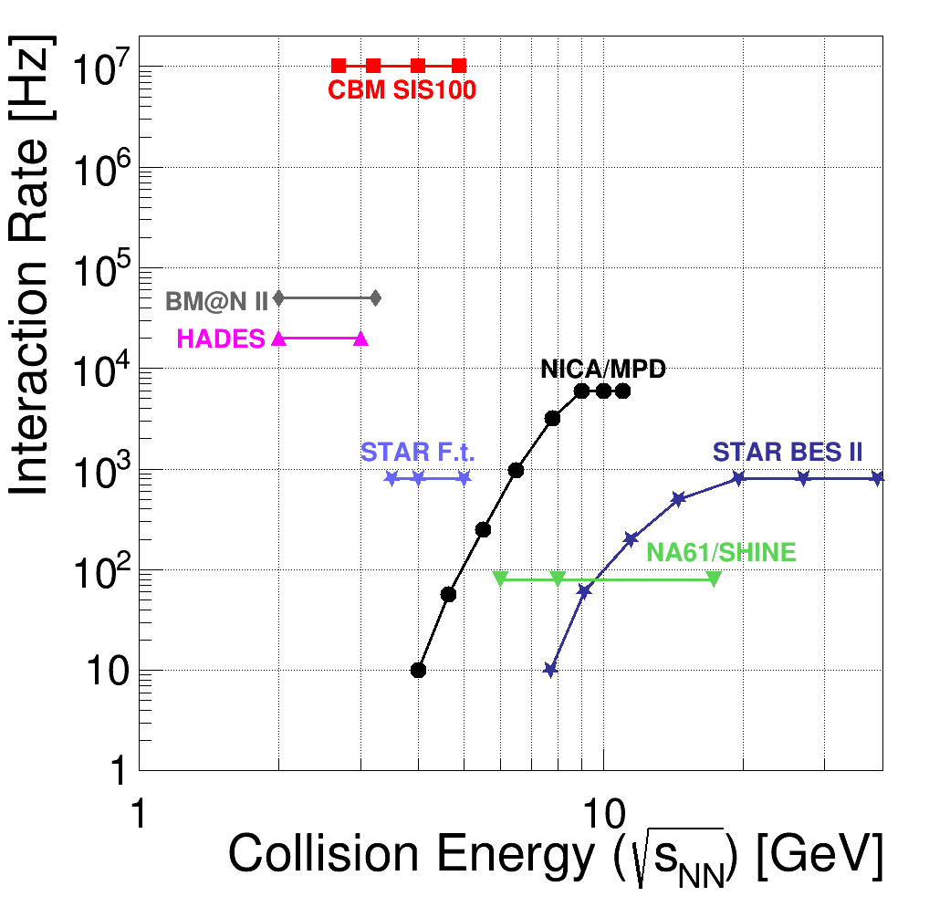
Experiments exploring dense QCD matter
high
net-baryon densities
The CBM Collaboration,
arXiv:1607.01487

Slide 43
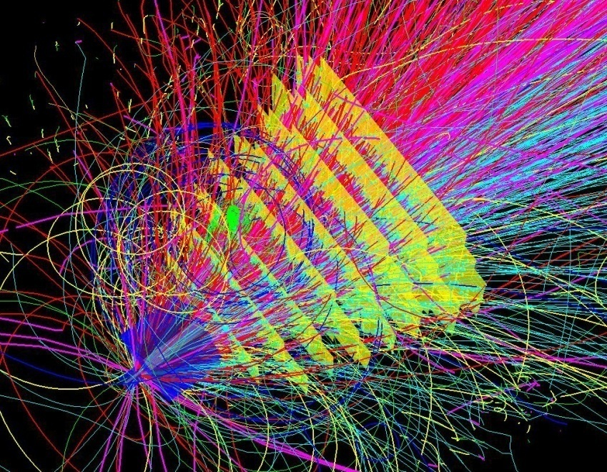
Experimental requirements
10⁵ - 10⁷ Au+Au reactions/sec
determination of displaced vertices (σ ≈ 50 μm)
identification of leptons and hadrons
fast and radiation hard detectors and FEE
free-streaming readout electronics
high speed data acquisition and high performance
computer farm for online event selection
4-D event reconstruction
43
Notes:
43
43
43

Slide 44
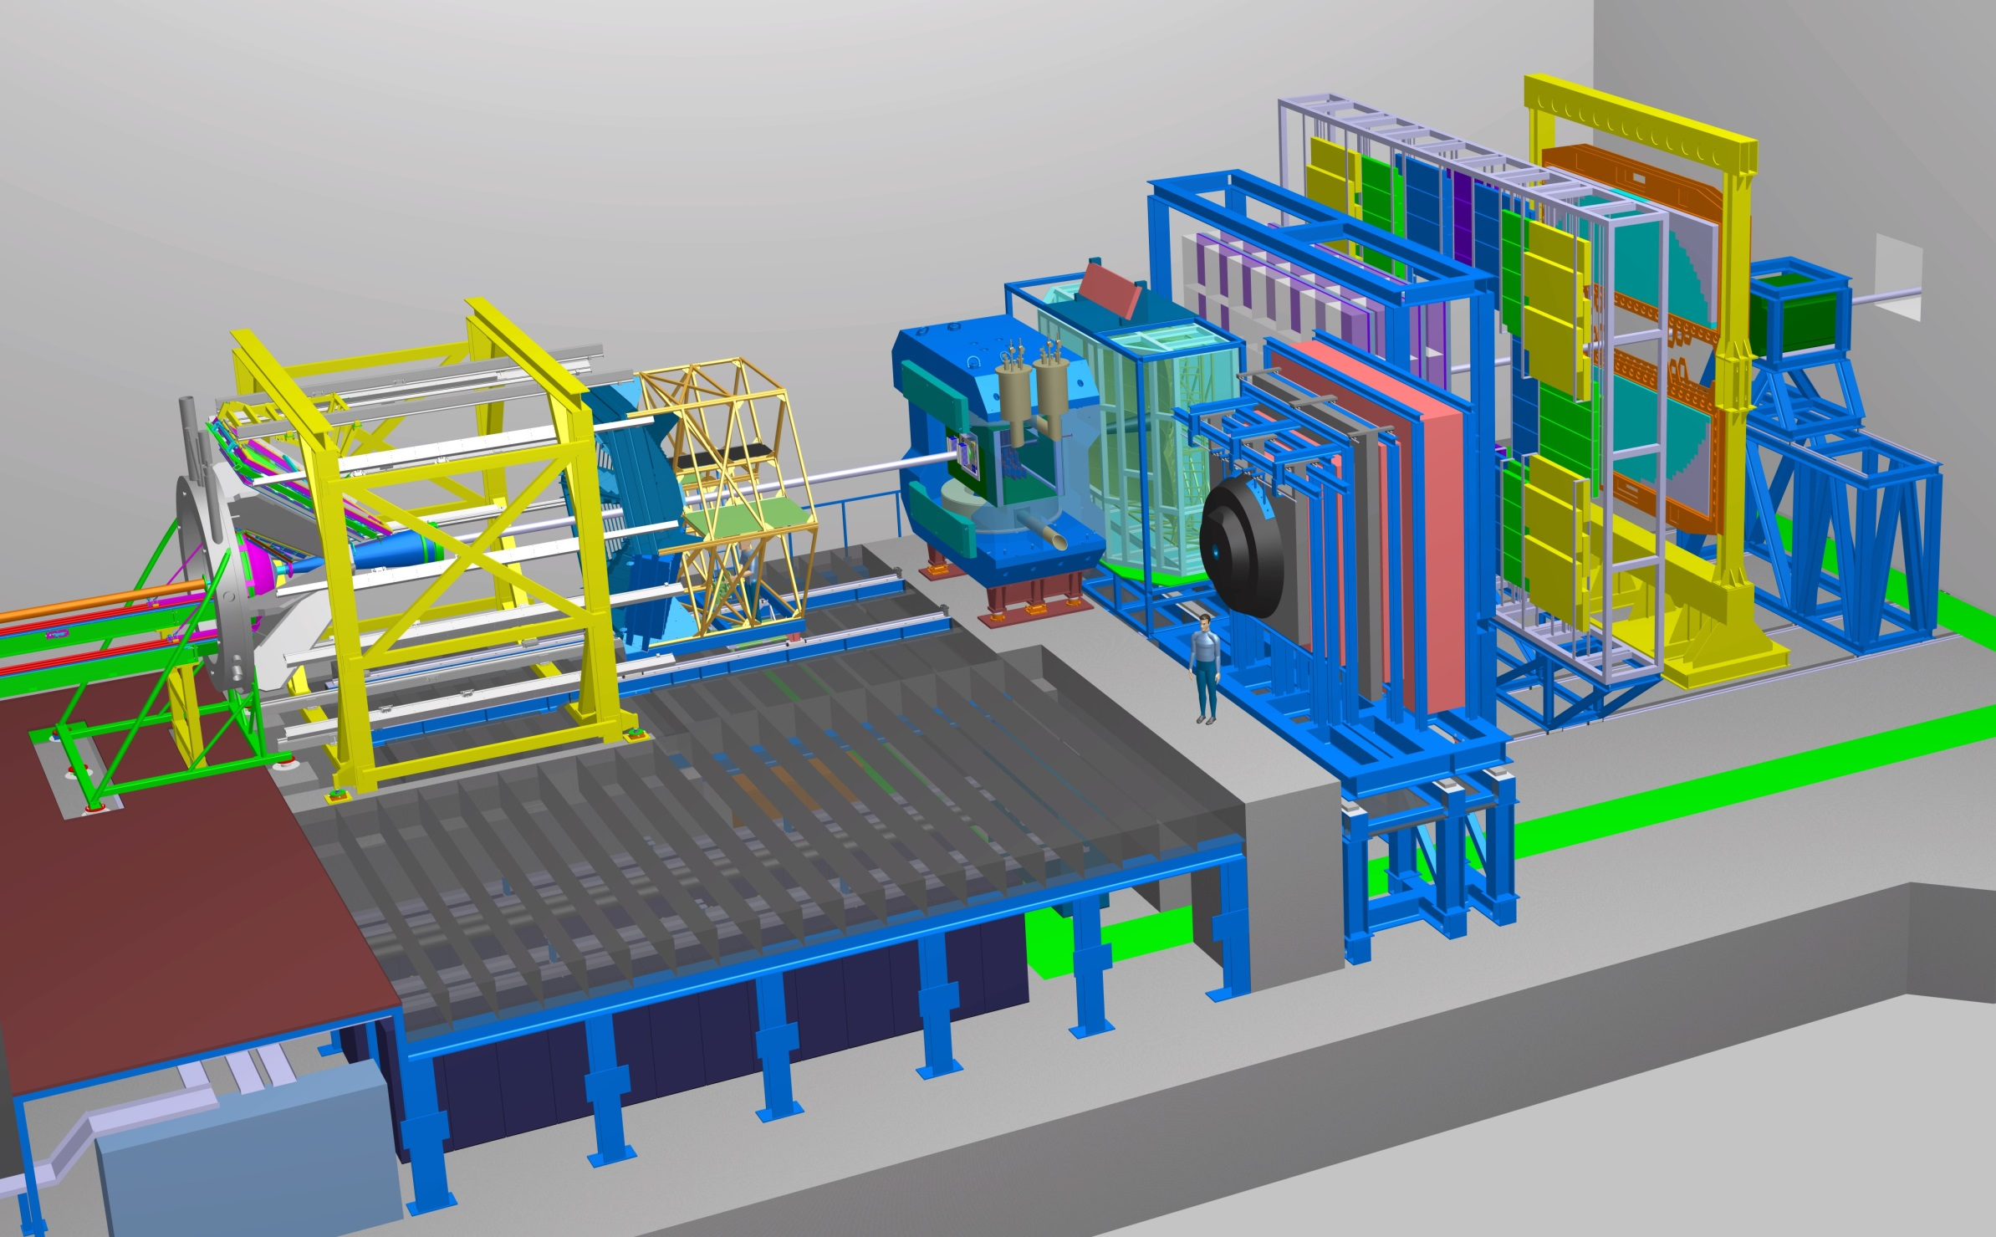
Experimental requirements
Transition
Radiation
Detector
Time of Flight
Detector
Ring
Imaging
Cherenkov
SC Dipol
Magnet
Silicon
Tracking
System
HADES
p+p, p+A
A+A (low mult.)
Micro
Vertex
Detector
Muon
Detector
Projectile
Spectator
Detector
DAQ/FLES HPC cluster

Slide 45
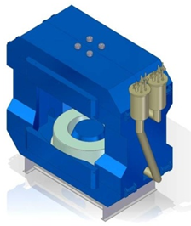
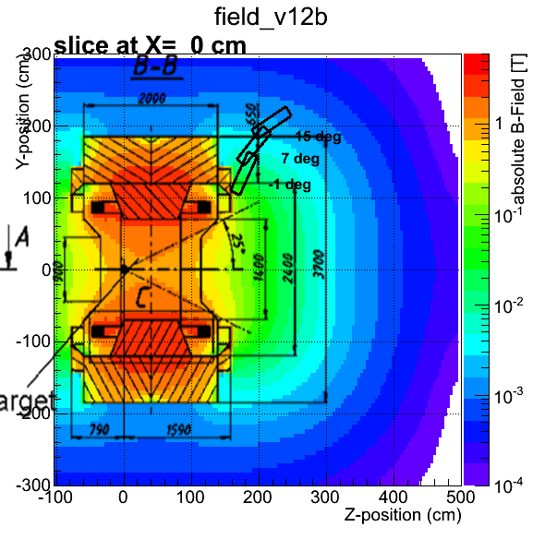
Superconducting Dipole Magnet
Large-acceptance superconducting dipole magnet.
The pole gap is 144 cm, the bending power 1 Tm.
Participating institutes:
Design by INR Dubna and GSI, under construction at BINP Novosibirsk
45

Slide 46
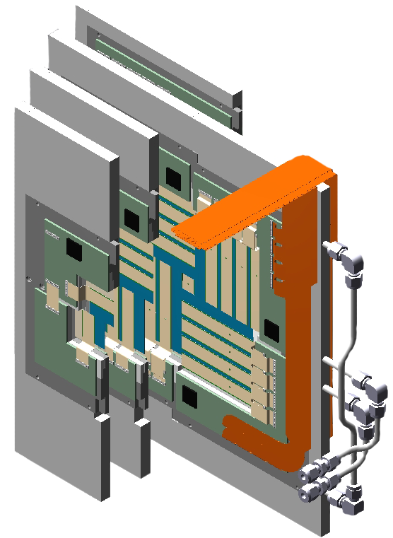
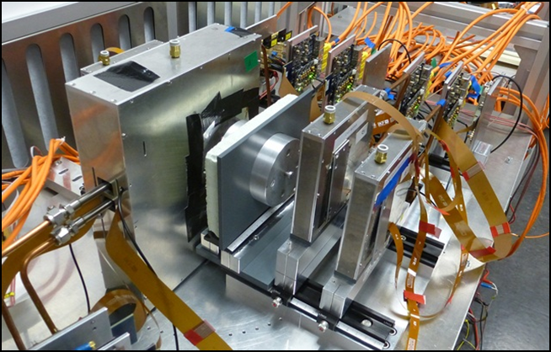
Micro Vertex Detector
➢ Background suppression for di-electron measurements
Determination of secondary vertices of open charm decays (τ = 10⁻¹²-10⁻¹³ s)
Improved tracking for hyperon-ID
The MVD consists of highly granulated Monolithic Active Pixel Sensors (MAPS) arranged in four ultra-thin detector arrays positioned close to the target. Determination of secondary vertices with high precision which is
required for the identification of charmed mesons.
Participating institutes: Univ. Frankfurt, IPHC Strasbourg
46

Slide 47
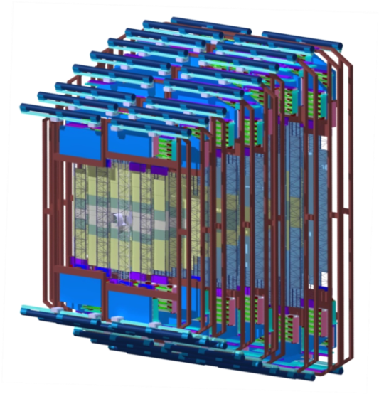



Silicon Tracking System
Silicon microstrip sensors
CiS (Germany), Hamamatsu (Japan)
The STS consists of about 1000 double-sided silicon micro-strip sensors arrangeg in 8 detector arrays located inside the dipole magnet. The detector provides track reconstruction and momentum determination for up to 1000 particles per event. The detector is operated at about -10°C, heat dissipation of the front-end electronics 40 kW, bi-phase CO₂ cooling system
Participating institutes: GSI, Darmstadt, JINR Dubna, KIT,
INR Kiev, AGH and UJ Krakow, Univ. Tübingen, Warsaw UT
47

Slide 48


Ring-Imaging Cherenkov (RICH) Detector
The RICH is used for the identification of electrons with momenta below 8 GeV/c (pion suppression factor of more than 500).
Participating institutes:
Univ. Gießen, Univ. Wuppertal, PNPI Gatchina,
48

Slide 49


Transition Radiation Detector (TRD)
Challenge: ε(e±)= 90%, ε(π) = 7.5% at 100 kHz/cm²
The TRD consists of 4 detectors layers. It provides identification of electrons with momenta above 1.5 GeV/c, and an energy-loss measurement
Participating institutes:
NIPNE Bucharest, JINR Dubna, Univ. Frankfurt, Univ. Heidelberg,
Univ. Münster
49

Slide 50

Muon Chamber (MuCh) System
PSD
Full size GEM detectors tested with free-streaming read-out electronics at the CERN-SPS Nov.-Dec. 2016
The MUCH consists of a combination of 15 detector stations sandwiched between one carbon and 4 iron absorber layers for hadron suppression. The MUCH provides the identification of muons with momenta above 1.5 GeV/c.
Tracking station 1+2: Two Gas-Electron-Multiplier (GEM) detector triplets
Tracking station 3+4: two low-resistivity Bakelite trigger RPC triplets
Tracking station 5: four Transition Radiator Detectors (used only as trackers)
Participating institutes: VECC Kolkata + 12 Indian Inst., PNPI Gatchina
50

Slide 51

The high-rate MRPC TOF wall
ToF MRPC detectors tested with free-streaming read-out electronics at the CERN-SPS Nov.-Dec. 2016
Multigap Resistive Plate Chambers (MRCP) provide the time-of-flight measurement for hadron identification. Challenge: Time resolution of 60 ps at rates of 25 kHz/cm², inner part low-resistivity glass electrodes, area 100 m²
Participating institutes: THU Beijing, NIPNE Bucharest, GSI Darmstadt, TU Darmstadt, IfI Frankfurt, USTC Hefei, Univ. Heidelberg, ITEP Moscow, HZDR Rossendorf, CCNU Wuhan
51

Slide 52


Projectile Spectator Detector
Fully assembled PSD module
at INR Moscow
The PSD is a lead-scintillator calorimeter and is used for the determination of the collision centrality and the orientation of the reaction plane.
Participating institutes:
INR Moscow, Prague, Rez, TU Darmstadt
52

Slide 53


CBM DAQ and online event selection
First-level Event Selector
GSI Green IT Cube
Novel readout system: no hardware trigger on events, detector hits with time stamps, full online 4-D track and event reconstruction.
53

Slide 54

CBM DAQ and online event selection
First-level Event Selector
GSI Green IT Cube
Novel readout system: no hardware trigger on events, detector hits with time stamps, full online 4-D track and event reconstruction.
54

Slide 55


Test beams at CERN
Prototype TOF, GEM, TRD and diamond detectors with common free-streaming readout system and DAQ successfully tested.
Pb+Pb collisions with energies of 13, 30 and 160 A GeV.
Teams from China, Germany, India, Romania

Slide 56



Simulation and reconstruction
Event generators UrQMD 3.3
Transport code GEANT3, FLUKA
Realistic detector geometries, material budget and detector response
reconstruction
Track reconstruction efficiency
min. bias Au+Au 25 A GeV
Notes:
56
56
56

Slide 57

Online particle identification in CBM:
The KF Particle Finder
successfully used online in the STAR experiment

Slide 58








Simulations: central Au+Au collisions at 8A GeV and 10A GeV
Hyperons at 10 A GeV
Dileptons 8A GeV
D mesons 30 GeV p+Au
e⁺e⁻
µ⁺µ⁻
η
ω
φ
ρ
Hypernuclei at 10 A GeV
D mesons Ni+Ni 15A GeV
Charmonium at 10 A GeV
58

Slide 59

Simulation and reconstruction
Hypernuclei in central Au+Au 10 AGeV

Slide 60
Simulation and reconstruction
Hyperons in
Au+Au 10 AGeV
(dds)
missing mass analysis
(uus)
(uus)

Slide 61



4D reconstruction
Au beam 8 A GeV
one single ion
passing the target
FairIon + GEANT3
Au+Au 8 A GeV
central collision
UrQMD + GEANT3
Au+Au 8 A GeV
peripheral collision
UrQMD + GEANT3

Slide 62
4D reconstruction
Hit and track time distribution for
Au+Au 10 AGeV mbias events at 10 MHz (UrQMD)

Slide 63

4D reconstruction
10 MHz Au+Au, 10 AGeV,
300k mbias UrQMD events, ideal PID
 |  | K⁰s | Λ | Λ̅ | Ξ⁻
 | ε_{method}, % | 68.6 | 61.2 | 67 | 46.7
 | ε_{4π}, % | 20.7 | 19.4 | 28 | 10.5
 | S/B | 10.6 | 23.7 | 12.7 | 21.8
 | ε_{method}, % | 68.5 | 62.0 | 62 | 45.2
 | ε_{4π}, % | 21.1 | 20.6 | 32 | 11.7
 | S/B | 9.8 | 12.9 | 10 | 14.2
 | ε_{method}, % | 67.5 | 60.9 | 59 | 46.0
 | ε_{4π}, % | 19.4 | 18.7 | 26 | 10.6
 | S/B | 9.3 | 12.5 | 10 | 12.3
 | ε_{method}, % | 66.8 | 60.0 | 64 | 41.8
 | ε_{4π}, % | 17.6 | 16.7 | 28 | 8.2
 | S/B | 9.2 | 12.2 | 8 | 11.7
3 D
0.1 MHz
1 MHz
10 MHz
all mother particles emitted from one primary vertex

Slide 64


For further reading ...
“Challenges in QCD Matter Physics – the scientific programme of the Compressed Baryonic Matter Experiment at FAIR”
135 contributions, 220 pages
ISBN 978-3-9815227-4-7.
https://repository.gsi.de/record/186952/
files/CBM-PR-2015%20[pdf].pdf
Ablyazimov, T. et al. Eur. Phys. J. A (2017) 53: 60. doi:10.1140/epja/i2017-12248-y

Slide 65





FAIR phase 0 experiments on dense QCD matter
1. Install, commission and use 430 out of 1100
CBM RICH multi-anode photo-multipliers (MAPMT)
in HADES RICH photon detector
2. Install, commission and use
10% of the CBM TOF modules
including read-out chain
at STAR/RHIC (BES II 2019/2020)
3. Install, commission and use 4 Silicon Tracking
Stations and the Project Spectator Detector
in the BM@N experiment at the Nuclotron in
JINR/Dubna (start 2019 with Au-beams up to 4.5 A GeV)
4. Build miniCBM at GSI/SIS18
for a full system test with
high-rate nucleus-nucleus
collisions from 2018 - 2021
65

Slide 66


The CBM Collaboration: 55 institutions, 460 members
China:
CCNU Wuhan
Tsinghua Univ.
USTC Hefei
CTGU Yichang
Czech Republic:
CAS, Rez
Techn. Univ. Prague
France:
IPHC Strasbourg
Hungary:
KFKI Budapest
Eötvös Univ.
Germany:
Darmstadt TU
FAIR
Frankfurt Univ. IKF
Frankfurt Univ. FIAS Frankfurt Univ. ICS
GSI Darmstadt
Giessen Univ.
Heidelberg Univ. P.I.
Heidelberg Univ. ZITI
HZ Dresden-Rossendorf
KIT Karlsruhe
Münster Univ.
Tübingen Univ.
Wuppertal Univ.
ZIB Berlin
Russia:
IHEP Protvino
INR Troitzk
ITEP Moscow
Kurchatov Inst., Moscow
VBLHEP, JINR Dubna
LIT, JINR Dubna
MEPHI Moscow
PNPI Gatchina
SINP MSU, Moscow
Ukraine:
T. Shevchenko Univ. Kiev
Kiev Inst. Nucl. Research
India:
Aligarh Muslim Univ.
Bose Inst. Kolkata
Panjab Univ.
Rajasthan Univ.
Univ. of Jammu
Univ. of Kashmir
Univ. of Calcutta
B.H. Univ. Varanasi
VECC Kolkata
IOP Bhubaneswar
IIT Kharagpur
IIT Indore
Gauhati Univ.
Korea:
Pusan Nat. Univ.
Poland:
AGH Krakow
Jag. Univ. Krakow
Warsaw Univ.
Warsaw TU
Romania:
NIPNE Bucharest
Univ. Bucharest
CBM Scientists
29th CBM Collaboration meeting at GSI
20-24 March 2017
66

Slide 67

Summary
FAIR: Forefront research in nuclear, hadron, atomic, plasma and applied physics. Construction started, full operational in 2025. Installation/commissioning of experiments planned 2021-2024.
CBM scientific program at SIS100: Exploration of the QCD
phase diagram in the region of neutron star core densities
→ large discovery potential.
CBM concept: High-rate detectors combined with free streaming
data readout and online event selection enable high-precision
multi-differential measurements of hadrons incl. multistrange
hyperons, hypernuclei and dileptons for different beam energies
and collision systems → terra incognita.
Status of experiment preparation: Prototype detectors fulfill
CBM requirements. Mass production starts in 2018
FAIR Phase 0: HADES experiments with CBM RICH photon detector, use CBM detectors at STAR/BNL and BM@N/JINR,
and miniCBM at GSI
67

