Slide 1

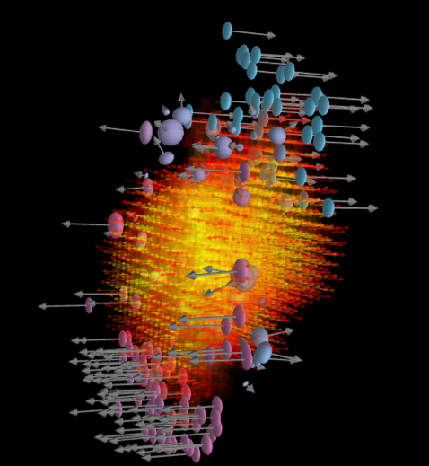



Slide 2

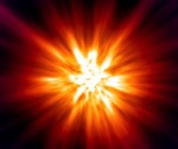



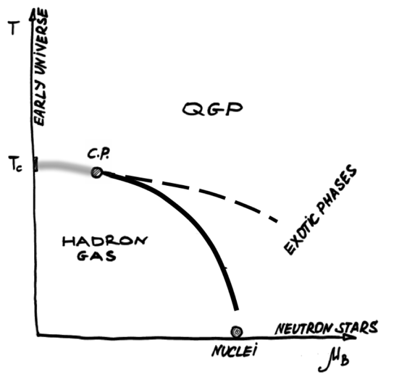

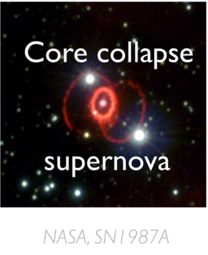
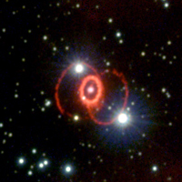
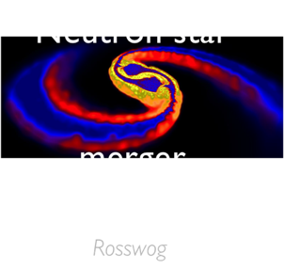
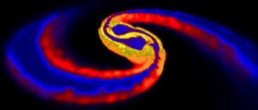
Early
Universe
Neutron star
merger
Core collapse
supernova
Rosswog
NASA, SN1987A

Slide 3









π, Κ, Λ, p, φ, Ξ, …

Slide 4


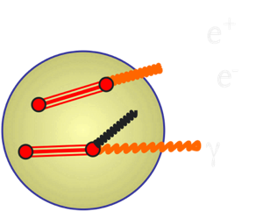

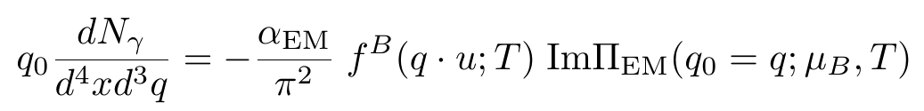


In heavy-ion collisions
Source strength: dependence on T, μ_{B}, μ_{p} , medium effects, …
System evolution: V(τ), T(τ), μ_{B}(τ), transverse expansion, …
Non-thermal sources: Drell-Yan, open-charm, hadron decays, …

Slide 5
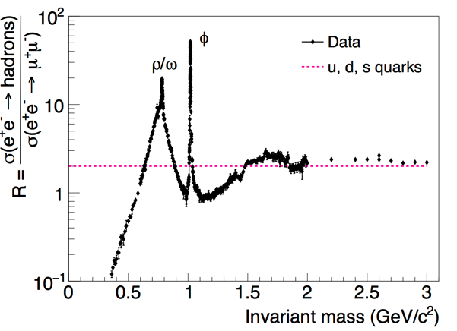

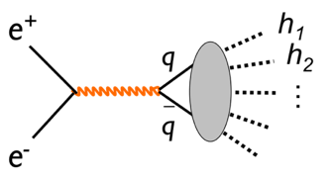
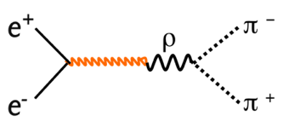
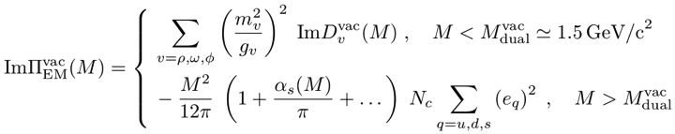




Vector Meson Dominance
(with ρ playing a dominant role)
pQCD continuum

Slide 6


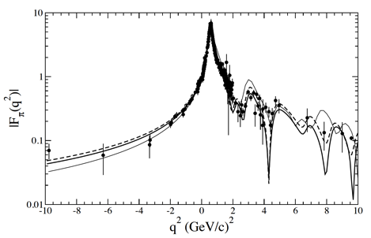


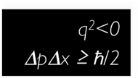
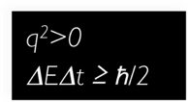

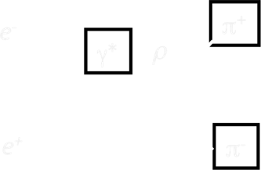



e⁻
π⁺
γ∗
ρ
J^{P} = 1⁻ for both γ* and Vector Meson
e⁺
π⁻
Strong coupling of γ* to Vector Meson
→ Vector Meson Dominance model
Observable: vector mesons (ρ, ω, φ)

Slide 7

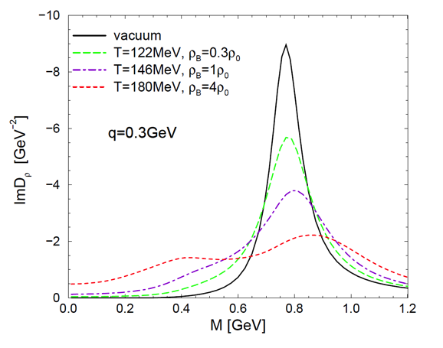


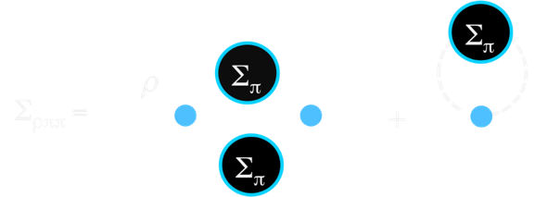


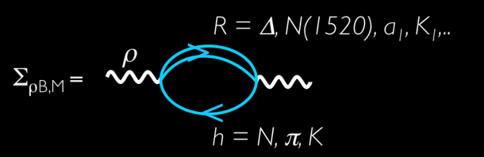


Slide 8
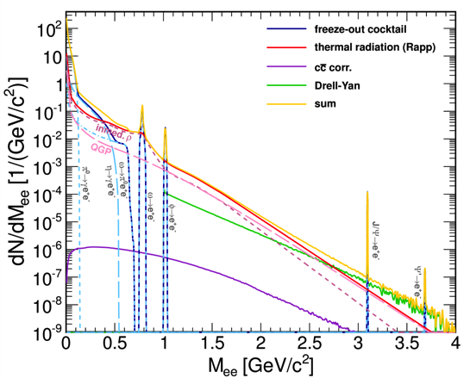
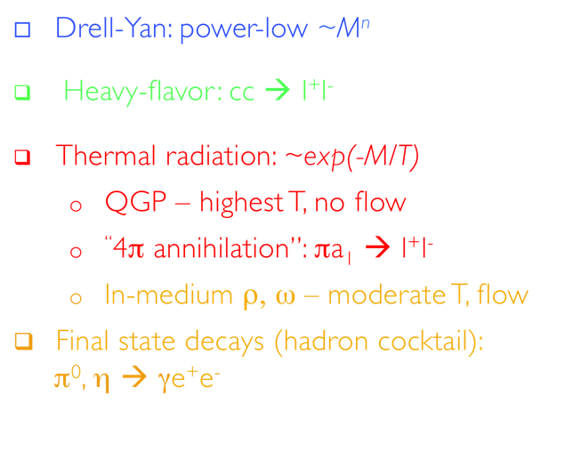



Slide 9
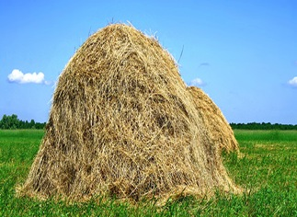
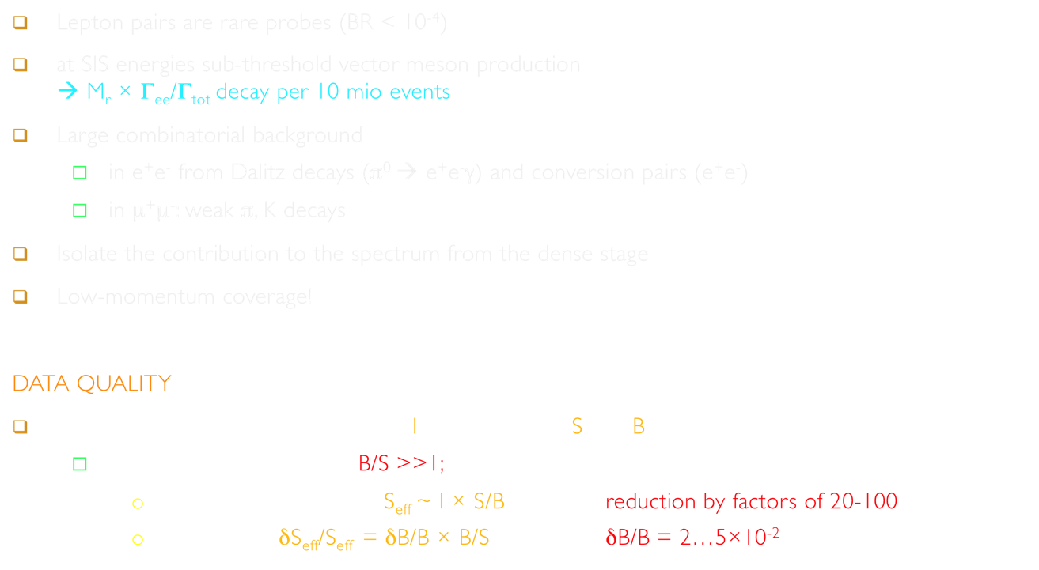

Lepton pairs are rare probes (BR < 10⁻⁴)
at SIS energies sub-threshold vector meson production
→ M_{r} × Γ_{ee}/Γ_{tot} decay per 10 mio events
Large combinatorial background
  in e⁺e⁻ from Dalitz decays (π⁰ → e⁺e⁻γ) and conversion pairs (e⁺e⁻)
  in μ⁺μ⁻: weak π, K decays
Isolate the contribution to the spectrum from the dense stage
Low-momentum coverage!
DATA QUALITY
The decisive parameters: Number of Interactions and Signal/Background
  Range of B/S: 20 - 100 → B/S >>1;
    Effective sample size: S_{eff} ~ I × S/B reduction by factors of 20-100
    Systematics: δS_{eff}/S_{eff} = δB/B × B/S δB/B = 2…5×10⁻²
Fotolia.de

Slide 10

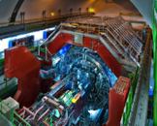

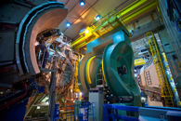

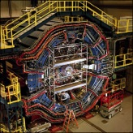

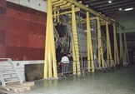
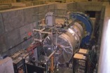


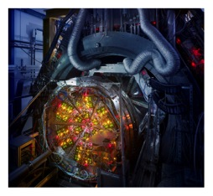



Slide 11

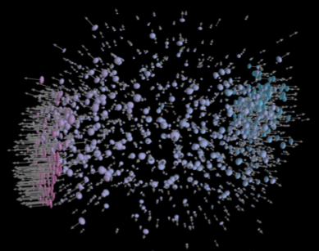


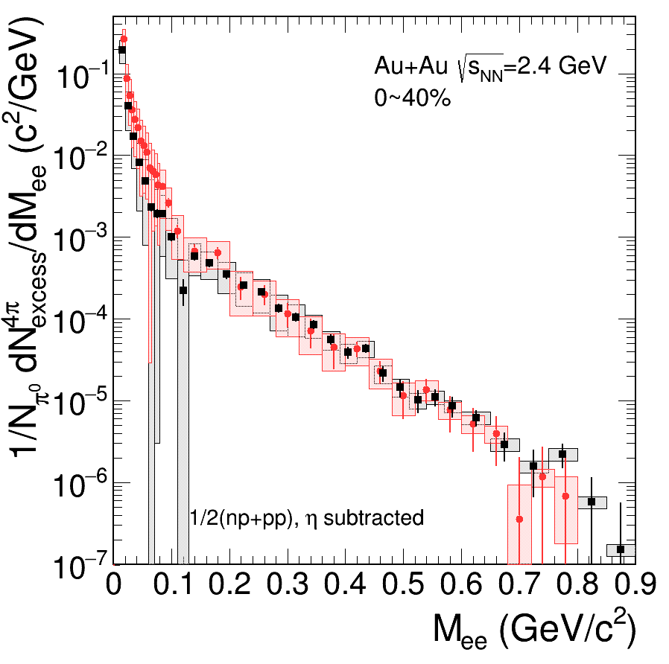
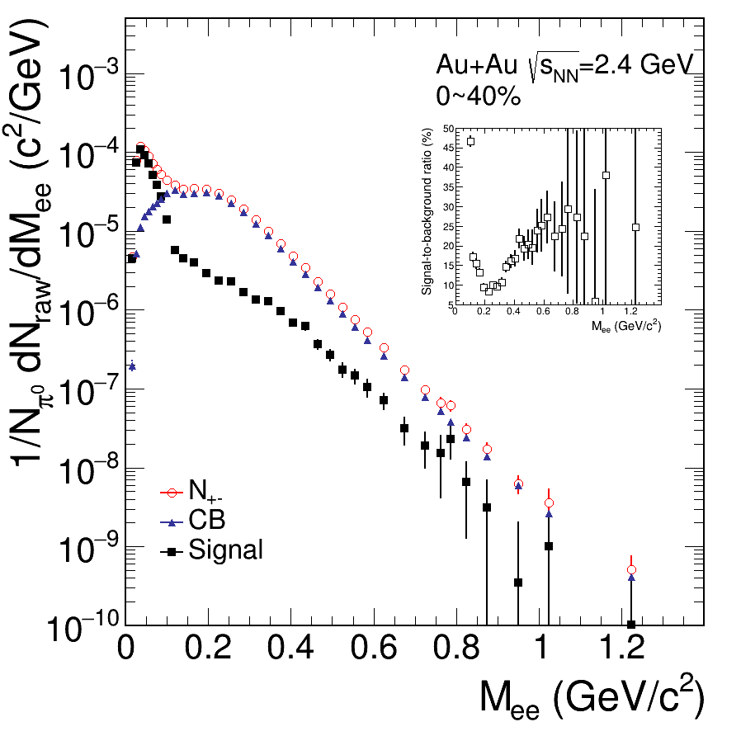
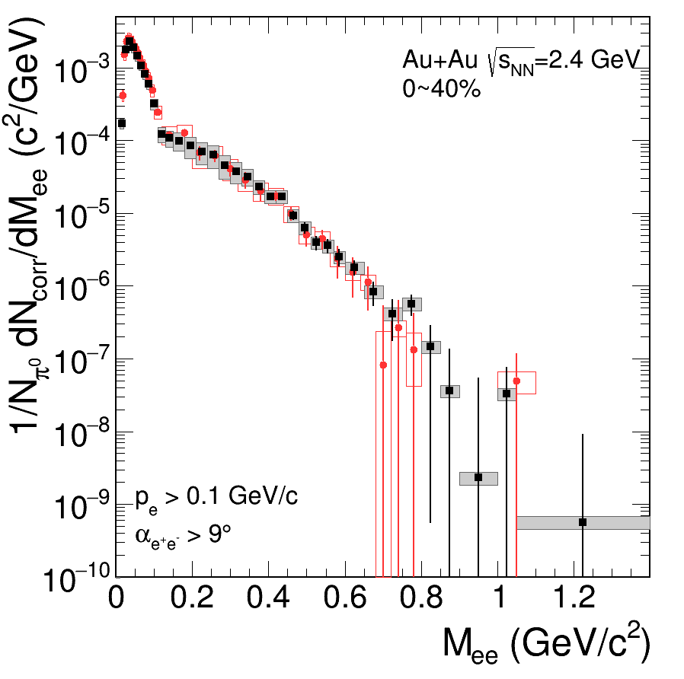
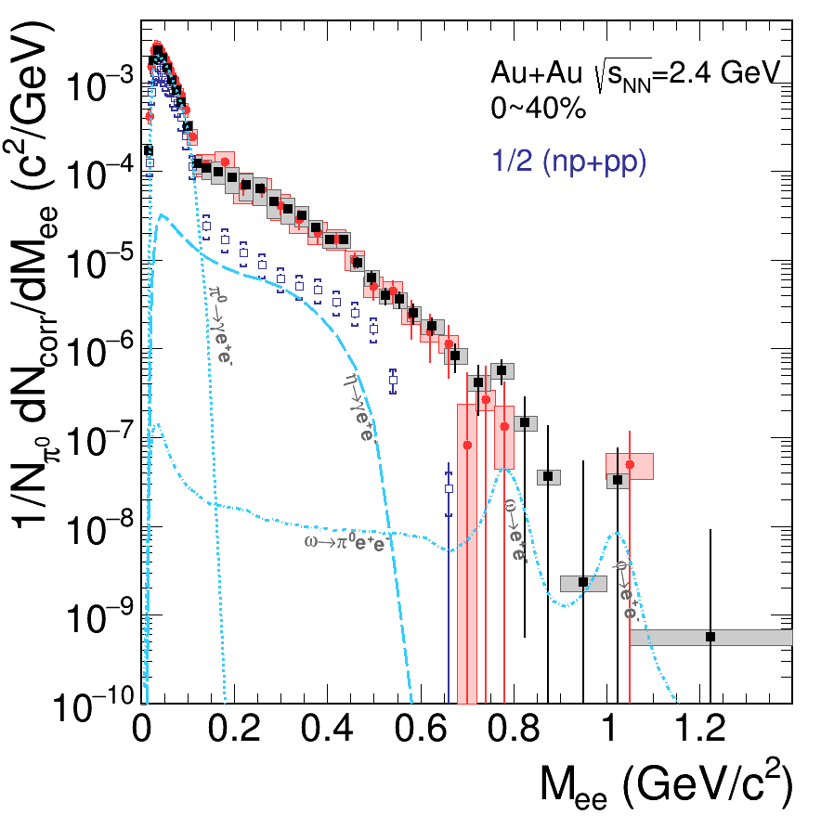

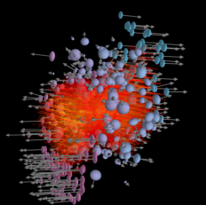





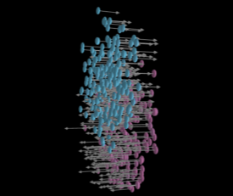

γ*
e⁺
Tracking
Electron identification
π⁰ and γ conversion rejection
Pairing
e⁻
Subtraction of background
(like-sign or event mixing)
Efficiency correction
γ*
→ →
e⁺
e⁻
γ*
Isolation of excess radiation
e⁺
→
→
e⁻
Acceptance correction

Slide 12
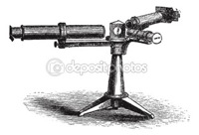

Slide 13

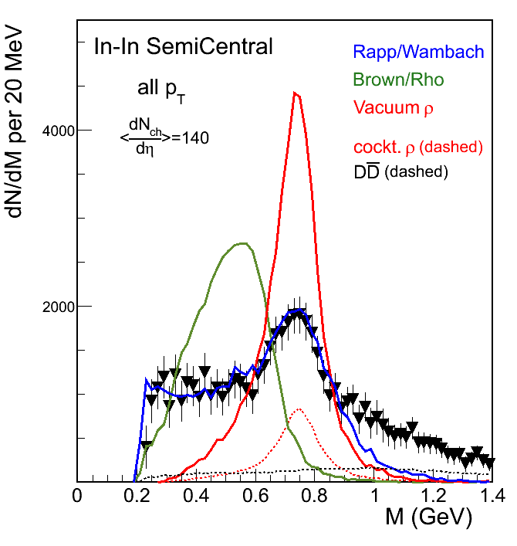




Slide 14
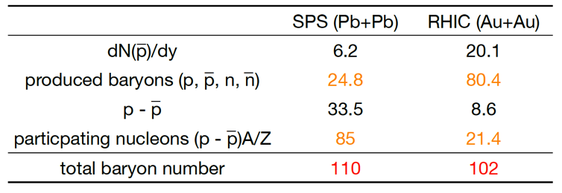
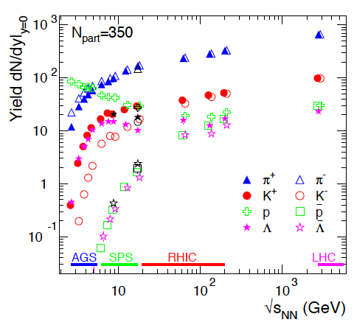
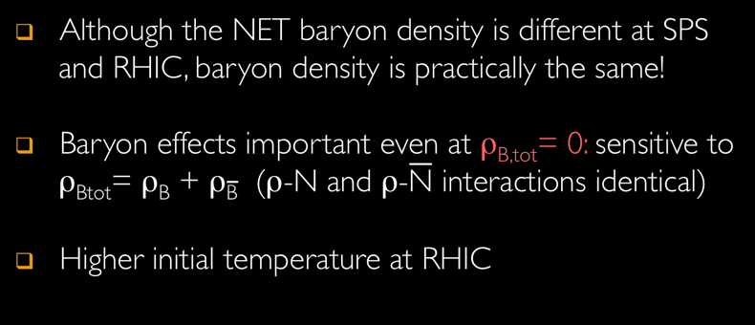


Slide 15
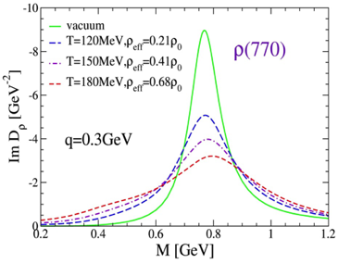
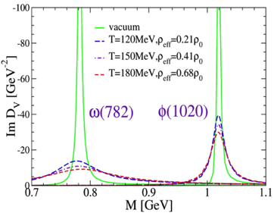
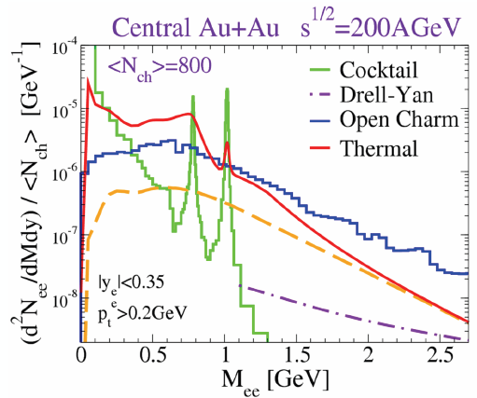


Open charm contribution
becomes significant

Slide 16


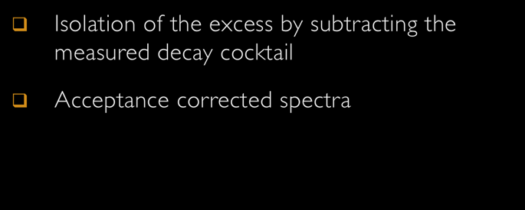


Slide 17

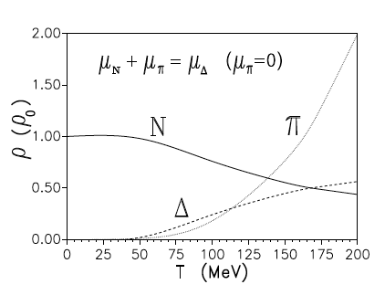
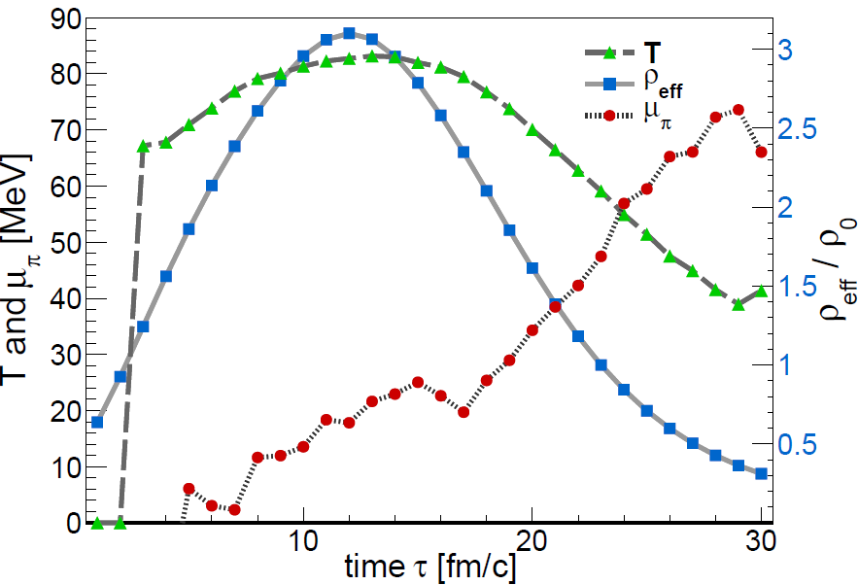




Long interpenetration times
Moderate temperatures: T < 90 MeV
Baryon-dominated system throughout the evolution (N_{π}/A_{part} ≈ 10%)
Comparatively long lifetime
of the dense ”fireball” (_{max} ≈ 3 ρ₀)

Slide 18
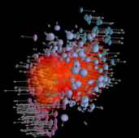
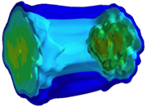








e⁺
e ⁻
Divide space-time evolution into 4-dimensional cells
21 x 21 x 21 space cells (1fm³), 30 time steps → ~ 280 k cells
Determine for each cell the bulk properties like T, μ_{B} , μ_{π},
collective velocity
Apply in-medium ρ & ω spectral functions to compute
EM emission rates
→ parameterization of RW in-medium spectral function
Sum up contributions of all cells

Slide 19






Robust understanding across QCD phase diagram

Slide 20


Slide 21







Phys. Rev. Lett. 100 (2008) 022302
Eur. Phys. J. C 59 (2009) 607
m_{T} spectra exponential for
m_{T}-M > 0.1 GeV; <0.1 GeV ??
Fit with 1/m_{T} dN/m_{T} ~ exp(-m_{T}/T_{eff})
Extract T_{eff} and create a Nu Xu plot
IMR
LMR

Slide 22




What can we learn from m_{T} spectra?
Radial Flow
Origin of dileptons

Slide 23






T - dependence of thermal distribution of “mother” hadrons/partons
m - dependent collective radial flow (v_{T}) of “mother” hadrons/partons
(p_{T} - dependence of spectral function; dispersion relation)
→ Handle on emission region,
i.e. nature of emitting source

Slide 24




Dominance of partons for M>1GeV/c²: support from theory:
  Hadronic sources alone (2π+4π+a1π) cannot produce a discontinuity
  Continuous rise of T_{eff} with mass

Slide 25





Slide 26


Slide 27









System size dependence of excess
“R-clock”
Preliminary
Rapid increase of relative yield reflect the number of ρ‘s / R’s regenerated in fireball

Slide 28





Slide 29






Slide 30






Slide 31





M is the only Lorenz-invariant thermometer of the field

Slide 32




Slide 33










Chemical freeze-out from measured particle yields analyzed with SHM
  Trajectories extracted from inner cube of cells with coarse-grained UrQMD
Time-window of dilepton emission → access to hot and dense stage of the heavy-ion collision
T_{max} = 85 MeV, ρ_{max} = 3 ρ₀
Excitation of the vacuum
(melting of condensate)
matches spectral medium effects!

Slide 34






What are the possible signatures in dilepton radiation?

Slide 35





Slide 36




Slide 37












Slide 38





Slide 39


“You may say I’m a dreamer…
but I’m not the only one”
 |  | 2016 | 2017 | 2018 | 2019 | 2020 | 2021 | 2022 | 2023 |  | 2024 |  | 2025
HADES | SIS18 |  |  | 2.5 GeV + pA, pA
STAR BES | RHIC |  |  |  | 8 – 20 GeV |  |  | 200 GeV
MPD | NICA |  |  |  | 4 – 11 GeV
CBM | SIS100 |  |  |  |  |  |  |  |  |  | 2 – 5 GeV
ALICE* | LHC | 5.5 TeV |  |  |  |  | 5.5 TeV
 | J-PARC** |  |  | pA 8 GeV |  |  |  |  |  |  |  | 2 – 5 GeV
NA60+ | SPS |  | LOI |  |  |  |  |  | 6 – 17 GeV
PHENIX | RHIC | 200 GeV
STAR | RHIC | 200 GeV | pp(500)
sPHENIX |  |  |  |  |  |  |  | 200 GeV
BM@N | Nuclotron |  | 2 – 3 GeV
* - ITS, 50kHz, lower field
** - Proposal to J-PARC → If approved, construction of HI injector and detectors in 10 years ?

Slide 40








Slide 41





Slide 42







Slide 43




Slide 44


Résumé and prospects
Thank you
for your attention!

