Slide 1
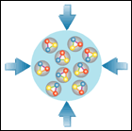
The Status of the
CBM Experiment
Walter F.J. Müller, FAIR, Darmstadt
CBM Magnet CDR
22-24 May 2017

Slide 2
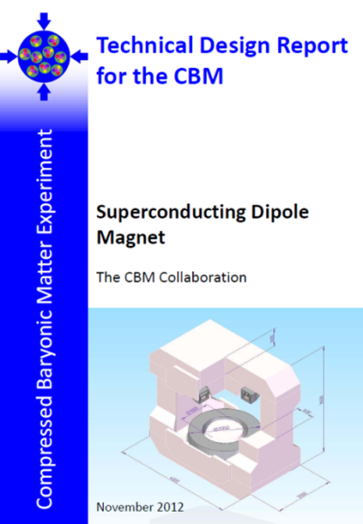
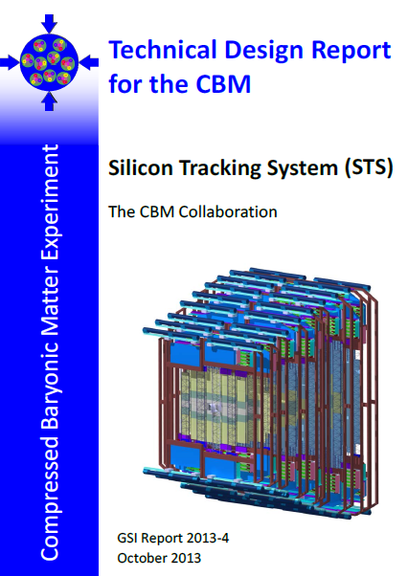
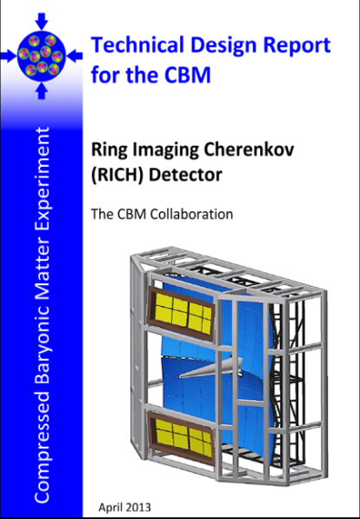
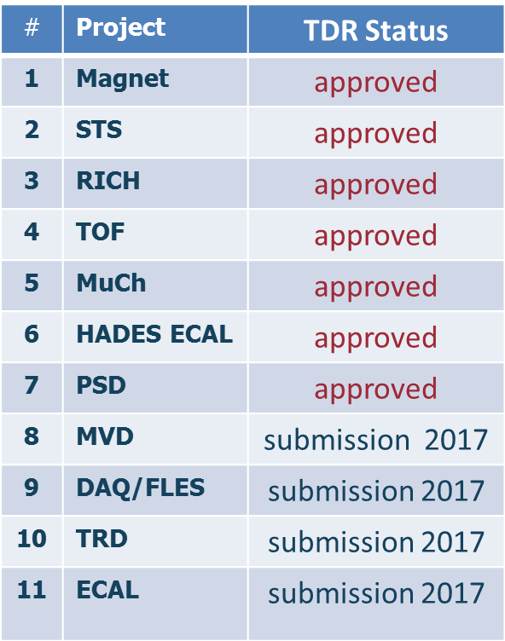
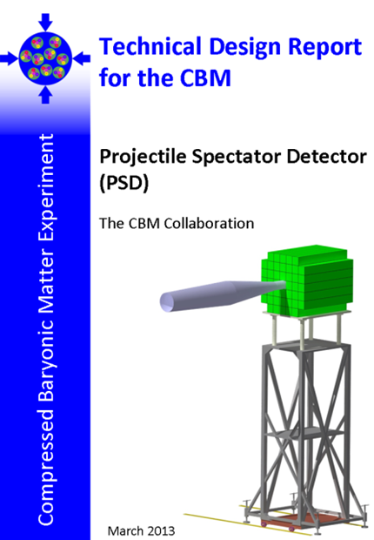
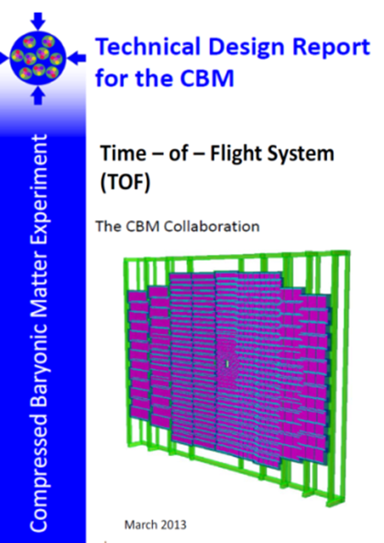
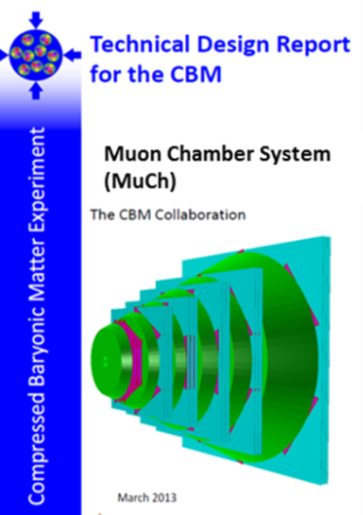
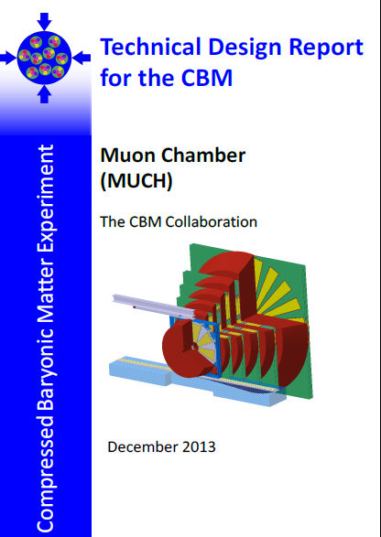
CBM Technical Design Report Status

Slide 3
FAIR Integrated Schedule
The integrated FAIR schedule
  covers civil construction, accelerator and experiments
  is based on a conservative planning (with buffers)
  for GSI activities also resource loaded
  serves as baseline
  key dates
    most building shells completed 2021
    all buildings fully commissioned 2022 (incl. services)
    FAIR operational 2025
Installation vs. Commissioning
  Installation window after building shell finished
  → only very basic services (crane ect)
  Commissioning window after building fully commissioned
  → all HVAC services available (Cryo comes later!)

Slide 4
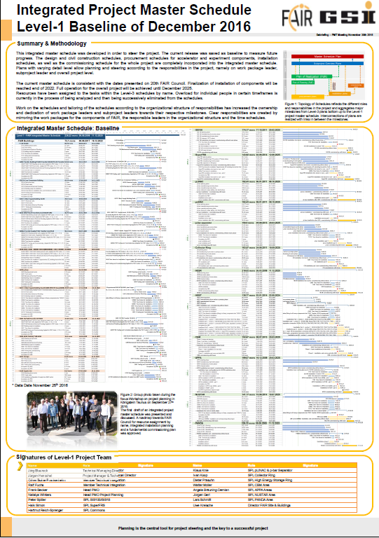
FAIR Schedule
Major effort
Presented to
FAIR council on
December 6th, 2016
Very positive reception

Slide 5
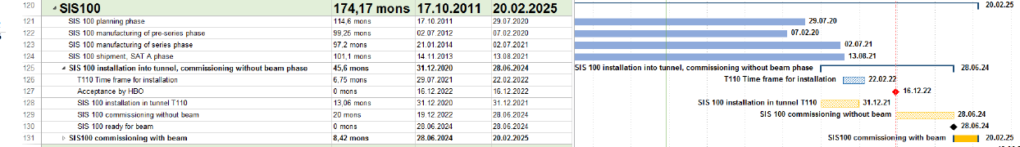
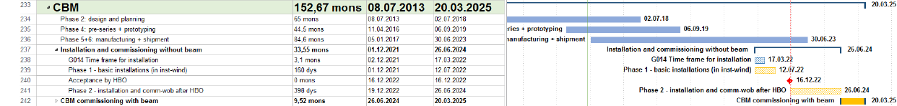
FAIR Schedule: SIS100 and CBM
The CBM bottom line:
  Dec ‘21 to Jul ‘22 1st installation window
  Dec ‘22 Building acceptance
  Dec ‘22 to Jun ‘24 Installation & commissioning w/o beam
  Mar ’23 Cryo: DB2 cold; ready for cool down CBM
  Jun ‘24 to Mar ‘25 Commissioning beam from SIS100

Slide 6
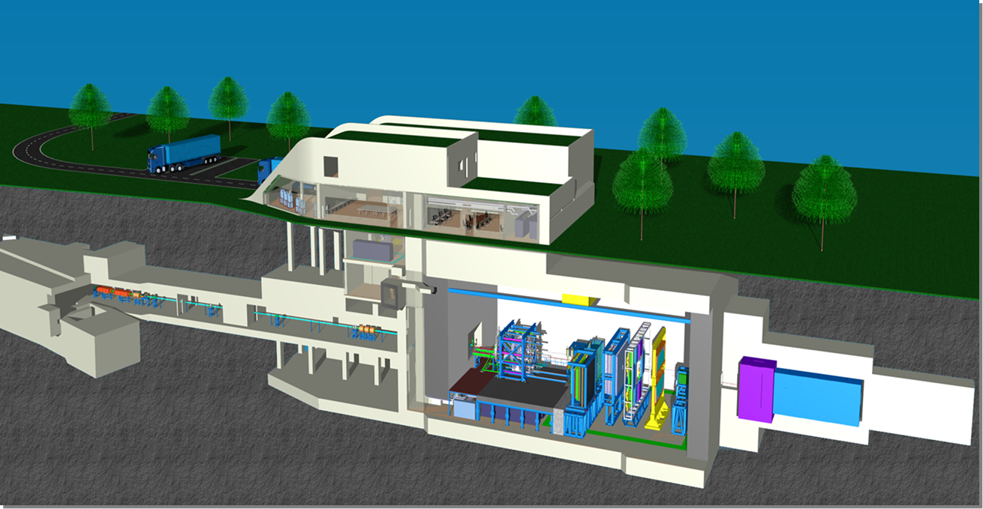
G014 – Home for CBM and HADES

Slide 7
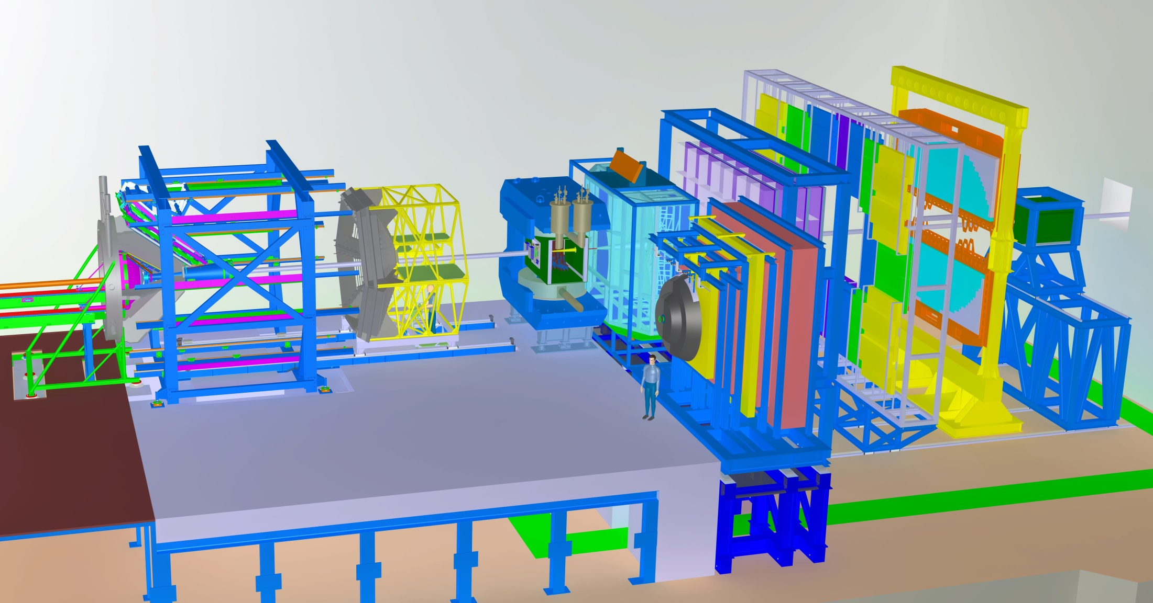
Full HADES+CBM Setup in CBM Cave
Ring
Imaging
Cherenkov
Transition
Radiation
Detector
Time of
Flight
Electromagnetic
Calorimeter
Dipol
Magnet
Micro
Vertex
Detector
Silicon
Tracking
System
Projectile
Spectator
Detector
Muon
Detector
HADES
p+p, p+A
A+A (low mult.)
CBM
p+A, A+A

Slide 8
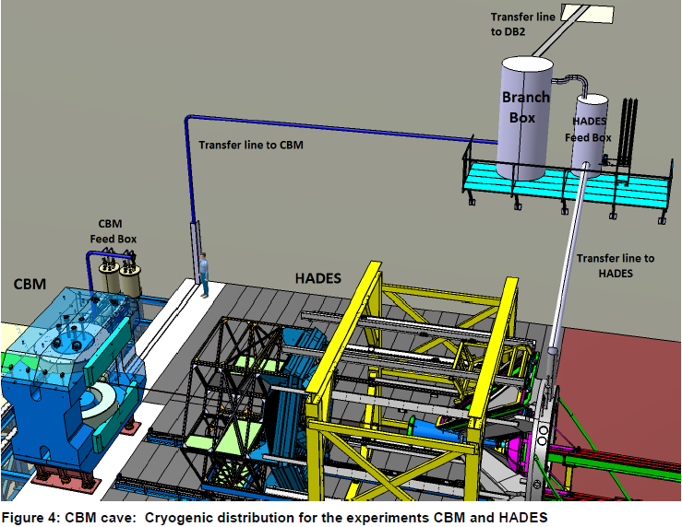
CBM Cave – Cryogenic Distribution

Slide 9
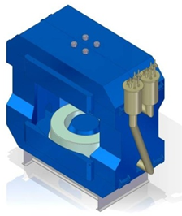
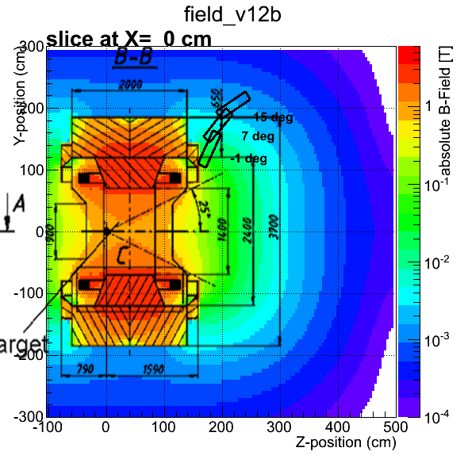
Superconducting Dipole Magnet
Large-acceptance superconducting dipole magnet.
The pole gap is 144 cm, the bending power 1 Tm.
Participating institutes:
JINR Dubna, BINP Novosibirsk, GSI Darmstadt

Slide 10
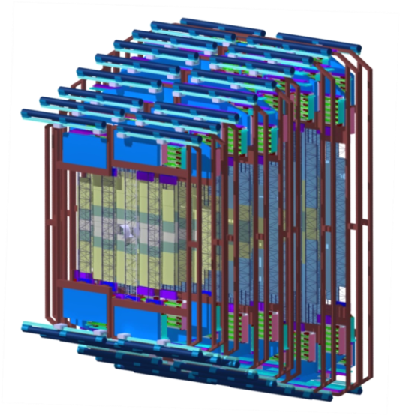
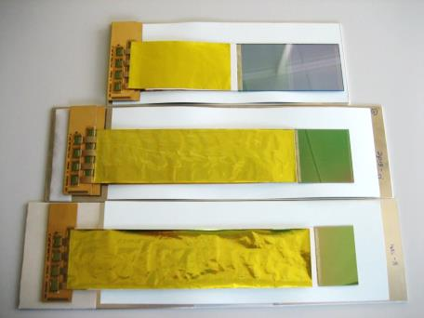
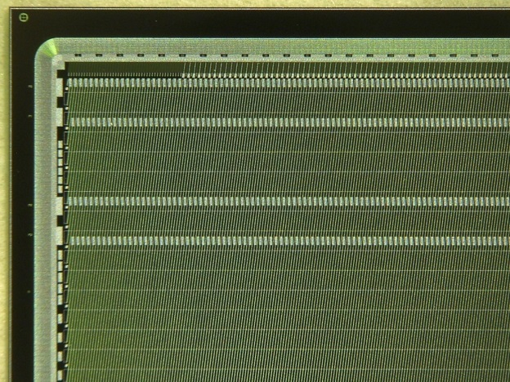
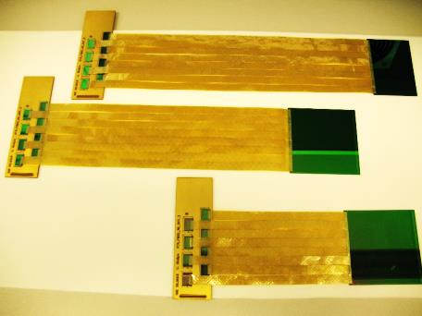
Silicon Tracking System
Silicon microstrip sensors
CiS (Germany), Hamamatsu (Japan)
The STS consists of about 1000 double-sided silicon micro-strip sensors arranged in 8 detector arrays located inside the dipole magnet. The detector provides track reconstruction and momentum determination for up to 1000 particles per event. The detector is operated at about -10°C, heat dissipation of the front-end electronics 40 kW, bi-phase CO2 cooling system
Participating institutes: GSI, Darmstadt, JINR Dubna, KIT, INR Kiev,
AGH and UJ Krakow, Univ. Tübingen, Warsaw UT

Slide 11
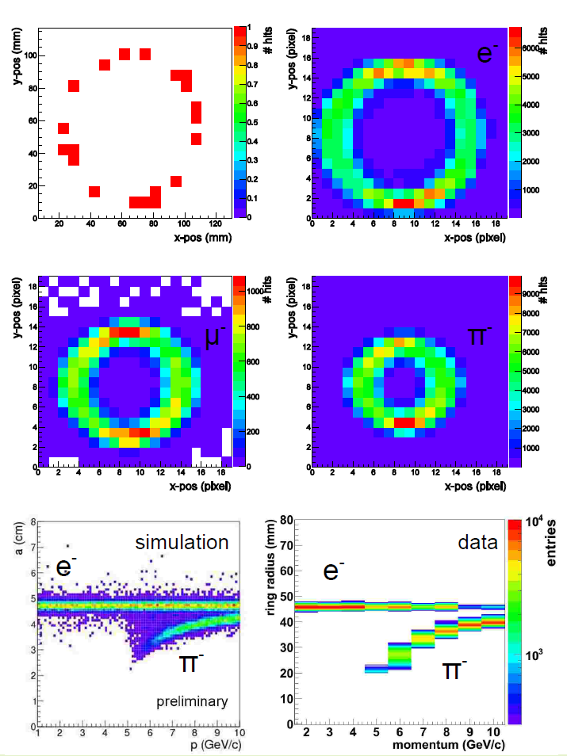
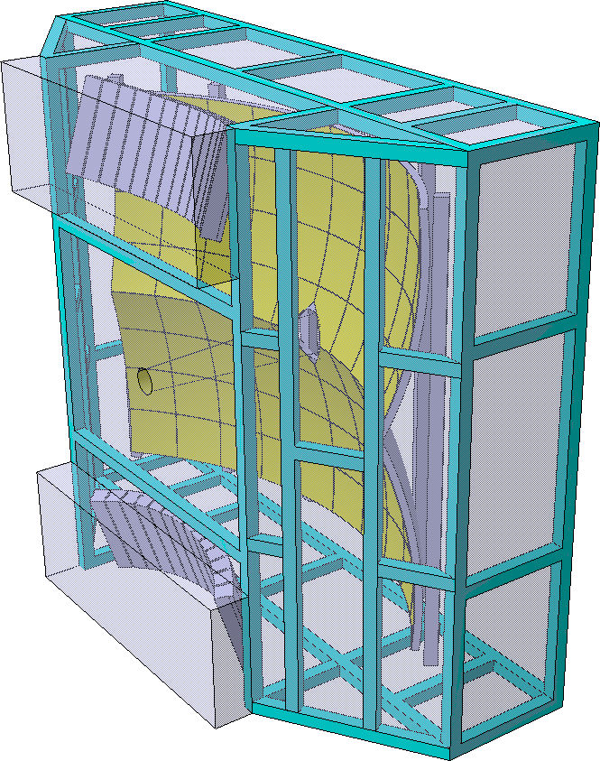
Ring-imaging Cherenkov (RICH) Detector
The RICH is used for the identification of electrons with momenta below 8 GeV/c (pion suppression factor of > 500).
Participating institutes: Gießen, Univ., Wuppertal, PNPI Gatchina

Slide 12
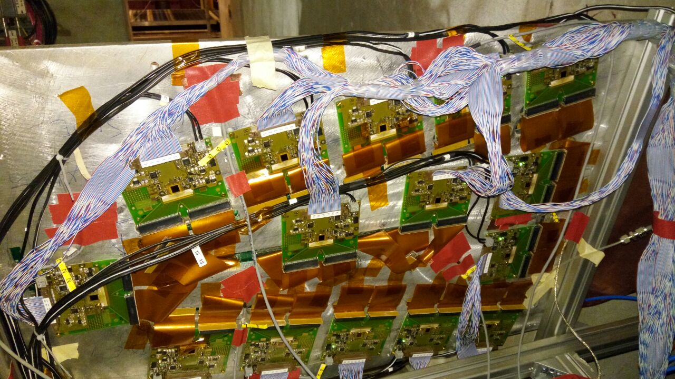
Muon Chamber (MuCh) System
Full size GEM detectors tested with free-streaming read-out electronics at the CERN-SPS Nov.-Dec. 2016
The MUCH consists of a combination of 15 detector stations sandwiched between one carbon and 4 iron absorber layers for hadron suppression. The MUCH provides the identification of muons with momenta above 1.5 GeV/c.
  Tracking station 1+2: Two Gas-Electron-Multiplier (GEM) detector triplets
  Tracking station 3+4: two low-resistivity trigger RPC triplets
  Tracking station 5: four Transition Radiator Detectors (used only as trackers)
Participating institutes: VECC Kolkata + 12 Indian Inst., PNPI Gatchina

Slide 13
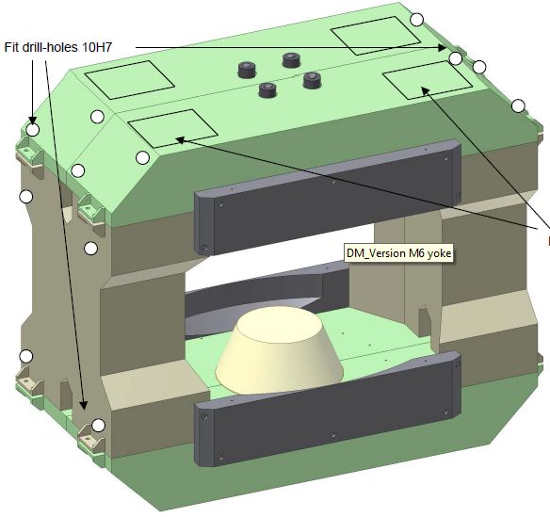
CBM Geometry
STS must fit in Magnet
  height: 1440 mm
  width: 3000 mm
  support rails !!
RICH
  sensitive to stray field
  → field clamps
MUCH
  very close to yoke
  → field clamps must
  be removed

Slide 14
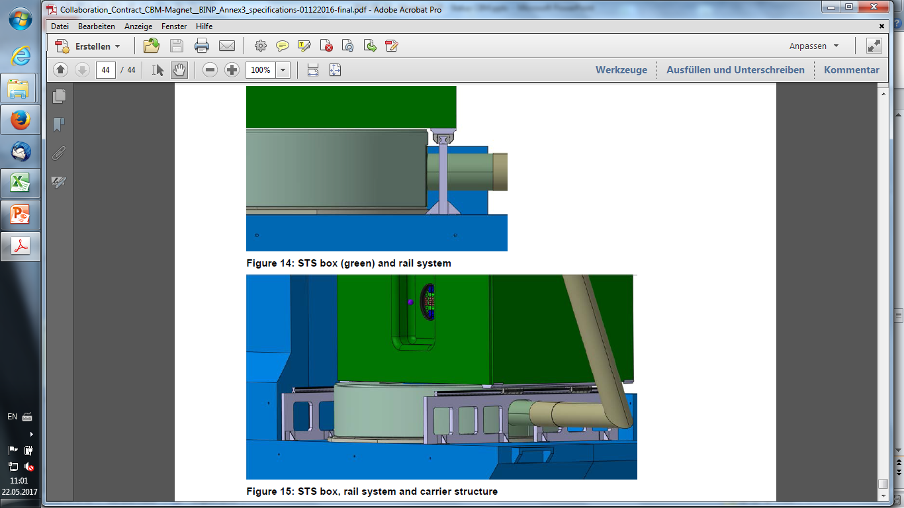
CBM Magnet – Geo to STS I

Slide 15
CBM Magnet – Geo to STS II

Slide 16



The End
Thanks for
your attention

Slide 17
Backup
Slides

Slide 18
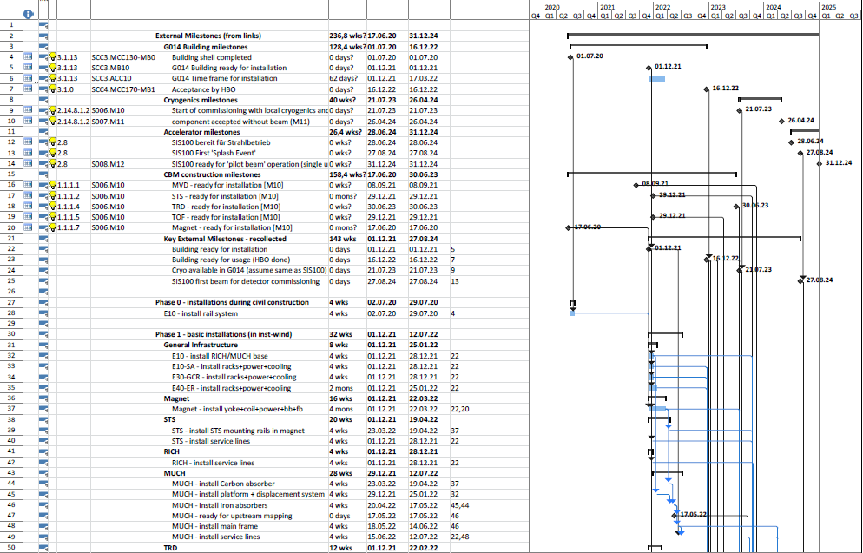
CBM: Installation Plan I

Slide 19
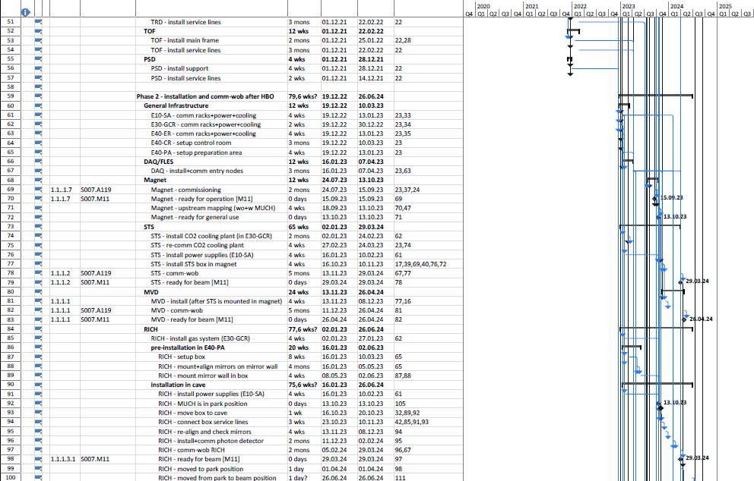
CBM: Installation Plan II

Slide 20
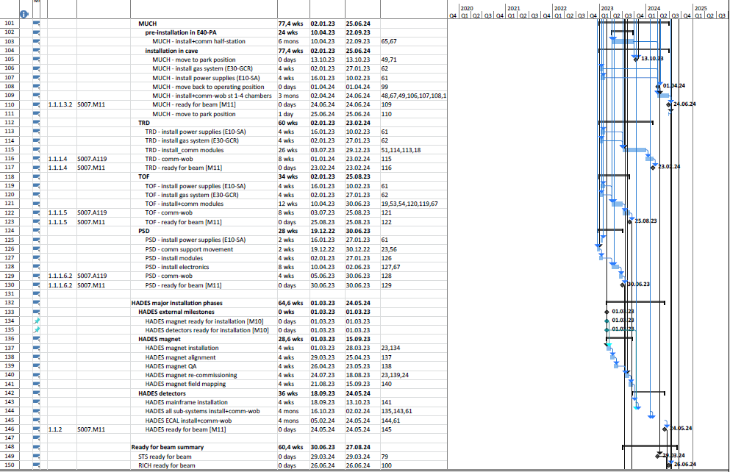
CBM: Installation Plan III

Slide 21
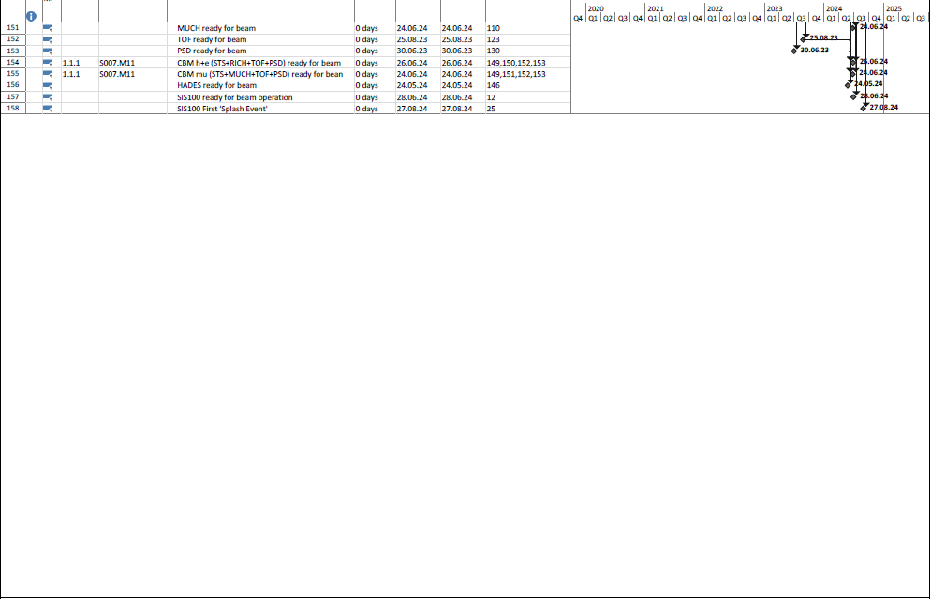
CBM: Installation Plan IV

Slide 22
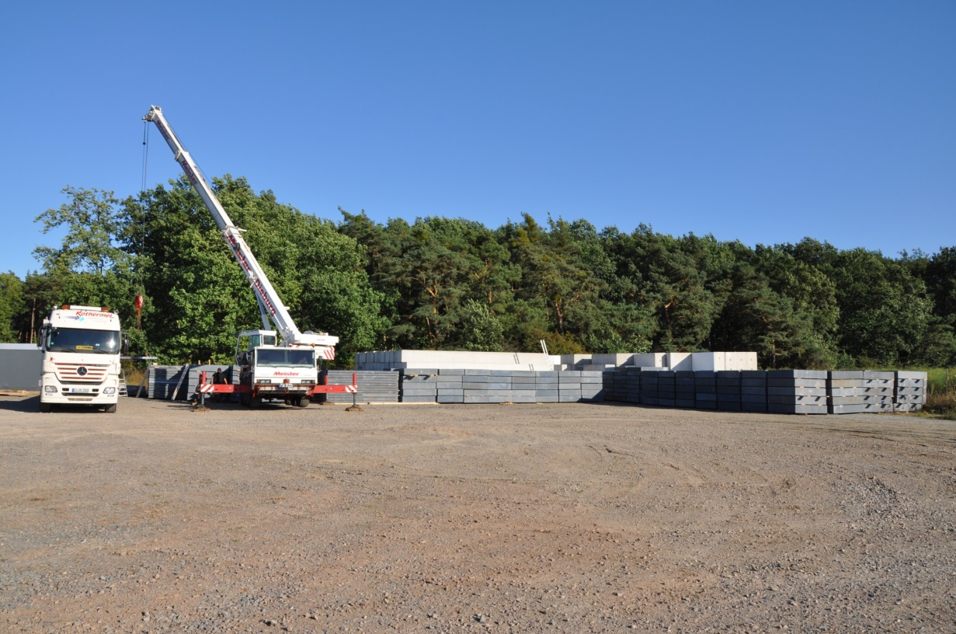
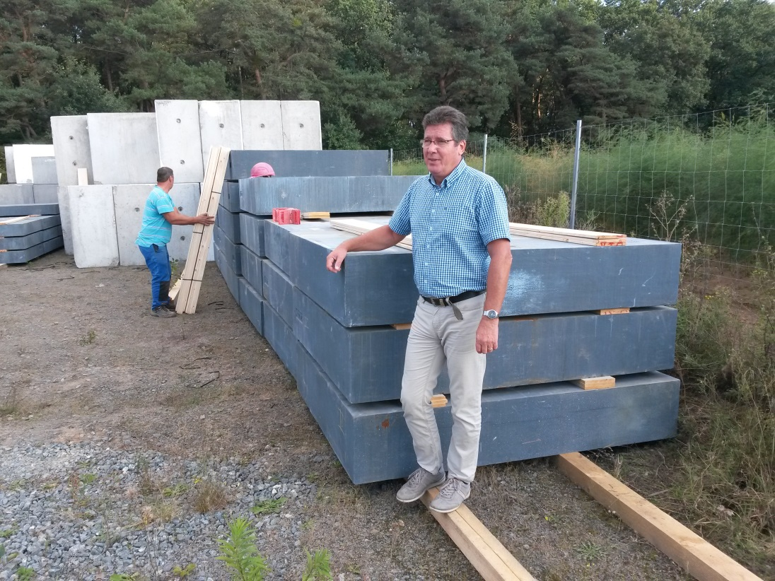
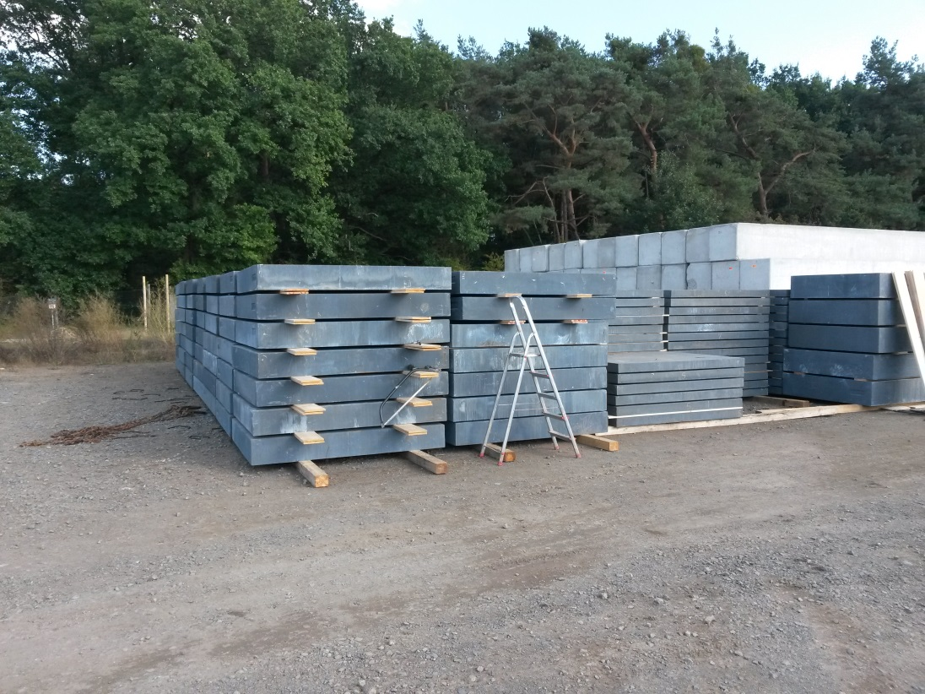
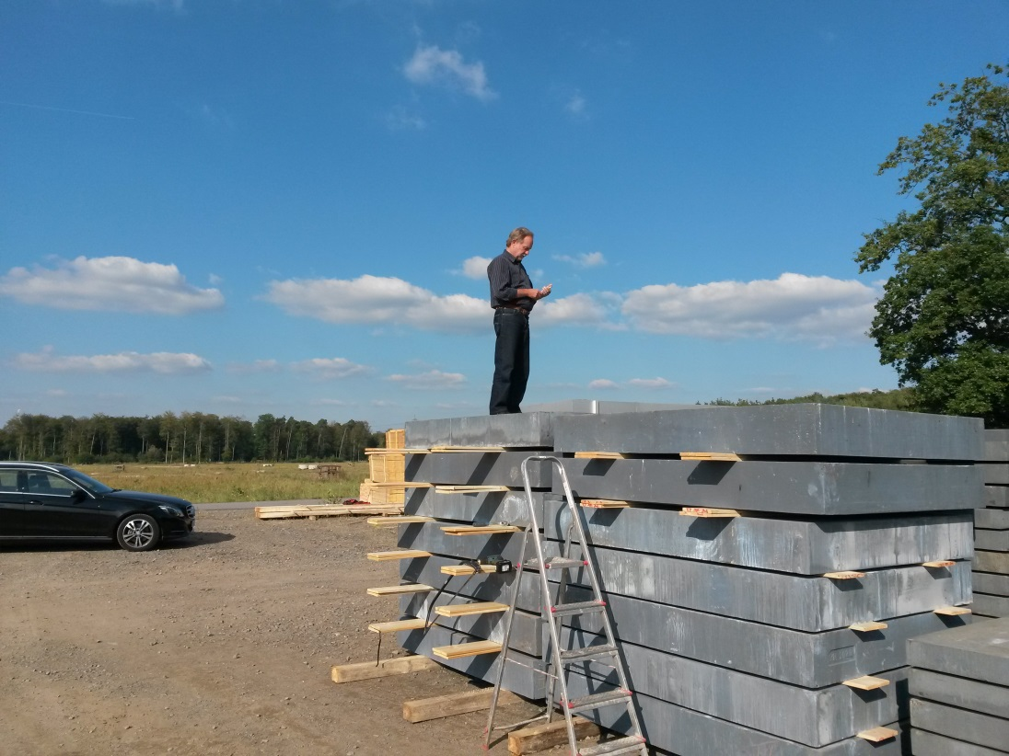
Little Heavy Detail: Beam Dump Iron

