Slide 1
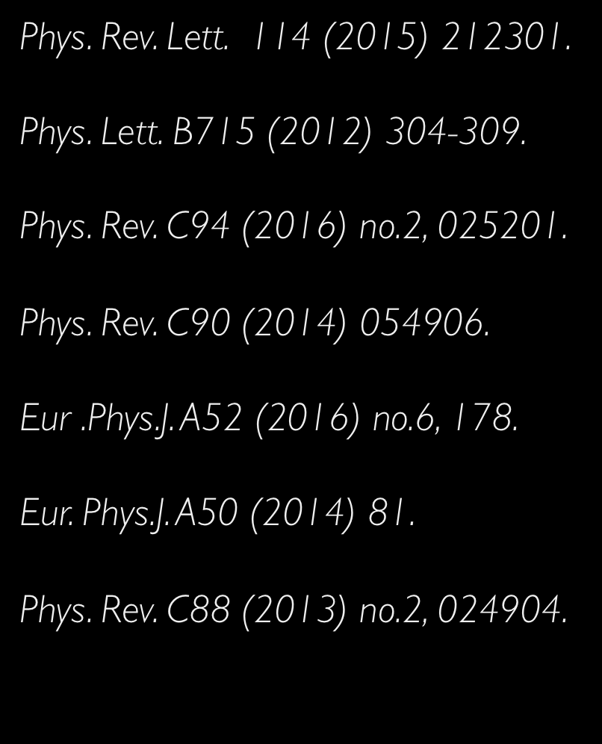
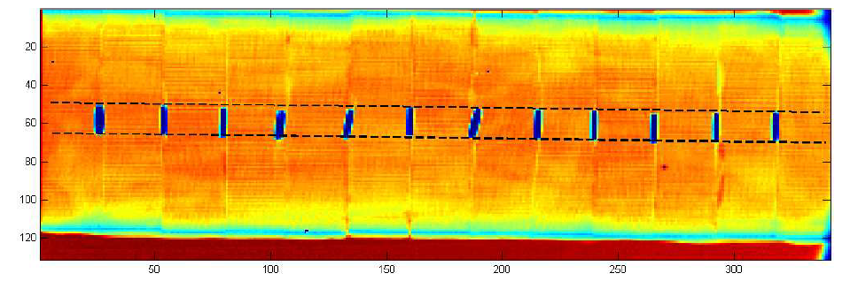



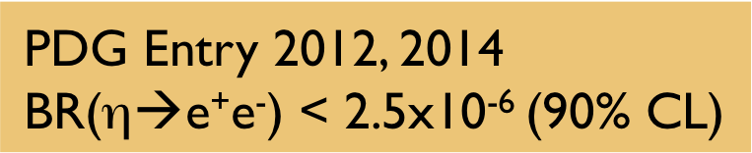
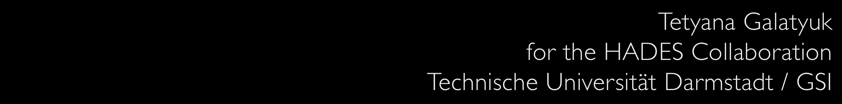
HADES p+Nb physics case
Ag

Slide 2

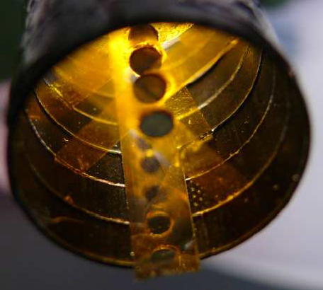
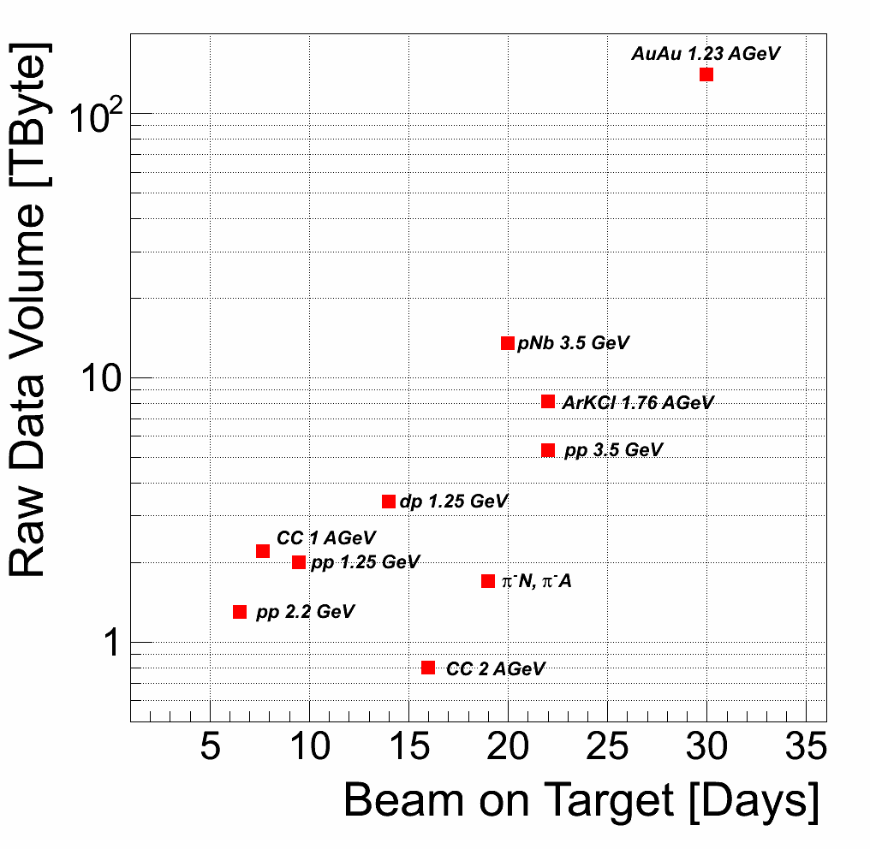
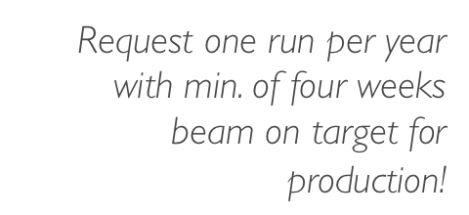
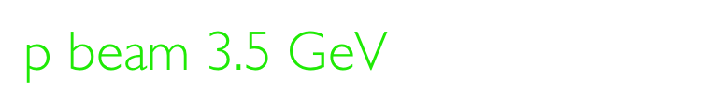


Slide 3

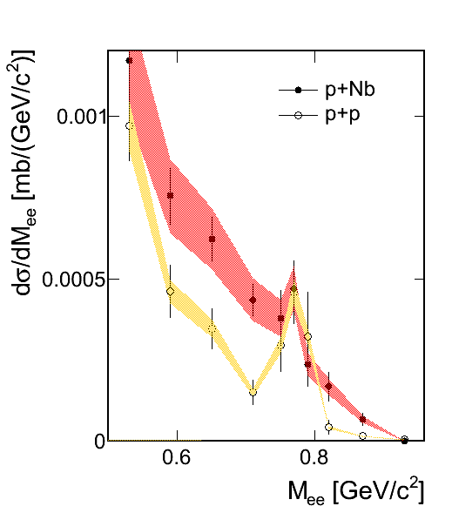

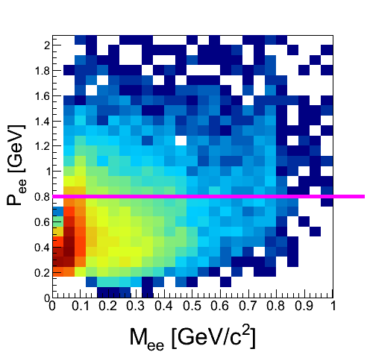
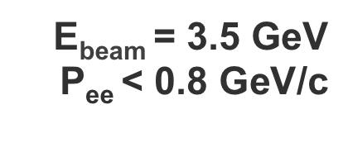


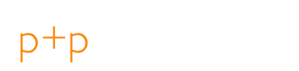
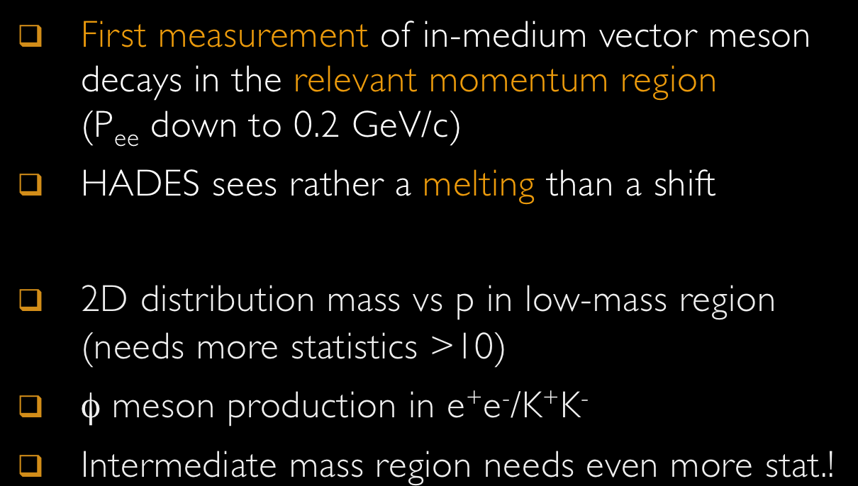

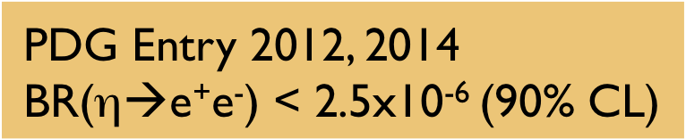
Notes:
KEK-E325 has published data for ρ− and ω−meson production:
Contradicting to CLAS and HADES
HADES: sees rather a melting than a shift
CLAS: high relative momentum to the medium

Slide 4
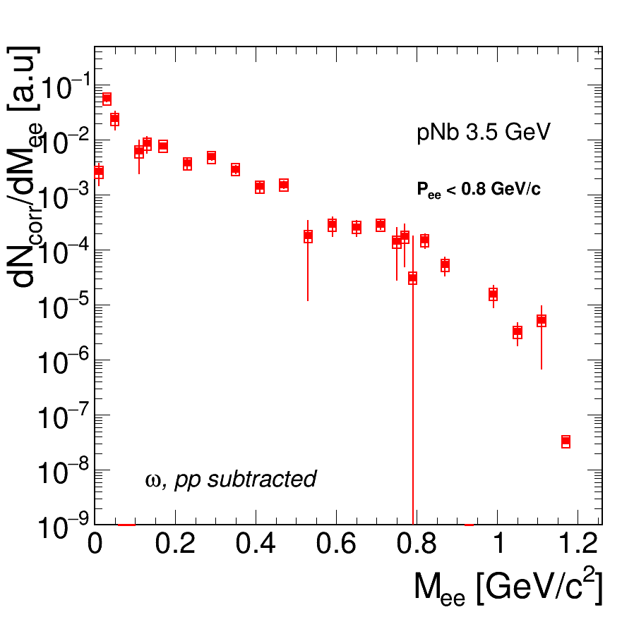


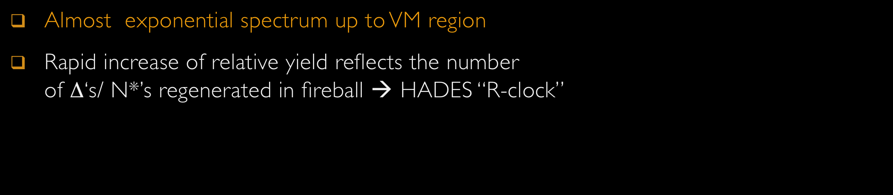

Slide 5


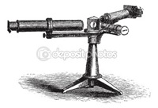

Slide 6




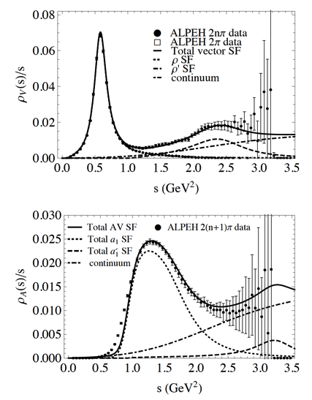
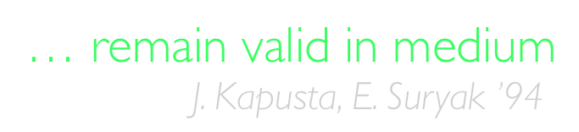

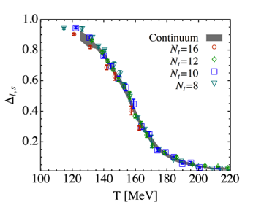
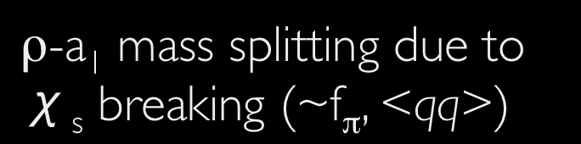
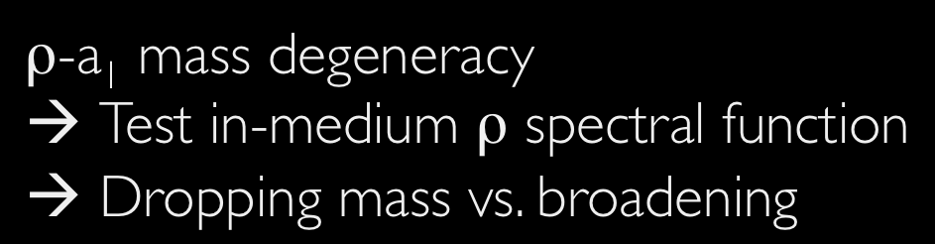

Slide 7

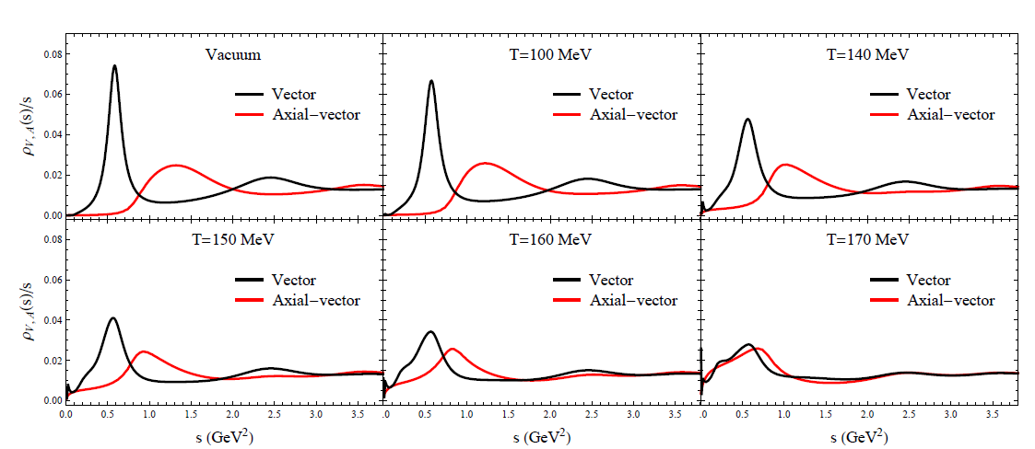


Slide 8
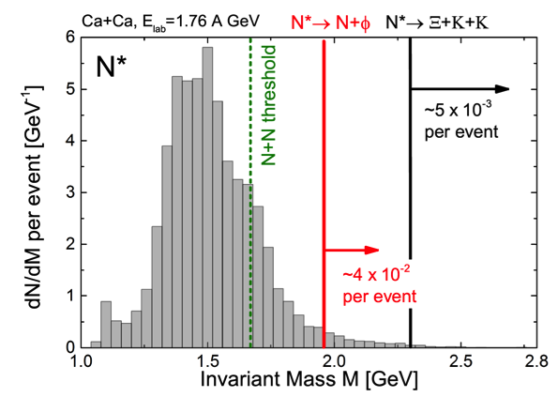








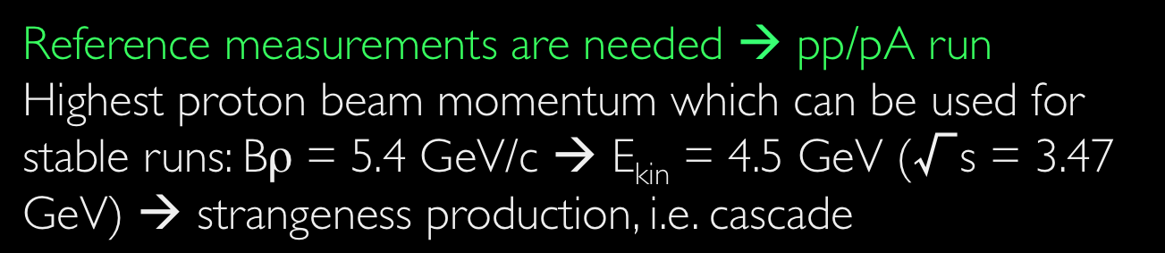
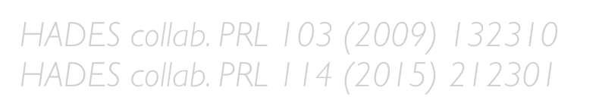
J. Steinheimer et al., J.Phys. G43 (2016) no.1, 015104
Multi-strange baryons (Ξ, Ω) are expected to be a sensitive probe for compressed baryonic matter
HADES observes unexpectedly large production cross sections in Ar+KCl and p+Nb collisions
UrQMD microscopic transport models →
dominant role of high mass baryonic resonances?
Reference measurements are needed → pp/pA run
Highest proton beam momentum which can be used for stable runs: Bρ = 5.4 GeV/c → E_{kin} = 4.5 GeV (√s = 3.47 GeV) → strangeness production, i.e. cascade

Slide 9
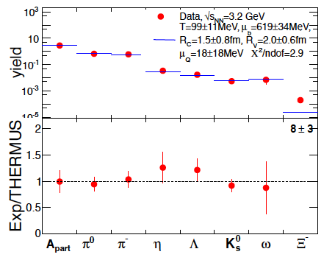
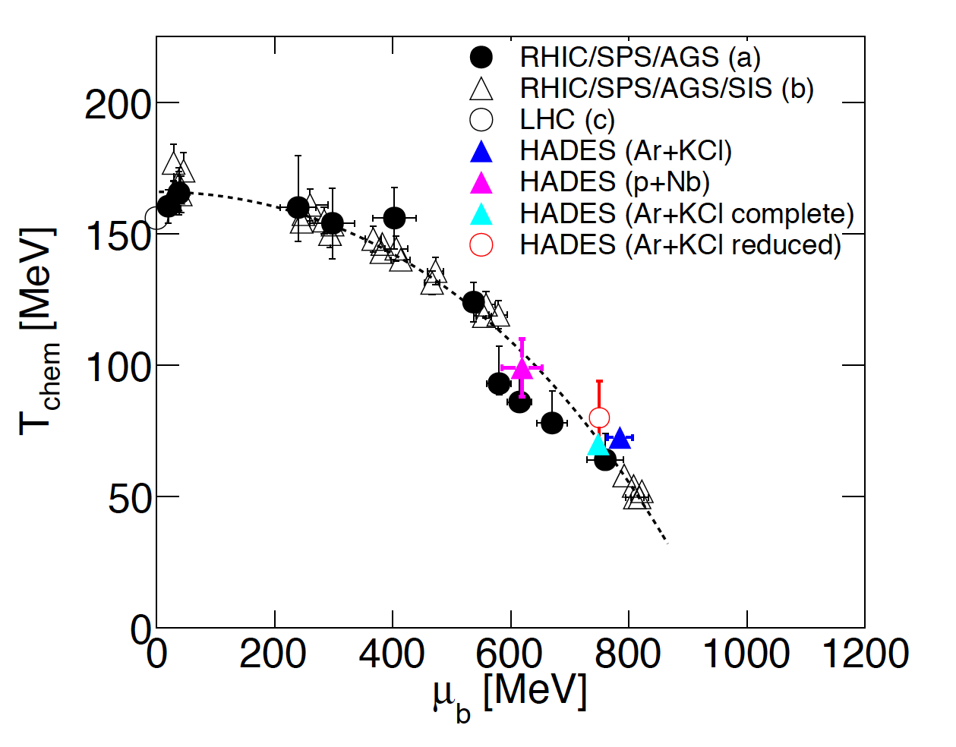




Grand canonical ensemble
(T, μ_{B}, V and sometimes γ_{s})
Strangeness canonically suppressed at low temperatures → needs additional parameter: R_{c} < R_{V}
Hadron abundances described by T, μ_{B,} R_{V}, R_{c}
Surprises:
  Ξ⁻ (s = -2) yield “enhanced”
  φ meson (hidden strangeness) not suppressed
  Needs further studies, i.e. include K^{+/-} and φ

Slide 10

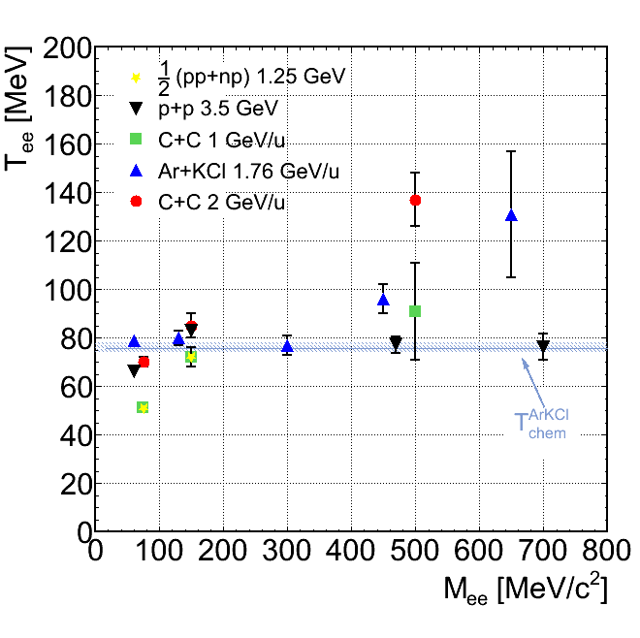
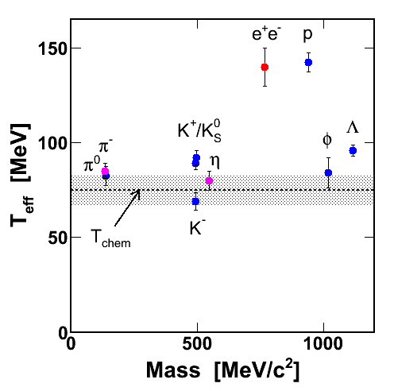



Slide 11

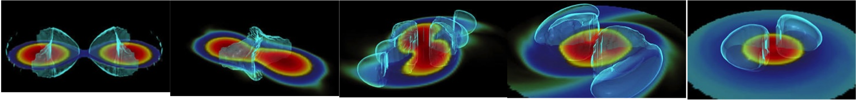

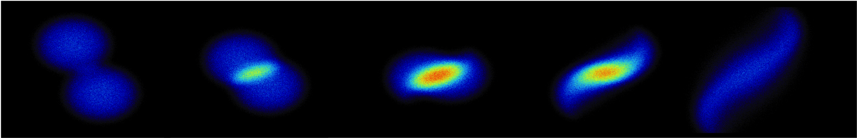



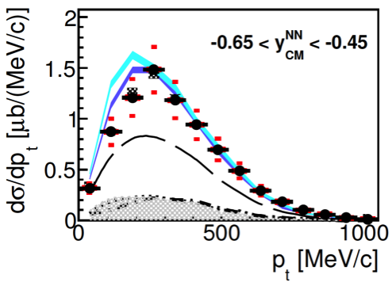

Slide 12
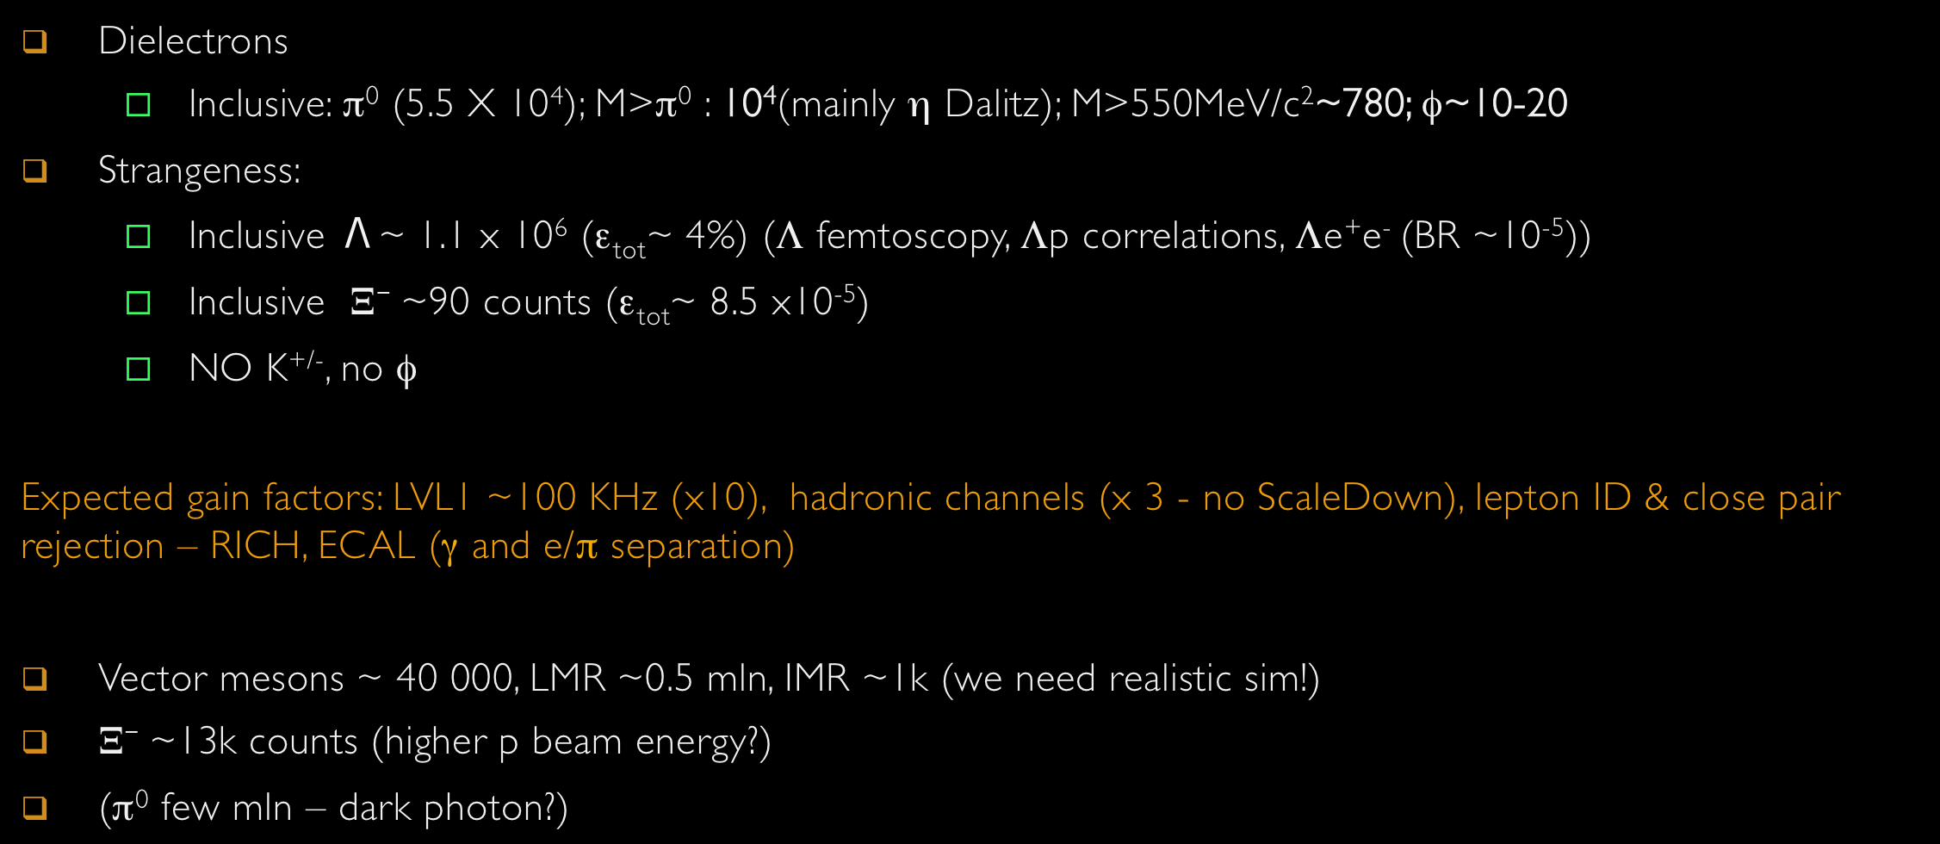
I_{beam} | Hours of data taking | I_{beam} (measured) | Trigger | Number of LVL1 events
~2×10⁶ p/sec | 546 | Total N_{beam}=3.9×10¹² p/sec 2.2% target | LVL1: M3 10kHz Scale down = 3 | 3.2×10⁹

Slide 13
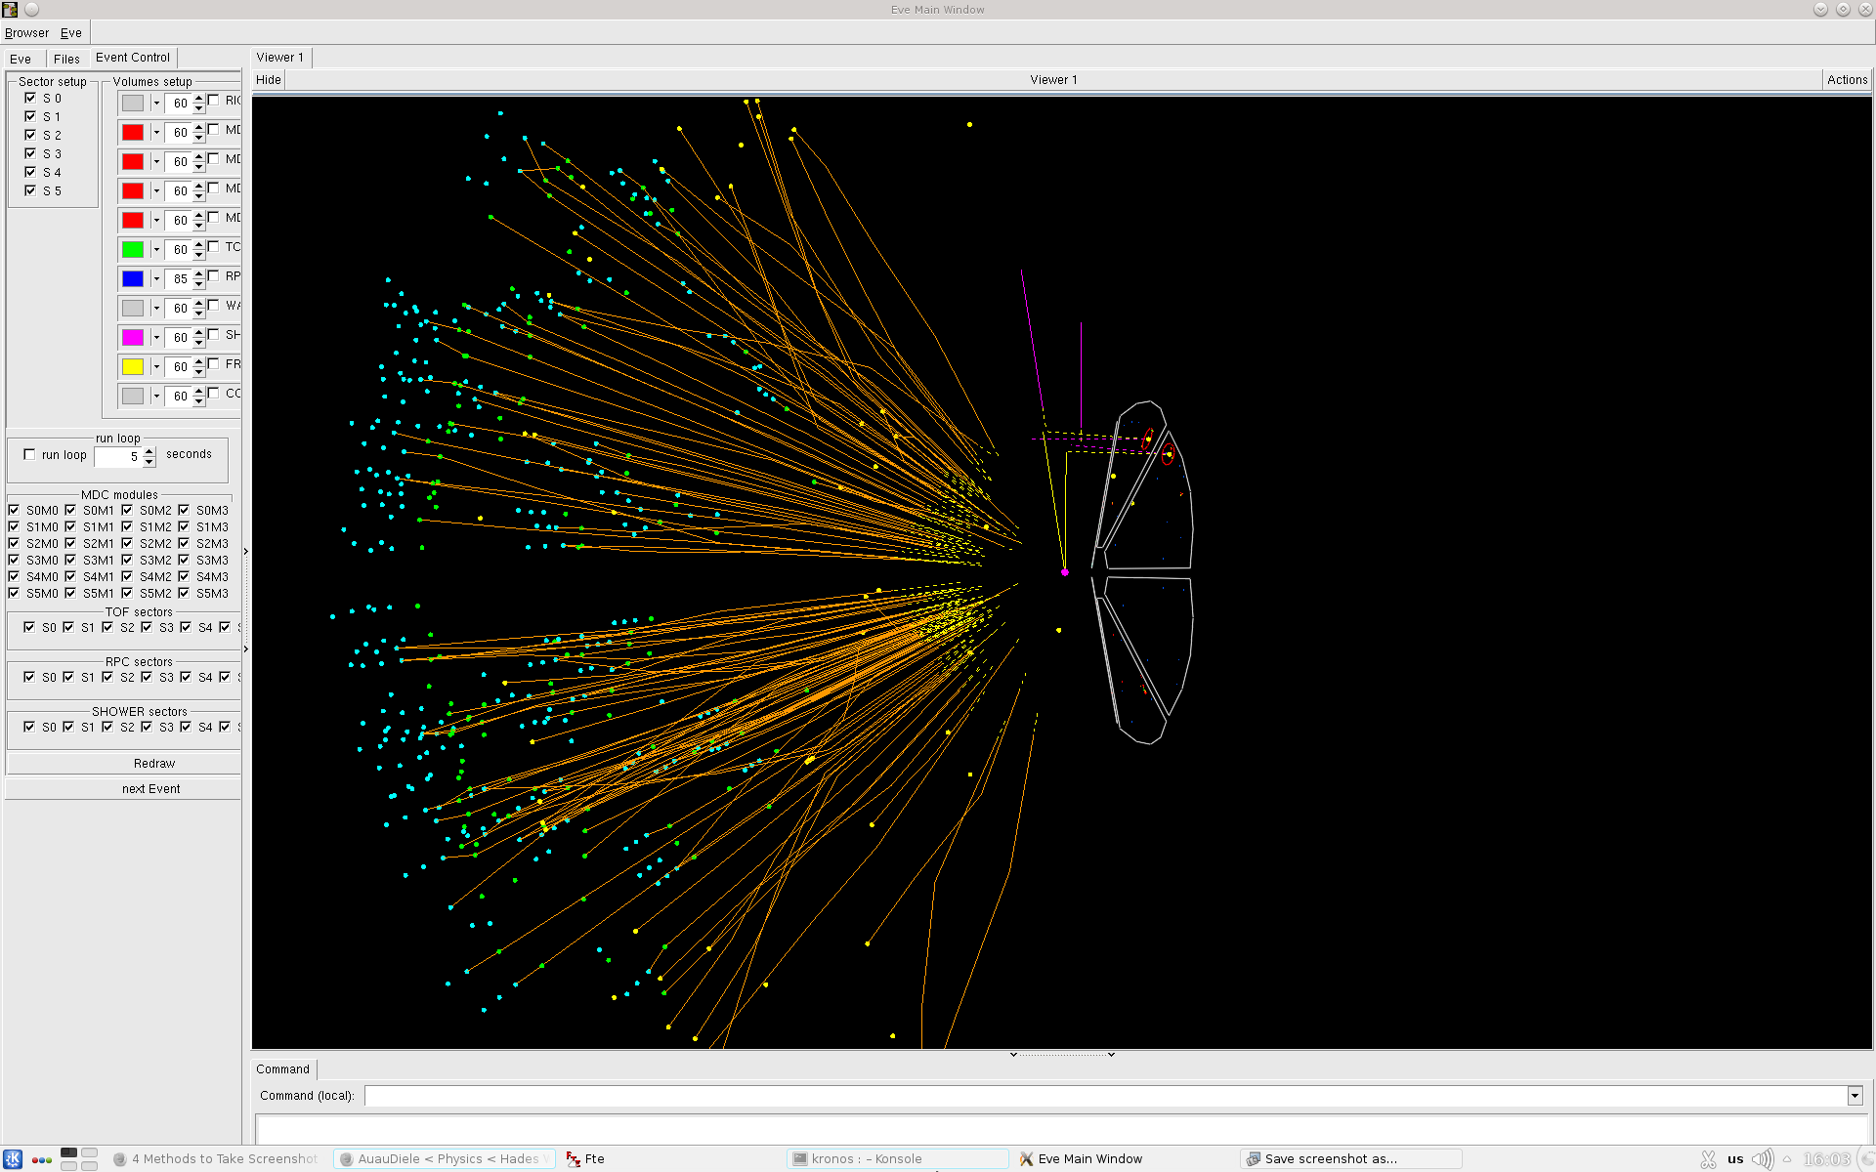

Slide 14


