Slide 1
An RCS with Integrable Optics for the Fermilab PIP-III Upgrade
Jeffrey Eldred, Sasha Valishev
Space Charge 2017
5 Oct 2017

Slide 2
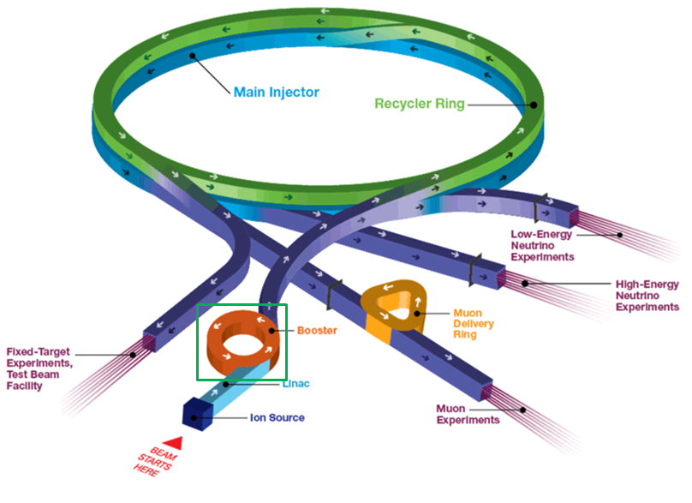
2
2
Fermilab Proton Accelerator Facility
Jeffrey Eldred | An RCS with Integrable Optics for the Fermilab PIP-III Upgrade
Notes:
2
2
2
2
2
2

Slide 3
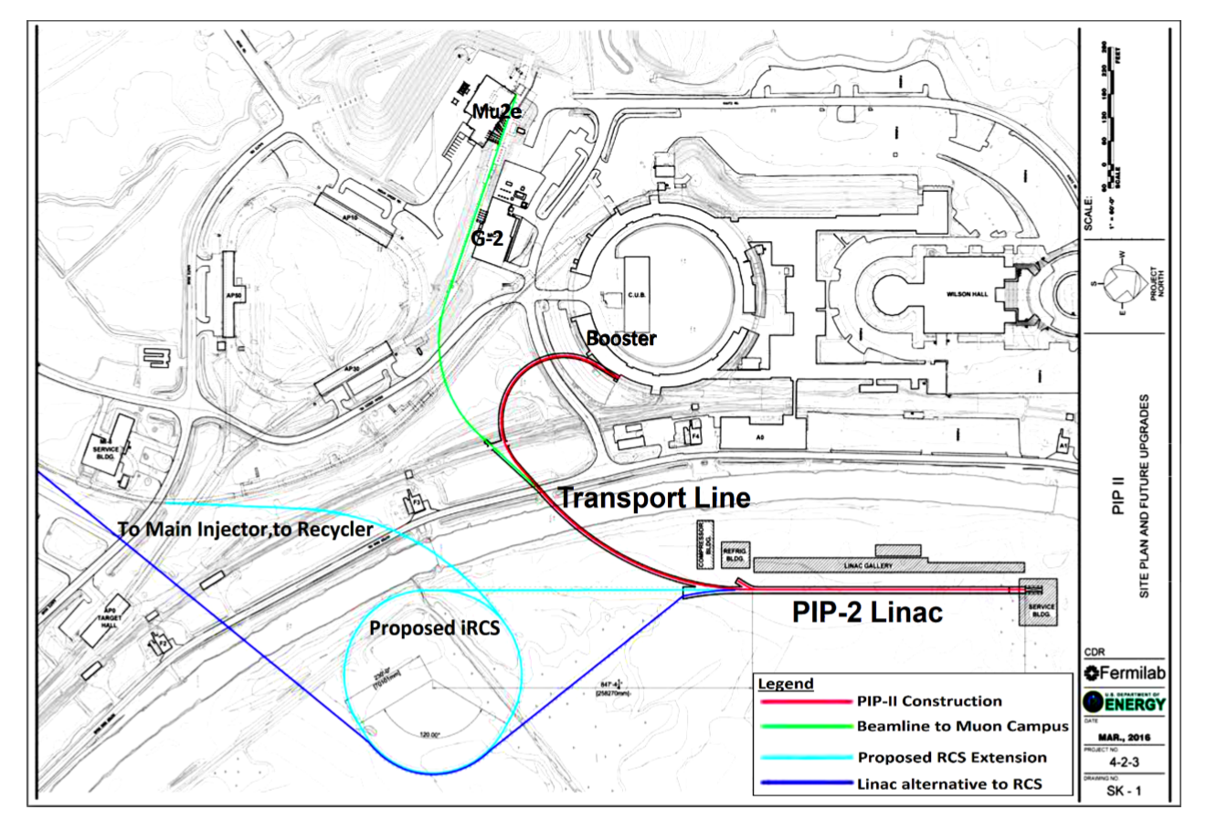
3
3
(Proposed) PIP-III Intensity Upgrade
3
Jeffrey Eldred | An RCS with Integrable Optics for the Fermilab PIP-III Upgrade
Notes:
3
3
3
3
3
3

Slide 4
4
Rapid-Cycling Synchrotron Design
Modern RCS design calls for several features:
Dispersion-free drifts, for RF
Low momentum compaction factor, to avoid transition.
Low beta functions, for maximum emittance per aperture.
Mitigation of collective instabilities, throughout the ramp.
Integrable optics design is a promising innovation to provide significant nonlinear focusing with two invariants of motions.
But first, it is necessary to demonstrate integrable optics is still helpful in the presence of strong space-charge forces.
4
Jeffrey Eldred | An RCS with Integrable Optics for the Fermilab PIP-III Upgrade
Notes:
4
4
4

Slide 5
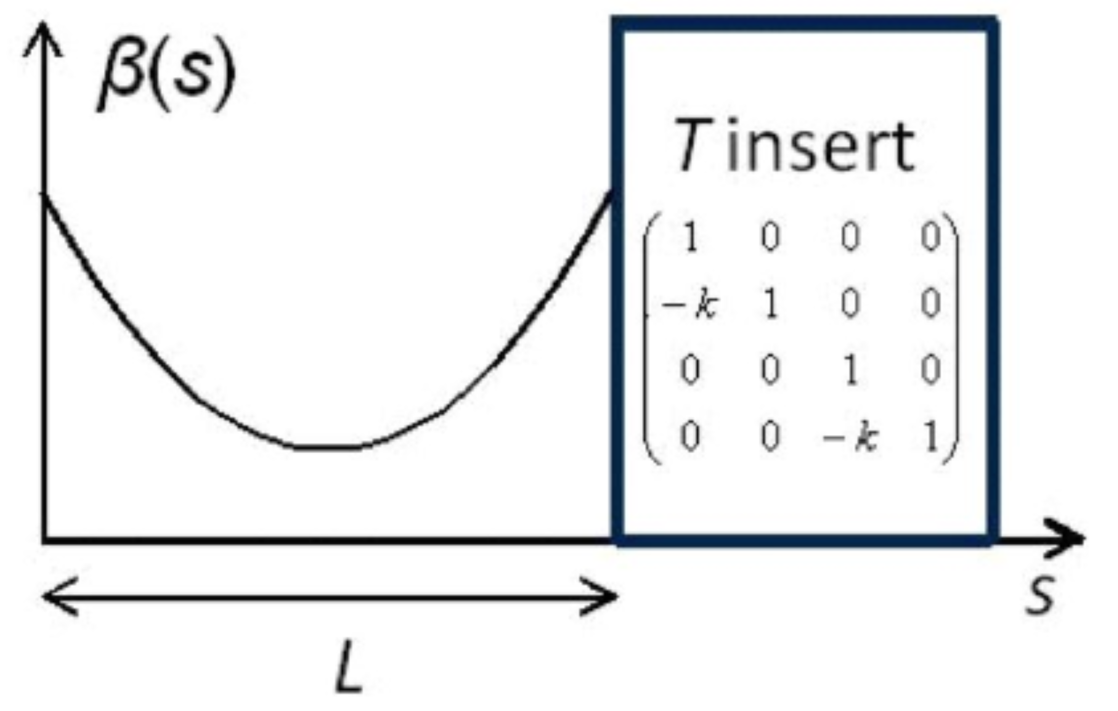
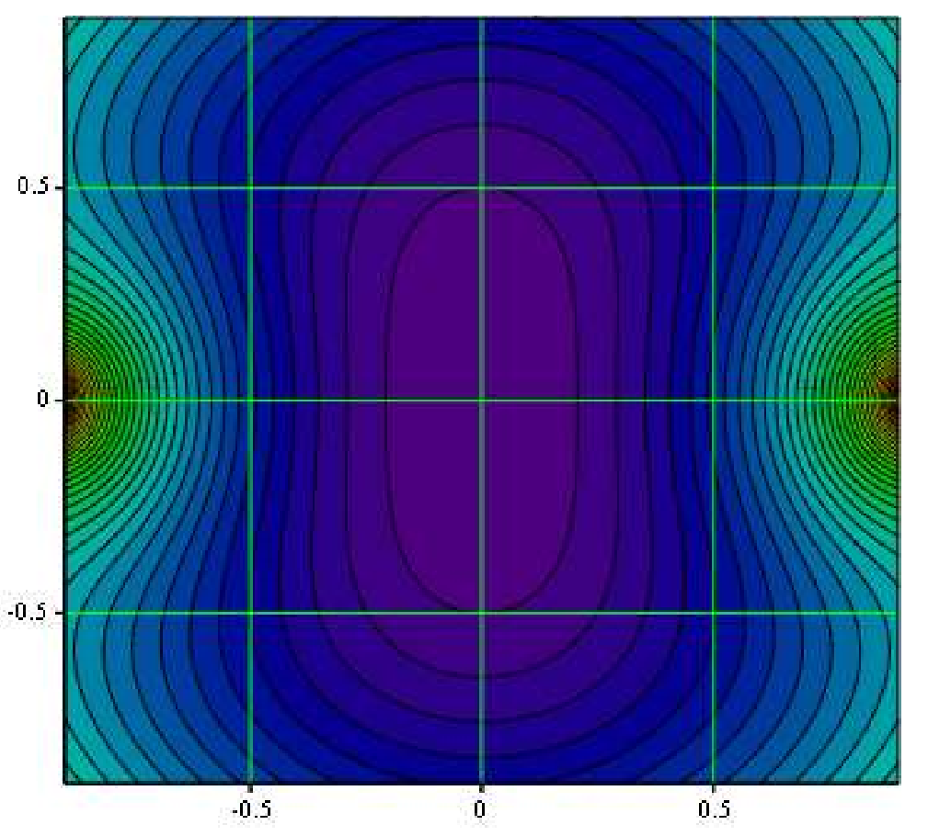
5
Danilov-Nagaitsev Integral Design
Time-independent kick:
Nonlinear kick separable in elliptic coordinates:
Notes:
5
5
5

Slide 6
6
Integral Design with Periodicity
Multiple Periodic Cells:
...
6
Jeffrey Eldred | An RCS with Integrable Optics for the Fermilab PIP-III Upgrade
Notes:
6
6
6

Slide 7
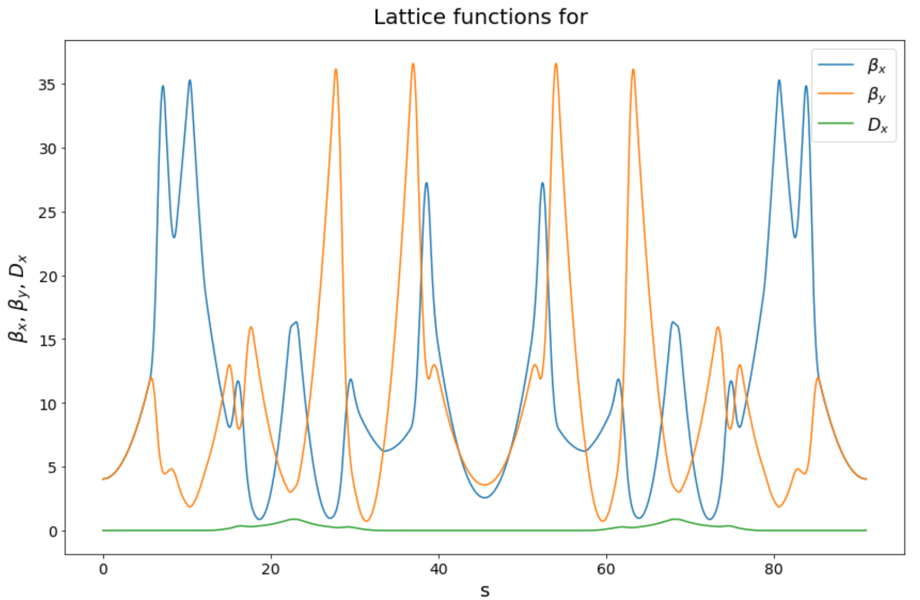
7
iRCS v2 Lattice Parameters
Periodicity: 6
Circumference: 542 m
Bend-radius rho: 15.4 m
Max Beta function: 35 m
Insertion length: 11.2 m
Betatron Tune: 16.8
Insert Phase-Advance: 0.3
Nonlinear t-value: 0.15
Minimum c-value: 3 cm
Beta at insert center: 4 m
Corrected Chromaticity: -7.7
Natural Chromaticity: -33
Second-order Chromaticity: -132
Notes:
7
7
7

Slide 8
8
8
Synergia Simulation
of Halo formed by
Beam Mismatched
8
Jeffrey Eldred | An RCS with Integrable Optics for the Fermilab PIP-III Upgrade
Notes:
8
8
8
8
8
8

Slide 9
Simulation Parameters
Coasting proton beam with PIC space-charge.
Injection energy of 0.8 GeV.
Initial normalized emittance 20 mm mrad.
2D Waterbag beam initially distributed along equipotential contours except with a 20% mismatch.
500 revolutions of iRCS (3000 iterations of periodic cell).
Phase advance through insert dΦ = 0.3
Nonlinear strength parameter t = 0.3
1 Conventional Design, Low Intensity Beam (dQ = -0.05)
2 Integrable Design, Low Intensity Beam (dQ = -0.05)
3 Conventional Design, High Intensity Beam (dQ = -0.20)
4 Integrable Design , High Intensity Beam (dQ = -0.20)
9
Jeffrey Eldred | An RCS with Integrable Optics for the Fermilab PIP-III Upgrade

Slide 10
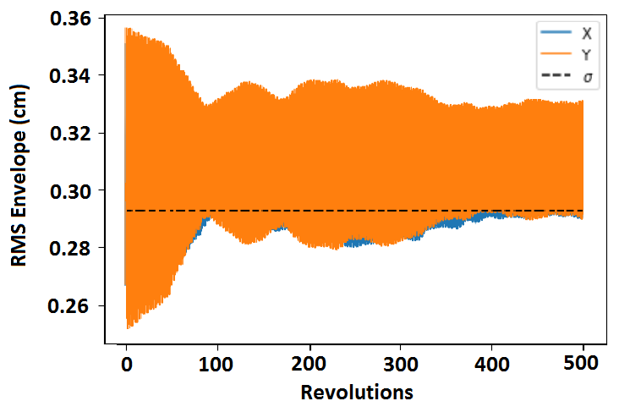
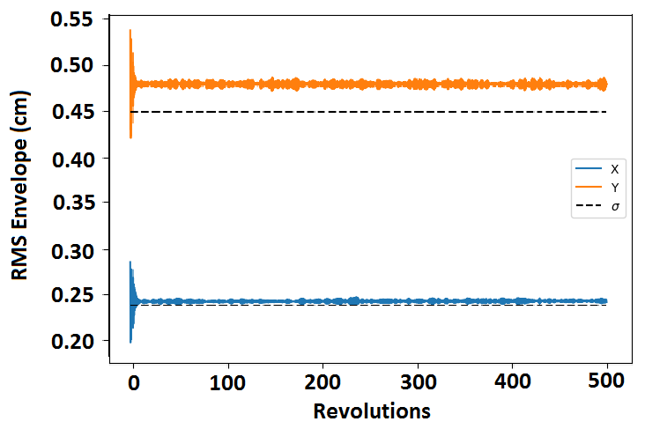
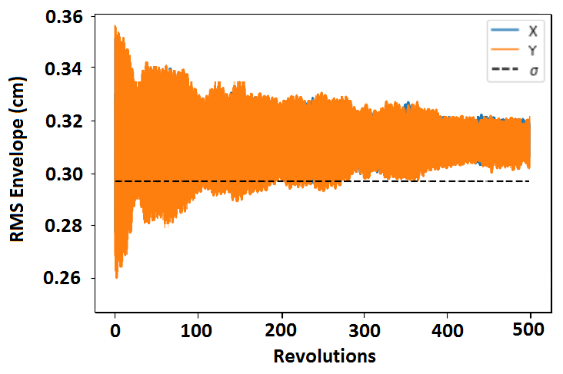
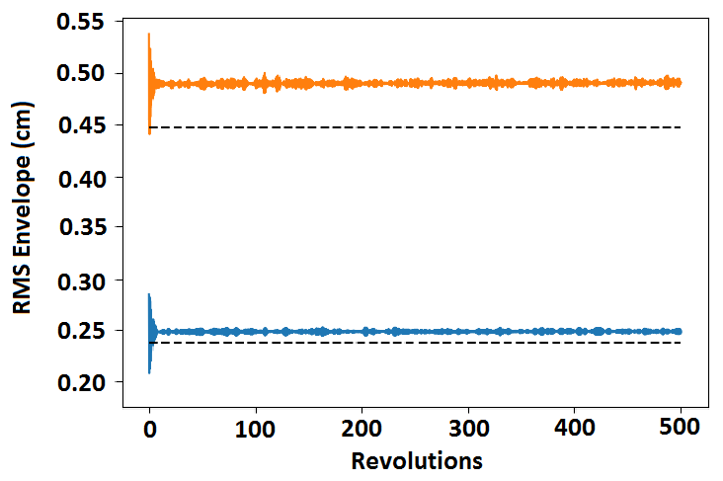
10
RMS Beam Size
1 Conventional, Low Int.
2 Integrable, Low Int.
3 Conventional, High Int.
4 Integrable, High Int.
10
Jeffrey Eldred | An RCS with Integrable Optics for the Fermilab PIP-III Upgrade
Notes:
10
10
10
10
10
10

Slide 11
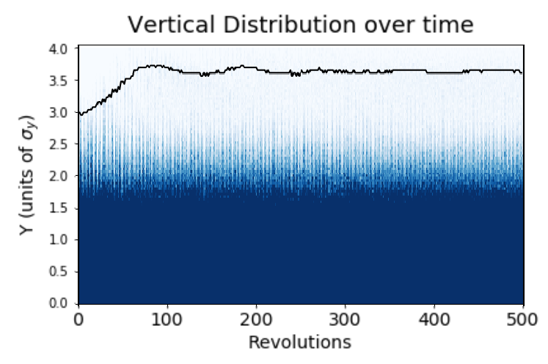
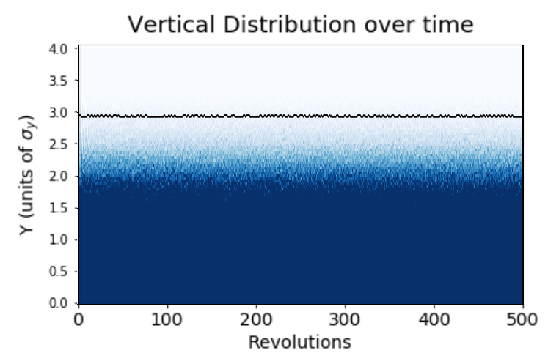
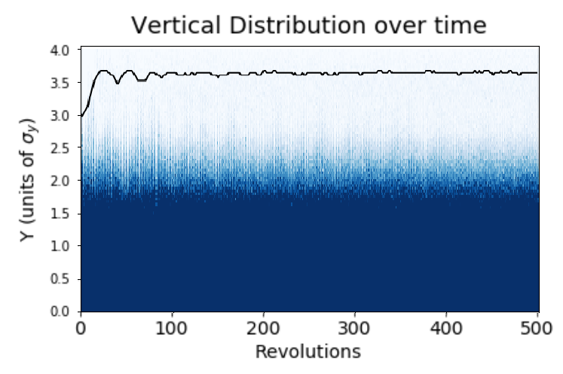
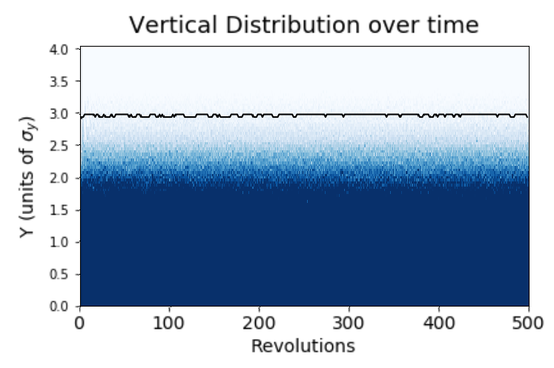
11
Transverse Beam Halo
1 Conventional, Low Int.
2 Integrable, Low Int.
3 Conventional, High Int.
4 Integrable, High Int.
Notes:
11
11
11
11
11
11

Slide 12
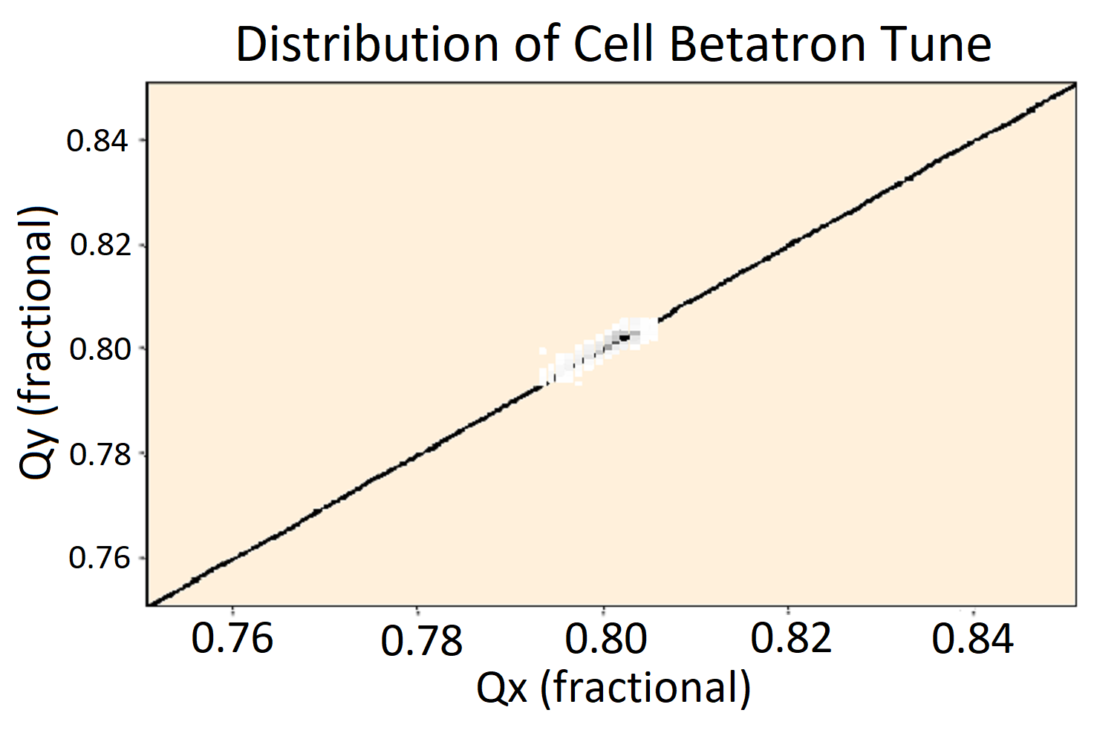
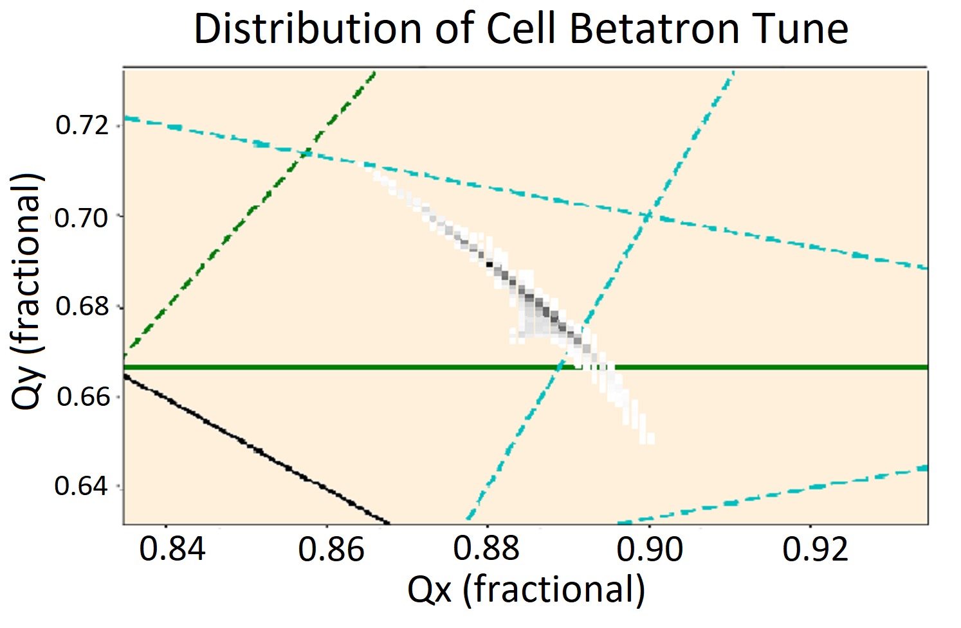
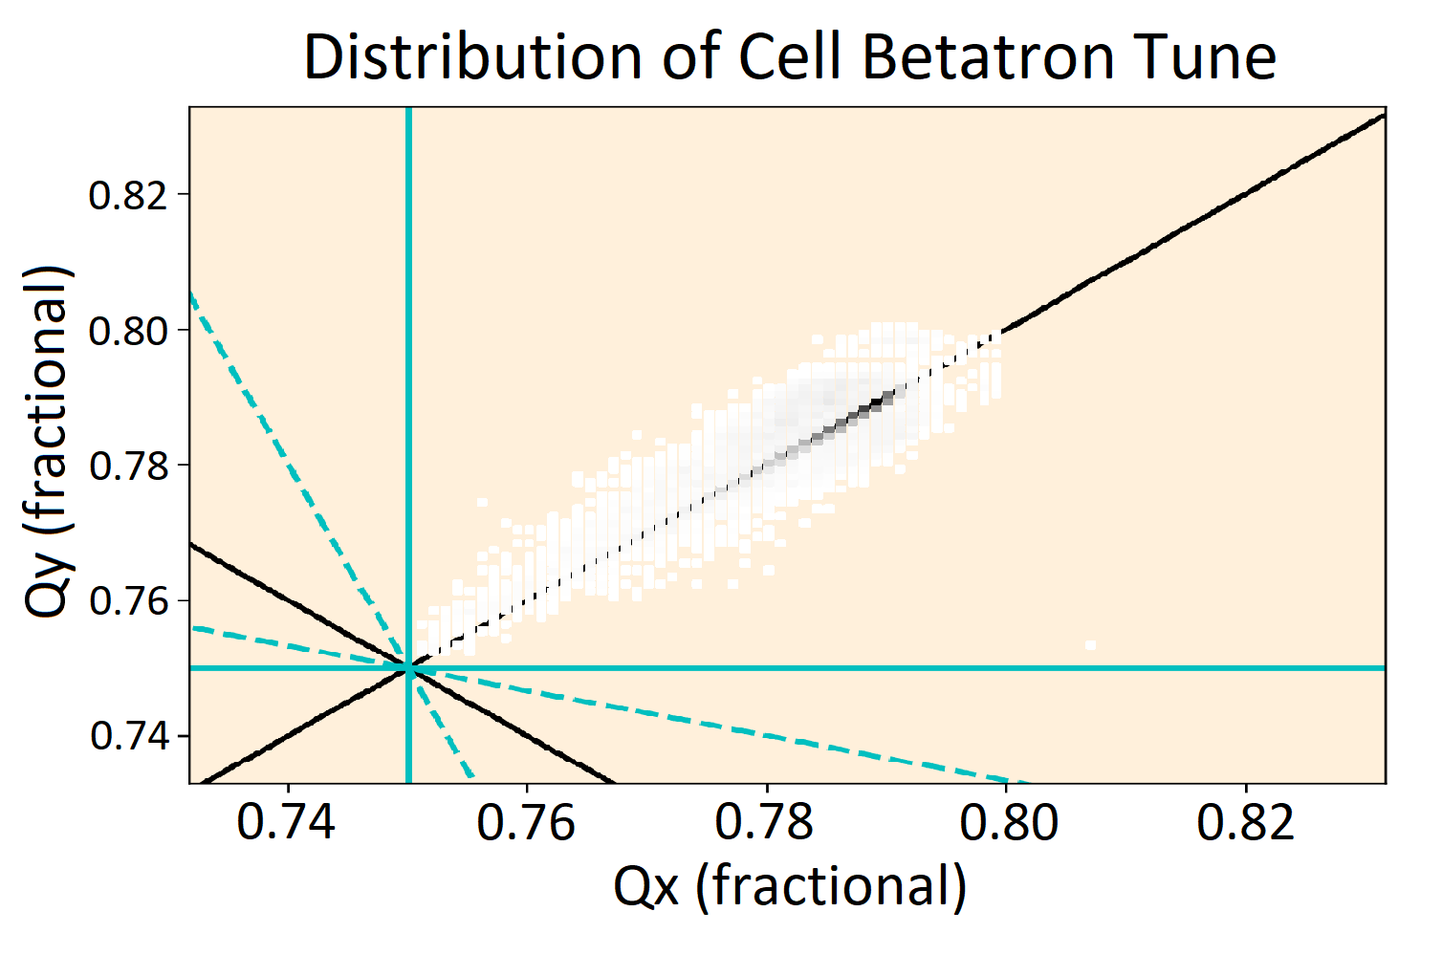
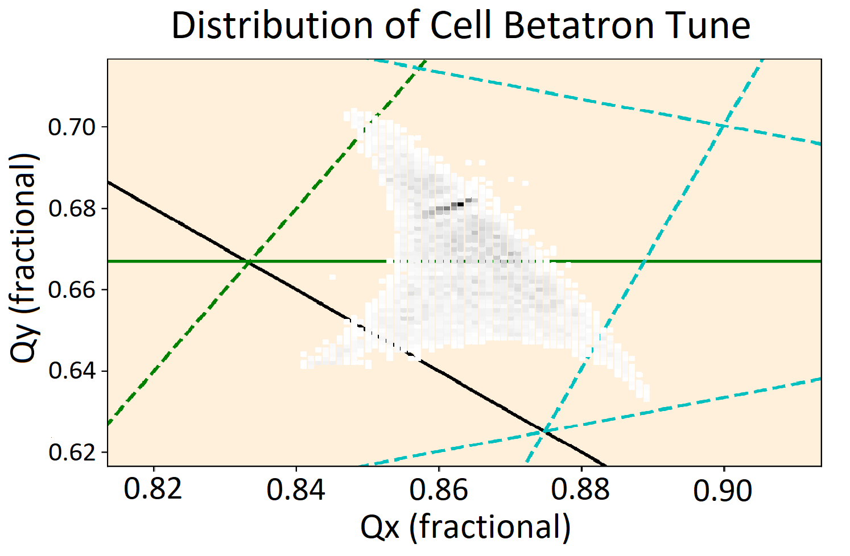
12
Cell Betatron Tune Distribution
1 Conventional, Low Int.
2 Integrable, Low Int.
3 Conventional, High Int.
4 Integrable, High Int.
12
Jeffrey Eldred | An RCS with Integrable Optics for the Fermilab PIP-III Upgrade
Notes:
12
12
12
12
12
12

Slide 13
13
Ring Betatron Tune Distribution
Description | 90% Horizontal Tune Spread | 90% Vertical Tune Spread
1 Conventional, Low Int. | 0.044 | 0.044
2 Integrable, Low Int. | 0.12 | 0.18
3 Conventional, High Int. | 0.16 | 0.16
4 Integrable, High Int. | 0.15 | 0.25
Nonlinear Parameters
Space-charge tune shift dQ = -0.05, -0.20
Phase advance through Insert dΦ = 0.3
Nonlinear strength parameter t = 0.3
13
Jeffrey Eldred | An RCS with Integrable Optics for the Fermilab PIP-III Upgrade
Notes:
13
13
13
13
13
13

Slide 14
14
14
Mismatched Waterbag
with Chromatic Tune Shift
14
Jeffrey Eldred | An RCS with Integrable Optics for the Fermilab PIP-III Upgrade
Notes:
14
14
14
14
14
14

Slide 15
Simulation Parameters
Coasting proton beam with injection energy of 0.8 GeV.
Same parameters, but now RMS momentum spread is introduced.
Nominal momentum spread based on zero-charge longitudinal simulation of RF capture of injected beam.
Space-charge tune shift dQ = -0.05
Phase advance through Insert dΦ = 0.3
Nonlinear strength parameter t = 0.3
Chromaticity (matched horiz. & vert.): -33
Chromatic tune-shift (3σ nominal): 0.025%
5 Integrable Design, Low Intensity, σp = 0.025% (Nominal)
6 Integrable Design, Low Intensity, σp = 0.500% (x20)
15
Jeffrey Eldred | An RCS with Integrable Optics for the Fermilab PIP-III Upgrade

Slide 16
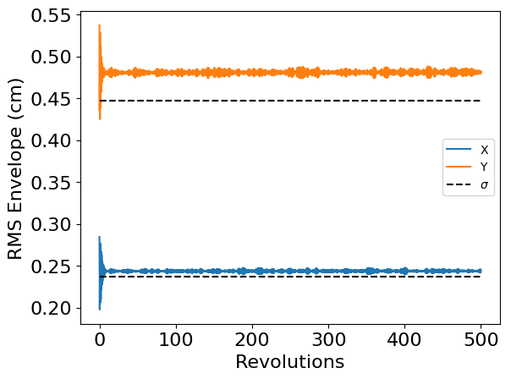
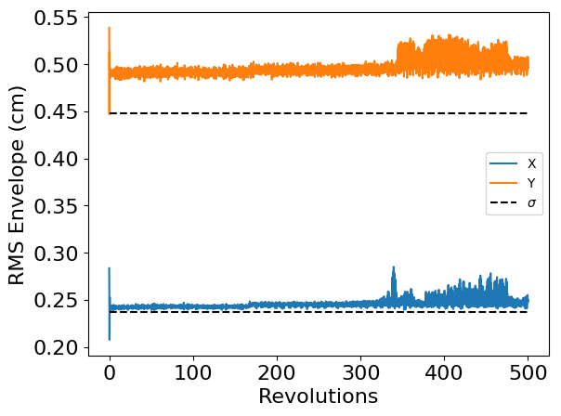
16
RMS Beam Size
5 Integrable WB, Nominal σp
6 Integrable WB, x20 σp
Sudden emittance growth occurs at ~340 revolutions, in the case of the exaggerated momentum spread but not the nominal momentum spread.
16
Jeffrey Eldred | An RCS with Integrable Optics for the Fermilab PIP-III Upgrade
Notes:
16
16
16
16
16
16

Slide 17
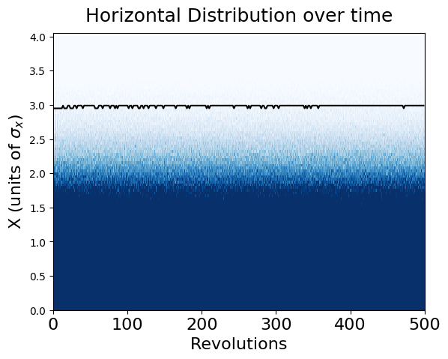
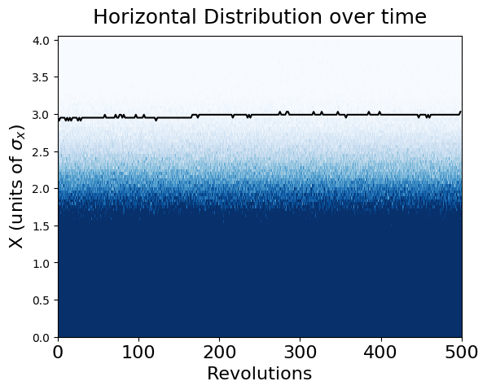
17
Transverse Beam Halo
5 Integrable WB, Nominal σp
6 Integrable WB, x20 σp
In this case, we see the sudden emittance growth doesn’t necessarily lead to any immediate change in the beam halo.
17
Jeffrey Eldred | An RCS with Integrable Optics for the Fermilab PIP-III Upgrade
Notes:
17
17
17
17
17
17

Slide 18
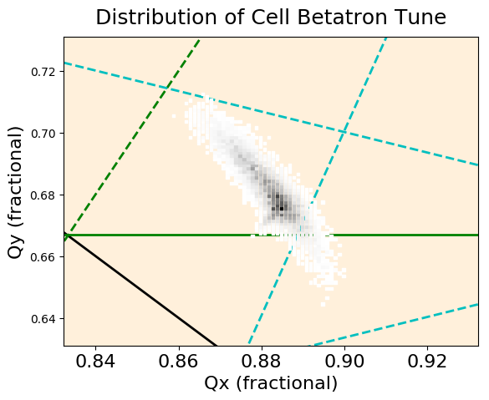
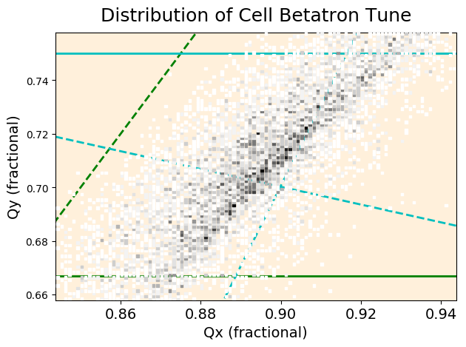
18
Cell Betatron Tune Distribution
5 Integrable WB, Nominal σp
6 Integrable WB, x20 σp
The chromatic tune-shift occurs diagonally and the amplitude tune-spread occurs off-diagonally.
No evidence particles are bound by the resonance lines.
18
Jeffrey Eldred | An RCS with Integrable Optics for the Fermilab PIP-III Upgrade
Notes:
18
18
18
18
18
18

Slide 19
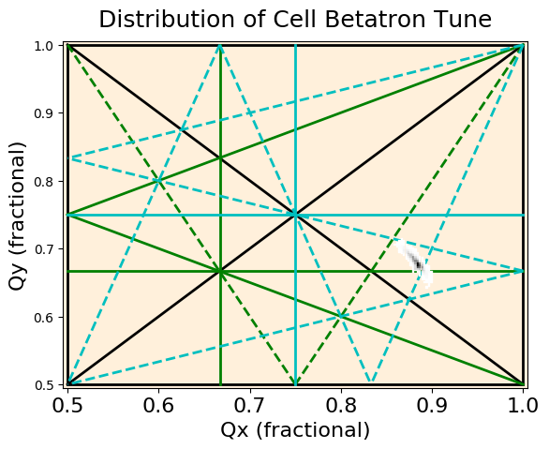
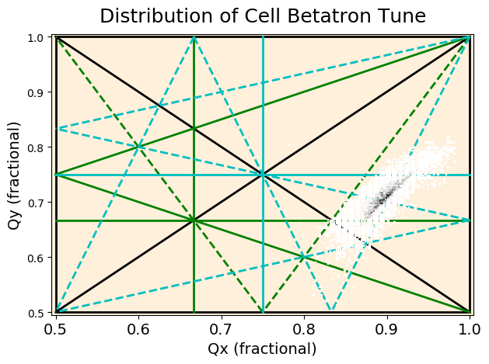
19
Cell Betatron Tune Distribution
5 Integrable WB, Nominal σp
6 Integrable WB, x20 σp
The chromatic tune-shift occurs diagonally and the amplitude tune-spread occurs off-diagonally.
No evidence particles are bound by the resonance lines.
19
Jeffrey Eldred | An RCS with Integrable Optics for the Fermilab PIP-III Upgrade
Notes:
19
19
19
19
19
19

Slide 20
Summary & Upcoming Work
Summary:
Integrable optics provide a large nonlinear tune-spread without introducing new resonances and can be used to mitigate the formation of beam halo.
Integrable optics is reasonably tolerant to space-charge and chromatic phase-errors.
Upcoming Work:
Analyze particles trajectories to better understand the physics.
Version of iRCS lattice with 12-fold periodicity and simpler arcs.
Plan to use random quad errors to break periodicity and investigate effects of integrable optics.
Bunched beam with RF and 3D space-charge forces.
20
Jeffrey Eldred | An RCS with Integrable Optics for the Fermilab PIP-III Upgrade

