Slide 1
Injection of a Self-Consistent Beam into the SNS Accumulatior Ring
Space Charge 2017
Darmstadt, Germany
October 4, 2017
Jeff Holmes

Slide 2
Motivation
Self-consistent beams may suppress space-charge induced halo growth → reduced beam loss in high intensity rings.
The beam density is uniform → better for targets.
They can be manipulated to give flat beams when space charge effects are weak → increased collision rates for colliders and heavy ion fusion applications.
From 2003-2006, S. Danilov and J. Holmes studied self-consistent distributions from a mathematical and computational standpoint.
The idea was to find beam distributions satisfying the Vlasov equation
  that are elliptical with uniform density in real n-dimensional space and
  that retain these properties, shape and density, under all linear transport, even accounting for space charge forces.
We called these distributions self-consistent.
Our goal: Find self consistent distributions that could be practically achieved in a real-life ring (SNS), and that would be robust under real transport, space charge effects, nonlinearities, impedances, and other loss mechanisms.

Slide 3
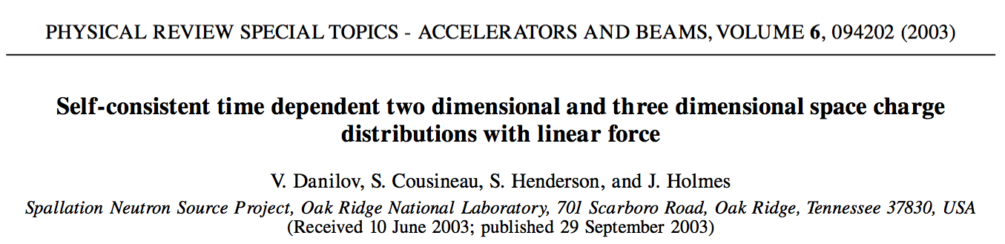
First Results: Theory
The initial 2003 journal article was mainly a mathematical exercise. It showed:
  There are an infinite number of self-consistent distributions,
  How to construct these distributions mathematically,
  That these distributions are singular – they occupy hypersurfaces in n-dimensional phase space,
  That one such distribution, a 2D coasting beam “rotating” distribution, is a good candidate for painting into SNS.
Some conditions had to be met to inject the rotating distribution:
  The painted horizontal and vertical emittances had to increase linearly in time in order to yield constant charge density.
  The horizontal and vertical tunes had to be equal during injection.
  The painted horizontal and vertical phases had to differ by 90°.

Slide 4
First Results: Computational
Computational feasibility studies for injecting the rotating distribution into SNS were undertaken, starting with simple models and adding physics:
  Coasting beam injection into a single rotating eigenfunction with simple linear transport was successful.
  Adding nonlinear effects (sextupoles and/or fringe fields) destroyed self-consistency by coupling degenerate, oppositely rotating eigenfunctions.
  Addition of solenoids into the lattice broke the degeneracy, again allowing for injection into a single rotating solution.
With the solenoids in place, further effects were included:
  Self-consistency withstood the addition of space charge, impedances, and foil scattering.
  Injection kicker waveforms were calculated for one potential injection scenario, and found to be feasible with modification of some of the power supplies. These were not tested in simulations because ORBIT included only artificial injection bumps at the time.
Coasting beams were replaced by bunched beams, first with barrier cavities, and then with the SNS dual harmonic cavities with design voltages.
  Although barrier cavities worked, the SNS cavities at design voltage did not.
  Also, SNS was beginning operation and the project was shelved for later.

Slide 5
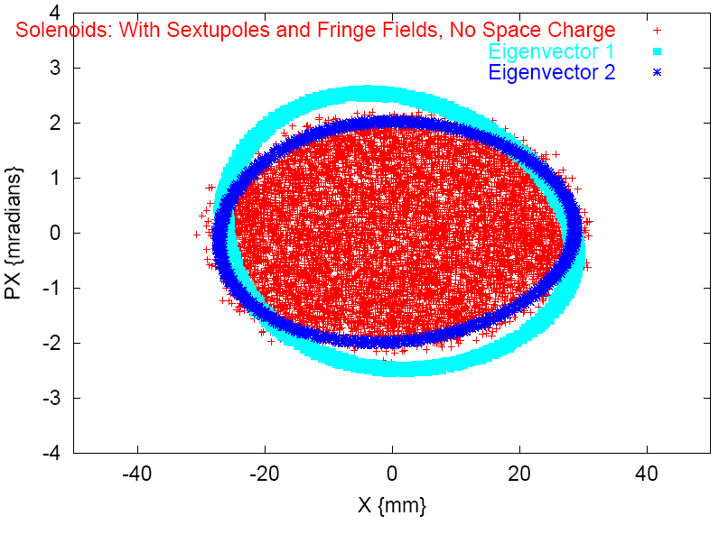
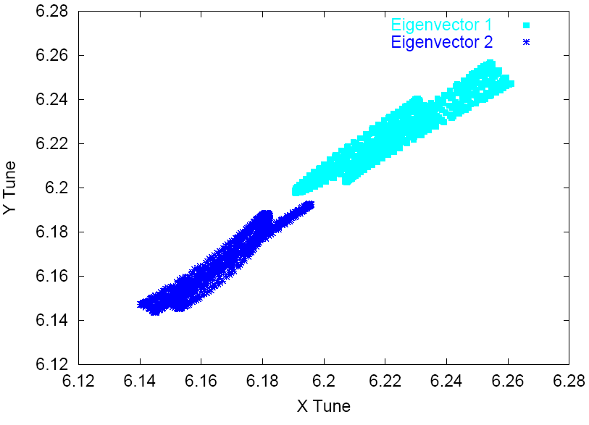
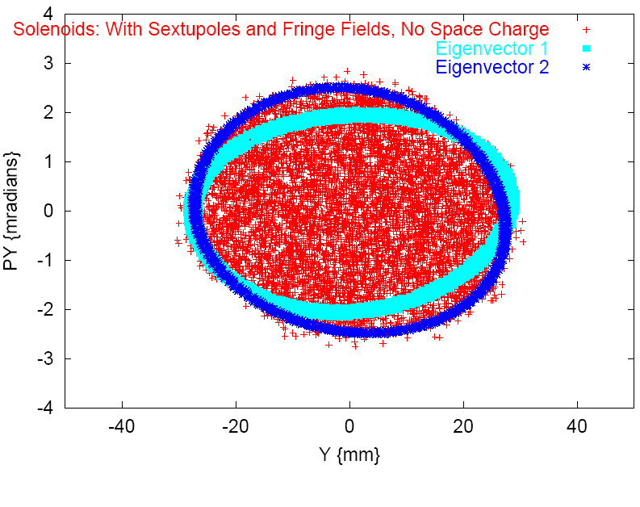
Include Solenoids to Split Tunes and Paint to the Desired Eigenfunctions
For the SNS lattice, include two solenoids symmetrically in RF straight section to split tunes and paint a rotating distribution to the desired rotating eigenfunctions.
Results show painted beam in phase space and tune separation and spread of eigenvectors.
x-x'
Tunes
y-y'

Slide 6
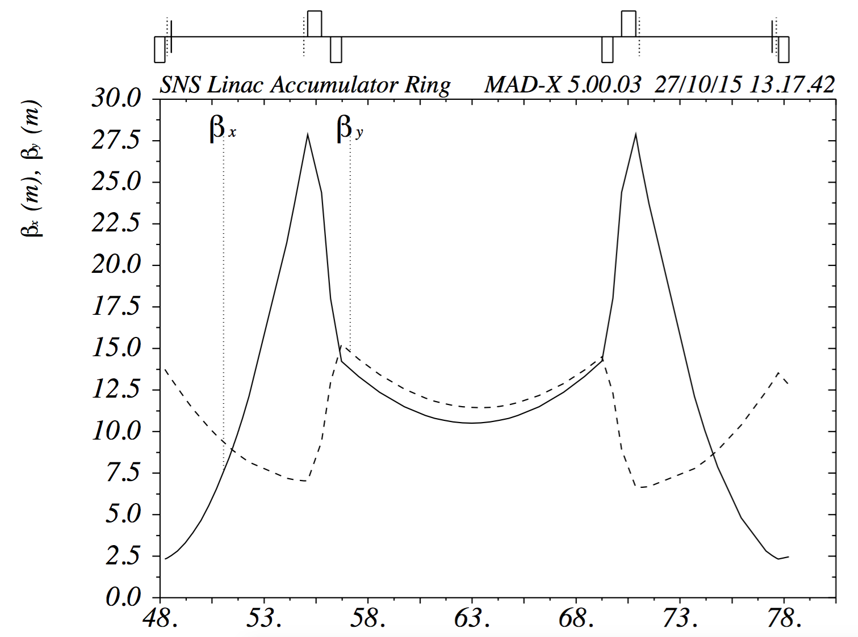
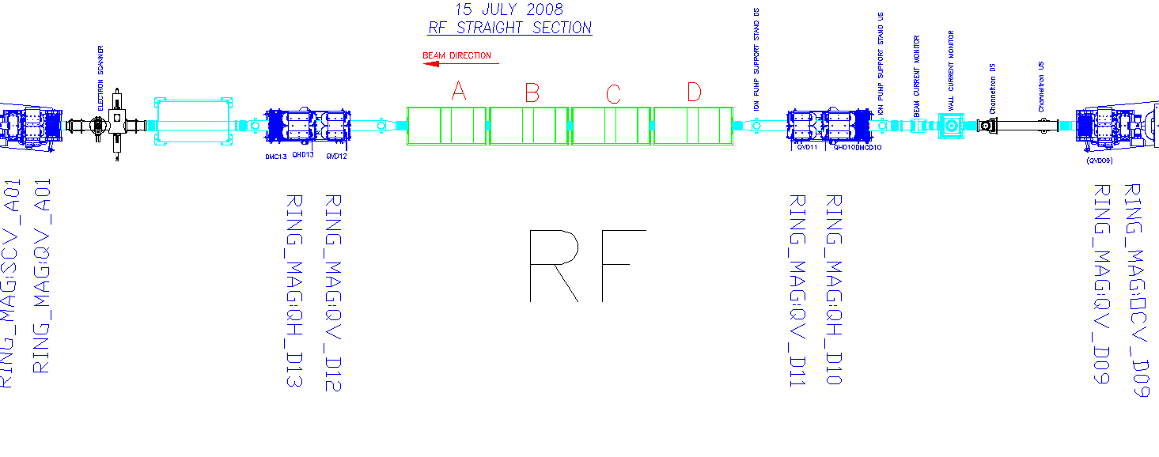
Ring RF area modifications – add two solenoid magnets
Solenoid placement
1.5 T, 0.5 m long
Note: beam is left to right on MADX plot,
right to left on CAD image

Slide 7
How to paint a Self-Consistent Rotating Distr.
Injection bump trajectories vs. distance
Injection kicker angles vs. time
Beginning
End

Slide 8
A Decade Later: Revived Interest
With the SNS accelerator performing well, we now have more freedom to play. Meanwhile, operation of the accumulator ring has evolved to much lower RF voltages than the design values, meaning less peaking of the bunched beam.
With that, and support from the DOE Office of Science, we have revived the self-consistent beam studies. The goal is to paint a rotating self-consistent beam into the SNS ring.
First steps include simulations with all relevant physics:
  Demonstrate feasibility of self-consistent injection.
    Use actual kickers for painting, rather than artificial bumps.
    Use production RF settings for bunched beams in the ring.
    Incorporate all relevant physics: space charge, impedances, nonlinearities, fringe fields, scattering and losses, etc.
  Optimize the injection scenario with respect to
    Beam quality,
    Painting scheme,
    Losses,
    Hardware requirements (solenoids and kickers).
Then carry out necessary hardware changes and do the experiments.

Slide 9
Barrier Cavities -> Existing RF
In the original (2003-2006) studies, barrier cavities were necessary to maintain self-consistency in bunched beams.
The design SNS ring RF cavities were to operate with 40 kV first harmonic and 20 kV second harmonic voltages, which destroyed the uniform density beam current profile.
Today, we actually operate with much smaller (<10 kV) ring RF voltages.
When we apply these operating voltages in the self-consistent beam simulations, self-consistency survives.
The results presented here were calculated using 4 kV first harmonic and 4 kV second harmonic RF voltages.

Slide 10
Effect of Dual Harmonic RF Cavities
V_{RF} = 4kV (both harmonics)
Longitudinal profiles peak up somewhat
Little effect on transverse properties

Slide 11
Painting and Extended Fringe Fields
A_{x} = -k’/12*(x³+3xy²) - k_{s}’/6*y³ + O(4)
A_{y} = +k’/12*(3x²y+y³) - k_{s}’/6*x³ + O(4)
A_{s} = k/2*(y²-x²) – k_{s}xy + O(5)

Slide 12
Sensitivity to Placement of Solenoids
In order to determine the sensitivity to the position of the solenoid magnets, four calculations, identical to a base case except for solenoid placement, were carried out:
  A) First solenoid downstream 1.016 m, second solenoid upstream 1.016 m
  B) First solenoid upstream 0.987 m, second solenoid downstream 0.805 m
  C) First solenoid upstream 0.987 m, second solenoid upstream 1.016 m
  D) First solenoid downstream 1.016 m, second solenoid downstream 0.805 m
Results in all these cases were virtually identical, so self-consistency is not sensitive to placement of the solenoids.

Slide 13
Sensitivity to Tune Separation
Because painting a round self-consistent beam requires equal tunes we tested the sensitivity to this condition by comparing cases with bare tunes of Q_{0x} = 6.18 and various Q_{0y} ranging from 6.13 to 6.23.
What we found was a pleasant surprise:
  Self-consistency is easily achieved for Q_{0y} near Q_{0x}.
  The robustness of self-consistency versus tune split improves with intensity.

Slide 14
Beam Profiles: Full Design Intensity
Q_{y0} = 6.13
Q_{y0} = 6.18
Q_{y0} = 6.23
Varying the vertical tune for a fixed horizontal tune Q_{x0} = 6.18
gives self-consistent beams over a sizable range of tunes.

Slide 15
Emittance Evolution at Full Intensity
Horizontal Emittances
Vertical Emittances
Vertical beam broadening at lower tune: half integer resonance.
Horizontal beam narrows – interesting.

Slide 16
Average Incoherent Tune Evolution
Differences between vertical and horizontal average tunes
are much smaller than the bare tune differences.

Slide 17
Final Average Incoherent Tunes
Differences between vertical and horizontal average tunes
are smaller than the bare tune differences, and are smaller
for high intensity beams than at low intensities.

Slide 18
What Might We Measure?
WS20
WS21
WS23
WS24

Slide 19
Beam on Target

Slide 20
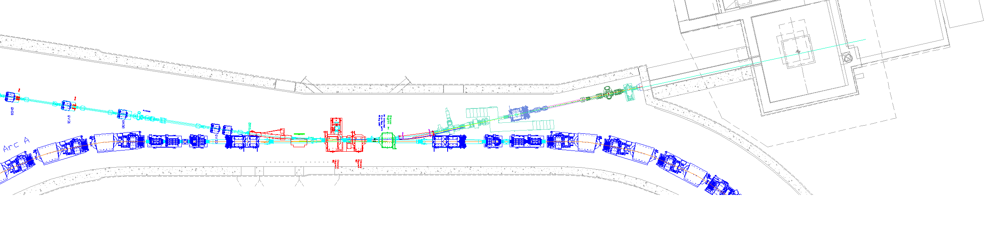
Ring modifications req’d for this experiment
Add two solenoid magnets in locations where the horizontal and vertical betatron functions are equal.
Modify injection kickers to be bipolar (at most two horizontal and one vertical, we now think this may not be necessary).
Upgrade H1, H2, V3, injection kicker power supplies to be bipolar
Ring injection section

Slide 21
Further Optimization
Until recently, studies were subject to a few drawbacks:
  Solenoid strengths of 1.4 Tesla are large.
  Up to three injection kicker power supplies must be modified.
  Beam losses of about 1% are predicted.
Subsequent studies are being conducted to answer the questions:
  Can solenoid strengths be reduced?
  Can self-consistent beams be painted without modifying power supplies?
  Can losses be reduced?
The answers appear to be affirmative.

Slide 22
Reducing Solenoid Strengths
Calculations with solenoids set at 0.85 T give
very similar results to those at 1.4 T

Slide 23
Painting Options
There is freedom to choose from a
range of injection painting scenarios.
We have found one scenario that
results in acceptable losses without
Requiring bipolar injection kickers.

Slide 24
Reducing Losses
By reducing the injected beam intensity from production settings
of 1.47*10¹⁴ to 0.75*10¹⁴ protons/pulse, we reduce losses by an
order of magnitude from ~1% to ~0.1%.

Slide 25
Summary
We have demonstrated the feasibility of injecting a self-consistent beam into the SNS accumulator ring.
Simulations have been performed to optimize the injection scenario for successful injection with
  minimal hardware changes and
  acceptable beam losses.
The next steps will be to implement the hardware changes (add two solenoids) and to consider diagnostic and experimental requirements.

