Slide 1
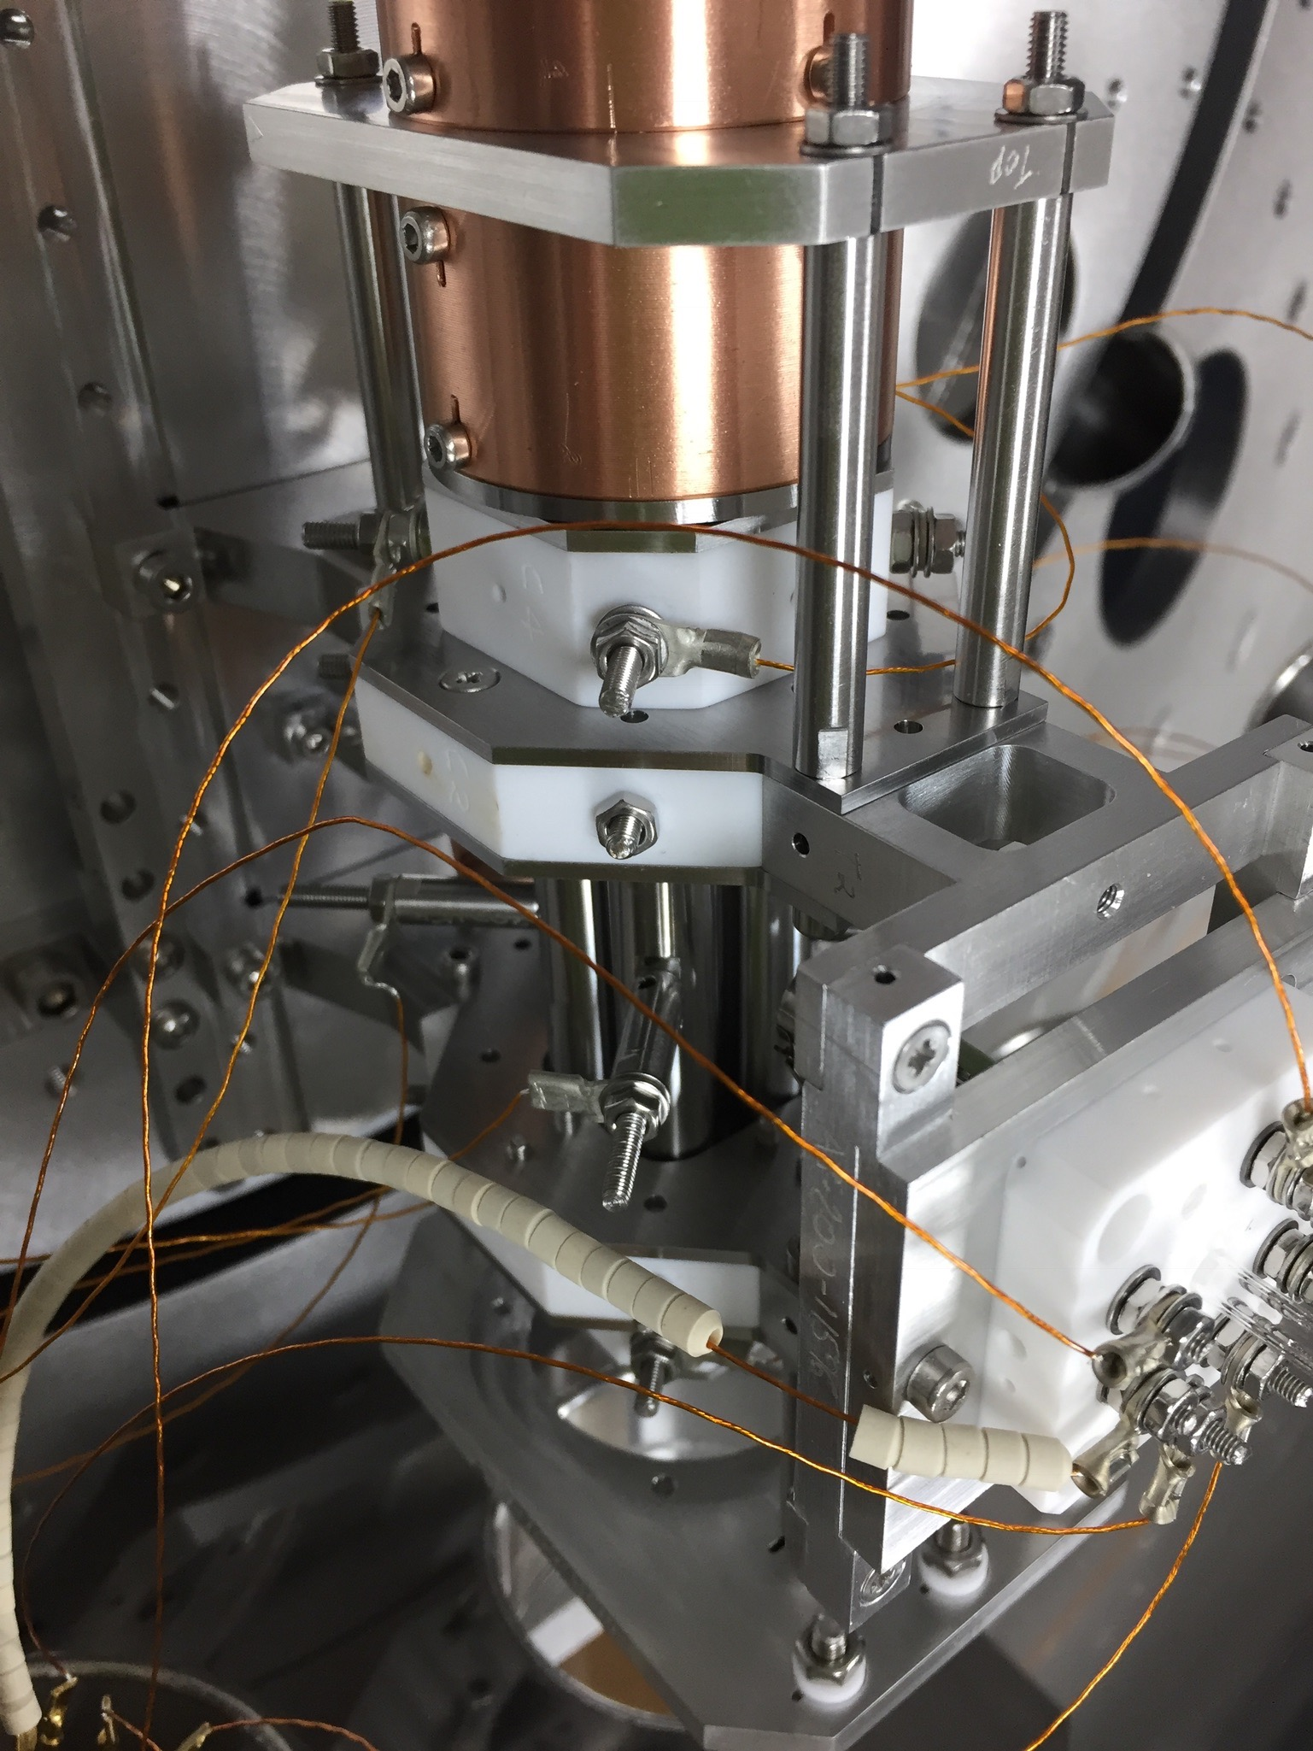


High intensity beam studies with a Linear Paul Trap
Lucy Martin

Slide 2
Introduction
Induced resonances due to external fields and space charge
The C_{m} factor in coherent resonances
Linear Paul Traps (LPTs) as a tool for high intensity accelerator physics
Experimental procedure for C_{m} measurement
Data analysis
Outcomes
I₁
I₂
+
+
F
P
P
P
P
F

Slide 3
Resonances and Space Charge
In Sacherer’s* 1968 PhD thesis resonant condition defined as
For a small multipole perturbation of order m with harmonic n
ΔQ = incoherent tune shift
Q₀ = tune at which resonance occurs (bare tune)
Sacherer realises this is too simple: In high intensity case beam size changes
Needs to be solved self consistently

Slide 4
System is solved using linearized Vlasov Poisson equations
Solutions are the envelope equations which describe beam size
Solving envelope equations gives:
Index m = azimuthal and k = radial mode, m = k are rigid modes
Mode (m, k) is driven by terms x^{k−1} cos(nθ) with n ≈ mν
The dipole resonance C₁ = 0
C_{m} < 1 and C₁ < C₂< C₃ < C₄ …
1
0.5
0
0.5
1

Slide 5
Space charge driven resonances
In H. Okamoto and K. Yokoya’s 2002 paper* the theory is extended:
No smoothing approximation is applied to the beta function
Aim to measure C_{m} factor for external and self field driven resonances
Theoretical values have been calculated (I. Hofmann 1998)
C_{m} has not previously been measured in an accelerator

Slide 6
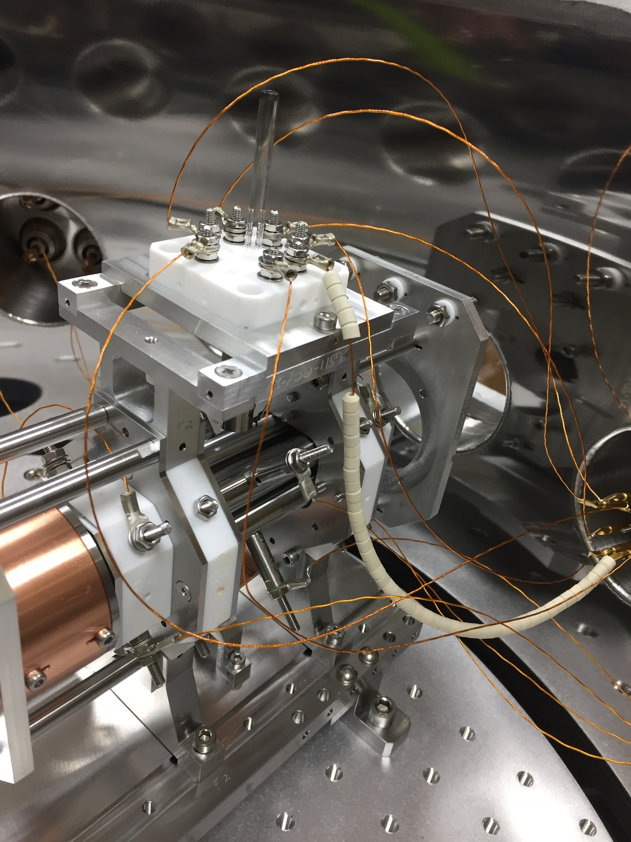
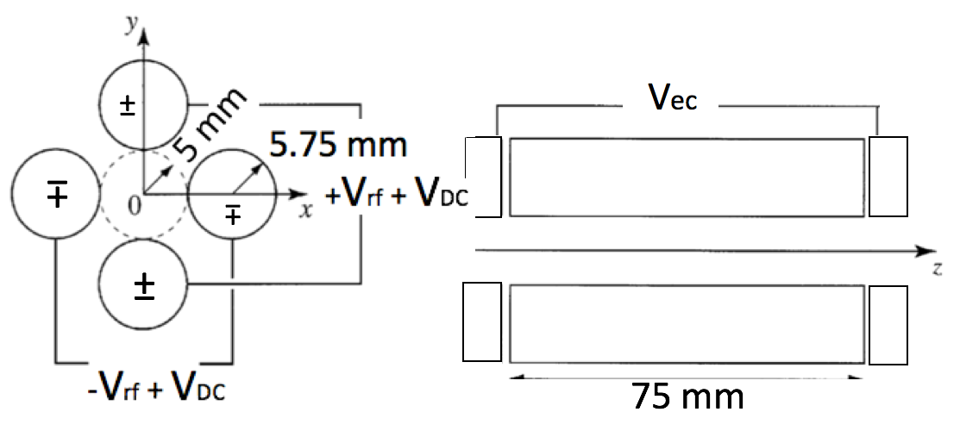
Linear Paul Trap
1. Argon gas introduced to vessel at ~10⁻⁷ mbar
2. Electron gun ionises Ar in trapping region
3. Ions confined transversely via 4 cylindrical rods
4. Ions confined longitudinally with end caps

Slide 7
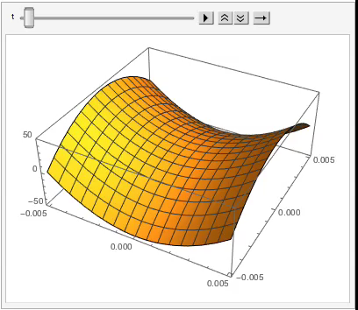
Potential in a Paul trap
Static potential can’t trap particles
Potential of the form
Is used in Linear Paul Traps (LPTs)
Potential created using 4 electrodes
Alternating rf voltage applied to electrodes
Electrical quadrupole field

Slide 8
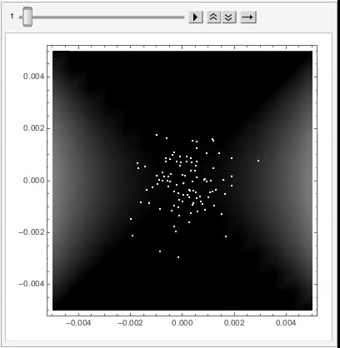
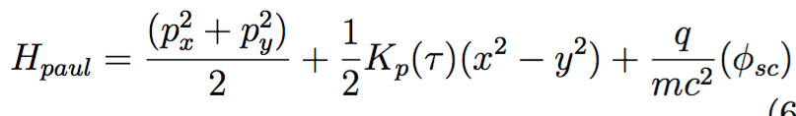
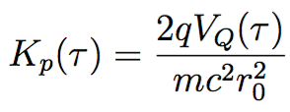
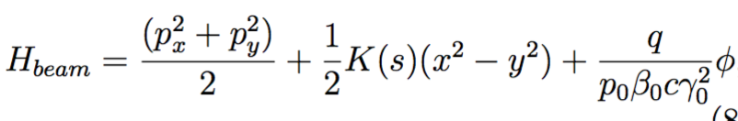
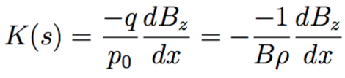
Motion in a Paul trap
Hamiltonian of a Paul trap :
where
Hamiltonian of a conventional accelerator:
where

Slide 9
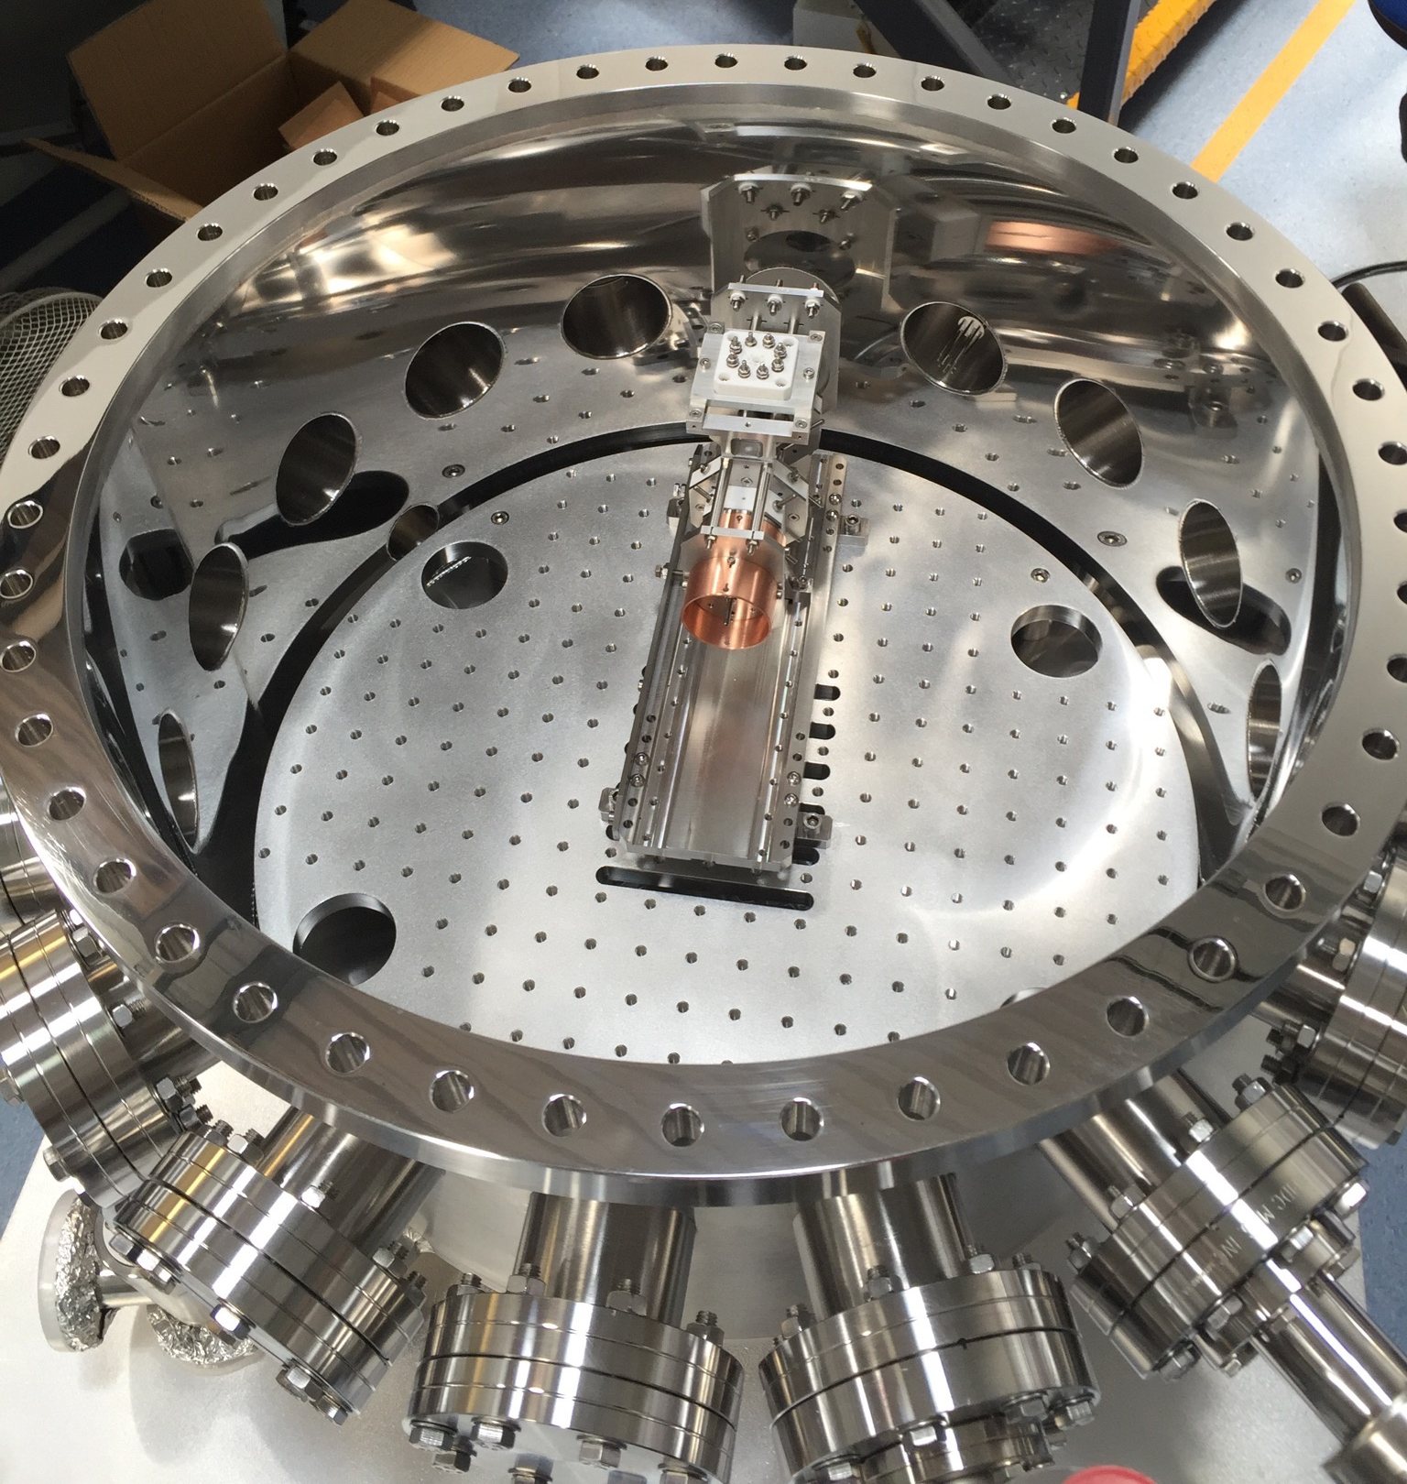


The solution: IBEX or SPOD Linear Paul Trap (LPT)
IBEX is located at the Rutherford Appleton Lab,
SPOD at Hiroshima University, Japan
Advantages of LPT:
  Noise free
  Relatively inexpensive
  Large beam loss does not damage system
  Large parameter space can be accessed
  Space charge interactions present
What a IBEX and SPOD can’t do:
  Simulate beam pipe effects
  Create controlled higher order multipoles (Yet!)
  Introduce dispersion
  Include relativistic effects (radiation damping etc.)

Slide 10
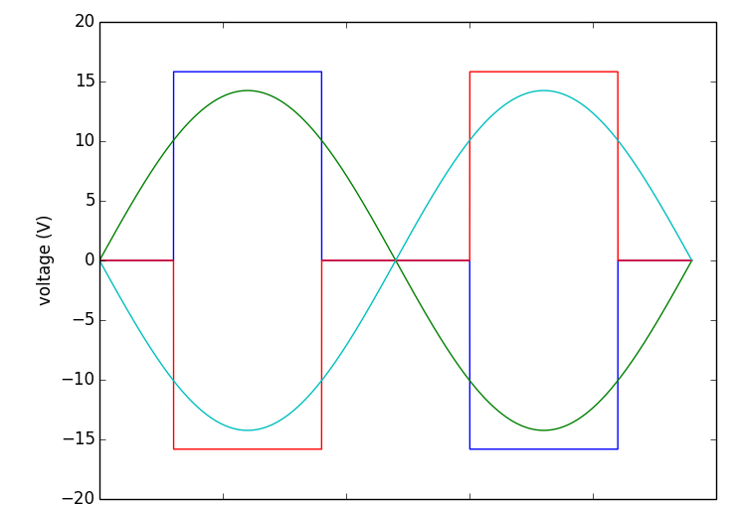
Experimental procedure
A simple FODO cell is created using a sine wave
System scans across a large range of tunes
Plasma is created at the optimal tune
Tune is then changed to the desired operating point by changing voltage
  Focusing period fixed to 1 MHz, tune changed over 100 focusing periods
At this tune plasma is stored for 100ms
Plasma is then extracted onto an MCP, which here acts as ion counter
time

Slide 11
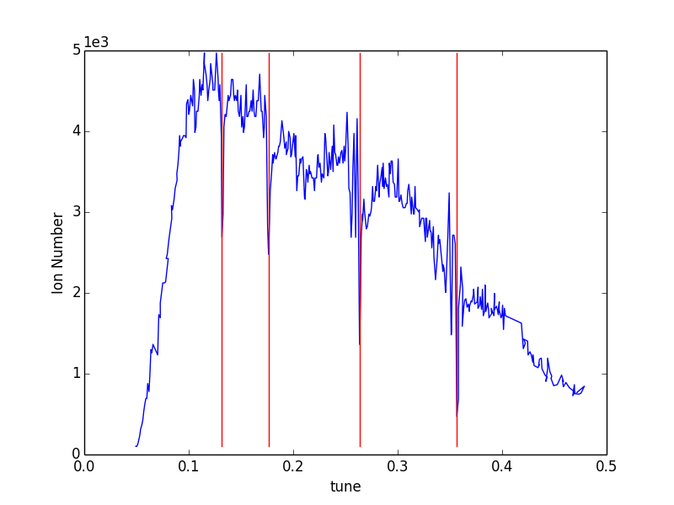
Characterisation of trap
1/8
1/6
1/4
1/3
= Cell tune
Lowest possible ion number used:
  This eliminates space charge effects
Allows calibration trap
1/7
Resonances due to external fields from misalignments
Even order multipoles appear to dominate
  (Probably due to symmetry of trap)
1/5
Cell tune

Slide 12
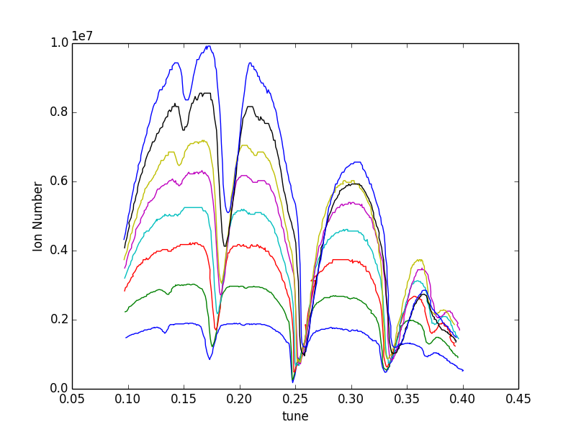
Results
Cell tune

Slide 13
Identifying resonances…
SC = space charge driven
EF = external field driven
EF:
SC:
At cell tune ~1/5
SC n = 2, m = 5
EF n = 1, m = 5
At cell tune ~1/4
SC n = 1, m = 2
EF n = 1, m = 4
At cell tune ~ 1/6
SC n = 1, m = 3
EF n = 1, m = 6
At cell tune ~ 1/3
SC n = 1, m = 6
EF n = 1, m = 3
At cell tune ~ 1/8
SC n = 1, m = 4
EF n = 1, m = 8
At cell tune ~ 3/8
SC n = 3, m = 4
Cell tune

Slide 14
Simple analysis: assumptions made
Resonance is coherent and so minima of the dip can be taken
Emittance does not change as tune is scanned to opperating point
Ion number causing incoherent tune shift = number of ions initially stored
From previous SPOD data:
Emittance is assumed to be 5.6e-9 mrad
  (K. Ito et al., Tune Depression of Ion Plasmas Observed in a Linear Paul Trap, J. Plasma Fusion Res. SERIES, Vol. 8, 2009 )
Effective plasma length is assumed to be 31mm
  (R. Takai et al., Nonlinear Resonance Effects in a Linear Paul Trap, Journal of the Physical Society of Japan, Vol.76, No. 1, January, 2007)

Slide 15
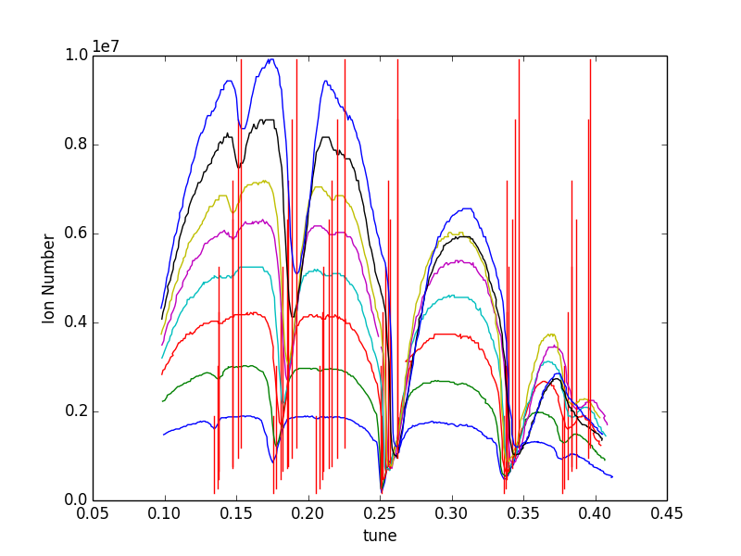
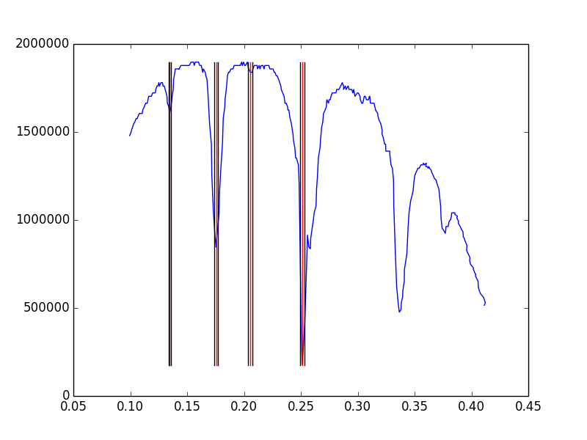
Extracting C_{m} from the data
Extract the correct value of the minima, with errors
Concentrate on the four resonances on the left for clarity
Cell tune

Slide 16
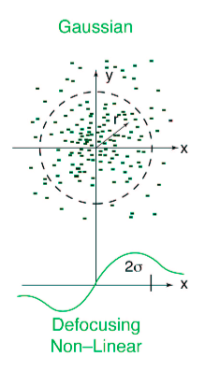
Incoherent tune shift
Assume a cylinder of charge
Charges have Gaussian distribution
Calculate the first order tune depression
Motion in Paul trap is non relativistic
Can neglect the magnetic fields
λ_{RF} = the RF wavelength of the trap
N = Ion number
L = effective plasma length
ε_{x} = emittance

Slide 17
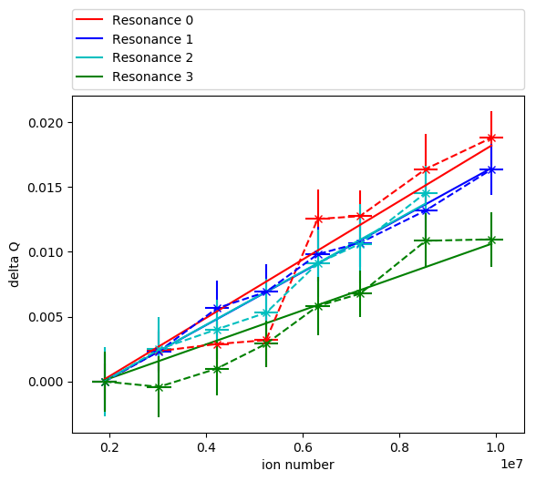
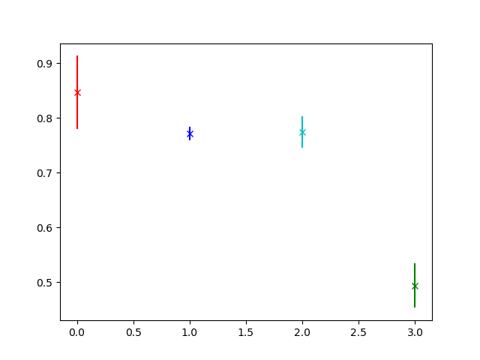
Resonance at tune = 1/8
Resonance at tune = 1/6
Resonance at tune = 1/5
Resonance at tune = 1/4
Order
8 or 4
6 or 3
5
4 or 2
C_{m} (preliminary)
Preliminary
Preliminary
1/8
1/6
1/5
1/4
Cell tune

Slide 18
Conclusions and further work
A linear Paul trap has been used to extract values of C_{m} for several resonances
C_{m} values found are all smaller than 1
Higher order resonances appear to have larger C_{m} values
Ratio of resonances may suggest which resonances are space charge driven
Further characterisation of trap to confirm assumptions
Repeat at lower storage time to study resonances at higher tune
Attempt on different trap (IBEX) / multipole trap to differentiate between external field and space charge resonances

Slide 19
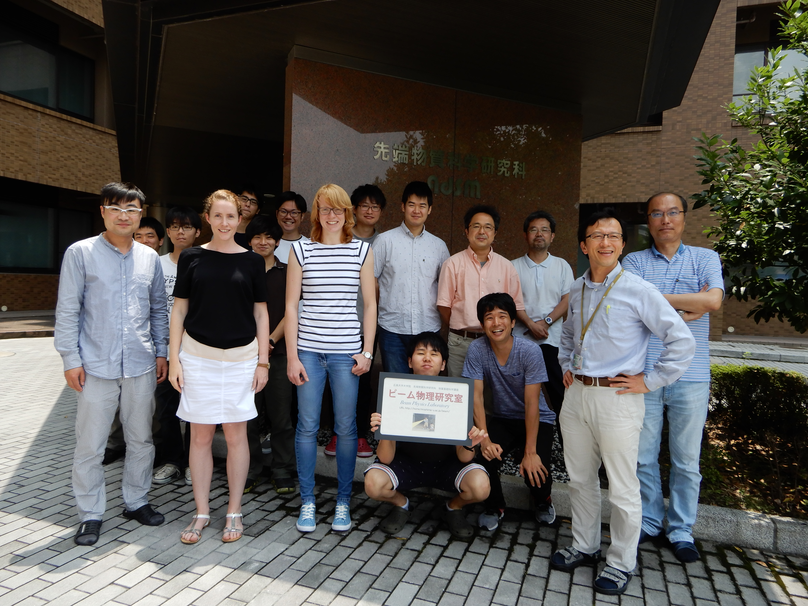
Thanks to
The Beam Physics Group,
Hiroshima University, Japan
Intense Beams Group,
Rutherford Appleton Lab, UK

Slide 20
Backup slides

Slide 21
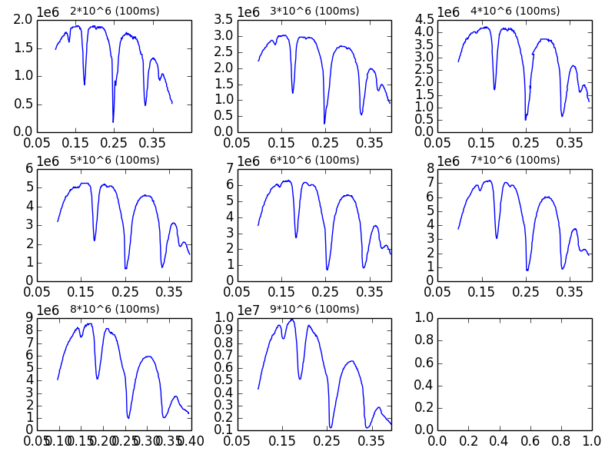
Resonance shape
Characteristic shape of resonances:
This is due to beam size change experienced near a resonance
Drop off in ion number due to the increase in maximum beta function
This is a consequence of large storage time

Slide 22
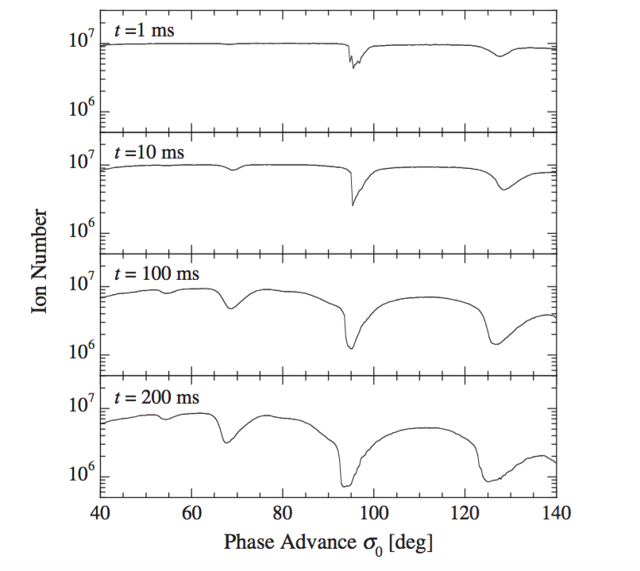
Ion loss with storage time
Red line shows the ionisation point at an ion number of 10⁷ and various storage times
K. Ito, H. Okamoto,* Y. Tokashiki, and K. Fukushima, Coherent resonance stop bands in alternating gradient beam transport, PHYSICAL REVIEW ACCELERATORS AND BEAMS 20, 064201 (2017)

Slide 23
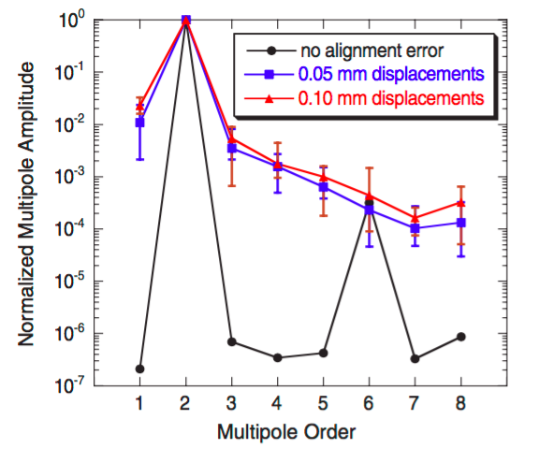
Measuring C_{m} on SPOD
To measure the C_{m} factors from external fields higher order multipoles are required in the trap
Fortunately(!) misalignments in the trap produce these fields
Previous studies show expected multipoles
Results are from simulation:
  Rods displaced from ideal with Gaussian distribution
Multipole fields with 0 errors are due to cylindrical rods
Plasma should be stored for a long period of time
Allows resonances from small perturbations to develop
100ms chosen
Store for too long and losses become too great
S. OHTSUBO et al. Phys. Rev. ST Accel. Beams 13, 044201 (2010)

Slide 24
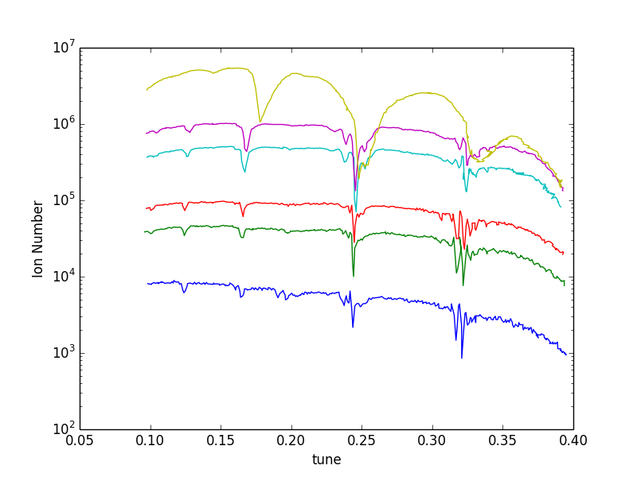
Further data

Slide 25
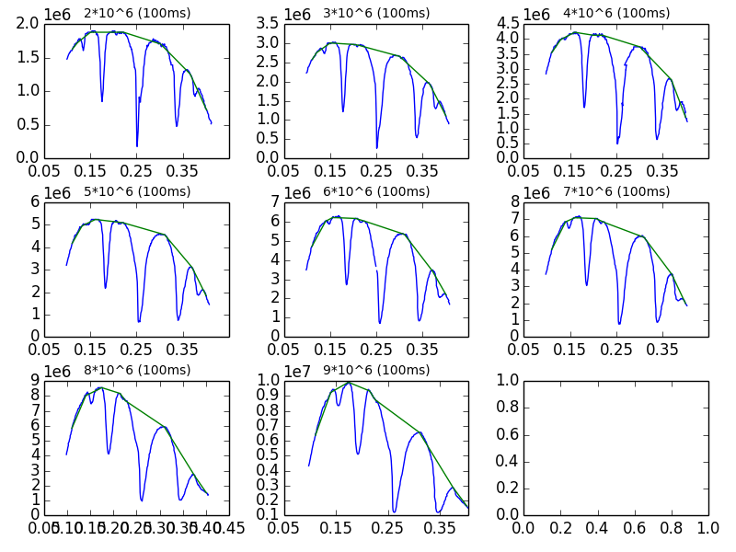
Alternative analysis options
Assuming ions are lost as maximum beta function increases

