Slide 1
Multi-bunch space charge effects for Slip-stacked beam in the Recycler
Rob Ainsworth
Space Charge 2017
4th October 2017

Slide 2
Outline
Accelerator complex
Slip-stacking
PIP and beyond
Synergia
Simulations
All plots presented are simulations (with exception of last one)
Summary

Slide 3
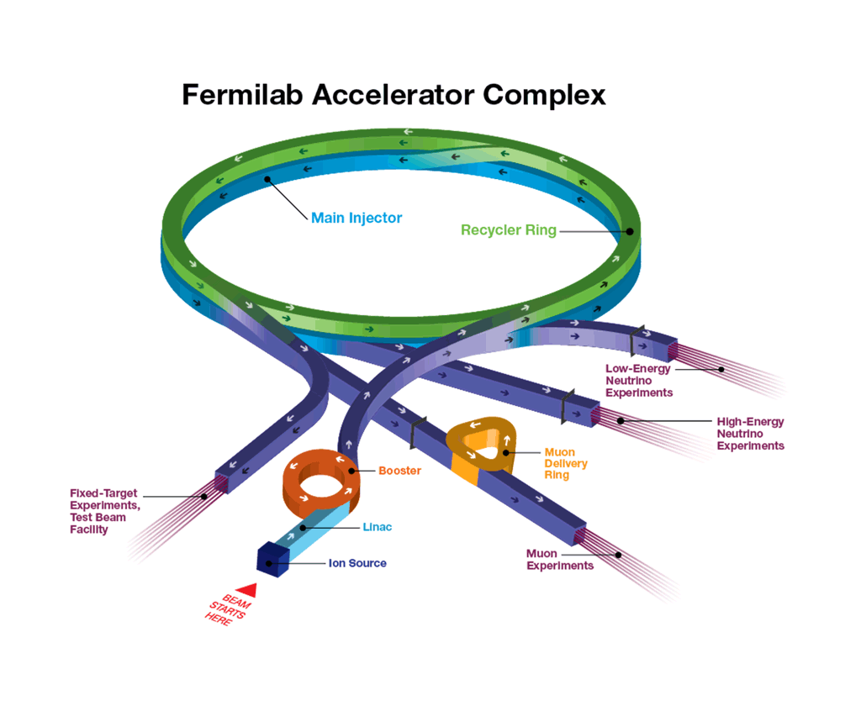
Accelerator complex
H⁻ linac
Booster
h = 84
15 Hz
400 MeV -> 8 GeV
Recycler
h = 588
Slip-stack 12 batches (double bunch intensity)
Main Injector
8 GeV -> 120 GeV

Slide 4
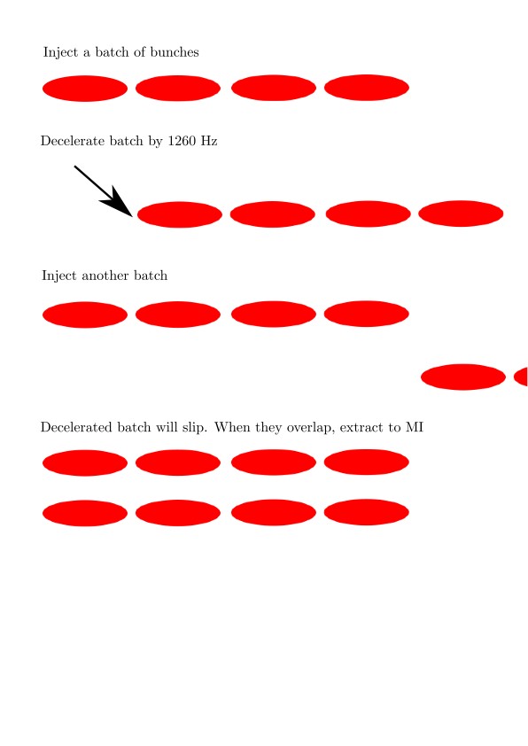
Slip-stacking
Slip-stacking allows us to double the intensity of the bunches in the Recycler

Slide 5
Power evolution
PIP
700 kW (~0.5 x 10¹¹ ppb)
15 Hz Booster
80 kV RF for recycler
1260 Hz separation for slip-stacking
PIPII
1.2 MW (~0.8 x 10¹¹ ppb)
20 Hz booster
140 kV RF for recycler
1680 Hz separation for slip-stacking
PIPIII
2.4 MW
No more slip-stacking, most likely replace booster with new RCS

Slide 6
Synergia
Self-consistent 3D Particle-in-cell accelerator simulation C++ code
Specifically to simulate collective effects in accelerators
Designed from the beginning to run on large parallel computing systems (but it doesn't have to)
Library of Objects which are combined to create a simulation
Lattice, Bunch(es), Diagnostics (bunch measurements), Collectives, Propagation scheme, all under programmatic control
One or two co-propagating single bunch or multi-bunch beams
Simulations are python scripts (not another special purpose language)
Collective effects included with split-operator formalism:
Space Charge (validated with GSI space charge benchmark, multiple models)
Impedance (per-element) within bunch and bunch-to-bunch, γ < ∞ for boosters
Single Particle Optics (full tracking or polynomial approximation)
Magnets, RF cavities, Drifts, Apertures, Septa
Simulation parameters may be dynamically controlled throughout execution by altering the state of the simulation objects (ramping of accelerator elements)
Combine most suitable algorithms in each area for a complete simulation.

Slide 7
Synergia
Synergia contains an internal test suite that verifies the correct operation of most modules. Particle tracking is verified with MAD-X/PTC and analytic calculations. Space charge kicks are verified with analytic calculations. Particles are labeled.
Synergia is actively used to model all of our circular machines:
Recycler, Main Injector, Booster, IOTA, Debuncher
Synergia is developed by the Acceleration Simulations Group within Fermilab’s Scientific Computing Division and is publicly available.
J. Amundson, P. Lebrun, Q. Lu, A. Macridin, L. Michelotti, C. S. Park, E. Stern, T. Zolkin.
https://web.fnal.gov/sites/synergia

Slide 8
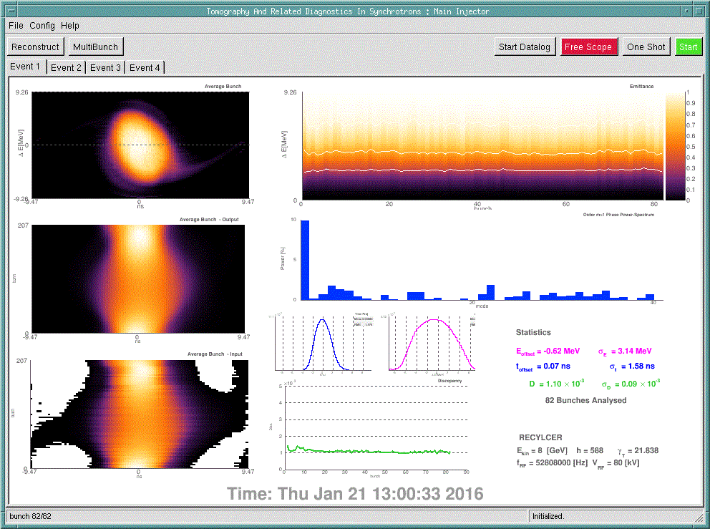
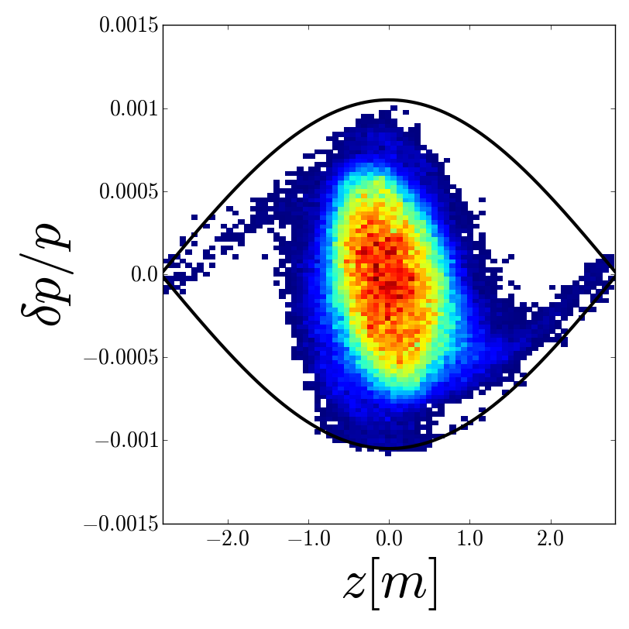
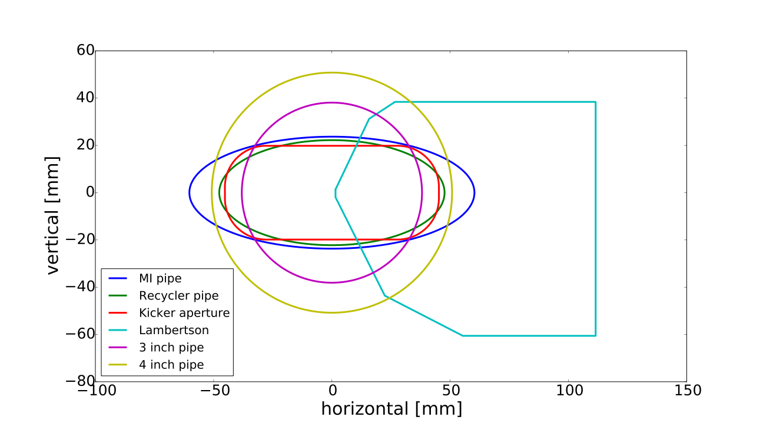
Recycler simulations - inputs
Realistic longitudinal distribution from tomography
Transverse distribution matched but using measured beam sizes
MAD8 input file
Using apertures, orbit bumps,

Slide 9
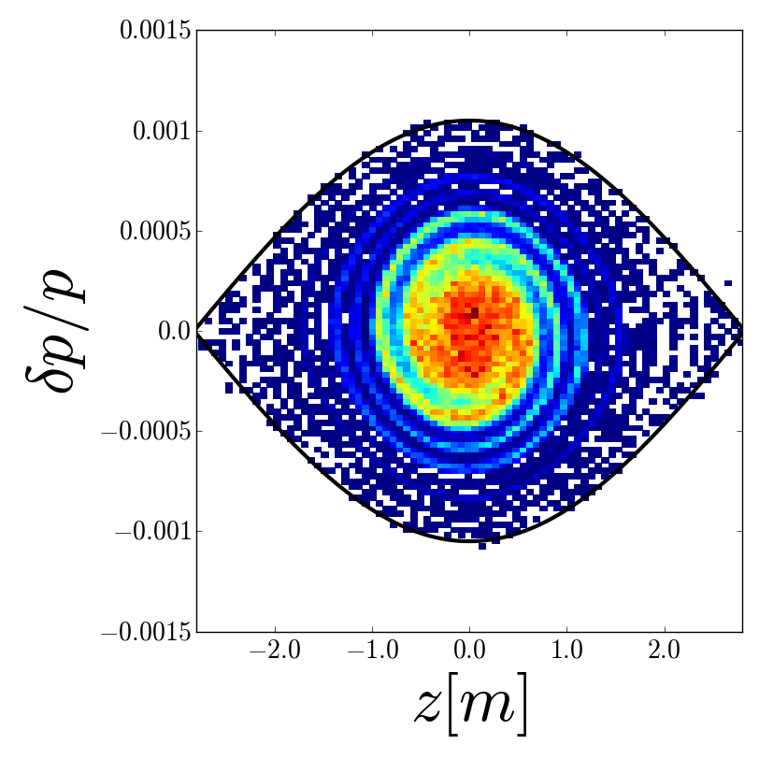
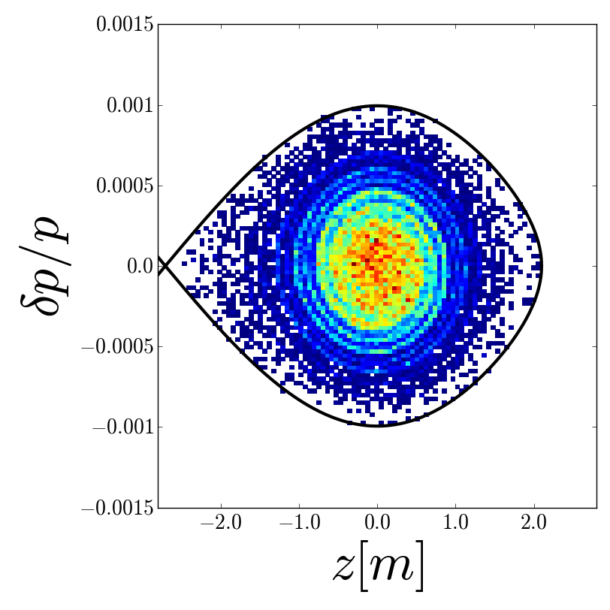
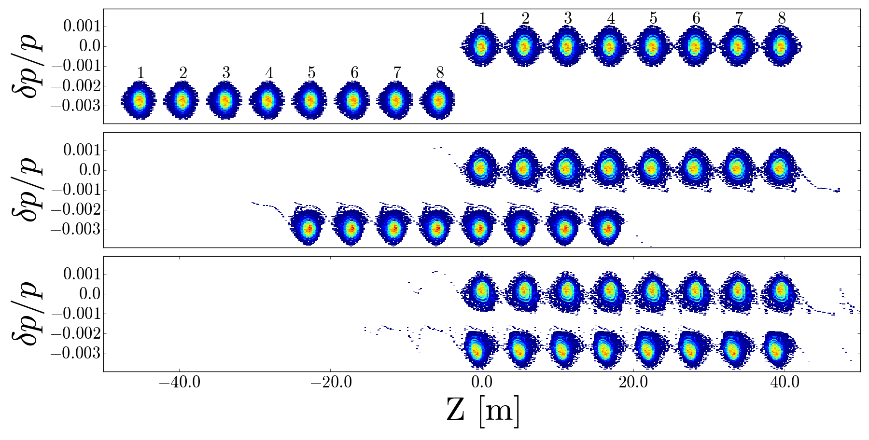
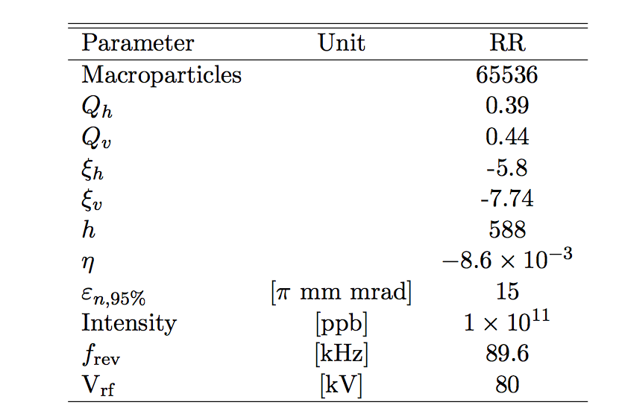
Recycler simulations
Decelerate
1260Hz
50ms
Filament
50ms

Slide 10
Space charge footprint

Slide 11
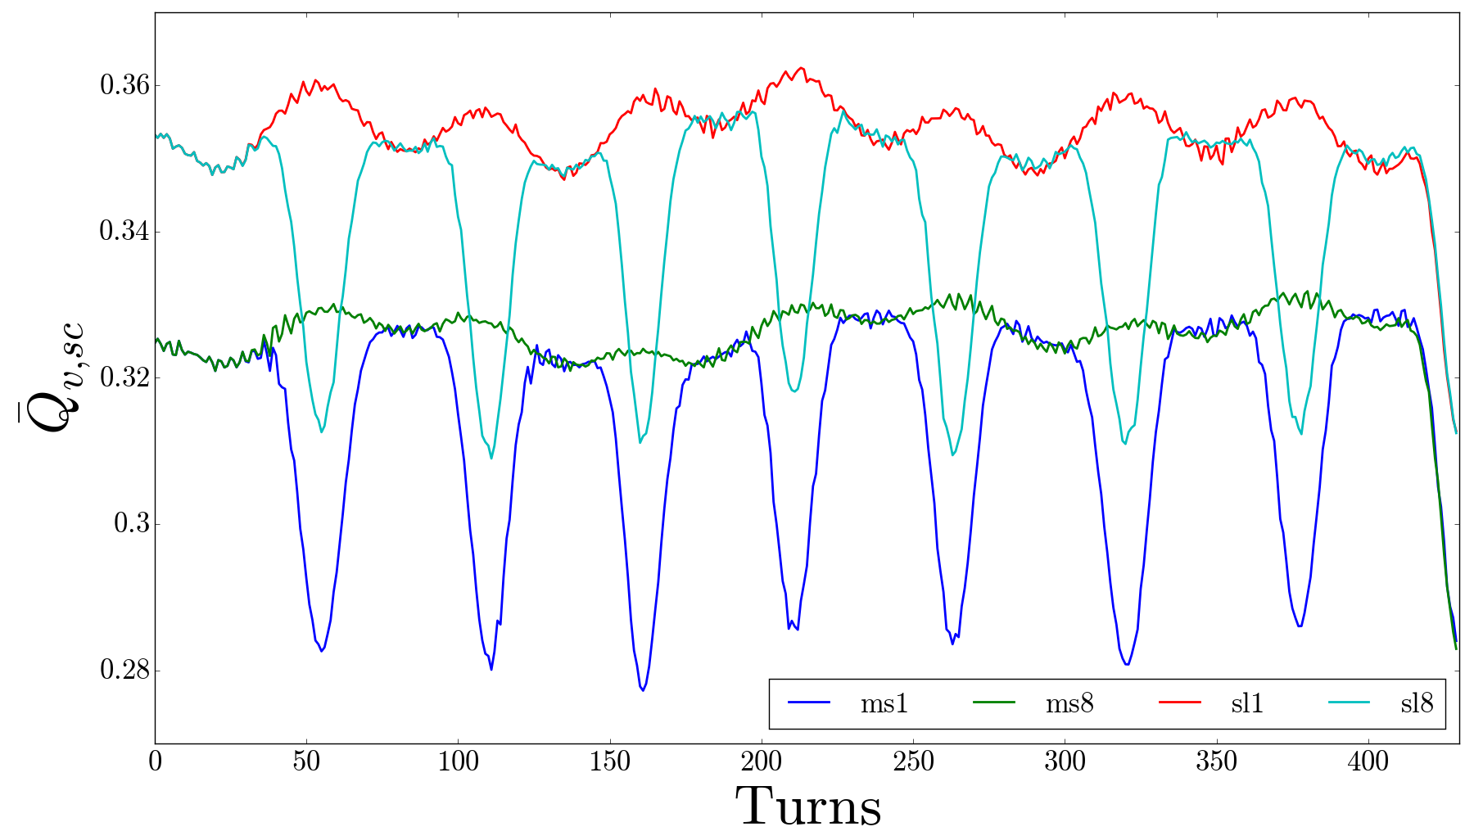
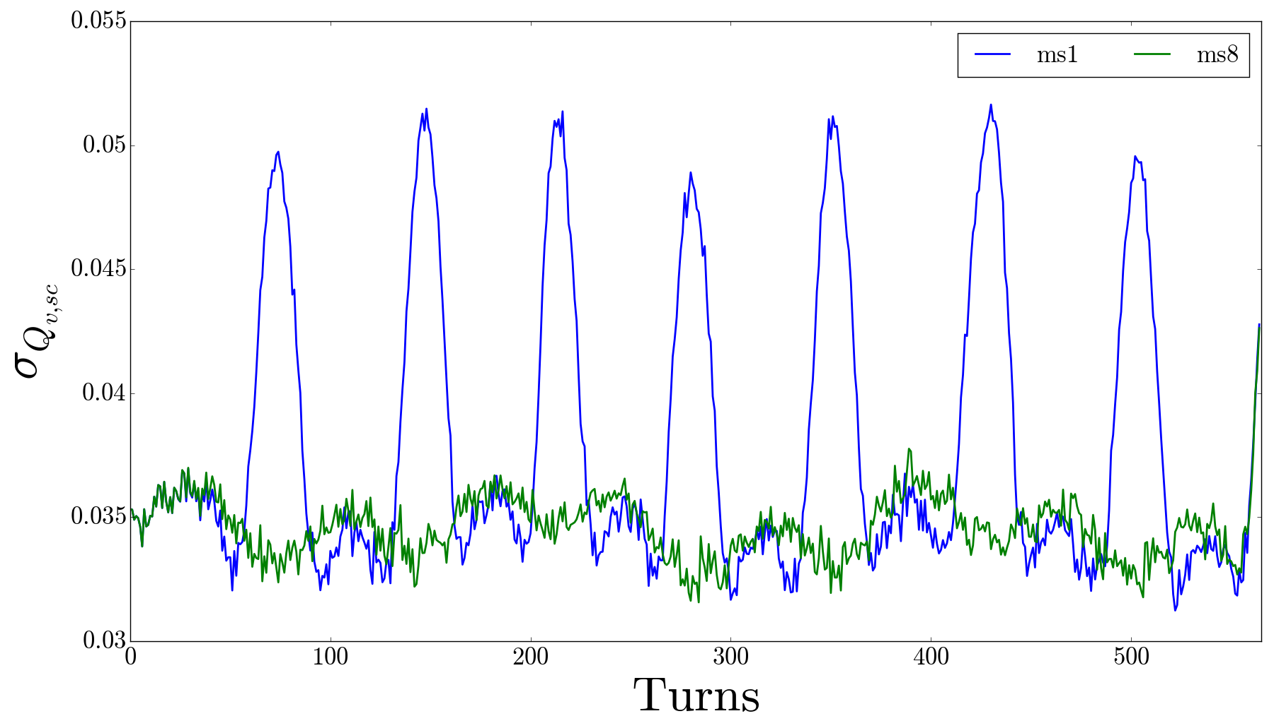
Footprint vs turn
Mean of the footprint
Std of the footprint

Slide 12
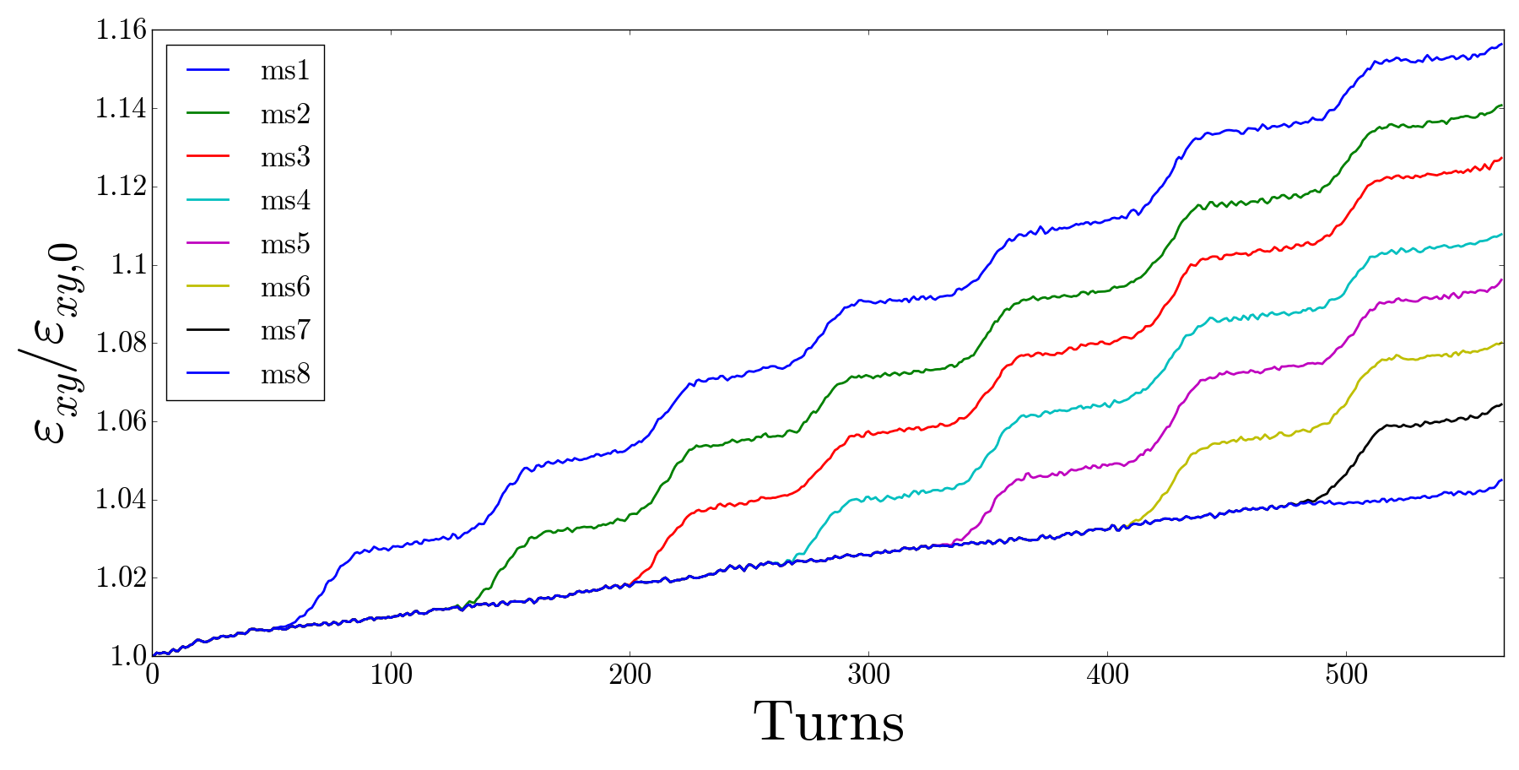
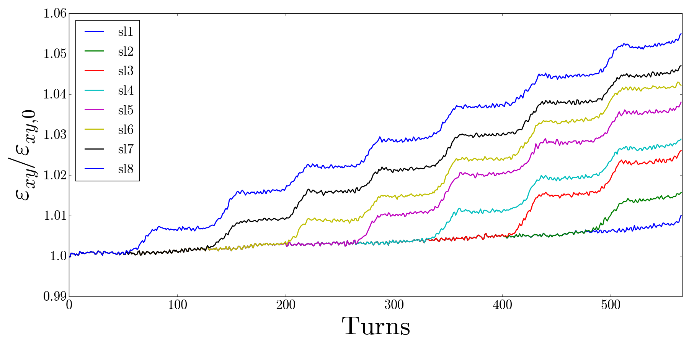
Effect on emittance

Slide 13
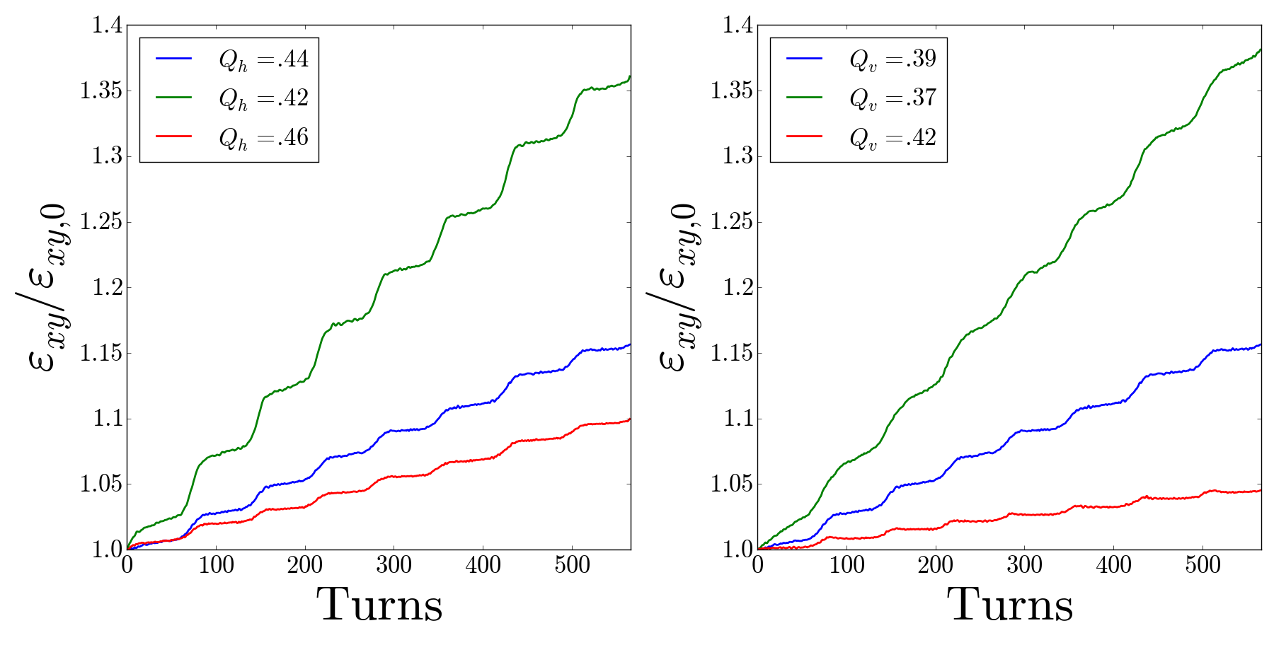
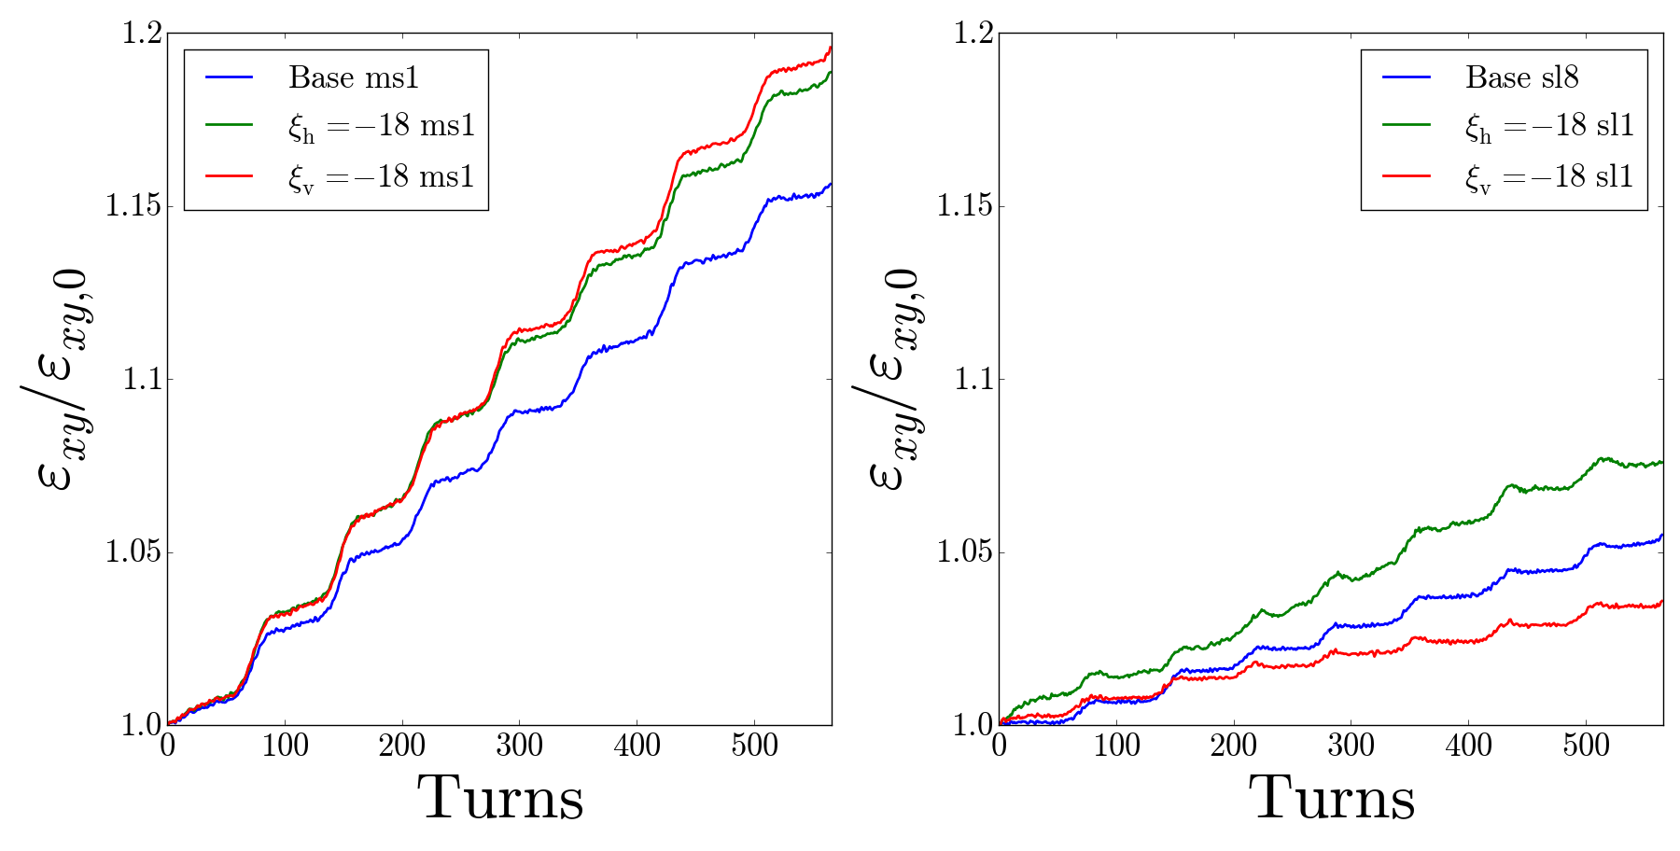
Tunes + Chromaticity
Lower tunes
worsens growth
as expected
Higher Chromaticity
also increases growth
in general
Off-Momentum sees
slight improvement due
shift from chromaticity

Slide 14
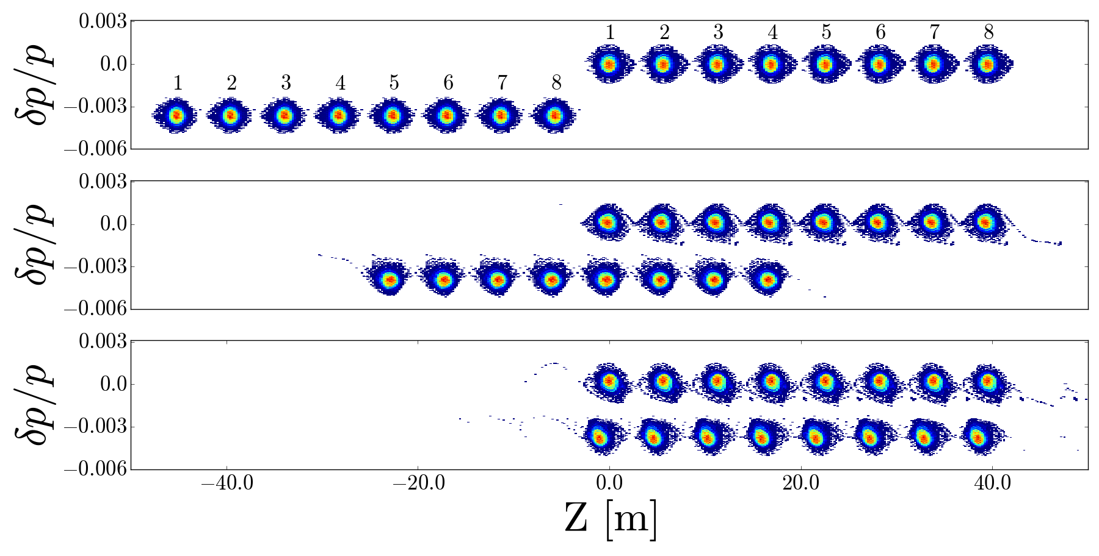
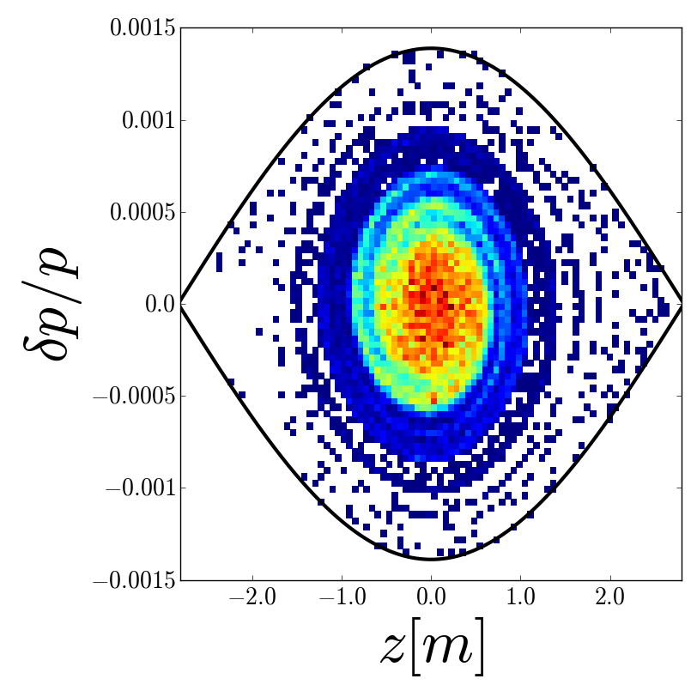
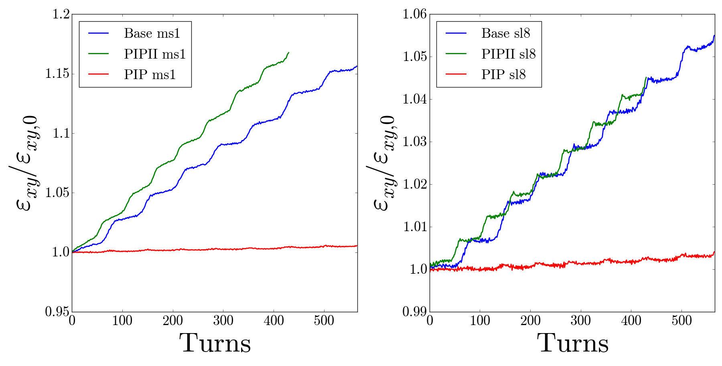
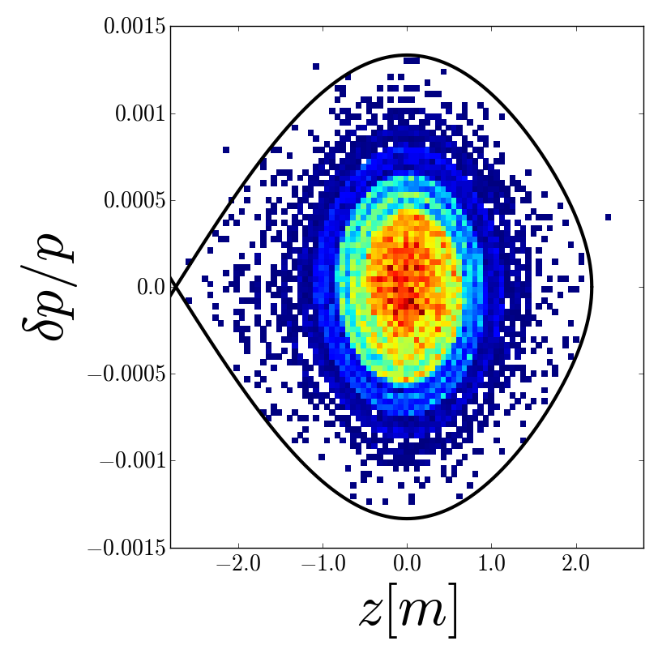
PIPII
Separation
increased
from 1260
to 1680 Hz
80 to 140 kV
15 Hz to 20 Hz

Slide 15
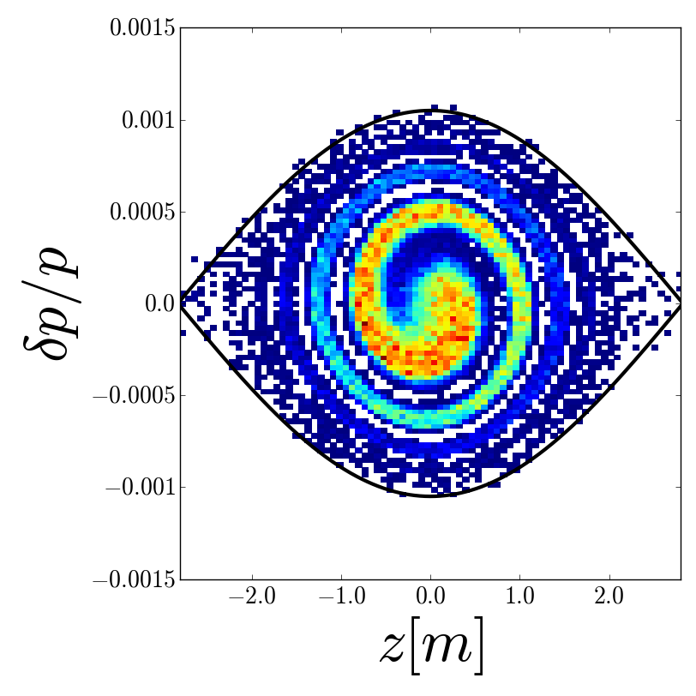
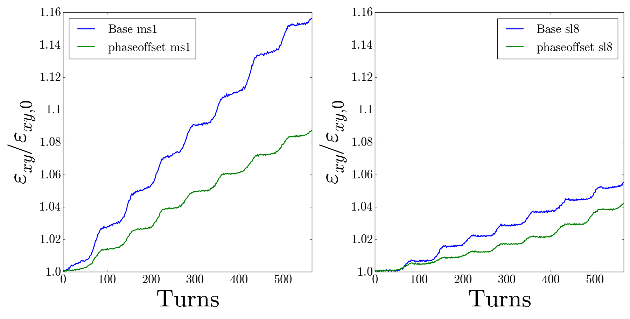
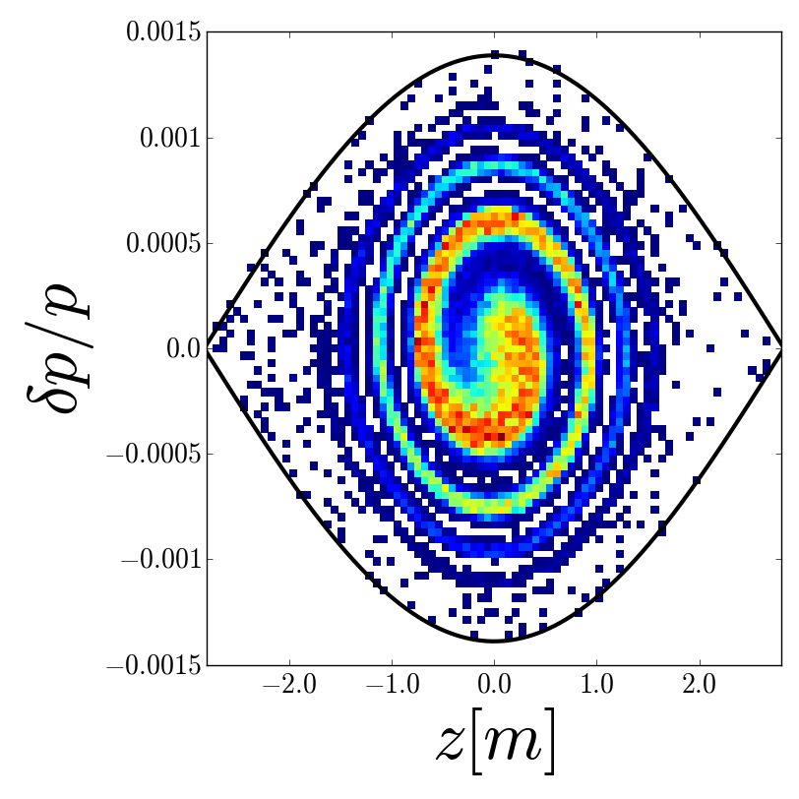
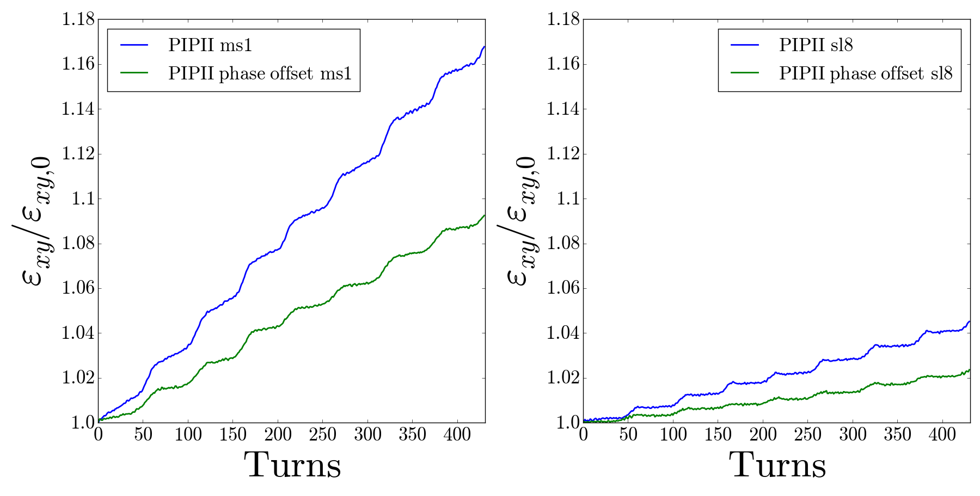
Phase-offset
Base case
with
1.5ns
injection
offset
PIPII case
with
1.5ns
injection
offset

Slide 16
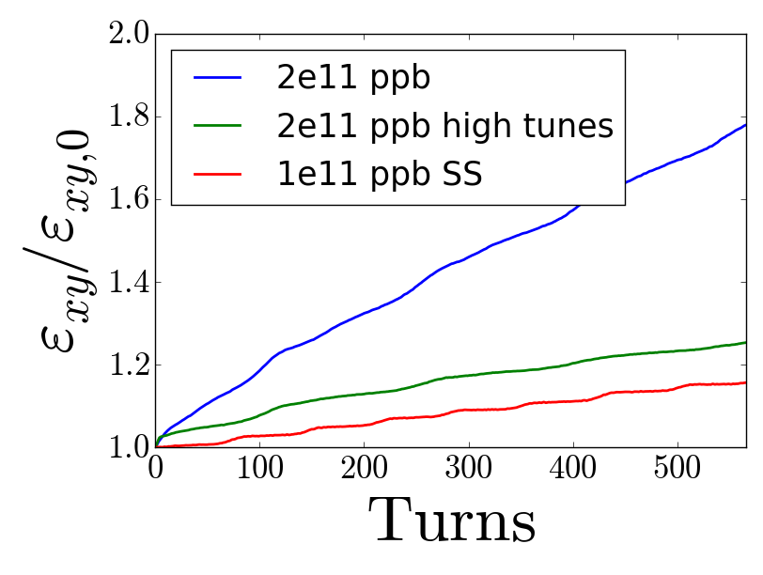
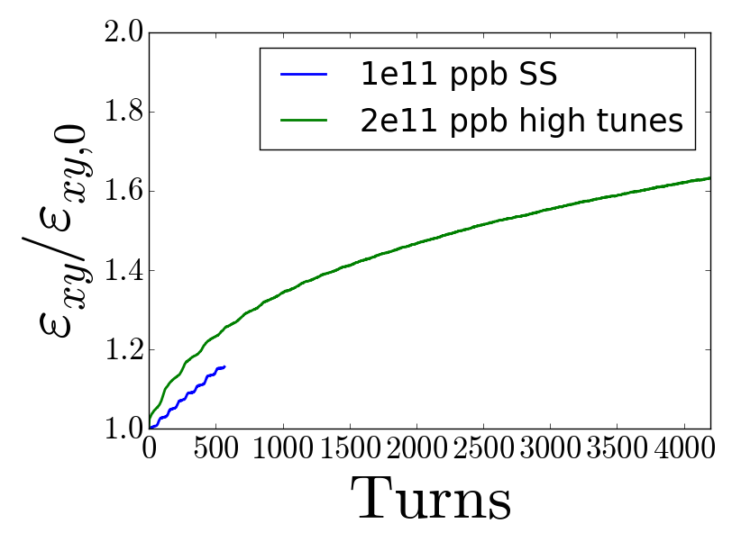
Single bunch vs Slip-stacking
Compared single bunch double intensity with slip-stacked case
Tune shift bigger for longer in single bunch however, more tune space available without off-momentum bunch
Need to see when SS case begins to saturate

Slide 17
Conclusions
As intensity increases, the space charge effects from slip-stacking result in emittance growth during the overlaps
PIP-II parameters help longitudinally (less uncaptured beam) however, the transverse growth is the same.
The effects can be minimized by optimizing the tunes and using an injection phase offset

Slide 18
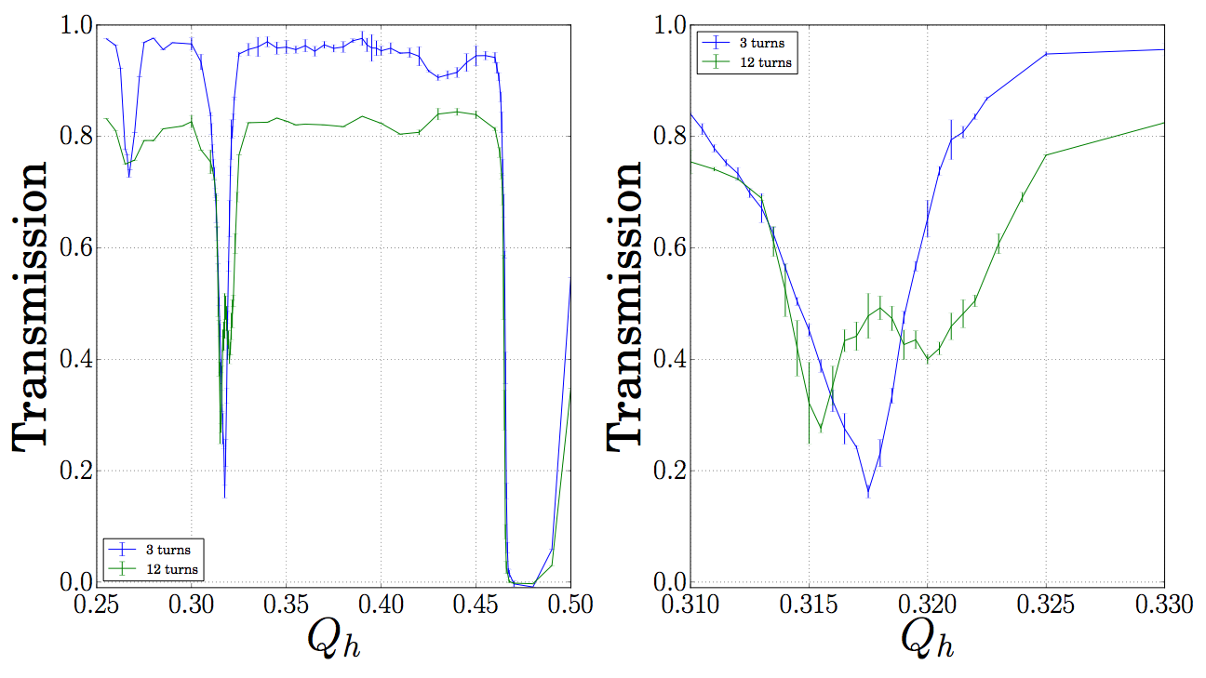
Next steps
81 bunch on 81 bunch simulation to determine when saturation occurs
Investigate resonance compensation of the 3rd to open up the tune space

Slide 19
Back-up

