Slide 1
PS Studies
Space Charge Workshop 04/10/2017
F.Asvesta, H.Bartosik , A.Huschauer, Y.Papaphilippou, M.Serluca, G.Sterbini

Slide 2
Overview
Motivation
Frequency Map Analysis
On-momentum particles
Off-momentum particles
Machine Development and Simulation Studies
Vertical Tune Scans (space charge dominated)
3rd Order Skew Resonance Compensation
Vertical Tune Scans (non- space charge dominated)
Summary

Slide 3
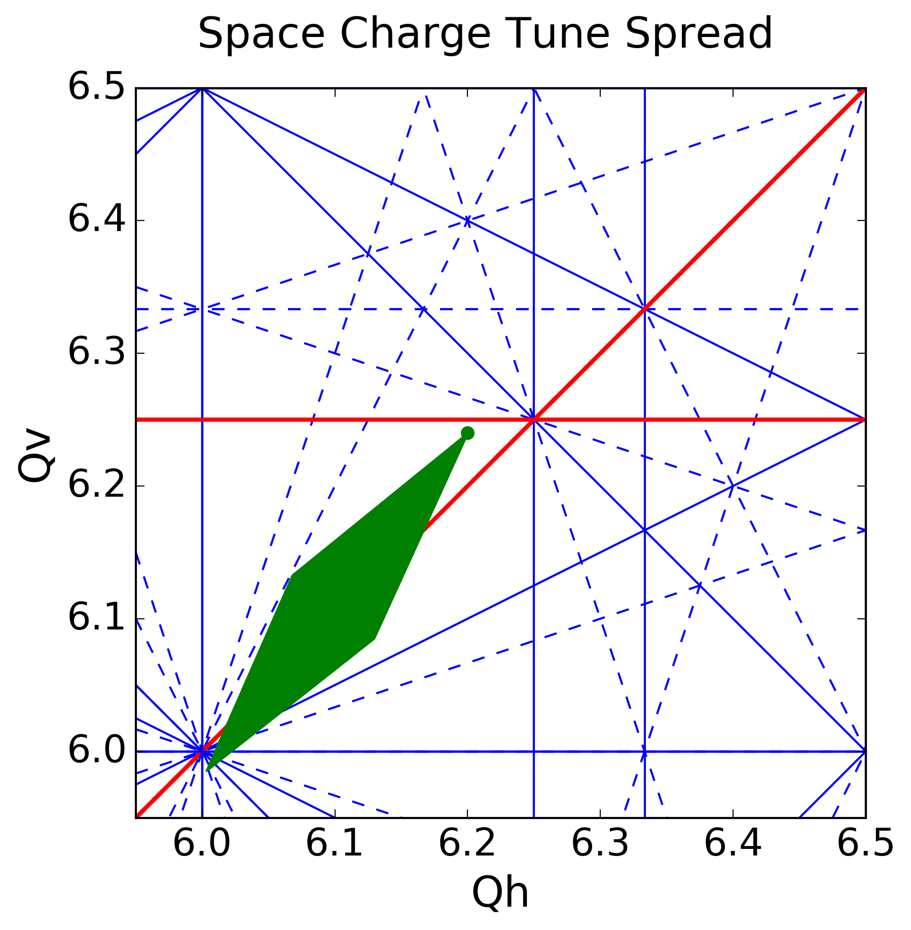
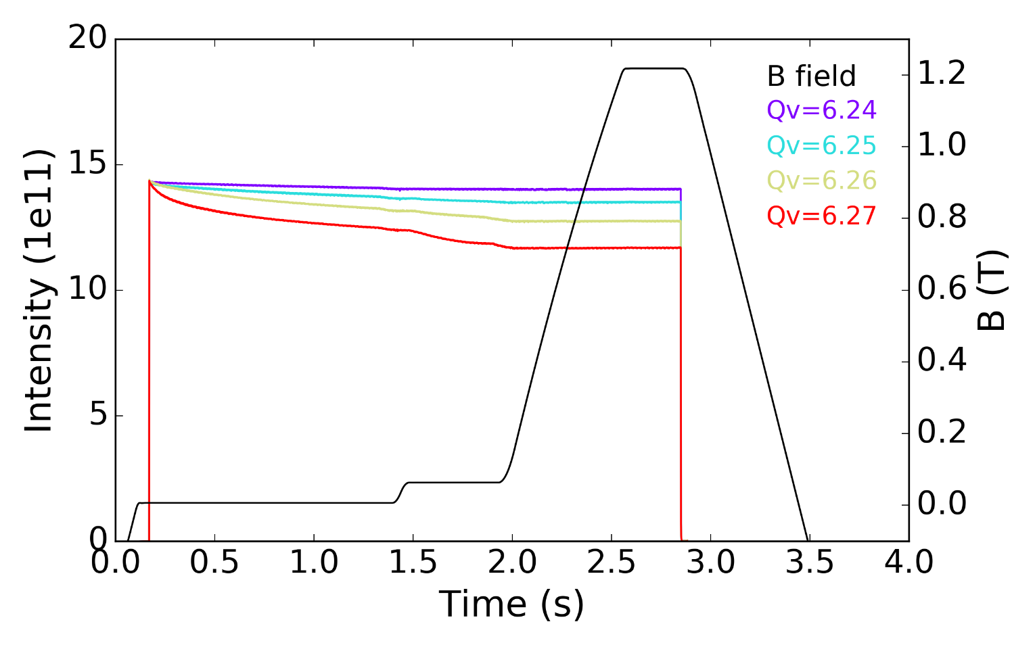
Motivation
Limitations towards the LIU goals for the PS performance connected to space charge:
Vertical integer resonance
The $Q_{v}=6.25$ 8th order structural resonance (S. Machida, R.Wasef et.al).
Space charge tune spread in the PS
for LHC-type beams.

Slide 4
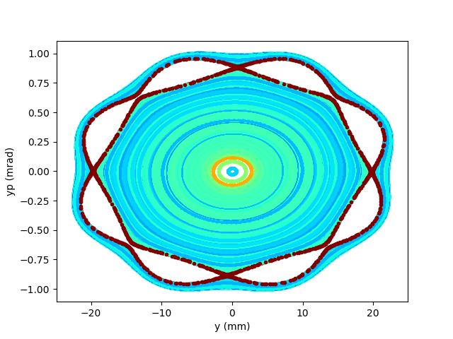
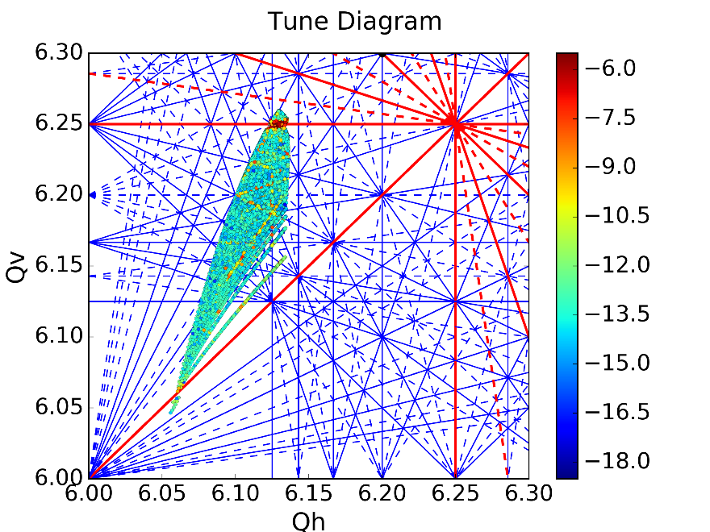
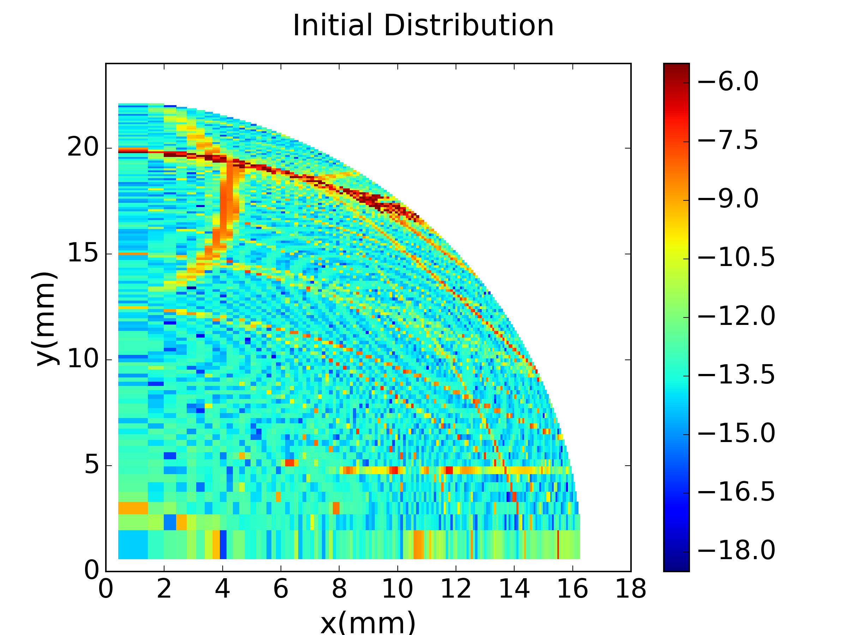
Frequency Maps
Diffusion:$D=\log{\sqrt{\left[{\left(Q_{x2}−Q_{x1}\right)}^{2}+{\left(Q_{y2}−Q_{y1}\right)}^{2}\right]}}$
$${ Q}_{2}, over second synchrotron period$$
$Q_{1}, over first synchrotron period$
Tracking on-momentum particles under the influence of space charge using the Py-ORBIT Frozen model
Tunes of individual particles
calculated over one synchrotron period
Resonance lines up to 8th order
Working Point
Initial position in the transverse plane of the tracked particles

Slide 5
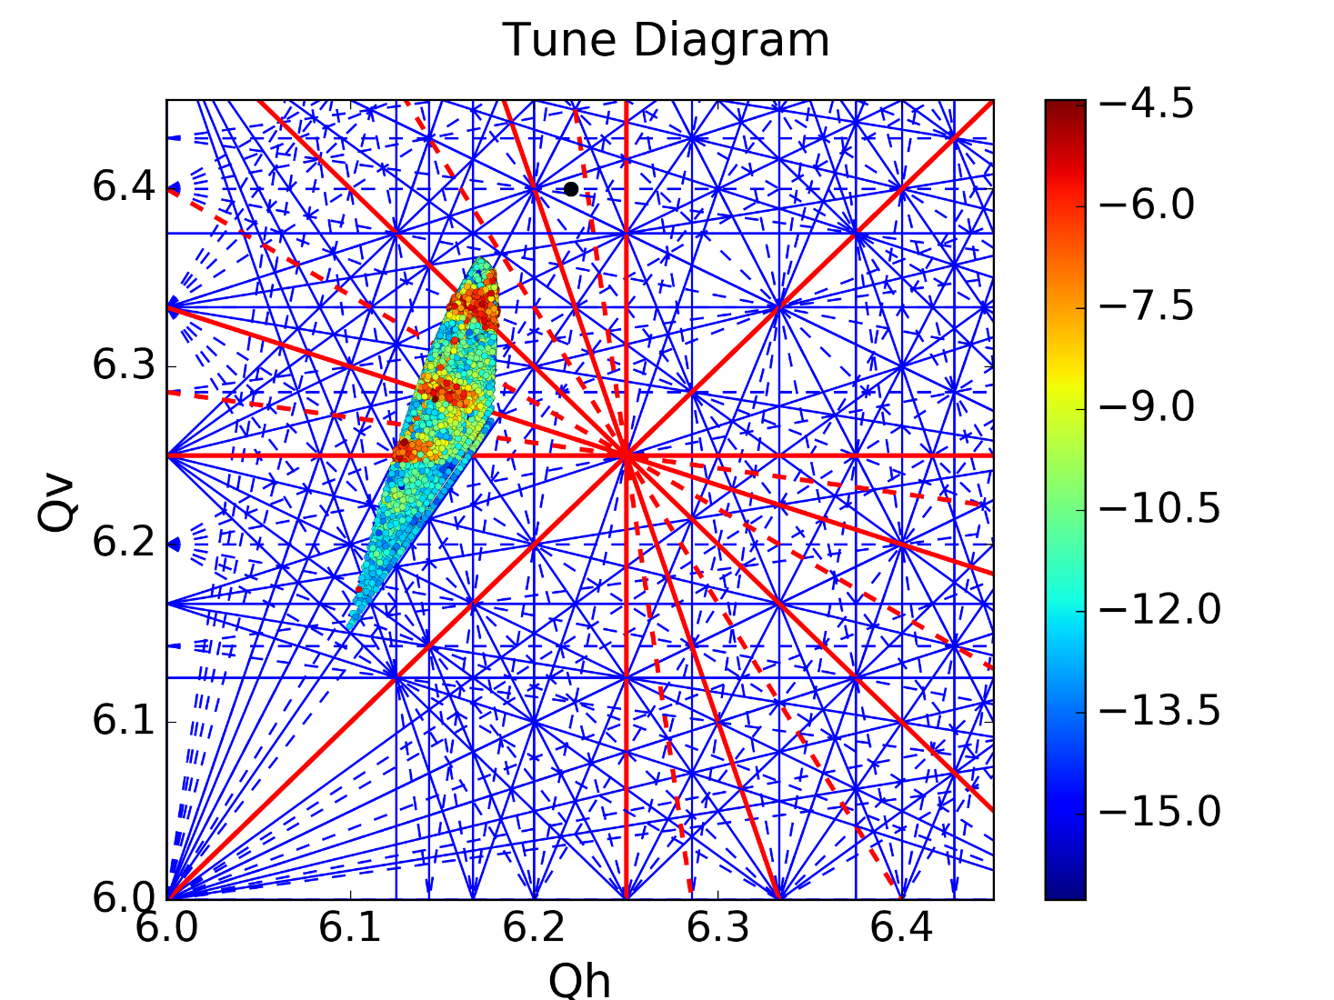
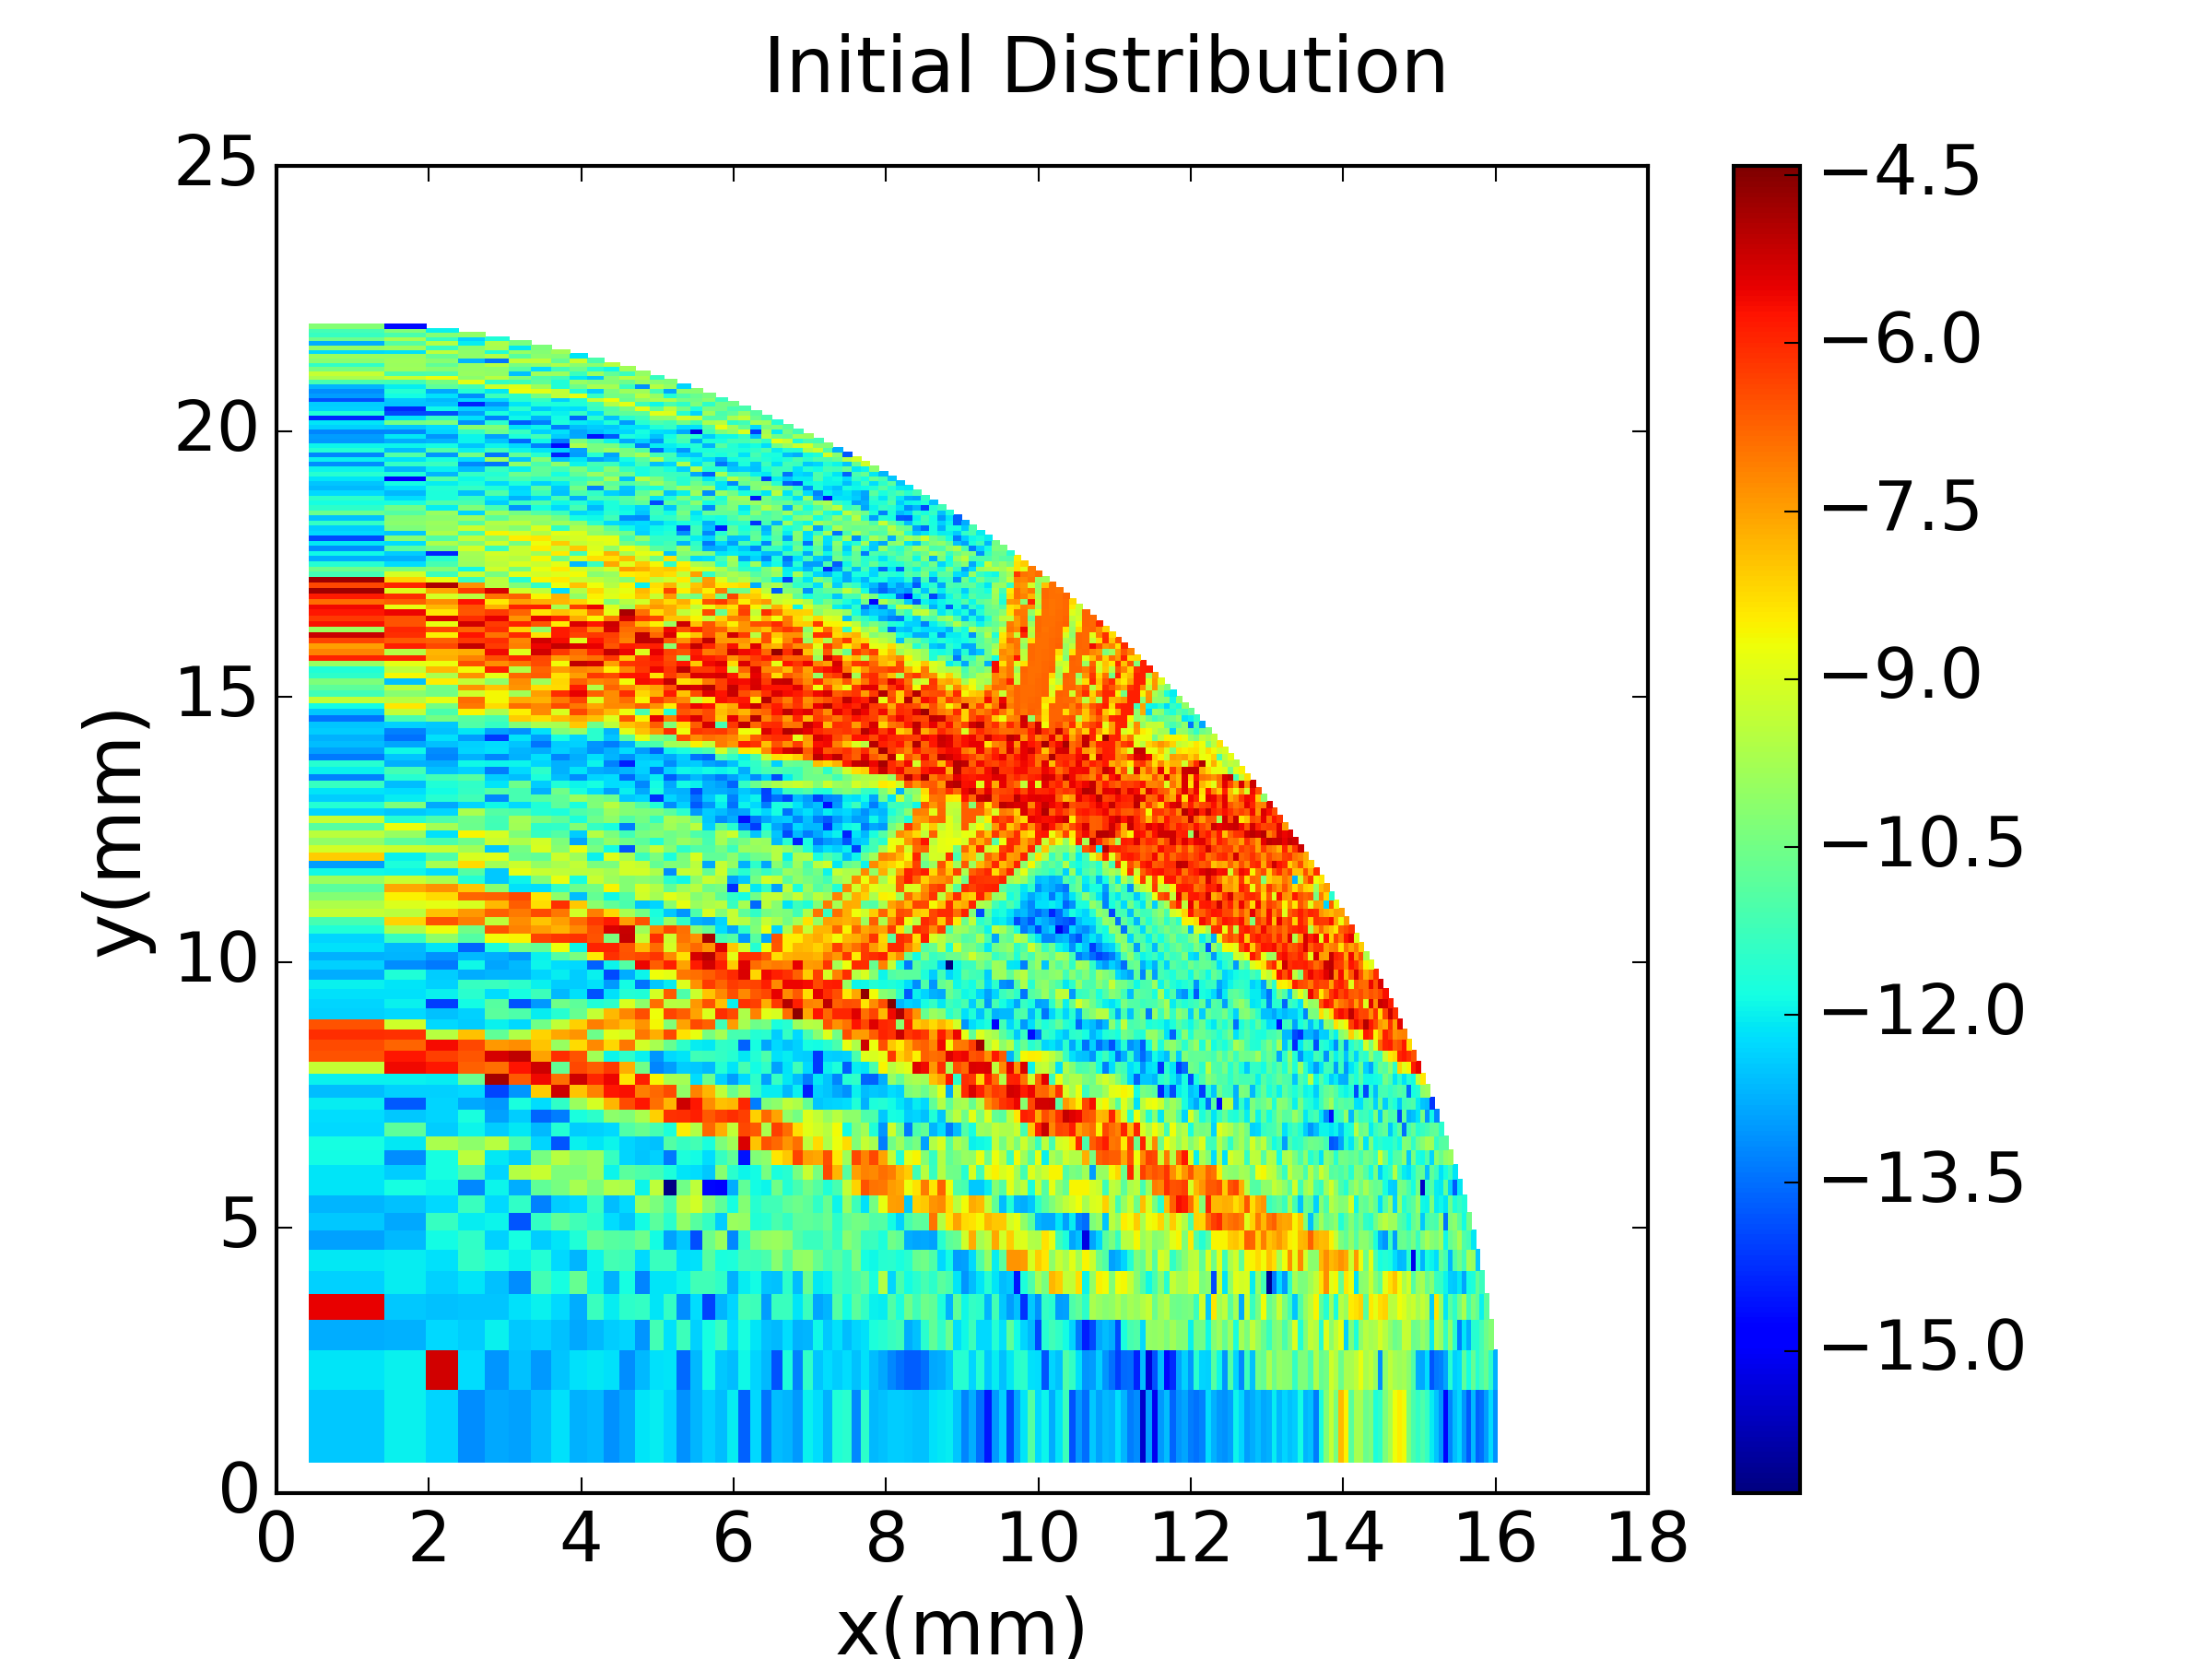
Frequency Maps
Tracking off-momentum particles under the influence of space charge using the Py-ORBIT Frozen model
More particles trapped by the resonances due to the periodic crossing
Excitation of all the 8th order structural resonances

Slide 6
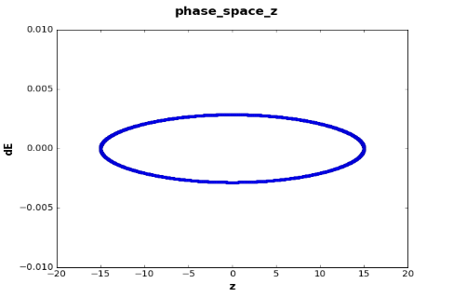
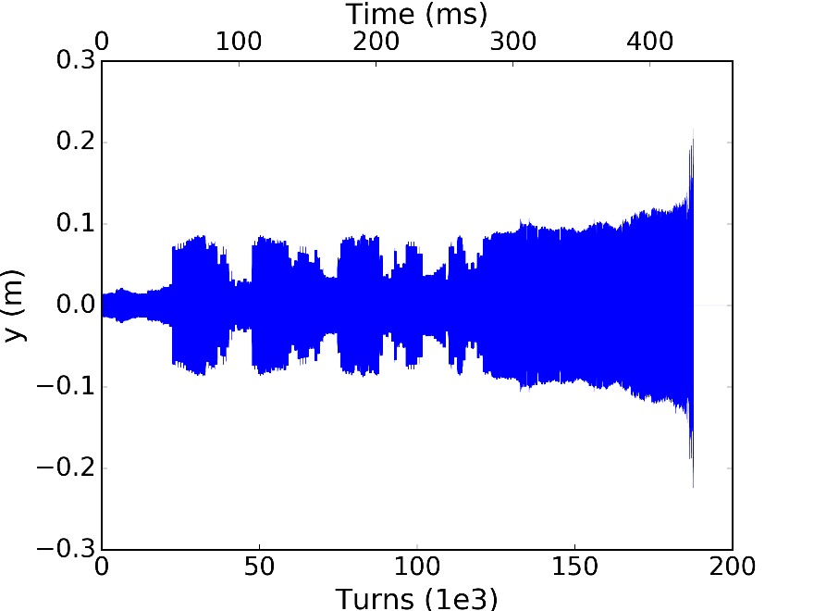
Frequency Maps
Longitudinal Phase Space
Tracking off-momentum particles with the same longitudinal action (${\frac{Δp}{p}}_{max}=2.27{∗10}^{−3}$) for $10k turns\sim 23ms$
Particles initialized with the same initial longitudinal position $z_{0}=−15m$ and ${\frac{Δp}{p}}_{0}=$0
Losses increase in steps since the particles cross the resonance at the same time in their synchrotron motion
Losses increase as we increase the number of turns since particles crossing the resonance gradually gain amplitude reaching the mechanical aperture

Slide 7
Machine Development and Simulation Studies
Machine Studies
Single Bunch
Coupling Corrected
In operation is enhanced to damp horizontal head tail instability
Transverse Feedback ON
In operation OFF
Simulation Studies
PS non-linear lattice
higher order multipoles from pole face windings in the main magnets
Space charge frozen model
electric field calculated for bi-Gaussian distribution using Bassetti Erskine formula

Slide 8
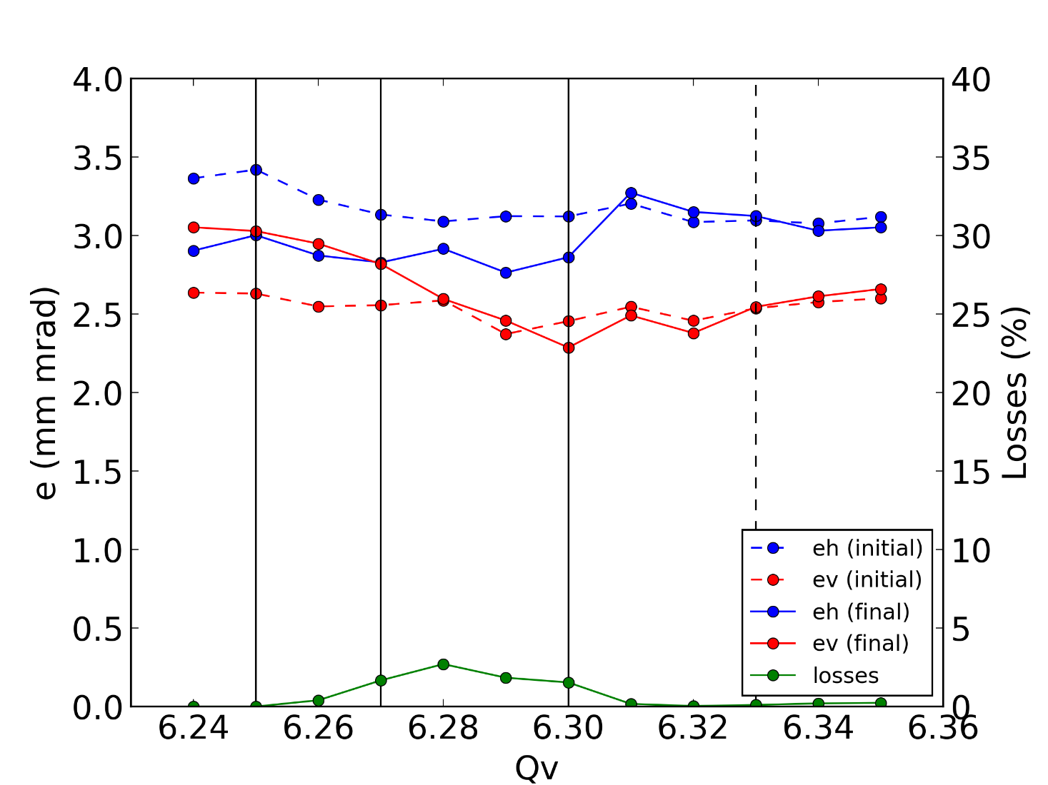
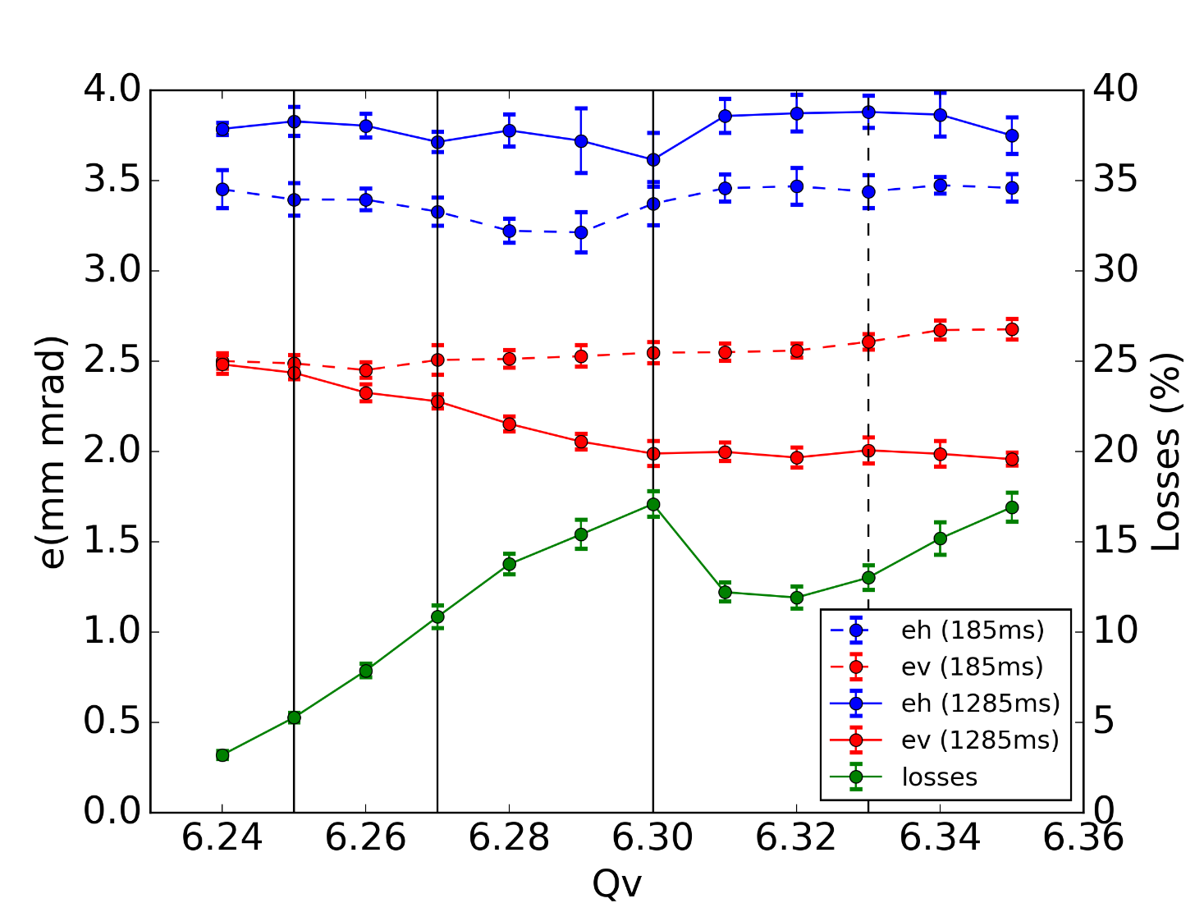
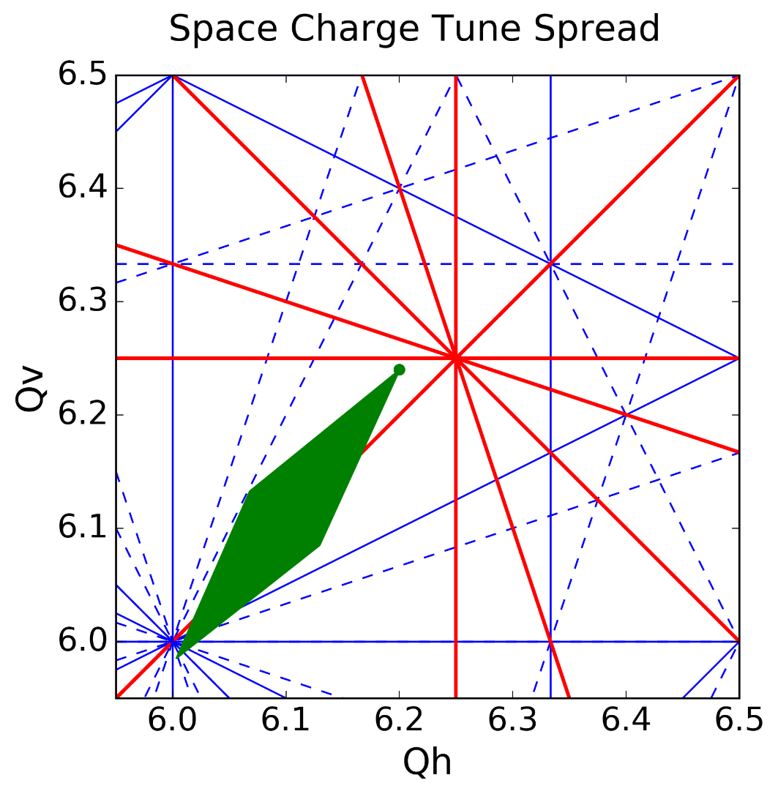
Vertical Tune Scan
Simulation for $500k turns\sim 1.2s$
$$Q_{h}=6.20$$
Experimental Data ($1.2s$ storage)
$$Q_{h}=6.20$$
Vertical chromaticity corrected
Discrepancy between measurement and simulation especially in terms of losses
$$20\% vs 5\%$$
Other resonances excited?
3rd (skew)
3rd (skew)
4th (skew) / 8th
4th / 8th
4th / 8th
4th / 8th
4th (skew)/ 8th
4th / 8th

Slide 9
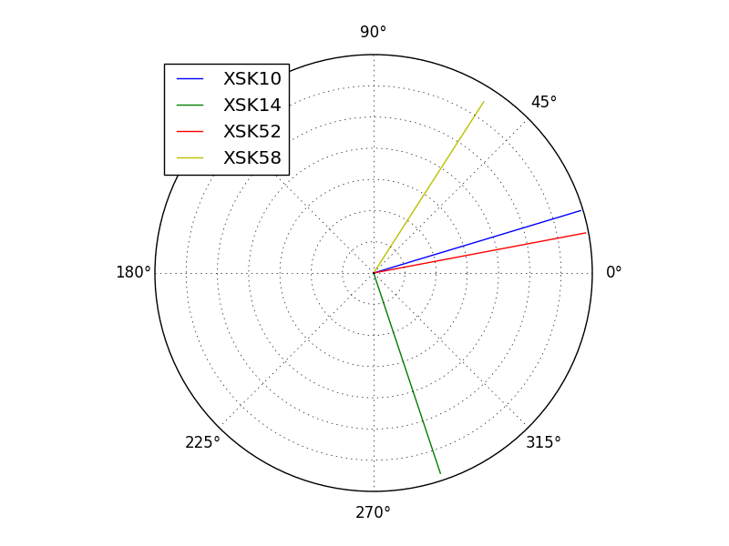
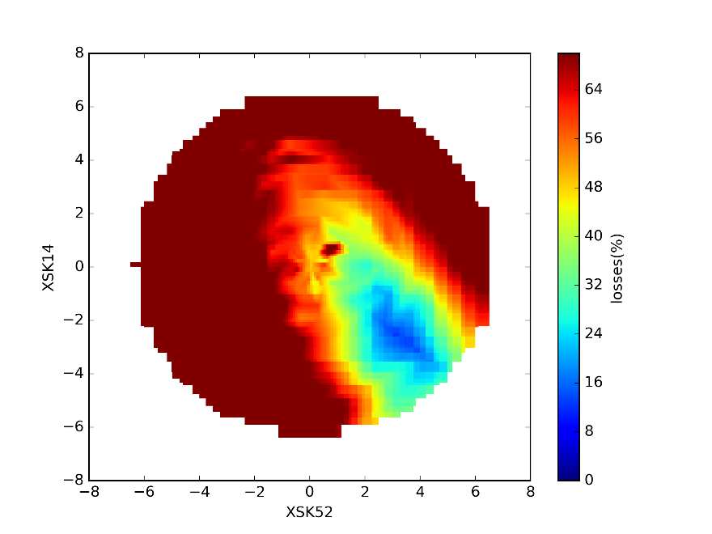
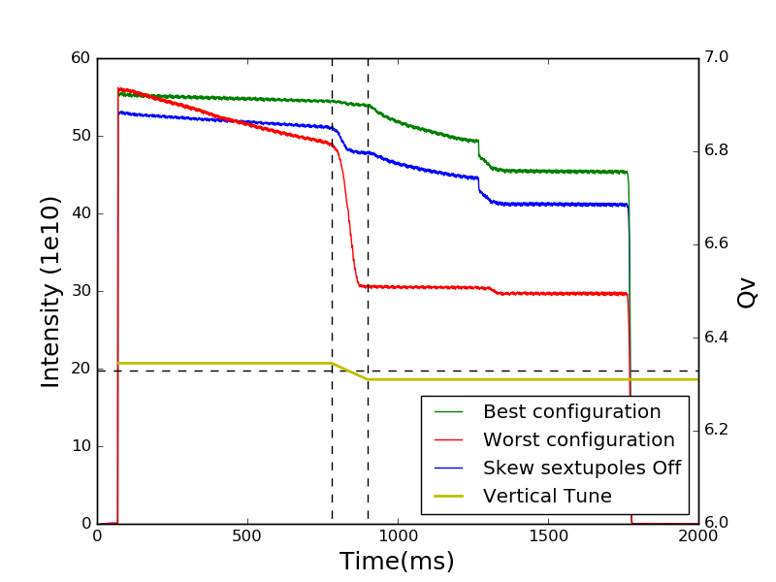
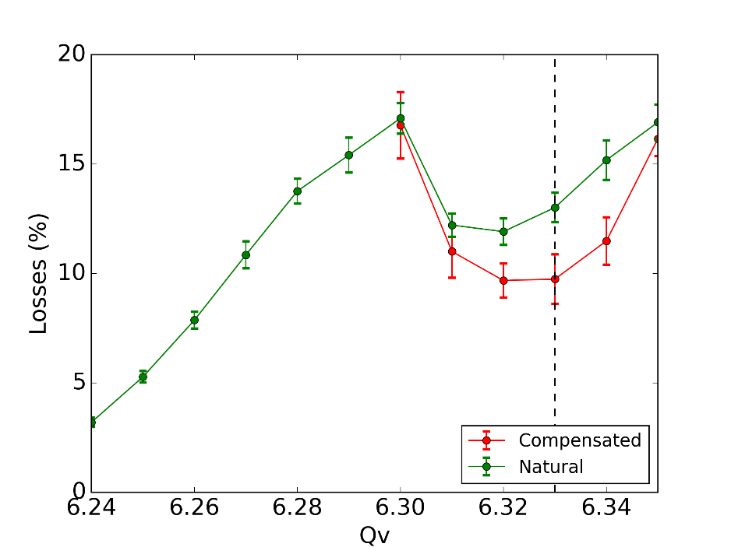
3rd Order Skew Resonance
Calculation of the resonance driving terms using PTC for the available skew sextupoles.
Various configurations of the sextupoles were tested while the resonance was dynamically crossed using a beam with a space charge tune spread $ΔQ_{h}\sim ΔQ_{v}\sim 0.08$.
Losses are reduced close to the$Q_{v}=6.33$
but come to a second maximum as the tune is further increased
More resonances excited?
Evaluating the beam losses in the time period of the tune change the best configuration for the resonance compensation was selected.
A vertical tune scan using an LHC type beam with a typical space charge tune spread of $ΔQ_{h}\sim 0.2,ΔQ_{v}\sim 0.25$ .
3rd (skew)

Slide 10
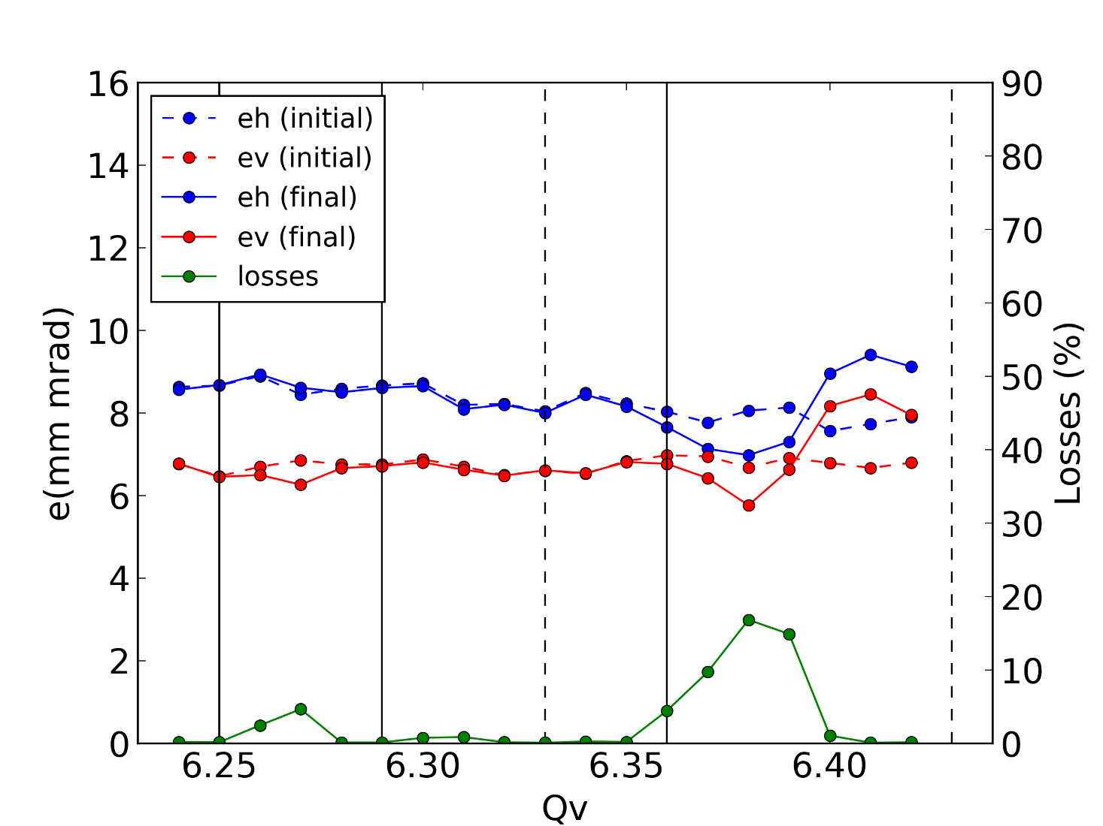
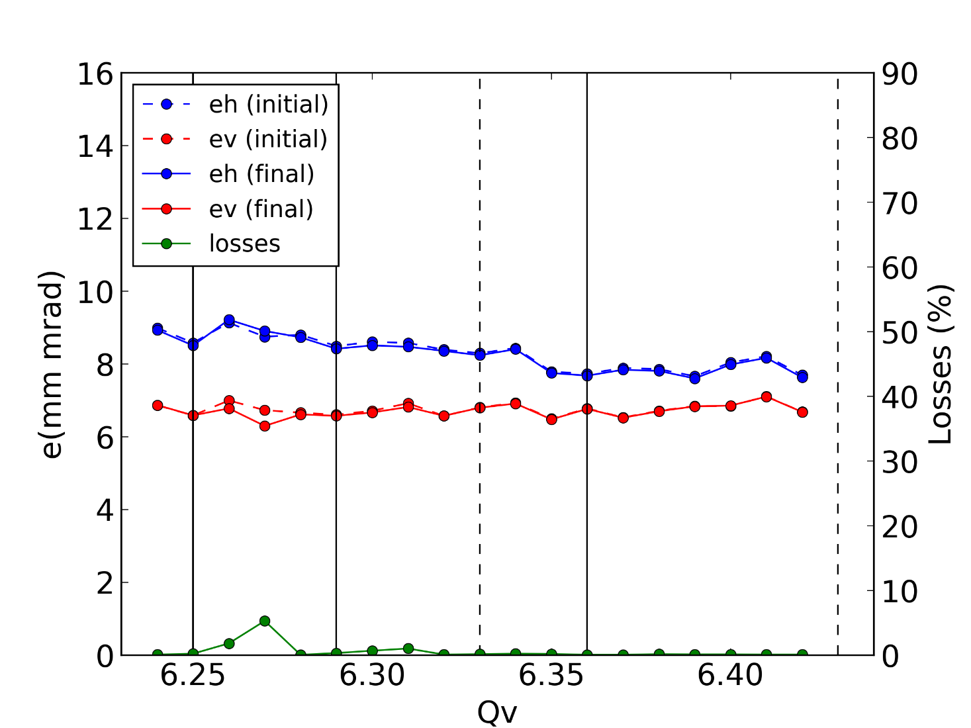
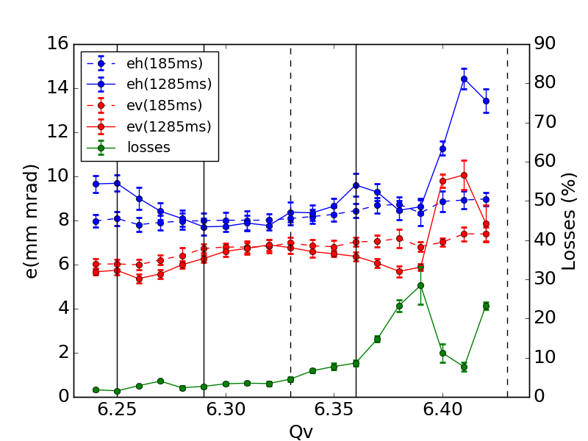
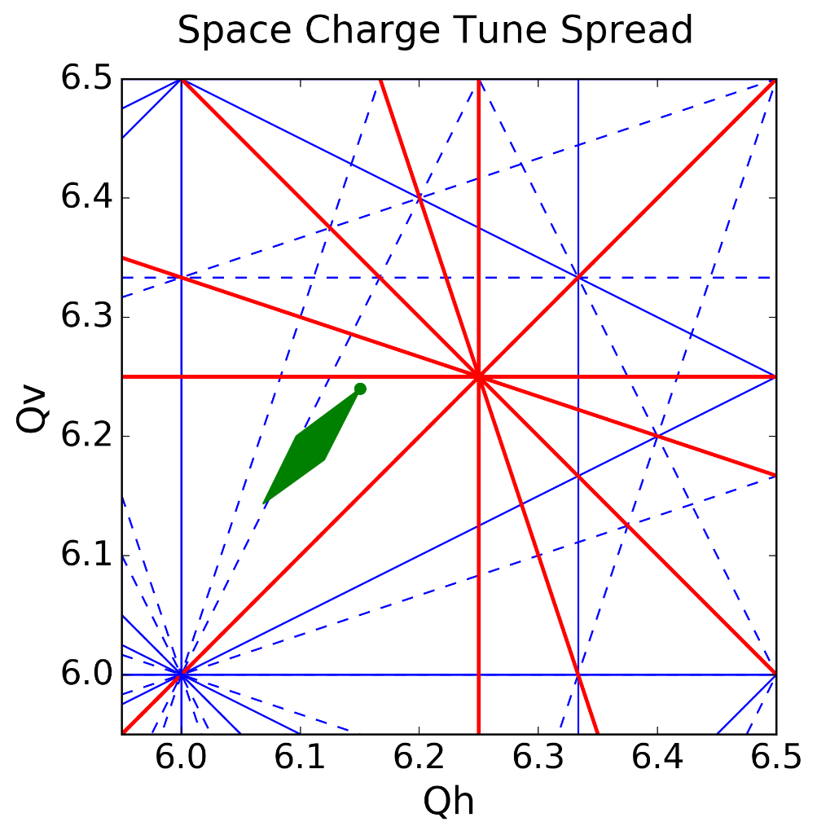
Vertical Tune Scan
Simulation for $100k turns\sim 250ms$ 2% max Octupole excitation
$$Q_{h}=6.15$$
Simulation for $100k turns\sim 250ms$
$$Q_{h}=6.15$$
Experimental Data ($1.2s$ storage)
$$Q_{h}=6.15$$
Natural Chromaticity
3rd order skew resonance compensated
Remnant fields from the octupoles used in some PS operational cycles (Multi Turn Extraction) seem to explain the behavior
Could degaussing of the octupoles reduce the losses?
4th / 8th
3rd (skew)
4th (skew)/ 8th
4th / 8th
3rd
3rd
4th (skew) / 8th
3rd (skew)
4th / 8th
4th / 8th
4th / 8th
4th (skew)/ 8th
4th / 8th
3rd
3rd (skew)

Slide 11
Summary & Outlook
Machine Studies
The effect of the 8th order structural resonance $8Q_{v}$ has been studied in terms of losses, emittance variation and profile evolution
The resonance ${3Q}_{v},$ naturally excited in the PS, has been compensated using skew sextupoles
The 4th order $2Q_{h}+2Q_{v}$ is also excited possibly due to the presence of remnant fields in the octupoles used during operation
Simulation Studies
The full PS flat bottom has been simulated using the Py-ORBIT frozen model
The simulation results cannot fully replicate the experimental data especially in terms of losses
Further studies
Stability issues for high vertical tunes (Transverse Feedback)
Degaussing of the octupoles used in operation
PS model and simulation tools optimization
Thank you for your attention

Slide 12
Back up

Slide 13
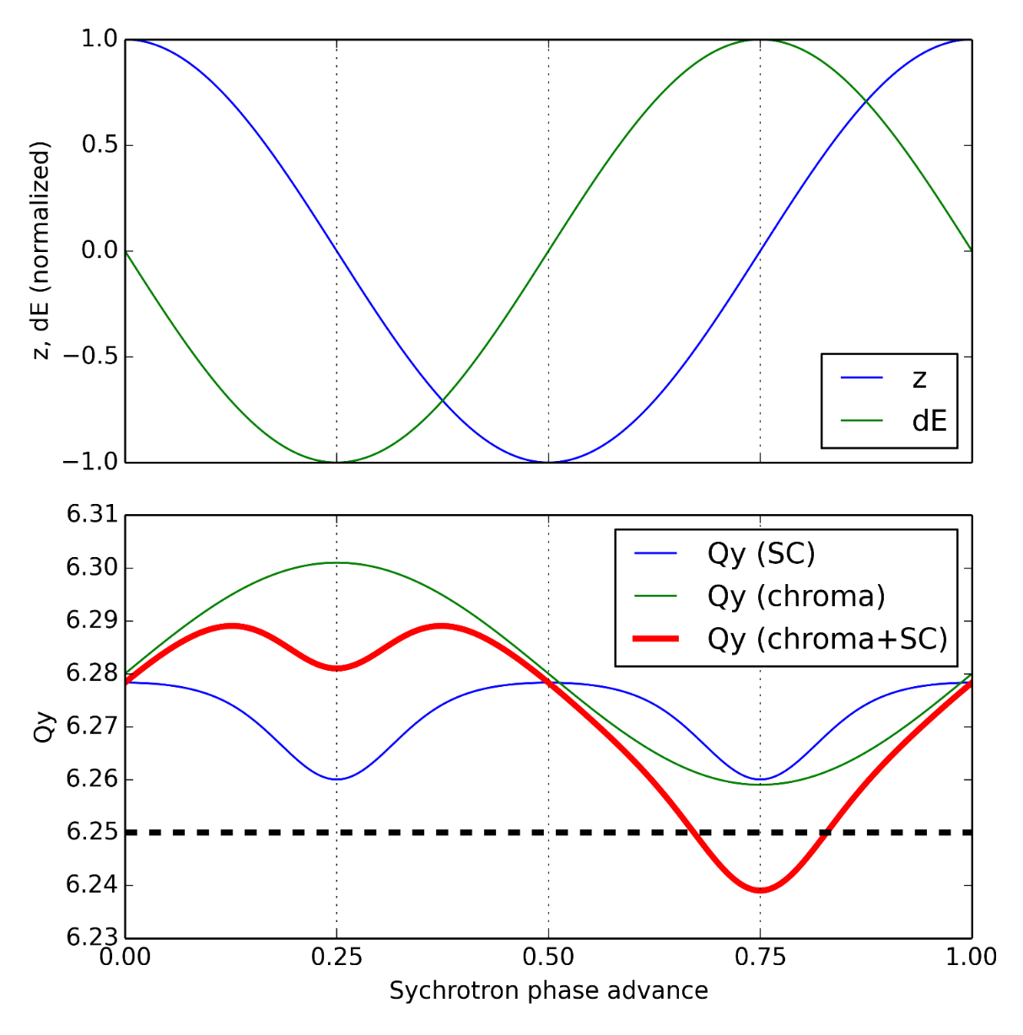
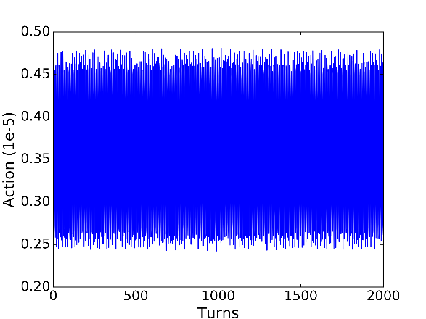
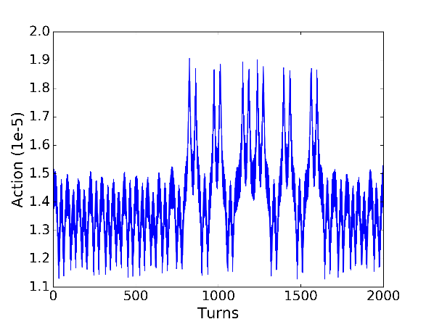
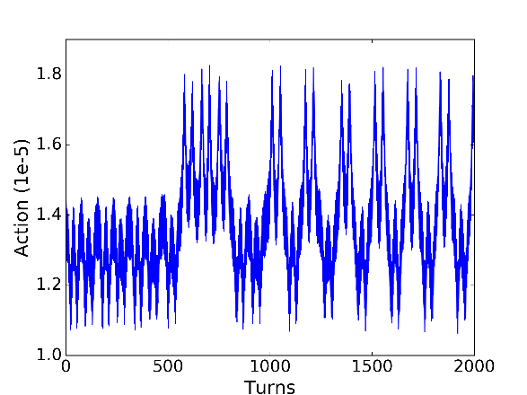
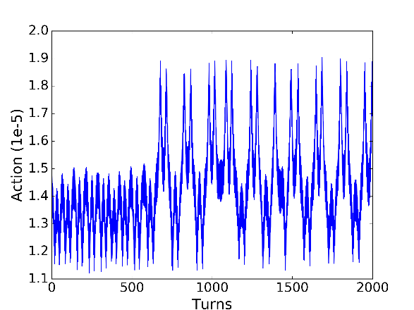
Resonance crossing

Slide 14
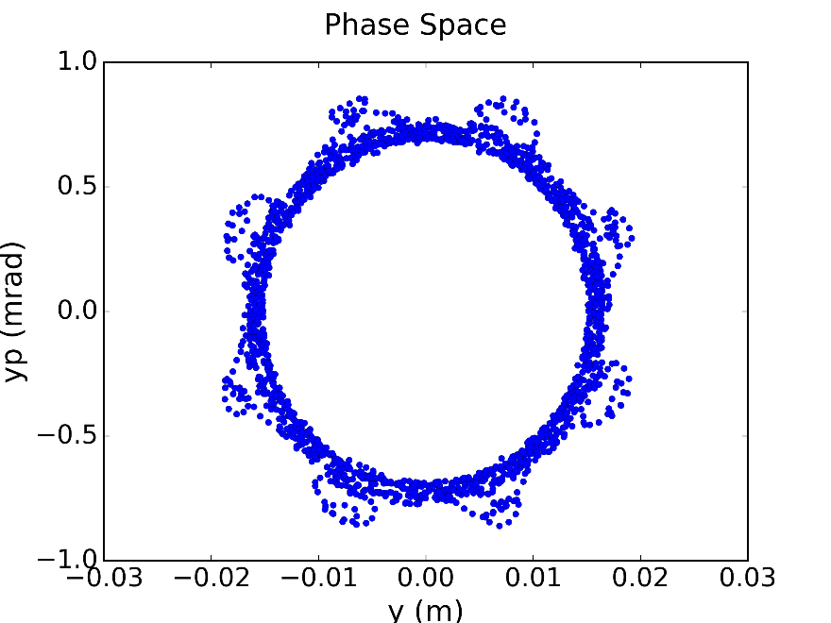
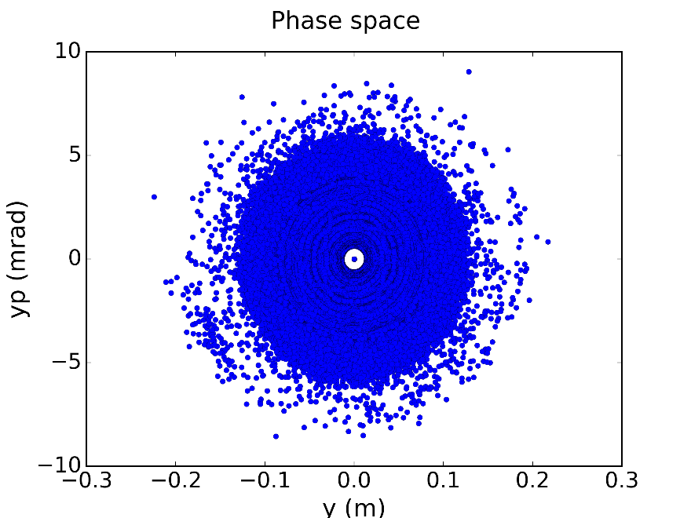
Single Particle Tracking

Slide 15
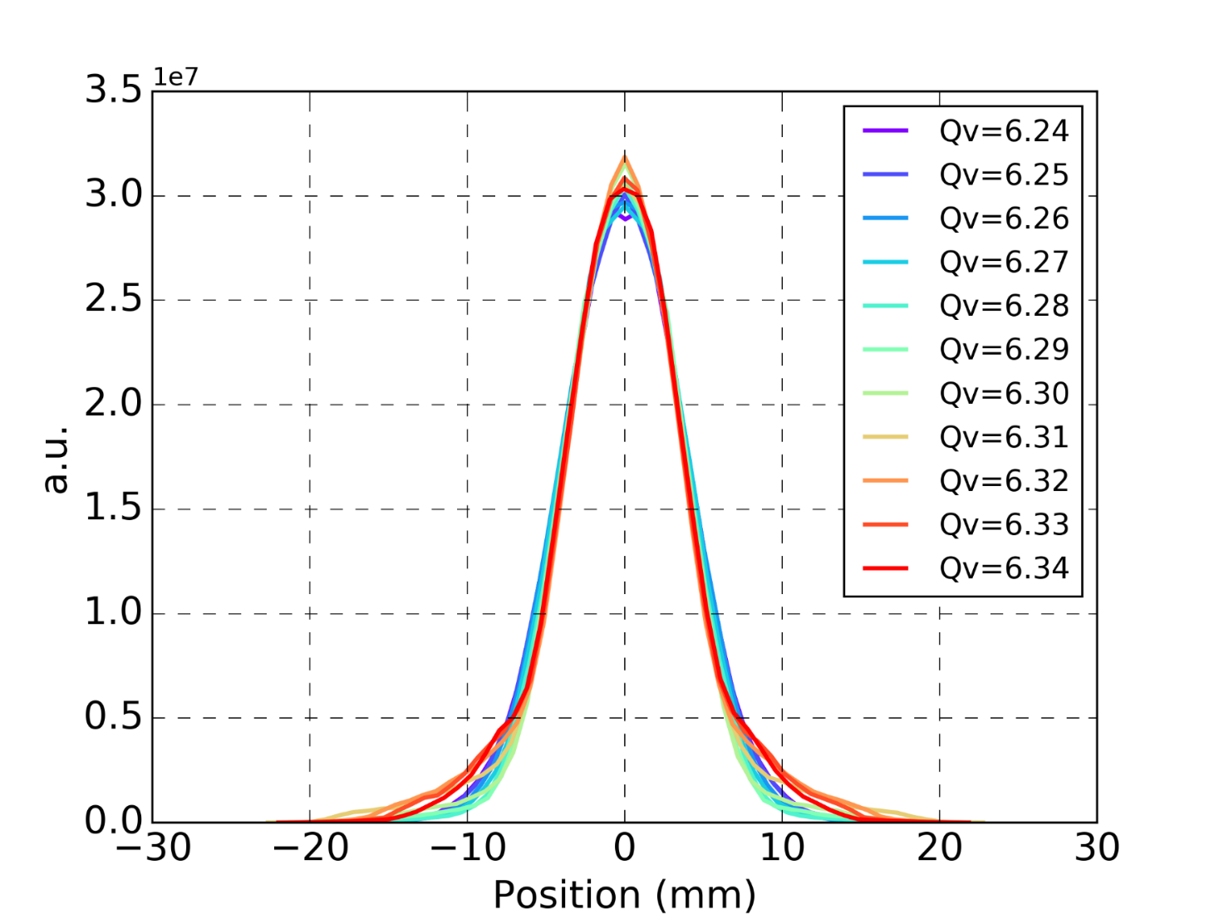
Vertical Beam Profiles
Simulation for $500k turns\sim 1.2s$
$$Q_{h}=6.20$$
Experimental Data ($1.2s$ storage)
$$Q_{h}=6.20$$

Slide 16
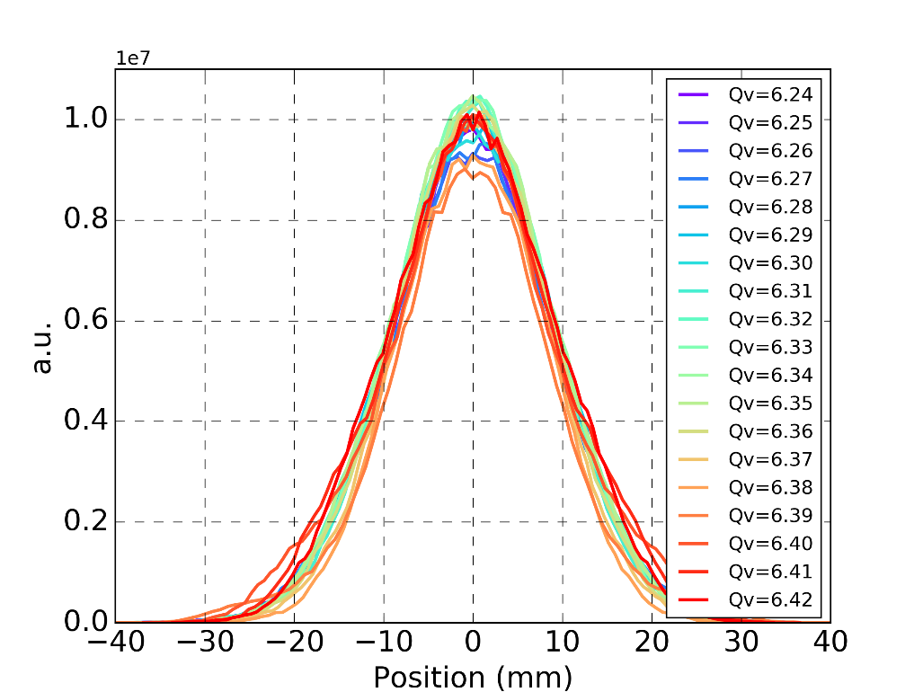
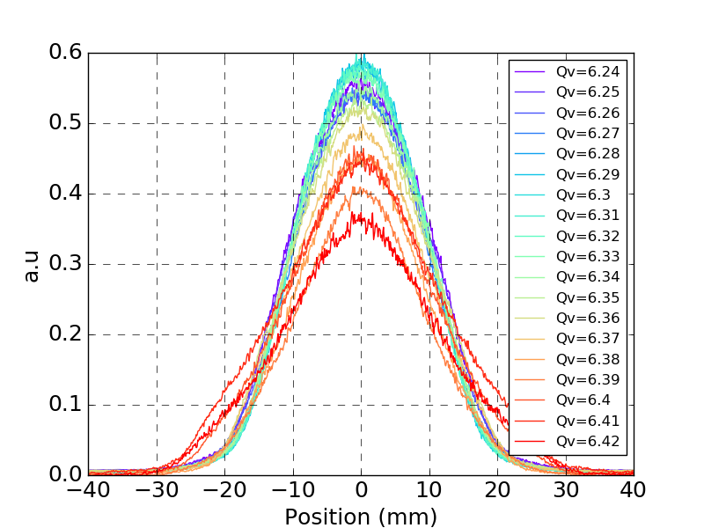
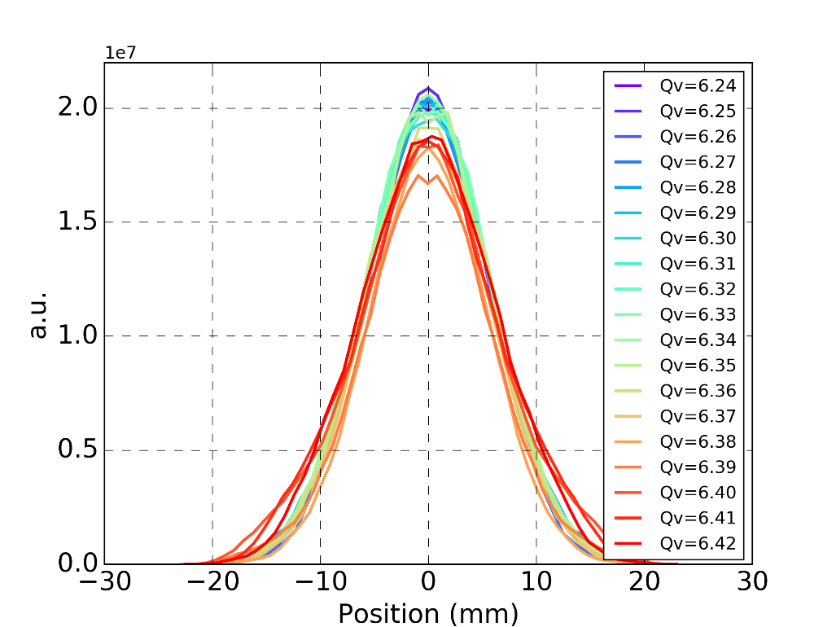
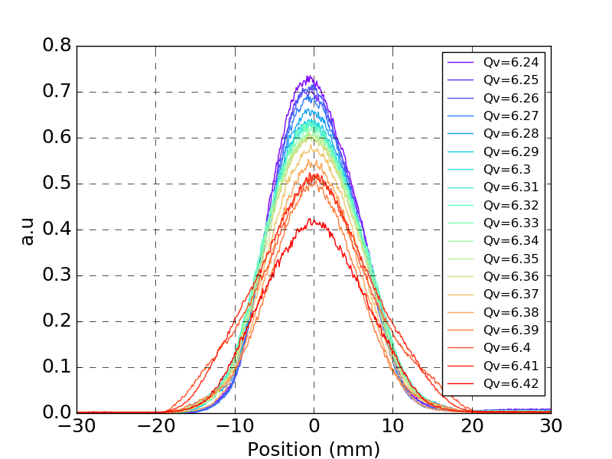
Vertical Beam Profiles
$$Q_{h}=6.15$$
$$Q_{h}=6.15$$
Horizontal
Profiles
Horizontal
Profiles
Simulation for $100k turns\sim 250ms$ 2% max Octupole excitation
Experimental Data ($1.2s$ storage)
Vertical
Profiles
Vertical
Profiles

Slide 17
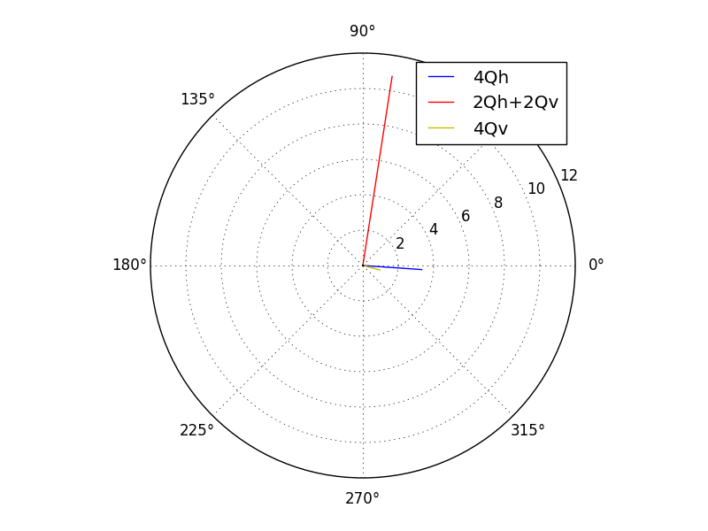
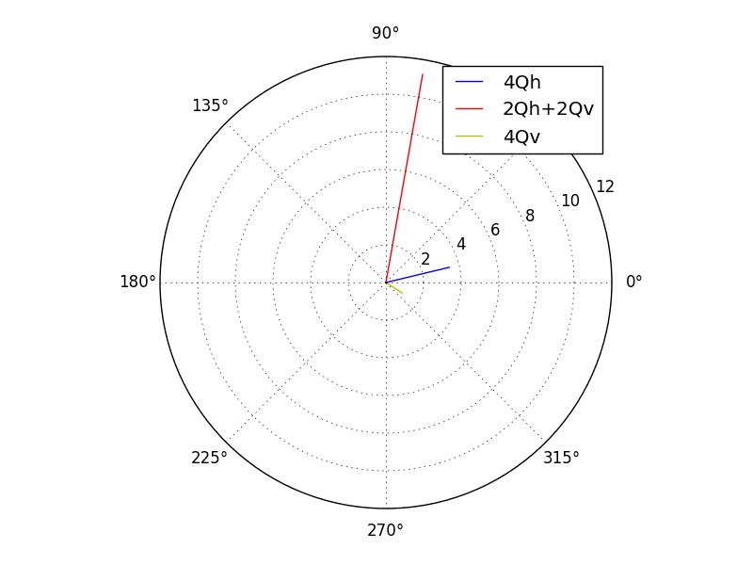
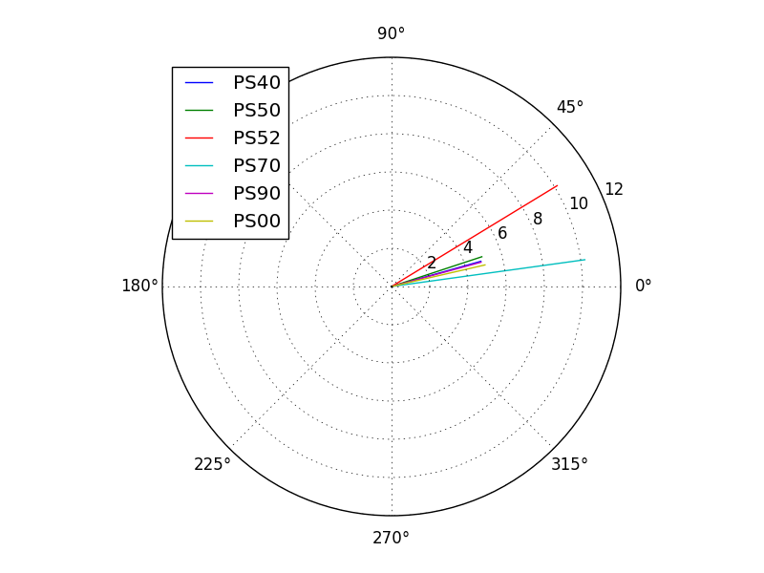
Resonance driving terms for the MTE octupoles
PS55
PS39
ODs
(${2Q}_{h}+{2Q}_{v}$)

