Slide 1
SPS space charge studies
(from high order resonances to power converter ripple)
H. Bartosik, F. Schmidt
Space charge workshop Darmstadt, October 2017

Slide 2
Outline
Introduction
Experiment
Discussion on resonances
Comparison with simulations
Conclusions and outlook

Slide 3
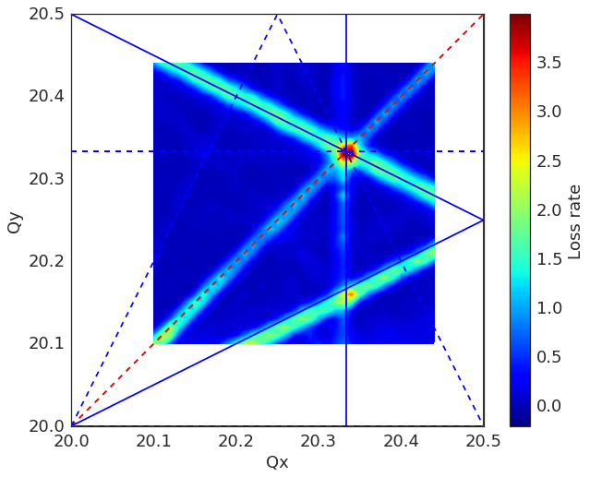
Introduction
It started as benchmarking experiment of the 3rd order horizontal resonance …
  In particular relevant for ion operation
Reference: experimental “zero” intensity tune scan
  Quite clean resonance diagram
  Mostly the 3rd order resonances seem to be excited (by residual sextupole errors)
A. Saa Hernandez
proton working point
ion working point
resonances:
red: systematic
blue: non-systematic
– upright
- - skew

Slide 4
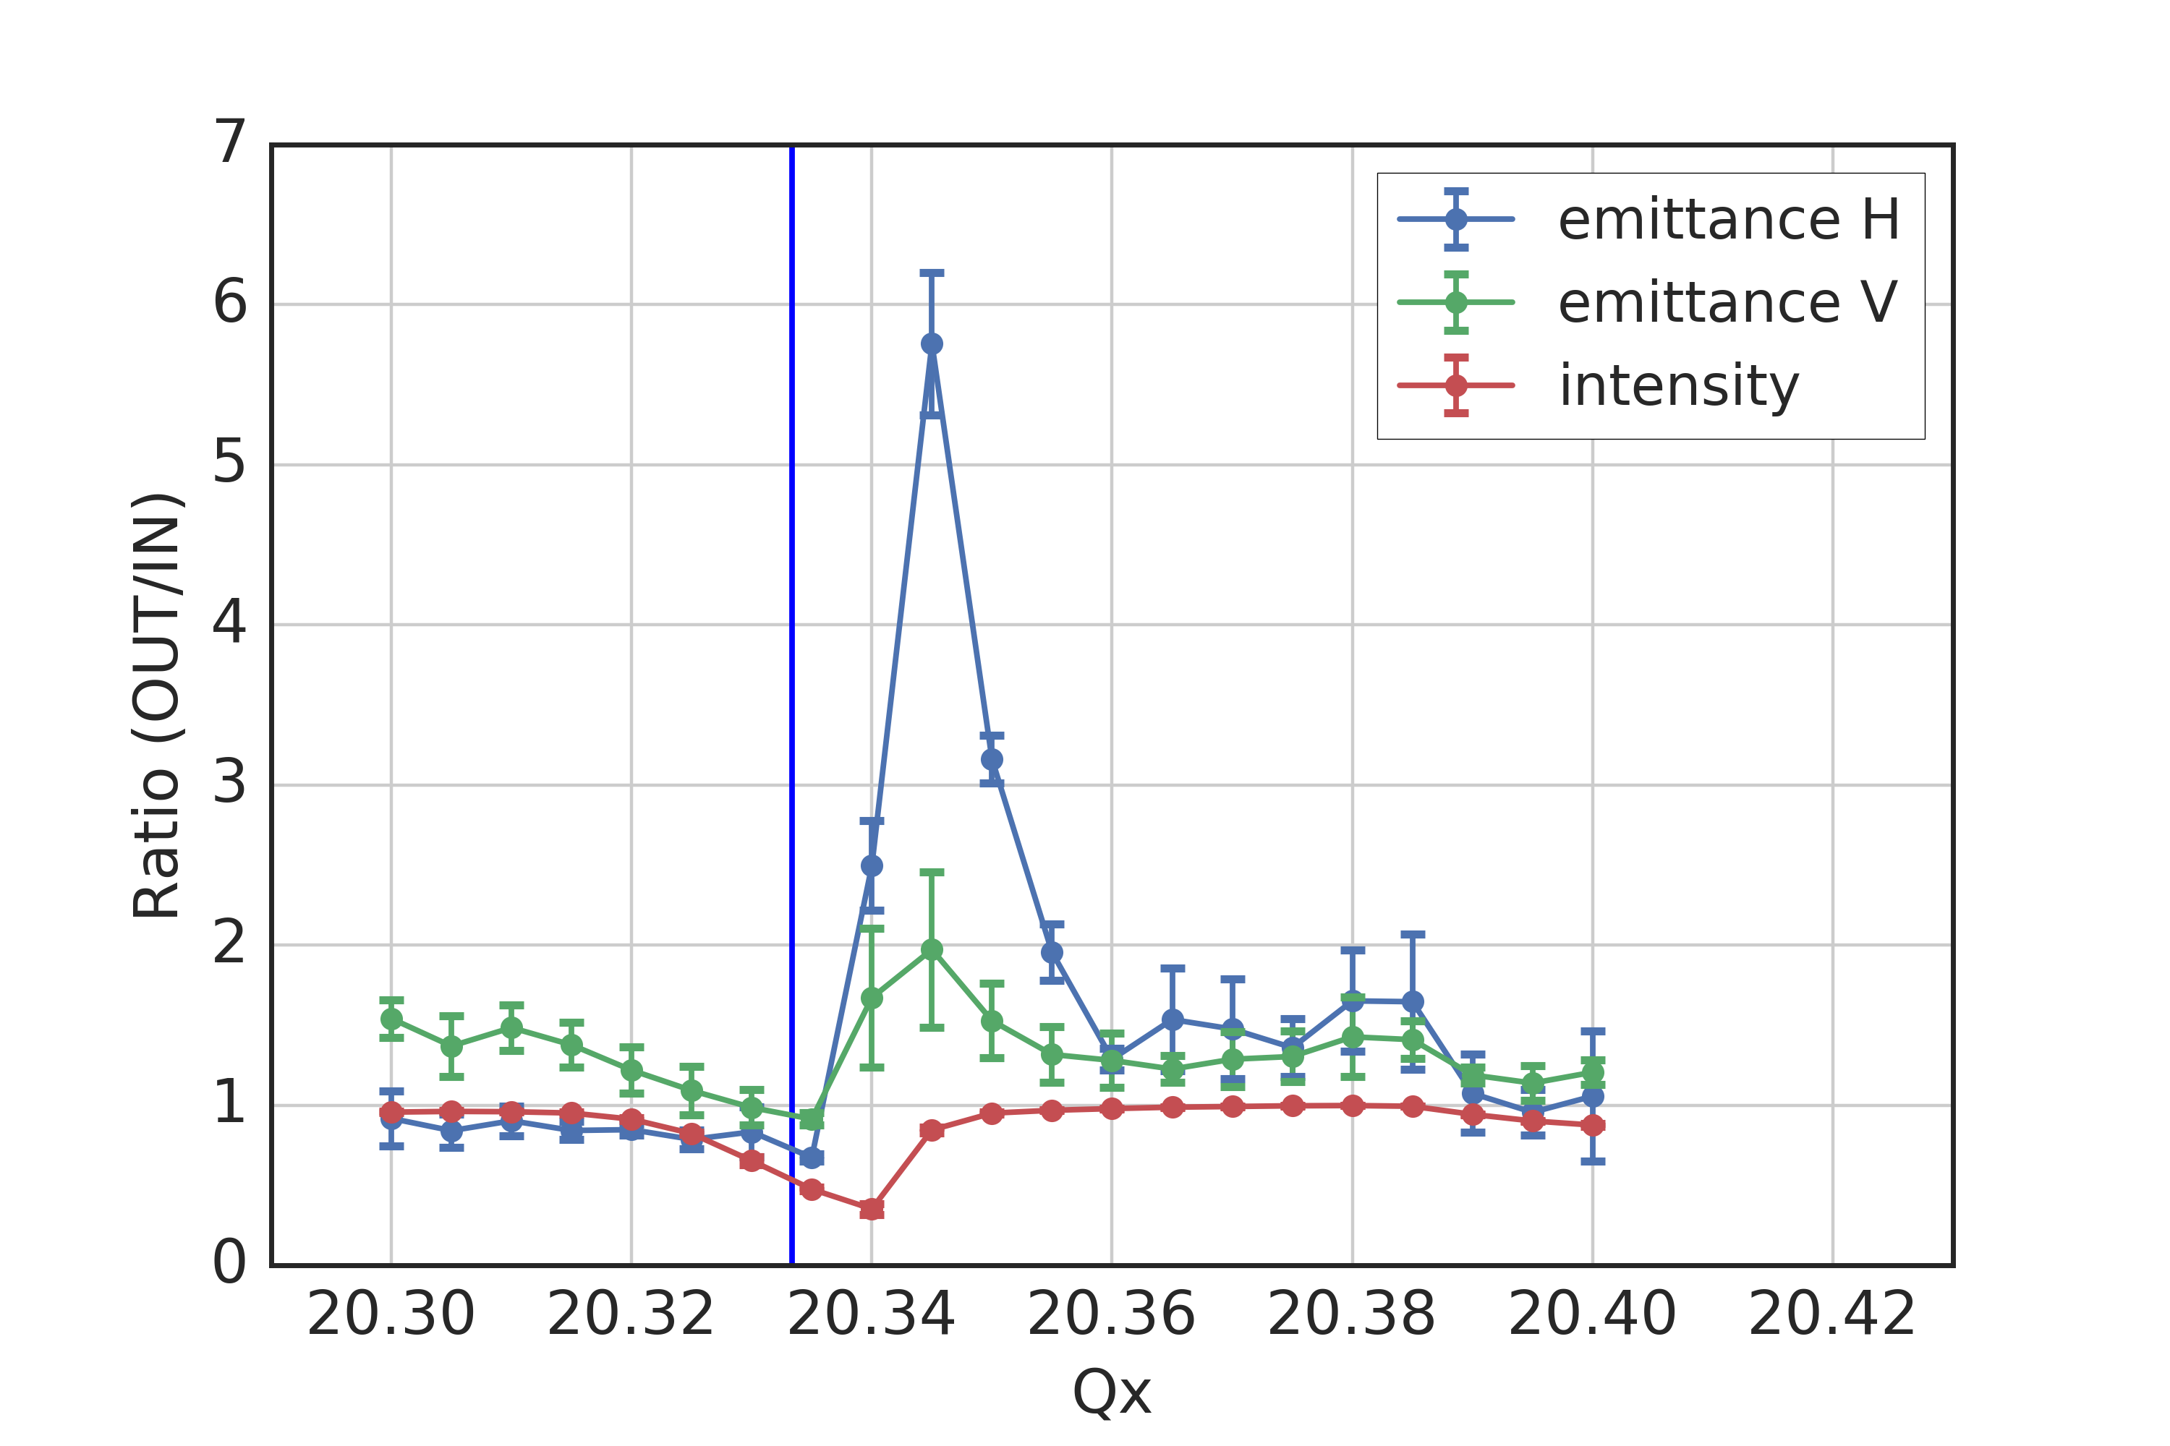
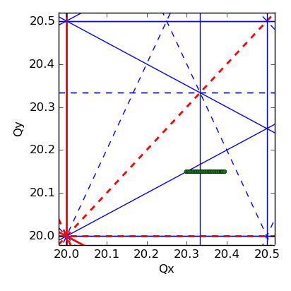
Experiment
  Tunes kept constant during ~3 s storage
  A sextupole is excited voluntarily starting from 160 ms after injection
  Space charge tune shift ΔQx/ΔQy ~ -0.06/-0.1 , 1/Qs ~ 70 turns
3 Qx = 61

Slide 5
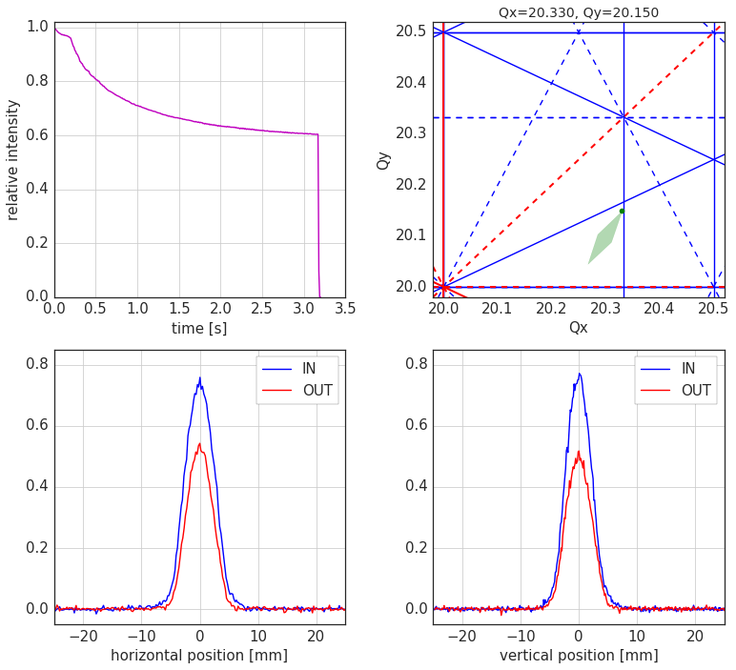
Experiment
  Tunes kept constant during ~3 s storage
  A sextupole is excited voluntarily starting from 160 ms after injection
  Space charge tune shift ΔQx/ΔQy ~ -0.06/-0.1 , 1/Qs ~ 70 turns
3 Qx = 61

Slide 6
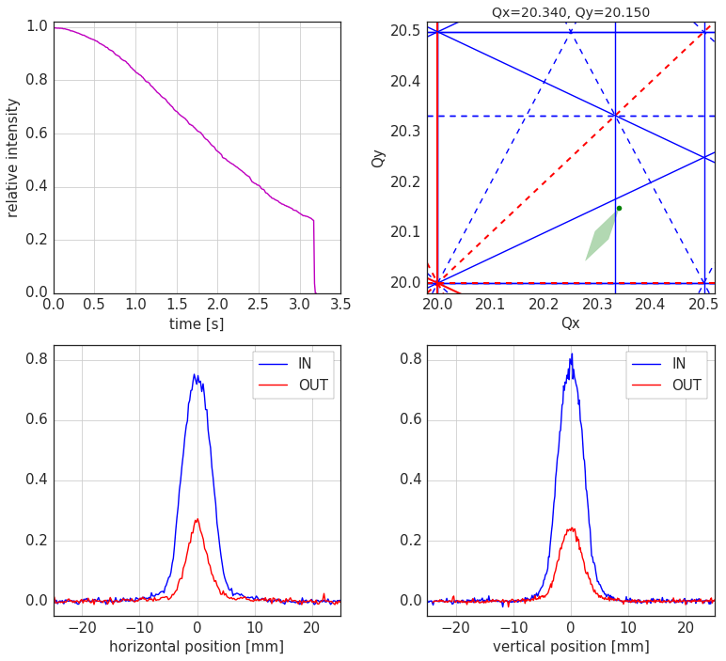
Experiment
  Tunes kept constant during ~3 s storage
  A sextupole is excited voluntarily starting from 160 ms after injection
  Space charge tune shift ΔQx/ΔQy ~ -0.06/-0.1 , 1/Qs ~ 70 turns
3 Qx = 61

Slide 7
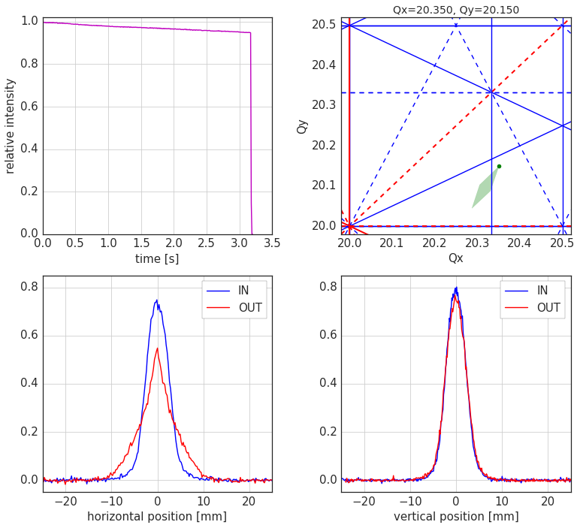
Experiment
  Tunes kept constant during ~3 s storage
  A sextupole is excited voluntarily starting from 160 ms after injection
  Space charge tune shift ΔQx/ΔQy ~ -0.06/-0.1 , 1/Qs ~ 70 turns
3 Qx = 61

Slide 8
Experiment
  Tunes kept constant during ~3 s storage
  A sextupole is excited voluntarily starting from 160 ms after injection
  Space charge tune shift ΔQx/ΔQy ~ -0.06/-0.1 , 1/Qs ~ 70 turns
3 Qx = 61

Slide 9
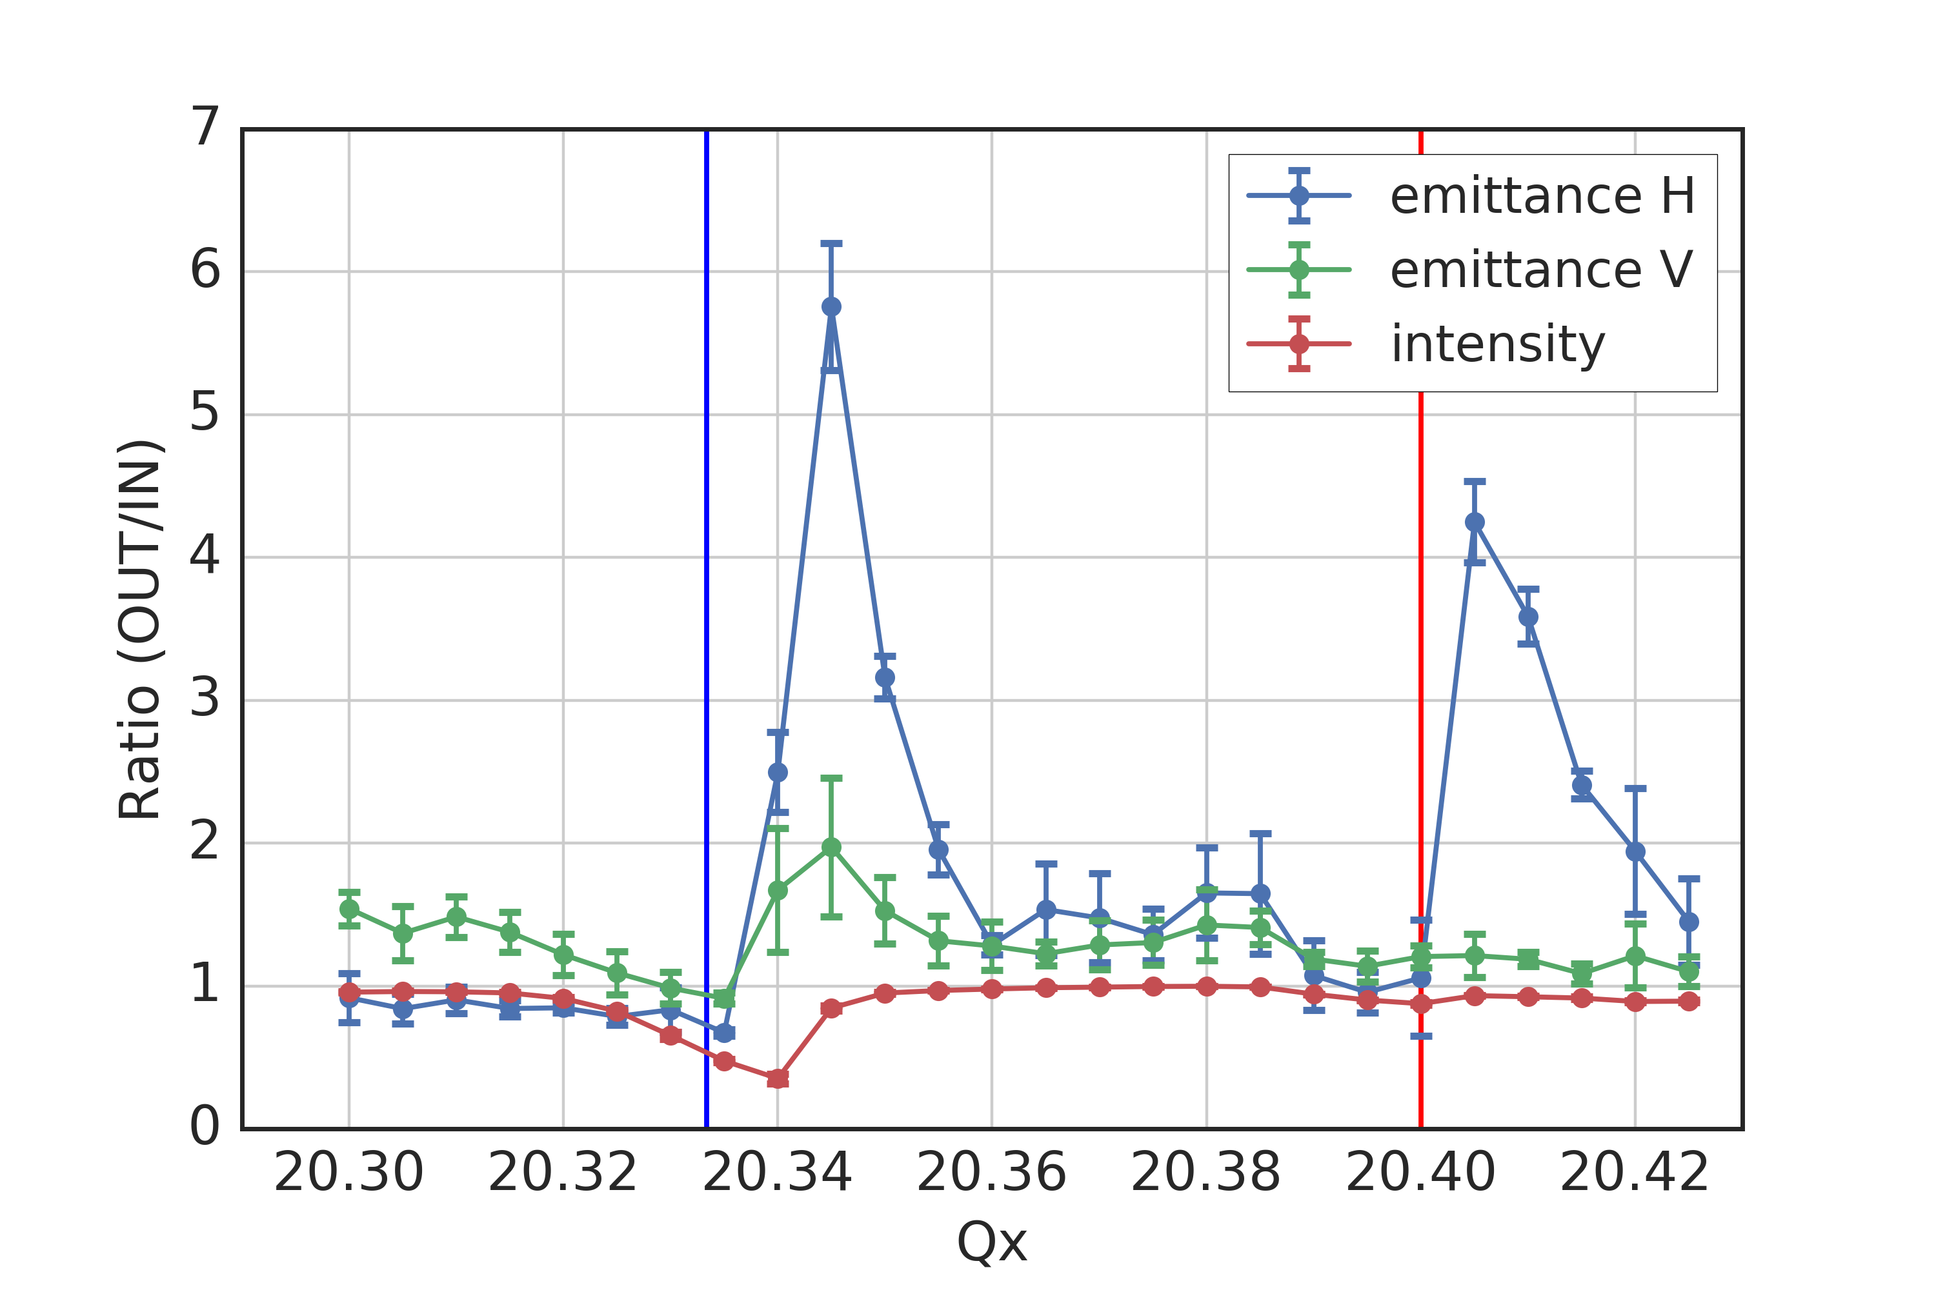
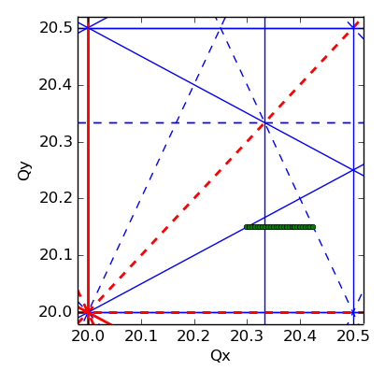
Experiment
  Tunes kept constant during ~3 s storage
  A sextupole is excited voluntarily starting from 160 ms after injection
  Space charge tune shift ΔQx/ΔQy ~ -0.06/-0.1 , 1/Qs ~ 70 turns
  Unexpected beam response due to resonance at Qx = 20.4
?
?
3 Qx = 61

Slide 10
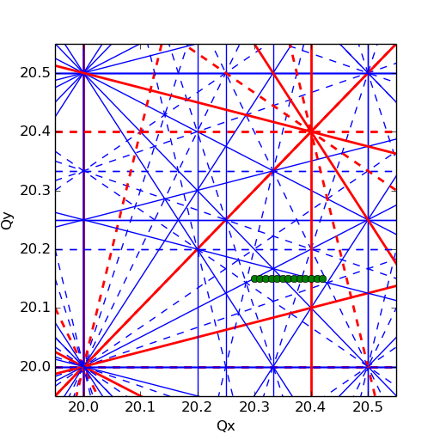
Resonances at Qx = 20.40
Systematic 5th order resonance: 5 Qx = 102 (not suppressed by periodicity)
  Driven by b5 components (decapole) in main dipoles …
  … which also produce Q’’’ non-linear chromaticity
Resonances up to 5th order
measurement vs. fitted model
significant Q’’’ due to b5 in dipoles
Red: systematic
Blue: non-systematic
– upright
- - skew

Slide 11
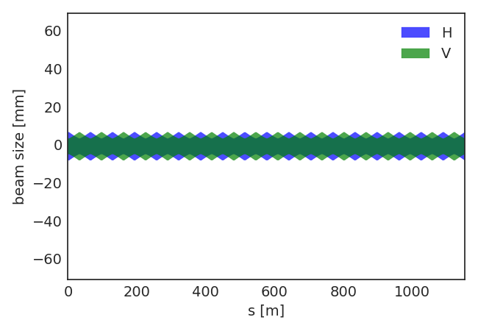
Resonances at Qx = 20.40
10th order structure resonance: 10 Qx = 204
  Driven by non-linearity of Gaussian space charge potential and beam size modulation
  SPS has 6-fold symmetry with 108 regular FODO cells in total (main lattice harmonic: 108)
3σ beam size without dispersion
(1 sextant)
(beam parameters from experiment)

Slide 12
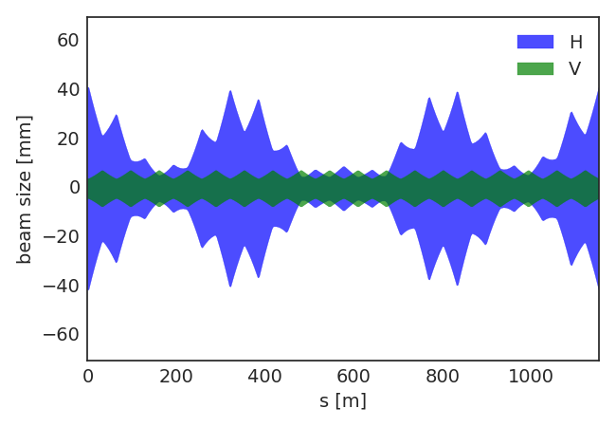
Resonances at Qx = 20.40
10th order structure resonance: 10 Qx = 204
  Driven by non-linearity of Gaussian space charge potential and beam size modulation
  SPS has 6-fold symmetry with 108 regular FODO cells in total (main lattice harmonic: 108)
  Beam size variation due to dispersion generates additional lattice harmonics
3σ beam size including dispersion
(1 sextant)
(beam parameters from experiment)

Slide 13
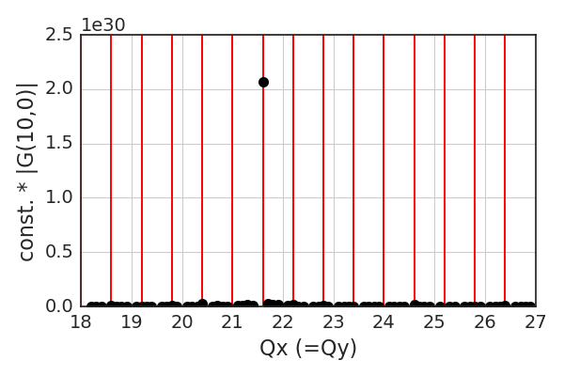
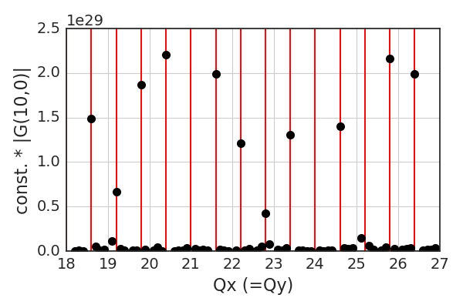
Resonances at Qx = 20.40
10th order structure resonance: 10 Qx = 204
  Driven by non-linearity of Gaussian space charge potential and beam size modulation
  SPS has 6-fold symmetry with 108 regular FODO cells in total (main lattice harmonic: 108)
  Beam size variation due to dispersion generates additional lattice harmonics
  Excitation of 10th order resonance clearly seen in driving term of space charge potential
δp/p(rms) = 0
δp/p(rms) = 1.7e-3
– systematic
resonance at Qx=21.6
(harmonic 216=2*108)
resonance at Qx=20.4
is one of the strongest

Slide 14
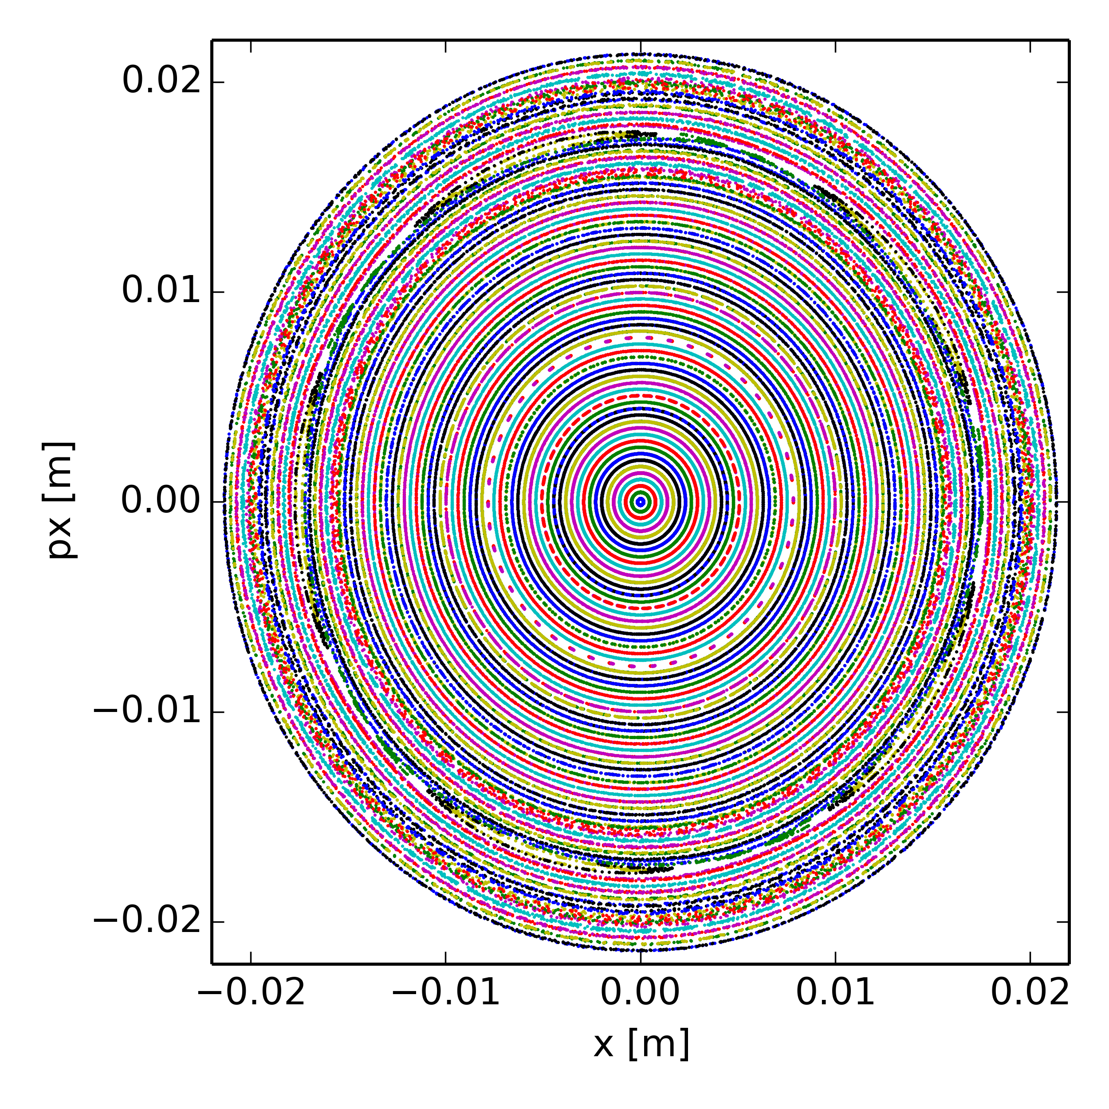
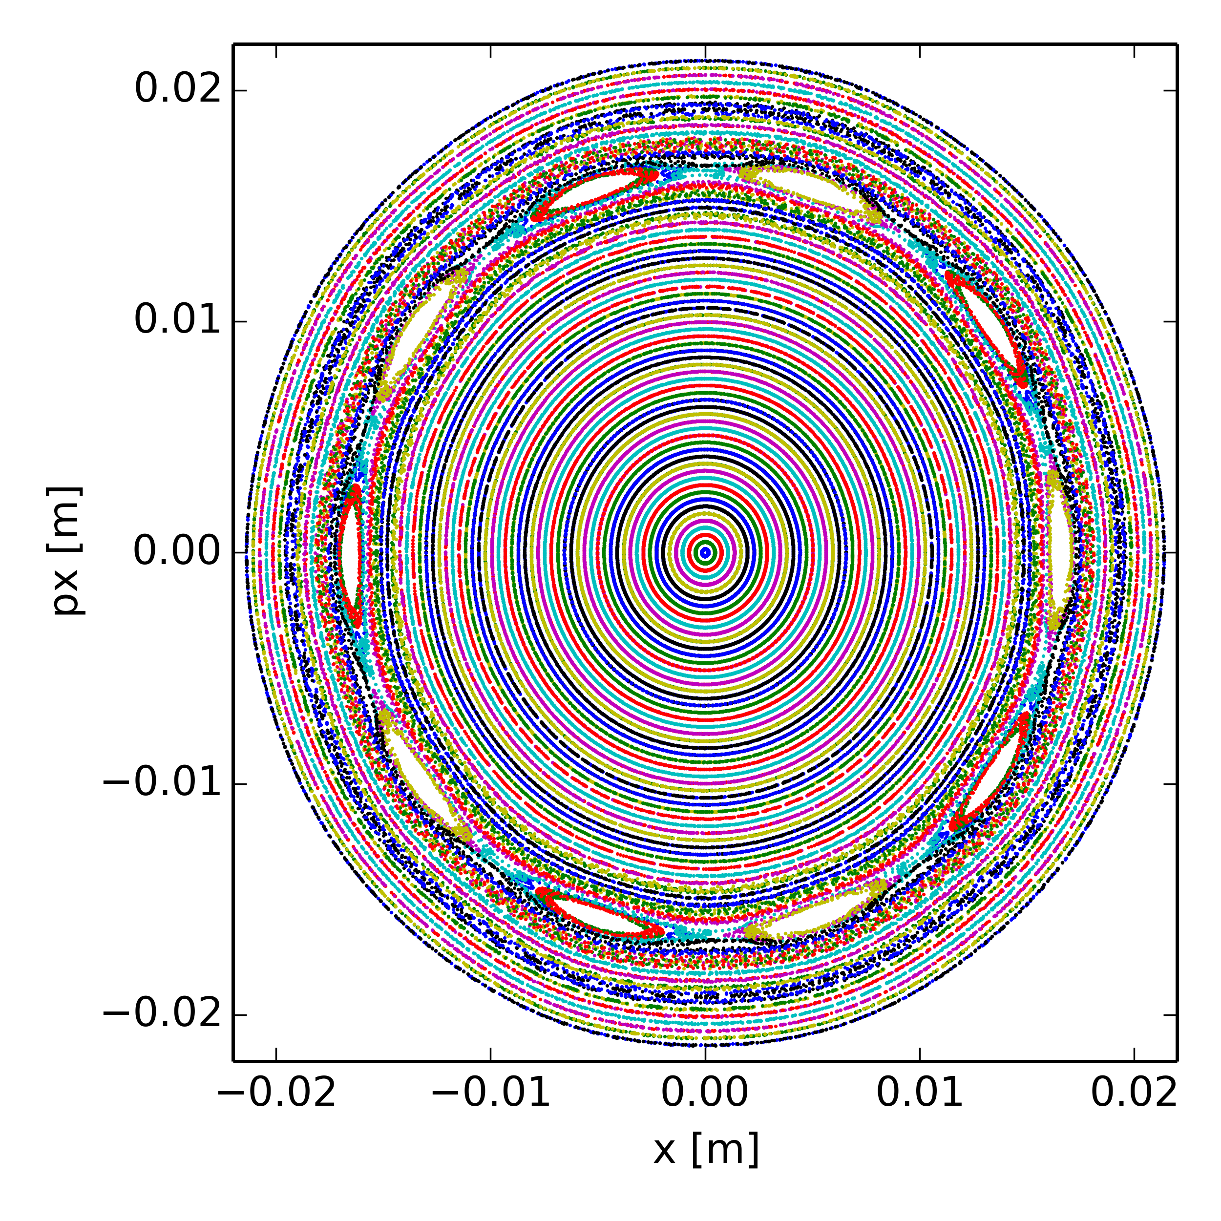
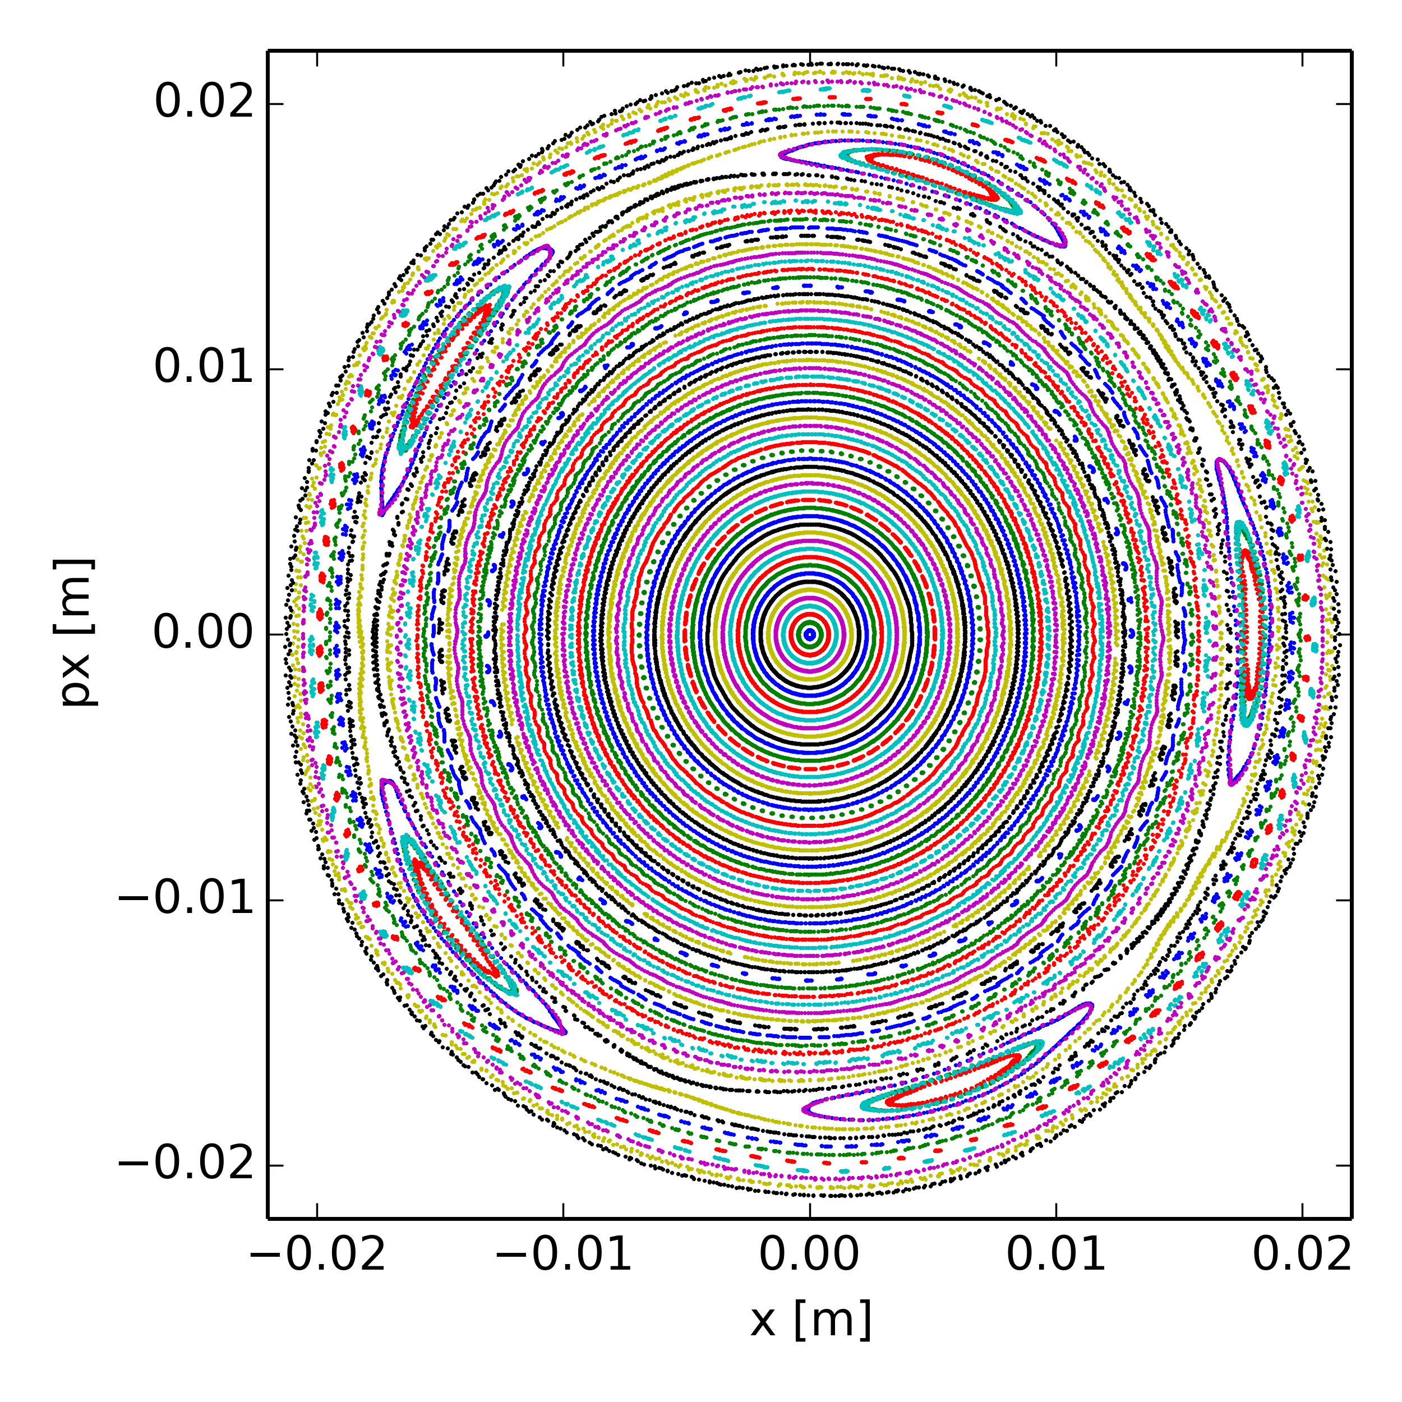
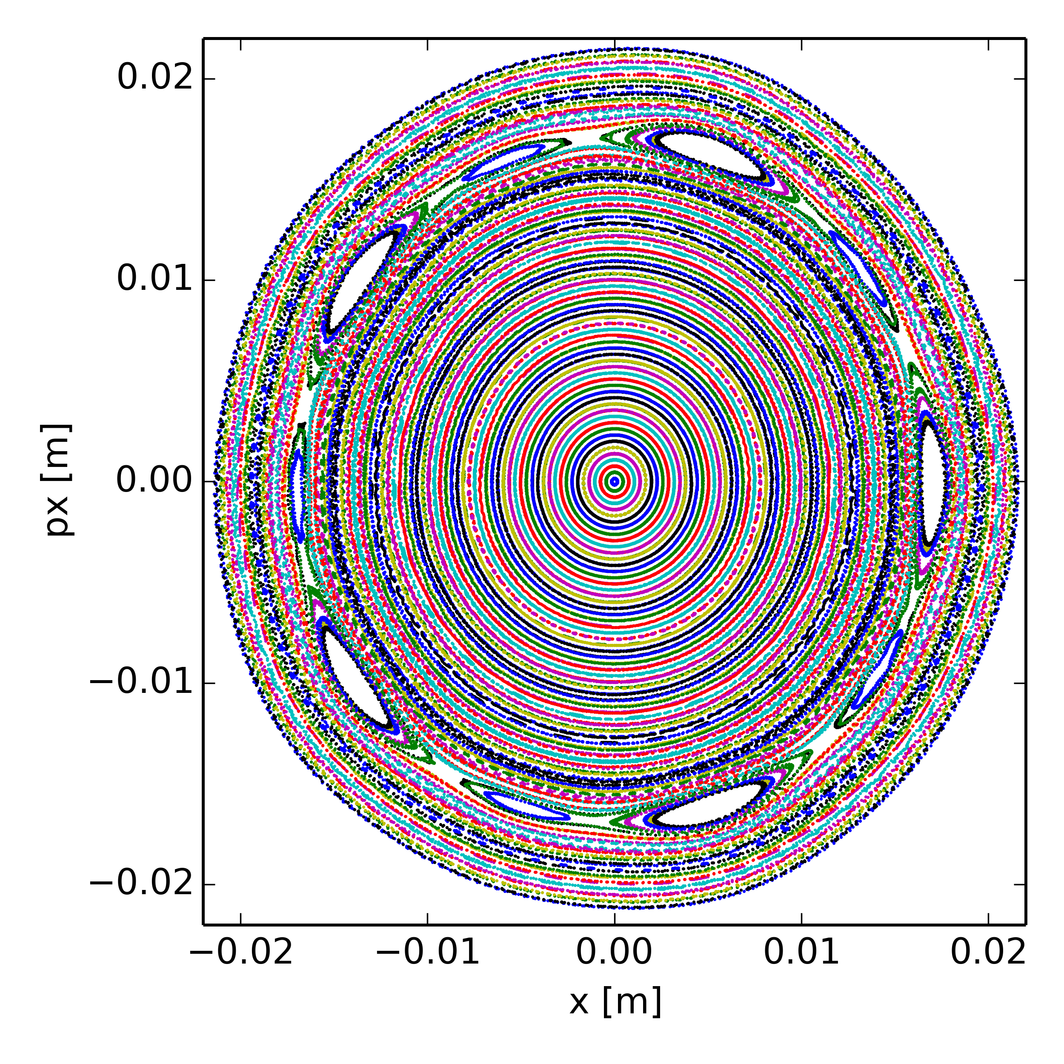
Poincaré maps at Qx = 20.40
space charge potential for beam without momentum spread
space charge potential for realistic beam incl. momentum spread
“no” resonance
10th order
bare lattice
(no nonlinear magnetic elements)
5th order
5th + 10th order
nonlinear model
(including b5 from dipoles)

Slide 15
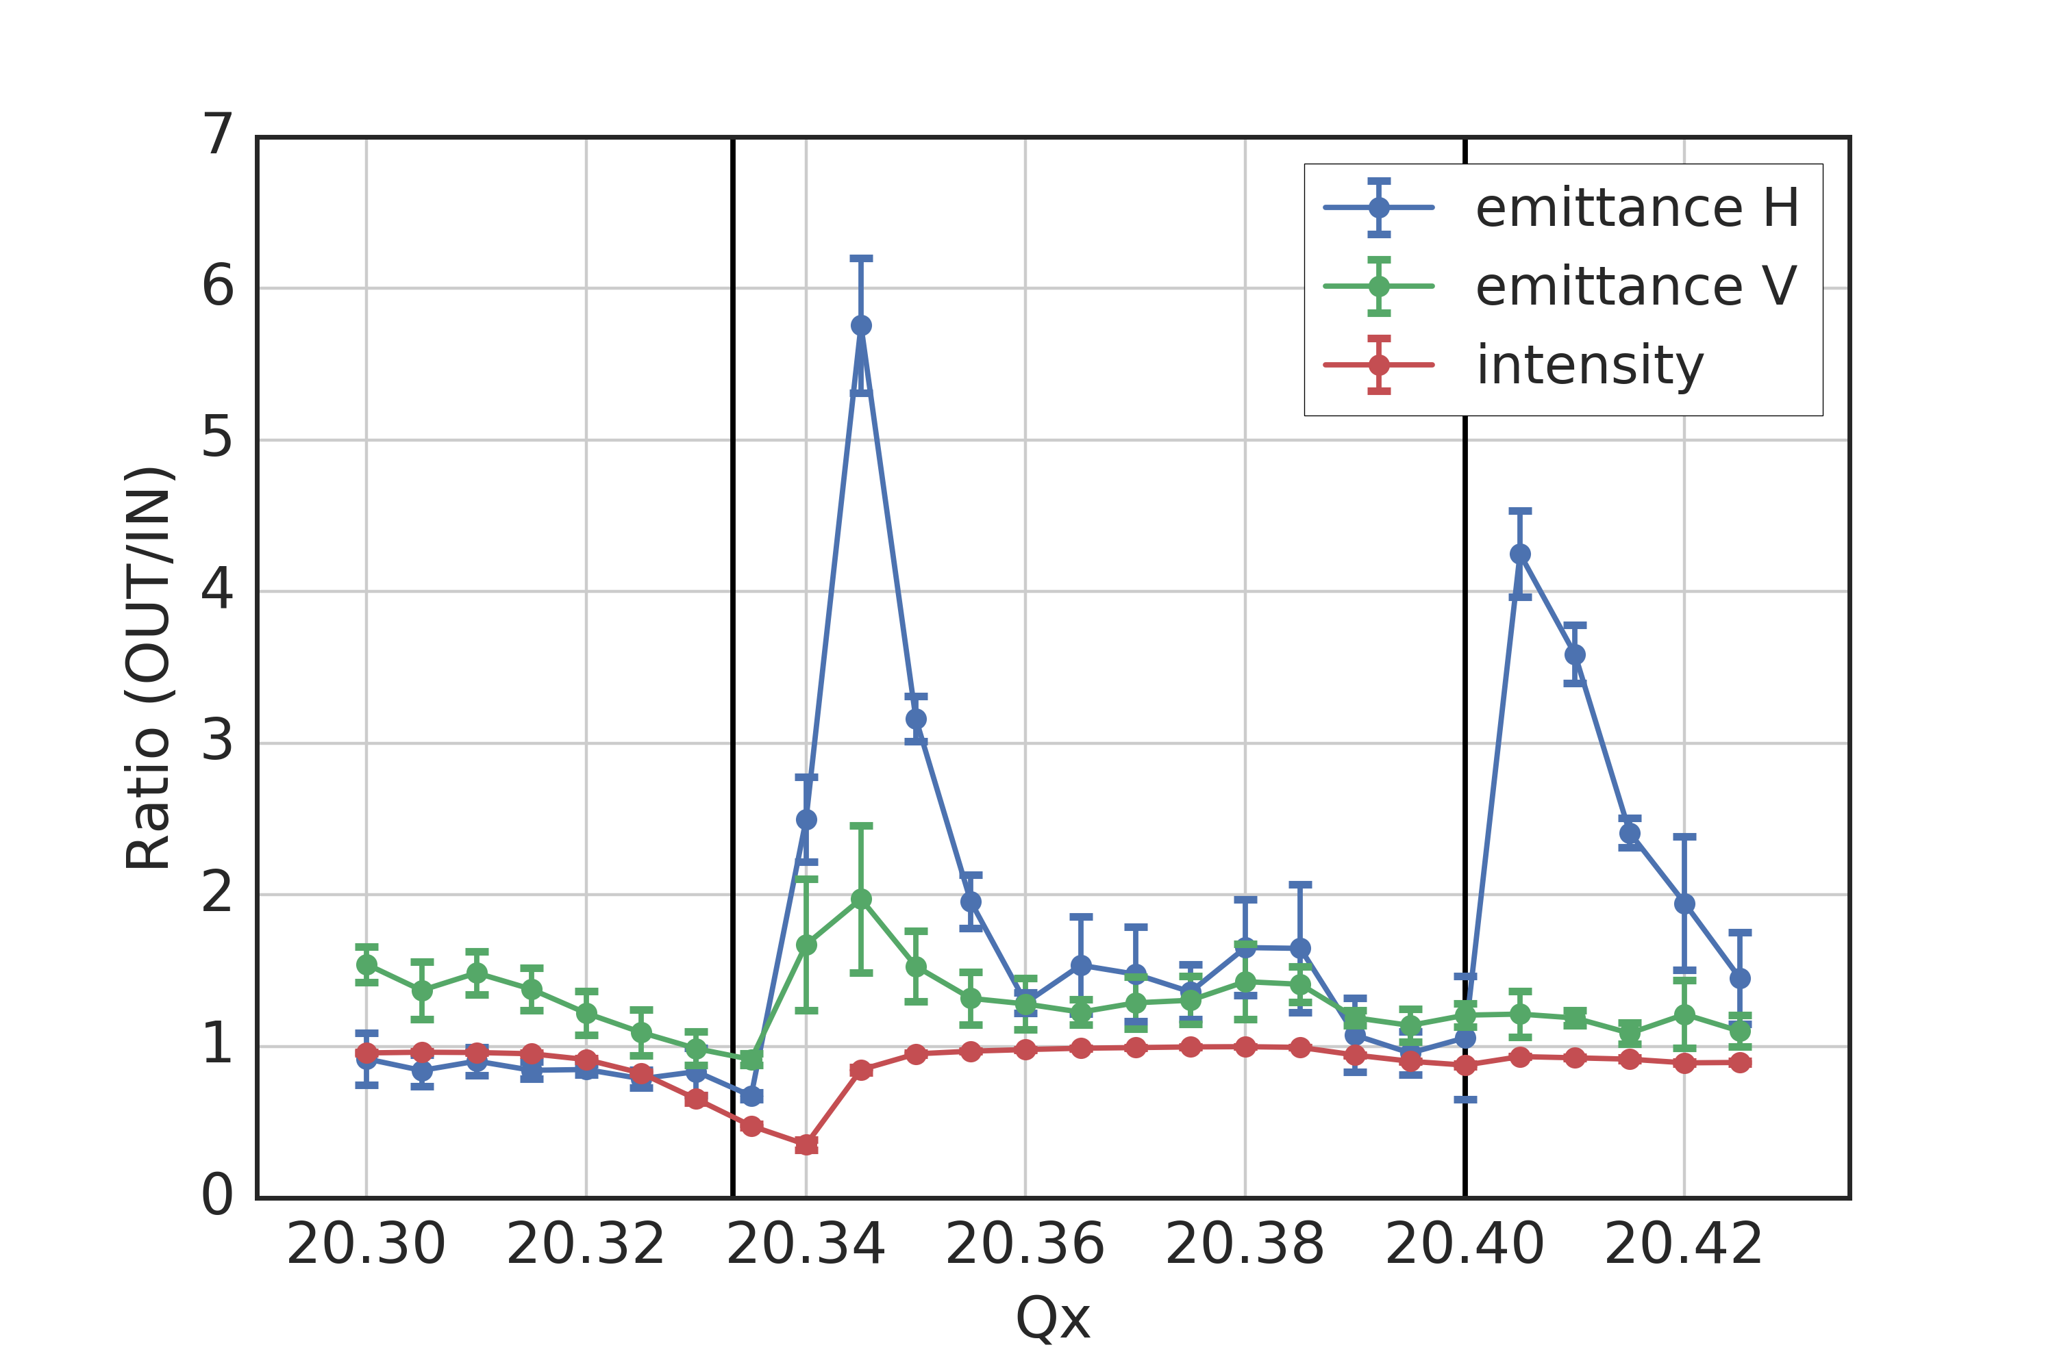
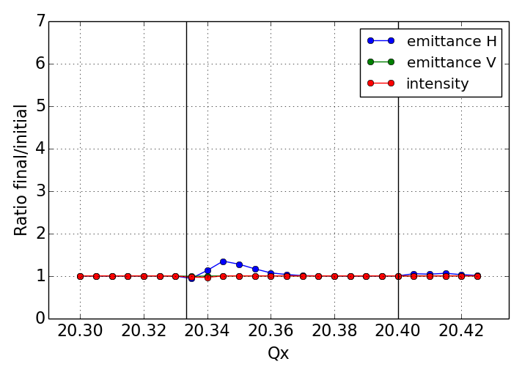
Measurements vs. simulations
Simulations using PTC-pyORBIT
  Frozen space charge model (non-adaptive)
  SPS nonlinear model – multipole errors (only systematic) up to b6
  5000 particles tracked for 140k turns (i.e. 3 s as in the experiment)
  Single sextupole excited as in experiment (starting from 0.16 s)
measurements
simulations
???

Slide 16
Measurements vs. simulations
Simulations using PTC-pyORBIT
  Frozen space charge model (non-adaptive)
  SPS nonlinear model – multipole errors (only systematic) up to b6
  5000 particles tracked for 140k turns (i.e. 3 s as in the experiment)
  Single sextupole excited as in experiment (starting from 0.16 s)
Impact of Power converter ripple from SPS quadrupoles?
  108 focusing quadrupoles (QFs) in series, 108 de-focusing quadrupoles (QDs) in series
  600 Hz ripple from 12 pole rectification suppressed by active filters
  Measured power converter current shows harmonics at multiples of 50 Hz
  Chain of magnets act as low-pass filter, vacuum chamber acts as additional filter (skin effect)
  Effective field modulation taking into account shielding effects amounts to ~ +/- 1e-4 relative to DC field → low frequency tune variation on the order of +/- 2e-3 (due to tunes of ~20!)
measurements
simulations
Measured ripple spectrum (QFs)
Measured vs. effective current deviation (QFs)

Slide 17
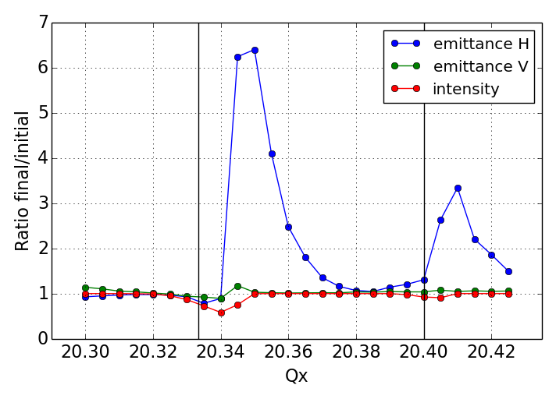
Measurements vs. simulations
Simulations using PTC-pyORBIT
  Frozen space charge model (non-adaptive)
  SPS nonlinear model – multipole errors (only systematic) up to b6
  5000 particles tracked for 140k turns (i.e. 3 s as in the experiment)
  Single sextupole excited as in experiment (starting from 0.16 s)
  Filtered quadrupole ripple on QFs and QDs taken into account (results in tune modulation similar to chromaticity but for all particles)
measurements
simulations
simulations with Q-ripple
???

Slide 18
Summary & Outlook
Experiment in SPS shows beam response at horizontal Qx = 20.4 resonance(s)
  Systematic 5th order resonance driven by b5 errors of dipoles
  10th order resonance driven by dispersion induced modulation of Gaussian space charge potential
  Most likely the effect of both resonances is observed (under study)
Experiment can be reproduced by simulations with frozen model if quadrupole ripple is taken into account
  The quadrupole ripple induces a tune modulation similar to chromaticity (but for all particles)
  Due to high tunes in SPS, the tune ripple can result in relatively strong tune modulation
Future studies
  Vertical resonance at Qy = 21.6 (5th order not excited by b5, but 10th order excited by space charge potential due to 108 FODO cells)
  Experiment with voluntarily enhanced quadrupole ripple
  Simulations with adaptive models

Slide 19
Thank you for your attention!

Slide 20
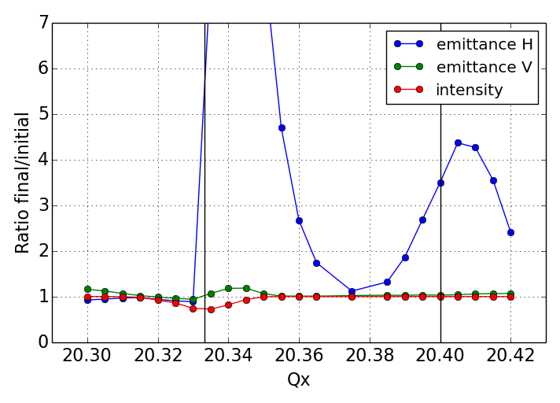
Measurements vs. simulations
Simulations using PTC-pyORBIT
  Frozen space charge model (non-adaptive)
  SPS nonlinear model – multipole errors (only systematic) up to b4
  5000 particles tracked for 140k turns (i.e. 3 s as in the experiment)
  Single sextupole excited as in experiment (starting from 0.16 s)
  Filtered quadrupole ripple on QFs and QDs taken into account (results in tune modulation similar to chromaticity but for all particles)
measurements
simulations
simulations with Q-ripple
Errors up to b4
strong response at both resonances, as effective chromaticity larger due to missing b5 component
???

