Slide 1
Preparing LEIR for the HL-LHC Era
A. Huschauer, H. Bartosik, S. Hancock, V. Kain
Presentation at Space Charge 2017, Darmstadt, Germany
4 October 2017
Acknowledgements to all contributors:
S. Albright, M-E. Angoletta, G. Arduini, J. Axensalva, G. Bellodi, N. Biancacci, A. Blas, M. Bodendorfer, J. Borburgh, C. Carli, G. Franchetti, A. Frassier, S. Gilardoni, D. Küchler, M. Jaussi, D. Manglunki, M. Meddahi, M. Migliorati, M. O’Neil, Y. Papaphilippou, S. Pasinelli, G. Rumolo, F. Schmidt, R. Scrivens, V. Toivanen, G. Tranquille, F. Wenander
Space Charge 2017

Slide 2
Outline
Introduction
The LEIR intensity limitation
Space charge studies
LEIR performance increase
Summary and outlook

Slide 3
Outline
Introduction
The LEIR intensity limitation
Space charge studies
LEIR performance increase
Summary and outlook

Slide 4
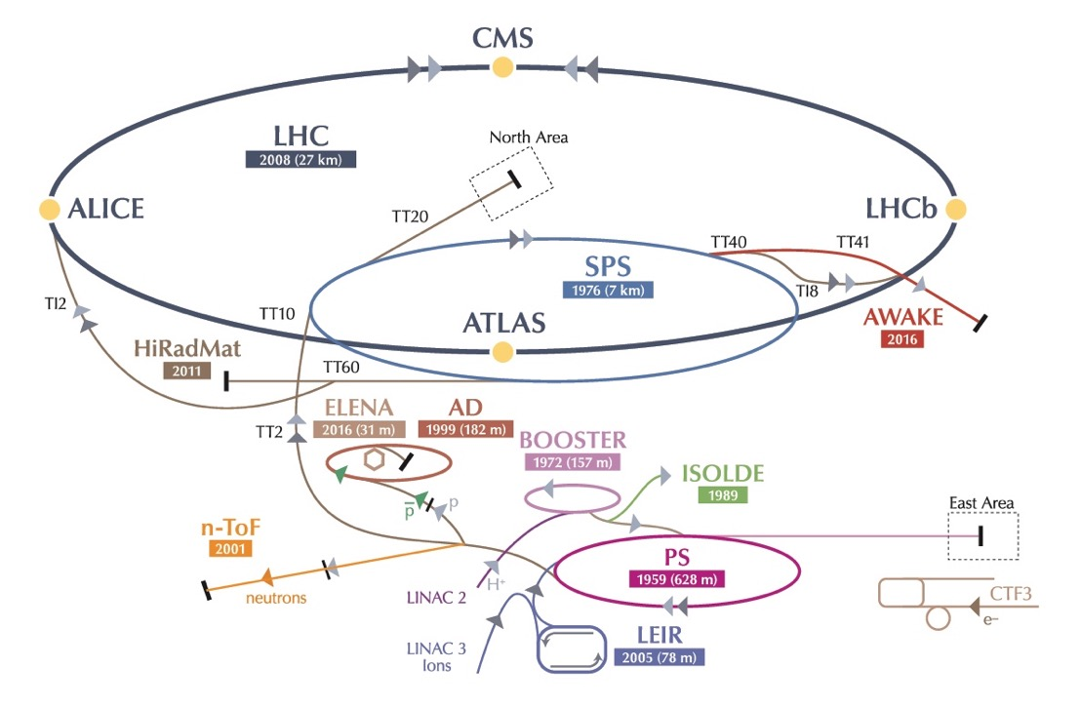
The LHC Ion Injector Chain
LHC heavy ion (Pb) physics program
  about one month per year dedicated to heavy ion physics
  ion accumulator ring LEIR to achieve required phase space densities

Slide 5
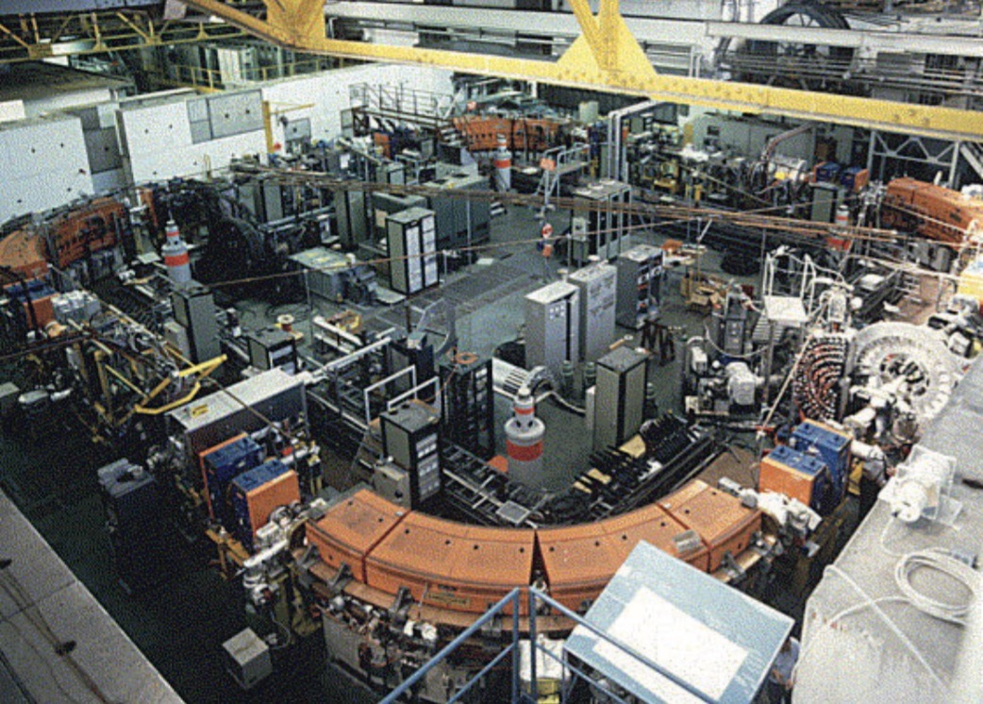
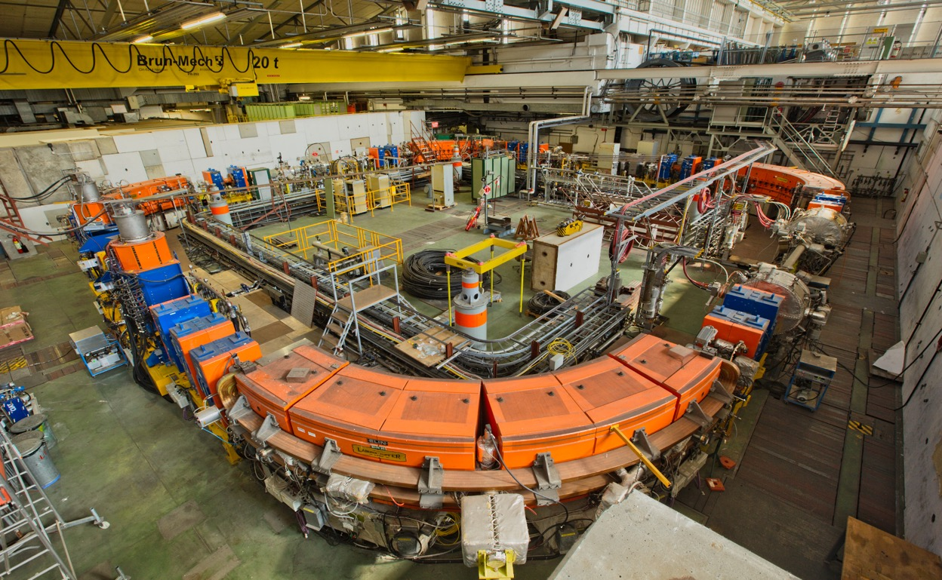
The Low Energy Antiproton Ring
Ion
Injection/extraction
Line (bi-directional)
Quadrupole
triplets
Quadrupole
doublets
Four 90∘ bending
dipoles

Slide 6
The Low Energy Ion Ring
Injection region

Slide 7
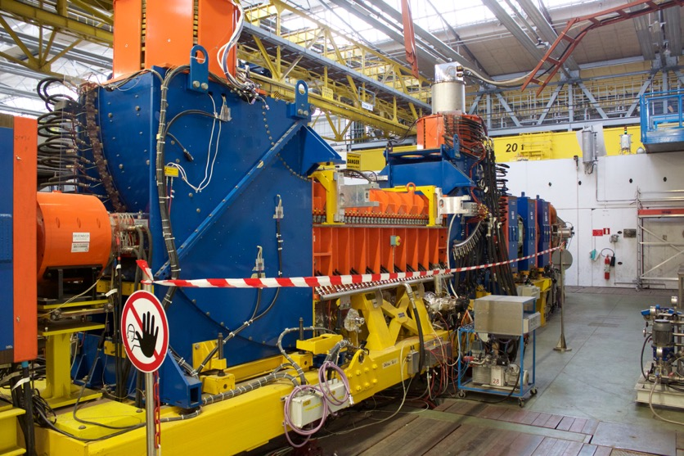
The Low Energy Ion Ring
Electron
cooler

Slide 8
The Low Energy Ion Ring
RF cavities + magnetic
extraction septum
Extraction
kickers

Slide 9
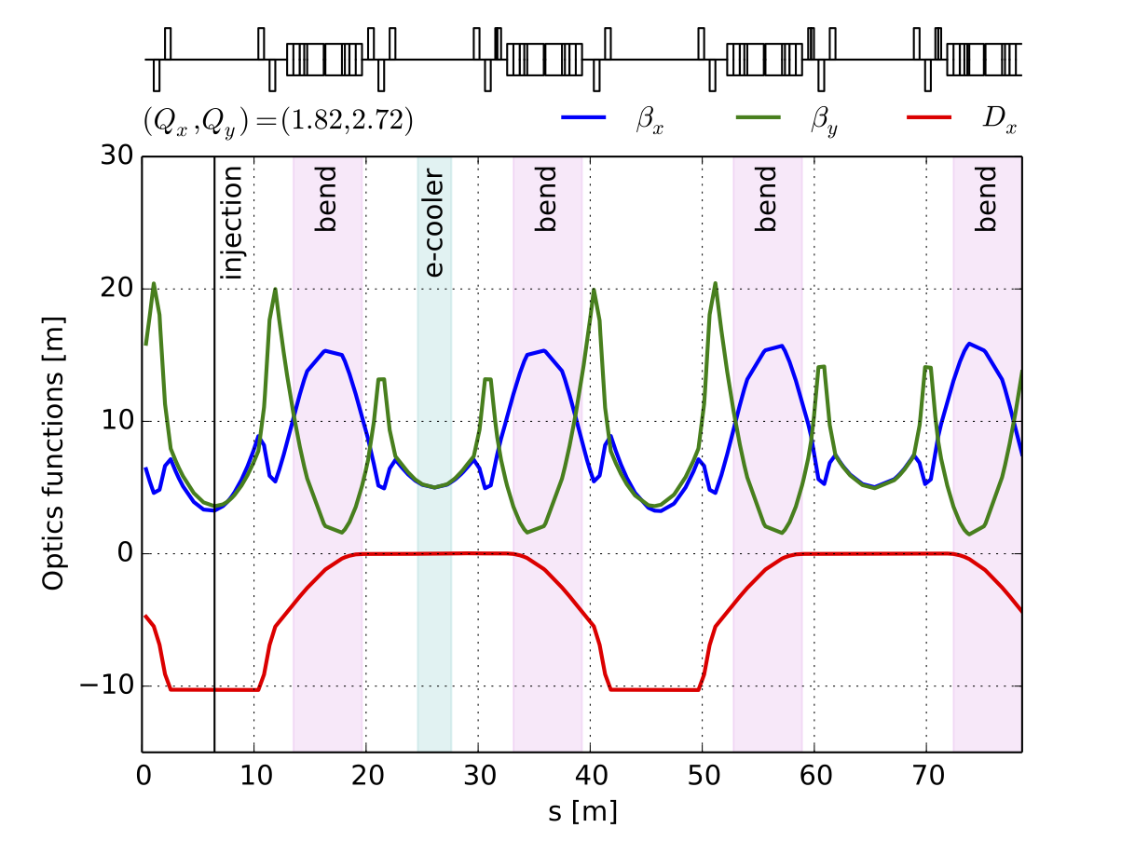
LEIR optics functions

Slide 10
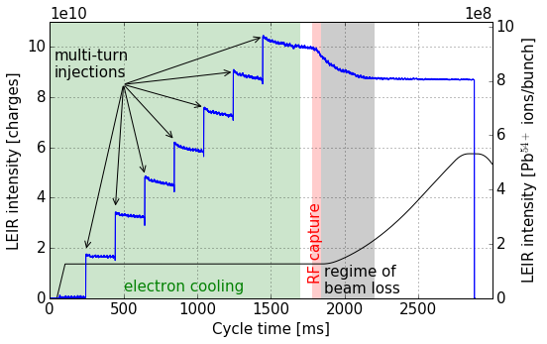
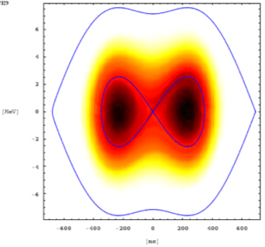
The NOMINAL cycle
RF capture: h=2 and double harmonic
E_{ext} = 72 MeV/n
E_{inj} = 4.2 MeV/n
Longitudinal Schottky spectrum of the
debunched beam:
cooling, dragging and stacking

Slide 11
Outline
Introduction
The LEIR intensity limitation
Space charge studies
LEIR performance increase
Summary and outlook

Slide 12
The LEIR intensity limitation – beam loss at RF capture
M. Bodendorfer
Beam loss at RF capture before 2015
  Extracted intensity was reported to saturate at 5.9 x 10⁸ Pb54+ ions/bunch (equivalent to 6.4 x 10¹⁰ charges)
  Up to 50% of the beam was lost after RF capture and during the first part of acceleration
Proposed actions
  Studying the LEIR intensity limitations in the framework of the LIU project to achieve the HL-LHC goals

Slide 13
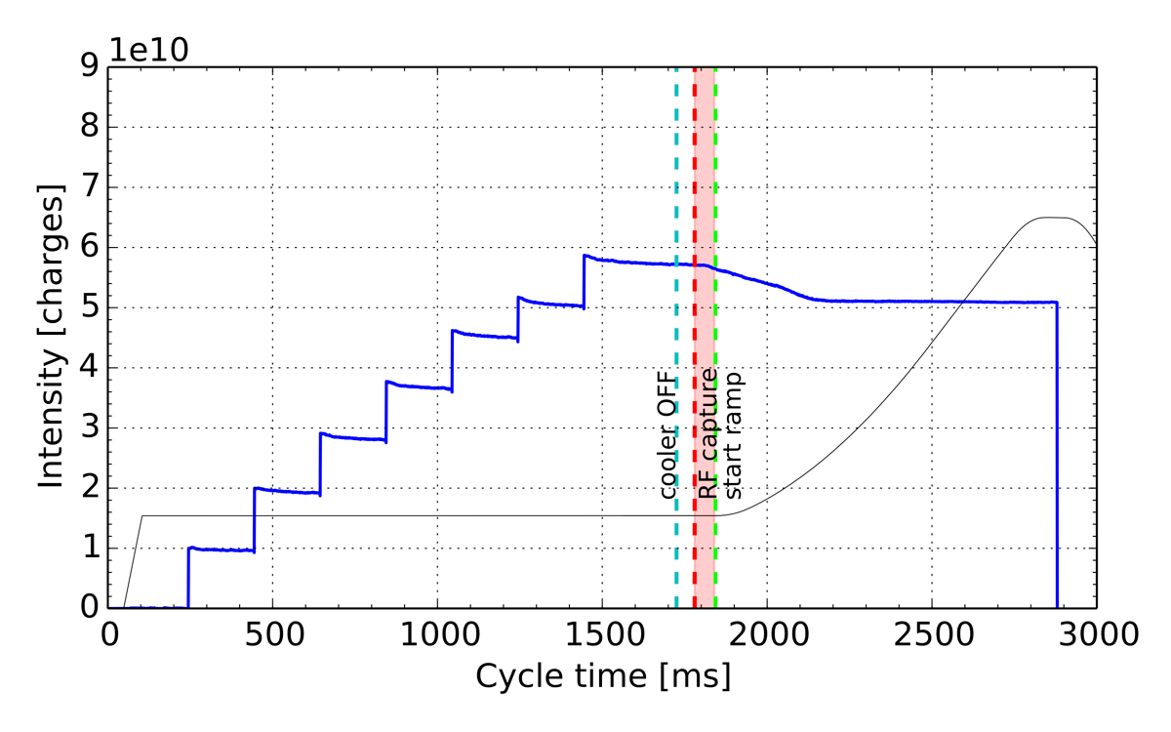
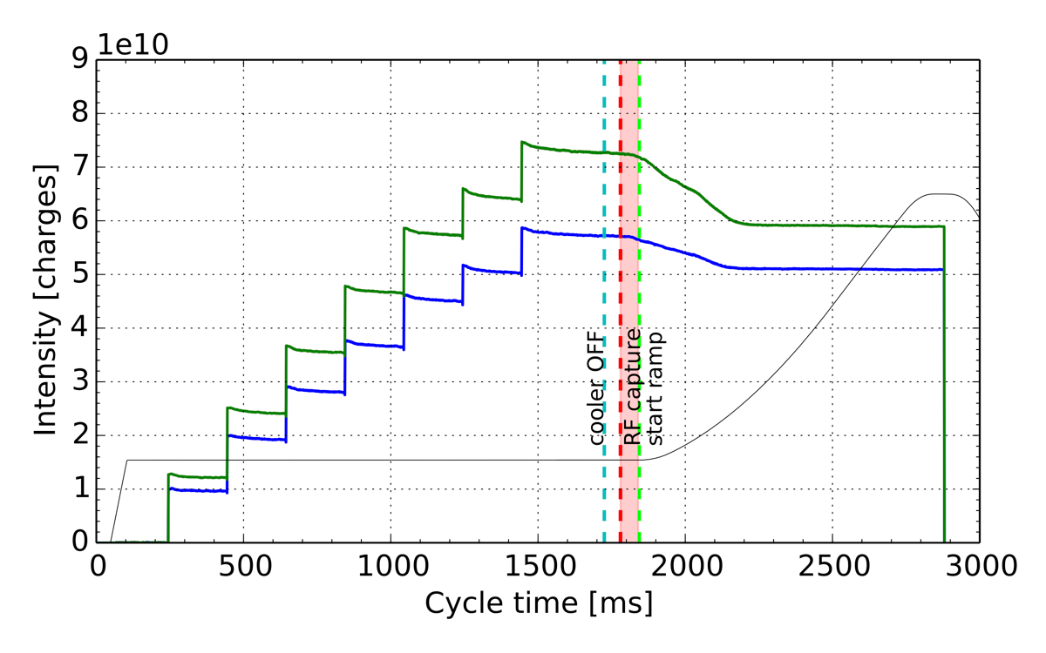
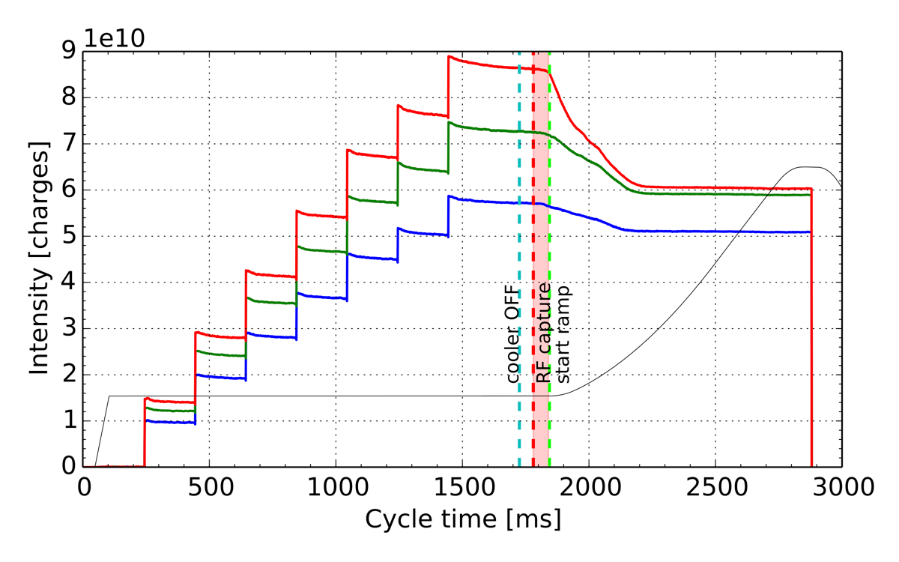
Loss pattern after RF capture
Achievable intensity at extraction appeared to saturate

Slide 14
The LEIR working point
Operational working point (Q_{x}, Q_{y}) = (1.82, 2.72)
normal resonances
- - - skew resonances
systematic resonances

Slide 15
Outline
Introduction
The LEIR intensity limitation
Space charge studies
LEIR performance increase
Summary and outlook

Slide 16
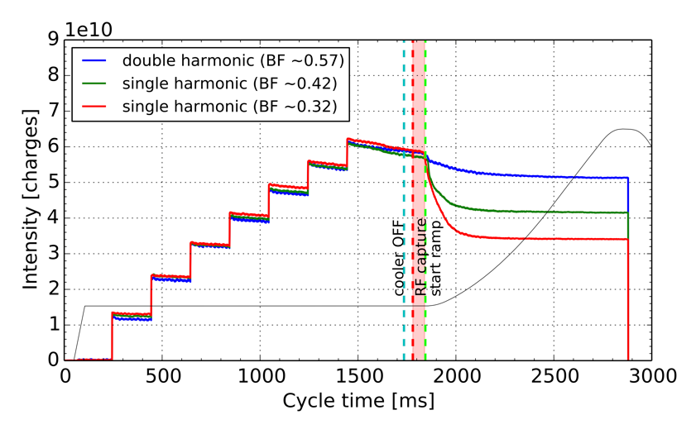
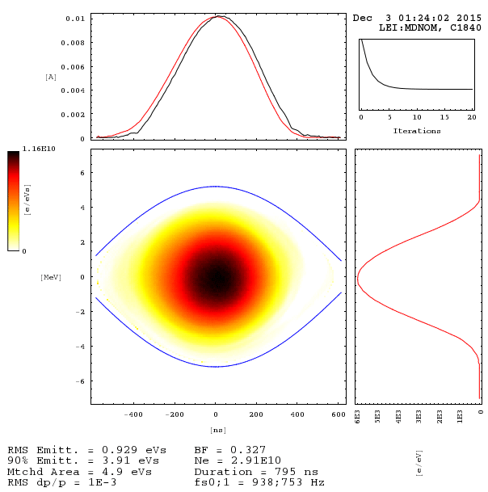
Variation of the longitudinal density
First hint towards importance of space charge effects due to dependency on line charge density.

Slide 17
Space charge detuning
coasting beam
bunched beam
  space charge detuning significantly enhanced during RF capture → multiple resonance crossing

Slide 18
Resonance identification
Tune diagram measurements show strong resonance excitation
  Sextupolar resonances close to the operational working point
  Very limited loss-free region
  Correct tuning of the working point crucial

Slide 19
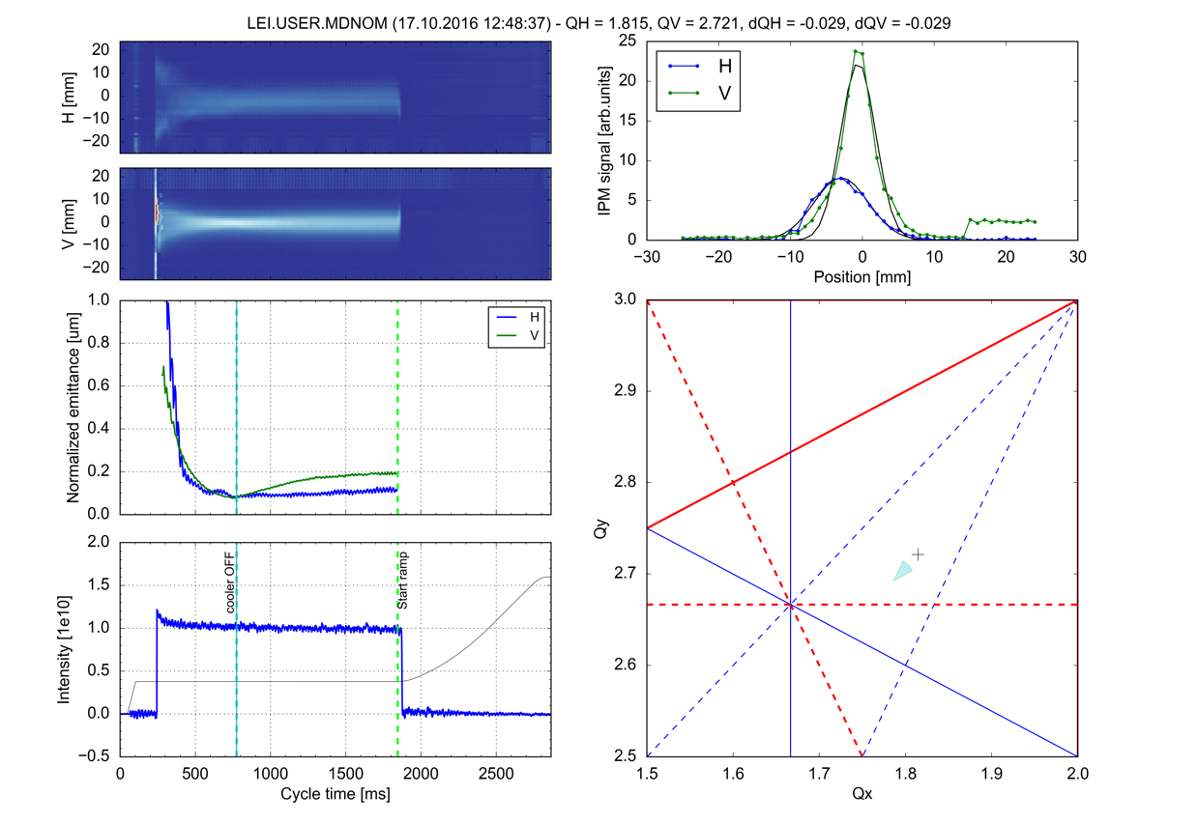

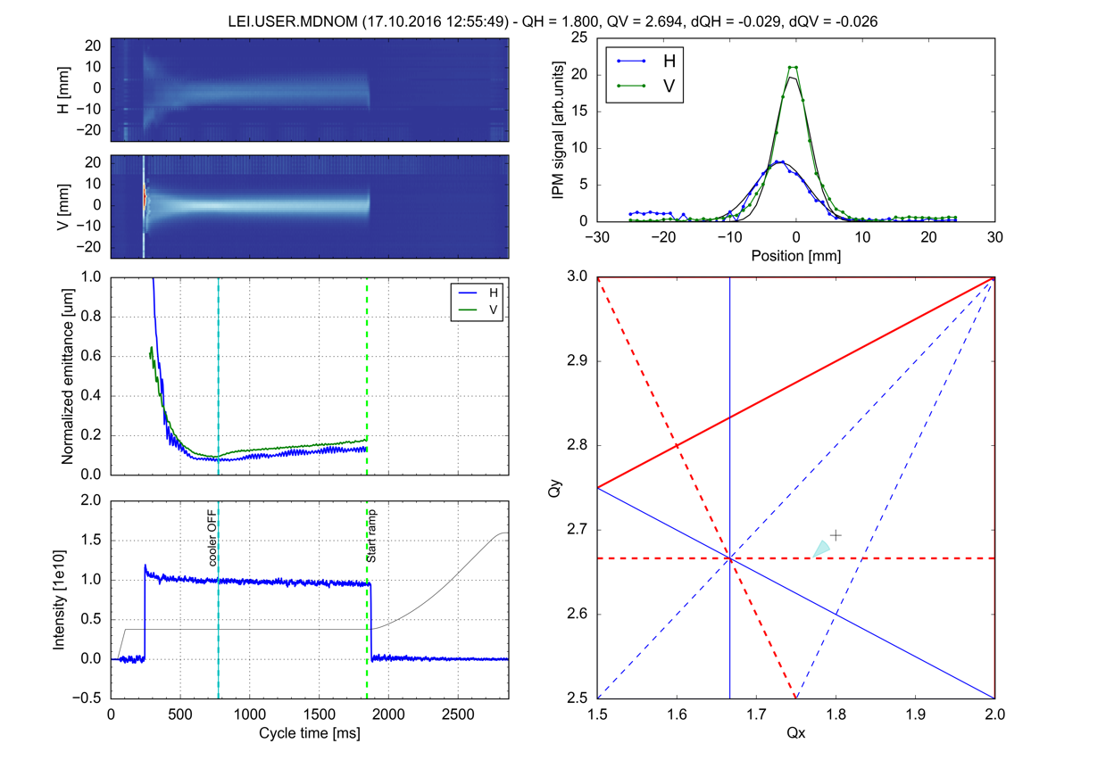
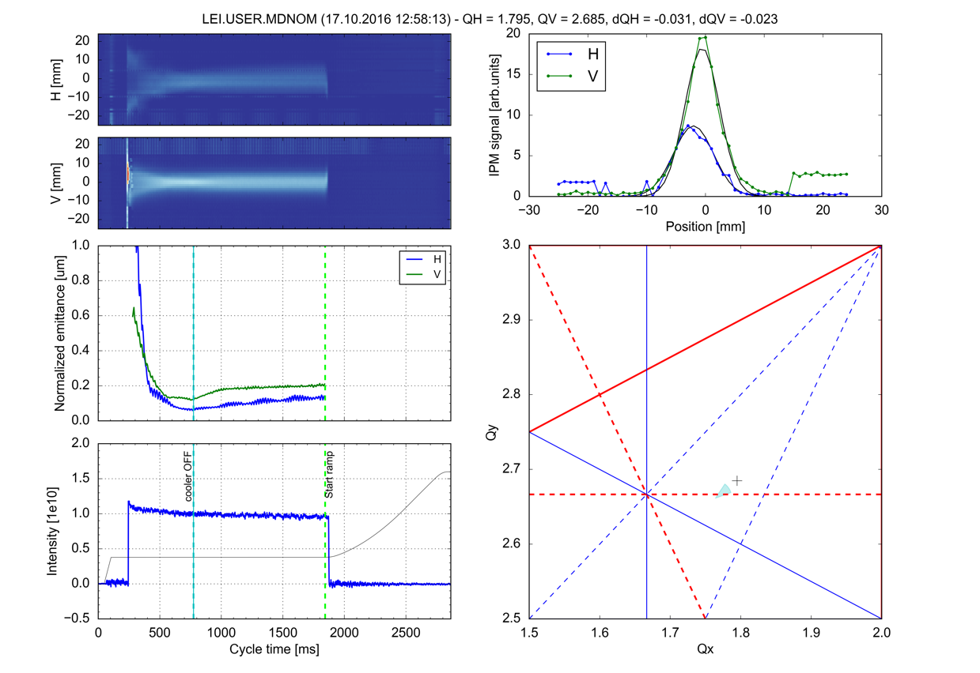
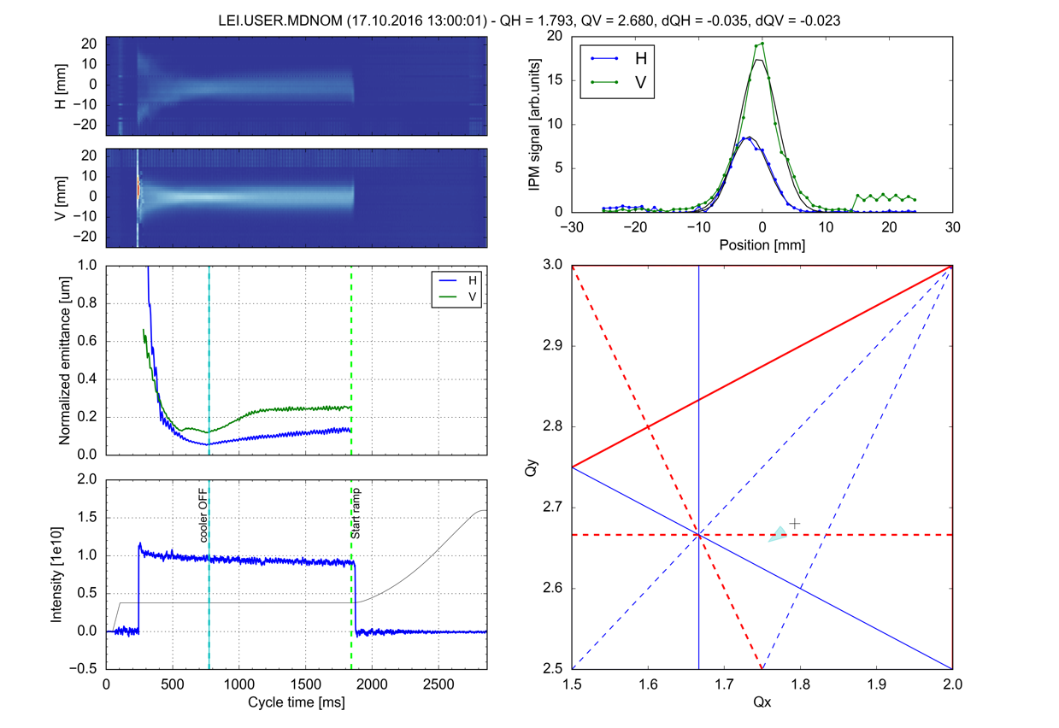
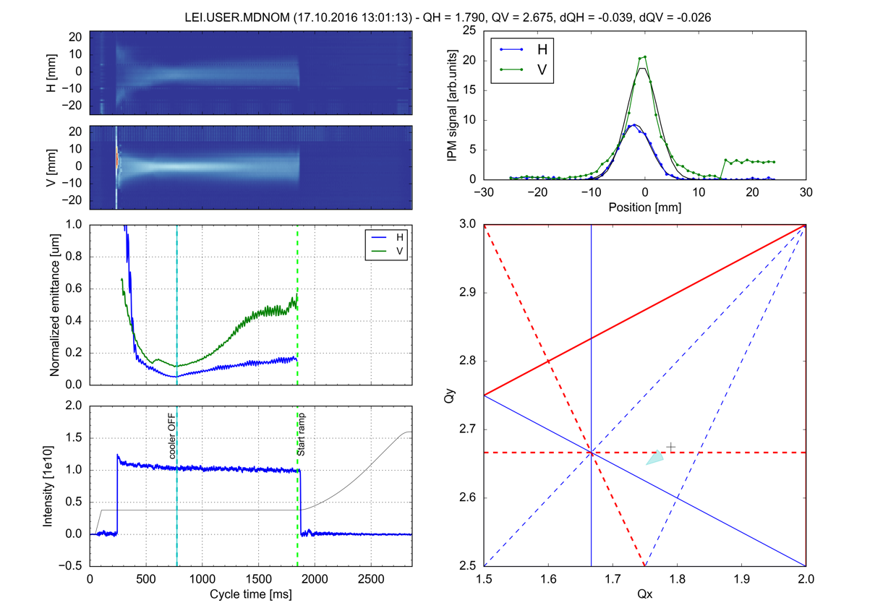
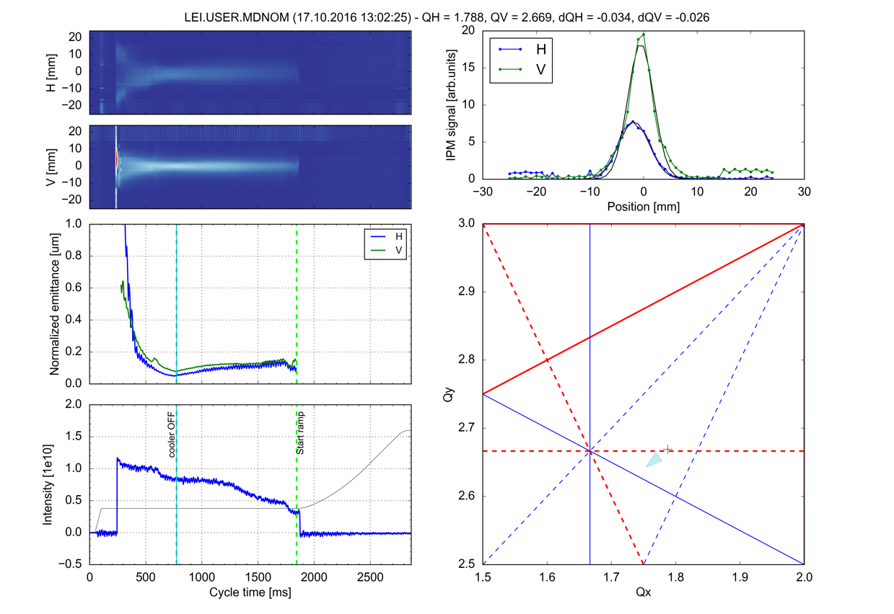


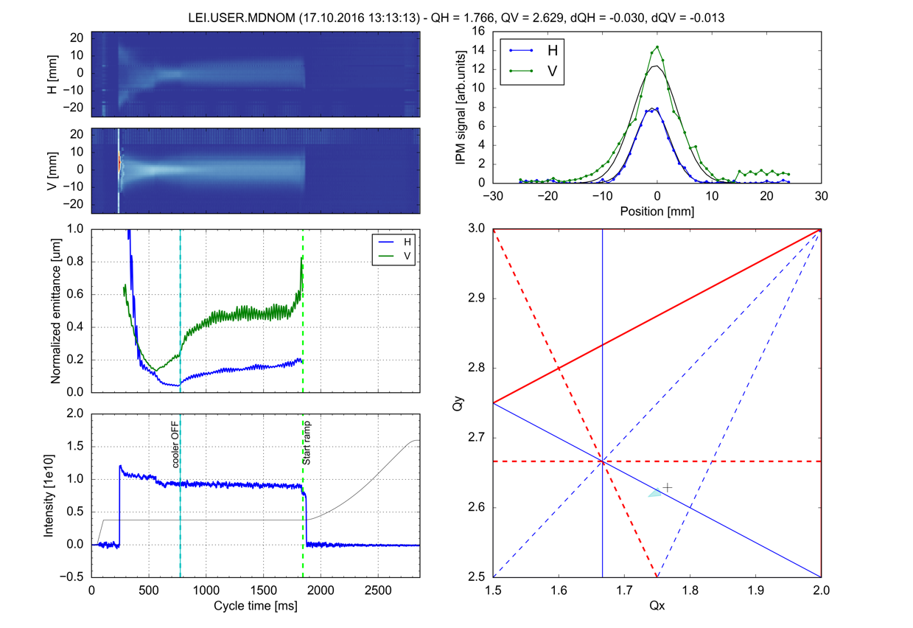
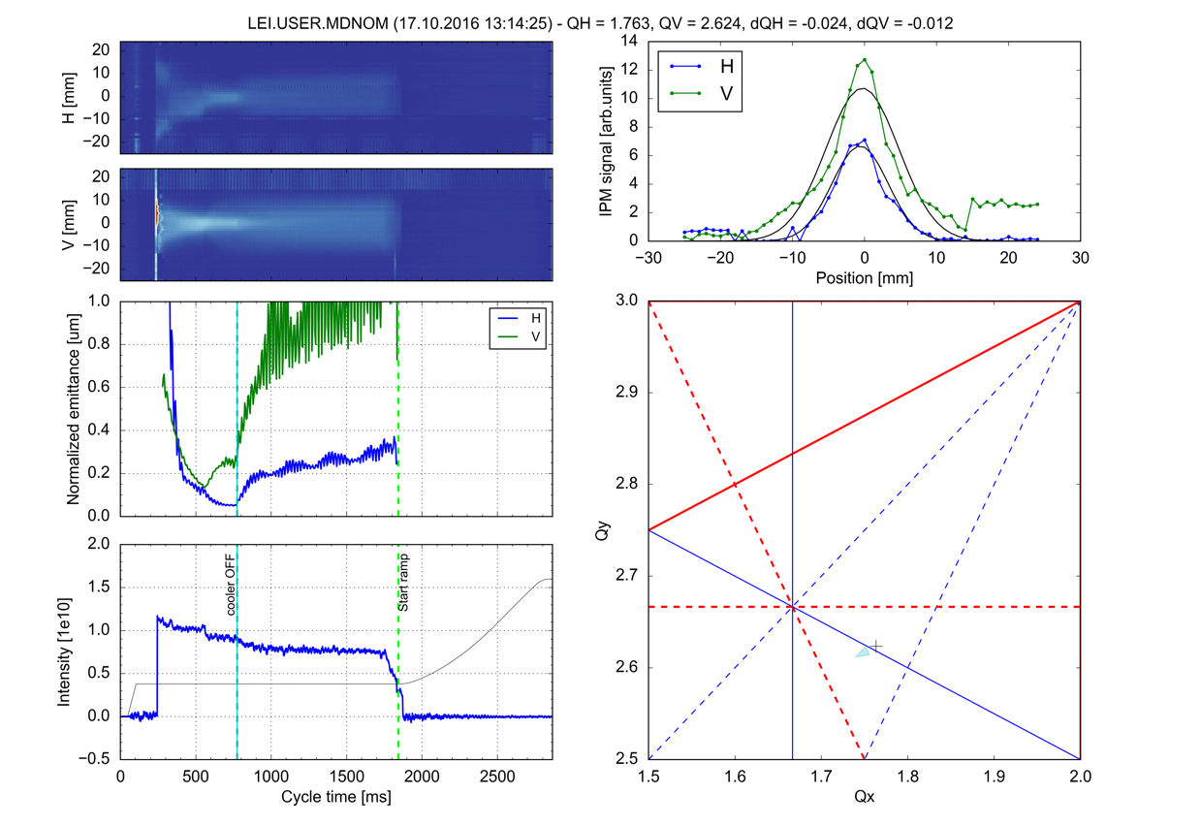
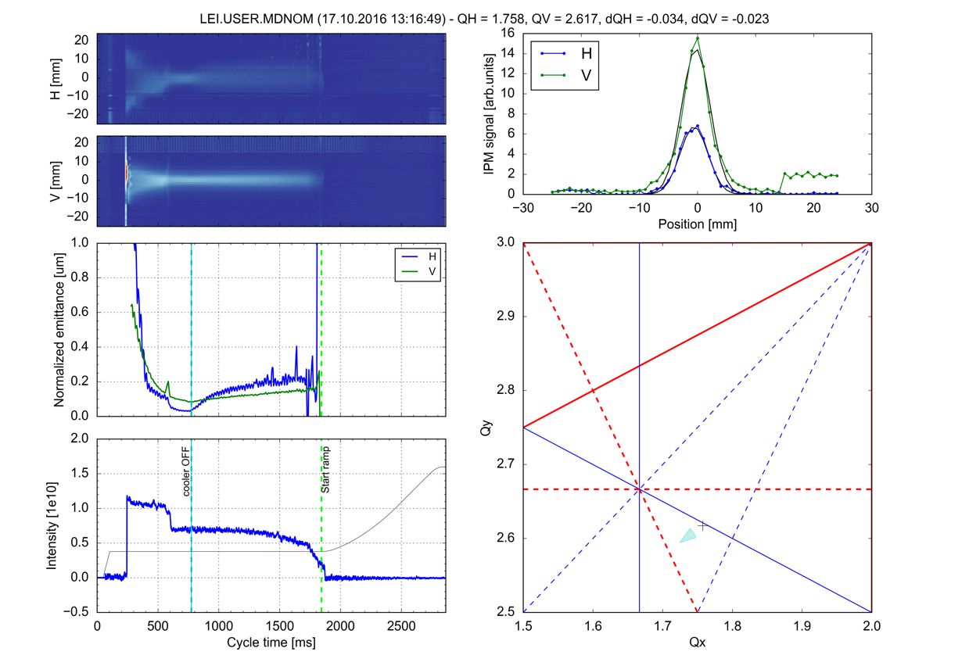
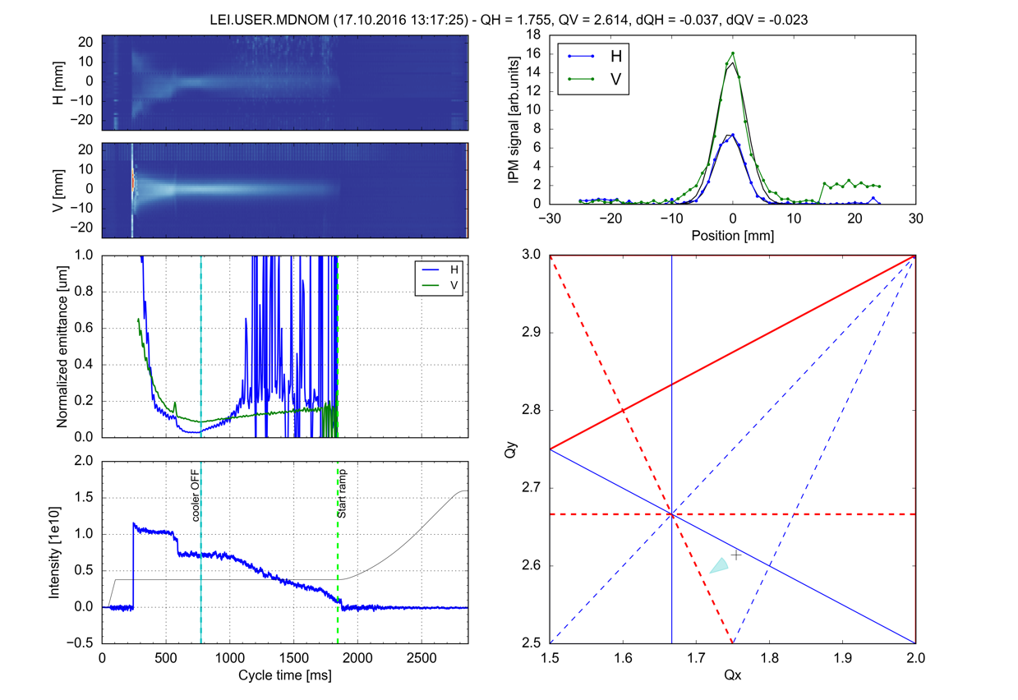
Resonance identification with IPM/BGI
Transverse profile evolution
Transverse emittance evolution
Bare machine working point (cross) and space charge detuning
Beam intensity

Slide 20
Resonance identification with IPM/BGI
  Summary of measurements on previous slide
  Various resonances can be nicely identified

Slide 21
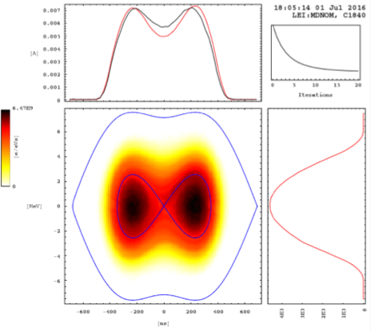
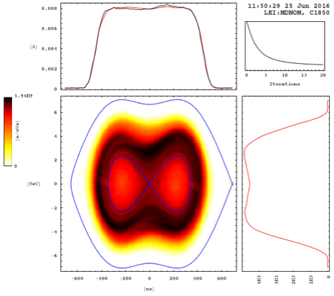
Flattening the longitudinal distribution
Beams operationally captured using a double harmonic RF system
  Offset the capture frequency away from central beam energy to obtain flat line density profile
  New approach successfully operationally applied at the end of 2016: modulation of capture frequency during bunching to stir beam
capture frequency offset
capture frequency centered
frequency modulation
S. Albright
S. Hancock

Slide 22
Resonance compensation
Polar scans of sextupole strength to determine maximum beam survival
  Resonance compensation was systematically studied using the available sextupoles
  Certain pairs of sextupoles allow to compensate the resonance Q_{x} + 2Q_{y} = 7
  Also attempted to (rather unsuccessfully) compensate skew resonance 3Q_{y} = 8

Slide 23
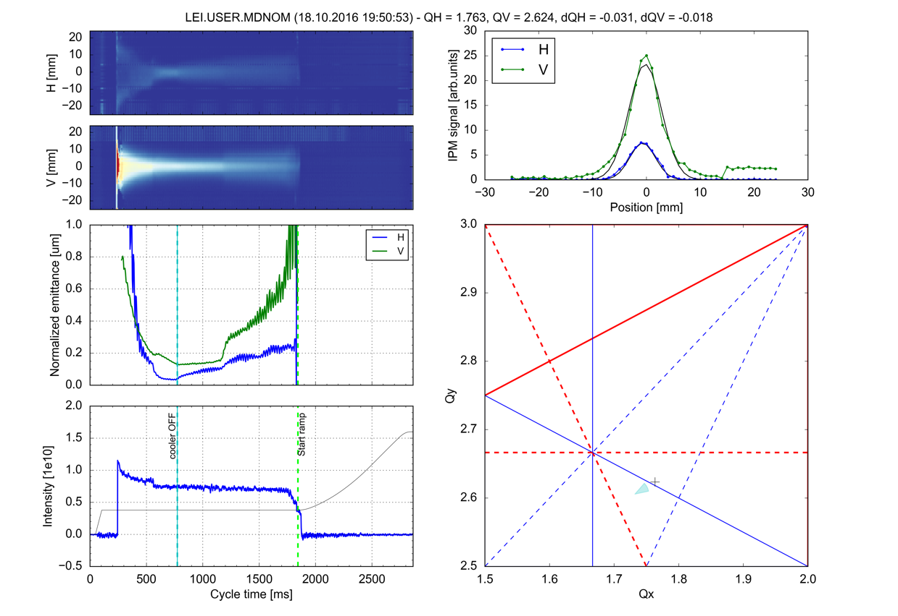
Resonance compensation
compensation ON

Slide 24
New LEIR optics
Drastic change of the working point to avoid excited resonances
Limited flexibility of the lattice due to various optics constraints:
  injection efficiency
  cooling efficiency
  vertical aperture restriction at the bends

Slide 25
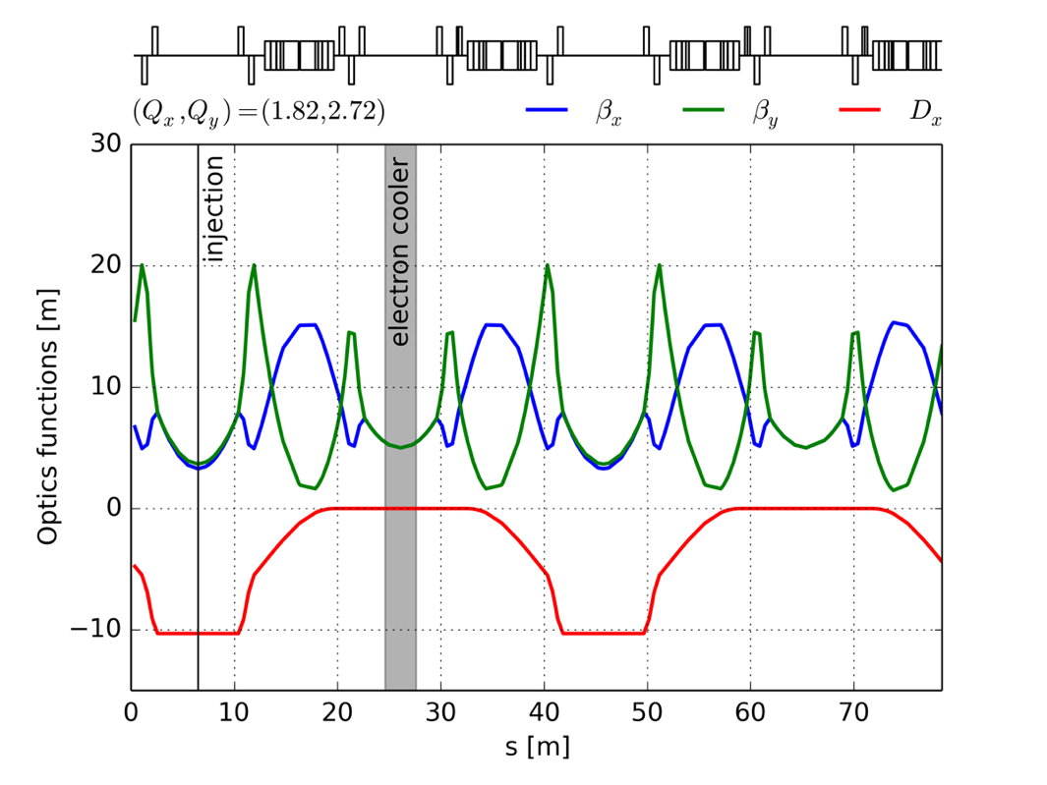
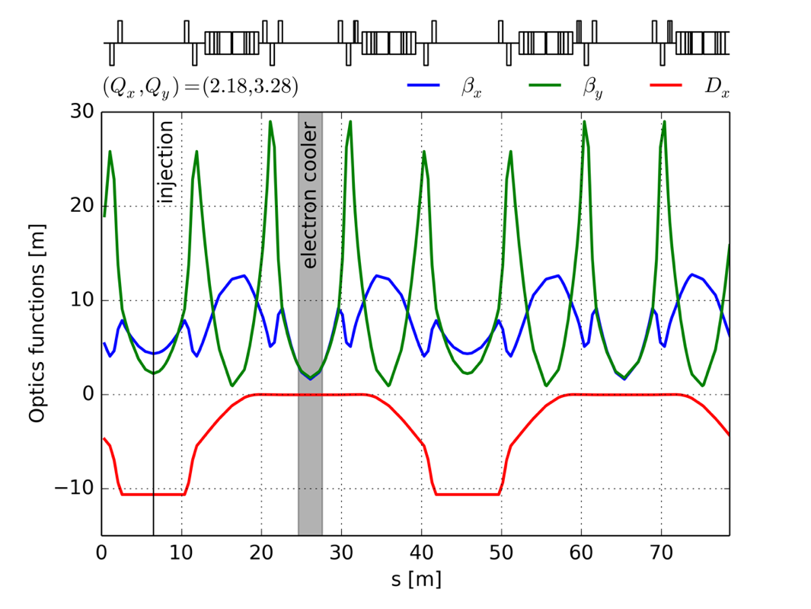
New LEIR optics
  vertical aperture restriction at entrance and exit of main magnets
  → no problem per se if blow-up can be reduced

Slide 26
New LEIR optics
Tune scans show significantly improved resonance-free area compared to nominal optics

Slide 27
Outline
Introduction
The LEIR intensity limitation
Space charge studies
LEIR performance increase
Summary and outlook

Slide 28
Comparison early 2015 – end of 2016

Slide 29
Outline
Introduction
The LEIR intensity limitation
Space charge studies
LEIR performance increase
Summary and outlook

Slide 30
Summary and outlook
Remarkable performance improvement of Linac3 and LEIR since 2015
  LHC Pb-Pb design luminosity surpassed by a factor 3
  LHC p-Pb design luminosity surpassed by a factor 8
  Achieved record intensity of > 10 x 10¹⁰ charges at extraction
LIU/HL-LHC beam parameters have already been achieved at LEIR extraction
  Only minor hardware modifications necessary to achieve this milestone
  Additional work remains to be done in the other machines
Major remaining challenge: maintain high performance of LEIR and reduce sensitivity to machine settings
  Exploit resonance compensation, improved longitudinal setup, new optics, …

Slide 32
Mitigation measures implemented

Slide 33
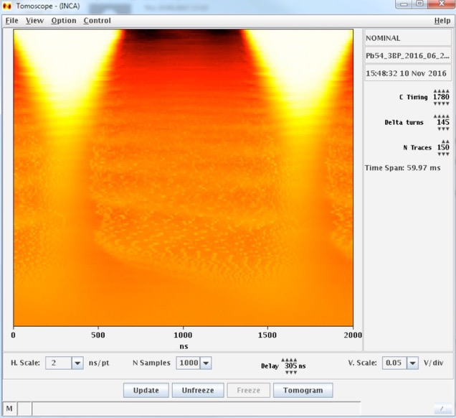
Iso-adiabatic RF capture

Slide 34
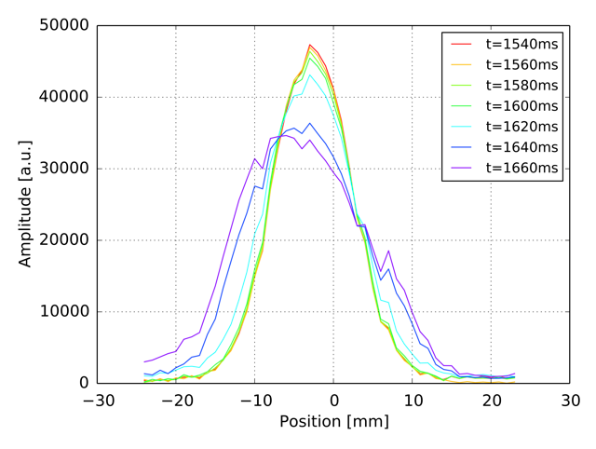
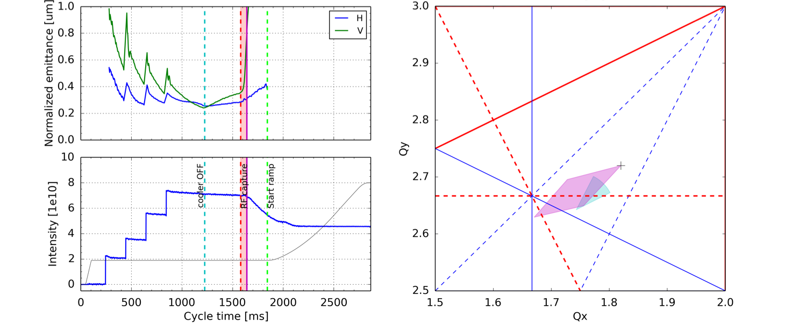
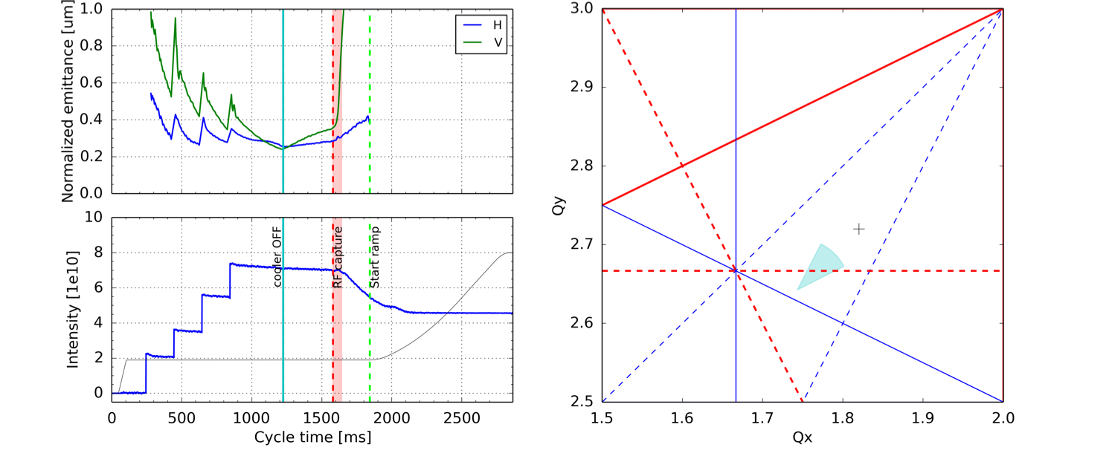
Disentangling the effect of the ramp and RF capture
vertical beam profiles
  RF capture advance by few 100 ms
  Same loss characteristics → not related to the magnetic ramp
  Drastic vertical blow-up observed at RF capture

Slide 35
Resonance identification
Static tune scans using low intensity / small tune spread
  Tune at injection kept constant to preserve injection efficiency
  Working point moved during electron cooling period to reduce losses when crossing resonances

Slide 36
Resonance compensation
Reduced strength of sextupoles after last injection
  Clear beneficial impact on resonance excitation and beam loss
standard sextupole settings
improved sextupole settings

