Slide 1
Overview of Space Charge Studies at CERN
Cern Participants:
S. Albright, F. Asvesta, H. Bartosik, A. Huschauer, J-B. Lagrange, E. Metral, A. Oeftiger, A. Saa Hernandez, M. Titze,
CERN, Geneva, Switzerland
External Collaborators:
G. Franchetti, O. Boine-Frankenheim, I. Hofmann, GSI, Darmstadt, Germany
S. Machida, RAL, UK
S. Cousineau, J. Holmes, SNS, Oak Ridge, USA
Y. Alexahin, J. Amundson, V. Kapin, E. Stern,
FERMILAB, Batavia, USA

Slide 2
Program
The CERN SC WG
SC Code Developments
Highlights of the last Years
Present SC Work at CERN

Slide 3
The CERN SC WG
In 2011 we decided to revive a working group on SC due to the renewed requirement to control this effect in view of the LHC pre-injector upgrade (LIU).
Most knowledgeable colleagues had long been retired
In fact, we are starting to loose the knowledge about our machines! ➔ Still looking for remedies: digitization, remeasurements, etc...
International collaborations, workshops (this one!)
Teaching a young team ➔ Series of Educational Talks
We now have staff, fellows & students for all machines

Slide 4
SC Code Development
To avoid year long delay we decided to use PTC-ORBIT for our workhourse since it is well connected to MAD-X and has most features required for our machines.
In the meantime we have moved to pyORBIT the successor of PTC-ORBIT including their bench-marking ➔ J-B Lagrange
In collaboration with Fermilab & BNL we have introduced SC into MAD-X both in purely frozen and adaptive mode ➔ news Y. Alexahin
We are planing a super-fast frozen SC module in SixTrack ➔ preliminary news J-B Lagrange
Last, we are in the process to also implement a fully homegrown SC module with all SC flavors into the CERN program facility. This should also take advantage of GPUs.

Slide 5
Highlights of the last Years
Disclaimer: Just a selection with no claim of completeness
It has been clear by now that the effect of SC can only be evaluated with trustworthy Linear & Non-linear model of the Machine. More recently we have (re)-discovered the Relevance of Power Supply „Ripple“ ➔ H. Bartosik
Example of the Relevance of the linear model.
Coupled non-linear Resonance Topology with SC.
There is some Progress on Noise of PIC codes but not fully solved yet.

Slide 6
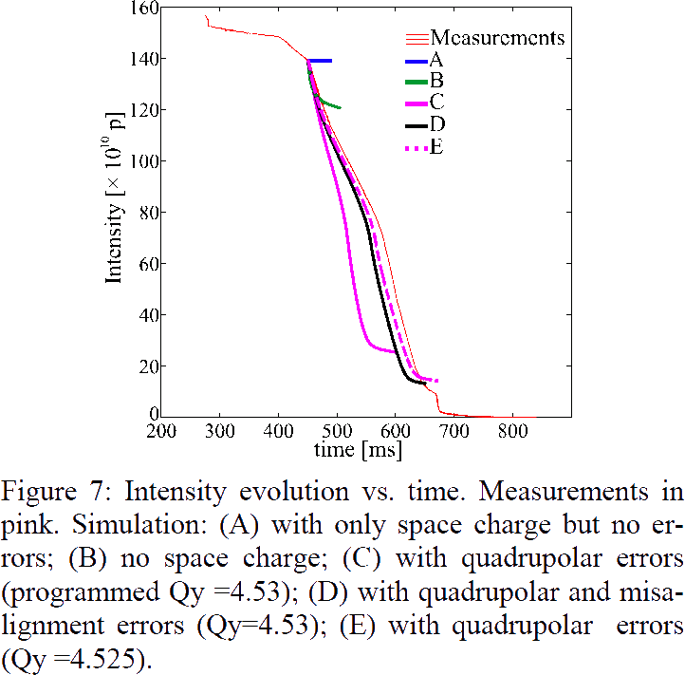
PSB Half Integer
HB16 Malmö, E. Benetto et al.
ΔQ > 0.5
Agreement when measured
quadrupolar errors and misalignment considered in
The Simulations:
➔ Know both linear and non-linear model of your machine

Slide 7
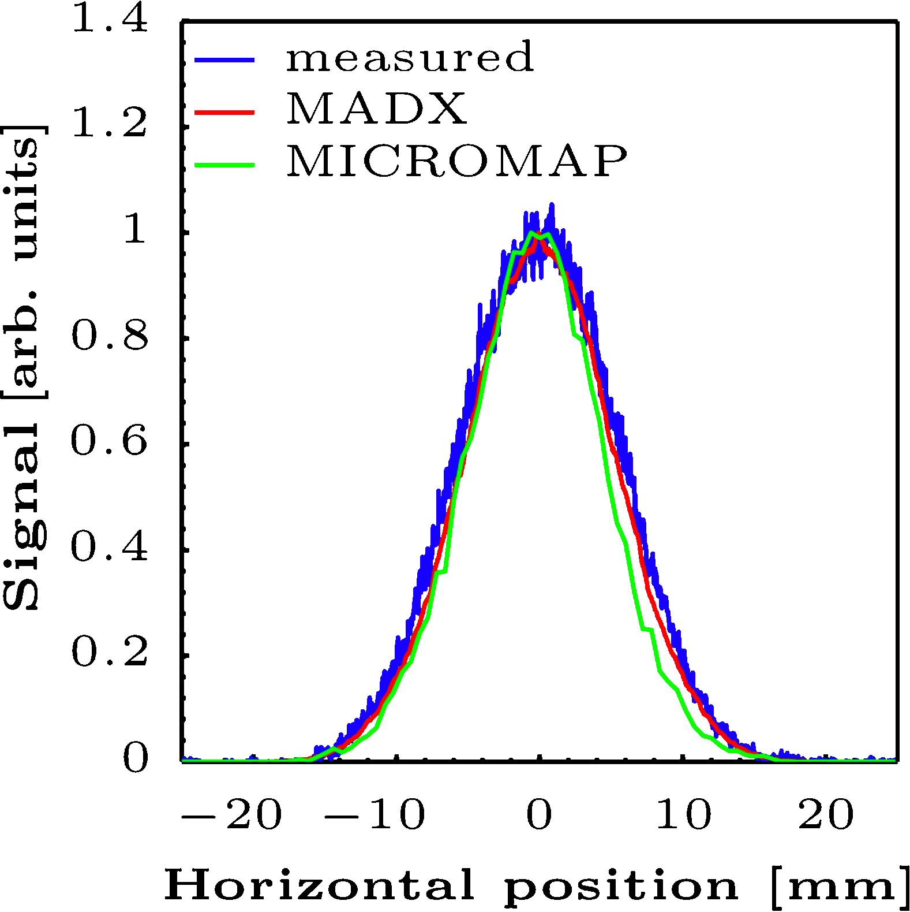
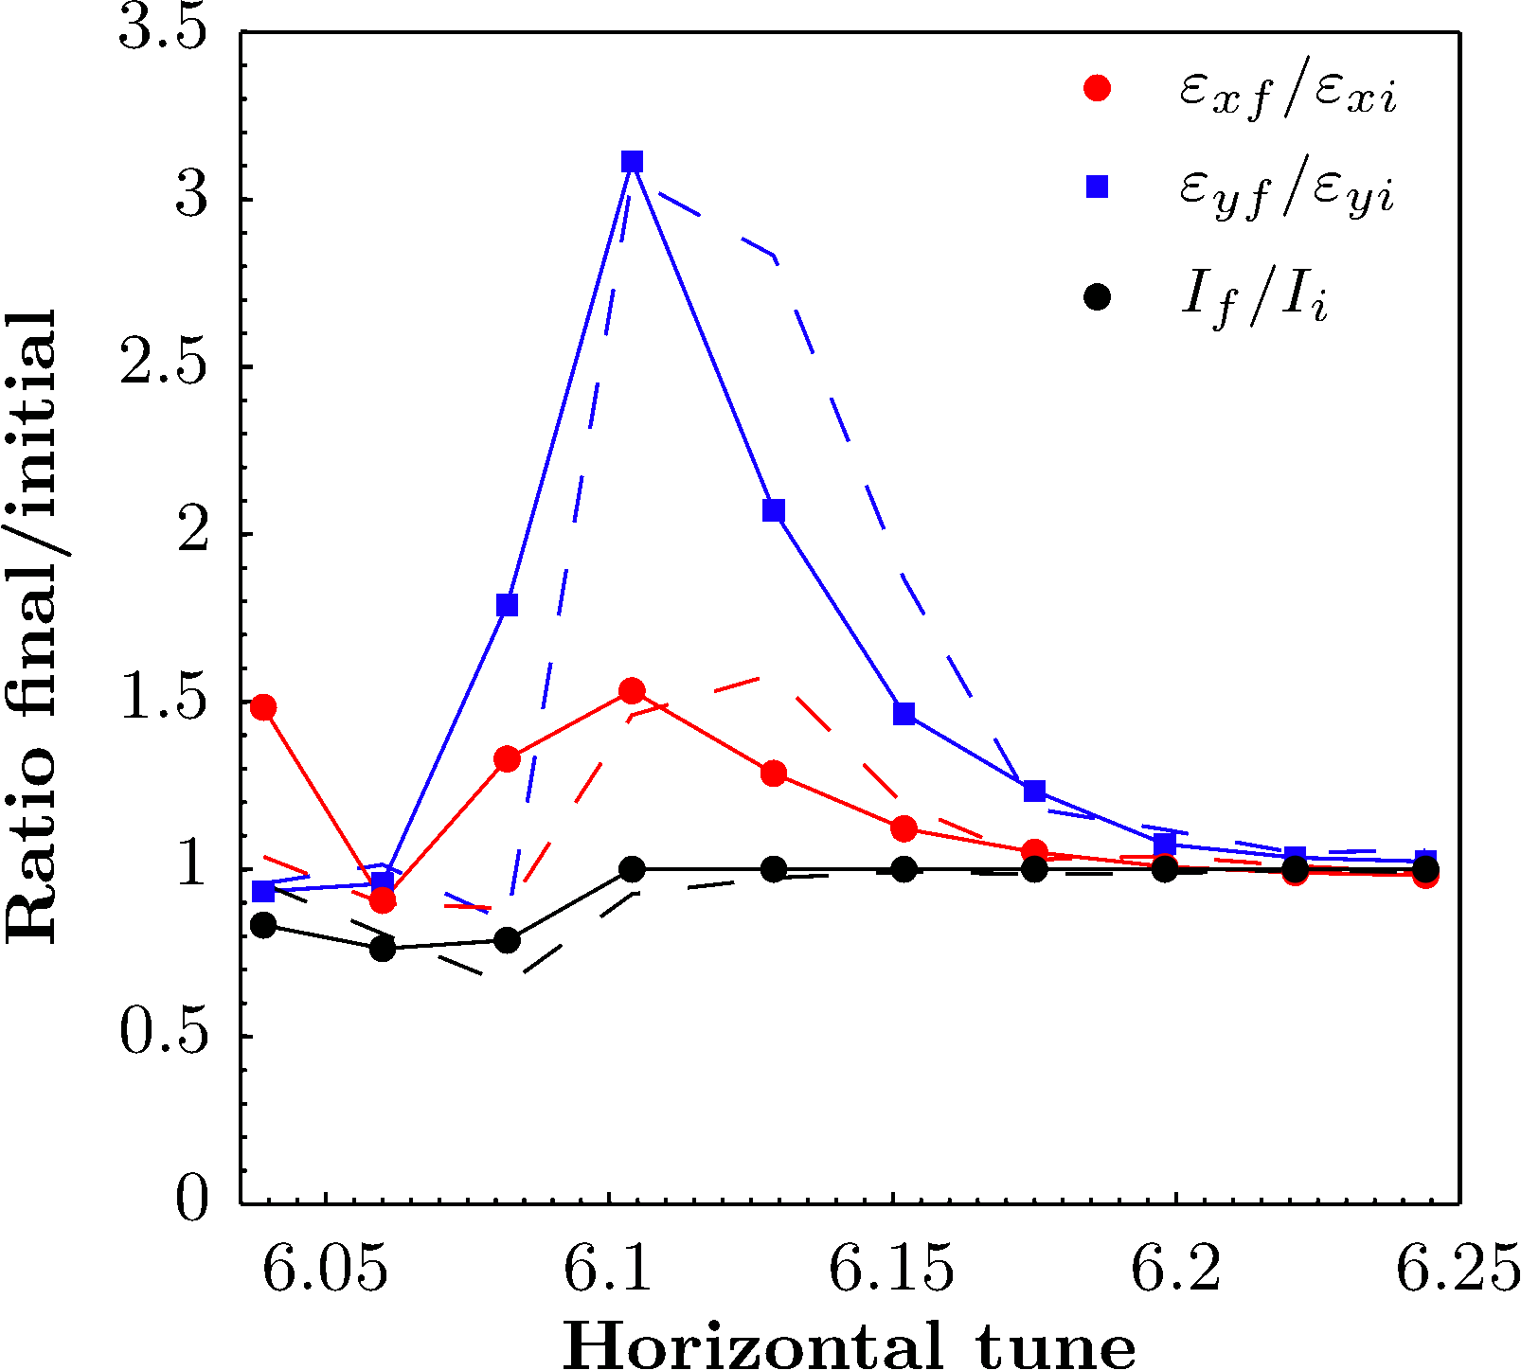
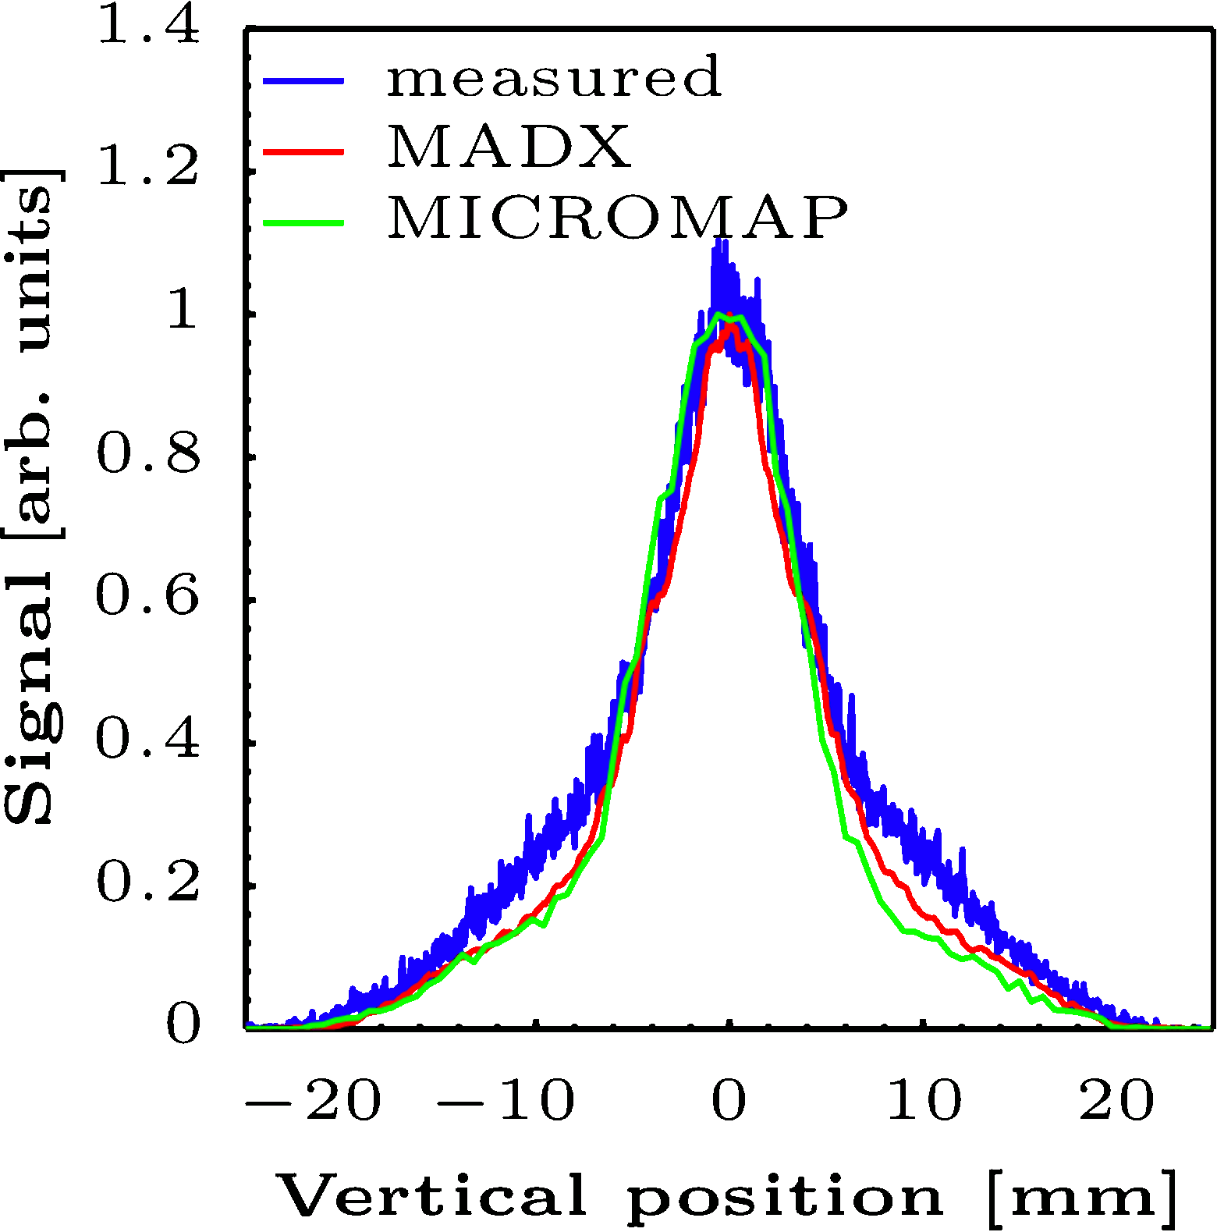
The eternal report about the 2012 PS Experiment

Slide 8
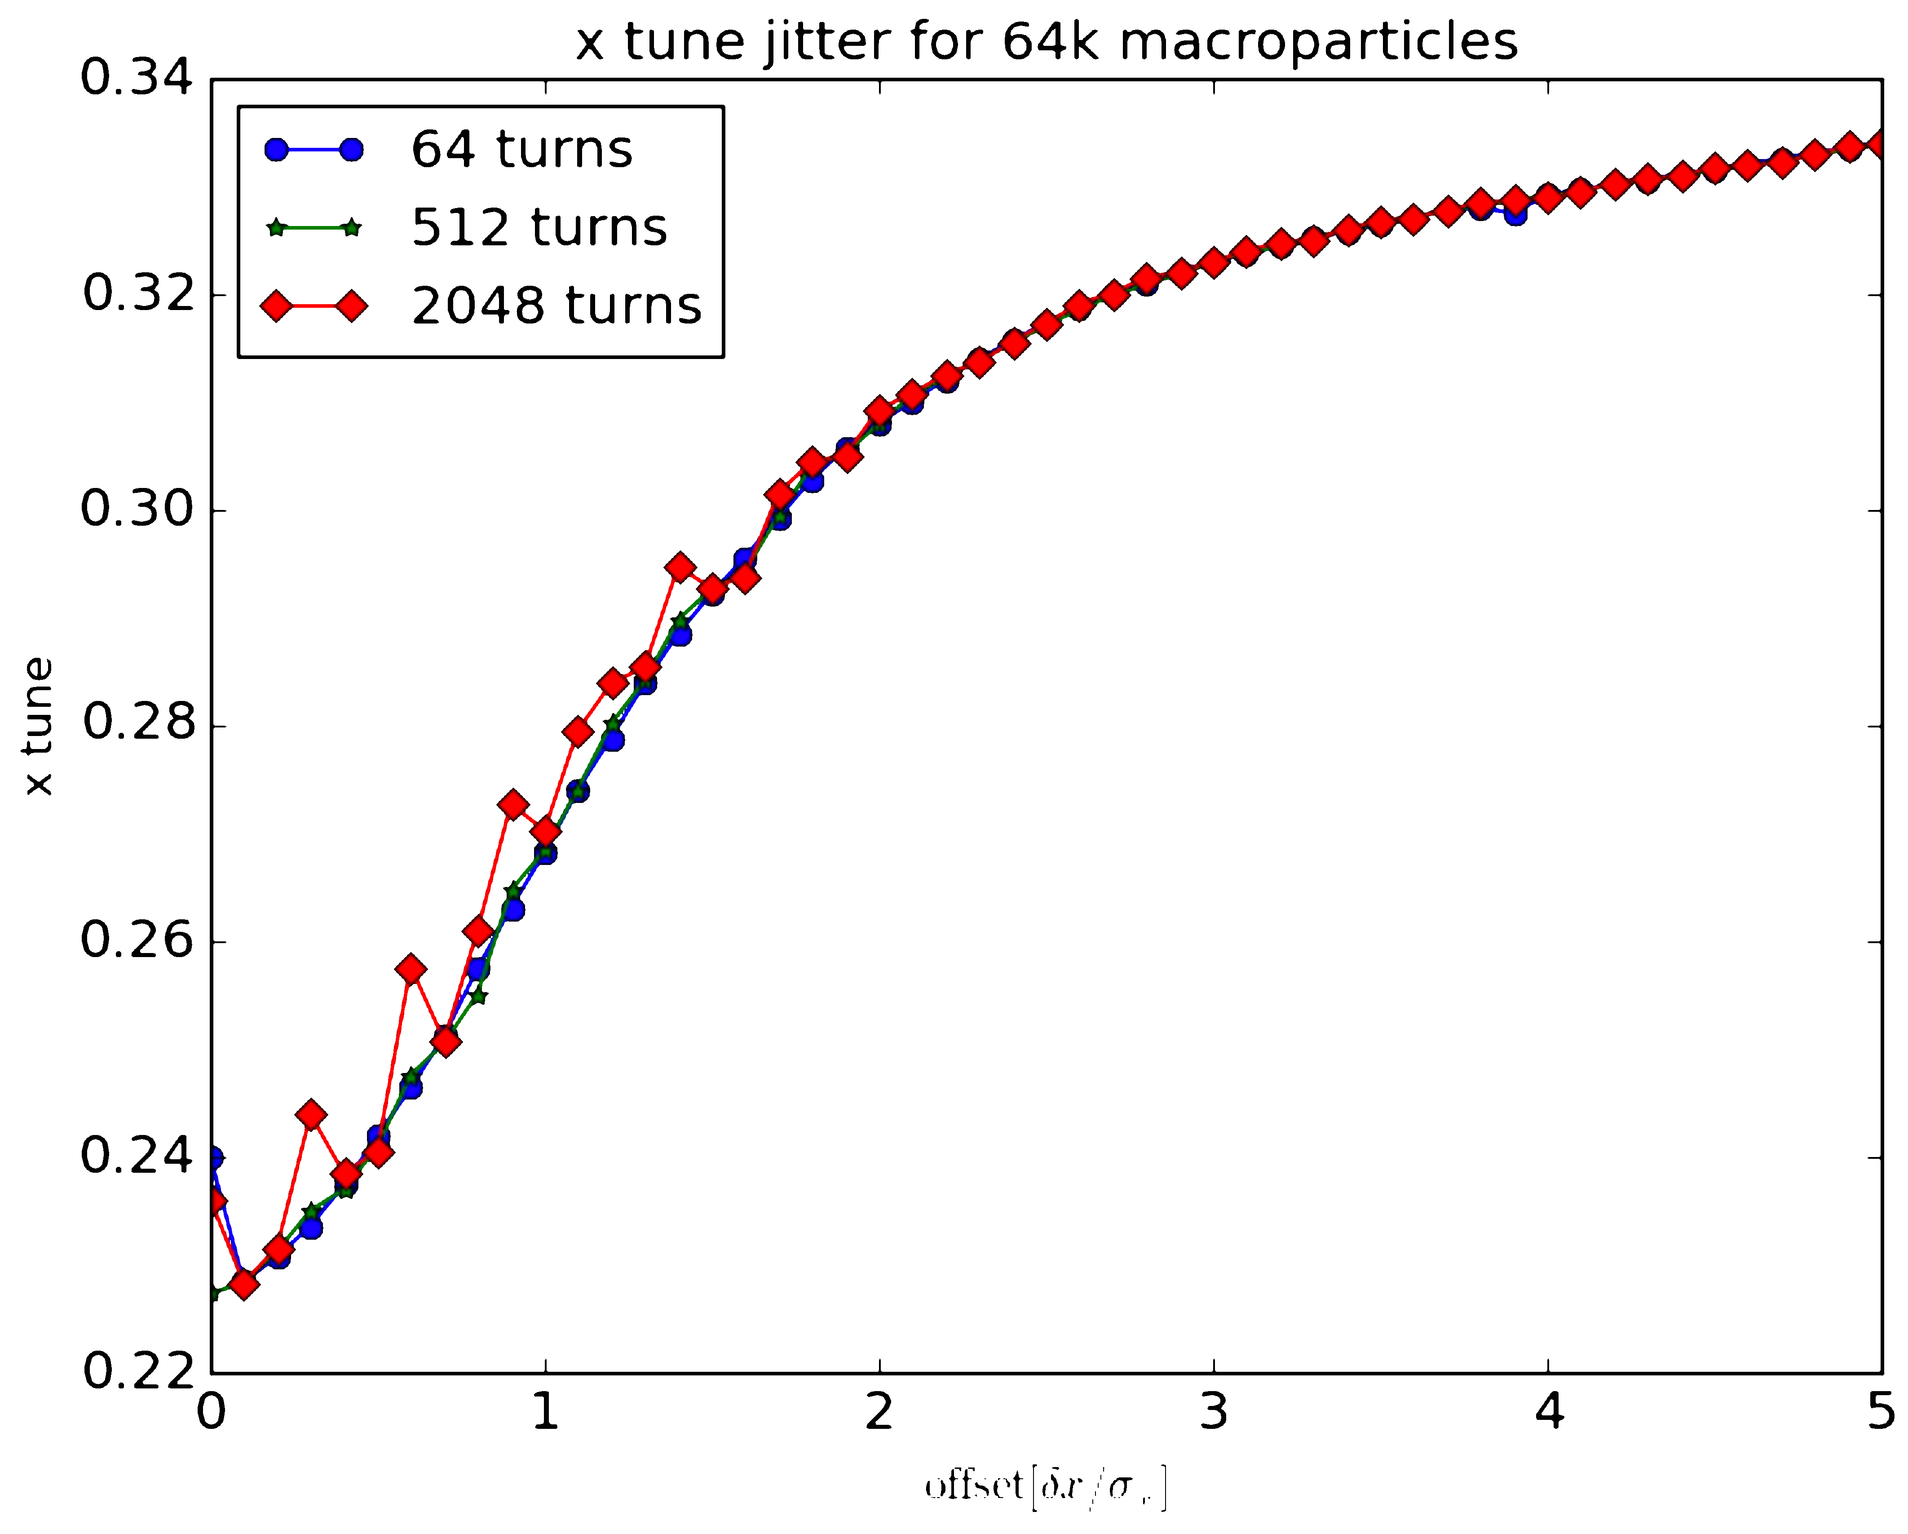
Effect of Grid Noise I
SYNERGIA
64K MP

Slide 9
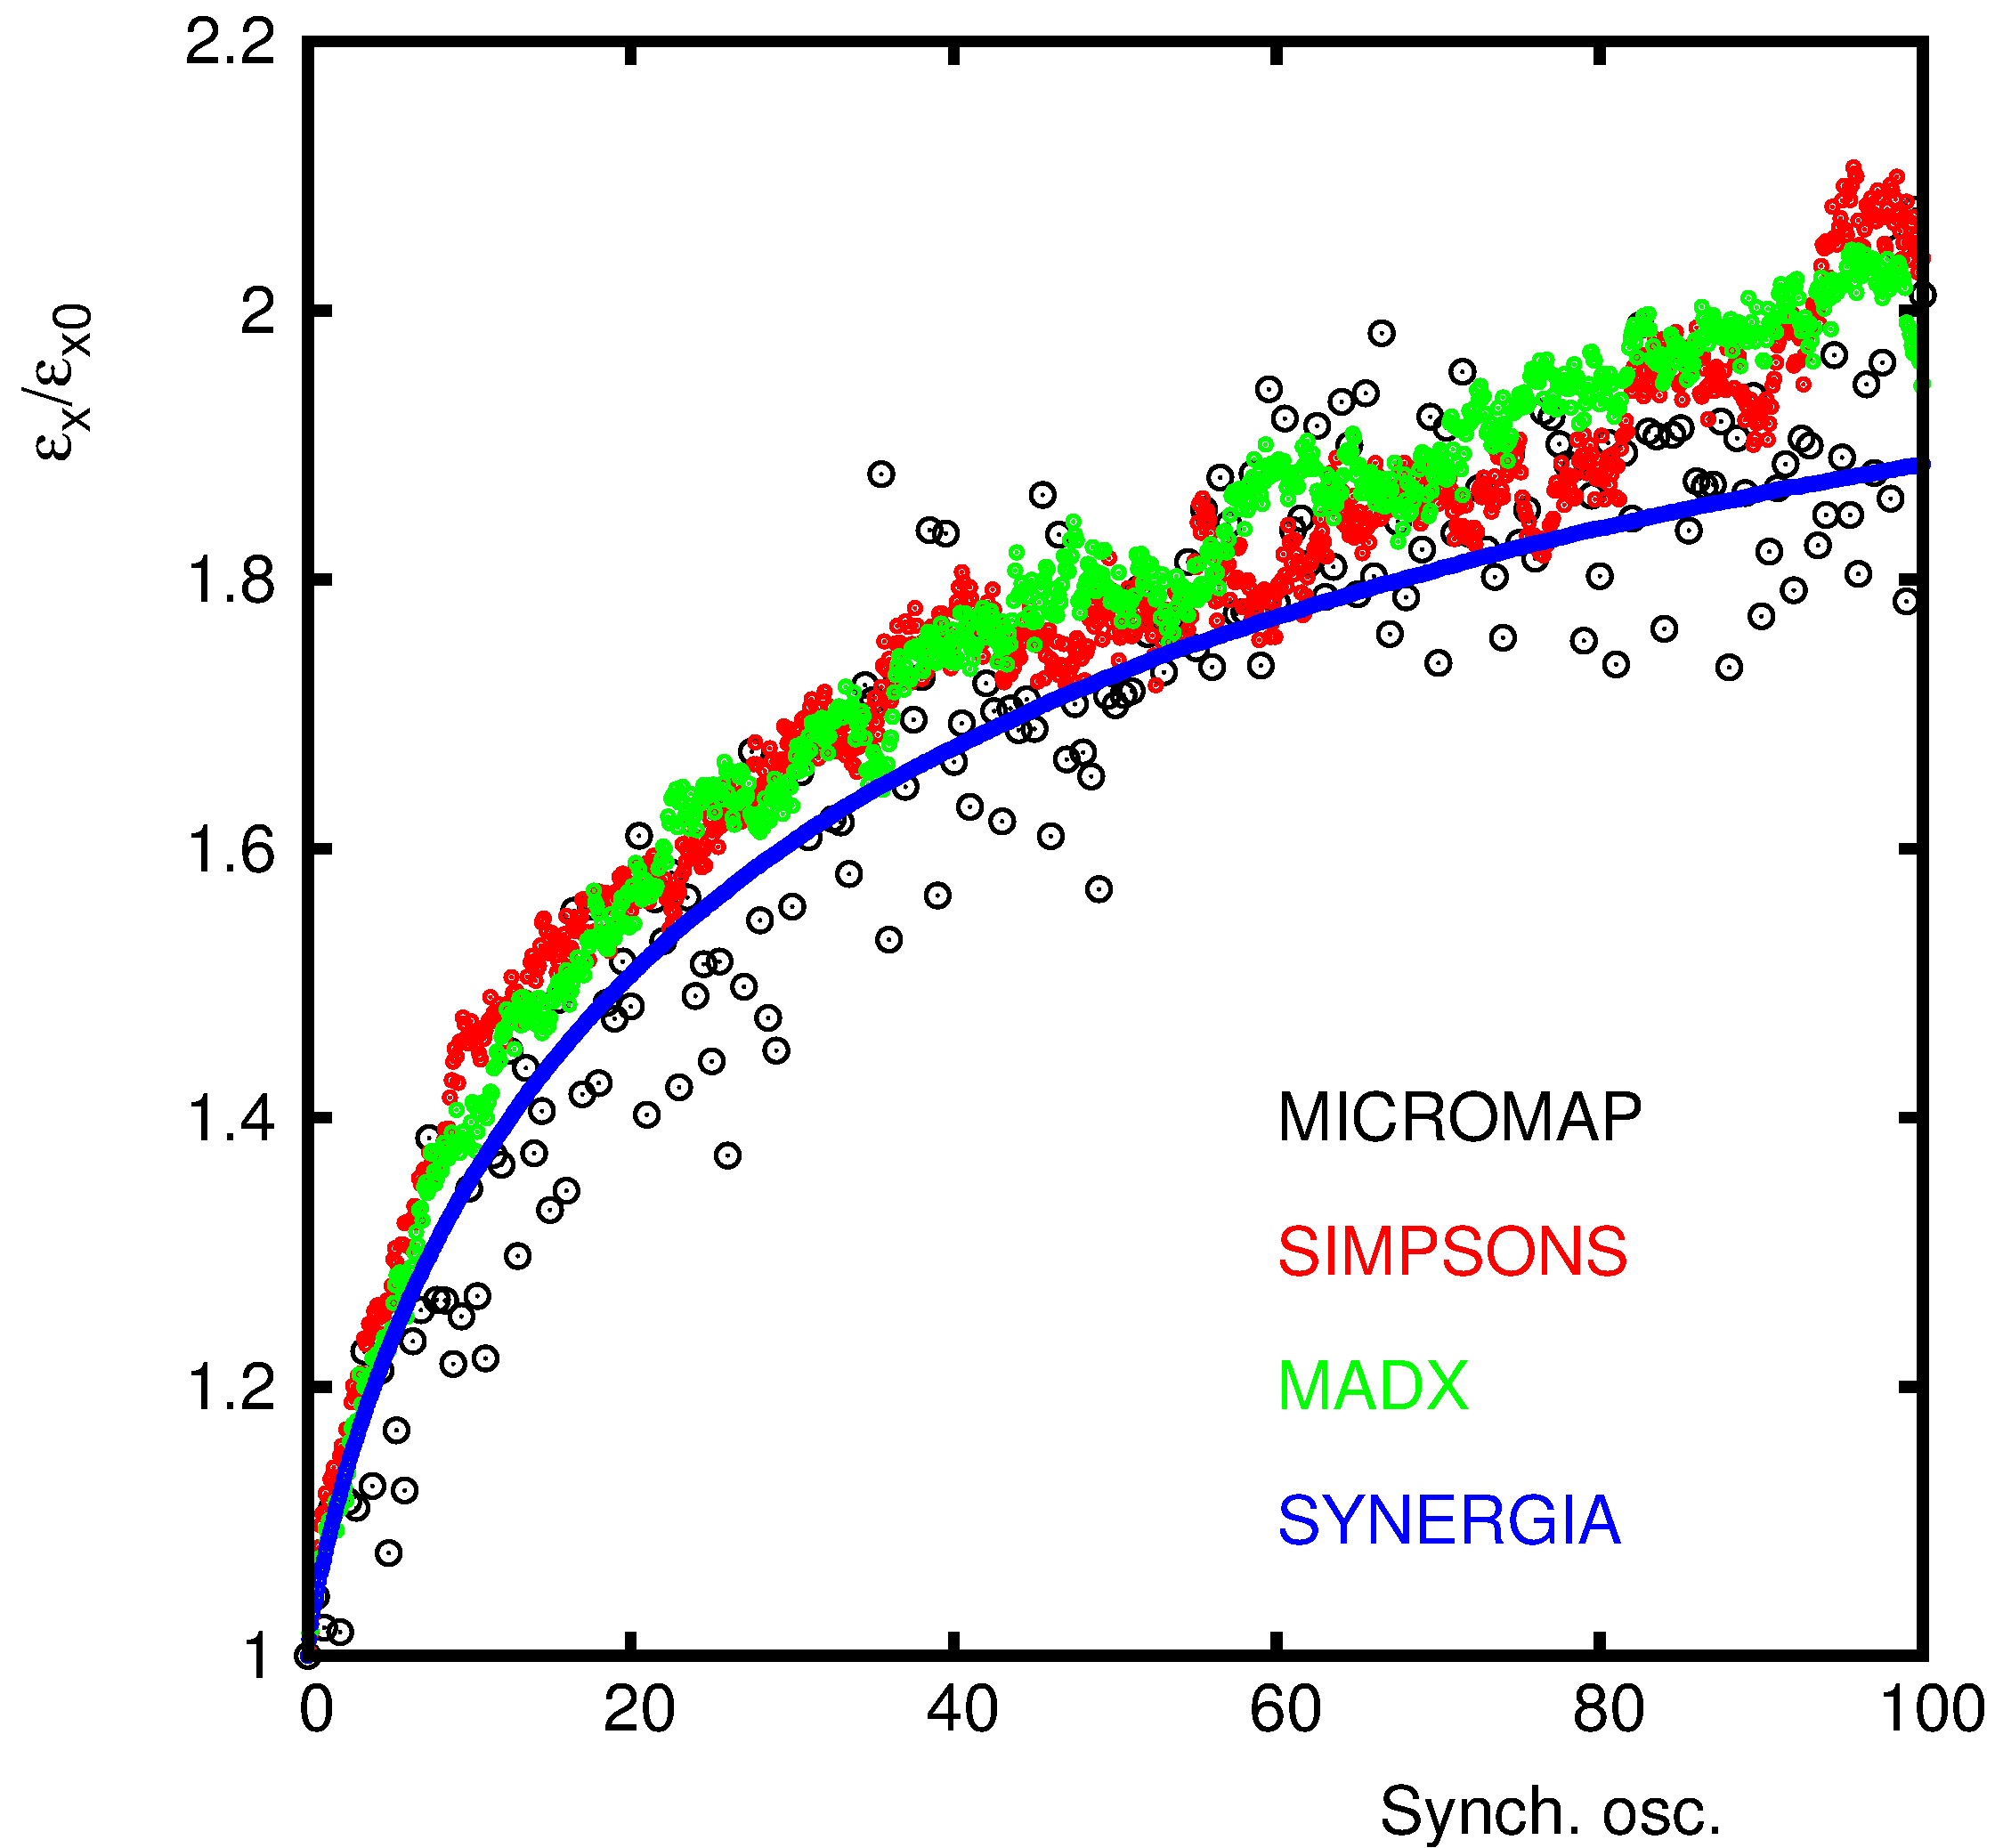
Effect of Grid Noise II
SYNERGIA 1024K MP

Slide 10
Present SC related Work at CERN

Slide 11
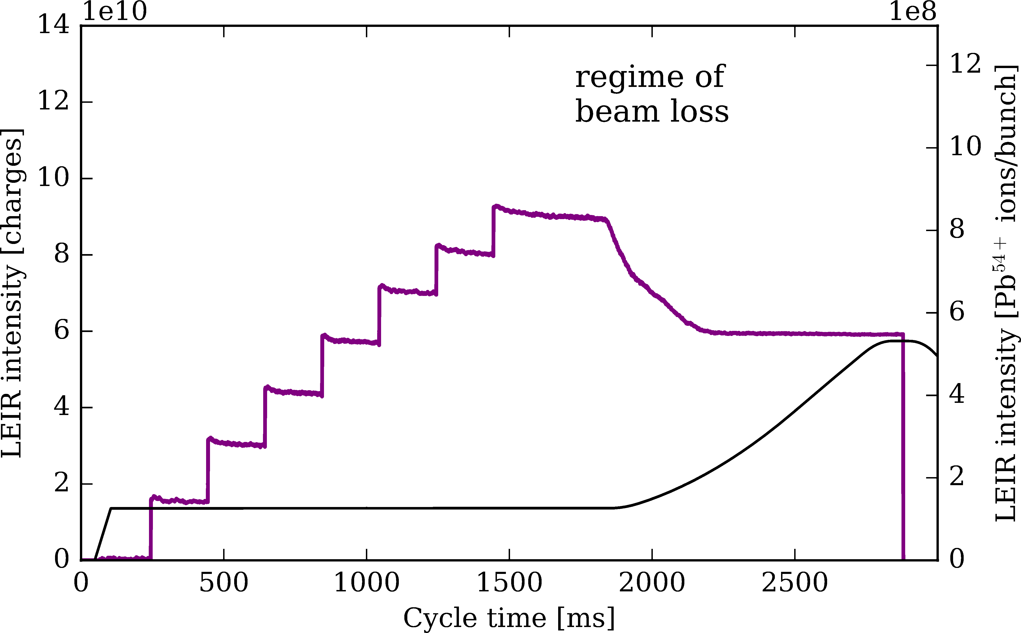
Preparation LEIR for the HL-LHC Era ➔ A. Huschauer

Slide 12
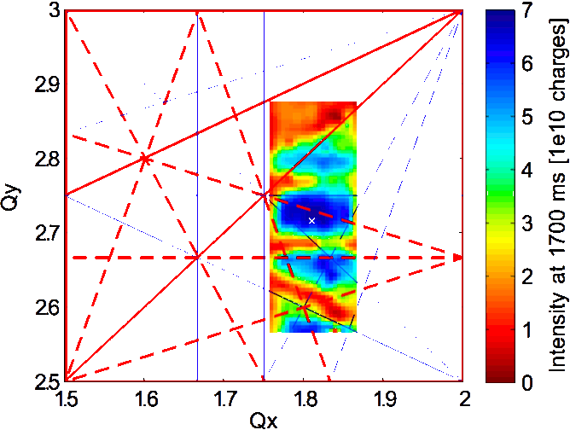
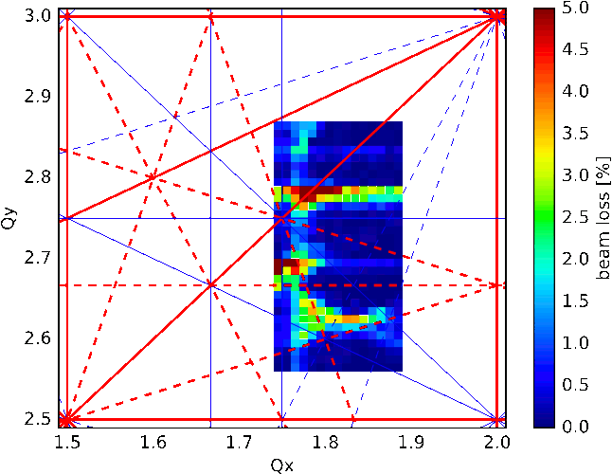
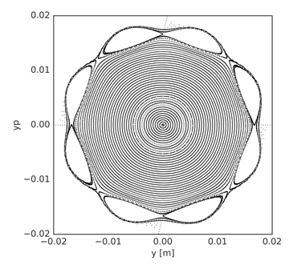
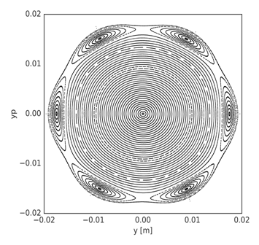
LEIR Space Charge simulations ➔ A. Saa Hernandez
First space charge simulations for LEIR to model measurements with Pb54+ beams
Measurements of beam survival after 0.4 s
Simulations of beam survival after 0.55 s

Slide 13
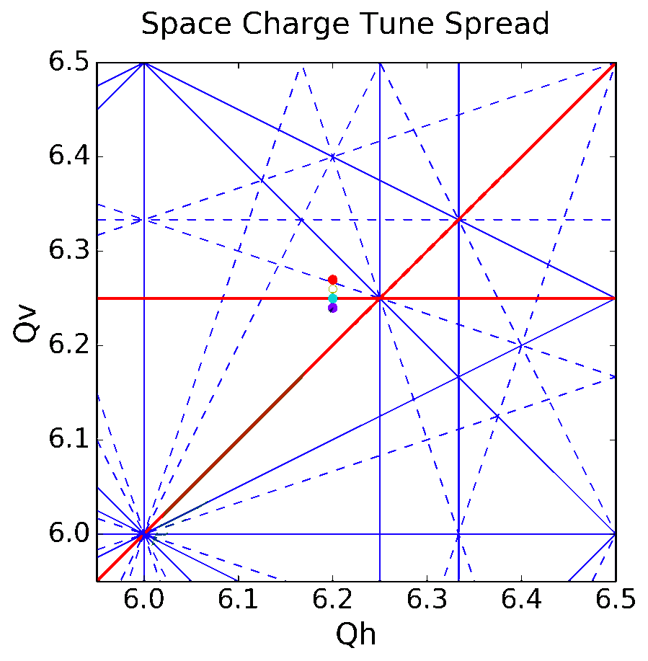
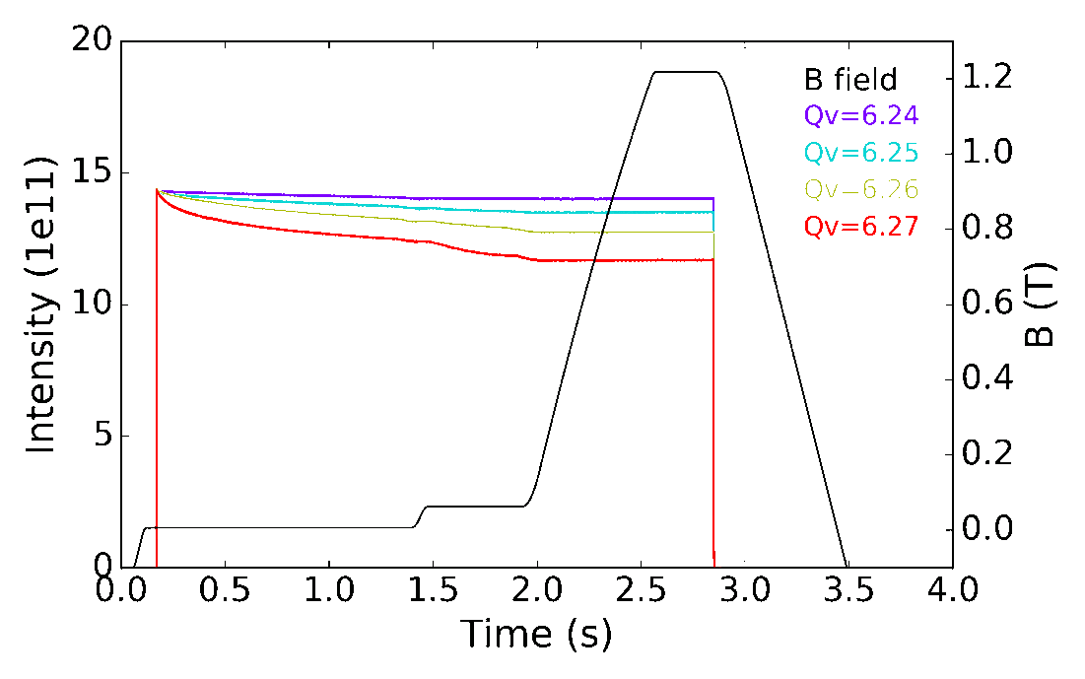
PS Working Point Studies ➔ F. Asvesta

Slide 14
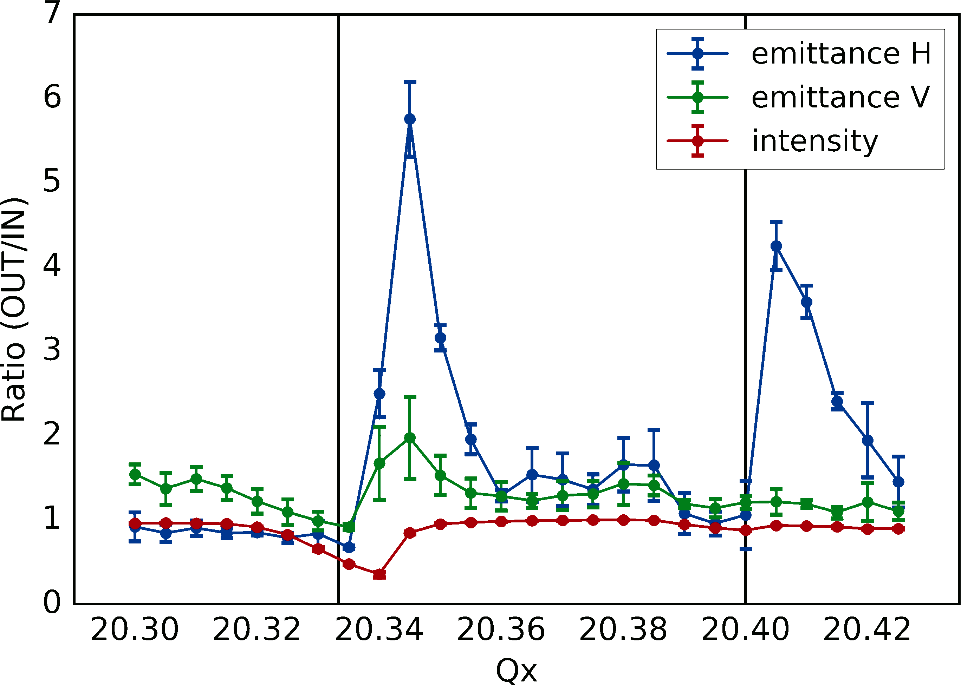
SPS Tune Scan with SC ➔ H. Bartosik
Excited
Not Excited!

Slide 15
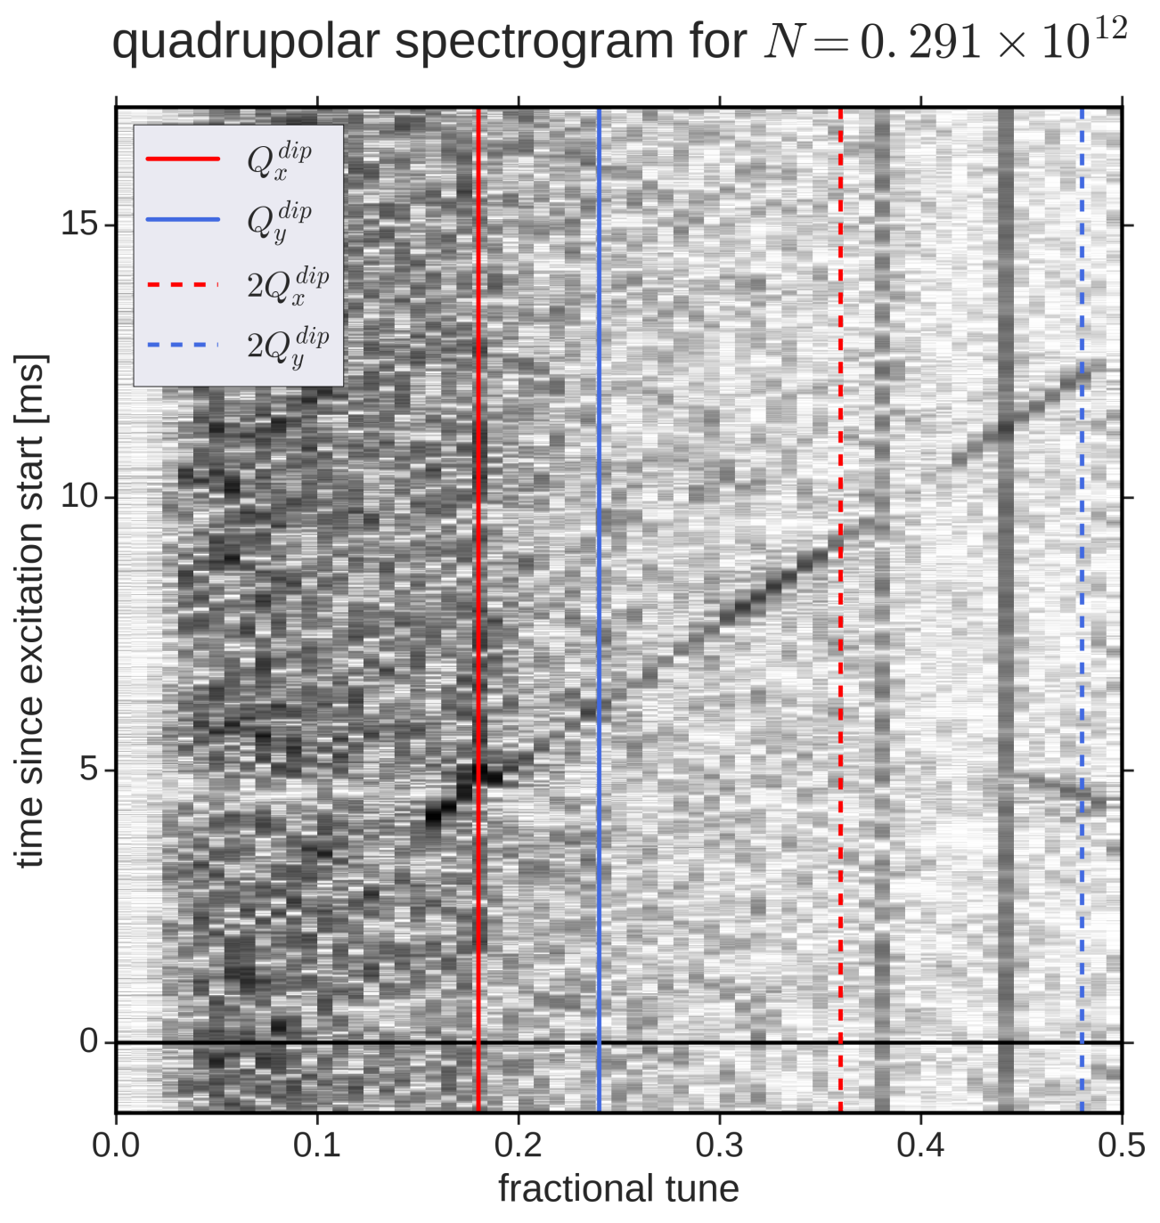
PS QPU Measurements ➔ A. Oeftiger

Slide 17
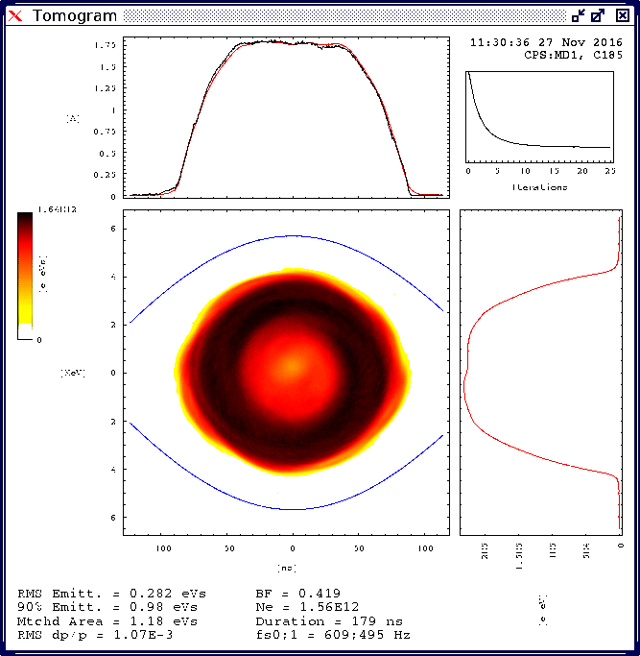
Hollow Bunch in the PS ➔ A. Oeftiger

Slide 18
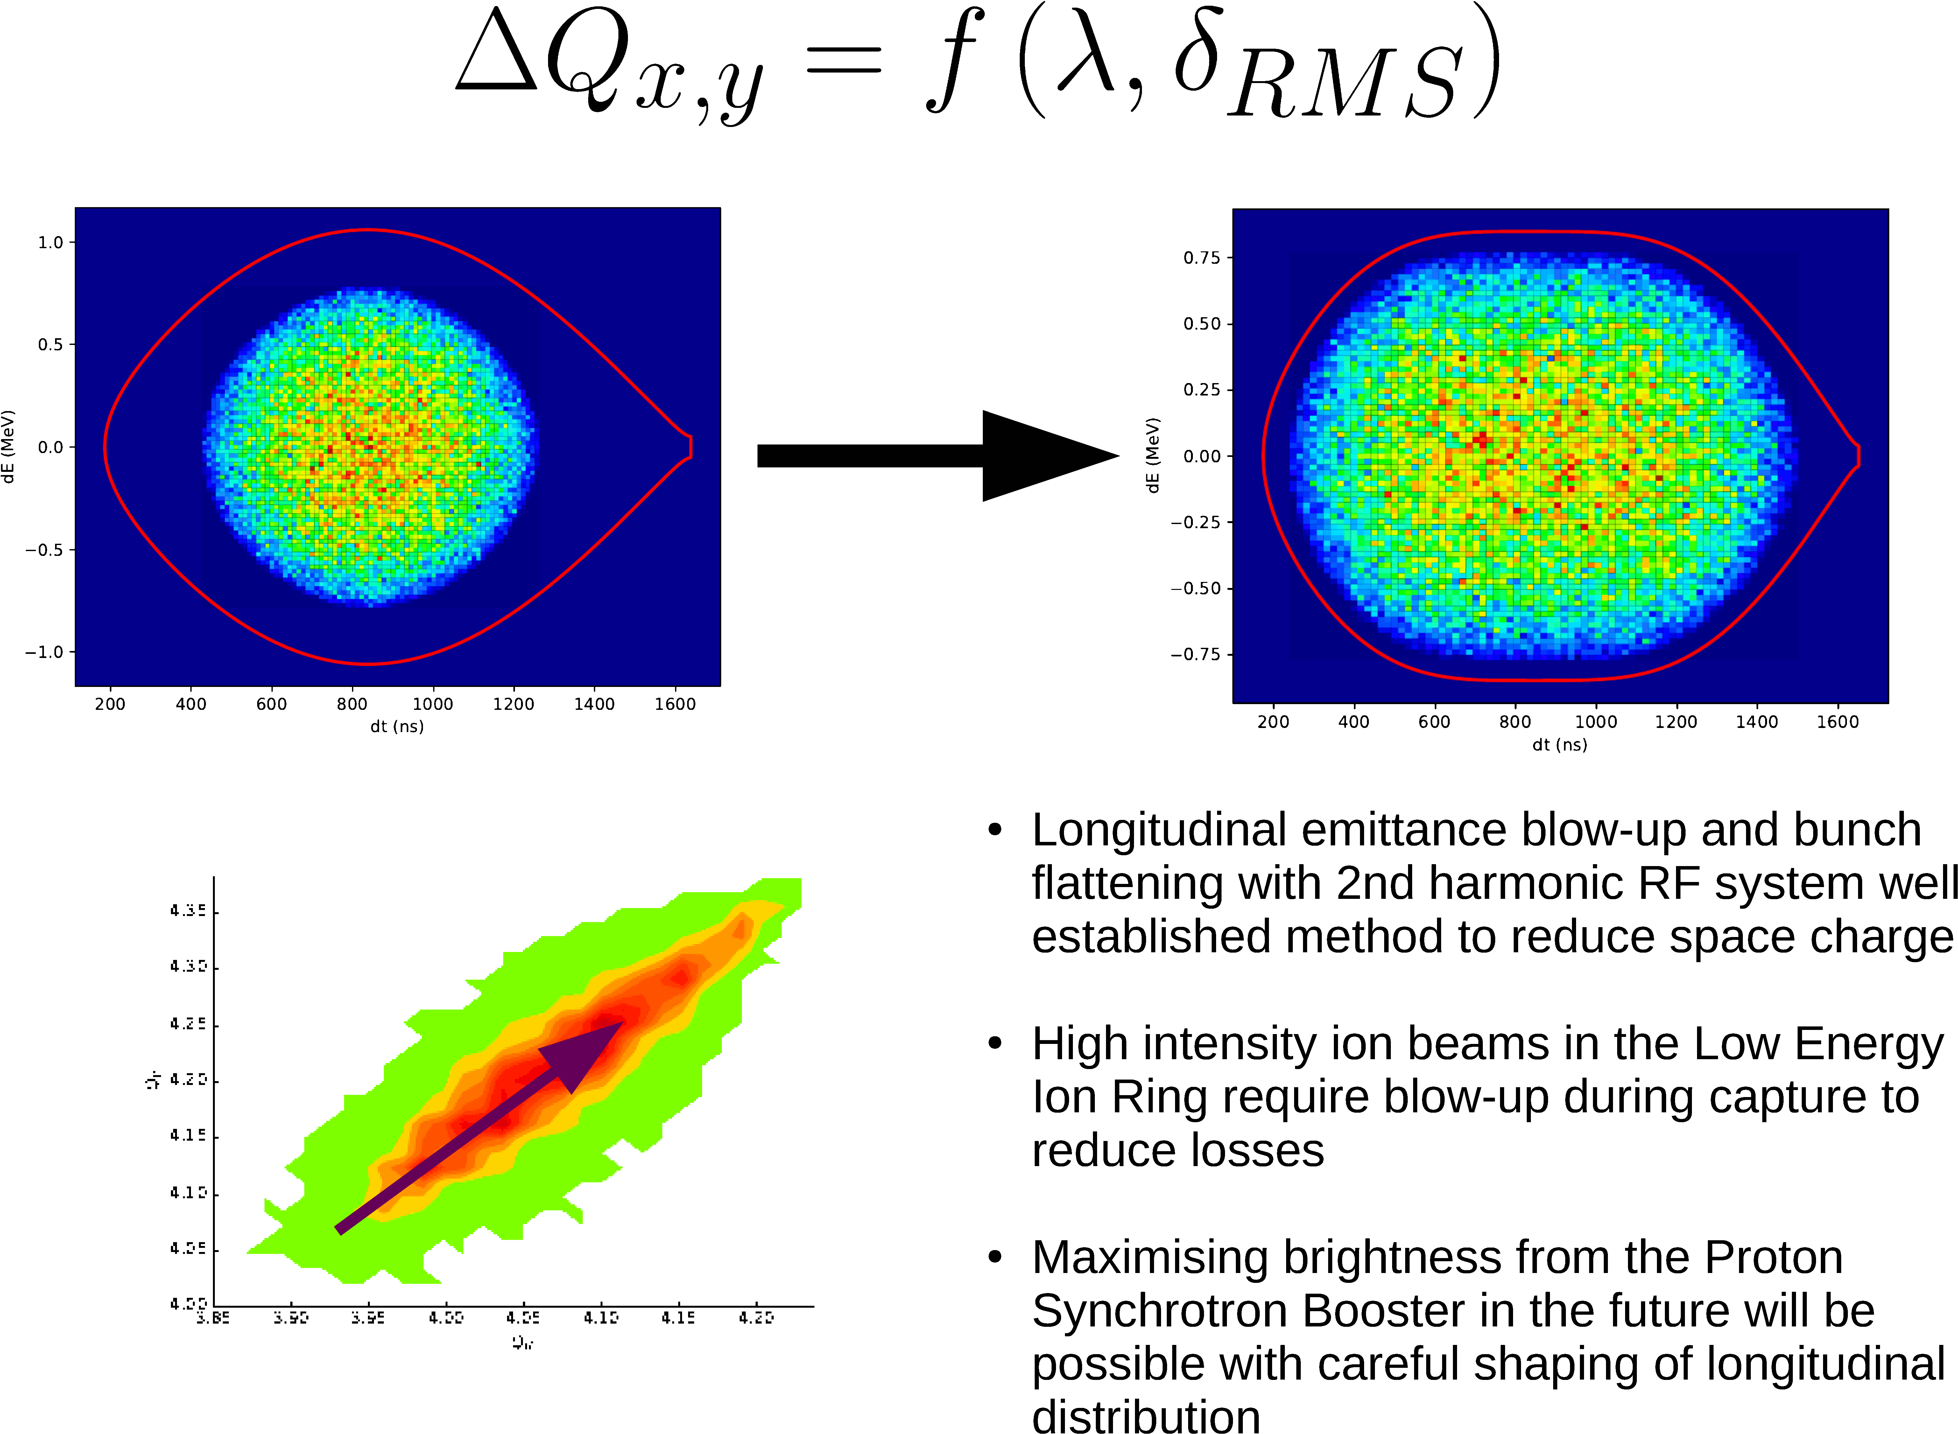
Simon Albright

Slide 20
Reserve

Slide 21
GSI BENCH-MARKING SUITE
Giuliano Franchetti has set-up the elaborate GSI bench-marking suite at:
web-docs.gsi.de/~giuliano/research_activity/trapping_benchmarking/main.html
As a simple example the SIS18 is used with one sextupole and a synchrotron period of 1000 turns.
It consist of 9 steps including:
phase space plots
SC amplitude dependent tune-shifts
trapping related phenomena
long-term evolution of emittance blow-up
The SYNERGIA & ORBIT team have worked on all steps and their results will be added to the web-site after this conference.

Slide 22
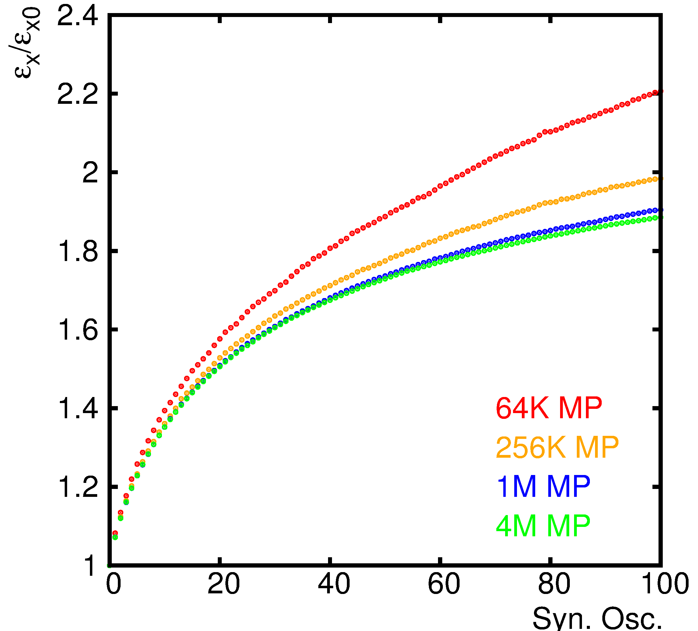
Long-Term Convergence Test
SYNERGIA

Slide 23
VARIANTS OF SPACE CHARGE FROZEN MODELS

Slide 24
Adaptive versus Purely Frozen Mode I
Frozen Mode looks at first sight like a flawed approach since it does not take into account the ever changing beam distribution due to SC and the lattice non-linearities.
However its very fast compared to the self-consistent PIC calculations and the calculation are symplectic.
Yuri Alexahin suggest a “hybrid” or “adaptive” solution that remains frozen at core but renormalizes the emittances once a turn.
To this end he has devised a fast iterative process to determine a good fit of Gaussians to the core of the beam distribution and ignoring tails.

Slide 25
Adaptive versus Purely Frozen Mode II
PROS: Introduce at least partially (the Gaussian part) of a changing distribution. Speed-up via OPENMP (BNL contribution).
Cons: Implementation nightmare due to re-entry into the run module and intermittent TWISS runs. Like in the self-consistent approach the information of all particles are needed. Therefore a serialization is not possible ➔ very heavy speed penalty! Question: Does this renormalization of the emittance create noise? Needs study!

Slide 26
A) CODES IN COMPARISON WITH MACHINE EXPERIMENTS
PS

Slide 27
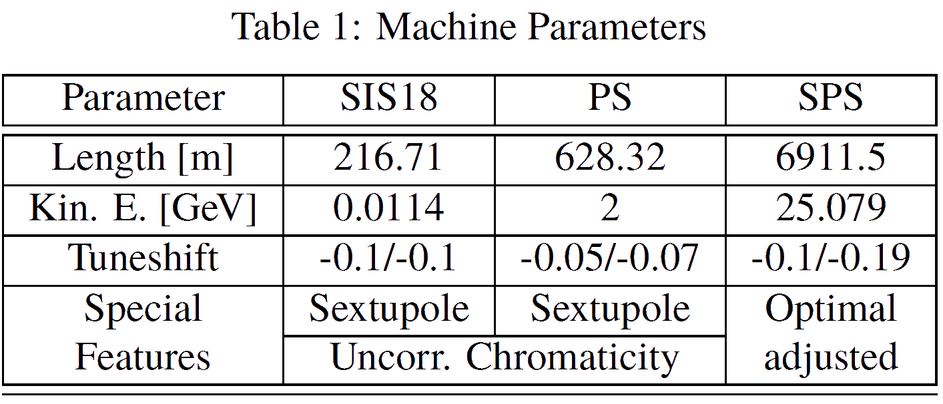
Machine Parameters

Slide 28
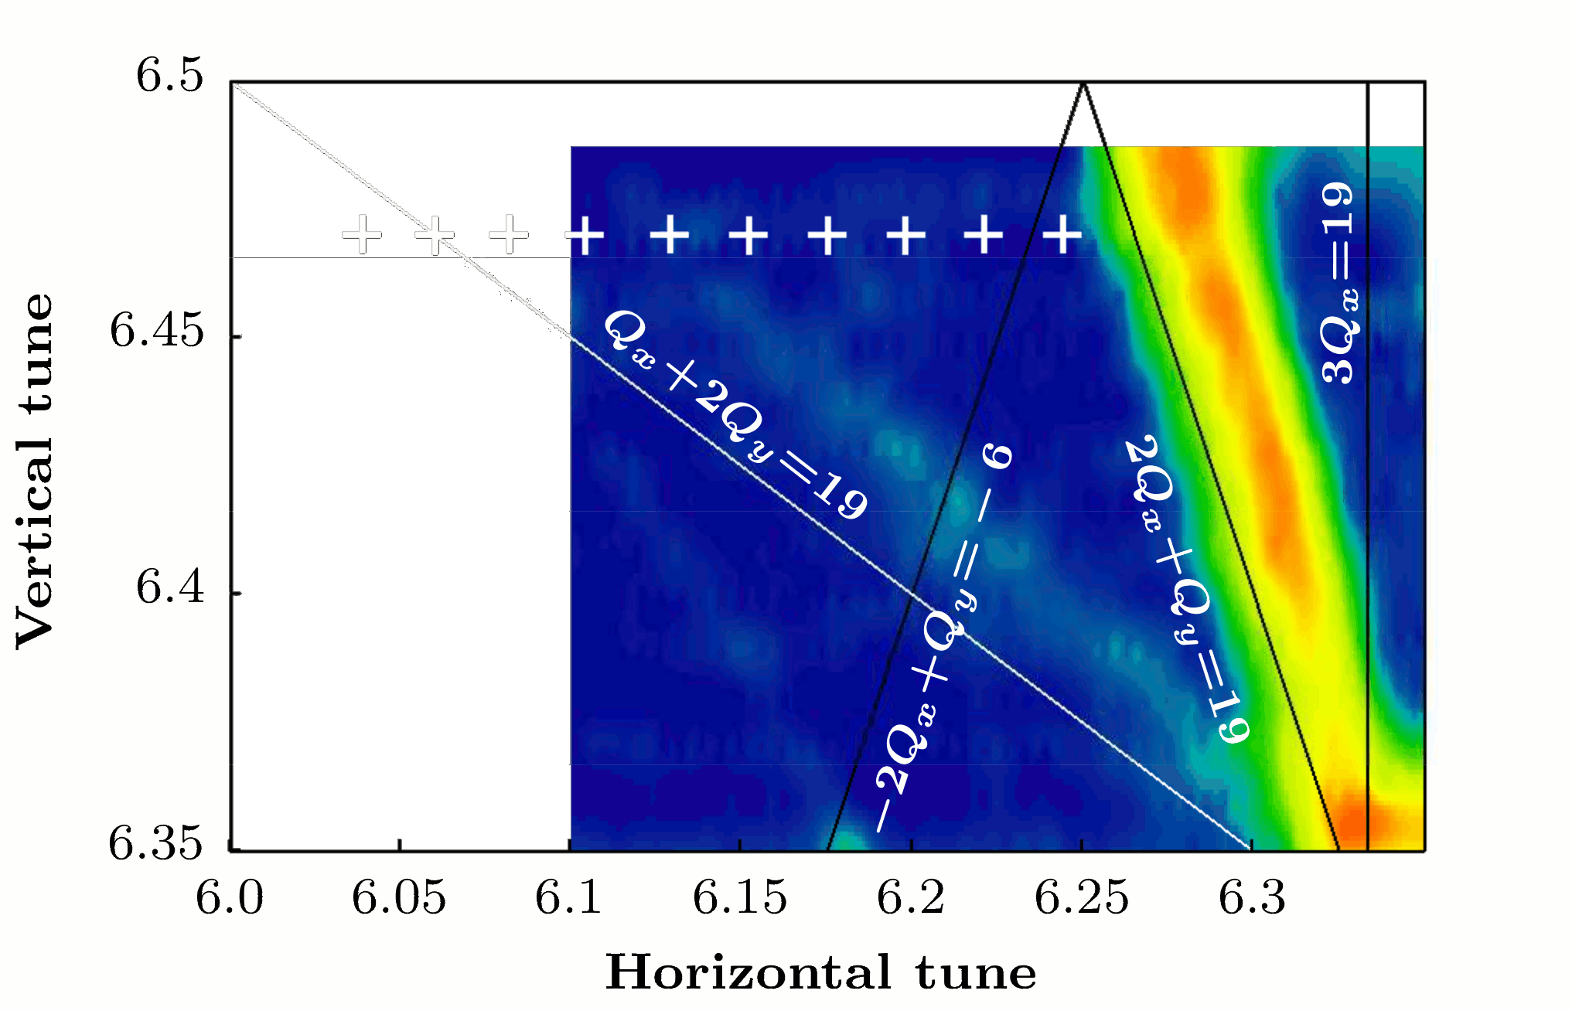
PS-Experiment I

Slide 29
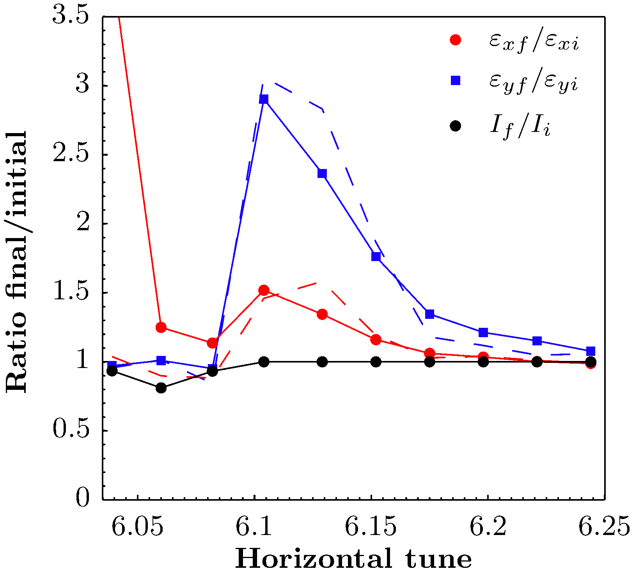
PS-Experiment II
ADAPTIVE

Slide 30
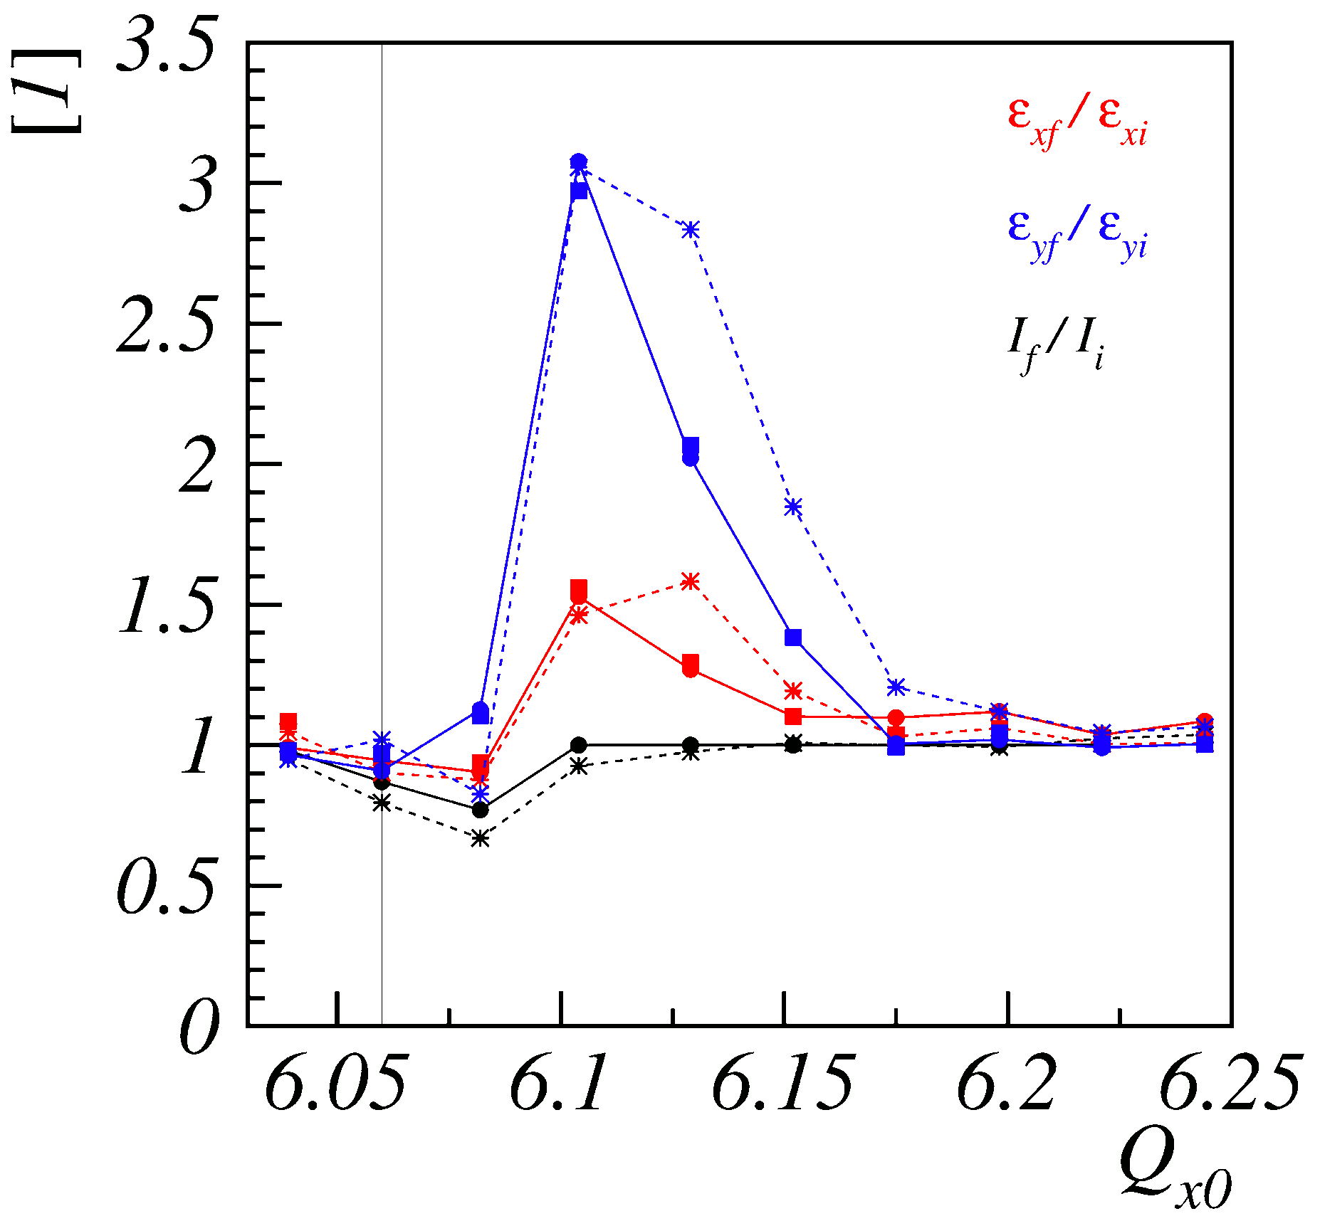
PS-Experiment III
FROZEN

Slide 31
PS Detailed MAD-X Simulations I
Given the differences found in this first round of simulations,
a more refined study has been repeated under the following conditions:
Re-study at Q_{x} = 6.039 and Q_{x} = 6.104
Use 2D polar Gaussian via Box-Muller transform and 6D transformation for fully matched 6D distributions and keep them for both WPs ➔ should be similar to the experimental set-up.
First trial of the new combined function magnet as derived and implemented by M. Titze, i.e. change of the horizontal chromaticity is about 16%.
Try out various sub-variants: adaptive/frozen with/without Twiss, combined function.

Slide 32
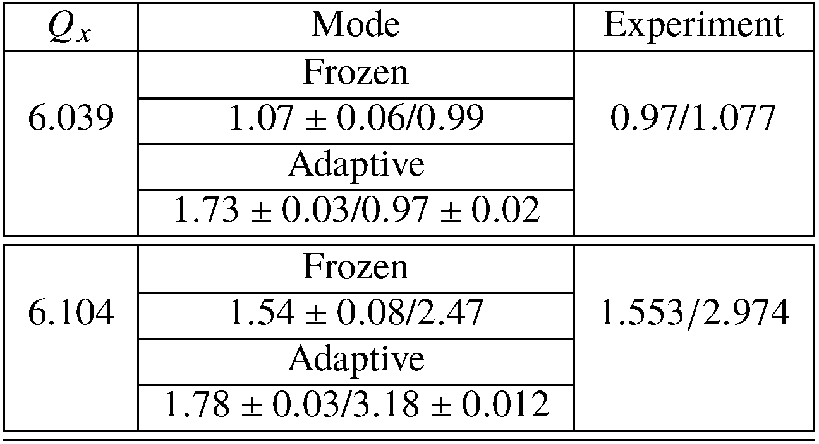
PS Detailed MAD-X Simulations II

Slide 33
B) CODES IN COMPARISON WITH MACHINE EXPERIMENTS
SPS

Slide 34
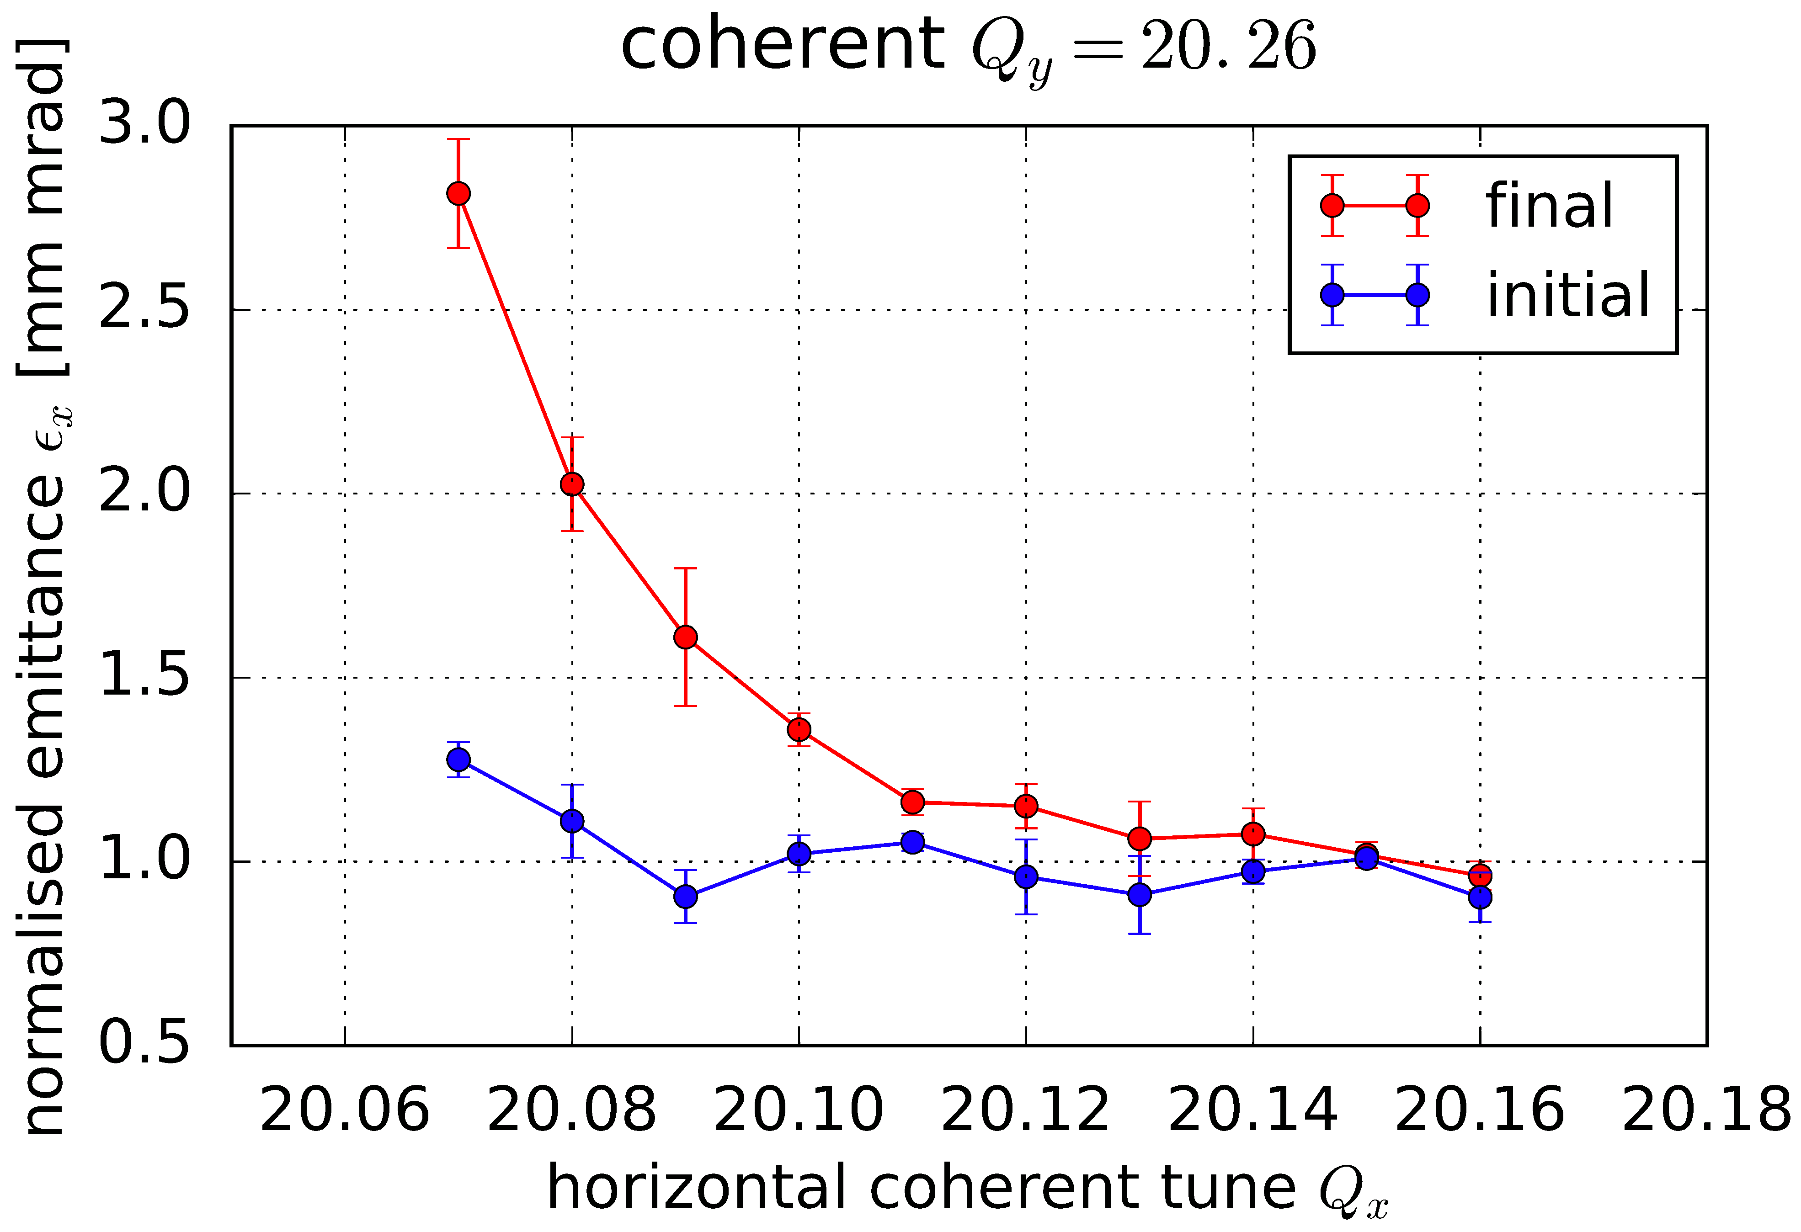
SPS-Experiment

Slide 35
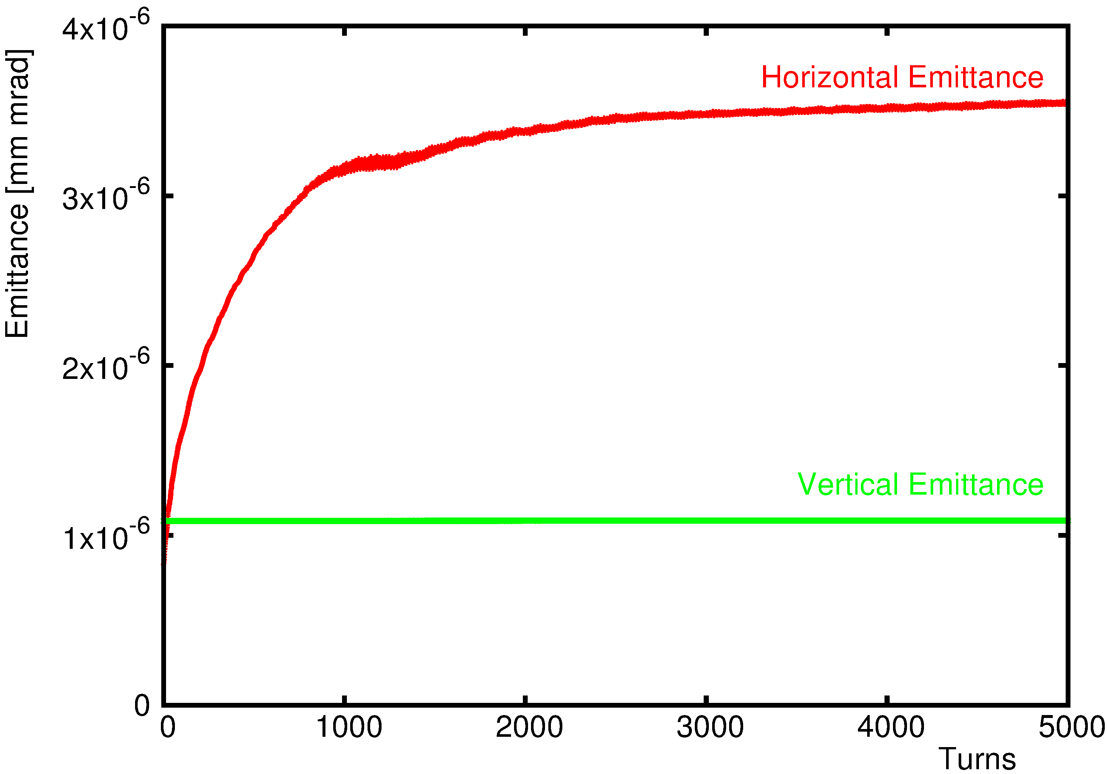
SPS PyORBIT Simulations
Preliminary, 2.5D Solver, 500K MP

Slide 36
THE NOISE ISSUE OF PIC CODES

Slide 37
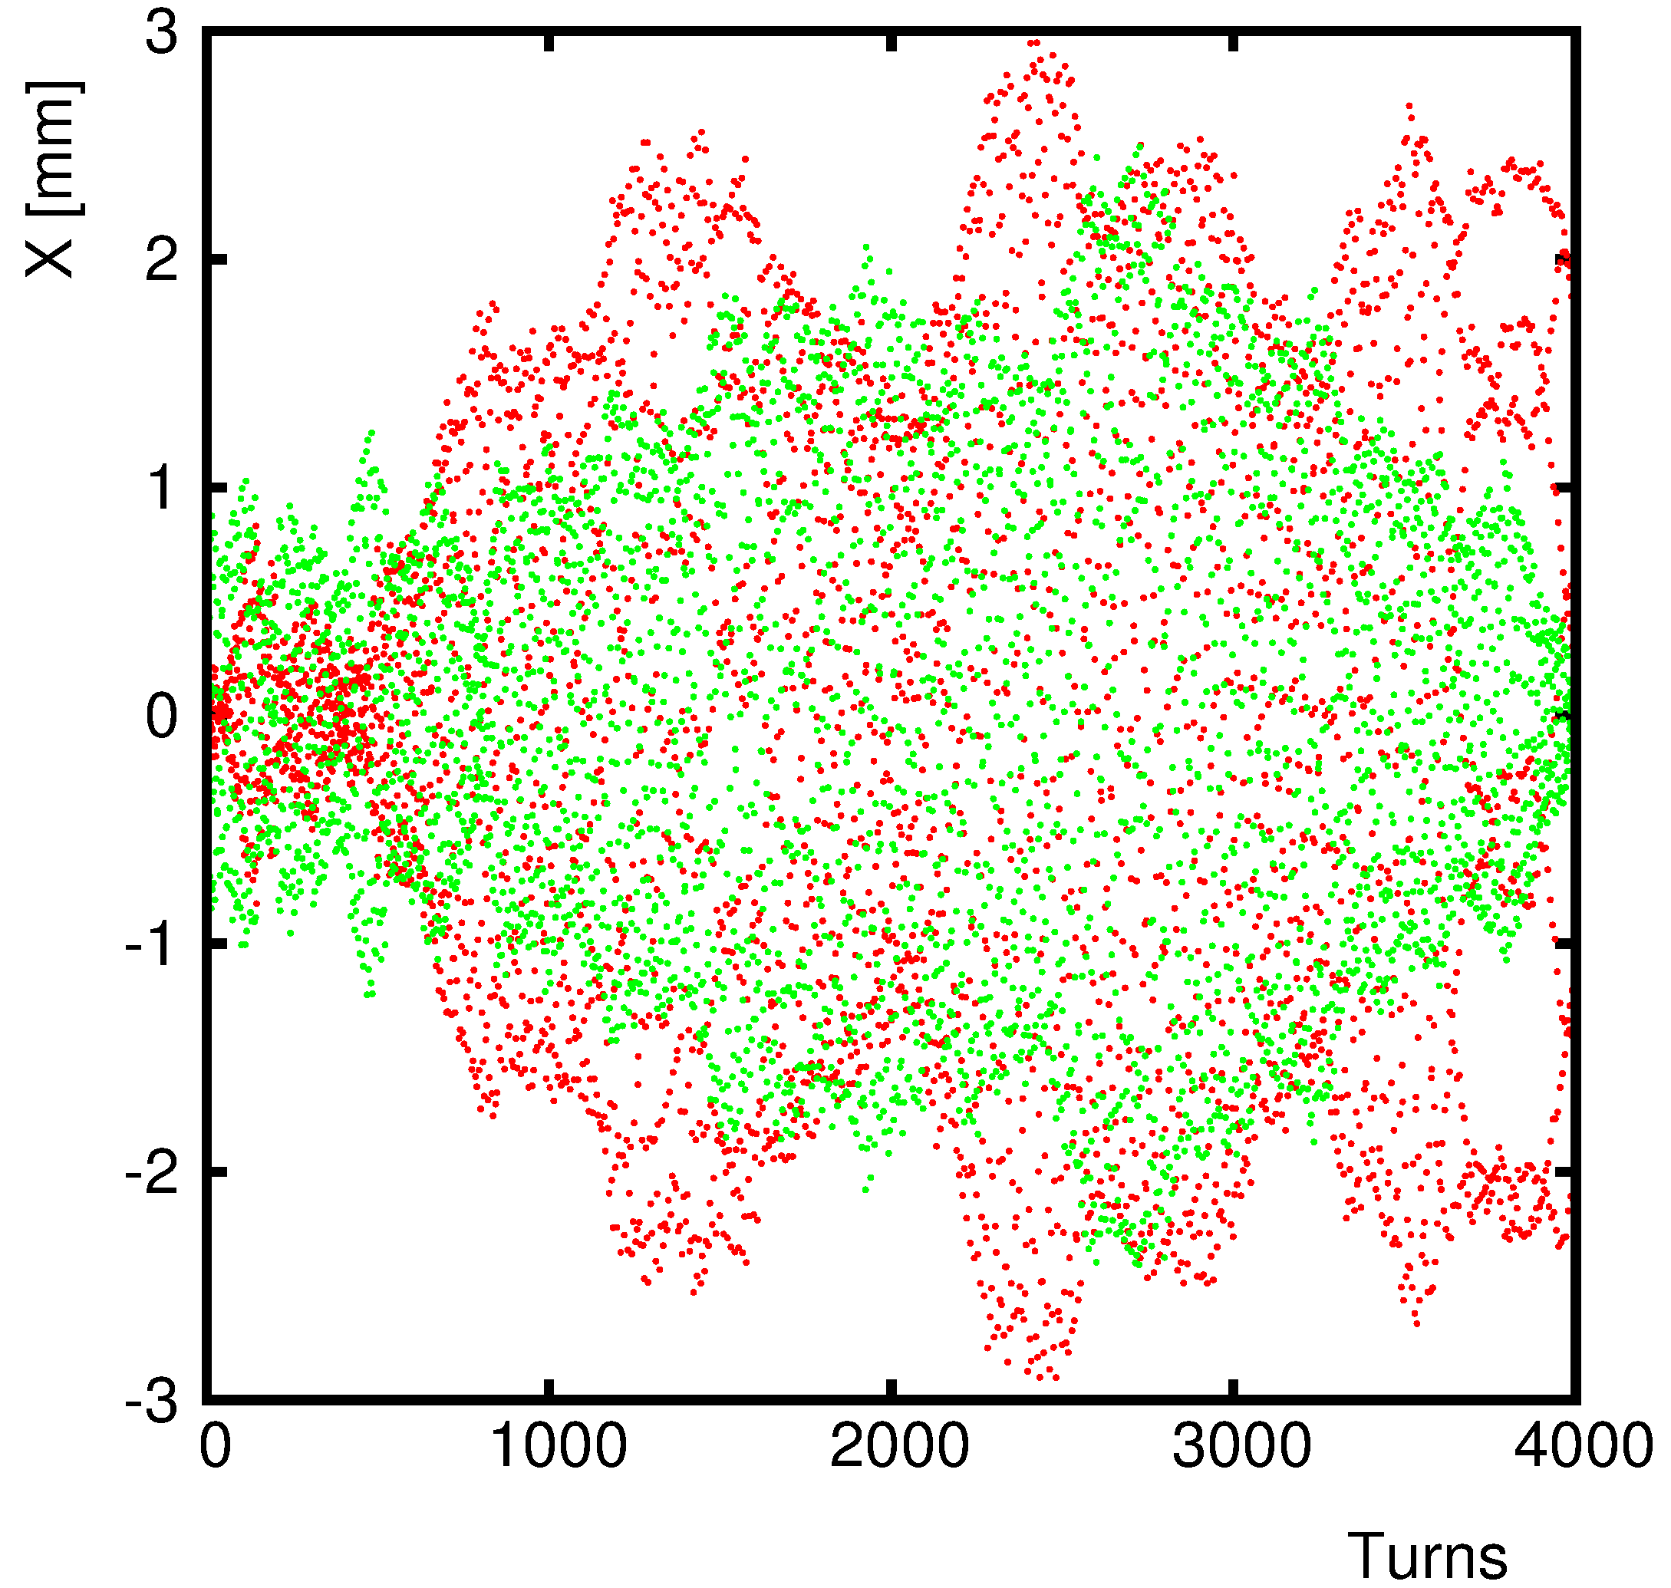
Effect of Grid Noise on Amplitude
PTC-ORBIT
100K MP

Slide 38
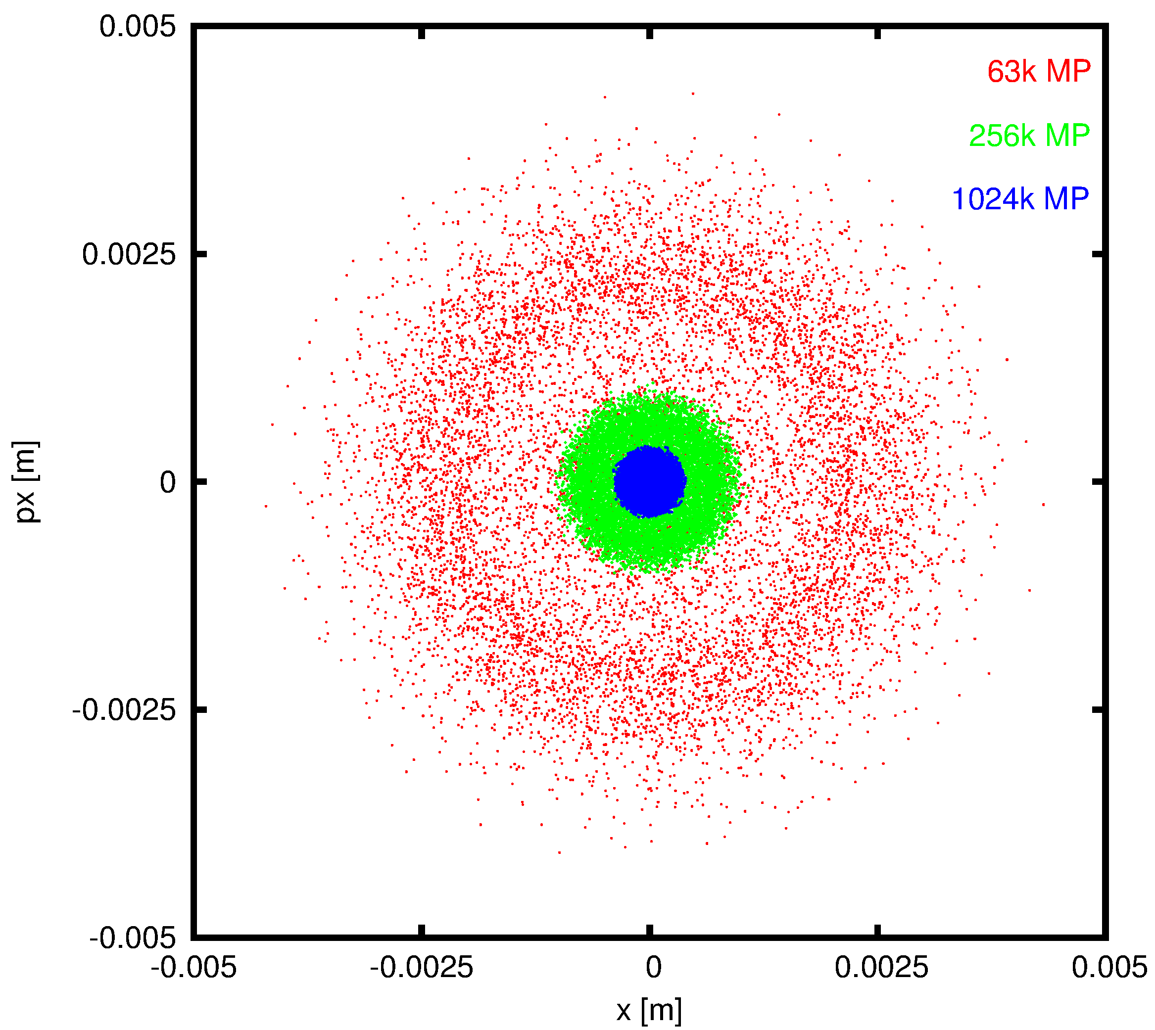
Effect of Grid Noise on Phase Space
SYNERGIA

Slide 39
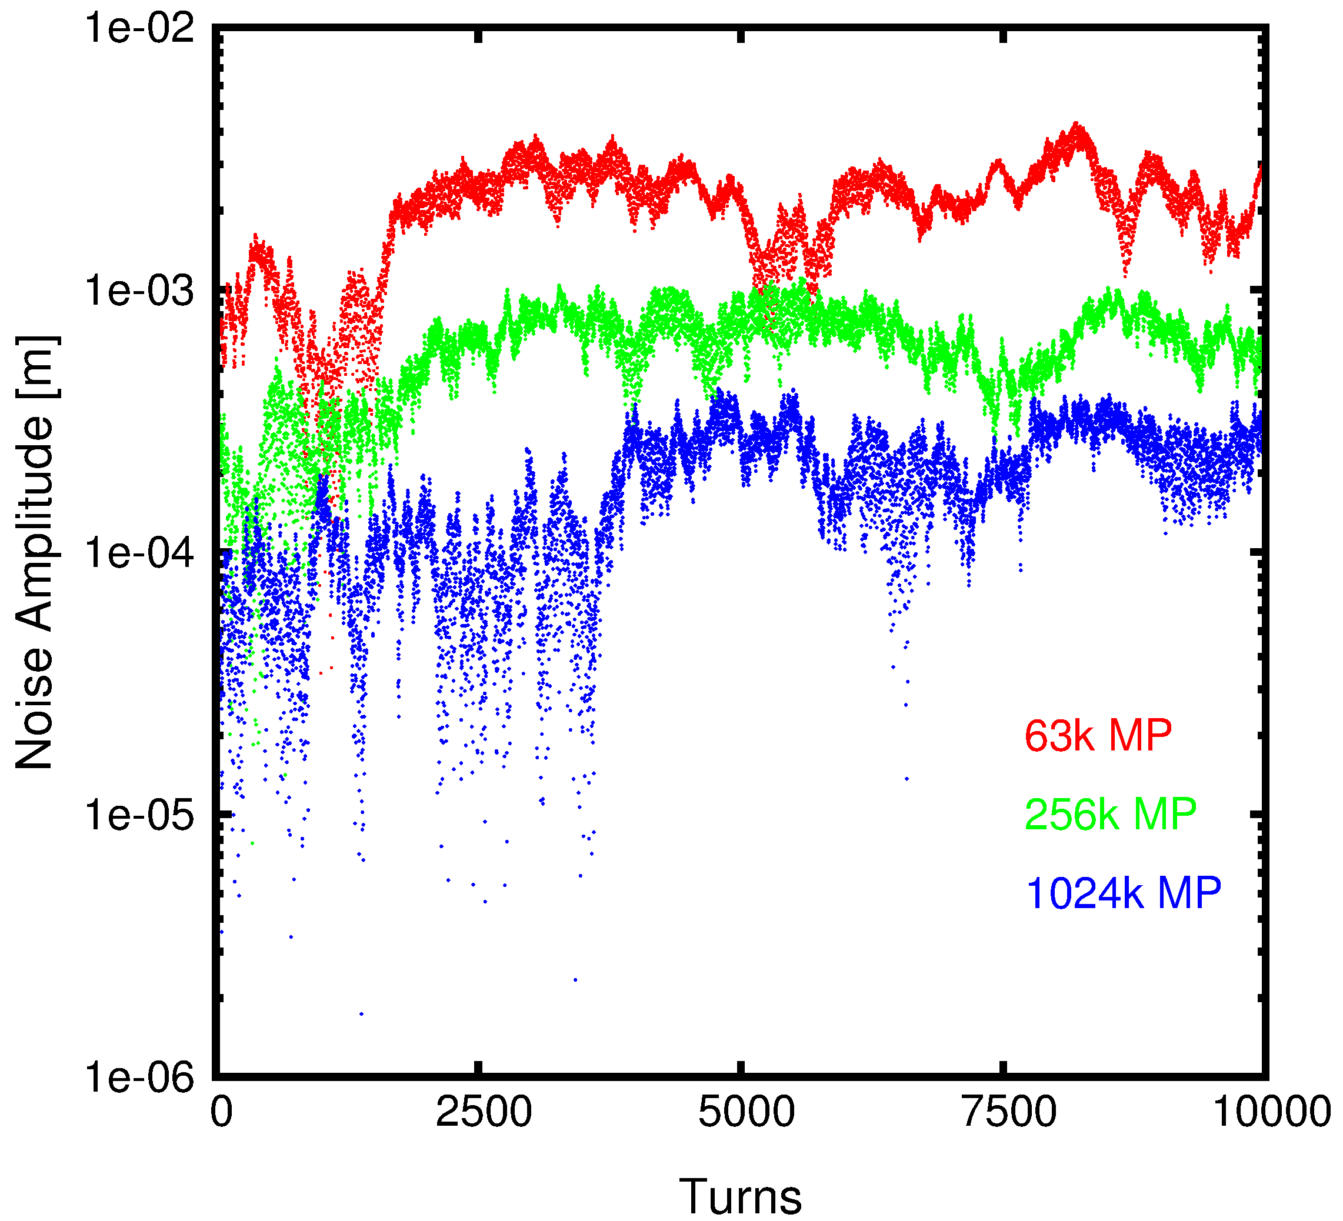
Effect of Grid Noise on Amplitude
SYNERGIA

Slide 40
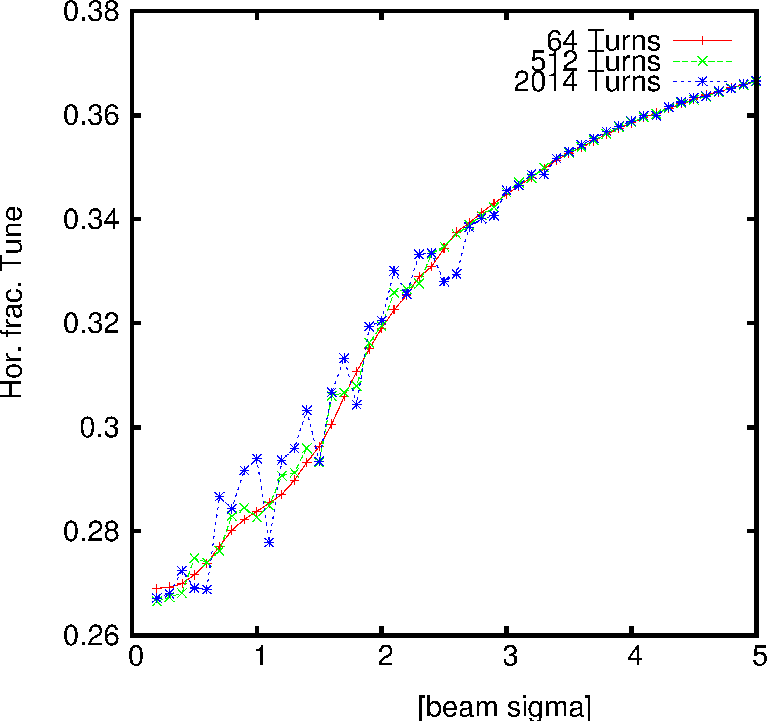
Effect of Grid Noise on Tunes
PTC-ORBIT
100K MP

Slide 41
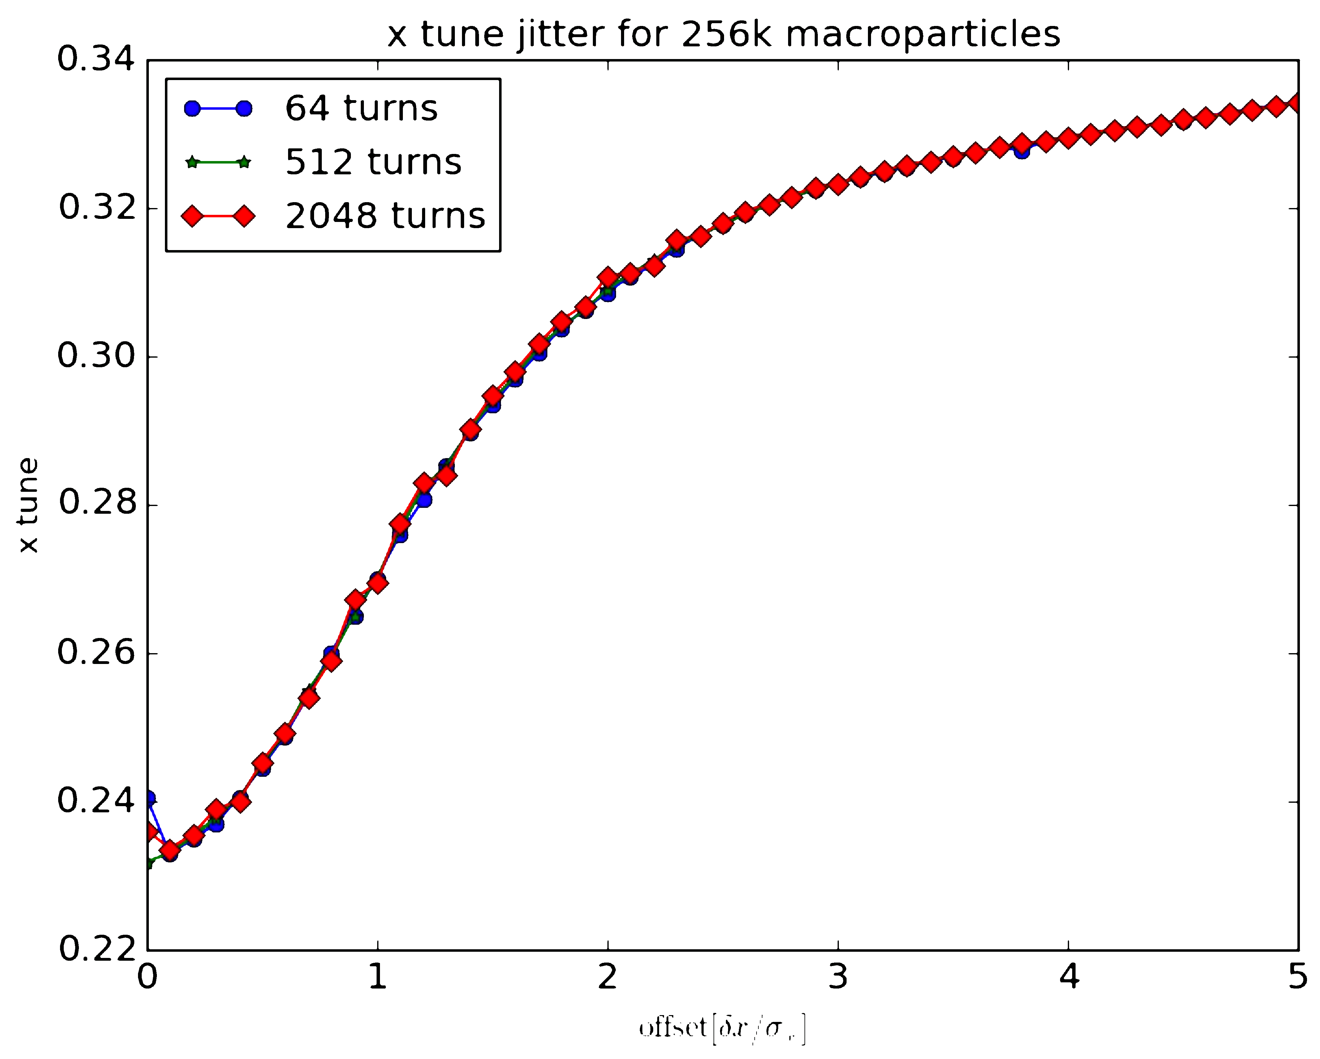
Effect of Grid Noise on Tunes
SYNERGIA
256K MP

Slide 42
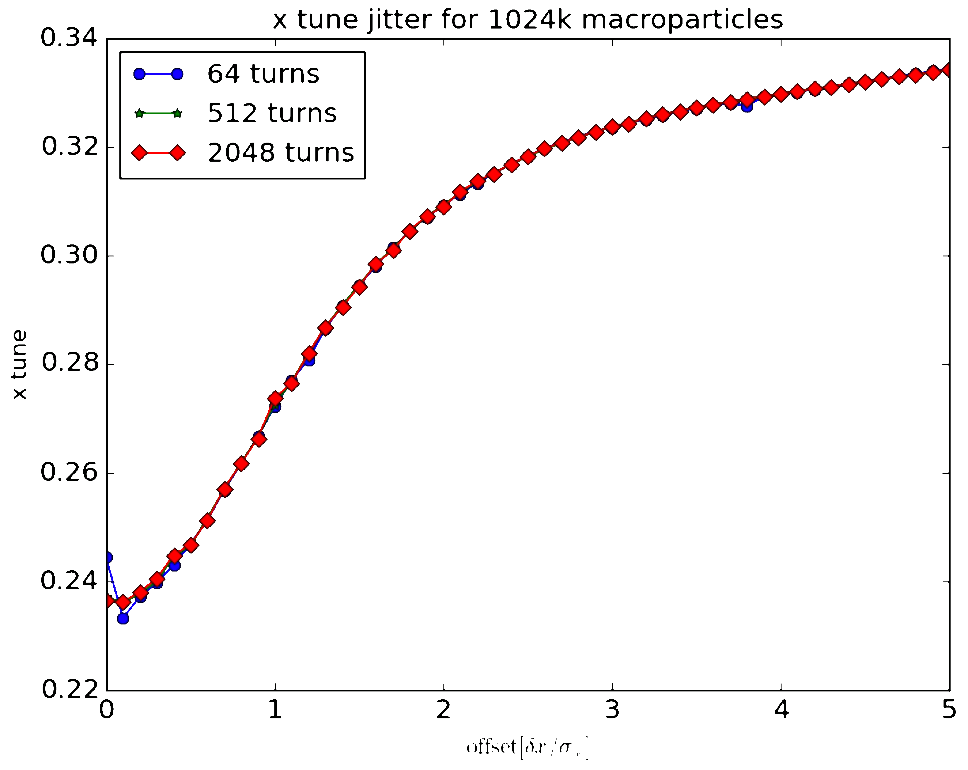
Effect of Grid Noise on Tunes
SYNERGIA
1M MP

Slide 43
ROUNDING ERROS IN CODES

Slide 44
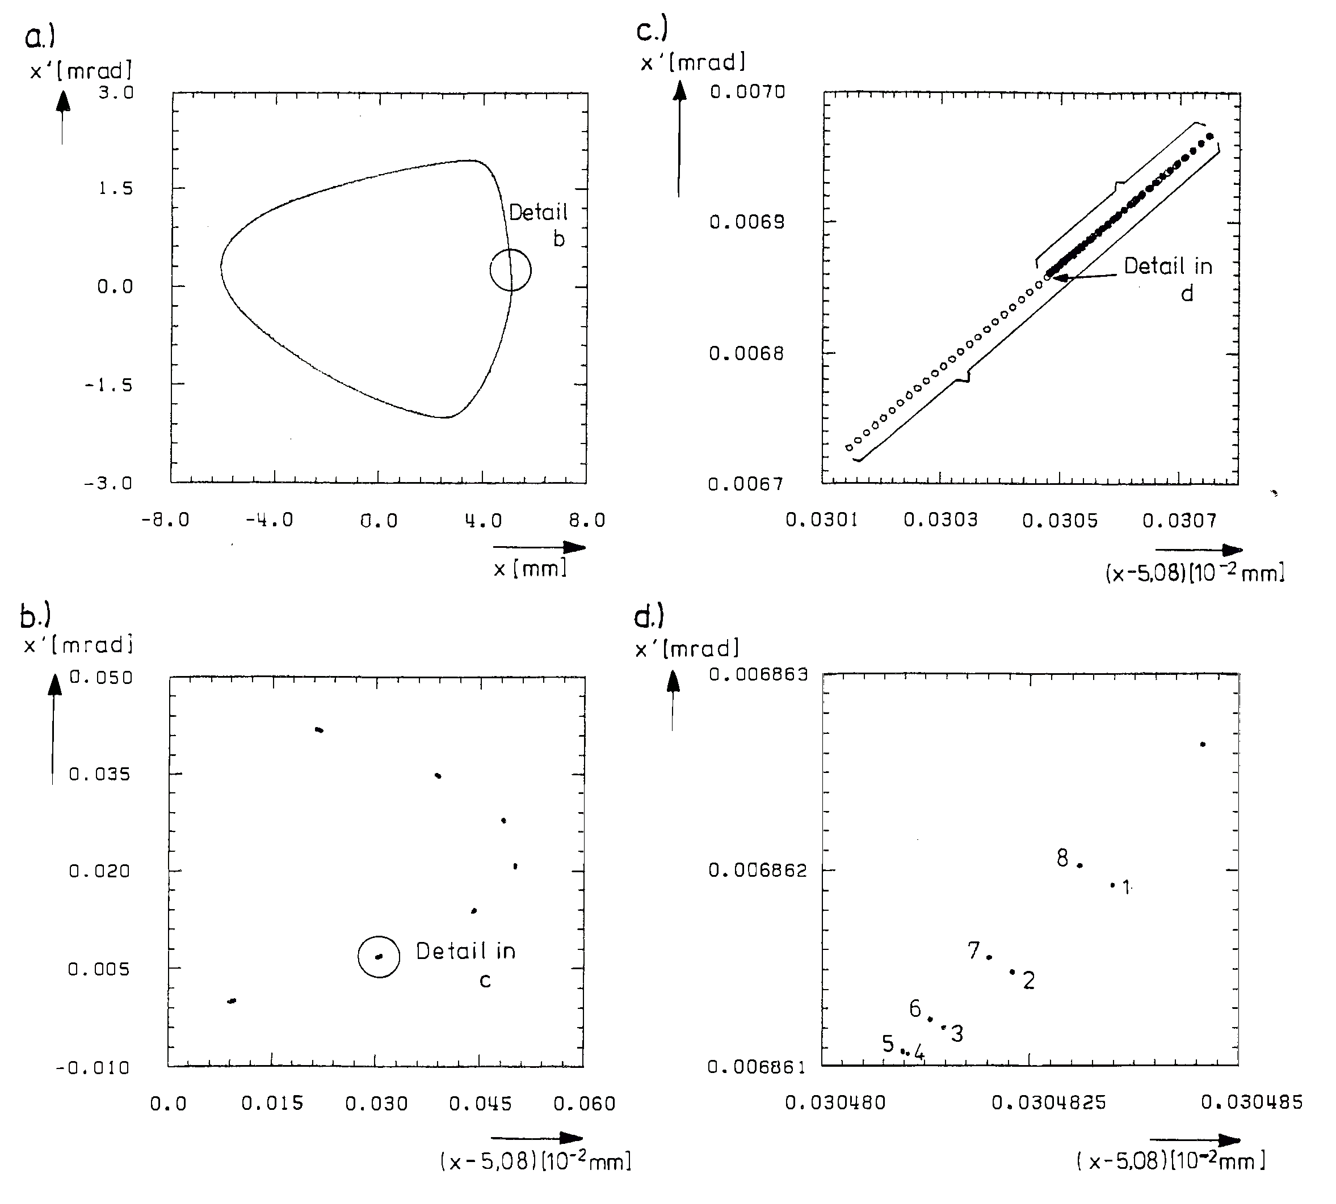
Rounding Errors in Phase Space
DBLE
QUAD

Slide 45
Conclusions
The world-wide collaboration on the on the GSI Bench-Marking Suite is now completed for the 2 PIC codes SYNERGIA and PyORBIT.
Long-term PIC Simulations seem feasible despite the fact that the noise remains measurably relevant.
Several bench-marking experiment have been compared with simulation results.
The agreement is quite impressive. However, in the frozen model the plain frozen might be better suited than the adaptive mode ➔ more studies needed.
Super-fast frozen mode planned with SixTrack ~100 times faster!
Simulations at the integer will be completed for both frozen and self-consistent codes ➔ M. Titze’s PhD.
Noise issues remain interesting and we are investigation apparent non-symplecticity of PIC codes (other main part of M. Titze’s PhD).
Eventually CERN will invest into its own symplectic self-consistent SC module.

