Slide 1

Upgrade of the SNS Beam Test Facility for
Studies of Beam Halo
Formation at Low Energies
Sarah Cousineau
On behalf of the SNS project
Space Charge 2017
Darmstadt
October 4, 2017

Slide 2
Goals and Properties of RF Linac Simulation
Top Level Goal: Accurate simulation of full distribution of beam in a linac.
Modern hadron linac layout
Ion Source
RFQ
LINAC
LEBT: DC beam
4D [x ,x’, y, y’]
MEBT: bunched beam
6D [x, x’, y, y’, z, z’]
Linac is single pass system → initial condition is key in particle dynamics
Beam is bunched and bunch is short → full 6D phase space treatment
Beam is non-relativistic (ɣ=1 – 2):
  Large emittance (mm range beam size)
  Significant space charge
  Weak compression of EM fields.

Slide 3
Difficulties in Simulating Beam in Linac at SNS
SNS MEBT, All RF Off
Emittance Device
Quads
Quads
Quads
Quads
X Emittance
Y Emittance
4 upstream WS
Now assemble initial distribution for simulation and benchmark with WS
1 downstream WS
Result:
No consistent agreement
Courtesy A. Shishlo

Slide 4
Benchmark Failures are Recognized as a Problem of Initial Distributions
Benchmarks of full distributions in linacs are historically unsuccessful. Thought to be due to lack of proper knowledge of initial distribution
The need for a good determination of initial distribution repeatedly cited:
    HB2004, Summary of Session on Space Charge Simulation and Experiment
    HB2006, Summary of Session on Space Charge Theory, Simulation, and Experiments
    HB2010, Summary of Session on Beam Dynamics in High Intensity Linacs
    HB2012, Summary of Session on Commissioning and Operation
Cited in LEDA papers:

Slide 5
Typical Initial Distributions Methods Insufficient
Simulate beam in RFQ
  Very complicated beam dynamics, high space charge
  Usually no agreement with measurement
Reconstruct using projections:
Typically, measure
projections:
x’
y’
φ
x
y
z
Combine assuming no other relationships between variables

Slide 6
A True 6D Distribution
These distributions are not the same in general:
Assumes all cross-terms = 0
Includes cross-terms:
The LHS and RHS are only equal if all cross terms are zero.
Possible sources of non-zero cross terms:
Solenoidal focusing in LEBT
Space charge
Non axially symmetric fields in ion source

Slide 7
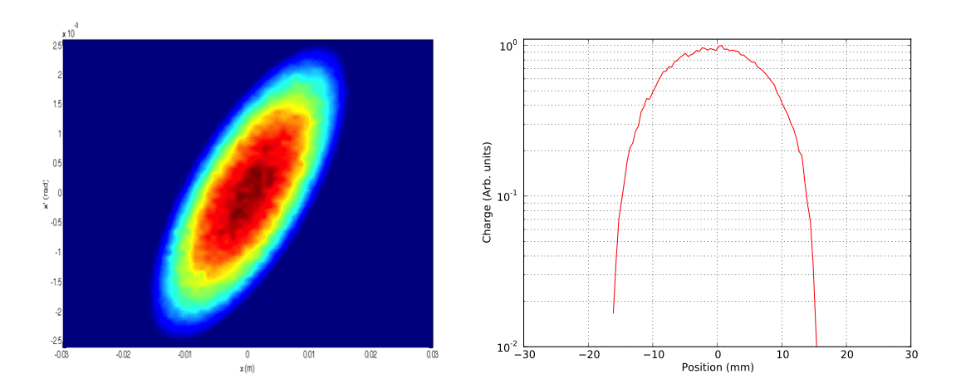
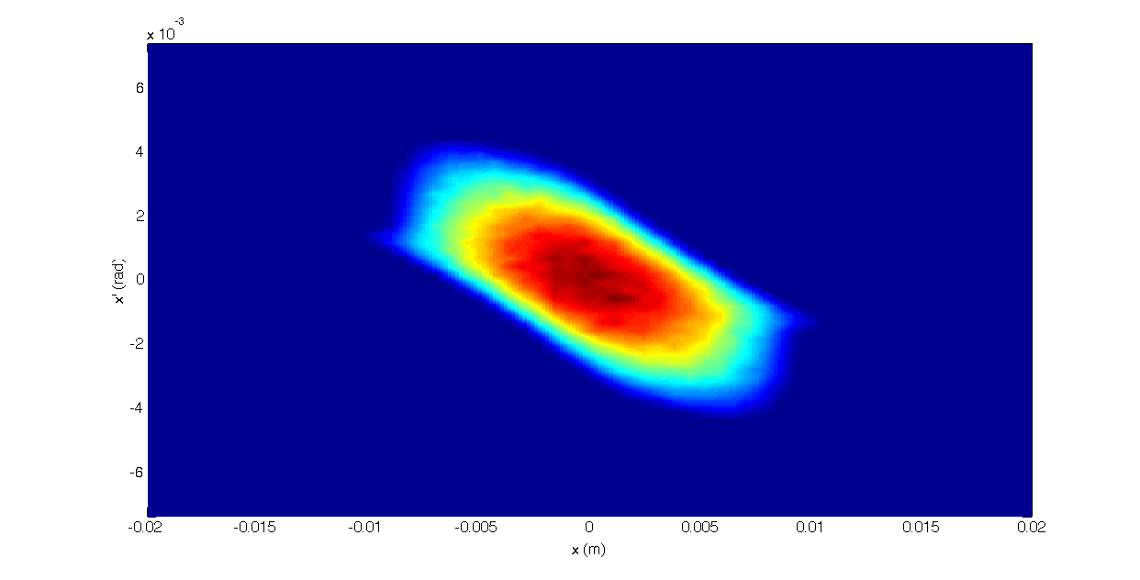
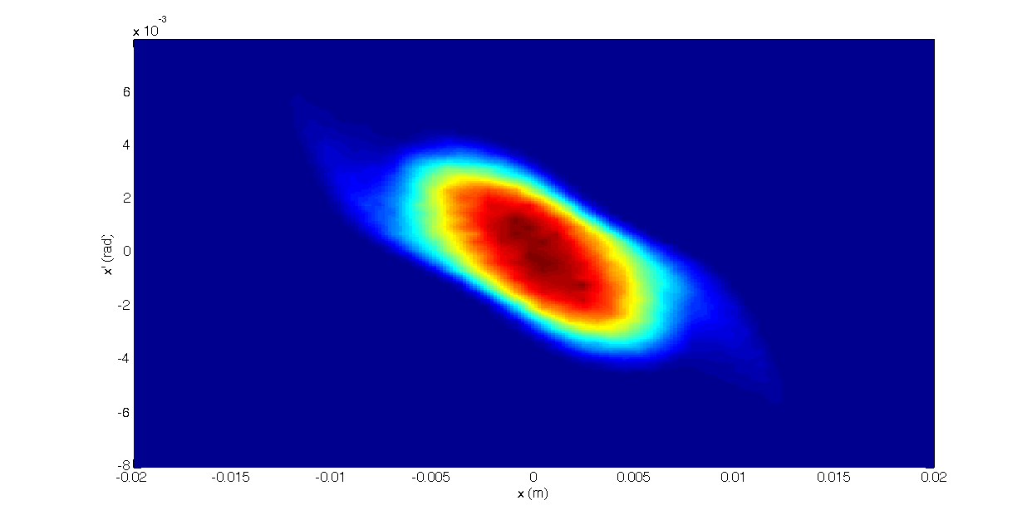
Cross Terms Have an Impact
Example: Start with 2 distributions whose typically measured properties look the same, but which differ in the underlying cross-terms.
Courtesy B. Cathey
KV (Correlated in cross terms)
FODO Transport
Sample and reconstruct with no correlations, e.g., all cross-terms = 0
Results are not the same
KV-ish

Slide 8
The “Curse of Dimensionality”
Traditional diagnostics can be used to measure all projections.
The limiting problem is scan time.
For a course measurement:
Scan rate 1 step/sec: 10⁶ sec = 280 hrs
Scan rate 10 step/sec: 10⁵ sec = 28 hrs
1 2 …….. m
Problem compounded by need to average over multiple samples.
Times are not reasonable for operational accelerators.

Slide 9
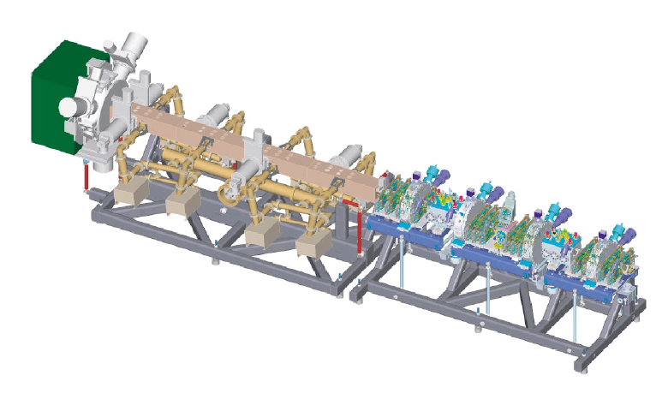
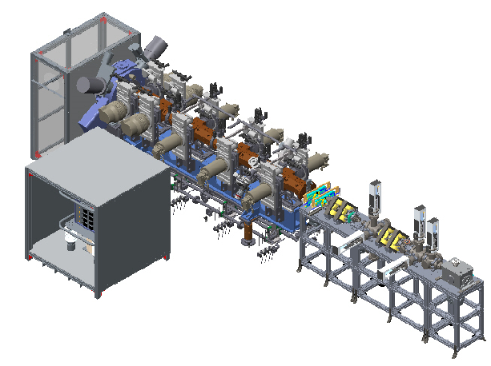
The SNS Beam Test Facility is a Functional Duplicate of the SNS Front End Accelerator
Beam Parameters:
≤ 50 mA H⁻ or protons
60 Hz
2.5 MeV
Our goal is to measure the full 6D distribution at the BTF, and to perform beam halo studies and simulations with this as initial condition
SNS Front End
Ion Source
LEBT
RFQ
MEBT
BTF
Courtesy A. Menshov

Slide 10
The Beam Test Facility Baseline and Upgrade
4D emittance included as part of baseline design
NSF-funded extension:
  Upgrade to full 6D measurement capability
  Lattice extension to study beam halo formation
10 m (including RFQ, not shown here)
Quadrupoles
Dipole / Energy spectrometer
Beam
High Power Beam Stop
Slits –
4D emittance
station
Energy selection slit
BCM
Bunch shape monitor and beam stop (low power)

Slide 11
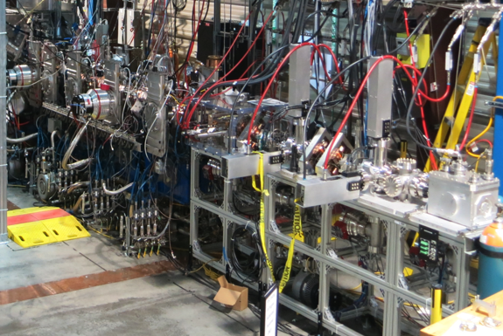
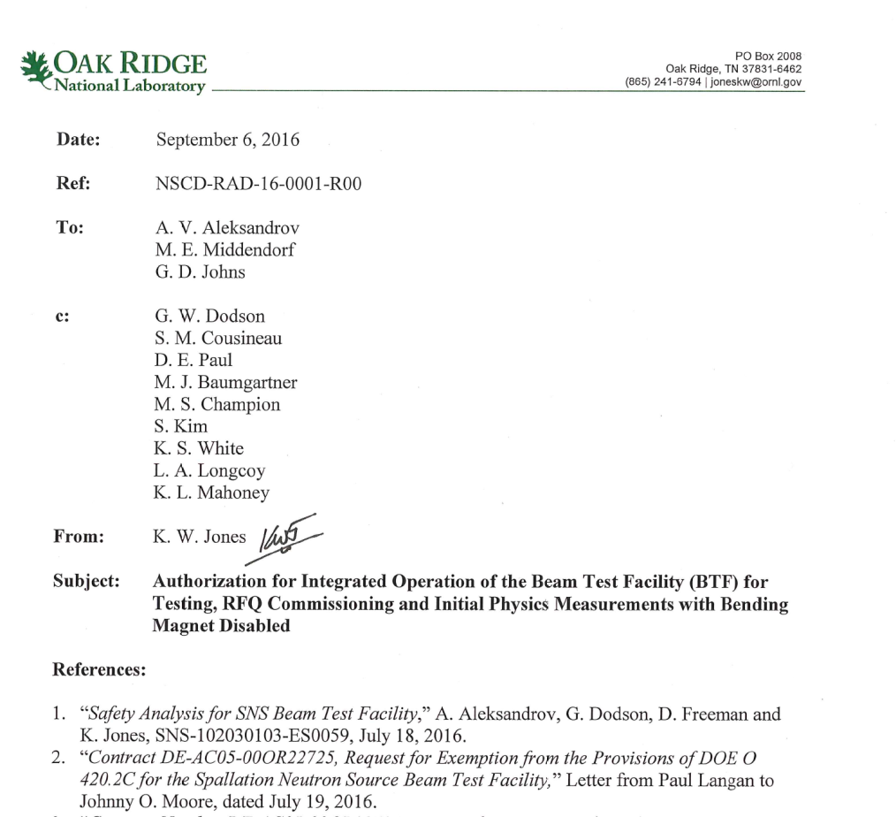
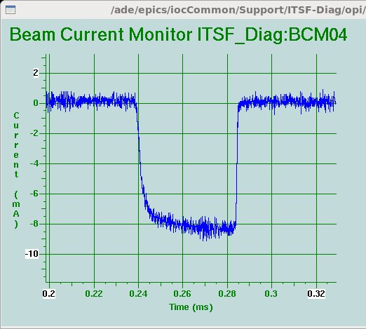
Status of BTF
Received authorization to run the facility on September 6th 2016
Commissioned BTF in Sept 2016
  Confirmed all key parameters
Routine operation with up to ~50 mA H⁻
Operation is now R&D focused.
First beam out of the new RFQ!
September 8, 2016

Slide 12
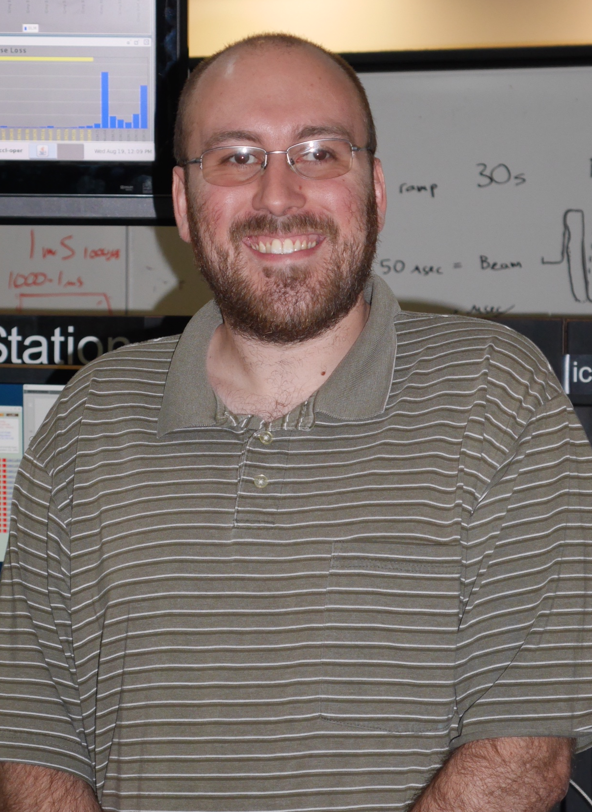
Status of Beam Physics R&D
R&D program began October 2016
All components for 6D measurements are installed
High dimensionality phase space measurements underway:
  1D, 2D, 4D, and 5D measurements performed
  Awaiting new detector for 6D measurement to reduce scan time
Lattice extension for studies of beam halo design complete
Lattice equipment purchased, currently under fabrication
Results of first measurements will be reported by Brandon Cathey tomorrow afternoon.

Slide 13
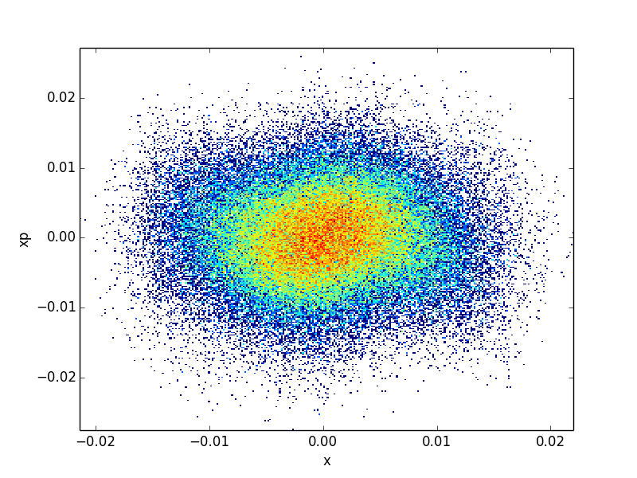
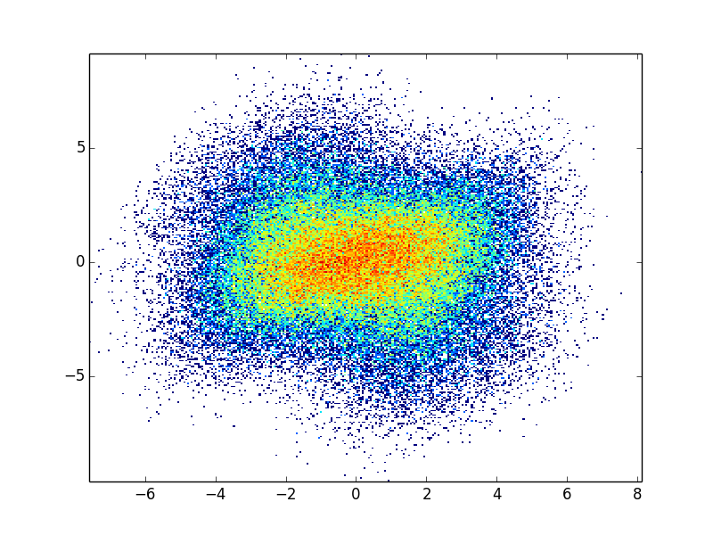
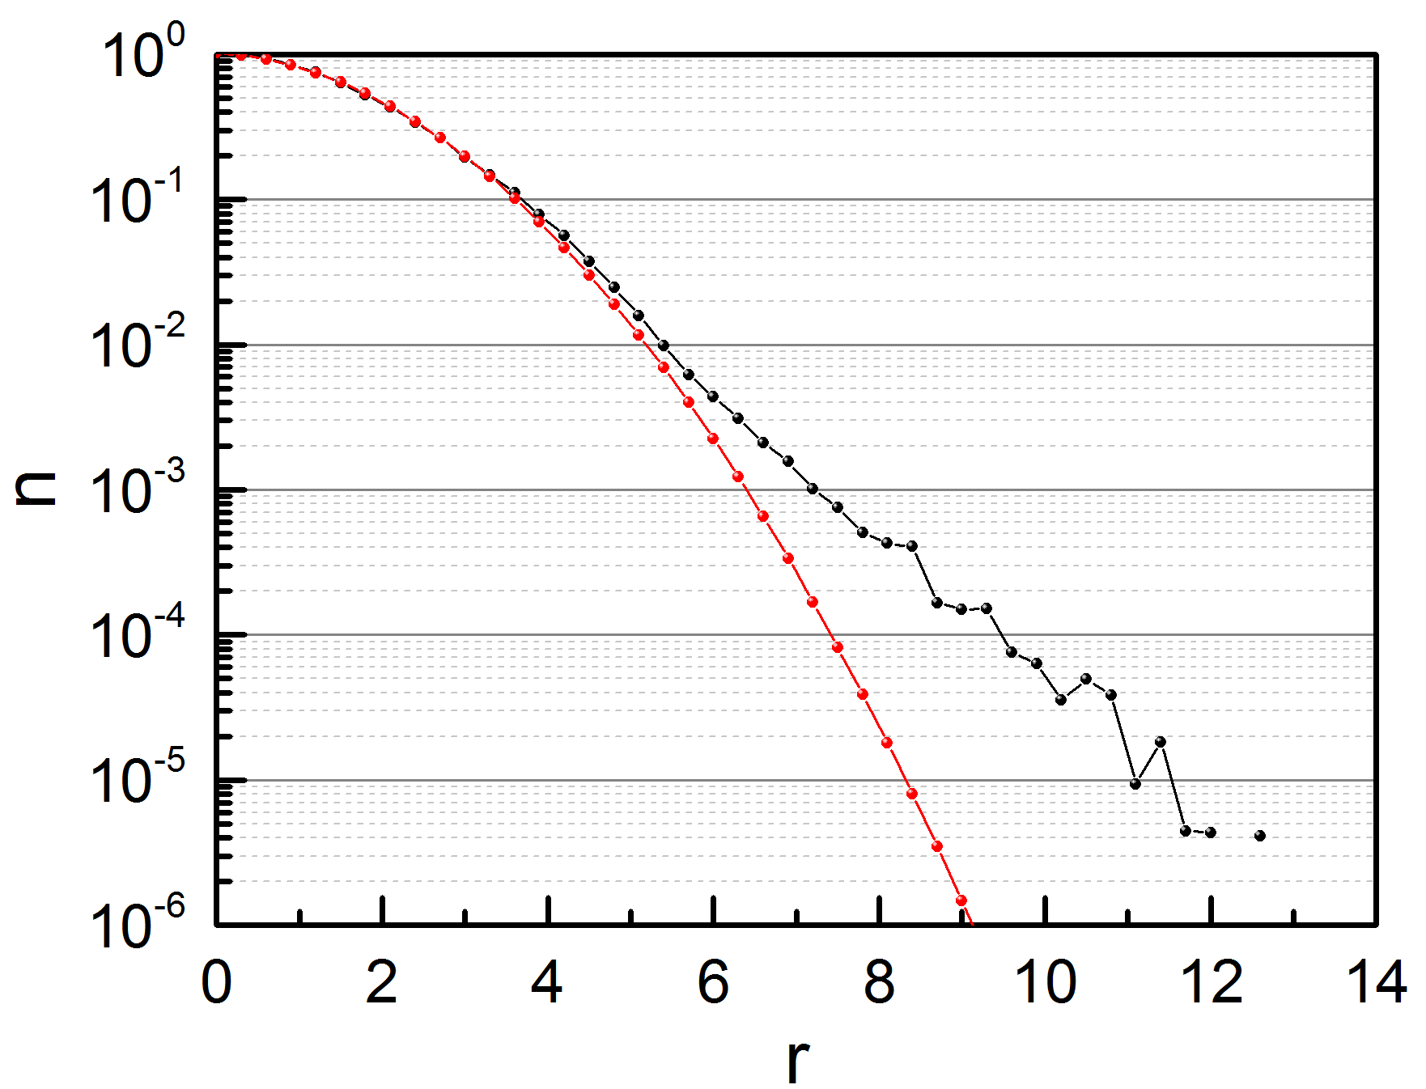
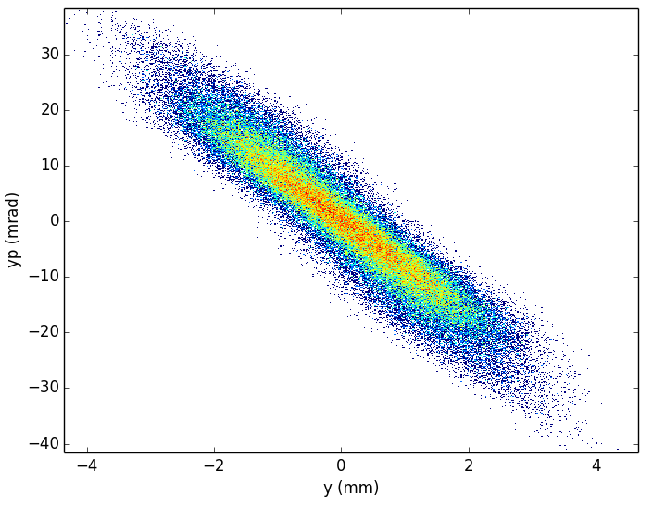

FODO Extension Designed to Study Halo
Goal: Design a lattice that can generate variable levels of beam halo.
Halo Definition
A.S. Fisher, “Summary of the 2014 Beam-Halo Monitoring Workshop”, in Proc. IBIC’15, paper THBLA01, pp. 630-636.
Core
< 10⁻²
Other design objectives:
Dispersion free
Small beam size
Variable matching
Adjustable phase advance (60º – 90º)
High dynamic range beam instrumentation
y
tail, shoulder
10⁻² – 10⁻⁴
Halo > 10⁻⁴
Courtesy Z. Zhang
x
SNS procedure for halo characterization:
Normalize phase space
$$r=\sqrt{x_{N}^{2}+{x′}_{N}^{2}}$$

Slide 14
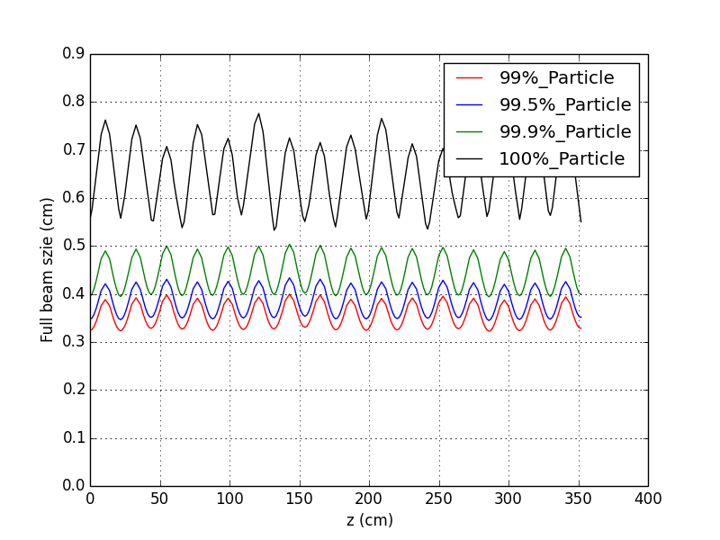
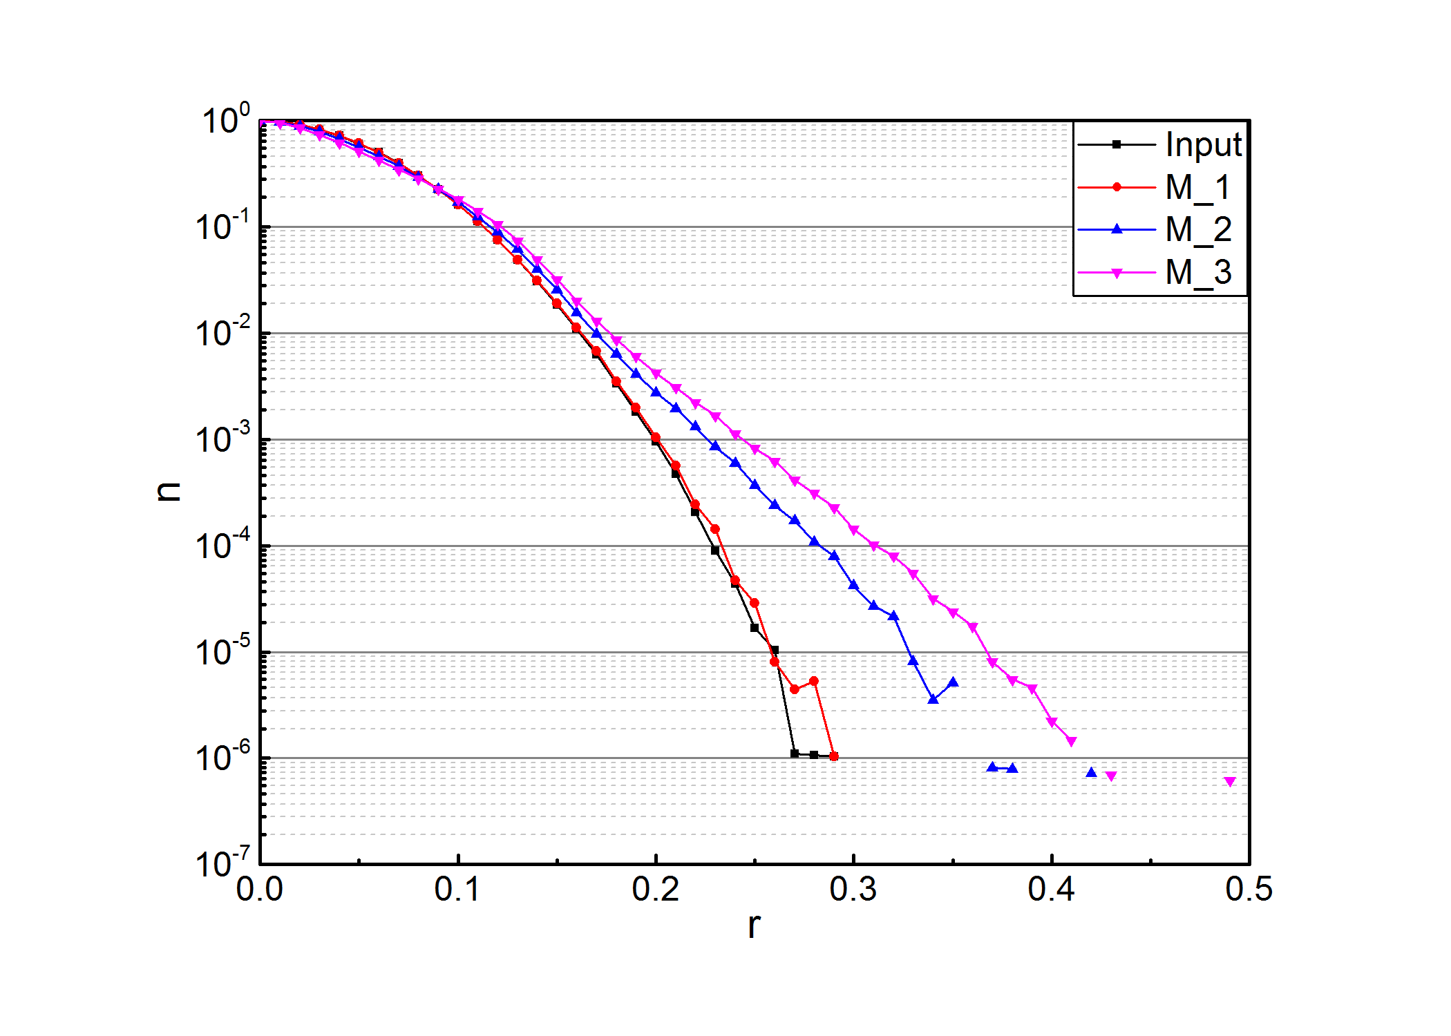
Final Design Achieved
Permanent magnet “pancakes” can be assembled in packages of 1 to 3 for variable strength
Design phase advance of 78º
2-3 betatron cycles in 5 m of FODO
Matching before FODO
Permanent magnets (cost)
Modular magnet assembly and positioning
Courtesy Z. Zhang

Slide 15
BTF Lattice Extension
4D emittance station
Permanent Magnet FODO
Matching Quads
Courtesy A. Menshov

Slide 16
Path Forward and Schedule
Now
-
Nov 1 2017
Nov 1, 2017
-
July 1, 2018
Aug 1, 2018
and beyond
Acquire as much 5D data as possible
Perform the full 6D measurement
RFQ Swap
Analyze 5D/6D data
Brandon Cathey write thesis and graduate!
Install new lattice
Commission new lattice
Begin halo studies in 5D/6D
Friends/colleagues welcome to join
This work has been partially supported by NSF Accelerator Science grant 1535312.

