Slide 1
Renormalization Theory of Beam-Beam Interaction
Yong Ho Chin (KEK)
ICFA Mini Workshop “Space Charge 2017”
Darmstadt, Germany
October 4-6, 2017

Slide 2
This work has been done during my last 6 months at DESY, 30 years ago.
I spent most of time in my office and the DESY library for this work.
I thought that this work would be my best work (more than ABCI and TMCI).
But, it has been forgotten since I moved to LBNL and started new work there.
I wish that young people would follow this theory and apply it to space charge.

Slide 3
Outline
Introduction
Renormalization Procedure
Direct Interaction Approximation
Closed Set of Equations
Comparisons with Simulations
Conclusions

Slide 4
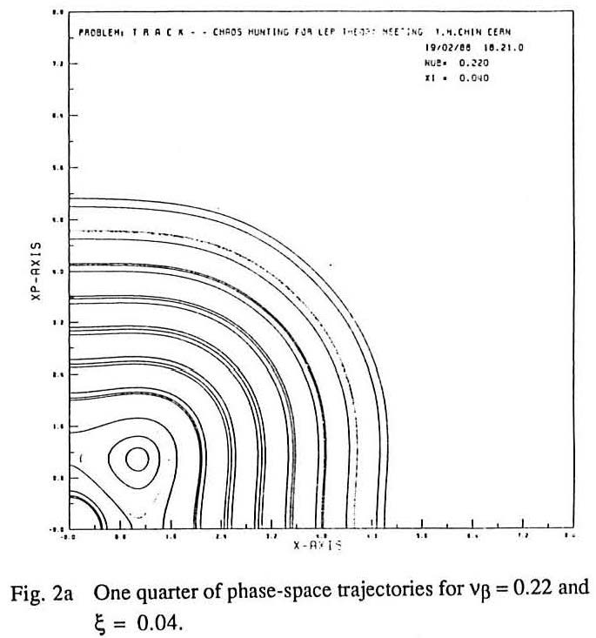
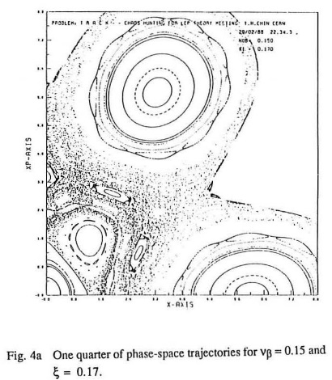
Introduction
The beam-beam interaction has been extensively studied in terms of Hamiltonian analysis of single particle dynamics.
The Hamiltonian analysis may predict orbits of regular particle motion, and may give us some criterions (e.g. Chirikov’s resonance overlap) for estimating the onset of chaotic behavior of particle orbit.
However, since the method is posed in terms of the behavior of a particle trajectory, it breaks down when the particle motion becomes chaotic.
Weak
Beam-Beam
Strong
Beam-Beam

Slide 5
Statistical Theory
What is needed is a more statistical theory for dynamics of, not single particle, but ensemble of many particles where the chaos may be described by statistical terms.
That theory would allow us to calculate particle distributions in the presence of the beam-beam interaction.
These quantities are straight linked with a beam blowup and particle losses.

Slide 6
Three Premises
Fokker-Planck equation for the evolution of the particle distribution
“Strong-weak" beam-beam interaction
One-dimensional
Warning
This talk is quite theoretical due to its nature.
If you still have a fresh memory of what you have learned on the quantum field theory at school, you can follow it (I cannot anymore).
Only the outline of the theory is presented in this conceptual talk, but the concrete solutions exist for numerical evaluations.
At the end, I show some comparisons with simulations

Slide 7
Crux of the Problem
Fokker-Plank equation for the particle distribution P:
θ= the azimuthal position in the ring
Λ=Fokker-Plank operator including all the effects (beam-beam, synchrotron radiation and so on)
If we can find the Green function which satisfies
the solution is
θ
Ring
Initial distribution
Done! Simple!

Slide 8
Exact Green Function
The exact Green function G includes all the orbit distortion effects and provides the exact transition probability of particle orbit, at any preceding moment, no matter whether the particle motion is chaotic or not.
It is too difficult to find it.
The renormalization technique may be the next best thing to finding the exact Green function.
Let us evaluate G with the perturbation method.
One important rule in choice of the perturbation method.
The method has to guarantee that a perturbation solution of any order will be smaller than the lower-order ones so that the perturbation expansion series converges.
It is not so obvious.

Slide 9
Renormalization Theory
Goal
Find a set of eigenfunctions which almost diagonalizes the system (the particle distribution)
The system may be decomposed into a set of modes.
The renormalization is a procedure to rewrite those equations of motion so that the coupling between the modes as solutions of the equations becomes minimum.
The theory is originally motivated to avoid the small denominator singularities at the centers of resonances by including orbit distortion of resonant particles due to other resonances.
But, it is most powerful when resonances strongly interact to each other, and the system can no longer be approximated by a collection of isolated resonances.

Slide 10
Renormalization Procedure
Let us write down the Fokker-Planck eq. for the particle distribution P in a slightly explicit form:
L: Fokker-Plank operator except the beam-beam
L_{B}: Operator for beam-beam as a function of potential U
Decompose P into
<P>: Average over the azimuthal angle φ in phase space
δP: Remaining part fluctuating around <P>
p
I
φ
x
<P>

Slide 11
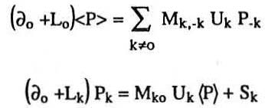
Fourier Decomposition
Due to the periodic boundary condition in φ,
∝ ξ : the beam-beam parameter
Averaging the Fokker-Plank Eq. over φ and Fourie decomposition lead equations for <P> and δP:
Beam-beam interaction
matrix operator
Mode coupling term from other modes P_{k-l}

Slide 12
Unperturbed Green Function
Equation for δP can be further Fourier decomposed in θ:
Here, the unperturbed Green function satisfies

Slide 13
Mode Coupling Term S_{kn}
The mode coupling term becomes important in two cases:
Very weak synchrotron radiation
The unperturbed green function is approximately given by
If we ignore the mode coupling term S_{kν,}
Nonlinear detuning term
Unperturbed betatron tune
Diverges at the center of
resonance =0

Slide 14
Resonance Singularity
The singularity emerges since we have
assumed that resonant particles receive
only a part of beam-beam kick which
creates the resonance.
In reality, particles receive the total kick of beam-beam force which generate all the resonances.
By the random kicks from other resonances, the particle tunes are fluctuating and not strictly locked at the resonance tune.
Therefore, the resonance singularity may be avoided in the real system even in the absence of the quantum fluctuation.

Slide 15
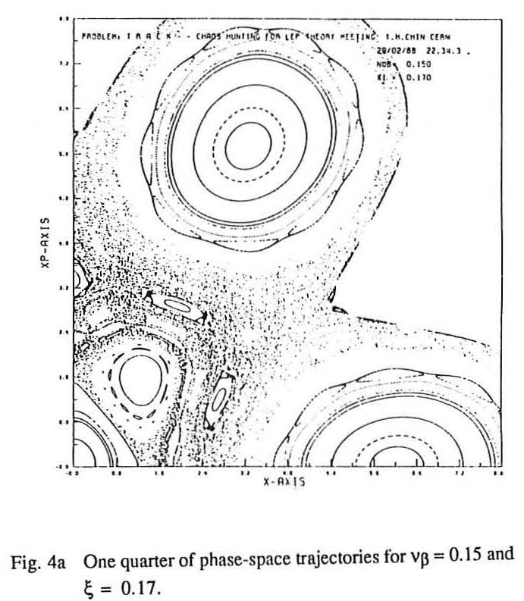
Strong Coupling between Resonances
In this case, the particle motion
between the resonances may be chaotic.
Apparently, the exact Green's function will be very different from which expresses regular orbits of resonant particles.
It cannot be constructed in terms of by calculating higher-order correction terms from the mode-coupling term S_{kν}, since the chaotic motion cannot be described by combination of regular motion.
If one tries, then the expansion series will not converge.

Slide 16
Renormalized Green's Function
Let us introduce the renormalized Green’s function:
: Renormalization correction operator to be determined
Then,
Decompose the mode coupling term S_{kν} to
: Proportional to
: The rest

Slide 17
Incoherent Noise
Identify (since both are proportion to )
Then, we have
By the definition, does not depend on and thus acts as an incoherent noise to
Resonances can still cause changes in other resonances through , but they are not coupled by

Slide 18
Direct Interaction Approximation
A resonance P_{k1ν1} can cause a change in another resonance P_{k2ν2} through the mode-coupling term S_{k2ν2.}
The change in P_{k2ν2} can act back to the resonance P_{k1ν1} through the mode-coupling S_{k1ν1} and P_{k1ν1} will be changed.
This self-interaction should be identified as , since its strength depends on P_{k1ν1} proportionally.
Only the direct interaction between resonances is considered in the present theory.
P_{k1ν1}
S_{k2ν2}
S_{k1ν1}
P_{k2ν2}
S_{k3ν3}
S_{k3ν3}
P_{k3ν3}

Slide 19
Renormalization Correction Term
g_{k-l ν−n}
The explicit form
The physical interpretation
The particle subject to the Green's function g_{kν} in the (k,v) resonance is scattered by the field U_{-l} and is effected by the resonance g_{k-l ν−n}
Then, it is scattered again by the field U_{l} to emerge at the initial resonance g_{kν} .
Since the particle comes back to the initial resonance, the above trajectory going through other resonance should be included in the transition probability of the particle orbit subject to the (k,v) resonance, namely the renormalized Green's function g_{kν} for the renormalized resonance.
U_{-l} i
U_{l}
U_{-l}
g_{kν}
The second order in the beam-beam parameter

Slide 20
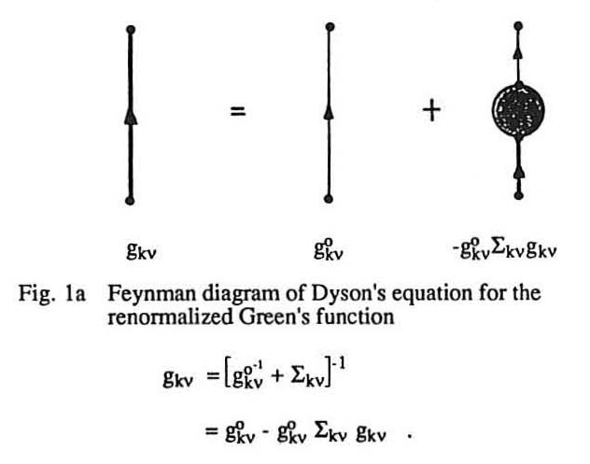
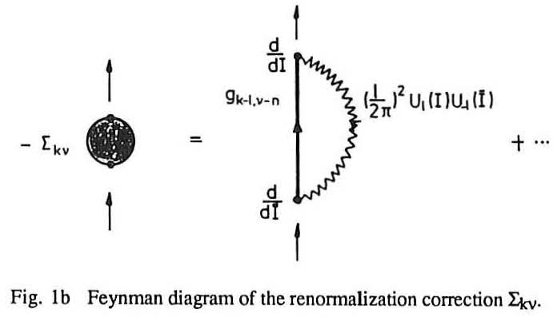
Feynman Diagrams
Hartree-Fock approximation for
self-energy of a fermion

Slide 21
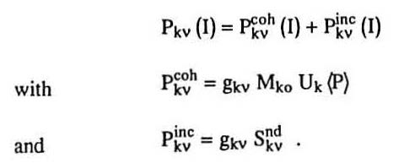
Solution
The solution P_{kν} can be decomposed to two terms:
The Green’s function g_{kν} has no small denominator problem anymore.
The incoherent part is formally one –order of magnitude smaller in ξ than the coherent part.
Let us neglect the incoherent part hereafter.

Slide 22
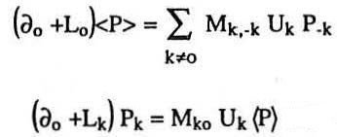
Closed Set of Equations
Now, each mode P_{kν} couples only with <P>, no longer with other modes.
Thus, the equations for <P> and P_{kν} are closed:
Once we know <P>, we can calculate P_{kν}, and vice versa.
These equations can be solved with rough approximations.
I skip what follows, but we can derive concrete solutions.

Slide 23
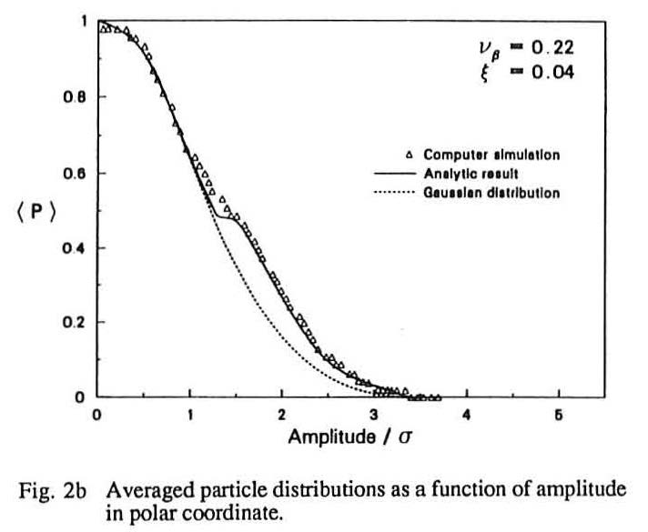
Comparison with Simulations Relevant to LEP at 50GeV
No chaotic case for ξ=0.04

Slide 24
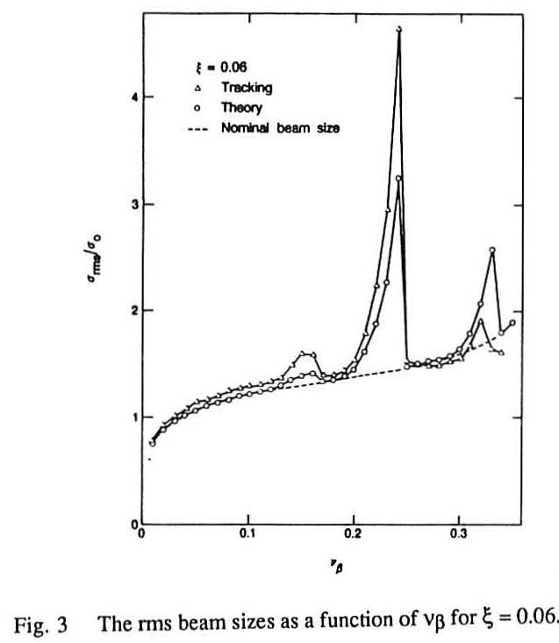
No Chaotic Case for ξ=0.06

Slide 25
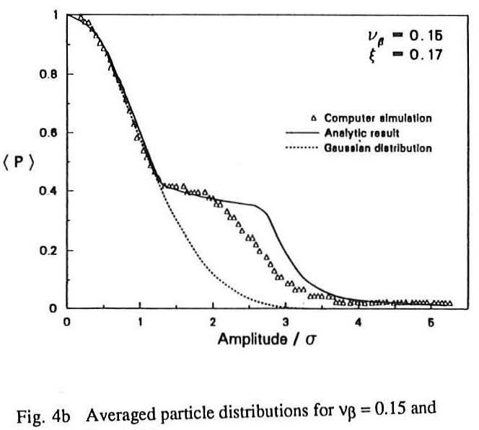
Very Chaotic Case for ξ=0.17

Slide 26
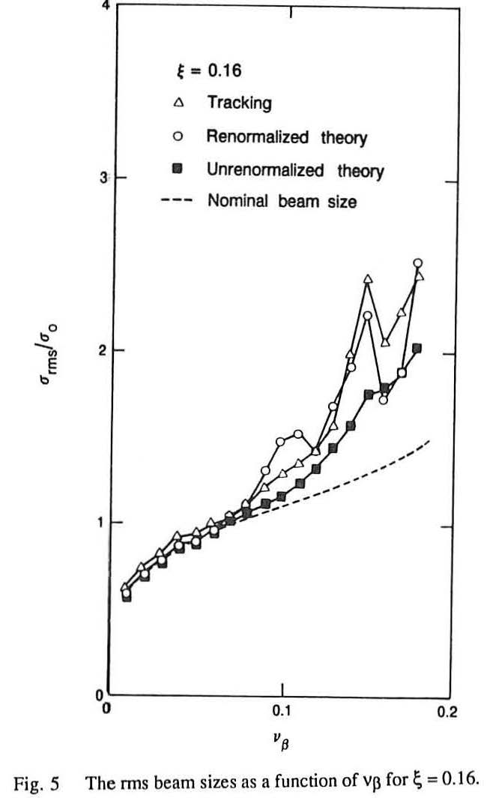
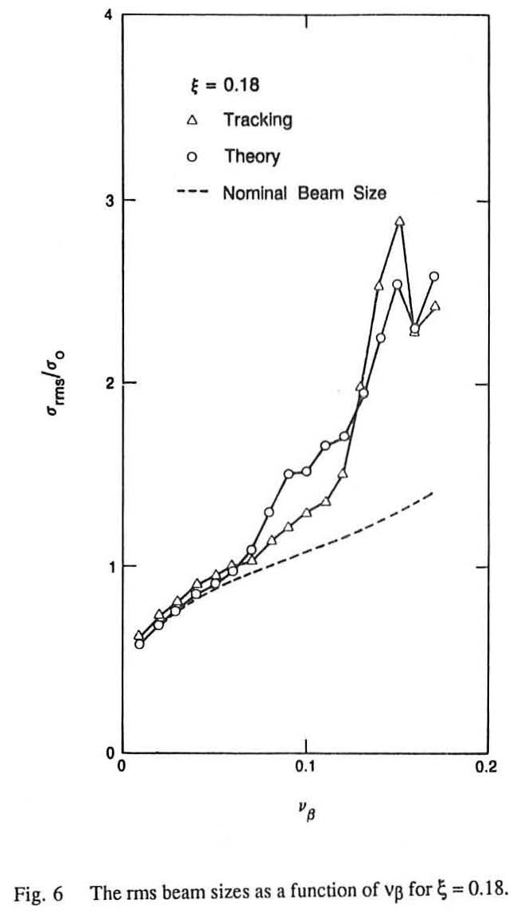
The RMS Beam Size for Large ξ

Slide 27
Conclusions
Despite of some rough approximations for the renormalized Green's function, the theory exhibits reasonably good agreements with computer simulations.
To try to explain a beam blowup by looking at the distortion of particle orbit lies on the same line as the Hamiltonian analysis.
However, by describing the orbit distortion in terms of the Green's function, we gain more capacity in the theory where statistics comes in.
At the same time, the physical mechanism of a beam blowup, due to either chaos or regular resonances, is explicit in the theory.
The present one-dimensional strong-weak beam picture is still unpractical for application to real machines, but the extension to the two dimensional strong-strong case is nearly impossible.
Hopefully, somebody will solve this problem for space-charge case.

