Slide 1
Space Charge Mitigation (in 2D)
William D. Stem
Oliver Boine-Frankenheim

Slide 2
Outline
Brief introduction to electron lenses
Simulation parameters, method, and assumptions
  Lattice assumptions (SIS18-specific!)
  2D vs 3D
2D PIC tracking results (fully self-consistent SC)
  Compared to analytic interpretations of coherent resonances and stability considerations
Final remarks and outlook

Slide 3
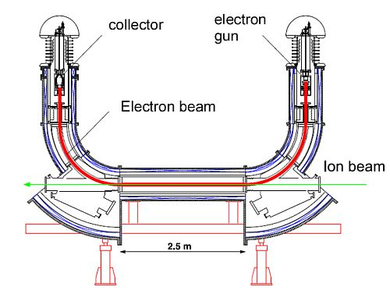
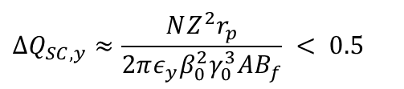
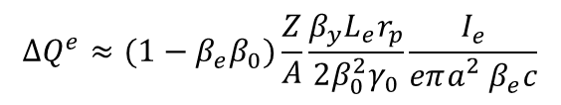
Electron Lenses
Distributed tune shift (Space Charge)
$$∆Q_{SC,y}≈\frac{NZ^{2}r_{p}}{2πε_{y}β_{0}^{2}γ_{0}^{3}AB_{f}} < 0.5$$
Localized tune shift (Electron Lens)
$$∆Q^{e}≈(1−β_{e}β_{0})\frac{Z}{A}\frac{{β_{y}L}_{e}r_{p}}{2β_{0}^{2}γ_{0}}\frac{I_{e}}{{eπa_{}^{2}β}_{e}c}$$
Assumption:
matched transverse and longitudinal beam profiles

Slide 4
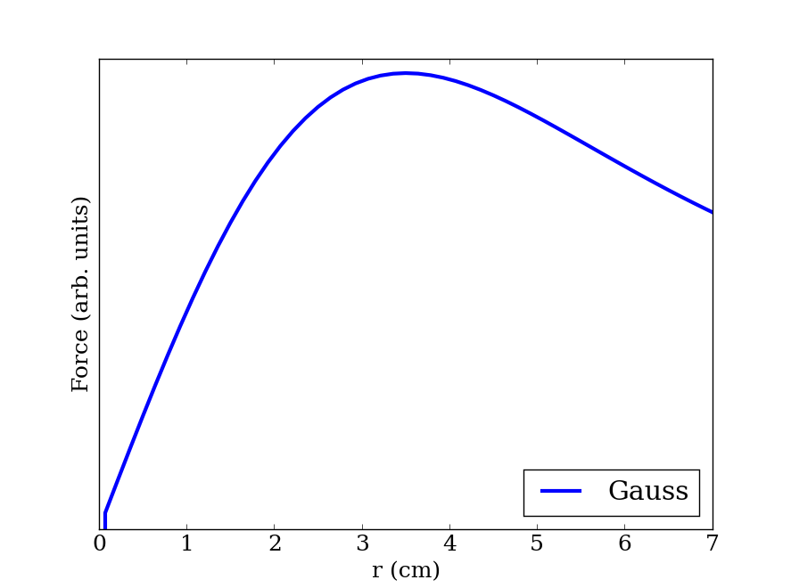
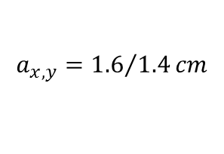
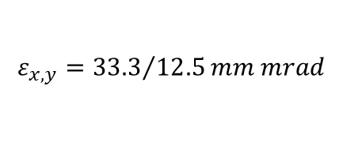
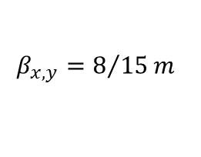
Nonlinear Density Profile
Gaussian Cross Section
At the lens (SIS18)
$$β_{x,y}=8/{15}m$$
$$ε_{x,y}={33.3}/{12.5}mm mrad$$
$$a_{x,y}={1.6}/{1.4}cm$$

Slide 5

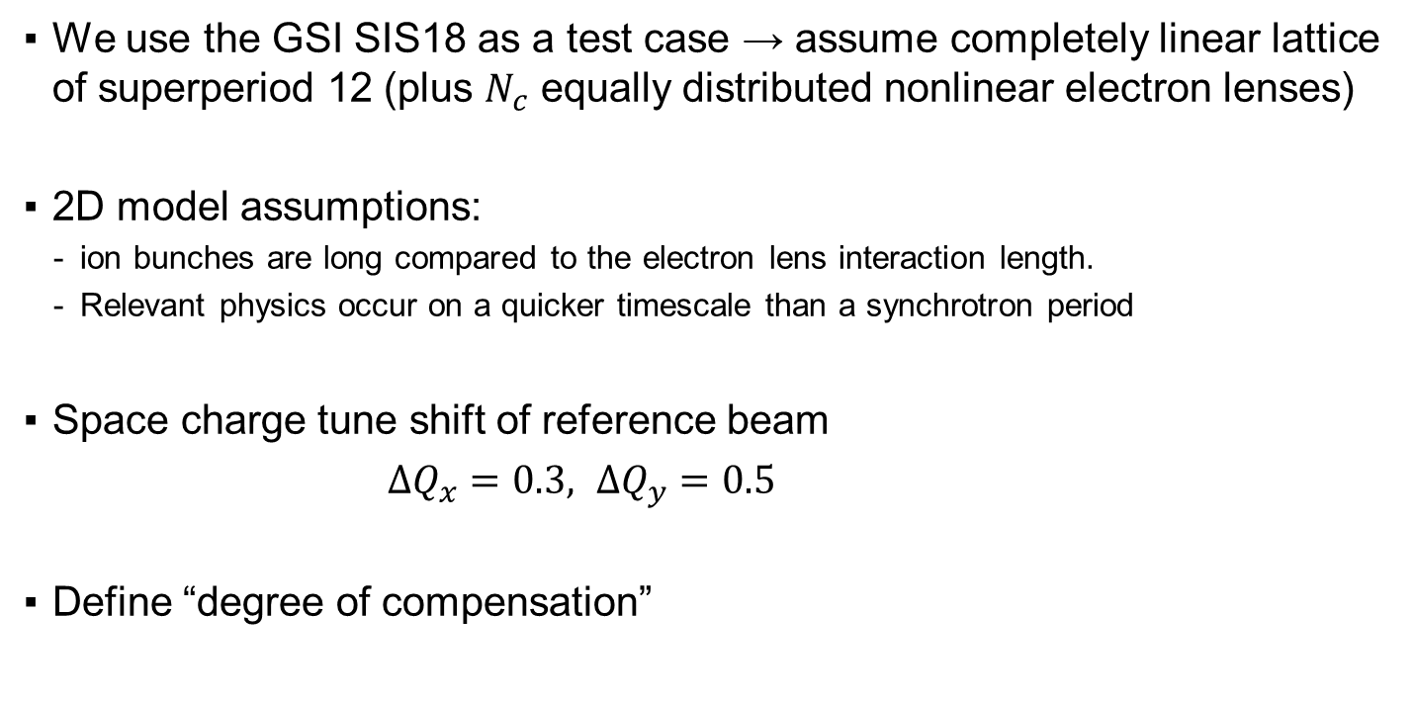
Simulation Setup
We use the GSI SIS18 as a test case → assume completely linear lattice of superperiod 12 (plus $N_{c}$ equally distributed nonlinear electron lenses)
2D model assumptions:
  ion bunches are long compared to the electron lens interaction length.
  Relevant physics occur on a quicker timescale than a synchrotron period
Space charge tune shift of reference beam
$∆Q_{x}=0.3, ∆Q_{y}=0.5$
Define “degree of compensation”
$$α_{x}≡\frac{∆Q_{e,x}}{{∆Q}_{x}}=$$
1 for full compensation

Slide 6
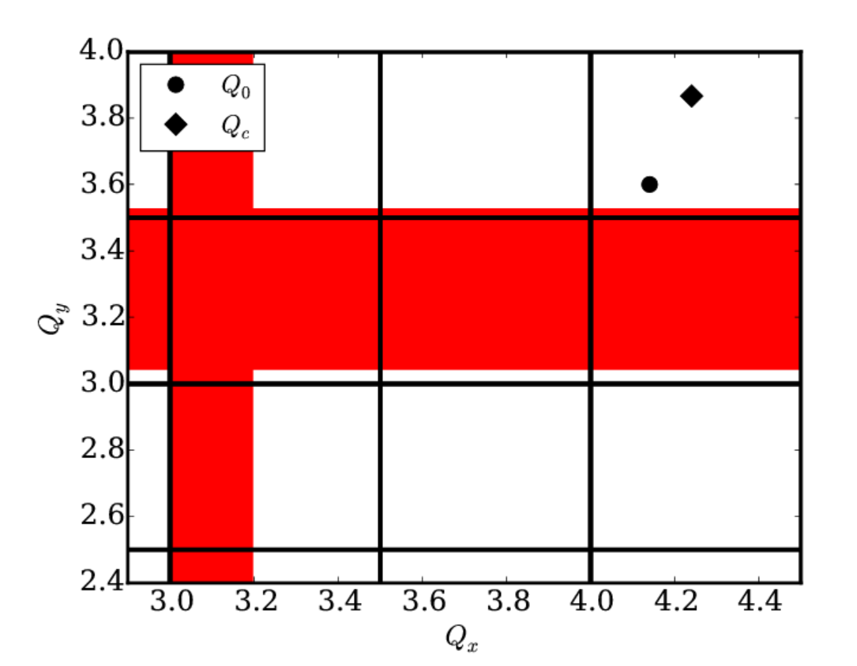
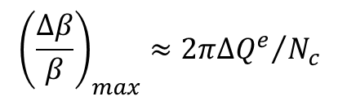
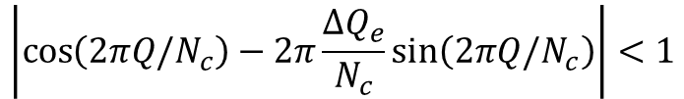


Single Particle Instabilities
Number of compensators needed depends on the stability criterion:
$$\left|\cos\left(2πQ/N_{c}\right)−2π\frac{∆Q_{e}}{N_{c}}\sin\left(2πQ/N_{c}\right)\right|<1$$
Beta beating with the onset of “localized focusing error“
$$2∆Q_{e}$$
$${\left(\frac{∆β}{β}\right)}_{max}≈{2π∆Q^{e}}/{N_{c}}$$
Cannot compensate for beta beating from pulsed lens with static quadrupoles
$$N_{c}/2$$

Slide 7
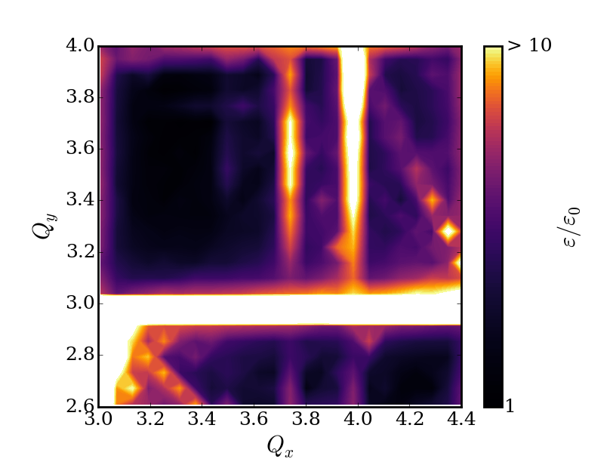



2D Self-Consistent SC PIC simulations
$$nQ_{x}+mQ_{y}=pN_{c}$$
$N_{c}=6, α_{y}=0.6$
$N_{c}=6, α_{y}=0.6$

Slide 8
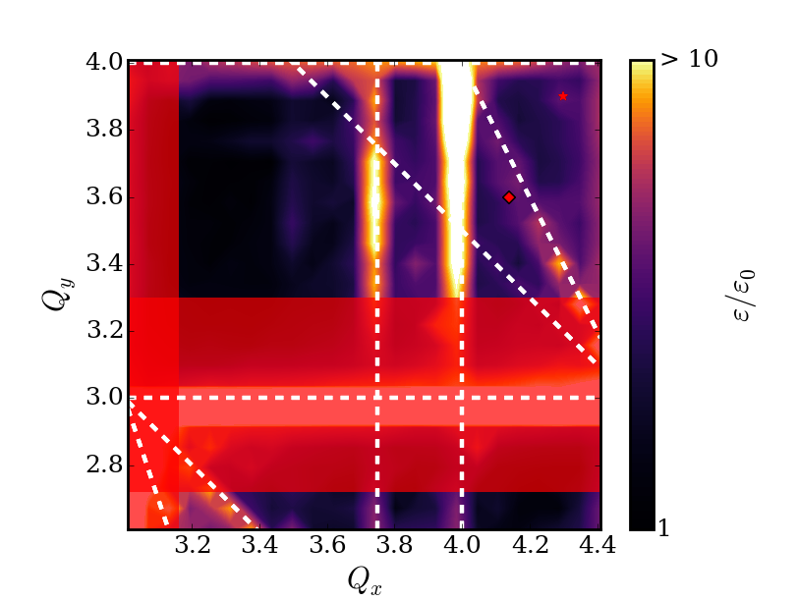
2D Self-Consistent SC PIC simulations
$$nQ_{x}+mQ_{y}=pN_{c}$$
$N_{c}=6, α_{y}=0.6$
(2,1,12)
(8,0,30)
(3,0,12)
(1,1,6)

Slide 9
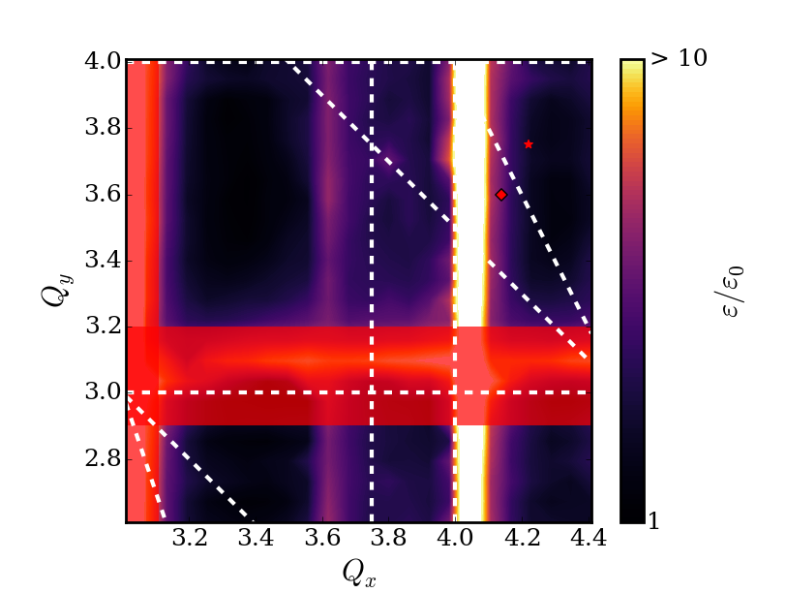

2D Self-Consistent SC PIC simulations
$$nQ_{x}+mQ_{y}=pN_{c}$$
$N_{c}=6, α_{y}=0.3$
(2,1,12)
(8,0,30)
(3,0,12)
(1,1,6)

Slide 10
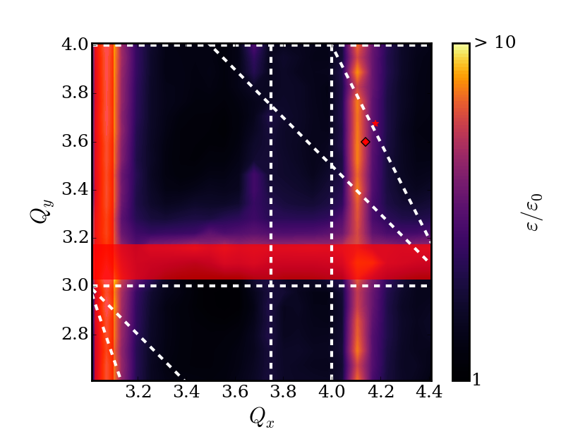

2D Self-Consistent SC PIC simulations
$$nQ_{x}+mQ_{y}=pN_{c}$$
$N_{c}=6, α_{y}=0.15$
(2,1,12)
(8,0,30)
(3,0,12)
(1,1,6)

Slide 11
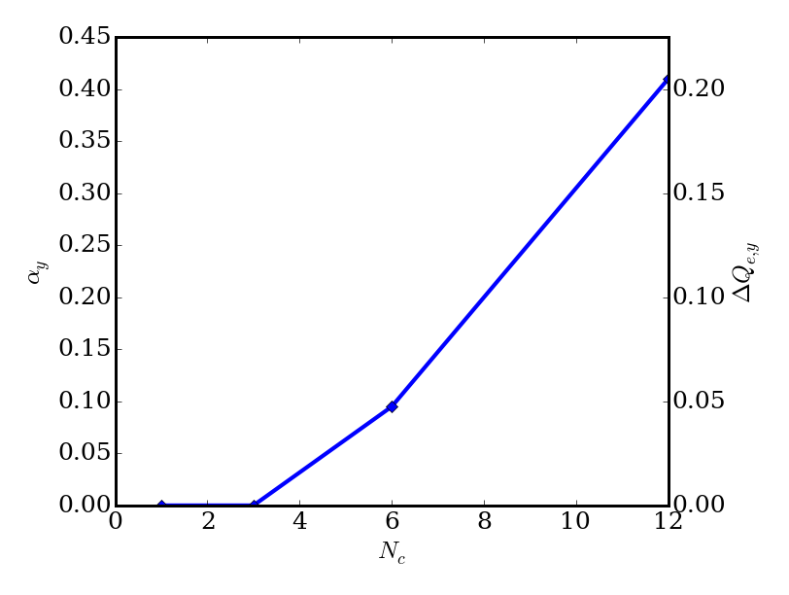

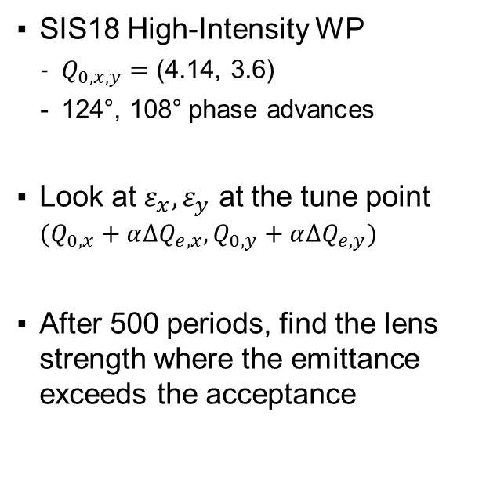
Compensation at the High-Intensity WP
SIS18 High-Intensity WP
  $Q_{0,x,y}=$ (4.14, 3.6)
  124°, 108° phase advances
Look at $ε_{x},ε_{y}$ at the tune point $(Q_{0,x}+α∆Q_{e,x},Q_{0,y}+α∆Q_{e,y})$
After 500 periods, find the lens strength where the emittance exceeds the acceptance
$$∆Q_{sc,x,y}=0.3, 0.5$$

Slide 12
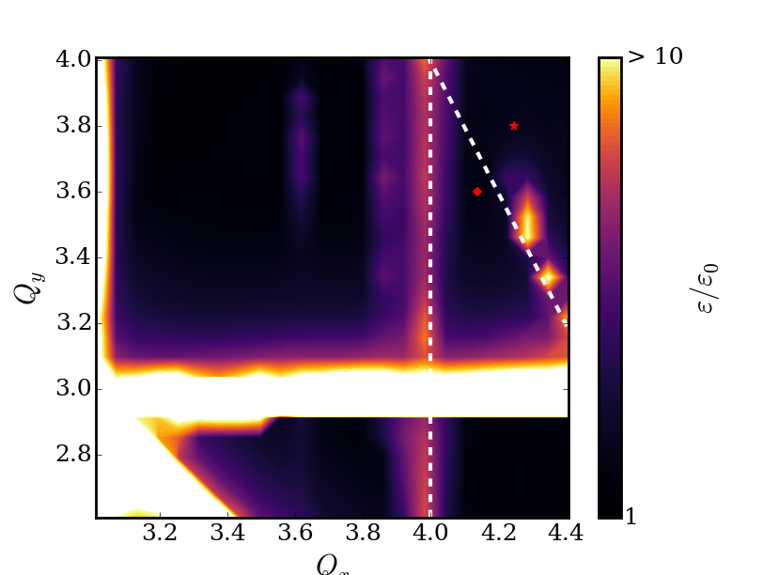


2D Self-Consistent SC PIC simulations
$$nQ_{x}+mQ_{y}=pS=pN_{c}$$
$N_{c}=12, α_{y}=0.5$
(2,1,12)
(3,0,12)
(3,0,12)

Slide 13
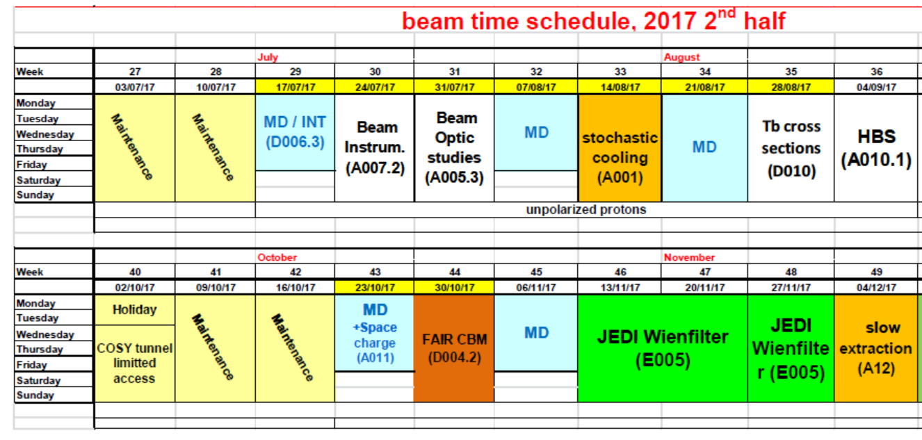
Nonlinear Resonance Experiment, COSY, Jülich

Slide 14
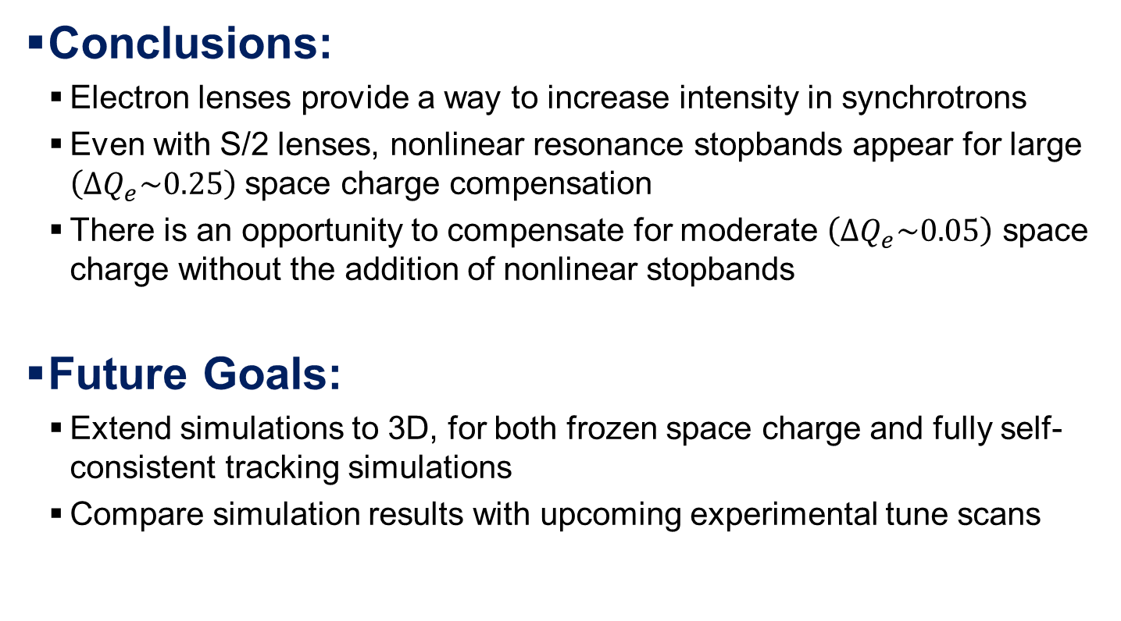
Conclusions and Outlook
Conclusions:
  Electron lenses provide a way to increase intensity in synchrotrons
  Even with S/2 lenses, nonlinear resonance stopbands appear for large $\left(ΔQ_{e}\sim 0.25\right)$ space charge compensation
  There is an opportunity to compensate for moderate $\left(ΔQ_{e}\sim 0.05\right)$ space charge without the addition of nonlinear stopbands
Future Goals:
  Extend simulations to 3D, for both frozen space charge and fully self-consistent tracking simulations
  Compare simulation results with upcoming experimental tune scans

Slide 15
Thank you
for your attention!

Slide 16
Acknowledgement and References
Funding
Work is supported by BMBF contract FKZ:05P15RDRBA
References
M. Aiba, M. Chanel, U. Dorda, R. Garoby, J.-P. Koutchouk, M. Martini, Proc. of the Particle Accelerator Conference (PAC) 2007
A.V. Burov, Proceedings of the 2001 Particle Accelerator Conference, Chicago (2001)
V. Shiltsev et al., Phys. Rev. ST-AB 103501 (2008)
V. Litvinenko, G.Wang, Phys. Rev. ST-AB
I. Hofmann and O. Boine-Frankenheim. PRL 115, 204802 (2015)
O. Boine-Frankenheim, I. Hofmann and J. Struckmeier, Phys. Plasma (2016)

Slide 17
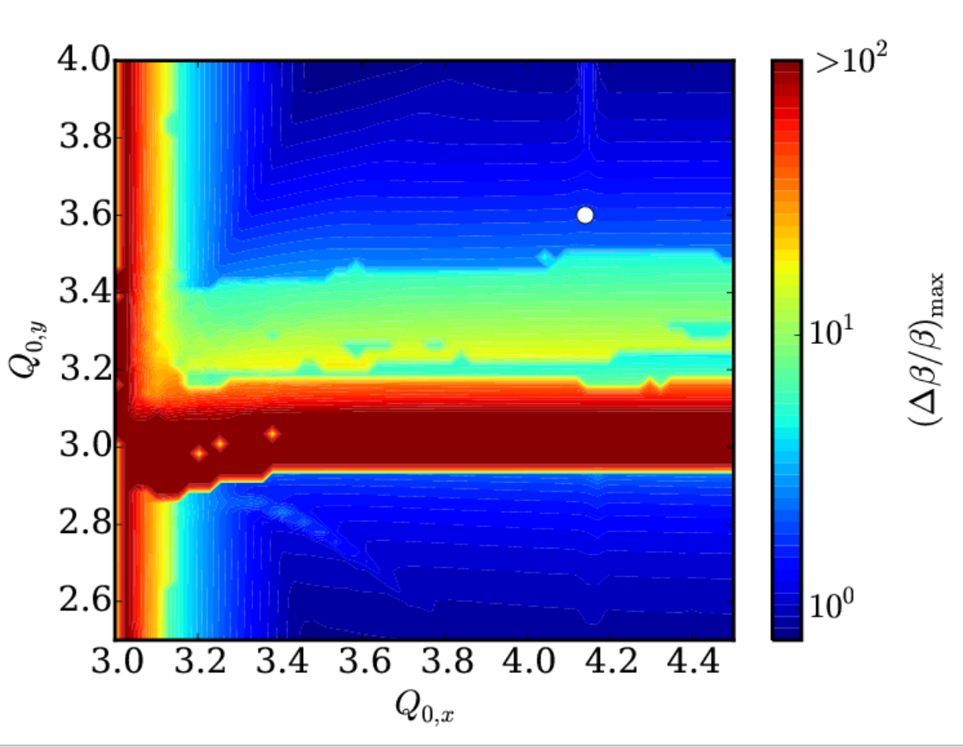
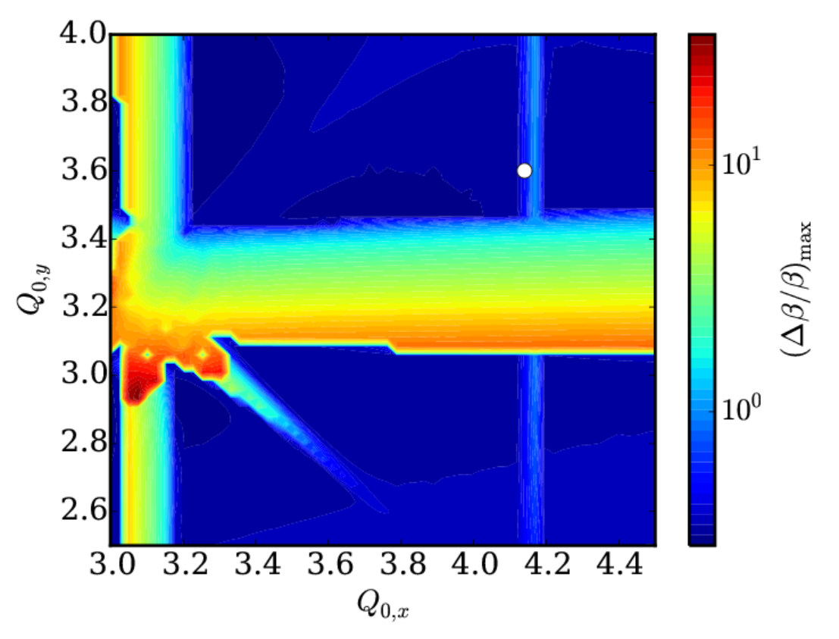
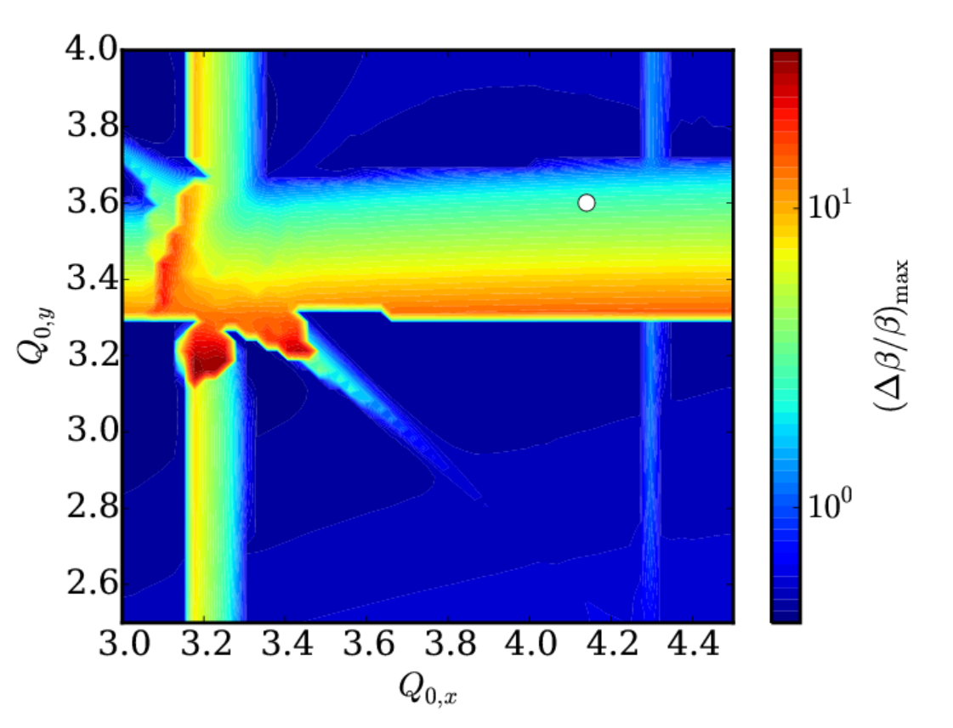



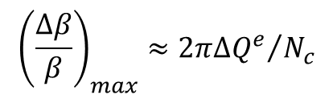

Coherent Stopbands (${∆β}/β\text{)}$
$$N_{C}=12, α=0.33$$
$$N_{C}=6, α=0.33$$
Parametric resonance condition (e.g. half-integer stopband)
$$2\left(Q_{0}−α∆Q\right)−∆Q_{2}=\frac{n}{2}N_{c}$$
Beta beating with the onset of “localized focusing error“
$${\left(\frac{∆β}{β}\right)}_{max}≈{2π∆Q^{e}}/{N_{c}}$$

Slide 18
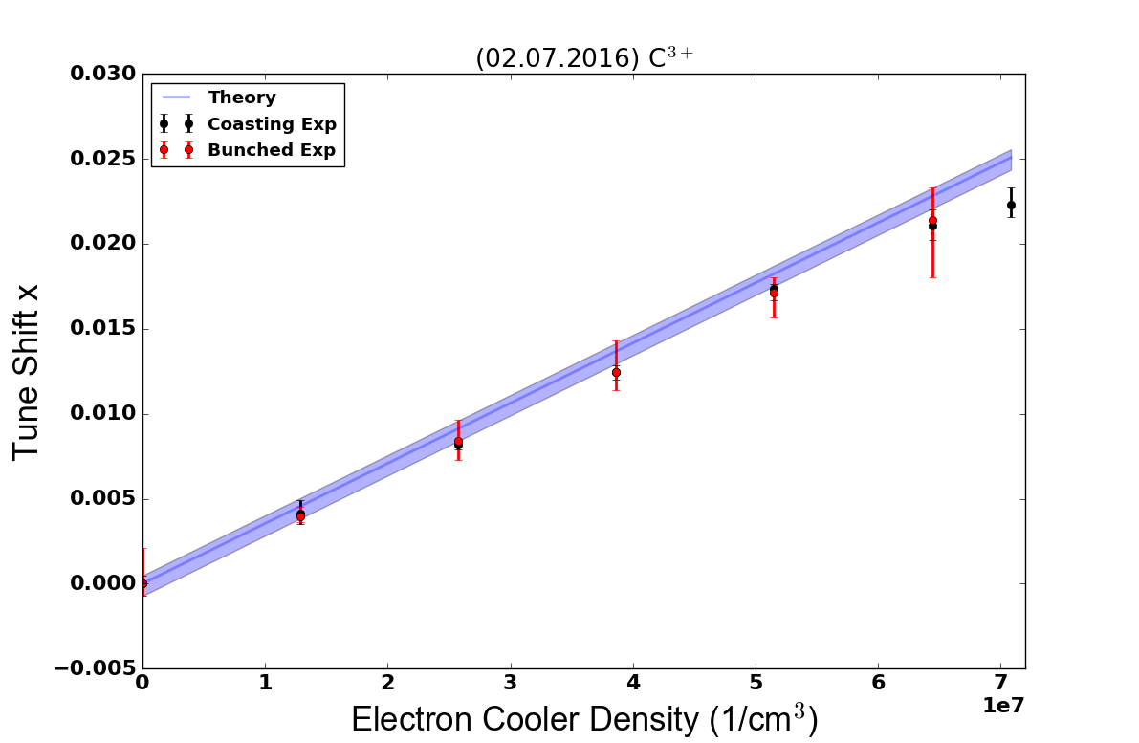

Measurement of Tune Shift, N_{c} = 1
SIS18
$$Q_{c}=Q_{0}+∆Q_{e}$$

Slide 19
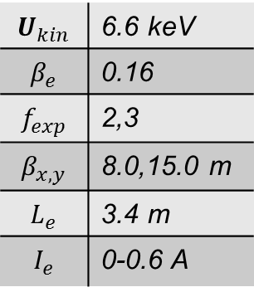
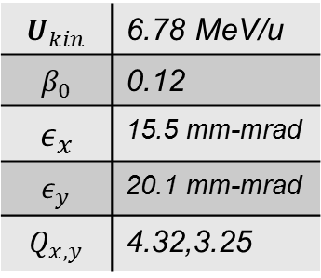
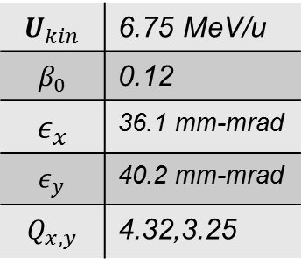
Benchmarking Experiments
Electron Cooler Parameters
$$U_{kin}$$ | 6.6 keV
$$β_{e}$$ | 0.16
$$f_{exp}$$ | 2,3
$$β_{x,y}$$ | 8.0,15.0 m
$$L_{e}$$ | 3.4 m
$$I_{e}$$ | 0-0.6 A
June 27, 2016
July 2, 2016
Xe⁴³⁺
C³⁺
$$U_{kin}$$ | 6.75 MeV/u
$$β_{0}$$ | 0.12
$$ε_{x}$$ | 36.1 mm-mrad
$$ε_{y}$$ | 40.2 mm-mrad
$$Q_{x,y}$$ | 4.32,3.25
$$U_{kin}$$ | 6.78 MeV/u
$$β_{0}$$ | 0.12
$$ε_{x}$$ | 15.5 mm-mrad
$$ε_{y}$$ | 20.1 mm-mrad
$$Q_{x,y}$$ | 4.32,3.25
Notes:
Future: Cry-ring testing

Slide 20
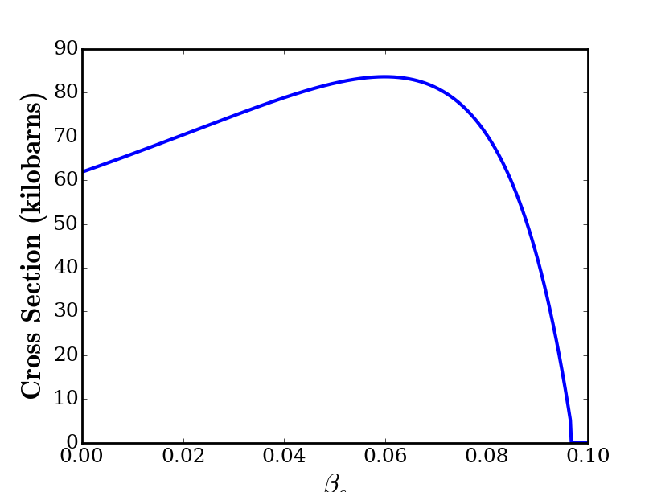
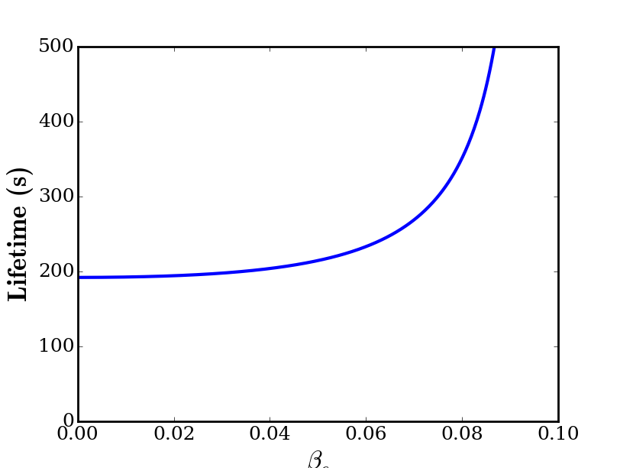

Cross Sections and Beam Lifetimes
Ion: U²⁸⁺ Mechanism: Ionization from free electrons
T. Peter and J. Meyer-ter-Vehn, PRA, 1991
$$τ=\frac{1}{n_{e}σ_{e}v_{r}f}$$

Slide 21

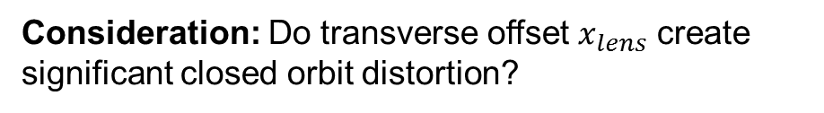





Offset Error
Consideration: Do transverse offset $x_{lens}$ create significant closed orbit distortion?
Can solve for closed orbit perturbation due to the lens:
An example (near SC limit):
$$∆Q_{e}=0.25$$
$$θ_{co}=\frac{f}{Ω−1}x_{lens}$$
$$Ω≈7.3, f_{max}≈0.4{ m}^{−1}$$
$$θ_{co,max}≈0.06x_{lens}$$
where
$$f=\frac{4π∆Q_{e}}{β_{e}}$$
negligible distortion
$$Ω=\frac{2π∆Q_{e}}{\tan\left(πQ_{c}\right)}$$
For larger tune shifts the closed orbit perturbation from the lens goes to 0.

