Slide 1
Longitudinal Effects in Space Charge Dominated Cooled Bunched Beams
Sergei Nagaitsev
Fermilab
Oct 5, 2017

Slide 2
Summary (in advance)
Longitudinal space-charge effects manifest themselves in several fascinating ways:
  Self-consistent stationary longitudinal distribution
  Synchrotron modes shifts with beam current
These effects are easily accessible in low-energy electron-cooled ion beams
This talk is based on my research at the Indiana University Cyclotron Facility (IUCF) Cooler, but easily applicable to all other cooler rings

Slide 3
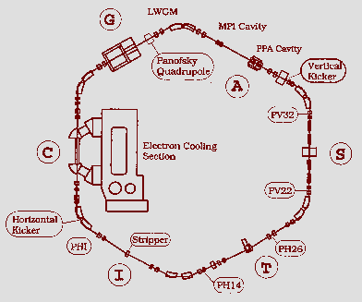
IUCF Cooler synchrotron (1988 – 2002)
~2002
These experiments were conducted with electron-cooled proton beams (45 – 150 MeV) below transition energy.
Longitudinal and transverse profiles were measured for a range of beam currents. Also, the synchrotron dipole and quadrupole frequencies were measured.

Slide 4
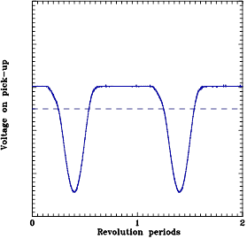
Measurements
Flying wire signal --
Transverse profile
Voltage on the pick-up electrode for τ » T (Rin = 1 MΩ).
Longitudinal profile

Slide 5
From measured long and transv beam profiles we can calculate the SC tune shifts:
This tune shift never exceeded -0.2

Slide 6
…First, a quiz…
A
C
B
D
These are measured stationary beam distribution profiles for a 150 MeV proton beam with continuous electron cooling. One profile is taken with “good” vacuum, one with “bad” vacuum.
Question: Which profiles correspond to “bad” vacuum?
Bad vacuum: (1) A and C; (2) B and C; (3) A and D; (4) B and D

Slide 7
The correct answer is (3)
A
C
B
D
(3) A and D;
Transverse beam profile gets broader (D) from Coulomb scattering (because of “bad” vacuum) but the bunch length gets shorter (A) because the longitudinal space-charge defocusing is reduced.

Slide 8
SC defocusing
RF focusing

Slide 9
With electron cooling, the Vlasov equation becomes the Fokker-Plank equation
For a uniform transverse distribution
g = log[chamber radius/beam radius] + ½ -- geometric factor
This equation can be solved analytically for a stationary distribution function

Slide 10
The stationary distribution
ρ_{o}(0) must be chosen such that ρ_{o}(ϕ) is normalized to unity
There are two unknowns: σ and g, the rms momentum spread and the geometric factor.
For vanishing space-charge (α = 0) the linear density ρ_{o}(ϕ) becomes Gaussian.
For vanishing momentum spread (σ → 0) the linear density becomes

Slide 11
Stationary longitudinal bunch charge density distributions for a fixed momentum spread (σ ) and various bunch charges
σ = 4e-5

Slide 12
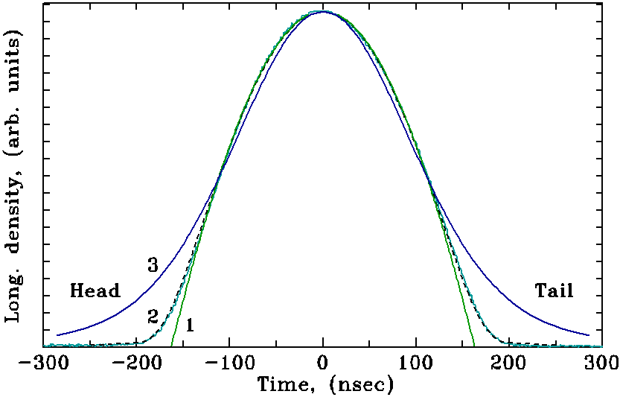
Measured (solid, 2) and theoretical (dashed, 2) linear density. Cosine (1) and Gaussian (3) fits are also presented. I_{o} ≈ 400 μA, V_{rf} ≈ 12 V. IUCF Cooler, 1994

Slide 13
Proton beam rms momentum spread vs. beam current. V_{rf} = 12 V (◻), V_{rf} = 126.4 V (Δ), and V_{rf} = 13.8 V (+). Derived from the bunch shape fitting.
The fit with two parameters (σ and g) is unambiguous
For gaussian beam distributions:
(arXiv:1508.00153, R. Baartman)

Slide 14
Cross-checking g vs transverse beam radius
rms size
Best fit corresponds to b ≈ 20 mm
The IUCF cooler had the average beam pipe radius of 25 mm

Slide 15
Ratio of the effective rf voltage to the applied rf voltage derived from the bunch shape fitting. V_{rf} = 12 V (◻), V_{rf} = 126.4 V (Δ).

Slide 16
Longitudinal dynamics of space-charge dominated bunched beams
Linear rf voltage model (from Neuffer’s 1979 paper)
Long envelope equation:
The dipole synchrotron frequency is not affected by SC
After linearization, one obtains for the small-amplitude quadrupole (bunch length) oscillation frequency:
With no SC: -- it’s a simple bunch rotation
With zero momentum spread:
For the sin() rf voltage the situation is more complicated

Slide 17
Long. bunch modes with sin() rf voltage
We found approx. analytic solutions for bunch modes with zero momentum spread. The modes are solutions to this equation
-- the dipole mode
The quadrupole mode was found numerically
For non-zero momentum spread we solved the time-dependent F-P equation numerically
Both modes were measured in the IUCF cooler

Slide 18
The dipole mode
Model
-Pure space
charge
Measurements,
IUCF cooler, 1994
For a space-charge dominated regime the bunch length is primarily a function
of a beam current, thus, for a sinusoidal rf voltage, the synchrotron frequency
depends on the beam current! (solid lines are numerical models)

Slide 19
The quadrupole mode
solid lines are numerical models
Measurements,
IUCF cooler, 1994
Pure space
charge model

Slide 20
Summary
The beam momentum spread can not be determined from the bunch length alone! Need to perform a fit with two parameters.
Electron-cooled bunched beams are typically space-charge dominated longitudinally: the effective rf voltage amplitude in the bunch is small, ~20% of external rf voltage.
  Need to take this into account in modeling of IBS, etc
The coherent synchrotron (dipole) frequency depends on the beam current! Also, no decoherence in large amplitude synchrotron oscillations is observed.

