Slide 1

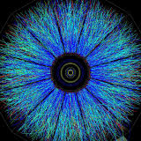
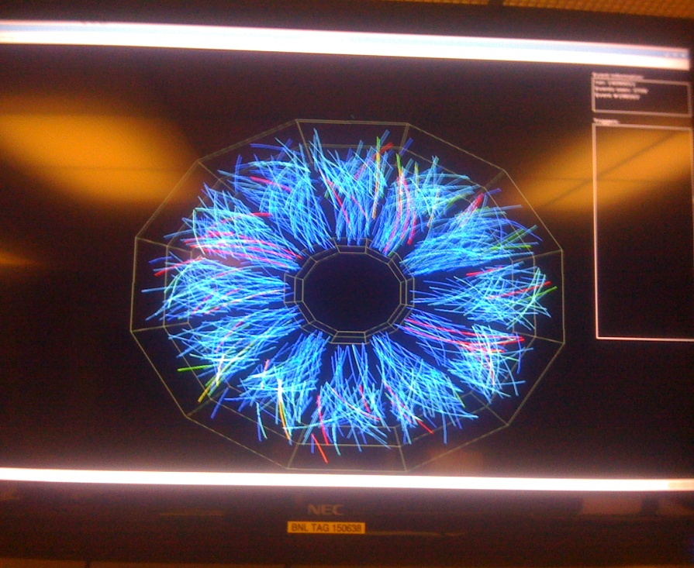
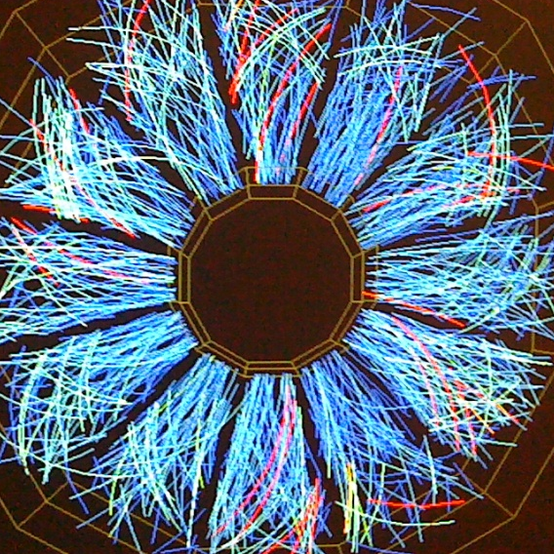
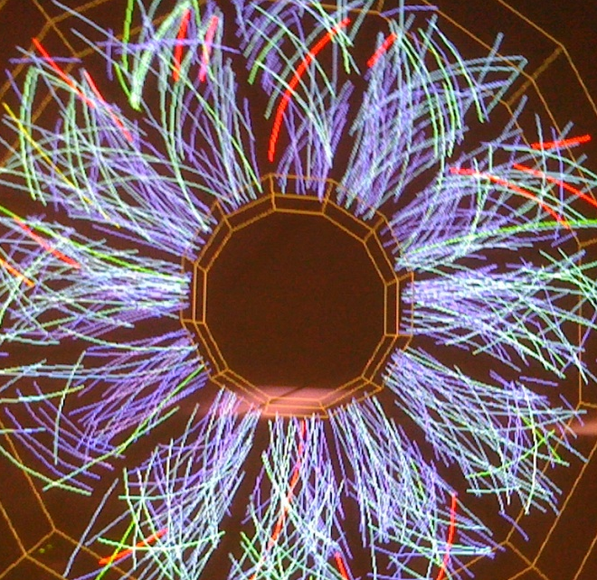
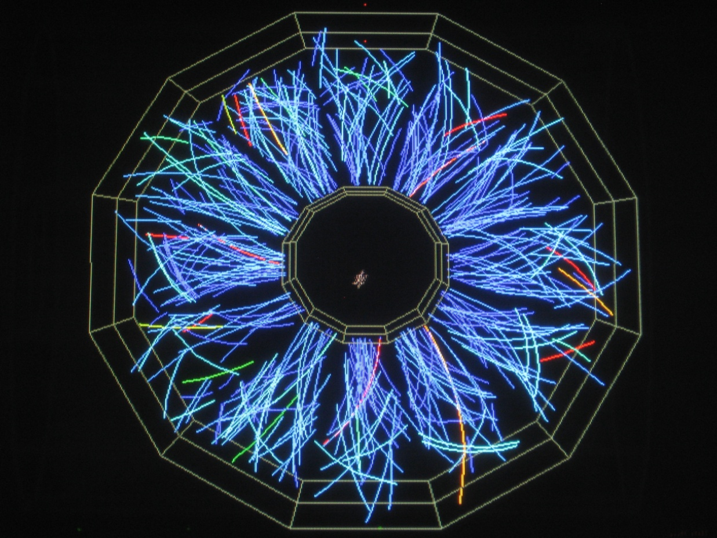

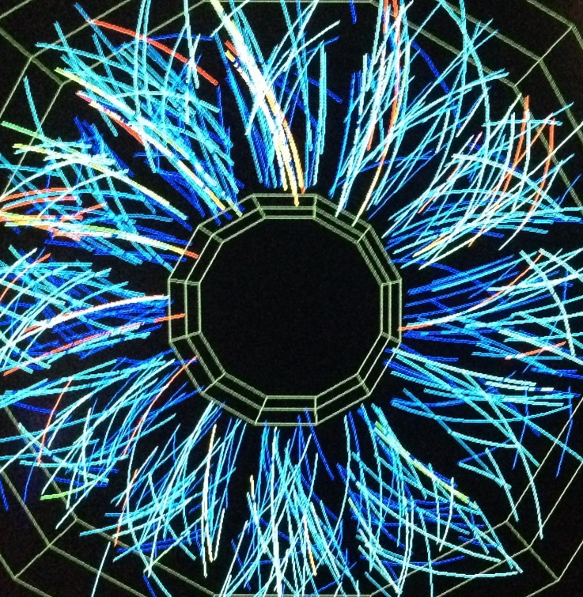
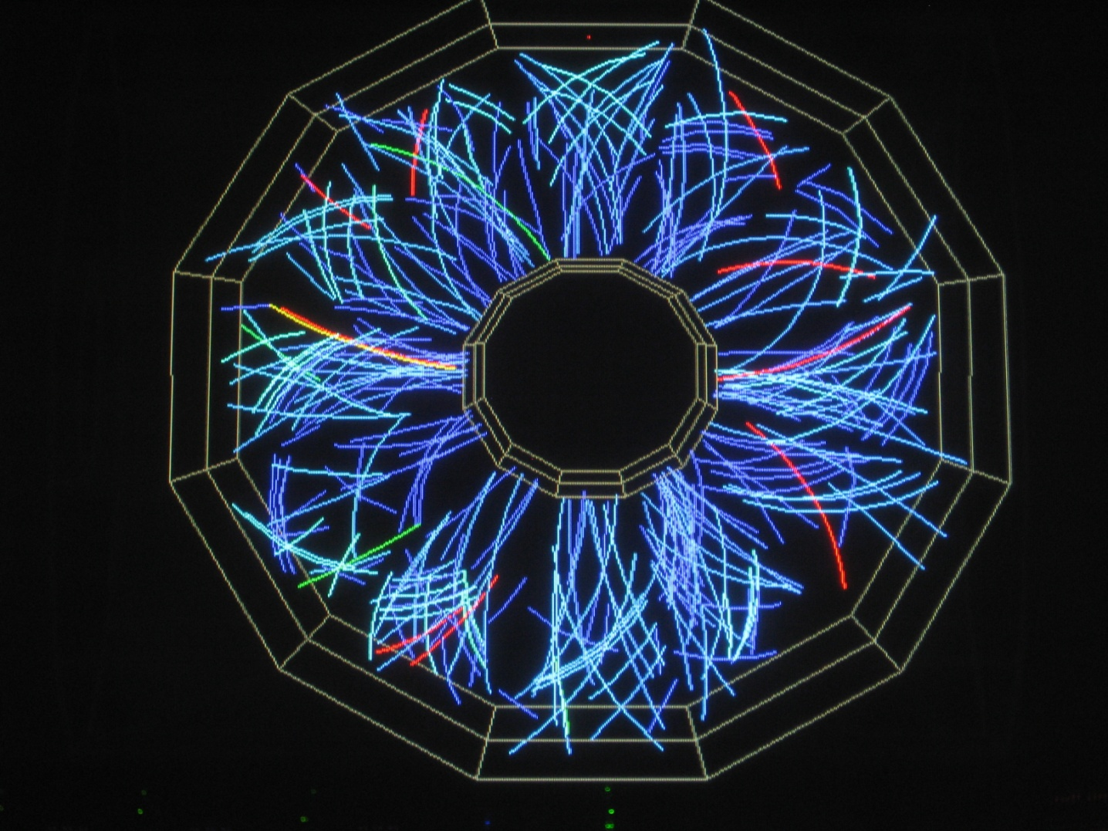
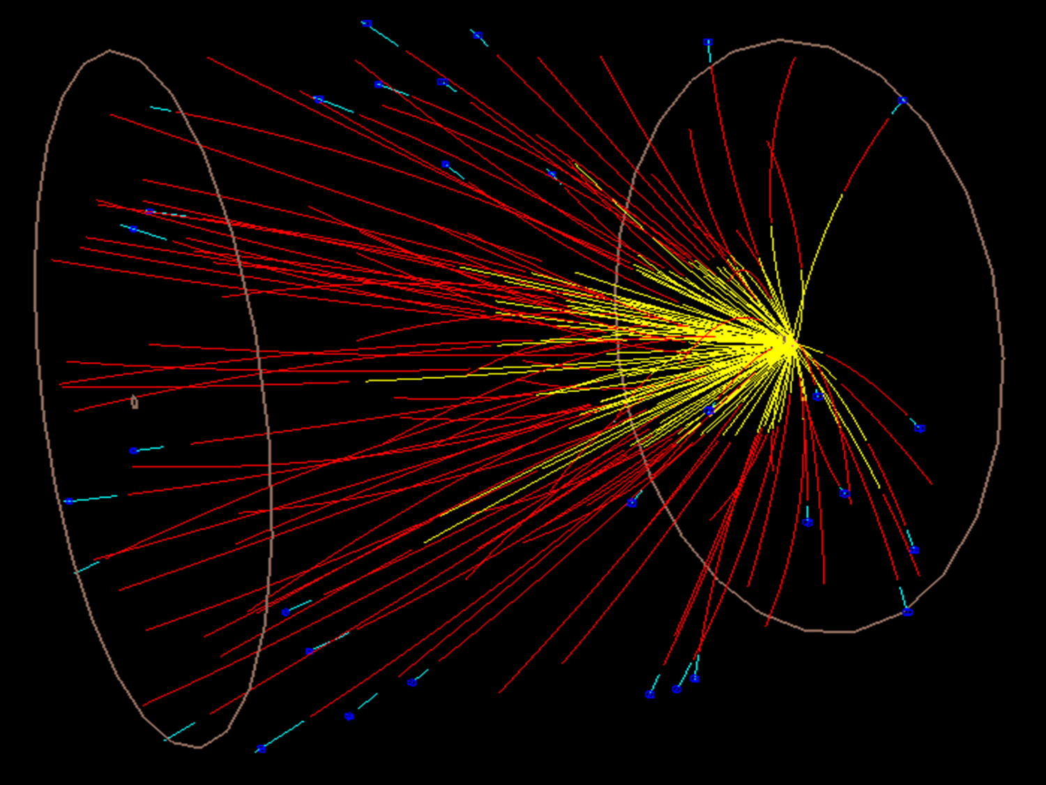
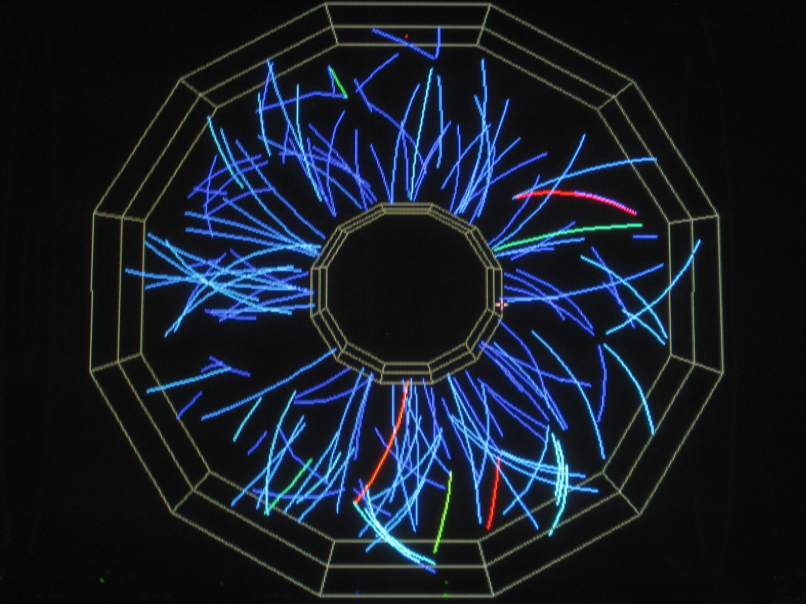
Beam Energy Scan II (BES-II) and FXT:
Status and Plans
Daniel Cebra
University of California, Davis
FXT
BES-II
Daniel Cebra
10/June/2014
CBM-STAR Joint Workshop
TU Darmstadt
Slide 1 of 23

Slide 2
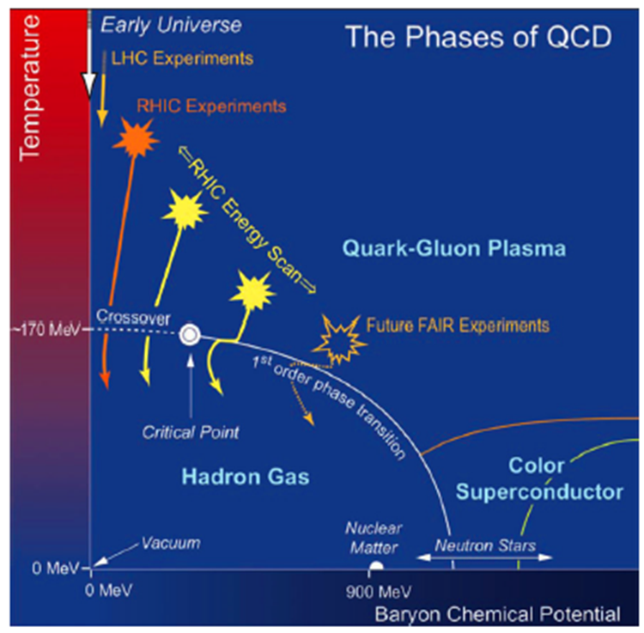
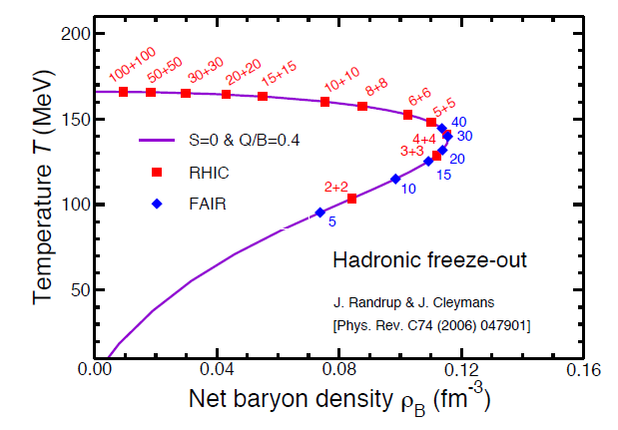
Motivation for Energy Scans
Onset of deconfinement; nature of the phase transition; Critical Point; Partonic Matter
The goal of the energy scans is to study regions of the QCD which exhibit different behaviors and the transitions between such regions
Meson Dominated
BES-II
Baryon Dominated
FXT
There is strong motivation to study both the baryon and meson dominated regions
Nuclear
Matter

Slide 3
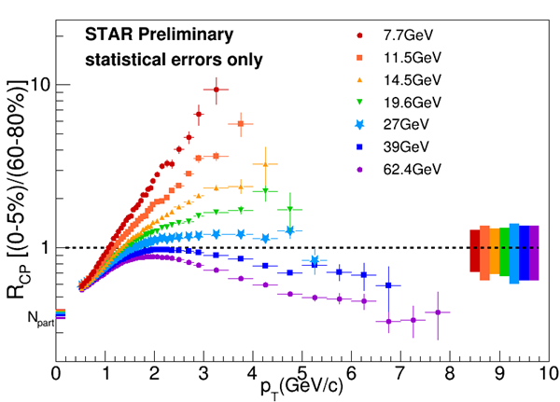
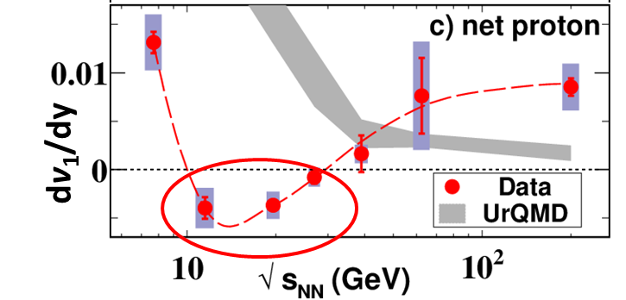
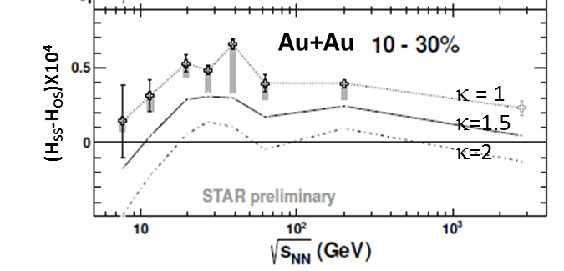
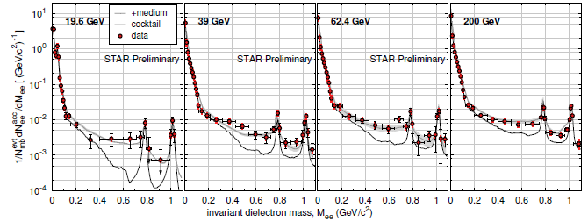
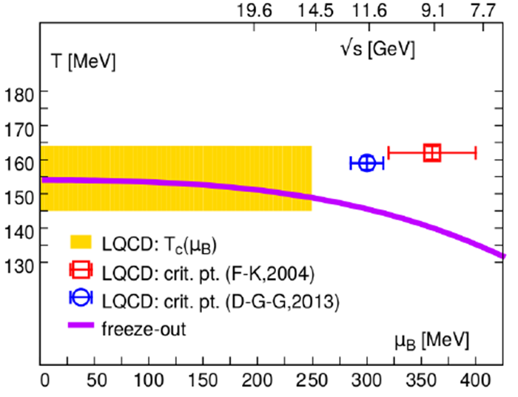
How High in Collision Energy?
➔ 19.6 GeV
ρ φ

Slide 4
How Low in Energy Should We Go? ➔ < 7.7 GeV
7.7 GeV is the lowest realistic collider energy
Critical Point studies need results below 7.7 geV
FXT program provides control measurements for critical point and onset of deconfinement
FXT span the region between the current SIS program and the RHIC BES program

Slide 5
All proposed RHIC energy scans recognize the need to study baryon dense matter
History
But low energies have proven to be difficult for the collider
Original BES
Proposal
STAR BUR 2007
4.6, 6.3, 7.6, 8.8, 12, 18, 28 GeV
Test runs in 2007 and 2008 for Au+Au collisions at 9.0 (0 events) and 9.2 GeV (7k events)
RHIC BES
Proposal
STAR BUR 2009
5.0, 7.7, 11.5, 17.3, 27, 39 GeV
Test runs in 2009 and 2010 for Au+Au collisions at 5.5 (0 events) and 5.0 GeV (1 Event)
Actual BES
Program
2010,2011,2014
7.7, 11.5, 14.5, 19.6, 27, 39, 62.4 GeV
2010-2014 ➔ Studies of collisions between beam halo and beam pipe ➔ feasibility
BES - II
Proposal
2014
FXT, 7.7, 9.1, 11.5, 14.5, 19.6 GeV
2015 ➔ Internal fixed target test run. 1.3 M Au+Au events at 4.5 GeV

Slide 6
Energy Steps for BES-II
BES Phase II is planned for two 24 cryo-week runs in 2019 and 2020
2020
2019
√S_{NN} (GeV) | 7.7 | 9.1 | 11.5 | 14.5 | 19.6
μ_{B} (MeV) | 420 | 370 | 315 | 250 | 205
BES I (MEvts) | 4.3 | --- | 11.7 | 24 | 36
Rate(MEvts/day) | 0.25 |  | 1.7 | 2.4 | 4.5
BES I L (1×10²⁵/cm²sec) | 0.13 |  | 1.5 | 2.1 | 4.0
BES II (MEvts) | 100 | 160 | 230 | 300 | 400
eCooling (Factor) | 4 | 4 | 4 | 3 | 3
Beam Time (weeks) | 12 | 9.5 | 5.0 | 5.5 | 4.5
We have been told also to develop a plan for a total of 20 weeks in FY 19/20
Beam Energy steps have been chosen to keep the μ_{B} step < 50 MeV
With electron cooling
Without cooling

Slide 7
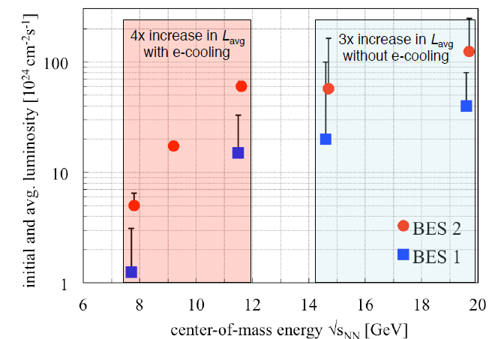
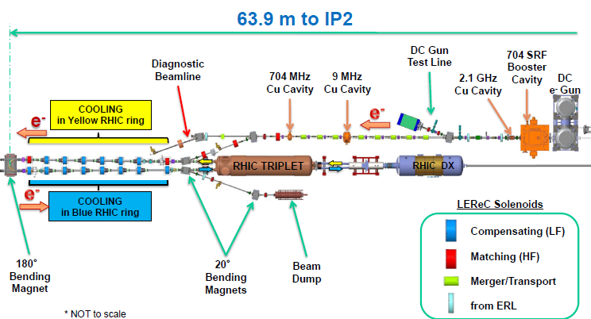
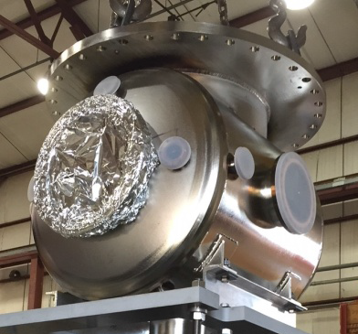
Low Energy Electron Cooling at RHIC
Improve luminosity for low energy beams with electron cooling
Start with 14.5 and 19,6 3X improvement
Following year, 7.7, 9.1, and 11.5. 4X improvement with eCooling
Run 24 weeks
DC Electron Gun

Slide 8
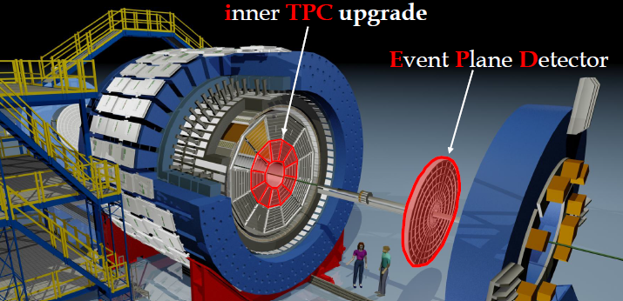
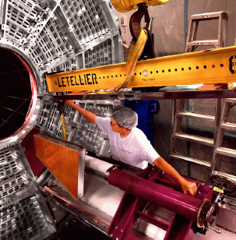
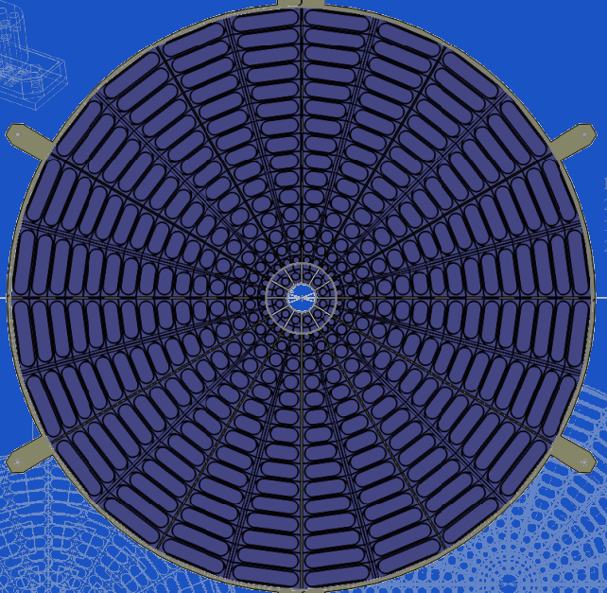
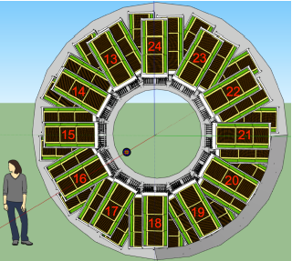
The STAR Upgrades ➔ BES-II and FXT
Endcap TOF
iTPC Upgrade:
Rebuilds the inner sectors of the TPC
Continuous Coverage
Improves dE/dx
Extends η coverage to 1.5 (2.2 for FXT)
Lowers p_{T} cut-in from 125 MeV/c to 60 MeV/c
Ready in 2019
EndCap TOF Upgrade:
Rapidity coverage is critical
PID at forward rapidity
Allows higher energy range of FXT program
CBM/FAIR
Ready 2019
EPD Upgrade:
Improves trigger
Reduces background
Allows a better and independent reaction plane measurement critical to BES and FXT
Ready 2018

Slide 9
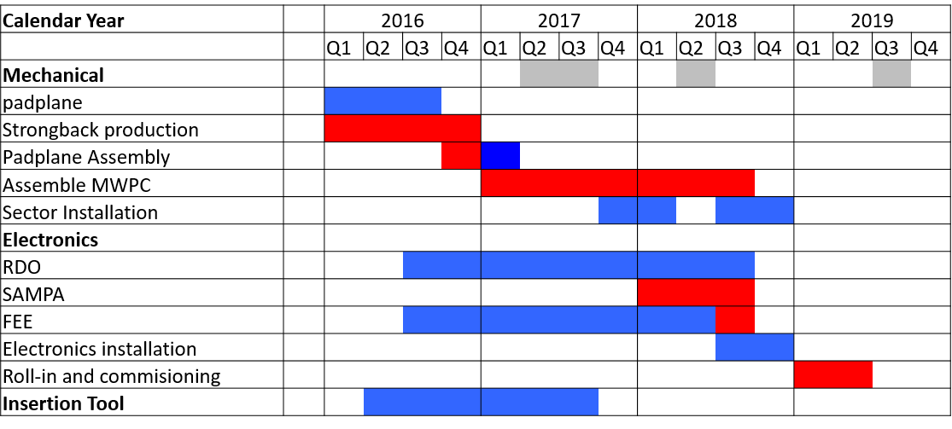
iTPC Schedule summary
Current schedule has STAR ready for data taking March 2019, with ~1.5 month of commissioning.
Single sector tested in run-18
Key goal of project is to have upgrade complete for Run-19.
Critical path goes through electronics path
  a) (SAMPA chip )
  b) sector production installation, and testing & commissioning

Slide 10
η=1.0
PseudoRapidity Considerations
η=0.96
η=1.09
Good tracks - Current
Note: There is and acceptance gap between bTOF and wTOF
L_{T}
eTOF lower eta limit
cm
Barrel TOF
η=0
210
190
η=1.5
Outer Sectors
32 pad rows
Outer Sectors
32 pad rows
Good tracks - iTPC
eTOF
η=1.62
eTOF upper eta limit
126
η=1.9
120
Inner Sectors
13 or 40 pads rows
Inner Sectors
13 or 40 pads rows
eTOF:
Z = -270 cm
R_{min} = 110 cm
R_{max} = 220 cm
60
Motivation is to mount eTOF modules at as large a Z and radius as possible ➔ limit is magnet iron
-270
-200

Slide 11
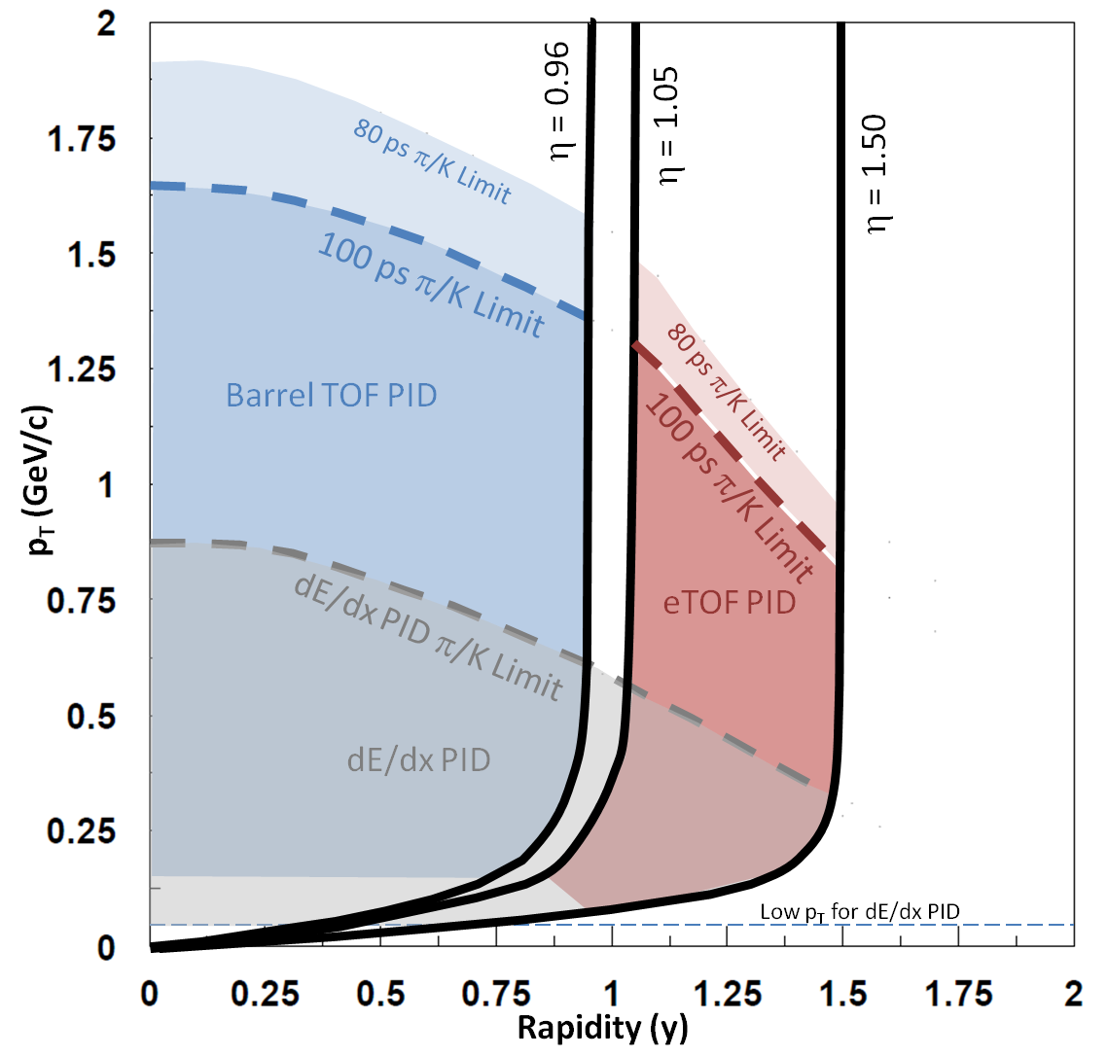
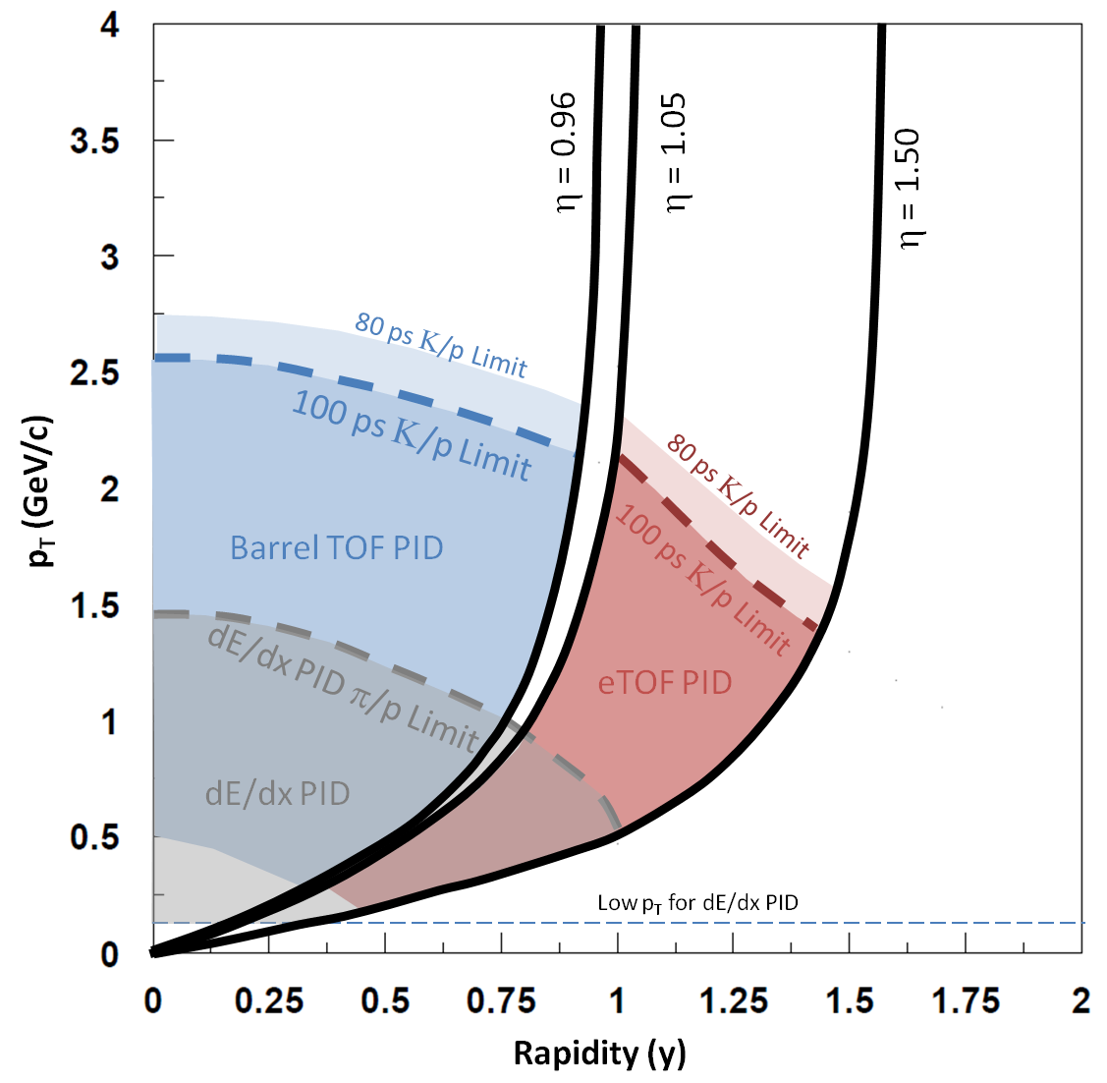
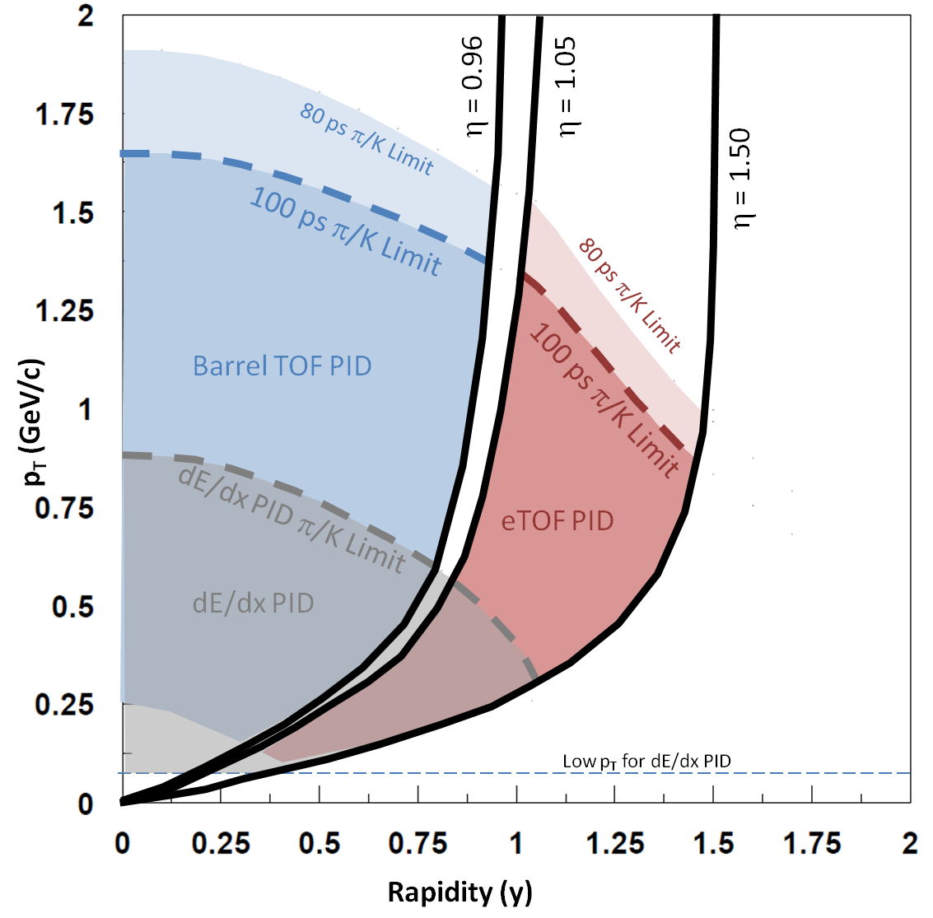
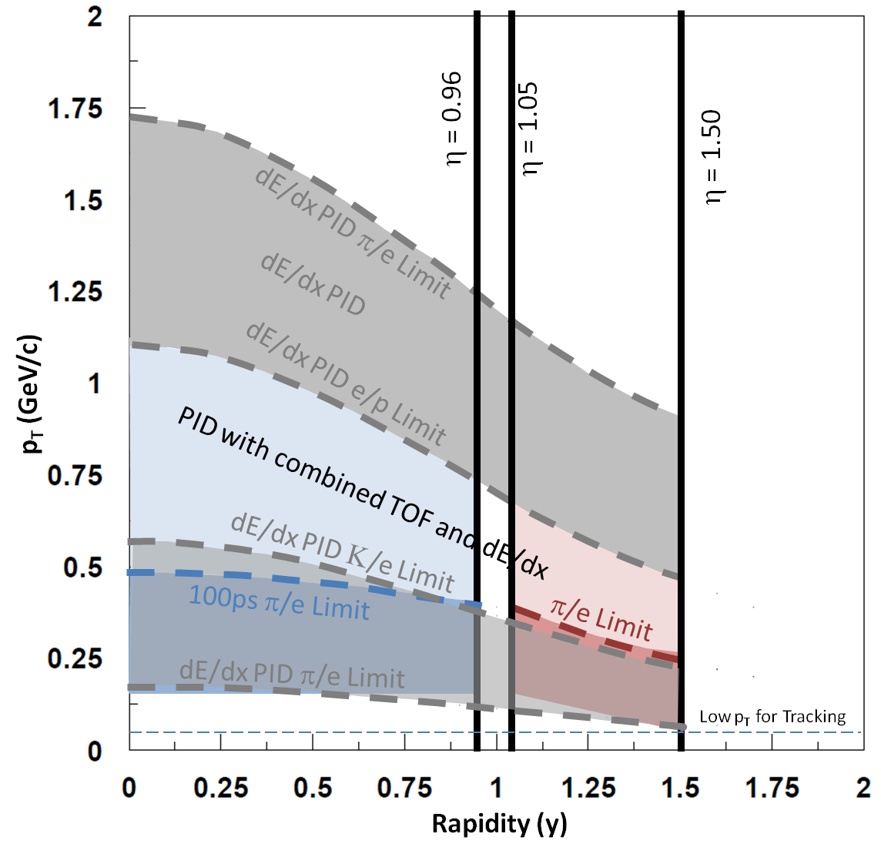
Acceptance Improvements
π
p
Extends rapidity coverage ➔ allows a change in μ_{B}
Improves yields of protons ➔ better kurtosis
Improves coverage for electrons ➔ better di-electron studies
K
e
Slide 9 of 27

Slide 12
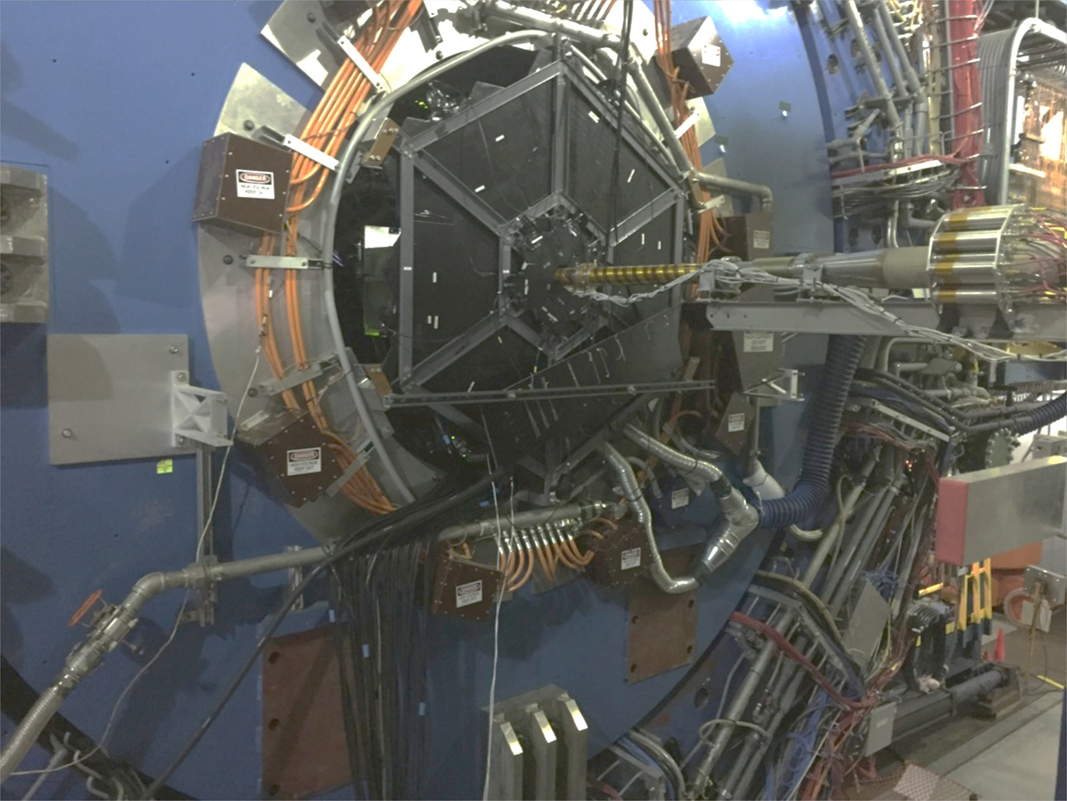
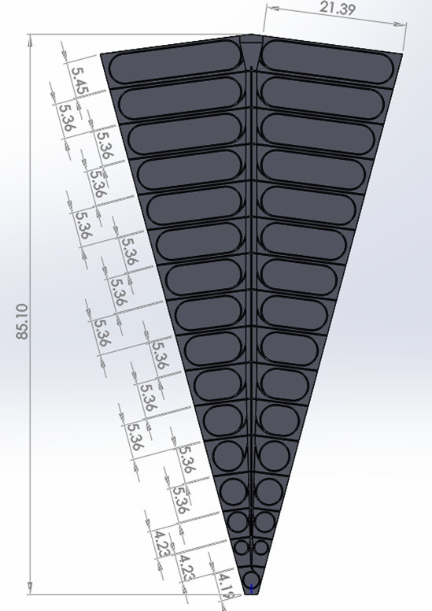
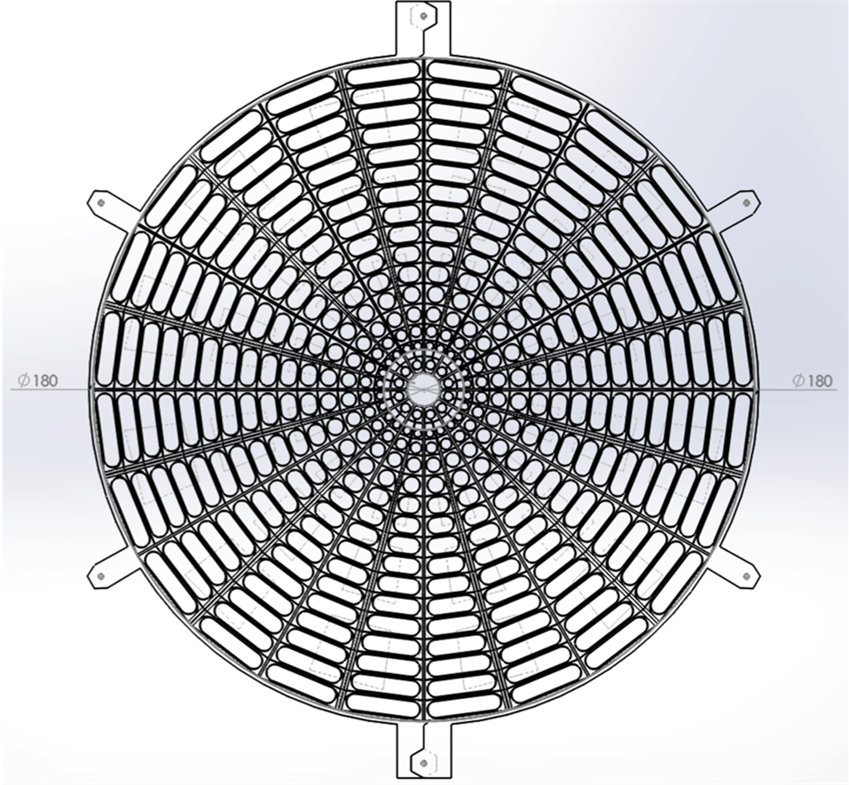
EPD Prototypes in FY 16 and 17 ➔ Full Detector in 2018

Slide 13
BES-II Analysis Priorities
R_{CP} of high p_{T} hadrons (up to 4.5 GeV), rapidity dependence
Elliptic Flow of the phi meson, rapidity dependence
Local Parity Violation studies (CME)
Directed flow as a function for impact parameter and rapidity
As HBT (proton-proton)
Net proton higher moments (κσ²)
Dileptons down to 7.7 GeV

Slide 14
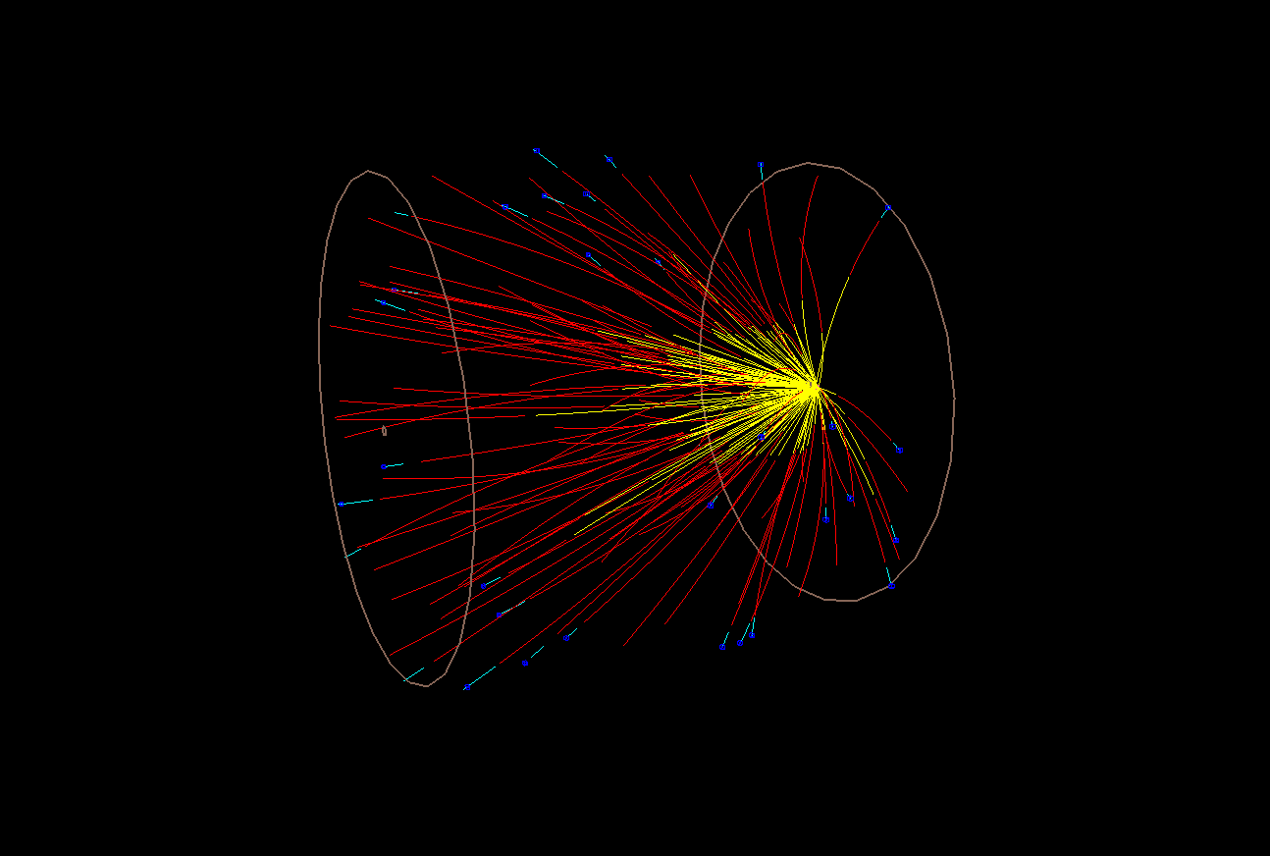
Fixed Targt Program
Slide 14 of 23

Slide 15
Slide 15

Slide 16
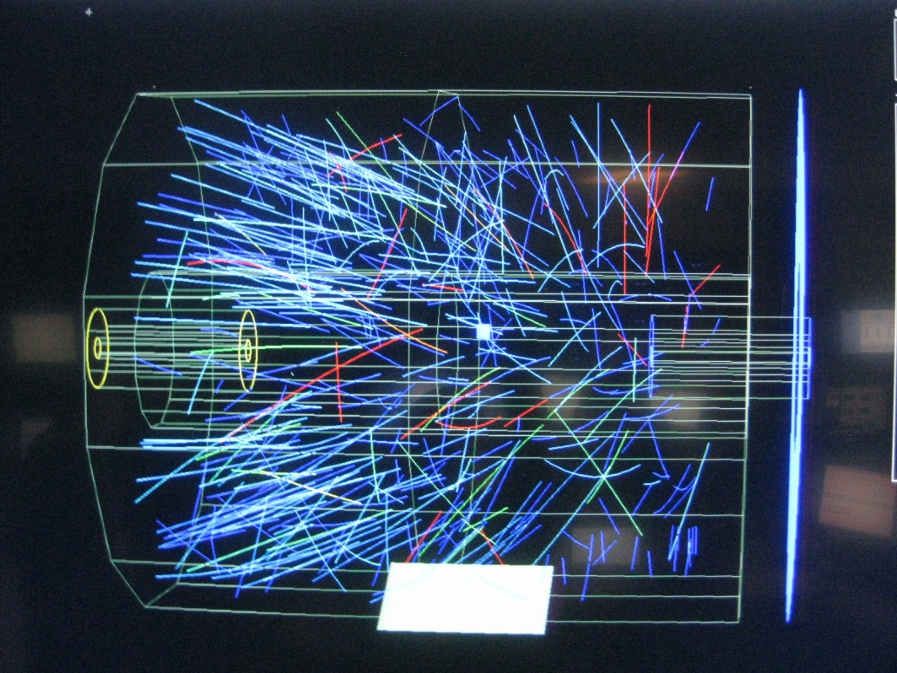
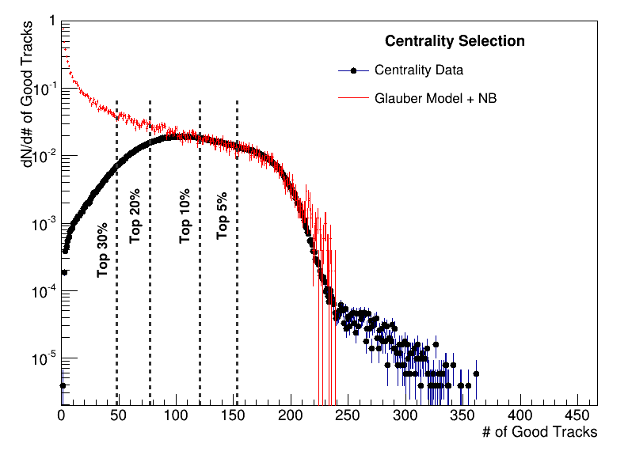
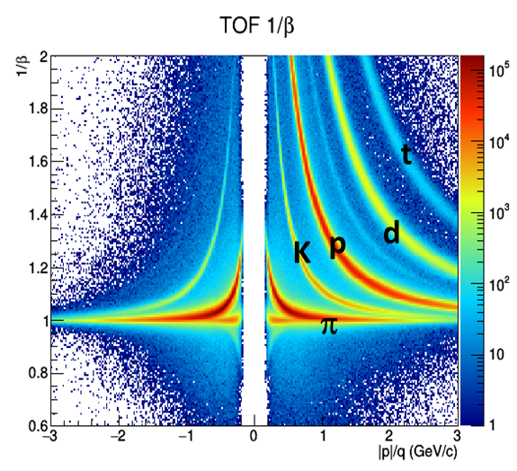
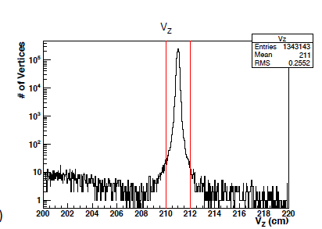
May 20th, 2015
Trigger was effective
Good Central Events
Saturated DAQ Bandwidth with 6 bunches.
99.5% triggers were Au+Au events
4.5 GeV Au+Au
1,300,000 events

Slide 20
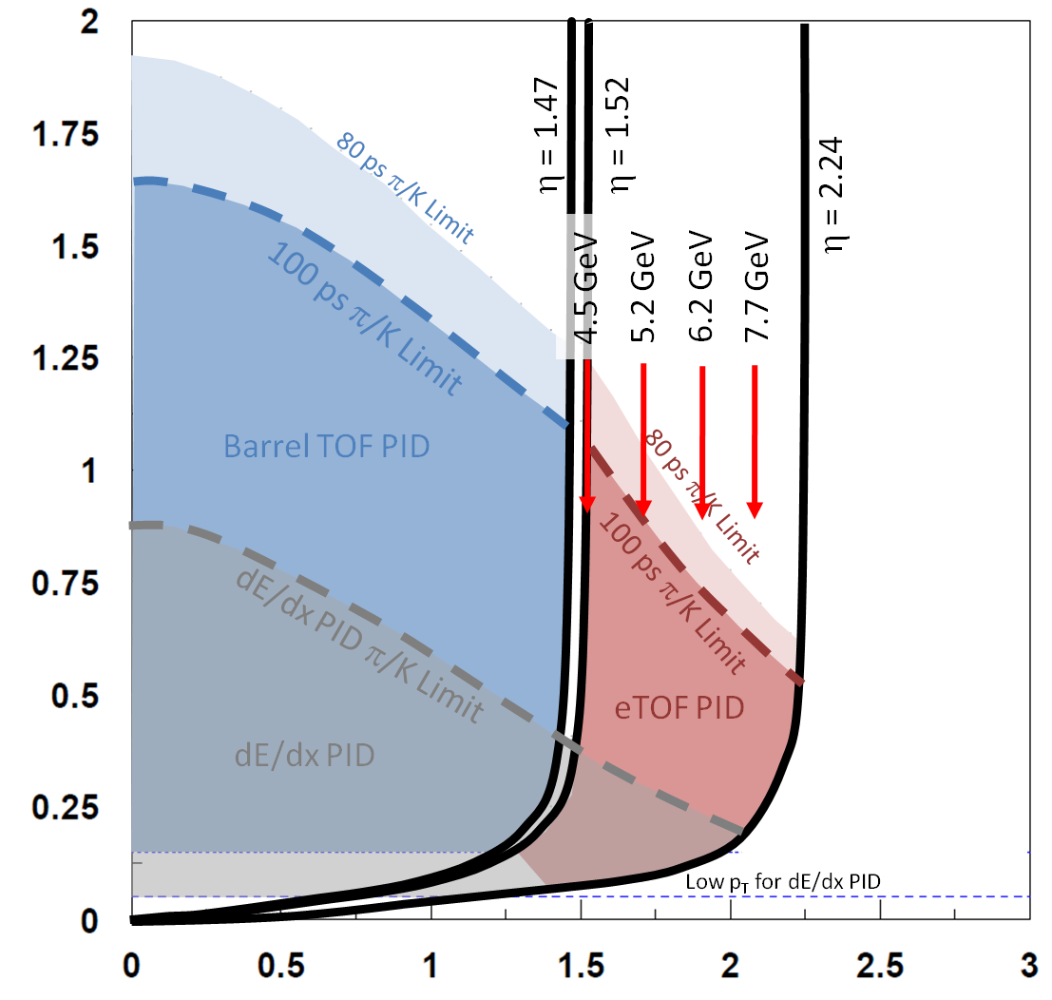
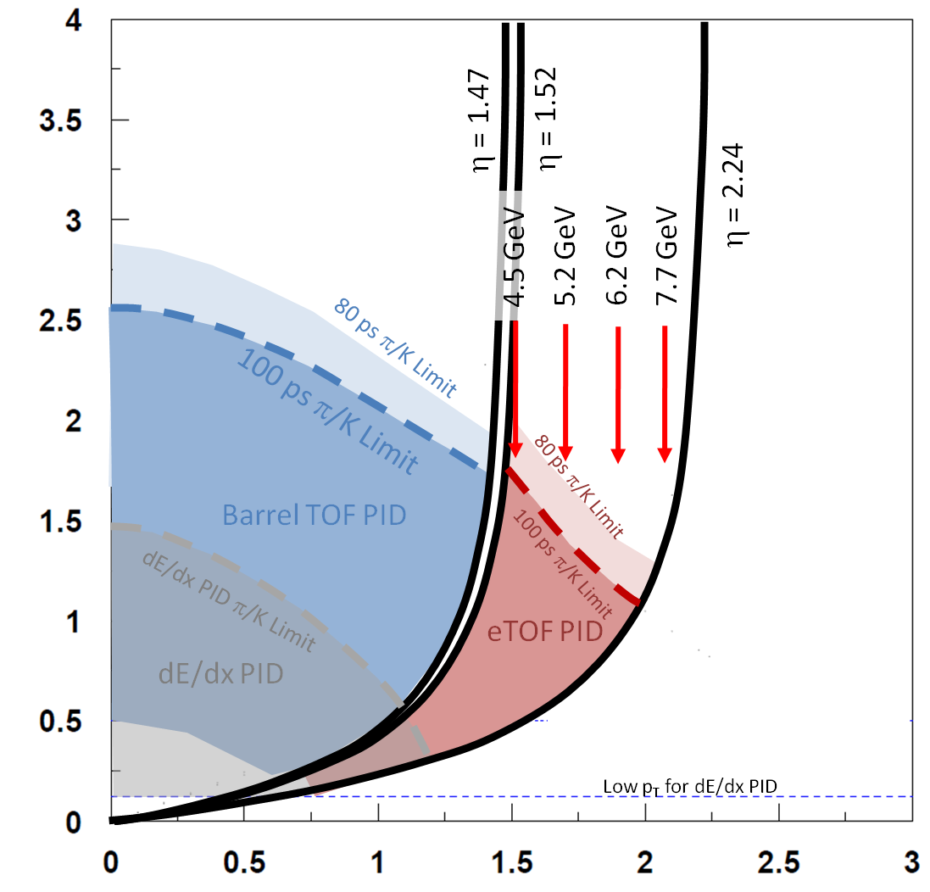
FXT Program
Collider Energy | Fixed-Target Energy | Single beam AGeV | Center-of-mass Rapidity | μ_{B} (MeV)
62.4 | 7.7 | 30.3 | 2.10 | 420
39 | 6.2 | 18.6 | 1.87 | 487
27 | 5.2 | 12.6 | 1.68 | 541
19.6 | 4.5 | 8.9 | 1.52 | 589
14.5 | 3.9 | 6.3 | 1.37 | 633
11.5 | 3.5 | 4.8 | 1.25 | 666
9.1 | 3.2 | 3.6 | 1.13 | 699
7.7 | 3.0 | 2.9 | 1.05 | 721
5.0 | 2.5 | 1.6 | 0.82 | 774
π
p
Data rate is DAQ limited
Would need 100 Million Events at each energy to make the sensitivity of BES-II
Roughly one to two days per energy

Slide 21
FXT Analysis Priorities
Excitation functions for multi-strange baryons
Excitation function and Flow of the phi meson
Local Parity Violation studies (CME)
Directed flow excitation function for (π, K, anti-p, Λ)
As HBT (2π) systematics
Net-p, net-K, net-Q higher moments (κσ²)
Study of the Hyper-triton lifetime

Slide 22
Timeline
2017
Beam use Request due May 15, defended June 15
eTOF, EPD prototypes
2018
EPD fully commissioned
iTPC prototype sector
27 GeV Au+Au Run
100 M events at 3.5 GeV FXT
2019
eTOF, iTPC fully commissioned
electron beam cooling commissioning
19.5 GeV (FXT 4.5)
14.5 GeV (FXT 3.9)
Dedicated FXT runs at 7.7, 6.2 and 5.2
2020
7.7 GeV (FXT 3.0)
9.1 GeV (FXT 3.2)
11.5 GeV (FXT 3.5)

Slide 23
Conclusions
Results from the first Beam Energy Scan at RHIC built the case and defined the best search range for BES-II
Key measurements need more data (v₂ of φ, dileptons)
Detector upgrades in progress will extend coverage ➔ physics reach (κσ²)
Fixed-target program will extend energy (μ_{B}) reach of BES program ➔ coverage of upgrade detectors needed

Slide 24
Extras

Slide 25
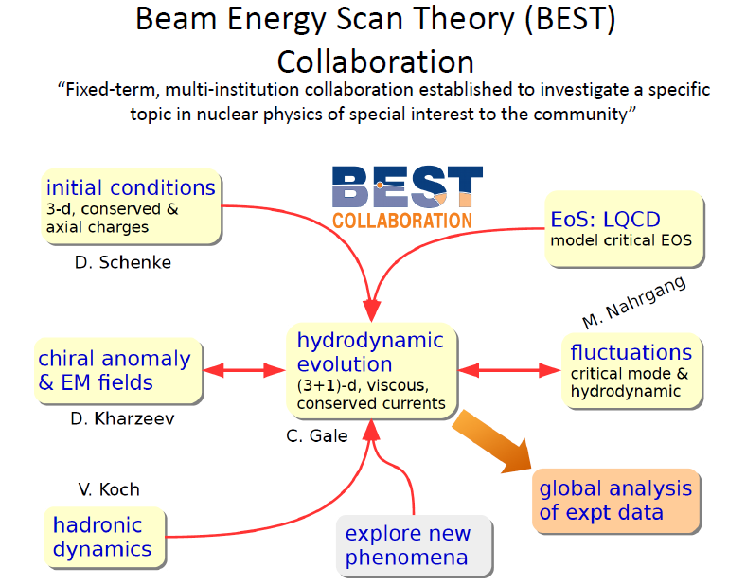

Slide 26

Beam Energy Scan I
(2010-2011, and 2014)

Slide 27
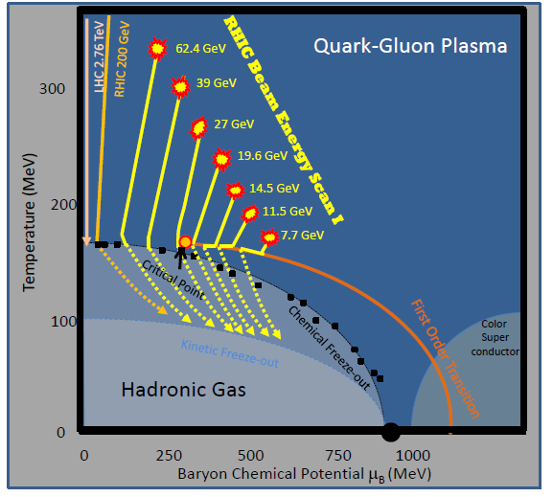
Exploring the Phase Diagram of QCD Matter
What was known prior to the RHIC Beam Energy Scan Program?
High Energy Heavy-ion Collisions ➔ partonic matter
Highest energies ➔ transition is a cross over
At increased μ_{B}, there might be a first-order phase transition
And if so, there should be a critical point
 | Energy (GeV) | Chemical Potential μ_{B} | Pred. Temp. (MeV)
LHC | 2760.0 | 2 | 166.0
RHIC | 200.0 | 24 | 165.9
RHIC | 130.0 | 36 | 165.8
RHIC | 62.4 | 73 | 165.3
RHIC | 39.0 | 112 | 164.2
RHIC | 27.0 | 156 | 162.6
RHIC | 19.6 | 206 | 160.0
SPS | 17.3 | 229 | 158.6
RHIC | 14.5 | 262 | 156.2
SPS | 12.4 | 299 | 153.1
RHIC | 11.5 | 316 | 151.6
SPS | 8.8 | 383 | 144.4
RHIC | 7.7 | 422 | 139.6
SPS | 7.7 | 422 | 139.6
SPS | 6.4 | 476 | 131.7
AGS | 4.7 | 573 | 114.6
AGS | 4.3 | 602 | 108.8
AGS | 3.8 | 638 | 100.6
AGS | 3.3 | 686 | 88.9
AGS | 2.7 | 752 | 70.4
SIS | 2.3 | 799 | 55.8
BES program searches for:
  Turn-off of QGP signatures
  First order phase transition
  Critical point
Cross-Over
2010: 62.4, 39, 11.5, 7.7
2011: 19.6, 27 GeV
2014: 14.5 GeV

Slide 28
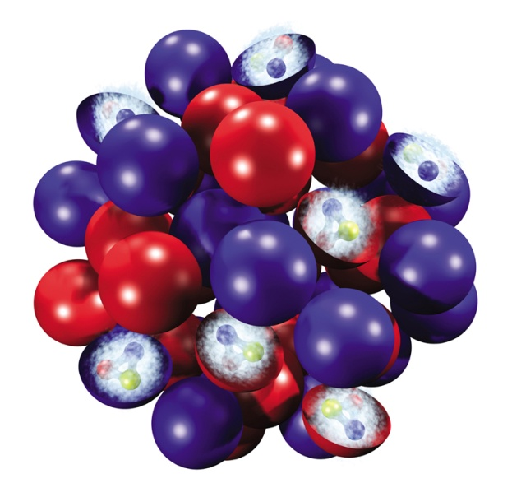
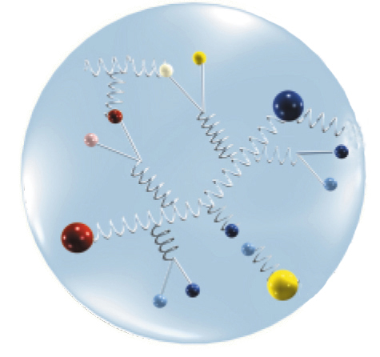
How Collision Energy Changes μ_{B}
deBroglie wavelength of constituent partons is effected by the beam energy.
Determines whether a parton images:
  The whole nucleus
  Individual nucleons
  Individual partons
At lower energy, nucleons are opaque, and the valence quarks are stopped in the fireball.
Excess quarks ➔ higher μ_{B}
At higher energy, nucleons are transparent, and the valence quarks are pass through and exit the fireball.
Equal quarks and anti-quarks ➔ lower μ_{B}

Slide 29
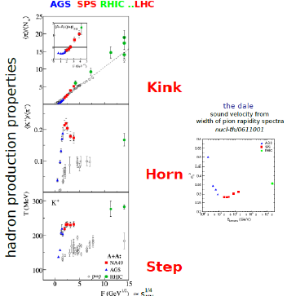
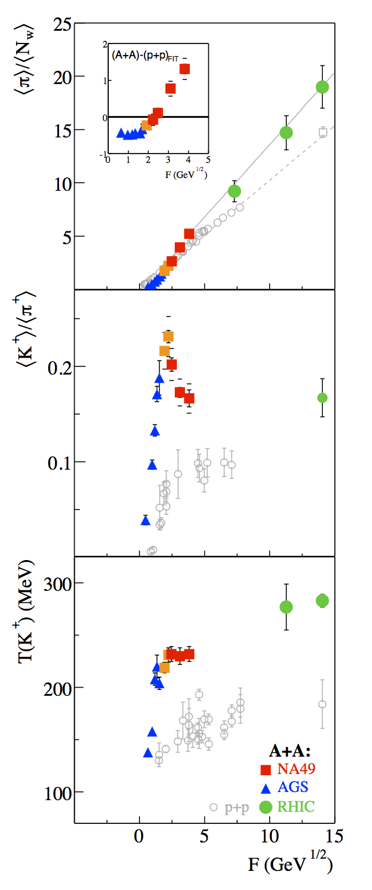

What Was Learned in the Earlier Scans?
Summary of AGS, SPS, and early RHIC Results
Inclusive observables ➔ onset of deconfinement at 7-8 GeV.
The observables suggest a change in the nature of the system.
More discriminating studies were needed to understand the nature of the phase transition and to search for critical behavior.
It is best to study regions above and below the possible onset energy.

Slide 30
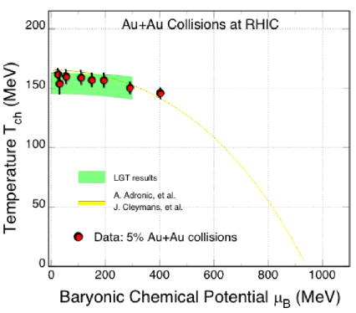

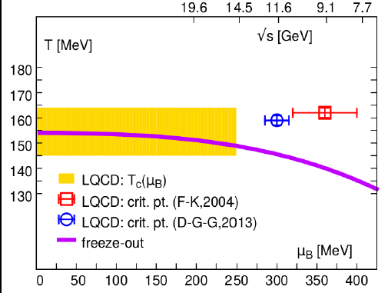

Setting the Scene
Using a statistical equilibrium model and the measured particle yields (π, K, p, Λ, Ξ, φ, Ω), one can estimate the location in the phase diagram.
BES-I: μ_{B} = 20 – 400 MeV
STAR Preliminary
BES-II White Paper
T_{c} = 154 (9)
S.Mukhergee
Some Lattice Gauge Theory predictions suggest that the low end of the BES-I scan one may find the critical point

Slide 31
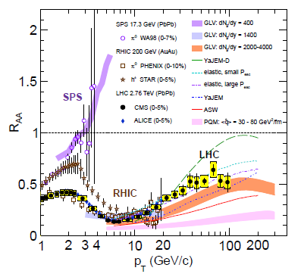
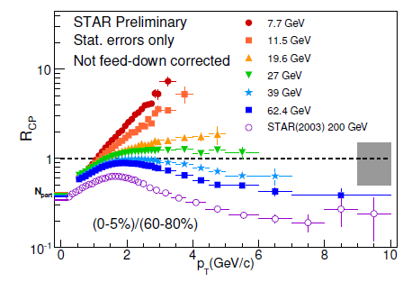
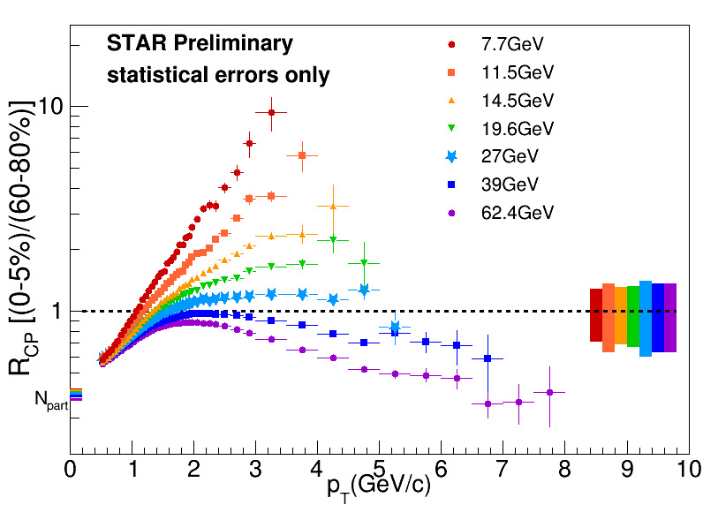
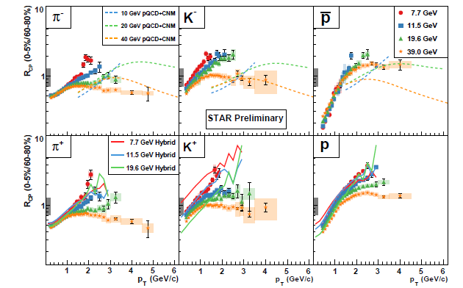
Disappearance of QGP Signatures - R_{CP}
R_{CP} for hadrons and for identified particles can provide a measure of partonic energy loss in the medium.
Not sufficient reach to search for evidence of high p_{T} suppression below 19.6 GeV
Stopped Baryons complicate inclusive R_{CP} measurements
pQCD calculations show high p_{T} suppression
Hybrid calculations describe the low p_{T} behavior
S. Horvat QM2015
pQCD calculations
E. Sangaline QM2012
Hybrid calculations
More p_{T} reach is needed
Slide 9 of 27

Slide 32
Chiral Phase Transition
R. Rapp, private communication,
R. Rapp Adv. Nucl. Phys. 25,1 (2000)
Low Mass Region:
Black lines are the Cocktail (excluding the ρ meson)
Grey lines are in medium calculations from R. Rapp which include both HG and QGP components (including medium broadened ρ meson). Model is able to match the data
Low Mass Region:
Emission depends on T, total baryon density, and lifetime
ρ φ
ρ φ
ρ φ
ρ φ
STAR BES II White Paper

Slide 33



Search for 1st Order Phase Transition – v₁
UrQMD p
Expansion
Compression
UrQMD Λ
PRL, 112 (2014) 162301
First order phase transition is characterized by unstable coexistence region. This spinodal region will have the softest Equation of State
v₁ is a manifestation of early pressure in the system
Anti-Λ

Slide 34



Search for the Critical Point – κσ²
STAR results show a fall and rise of the fluctuation variable
Negative
kurtosis
Positive
kurtosis
M. Stephanov
STAR preliminary
http://arxiv.org/abs/1503.02558v2
Negative
kurtosis

Slide 35
BES Phase I – What have We Learned
The BES at RHIC spans a range of μ_{B} that could contain features of the QCD phase diagram.
Signatures consistent with a parton dominated regime either disappear, lose significance, or lose sufficient reach at the low energy region of the scan.
Dilepton mass spectra show a broadening consistent with models including hadron gas and quark-gluon plasma components
There are indicators pointing towards a softening of the equation of state which can be interpreted as evidence for a first order phase transition.
The higher moment fluctuation is sensitive to critical phenomena, but these analyses place stringent demands on the statistics.
Open Questions

Slide 36

Beam Energy Scan II (2019-2020)
Select the most important energy range
➔ 5 to 20 GeV
Improve significance
Long runs, higher luminosity
Refine the signals
➔ Detector improvements

Slide 37

Reduction in Errors with Improved Statistics

Slide 38



Improvements due to Upgrades

Slide 39


Target Design 2014 and 2015
Target design:
Gold foil
1 mm Thick
~1 cm High
~4 cm Wide
210 cm from IR

Slide 40


Run 14 and 15 Setup

Slide 41
Internal Fixed Target
PseudoRapidity Considerations
eTOF:
Z = -270 cm
ΔZ = 480 cm
R_{min} = 110 cm
R_{max} = 220 cm
L_{T}
η=0
Small acceptance gap
cm
Barrel TOF
210
η=1.52
Outer Sectors
32 pad rows
Outer Sectors
32 pad rows
η=1.47
190
η=1.6
eTOF
eTOF lower eta limit
Good tracks - Current
126
120
Inner Sectors
13 or 40 pads rows
Inner Sectors
13 or 40 pads rows
η=2.24
Good tracks - iTPC
eTOF upper eta limit
η=2.6
60
EPD
Inner eTOF edge matches tracking limit
-270
-200
0
200
Target located at Z = +200 cm

Slide 42
What do the iTPC and eTOF do for Fixed Target?
Allows the program to reach 7.7 GeV!
π
p

Slide 43

Acceptance

Slide 44
Collision Energy (GeV) | Single Beam Energy | Fixed Target Root s | Single Beam Rapidity | Center of Mass Rapidity | Chemical Potential μ_{B} | Events (Millions)
200 | 100 | 13.713 | 5.369 | 2.685 | 0.276 | NA
130 | 65 | 11.083 | 4.938 | 2.469 | 0.325 | NA
62.4 | 31.2 | 7.737 | 4.204 | 2.102 | 0.420 | 100
39 | 19.5 | 6.170 | 3.734 | 1.867 | 0.487 | 100
27 | 13.5 | 5.185 | 3.366 | 1.683 | 0.541 | 100
19.6 | 9.8 | 4.468 | 3.042 | 1.521 | 0.589 | 100
14.5 | 7.25 | 3.904 | 2.741 | 1.370 | 0.633 | 100
11.5 | 5.75 | 3.528 | 2.507 | 1.253 | 0.666 | 100
9.1 | 4.55 | 3.196 | 2.269 | 1.134 | 0.699 | 100
7.7 | 3.85 | 2.985 | 2.097 | 1.049 | 0.721 | 100
5.0 | 2.50 | 2.320 | 1.644 | 0.822 | 0.774 | 100

Slide 45
Run 14 and 15 Setup

Slide 46
Comparison of Facilities
Facilty
Exp.:
Start:
Energy:
Rate:
Physics:
RHIC BESII
STAR
+FXT
2019-20
2018
7.7– 19.6
2.5-7.7
100 HZ
2000 Hz
CP&OD
SPS
NA61
2009
4.9-17.3
100 HZ
CP&OD
NICA
MPD
+ BM@N
2020
2017
2.7 - 11
2.0-3.5
<10 kHz
OD&DHM
SIS-100
SIS-300
CBM
2022
2.7-8.2
<10 MHZ
OD&DHM
J-PARC HI
JHITS
2025
2.0-6.2
100 MHZ
OD&DHM
√s_{NN} (GeV)
At 8 GeV
Collider
Fixed Target
Collider
Fixed Target
Fixed Target
Fixed Target
Fixed Target
Lighter ion
collisions
CP = Critical Point
OD = Onset of Deconfinement
DHM = Dense Hadronic Matter

Slide 47
BES Phase II Proposal
BES Phase II is planned for two 24 cryo-week runs in 2019 and 2020
√S_{NN} (GeV) | 7.7 | 9.1 | 11.5 | 14.5 | 19.6
μ_{B} (MeV) | 420 | 370 | 315 | 250 | 205
BES I (MEvts) | 4.3 | --- | 11.7 | 24 | 36
Rate(MEvts/day) | 0.25 |  | 1.7 | 2.4 | 4.5
BES I L (1×10²⁵/cm²sec) | 0.13 |  | 1.5 | 2.1 | 4.0
BES II (MEvts) | 100 | 160 | 230 | 300 | 400
Improvement (X) | 4 | 4 | 4 | 3 | 3
Beam Time (weeks) | 12 | 9.5 | 5.0 | 5.5 | 4.5
Revised estimates

Slide 48

Yields of Hadrons ➔ Mapping the Phase Boundary
Acceptance of π, K, p is good to midrapidity at all FXT energies. Acceptance for weak decay parents should be good as well.
Measurements can be extrapolated to 4π
Will be able to extend the low energy limits of measurements of most strange hadrons
4π strange hadron yields are needed for chemical equilibrium models to determine T and μ_{B}

Slide 49

Hypernuclei
Perfect energy range to map out the production of ³_{Λ}H and ⁴_{Λ}H
Previously only measured at two energies
Dynamic range will exclude searches for doubly strange hypernuclei

Slide 55


