Slide 1
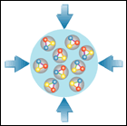
CBM Timeline
Walter F.J. Müller, FAIR, Darmstadt
CBM-STAR joint Workshop
18 March 2017

Slide 2











FAIR – Conceptual View
SIS100/300
p-Linac
SIS18
Compressed Baryonic Matter
Anti-Proton Physics
HESR
Super Fragment-Separator:
Nuclear Structure and Astrophysics
Primary Beams
10¹²/s; 1.5 GeV/u; ²³⁸U²⁸⁺
10¹⁰/s ²³⁸U⁹²⁺ up to 11 (35) GeV/u
3x10¹³/s 30 (90) GeV protons
Secondary Beams
FAIR phase 1
FAIR phase 2
radioactive beams up to 1.5 - 2 GeV/u;
10¹¹ antiprotons 1.5 - 15 GeV/c
CR
2

Slide 3
GSI/FAIR Project Re-Organization
GSI and FAIR were two separate organizations
starting 2014 joint managing directors were appointed
  Nov 2014: Ursula Weyrich (Administrative)
  Feb 2016: Jörg Blaurock (Technical)
  Jan 2017: Paolo Guibellino (Scientific)
in 2016 GSI/FAIR were re-organized
GSI/FAIR is today one single organization.
They are still two separate legal entities, but this is mostly relevant for lawyers and accountants, but otherwise not relevant anymore.
The legal merger will come.

Slide 4
GSI/FAIR Project Re-Organization
The new joint GSI/FAIR organization, for a first time, provides proper communication paths between
- civil construction
- accelerator
- experiments
Some initial phases of civil construction were done
- construction area cleared
- foundation pillars build
but stalled afterwards
Civil construction is now back on track
  new construction manager: Uwe Kreische
  persons involved in CC are concentrated in one ‘task force’

Slide 5
FAIR – Many Engineer Years Later

Slide 6
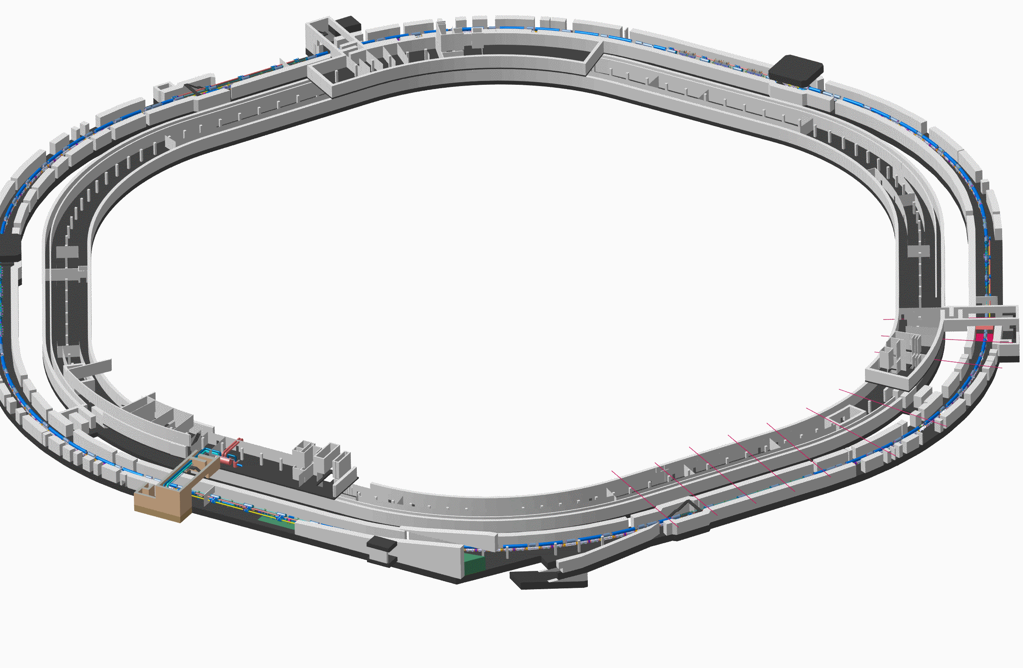
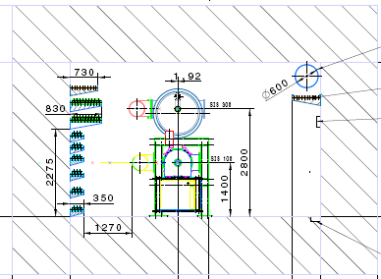
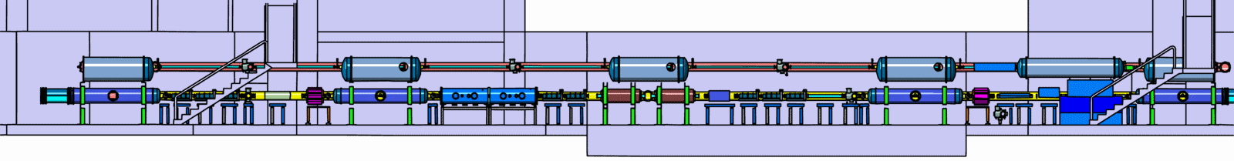
Tunnel for SIS100 and (later) SIS300(+)

Slide 7
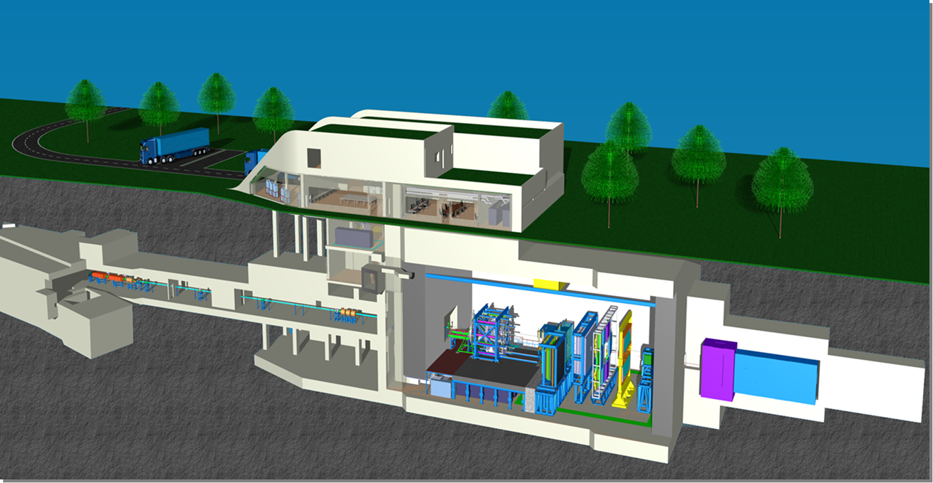
G014 – Home for CBM and HADES

Slide 8
Status Civil Construction
New tendering concept was accepted by BMBF
a funding pre-release of 203 M€ for CC approved by BMBF on September 13th 2016
1st CC lot went for tender on September 26th 2016
(water management and excavation)
2nd CC lot went for tender in November 22nd 2016
(shell construction ‘north area’, includes SIS100 and CBM)
start of excavation: mid-2017
start of shell construction: late 2017 / early 2018
The ball is rolling !! No project slippage anymore !!

Slide 9
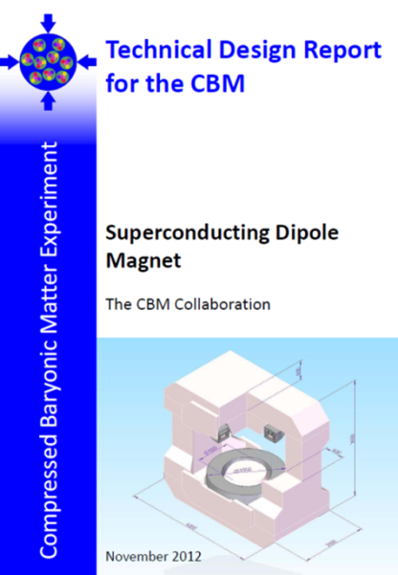
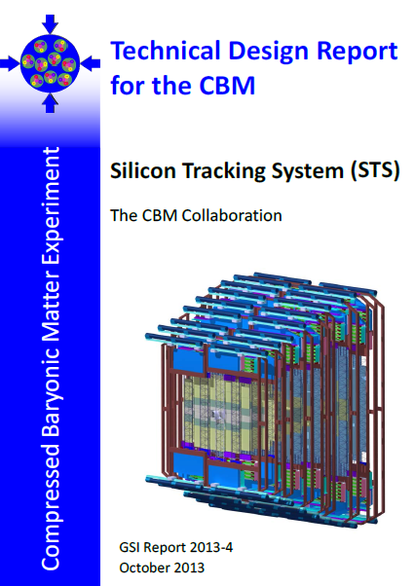
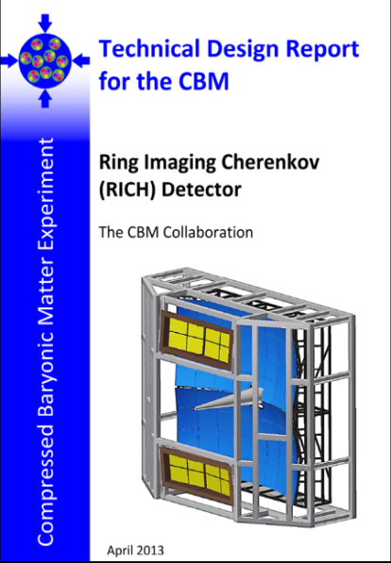
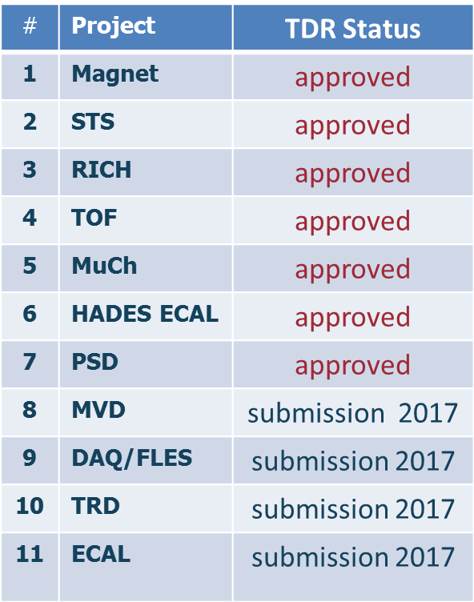
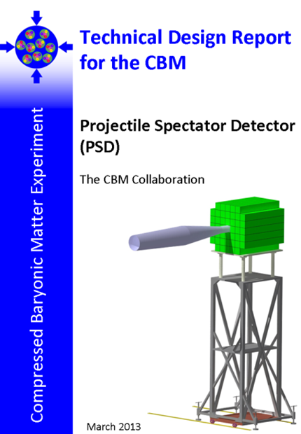
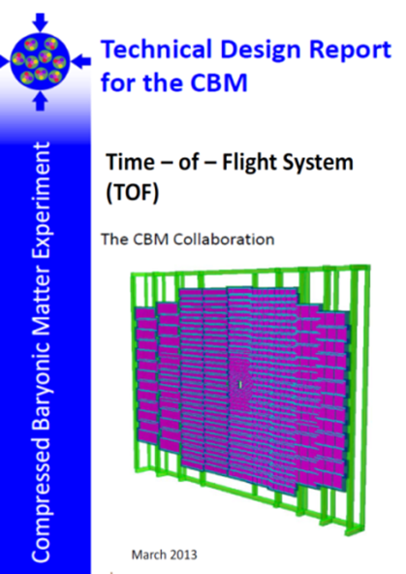
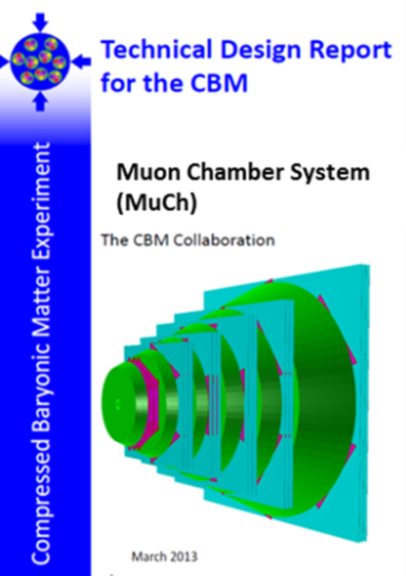
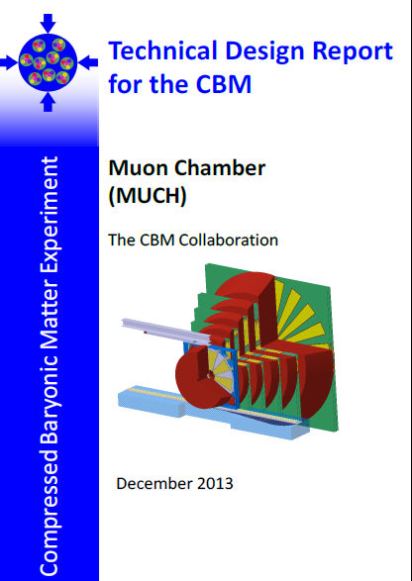
CBM Technical Design Report Status

Slide 10
FAIR Baseline Schedule
Major consolidation of all planning done in 2016
Goal of the management was
  to create a conservative planning (“done not later than ”)
  to have, for a first time, an integrated planning
    civil construction
    accelerator
    experiments
  covering construction, installation and commissioning phases
  for GSI campus based activities also resource loaded
  which serves as baseline
  to substantiate the earlier statements
    buildings finished 2022
    FAIR operational 2025

Slide 11
Planning Structure: CBM part
Management overview
Level2_CBM
Installation and
commissioning w/o beam
→ CBM ready for beam
CBM_installation
Detector construction
→ ready for installation
FAIR CC
PdR
STS_construction
TOF_construction
Contracting and procurement
Contract 1a
Contract 2a
Contract 1b
Contract 2b

Slide 12
Planning Structure: Full Picture
Level1_FAIR
shown to
council
material for
council
....
Level2
SIS100
Level2
HESR
Level2
CBM
lots of planning
for each
sub-project
CBM_installation
FAIR CC
PdR
STS_construction
TOF_construction
Contract 1a
Contract 2a
Contract 1b
Contract 2b

Slide 13
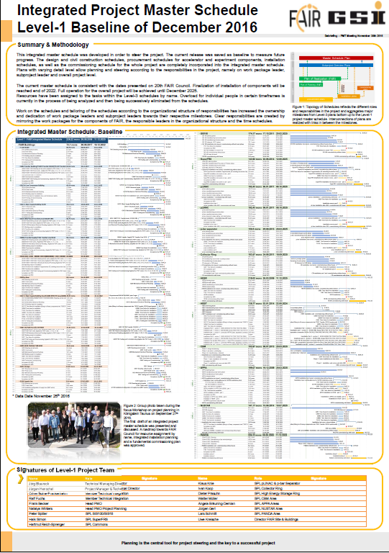
FAIR Schedule
Major effort
Presented to
FAIR council on
December 6th, 2016
Very positive reception

Slide 14
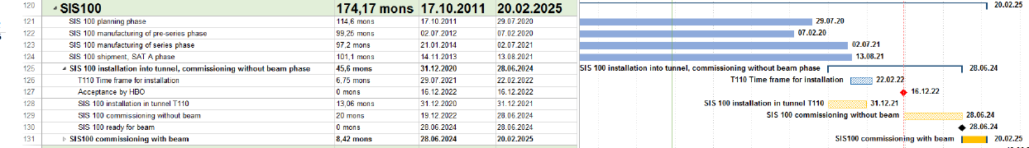
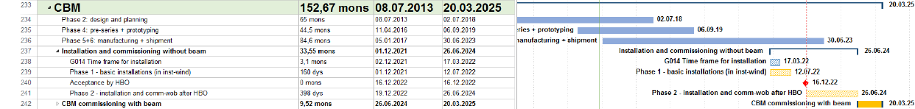
FAIR Schedule: SIS100 and CBM
The CBM bottom line:
  Dec 2021 to Jul 2022 1st installation window
  Dec 2022 Building acceptance
  Dec 2022 to Jun 2024 Installation & commissioning w/o beam
  Jun 2024 to Mar 2025 Commissioning beam from SIS100

Slide 15
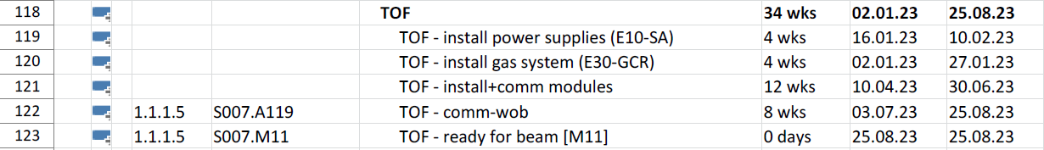
CBM Schedule: TOF Installation
The CBM bottom line (reminder):
  Dec 2022 to Jun 2024 Installation & commissioning w/o beam
  Jun 2024 to Mar 2025 Commissioning beam from SIS100
The CBM TOF bottom line:
  Apr 2023 to Jul 2023 Installation
There should be no schedule conflict with STAR-BES-II

Slide 16
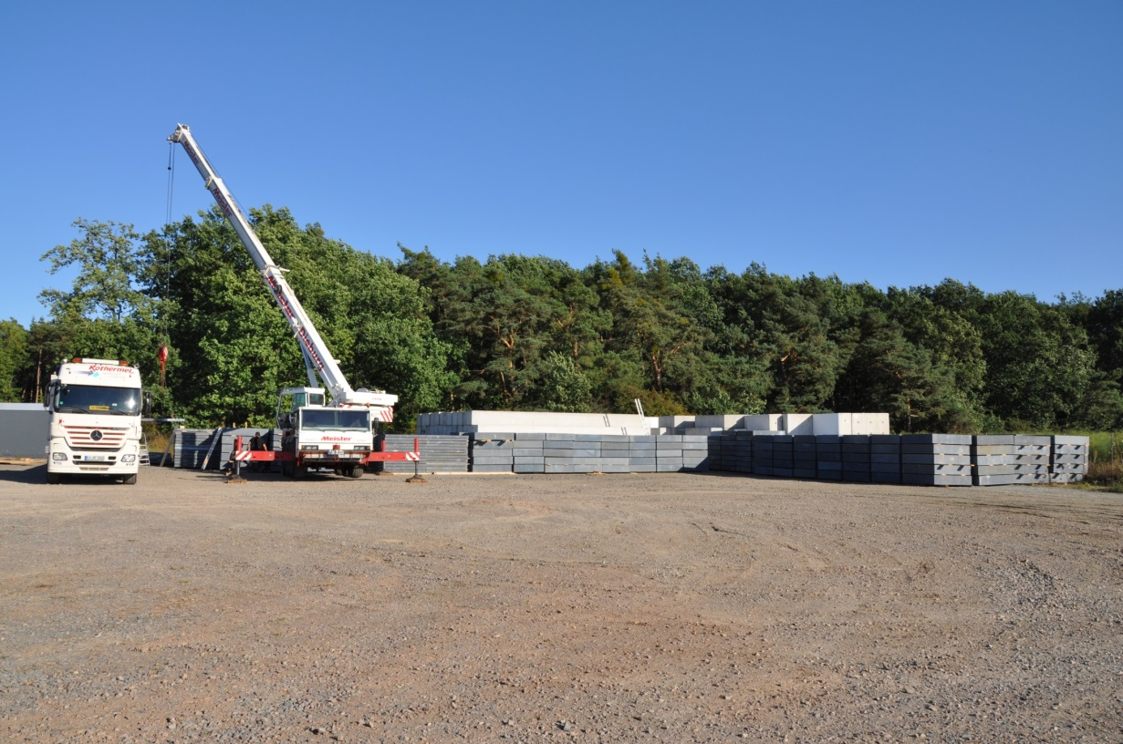
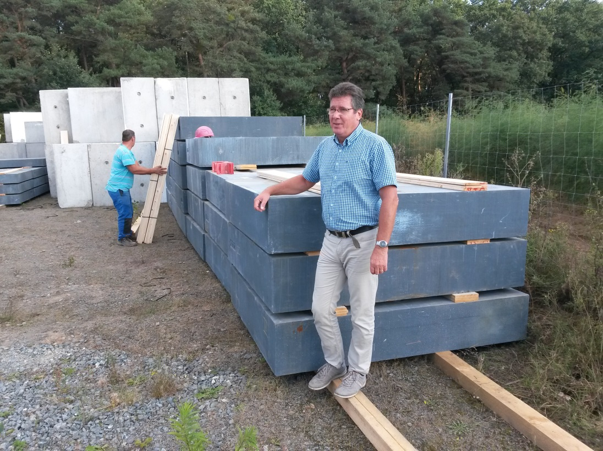
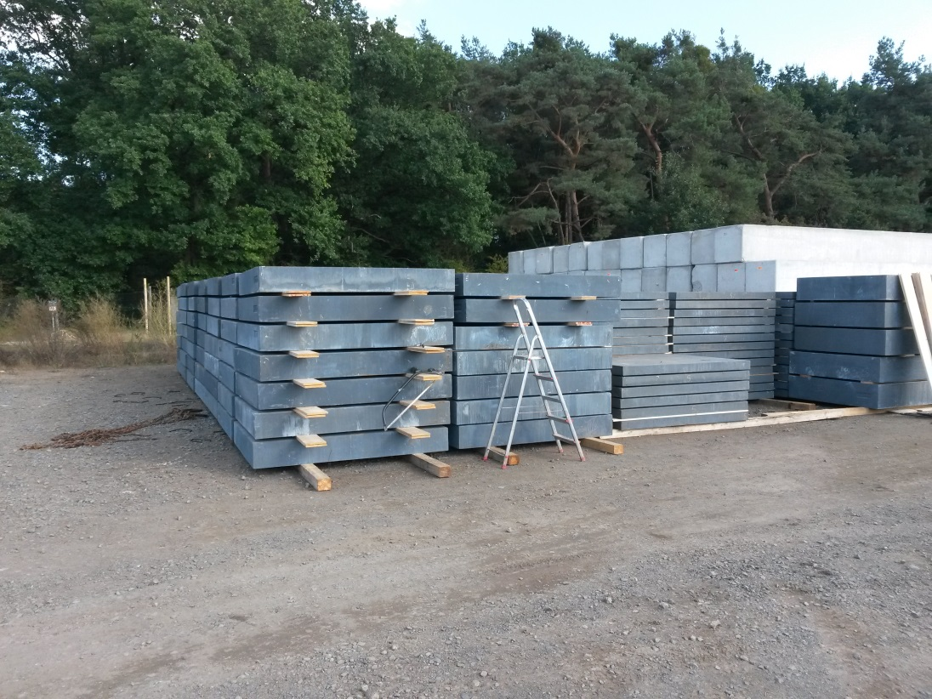
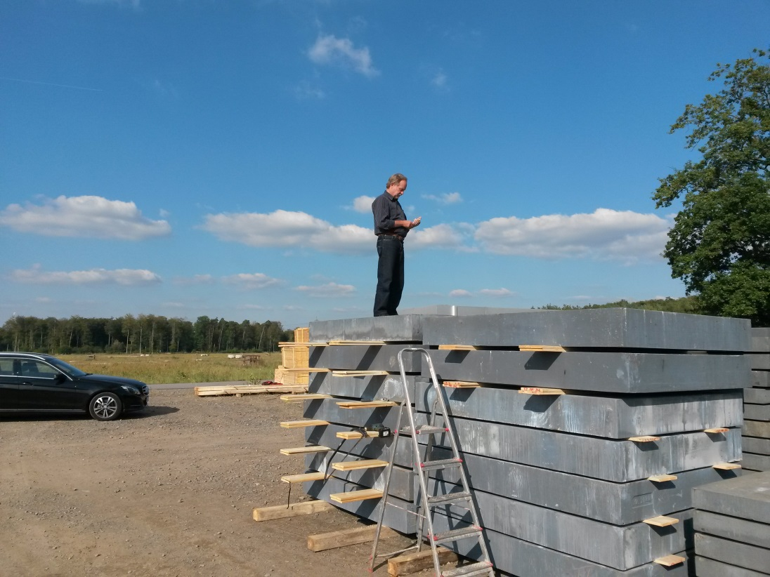
Little Heavy Detail: Beam Dump Iron

Slide 17



The End
Thanks for
your attention

Slide 18
Backup
Slides

