Slide 1
Day-1 Physics: Baryon Spectroscopy
Dec 5, 2016 | Albrecht Gillitzer
LIX PANDA Collaboration Meeting, GSI Darmstadt, 5-9 Dec 2016

Slide 2
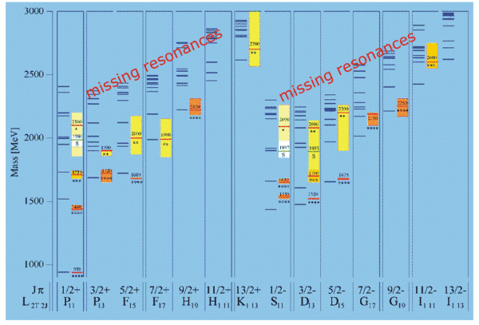
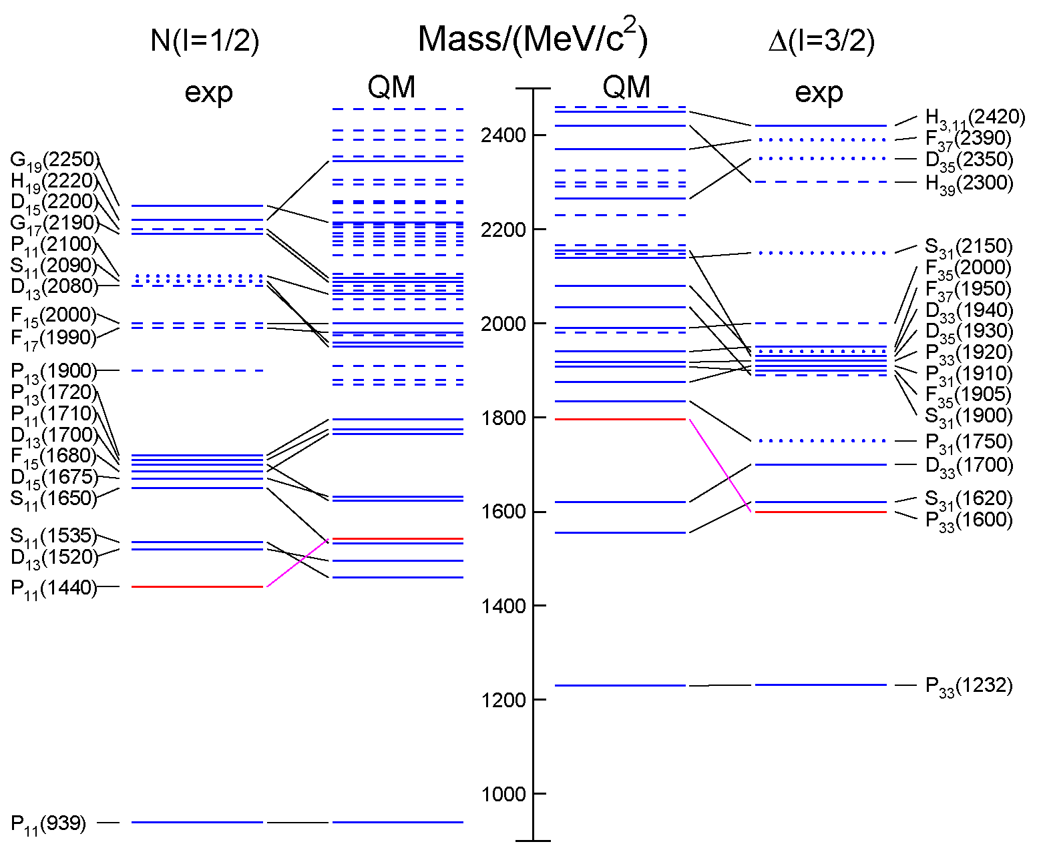
Open Questions
Missing resonances
Wrong masses, wrong sequence
Relevant degrees of freedom?
3-quark?
quark-diquark?
meson-baryon dynamics
from RPP 2014 / QM: S. Capstick, W. Roberts

Slide 3
Strange Partners
Approximate SU(3) flavor symmetry
N* & Δ states have partners in the strange sector
focus on Ξ and Ω
Ξ: as many states as N* & Δ together ⁽¹⁾
Ω: as many states as Δ
scrutinize our understanding of the baryon excitation pattern
⁽¹⁾ in case of SU(3) symmetry !

Slide 4
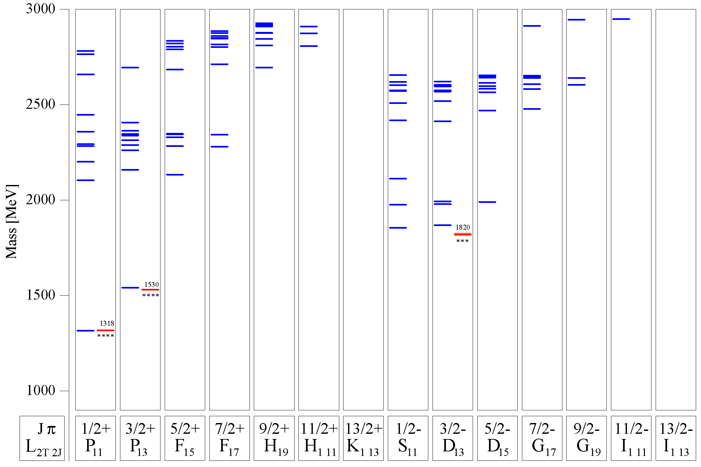
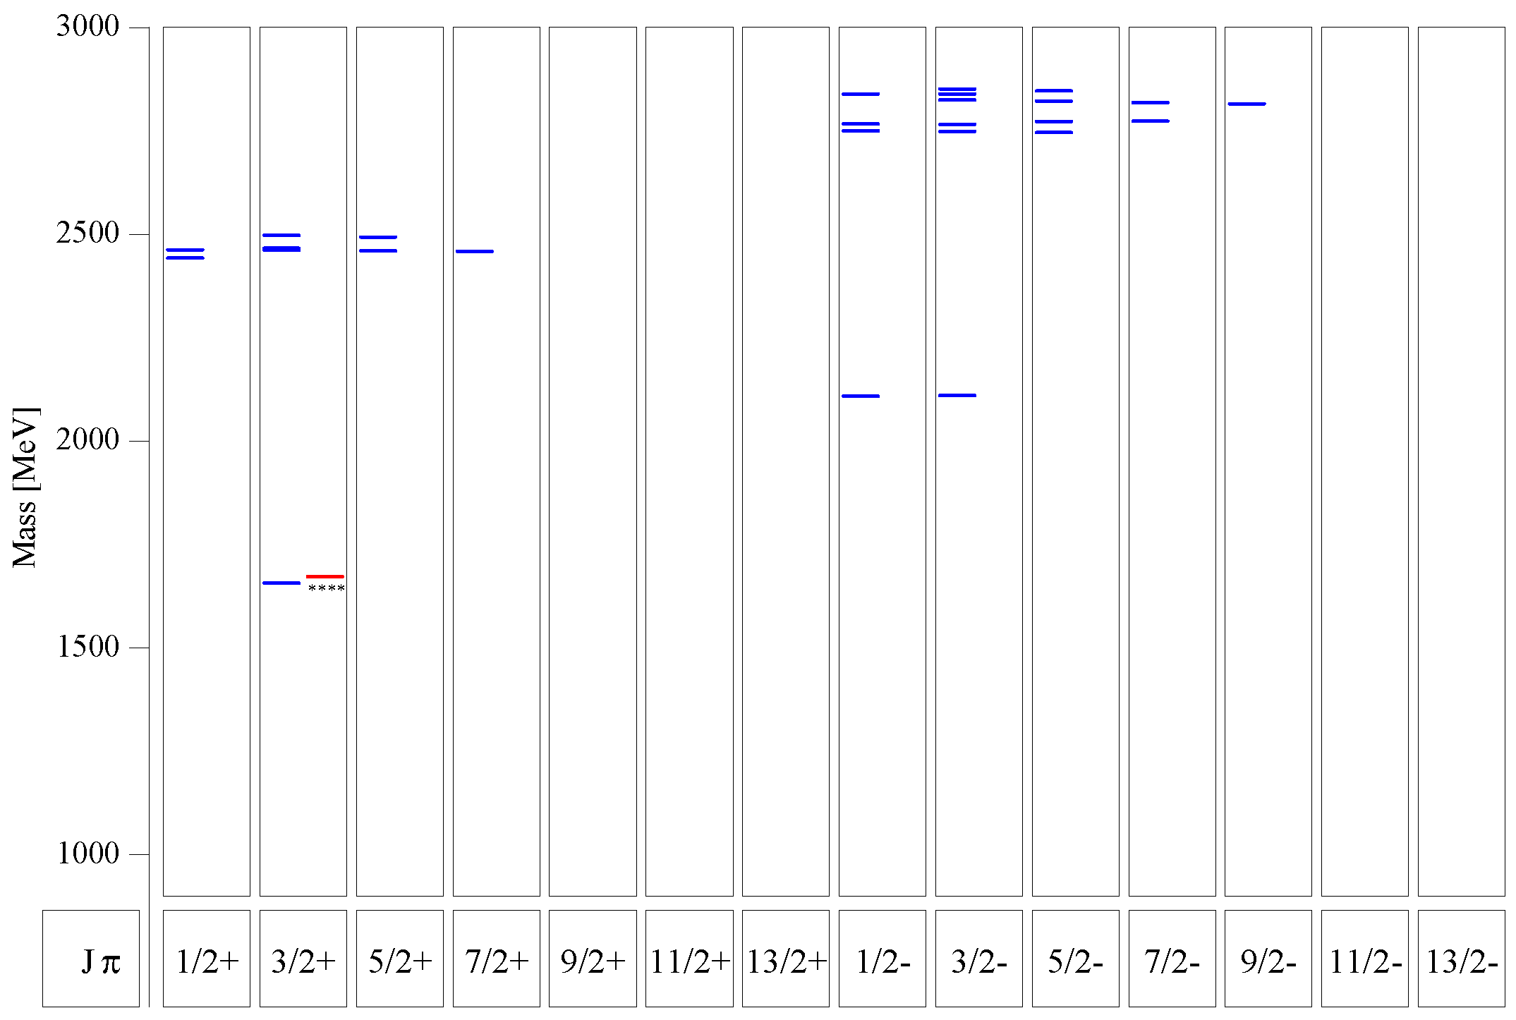
Quark Model for Ξ & Ω
Ξ:
many states predicted below 3 GeV
compare 1/2⁺ and 1/2⁻ excitation
Ω:
several states predicted between 2 GeV and 3 GeV
compare 3/2⁺ and 3/2⁻ excitation
Ξ
U. Löring et al., EPJA 10 (2001) 447
Ω
s.a.: M. Pervin, W. Roberts, PRC 77 (2008) 025202

Slide 5
Most Promising: Study Ξ Resonances
very little known ←→ rather high cross section
find missing resonances
determine branching to various decay modes:
$Ξπ, Ξπ^{+}π^{−}, Ξπ^{0}π^{0}, ΛK^{−}, Σ\overline{K}, Ξη, Ξηπ, Ξη^{′}, Ξω, Ξφ, …$
determine J^{P} quantum numbers if possible
recent progress:
PAWIAN now includes baryons
strategy:
select $\overline{p}$ momentum to produce a specific resonance close to threshold

Slide 6
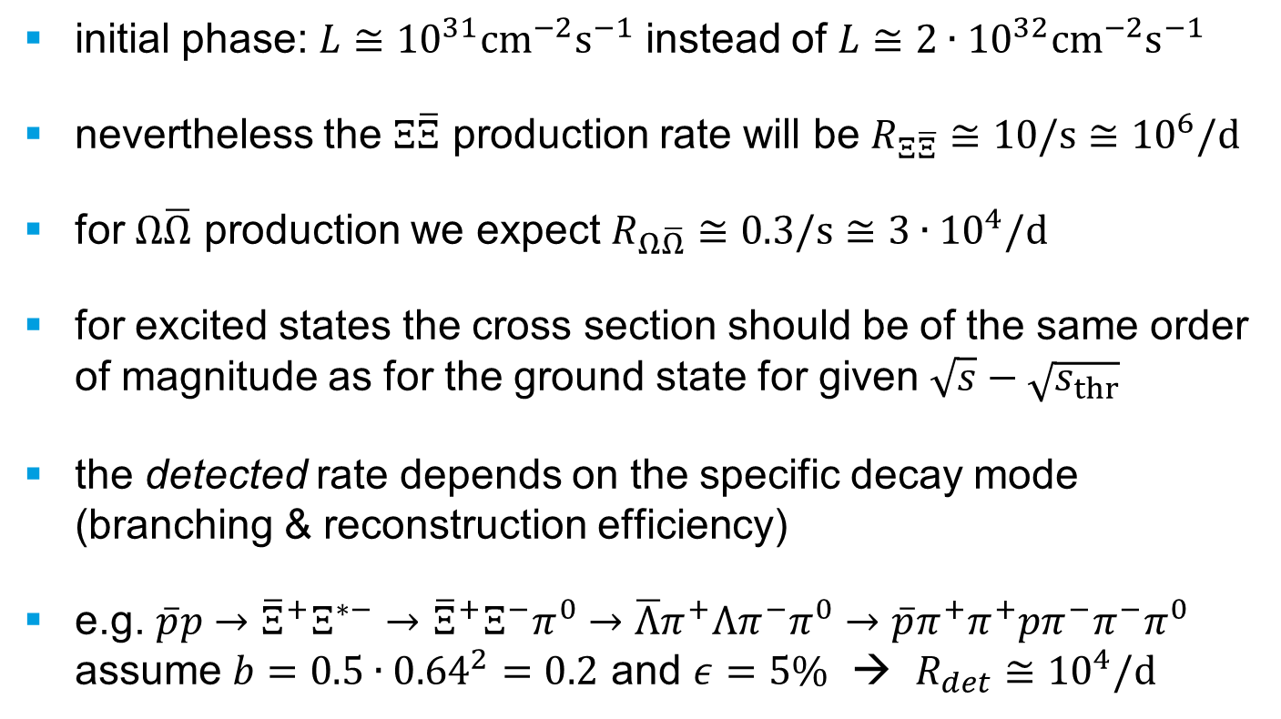
Early Physics: Expected Rates for Strange Baryons
initial phase: $L≅{10}^{31}{cm}^{−2}s^{−1}$ instead of $L≅{2∙10}^{32}{cm}^{−2}s^{−1}$
nevertheless the $Ξ\overline{Ξ}$ production rate will be $R_{Ξ\overline{Ξ}}≅10/s≅{10}^{6}/d$
for $Ω\overline{Ω}$ production we expect $R_{Ω\overline{Ω}}≅0.3/s≅{3∙10}^{4}/d$
for excited states the cross section should be of the same order of magnitude as for the ground state for given $\sqrt{s}−\sqrt{s_{thr}}$
the detected rate depends on the specific decay mode (branching & reconstruction efficiency)
e.g. $\overline{p}p→{\overline{Ξ}}^{+}Ξ^{∗−}→$ ${\overline{Ξ}}^{+}Ξ^{−}π^{0}→\overline{Λ}π^{+}Λπ^{−}π^{0}→\overline{p}π^{+}π^{+}pπ^{−}π^{−}π^{0}$ assume $b=0.5∙{0.64}^{2}=0.2$ and $ε=5\%$ → $R_{det}≅$ ${10}^{4}/d$

Slide 7
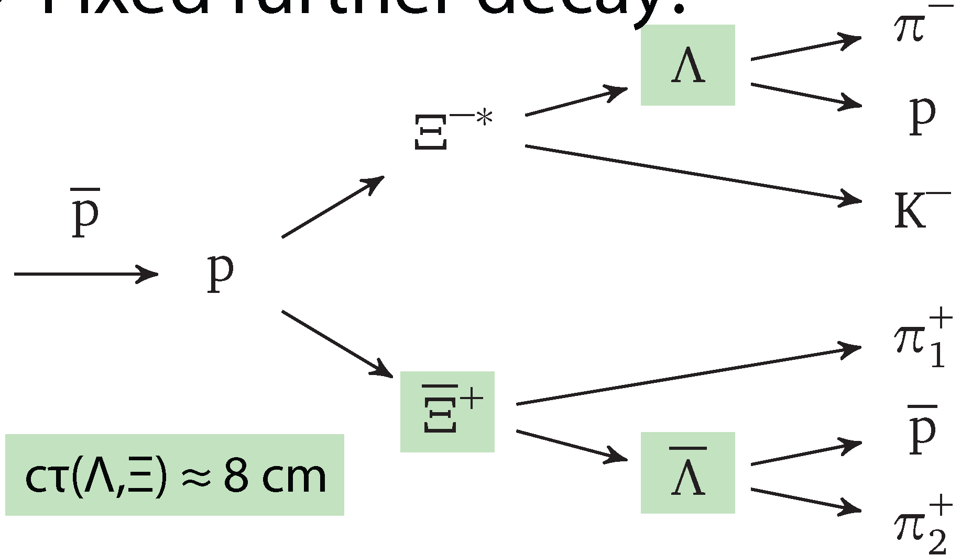
Recent Simulation & Analysis
new MC simulations & analyses:
André Zambanini, completed, PhD thesis U Bochum 2015
4.1 GeV/c pp → Ξ(1690)⁻Ξ⁺ → K⁻ΛΞ⁺
~0.5⋅10⁶ signal events, ~50⋅10⁶ DPM background events
Jennifer Pütz, PhD thesis fully devoted to Ξ spectroscopy
4.6 GeV/c pp → Ξ(1820)⁻Ξ⁺ → K⁻ΛΞ⁺ & c.c.
1.5⋅10⁶ signal events, 15⋅10⁶ DPM background events so far
_
_
_
_
_
_
reco eff. 2.2 %

Slide 8
„Bottlenecks“: General Issues
GEM needed
FTS needed (maybe not complete but planes 1,2,5,6)
Realistic tracking for displaced tracks
Realistic tracking in the Forward Spectrometer
Manpower for simulation & analysis !

Slide 9
„Bottlenecks“: Day-1 physics simulation
One single PhD student available for ~3 months (Jenny Pütz)
Clarify all parameters for the simulation:
pandaroot release?
detector configuration? (here: GEM + FTS 1,2,5,6)
tracking for delayed particles? (ideal)
tracking in FS? (ideal)
PID? (ideal / realistic)
signal reaction & statistics 4.6 GeV/c $\overline{p}p→{\overline{Ξ}}^{+}ΛK^{−} \& cc$ with $Ξ\left(1690\right), Ξ\left(1820\right), ΛK$ cont.
DPM background statistics

