Slide 1
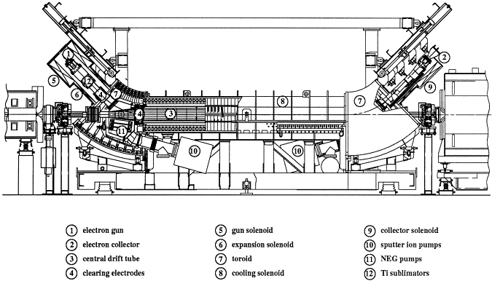
Electron Lenses for Space Charge Compensation in the SIS18 (and COSY)
William D. Stem
Oliver Boine-Frankenheim
Notes:
12/2/16
| Fachbereich 18 | Institut Theorie Elektromagnetischer Felder | Prof. Dr.-Ing. Thomas Weiland
| <number>

Slide 2
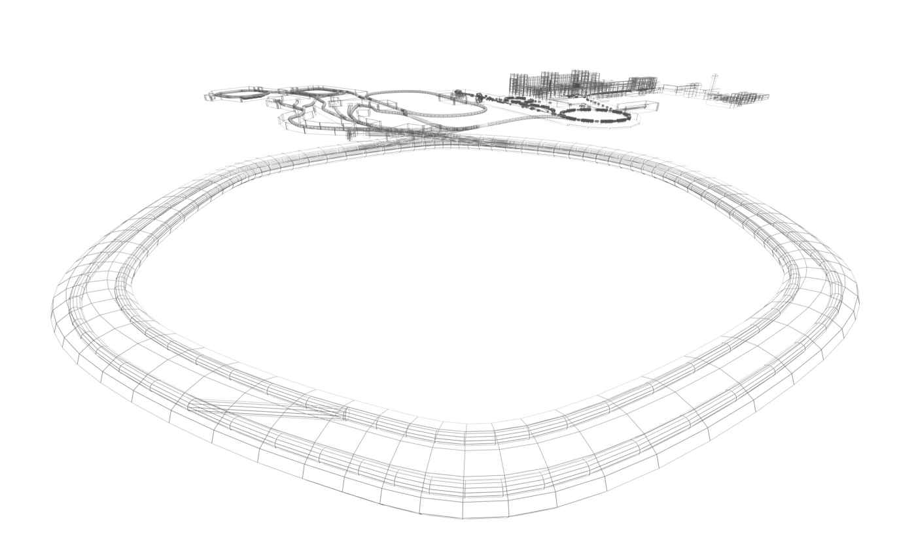
High-Intensity at FAIR
Facility for Antiproton and Ion Research
Incoherent Tune Shift
FAIR intensities imply high tune shifts
SIS100
Notes:
12/2/16
| Fachbereich 18 | Institut Theorie Elektromagnetischer Felder | Prof. Dr.-Ing. Thomas Weiland
| <number>

Slide 3
Electron Lenses
E lens tune shift (co-propagating):
e⁻ gun
Interaction Region
For SC Compensation:
e⁻ collector
Avoid cooling regime
Match transverse profiles
Center ion beam in lens or suffer closed orbit distortion
Match longitudinal bunch profiles (pulsed electron beam)
Notes:
12/2/16
| Fachbereich 18 | Institut Theorie Elektromagnetischer Felder | Prof. Dr.-Ing. Thomas Weiland
| <number>

Slide 4
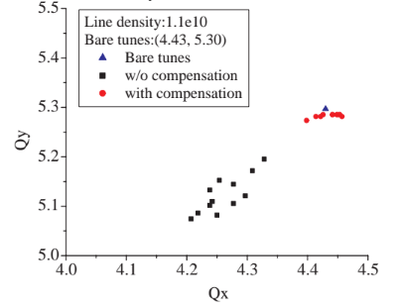
Electron Lenses
E lens tune shift (co-propagating):
e⁻ gun
Items we are addressing:
What is the percentage of tune shift each lens compensator can produce?
Focusing error instabilities and required number of compensators
Effect on both the incoherent (single particle) and coherent (envelope) stop bands
Ionization and capture cross sections/ beam lifetimes
Pulsed electrons for bunch compensation (future)
Interaction Region
e⁻ collector
Notes:
12/2/16
| Fachbereich 18 | Institut Theorie Elektromagnetischer Felder | Prof. Dr.-Ing. Thomas Weiland
| <number>

Slide 5
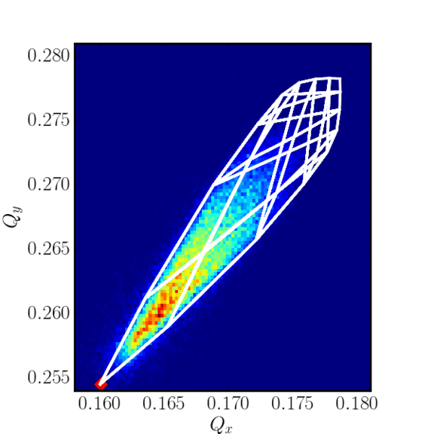
Electron Lenses
SIS18 pyORBIT simulation
E lens tune shift (co-propagating):
e⁻ gun
Items we are addressing:
What is the percentage of tune shift each lens compensator can produce?
Focusing error instabilities and required number of compensators
Effect on both the incoherent (single particle) and coherent (envelope) stop bands
Ionization and capture cross sections/ beam lifetimes
Pulsed electrons for bunch compensation (future)
Interaction Region
e⁻ collector
Notes:
12/2/16
| Fachbereich 18 | Institut Theorie Elektromagnetischer Felder | Prof. Dr.-Ing. Thomas Weiland
| <number>

Slide 6
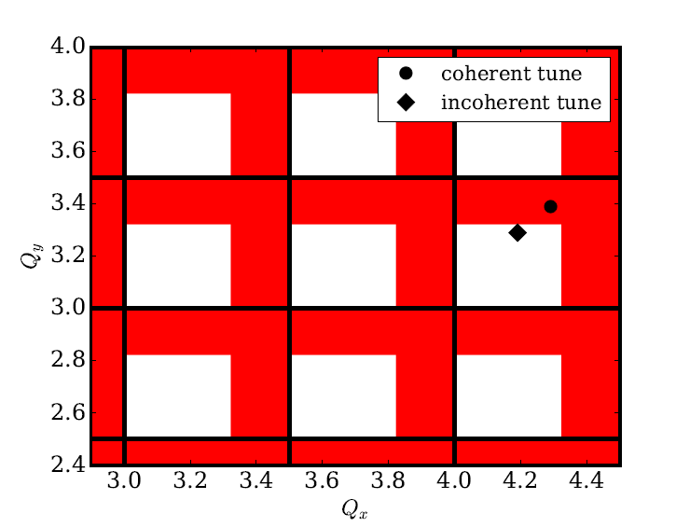
Some Electron Lens Challenges
SIS18, U²⁸⁺
Half integer resonances and shifting coherent stopbands
Incoherent single particle closed orbit instabilities set compensation limit for each electron lens (see tune plot)
Possible Solution:
McMillan Lens
Notes:
12/2/16
| Fachbereich 18 | Institut Theorie Elektromagnetischer Felder | Prof. Dr.-Ing. Thomas Weiland
| <number>

Slide 7
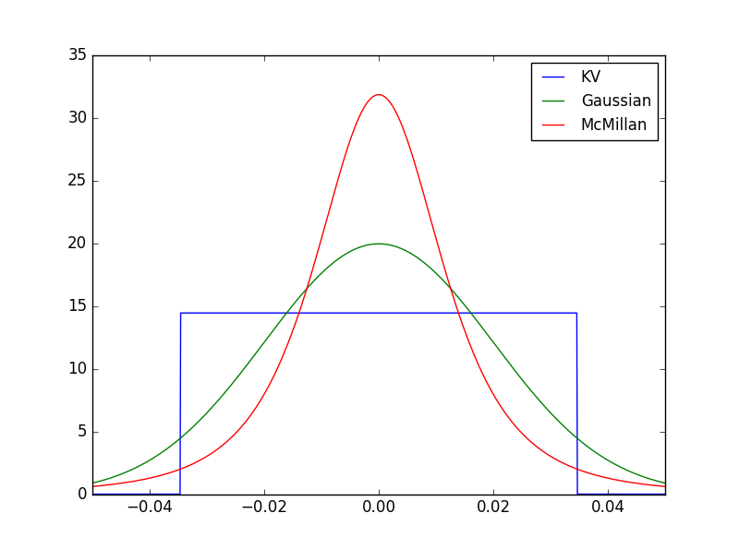
McMillan Lens
Giulio Stancari, HB 2016
Notes:
12/2/16
| Fachbereich 18 | Institut Theorie Elektromagnetischer Felder | Prof. Dr.-Ing. Thomas Weiland
| <number>

Slide 8
Benchmarking Experiments in the SIS-18
What are the simplest experiments we can perform with the most impactful results?
Goals:
Measure coherent tune shift as a function of electron density
Measure the effect of the beam offset on the closed orbit
Measure beta beat onset as a function of electron density in the cooler
Notes:
12/2/16
| Fachbereich 18 | Institut Theorie Elektromagnetischer Felder | Prof. Dr.-Ing. Thomas Weiland
| <number>
Future: Cry-ring testing

Slide 9
Benchmarking Experiments
Electron Cooler Parameters
 | 6.6 keV
 | 0.16
 | 2,3
 | 8.0,15.0 m
 | 3.4 m
 | 0-0.6 A
 | 6.6 keV
 | 0.16
 | 2,3
 | 8.0,15.0 m
 | 3.4 m
 | 0-0.6 A
June 27, 2016
July 2, 2016
Xe⁴³⁺
C³⁺
 | 6.78 MeV/u
 | 0.12
 | 15.5 mm-mrad
 | 20.1 mm-mrad
 | 4.32,3.25
 | 6.75 MeV/u
 | 0.12
 | 36.1 mm-mrad
 | 40.2 mm-mrad
 | 4.32,3.25
 | 6.78 MeV/u
 | 0.12
 | 15.5 mm-mrad
 | 20.1 mm-mrad
 | 4.32,3.25
 | 6.75 MeV/u
 | 0.12
 | 36.1 mm-mrad
 | 40.2 mm-mrad
 | 4.32,3.25
Notes:
12/2/16
| Fachbereich 18 | Institut Theorie Elektromagnetischer Felder | Prof. Dr.-Ing. Thomas Weiland
| <number>
Future: Cry-ring testing

Slide 10
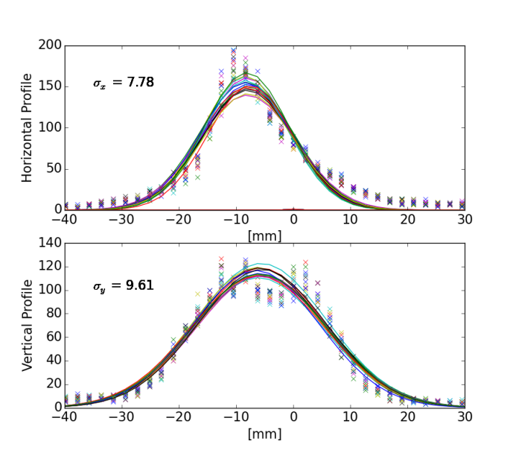
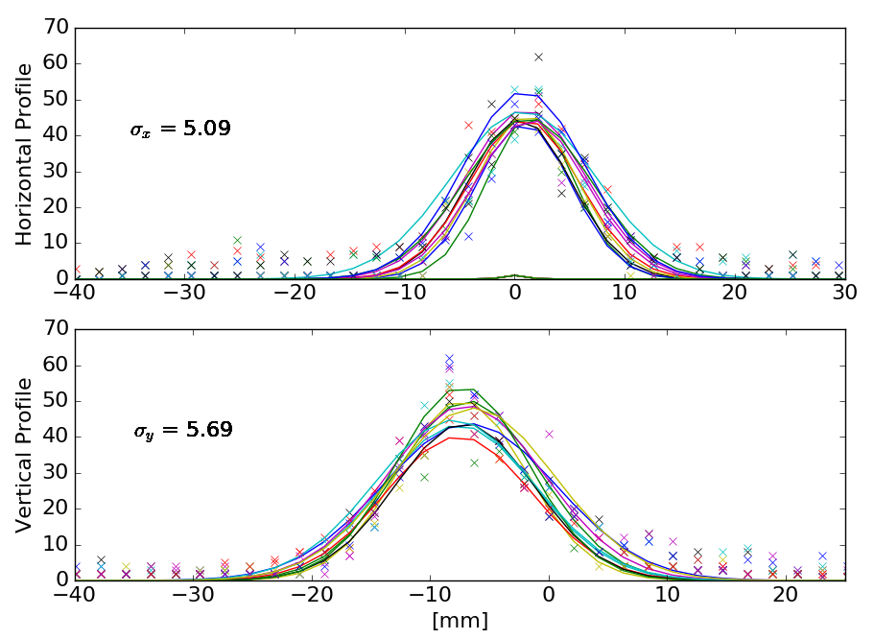
Experimental Procedure
Low intensity beam at injection energy (<5 turn stacking)
Measure ion current to approximate SC tune shift (should be negligible!)
Measure beam profiles with Residual Gas Monitor (RGM) to get emittances
v
Xe⁴³⁺
C³⁺
v
Notes:
12/2/16
| Fachbereich 18 | Institut Theorie Elektromagnetischer Felder | Prof. Dr.-Ing. Thomas Weiland
| <number>
Future: Cry-ring testing

Slide 11
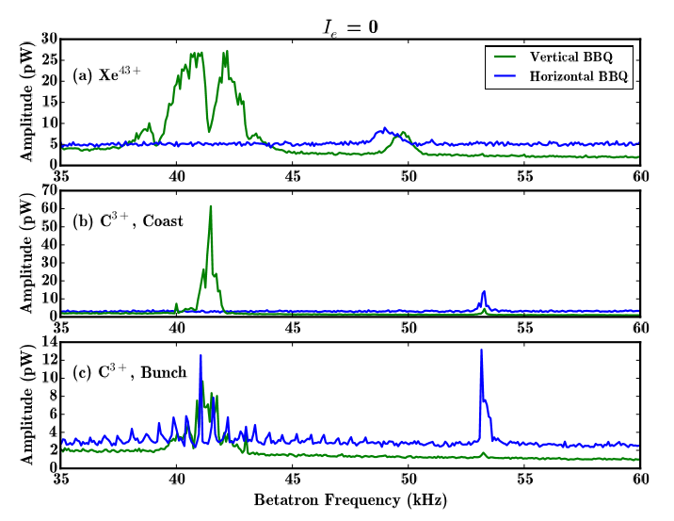
Experimental Procedure
Measure tune as a function of electron density
Used Schottky and Base Band Tune (BBQ) measurement
Notes:
12/2/16
| Fachbereich 18 | Institut Theorie Elektromagnetischer Felder | Prof. Dr.-Ing. Thomas Weiland
| <number>
Future: Cry-ring testing

Slide 12
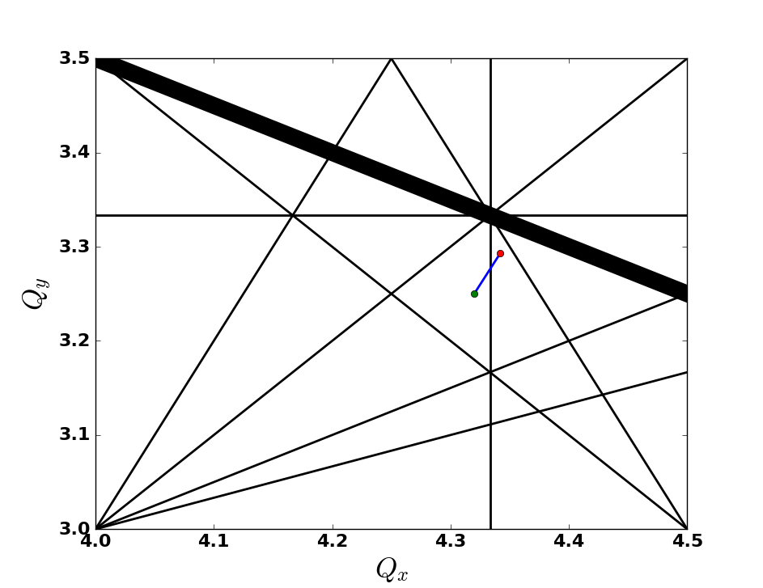
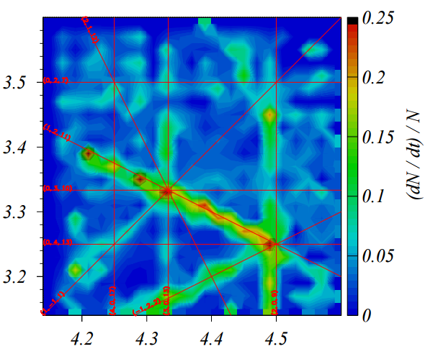
Tune Space
Franchetti, HB Proceedings 2008
(1,2,11)
(2,1,12)
(0,3,10)
(1,-1,1)
(3,0,13)
Notes:
12/2/16
| Fachbereich 18 | Institut Theorie Elektromagnetischer Felder | Prof. Dr.-Ing. Thomas Weiland
| <number>
Future: Cry-ring testing

Slide 13
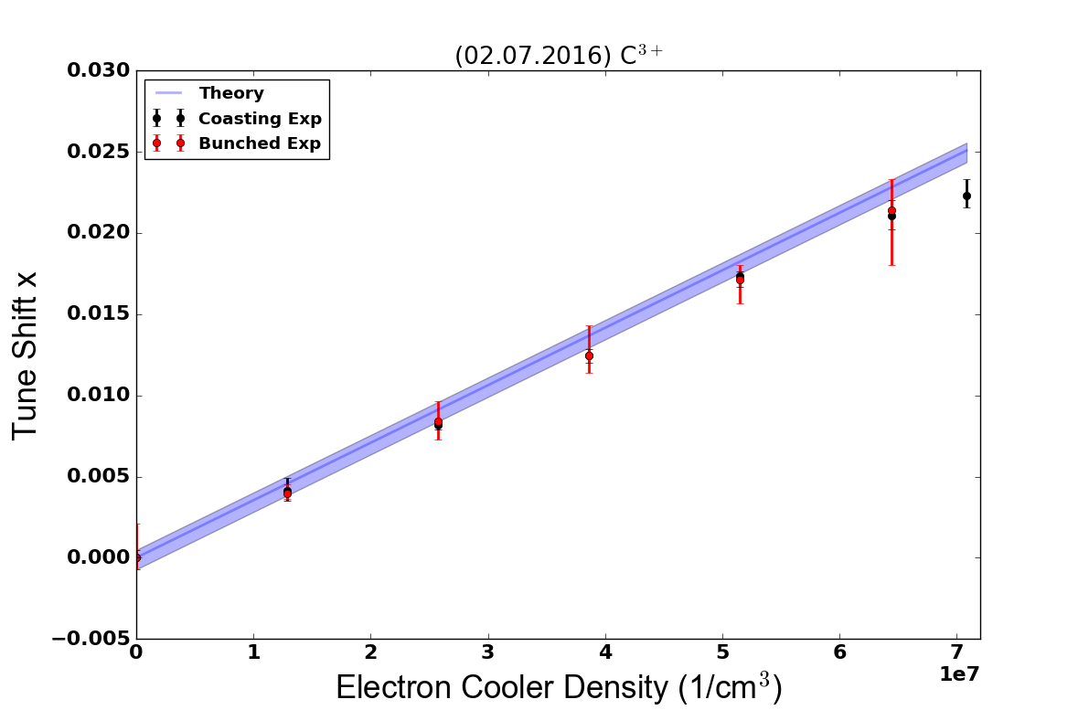
(Preliminary) Experimental Results!
Notes:
12/2/16
| Fachbereich 18 | Institut Theorie Elektromagnetischer Felder | Prof. Dr.-Ing. Thomas Weiland
| <number>

Slide 14
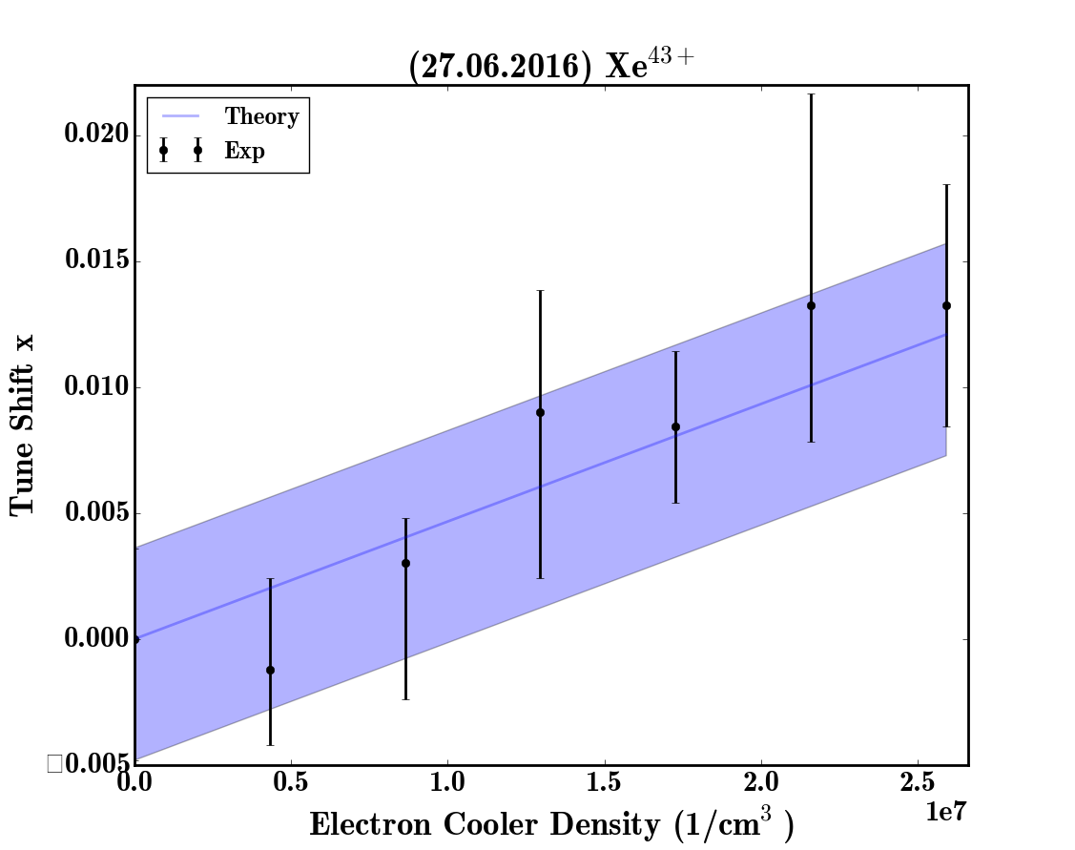
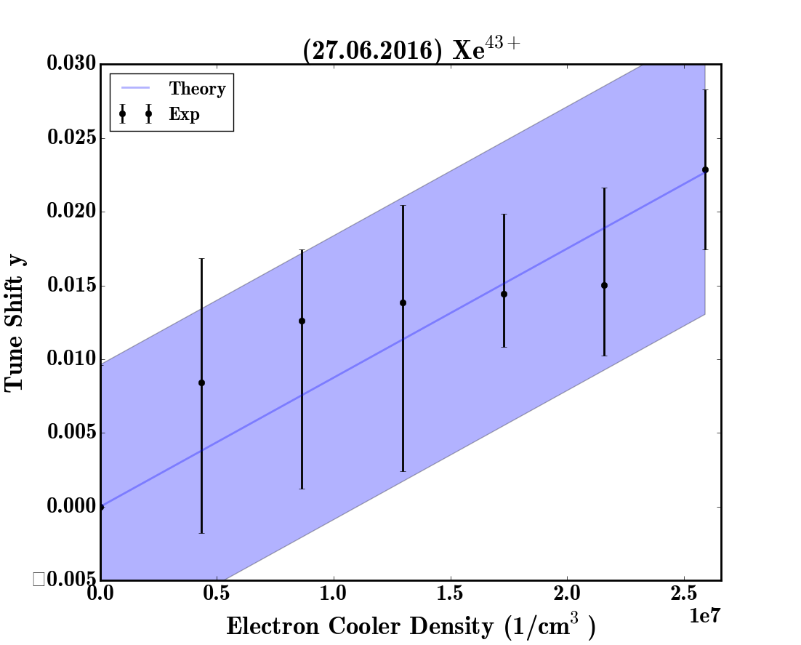
(Preliminary) Experimental Results!
Notes:
12/2/16
| Fachbereich 18 | Institut Theorie Elektromagnetischer Felder | Prof. Dr.-Ing. Thomas Weiland
| <number>

Slide 15
Outlook
Ideas for COSY beamtime:
Reproduce simulation results of instabilities stopbands by performing a tune scan with an electron lens
Re-explore closed orbit as a function of ion beam offset
Explore the effect of two compensators (labeled as 100 keV and 2 MeV in other presentations)?
Pulsed electron lens (if possible) to match longitudinal ion bunch profile
Look at alternative transverse electron density profiles (e.g. McMillan) to see where the limitation is experimentally

Slide 16
Acknowledgements and References
Experiment Team
Oliver Boine-Frankenheim, Rahul Singh, Christina Dimopoulou, Markus Steck, Sabrina Appel, Ivan Karpov, Lars Bozyk, Philipp Gardlowski
References
M. Aiba, M. Chanel, U. Dorda, R. Garoby, J.-P. Koutchouk, M. Martini, Proc. of the Particle Accelerator Conference (PAC) 2007
A.V. Burov, Proceedings of the 2001 Particle Accelerator Conference, Chicago (2001)
V. Shiltsev et al., Phys. Rev. ST-AB 103501 (2008)
V. Litvinenko, G.Wang, Phys. Rev. ST-AB
R. Singh, Ph.D. Dissertation, TUD (2014).
Work is supported by BMBF contract FKZ:05P15RDRBA
Notes:
<number>

Slide 17
Thank you
for your attention!
Notes:
<number>

Slide 18
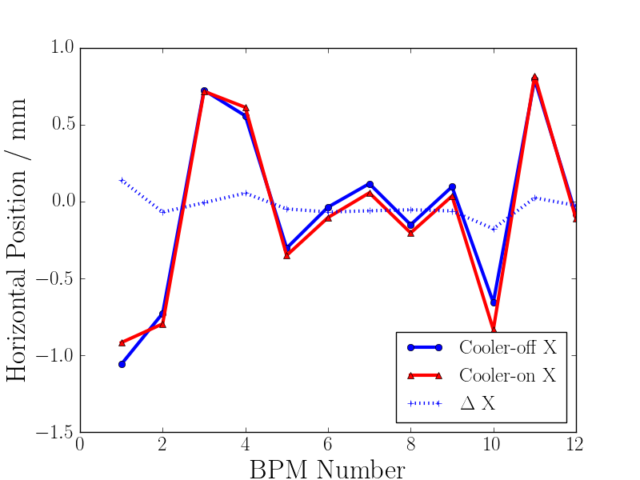
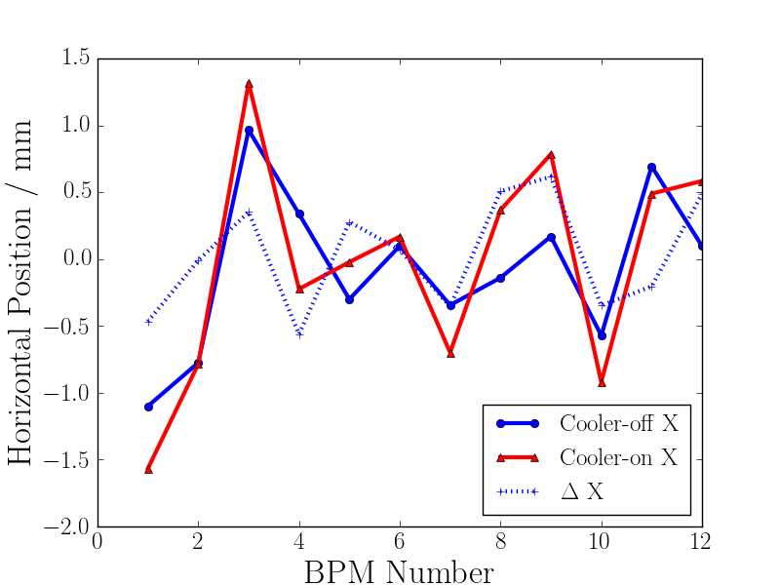
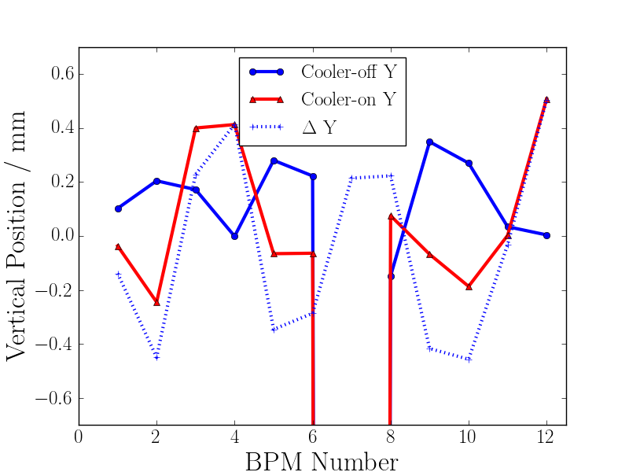
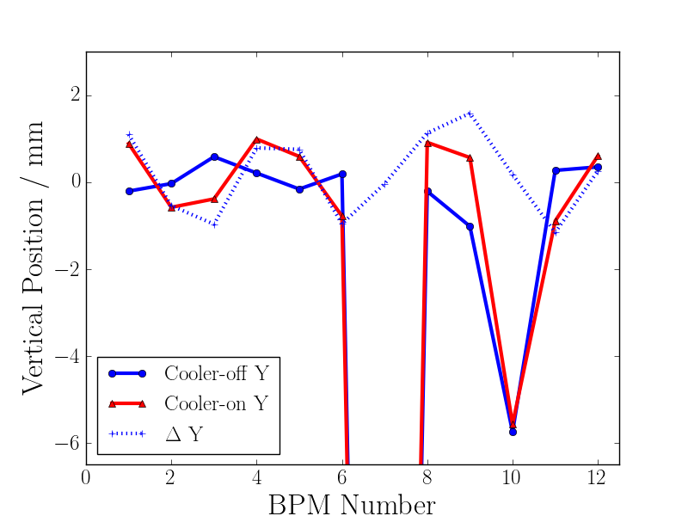
Backup: Closed Orbit Distortions
5mm offset
Notes:
<number>

