Slide 1
Injection and optimization
Sabrina Appel, Accelerator Physics Department, GSI, Darmstadt
Notes:
Proton Intensity from UNILAC
Expected proton intensity from UNILAC for pbar-chain

Slide 2
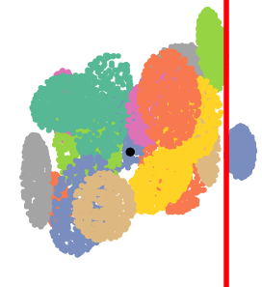
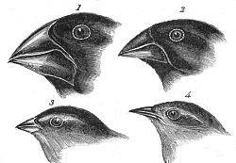
Outline
Multi-Turn Injection
  Single plan multi-turn injection
  Two plan injection
    Skew quadrupoles
    Titled septum
Septum
Y
X
Optimization
  Traditional
  New methods: Evolutionary algorithms
  Sensitivity analysis

Slide 3
Multi-turn injection (MTI) into SIS18
SIS18 electrostatic injection septum
SIS18 flexibility in providing a broad range of ions allow only Liouvilian injection schemes
Cathode
MTI has to respect Liouville’s theorem: Injected beams only in free space
300 kV
Anode
The beam from linac is injected in horizontal phase space until the machine acceptance is reached
Measured MTI performance in SIS18
Loss at septum and acceptance should be as low as possible due to loss induced dynamic vacuum
≈20 turns
Large frequency difference between UNILAC + SIS18
  During injection the rf is switch of
  Micro bunches filament to costing beam
T_{rev}≈5 μs
Notes:
Altitude

Slide 4
Multi-turn injection into SIS18 (single)
Multi-objectives
Gain factor (maximize)
Beam loss (minimize)
Inj. emittance (maximize)
output
1-2 m
Optimization parameters
Incoming beam
Orbit bump
Injected turns
Horizontal tune
Horizontal emittance
Horizontal
Model in
simulation code
Septum
Constraints: Septum position, acceptance, ...
Notes:
Altitude

Slide 5
Multi-turn injection
Smaller beam emittance increase MTI performance
Available acceptance limited MTI performance
Besides the horizontal phase space, the vertical one can also be exploited, which can lead to higher gain factors
  Titled septum or skew quadrupoles
Titled septum
Y
X
Two
Single plane:
Gain factor
Two plane:
Single
Emittance
G.H. Rees in Handbook of accelerator physics and engineering
Notes:
Reachable

Slide 6
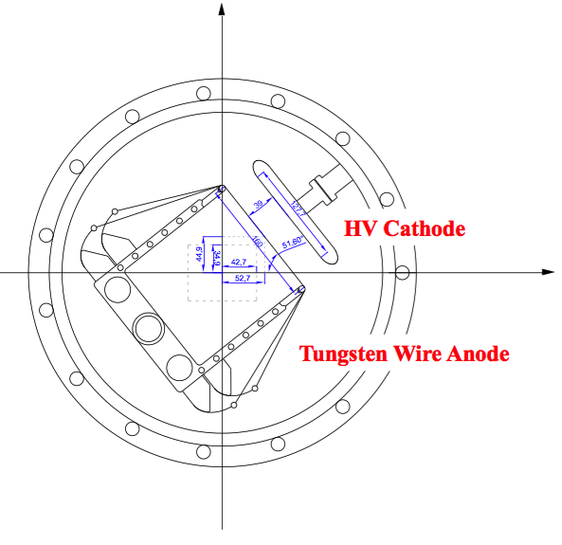
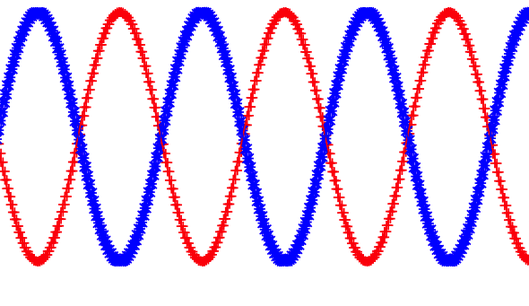
Multi-turn injection (Two plane)
Titled septum
Need new technical development
Titled septum and magnets in transfer line
Coordinate rotation system
Four additional bumpers (vertical)
BRing of
HIARF project
Skew quadrupoles
Using installed skew quadrupoles
Linear coupling of hor. and ver. phase space
Skew strength should be swift off after injection
Emittance
Turns
Which gain factors can be reached for a given beam emittance and loss for SIS18 acceptance?
For conventional, skew and titled septum injection?

Slide 7
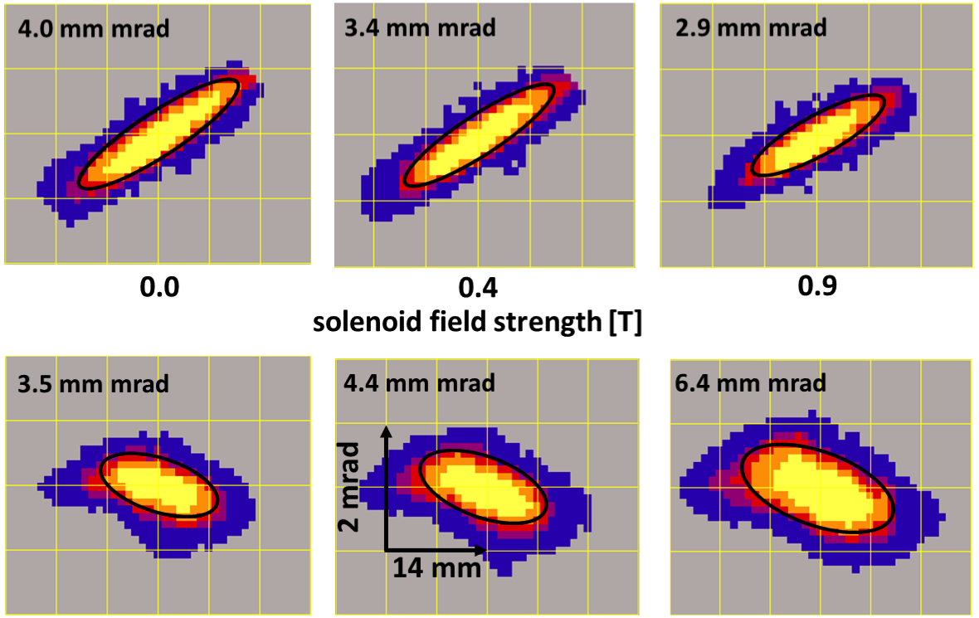
Injector brilliance depending
EMittance Transfer EXperiment (EMTEX)
Amount of beam flatness is controlled by solenoid field
Twiss-parameters are preserved
Performance as function of injected emittance
Excellent agreement between simulation and measurement
flat beam
round beam
L. Groening, S. Appel el: Demonstration of Flat Ion Beam Creation and Injection into a Synchrotron, Proc. of IPAC2015

Slide 8
Numerical Optimization
Pareto front:
Find set of optimal solutions instead of single one
The optimization problem is multi-objective
(several criterions to optimize)
B
A
C
The criterions can be contradicting:
Improving one criterion means worsening others
PA front
Imagined
best solution
D
Traditional:
Gradient-based methods or parameter scans
New methods:
Genetic algorithms, particle swarms are smart parameter scans
Scan
Darwin Finches
J. Gould,
Voyage of the Beagle
Gradient

Slide 9
Multi-turn injection into SIS18
Optimization of loss
Genetic algorithms can improve MTI
Especially for longer injection GA discovers a much better solution
Optimization of loss and gain factor
Dependence of gain factor on loss
Loss-free injection could be found
Space charge results in a similar PA front, but with different injection settings
Notes:
dependence

Slide 10
Multi-turn injection into SIS18
Optimization of loss, gain factor and beam emittance (injector)
Dependence of interface parameter
allows to define a frame, in which the required beam parameter can be matched at best for a high performance
This crucial information gives more flexibility for the injector upgrade layout.
  Ongoing: For MTI with skew quadrupoles and titled septum
Notes:
dependence

Slide 11
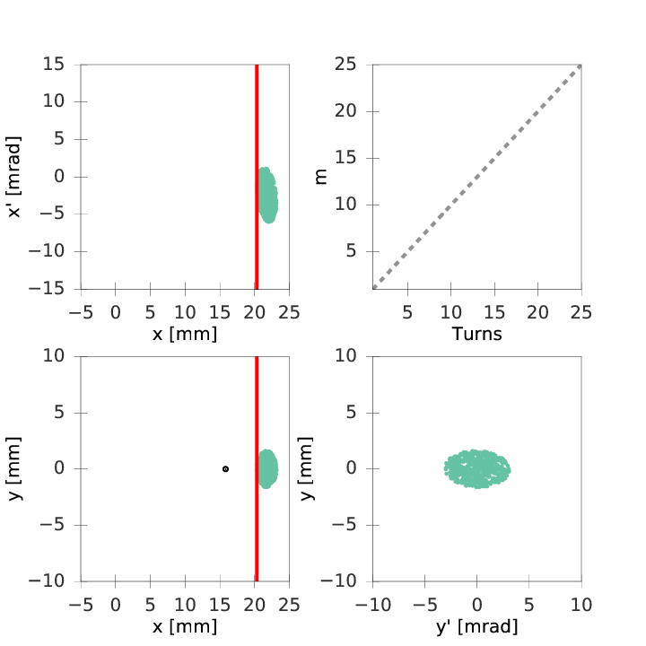
Skew quadrupoles
With linear coupling the injection loss could reduce from 15% to 1% for n = 20
Coupling parameters:
Emittance development
Limit

Slide 12
  Sensitivity analysis
beam size and beam shape
(Missmatch parameter)
MTI Parameters has been varied (few percent) and loss has been calculated
Probability
Skew strength
Position at septum
Sensitivity of MTI parameters request a online optimization
Loss [%]

Slide 13
Proposal
1. Online optimization of injection
Evolutionary
algorithm
Current
Evolutionary algorithm available in python, C++, Java, ...
  Require:
    Full online control of all injection parameters
    Online measurement of current (low noise and fast)
Control settings
Cycle
2. Skew injection
Require:
  skew quadrupoles
  freely selectable tunes

Slide 14
Thank you for your attention

Slide 15
  Sensitivity analysis
Sobol sensitivity analysis determines the contribution of each input parameter (first order) and their interactions between them (total order).
Beam
parameter
Y
Sensitivity
X
Position at septum
Missmatch parameter determine beam size and beam shape
MTI Parameters
Sensitivity of MTI parameters request a online optimization

