Slide 1
Beam Dynamics meets Vacuum, Collimations, and Surfaces
G. Franchetti
GSI

Slide 2


EuCARD-2 is an Integrating Activity Project for coordinated Research and Development on Particle Accelerators, co-funded by the European Commission under the FP7 Capacities Programme; see http://cern.ch/eucard-2. “Extreme Rings” (XRING) is a networking task of EuCARD-2 Work Package 5 “Extreme Beams” (XBEAM; http://cern.ch/xbeam), targeted at creating synergies between different accelerator communities in order to enhance accelerator R&D at the forefront of global research. The 2017 workshop "Beam Dynamics meets Vacuum, Collimations, and Surfaces” follows earlier successful XRING events.

Slide 3
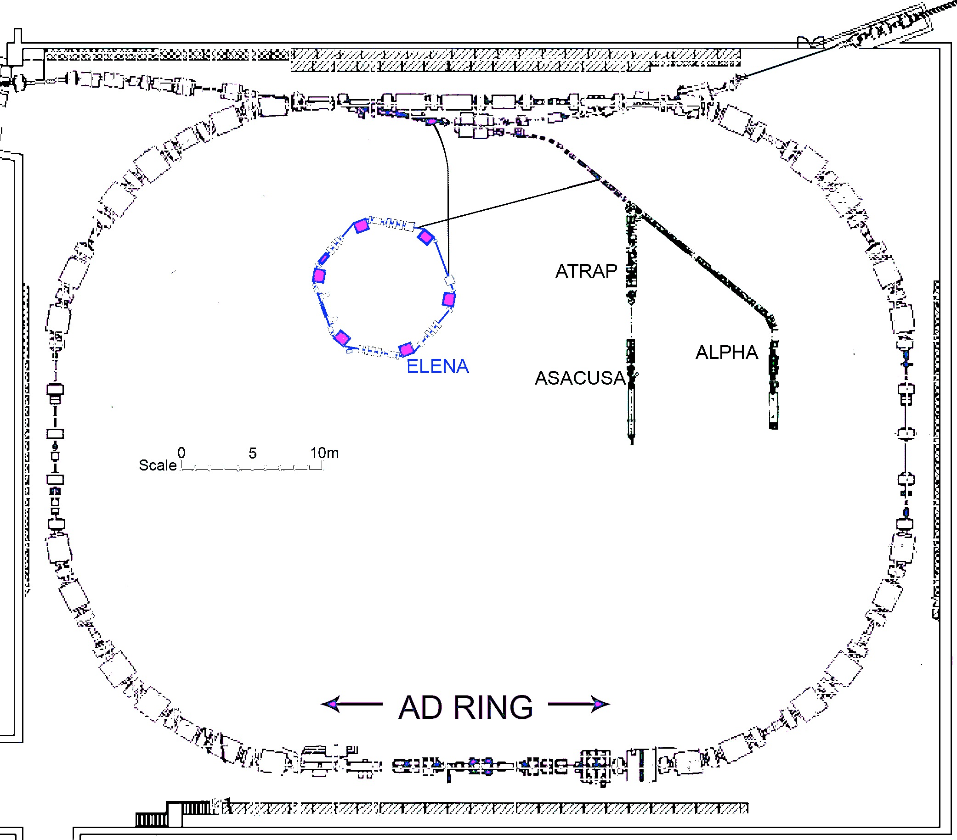

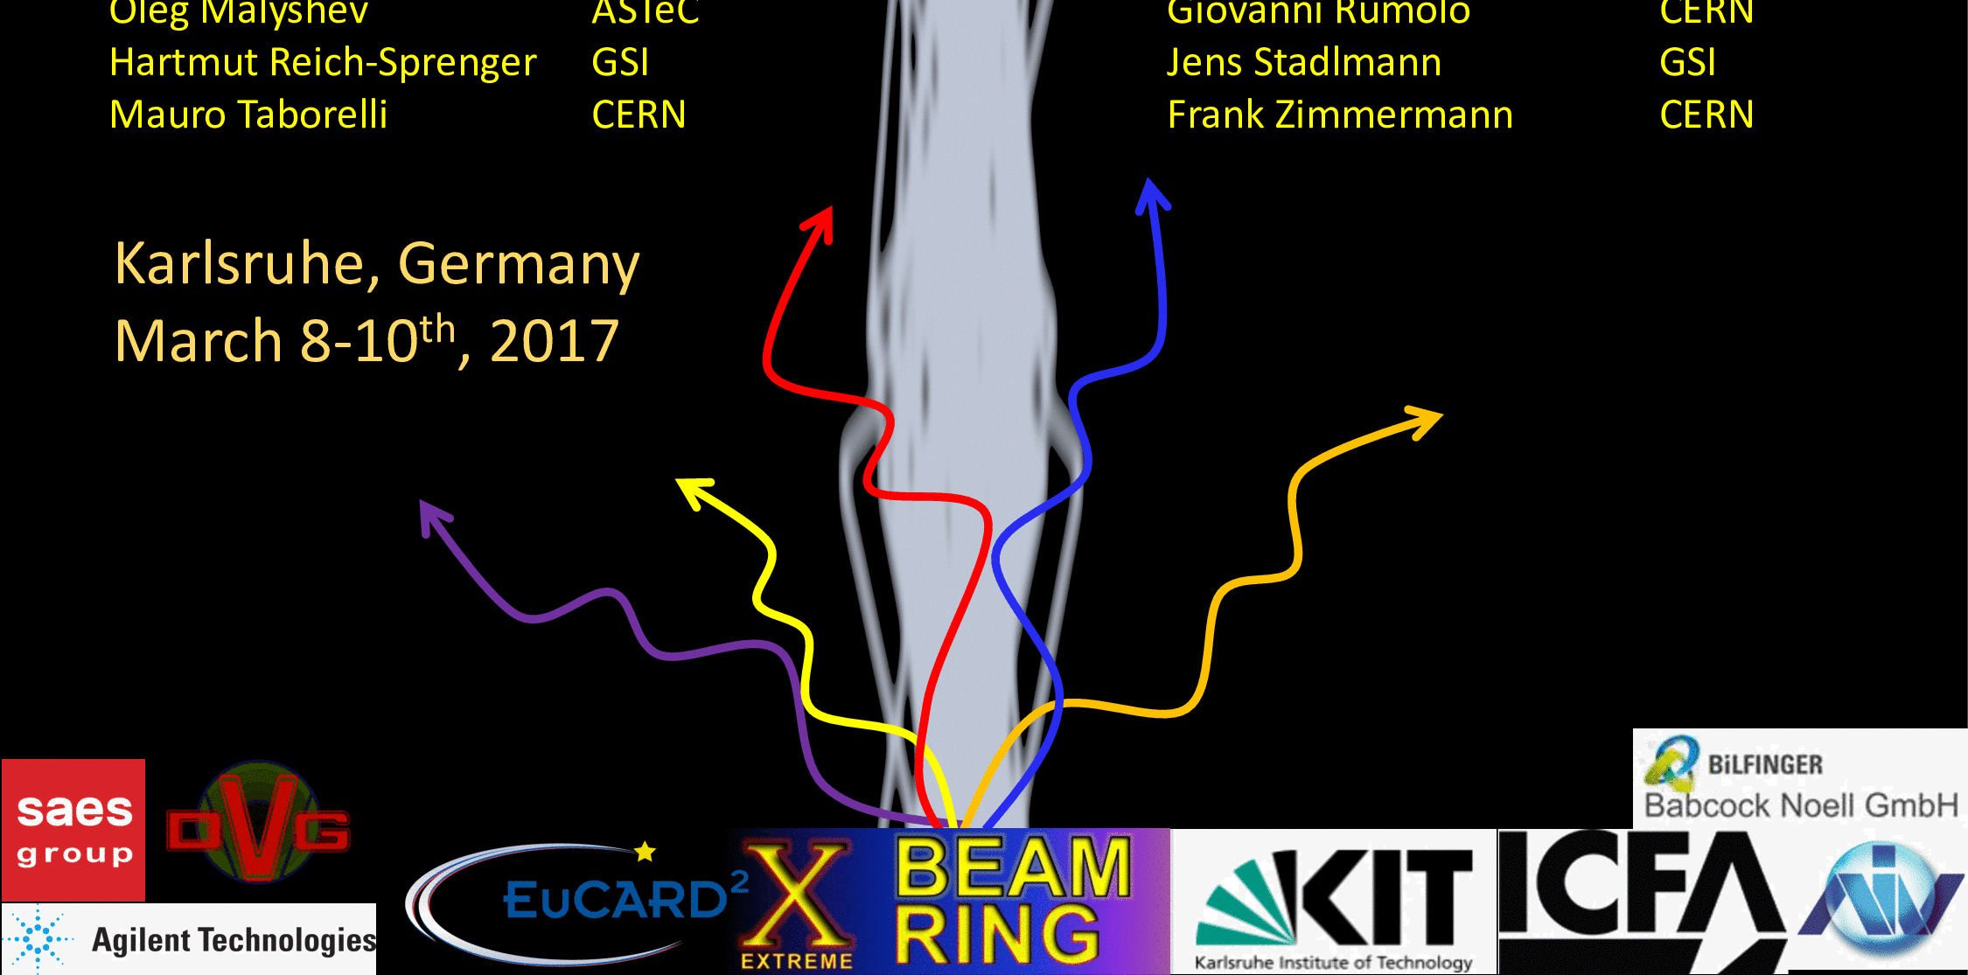
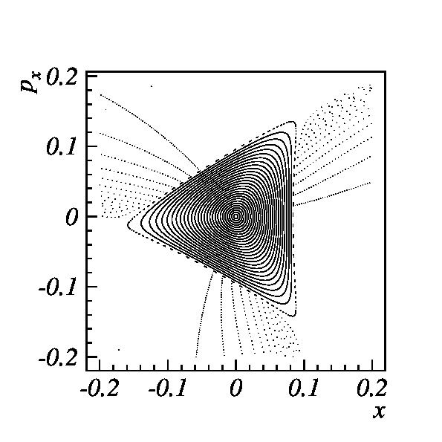

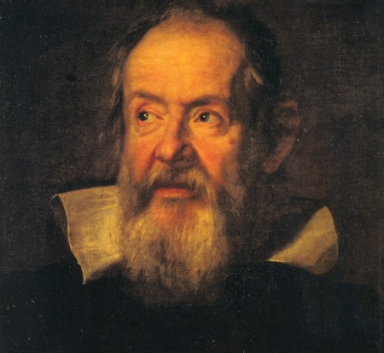
Beam Dynamics
meets
Magnets
Dec. 2013, Darmstadt
Advanced Optics Control
Workshop
2015, CERN
Mechanisms
Collaboration meeting
2014, CERN
Space charge,
Oxford 2015
by PSI, Dec. 2014
Beam
Dynamics
Beam Dynamics meets Vacuum,
Collimation, and Surfaces
2017
Beam dynamics meets Diagnostics
The Slow
Extraction
2015
Workshop
2016

Slide 4
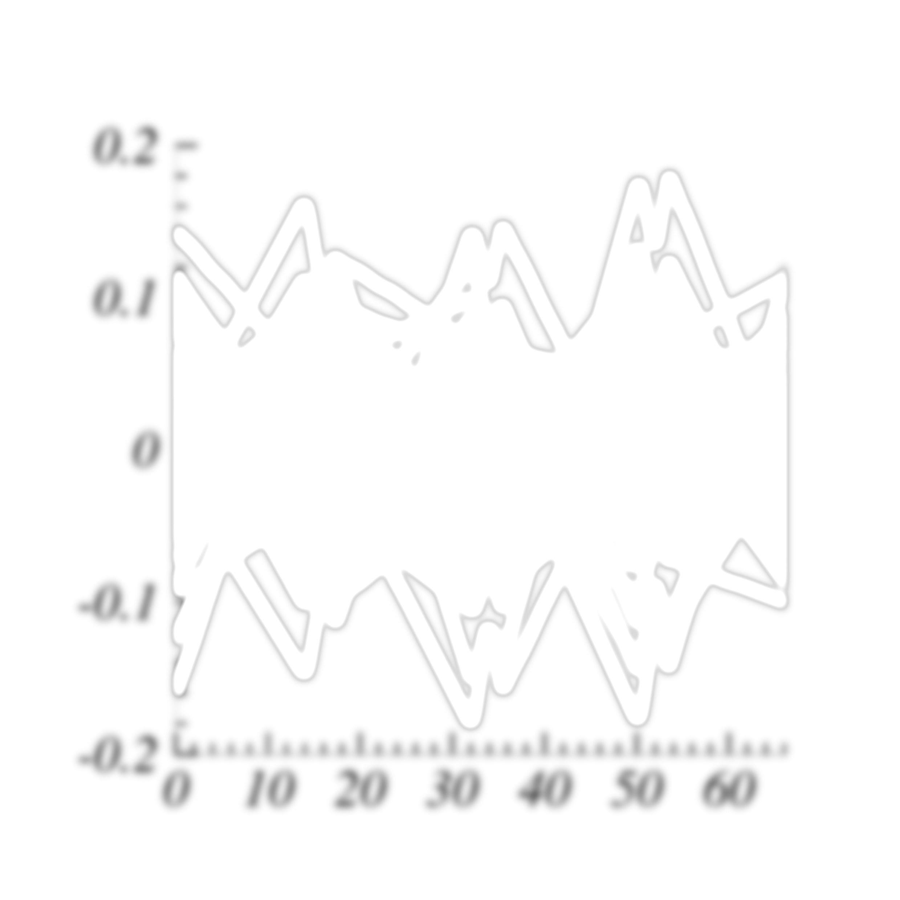

Slide 5


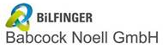

industry
laboratories

Slide 6
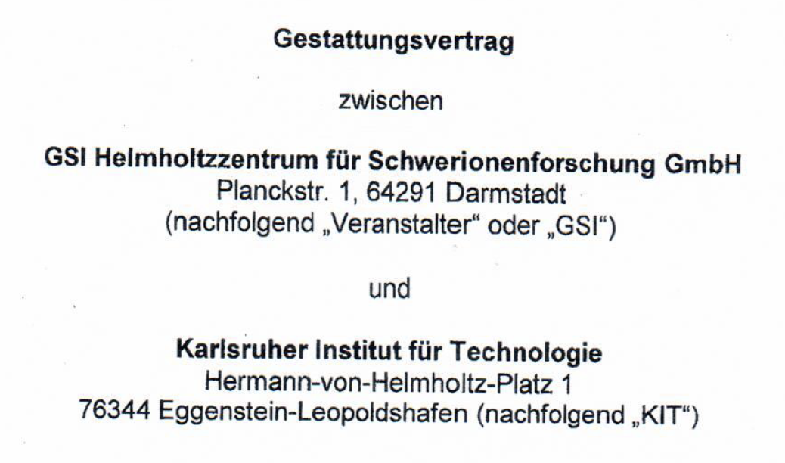


Slide 7



Auspices from associations and committees
International Committee
for Future Accelerators
Deutsche Vakuum Gesellschaft
Associazione Italiana Vuoto

Slide 8
Thanks to
Co-chair: Sara Casalbuoni KIT, Cristina Bellachioma GSI
Secretariat: Margit Costarelli KIT
Secretariat: Paola Lindenberg GSI
GSI Law Office: Wolfgang Dahlem
KIT Law Office: Julia Groh
GSI EU-Office: Lucilla Ferri, Irene Reinhardt
GSI Operation division: Udo Weinrich, Gerti Walter
All the International Advisory Committee
(program and advises!)

Slide 9
Have a good workshop !

