Slide 1
Impact of vacuum quality in light sources:
beam lifetime and ion instabilities
U. Iriso
ALBA - CELLS
U. Iriso
ESLS XXIII
Nov. 2015

Slide 2
OUTLINE
Beam Lifetime
  Analytical description
  Observations in Light Sources
Ion Instabilities
  Analytical description
  Observations in Light Sources
Conclusions
U. Iriso
ESLS XXIII
Nov. 2015

Slide 3
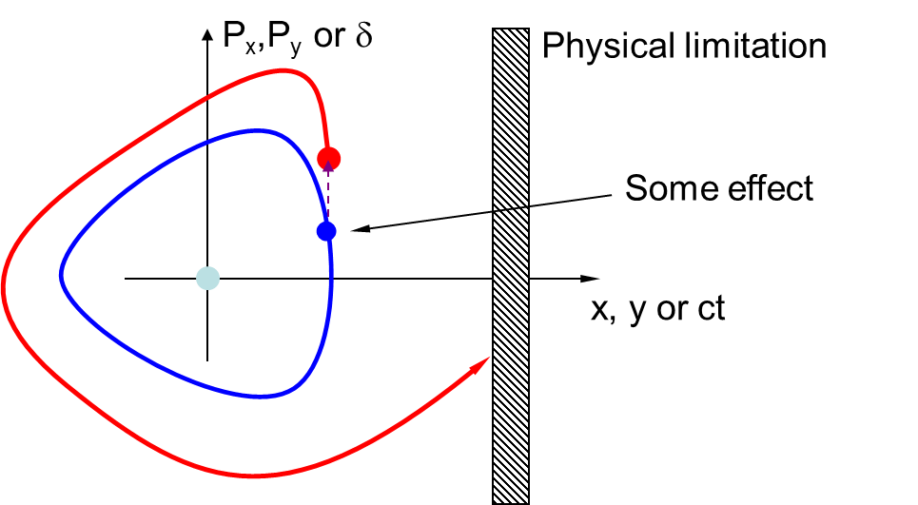
Lifetime: Particle Loss in LS
Main Lifetime contributors:
Gas Lifetime:
  Interactions with residual gas nucleus or electrons (elastic or inelastic)
Touschek effect:
  Interactions among beam particles with energy transfer.
Quantum Lifetime:
  Emission of radiation quanta when particles are close to the aperture limitations. Usually negligible, since it is ~1e5h or more.

Slide 4
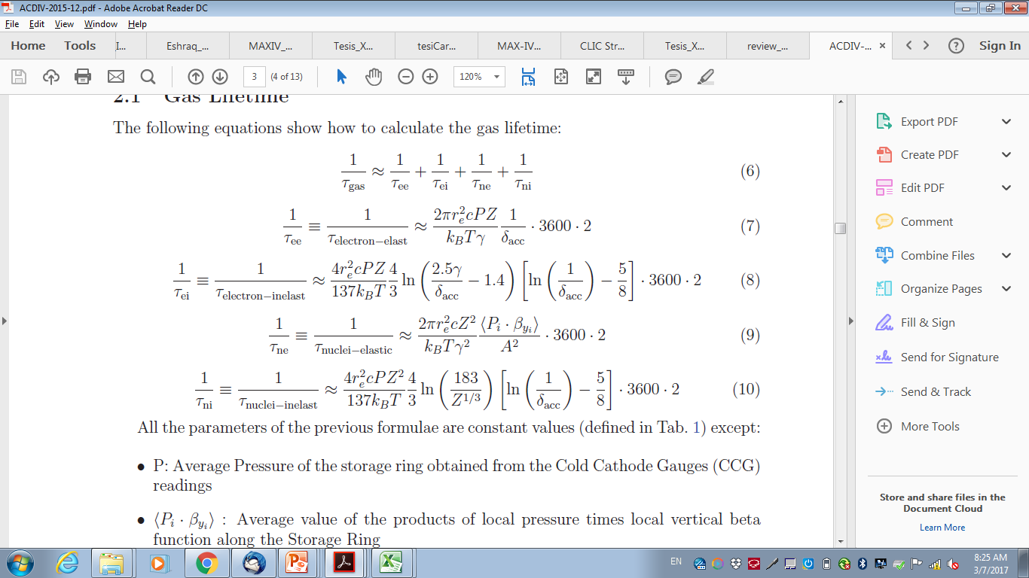
Elastic Gas Scattering
Deflections caused by the electrical force of the residual gas atoms
Beam
gas
Simplified Eqs*:
Note for LS, e-elast ~ [2-3] orders of magnitude larger
Number of residual particles (pressure): P↑→τ↓
Particle Charge: Z↑→τ↓
Beta function. β↑ →τ↓
Vacuum chamber: A↑→τ↑
Beam energy: γ↑ →τ↑

Slide 5
Inelastic Gas Scattering
Energy loss caused by radiation emission (mostly) at the vicinity of the gas atoms.
RF
particle escapes the bucket potential well
Beam
gas
Simplified Eqs*:
Both shall be accounted for LS
Number of residual particles (pressure): P ↑→τ↓
Charge of every particle: Z ↑→τ↓
RF acceptance. δ_{acc}↑→τ↑

Slide 6
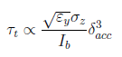
Touscheck Lifetime (I)
Limiting effect in LS (although not in the scope of this workshop)
Due to energy exchange between particles within the bunch, which can bring the particles out of the energy acceptance
It is not exponential, but assymptotic:
τ complex expression*, but its main dependencies:
➔ Product τ* I_{b} = ct , widely used in LS (instead of τ)
V_{RF} ↑→ RF acceptance δ_{acc}↑→τ↑
Beam density (coupling, bunch length). ρ↑→τ↓
Beam bunch intensity: I_{b} ↑→τ↓
*See Piwinsky Equation, Chao’s book

Slide 7
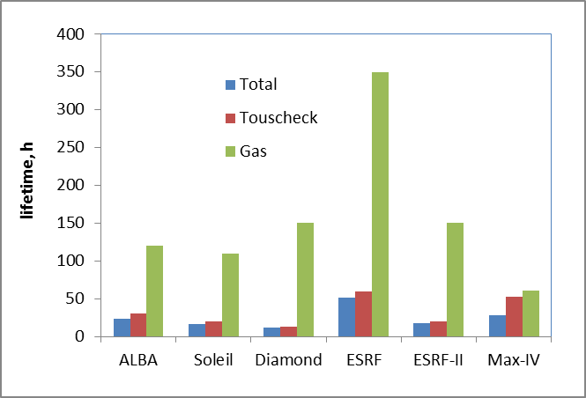
Lifetime in LS
Lifetime in LS is dominated by Touscheck effect, except in MAX-IV prediction@500mA
Gas lifetime (including elastic & inelastic) only important at early commissioning phases or during installation of new IDs
Soleil: X.N. Gavalda, Phd Thesis
Diamond: I. Martin, priv. communications
ESRF: N. Carmignani, priv. communications
MAX-IV: S.C. Leeman, PRST-AB 12, 120701 (2009) – 500mA

Slide 8
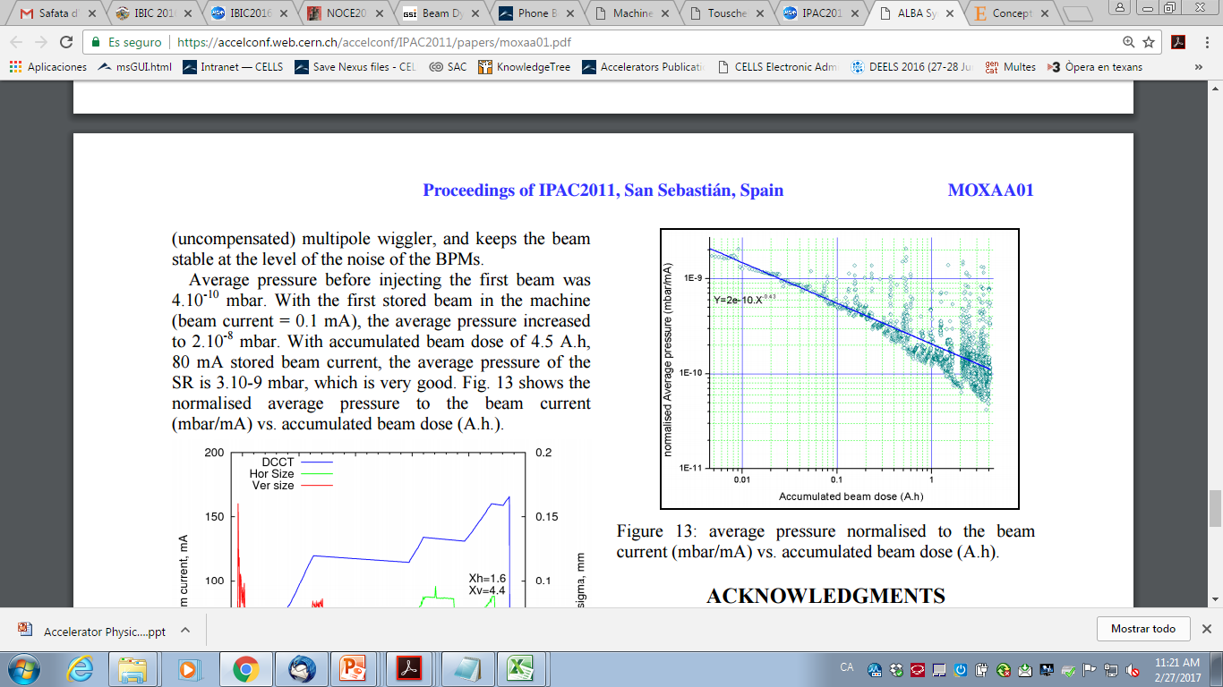
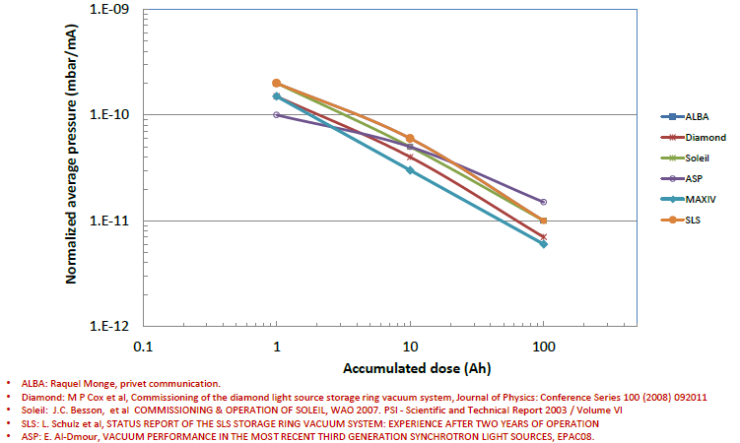
Gas Lifetime in LS: commissioning
Rule of thumb: Gas lifetime ~100h, when P-avg<1e-9, which is usually achieved after ~100 A*h
At ALBA, this was achieved after ~6 months of operation
D. Einfeld, IPAC11
E. Al-Dmour, XXIV SLS Workshop, 2016

Slide 9
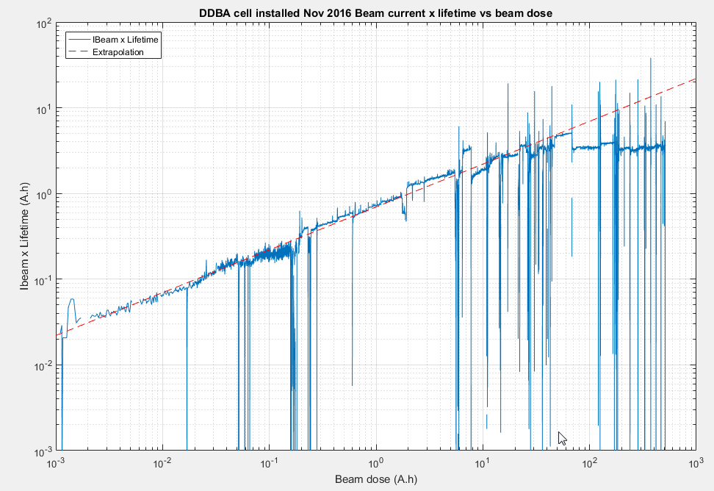
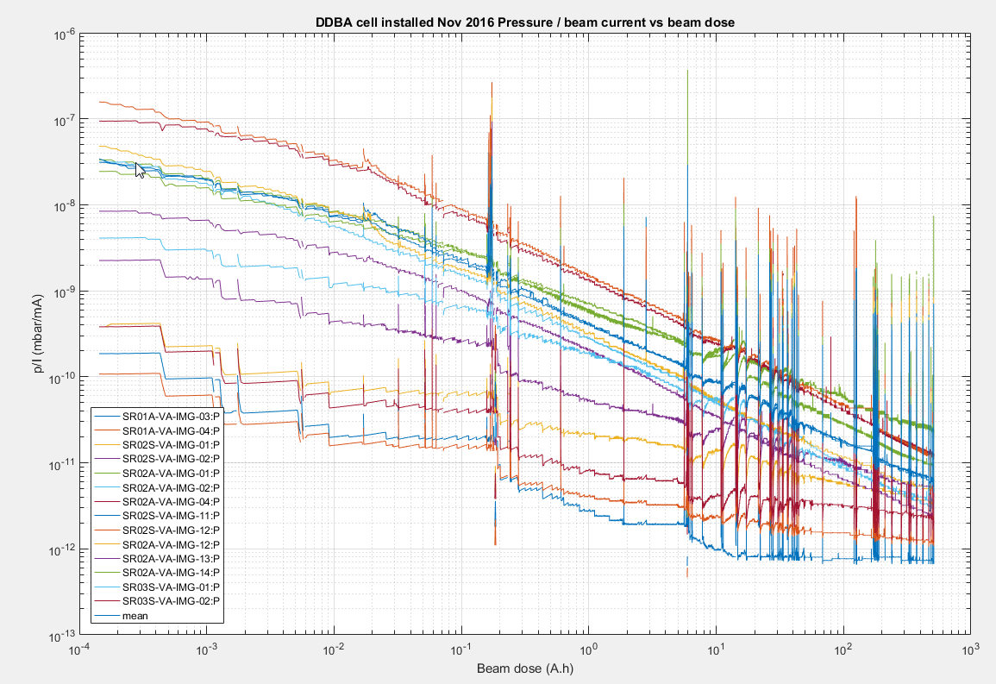
Installation of new components
Example: Complete Cell exchange in Diamond
Courtesy of M.Cox and I. Martin (Diamond)
Lifetime Product estabilized at ~50A*h
Pressure stabilized >100A*h

Slide 10
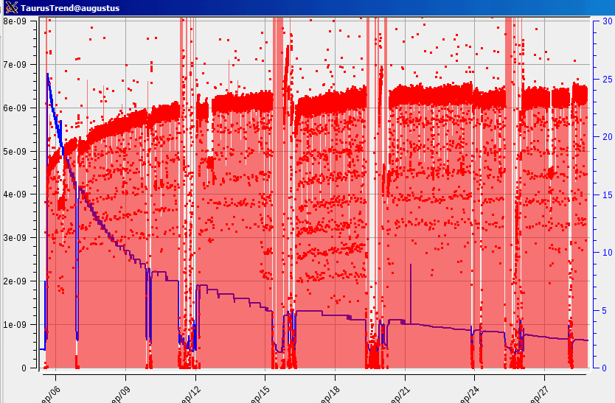
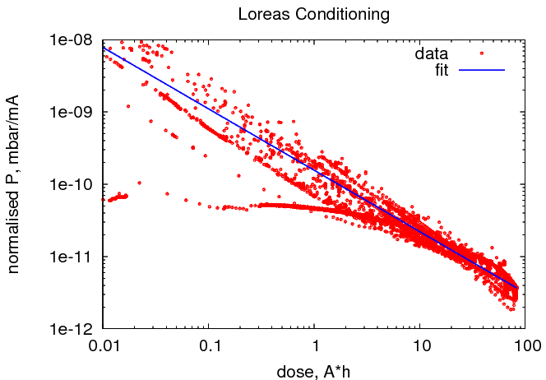
Installation of new components
Example: New Insertion Device (Loreas) @ALBA
~3 weeks to decrease pressure ~1order of magnitude
~2 weeks to stabilize lifetime (from 18h to 24h)
Accumulated Dose: 80A*h
Lifetime
Pressure
α=-0.85
3 weeks

Slide 11
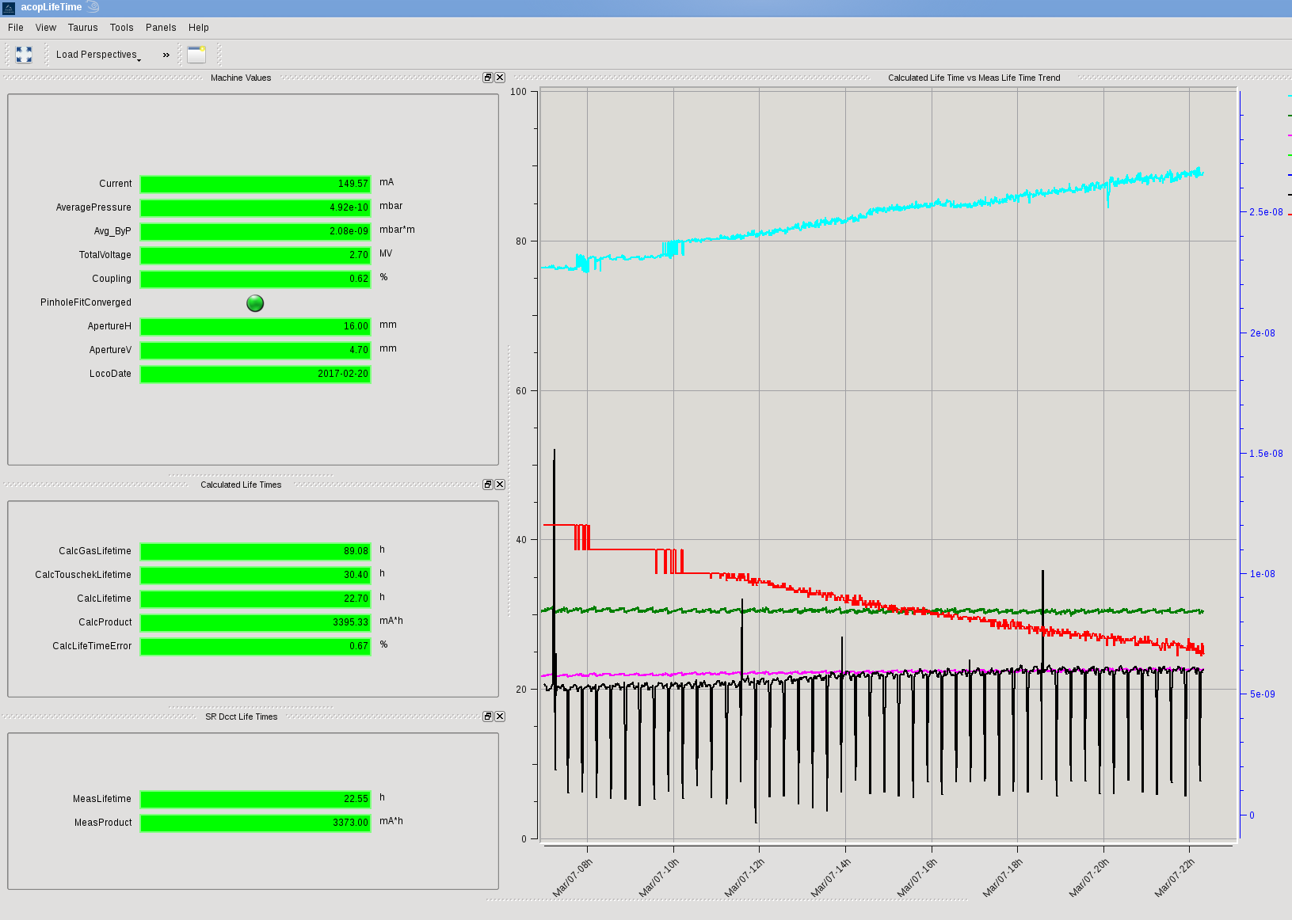
Lifetime Calculator GUI
Used at ALBA Control Room to crosscheck machine performance
P@CCG, β_{x,y} functions, ε_{xy}, cross sections, etc calculated on-line --> also τ_{gas} & τ_{Touscheck}
Example during conditioning of new vac. chamber
τ_{gas}~ 85h
GUI – Simple View
τ_{Touscheck}~30h
Pressure~[20- 6]e-9mbar
τ_{Measured}~22.5h
τ_{calculated}~23h
Developed by M.Alvarez

Slide 12
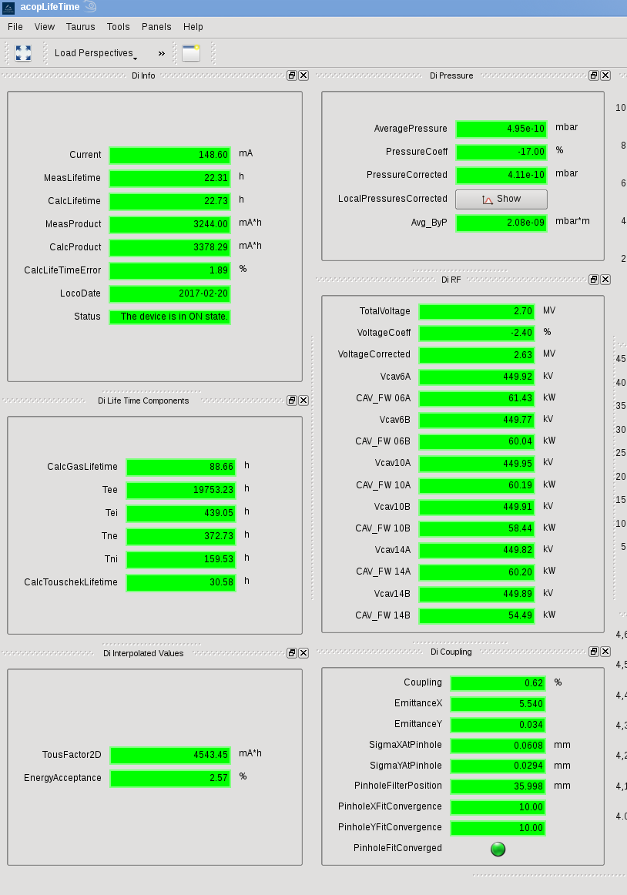
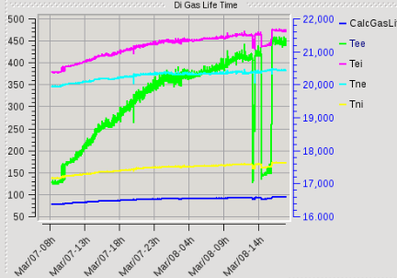
Lifetime Calculator GUI
Used at ALBA Control Room to crosscheck machine performance
P@CCG, β_{x,y} functions, ε_{xy}, cross sections, etc calculated on-line --> also τ_{gas} & τ_{Touscheck}
GUI – Expert View: allows you to control/measure all lifetime related params
<β*P> params
RF parameters
τ_{e-elastic}
τ_{e-inelastic}
τ_{n-elastic}
τ_{n-inelastic}
ε-related params
Touscheck params
Developed by M.Alvarez

Slide 13
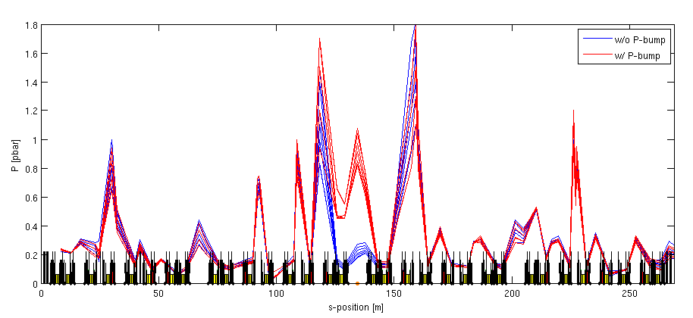
Controlled pressure bump
Experiment goal: change gas lifetime w.o. varying Touscheck
Switch off Ion Pumps in one sector (out of 16).
NEG pumping on → pressure increase ~1 order of magnitude in the Cell

Slide 14
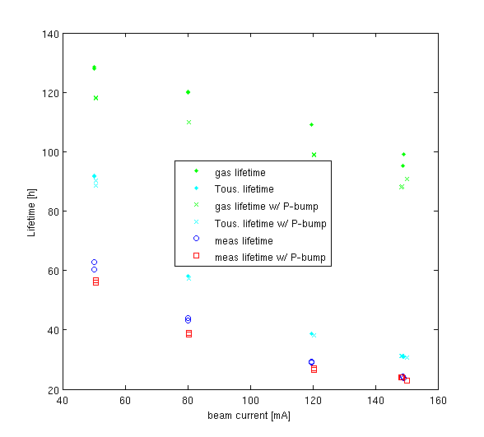
Controlled pressure bump
Lifetime comparison at different beam currents
At 50mA, the lifetime difference is only 10% .
At 150mA, the differences are barely noticeable, since Touscheck lifetime dominates
Courtesy of Z. Martí

Slide 15
OUTLINE
Beam Lifetime
  Analytical description
  Observations in Light Sources
Ion Instabilities
  Analytical Description
  Observations in Light Sources
Conclusions
U. Iriso
ESLS XXIII
Nov. 2015

Slide 16
Ion Instabilities in LS
See G. Rumolo and R. Nagaoka talks
Rest gas ionization produced by e-beam generates ions inside vac. chamber
Ions are heavy particles and they usually feel only a sequence of attractive kicks from the bunches, which keep them confined near the beam core
If the ion trapping condition is fulfilled, the ion remains oscillating around the beam
The Ion Instabilities can be either:
  “Ion Trapping Instability” (ITI): multi-turn ion accumulation that degrades beam quality (cured typically with abort gap)
  “Fast Beam Ion Instability” (FBII), the ion production & accumulation occur within one turn, affecting mainly last bunches in the train.
Main consequences: emittance growth, tune shift, pressure rise...

Slide 17
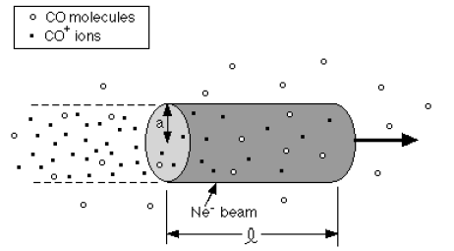
Ion Instability: ion generation
- Rest gas ionization produced by e-beam generates ions inside vac. chamber
Scattering ionization (depends on cross section σ_{ion})
~20 ions/bunch/m (ALBA, P=1pbar, σ_{ion} = 2MB - CO)
Field ionization could also happen above a certain threshold, but negligible in current LS – may be relevant for CLIC Linacs

Slide 18
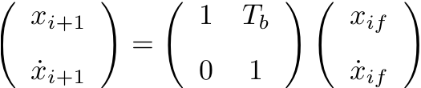

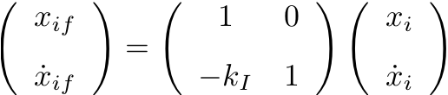
Ion Instability: Trapping Condition
G. Rumolo -“Two stream
Instabilities” – USPAS
Ion of mass A
T_{b}
Bunch i
Bunch i+1
Transport through the drift space between bunches
Kick from the passing bunch

Slide 19
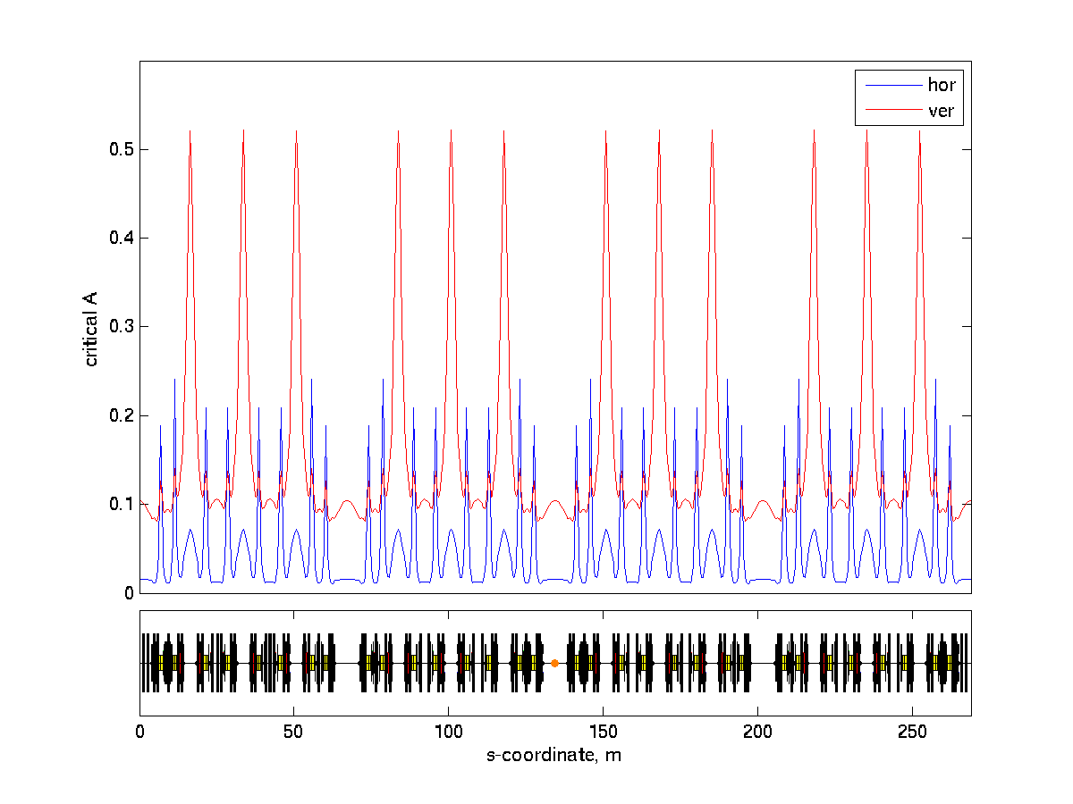
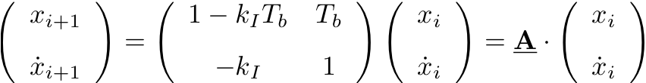
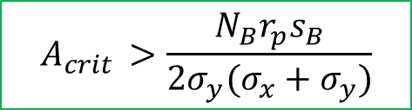
Ion Instability: Trapping Condition
Ion Motion easily expressed in matrix notation:
Stability if Tr(A) < 2:
$$A_{crit }>\frac{N_{B}r_{p}s_{B}}{2σ_{y}(σ_{x}+σ_{y})}$$
  Assumed Gaussian beams
  Ions with atomic mass > A_{crit} are trapped!
ALBA @150mA:
All ions can be trapped!!
It does not affect ALBA due to use of abort gaps and low pressure (~1e-10mbar)
Dependence on lattice position through (σ_{x}, σ_{y})

Slide 20
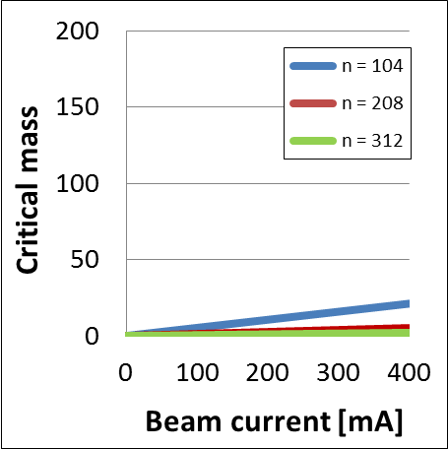
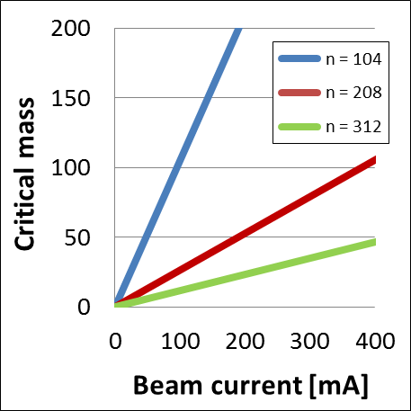
Ion Instability: Trapping Condition
Ion Motion easily expressed in matrix notation:
Stability if Tr(A) < 2:
$$A_{crit }>\frac{N_{B}r_{p}s_{B}}{2σ_{y}(σ_{x}+σ_{y})}$$
  Assumed Gaussian beams
  Ions with atomic mass > A_{crit} are trapped!
R. Nagaoka talk
- For low-e rings, A_{crit} increases
Calculated with ε_{x} = 4 nm (left) and 0.2 nm (right) with SOLEIL parameters (1% coupling)

Slide 21
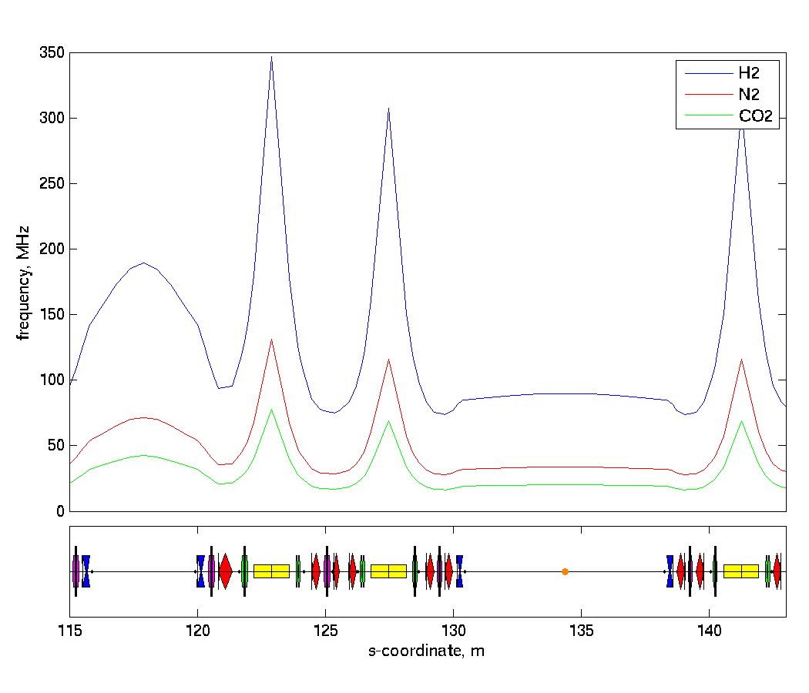

Ion Instability: Osc. Frequency
and
..
From
x = Δx/T_{B}
We get the ion oscillation frquency:
$${ω_{}^{2}}_{ion}=\frac{2N_{B} c r_{p}}{Aσ_{y}\left(σ_{x}+σ_{y}\right)T_{B}}$$
observable with spectrun analyser
ALBA Case @150mA in one sector:
Inversely proportional to A
Between ~[10 – 300MHz]
Also depends on s-position

Slide 22
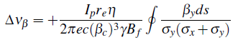
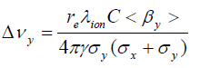
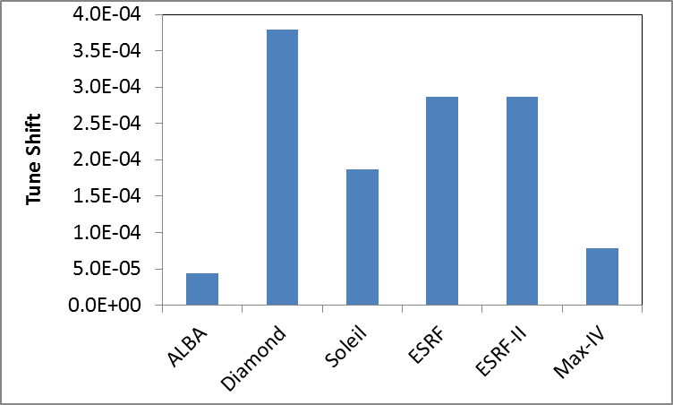
Ion Instabilities: tune shift
Induced tune shift due to focusing force:
An easier simplification from above equation is:
Note:
positive tune shift
For FBII, λ_{ion} depends on the bunch #, so the tune shift depends on the bunch 3
CO ions; P=1pbar; σ_{ion} = 2MB
Nominal operation conditions
Tune shift small, but measurable

Slide 23
Fast Beam Ion Instability - FBII
The ions accumulate along one bunch train
Head and tail of the train are coupled through the ions
Coupled motion between ions & e-beam: ions “keep memory” of the offset of the generating bunch and transfer this information to the following bunches.
The driven oscillation is expected to be at a main frequency related to the ion oscillation frequency.
See analytical models at:
Raubenheimer et al. Phys. Rev. E 52, 5, 5487, Stupakov et al. Phys. Rev. E 52, 5, 5499

Slide 24
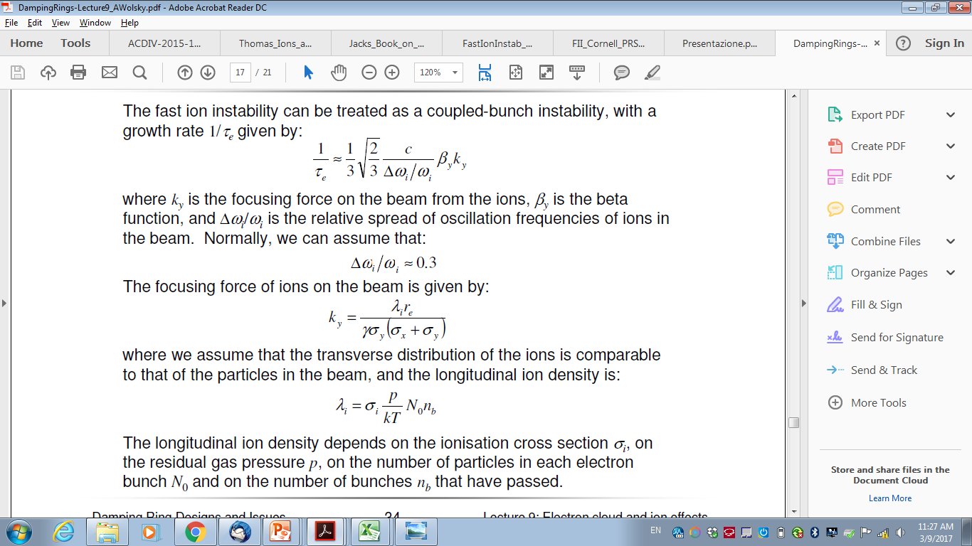
Fast Beam Ion Instability - FBII
Analytical instability models* allow to estimate rise times:
With K_{y} the focusing strength
This gives rise times ~2us range at ALBA, although coherence effects along the ring can increase this rise times by 1-2 orders of magnitude
Each case needs a careful analysis
Computer simulation codes (FASTION ad PyHEADTAIL**) can be used to carefully calculate these rise times.
*Raubenheimer et al. Phys. Rev. E 52, 5, 5487, Stupakov et al. Phys. Rev. E 52, 5, 5499
**L.Mether, “Numerical model of FBII”, Proc. of HB2016
A.Chaterjee et al, PRST-AB 18 064402 (2015)

Slide 25
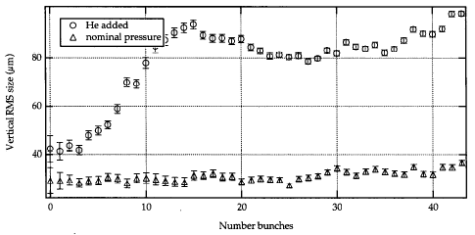
Ion Instabilities Observations
Fast Beam Ion Instabilities observed in LS are produced artificially induced by injecting gas into the vacuum chamber
See examples at ALS & CESR
ALS experiment*:
all Ion Pumps off
Inject He: avg P from 0.25 to 80 nTorr
*J.Byrd et al, PRL 79, 1 (1997)

Slide 26
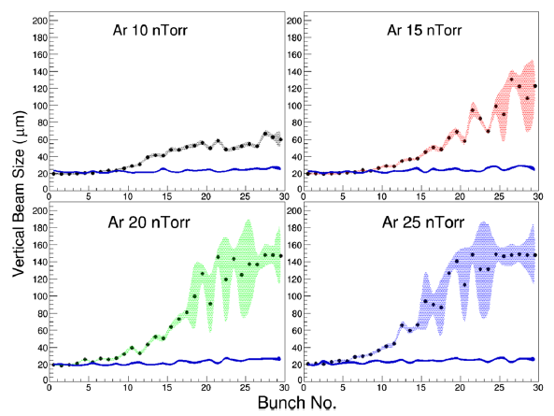
Ion Instabilities Observations
Fast Beam Ion Instabilities observed in LS are produced artificially induced by injecting gas into the vacuum chamber
See examples at ALS & CESR
CESR experiment*:
Localized pressure bump of ~10m
Inject Ar and Kr: from 1 to 25 nTorr
Beam Size observation
BBB feedback can damp instability
Observations match well with simulations using FASTION
*A.Chaterjee et al, PRST-AB 18 064402 (2015)

Slide 27
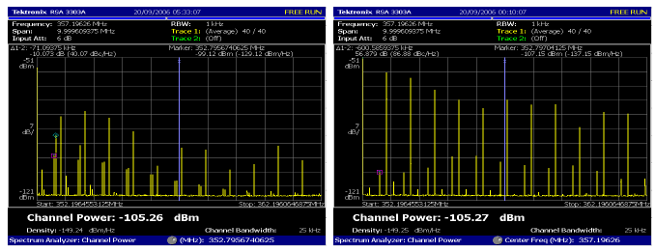
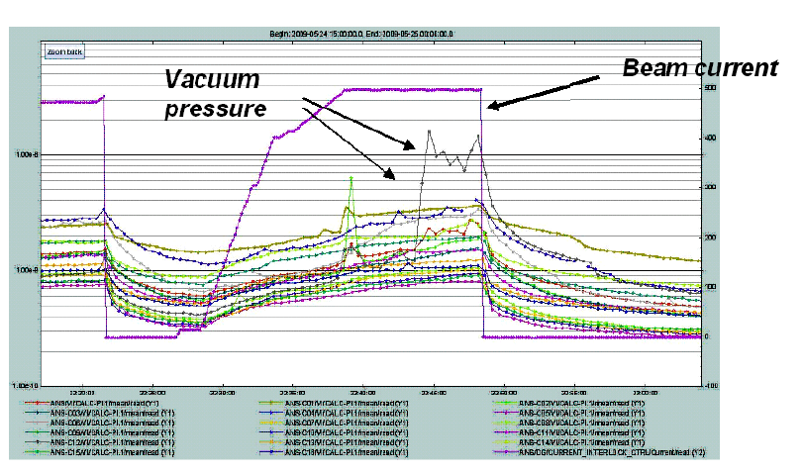
Ion Instabilities Observations
Beam Spectra and Pressure Rise in Soleil
R. Nagaoka, IPAC’10
Soleil is so far the only LS affected by ions during operation
The beam spectrum for ions dominated instabilities show a distinct pattern wrt usual RW spectrum
RW dominated
Ions dominated
To prevent this instability, Soleil runs with full filling pattern rather than partial filling (lower I_{B})
This prevents pressure to rise (due to thermal outgassing), and trigger instability
➔ Not Ion Trapping, but FBII

Slide 28
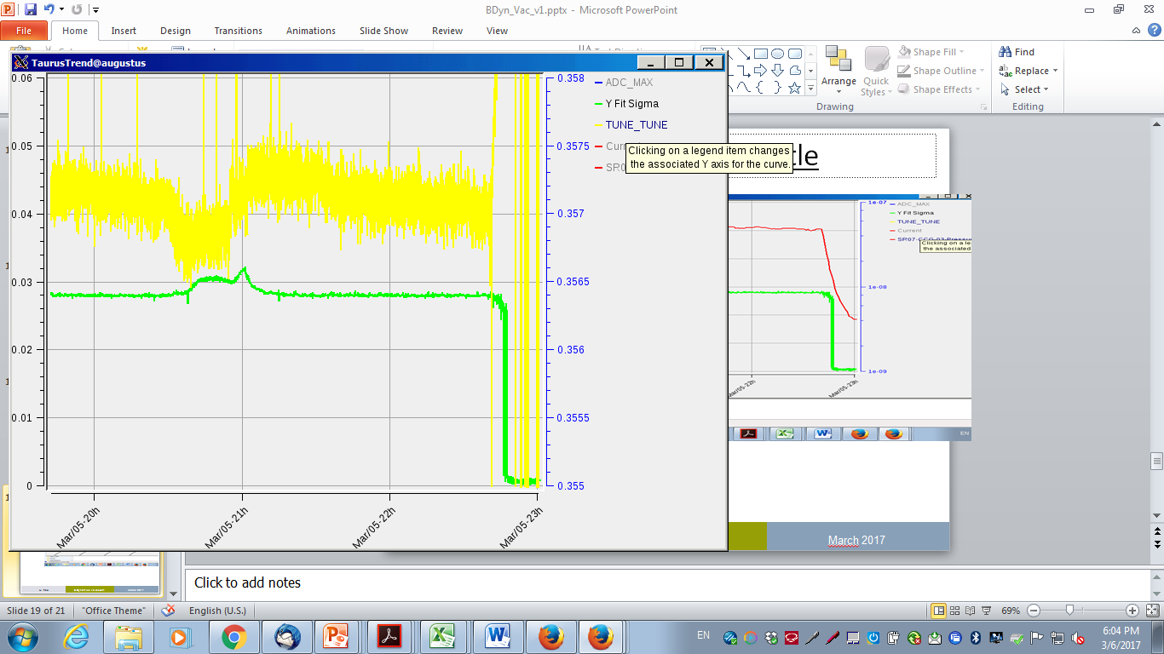
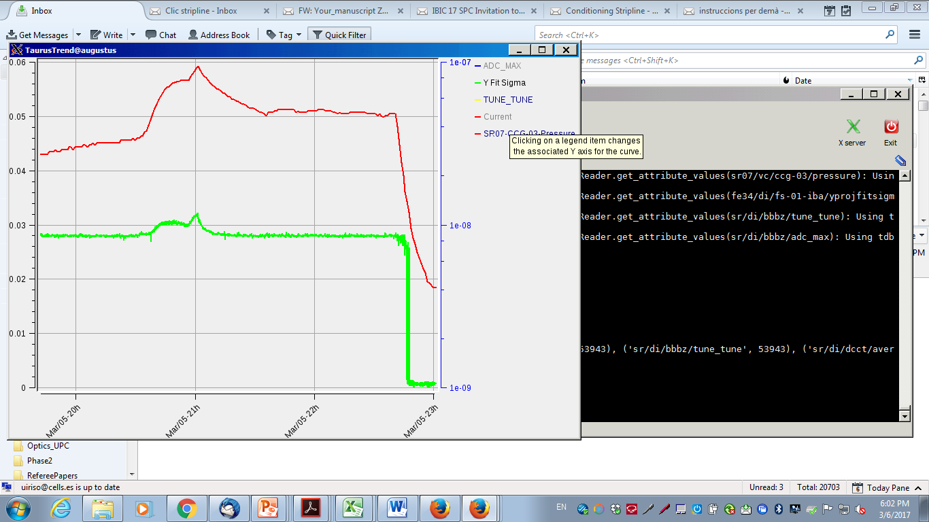
Ion Instabilities Observations
Installation of CLIC SL Kicker @ALBA
(Data from 6/3/2017)
While conditioning the new vacuum chamber, injecting from 125mA to 135mA produced a:
-pressure rise: ~3e-8mbar
-beam blow up (by 20%)
-tune shift of 2e-4
-BBB feedback could not damp it
Compatible with ion instabilities in this case produced by larger atomic masses (see next)
ΔQ = 2e-4
ΔP: from 4 to 7e-8mbar
Δσ_{y} = 5um

Slide 29
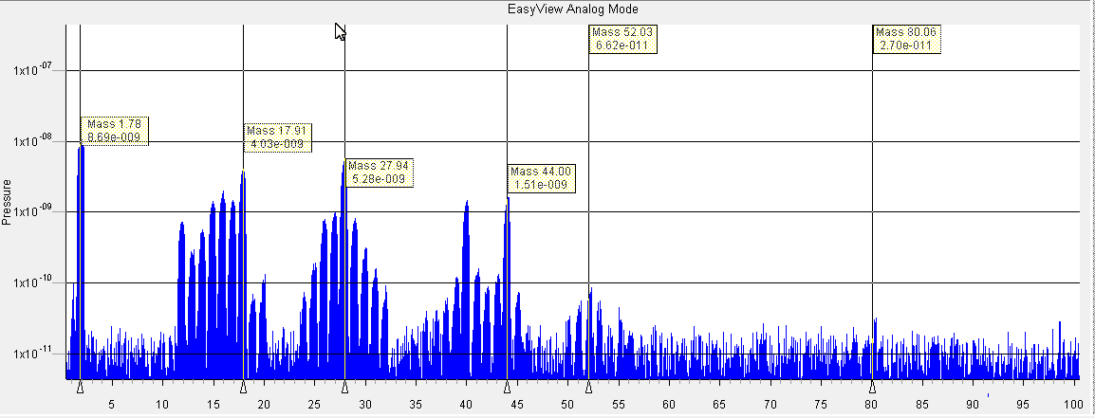
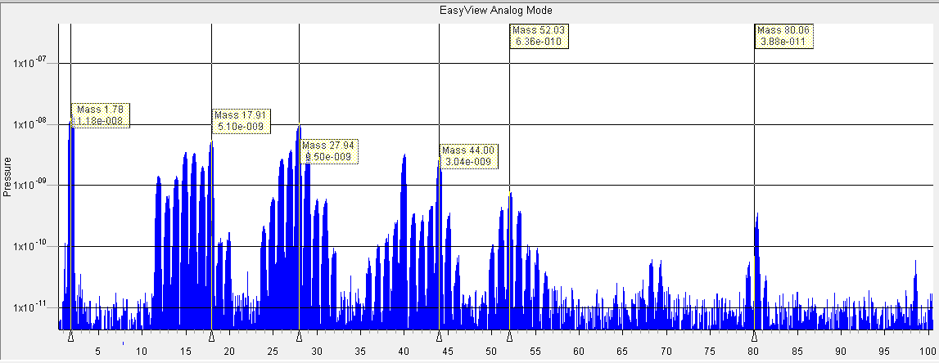
Ion Instabilities Observations
Installation of CLIC SL Kicker @ALBA
(Data from 6/3/2017)
RGA data showed peaks at A=52 and A=80, likely due to desorption produced by Macor rings
CLIC SL removed to guarantee operation
125 mA
135 mA

Slide 30
Controlled pressure bump
Switch off Ion Pumps in one sector (out of 16).
NEG pumping on → pressure increase ~1 order of magnitude in the Cell
Check instability thresholds w. & w.o. pressure bumps
1pbar = 0.75nTorr

Slide 31
Controlled pressure bump
➔ Beam size increase with increasing current with & w.o. pressure bump
Xi = (1,2), threshold ~80mA for both cases
But for normal pressure, the emittance increase is much violent. Co-existance of RW and Ions?
At ~120mA, beam size follows the same trend as the case with normal P
(larger Nb, ions “untrapped”?)
Further studies going-on

Slide 32
OUTLINE
Beam Lifetime
  Theoretical Equations
  Impact on current Light Sources
Ion Instabilities
  Analytical Equations
  Observations in Light Sources
Conclusions
U. Iriso
ESLS XXIII
Nov. 2015

Slide 33
CONCLUSIONS
As for the lifetime…
Lifetime in LS is limited by Touscheck effect for machines with doses >100 A*h
Gas lifetime (elastic and inelastic) ~100h, while Touscheck lifetime ~20h.
Gas lifetime only relevant in commissioning periods, or after installation of new components
As a rule of thumb, need in ~100A*h to recover P<1e-9mbar (0.75nTorr)

Slide 34
CONCLUSIONS
As for the ion instabilities…
Ion trapping condition is easily fulfill in LS. However, observations of ion instabilities are rare due to a very good vacuum conditions (Pavg < 5e-10mbar) .
Ion instabilities are only relevant in commissioning periods or after installation of new components in the vacuum chamber
FBII have only seen in artificially bad vacuum conditions (injecting Ar gas) and/or switching off Ion Pumps to bring P>10nTorr
Ion instabilities may co-exist with other instabilities (RW) , and active feedback may effectively damp them (CESR) or not (Soleil)
Soleil is (so far) the only machine whose operation is limited by ion instabilities (FBII).
Simulation codes exist (FASTION & PyHeadtail), but more benchmarking is appreciated

Slide 35
Acknowledgements
Many colleagues from ALBA and other labs contributed to this talk:
M. Alvarez, T. Guenzel, Z. Marti, R. Monge (ALBA)
I.Martin, M.Cox (Diamond)
N.Carmignani (ESRF)
X. Nuel (Soleil)
J. Sundberg (Max-IV)
G. Rumolo (CERN)

Slide 36
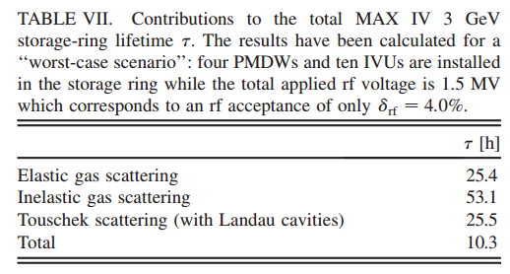
Extra slides
http://inspirehep.net/record/846682/files/PhysRevSTAB.12.pdf
S.C. Leeman, Phys. Rev. ST Accel. Beams 12, 120701 (2009)

Slide 37
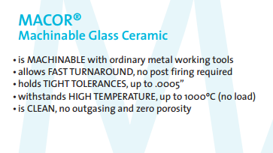
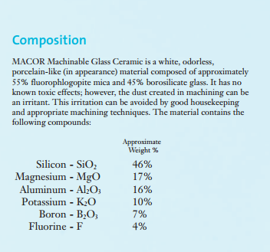

Slide 38
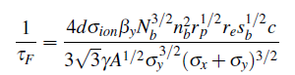
Fast Beam Ion Instability - FBII
Analytical model available*
  Instability rise time equations, with & w.o. ion freq. spread along s
Lower ε = faster instability
Raubenheimer et al. Phys. Rev. E 52, 5, 5487, Stupakov et al. Phys. Rev. E 52, 5, 5499

Slide 39
Elastic Gas Scattering
Deflections caused by the electromagnetic force of the residual gas atoms.
It can be due either by electrons or the nuclei (but the e- part is usually negligible for current LS)
particle loss
Beam
gas
Simplified Eqs:
Basic dependencies:
Number of residual particles (pressure): P↑→τ↓
Particle Charge: Z↑→τ↓
Beam energy: γ↑ →τ↑
Beta function. β↑ →τ↓
Beam size: σ_{y}↑→τ↑

Slide 40
Inelastic Gas Scattering
Energy loss caused by radiation emission (mostly) at the vicinity of the gas atoms.
In this case, electron and nuclei contributions are accounted
RF
Beam
gas
Simplified Eqs:
particle escapes the bucket potential well
Basic dependencies:
Number of rest gas atoms: P ↑→τ↓
Charge of every particle: Z ↑→τ↓
RF acceptance. δ_{acc}↑→τ↑

Slide 41
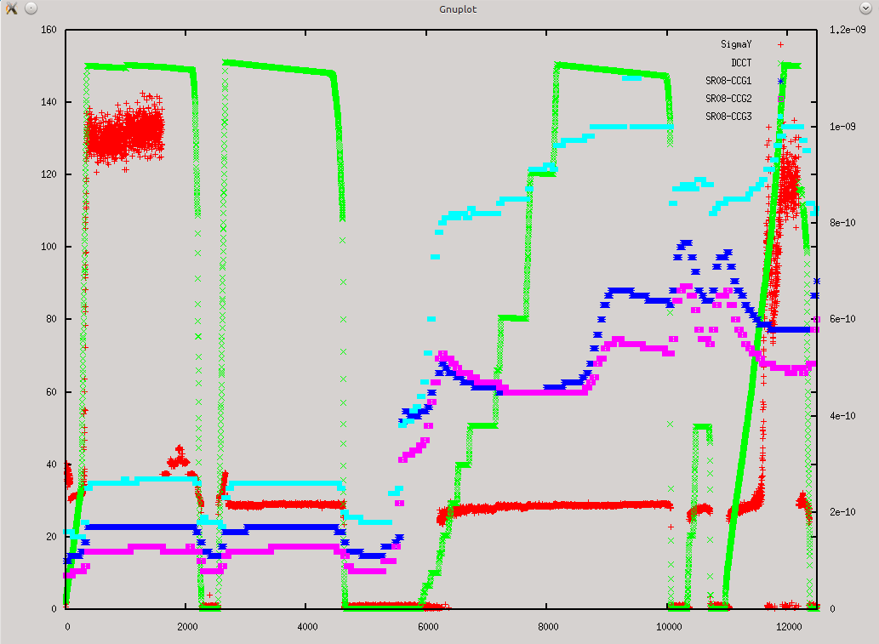
Only SR08-CCG3 behaves “as expected” in the whole range.
For CCG1 and 2, after switching off certain pumps, there is a point in which both decrease even though the current increases: this (may) mean that after a certain P, you start the formation of a significant amount of gas ionization (or e-) which affects the pressure readings.

Slide 42
