Slide 1
Alternative concept for synchrotron radiation protection for future proton colliders
R. Cimino
LNF-INFN
Motivation
An alternative solution: the concept
Preliminary experimental investigation
Conclusion

Slide 2
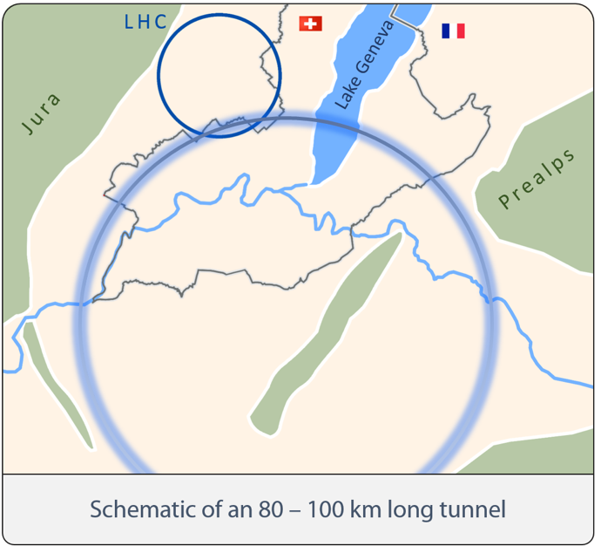
FCC-hh
Key Parameters

Slide 3
FCC-hh
Key Parameters

Slide 4
Some Numbers:
(Power ➔ Feasibility ➔ Sustainability!)
To dissipate ~ 5 MW in the FCC-hh :
@ 1.9 K (cold bore temperature) | > 7 GW
@ 4.2 K (Liquid He temperature) | > 3 GW
5 K < T < 20 K (LHC BS temperature) | > 1 GW
40 K < T < 60 K (FCC-hh BS temperature) | Hopefully 100 M W (max. available power!)
At Room temperature | ~ 6 - 10 M W

Slide 5


From LHC Beam screen concept
(5 K < T < 20 K)
LHC
F. Zimmermann et al., HF2014, Bejing, China (THP3H1)
43.6 mm
SR = 0.17 W/m/ap
Tot. Power =0.007 MW
O. Gröbner, Vacuum 60 (2001) 25-34

Slide 6
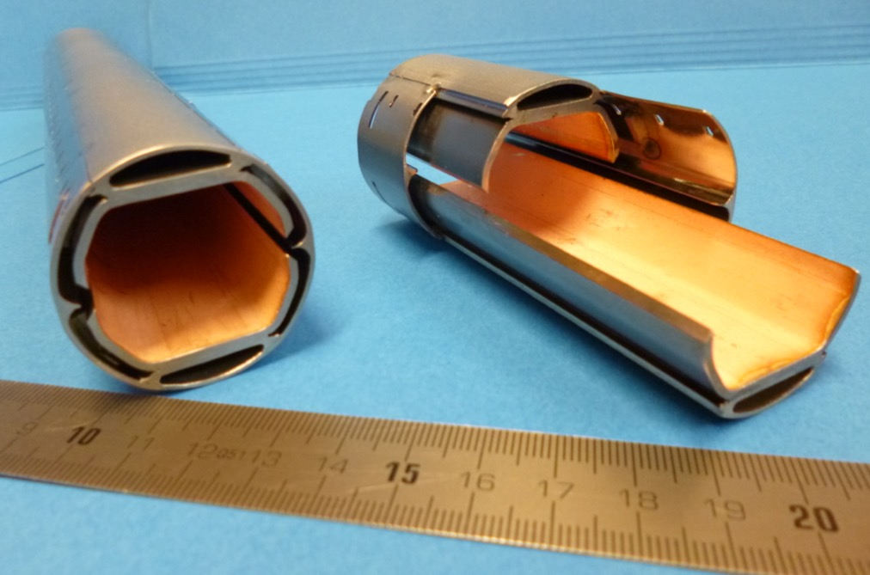
To FCC-hh Beam screen optimization
(40 K < T < 60 K)

Slide 7
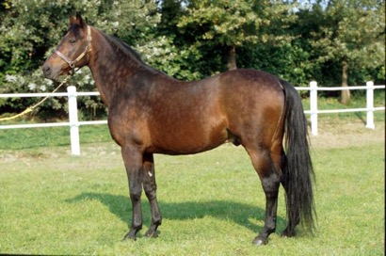
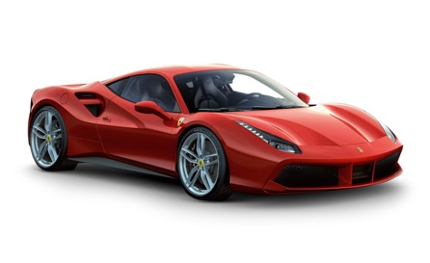
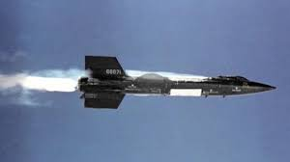
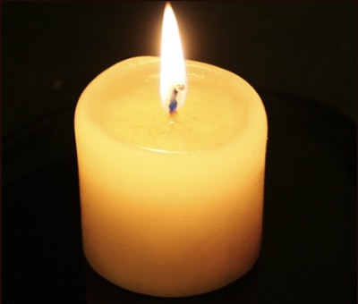

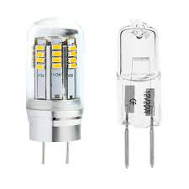
Optimization often is the only way!
But it is not always the solution.
X
X
X
X

Slide 8
Do alternatives to optimization of HL removal from BM cold masses exists?
From:
APS/Alan Stonebraker
Superconducting magnets continuously radiates photons and hence heat. This heat-removal process is already expensive, costing a few thousand dollars per hour of operation; estimates suggest that the weekly bill for a 100-TeV accelerator might soar into the millions. The proposal by Cimino (Phys. Rev. Lett. 115, 264804 (2015)) and his colleagues is to coat the interior of the copper tube with a thin layer of carbon that reflects all the incident radiation. The surface structure of the carbon coating is designed so that the radiation, and the heat it carries, is transported away from colder regions towards periodically placed room-temperature absorbers, which are easier and cheaper to cool than the tube itself. The authors claim that this design would reduce the power consumption potentially cutting the associated costs in half. (– Katherine Wright, APS, Physics)

Slide 9
Speculation:
Is there an alternative method to deal with SR in FCC-hh?
SR interacts with matter so that:
T(rasmission) + R(eflected) +A(absorbed) =
28.4 (44.3) W/m/aperture

Slide 10
Ideally, by reflecting most photons from cold parts and adsorb them at Room temperature one can reduce the HL on Dipole cold masses.
Reflectivity depends on:
machine parameters like:
Photon energy
Angle of incidence
Material properties like:
Surface composition
Roughness

Slide 11
Ideally, by reflecting most photons from cold parts and adsorb them at Room temperature one can reduce the HL on Dipole cold masses.
Reflectivity depends on:
machine parameters like:
Photon energy
Angle of incidence
Material properties like:
Surface composition
Roughness

Slide 12
R. Cimino, et al PRL. 115 (2015) 264804

Slide 13
Percentage of SR power carried by all photons at lower energies than a given
photon energy (hn) normalized to E_{c}
R. Cimino, et al PRL. 115 (2015) 264804

Slide 14
Ideally, by reflecting most photons from cold parts and adsorb them at Room temperature one can reduce the HL on Dipole cold masses.
Reflectivity depends on:
machine parameters like:
Photon energy
Angle of incidence
Material properties like:
Surface composition
Roughness

Slide 15
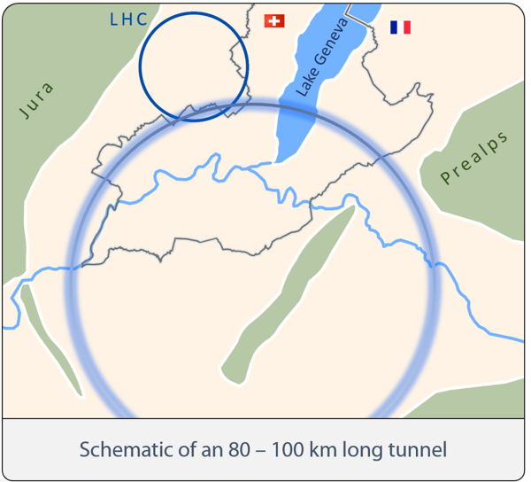
SR Geometry for FCC-hh
a 100 Km ring imply that SR will impinge at an incredibly small angle:
Θ ~0.62 mRad ~ 0.035°
at ~ 21 m from source
photon fan strip ~ 2 mm
R. Cimino, et al PRL. 115 (2015) 264804

Slide 16
Ideally, by reflecting most photons from cold parts and adsorb them at Room temperature one can reduce the HL on Dipole cold masses.
Reflectivity depends on:
machine parameters like:
Photon energy
Angle of incidence
Material properties like:
Surface composition
Roughness

Slide 17
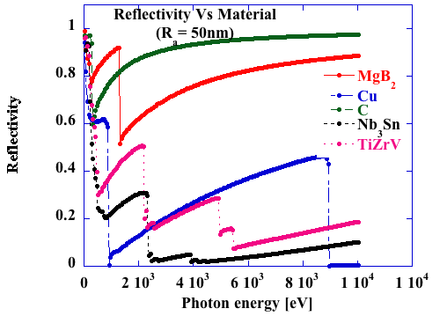
Reflectivity of Beamscreen between 30 eV and 10 KeV
at ~ 0.035° grazing incidence vs material (50 nm roughness)
R. Cimino, et al PRL
115 (2015) 264804

Slide 18
Ideally, by reflecting most photons from cold parts and adsorb them at Room temperature one can reduce the HL on Dipole cold masses.
Reflectivity depends on:
machine parameters like:
Photon energy
Angle of incidence
Material properties like:
Surface composition
Roughness

Slide 19
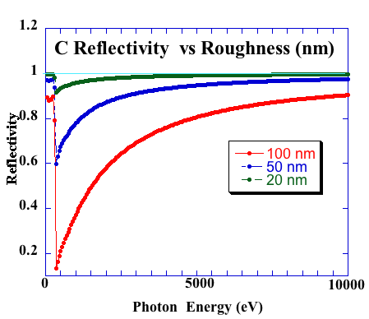
A-c R between 30 ev and 10 kev at ~ 0.035° grazing incidence vs roughness
(N. Kos, CERN TE-VSC: Ra of LHC copper layer was 0.05-0.1 µm.)
50 %
power
50 %
power
ε_{c}
R. Cimino, et al PRL. 115 (2015) 264804
http://henke.lbl.gov/optical_constants/ & RELFEC

Slide 20
Surface roughness: at very grazing angle difficult to treat theoretically as a Debye Waller factor
R. Cimino, et al PRL. 115 (2015) 264804

Slide 21
Within 500m ~ 30% of expected HL adsorbed @ LT

Slide 22
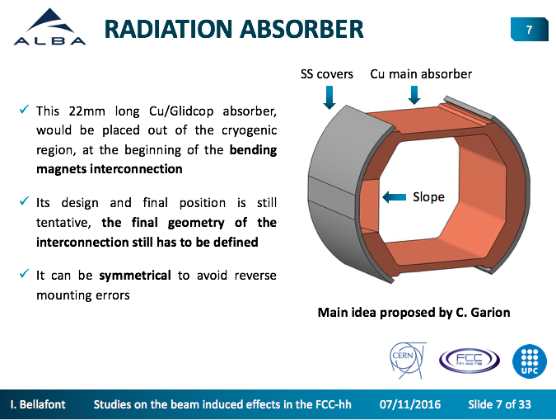
Room temperature absorbers already considered for the base line design of FCC-hh!

Slide 23
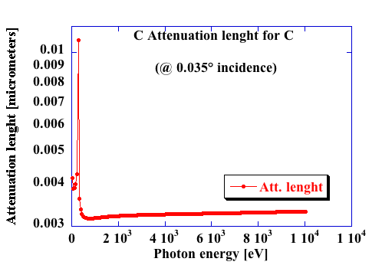
BUT will a C Layer cause Impedance problems?
R. Cimino, et al PRL. 115 (2015) 264804
C thickness | T (%)
~ 3.5 nm | ~ 37%
~ 7 nm | ~ 13 %
~ 10 nm | ~ 5 %
~ 14 nm | ~ 2 %
~ 20 nm | ~ 0.02 %
20 nm of a-C are enough!
Attenuation Length:
The depth into the material measured along the surface normal where the intensity of x-rays falls to 1/e of its value at the surface.
Little or no effect on Impedance (which will be affected by the properties of at least few microns).
http://henke.lbl.gov/optical_constants/

Slide 24
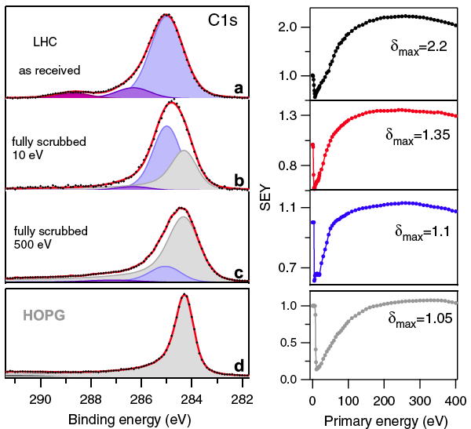
Reflected HL can be absorbed in “ad hoc” designed RT machine parts!
Obtaining low R surfaces is as difficult (or more) than high since:
Low grazing incidence (high reflectivity)
Roughness not too efficient to reduce R (to be studied).
High absorbing material choice could be irrelevant due to the natural ease at which C layers grow on surfaces upon electron (or) photon irradiation:
the chemical origin of “scrubbing”
at LT: A. Kuzucan, et al JVAC. A 30, 051401 (2012)
Photon distribution along the beam
pipe depends on the curvature of the
tube (Optical ray tracing)
R. Cimino, et al PRL. 109 (2012) 064801

Slide 25
Optical RAY tracing:
It instructive to push to the limit and calculate the X-Ray transmission trough a perfectly reflecting and Cylindrical in shape beam pipe.
Optical raytracing for an X-ray at εc (hν=4.5 KeV)
Source:10x10μm 1 mm long.
Photon Beam divergence: hor = arbritary ; Vert. = 1/γ
R. Cimino, et al PRL. 115 (2015) 264804

Slide 26
Ray tracing calculations with perfect optics:
SO
CY (ρ=13. mm)
SIDE VIEW
CY
1/γ = 18.7 μrad
2 mm
0
21
Distance to source (m)
63
Source
10x10 μm
@ 21m
<2 mm vertical
First focus
Verical~13 μm
@ 63 m
<2 mm vertical
R. Cimino, et al PRL. 115 (2015) 264804

Slide 27
@ 63 m Vert. Hight < 2 mm
@ 105 m Vert. Hight < 2 mm
@ 147 m Vert. Hight < 2 mm
Calculation done with:
RAY & Reflec codes developed
for X-ray optics at BESSY 2
See: “The BESSY Raytrace Program RAY”, By F. Schäfers in: “Modern Developments in X-Ray and Neutron Optics” Springher.
R. Cimino, et al PRL. 115 (2015) 264804

Slide 28
@ 63 m Vert. Hight < 2 mm
@ 105 m Vert. Hight < 2 mm
If Reflectivity is high enough not only we can control and “push” the heat load out of dipoles, but, exploiting the beampipe curvature, confine photons (and photoelectrons) in the horizontal plane!
@ 147 m Vert. Hight < 2 mm
Calculation done with:
RAY & Reflec codes developed
for X-ray optics at BESSY 2
See: “The BESSY Raytrace Program RAY”, By F. Schäfers in: “Modern Developments in X-Ray and Neutron Optics” Springher.
R. Cimino, et al PRL. 115 (2015) 264804

Slide 29
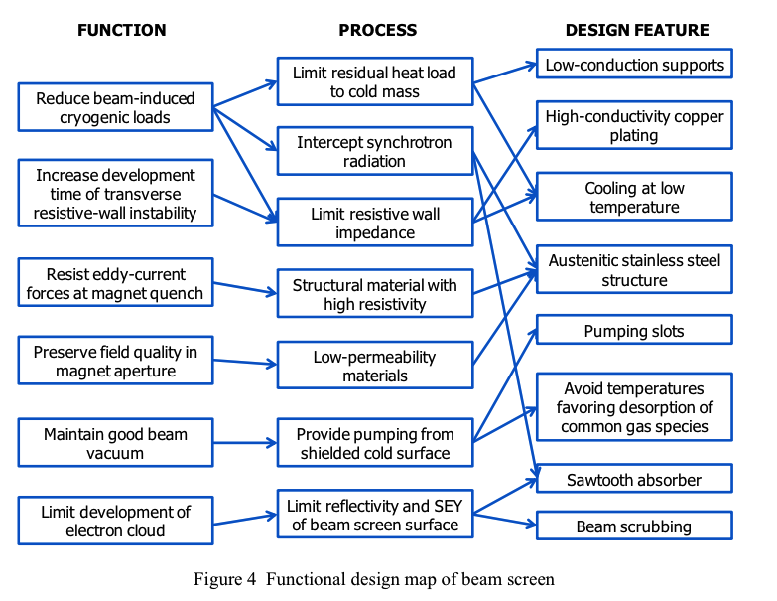
Any adopted solution for the Beam screen has to compel with many other requirements and boundary conditions.
From:
Cryogenic Beam Screens for High-Energy Particle Accelerators
By:
V. Baglin , Ph. Lebrun, L. Tavian, R. van Weelderen
CERN-ATS-2013-006
Presented at ICEC24-ICMC2012.

Slide 30
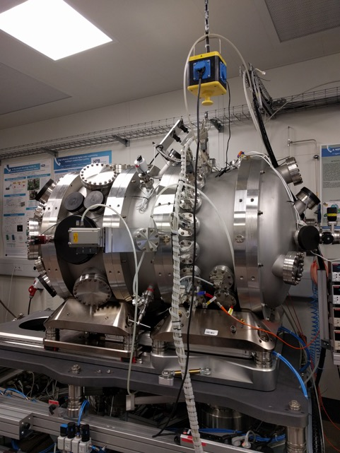
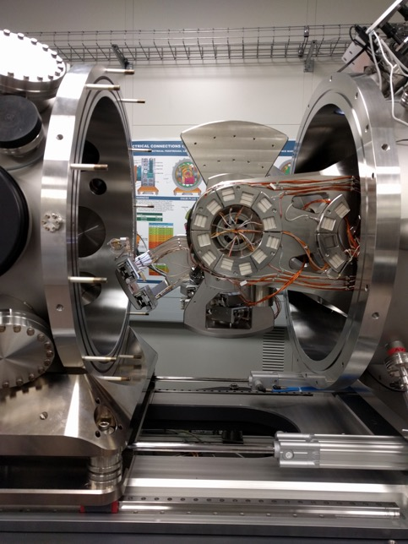
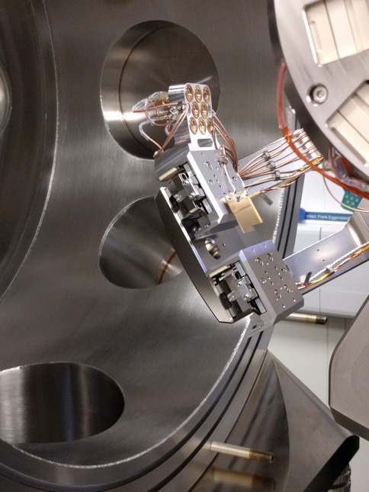
Preliminary search for experimental proofs:
BESSY II reflectometer

Slide 31
Bessy II Reflectometer
Incidence angle θ: -90° – 90°
Detector in-plane 2θ: -180° – 180°
Detector off-plane χ : -4° – 4°
Sample – detector: 310 mm
Six axes sample positioning
Sample current measurement
GaAs-Photodiodes
Detector slits, pinholes

Slide 32
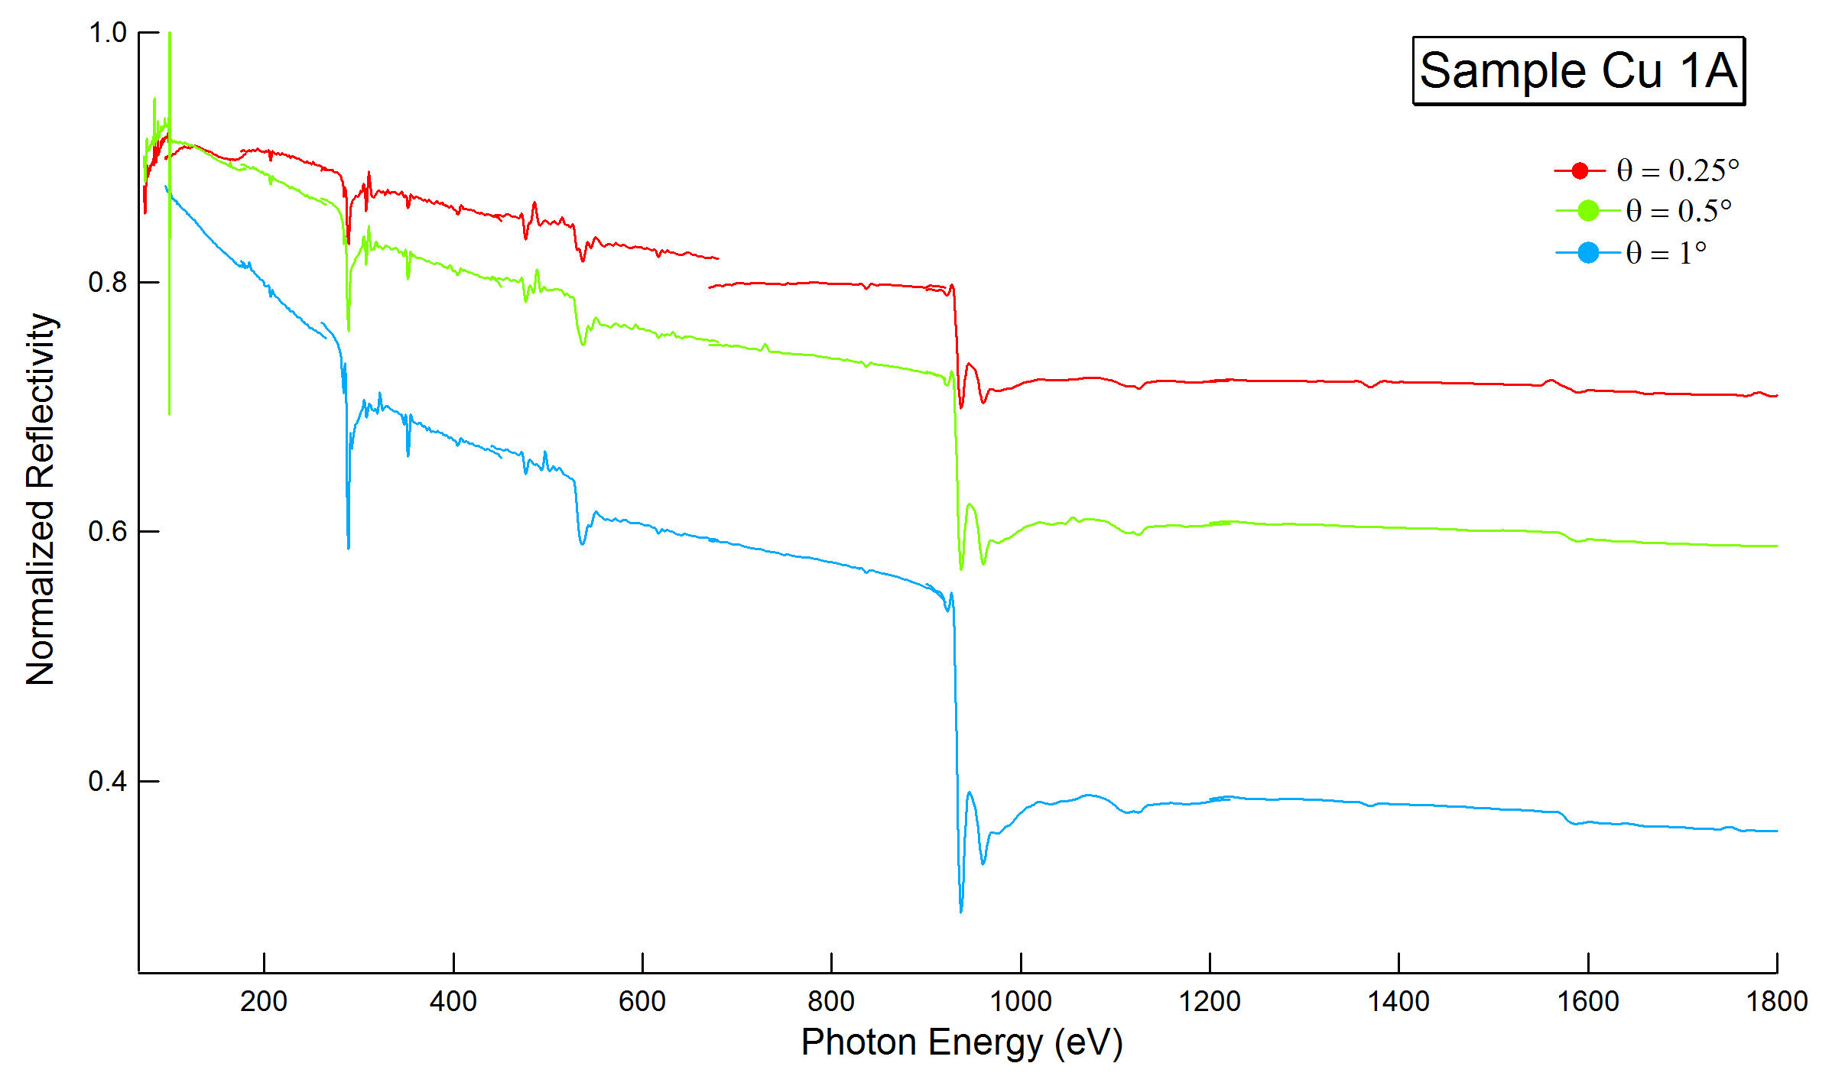
Cu L_{2,3} edge
Preliminary
measurements
Θ = 0.25°
Θ = 0.5°
Θ = 1°
O K edge
C K edge

Slide 33
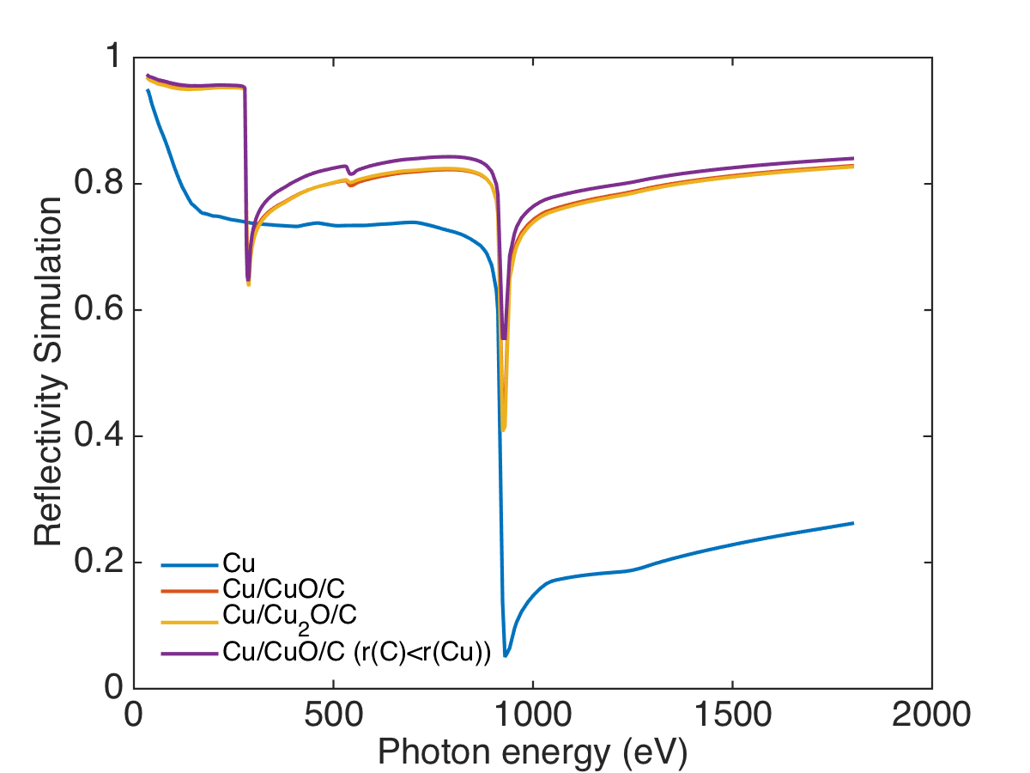
Cu – Ra=10 nm - Θ = 0.25°
Cu + CuO+a-C
Preliminary
simulations
Pure Cu

Slide 34
In conclusion:
Reflectivity is an extremely important parameter to be controlled and (eventually) beneficially utilized. In all cases:
Validate reflectivity simulations and refine models.
Developing and study smooth surfaces and high quality low C coverages (~ 20 nm).
Identify absorbers type and locations.
Identify compatibility with machine design and Beam Screen constrains.
Study and measure realistic Photo Yield and Reflectivity, as essential ingredients to single bunch and/or e⁻cloud related instabilities.
Carbon reflecting layers will be there…. they should be studied anyway!
Lot of work to bring this “Speculation” to be a B plan for the Feasibility and Sustainability of FCC-hh project.

Slide 35



Acknowledgments:
Eliana La Francesca, Marco Angelucci
& DAFNE-Light team
INFN-LNF, Frascati (RM), Italy
Franz Schäfers (HZB), A. Sokolov, F. Sievert BESSY II, Institute f. Nanometre Optics and Technology Berlin, Germany
V. Baglin, and the Vacuum Group @ CERN, Geneva, Switzerland

