Slide 1
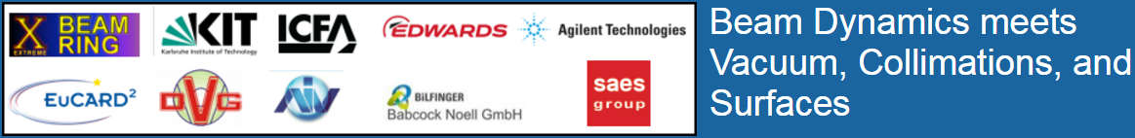

Slide 2
The SR in the FCC-hh 2 m-Long Test Tube at ANKA
LHC at similar current and energy (0.5 A, 7 TeV), 8.33 T bending field (ρ=2804m):
Critical energy: 43.8 eV
Photon flux: 7.4·10²⁰ ph/s → 4.2·10¹⁶ ph/m/s (m of arc dipole trajectory)*
Power: 3.3 kW → 188 mW/m (m of arc dipole trajectory)*
FCC-hh at nominal current and energy (0.5 A, 50 TeV), 15.9 T bending field:
Critical energy: 4.3 keV
Photon flux: 9.69·10²¹ ph/s → 1.47·10¹⁷ ph/m/s (m of arc dipole trajectory)*
Power: 2.32 MW → P’ = 35.2 W/m (m of arc dipole trajectory)*
ANKA (0.150 A, 2.5 GeV), 1.5 T bending field (ρ=5.56m):
Critical energy: 6.23 keV
Photon flux: 2.72·10²⁰ ph/s → 4.34·10¹⁶ ph/s/mrad
Power: 93.22 kW → 14.84 W/mrad
ANKA (0.150 A, 2.209 GeV), 1.473 T bending field (ρ=5.56m):
Critical energy: 4.3 keV (same as FCC-hh at 50 TeV)
Photon flux: 2.33·10²⁰ ph/s → 3.7·10¹⁶ ph/s/mrad
Power: 56.82 kW → 9.04 W/mrad
Conclusion: Photodesorption is much more important for the vacuum quality in FCC-hh as compared to LHC; ANKA can simulate reasonably FCC-hh’s spectrum and linear power, and even at nominal beam energy (2.5 GeV) ANKA’s spectrum is a close match of that of FCC-hh.
(*) without considering the filling factor in the arcs

Slide 3
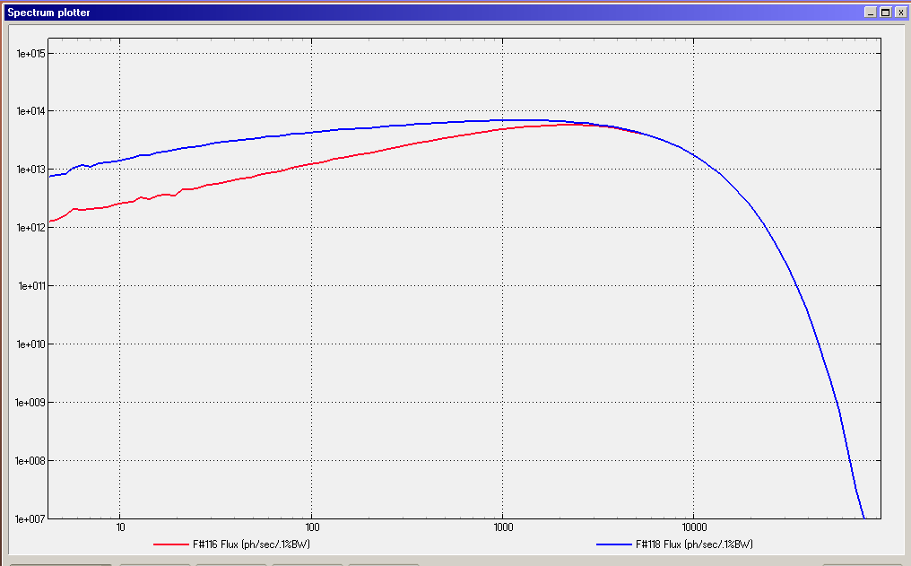
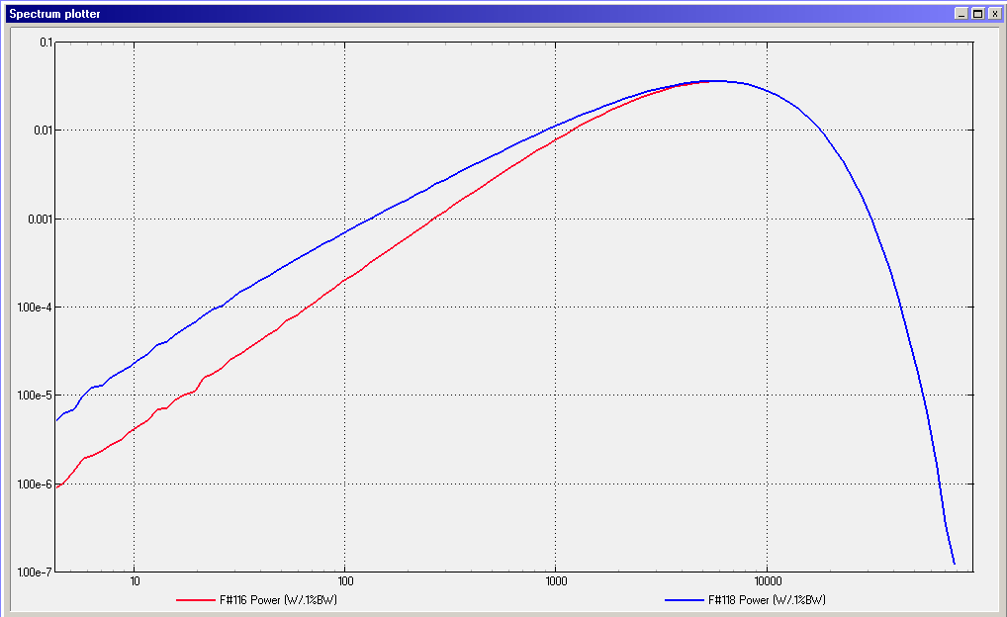
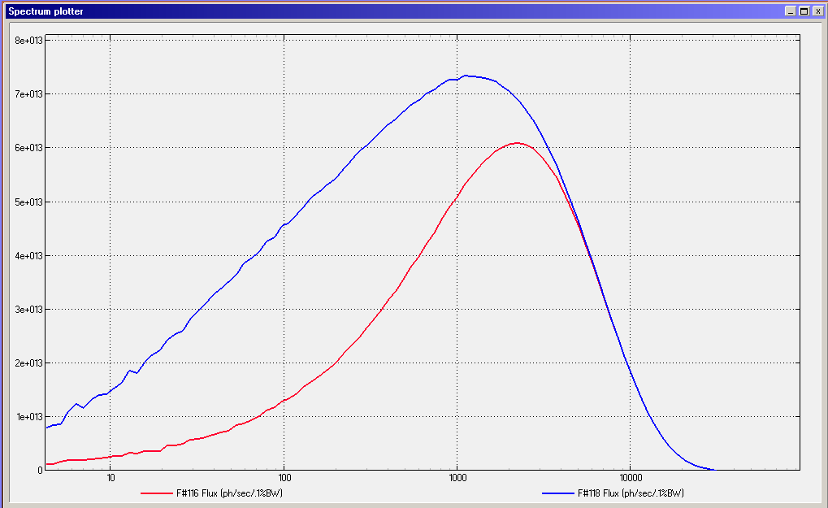
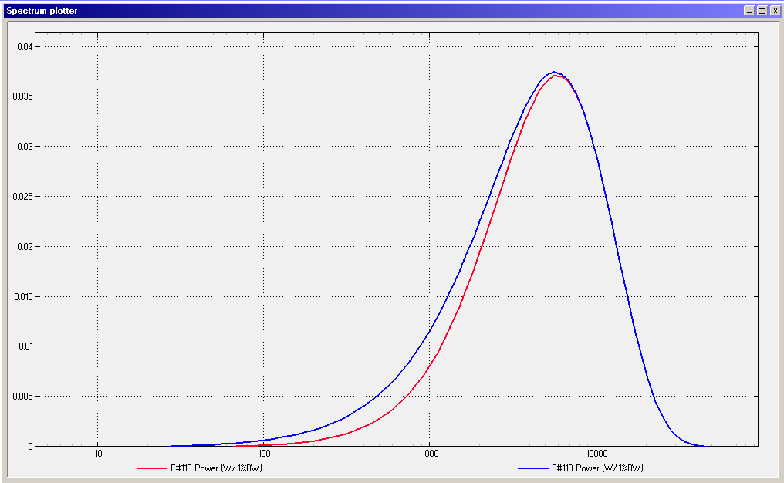
The Synchroton Radiation in the FCC-hh 2 m-Long Test Tube at ANKA
SR spectrum: full vertical opening vs 2mm-high collimation
Beam energy: 2.209 GEV; Beam current: 400 mA
About 42.3% of the generated photon flux is cropped by the 2mm vertical collimation ←
10% of the power is cropped too ←

Slide 4
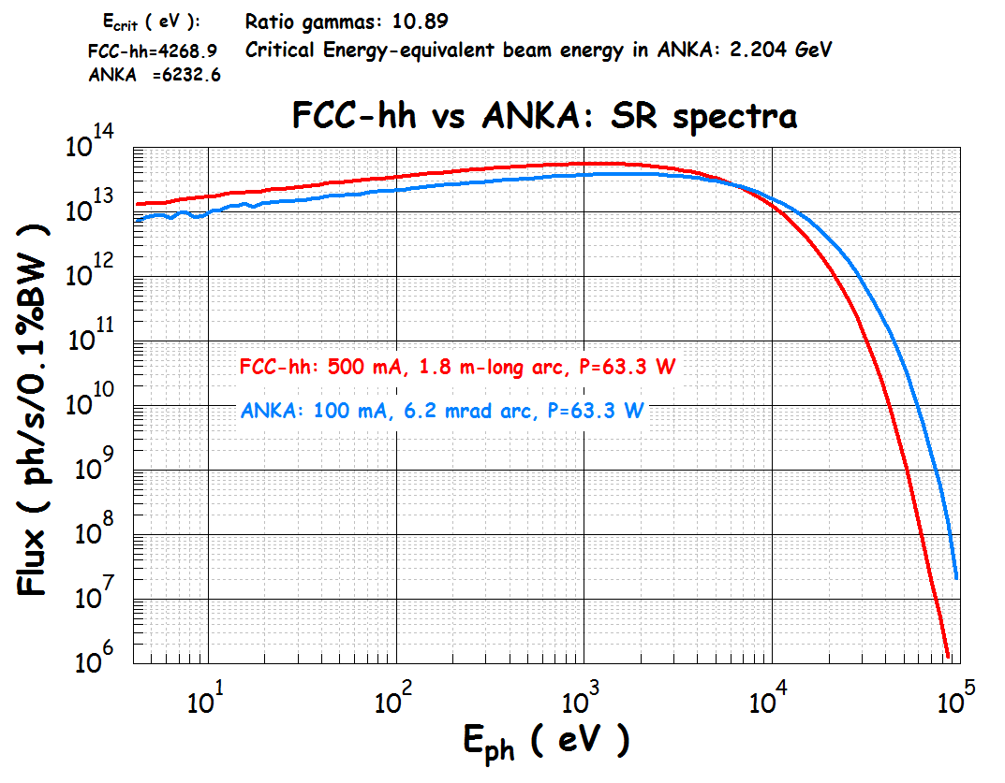
The Synchroton Radiation in the FCC-hh 2 m-Long Test Tube at ANKA
TOTAL PHOTON FLUX:
FCC-hh: 2.65·10¹⁷ ph/s
ANKA : 1.79·10¹⁷ ph/s (0.68x)

Slide 5
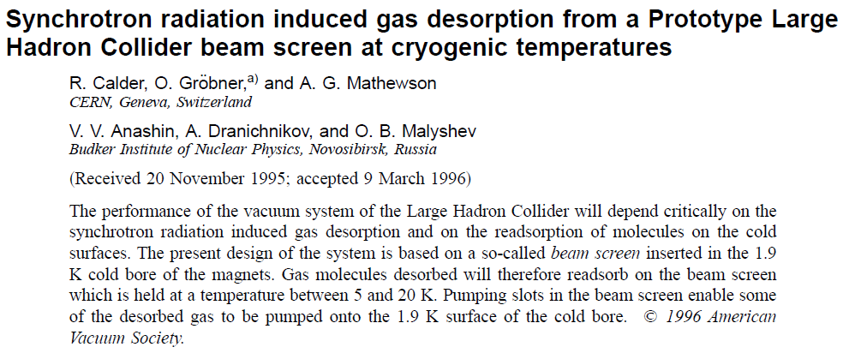
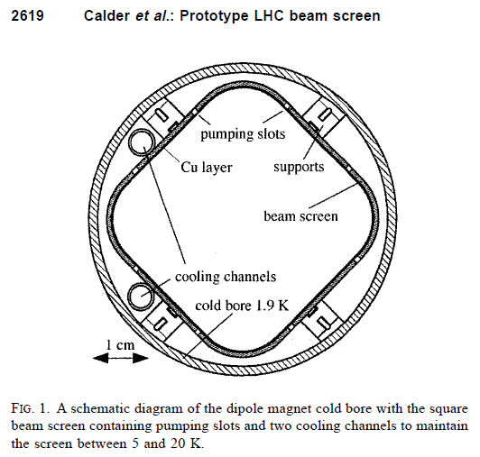
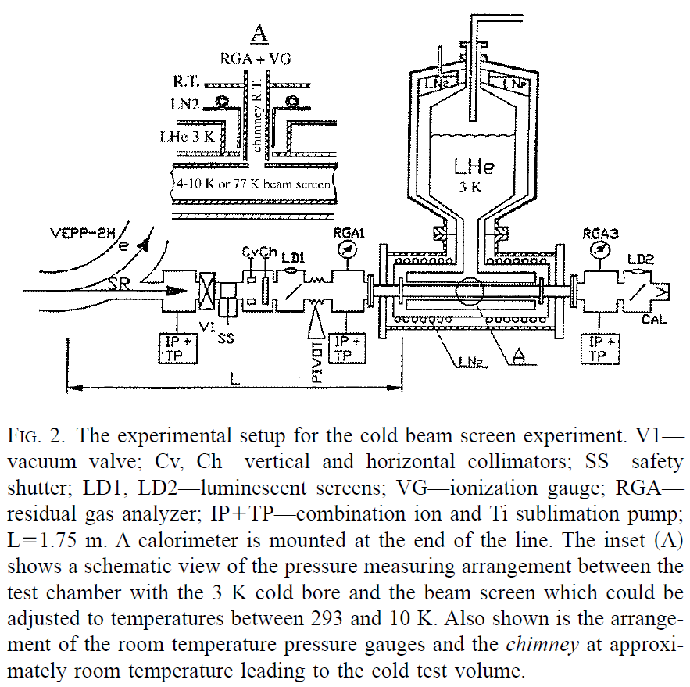
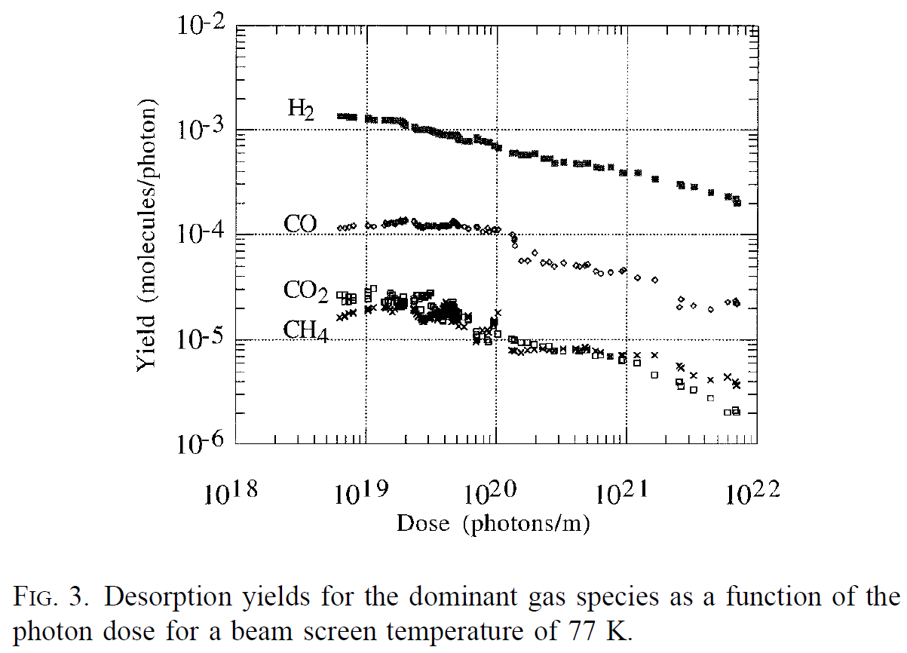
How to measure the primary photodesorption yield (PPY), and other quantities relevant to vacuum as well?
In the past, it has been measured like this (beam screen at LHe temp.):
When a perforated beam-screen is present, the axially-distributed linear pumping given by the pumping slots makes such that sufficiently away from the ends (~2 times the BS internal diameter) the pressure/gas density is not sensitive to what happens outside of the BS, in the room-temperature part of the system;
That is why a “chimney” is placed in the middle of the BS, to measure the local pressure/density.

Slide 6
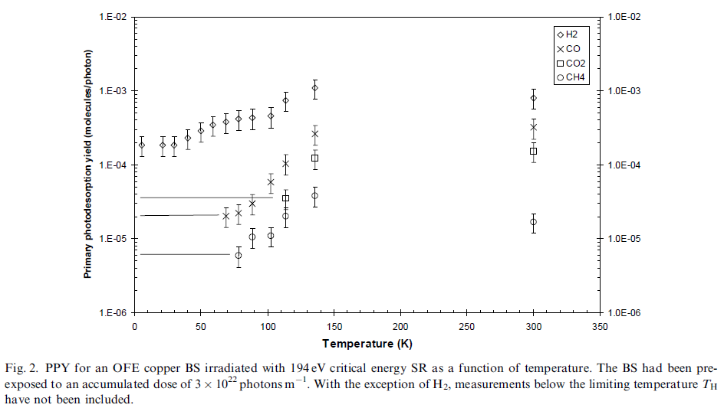
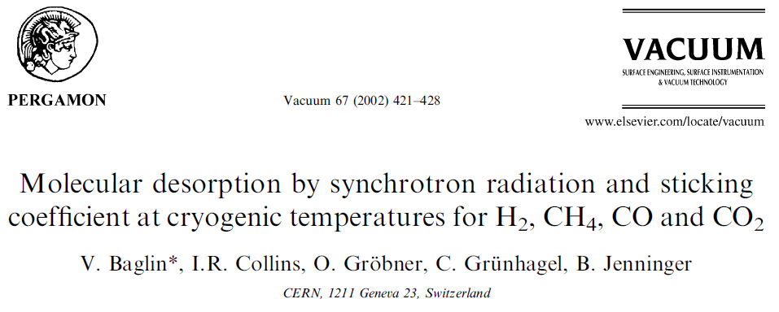
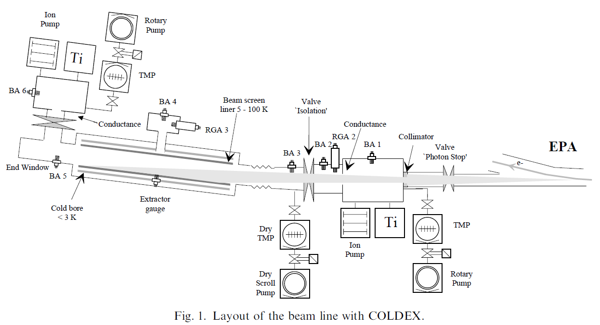
In the past, it has been measured like this (beam screen at LHe temp.):

Slide 7
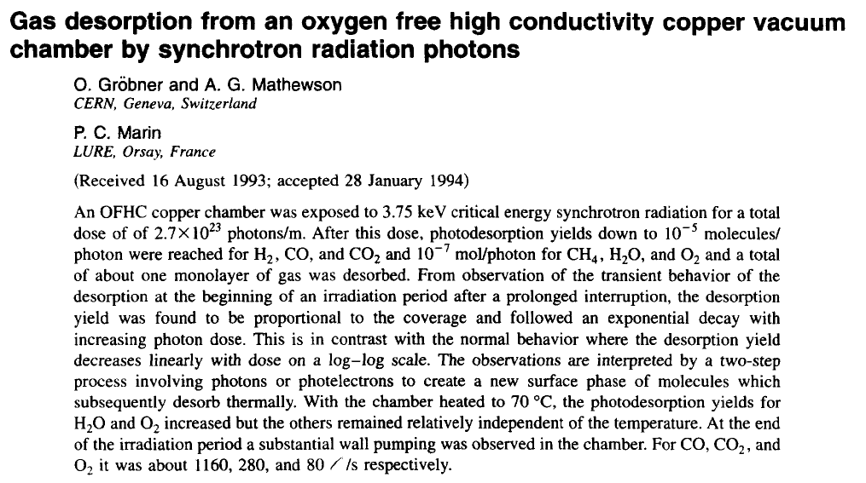
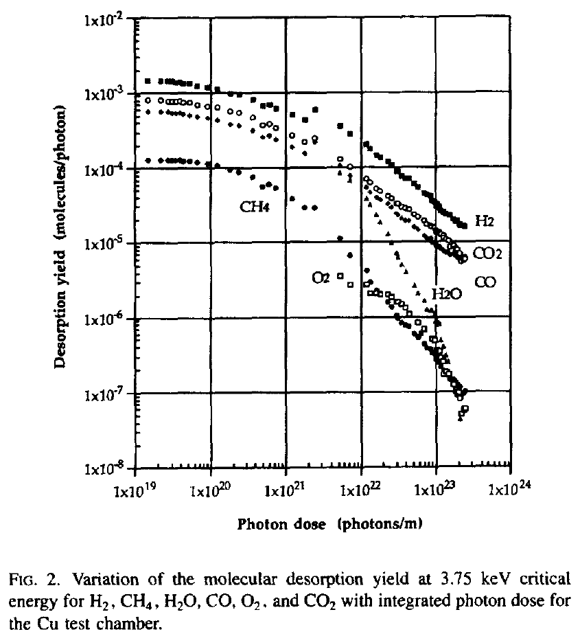
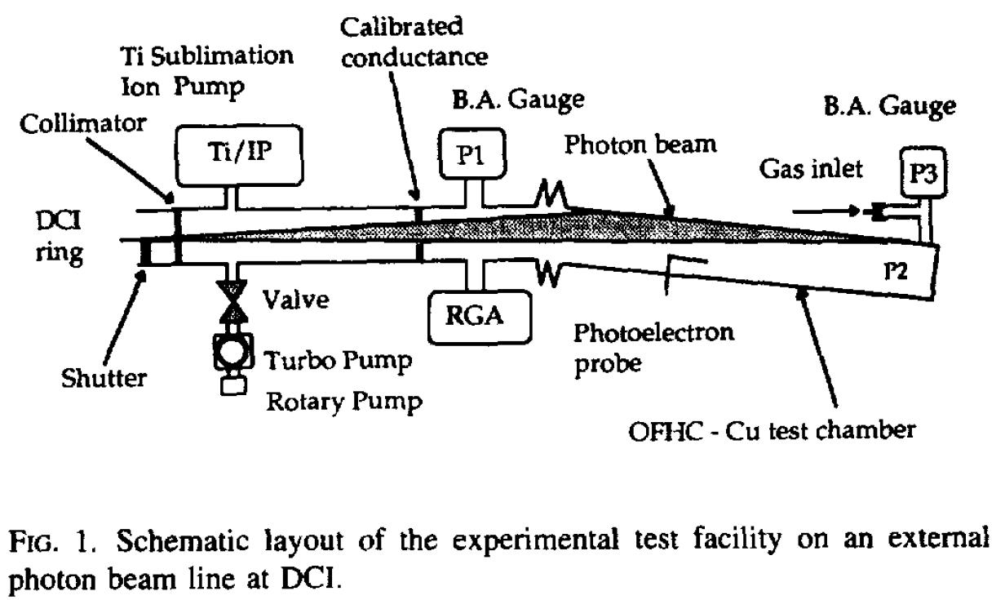
For room temperature measurements on tubes:
D=Photon Dose
η(D)=η₀ D^{-x}
Typ.: 0.33<x<1
At room temperature, when no BS is present, there is no need for a central point of measurement of the pressure/density;
The value of the PPY η(mol/ph) is typically calculated by measuring the pressure drop across a known conductance;

Slide 8
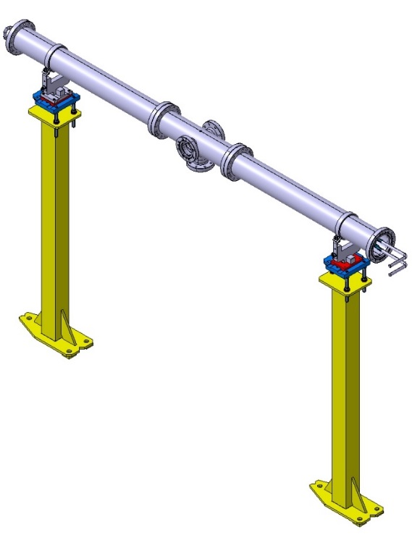
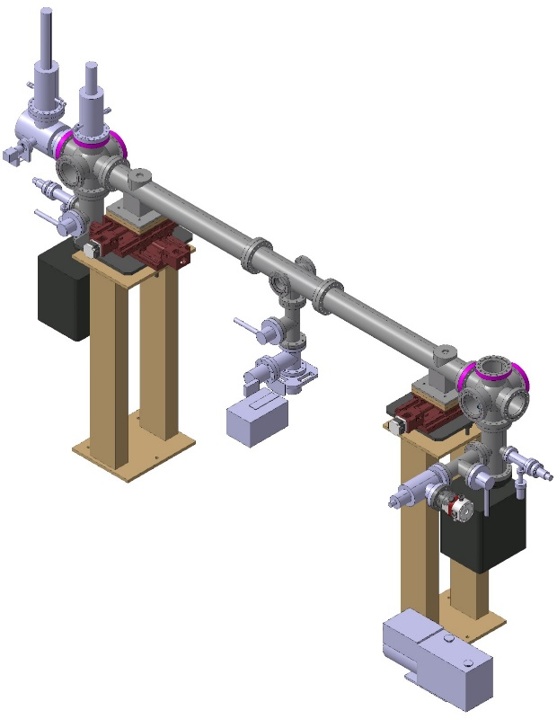
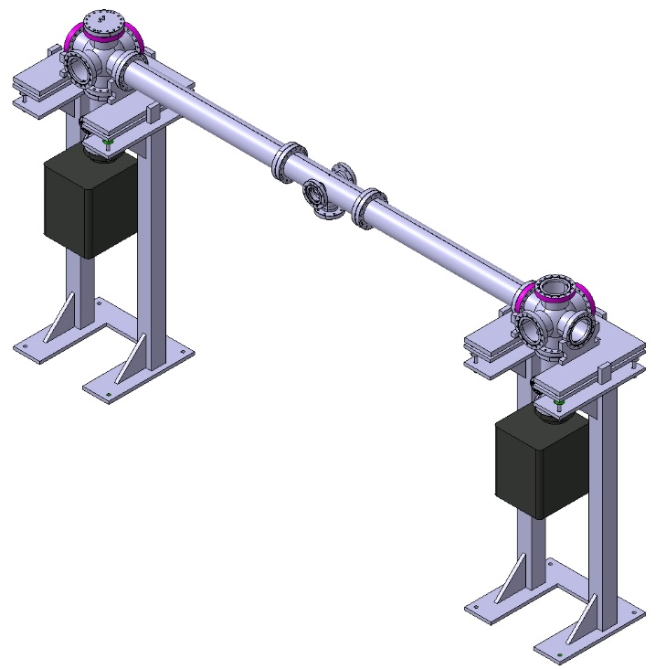
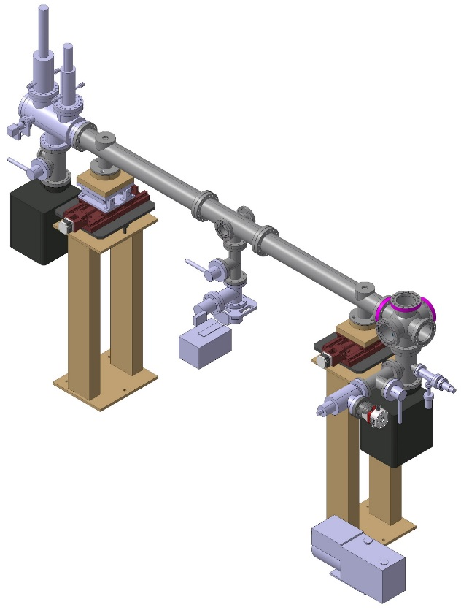
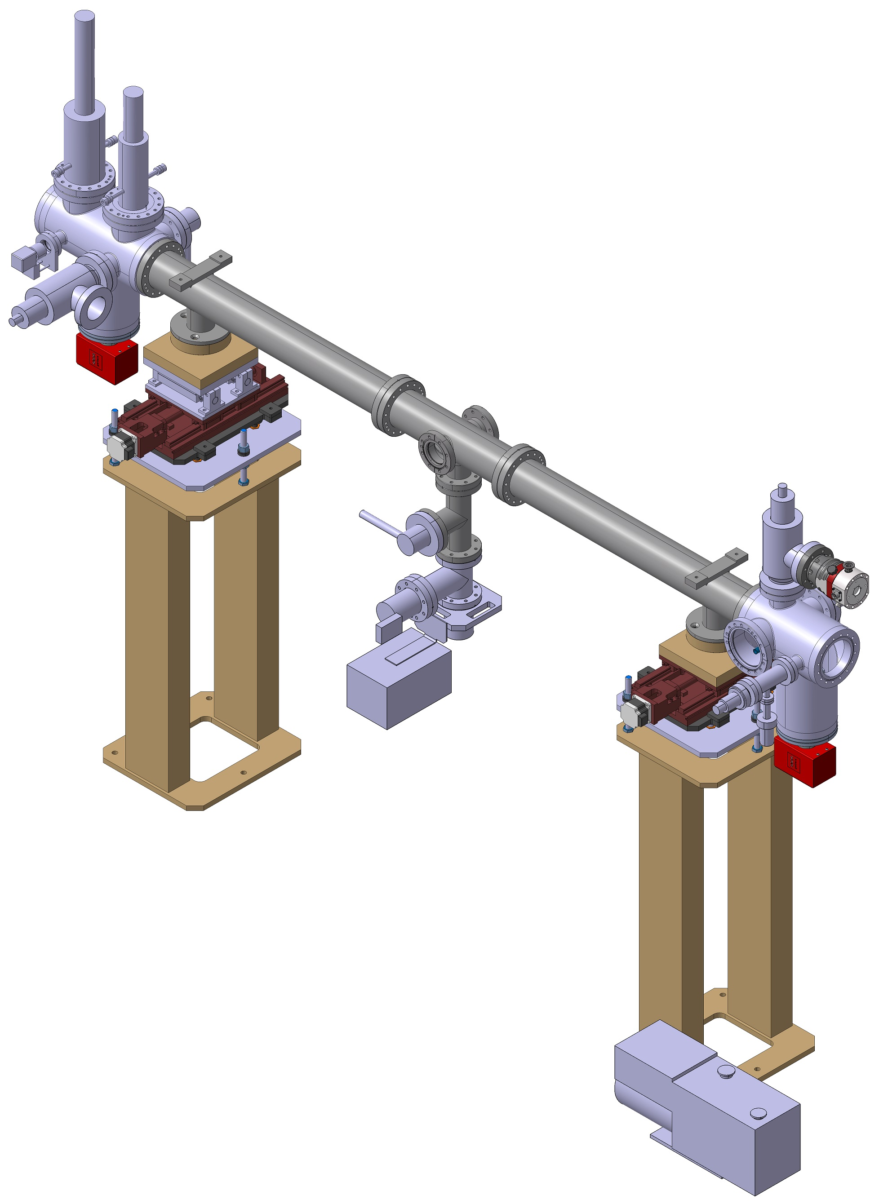
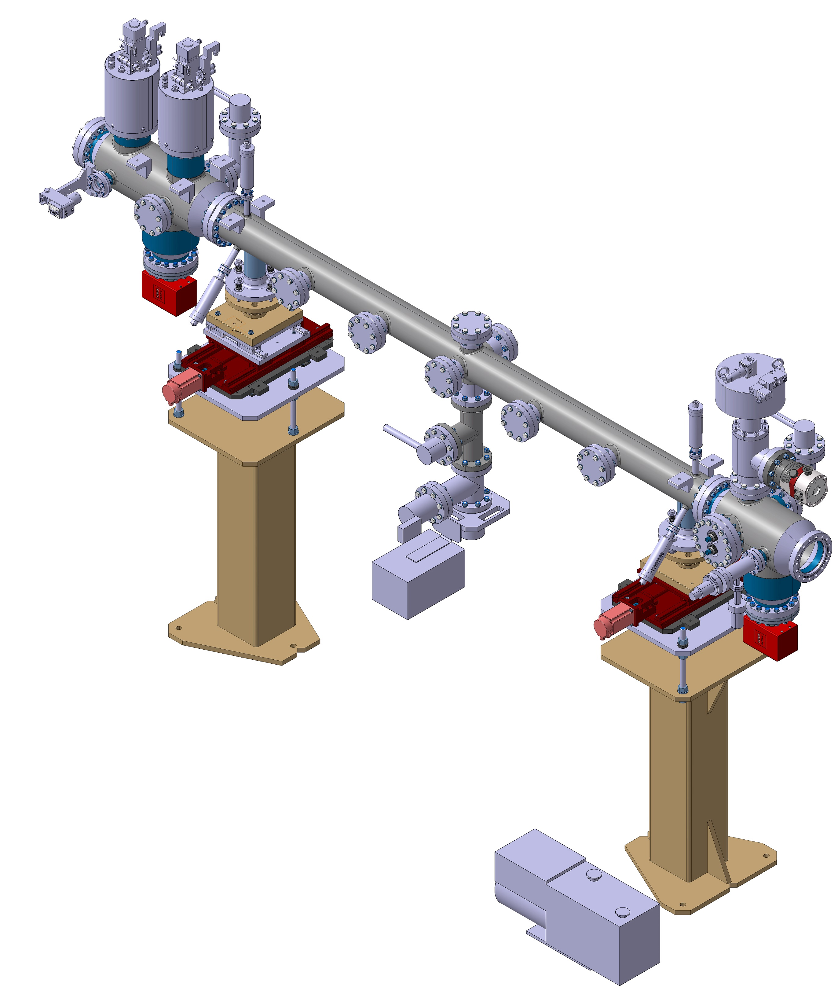
The ANKA Beamline Set-up: with Chimney and no Conductance
Slides provided by M. Gil Costa (CIEMAT/CERN) and L. Gonzalez Gomez (INFN/CERN)
November 2015
February 2016
March 2016
*Design presented in Orsay Dec/2015
*Design presented during ANKA visit March/2016
April 2016
July 2016
November 2016
*Design presented at CERN July/2016
*Design presented in Barcelona November/2016

Slide 9
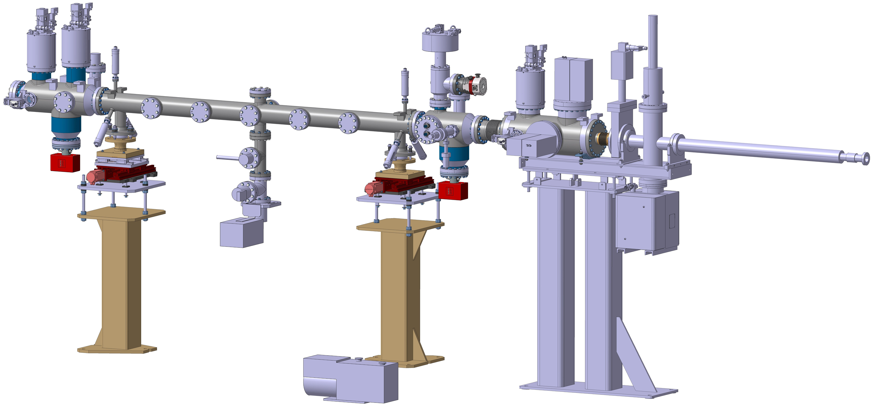
2 - FCC Test Line 5th Update

Slide 10
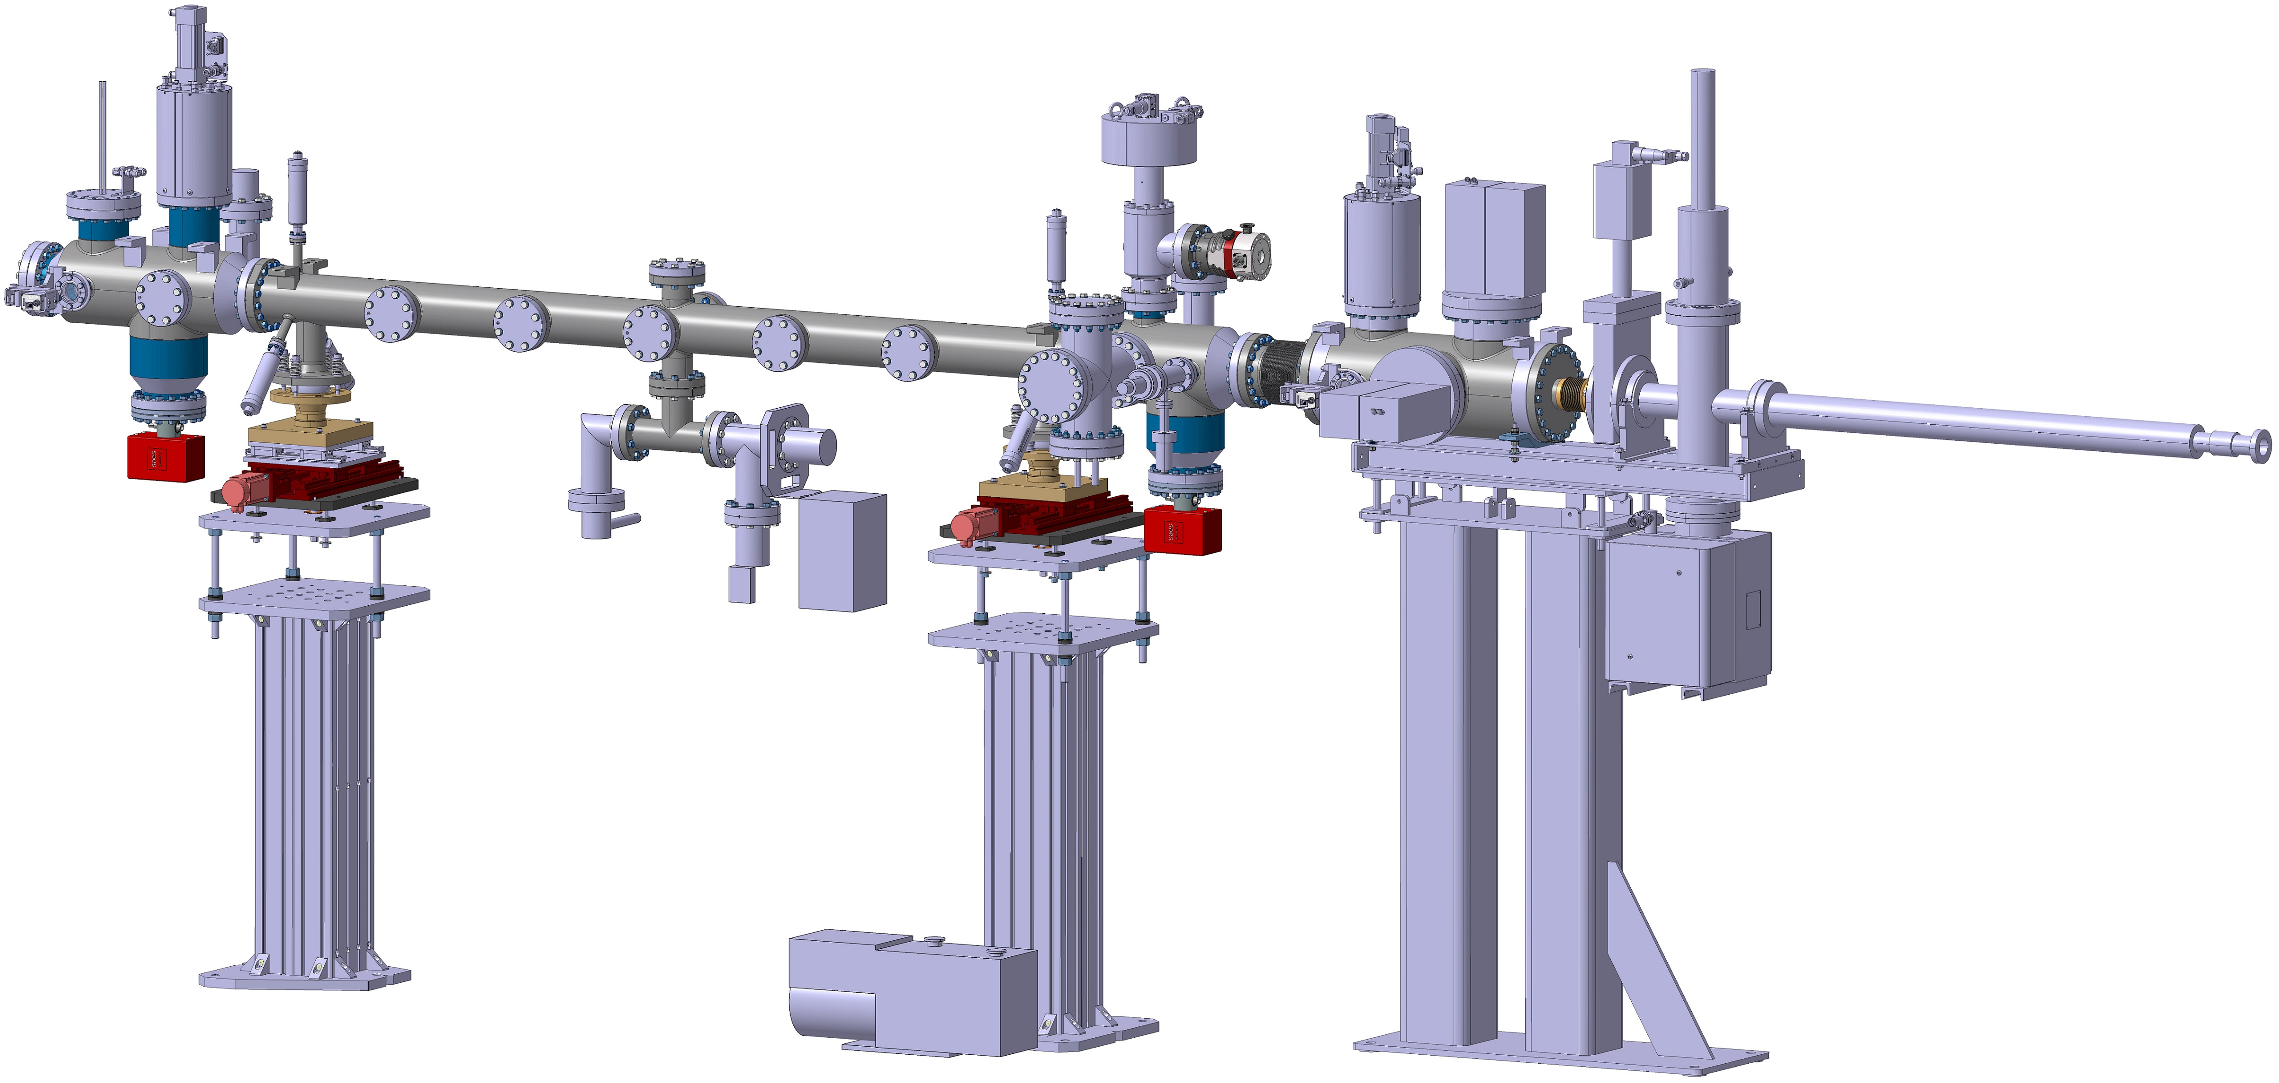
2 - FCC Test Line 5th Update

Slide 11
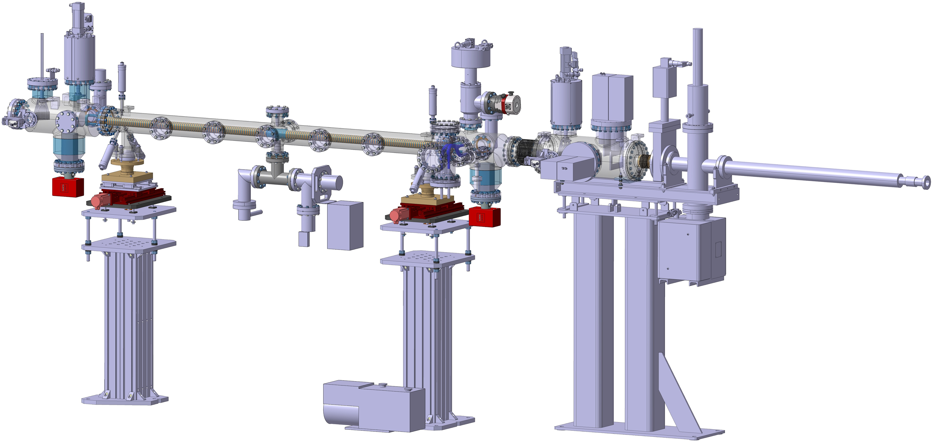
2 - FCC Test Line 5th Update

Slide 12
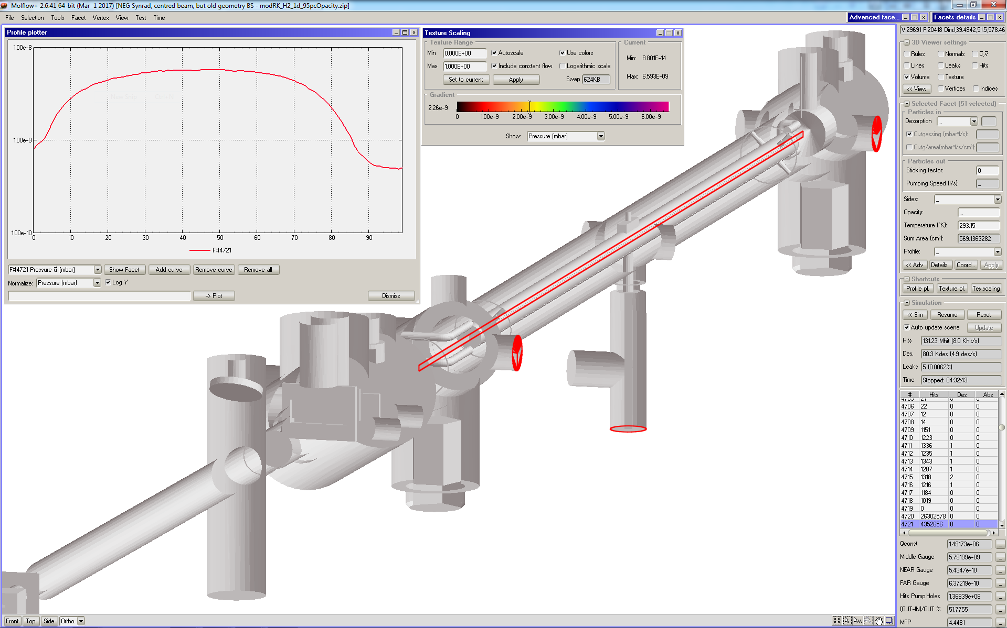
Montecarlo Ray-Tracing Analysis: the Model
Exported from CAD (STL format): All BL components are in; Longitudinal rectangle: 2.42 m-long test pressure facet; other red surf.: gauges’ positions

Slide 13
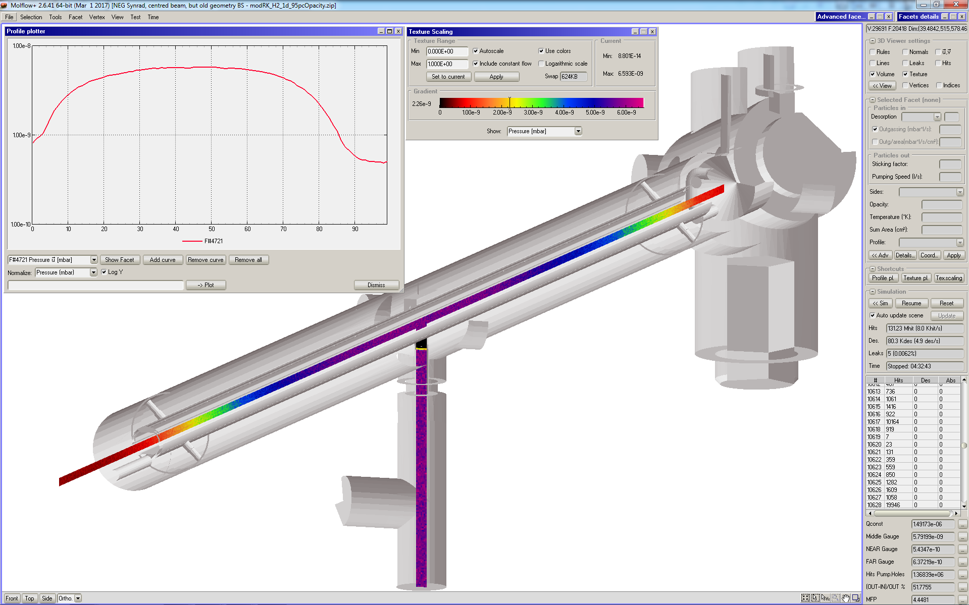
Montecarlo Ray-Tracing Analysis: the Model with Test Pressure Facets
Longitudinal and vertical pressure profiles (textured); the one along the chimney is ~ constant (minimal contribution from scattered photons);

Slide 14
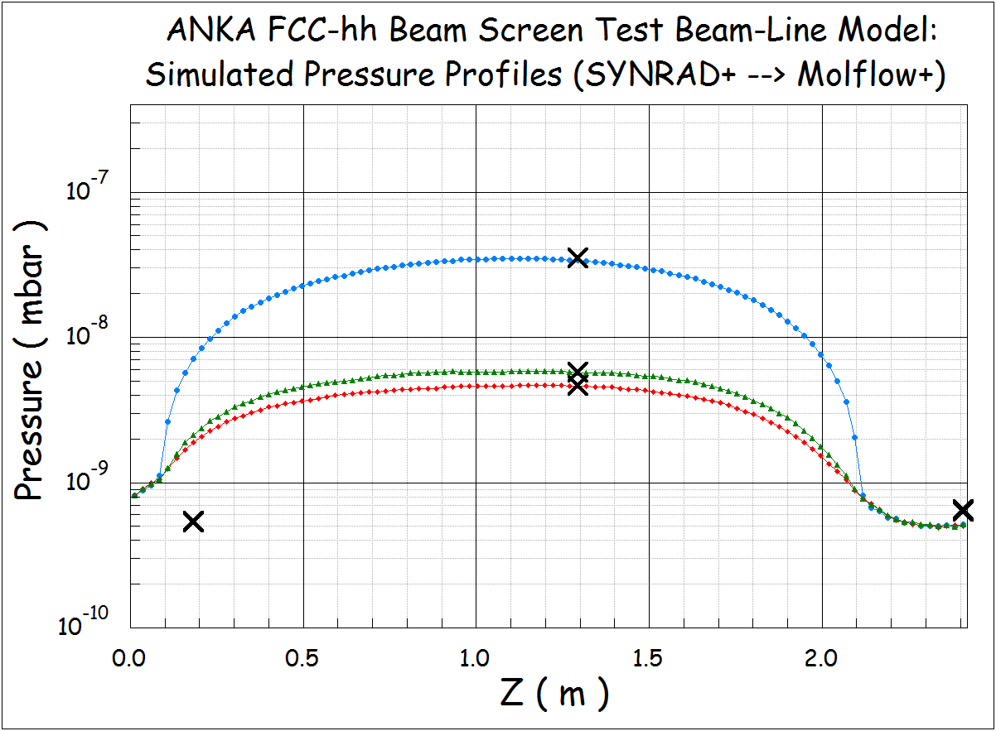

Montecarlo Ray-Tracing Analysis: the Pressure Profiles
Inset columns: ratio of pressure at the chimney and near gauge, and at chimney and far gauge
Longitudinal pressure profiles for the nominal (0%, 5% and 9% (nominal) slotted pumping holes surface; “X”s indicate the pressure at the 3 gauge locations

Slide 15
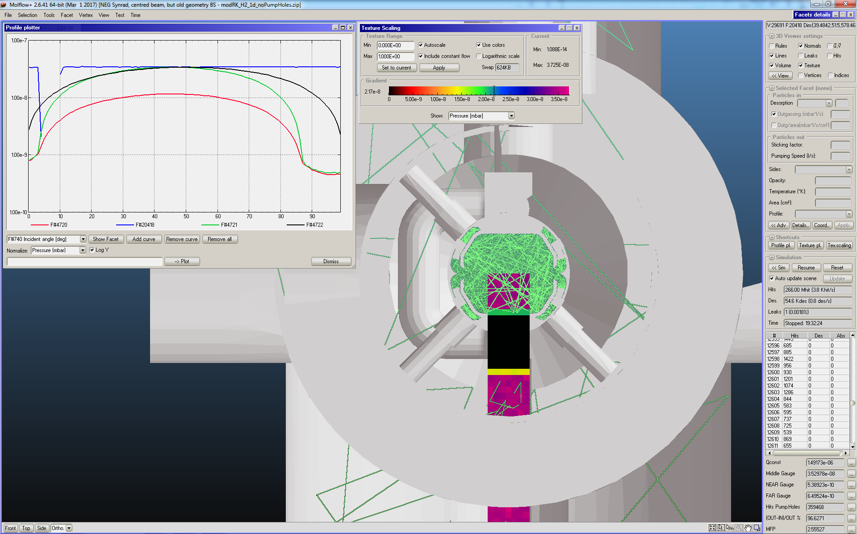
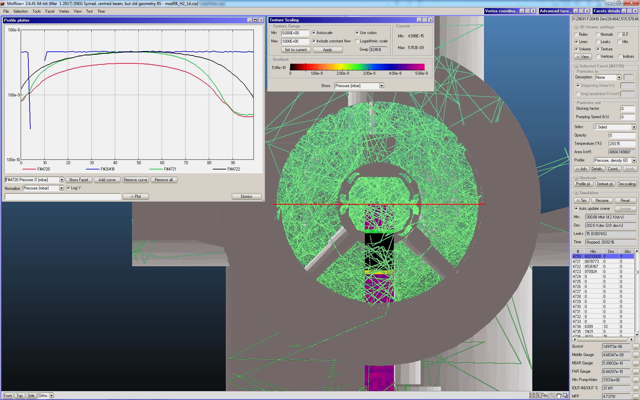
Montecarlo Ray-Tracing Analysis: Different Pumping Paths
Ray-traced molecules with 0% pumping slot surface
(1E-10~1E-7 mbar range)
Ray-traced molecules with ~9% (nominal) pumping slot surface
(1E-10~1E-8 mbar range)

Slide 16
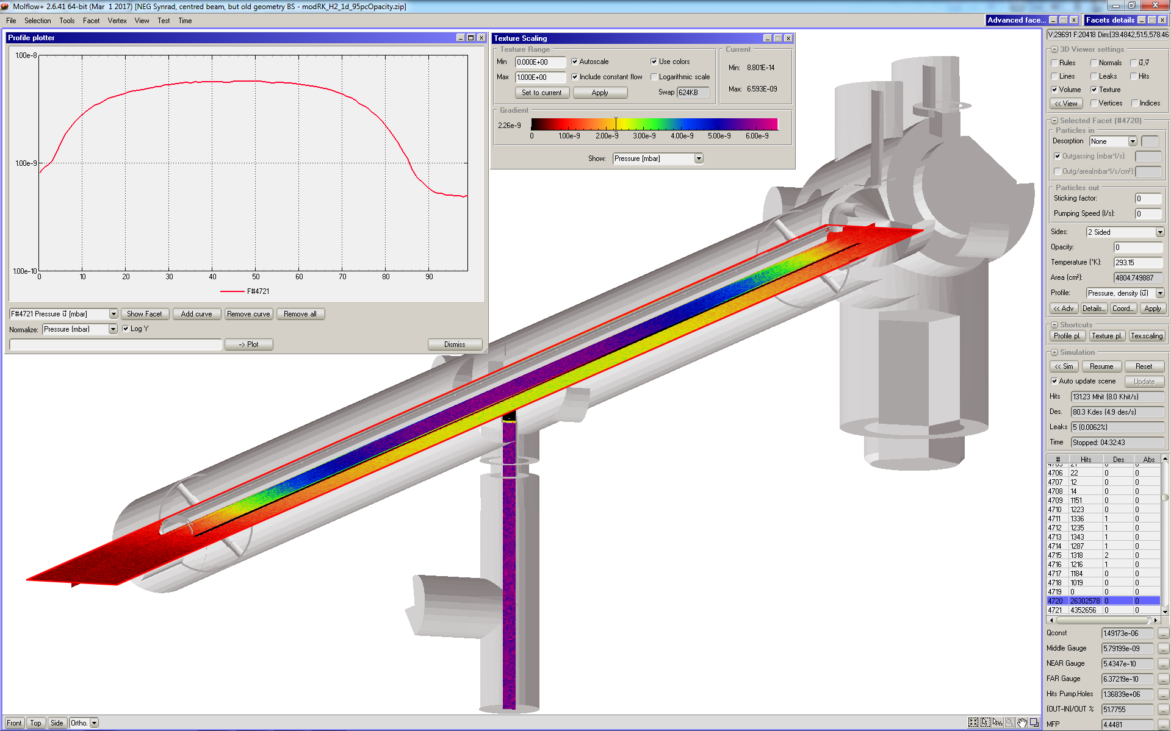
Montecarlo Ray-Tracing Analysis: the Model with Test Pressure Facets
Extended test pressure facet showing different pressure outside of the BS vs inside of it (case with 5% slotted surfaces);

Slide 17
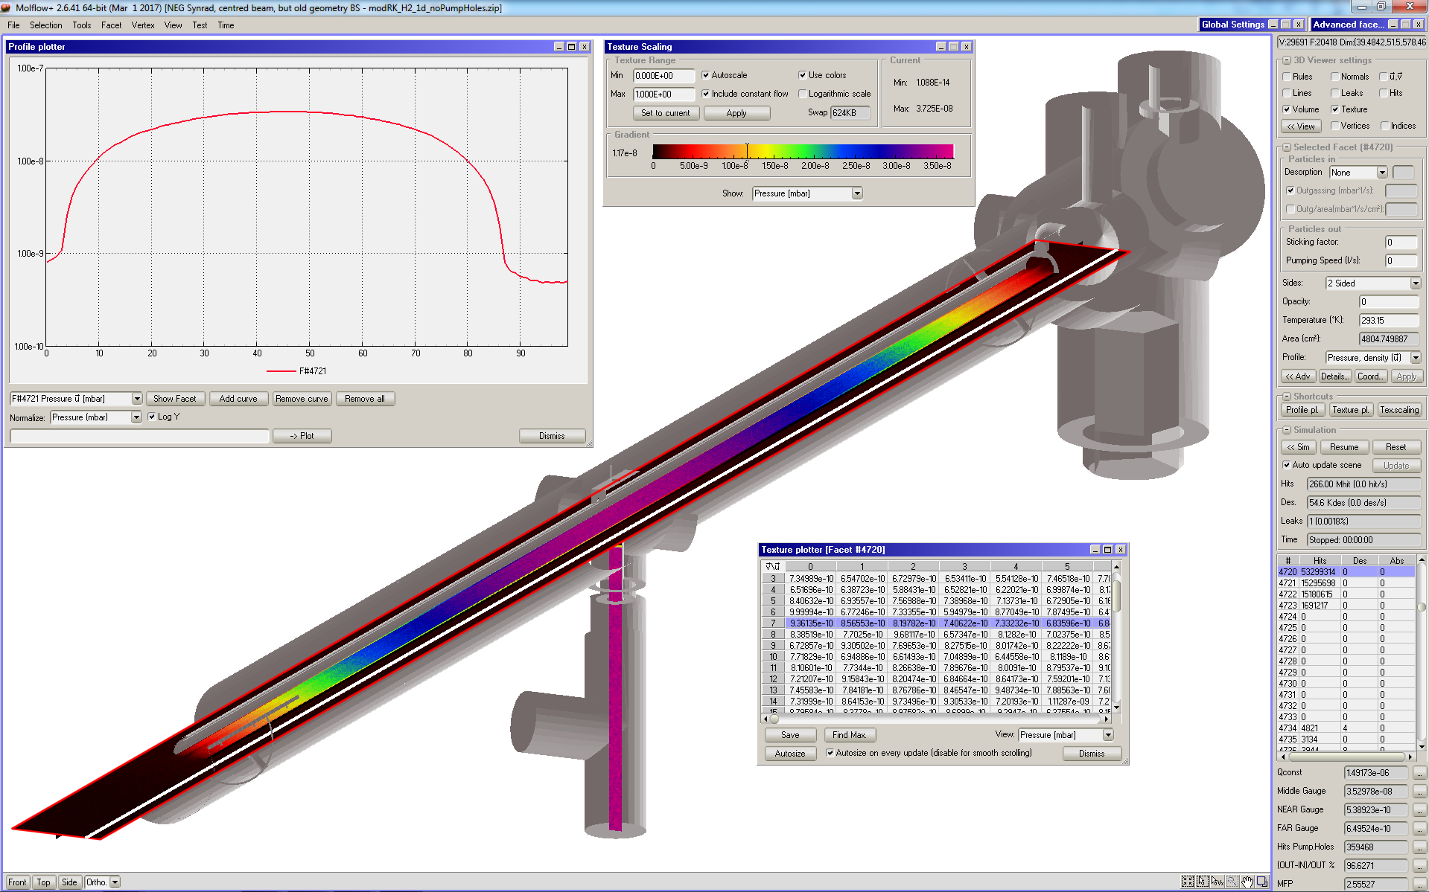
Montecarlo Ray-Tracing Analysis: the Model with Test Pressure Facets
Extended test pressure facet showing different pressure outside of BS vs inside of it (case with 0% slotted surfaces); Big difference (see next slide);

Slide 18
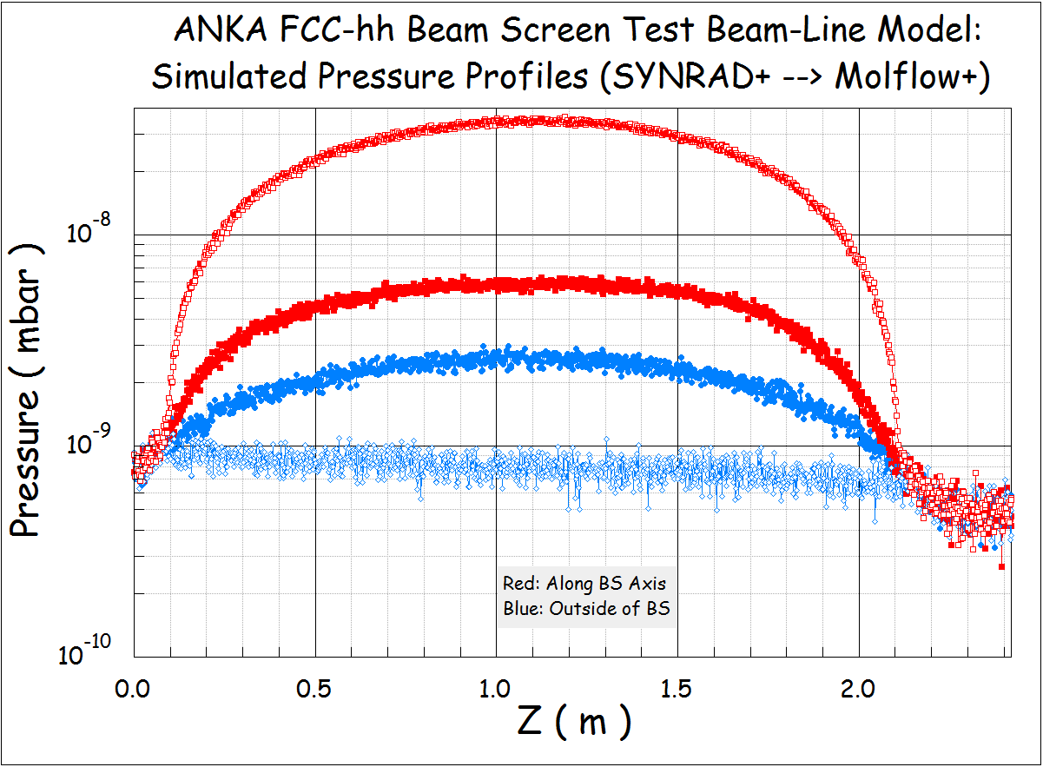
Montecarlo Ray-Tracing Analysis: the Pressures
0% slotted surface
Longitudinal pressure profiles for the nominal (0% and 5% slotted pumping holes surface; Red: along BS axis; Blue: Parallel to it, outside;

Slide 19
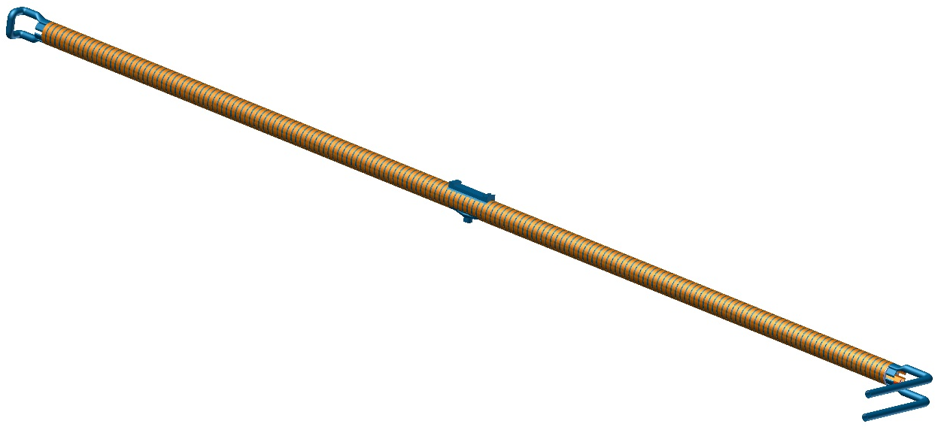
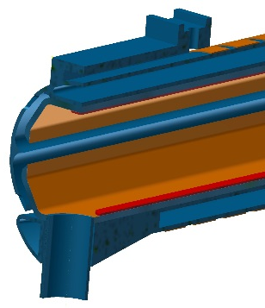
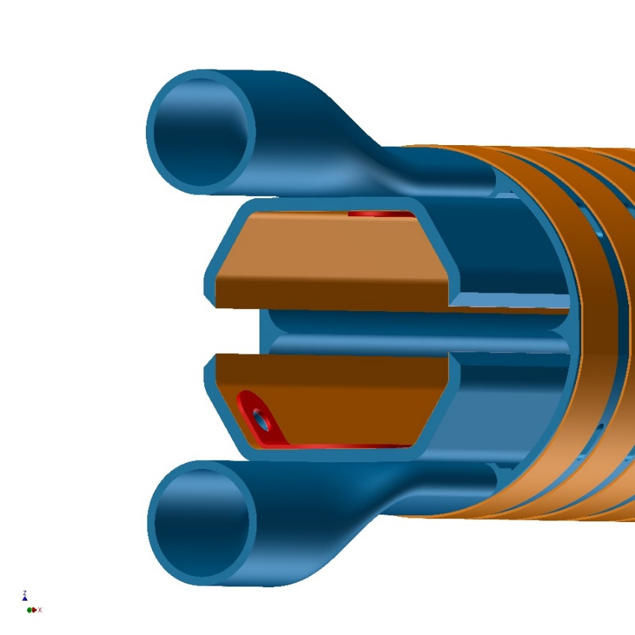
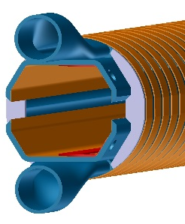
Beam Screen Configuration
The retained configuration for the first prototype is based on the version presented at the FCC week in Rome, April 2016.
Fixed point
Chimney for pressure measurement
Internal electrode(*):
Copper, 6 mm wide
Ceramic insulation
(*) Second BS prototype only; Third one has laser-ablated surface structure
Cooling circuit
Beam screen wall:
304L, 1.5 mm
copper electrodeposition, 0.05 mm
End plate at both extremities
External copper rings:
~ 6 mm * 0.5 mm
Pitch: 11 mm
Probably no coating in the middle of the beam screen
Reflector: 304
Cooling channel: 316L
Slit height: 5 mm

Slide 20
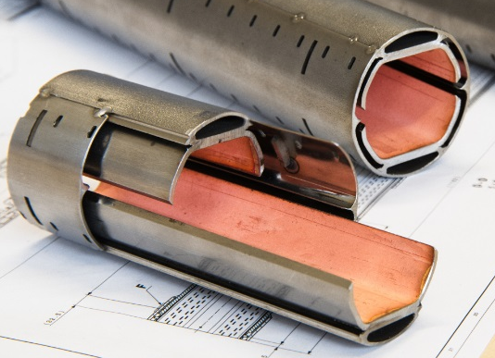
BS Manufacturing Procedure: Short Proto.
Assembly:
~ 40 cm long
Transition and special central pieces
Cooling channel
Powder
3D printing
Machining
Welding
Welding
Machining
Beam screen wall
Sheet
Forming
Machining
Welding
Cu Coating
Machining
Coating
Welding
Reflector
Flat bar
Heat treatment
Machining
polishing
Forming
Cutting
Deburring
Forming
Machining
Welding
Machining (FP)
Reinforcement
Sheet
Cutting
Deburring
Coating
End plate
Sheet
Cutting
Deburring

Slide 21
Key technologies
Technology |  | Risk | Mitigation
3D printing |  | Leak | Leak tests of 100% of 3D printed parts
 |  | Deformation | Minimize the machining Dedicated tooling during welding
Laser cutting and welding |  | Metal projection | Tooling
 |  | Deformation | Tooling Additional forming
Sheet metal working and machining |  | Precision | Heat treatment Dedicated tooling
Coating | Electrodeposition | Peel off | Apply known procedures
 | Plasma and cold spray |  | Tests on dedicated representative samples
 |  |  | Thermal shock cycles

Slide 22
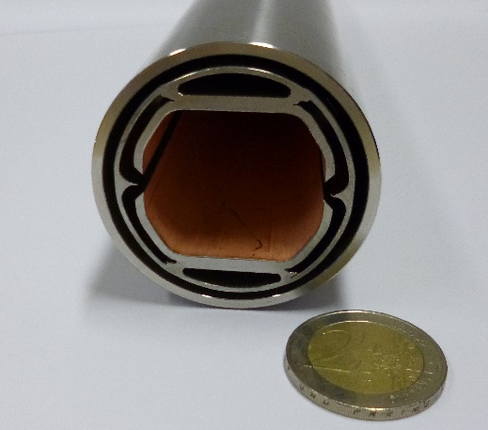
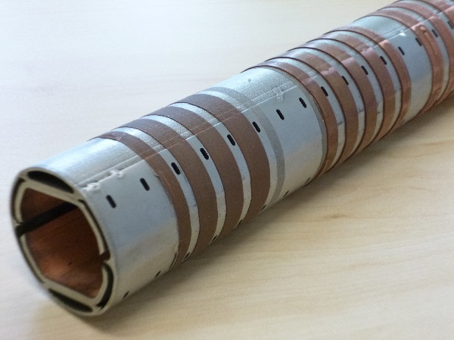
Key technology validation
Main technologies have been validated by the production of two 30 cm long prototypes.
Different surface preparations have been assessed for the copper cold spray.
Production of a 30 cm prototype
Copper cold sprayed strips on beam screen short prototype

Slide 23
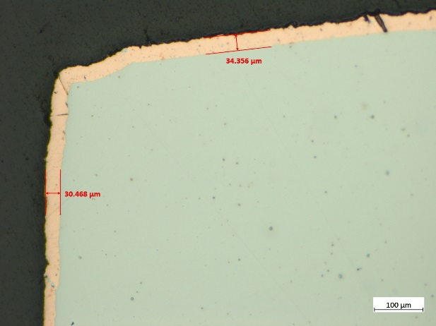
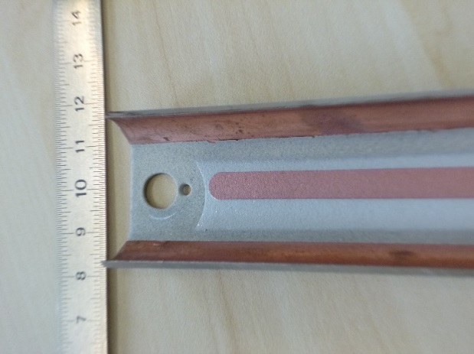
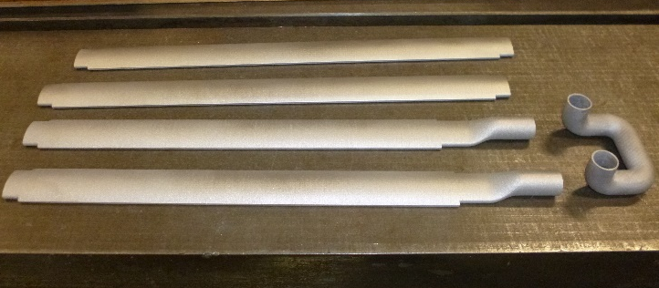
Key technology validation
Uniformity of the copper electrodeposition has been assessed along the 2 m long prototype.
Internal electrode has been produced by plasma and cold spray coating. Electrical insulation has been validated after thermal shock cycles (77K-~400K).
All 3D printed parts for the cooling channel have been leak tested at reception.
Ceramic
Aluminium
Copper
A few 3D printed parts
Measurements of the electrodeposited copper thickness
Electrode obtained by plasma and cold spray

Slide 24
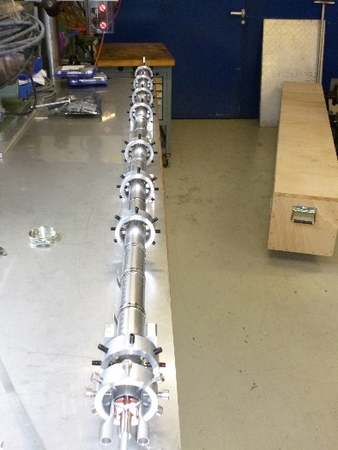
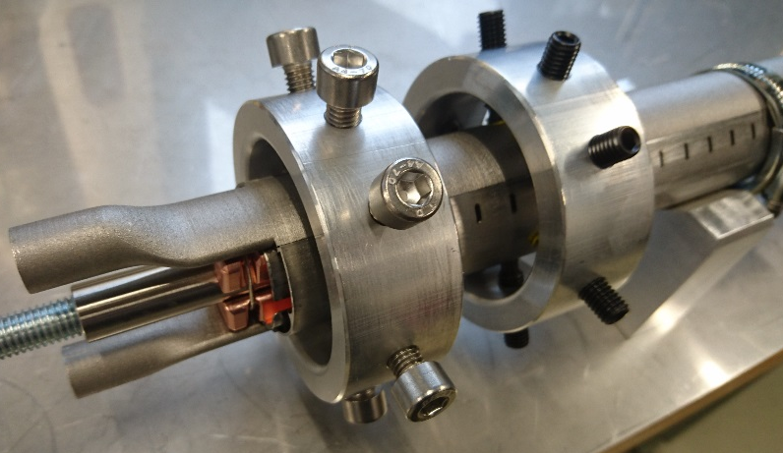
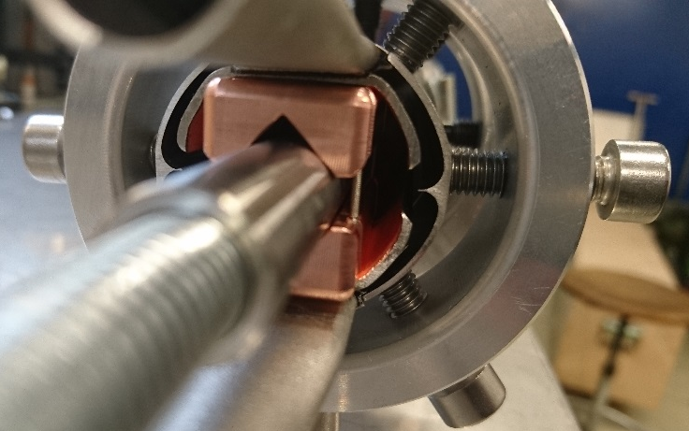
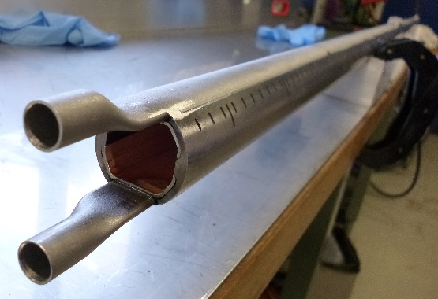
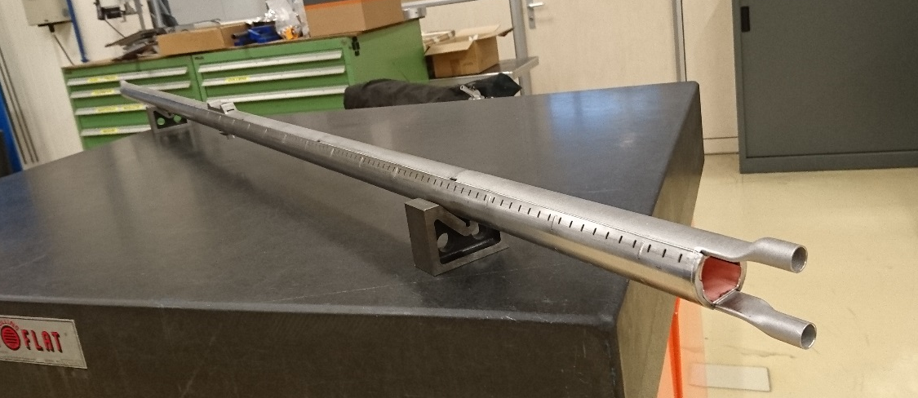
Last news: 2 m long beam screen prototype manufacturing (CERN)
Beam screen assembly before tack welding, with jigs and fixtures
Beam screen assembly after tack welding
Next steps:
Cold sprayed copper rings
Fixed point machining
Instrumentation (temperature sensor) installation
Beam screen assembly after welding: very good straightness

Slide 25
2m-long BS prototype to be installed at ANKA
Assembly:
~ 40 cm long
Transition and special central pieces
Cooling channel
Powder
3D printing
Machining
Welding
Welding
Beam screen wall
Sheet
Forming
Coating
Machining
Welding
Reflector
Flat bar
Machining
Forming
Cutting
polishing
Reinforcement
Sheet
Cutting
Welding
Coating

Slide 26
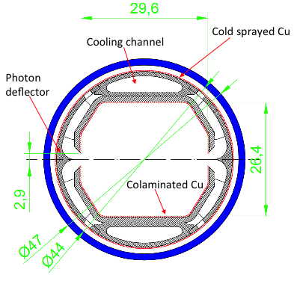

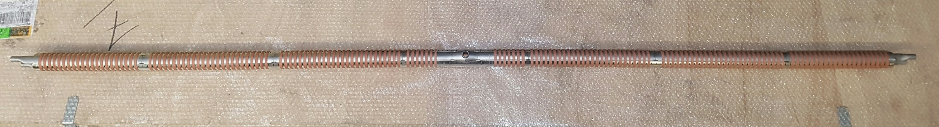
Manufacturing Status
Assembly:
Cooling channel
Powder
3D printing
Machining
Welding
Sheet
Forming
Machining
Welding
Welding
Machining
Beam screen wall
Cu Coating
Machining
Welding
Reflector
Flat bar
Heat treatment
Machining
polishing
Forming
Cutting
Deburring
Forming
Machining
Welding
Coating
Reinforcement
Sheet
Cutting
Deburring
End plate
Sheet
Cutting
Deburring
Picture courtesy A. Bacciochini, Mallard
Machining (FP+instrumentation)
Instrumentation
Welding metal hoses

Slide 27

Manufacturing precision
Shape tolerance assessment before cold spray coating
6 measurements of the outer diameter along the beam screen (nominal dimension 41 mm):
Horizontal direction:<d> = 41.11 mm, σ = 0.15 mm
Vertical direction:<d> = 40.72 mm, σ = 0.11 mm
Overall results: <d> = 40.92 mm, σ = 0.24 mm
→ Ovalization of around +/- 0.2 mm.

Slide 28
Configuration #2 (clearing electrodes):
The retained configuration for the second prototype is based on the version presented at the FCC week in April 2016.
Fixed point
Chimney for pressure measurement
Internal electrode:
Copper, 6 mm wide
Ceramic insulation
Cooling circuit
Beam screen wall:
304L, 1.5 mm
copper electrodeposition, 0.05 mm
End plate at both extremities
External copper rings:
~ 6 mm * 0.5 mm
Pattern to be adjusted
Reflector: 304
Cooling channel: 316L
Slit height: 5 mm

Slide 29

Manufacturing procedure #2
Assembly:
~ 40 cm long
Transition and special central pieces
Cooling channel
Powder
3D printing
Machining
Welding
Welding
Machining
Beam screen wall
Sheet
Forming
Machining
Welding
Cu Coating
Machining
Coating
Welding
Reflector
Flat bar
Heat treatment
Machining
polishing
Forming
Cutting
Deburring
Forming
Machining
Welding
Coating
Reinforcement
Sheet
Cutting
Deburring
Machining (FP)
End plate
Sheet
Cutting
Deburring
Manufacturing procedure similar to prototype #1

Slide 30

Manufacturing status #2
Assembly:
Cooling channel
Powder
3D printing
Machining
Welding
Welding
Machining
Beam screen wall
Sheet
Forming
Machining
Welding
Cu Coating
Machining
Coating
Welding
Internal screen with electrodes
Reflector
Flat bar
Heat treatment
Machining
polishing
Forming
Cutting
Deburring
Forming
Machining
Welding
Coating
Reinforcement
Sheet
Cutting
Deburring
Machining (FP)
End plate
Sheet
Cutting
Deburring

Slide 31

Manufacturing procedure #3 (laser-ablated surface, LA)
Assembly:
~ 30 cm long
Transition and special central pieces
Cooling channel
Powder
3D printing
Machining
Welding
Welding
Machining
Beam screen wall
Colaminated Sheet
Machining
Forming
Welding
L.A.
Welding
Reflector
Flat bar
Heat treatment
Machining
polishing
Forming
Cutting
Deburring
Forming
Machining
Welding
Coating
Reinforcement
Sheet
Cutting
Deburring
Machining (FP)
End plate
Sheet
Cutting
Deburring

Slide 32



3 – Design, Purchase & Manufacturing progress
All pieces manufactured
Cleaning ongoing @ CERN
Design finished
Purchase of elements finished
To be manufactured @ CERN

Slide 33



Present status: pre-tests at CERN
Without and with bake-out equipment and pumps (Luis Gonzalez Gomez and Miguel Gil Costa);
Dedicated crate with instrumentation’s controllers, SCADA control system devices, and power supplies on the left

Slide 34

Present status: pre-tests at CERN
80 l/s
Turbo
pump
RGA +
Pressure Gauge
on “Chimney”
2000 l/s
NEXTorr
pump
The 80 l/s turbo pump is installed with pneumatic gate valve; Note the remotely-controlled, horiz.-moving supports;
Most cables have been already tested, and some are visible on the floor;

Slide 35


Present status: pre-tests at CERN
Horizontal and Vertical Slits for the ANKA front-end under test with new SCADA/UNICOS control system

Slide 36


Present status: BS prototype Fabrication
Different stages of the preparation and deposition of the cold sprayed copper layer on the outside of the BS;
The rings are used to prevent the cold spray from cluttering the pumping holes.

Slide 37




Present status: Dummy BS prototype
Prior to irradiating the real BS, a thorough conditioning of the beamline components (e.g. slits, end absorber, fluorescent screens) should be carried out, in order to reduce the background signals;
During the first weeks of such commissioning, we would like to install a dummy BS, with no pumping holes and no cooling pipes: it could take beam on it only with a reduced current (10 mA or so), possibly for short time intervals, due to the absence of active cooling, but it would nevertheless give us valuable information on the operation of the beamline (see slide 14);
Material 304L SS; ID 34 mm; central connection for the “chimney”, to measure directly the pressure in the middle;

Slide 38

Planning
Delivery FMB UK
(movable-end Absorber and fluorescent screens, due 31/3/17)
Finalizing Mechanical
work @ CERN + Metrology Work
Commissioning @ CERN

Slide 39
Conclusions 1.
A dipole radiation beamline dedicated to the study of FCC-hh beamscreen (BS) geometries has been designed at ANKA;
The spectral properties (flux, power, and their linear densities) are comparable to those of the 50+50 TeV FCC-hh collider;
Since the design and fabrication of a cryostat-ed test chamber would take too long with respect to the timeline of the EuroCirCol Horizon 2020 funding and the need to produce a CDR for the FCC study program by end of 2018, it has been decided to run a first version of the experiment at room temperature: according to detailed MC ray-tracing simulations, this should allow us to determine and confirm the efficient reduction of residual gas density caused by the “double-slot with reflector” design;
The beamline is located inside of the ANKA ring area and run parasitically: it must be remotely operated with minor needs to intervene during regular operation of the light source in user mode; Short dedicated fillings will be necessary for initial commissioning;
A room temperature, 2 m-long FCC-hh BS prototype has been designed, after some reduced-scale prototype have allowed us to confirm the feasibility of various fabrication technologies (e.g. 3D printed parts), compatible with UHV conditions;
Three different devices are being fabricated:
  The first one has its interior coated with 5 micrometers of electrodeposited copper;
  The second one has plasma-sprayed insulated clearing electrodes along most of its length;

Slide 40
Conclusions 2.
The third one will have its 2 horizontal surfaces treated via laser-ablation;
The three 2m-long prototypes of the double-slot BS geometry are in an advanced stage of fabrication: the first one will be soon installed at ANKA, after having passed preliminary tests at CERN (leak tightness, interlock and control system interfacing, etc…);
If everything goes as scheduled, in a year’s time we will know whether the proposed FCC-hh BS design is a viable solution or not, and if that will be the case we will work towards the design, fabrication and testing of a cryostat-ed low-temperature version, similar to the COLDEX cryostat presently installed at CERN on the SPS: it remains to be decided where such tests could take place, and how this program would be funded.
Future Developments
In parallel, although not discussed in this talk, a collaboration between CERN and INFN Frascati is being set-up with the aim to study, among other things, the reflectivity of technological surfaces potentially usable on the FCC-hh BS: this will be done using two separate SR beamlines at DAFNE (one from a dipole, white beam, and another one from a wiggler, monochromatized light);
Additional similar measurements are being carried out now at BESSY-II, and should produce soon the first results (see R. Cimino et al.).

Slide 41
Acknowledgments
Many thanks for the input received from many colleagues and collaborators in the EuroCirCol WP4.
Thank you for your attention ☺

