Slide 1
Vacuum Issues in the IR of an Electron-Ion Collider
Christoph Montag
BNL

Slide 2

EIC Interaction Region Design Challenges
Very asymmetric beam energies
High luminosity requires early beam separation to allow focusing close to the IP
Hard, intense synchrotron radiation generated near or even inside the detector must be passed safely through the IR
Short electron bunches excite HOMs that lead to gas desorption
p-A (proton beam-gas) cross sections typically 100-1000 times larger than e-p “Physics” cross sections
$$1−10∗{10}^{33}$$

Slide 3
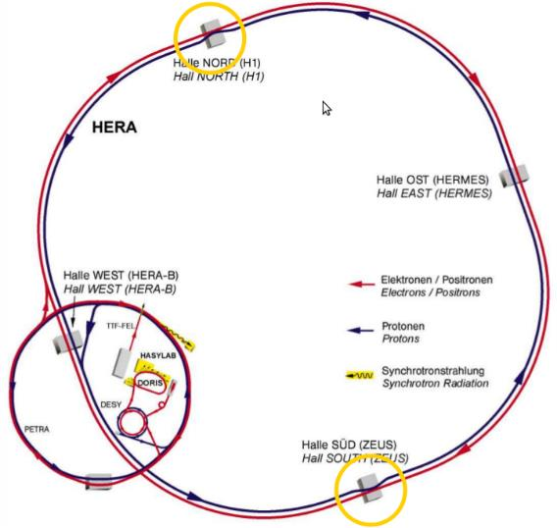
The HERA Experience
Only electron-ion collider ever built
920GeV protons, 27.5GeV electrons (or positrons)
Comparatively low beam currents, ~100mA protons, ~50mA electrons
180 bunches per ring
96nsec bunch spacing
250m long straight sections for low-β focusing, beam separation, and spin rotators

Slide 4
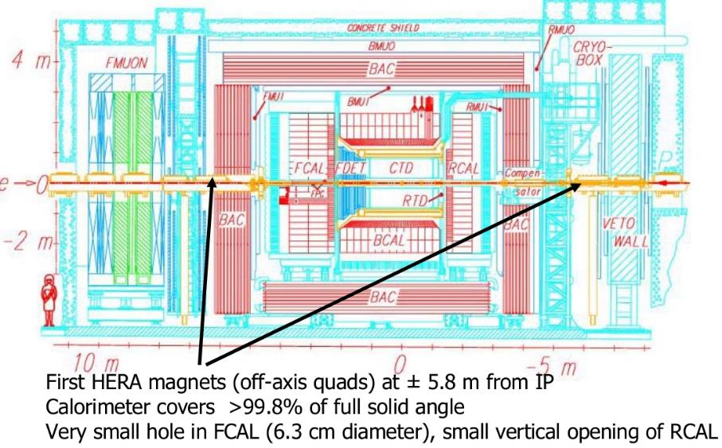
HERA-I Interaction Region (ZEUS Detector)

Slide 5
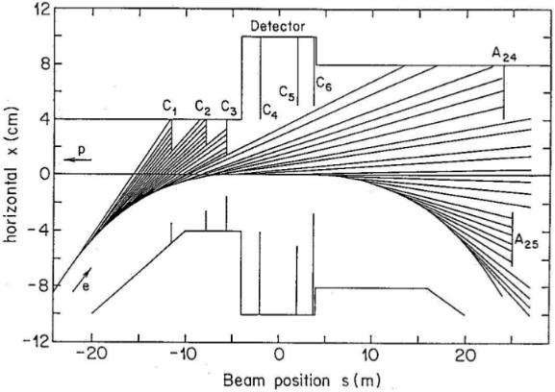
Synchrotron Radiation in HERA-I
6kW total SR power, critical energy 34keV
Half of SR power absorbed upstream of detector by 3 movable collimators (C1-C3)
Two fixed collimators (C4, C5) near IP against back-scattering
SR absorbers at 24m/25m downstream of IP
Very good background conditions

Slide 6
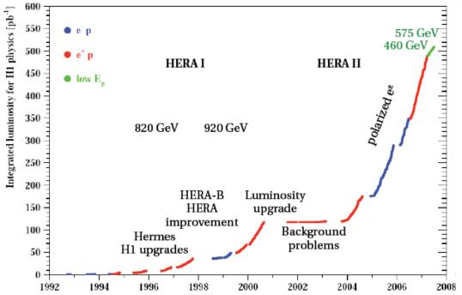
HERA-II – The Luminosity Upgrade
New interaction regions, with smaller beam cross sections at the IP, achieved by stronger focusing
Low-β quadrupoles close to the IP for sufficient aperture
Beam separation and electron beam focusing by superconducting combined-function magnets inside the detectors
Based on novel, exotic IR magnets
Factor 3 luminosity improvement over HERA-I

Slide 7
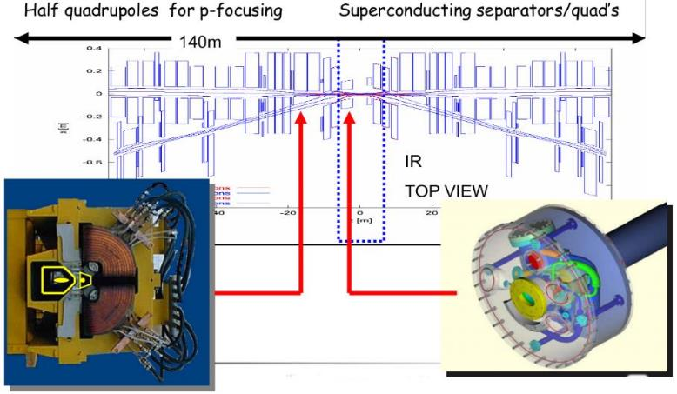
HERA-II Interaction Region
Superconducting combined-function quadrupoles 1.7m from the IP inside the detector, providing electron beam focusing and beam separation
Normal-conducting mirror-plate quadrupoles to focus proton beam and pass electron beam and synchrotron radiation fan

Slide 8
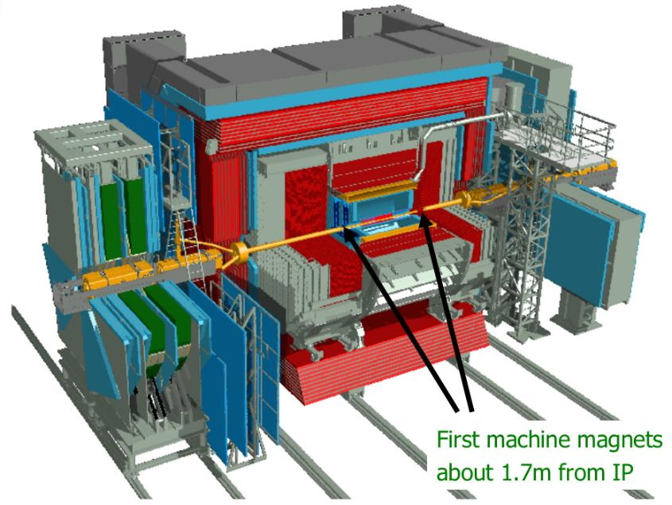
ZEUS Detector after the Luminosity Upgrade

Slide 9
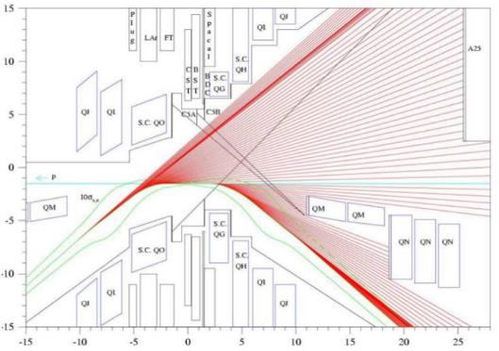
Synchrotron Radiation Fan in HERA-II
18kW of synchrotron radiation power, with up to 115keV critical energy produced by separator magnets inside the detector
No upstream SR collimators; entire radiation fan must pass through the detector
Synchrotron radiation absorbers at 11m septum, and at 27m – main source of background

Slide 10
Vacuum System
Vacuum pipes for electrons, protons and SR separate 11m downstream of IP
Flat cross section of common stainless steel chamber requires special flanges, and protection by emergency absorbers
Lots of pumping installed:
NEG strips in all stainless steel chambers
Ion getter and Ti sublimation pumps in-between magnets
Integrated ion getter pump inside the detector, at 1.3m from the IP
Superconducting magnet beam pipes at 40-80K
Needed to be warmed up for regeneration of NEG pumps
No valves between warm and cold magnets due to space constraints

Slide 11
Background Conditions in HERA-II
Very severe background conditions after luminosity upgrade, limiting beam currents and therefore luminosity to avoid radiation damage to detectors
Extensive background studies leading to modifications during several months of shutdown:
Proton beam-gas interactions
Larger pumps at critical locations
Increased pumping port conductance
Improved mask shapes to reduce HOM losses
Synchrotron radiation background
Added synchrotron radiation collimator far upstream
Improved masks in IR
Improved magnet alignment, beam steering, and control
Electron beam-gas (off-momentum positrons)
Additional vacuum pumps 30m upstream

Slide 12
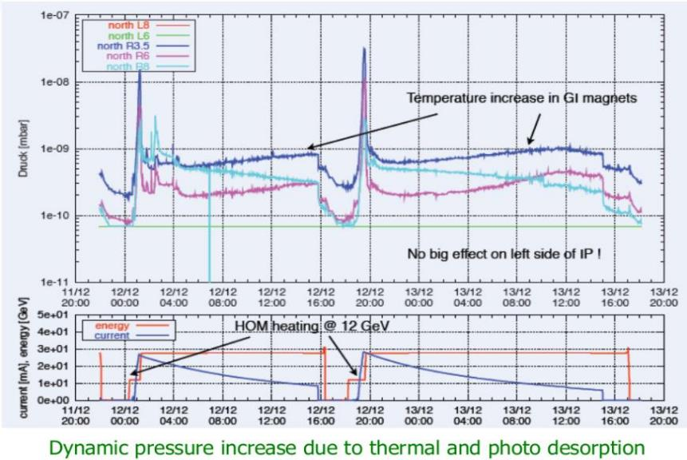
IR Vacuum Pressure during HERA-II Luminosity Stores

Slide 13
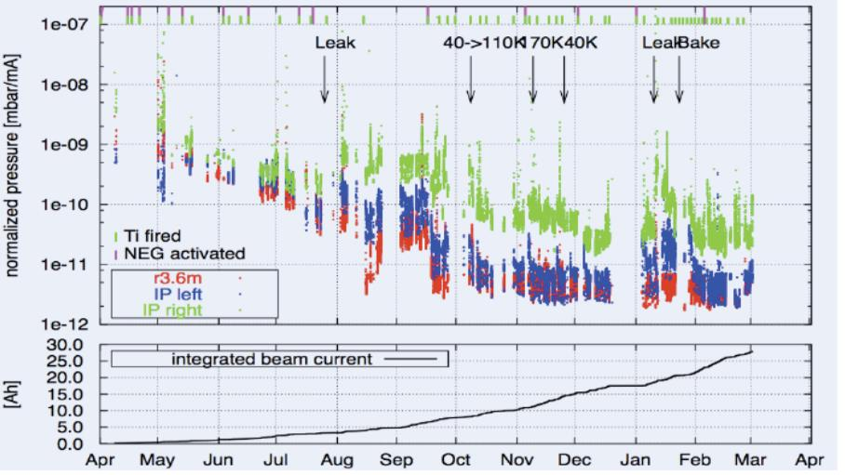
IR Vacuum Evolution
Gradual improvement due to beam conditioning, interrupted by a few vacuum failures (leaks)

Slide 14
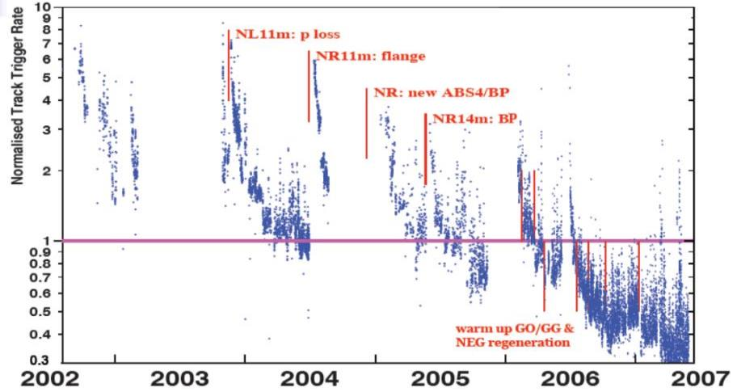
Beam-Gas Background in HERA-II
Two time constants for vacuum conditioning:
Short term after leaks, 20-30 days
Long term, ~2 years

Slide 15
RHIC Experience
Two superconducting storage rings
Energy range 10 – 100GeV/n Au, 25 – 250GeV protons
111 bunches/ring, 106nsec bunch spacing
All ions other than protons cross transition

Slide 16
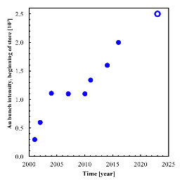
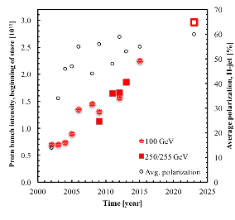
RHIC bunch intensity evolution
Steady bunch intensity increases achieved by:
NEG coating of warm beam pipes (2004-2008)
Pre-pumping before cool-down (from 2006)
Keeping machine at liquid nitrogen temperature over the shutdown
Intentional scrubbing at injection, using short, high-intensity bunches
“Parasitic” scrubbing by long physics runs, and no vacuum breaks in-between

Slide 17
RHIC Vacuum in STAR Detector After Solenoid Power Supply Failure
STAR detector solenoid prevents electron cloud instability in detector beampipe

Slide 18
eRHIC
High beam currents
330 bunches per ring in initial phase, up to 1320 in final configuration
Large crossing angle (22mrad) to avoid dipoles near IP
Large electron beam-beam parameter (up to 0.1) requires near-integer tunes for dynamic focusing to compensate emittance blow-up
Strong dynamic focusing effects increase beam divergence at the IP, and beam sizes in the low-beta quadrupoles
Increased beam size results in more electrons experiencing large magnetic fields in those magnets, increasing synchrotron radiation power and critical energies
Dynamic focusing effects have to be taken into account when determining required apertures in IR design

Slide 19
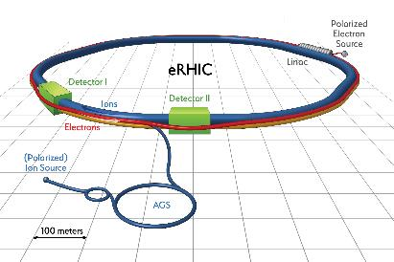
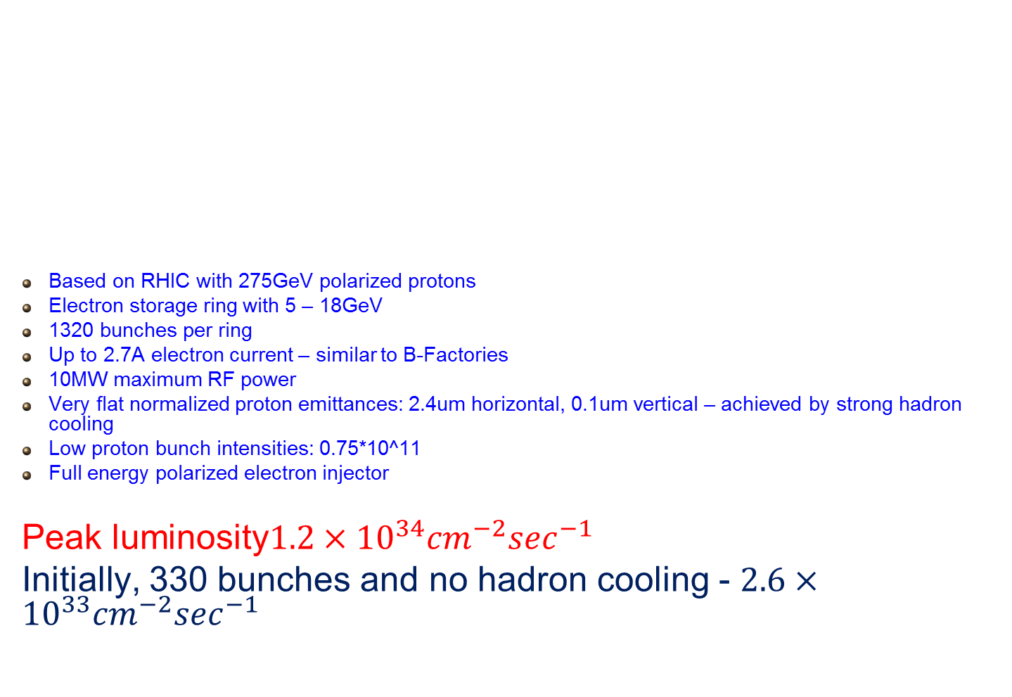
Design Concept
Based on RHIC with 275GeV polarized protons
Electron storage ring with 5 – 18GeV
1320 bunches per ring
Up to 2.7A electron current – similar to B-Factories
10MW maximum RF power
Very flat normalized proton emittances: 2.4um horizontal, 0.1um vertical – achieved by strong hadron cooling
Low proton bunch intensities: 0.75*10^11
Full energy polarized electron injector
Peak luminosity$1.2×{10}^{34}{cm}^{−2}\sec^{−1}$
Initially, 330 bunches and no hadron cooling - $2.6×{10}^{33}{cm}^{−2}\sec^{−1}$

Slide 20
In-situ RHIC beam pipe coating
Large number of short, intense proton bunches requires in-situ copper coating of stainless steel RHIC beam pipes to reduce resistive wall heat load on cryo system
May need additional layer of amorphous carbon to reduce SEY for electron cloud reduction

Slide 21
Interaction Region Layout
Interleaved arrangement of electron and hadron quadrupoles
22mrad total crossing angle, using crab cavities
Beam size in crab cavity region independent of energy – crab cavity apertures can be rather small, thus allowing for higher frequency
Forward spectrometer (B0) and Roman Pots (R1-R4) for full acceptance

Slide 22
IR Detail
Actively shielded electron beam pipe through superferric hadron spectrometer B0

Slide 23
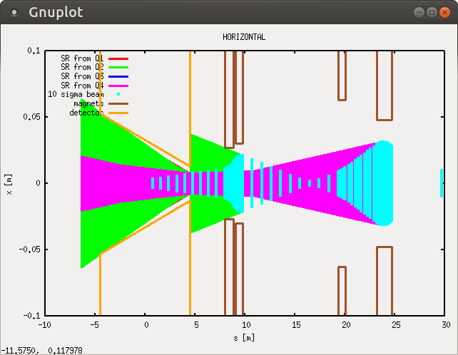
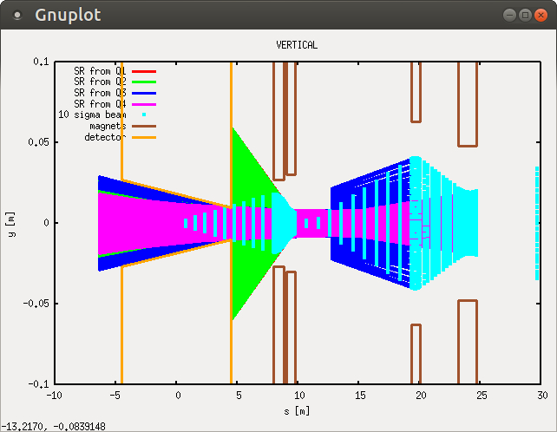
Synchrotron radiation in eRHIC IR
Synchrotron radiation from quadrupoles only; no dipoles due to crossing angle
Few electrons in transverse tails experience high magnetic fields

Slide 24
SR Power Density outside 1mm Be Pipe Wall
Effects on detector background still under study

Slide 25
Summary
Multiple sources contribute to background conditions in electron-ion collider detectors – synchrotron radiation and beam-gas scattering
Measures to reduce one source may increase another – HOMs from synchrotron radiation masks may lead to thermal desorption of gas molecules, resulting in increased beam-gas background
Close interaction between machine and detector during the design process as well as during commissioning and operations is necessary for success

