Slide 1
Beam dynamics meets vacuum
Collimations and surfaces
Karlsruhe, 8-10 March 2017
Advances in NEG coating technology
Paolo Manini, E. Maccalini, T. Porcelli, S. Raimondi
SAES Getters S.p.A., viale Italia 77, 20020 Lainate (Milan), Italy

Slide 2
Outline
NEG technology and NEG coating at SAES
Narrow-gap Insertion Devices (IDs): status & technology limits
The new challenges: 10–4 mm diameter NEG-coated tubes:
status of the R&D activity;
characterisation of the coated chambers (SEM/EDS);
critical issues and challenges.
Further testing activity and perspectives
Conclusions.

Slide 3
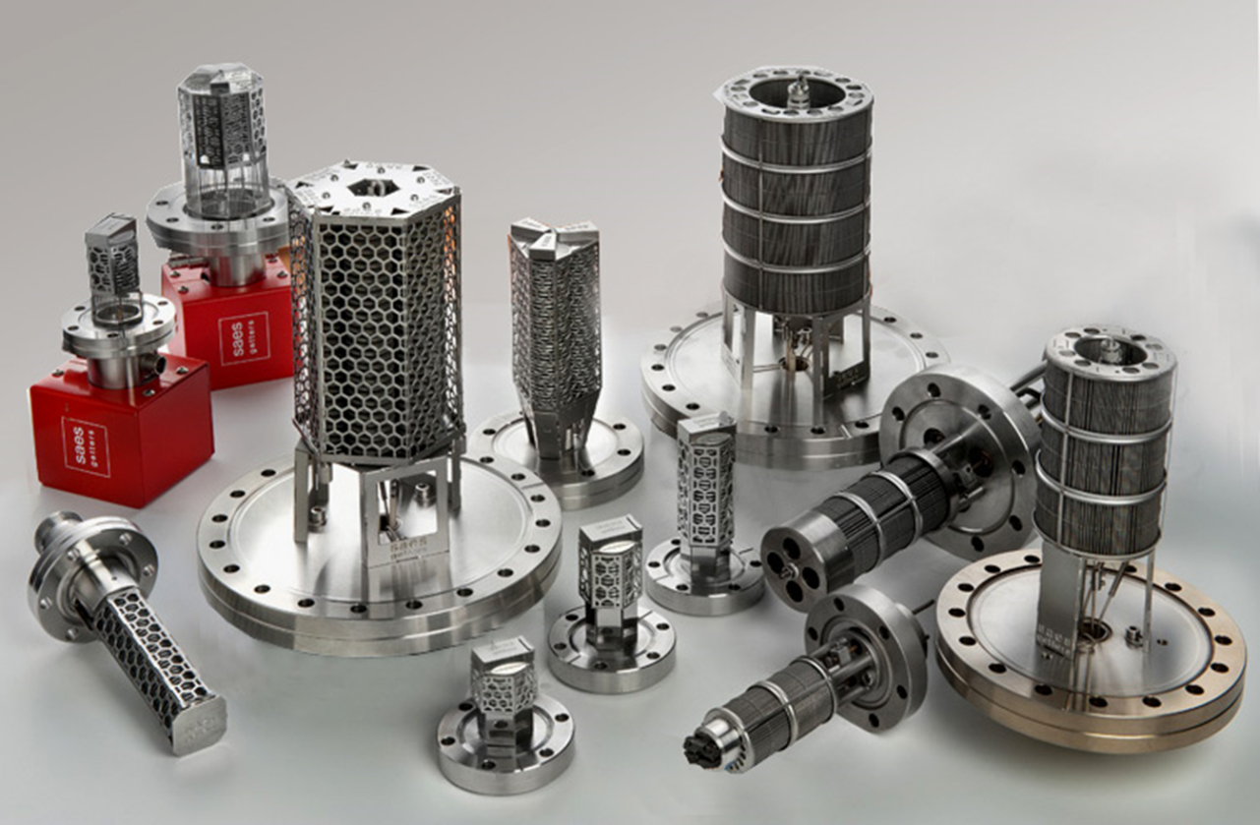
SAES’ commitment to ultra-high vacuum
SAES Getters has been pioneering NEG technology since the 1960s, developing a variety of NEG alloys, getter-related technologies and NEG solutions which have found wide use in a variety of industrial and research applications (X-ray tubes, lamps, sealed-off devices, purifiers for the semiconductor industry, etc.).
NEG pumps are currently used in a variety of application from High to UHV and XHV.

Slide 4
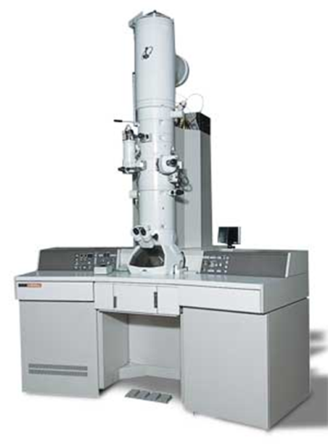
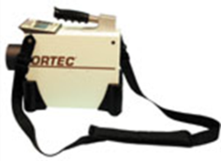
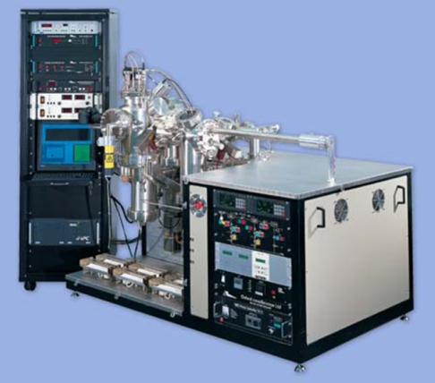
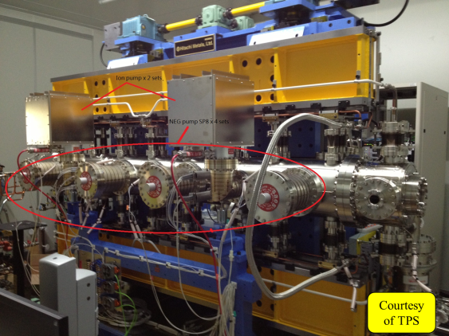
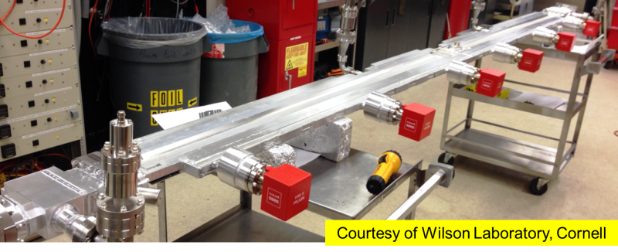
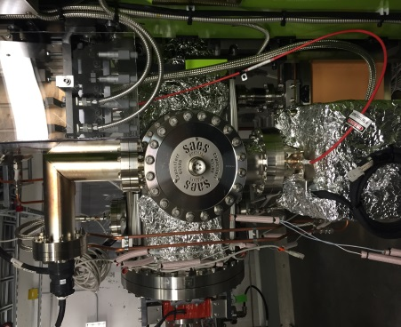
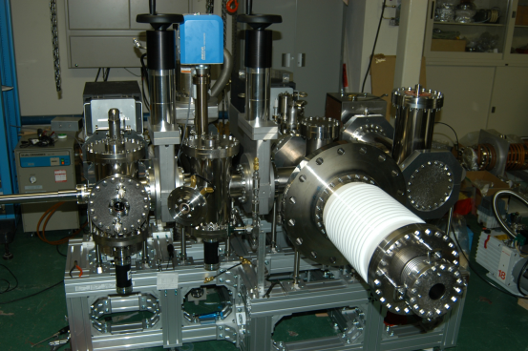
Use of NEG pumps in UHV-XHV systems
In the industry
Scanning/Transmission electron microscopes
Portable mass spectrometers
Semiconductor lithographic & metrological tools
X-ray inspection equipment, EDX analyzers ……
In large physics projects
Synchrotron Light sources, FEL, ERL
Colliders and accelerators
Fusion devices
Gravitational experiments….
In Scientific Laboratories
Cold atom /ion trapping
Atomic clocks
Surface science, STM, MBE
Vacuum suitcases
CONFIDENTIAL
Courtesy of JAEA

Slide 5
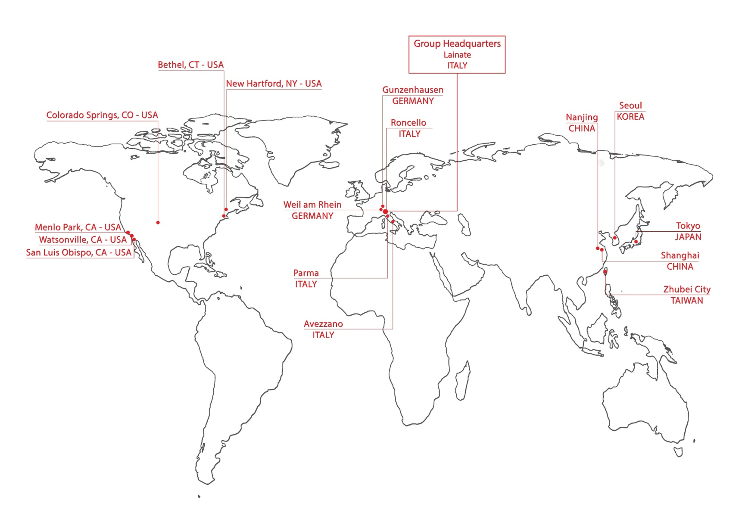
The SAES Group: vacuum technology and material science
1100 employees worldwide, 190M€ turnover (2016)
10 manufacturing facilities, six in the USA, three in Italy and one in Germany
Asian subsidiaries located in Japan, China, South Korea and Taiwan
Authorized distributors worldwide

Slide 6
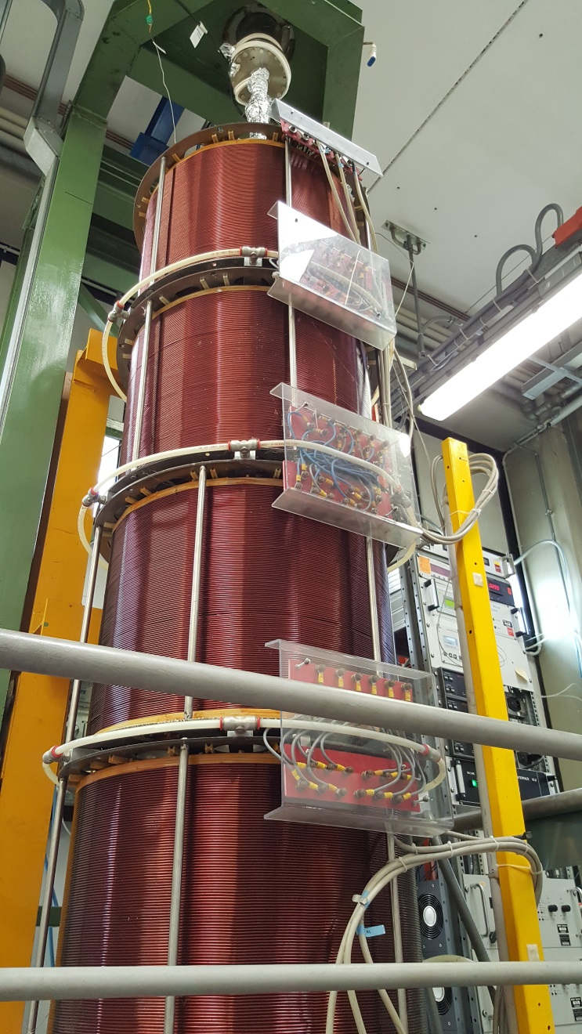
NEG-coating deposition at SAES
About 15 years ago, SAES added—through a licence agreement with CERN—the NEG coating technology to its product portfolio, to complement the product family based on lumped NEG pumps (e.g., Capacitorr pumps).
Since then, a substantial R&D and NEG coating activity has been done in our company to :
industrialise the process;
explore the feasibility of NEG coating on complex-shape chambers, including narrow-gap IDs.
More than 500 chambers and 100 IDs coated by SAES

Slide 7
NEG coating of non-circular cross-sections
NEG coatings are deposited by magnetron sputtering [1].
Intertwisted wires of Ti, Zr, and V are commonly employed as cathodes for sputtering.
When dealing with non-circular cross-sections (e.g., elliptical), at least two cathodes should be used.
A film thickness variation along the perimeter is in any case unavoidable.
The use of 3 cathodes instead of 2 helps to smooth this thickness distribution.
[1] C. Benvenuti et al., Vacuum 53 (1999) 219–225.

Slide 8
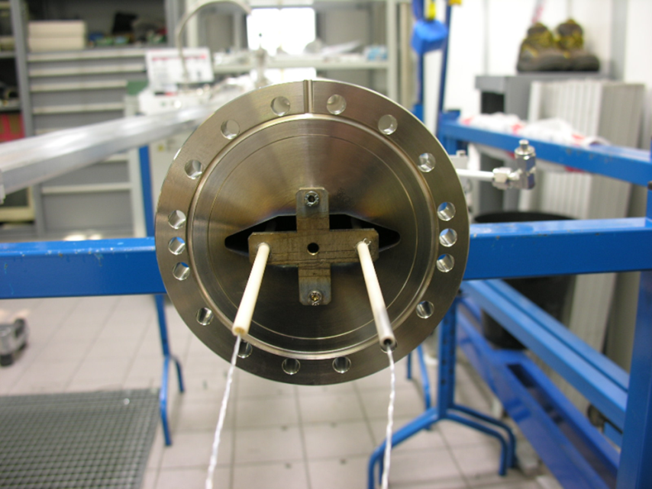
NEG coating of SOLEIL chambers
SOLEIL was the first large synchrotron project where:
relatively small-section chambers were used;
NEG coating was extensively adopted, both in quadrupoles/sextupoles and IDs (≈60% of the storage ring circumference).
Depending on the film specifications, 2 or even 3 cathodes were used in the assembly.
Cathode wires could be suitably positioned inside the cross-section of the chambers, as this was reasonably large.
Spacing among cathodes was modelled to ensure that the thickness distribution was as close as possible to user’s requirements.
Courtesy of SOLEIL, France
Using three cathodes:
more film deposited at the edges (~1 μm);
less in the central part (~0.5 μm);
possible impedance effects are thus minimised.

Slide 9
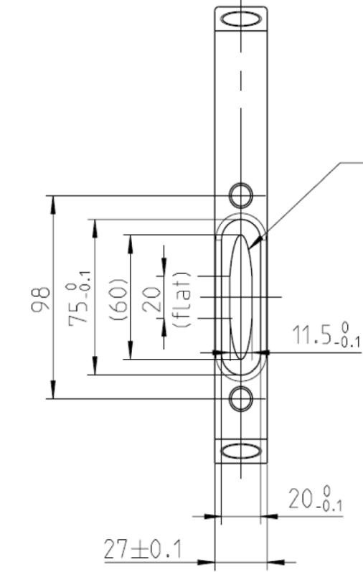
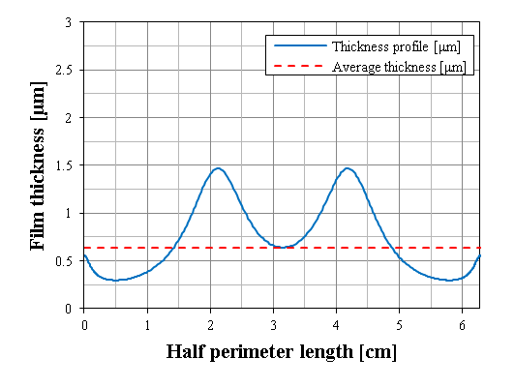
Typical thickness variations in narrow-gap IDs
A typical thickness distribution is shown in the chart below for the ID section given in the picture.
Average film thickness is about 0.6 μm, but thickness can range between 0.3 μm and 1.5 μm.
Cathodes
This is unavoidable, as there is no way to prevent sputtered atoms from depositing closer to the emitting source (i.e., the cathode).

Slide 10
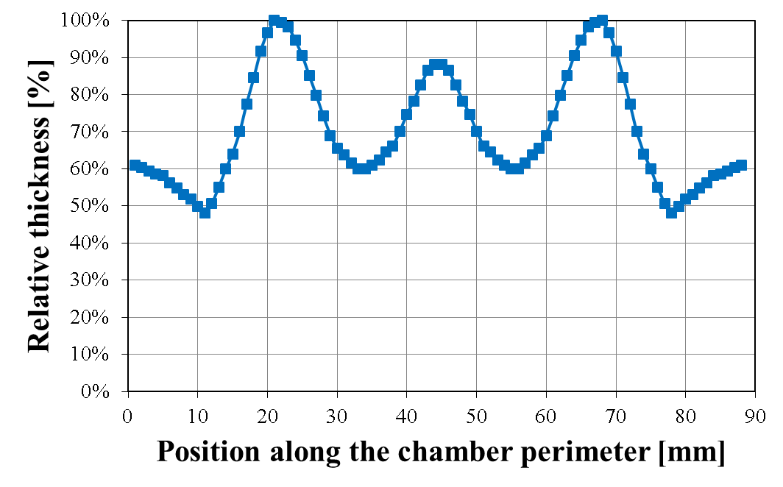
Typical thickness variations in narrow-gap IDs (2)
Cathodes
The use of three cathodes can mitigate the issue and smooth somewhat the thickness distribution.

Slide 11
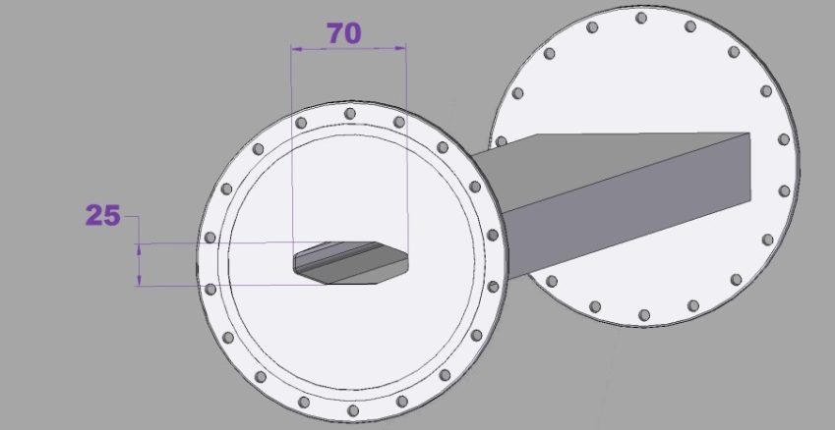
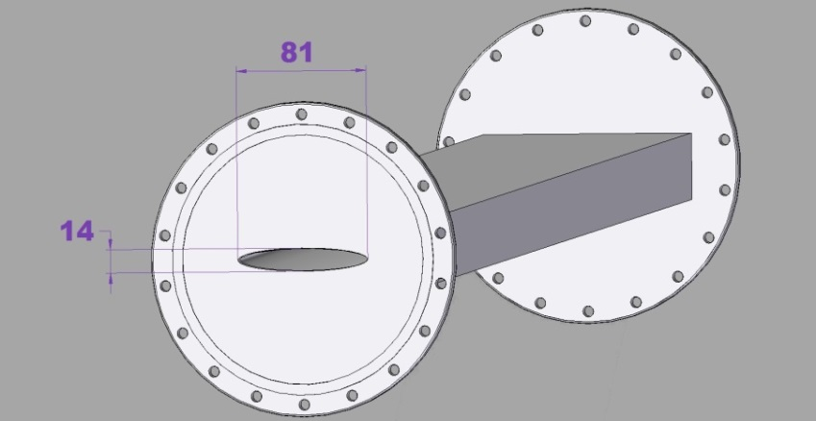
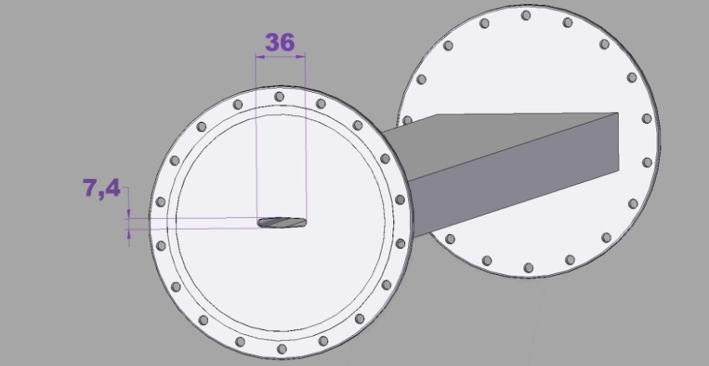
Current trends in narrow-gap chambers
Following SOLEIL, several other facilities (DLS, MAX, NSRRC, PSI,…) started to ask for NEG coating of insertion devices with 12 to 9 mm vertical gaps.
In the following years, gaps have further decreased down to 7 mm.
Also the horizontal section length has been accordingly reduced (from 70 mm to 35 mm, typically).

Slide 12
Current trend: critical aspects
This progressive cross-section reduction is critical for many reasons:
inserting and mounting the cathodes becomes more difficult;
the plasma volume is pretty much reduced, and this may cause plasma instabilities and/or dis-uniformities, unless properly addressed;
plasma adjustments might require higher working pressures;
cleaning of long IDs is also more critical as the flowing of reactants and chemicals is more difficult;
cathodes might be misaligned and thus too close to the chamber’s walls, making the sputtering process unstable. This is especially true for long IDs (e.g., 4–6 m), in which the possibility for the cathode assemblies to shift a few mm along the whole length cannot be ruled out.

Slide 13
Narrow-gap chambers: further critical aspects
The following important aspects should be also taken into account:
If the horizontal section is <50 mm, the use of three cathodes should be ruled out: space for inserting them in a controlled and reliable way is not enough.
Using two cathodes, more thickness variation along the section profile is unavoidable.
Keeping the section perimeter fixed while reducing the gap also determines more severe thickness variations along the profile.
BUT:
IN ADDITION:

Slide 14
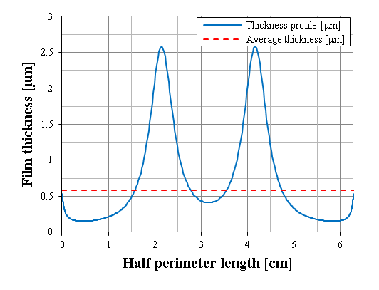
Reducing the gap: thickness distribution
60x11.5 mm elliptical cross-section.
Film thickness: 0.25–1.5 μm.
62x6 mm elliptical cross-section.
Same perimeter and same amount of deposited material.
Film thickness: 0.2–2.6 μm.
Smaller gap → larger thickness range

Slide 15
Technological limits in IDs’ NEG coating
IDs with gap down to 8 mm and up to 6 m long have been coated by SAES.
IDs with a 7 mm gap and up to 2.5 m long have been also successfully processed.
The sputtering setup is well established, hence major issues are not expected also in the case of longer chambers having the same gap.
Based on this, the following dimensions are assumed as a practical limit for NEG deposition on elliptical IDs:
Narrower and longer chambers might be feasible, but more drastic thickness variations along the profile would be in this case unavoidable.
Section: 7x30 mm
Length: 6 m

Slide 16
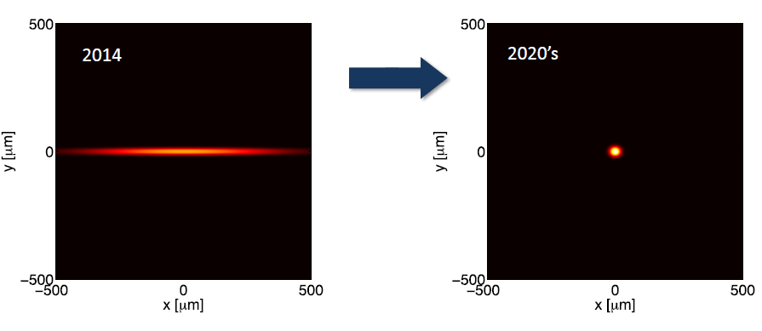
The new wave : ultra-low emittance synchrotrons
The next generation of light sources aims to achieve very high brilliance (high number of photons of given wavelength, per unit area and time). To achieve this target the beam emittance must be very low.
Courtesy of Andre Anders, LBL
Insertion devices for Ultra-low emittance synchrotrons will be round pipes with diameter <10 mm….
NEG coating is the only option to ensure appropriate pumping and pressure profile.

Slide 17
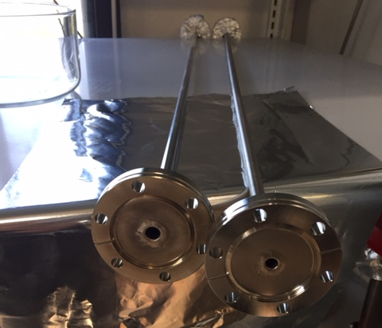
Small-aperture beam pipes
Interest is growing in the accelerator community in understanding the coating process and its feasibility in small diameter pipes.
As of now, stainless-steel pipes with the following internal diameters have been coated and characterised at SAES:
10 mm,
8 mm,
6 mm.
Preliminary trials on pipes with 4 mm diameter (ongoing).
An update of this activity is provided in the following.

Slide 18
Small-diameter pipes: 10 mm
Stainless-steel 2 m long pipes with 10 mm internal diameter.
Plasma could be ignited without major issues, neither in the plasma ignition nor in the coating-process stability.
The pipes were cut and inspected, both visually and by SEM, to check for uniform presence of the film:
100% covered area.
Thickness and chemical composition measurements were made by EDS at different positions along the pipe:
average thickness 1.06 μm (±38%);
average composition very close to the nominal one.
 | Ti [at.%] | V [at.%] | Zr [at.%]
Nominal composition | 30.0 | 40.0 | 30.0
Experimental average | 29.8 | 40.0 | 30.2

Slide 19
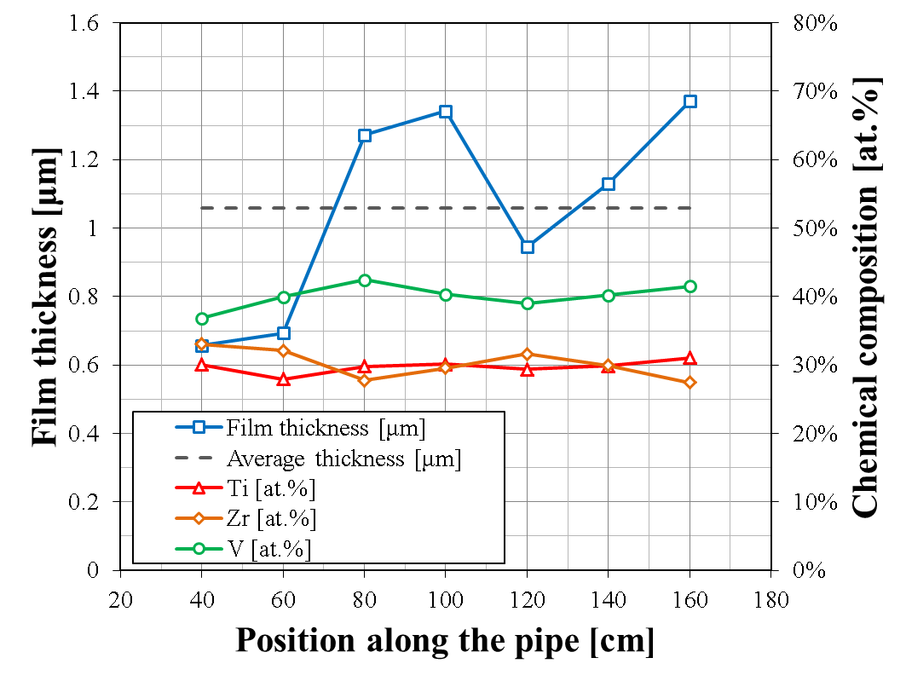
10 mm pipes: thickness and chemical composition profile
Average thickness:
~1 μm (±38%)
The chemical composition is overall constant along the pipe.

Slide 20
10 mm pipes: SEM analysis
The coated film is quite conformal and follows the surface roughness and morphology of the substrate.
a
b
50 μm
50 μm
c
a: non-coated clean surface area.
b: ~1.5 μm thick NEG coating.
c: ~4.0 μm thick NEG coating (more cauliflower-like but still well adherent).
50 μm

Slide 21
Small-diameter pipes: 8 mm
Stainless-steel 2 m long pipes with 8 mm internal diameter.
Also in this case plasma was ignited without issues and the coating process was smooth with coating parameter recorded and stable.
The pipes were cut and inspected, both visually and by SEM, to check for uniform presence of the film:
100% covered area.
Thickness and chemical composition measurements were carried out by EDS at different positions along the pipe:
average thickness 1.05 μm (±43%);
average composition close to the nominal one.
 | Ti [at.%] | V [at.%] | Zr [at.%]
Nominal composition | 30.0 | 40.0 | 30.0
Experimental average | 25.3 | 46.3 | 28.4

Slide 22
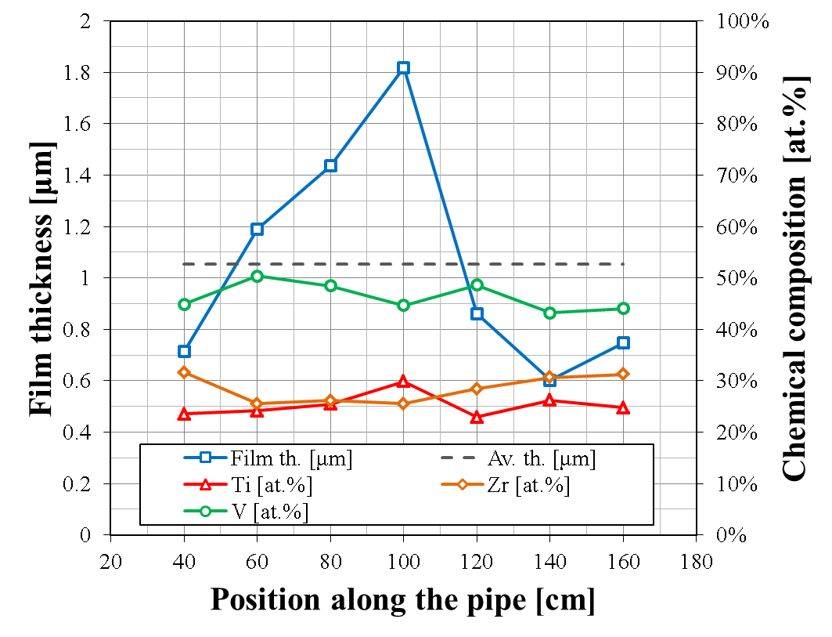
8 mm pipes: thickness and chemical composition profile
Average thickness:
~1 μm (±43%)
The chemical composition is overall constant along the pipe.

Slide 23
8 mm pipes: SEM analysis
The deposited film is quite conformal and follows the surface roughness and morphology of the substrate.
zoom
zoom
Film thickness:
1.5μm

Slide 24
Small-diameter pipes: 6 mm
Initial tests: stainless-steel 2 m long pipes with 6 mm internal diameter.
A number of issues encountered about the mounting of the cathodes and the stabilisation and uniformity of plasma conditions.
Test-pipe 1 m.
Plasma ignition was successful, although higher plasma pressure was required.
Visual and SEM inspection:
100% covered area.
Thickness and chemical composition measurements by EDS along the pipe:
average thickness 1.32 μm (±38%);
average composition close to the nominal one.

Slide 25
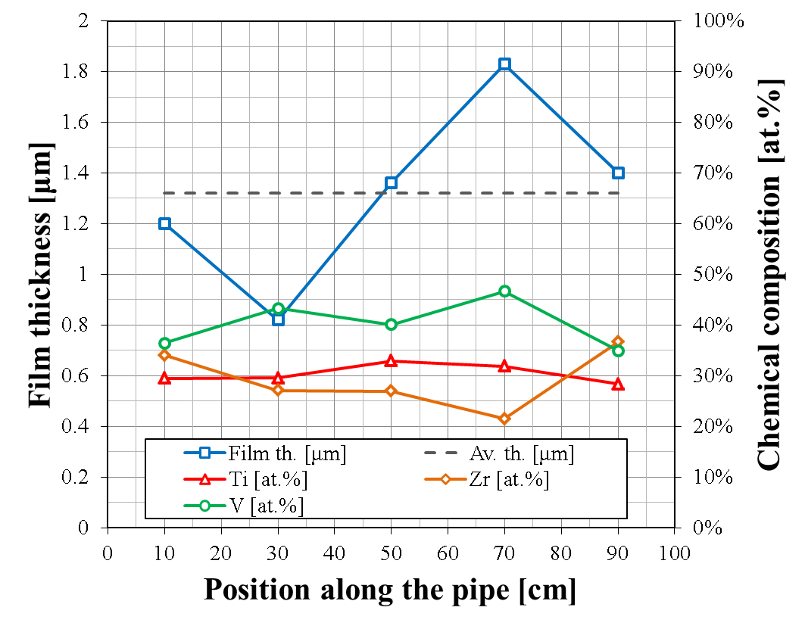
6 mm pipes: thickness and chemical composition profile
Average thickness:
~1.3 μm (±38%)
 | Ti [at.%] | V [at.%] | Zr [at.%]
Nominal composition | 30.0 | 40.0 | 30.0
Experimental average | 30.5 | 40.3 | 29.2

Slide 26
6 mm pipes: SEM analysis
Stainless-steel substrate
1.8 μm thick
NEG film

Slide 27
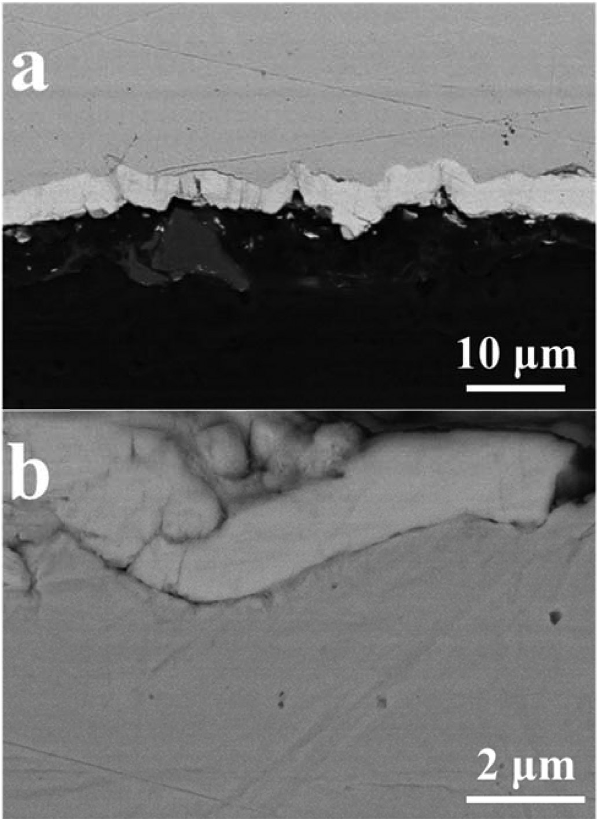
Assessment of coating adhesion
In addition to visual inspection, film adhesion is verified also by SEM/EDS.
Samples of narrow tubes (down to Ø 6 mm) cut longitudinally and fixed in resin.
The cut section profile is analysed.
Good adhesion evidenced by SEM, both on a larger scale (fig. a) and at a closer view (fig. b).
Adhesion is still very good, in spite of inevitable stress and deformation induced by sample preparation and resin shrinkage.
Predominance of Ti, Zr, and V, in the areas identified as NEG coating, is clearly confirmed by EDS analysis.
Stainless-steel substrate
Deposited NEG coating
Stainless-steel substrate
T. Porcelli et al., Vacuum 138 (2017) 157–164.

Slide 28
4 mm pipes: work in progress
Coating 4 mm pipes has not yet been accomplished. Many factors have to be optimised. In particular:
adjust the plasma parameters and pressure to the given geometry (length, curvature, …);
use high applied magnetic fields to ensure that the plasma discharge is kept stable and running during the whole coating process;
design the cathode assembly in the proper way, to avoid shorts and to allow at the same time enough space for the pumping and plasma discharge volume. Use of very thin cathodes is key with this regard.
Even though twisted multiple cathodes have been so far working, the use of a single-alloy wire might be beneficial to increase the distance between the cathodes and the chamber surface. Activity in this directions is ongoing.
Finally, as the pressure of the sputtering discharge has to be increased, Kr outgassing has to be evaluated.

Slide 29
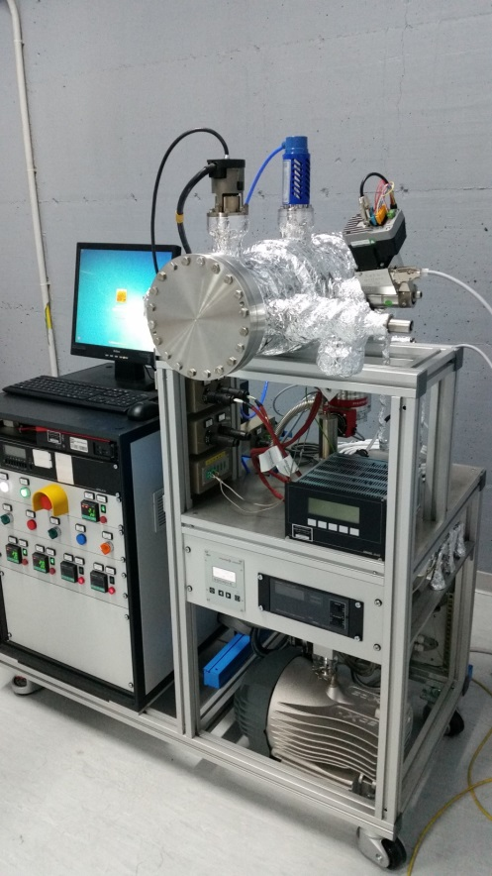
Improvement of SAES’ coating facility
SAES’ NEG coating facility is currently being improved and enlarged.
A new NEG deposition facility has been set up. It has a 2 m long, Ø 680 mm internal diameter solenoid, so to coat large vacuum chambers with complex shapes.
A cleanroom ISO 6 is being installed, for future sample handling and preparation prior to coating deposition.
A dedicated test-bench with a Fischer-Mommsen dome for transmission factor measurements is now available.

Slide 30
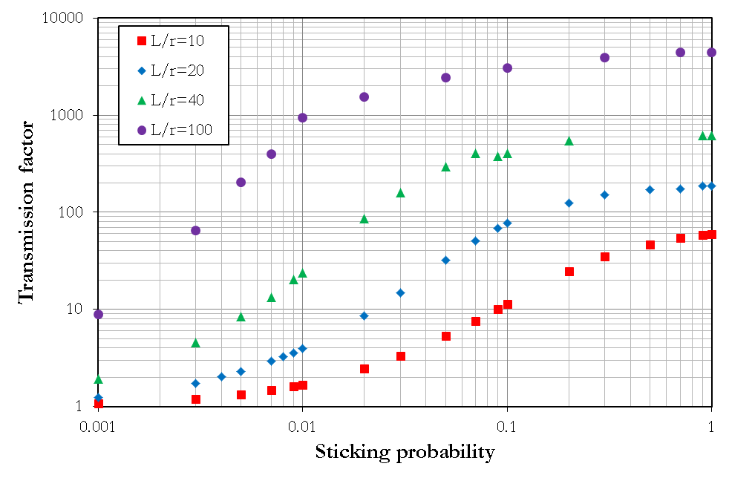
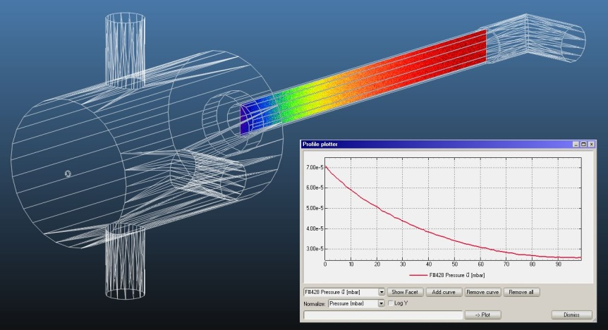
Transmission factor measurements
Calibration curves simulated with Molflow+ are used to correlate the Tr factor measured on NEG-coated chambers with their corresponding sticking probability, depending on the aspect ratio L/r.
When dealing with narrow coated tubes, Tr factor measurements could be altered by non-getterable gases (CH4) interacting arriving to the gauge at the end of the tube → use of RGA and, possibly, N2 cooling of the end gauge become essential.

Slide 31
Conclusions
NEG coated elliptical IDs are extensively used ( ≈ 100 IDs delivered by SAES to the accelerator community in the past 10 years).
There is a trend towards narrow gap IDs. Consistent NEG coating up to 6 m long, with gaps as low as 7 mm demonstrated in our facility.
Chemical uniformity and thickness distribution can be ensured by a stringent manufacturing protocol and process control. However, thickness variations are unavoidable in non circular shapes.
Coating of small diameter round pipes possible down to 6 mm diameter at least up to 1 m length with good control of the chemical composition and acceptable thickness variation (± 40% ).
Coating of 4mm pipes is theoretically possible. However, strong technological barriers do exist. Work is in progress to confirm whether the target is practically achievable.

Slide 33
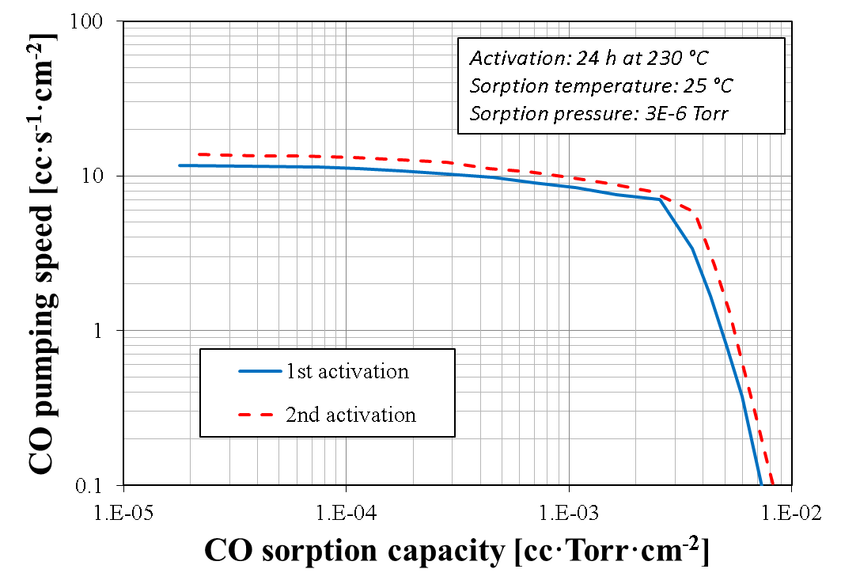
8 mm pipes: ASTM sorption tests
ASTM [1] sorption tests have been carried out on 20 cm long NEG-coated pipes (smooth film, ~0.6 μm thick).
No pumping speed measurement was possible, due to the strong, intrinsic conductance limitations determined by the pipe’s geometry.
The aim was to assess the pumping capability and the maximum CO sorption capacity of the NEG coating.
Measured capacities are in line with previous SAES measurements.
More tests (also in accordance with the transmission factor method) are in progress.
[1] ASTM F798-97.

Slide 34
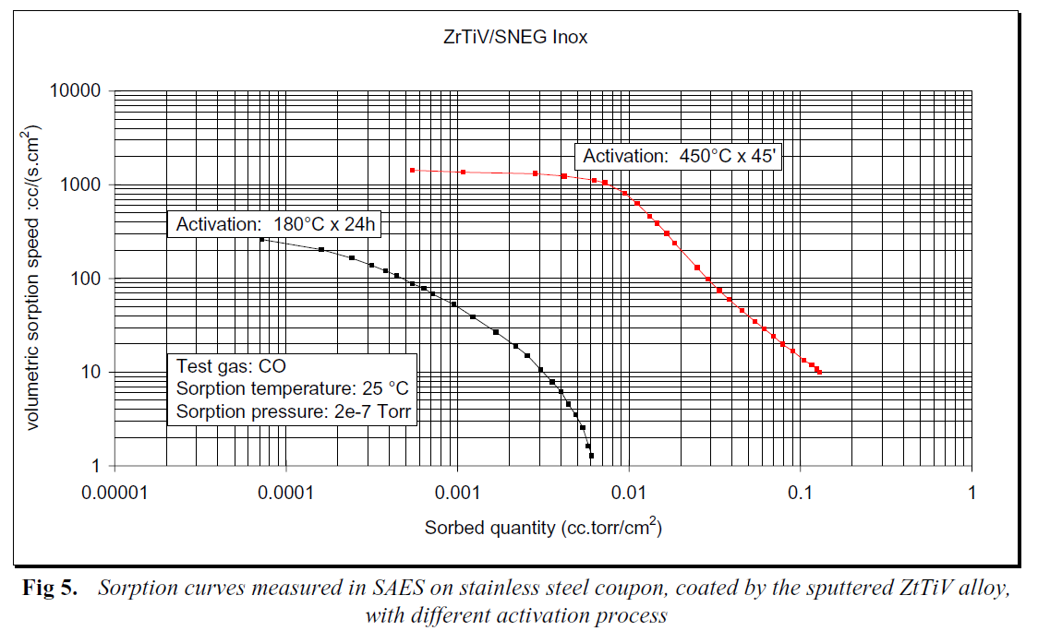
SAES historical data on NEG coating capacity for CO
SAES internal technical report (2006)
CO sorption capacity [molecules/cm²]
8 mm pipe | SAES internal data | Literature data [1]
5.4·10¹⁴ (smooth) | 6.5·10¹⁴–1.6·10¹⁵ (smooth-rough) | 8.0·10¹⁴–8.0·10¹⁵ (smooth-rough)
[1] P. Chiggiato and P. Costa Pinto, Thin Solid Films 515 (2006) 382.

