Slide 1
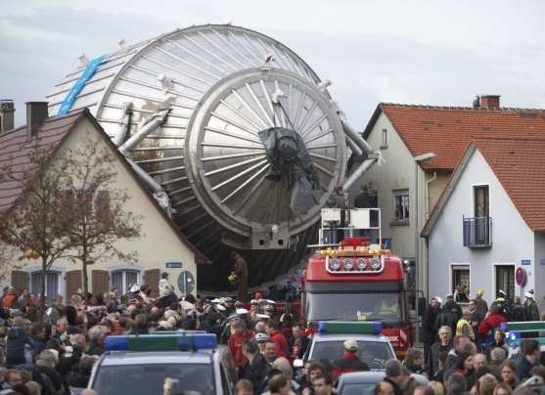

The KATRIN Experiment
Joachim Wolf
KIT, 09.03.2017
KATRIN Experiment
Tritium Source
Pumping and Transport Section
Spectrometer and Detector Section
Conclusions / Next Steps

Slide 2
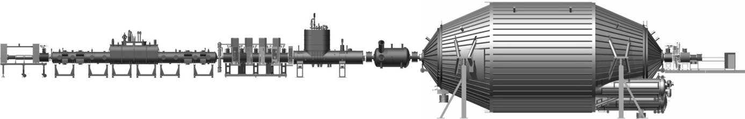
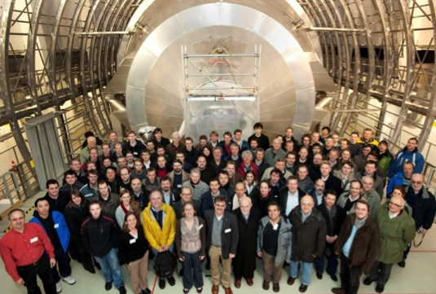


















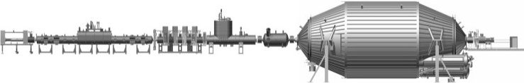
The KArlsruhe TRItium Neutrino Experiment
Sensitivity on m(ν_{e}): 2 eV/c² → 0.2 eV/c²
Goal: measure the effective neutrino mass
International KATRIN collaboration:
  about 130 members
  6 countries (GER, US, CZ, RUS, ES, F)
  19 institutions

Slide 3
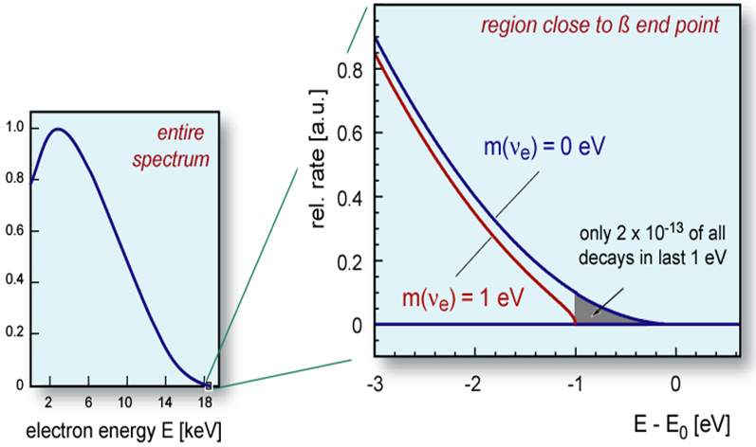
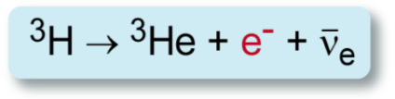
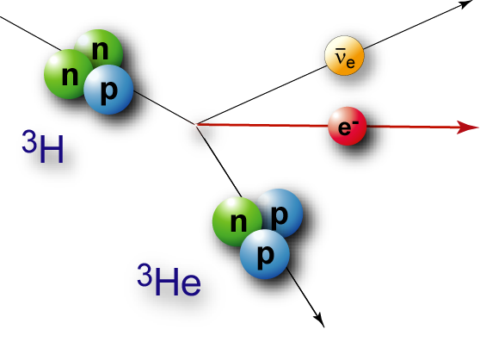
The KArlsruhe TRItium Neutrino Experiment
70 m
Source & Transport Section (STS)
Spectrometer & Detector Section (SDS)
³H: super-allowed
E₀ | 18.6 keV
t_{1/2} | 12.3 y
most sensitive method
ideal
β-emitter
G. Drexlin, V. Hannen, S. Mertens, C. Weinheimer, Current Direct Neutrino Mass Experiments (Review), Adv. In High Energy Phys. (2013) 293986
J. Wolf - The KATRIN Experiment

Slide 4
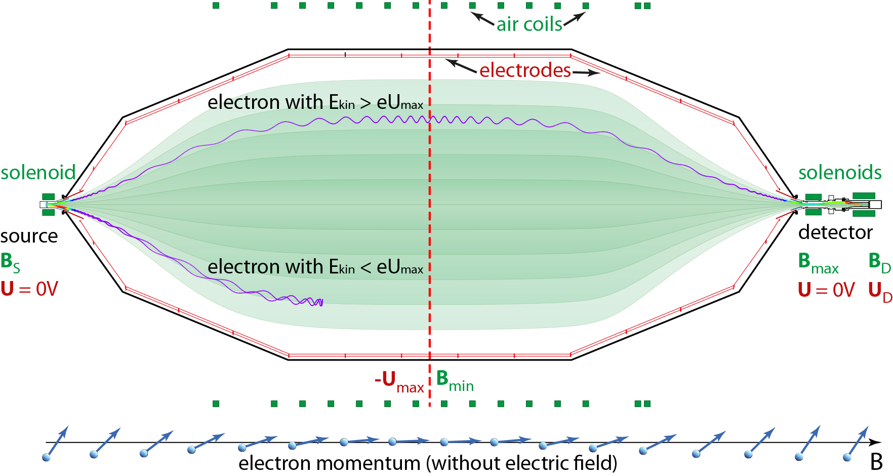
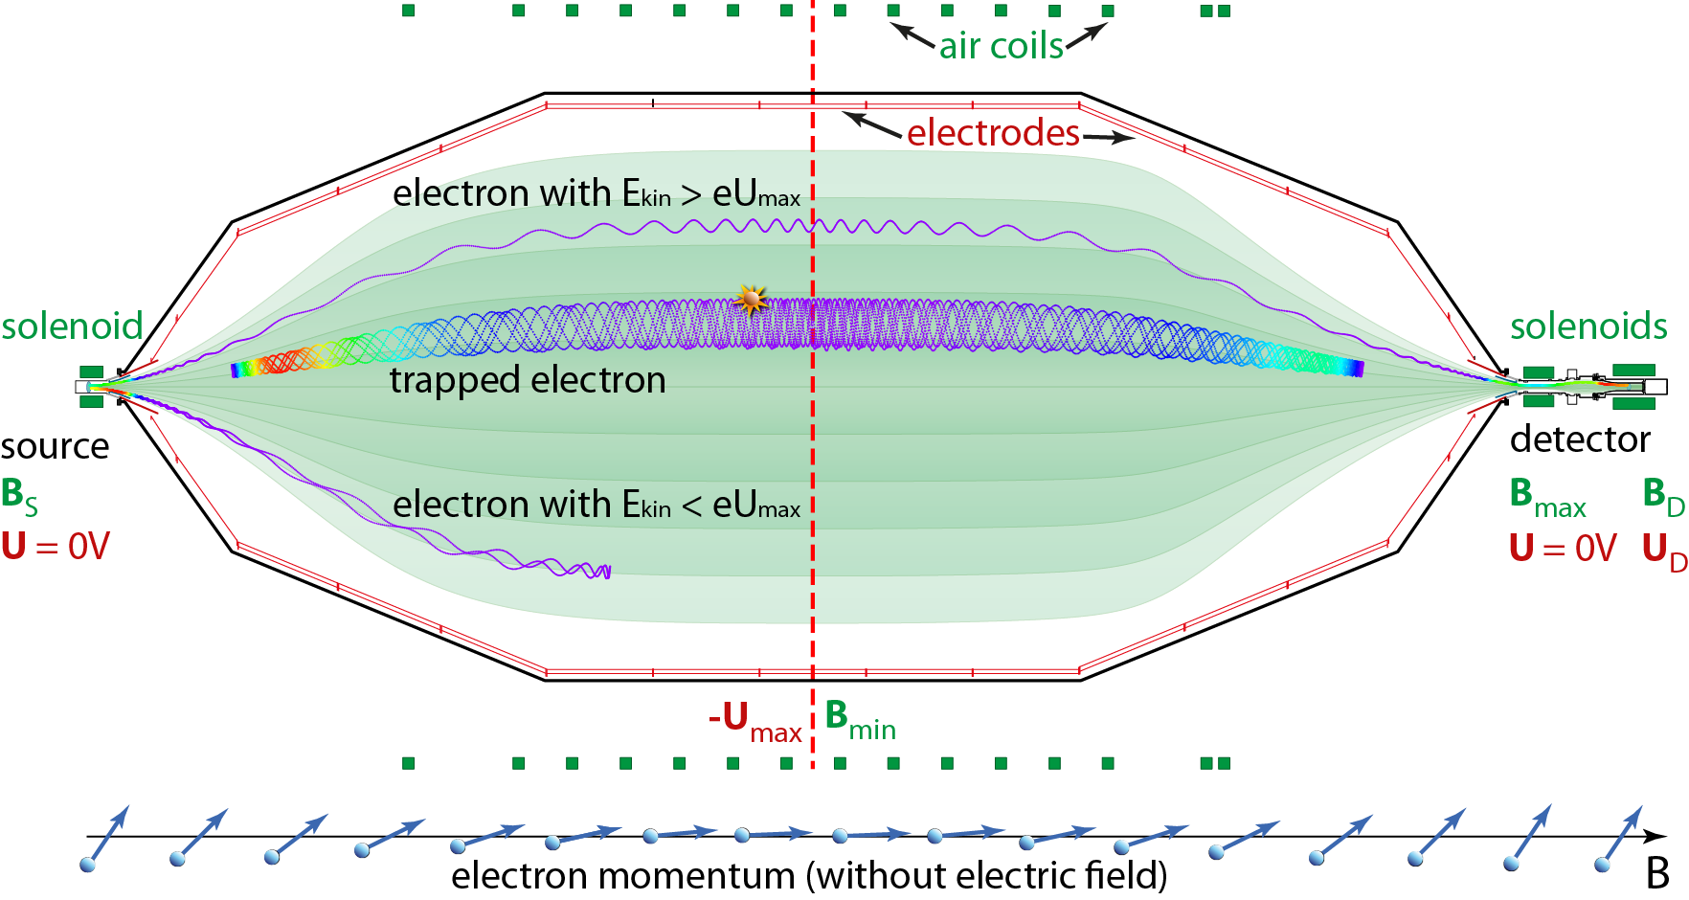

The MAC-E Filter
Magnetic Adiabatic Collimation
with Electrostatic Filter
A. Picard et al., NIM B 63 (1992)‏
  collimation: μ = E⊥ / B = const, ➔ E⊥ → E|| for B = 6 T → 3mT
  energy analysis: transmission condition: E|| > eU_{max} (retarding potential)
  energy resolution: ΔE = E ∙ B_{min} / B_{max} = 18.6 keV ∙ 0.3 mT / 6 T = 0.93 eV

Slide 5
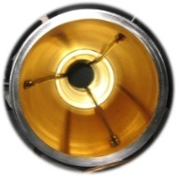
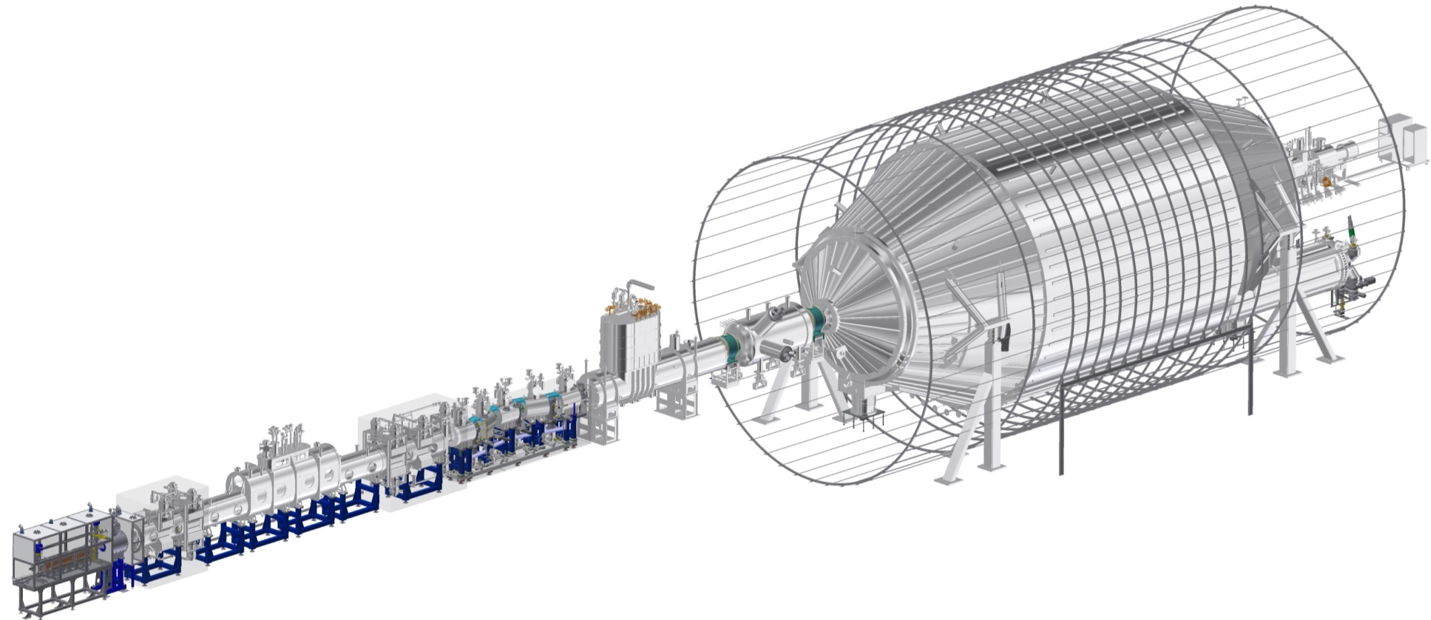


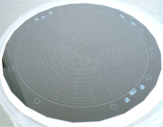
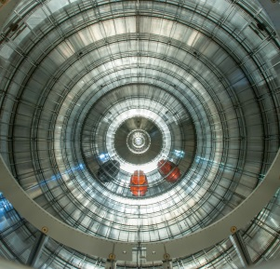
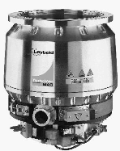
KATRIN overview: 70 m beamline
cryogenic
pumping
windowless gaseous
tritium source
electron
counting
integral
energy
analysis
differential
pumping
diagnostics

Slide 6
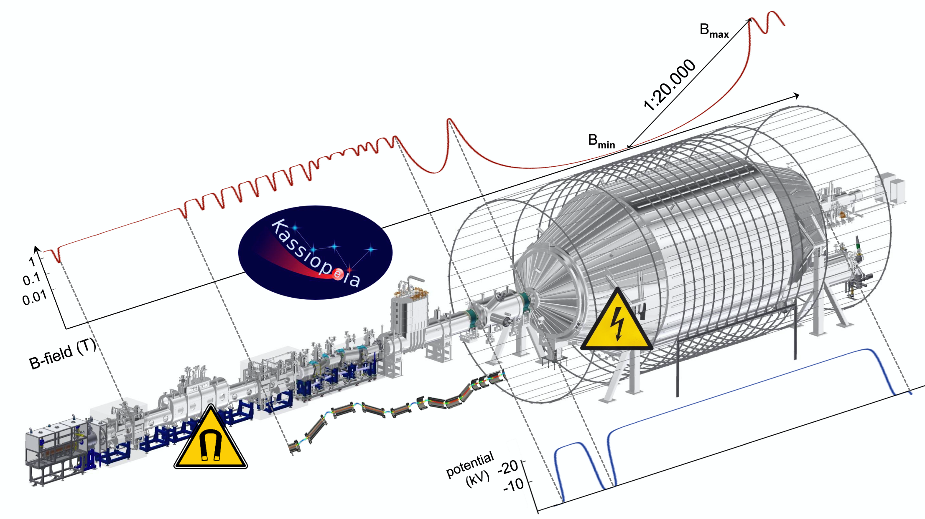
KATRIN overview: particle tracking
ultra-precise calculation of electro- / magneto-static fields
high-statistics simulations of particle trajectories
Kassiopeia software also used by other projects

Slide 7

KATRIN overview: benchmark parameters
Source & Transport Section (STS)
Spectrometer & Detector Section (SDS)
tritium source: 10¹¹ β-decays/s
total background: 10⁻² cps
experimental challenges
 10⁻³ stability of tritium source column density
10⁻³ isotope content in source
 10⁻⁵ non-adiabaticity in electron transport
 10⁻⁶ monitoring of HV-fluctuations
 10⁻⁸ remaining ions after STS
 10⁻¹¹ mbar in Main Spectrometer
 10⁻¹⁴ remaining flux of molecular tritium in SDS

Slide 8
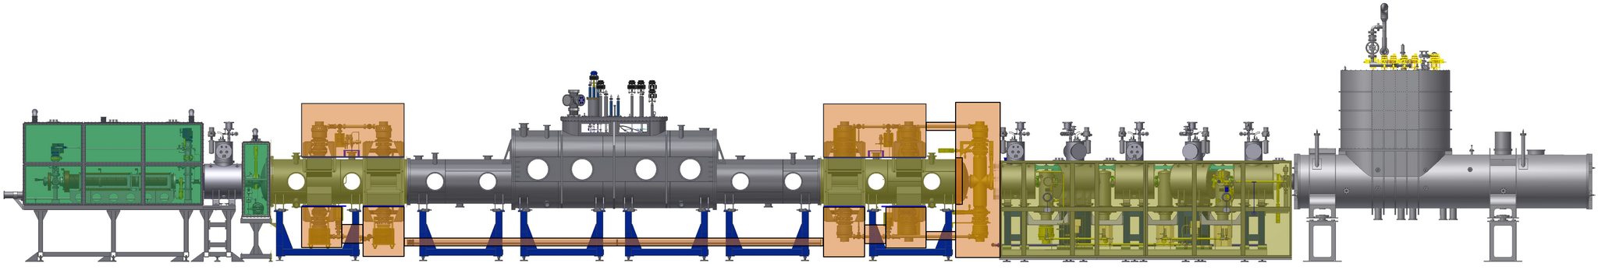
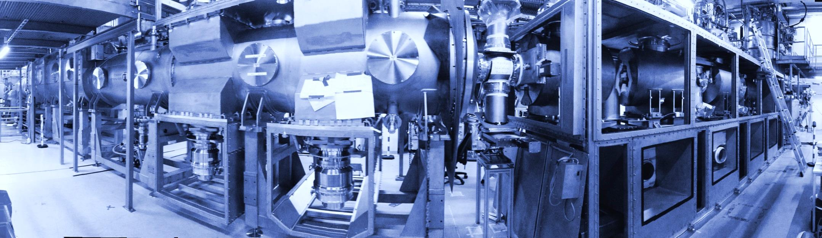
KATRIN Source and Transport Section

Slide 9
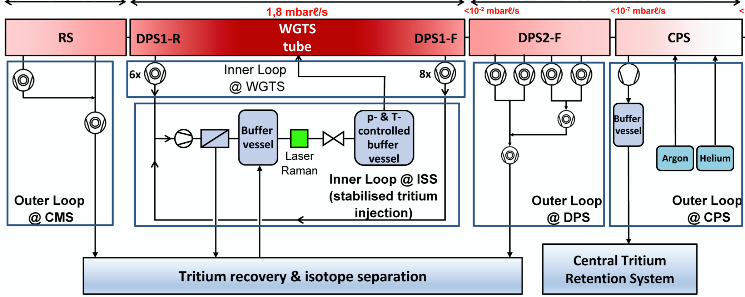
KATRIN Source and Transport Section
■ Source - stringent control of systematic effects: isotopic purity,
gas temperature, plasma effects

Slide 10
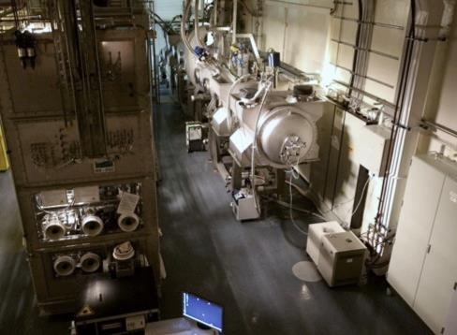
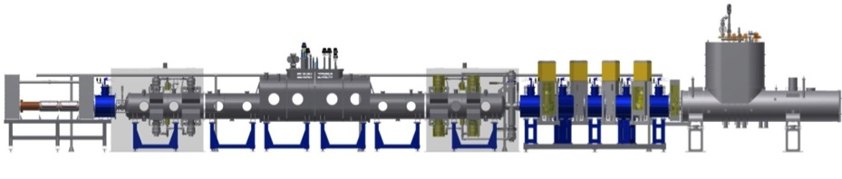
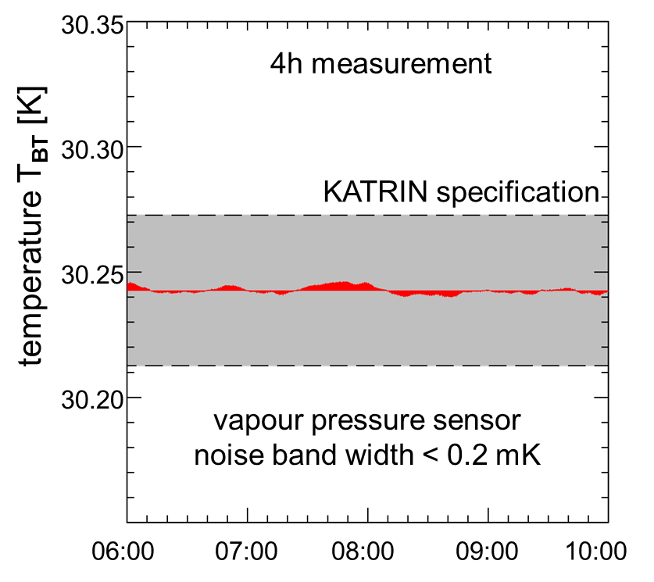
Windowless Gaseous Tritium Source WGTS
Beam tube temperature
beam
tube Temp.
Challenge
2-phase
neon
temperature stability on 10⁻³ level
Technological development
- novel 2-phase neon cooling system
- required: ΔT = ± 30 mK (1 h)
- achieved: ΔT = ± 1.5 mK (1 h)
→ stability surpassing specifications

Slide 11
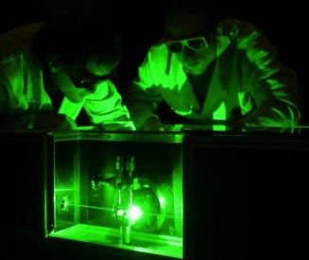



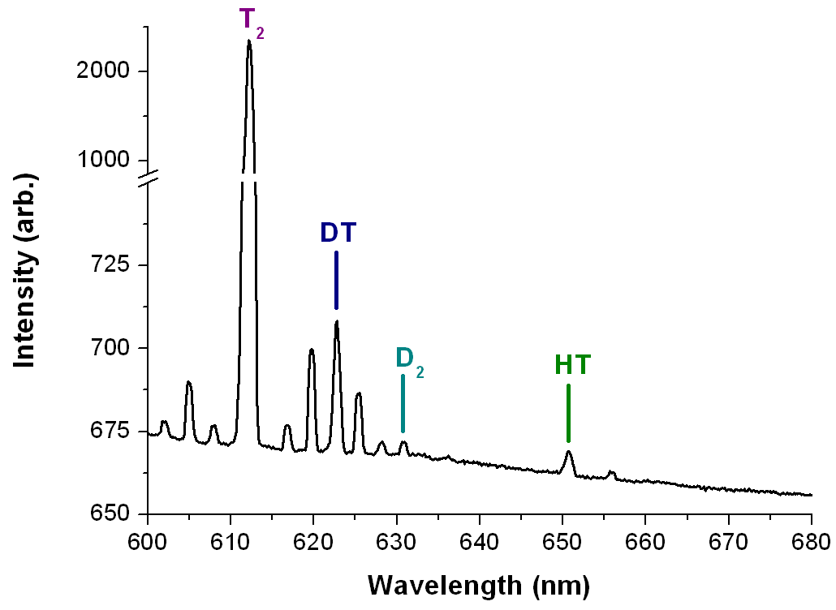
Windowless Gaseous Tritium Source WGTS
Raman spectroscopy
isotopic
content
Raman
spectr.
Challenge
- measure isotopic source content
with 10⁻³ accuracy in 100 s
Technological development
- calibrated Laser-Raman system
for all 6 hydrogen isotopologues
- achieved: < 10⁻³ accuracy in 60 s

Slide 12
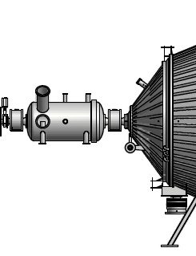
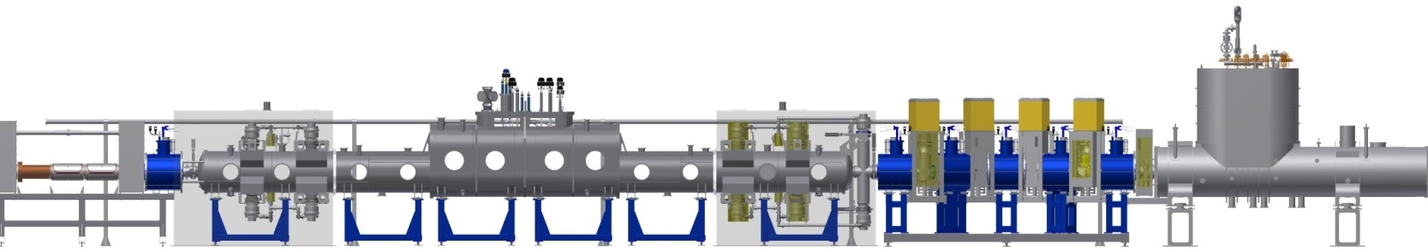
Transport and Pumping Sections
Suppress tritium flow from source to spectrometer by factor > 10¹⁴
differential pumping
tritium free
cryogenic
pumping
T₂ injection
10¹
10⁻¹
10⁻³
10⁻⁵
10⁻⁷
10⁻⁹
10⁻¹¹
10⁻¹³
10⁻¹⁵
10⁻¹⁷
tritium flow rate [mbar ℓ /s]
differential & cryo-pumping

Slide 13
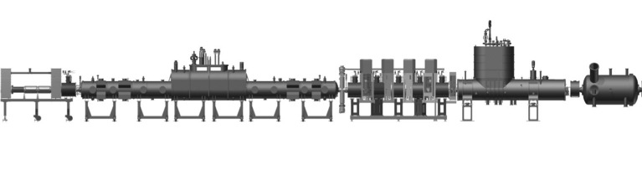
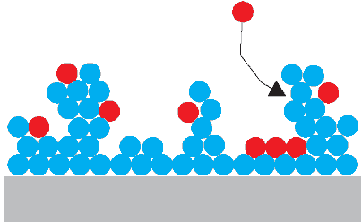
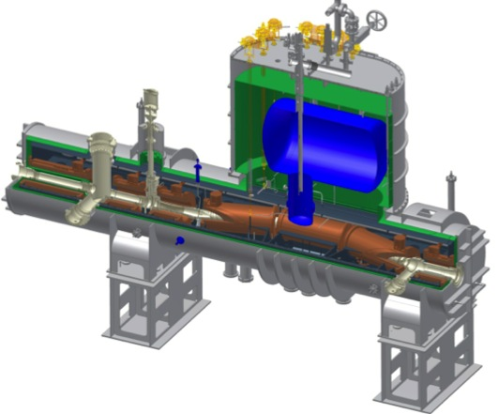
Transport and Pumping Sections
DPS1-R
DPS1-F
cryo-sorption
T₂
Ar Frost
DPS2-F
CPS
stainless steel
β
β
Argon Frost Pump
T = 3 – 4.5 K
Differential Pumping Section (DPS)
active pumping: 6 + 8 + 4 TMPs
tritium retention: 10⁷
tritium ion removal: dipole electrodes
magnetic field: 5.6 T
built at KIT, commissioning 2016
Cryogenic Pumping Section (CPS)
based on by cryo-sorption
tritium retention: >10⁷
beam diagnostics: retractable detector
magnetic field: 5.6 T
delivered: 2015, commissioning: 2016
X. Luo et al., Vacuum 80 (2006), 864 - 869
F. Eichelhardt et al, Fusion Science and Tech. 54 (2008) 615

Slide 14
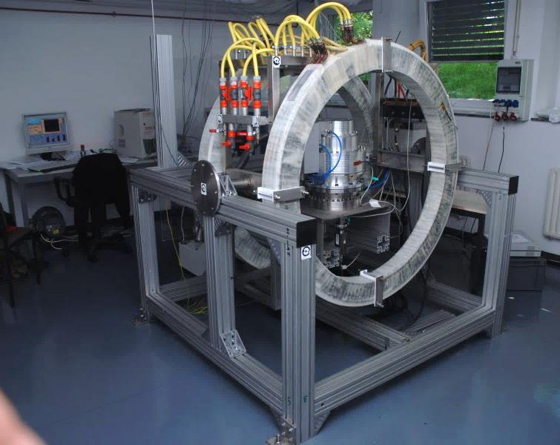
Risky operating conditions for TMPs?
Endurance test for TMP with tritium
tritium can affect non-metal parts of pump
TMP type: Leybold MAG-W 2800
tested at Tritium Laboratory Karlsruhe (TLK)
398 days operation with tritium
throughput: 1106 g tritium
F. Priester, PhD thesis at KIT (2013)
TMP in a magnetic field
eddy currents can over-heat rotor
high mag. field can slow down rotor
failure of magnetic bearing
test setup built at KIT for large TMPs
math. model developed for prediction
R. Größle et al., Vacuum 86 (2012) 985-989

Slide 15
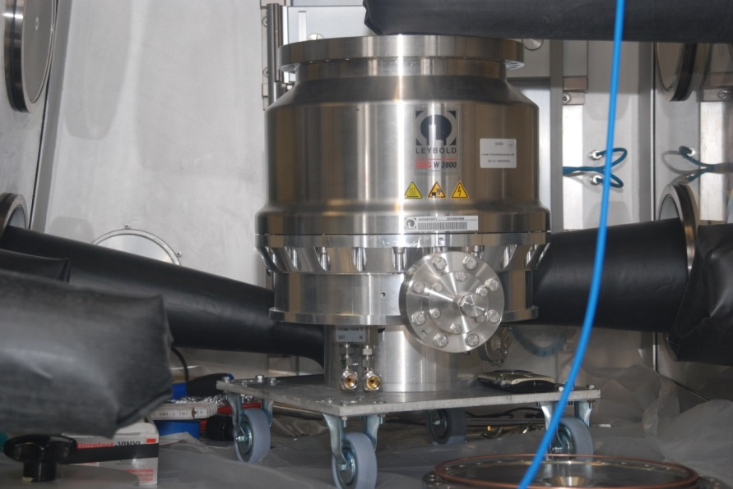
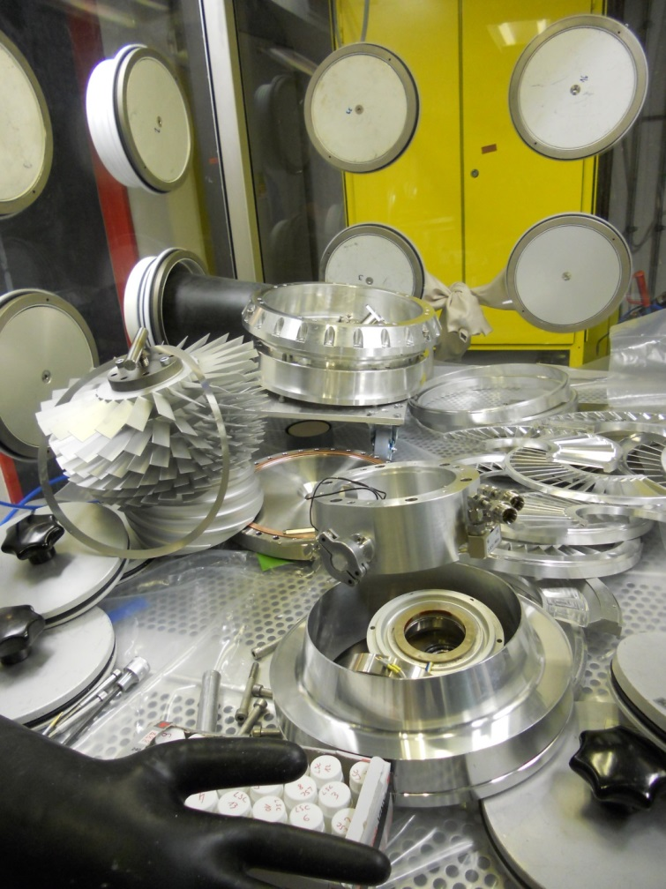
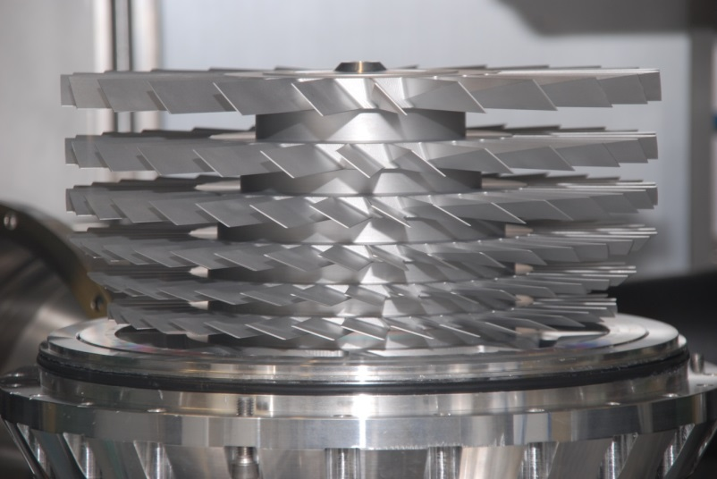
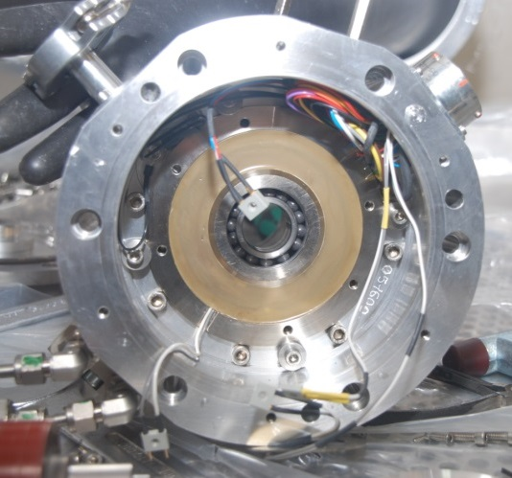
Complete dismantling of a MAG W 2800
parts were highly contaminated with tritium, but …
… parts looked like new, no indication of wear, cables and O-rings ok

Slide 16
Risky operating conditions for TMPs?
Endurance test for TMP with tritium
tritium can affect non-metal parts of pump
TMP type: Leybold MAG-W 2800
tested at Tritium Laboratory Karlsruhe (TLK)
398 days operation with tritium
throughput: 1106 g tritium
F. Priester, PhD thesis at KIT (2013)
TMP in a magnetic field
eddy currents can over-heat rotor
high mag. field can slow down rotor
failure of magnetic bearing
test setup built at KIT for large TMPs
math. model developed for prediction
R. Größle et al., Vacuum 86 (2012) 985-989

Slide 17
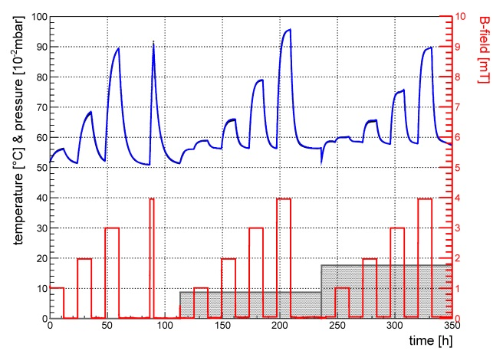
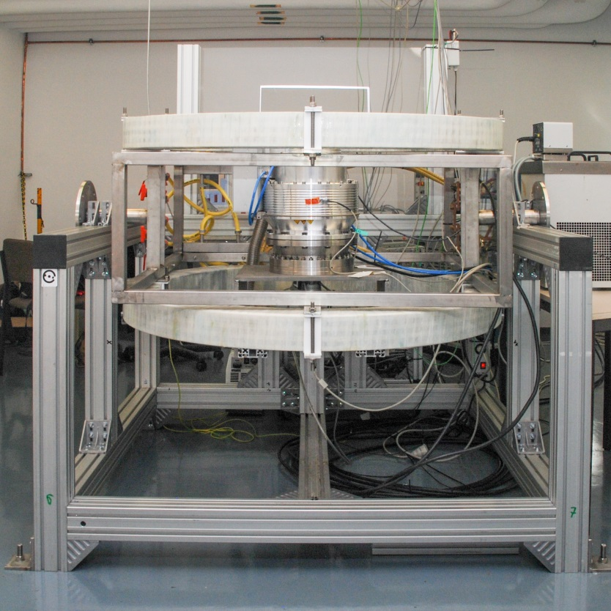
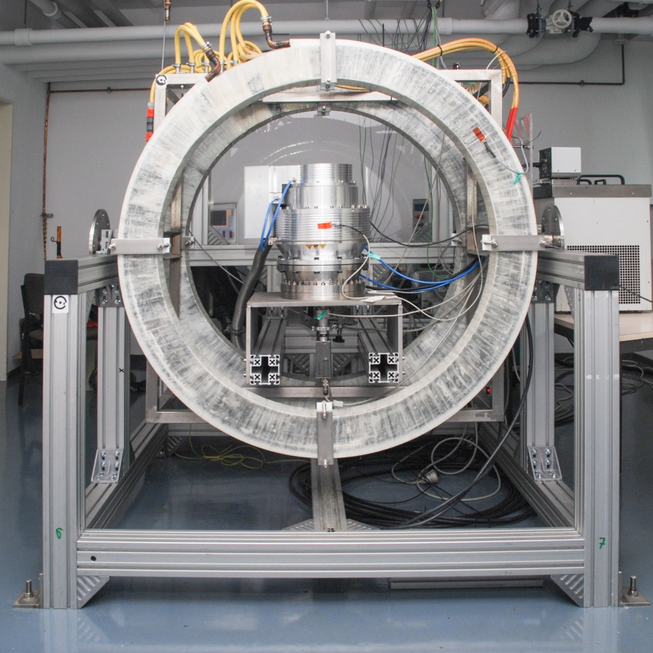
TMP in a magnetic field
Helmholtz coils: radius = 60 cm
B-field: 0 – 50 mT
coils can be turned by 90°
pyrometer used for rotor temperature
gas flow possible
measures parameters for empirical model
Helmholtz coils
(∅ = 120 cm)
TMP
Pyrometer
gas inlet

Slide 18
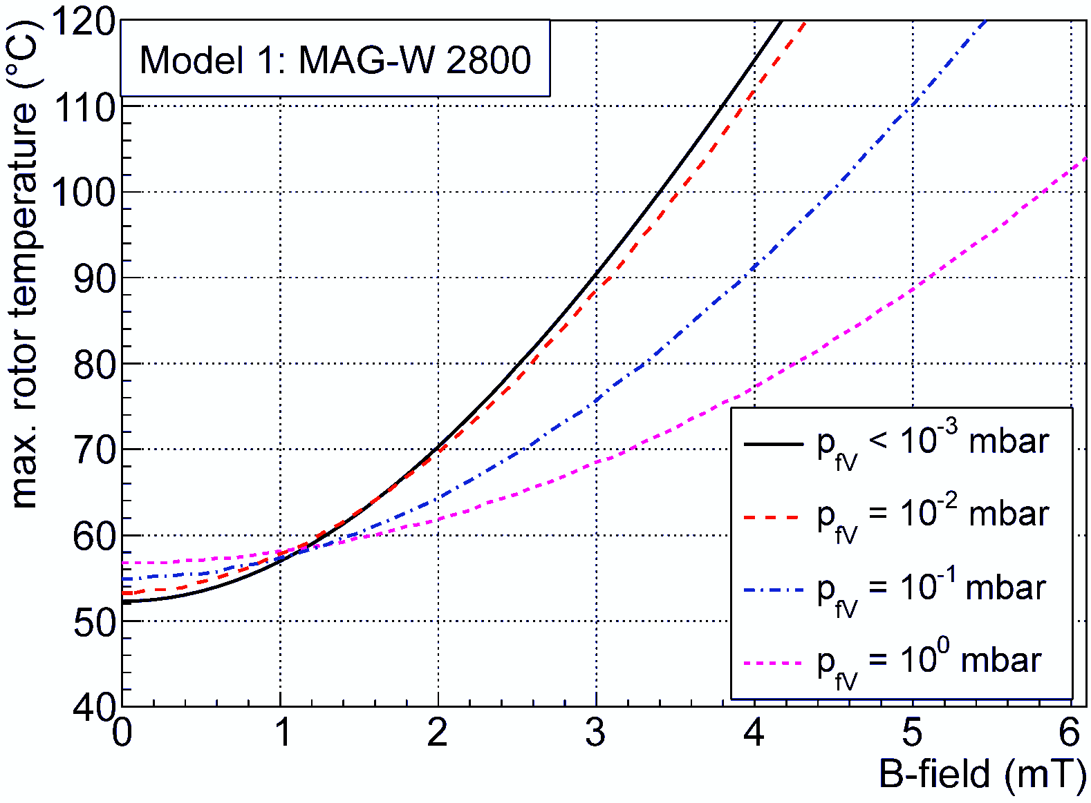
TMP in a magnetic field
WGTS: TMPs operated in 18.5 mT
8 mm St37 steel shielding: < 70°C
B_{max} at 70°C rotor temp.
no shielding: 2 mT
5 mm shield.: 13 mT
8 mm shield.: 20 mT

Slide 19
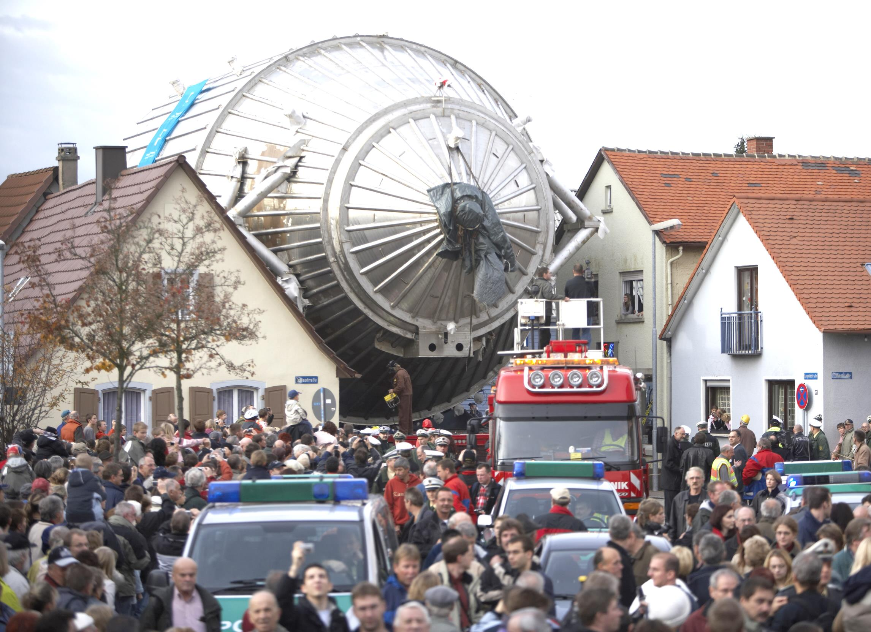
The KATRIN Main Spectrometer

Slide 20
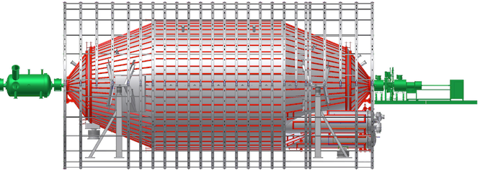
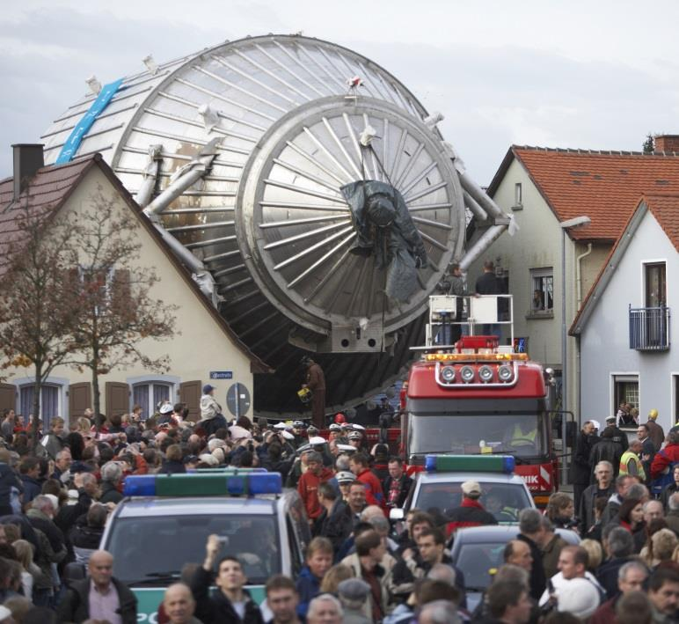
KATRIN Main Spectrometer
windowless gaseous electron transport and
tritium source pumping section
detector
Main Spectrometer
  MAC-E Filter principle → precise electron energy measurement
    Vacuum vessel & electrodes on
    variable retarding potential (18.6 kV)
    Magnetic guiding field: 0.3 mT – 6 T
    High resolution: ΔE = 0.93 eV @ 18.6 keV
arrival at KIT: 26.11.2006

Slide 21
KATRIN Main Spectrometer
windowless gaseous electron transport and
tritium source pumping section
detector
Main Spectrometer
  MAC-E Filter principle → precise electron energy measurement
    Vacuum vessel & electrodes on
    variable retarding potential (18.6 kV)
    Magnetic guiding field: 0.3 mT – 6 T
    High resolution: ΔE = 0.93 eV @ 18.6 keV
  Stainless steel (~200 to, 316LN)
  Dimensions:
    diameter: 10 m
    Length: 23 m
      volume: 1240 m³
      inner surface: 1240 m² (including wire electrodes)
arrival at KIT: 26.11.2006

Slide 22
KATRIN Main Spectrometer
windowless gaseous electron transport and
tritium source pumping section
detector
Main Spectrometer
  Requirements:
  Low pressure (~ 10⁻¹¹ mbar)
    tritium partial pressure <10⁻²¹ mbar
    few radon decays per day
    outgassing rate ~10⁻¹² mbar·ℓ/s·cm²
    total leak rate < 5·10⁻⁹ mbar·ℓ/s
  Bakable at 350°C (NEG activation)
  Stable operation at 20°C
arrival at KIT: 26.11.2006

Slide 23
KATRIN Main Spectrometer
windowless gaseous electron transport and
tritium source pumping section
detector
Main Spectrometer
  Requirements:
  Low pressure (~ 10⁻¹¹ mbar)
    tritium partial pressure <10⁻²¹ mbar
    few radon decays per day
    outgassing rate ~10⁻¹² mbar·ℓ/s·cm²
    total leak rate < 5·10⁻⁹ mbar·ℓ/s
  Bakable at 200°C (NEG elec. activated)
  Stable operation at 20°C (10°C)
  Vacuum components operated in
    Magnetic field: 0.3 mT – 6 T
    Electric potential: 18.6 kV
arrival at KIT: 26.11.2006

Slide 24
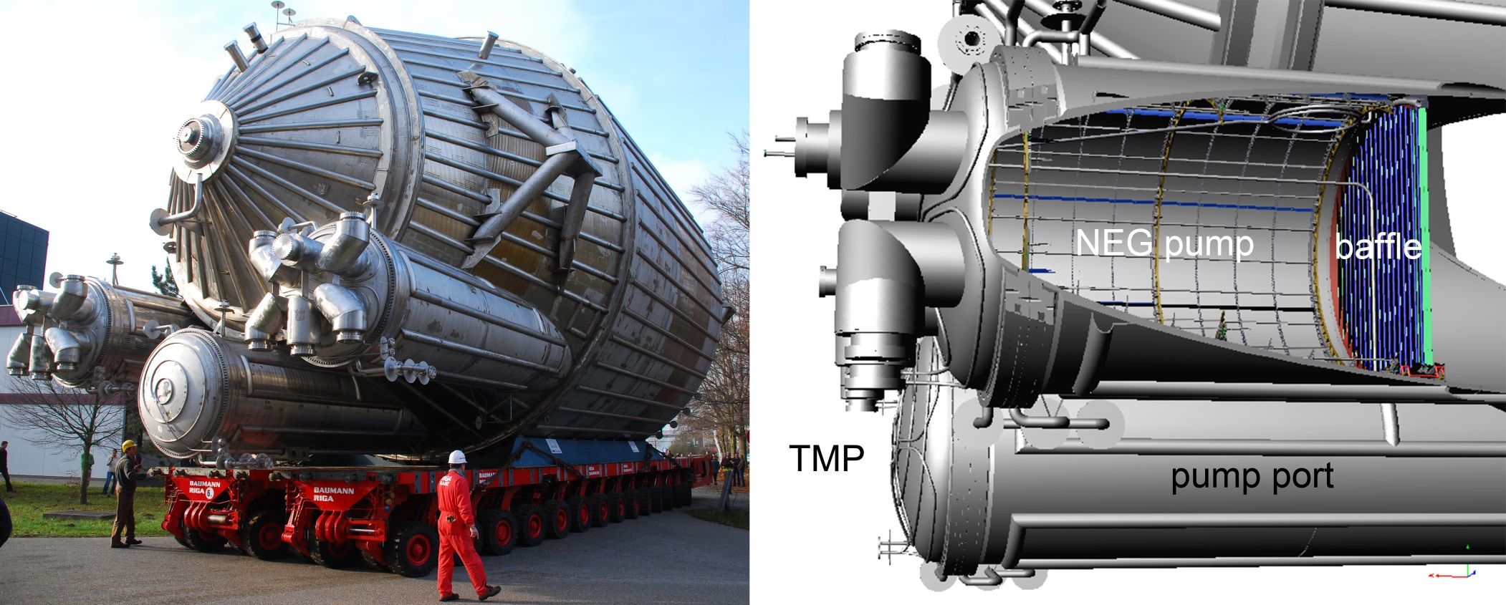
KATRIN Main Spectrometer Vacuum
3 TMPs
3 TMPs
Roughing pump: 640 m³/h screw-pump
6 turbo-molecular pumps (Leybold MAG-W 2800): 10 000 ℓ/s (H₂)

Slide 25
KATRIN Main Spectrometer Vacuum
Roughing pump: 640 m³/h screw-pump
6 turbo-molecular pumps (Leybold MAG-W 2800): 10 000 ℓ/s (H₂)
Fore-vacuum: 300 ℓ/s TMP and scroll pump (30 m³/h)

Slide 26
KATRIN Main Spectrometer Vacuum
Roughing pump: 640 m³/h screw-pump
6 turbo-molecular pumps (Leybold MAG-W 2800): 10 000 ℓ/s (H₂)
Fore-vacuum: 300 ℓ/s TMP and scroll pump (30 m³/h)
3 NEG-pumps (3000 m SAES St707 getter strips): ~10⁶ ℓ/s (H₂)

Slide 27
KATRIN Main Spectrometer Vacuum
Roughing pump: 640 m³/h screw-pump
6 turbo-molecular pumps (Leybold MAG-W 2800): 10 000 ℓ/s (H₂)
Fore-vacuum: 300 ℓ/s TMP and scroll pump (30 m³/h)
3 NEG-pumps (3000 m SAES St707 getter strips): ~10⁶ ℓ/s (H₂)
3 cryogenic LN₂ baffles (radon): ~160 000 ℓ/s (Rn)
2
250 000 ℓ/s

Slide 28
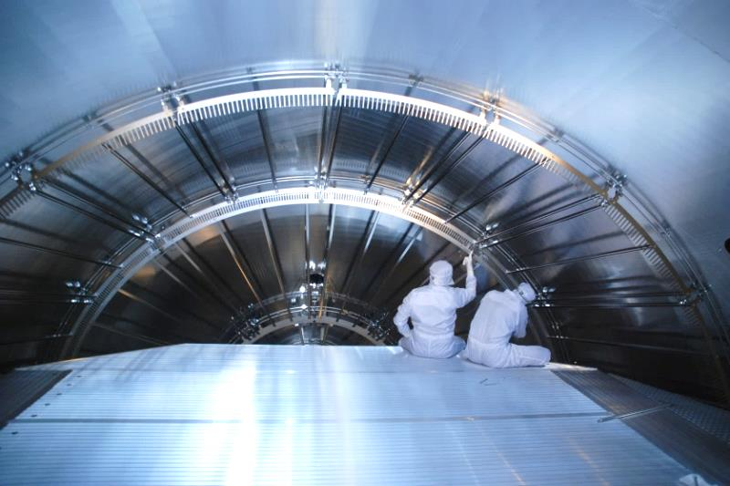
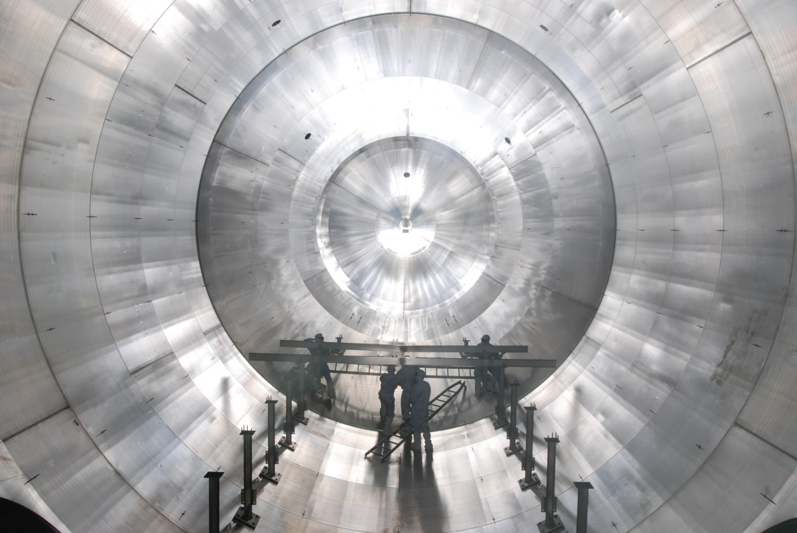

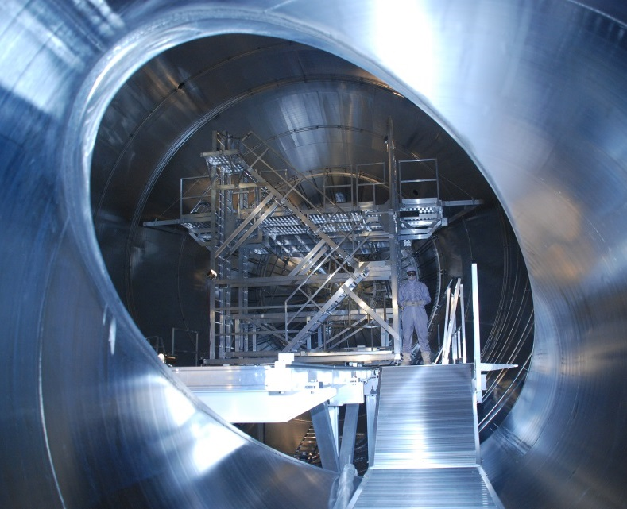
2008 – 2012: Wire Electrode Installation
248 wire electrodes on the inner surface
  23 440 insulated wires
  120 000 individual parts
Installed under cleanroom conditions

Slide 29
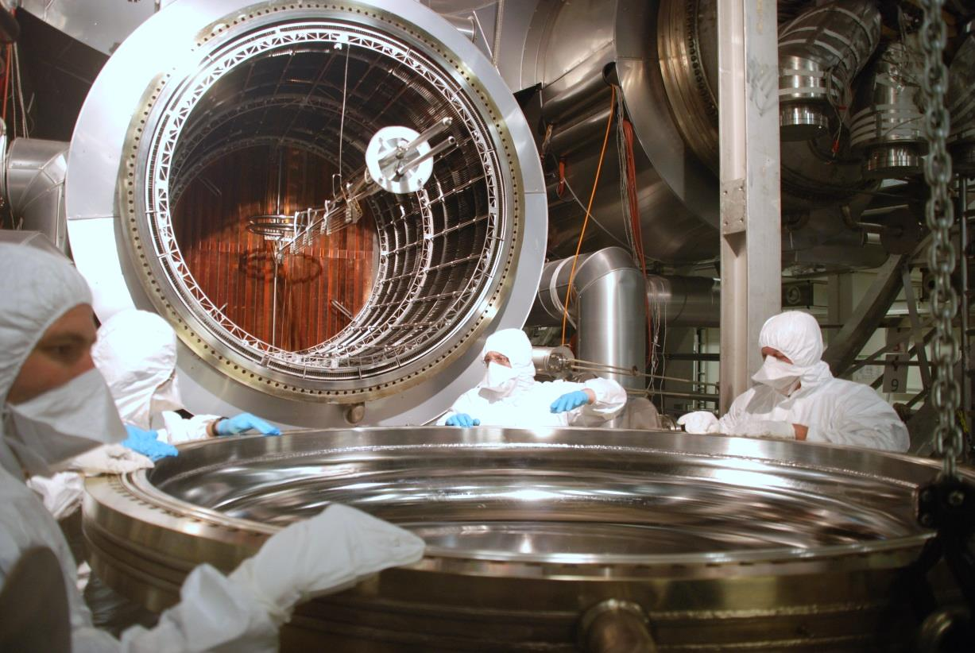
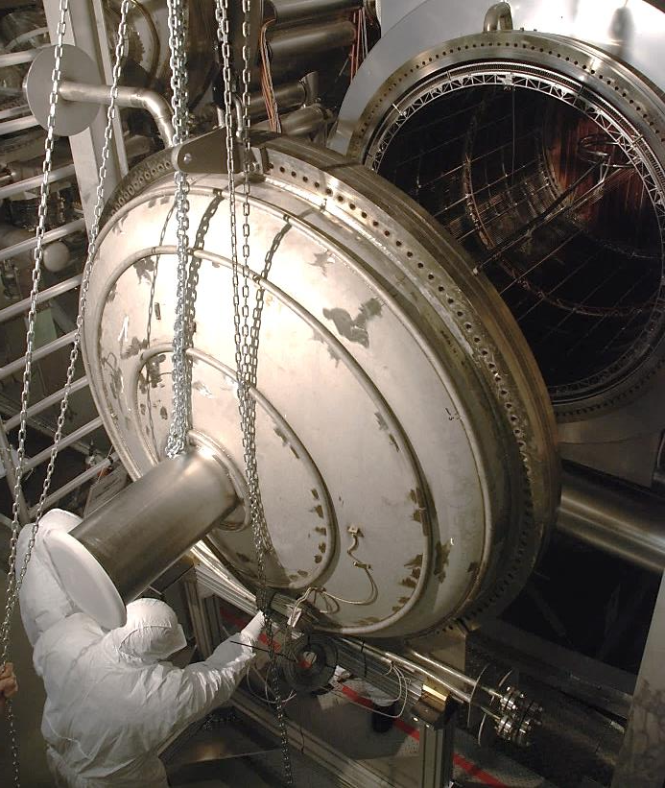
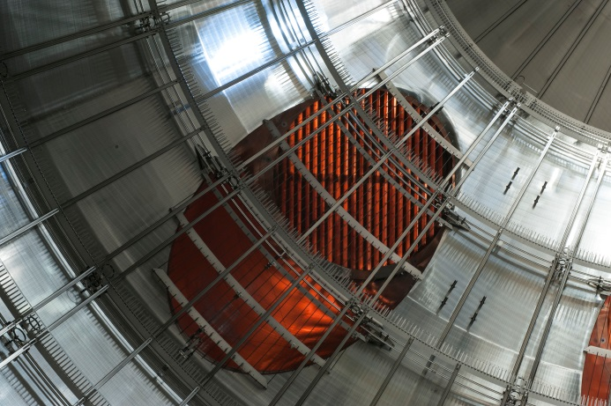
2012: Preparation of first measurements
Electrode installation completed
Vacuum chamber closed
Successful leak test
first bake-out, NEG activ. in Jan. 2013
> 1 year of data from 2013 - 2016

Slide 30
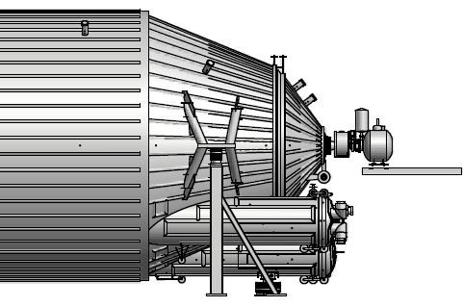
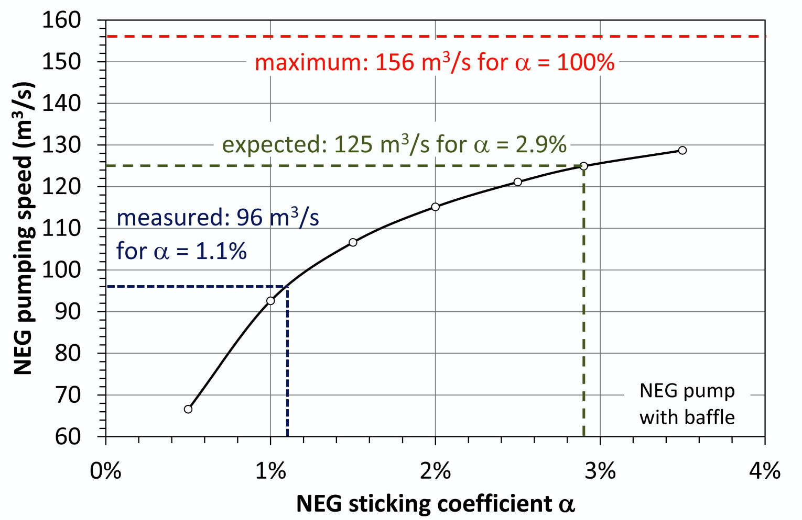
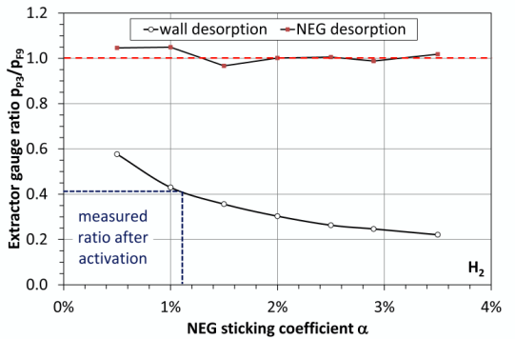
NEG activation
F9
Indicator for NEG activation:
  pressure ratio between vessel and pump port
  after baking: p_{P3}/p_{F9} = 0.41 ➔ S_{NEG} ≈ 290 m³/s
P3
Expected outgassing rate: 10⁻¹² mbar·ℓ/s·cm²
Actual H₂ outgassing rate: ~1.4 – 2.5·10⁻¹² mbar·ℓ/s·cm²
Surface (vessel & electrodes): 1240 m²
Effective pumping speed: ~290 m³/s
Expected pressure in vessel: 3.3·10⁻¹¹ mbar
Actual pressure in vessel: ~1.3·10⁻¹⁰ mbar
MolFlow+ simulation
M. Arenz et al., JINST 11 (2017) P04011

Slide 31



KATRIN - MAC-E filter characteristics
■ main spectrometer works as high-resolution MAC-E filter:
- sharp transmission function for 18.6 keV e- from egun
- width limited by egun emission spectrum
- HV stability on ppm-scale
different
emission
angles
transmitted e⁻
reflected e⁻
e-gun with small angular spread

Slide 32






Radon as background source (problem)
²¹⁹Rn emanation from St707 NEG getter strips (2000 m) in pump ports
²²⁰Rn emanation from stainless steel walls/weldings
shake-off
electrons
conversion
electrons
NEG
Auger
electrons
F.M. Fränkle et al., Astropart. Phys. 35 (2011) 128
S. Mertens et al., Astropart. Phys. 41 (2013) 52
shell reorganisation electrons

Slide 33



Radon as background source (solution)
■ passive background reduction: LN2-cooled baffles to cryo-sorb ²¹⁹Rn, ²²⁰Rn
MolFlow+ simulation
Reduction of effective NEG pumping speed: 38%
Reduction of ²¹⁹Rn flow into main vol. : ~ 0.6%
Reduction of ²²⁰Rn flow into main vol. : ~ 6%
G. Drexlin et al., Vacuum 138 (2017), 165–172

Slide 34

Radon as background source (solution)
■ passive background reduction: LN2-cooled baffles to cryo-sorb ²¹⁹Rn, ²²⁰Rn
MolFlow+ simulation
Reduction of effective NEG pumping speed: 38%
Reduction of ²¹⁹Rn flow into main vol. : ~ 0.6%
Reduction of ²²⁰Rn flow into main vol. : ~ 6%
Pumping speed for ²¹⁹Rn from walls: 160 000 ℓ/s
Pumping speed for ²²⁰Rn from walls: 75 000 ℓ/s
G. Drexlin et al., Vacuum 138 (2017), 165–172

Slide 35





Remaining background (0.5 cps) ?
< 100 meV
H*
²¹⁰Pb decay
isotropic bg for
longer exposure
■ H* Rydberg atoms:
- desorbed from walls due to ²⁰⁶Pb recoil ions
- non-trapped electrons on meV-scale
- bg-rate: ~0.5 cps
- countermeasures (work in progress):
reduce H-atom surface coverage:
- extended bake-out phase
- strong UV illumination source

Slide 36


²³⁸U decay chain (²²²Rn, ²¹⁰Pb, ²⁰⁶Pb)
www.wikipedia.com (Tosaka)

Slide 37





KATRIN milestone 2016 – first light

Slide 38
KATRIN – next steps
final commissioning tests 2017
spectrometer bake-out 2017
more engineering runs with deuterium 2017/18
first tritium data 2018
operation: ~ 5 years

Slide 39


Thank you for your attention
Supported by:

Slide 40
Backup slides

Slide 41

The KATRIN Setup - Overview
Tritium source
Transport section
Pre spectrometer
Spectrometer
Detector
³H
E > 18.3 keV
ΔE = 0.93 eV
e⁻
e⁻
e⁻
β decay
e⁻
e⁻
10¹¹ e⁻ /s
e⁻
E = 18.6 keV
10¹⁰ e⁻ /s
1 e⁻ /s
10³ e⁻ /s
³He
³H
³He
≈ 70 m

Slide 42





The MAC-E Filter
Magnetic Adiabatic Collimation
with Electrostatic Filter
A. Picard et al., NIM B 63 (1992)‏
eU₀
isotropically emitted
tritium β-electrons
adiabatically collimated
by magnetic field
electrons filtered
by electric potential
remaining electrons
counted after filtering

Slide 43

Source and Transport Section
Source systematics
Challenge Technological development
reduce source systematics monitoring & control of all relevant
by > factor 10 compared to parameters with unprecedented
previous experiments precision & accuracy
CMS DPS1-R WGTS DPS1-F DPS2-F CPS
calibration, differential windowless gaseous tritium differential pumping cryogenic
monitoring pumping source pumping
column
density
gas
injection
beam
tube T
ion
diagnost.
electron
gun
pressure
stabil.
2-phase
neon
FT-ICR
isotopic
content
ion
removal
beam
size
activity
X-ray
detector
Raman
spectr.
dipole
electr.
Si PIN
det.

Slide 44



DPS 2-F – differential pumping section
■ DPS: active differential pumping by 4 main TMPs - retention factor 10⁵
TMP
WGTS
CPS
subsections tilted by 20°

Slide 45



CPS – cryogenic pumping section
■ CPS: passive cryotrap
cryogenic pumping
- 3 K beam tubes with Ar frost
- tritium retention factor > 10⁷
adiabatic guiding of electrons
- 7 s.c. solenoids (B = 5.6 T)
Port instrumentation
vertical access port for
condensed ^{83m}Kr source
horizontal port for monitoring
CPS

Slide 46

Model 1: fit of parameters k₁ … k₆
Leybold MAG W 2800
T_{R} (measured)
T_{R} (fit)
B
p_{fv}

Slide 47

Model 1 test:
Rotor temperature in a pulsed mag. field
Leybold MAG W 2800

Slide 48

Influence of magnetic field on TMP
parallel field:
failure of magn. bearing (PZ12)
  for B ↑ at 12.6 mT
  for B ↓ at 21.5 mT
no heating of the rotor
perpendicular field:
heating of the rotor (eddy current) < 5 mT
reduction of rotation speed at 8 - 10 mT
bearing stable up to 40 mT
controller in magnetic field:
fan fails at 6.5 mT
pump shut down at 11 mT
 TMPs need magnetic shielding at WGTS and DPS
φ
B₀ · sin(φ)
(magnetic field values valid for MAG W 2200 and 2800)

Slide 49




Magnetic field & electrostatic potential
tritium source
B_{max}
1
10⁻¹
10⁻²
spectrometer
B-field [T]
1:20000
B_{min}
-20
-10
0
potential [kV]
70 m
F. Glück, Prog. in Electromagnetics Research B, 32 (2011) 351-388 & 319-350

Slide 50

2013: Spectrometer Commissioning
Vacuum conditioning for the MAC-E-filter test measurements
  Plan: baking of the M.S. at 350°C (cleaning and activation of NEG)
  Goal: reach UHV conditions with p ≈ 10⁻¹¹ mbar
  Bake-out in January 2013
Problems during bake-out (partly solved)
  Short circuit between current leads to electrodes @ 200°C – 300°C
    Reduced baking temperature (300°C) to avoid further damage
  Leakage in CF flange at 50°C
    Differentially pumped vacuum sleeve
    Another leakage after Ar venting
  Leakage in beam-line valve
    Ar venting for repair
Detector and e-gun connected
Start of MAC-E-filter tests
temperature map

Slide 51
KATRIN Main Spectrometer and Detector Commissioning 2013
angular selective electron gun
UHV
conditions
10⁻¹¹ mbar
Si-PIN
detector
MAC-E filter,
energy analysis
transmission function properties
vessel on HV,
wire electrode
6 weeks baking,
T_{max} = 300 °C
low background,
148 pixel

Slide 52





KATRIN Main Spectrometer (Deggendorf)

Slide 53





KATRIN Main Spectrometer Journey to KIT
↕ 7 cm
340 km
8800 km

Slide 54

Baking of the Main Spectrometer
Duration of baking: 4 weeks
24/7 shifts
Max. temperature: 300°C (now 200°C)
Heating rate: 1°C – 5°C/h
Thermal expansion during bake-out: ~ 10 cm

Slide 55


Spectrometer Commissioning: Bake-out

Slide 56

Vacuum status after bake-out

Slide 57




Coupling of Spectrometer and Detector
    Detector de-coupled during bake-out
    Requires valve inside magnet bore
    O-ring partly slipped out during baking
    Challenge: attach detector without saturation of the activated NEG-pump
visual
X-rays

Slide 58




Coupling of Spectrometer and Detector
    Solution: replacing the O-ring under inert gas atmosphere (Ar)
    Gas quality N9.0 required to prevent contamination of NEG
1240 m³
Ar 9.0
Ar 6.0
144 bottles Argon N6.0
O-ring exchanged in Ar atmosphere
beam-line valve now leak tight
detector section attached
XENON 1t
gas purification system (SAES)

Slide 59

Vacuum status after venting with argon

Slide 60

NEG activation
F9
Indicator for NEG activation:
  pressure ratio between vessel and pump port
P3
simulation

Slide 61


KATRIN Main Spectrometer Measurements
detailed transmission and background studies
sharpest transmission function ever measured with MAC-E filter
background from ²¹⁹Rn/²²⁰Rn emanation eliminated
will be improved during 2014 commissioning runs
mean global rate: 0.78 ± 0.20 cps
mean global rate: 0.47 ± 0.09 cps

Slide 62

Vacuum scheme of the Main Spectrometer

Slide 63

Flanges and Gaskets:
KATRIN Main Spectrometer Vacuum
UHV:
  CF gaskets up to 250 mm
  HTMS double gaskets:
    500 mm ground-electrodes
    1700 mm pump ports
  all gaskets bakable at 350°C
intermediate vacuum:
  CF gaskets
fore-vacuum:
  KF O-rings
  ISO K for pump-down and venting

Slide 64
KATRIN Main Spectrometer
Component | Material | Temp. | Surface
Main Spectrometer vacuum vessel | 316LN | 20°C | 690.0 m²
Wires (23440 wires with a total length of 42400 m) | 316L | 20°C | 33.6 m²
Electrode frames (248 modules) | 316L | 20°C | 436.8 m²
Electrode rail system | 316LN | 20°C | 58.0 m²
Feedtrough flanges | 316LN | 20°C | 2.0 m²
Small components (frame NEG-pumps, etc.) | 316L | 20°C | 1.5 m²
Σ stainless steel | 316L(N) | 20°C | 1221.9 m²
Σ ceramic insulators | Al₂O₃ | 20°C | 5.8 m²
Σ anti-penning electrodes | Ti | 20°C | 11.0 m²
Σ ground electrodes | Al | 20°C | 1.3 m²
Σ surfaces at room temperature |  | 20°C | 1240 m²
Σ cryogenic baffles | Cu | 77 K | 31 m²
Σ NEG-strips | St707 | 20°C | 180 m²
Volume Main Spectrometer |  |  | 1240 m³

Slide 65

Simulations of the Main Spectrometer
simplified model of the main spectrometer created (optimized discretization for Molflow)
simulate pressure ratio p_{P3} / p_{F9} of pressure gauges

Slide 66
Simulations of the Main Spectrometer
three possible gas sources for hydrogen and radon:
  complete stainless steel tank
  NEG strips in pump ports
  diagonal virtual area in one pump port (cross section between port and vessel) for determination of pumping speeds
three possible pump variations:
  NEG pumps hydrogen with α_{NEG} between 0.5% and 3.5% (2.9% expected)
  TMPs for hydrogen or radon with their respective α_{TMP}
  baffles with α_{baffle} between 0% and 100% for radon
aims:
  find correlations between α_{baffle} , α_{NEG} and pressure ratios
  simulation of effective pumping speed of NEG, TMPs and baffles
  comparison with experimental ratios ➔ effective pumping speed
  simulate radon suppression factor

Slide 67

Simulation of the Main Spectrometer
(MolFlow+)
main components:
  CF 200 ports on main vessel
  Baffles
  NEG strips
  Vacuum gauges
  TMPs
Source:
S. Görhardt: Background Reduction Methods and Vacuum Technology at the KATRIN spectrometers,
PhD thesis, Karlsruhe 2014

Slide 68




Simulation of an effective pumping speed
Simulate pump as surface with an adsorption probability α
Determine pumping probability: w = N_{ads}/N_{des}
Calculate the effective pumping speed:
: mean molecular speed for mass M
A_{port} : desorption area (virtual area)
N_{ads} : number of adsorptions in pump
N_{des} : total desorption number
$$S(\text{M})=1/4{\overline{c}}_{M}{∙A}_{port}∙w$$
A_{port}
simplified model
pump port

Slide 69




TMP simulation
Determine pumping speed of TMP for mass of gas particle (Malyshev model)
Simulate pumping probability w = N_{ads}/N_{des}
Effective pumping speed:
$$S(M_{2}\text{)}=1/4{\overline{c}}_{M_{2}}{∙A}_{port}∙w$$
Malyshev model:
O. Malyshev, Vacuum 81 (2007) 752–758
N₂(28): 2650 ℓ/s
$$\frac{S(M_{1}\text{)}}{S(M_{2}\text{)}}≈\frac{\sqrt{M_{2}}}{\sqrt{M_{1}}}∙\frac{\ln{M_{1}}}{\ln{M_{2}}}$$
Pumping speed of TMP:
$$S(M_{2}\text{)}=1/4{\overline{c}}_{M_{2}}{∙A}_{TMP}∙α_{TMP}$$
H₂(2): 2060 ℓ/s
Rn(220): 1530 ℓ/s

Slide 70

NEG-pump simulation (without baffle)

Slide 71

NEG-pump simulation (with baffle)

Slide 72



Hydrogen outgassing and pressure at 20°C
Fit of p_{P3} versus p_{F9}
  NEG pumping speed from p_{P3}/p_{F9}: 290 m³/s (α = 1.1%)
  Offset of Extractor gauge F9: 1.8·10⁻¹⁰ mbar
Fit of $p_{F9}∙\sqrt{T/293K}$ versus 1/T
  Desorption enthalpy of H₂ on st. steel: 53 kJ/mol = 0.55 eV/H₂
  Extrapolated pressure at 20°C: 2.6·10⁻¹¹ mbar (gas corr. H₂: 5.7·10⁻¹¹ mbar)
Outgassing rate $j_{H_{2}}=p\left(20°C\right)∙{S_{eff}}/A=$ 1.4·10⁻¹² mbar·ℓ/s·cm²
NEG activation
$$p_{F9}∙\sqrt{\frac{T}{293 K}}=a_{0}∙e^{−\frac{a_{1}}{T}}$$
desorption of H₂
F9 offset
pressure at 20°C

Slide 73



KATRIN Main Detector
Si-PIN diode
detection of transmitted β’s (mHz to kHz)
low background for T₂ endpoint investigation
high energy resolution:
ΔE = 1.48(1) keV (FWHM) at 18.6 keV
12 rings with 30° segmentation + 4-fold center = 148 pixels
  minimize bg, investigate systematic effects
  compensate field inhomogeneities
  of spectrometer’s analyzing plane.

