Slide 1
FairMQ Status
Data Transport for Online & Offline Processing
Alexey Rybalchenko
(GSI Darmstadt, FairRoot group)
PANDA Collaboration Meeting
GSI, December 6, 2016

Slide 2
What is FairMQ?
Organize processing tasks in topologies, consisting of independent processes (Devices),
that communicate via asynchronous message queues over network or inter-process.
Ethernet, InfiniBand (IP-over-IB)
FAIRMQ TOPOLOGY (example)
SAMPLER
PROCESSOR
SPLITTER
PROCESSOR
MERGER
SINK
SAMPLER
PROCESSOR
Communication patterns: PUB-SUB, PUSH-PULL, REQ-REP, ...
Ready to use devices are provided for typical scenarios.
User-defined devices can be implemented by inheriting from FairMQDevice.
Alexey Rybalchenko | PANDA Collaboration Meeting | 05.12.2016
2/13

Slide 3
FairMQ Status
Reducing the amount of boilerplate code needed to create a device executable and simpler API to implement communication logic.
Configuration subscriptions.
Plugin system for device configuration and control.
Alexey Rybalchenko | PANDA Collaboration Meeting | 05.12.2016
3/13

Slide 4
Reducing Boilerplate
Recent FairMQ developments and user feedback allows us to significantly simplify executable creation and device code.
Extract the main() function to a common header file.
Provide simple callback-based API for handling data from the communication channels.
Simplify configuration access and its extension.
Extract dynamic configuration & control (via DDS) into a plugin system.
Provide a simple recommended way to write and run a device which does not exclude any complex use cases.
Alexey Rybalchenko | PANDA Collaboration Meeting | 05.12.2016
4/13

Slide 5
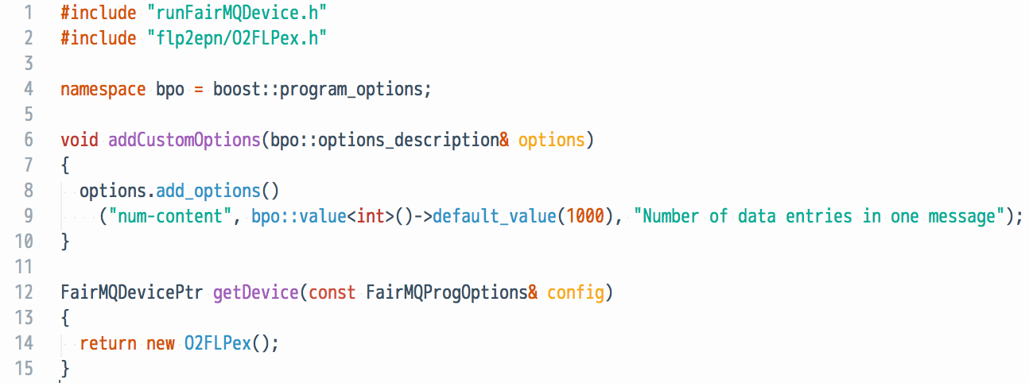
Common main()
Extract the main() function to a common header file to minimize amount of boilerplate code.
Allows us to hide more internal details from the user and easily extend/change them in the future.
User has to implement two functions:
addCustomOptions(...) : add custom command line options (optional), accessible from the device via fConfig.
getDevice(...) : return the device to run.
Example:
https://github.com/FairRootGroup/FairRoot/tree/dev/examples/MQ
Alexey Rybalchenko | PANDA Collaboration Meeting | 05.12.2016
5/13

Slide 6
Callback API
Allow the user to register callback(s) for specific communication channels, that are called when data arrives on them:
OnData(“channelA”, [](FairMQMessagePtr& msg){ /* use data */ });
OnData(“channelB”, [](FairMQParts& parts){ /* use data */ });
Hides the state check and the loop iterating over Receive().
Set in the constructor of the device or in InitTask().
Callbacks are called only when the device is in the RUNNING state.
If a callback returns false, the device goes into IDLE state.
https://github.com/FairRootGroup/FairRoot/tree/dev/examples/MQ
Alexey Rybalchenko | PANDA Collaboration Meeting | 05.12.2016
6/13

Slide 7
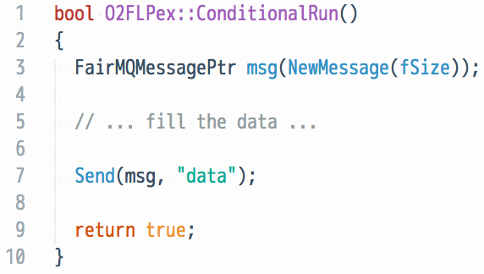
Device without input channels: ConditionalRun()
For devices without incoming data channels OnData() cannot be used.
Instead the device implements ConditionalRun() method.
It is called repeatedly until it returns false, after which the device goes into IDLE state.
As with OnData(), this method hides the state check loop.
https://github.com/FairRootGroup/FairRoot/tree/dev/examples/MQ
Alexey Rybalchenko | PANDA Collaboration Meeting | 05.12.2016
7/13

Slide 8
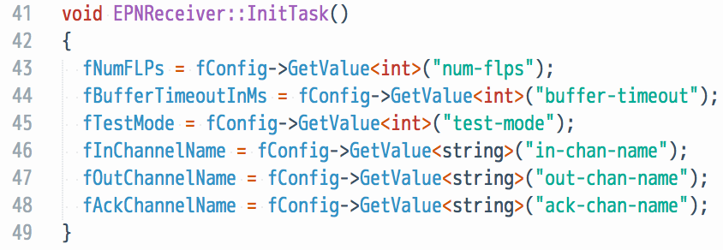
Configuration Access and Extension
The old GetProperty()/SetProperty() methods in FairMQ device are very verbose to extend in the derived devices, especially when support for custom options descriptions and different types is needed.
Now the device has direct access to the FairMQProgOptions class via fConfig member. It allows easy access to all the provided command line options and other configuration parameters (e.g., from the JSON file).
Here is an example of its use to set some device members from cmd options:
Alexey Rybalchenko | PANDA Collaboration Meeting | 05.12.2016
8/13

Slide 9
Configuration Subscriptions
The FairMQProgOptions class also allows the user to subscribe for configuration updates.
This can be used, for example, to react when an external tool updates the configuration (to change device state and/or reinitialize).
API:
config.Subscribe<string>("data.0.address", [&device](const string& key, const string& value)
{
LOG(INFO) << ”Address configuration has changed: " << key << " = " << value;
device.fChannels.at("data").at(0).UpdateAddress(value);
});
config.UpdateValue<string>("data.0.address", "tcp://localhost:4321"); // callback will be called after this
Nicolas Winckler
Example: https://github.com/FairRootGroup/FairRoot/blob/dev/fairmq/options/runConfigEx.cxx
Alexey Rybalchenko | PANDA Collaboration Meeting | 05.12.2016
9/13

Slide 10
Device Plugins for Configuration/Control
Provide a plugin system for:
Updating device configuration:
configure connection parameters with values from runtime environment, configuration files, deployment system.
Controlling the state of the device:
accepting commands from an external control system and translating these into device state changes: init, run, stop, etc.
device executable
config
manager
config plugin
device
class
control plugin
Alexey Rybalchenko | PANDA Collaboration Meeting | 05.12.2016
10/13

Slide 11
Device Configuration Plugin: DDS
Configure a running topology of devices dynamically by exchanging connection information via DDS.
Plugin can be applied to any device without changing its code via command line option:
--config libFairMQDDSConfigPlugin.so
(default is ‘static’)
The mapping is done via channel names corresponding to DDS property names in the DDS XML topology file:
Binding channels write DDS properties.
Connecting channels read DDS properties.
E.g.:
example topology
device1
channelA : bind
channelA : connect
channelA : connect
device2
...
device2
channelB : connect
channelB : connect
channelB : bind
device3
"channel”: {
"name": “channelA",
"method": "bind",
...
}
<properties>
<id access="write">channelA</id>
</properties>
Example: https://github.com/FairRootGroup/FairRoot/tree/dev/examples/MQ/3-dds
Alexey Rybalchenko | PANDA Collaboration Meeting | 05.12.2016
11/13

Slide 12
Device Control Plugin: DDS
FairMQDDSControlPlugin uses DDS CCustomCmd interface to listen to incoming commands.
The commands are sent by a simple reference utility
https://github.com/FairRootGroup/FairRoot/blob/dev/fairmq/run/runDDSCommandUI.cxx
(to run: $FAIRROOTPATH/bin/fairmq-dds-command-ui (when dds-server is running))
Plugin can be applied to any device without changing its code via command line option:
--control libFairMQDDSControlPlugin.so
(other options are ‘static’ or ‘interactive’ (default))
The reference utility allows querying and changing the device state.
DDS CCustomCmd interface allows to target which tasks to send the commands to (via topology path).
device
process
device
ChangeState()
GetCurrentState()
control plugin
FairMQ DDS Command UI
process
DDS
Example: https://github.com/FairRootGroup/FairRoot/tree/dev/examples/MQ/3-dds
Alexey Rybalchenko | PANDA Collaboration Meeting | 05.12.2016
12/13

Slide 13
Miscellaneous
--log-to-file <filename> to log to a file instead of console.
NewSimpleMessage() for simpler creation of small messages (copying!).
Configurable logging interval per channel (“rateLogging”: “<seconds>”).
FairMQMultiplier device – send same incoming message to multiple receivers with PUSH-PULL (without an additional copy).
Simpler API for send/receive timeouts: Send(msg, “data”, 0, <milliseconds>).
Work in Progress:
Extension of the configuration plugin to support configuration updates (e.g. topology updates).
Integration of the shared memory transport prototype as a third transport (beside zmq/nanomsg).
Alexey Rybalchenko | PANDA Collaboration Meeting | 05.12.2016
13/13

