Slide 1
A Simple Generator for pA Collisions
_
Dec 6, 2016 | Albrecht Gillitzer
LIX PANDA Collaboration Meeting, GSI Darmstadt, 5-9 Dec 2016

Slide 2
Antiproton-Nucleus Physics for „Day-1“
Nuclear potential of $\overline{Λ}$
Mean p_{T} in correlated $Λ\overline{Λ}$ pairs
Missing mass in of forward $Λ$
Color Transparency
Short Range Correlations
$ΔΔ$ component in the deuteron (and in nuclei)
Additional ideas (?)

Slide 3
Existing Event Generators for $\overline{p}$A
URQMD
background generator
little flexibility, no access to source code(?)
I‘ve never used it
GiBUU
use for both background and signal
flexibility, many options, access to source code, very complex
I‘ve used it for $\overline{p}{}_{ }^{ 40}{Ca}→J/ψX→e^{+}e^{−}X,μ^{+}μ^{−}X$
FTF
both for $\overline{p}p$ and $\overline{p}A$, emphasis on background
some flexibility
I‘ve used it for $\overline{p}d$ only

Slide 4
Need Simple Signal Generator in $\overline{p}$A
Idea: implement $\overline{p}A$ collisions in EvtGen
Physics model: quasi-free $\overline{p}N$ reactions with (A-1) spectator nucleus on nuclear proton or neutron with internal momentum

Slide 5
Decay File for EvtGen
decay model
pbarNe20_pbarpX.dec :
noPhotos
#
Decay pbarASystem
1.0 A-1System pbarpSystem NucleusSpectator 20.0 1.0 1.88;
Enddecay
#
Decay pbarpSystem
1.0 p+ anti-p- PHSP;
Enddecay
#
End
parameters

Slide 6
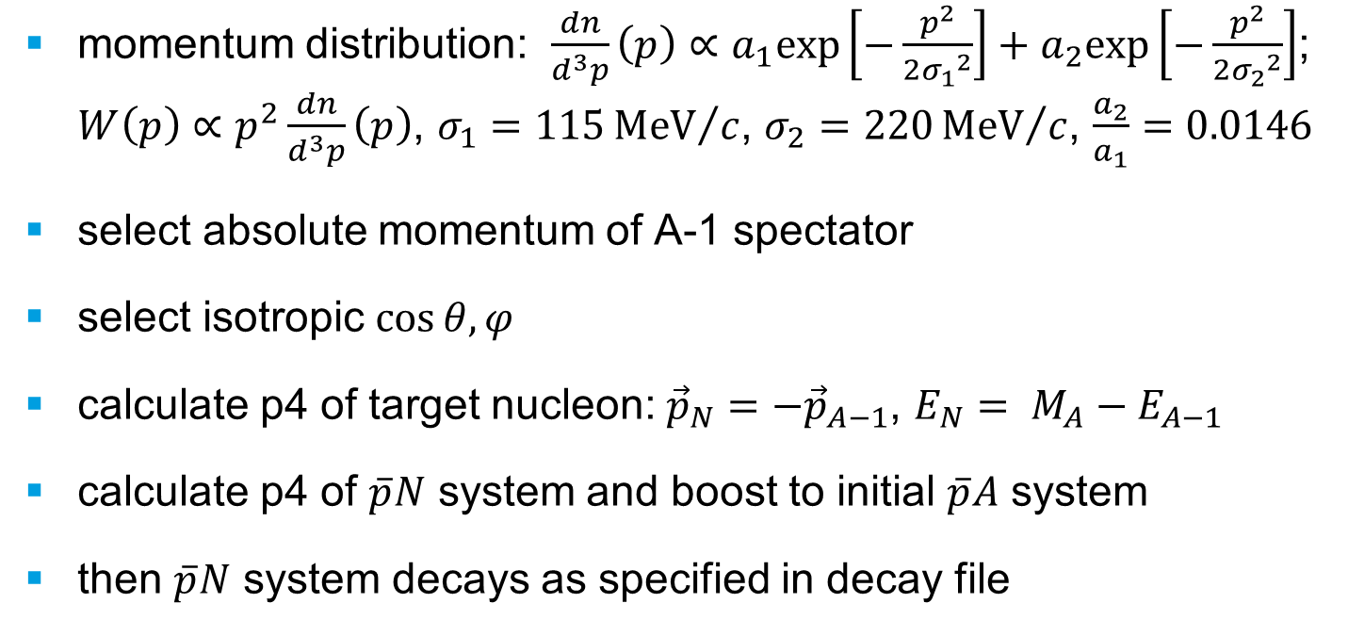
Decay Model
momentum distribution: $\frac{dn}{d^{3}p}\left(p\right)∝a_{1}exp\left[−\frac{p^{2}}{2{σ_{1}}^{2}}\right]+a_{2}exp\left[−\frac{p^{2}}{2{σ_{2}}^{2}}\right]$; $W\left(p\right)∝p^{2}\frac{dn}{d^{3}p}\left(p\right)$, $σ_{1}=115{MeV}/c$, $σ_{2}=220{MeV}/c$, $\frac{a_{2}}{a_{1}}=0.0146$
select absolute momentum of A-1 spectator
select isotropic $\cos{θ, φ}$
calculate p4 of target nucleon: ${\vec{p}}_{N}=−{\vec{p}}_{A−1}$, $E_{N}= M_{A}−E_{A−1}$
calculate p4 of $\overline{p}N$ system and boost to initial $\overline{p}A$ system
then $\overline{p}N$ system decays as specified in decay file

Slide 7
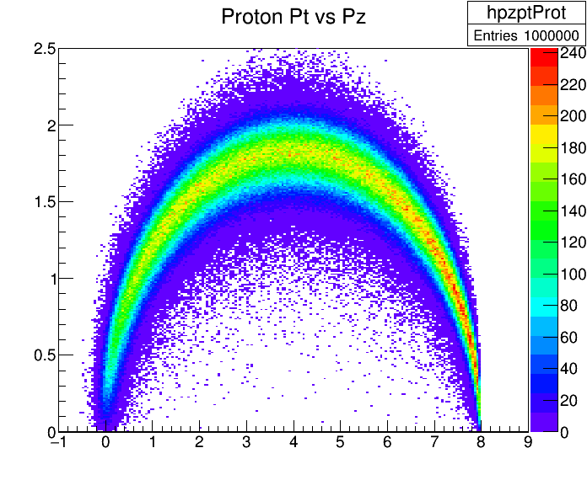
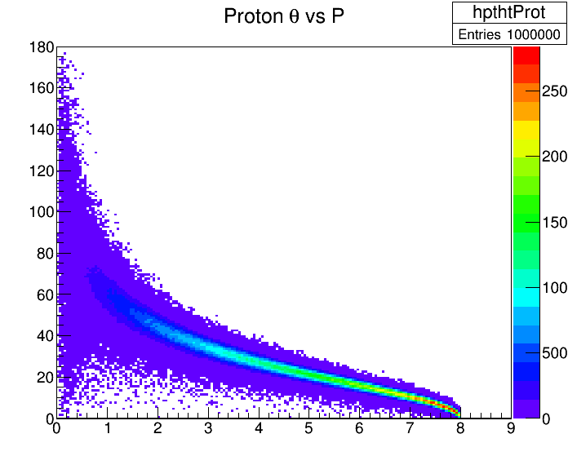
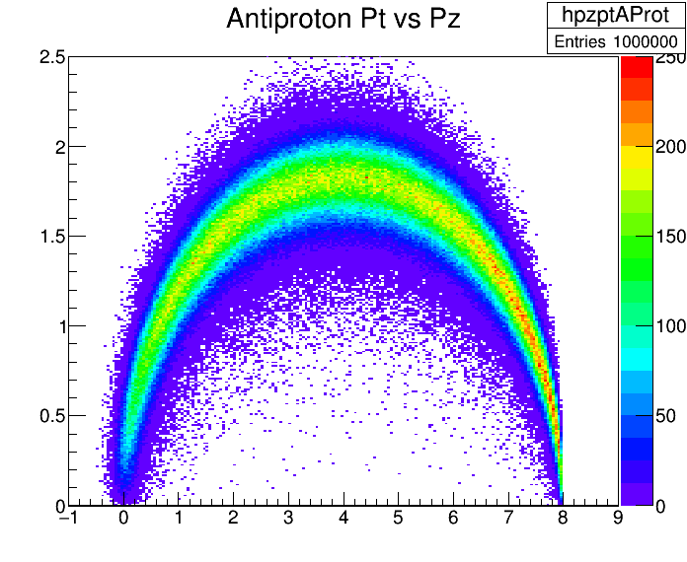
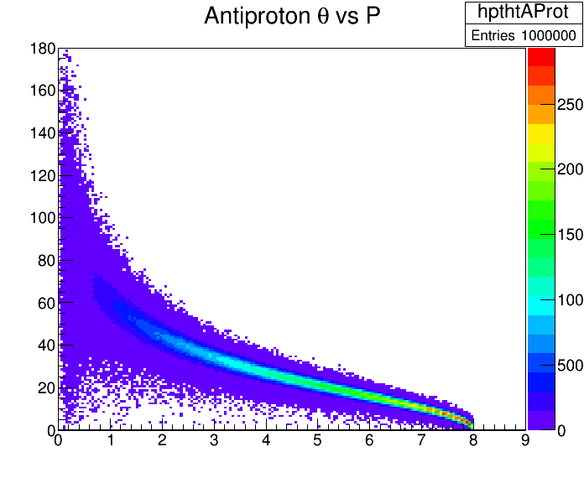
$$p_{\overline{p}}=8.0 GeV/c$$

Slide 8
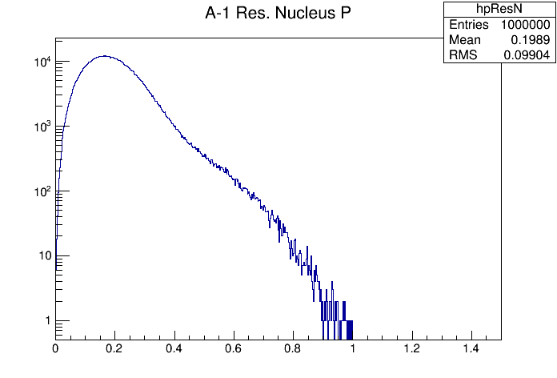
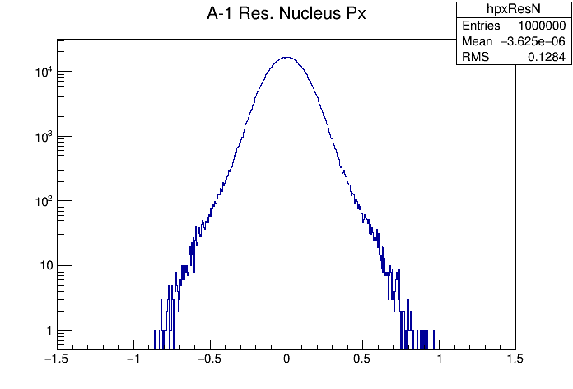
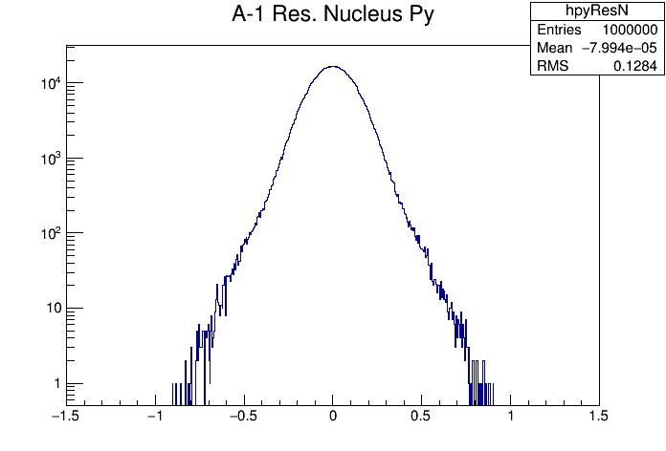
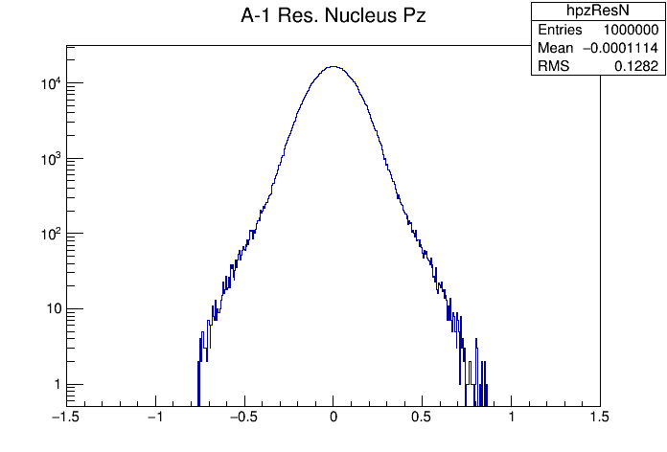

Slide 9
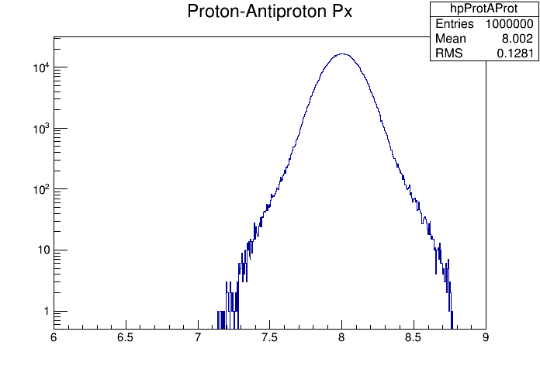
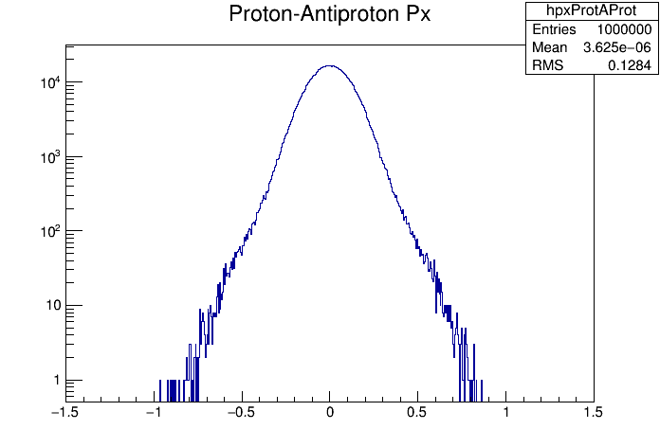
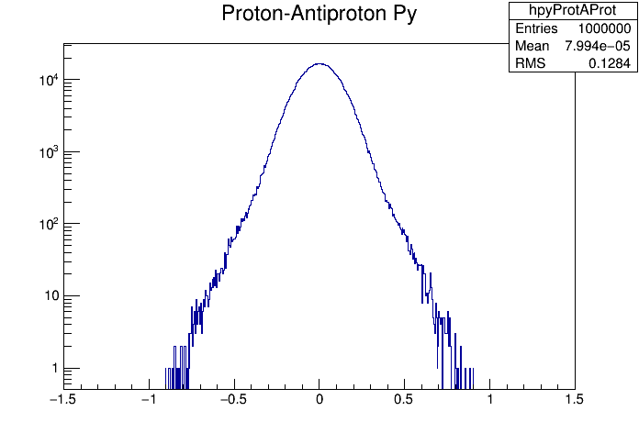
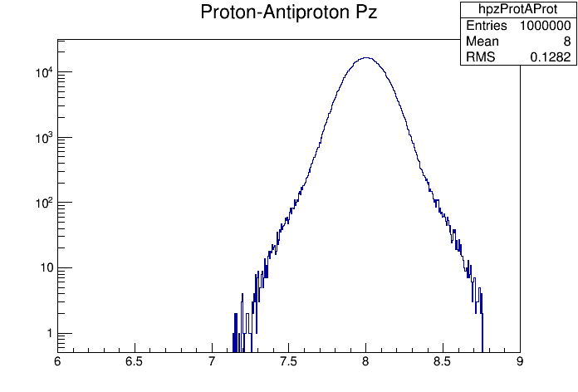

Slide 10
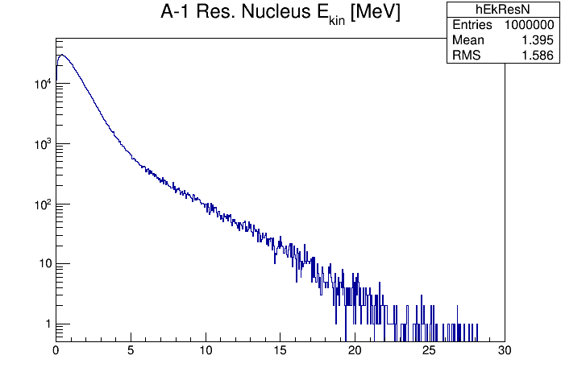
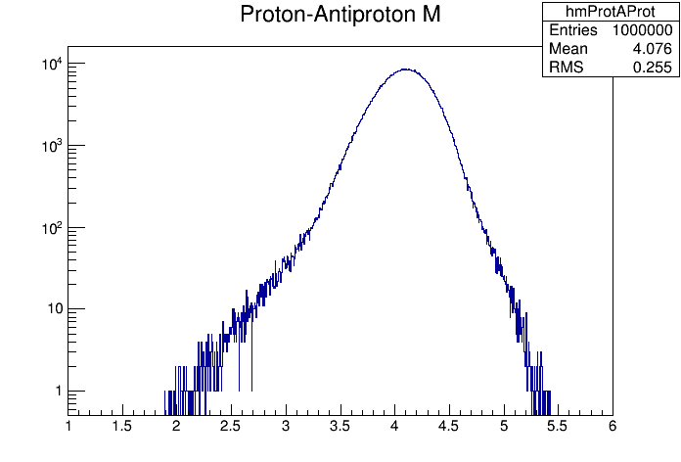
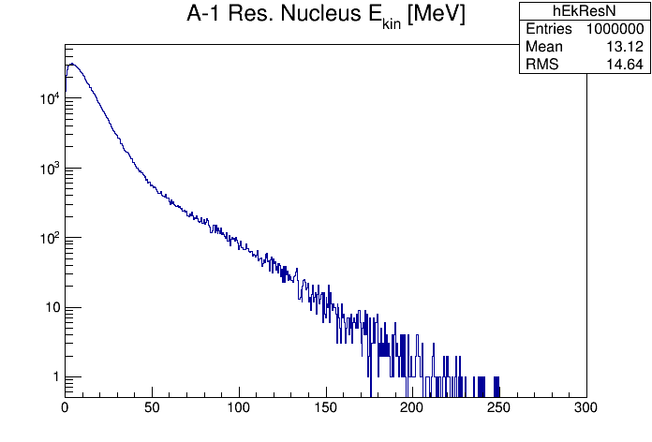
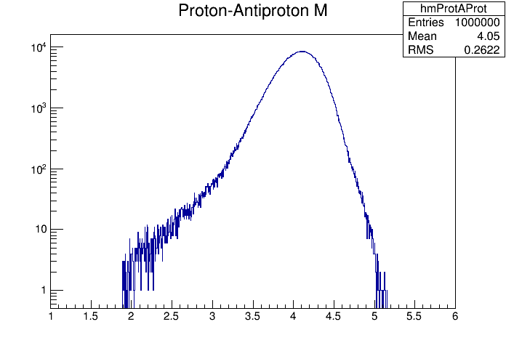
Ne-20
Ne-20
He-3
He-3

Slide 11
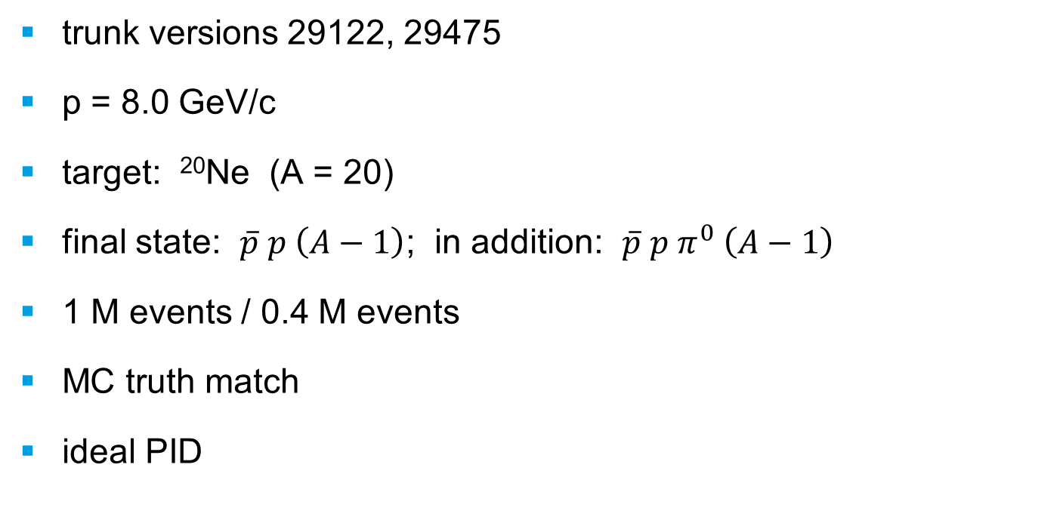
PandaRoot Simulation & Analysis
trunk versions 29122, 29475
p = 8.0 GeV/c
target: ²⁰Ne (A = 20)
final state: $\overline{p} p \left(A−1\right)$; in addition: $\overline{p} p{ π}^{0} \left(A−1\right)$
1 M events / 0.4 M events
MC truth match
ideal PID

Slide 12
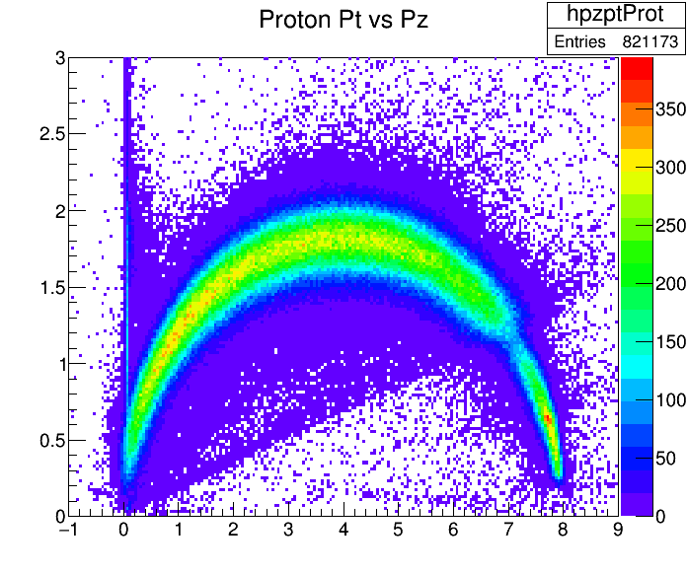
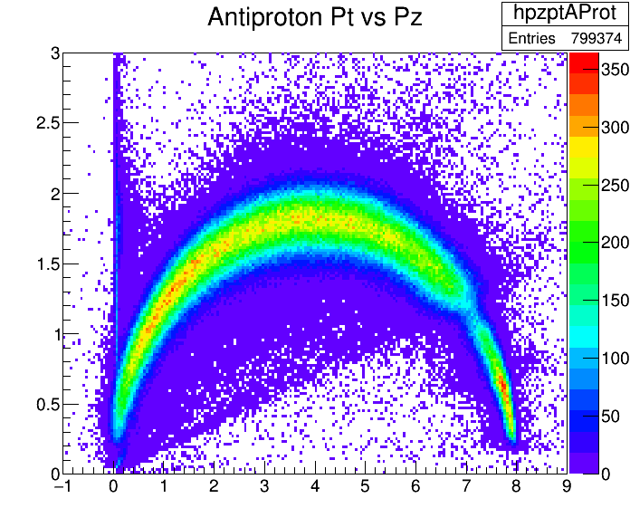
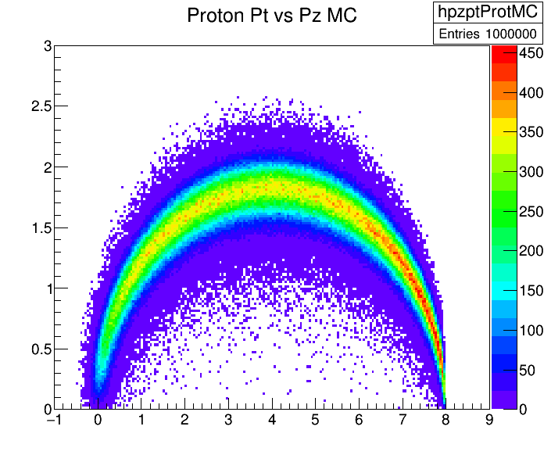

Slide 13
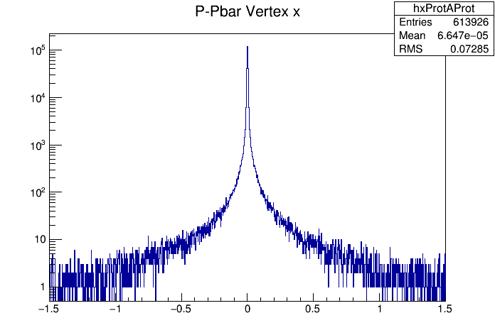
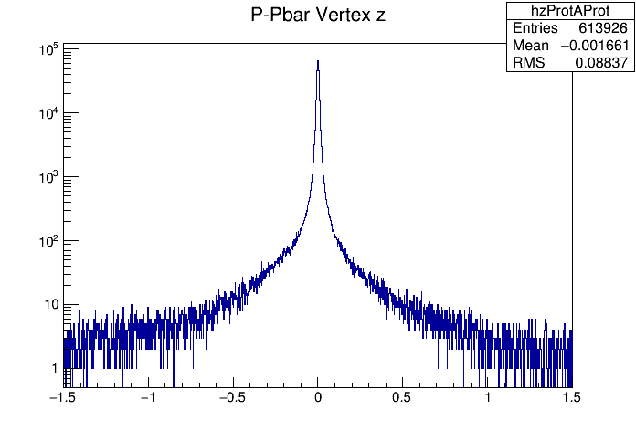
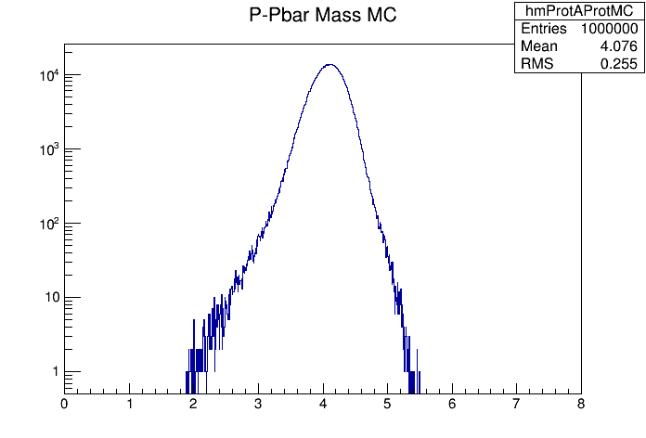
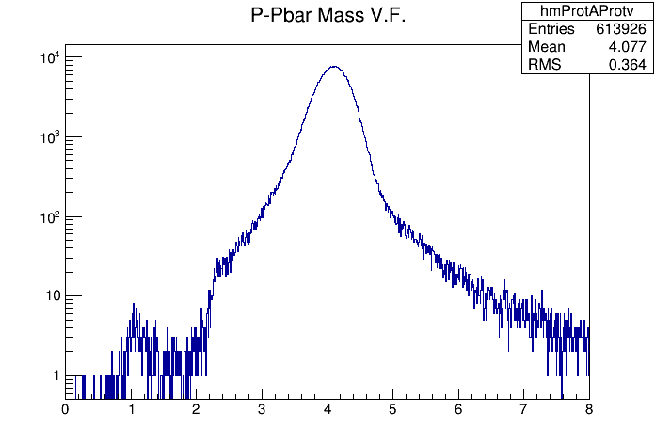

Slide 14
Status
Tested with simpleEvtGen for various nuclei: ³He, ²⁰Ne, ⁴⁰Ca, ²⁰⁸Pb, ²³⁸U
Full simulation & analysis: 1 M events $\overline{p}A→\overline{p}p\left(A−1\right)$
Full simulation & analysis: 0.4 M events $\overline{p}A→\overline{p}pπ^{0}\left(A−1\right)$
Relevant files uploaded to the repository
Should work from present trunk – Try it !

