Slide 1
Summary of 2016 Workshop
IPM17 Workshop, GSI, May 23rd,2017
Mariusz Sapinski

Slide 2
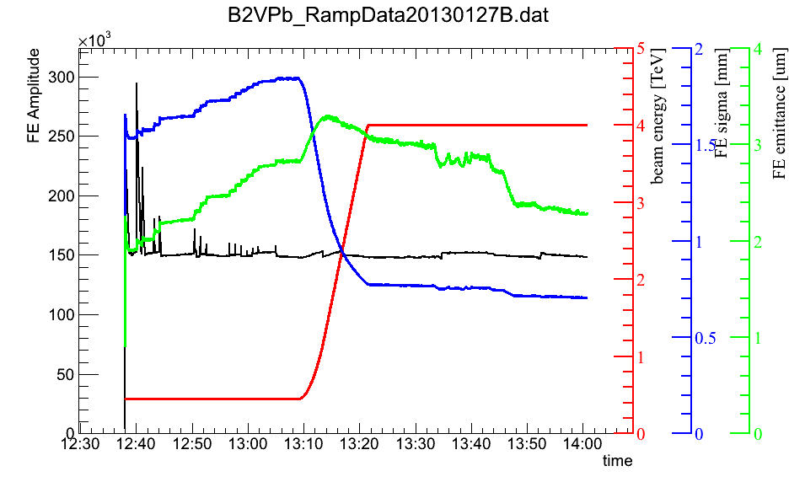
Simulations-situation in 2015
CERN: after significant effort to understand IPM calibration we were convinced that beam space charge distorts the profile.
Simulation tools:
Geant4 – lack of space charge
Modified pyECLOUD code was the main tool.
Used by M. Patecki and D. Vilsmeier.
Analytical estimations by G. Franchetti (published in M.Patecki thesis).
typical example
M. Patecki: Analysis of LHC Beam Gas Ionization monitor data and simulation of the electron transport in the detector (CERN-THESIS-2013-155, 2013)
D. Vilsmeier: Profile distortion by beam space charge in Ionization Profile Monitors CERN-THESIS-2015-035
M. Sapinski et al., Investigation of the effect of beam space-charge on electrons in ionization profile monitors, Proceedings of HB2014, MOPAB42
Notes:
another plot with only ramp issue?

Slide 3
Simulations-situation in 2015
In 2015 Kenichiro – during his stay at CERN - created more complete code for PS IPM study. This code, used for LHC, gave similar results as modified pyECLOUD.
Such codes are/were also developed in other labs.
Particularly active recently: ESS IPM (Cyrille, Francesca).
It was not clear what is the status of these simulations.
A summary of these efforts and maybe a common strategy were needed.
Notes:
Goal of the study – find space-charge deformation

Slide 4
Simulations-situation in 2015
→ Document “Collaborative project for IPM beam profile simulation code” (available on workshop page and on TWiki)
create a common code with solid maintenance and development
→ Organize IPM simulation workshop to discuss these issues.
Notes:
Goal of the study – find space-charge deformation

Slide 5
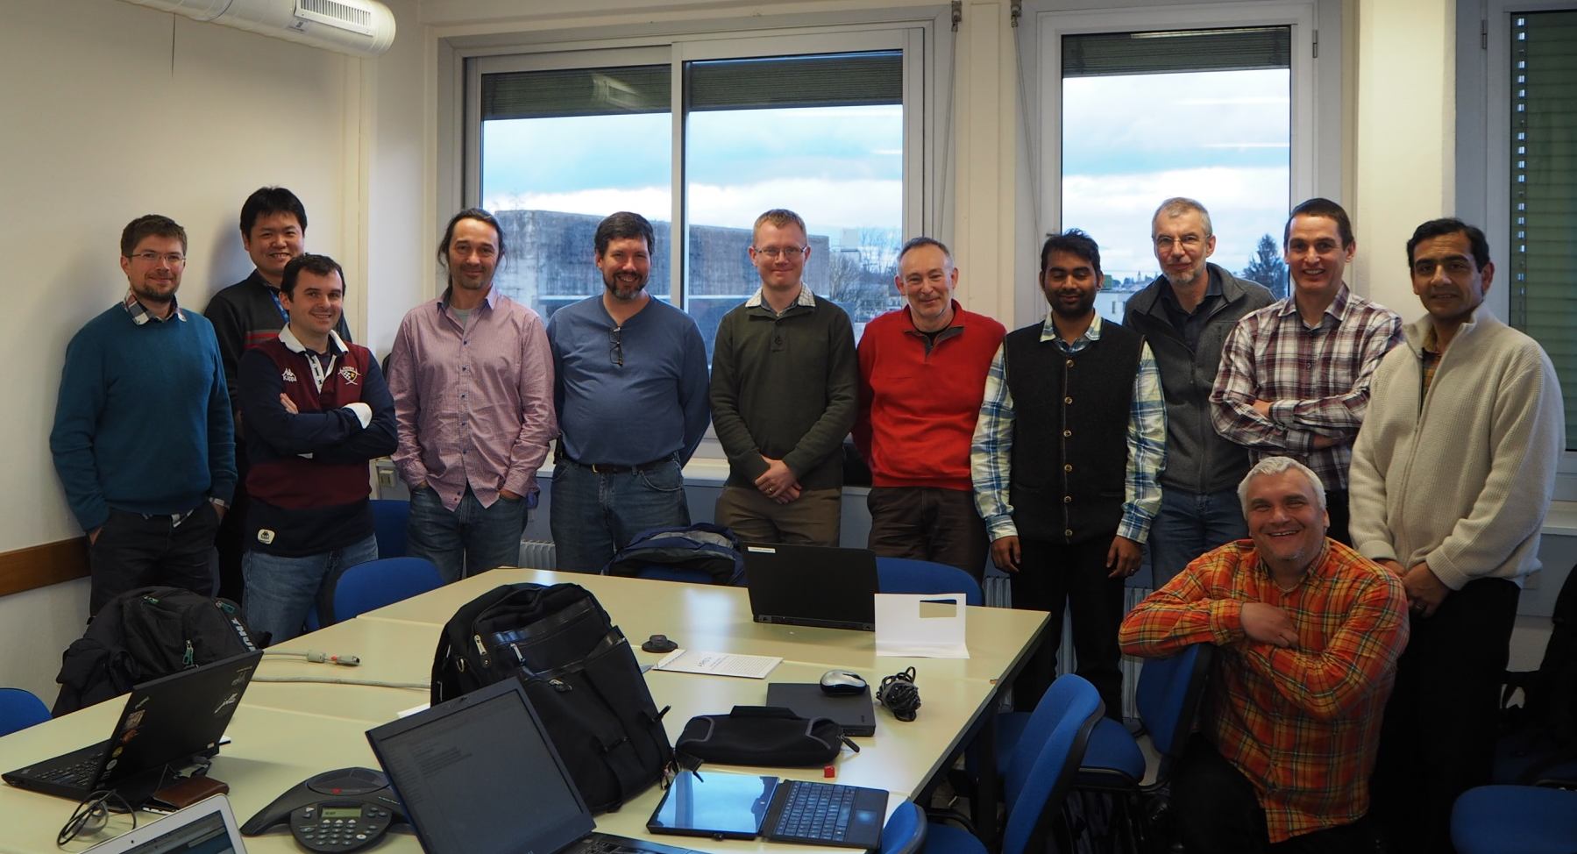
IPM Simulation Kickoff Workshop
CERN, March 3-4, 2016
https://indico.cern.ch/e/IPMSim2016
(https://indico.cern.ch/event/491615/)
Notes:
Goal of the study – find space-charge deformation

Slide 6
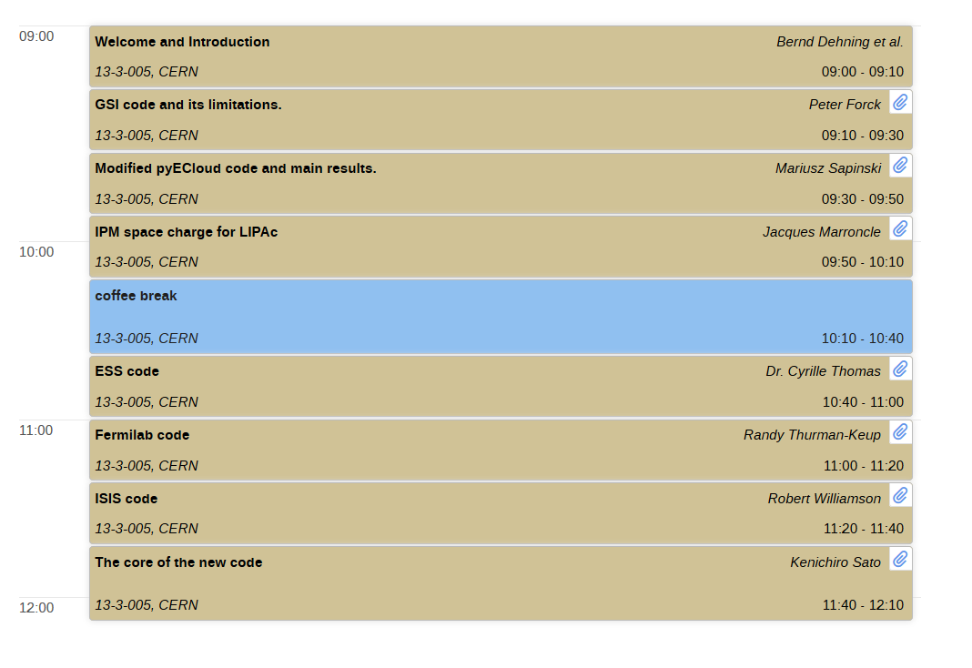
Agenda of 2016 workshop

Slide 7
Codes presented
Code | Implemen-tation | Tracking | Benchamrks | Remarks
GSI | C++ | E, B | None. | Bugs in the code (to be corrected), uniform guid. fields. Tracking 3D. Need to correct relativisitic part.
pyECLOUD | python | E, B | c.f. SPS/LHC IPM data; Not conclusive. | Uniform guiding fields, relativistic
FNAL | matlab | E, B | None. | Free space boundary conditions. 3D tracking.
ESS | Matlab/C++ | E, B | Started c.f. Kenichiro’s code. | Free space boundary conditions. 3D tracking.
CEA | C++ | E, ions | Correction of beam profile; Nice results at 90keV. | Round DC beam. Lorentz solver for E-field.
ISIS | C++ | E | Correction of beam profile; Good in range 70 MeV – 800 MeV,beam sizes & intensities. | Assumes DC beam. Import CST electric fields.
Kenichiro | python | E, B | c.f. pyECLOUD - good agreement. | Field maps (CST/poisson), relativisitc beam. 3D tracking. Will soon introduce analytical gaussian beam.

Slide 8
Action list and future plans
The most important of our plans:
ESS, GSI and Kenichiro plan to keep developing their codes in the near future.
A future development of Kenichro code will be supported by CERN and GSI.
Selected actions:
- Setup project Wiki and Github spaces @ CERN.
- Make LHC IPM data available on wiki.
- Investigate double differential cross section.
- Measure profiles in SIS-18 for different beam currents, compare against codes.
- Involve Dominik Vilsmeier in the project at a working student in GSI.
- Investigate the possibility of future meeting at GSI.
- Investigate COMSOL (…)
gitlab and TWiki
Basically GSI, CERN, ESS and J-PARC – strongly interested in development of the simulations, FNAL, ISIS – rather happy with what they have, but observing the situation.

Slide 9
What happened (preliminary)
Cyrille, matlab
Kenichiro,
python
Serban, C++
Py ECLOUD
FNAL, ISIS
2016
Dominik,
python
bench.
ESS
inspiration
2017
Francesca,
C++

Slide 10
Conclusions
Things went a little different than planned.
In general:
a lot of work done.
interesting developments.
Looking forward to today’s presentations.
Thank you for your attention!

