Slide 1
IPM Simulations at Fermilab
23 May 2017
Randy Thurman-Keup

Slide 2
Nova Era Main Injector / Recycler
Recycler accumulates protons from Booster synchrotron
  8 GeV
  ~5 x 10¹³ protons
Main Injector receives beam from Recycler
  8 GeV incoming
  Up to 120 GeV outgoing
    Nova neutrino experiment
  588 53-MHz rf buckets
    each bucket ~19 ns
    1 x 10¹¹ protons per bucket
    rms bunch length typically ~1-3 ns

Slide 3
IPM Concept
Magnet with vertical B field
Cathode
Electron Suppression Grid
Ions
Field shaping electrodes
Beam
(into page)
Ionization Happens
Electrons
Wire mesh gate
Microchannel Plate (MCP)
Anode strips
500 μm spacing

Slide 4
Gated IPM Concept
Problem with MCP is short lifetime
  Plate is using up lifetime whenever beam is in the machine and the IPM voltage is on
  Voltage takes a while to raise and lower
Would like to be able to gate the charge to preserve the MCP
  Stop the electrons and ions from reaching the MCP
  Allow the electrons and ions an escape path from the IPM active region
    i.e. no Penning traps

Slide 5
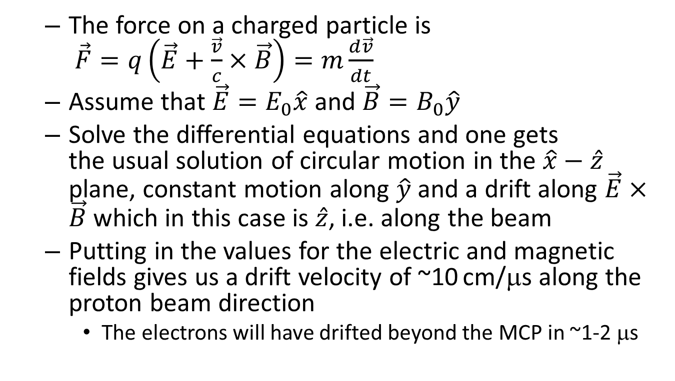
Gated IPM Concept
  The force on a charged particle is
  $\vec{F}=q\left(\vec{E}+\frac{\vec{v}}{c}×\vec{B}\right)=m\frac{d\vec{v}}{dt}$
  Assume that $\vec{E}=E_{0}\hat{x}$ and $\vec{B}=B_{0}\hat{y}$
  Solve the differential equations and one gets
  the usual solution of circular motion in the $\hat{x}−\hat{z}$ plane, constant motion along $\hat{y}$ and a drift along $\vec{E}×\vec{B}$ which in this case is $\hat{z}$, i.e. along the beam
  Putting in the values for the electric and magnetic fields gives us a drift velocity of ~10 cm/μs along the proton beam direction
    The electrons will have drifted beyond the MCP in ~1-2 μs

Slide 6
MATLAB Simulation
Simulation tracks particles through arbitrary E and B fields
Uses interpolation to obtain the fields at any point from previously calculated field distributions
Propagates using a relativistic formula
Invert

Slide 7
Matlab Simulation
Once the acceleration is determined, a discrete evaluation of the differential equation of motion is used to step the particles
The magnetic and electric fields are handled separately
  Magnetic contribution to the motion is only applied to the components perpendicular to the B field
  Magnitude of the velocity perpendicular to the B field is forced to be preserved, since the B field does no work
    This in particular helps with the tight spirals along the field lines

Slide 8
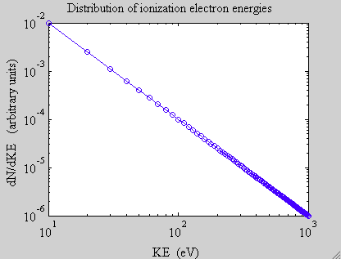
Matlab Simulation
The electric and magnetic fields of the bunch are evaluated on a grid for various bunch parameters
  Shifted as a function of time to represent the moving beam
Electric field of IPM from a Poisson calculation (2D)
Magnetic field from 3-D magnet
model
Ionized particle distributions are
random in emission angle with
1/E² energy distribution

Slide 9
Gated-on IPM
Magnet with vertical B field
ON
Cathode
E Field ~ 1 kV/m
Electron Suppression Grid
B Field ~ 1 kg
Field shaping electrodes
Wire mesh gate
Microchannel Plate (MCP)
Electrons spiral
down helically
Anode strips

Slide 10
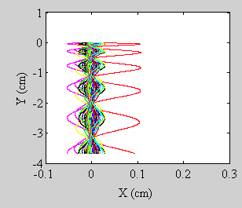
Gated-on IPM
Anode Strip
Particles originating from single point
(resolution contribution)
Elapsed time ~ 1.7 ns

Slide 11
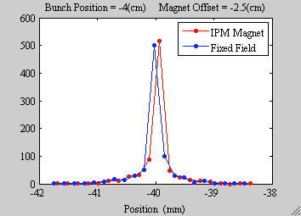
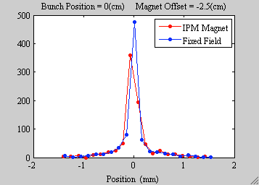
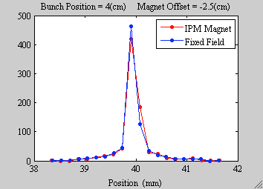
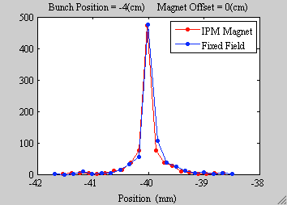
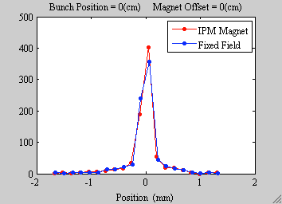
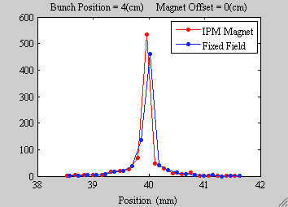
Gated-on IPM
Particles originating from single point
(resolution contribution)
Bunch offset refers to x

Slide 12
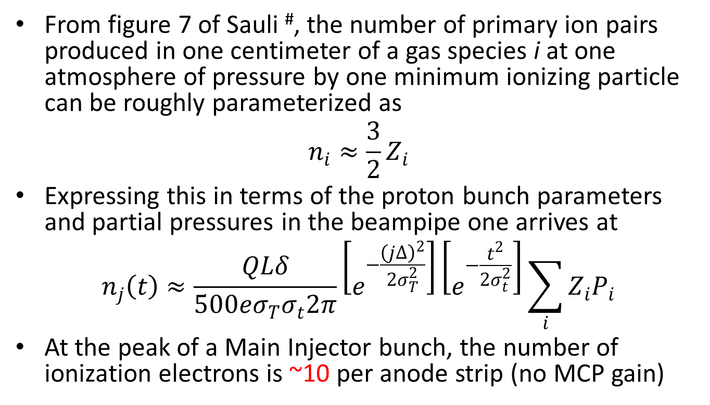
Gated-on Expected Signal
From figure 7 of Sauli #, the number of primary ion pairs produced in one centimeter of a gas species i at one atmosphere of pressure by one minimum ionizing particle can be roughly parameterized as
$$n_{i}≈\frac{3}{2}Z_{i}$$
Expressing this in terms of the proton bunch parameters and partial pressures in the beampipe one arrives at
$$n_{j}\left(t\right)≈\frac{QLδ}{500eσ_{T}σ_{t}2π}\left[e^{−\frac{{\left(j∆\right)}^{2}}{2σ_{T}^{2}}}\right]\left[e^{−\frac{t^{2}}{2σ_{t}^{2}}}\right]\sum_{i}{Z_{i}P_{i}}$$
At the peak of a Main Injector bunch, the number of ionization electrons is ~10 per anode strip (no MCP gain)
#F. Sauli, “Principles of Operation of Multiwire Proportional and Drift Chambers”, CERN 77-09, 3/5/77.

Slide 13
Gated-off IPM
Magnet with vertical B field
OFF
Cathode
E Field ~ 0 kV/m
Electron Suppression Grid
B Field ~ 1 kg
Field shaping electrodes
Wire mesh gate
Microchannel Plate (MCP)
Electrons
propagate into
or out of the page
Anode strips

Slide 14
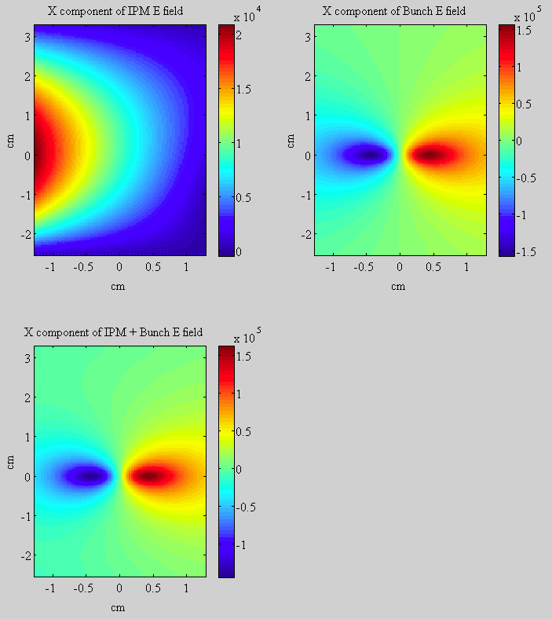
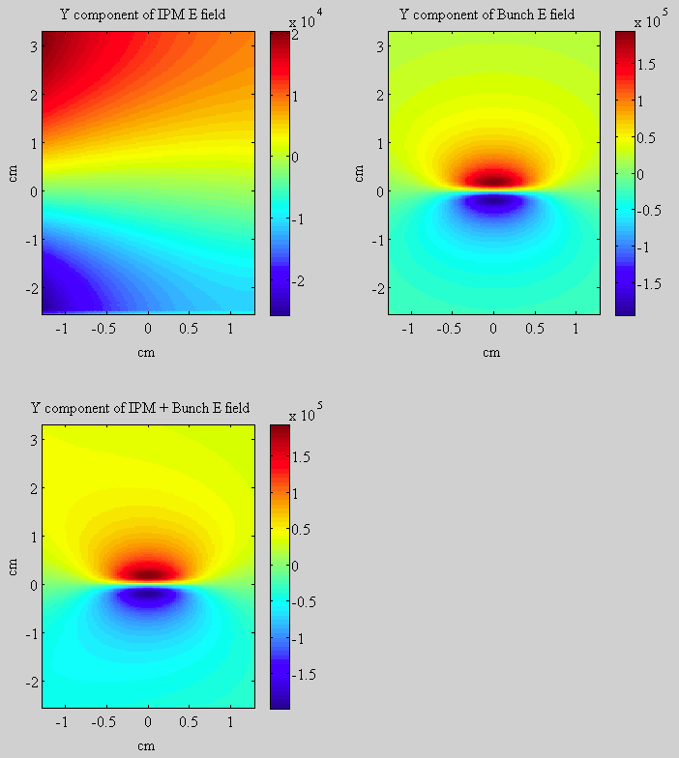
Gated-off Fields
X Component of E field
Y Component of E field

Slide 15
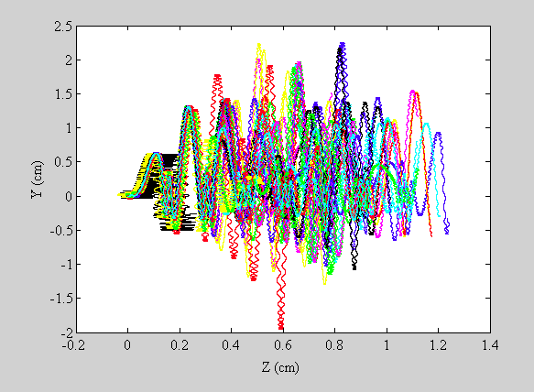
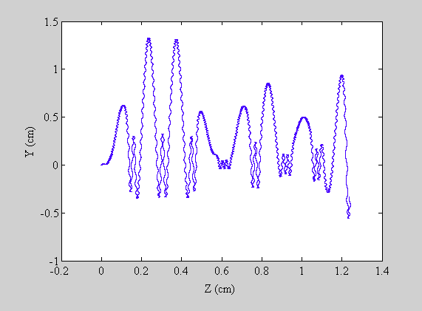
Gated-off Motion
Electron drift along beam direction
Single particle
Particle origination point

Slide 16
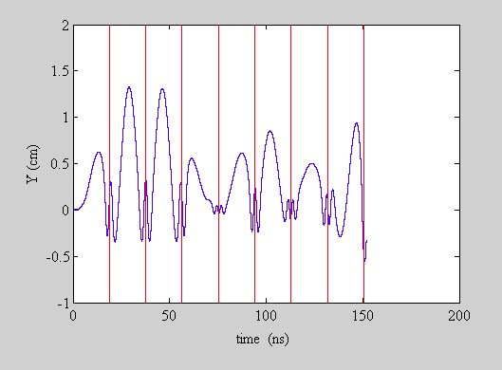
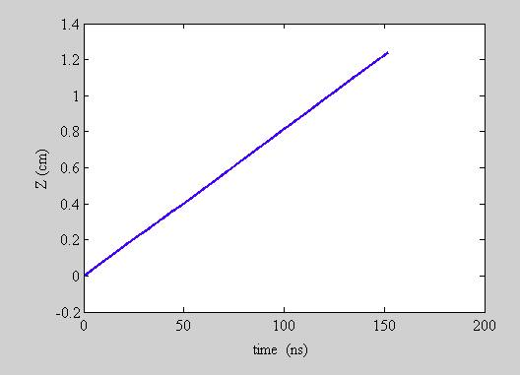
Gated-off Behavior
Y motion vs time
Drift Velocity
1.2 cm / 150 ns = 8 cm/μs
Compared to
10 cm/μs analytically estimated
Bunch Centers

Slide 17
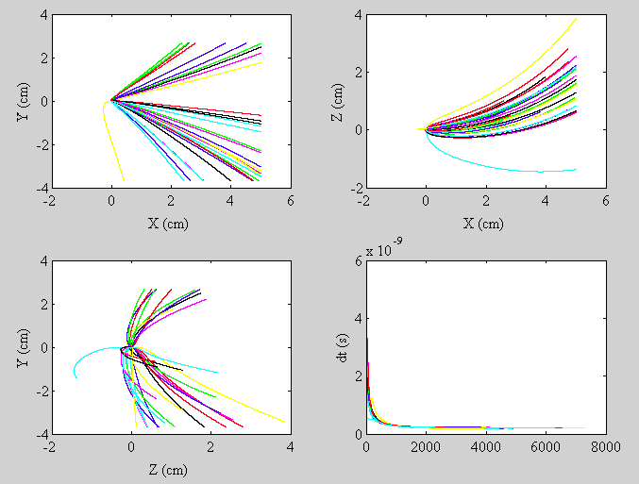
Gated-off Ion Paths
Elapsed time is ~1.5 μs
Maybe Ok, since ions do not
go past the gating grid…
However, secondary electrons from ion impacts on the MCP-side of the gating grid will still travel to the MCP

Slide 18
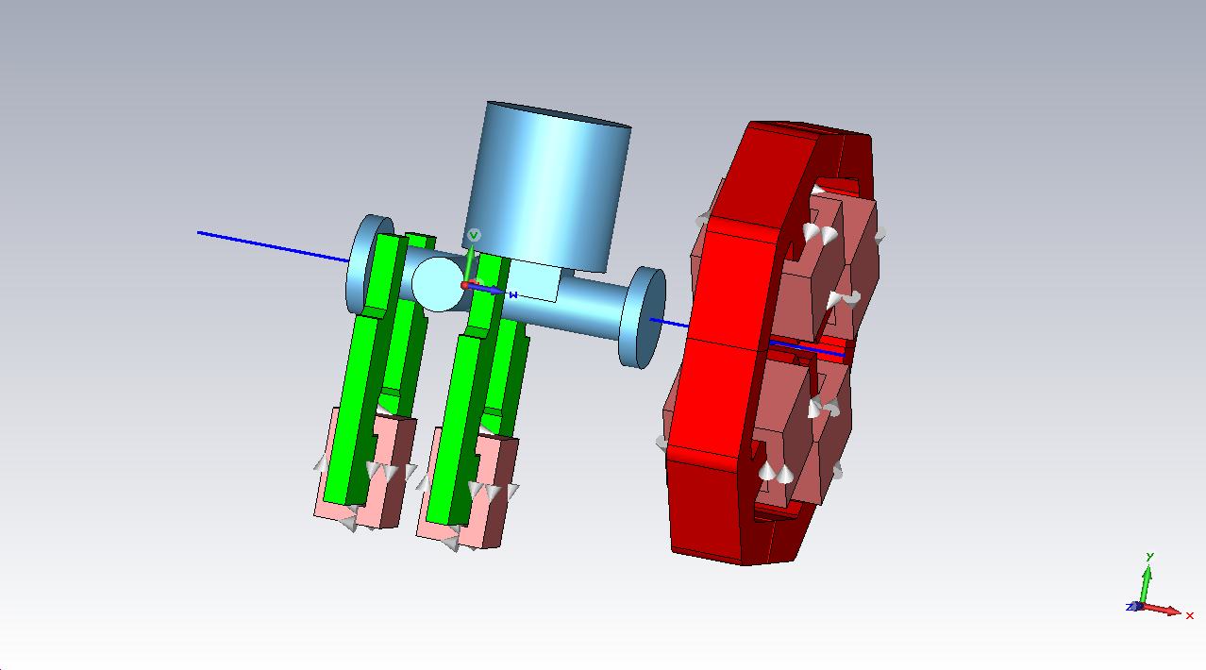
Other Simulation Uses
Laser wire intensity monitor
  Tracking of laser-stripped electrons from H⁻ beam into collector
Detector
CST Model
H⁻ Beam
Laser
Bending C-magnet

Slide 19
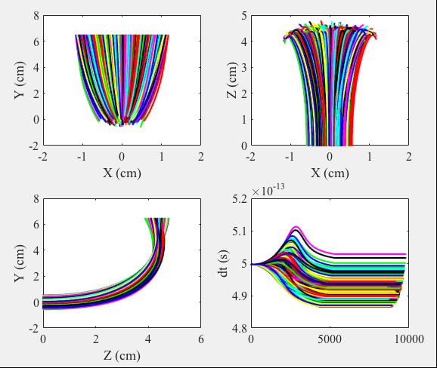
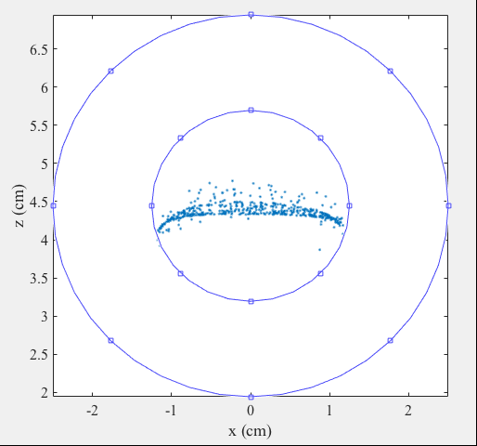
Laser Wire Intensity Monitor
Larger Detector Option
Smaller Detector Option

Slide 20
Other Simulation Uses
Electron Beam Profiler
  Tracking of electrons from thermionic gun through proton beam to detector
    Deflector and proton bunch fields
    Deflector is modeled in Poisson (2D)
Electron beam is deflected by electric
and/or magnetic fields of proton beam
Deflection
Impact parameter
Electron beam
Proton Beam

Slide 21
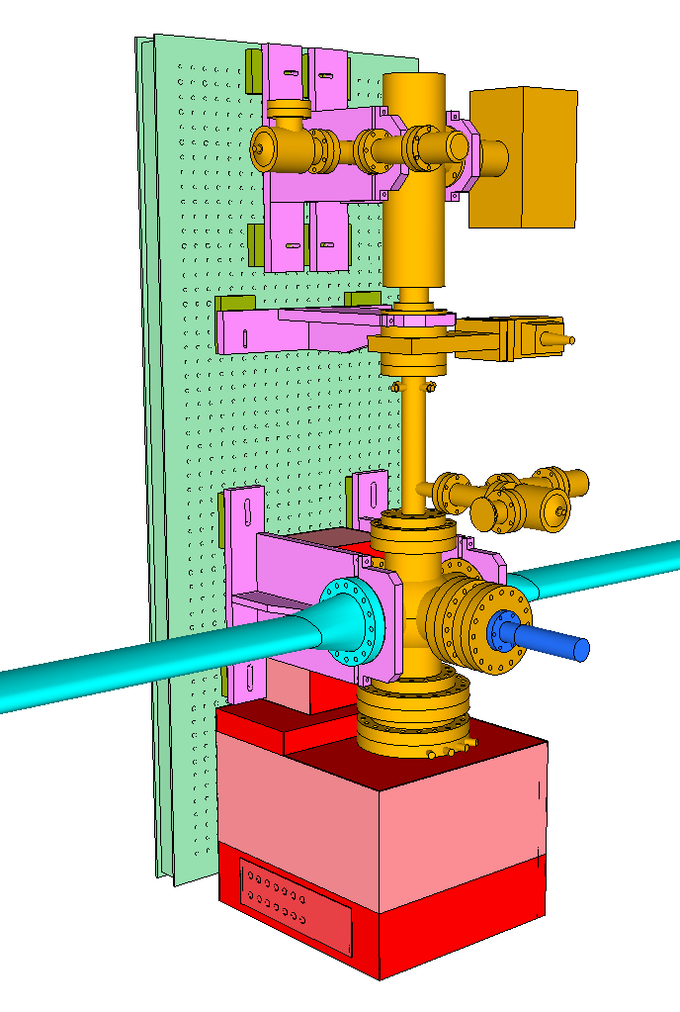
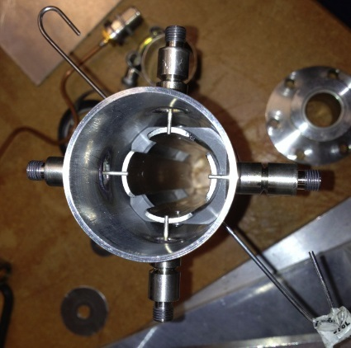
Electron Beam Profiler
Ion Gauge
Optical Breadboard
~ 60 cm x 150 cm
Ion Pump
60 keV Electron Gun
Kimball Physics
Pneumatic
Beam Valve
Electrostatic Deflector
Ion Gauge
Pneumatic
Insertion Device
with OTR Stainless
Steel Mirror
Main Injector
beampipe
Optical components box
Phosphor Screen

Slide 22
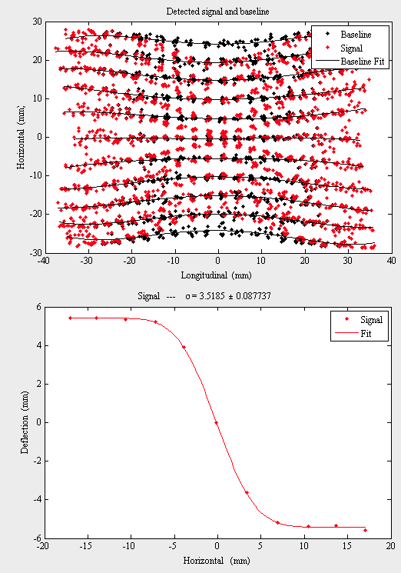
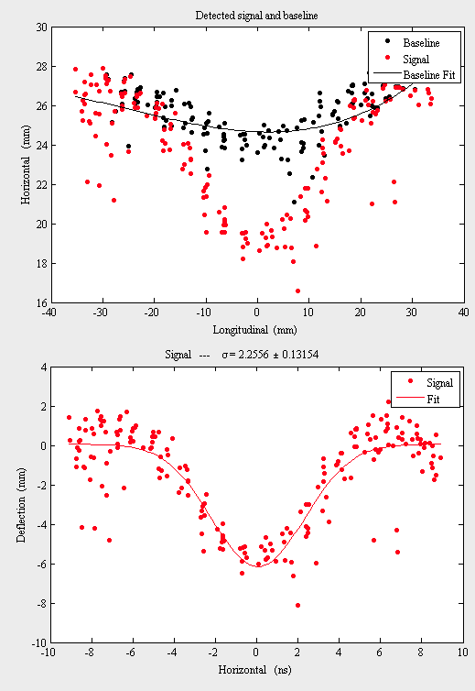
Electron Beam Profiler

Slide 23
IPM at IOTA
IOTA → Integrable Optics Test Accelerator
Accelerator ring designed primarily to study the behavior of a nonlinear integrable lattice
  V. Danilov and S. Nagaitsev, Phys. Rev. ST Accel. Beams 13, 084002 (2010)
The purpose of the nonlinear integrable lattice is to make beam dynamics more robust by generating large stable tune spreads and preserving dynamic aperture
  Studies require monitoring the evolution of the beam profile on short time scales to detect beam growth and instabilities
  Ideally profile measurements every turn

Slide 24
IPM at IOTA
2.5 MeV, 10¹¹ protons
40 m circumference
(30 MHz or 2.34 MHz modulation)
Vacuum needs to be 10⁻¹¹ Torr
Ionization cross section much higher due to low beam energy
  M.E. Rudd et al., Phys. Rev. A 28, 3244(1983)
  Balances the very high vacuum
Expected number of ionizations per turn is ~18
  Expected number of ionizations per bunch in MI is ~100

Slide 25
Conclusions
The simulation tool works for not only IPM, but also other tracking needs
  Recently modified solver to use Runge-Kutta method
Questions about gated-off state of IPM
  Where do the electrons go when they reach the edge of the E field region?
    Need 3-D E field calculation (have CST; need time)
    May be difficult to precisely model details

Slide 26
Extras

Slide 27
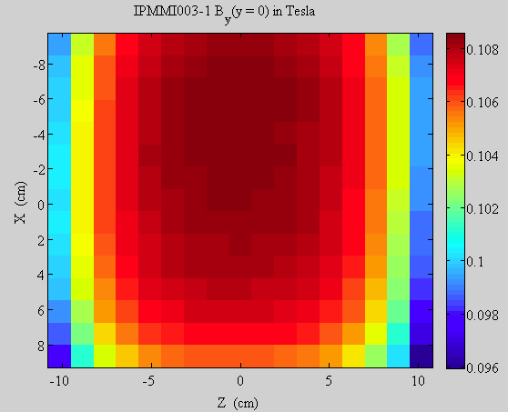
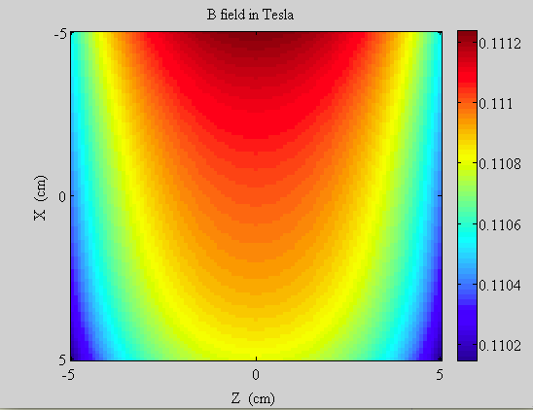
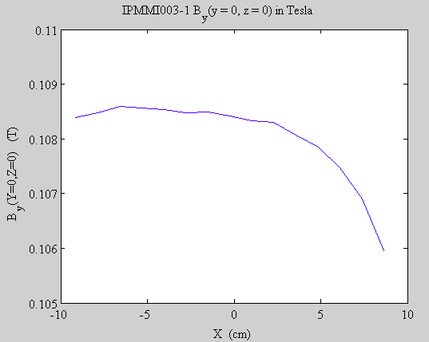
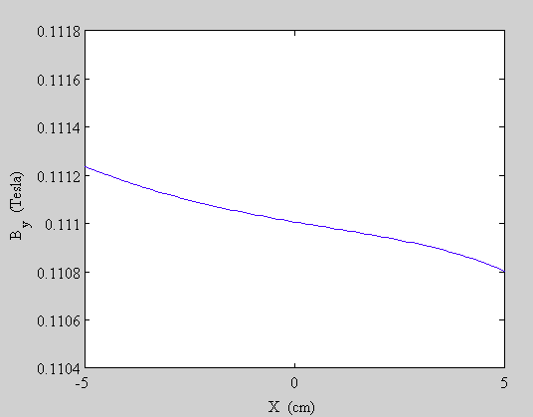
Magnetic Field in Simulation
Measured
Model
0.0005 T
0.0004 T

Slide 28
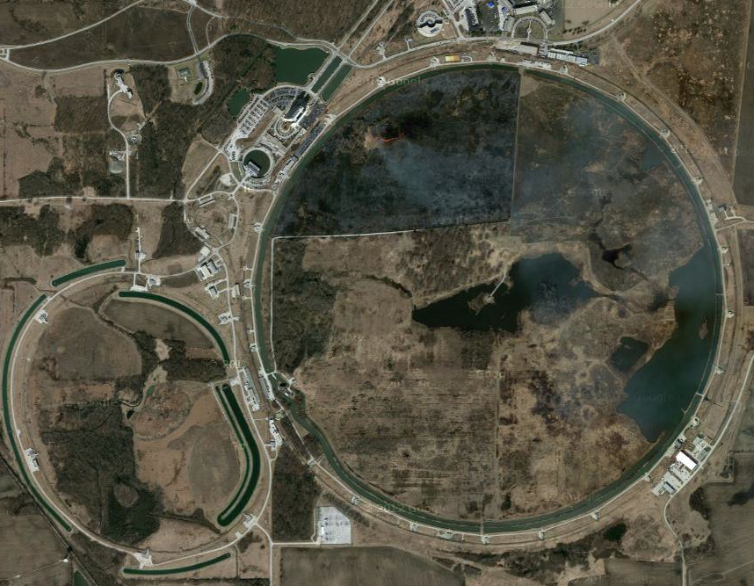
Fermilab
ν to Nova
Source and Linac
Booster Synchrotron
Tevatron
Antiproton
Accumulator and
Debuncher
Recycler and
Main Injector

Slide 29
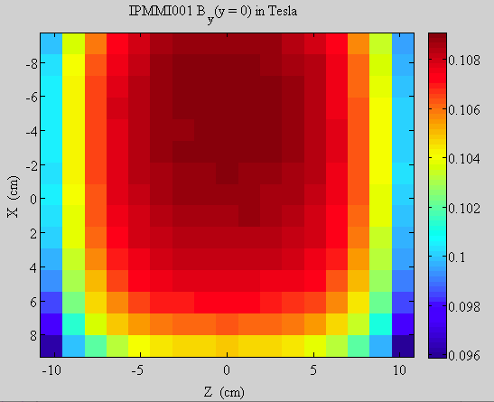
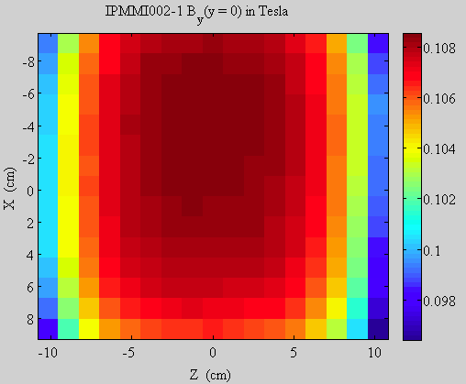
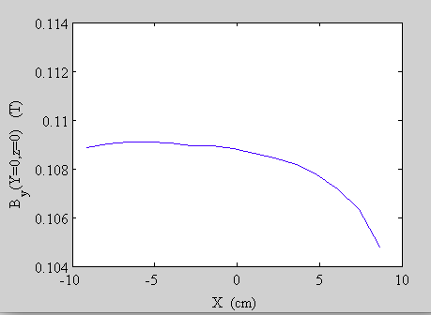
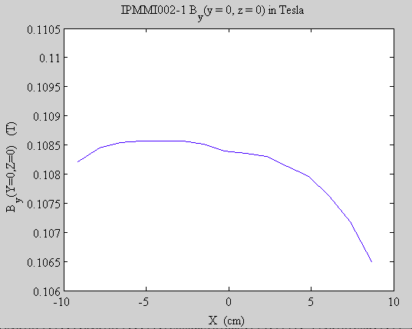
Magnet Measurements
IPM Active Region
Old Shunt
New Shunt
0.004 T
0.002 T

Slide 30
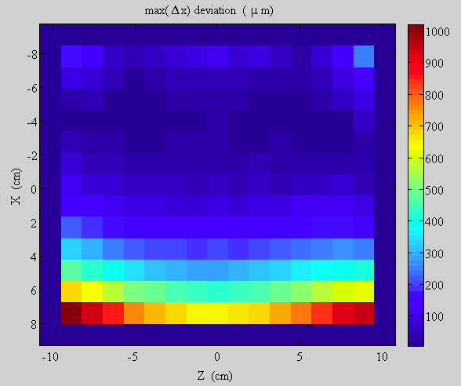
Magnet Measurements
B Field Line
Maximum
Deviation

Slide 31
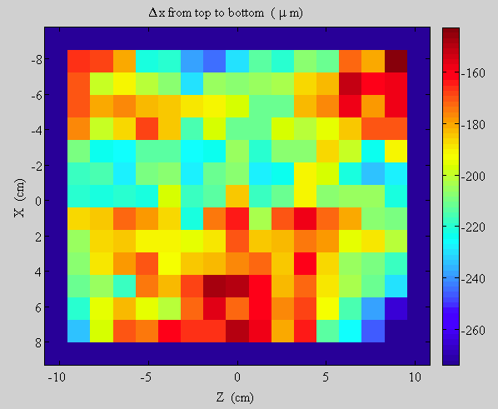
Magnet Measurements
B Field Line
Deviation from top to bottom
Average value of 200 μm could be hall probe rotation; corresponds to ~0.1 degrees

Slide 32
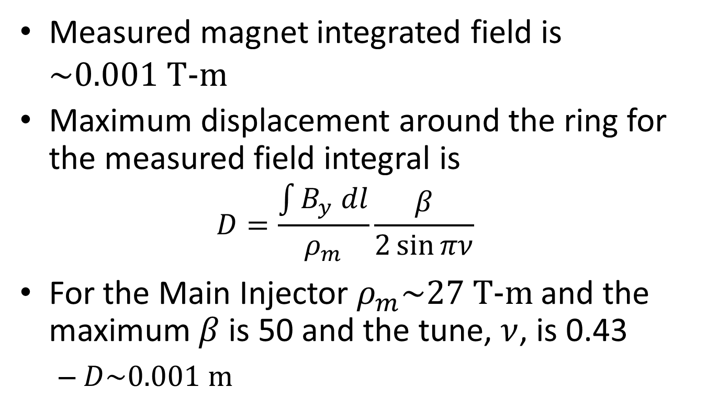
MI Orbit Perturbation
Measured magnet integrated field is $\sim 0.001 \text{T}\text{−}\text{m}$
Maximum displacement around the ring for the measured field integral is
  $$D=\frac{\int{B_{y} dl}}{ρ_{m}}\frac{β}{2\sin{πν}}$$
For the Main Injector $ρ_{m}\sim 27 \text{T}\text{−}\text{m}$ and the maximum $β$ is 50 and the tune, $ν$, is 0.43
  $D\sim 0.001 \text{m}$

