Slide 1
Bunch: A Tracking Code Based upon Analytic Field Computations in Use at GSI
Şerban Udrea, Peter Forck, GSI
Original analytic field solution: P. Strehl, M. Dolinska, R.W. Müller (2000)
Initial implementation: M. Herty, supervision P. Forck (2004)
Further development: S. Udrea, P. Forck (since 2015)
Outline of the talk:
Code description
Example of code input and results
Present issues and possible solutions
Summary and Outlook

Slide 2
Simulation code: Theoretical background
Homogenous guiding external electric and magnetic fields
Analytical description of bunch charge density$ρ(\vec{x})$
Bunch electrostatic $\vec{E}(\vec{x})$-field via analytical solution of the Poisson equation $∆ϕ\left(\vec{x}\right)=−\frac{ρ\left(\vec{x}\right)}{ε_{0}}$ in free space and the frame of the bunch
Movement of bunches each time step, multiple bunches can be defined
Monte Carlo based selection of initial coordinates and velocities of the ions or electrons to be tracked
Trajectory computed by 4th order Runge-Kutta in moving bunch and guiding fields
Storage of initial and final coordinates, velocities and arrival time for each particle
History: Code produced by a PhD student in 2004
Language: C++ with specifics of Borland C++ Builder 6, which is not available anymore, maintenance difficult
Should be usable for LINAC and synchrotron beams 1 MeV/u < E_{kin} < 30 GeV/u

Slide 3
Simulation code: Input considerations
Bunches have cylindrical symmetry: stretched (prolate) ellipsoids of revolution with the longer semi-diameter on the z axis, which is also the axis of movement. Spheres are also included as special cases and treated separately.
Density: homogeneous $ρ\left(\vec{x}\right)=const$ or parabolic $ρ\left(r,z\right)∝\left(1−\frac{r^{2}}{R^{2}}−\frac{z^{2}}{L^{2}}\right)$
Solution of bunch field using curvilinear coordinates i.e. non-linear transformation
No boundary condition (i.e. free space = ‘open boundary’ is assumed)
Movement of bunches: initial implementation targeted non-relativistic LINACs, no magnetic field associated with the bunch movement
Lorentz-Transformation of fields and corresponding magnetic field got added later, an implementation bug recently discovered (2016) has been corrected
Only homogeneous guiding external E and B fields
Simple electron start velocities distribution, ions are considered to start at rest
Advantage: The bunches are described by few parameters, fast computations

Slide 4
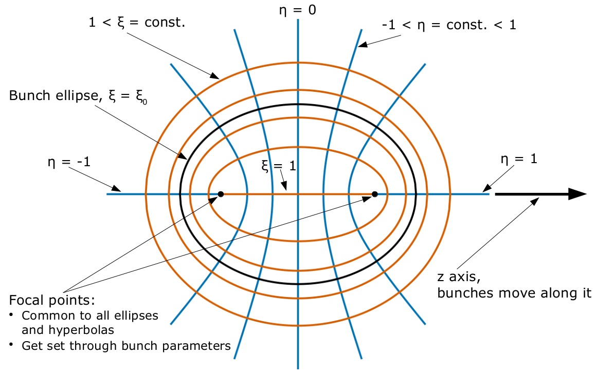
Prolate spheroidal coordinates
The prolate spheroidal coordinates ξ and η allow for solutions of the Poisson equation in terms of elementary functions. These coordinates are defined as follows:
$z\left(ξ,η\right)=c∙ξ∙η$ and $r\left(ξ,η\right)=c∙\sqrt{(ξ^{2}−1)(1−η^{2})}$
$−1 ≤η ≤1$ and $1≤ξ≤∞$ with the normalization $c=\sqrt{a^{2}−b^{2}}$ and z, r being the usual cylindrical coordinates. $ξ0=a/\sqrt{a^{2}−b^{2}}$ corresponds to the bunch surface.

Slide 5
Poisson equation and solution example
The Poisson equation in prolate spheroidal coordinates is:
For the case of a parabolic charge distribution the solution inside the bunch is given by simple polynomials:
In the present implementation the computation of the a_{ij} coefficients becomes unstable for extremely elongated bunches. D. Vilsmeier has shown that this is a numerical and not an analytical issue. Work is in progress to make the relevant code more robust and allow for computations in the case of ultra-relativistic bunches.

Slide 6
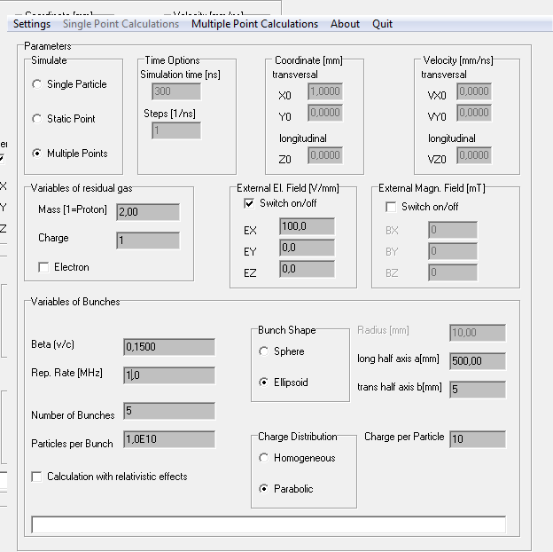
Code input: Main window
Usage modes:
E & B field at fixed location
Single particle trajectory
IPM mode: Boundary dependent
BIF-mode: Time dependent
Actual parameters:
H₂⁺ ion detection
E_{x} = 100 V/mm
β = 15 %
1 MHz rep. rate
Bunch 1 m length = 22 ns
1 cm transversal extension
parabolic density profile
10¹¹ elementary charges
Non-relativistic computation

Slide 7
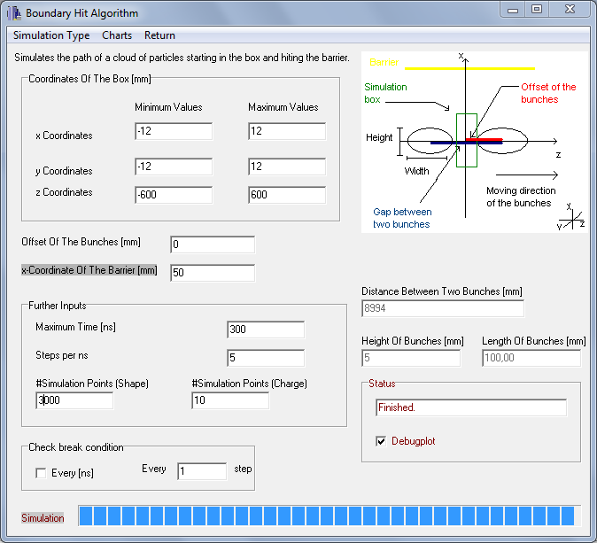
Code input: IPM mode
Bounding box
& number of trajectories
Actual parameters:
H₂⁺ ion detection
E_{x} = 100 V/mm
Bunch 1 m length
1 cm trans. extension
parabolic density distrib.
10¹¹ charges
β = 15 %,
1 MHz rep. rate

Slide 8
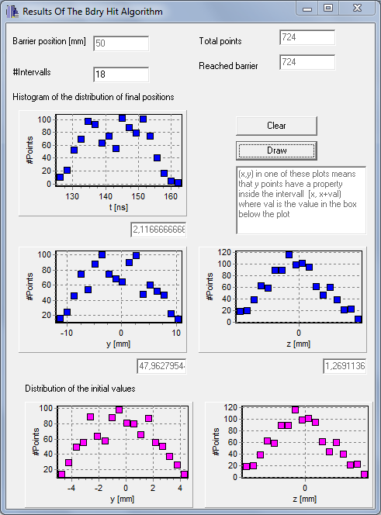
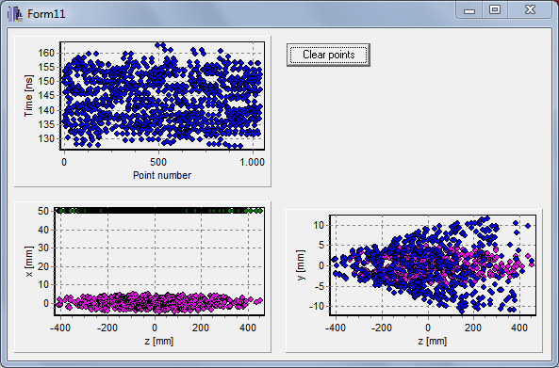
Code output: IPM mode, ion detection
Actual parameter:
H₂⁺ ion detection
E_{x} = 100 V/mm
Bunch 1m length = 22ns
1 cm trans. extension
parabolic density distrib.
10¹¹ charges
β = 15 %
1 MHz rep. rate
broadening for ion detection
differences for head ↔ tail
initial coordinate
final x coordinate
final y coordinate

Slide 9
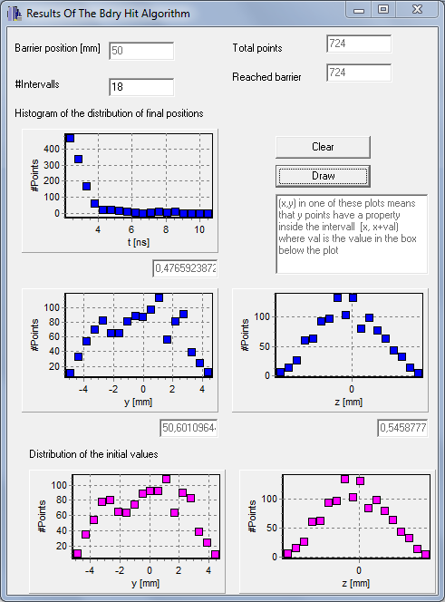
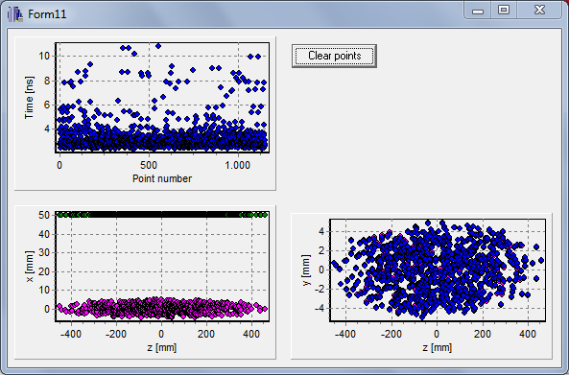
Code Output: IPM mode, electron detection
Actual parameters:
electron detection
v_{ini} = 0
B_{x} = 100 mT
E_{x} = 1 kV/cm
Bunch 1 m length
1 cm trans. extension
parabolic density distrib.
10¹¹ charges
β = 15 %,
1 MHz rep.
rate
no broadening for e⁻ detection

Slide 10
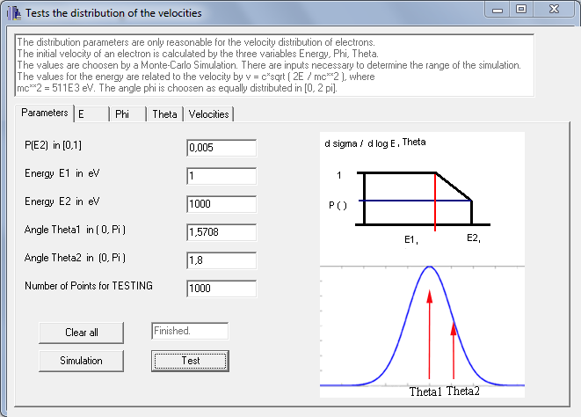
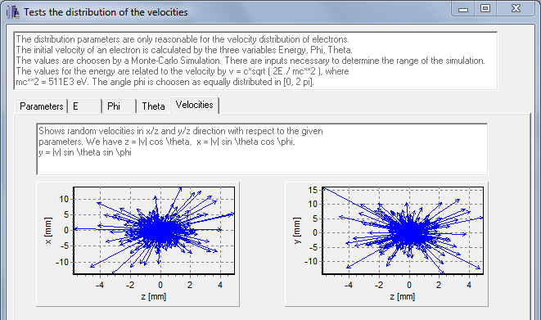
Usage of initial e⁻ velocity distribution
Electron parametrization with ‘separated’ ansatz:
Energy: dσ / dE constant value for
0 < E < E₁ ; linear decay for
E₁ < E < E₂ ; σ= 0 for E > E₂
Angular: dσ / dθ Gaussian with center θ₁ and width θ₂
Improvements contributed by Dr. Jun He, Institute of High Energy Physics, Chinese Academy of Sciences

Slide 11
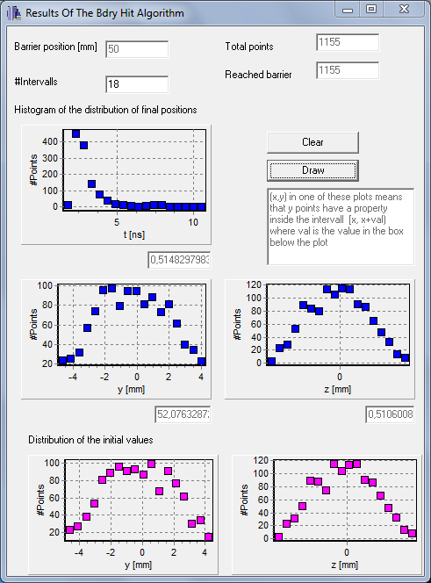
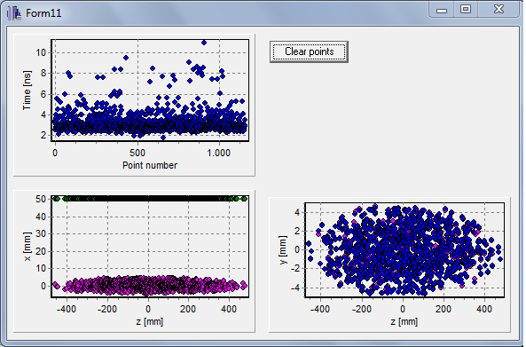
Simulation with initial e⁻ velocity distribution
Actual parameters:
electron detection
B_{x} = 100 mT
E_{x} = 1 kV/cm
Bunch 1 m length
1 cm trans. extension
parabolic density distrib.
10¹¹ charges
β = 15 %
1 MHz rep.
rate
no significant difference compared to v_{ini} = 0 for this case

Slide 12
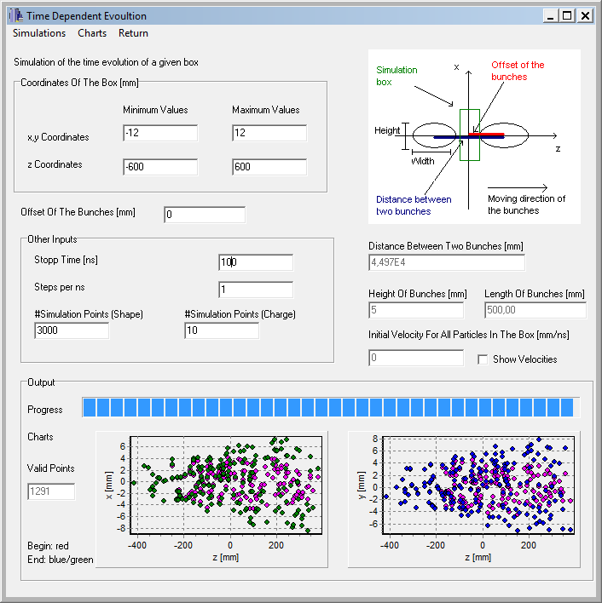
Code input/output: BIF mode with H₂⁺ ions
Actual parameters:
H₂⁺ ion detection
Bunch 1 m length
1 cm trans. extension
parabolic density distrib.
10¹¹ charges
β = 15 %
1 MHz rep. rate
H₂⁺ fluorescence
→ position after 100 ns

Slide 13
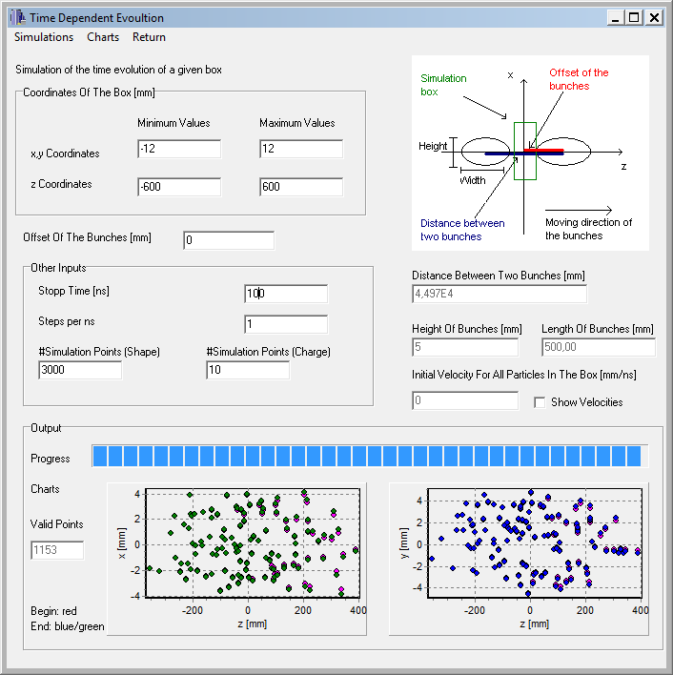
Code input/output: BIF mode with N₂⁺ ions
Actual parameters:
N₂⁺ ion detection
Bunch 1 m length
1 cm trans. extension
parabolic density distrib.
10¹¹ charges
β = 15 %
5 MHz rep. rate
N₂⁺ fluorescence
→ position after 100 ns

Slide 14
Summary and Outlook
Features:
Easy to use GUI with real time capabilities
Based on analytical expressions for the bunch fields, allowing for fast computations
Homogeneous external E and B guiding fields
Density: $ρ\left(\vec{x}\right)=const$ (i.e. transversal KV-distr., longitudinal ‘air-bag’) used for tests or parabolic $ρ\left(r,z\right)∝\left(1−\frac{r^{2}}{R^{2}}−\frac{z^{2}}{L^{2}}\right)$
Relativistic and non-relativistic bunches
For electrons non-zero start velocities can be used, the velocity distribution is based on a ‘separated’ ansatz
Outlook:
Rewrite parts of the code to increase numerical robustness and allow for strongly stretched bunches
Separate GUI code from the computational one and produce a new GUI based on modern portable libraries
Benchmark against other codes and also experiments

