Slide 1
Analysis of optical IPM data
IPM17 Workshop, GSI, May 22nd,2017
Mariusz Sapinski

Slide 2
Outlook
Motivation.
LHC IPM.
Features of 2D IPM image on example of LHC monitor.
Filtering in frequency domain.
Slicing 2D image – camera tilt correction.
Deconvolution of optical Point Spread Function (PSF).
Conclusions.
Notes:
Goal of the study – find space-charge deformation

Slide 3
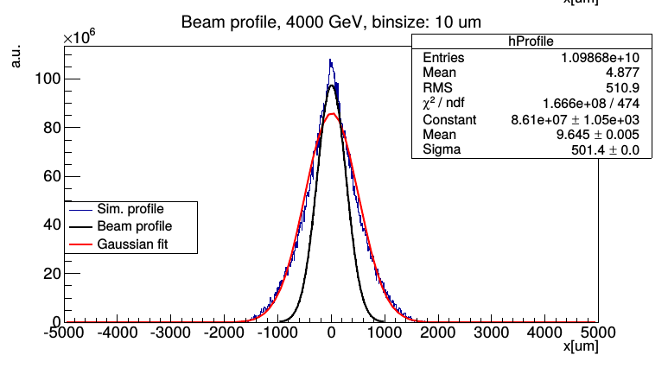
Motivation
Inability to calibrate LHC IPM (BGI) attributed to beam space-charge.
This leads to non-gaussian deformation of observed profiles.
Can we see this deformation in LHC data?
In other words: can we clean the data from other effects?
The following examples are obtained using ROOT.
After recent experiences I would rather recommend Python and numpy.
Notes:
Goal of the study – find space-charge deformation

Slide 4
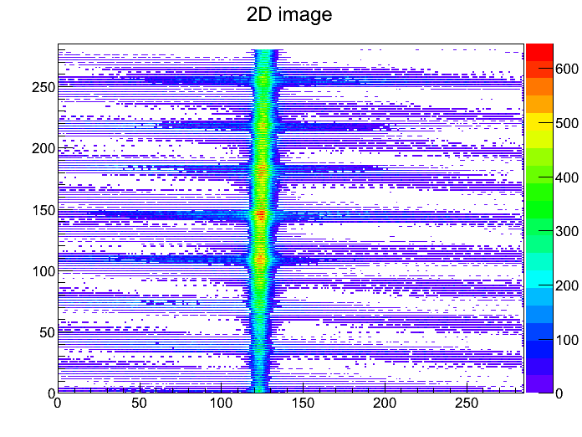
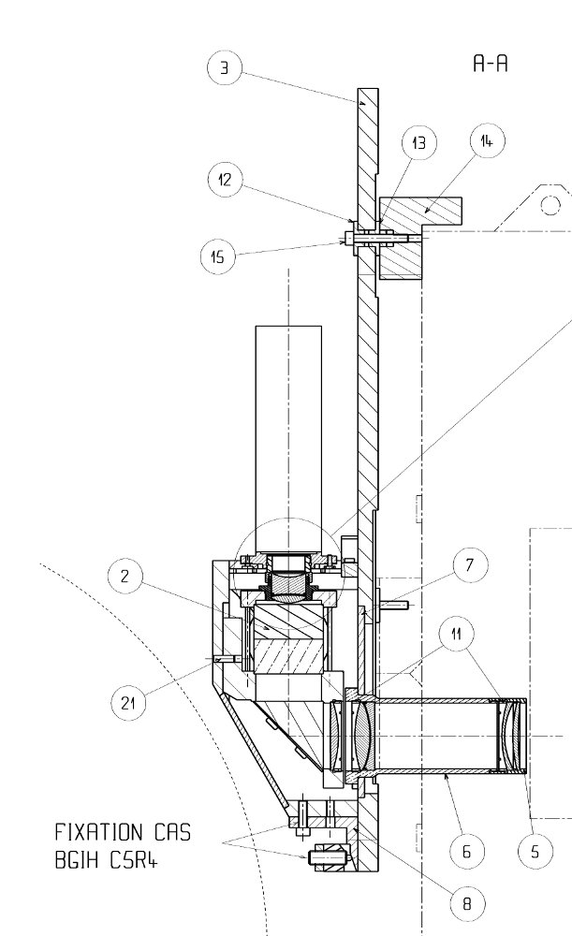
LHC IPM
MCP ageing,
phosphor screen burn-in
MCP resolution 32 μm
electron emission cone
Frame grabber
ion trap wires glowing
Noise on analog video signal
beam space charge,
electron cloud
~180 m
CID camera
(intensified)
Thermo Scientific
CID8712D1M-XD4
E
B
beam
MCP
Phosphor
Prism
Video amplifier
Optical system PSF is
estimated to be 25 μm (ZEMAX) x 5
D. Kramer et al., CERN-AB-2005-072
Optical system View port
Camera tilt

Slide 5
LHC IPM
important, could not find calibration data
MCP ageing,
phosphor screen burn-in
MCP resolution 32 μm
electron emission cone
Frame grabber
ion trap wires glowing
Noise on analog video signal
beam space charge,
electron cloud
~180 m
CID camera
(intensified)
Thermo Scientific
CID8712D1M-XD4
E
B
beam
MCP
Phosphor
Prism
Video amplifier
Optical system PSF is
estimated to be 25 μm (ZEMAX) x 5
D. Kramer et al., CERN-AB-2005-072
Optical system View port
Camera tilt

Slide 6
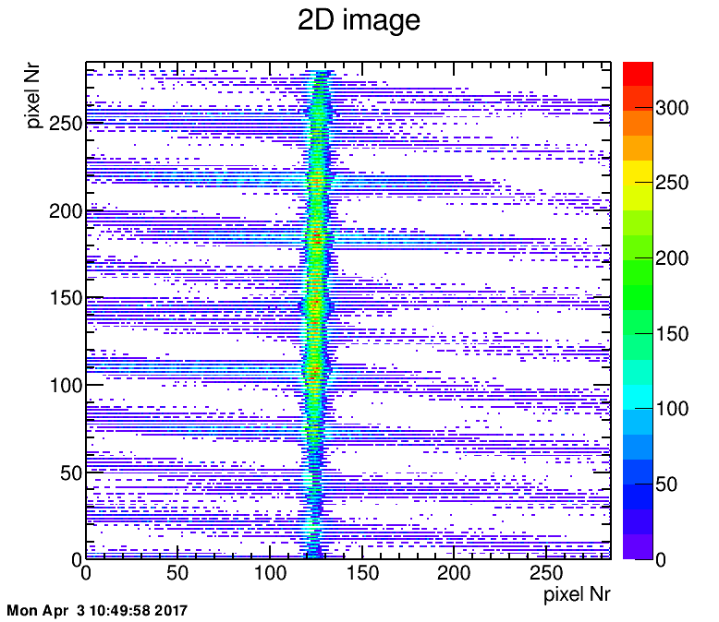
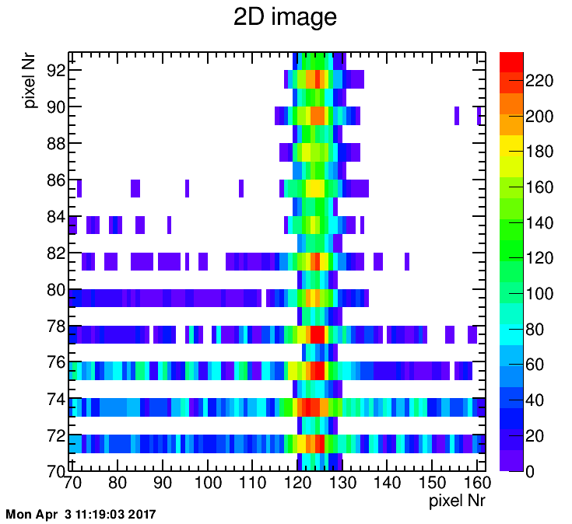
Features of a raw 2D image
LHC IPM B2V at 4 TeV as example.
Data from August 26, 2012.
Effects seen on the image:
‘TV-noise’ (stripes)
interlace
additional periodicity related to ion-trap wires
camera tilt
nonuniformity of MCP/Phosphor response
Point Spread Function of optical system
interlace

Slide 7
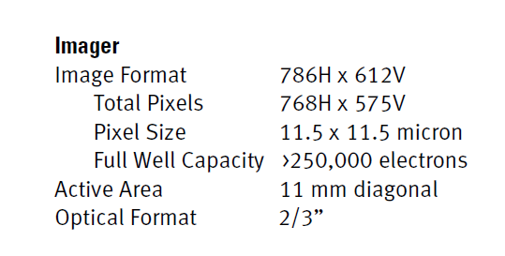
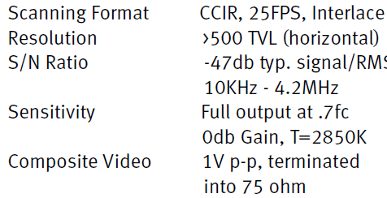
convert to 1D signal
probable scan direction
Camera specification:
this is only part of the image
 | period | frequency
image | 40 ms | 25 Hz
half-image | 20 ms | 50 Hz
line | 64 µs | 15625 Hz
pixel | 81.42 ns | 12.3 MHz
BTW, bandwidth of typical video cable 6 MHz → rotate camera?
sampling frequency

Slide 8
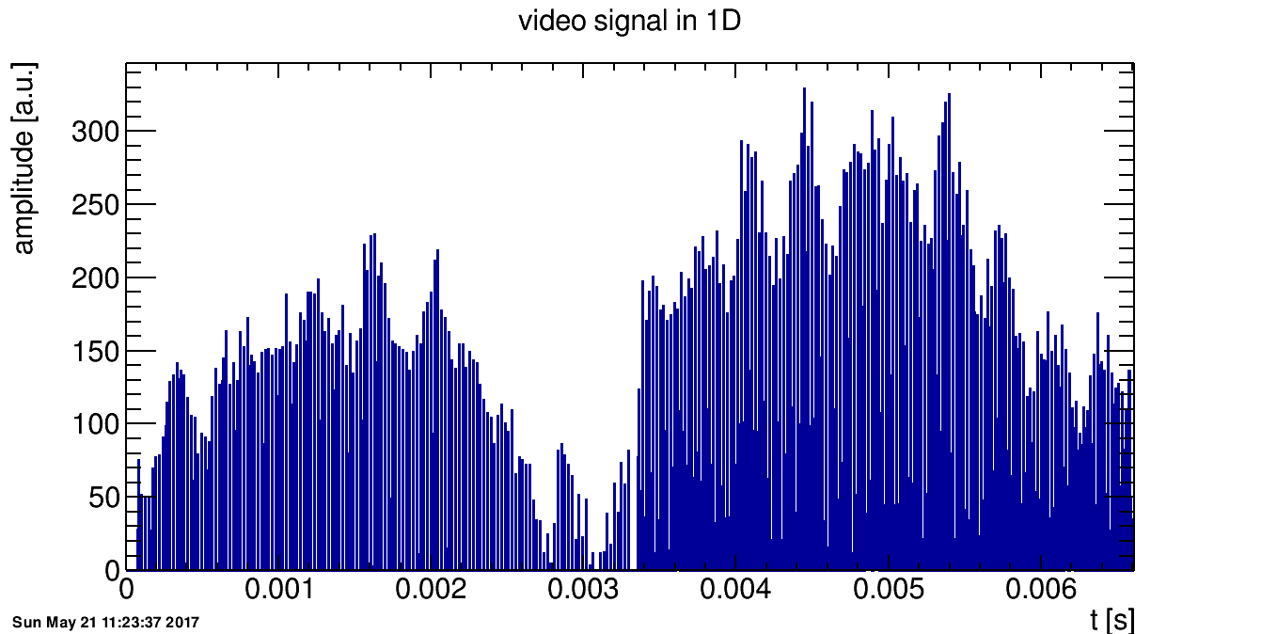
convert to 1D signal
about 25 Hz noise?
even lines
odd lines
part of image so: 6 ms instead of 40 ms

Slide 9
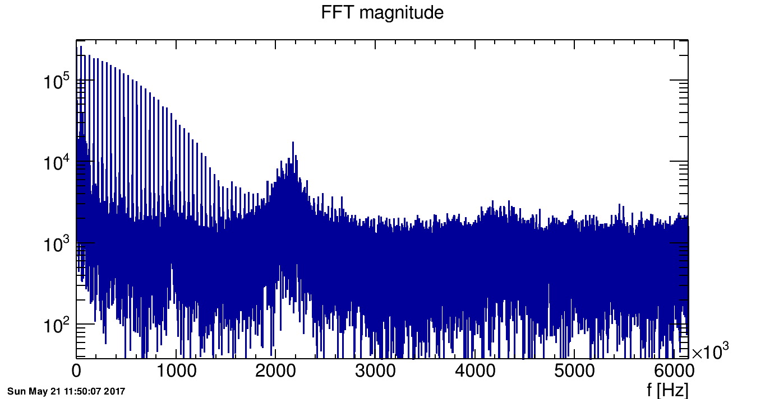
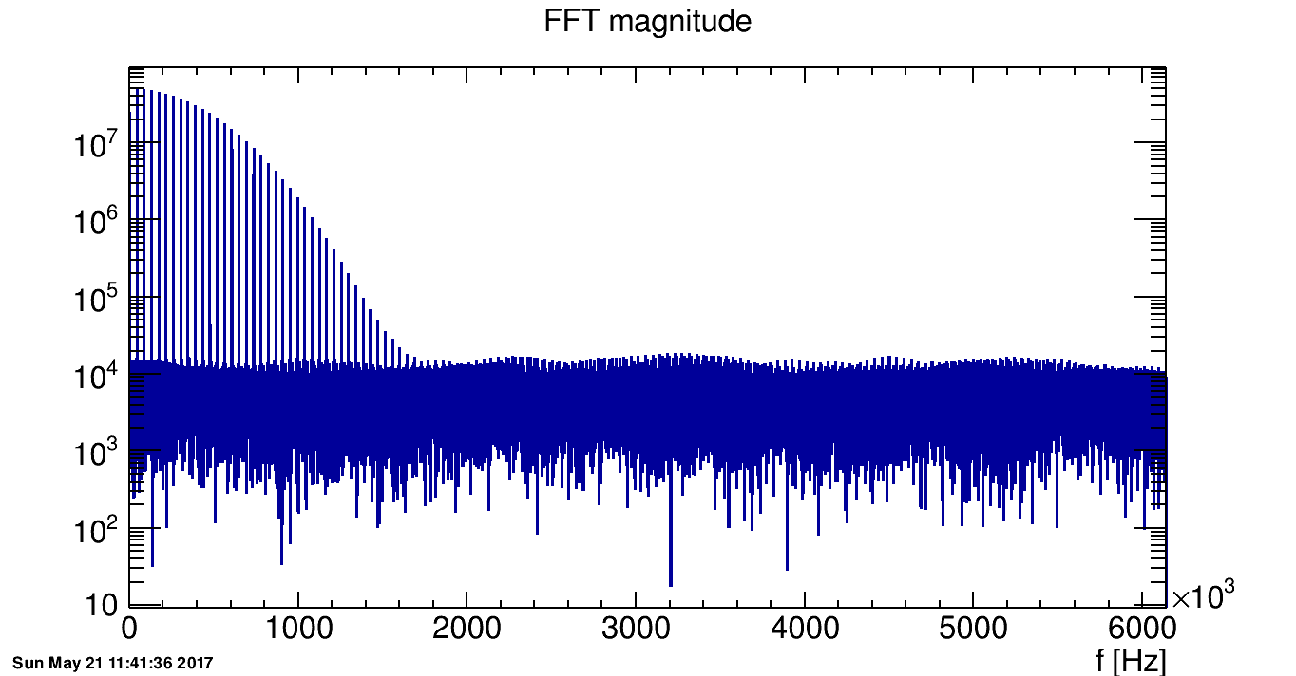
1D signal - FFT
Hanning window used
beam
undesired features?
886 kHz
data
2.1 MHz
~761 kHz
resolution = 150 Hz
real frequencies =*0.36
~321 kHz
range and shape of these lines defines quality of beam signal
ideal image

Slide 10
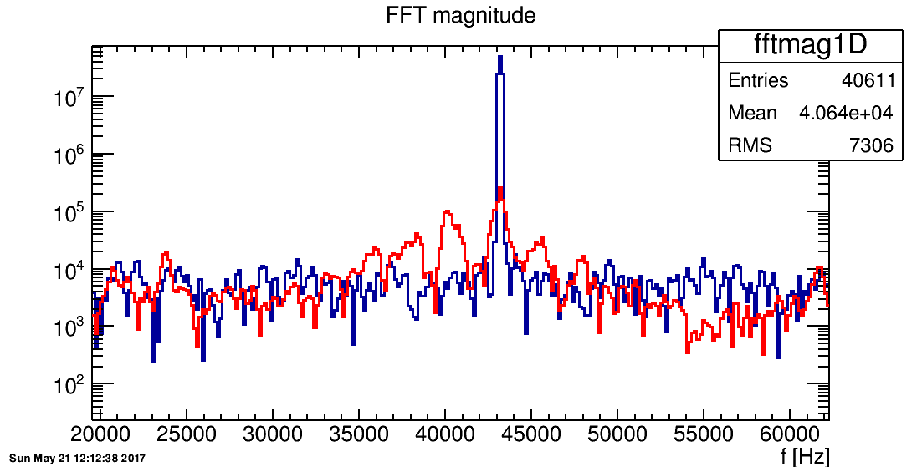
FFT – zoom around line frequency
because of image cropping line frequency is now about (786/285)*15625 Hz=
~43 kHz
f_{real}=0.36*f
line frequency
data
ideal
40.3 ±0.4
kHz
37.9 ±0.7
kHz
45.3 ±0.5
kHz
~13.7 ~14.6 ~16.4

Slide 11
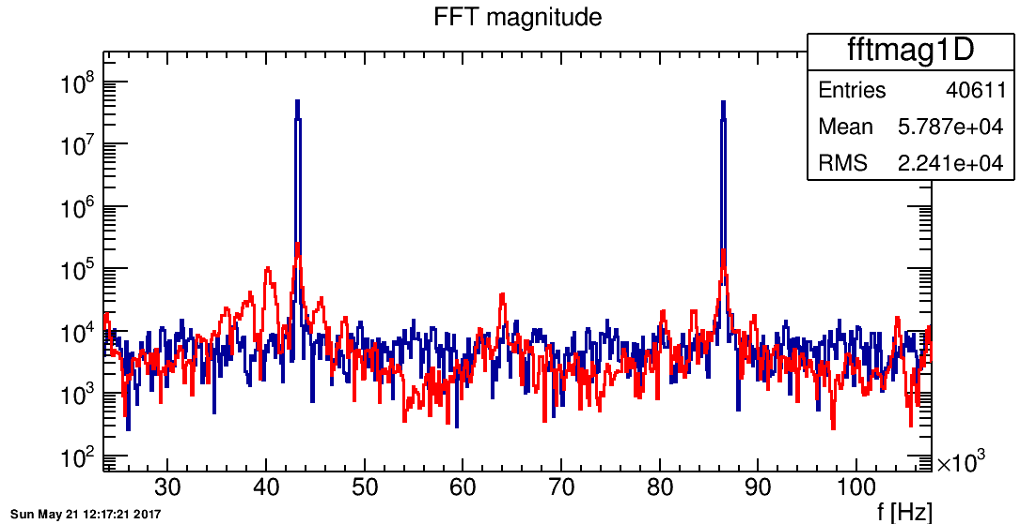
FFT – zoom around line frequency
unzoom a bit
data
ideal
64 kHz
~23.2 kHz

Slide 12
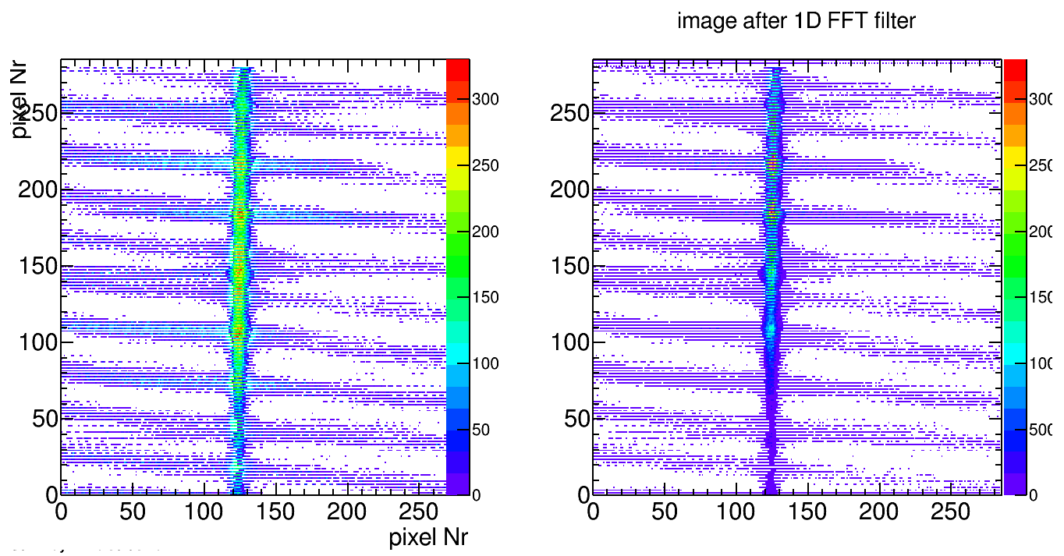
after filtering
slightly better contrast, less power in bands but no real improvement (discussion: how to quantify improvement?)
ion trap grid wires

Slide 13
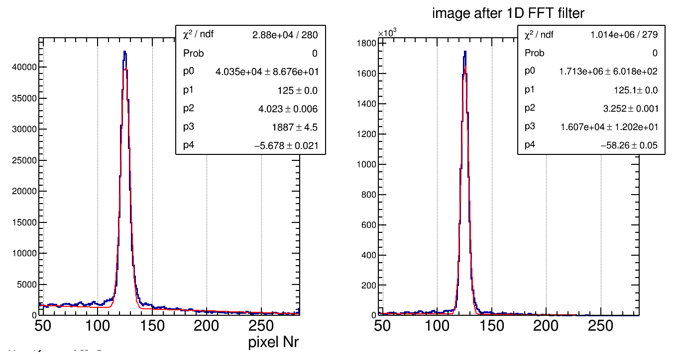
after filtering
profile looks better
calibration=0.12mm/pixel
σ_{calib}=0.48 mm
σ_{calib}=0.39 mm

Slide 14
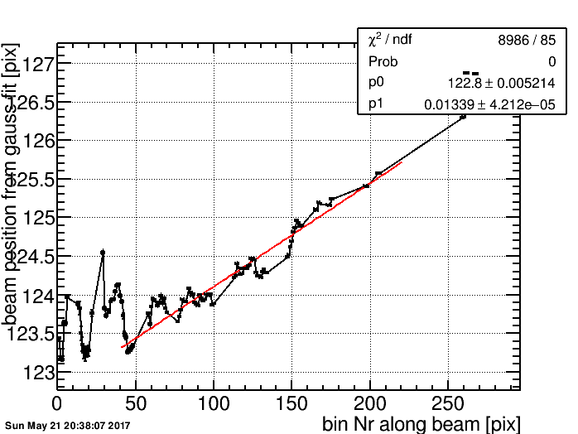
Camera tilt
tilt is 7 degrees:
3.8 pixels along the image
or 219 µm
beam size is comparable – tilt is important

Slide 15
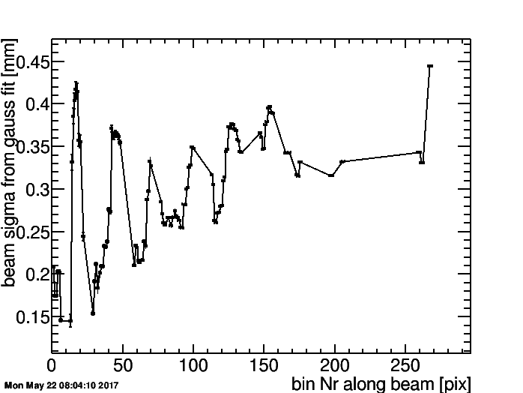
Beam width along the image
grid wires give larger σ – should be filtered out
fitted sigma increases along the beam – amplitude effect (?)

Slide 16
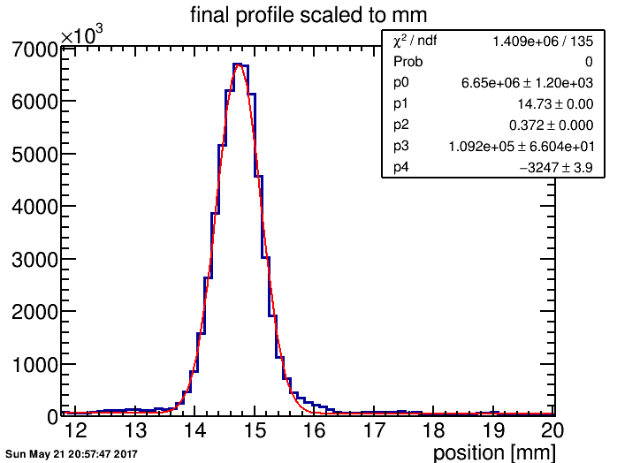
Tilt correction
effect on sigma: about 5%
idea: use the tilt to increase the binning of the histogram
σ_{real}=0.37 mm

Slide 17
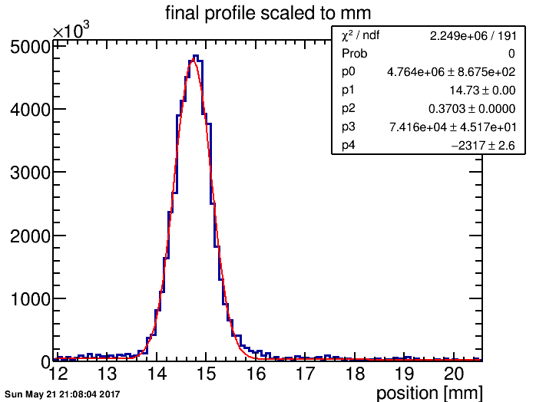
Tilt correction
40% more bins, so bin size at beam position: 57.5→41 µm
looks a little better
but be careful not to introduce artefacts
optical PSF is much bigger then bin size!

Slide 18
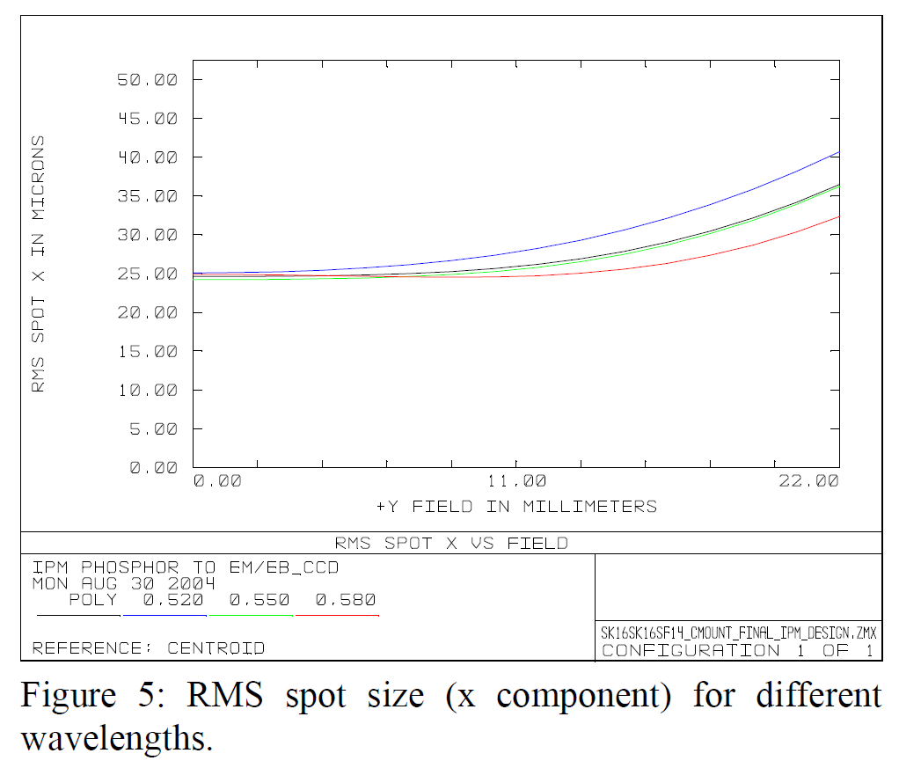
PSF deconvolution
RMS spot size is 25 µm on sensor side
Optical system magnification is 0.2
So RMS spot size on beam side is 125 µm
Lets assume PSF is gaussian: sigma = RMS
if beam is gaussian, the correction is simple:
σ=$√(\text{σ}$_{meas}²-$\text{σ}\text{p}$_{sf}²) = 0.35 mm
(another 5%)!
D. Kramer et al., CERN-AB-2005-072

Slide 19
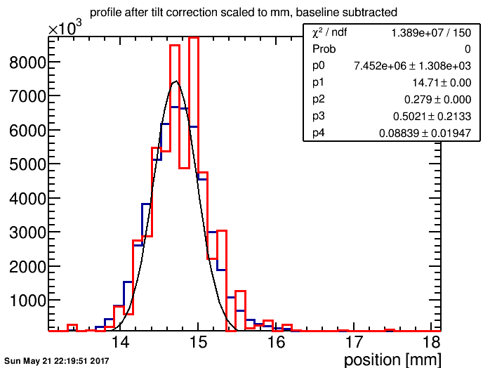
PSF deconvolution
We can also try to use deconvolution algorithm, eg. Gold deconvolution implemented in ROOT::TSpectrum
Increased binning not applied here.
Result not convincing.
“Windowing before FFT decreases resolution”.
Try without Hanning window.

Slide 20
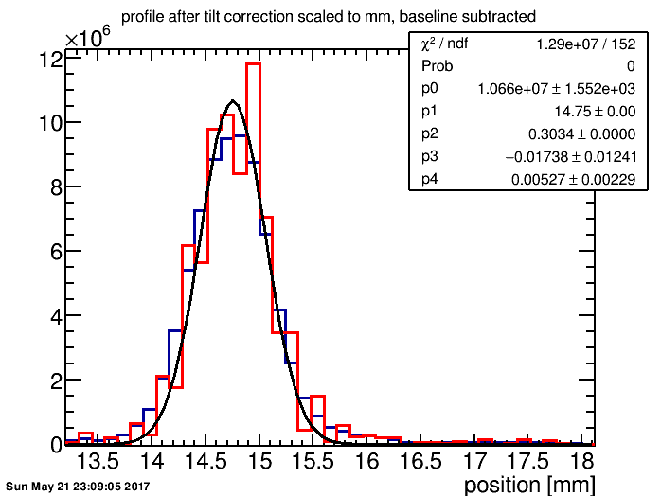
PSF deconvolution
Result slightly better, but still not convincing.
More study needed.
Better resolution would be definitely helpful.
σ_{real}=0.303 mm

Slide 21
Conclusions
Signal cleaning with FFT not very successful.
However it gives 19% smaller σ.
Tilt correction crucial, further σ decrease (~5%).
Tilt maybe potentially used to increase profile sampling.
Optical Point-Spread Function effect is significant.
However deconvolution is did not work yet.
Overall data quality not good – lack of calibration files, sigma variation along the image, etc.
If we want to study further profile deformation in electron IPM with magnetic field, need other data:
J-PARC? SIS18?

Slide 22
Acknowledgements
special thanks for discussions and suggestions to Sofia Kostoglou (CERN), Dominik, Rahul.
Thank you for your attention!

Slide 23
Spare slides

