Slide 1
News from J-PARC: the system, the data and the simulation code
Simulation, design and operation experience of Ionization Profile Monitors
21-24/5/2017
J-PARC MR beam monitor G
Kenichirou Satou

Slide 2
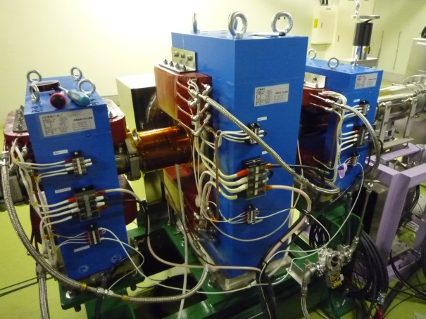
Outline
J-PARC MR IPM system overview
Magnet system
Electron contamination issue
Beam based MCP gain calibration
Development of Gated IPM system for J-PARC system
Data set for IPM simulation from J-PARC
Summary
Photo of IPM

Slide 3
MR IPM specification
MR IPM specification
Number | 3
Twiss parameter | Vertical βx=12.1m, βy=27.3m,η=0m Horizontal βx=13.1m, βy=21.6m,η=0m Horizontal βx=8.4m, βy=15.5m,η=2.0m
Gap size | 130mm
Maximum HV | 50kV
Operation voltage | <30kV
w/w.o. Magnet | D2H: w. D2V,D3H:w.o.
Detector | 1 chevron MCP
Current pickup | 32ch strip anode
Anode width | 2.5mm
MCP calibration source | Cold electron source: EGA
Notes:
As for the MR IPM, there are 2 IPM systems for vertical and horizontal profile measurement, and the other IPM system have installed this summer shat-down. The gap side of the electrodes is 130mm which is 2.3 times smaller than that of the RCS IPM. The maximum HV is 50kV and the operation voltage is now limited under 30kV, but will be upgraded to the maximum value in the near future. The magnet system has not yet installed, and one chevron MCP is used.

Slide 4
IPM components and two mode operations
A set of electrodes to generate electric field to collect charged particle
High voltage to overcome the space charge electric field of the high intensity bunched beam
  Space charge E field
    1800kV/m for MR ext. beam
3-pole magnet system to generate guiding field to collect electrons against space charge electric field
Ideally the E and B field doesn’t make any force
MCP to multiply the signal
Multi strip anode to read out the charge from MCP
Electron source, EGA (Electron generator arrays), to check gain aging of the MCP -> Will be removed this summer
Two mode operation and related issues
  Ion collection without guiding field
  The HV is now poor for the extraction beam, thus space charge effect should be taking into account to estimate the emittance
  Guiding field assisted electron collection
  Is it possible to collect electrons only from the ionization process?
Notes:
This figure shows IPM components. This is electrodes to generate the To collect ionized positive ions or liberated electrons, the uniform external electric field is produced by applying HV to the electrodes. The magnetic field assisted electron collection is required for high intensity beam measurement against its strong space charge effect. Ideally, the external electric and magnetic field are parallel, and thus generate no cross term force.
In case of the ion collection mode without magnetic field, the calculation taking into account the space charge effect of the bunched beam is required to estimate the emittance.
The two stage MCP, called chevron-type, with multi-strip anodes is used as a signal multiplication and charge read out devices, and electron source set opposite side is used to check MCP gain change for long term usage.

Slide 5
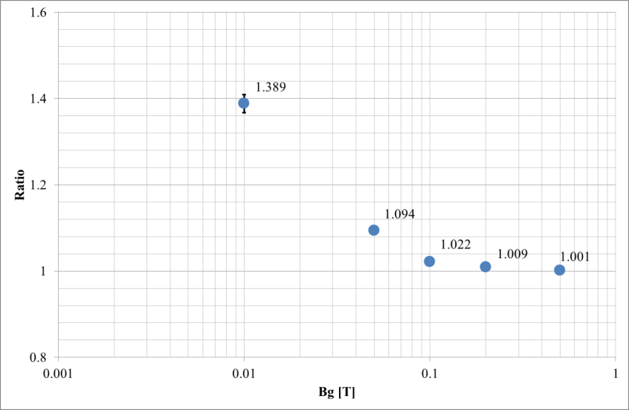
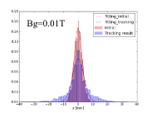
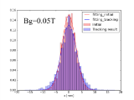
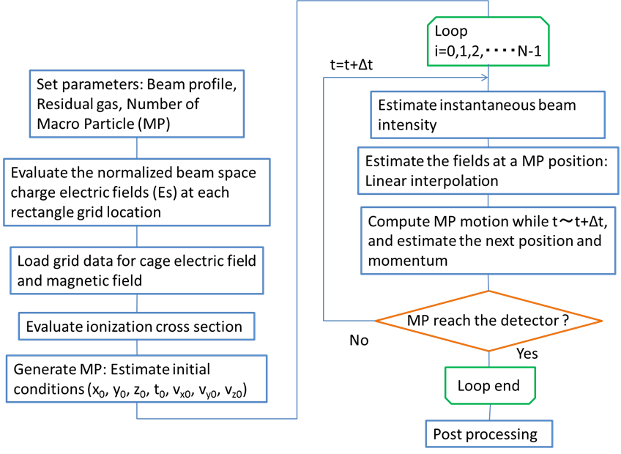
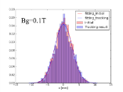
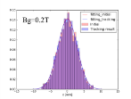
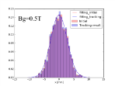
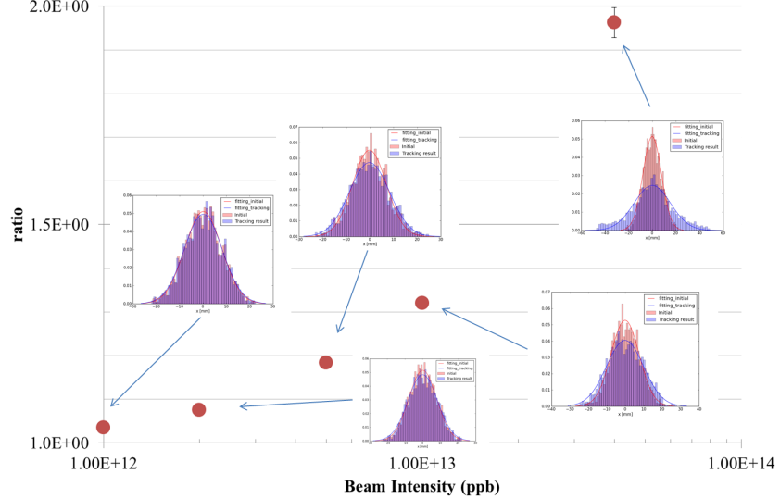
Magnet : Required B
Electron collection w. Bg at the flat top energy of 30GeV
Flow chart of the code IPMsim3D
Ion (m/q=1) collection w. Bg=0.2T for the bunched beam
at the injection energy of 3GeV

Slide 6
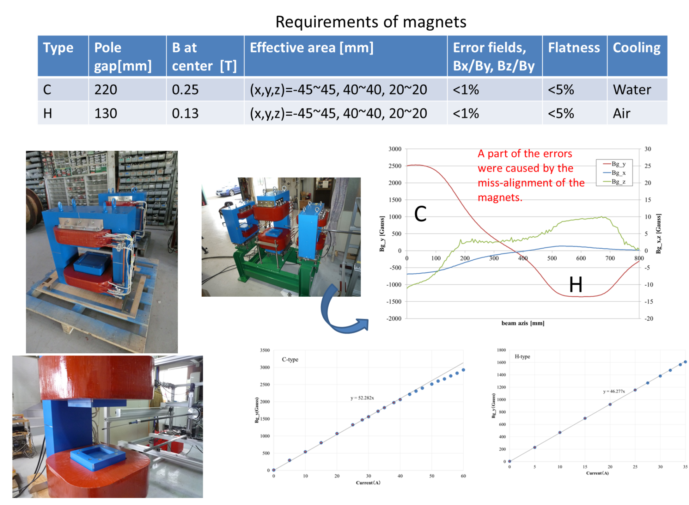
Magnet : performance

Slide 7
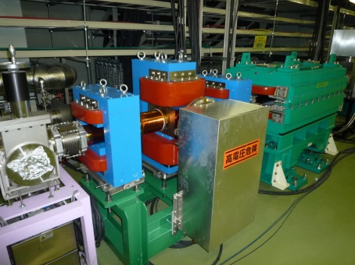
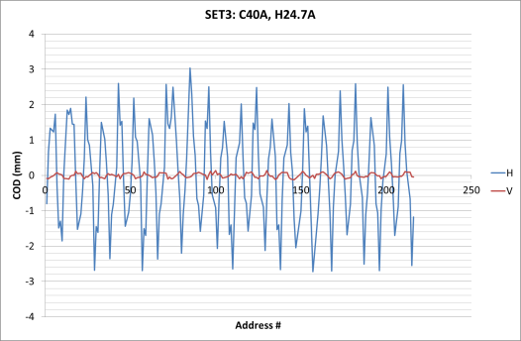
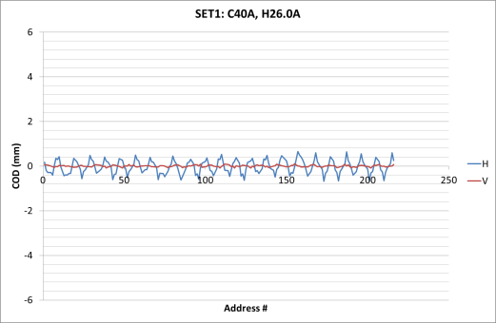
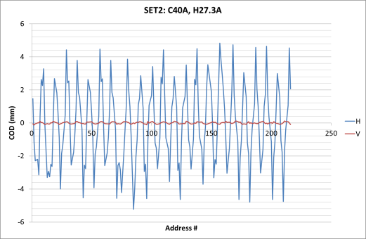
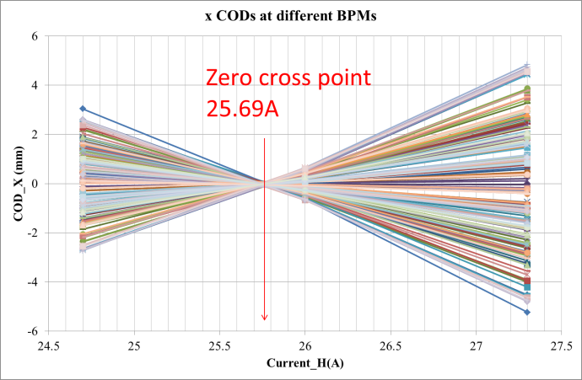
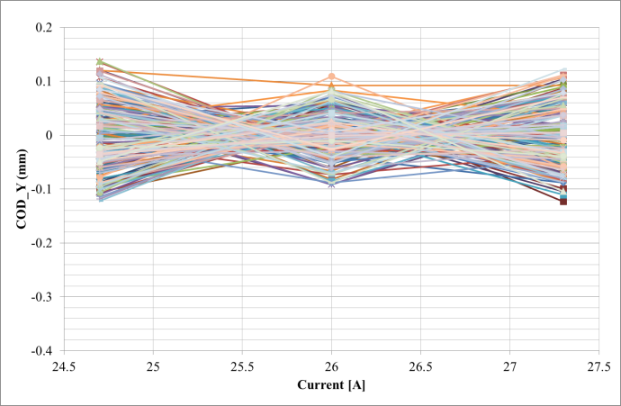
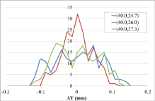
Magnet : Current balance tuning
Residual BL product -> Horizontal kick -> COD_x
The CODs along MR ring at different current settings (40, 24.7), (40, 26.0), (40, 27.3)
The cross points showing COD_x = 0 mm suggest that the current setting of (40.0, 25.7) is appeared to be the balanced setting. We have also checked the vertical CODs and these does not shows clear position deviations, however the histograms of the (40.0, 26.0) is somehow narrower than that of the others. Since the magnet alignment criterion was less than 1mrad, so we expect that the alignment error of the H-type magnet induces small vertical kick and thus CODs, which are less than 100μm.
COD_x(y) change at 186BPMs

Slide 8
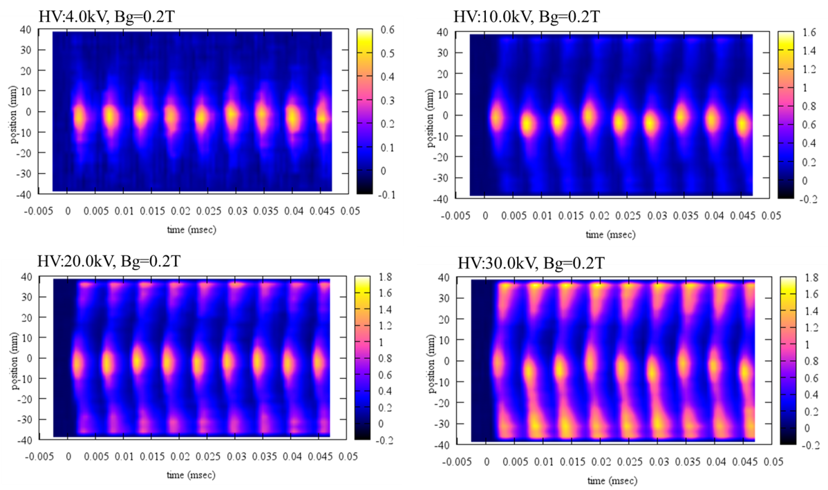
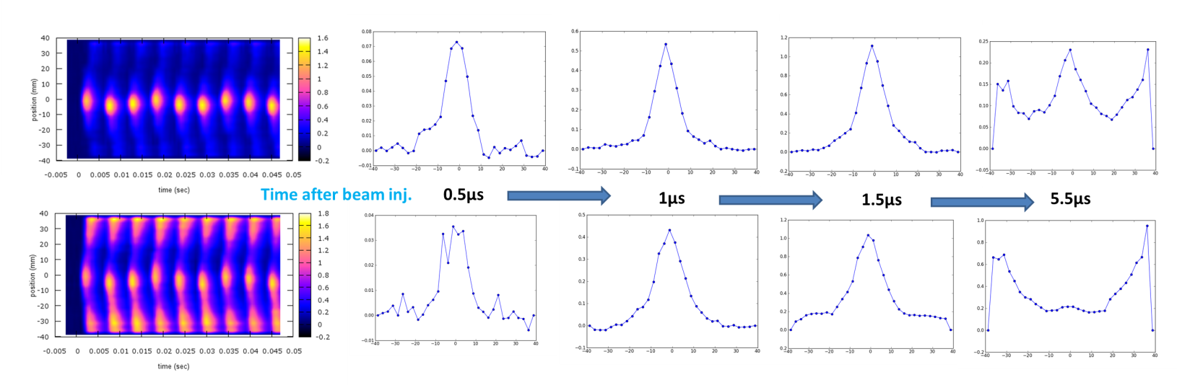
Contamination issue : Electron collection with the magnetic field
The turn by turn profile showed beam induced contamination, and it depends on HV
The contaminant electrons appeared ~1.5 μs after the beam passage
Mechanism of this contamination issue is under investigation
Sliced profile at selected time, 0.5, 1, 1.5, and 5.5 μs after the beam injection

Slide 9
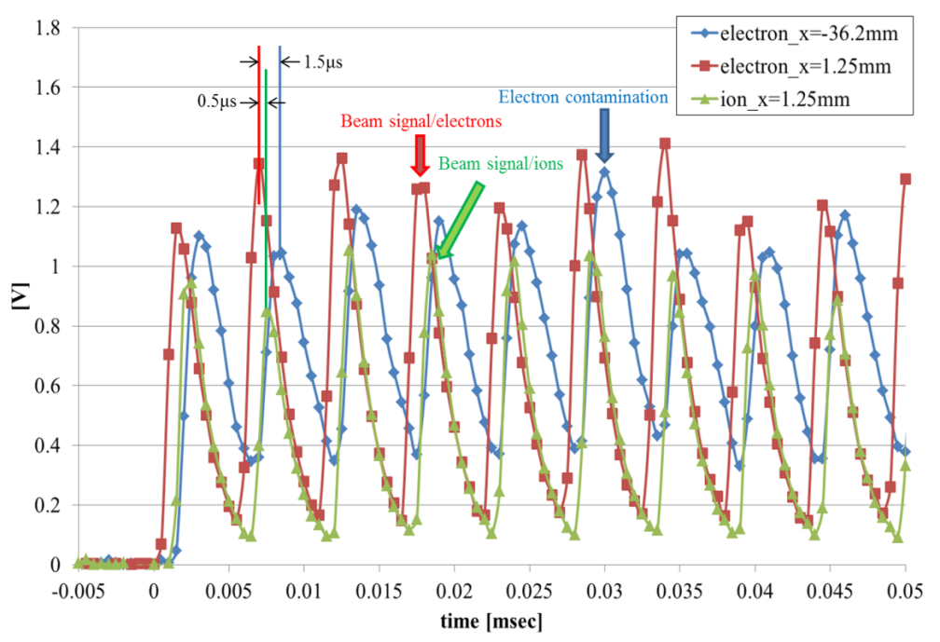
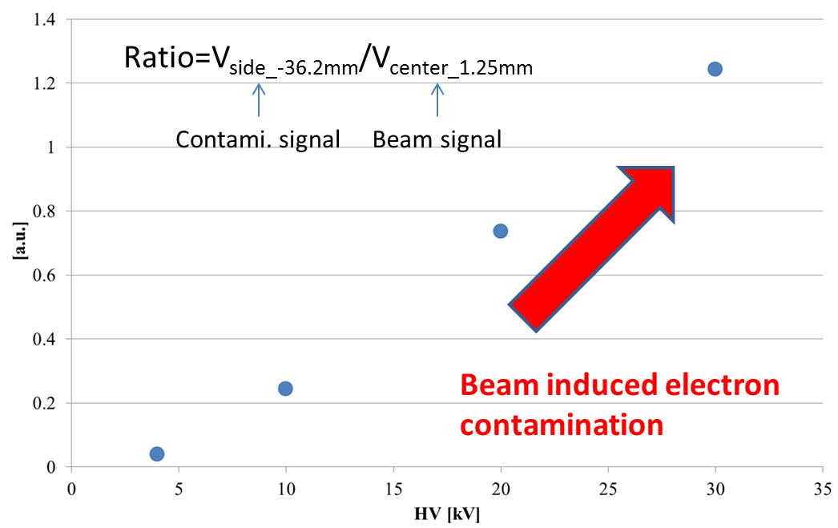
From where?
The time difference between a real beam signal of electrons and ions is about 500ns. This time difference is the result of the time of flight (TOF) to the MCP detector, a few ns in case of electrons and a few hundred ns for ions. The electron contamination shows somewhat broad structure and likely arrived on the detector surface at about 1.5μs after beam passage.

Slide 10
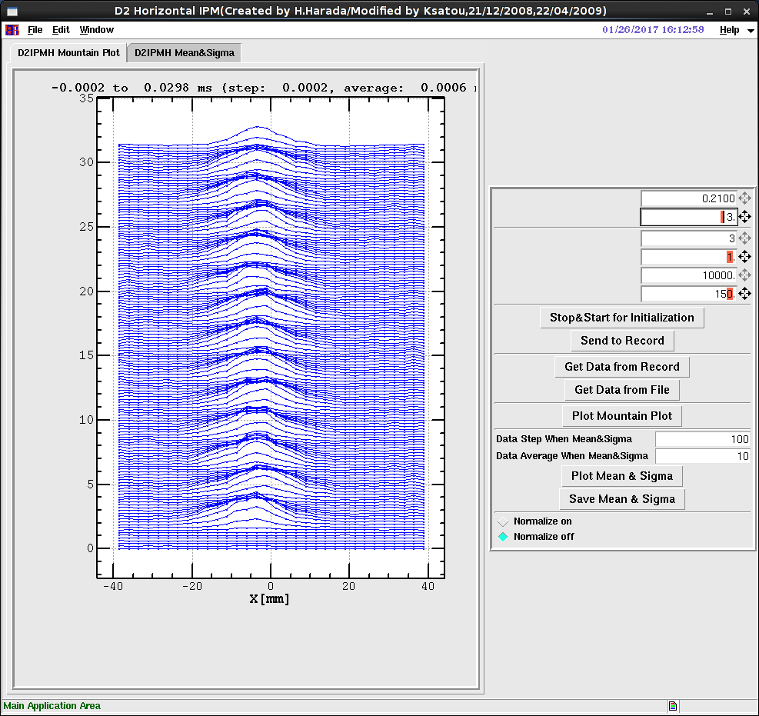
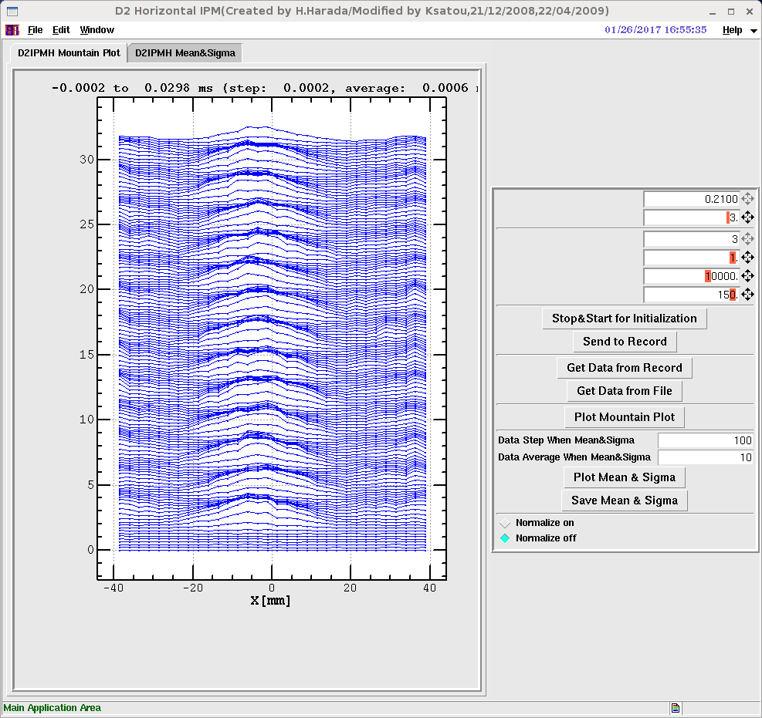
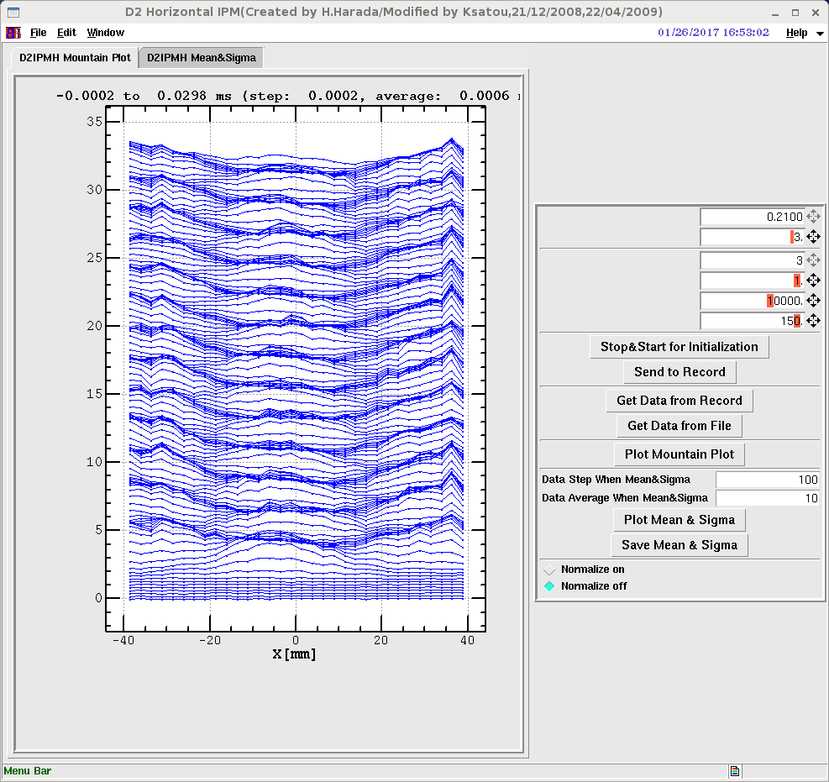
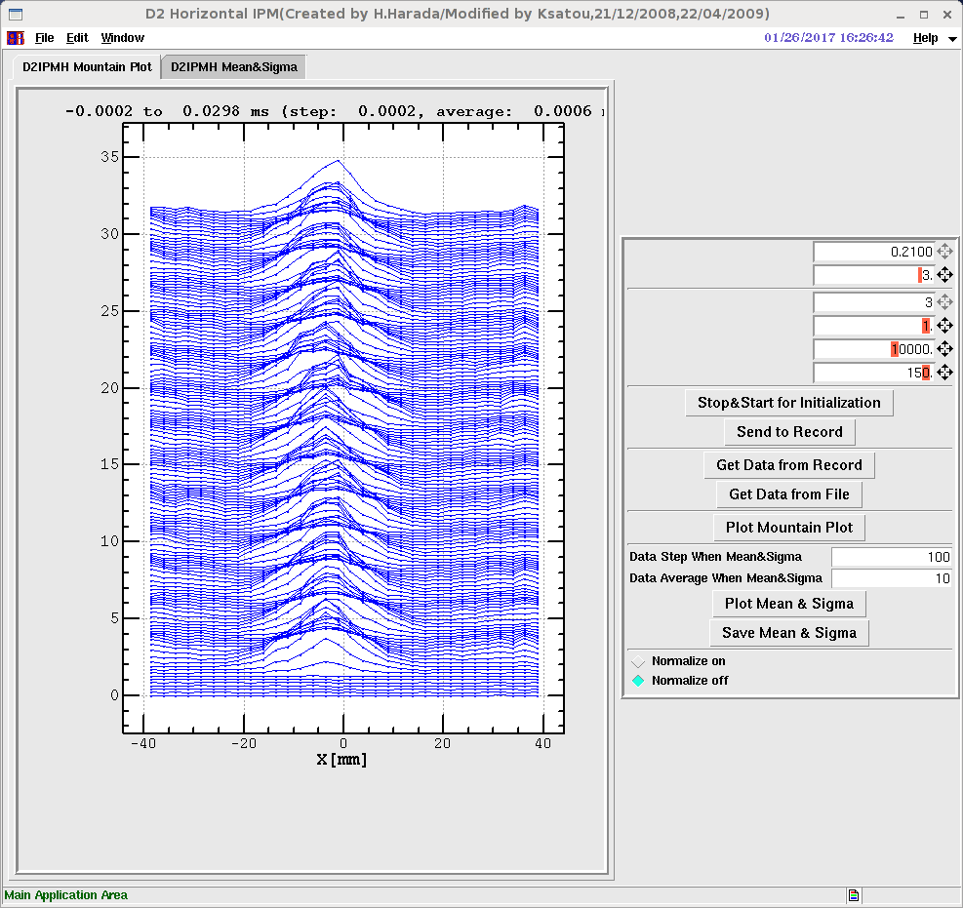
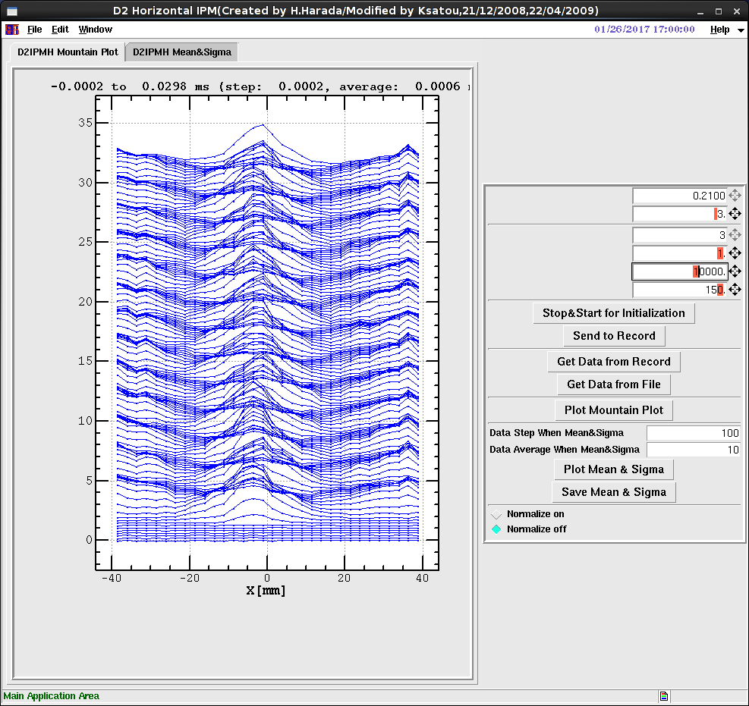
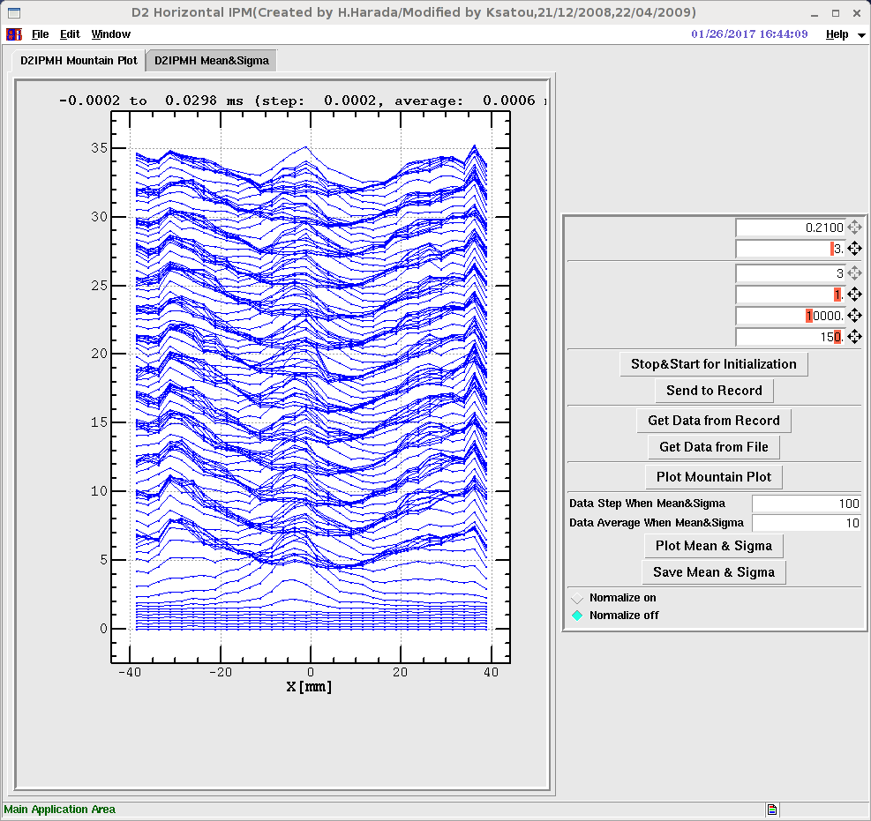
Contamination issue: B dependence
0.2T
0.15T
0.1T
#20
HV=-5kV
#26
HV=-5kV
#27
HV=-5kV
#22
HV=-7.5kV
#25
HV=-7.5kV
#28
HV=-7.5kV

Slide 11
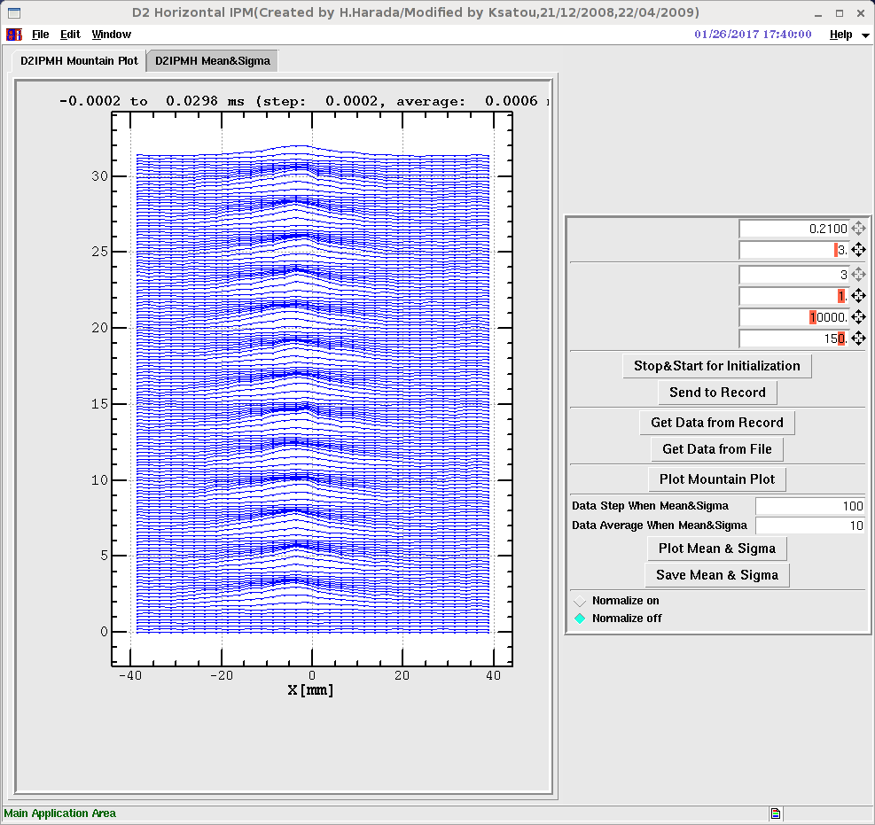
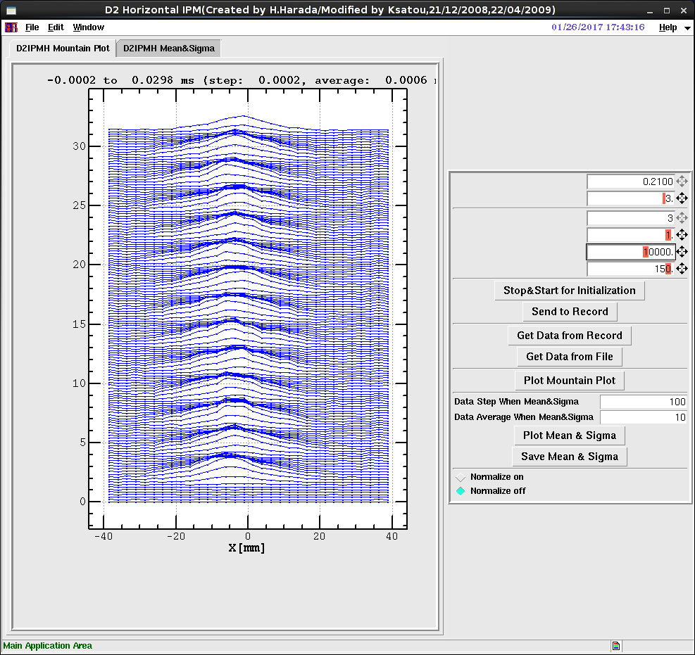


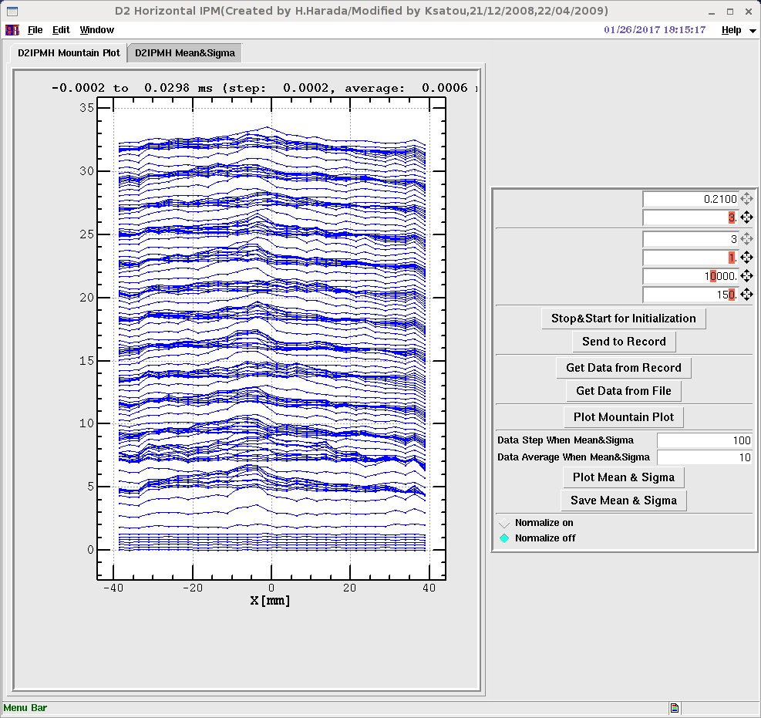
Contamination issue：Beam intensity dependence
B=0.2T
#33
RF:A) 3.11E12ppb
HV=-5kV
MCP 2.2-0.5kV
#34
RF:B) 5.78E12ppb
HV=-5kV
MCP 2.3-0.5kV
#35
RF:C) 1.24E13ppb
HV=-5kV
MCP 2.25-0.5kV
#36
RF:C) 1.24E13ppb
HV=-4kV
MCP 2.25-0.5kV
#38
RF:E) 2.52E13ppb
HV=-4kV
MCP 2.52-0.5kV

Slide 12
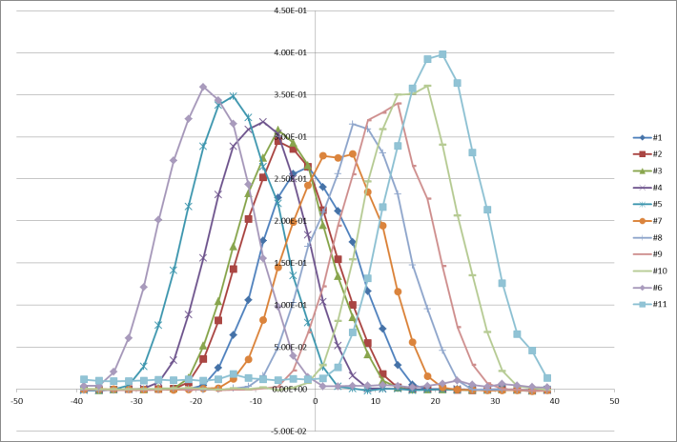
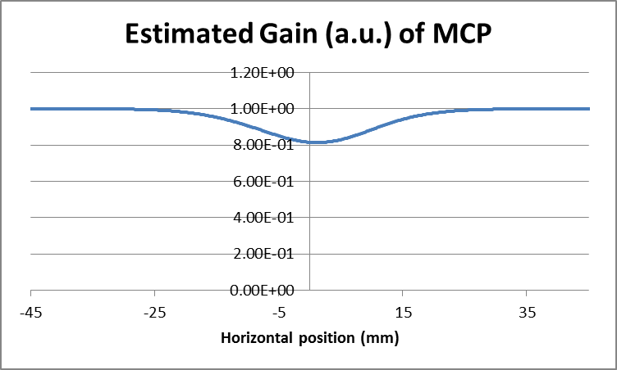
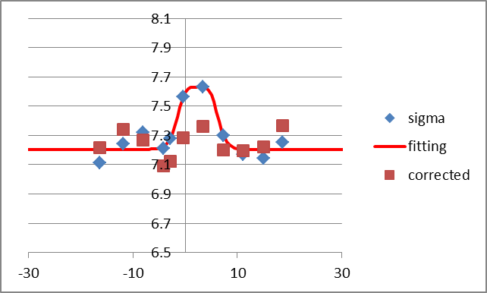
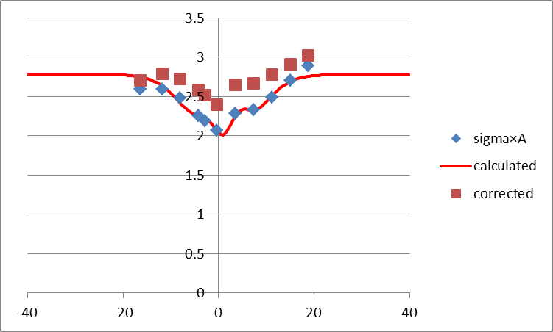
How to calibrate MCP without source?
Gauss fitting
Fitting functions

Slide 13
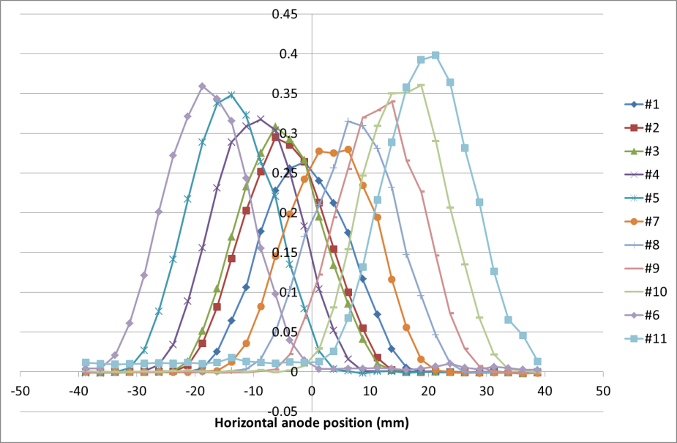
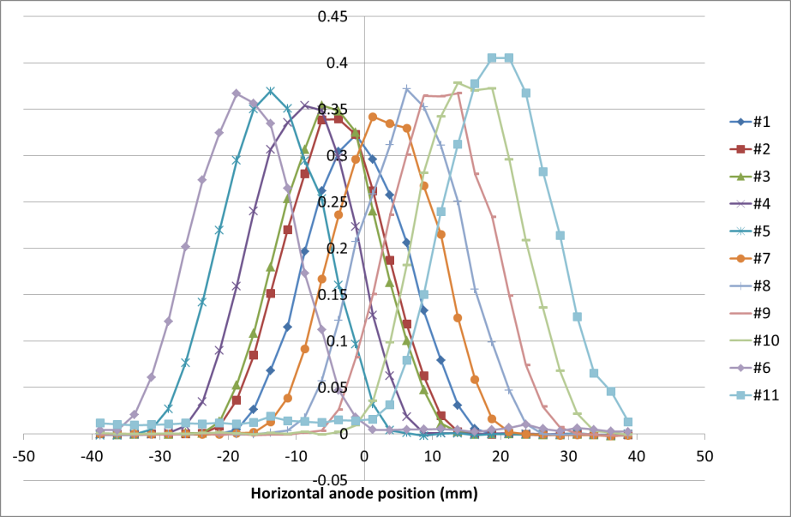
Before and after gain correction
The profile widths are corrected well, however small intensity gaps are remained
Some iterations may improve the situation

Slide 14
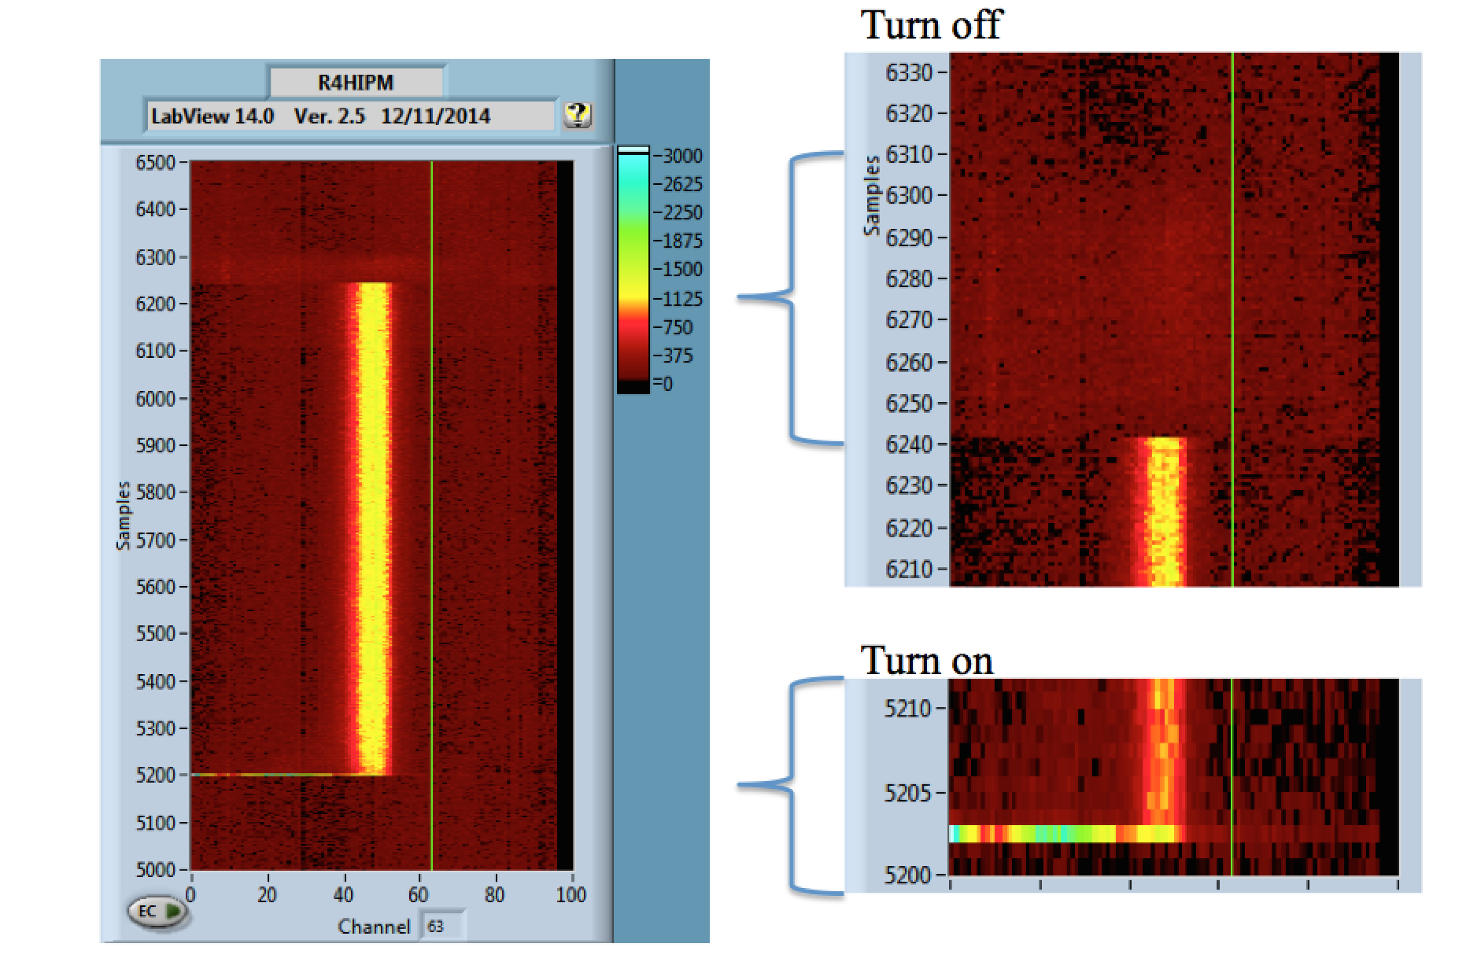
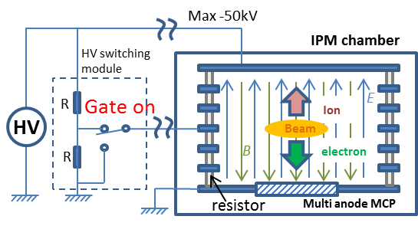
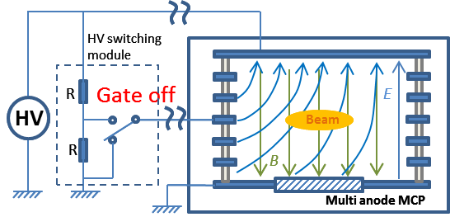
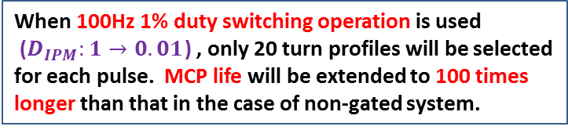

Solution: HV DC -> Pulse mode operation
Local gain decrease can be expressed as
Integrated time of measurement
Integrated output charge
Beam center fluctuation
Beam on ratio
$$∆G\left(x\right)∝Q\left(x\right)∝G_{0}\left(V_{bias}\right)∙\tilde{ρ}\left(x−f_{x0}\left(x\right)\right)∙\tilde{I_{0}}∙T∙D_{beam}{∙D}_{IPM}$$
Local gain change
MCP gain set
Duty of IPM operation
Averaged profile measured
Averaged intensity
Gated IPM system can
optimize this parameter
Gated system
On mode
Original idea comes
from FANL IPM
Off mode
Courtesy of Randy Thurman-Keup, profile measured by the IPM @ FNAL with pulsed HV: From the presentation file of US/Japan monitor meeting at FNAL, 2015.
When 100Hz 1% duty switching operation is used
($D_{IPM}:1→0.01$) , only 20 turn profiles will be selected for each pulse. MCP life will be extended to 100 times longer than that in the case of non-gated system.
$E×B {(v}_{z}=E_{x}B_{y})$ drift sweeps the charged particle away from the area of MCP detector

Slide 15
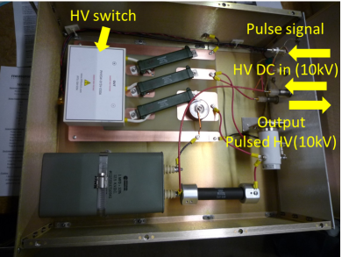
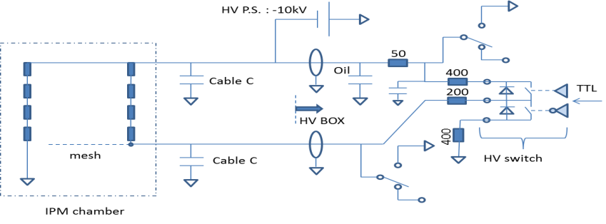
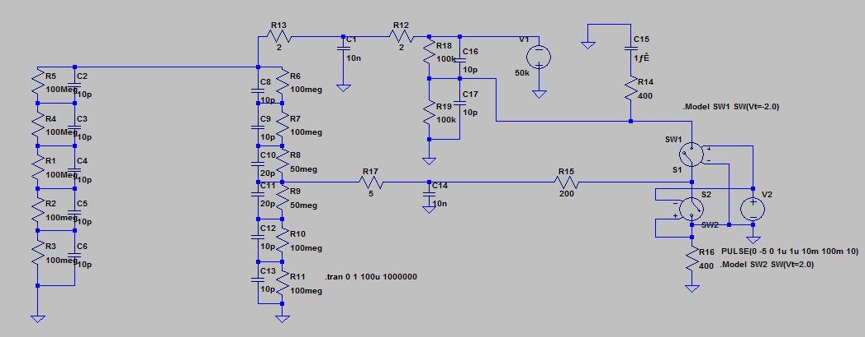
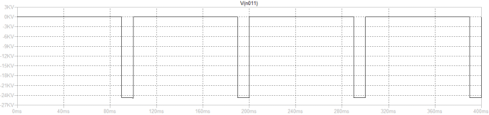
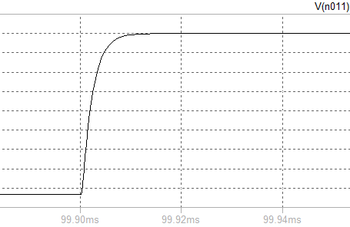
HV switching module design
Schedule
Courtesy of James R Zagel: Photo and block diagram of the HV switching module for FANL IPM
FY2016
  Design of the HV switching module
  Component procurement
  Performance check with test circuit
  Particle tracking simulation of gated IPM system
FY2017
  Component procurement
  Construction
    HV switching module
    New faraday cage
  Performance check of the HV switching module
  Particle tracking simulation of gated IPM system
FY2018
  Install
    New faraday cage
    HV switching module
  Performance check of the new gated IPM system
New HV switching module for J-PARC is now under design
Same design as FNAL IPM cannot be used due to the higher voltage of 50kV
At each stage, the discussion with the team at FNAL is required to get their expertise on the construction of the gated system, and to share the new knowledge from the new system of J-PARC
Gate off
Gate on
10μs
10ms
Proposed circuit for gated IPM system of J-PARC and its simulated results

Slide 16
IPM Data set for simulation works from J-PARC MR
As for the ion&electron collection mode, the data set for IPM simulation were measured.
A)3.11E12 ppb
  RF para
    100us, 228ns, delay1010ns, 32/32
  MRPM data: Shot#266392, WCM data:wfm170126_09(and 15)_wcm.tekwfm
B)5.78E12 ppb
  RF para
    300us, 228ns, delay1010ns, 20/32
  MRPM data: Shot#266393, WCM data:wfm170126_10_wcm.tekwfm
C)1.24E13 ppb
  RF para
    300us, 456ns, delay896ns, 20/32
  MRPM data: Shot#266393, WCM data:wfm170126_11_wcm.tekwfm
D) 2.96E13 ppb
  RF para
    500us, 462ns, delay896ns, 28/32
  MRPM data: Shot#266455, WCM data:wfm170126_13_wcm.tekwfm
E) 2.52E13 ppb
  RF para
    500us, 462ns, delay896ns, 24/32
  MRPM data: Shot#266458, WCM data:wfm170126_14_wcm.tekwfm
Wil be ready in June.

Slide 17
Summary
3 IPM systems are now operating in J-PARC MR, only one system has magnet system to collect electrons.
The magnet installed and start operation after 2016 summer long shut-down.
The current balance tuning between the PS of the main (C type) magnet and the PS of the two correction (H type) magnet was made by checking the CODs from BPMs, and the balance tuning is now reasonably well within the uncertainties of BPM resolution and magnet installation error.
The electron contamination issues were found in electron collection mode with magnetic field, and these contaminant depends on HV, B, as well as the beam intensity -> Further study will needed to clear the source of the contaminations.
The beam based MCP gain calibration was made.
Development of Gated IPM system for J-PARC MR, with helps from FNAL group, was proposed for one of the projects of Japan-US collaboration framework for upgrade of neutrino beams and accepted recently.
Some sets of data was measure for IPM simulation for both ion and electron collection mode and will be be ready in next month.

