Slide 1
Supersonic Gas-Jet Beam profile monitor
Hao Zhang

Slide 2
Outline
Gas-jet project review
  The gas-jet setup in CI
    Gas jet setup
    Generation of supersonic gas jet
    Beam profile Measurement (IPM mode)
    Resolution
    Gas dynamics
    BIF mode

Slide 3
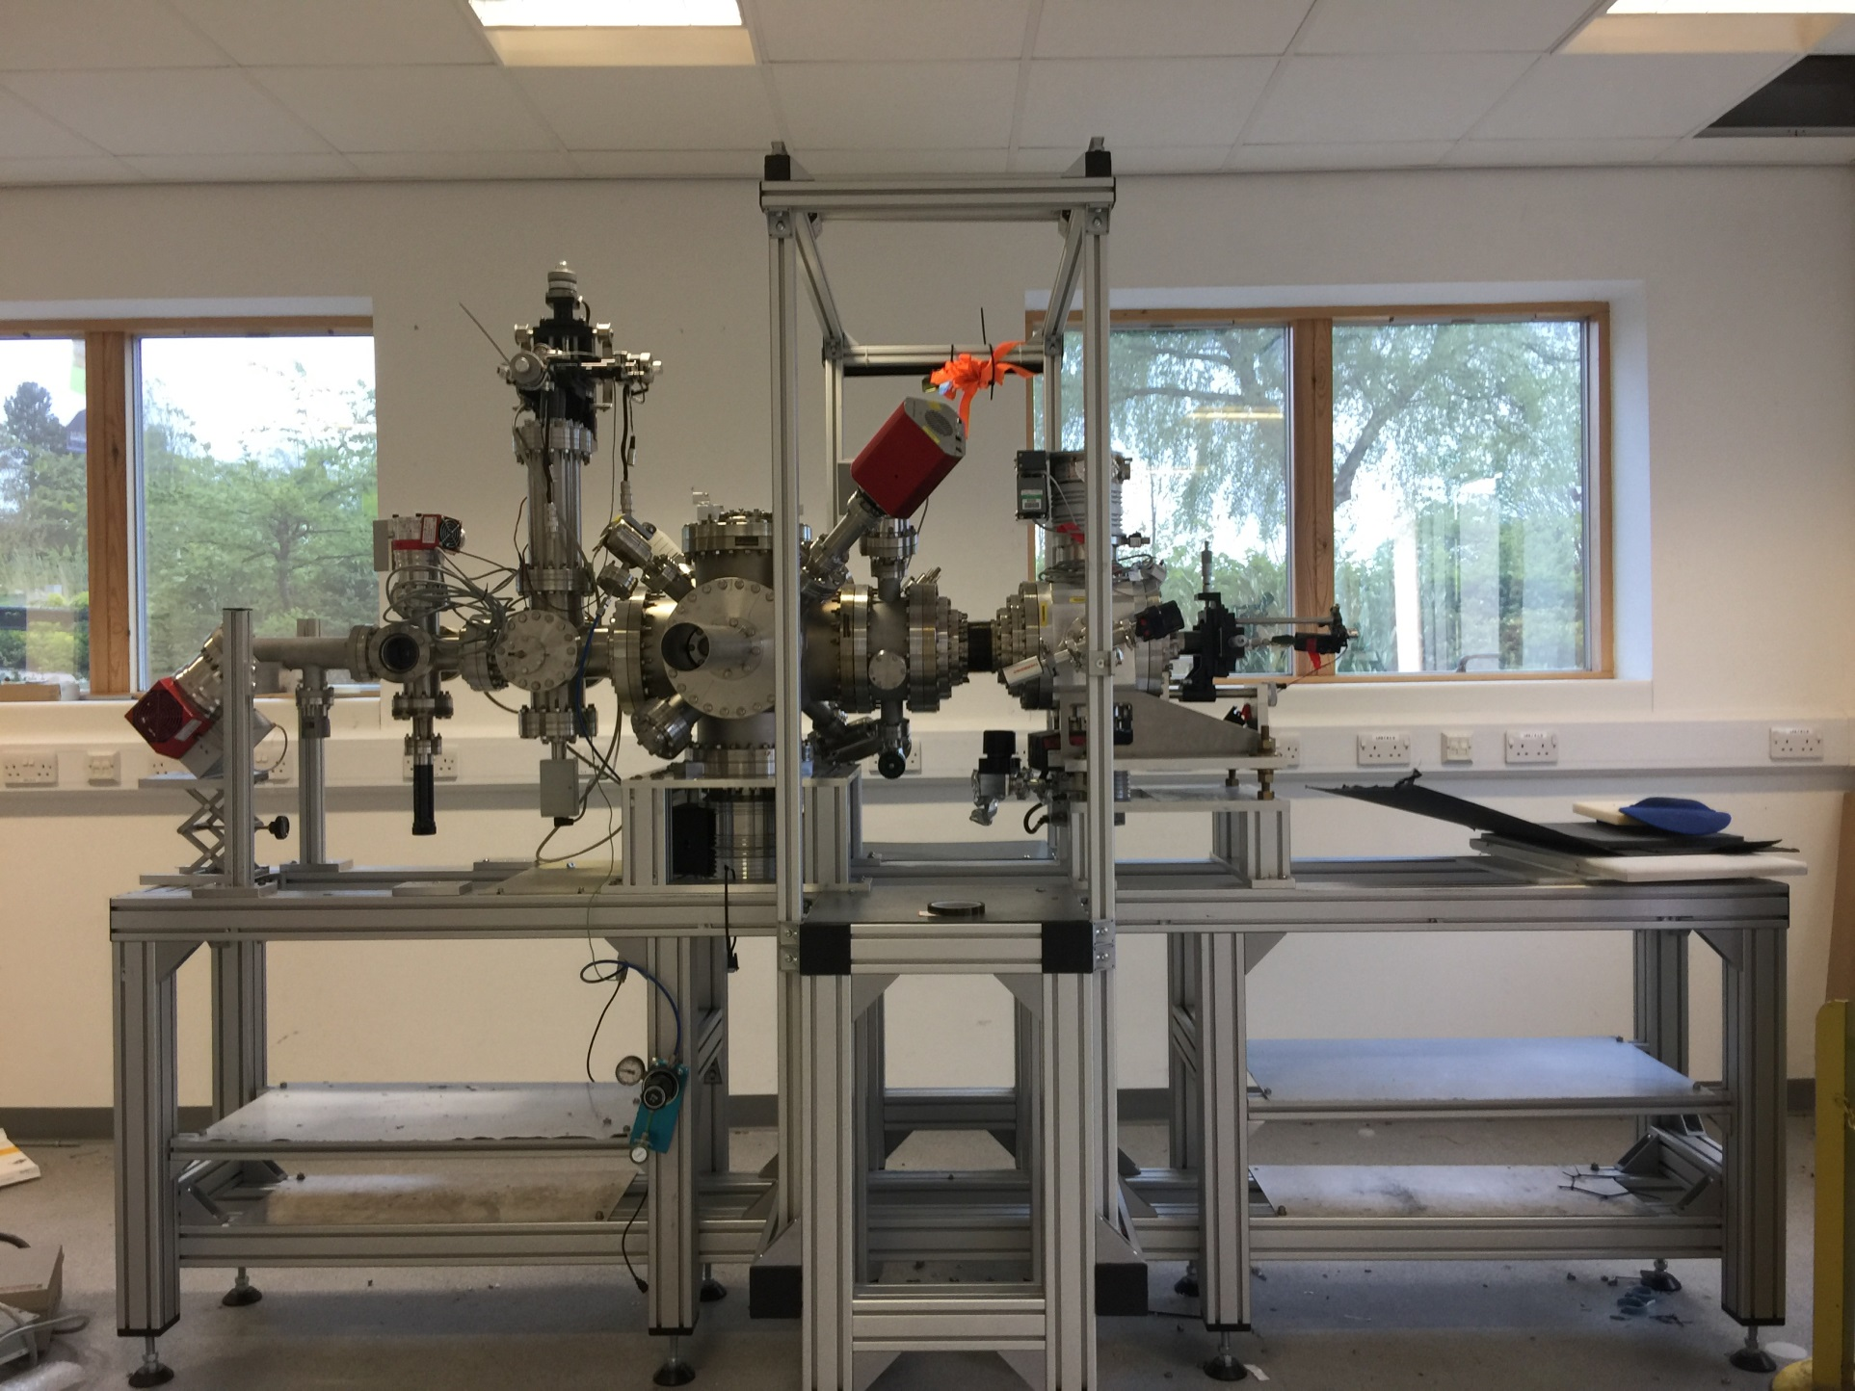
Get-jet Monitor Setup

Slide 4
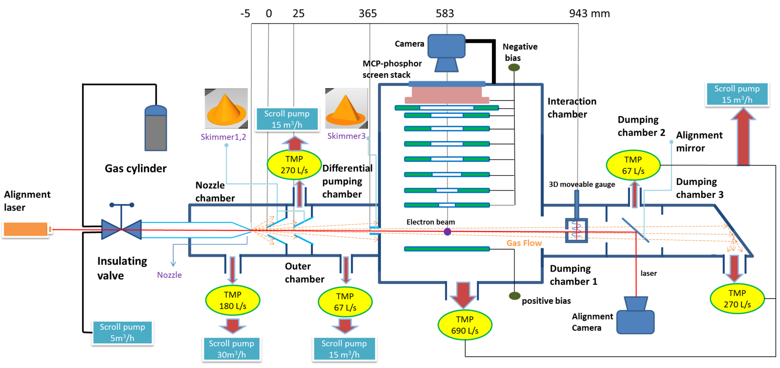
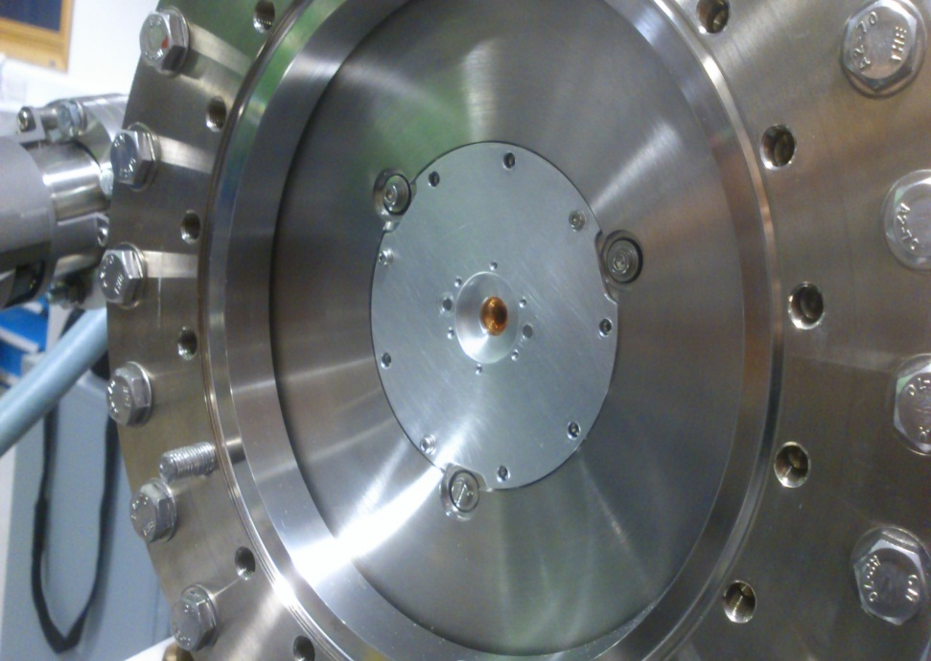
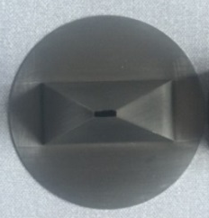
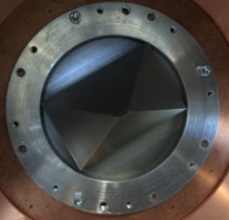
Get-jet Monitor Setup
Nozzle
First &Second skimmers
Third skimmers
Off centred nozzle hole
30 μm
180 μm & 400 μm
7.2 mm *1.8 mm
4.0 mm * 0.4 mm

Slide 5
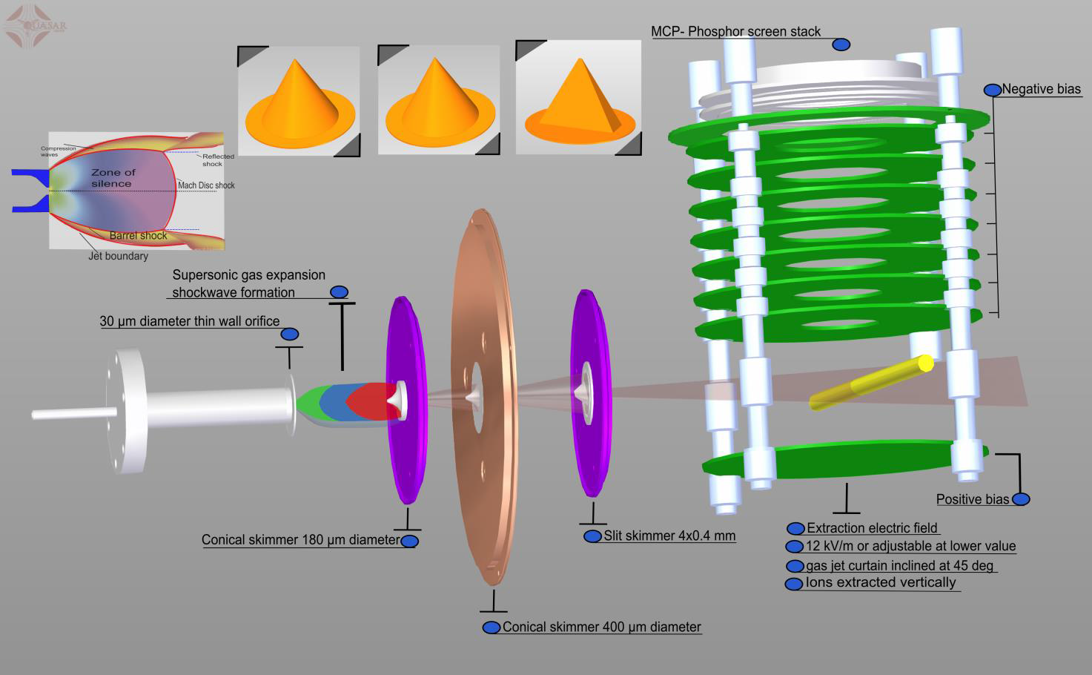
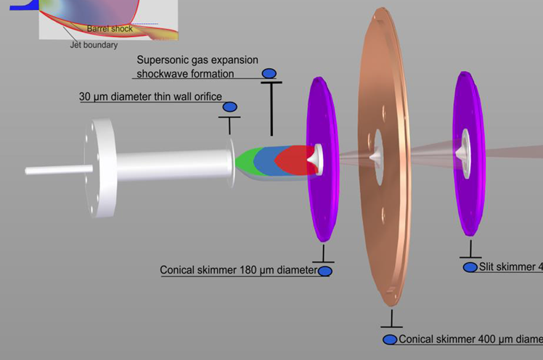
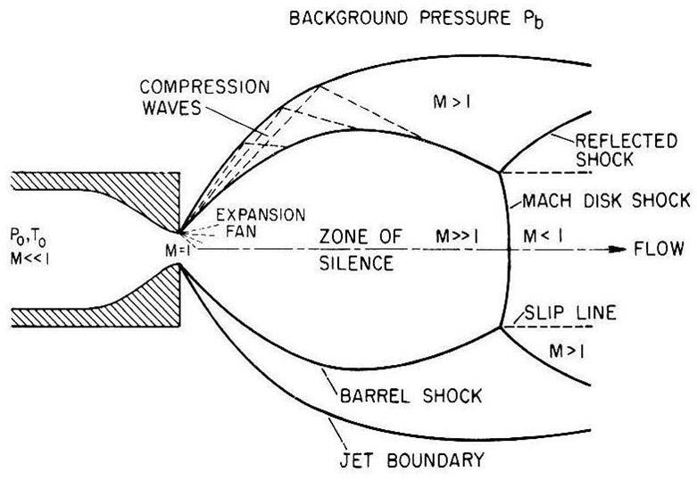
Generation of supersonic gas jet

Slide 6
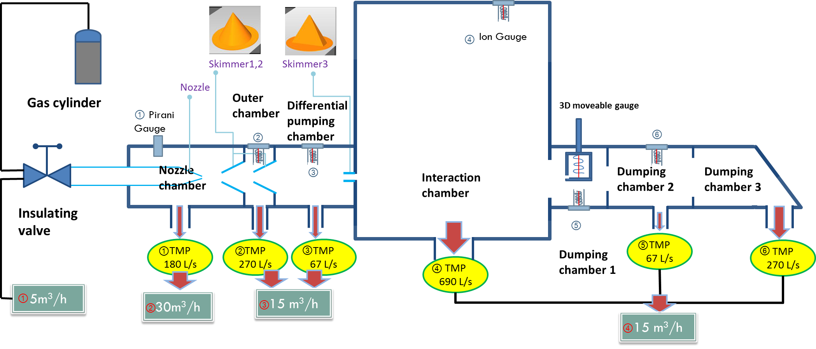
Vacuum consideration
Number | 1 | 2 | 3 | 4 | 6
Jet off (mbar) | <5.0*10⁻⁴ | 2.1*10⁻⁶ | 9.7*10⁻⁸ | 1.8*10⁻⁸ | 5.36*10⁻¹⁰
Jet on (mbar) | 1.19*10⁻³ | 6.9*10⁻⁵ | 4.8*10⁻⁶ | 2.3*10⁻⁸ | 1.21*10⁻⁹

Slide 7
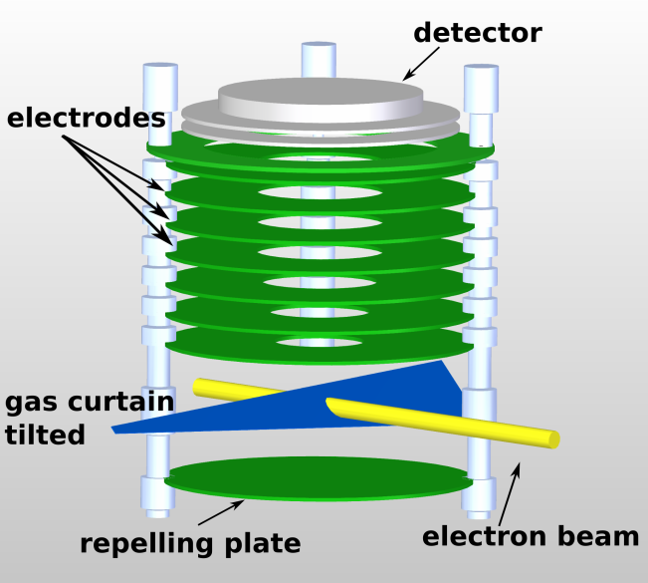
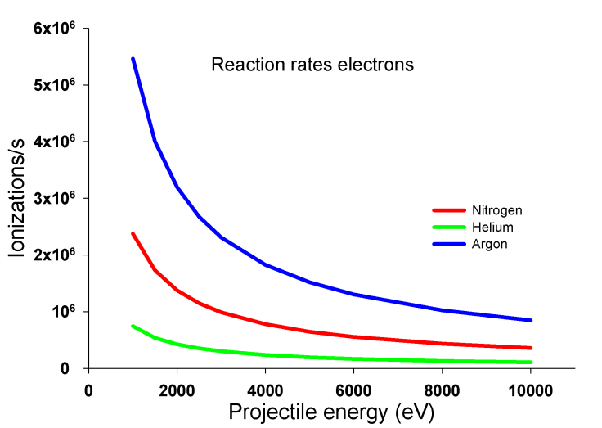
    Ionization detection
Camera
E-gun
Estimated jet property
Reaction rate
Visible light
Parameter | Value
Energy | 1 – 5 keV
Current | 0.1 – 7.0 μA
Phosphor screen
MCP
Parameter | Value
Density | 2.5*10¹⁰ particle/cm³
Thickness | 0.5 mm
Vertical size | 5 mm
Ions extraction
Ionization
Estimated integration time = 1 ms

Slide 8
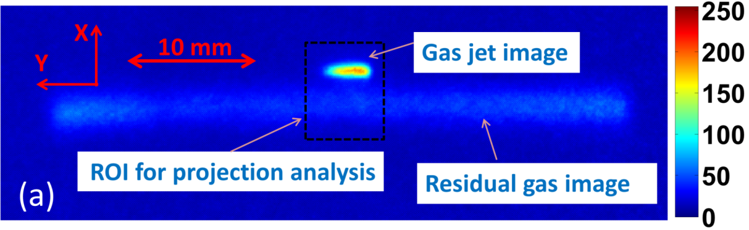
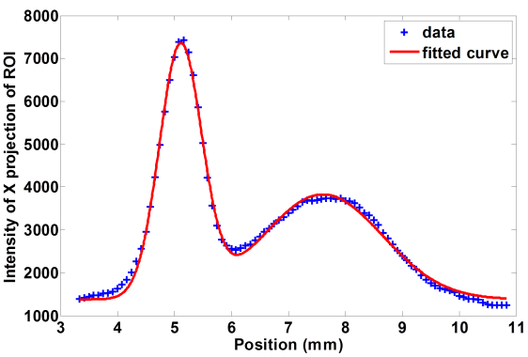
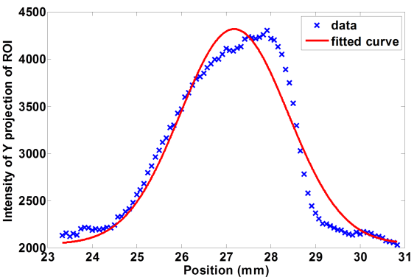
Typical measurement with Large skimmer
7.2 mm *1.8 mm
Setting | Value
Energy | 3.75 keV
Current | ~5.0 μA
External field | 7.5 kV/m
Exposure | 70 ms
size | Value
Xrms | 0.37
Yrms | 1.21
Xrms from residual | 1.05

Slide 9
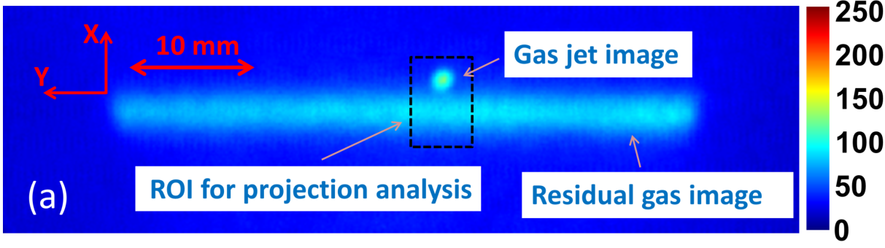
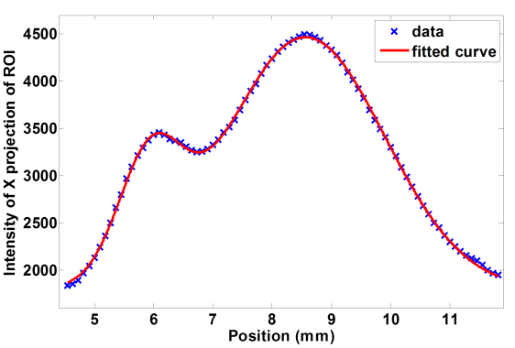
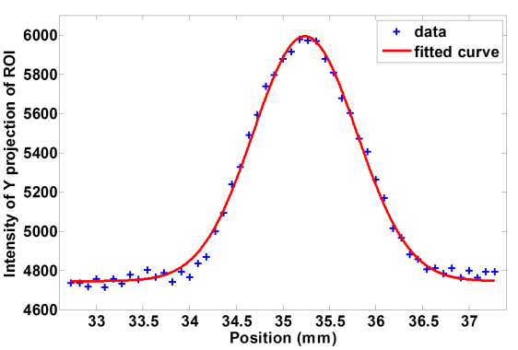
Small skimmer
4.0 mm * 0.4 mm
Setting | Value
Energy | 3.5 keV
Current | ~7.0 μA
External field | 8.0 kV/m
Exposure | 120 ms
size | Value
Xrms | 0.54
Yrms | 0.56
Xrms from residual | 1.34

Slide 10
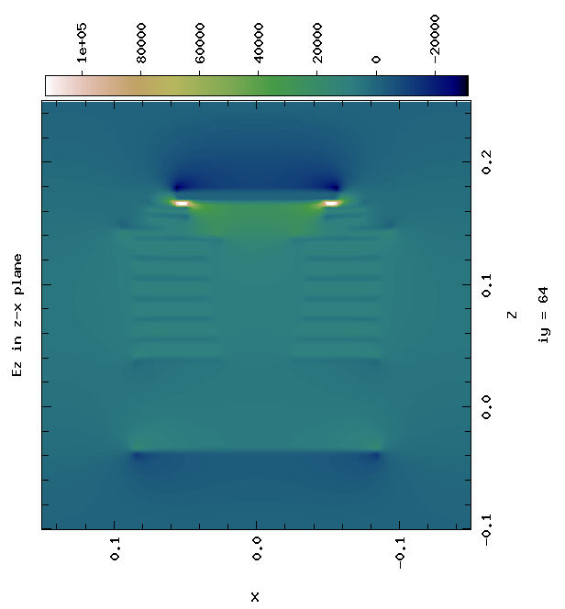
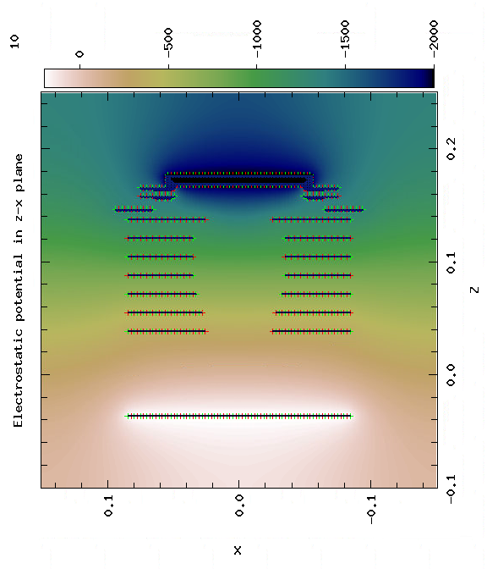
New Model in Warp
Field simulation

Slide 11
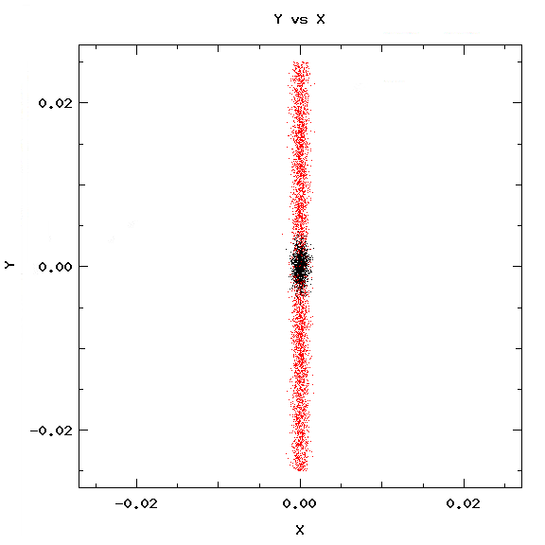
Particle initiation
Nitrogen ion (N₂⁺).
Gaussian distribution for both ions sources.
The ion beam from residual gas is cut off by a cylinder (r = 0.25mm).
Initial thermal spread is 30 K for gas jet ion beam, 300 K for residual gas ion beam
Gas jet has a initial v_{x} = 1200 m/s
Ion from residual gas
300 K
v_{x} = 1200 m/s
30 K
Ion from gas jet
The particle source is on the x-y plane, not 45 degree tilted.

Slide 12
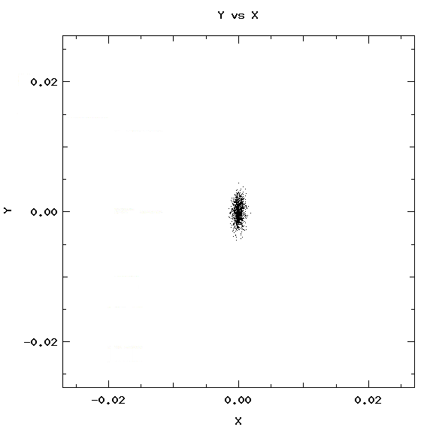

Image broadening by jet thickness
Assumption
  the original beam is round Gaussian beam (σ_{beam} = 0.5 mm).
  The broadening by jet thickness is taken by quadratic form. (σ_{ion} ²= σ_{beam}²+ σ_{jet_thick}²)
Larger 3rd skimmer
Smaller 3rd skimmer
σ_{jet_thick} = 0.91 mm
σ_{jet_thick} = 0.26 mm
Estimated by assuming the same expanding rate as the smaller 3rd skimmer
Estimation from vertical moveable gauge scan
σ_{ion} = 0.49 (x), 1.06 (y)
σ_{ion} = 0.49 (x), 0.57 (y)

Slide 13
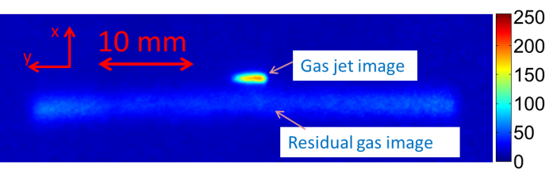
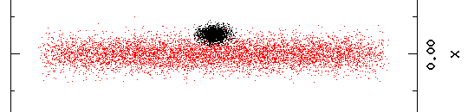
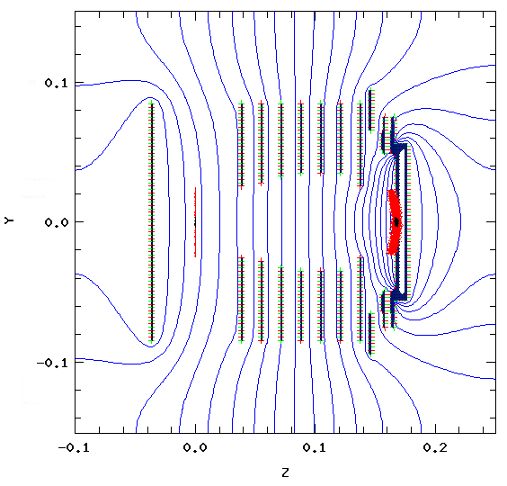
Comparison for Larger 3rd skimmer
Experiment
Simulation
Unit(mm) | Experiment | Simulation
σ_{x} | 0.37 | 0.57
σ_{y} | 1.21 | 1.02
σ_{x} (residual gas) | 1.05 | 1.24

Slide 14

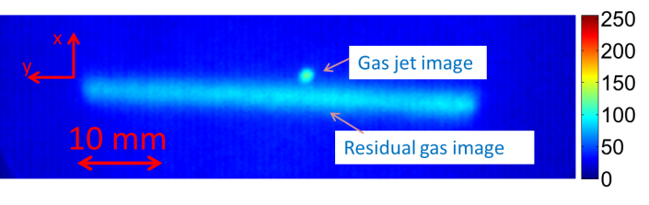

Smaller 3rd skimmer
Unit(mm) | Experiment | Simulation
σ_{x} | 0.54 | 0.57
σ_{y} | 0.56 | 0.61
σ_{x} (residual gas) | 1.34 | 1.23

Slide 15
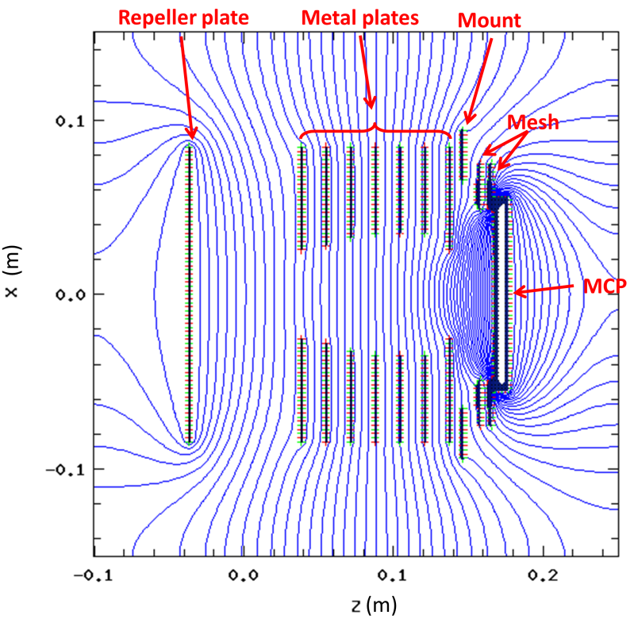
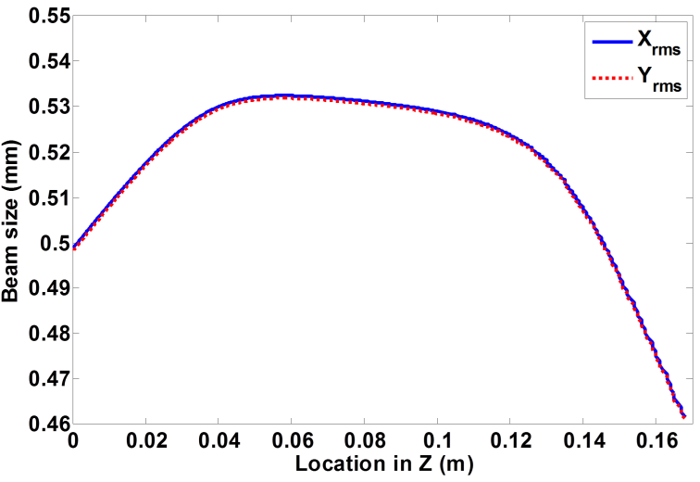
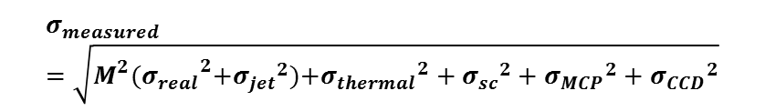
Resolution
Image broadening because of thermal drift and magnification of external fields
Error term | Value
Magnification | External field dependent
σ_{jet} | 0.28 mm
σ_{thermal} | 0.17 mm
σ_{sc} | 0
σ_{MCP} | 0.08 mm
σ_{CCD} | 0.08 mm
Summary of the image broadening terms for the experiment
$$σ_{measured}=\sqrt{M^{2}{(σ_{real}}^{2}+{σ_{jet}}^{2}){{+σ}_{thermal}}^{2}+{σ_{sc}}^{2}+{σ_{MCP}}^{2}+{σ_{CCD}}^{2}}$$

Slide 16
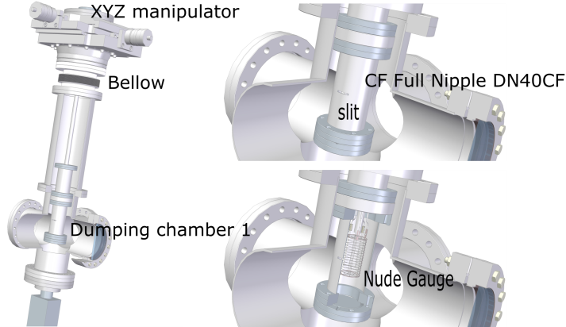
Gas dynamics
Movable gauge
Motorized and can be controlled though serial connection
Slit size 10*0.5 mm²
Gauge signal is amplified by pico-ampere meter and record by scope.

Slide 17
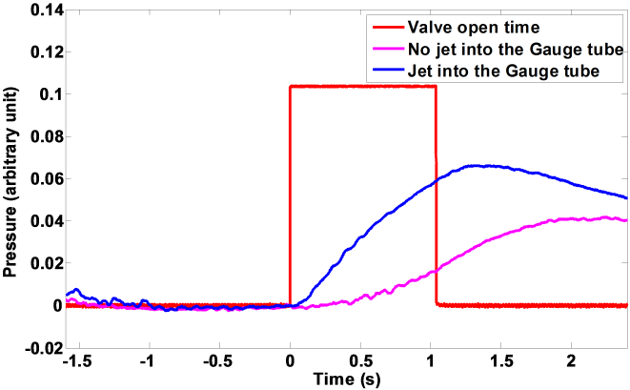
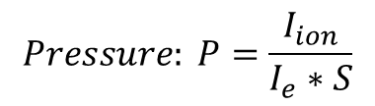
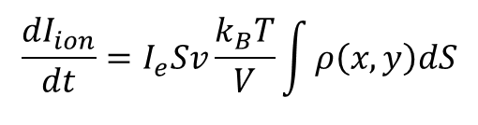
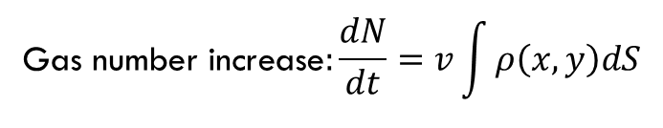
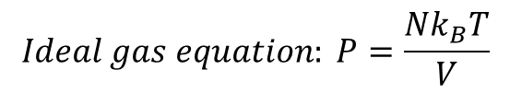
One typical measurement
Side view of the detection
Gas molecule will experience 20000 collision with tube wall per second
Third skimmer
Assumption:
Gas molecular from jet entering the slit will immediately evenly distributed inside the tube.
Residual gas in and out is in a equilibrium state.
There is no molecular from the jet escaping the tube.
D: 40 mm
Gauge detection
Front view of the detection
Ion current
Tube
$$Pressure: P=\frac{I_{ion}}{I_{e}∗S}$$
Slit size: L_{x}, L_{y}
Sensitivity
Slit
Jet
Emitting current
Jet velocity
$$\text{Gas} \text{number} \text{increase}:\frac{dN}{dt}=v\int{ρ\left(x,y\right)dS}$$
$$Ideal gas equation: P=\frac{Nk_{B}T}{V}$$
$$\frac{dI_{ion}}{dt}=I_{e}Sv\frac{k_{B}T}{V}\int{ρ\left(x,y\right)dS}$$

Slide 18
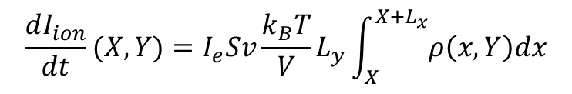
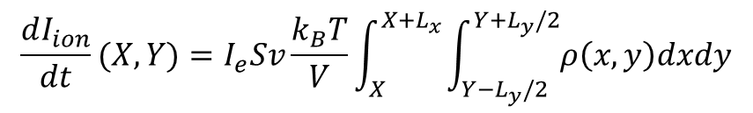
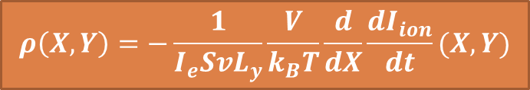

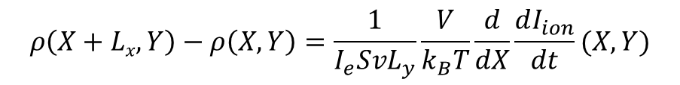
Analysis continue…
$$\frac{dI_{ion}}{dt}(X,Y)=I_{e}Sv\frac{k_{B}T}{V}\int_{X}^{X+L_{x}}{\int_{Y−L_{y}/2}^{Y+L_{y}/2}{ρ\left(x,y\right)dxdy}}$$
Since the slit size is small in vertical axis, this can be simplified as:
$$\frac{dI_{ion}}{dt}(X,Y)=I_{e}Sv\frac{k_{B}T}{V}L_{y}\int_{X}^{X+L_{x}}{ρ\left(x,Y\right)dx}$$
$$ρ\left(X+Lx,Y\right)−ρ\left(X,Y\right)=\frac{1}{I_{e}SvL_{y}}\frac{V}{k_{B}T}\frac{d}{dX}\frac{dI_{ion}}{dt}(X,Y)$$
Take derivative about X, we got:
$ρ\left(X+Lx,Y\right)$ = 0
If we scan from right to left,
$$ρ\left(X,Y\right)=−\frac{1}{I_{e}SvL_{y}}\frac{V}{k_{B}T}\frac{d}{dX}\frac{dI_{ion}}{dt}(X,Y)$$

Slide 19
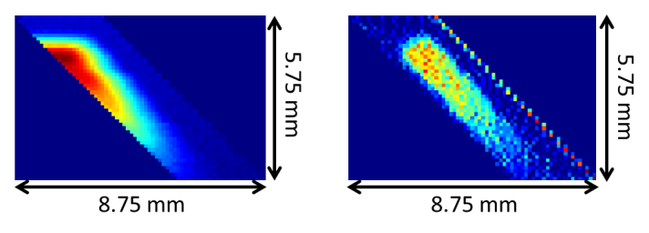

Edge scan (small skimmer)
Skimmer size | 4×0.4 mm²
Oriental angle | 45˚
I_{ion}(X,Y)
$$ρ\left(X,Y\right)$$
Resolution: 1pixel = 0.1mm
1.55 mm
5.44 mm
Differentiate the data in horizontal axis
Jet size in interaction point is estimated as : 4.54 mm * 0.83 mm
σ_{jet} = 0.29 mm

Slide 20
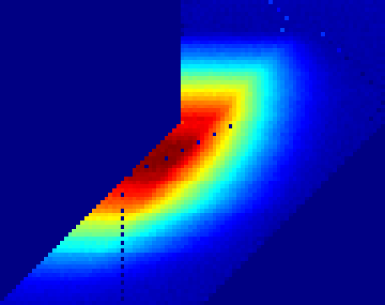
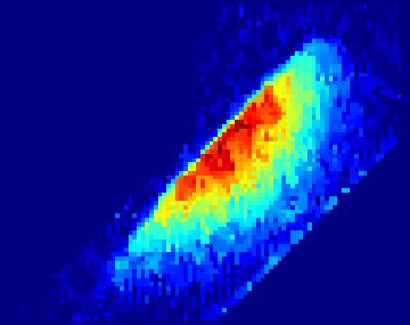

Edge scan (large skimmer)
Skimmer size | 7.2×1.8 mm²
Oriental angle | 45˚
I_{ion}(X,Y)
$$ρ\left(X,Y\right)$$
Resolution: 1pixel = 0.2mm
4.5 mm
14.7 mm
15.2 mm
15.2 mm
19.2 mm
19.2 mm
Differentiate the data in horizontal axis
Jet size in interaction point is estimated as : 10.03 mm * 2.81 mm
σ_{jet} = 0.99 mm

Slide 21
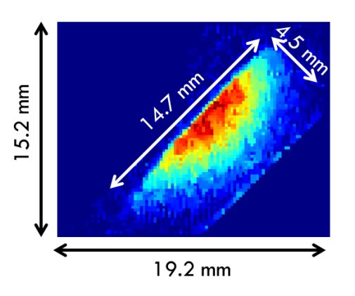
Beam enlarged by jet thickness
View point
View point
ebeam
ebeam
1.55 mm
5.44 mm
Beam size | mm
σ_{x} (Gas jet) | 0.5 ± 0.2
σ_{y} (Gas jet) | 0.5 ± 0.2
Beam size | mm
σ_{x} (Gas jet) | 0.4 ± 0.2
σ_{y} (Gas jet) | 1.2 ± 0.2
σ_{jet} = 0.29 mm
σ_{jet} = 0.99 mm

Slide 22
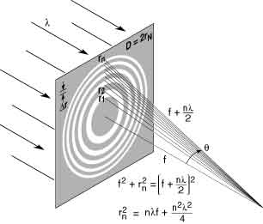
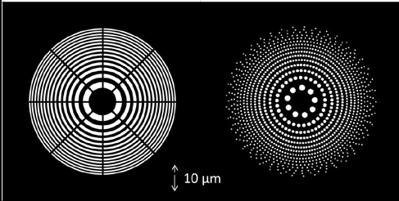
Can we go even smaller jet??
Fresnel zone plate
Largest hole size is less than 2 micron for our case
Notes:
Photon sieve,

Slide 23
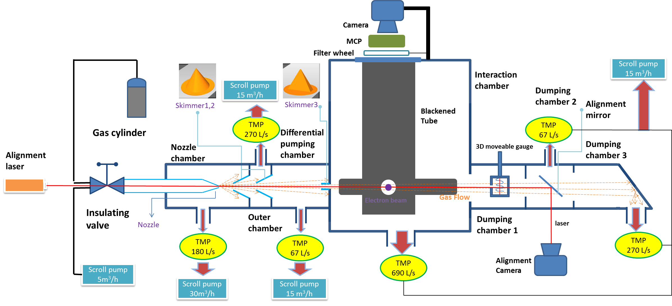
Beam induced Fluorescent (BIF) detection

Slide 24
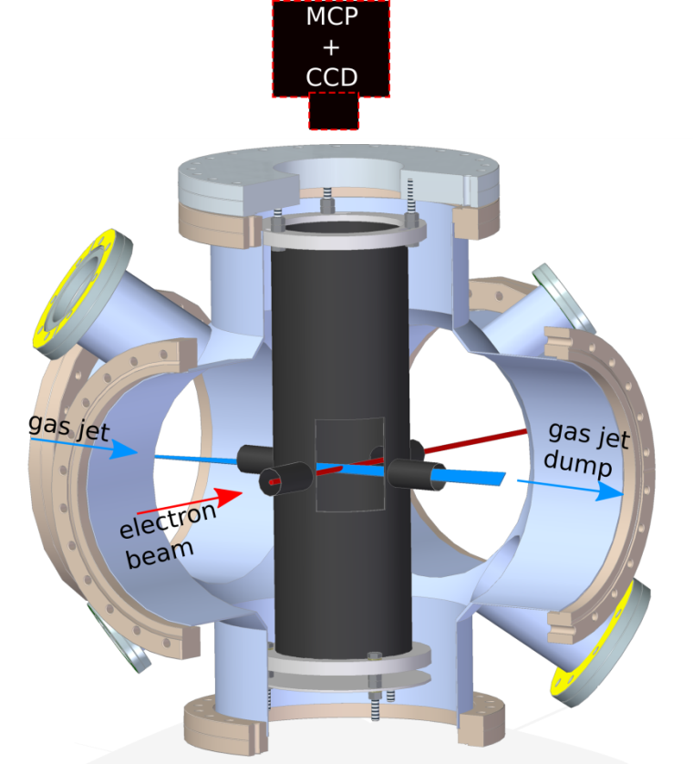
Beam induced Fluorescent (BIF) detection
Previously: Ionization detection
What is new
Ion
Setting | Value
Inlet pressure | 5 bar
Energy | 3.5 keV
Current | ~7.0 μA
Setting | Value
Exposure | 2 s
Frame | 4000
Total integration time | 8000 s

Slide 25






Some basics for integration time
Cross section:
Based on 10keV electron
Based on 7 TeV Proton
Number of Photon detected :
I (electron current) | 10A
n (gas jet density) | 2.5e10 cm⁻³
d (jet thickness) | 0.5 mm
Ω(acceptance solid angle) | 4π·10e-5 sr
η_{pc}(MCP photocathode efficiency) | 0.2
η_{MCP}(MCP detection efficiency) | 0.5
T(Transmittance of optics) | 0.65
T_{f}(Transmittance of band pass filter) | 0.3
Proton detection:
Electron detection:

Slide 26
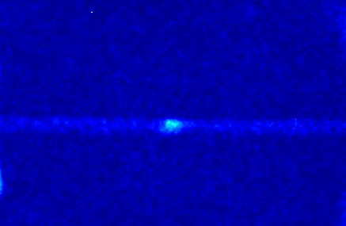
Gas jet image from fluorescent
250
200
10 mm
150
Gas jet image
100
y
ROI
50
x
Residual gas image
0
Axis | Size
Xrms | 1.96 mm
Yrms | 1.33 mm
1pixel = 0.215 mm

Slide 27
Conclusion
Demonstrated a supersonic gas jet based beam profile monitor using both IPM or BIF mode.
Future study to increase the resolution by smaller 3rd skimmer or Fresnel zone plate.
Gas jet dynamic study to help design a better and suitable jet intensity and surround pressure for more applications.

Slide 28
Discussion
Any Questions or Comments?

Slide 30
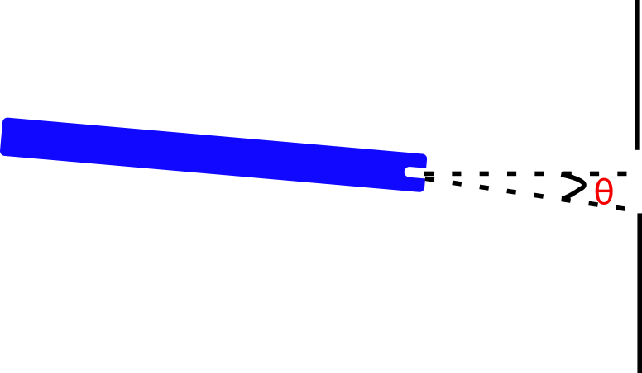
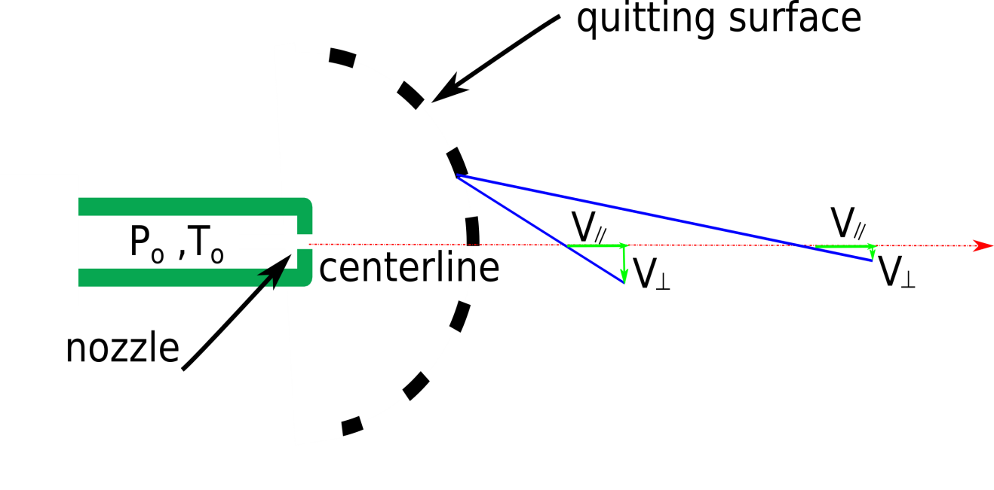


Nozzle alignment

Slide 31
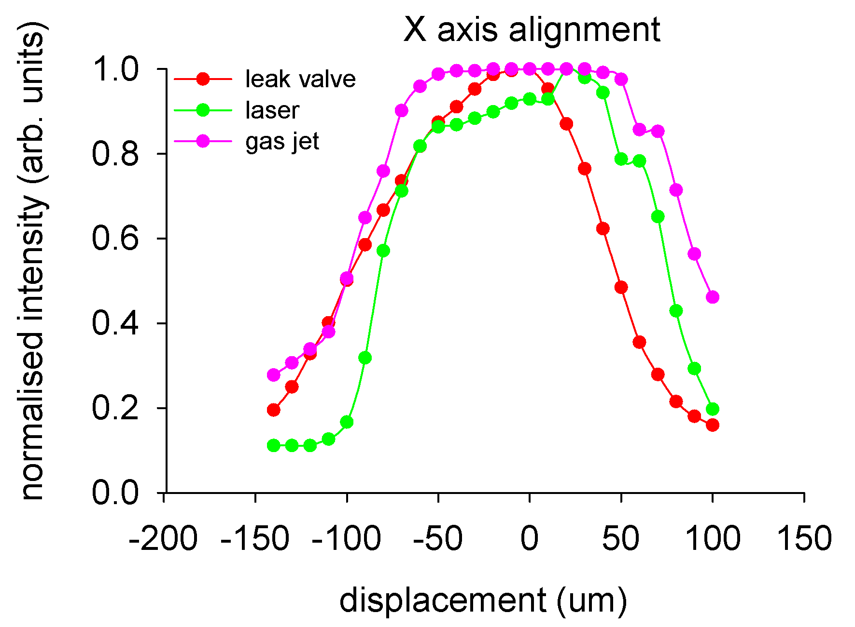

Nozzle alignment measurement (old)

Slide 32

Nozzle alignment measurement (new)

Slide 33

Before pump-down

Slide 34

After pump-down

Slide 35


Slide 36


Nozzle alignment measurement (new)

Slide 37


Nozzle alignment measurement (new)

Slide 38

Importance of small angles
Nozzle is tilted by 0.115⁰ and translated by 1.8 mm towards the downstream direction
Nozzle-slimmer distance is 1-10 mm
Skimmer diameter is 180 μm

Slide 39




Importance of small angles
3
Largest acceptable angle
from nozzle centerline to 3rd skimmer is 0.36⁰ θ₃ from nozzle centerline to 2nd skimmer is 0.46⁰ θ₂
from nozzle centerline to 1st skimmer is 1.03⁰ θ₁

Slide 40
Nozzle alignment ( if you forgot it)

Slide 41


Alignment of nozzle & skimmers
30 μm
180 μm
400 μm
Laser

Slide 42
Alignment issue and comments
Small acceptance region

Slide 43
Alignment issue and comments
Resent measurement shows Nozzle is tilted by 0.115⁰ when pumping down and
translated by 1.8 mm towards the downstream direction
Nozzle-slimmer distance is 1-10 mm
Skimmer diameter is 180 μm
This will cause a reduced density as we see from the images when we change the skimmer.

Slide 44
Possible explanation and possible solution
Jet and e-beam does not meet each other.
  Scan the e-beam vertically until they meet.
    We did try but We don’t know how much we move the electron beam. Previously we removed phosphor screen in the back to prevent the light contamination from phosphor but we lose the sense of location of the electrons.
    Fix: we will redo the scan but with the screen re-installed with a gated valve
Reaction rate is low
  Long integration time, each data point need 2 hour, and each scan will take 20 data point.
  Increase the gas jet density (which might give us a factor of 5)
    Tilted nozzle problem.
    Large 3rd skimmer has a large acceptance angle and thus have a larger density. See next slide.
    Fix: we get the skimmer installed recently.
  Lower the E-beam energy
    1keV E-beam has a larger cross section. (about a factor of 2)
  Higher current electron gun (Very expensive, about $30k)
    Increase current from ~7uA to 1 mA (give us a factor about 200)

Slide 45
Pump and Gauge
Scroll Pump
Turbo Pump
Pirani Gauge
Ion Gauge
Number | Brand | Type | Pumping Speed
1 | ScrollVAC | SC5D | 5 m³/h
2 | ScrollVAC | SD30D | 30 m³/h
3 | ScrollVAC | SD15D | 15 m³/h
4 | ScrollVAC | SD15D | 15 m³/h
Number | Brand | Type | Min pressure
1 | Laybold Thermovac | TTR91 DN16KF | 5*10⁻⁴ mbar
Number | Brand | Type | Min pressure
2 | Laybold Ionivac | Sensor IE514 | 2*10⁻¹² mbar
3 | Laybold Ionivac | Sensor IE514 | 2*10⁻¹² mbar
4 | Pfeiffer | PBR260 | 5*10⁻¹⁰ mbar
5 | Pfeiffer | PBR260 | 5*10⁻¹⁰ mbar
6 | Laybold Ionivac | Sensor IE514 | 2*10⁻¹² mbar
 | Brand | Type | Pumping Speed*
1 | Pfeiffer | TMU200MP | 180 L/s
2 | Leybold | SL300 | 270 L/s
3 | Pfeiffer | Hipace80 | 67 L/s
4 | Leybold | SL700 | 690 L/s
5 | Pfeiffer | Hipace80 | 67 L/s
6 | Leybold | SL300 | 270 L/s
*based on N₂ gas.

Slide 46

Nozzle skimmer distance study
P_{b}
For our case, P₀ = 5 bar,
P_{b} ~ 1.0e-3 mbar
=> x_{M}/d = 1500;
d =30μm=> x_{M} = 45 mm
This curve give a Mach disk about 25 mm, which is in the same order of magnitude with the calculation.

