Slide 1
Simulations and Studies of ISIS IPMs
Chris Wilcox, Rob Williamson
23/05/2017
christopher.wilcox@stfc.ac.uk, rob.williamson@stfc.ac.uk

Slide 2
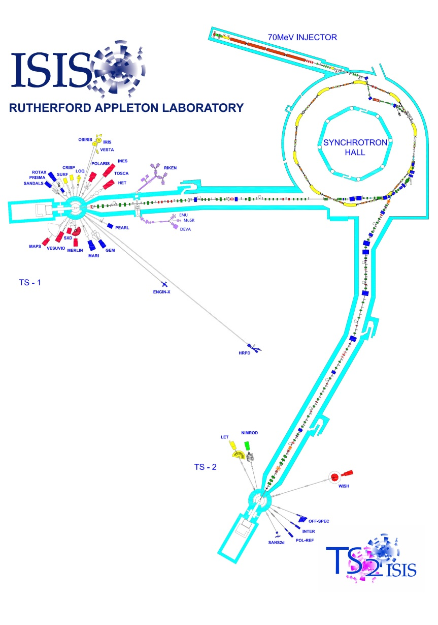
ISIS Spallation Neutron & Muon Source
Layout
70 MeV H⁻ Linac
70-800 MeV proton synchrotron
Two extracted proton beam transfer lines (EPBs) to targets
Highlighted Parameters
50 Hz repetition rate
Intensity ~2.5x10¹³ protons per pulse
Vacuum pressure ~10⁻⁷ mbar
At extraction:
2x100ns proton bunches, ~200ns separation

Slide 3
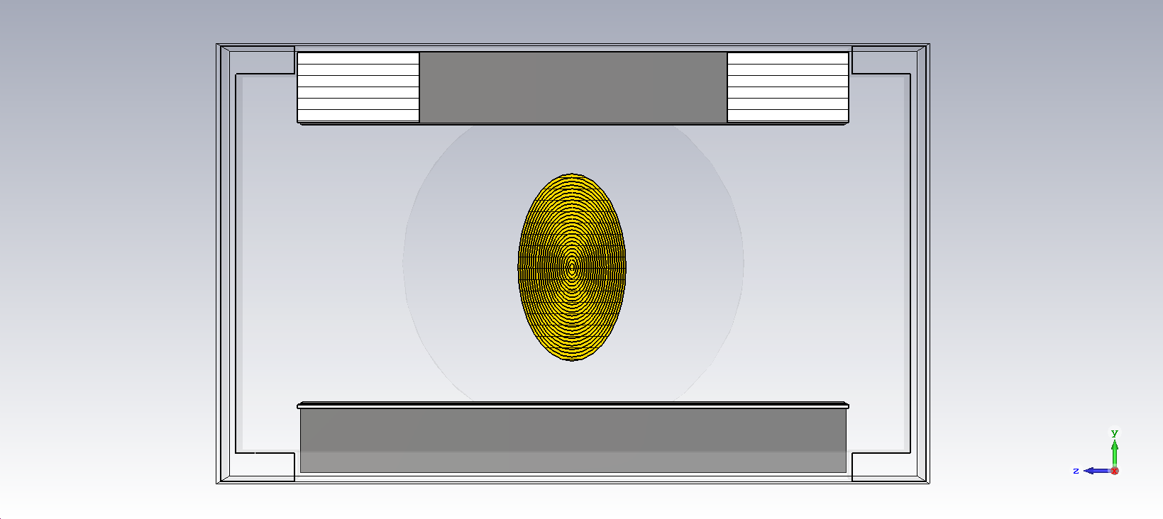
IPMs at ISIS: Transverse Plane
Profile measurements use positive residual gas ions, not electrons.
Ions are detected by an array of Channeltrons (electron multipliers).
No shaping field electrodes.
240 mm
40 Detector Array
220 mm
BEAM
+15 kV (typical)
Drift field electrode (variable up to 60 kV)
Transverse cross-section view of an ISIS IPM

Slide 4
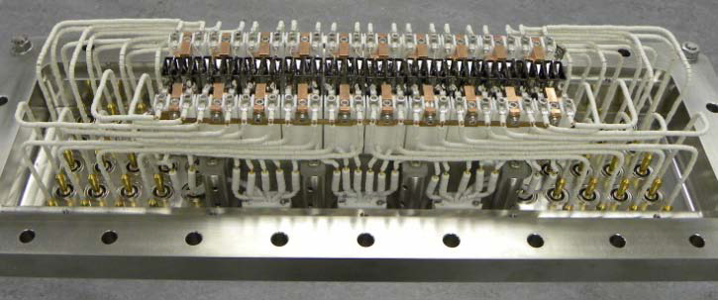
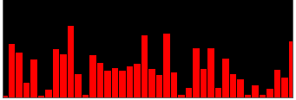
IPMs at ISIS: Multi-Channeltron Array
Electron multipliers, manufactured by Photonis.
240mm wide array of 40 Channeltrons, providing 6 mm resolution.
40 power supplies used to bias each Channeltron individually.
6 mm
A single channeltron
The 40 channeltron array used to measure beam profile
With equal biases, gain varies significantly between Channeltrons.
In-situ calibration required
Raw beam profile data (taken when all channeltrons have same bias voltage)

Slide 5
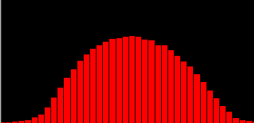
IPMs at ISIS: Longitudinal Plane
Each IPM contains two sets of detectors and two separate electrodes:
Compensating field ensures no net kick on the beam
Single, moveable Channeltron used to calibrate the Multi-Channeltron array.
Multiple Channeltron Array (MCPM)
Compensating Field Electrode
y
BEAM
BEAM
z
Single Motorised Channeltron
(SCPM)
Drift Field Electrode
Raw and Calibrated Beam Profile Data
Simplified longitudinal view of an ISIS IPM

Slide 6
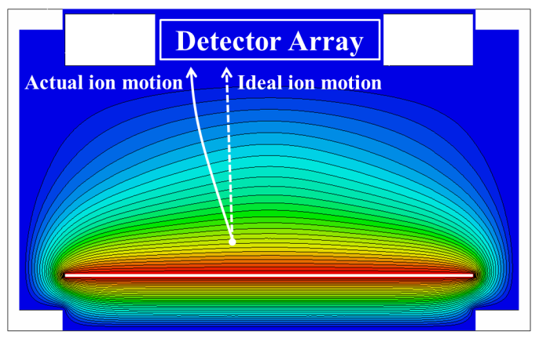
Measurement Errors
Three main sources of measurement error:
Transverse drift field shape
Beam space charge field
Longitudinal saddle point
Detector Array
Widens the measured profile.
Introduces roughly 30% error in normal operation (15 kV).
Transverse electric potential distribution created by the drift field electrode

Slide 7
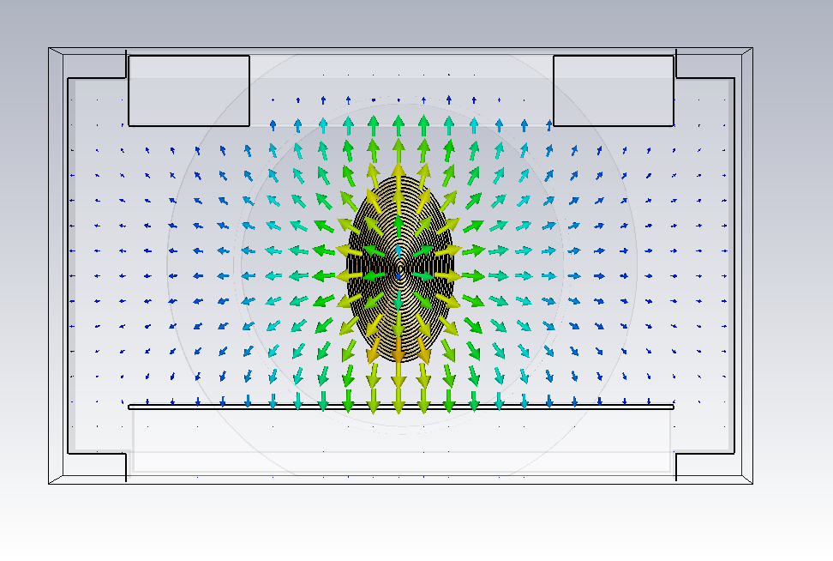
Measurement Errors
Three main sources of measurement error:
Transverse drift field shape
Beam space charge field
Longitudinal saddle point
Detector Array
Also widens the measured profile.
Effect varies with beam properties and drift field strength.
Time-varying: only present while each proton bunch is passing through the IPM.
Transverse space charge field pattern created by the beam

Slide 8
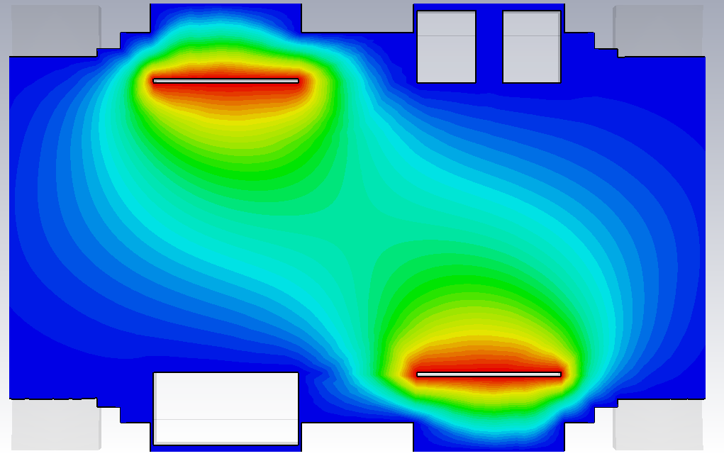
Measurement Errors
Three main sources of measurement error:
Transverse drift field shape
Beam space charge field
Longitudinal saddle point
MCPM Detectors
Caused by the compensating field interacting with the drift field.
Extra ions reach the detectors, following complex trajectories.
The monitor is not sampling a purely 2D transverse slice of the beam.
Saddle point
SCPM Detector
Longitudinal electric potential distribution created by the two drift field electrodes

Slide 9
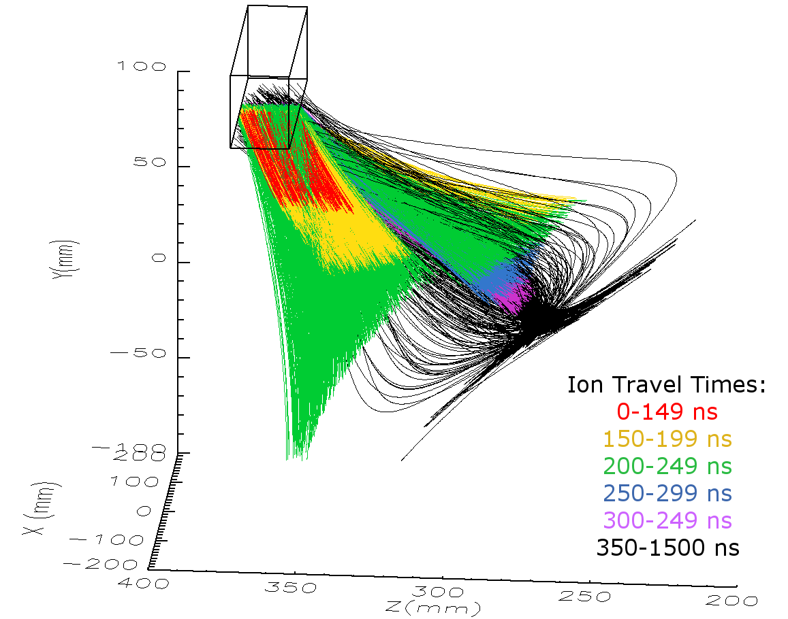
Measurement Errors
Three main sources of measurement error:
Transverse drift field shape
Beam space charge field
Longitudinal saddle point
MCPM Detectors
Caused by the compensating field interacting with the drift field.
Extra ions reach the detectors, following complex trajectories.
The monitor is not sampling a purely 2D transverse slice of the beam.
Combined effect of all error sources means true beam width can be only ~35-60% of the measured beam width!
Simulation output showing sample 3D trajectories of ions that reach the detectors in the longitudinal plane.

Slide 10
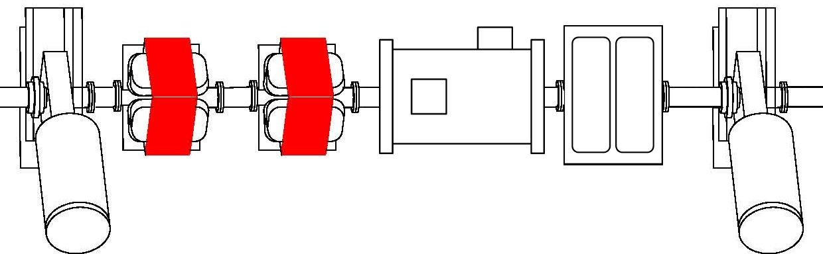
Benchmark Measurements:
EPB1 Monitor
Software correction is used to compensate for drift field and space charge errors.
Works reliably for low intensity, centred beams.
For further study, we moved an IPM to a beam transfer line (EPB1), to take test measurements where the beam is well defined.
Benchmarking IPM
SEM Grid Profile Monitor
Dual-Plane Position Monitor
SEM Grid Profile Monitor
Test IPM location in EPB1. Nearby monitors provide accurate beam parameters for comparison with IPM measurements.

Slide 11
IPM Simulation Approach
A thorough IPM simulation model is in development, and is benchmarked against measurements from the EPB monitor.
Aim to verify the profile correction scheme and expand it to varied beam properties.
3D Electric Field Calculation (CST EM Studio)
Calculation of drift fields and beam field
Two fields calculated – with and without beam
Live Beam Measurements (ISIS)
When benchmarking
Detector array of 40 channeltrons
Compensating field hv plate
Beam
Single channeltron detector
Drift field hv plate
Simplified monitor geometry used in the CST model

Slide 12
IPM Simulation Approach
A thorough IPM simulation model is in development, and is benchmarked against measurements from the EPB monitor.
Aim to verify the profile correction scheme and expand it to varied beam properties.
3D Electric Field Calculation (CST EM Studio)
Calculation of drift fields and beam field
Two fields calculated – with and without beam
Live Beam Measurements (ISIS)
When benchmarking
Particle Tracking Simulation (C++)
Creates and tracks ion distribution through E-field
Time-varying E-field approximation
Acceleration calculated from Lorentz force on each ion, B≡0.
Tracking using 2nd Order Euler Method, 1 ns time step
*see appendix for detail
Post Processing (IDL)
Calculates profile measurement
Applies weightings to account for detector behaviour
Detector Characterisation Experiments
Vacuum tank & ion gun
Data Analysis & Visualisation (IDL)

Slide 13
Simulated Profiles Vs. Measurement
Simulation output profiles closely match measurements from the test IPM.
…when running at low beam intensities.
Comparisons between real IPM beam profile measurements (black) and simulation results (blue) for the low beam intensity measurements (~5x10¹² ppp)

Slide 14
Simulated Profiles Vs. Measurement
Simulation output profiles closely match measurements from the test IPM.
…when running at low beam intensities.
At high intensities, simulation does not reproduce high enough amounts of profile widening.
Further studies to understand why:
Channeltron detector studies in lab test setup.
Machine measurements with a fast amplifier, to study measured profile time structure.
A typical high intensity beam profile (2.5x10¹³ ppp) comparison between simulation and measurement.

Slide 15
Channeltron Tests: Motivation
Simulation output showed ions entering the Channeltrons at different angles of incidence.
Detection efficiency vs. incident angle data was not available.
Sample trajectories of ions that reach the detectors in the longitudinal plane.

Slide 16
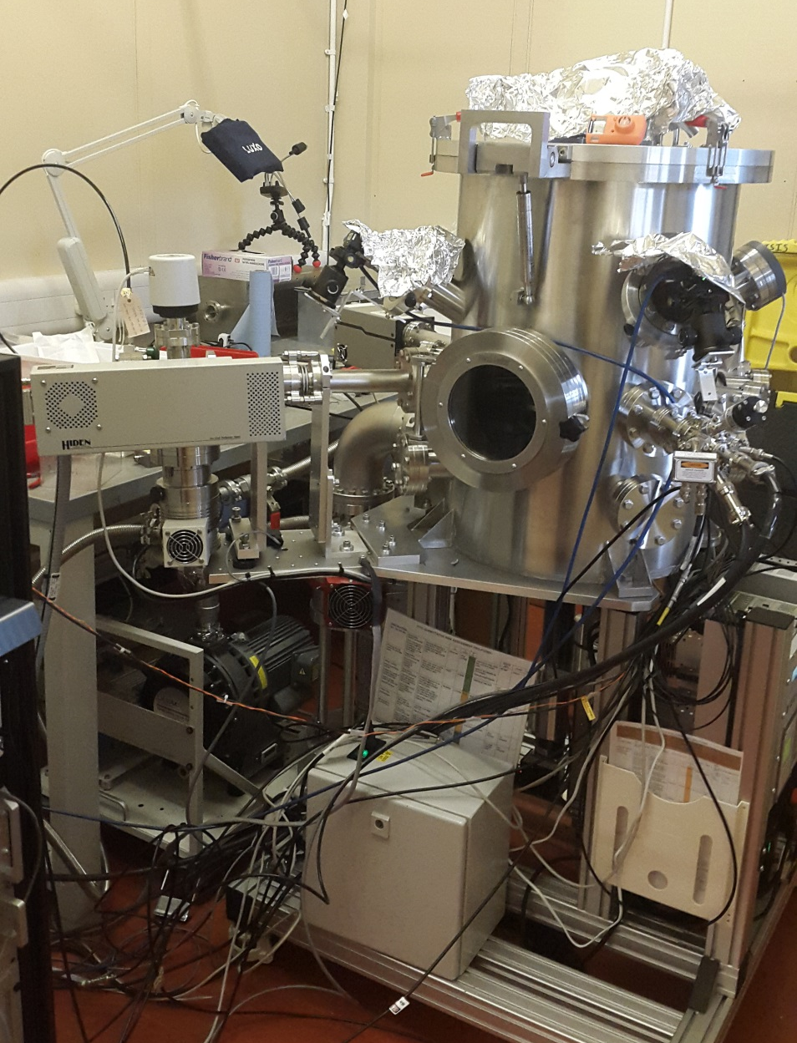
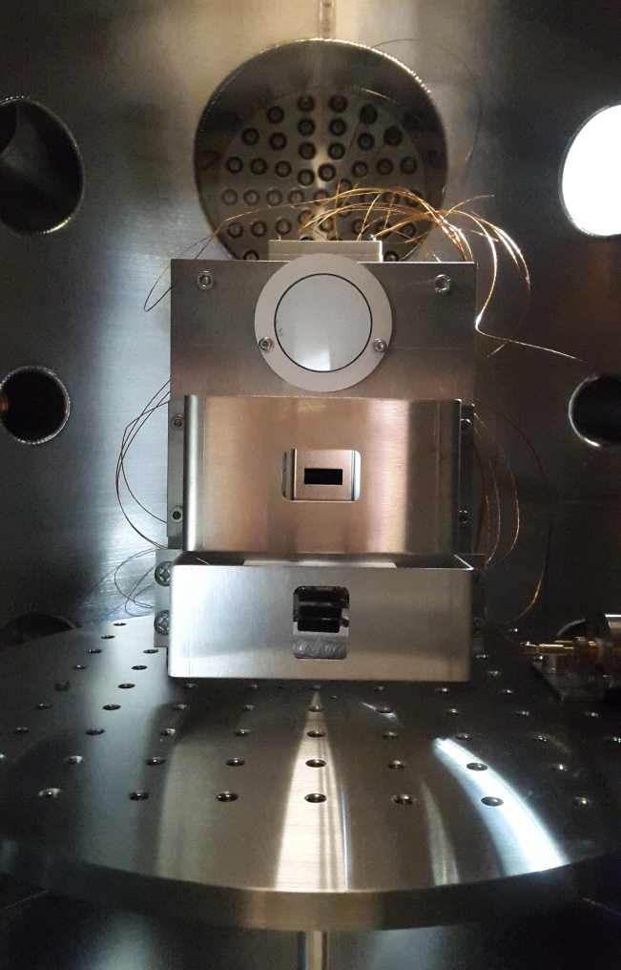
Vacuum Tank Tests: Setup
Ion gun
Phosphor screen
Channeltrons
Electron gun
Faraday cup
Motorised mounting plate
Channeltron test housing inside the vacuum tank. Test housing geometry matches the IPM Channeltron housing.

Slide 17
Channeltron Tests: Motivation
“Normal” ions
~5-20º
Simulation output showed ions entering the Channeltrons at different angles of incidence.
Detection efficiency vs. incident angle data was not available.
Neither was accurate data for variations in ion energy or mass.
Photonis advised us to test the Channeltrons ourselves, and not rely on “approximate” data available in their brochure.
No. ions Detected
Saddle point ions ~30-50º
Longitudinal Angle of Incidence
Histogram showing the angles of incidence at which the simulated ions enter with the detectors.

Slide 18
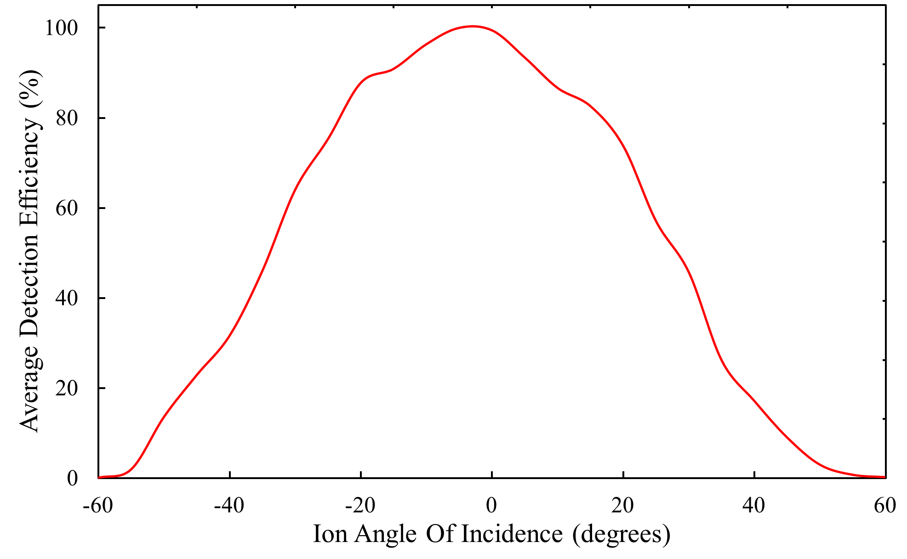
Vacuum Tank Tests: Results
Channeltrons bombarded at various angles with a 4 keV Helium ion beam.
Higher angle saddle point ions detected at ~50% of peak efficiency.
Weightings calculated from these results and applied in simulation.
Measured detection efficiencies of multiple array Channeltrons vs. ion angle of incidence

Slide 19
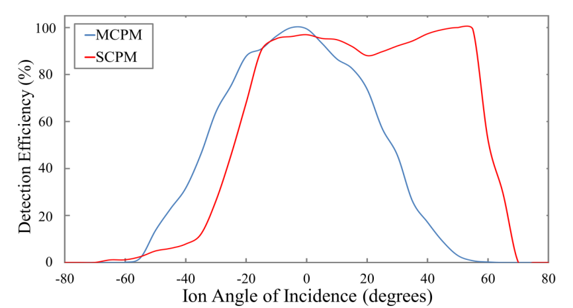
Vacuum Tank Tests: Results
Channeltrons bombarded at various angles with a 4 keV Helium ion beam.
Higher angle saddle point ions detected at ~50% of peak efficiency.
Weightings calculated from these results and applied in simulation.
Further tests:
Different models of Channeltron produce different results (SCPM vs. MCPM).
Channeltron behaviour more stable with higher bias voltages.
Detection efficiency decreases as ion mass increases.
Advice: make sure you understand your detectors when simulating an IPM!
Comparison of detection efficiencies of the two different models of detector used in ISIS IPMs

Slide 20
Fast Amplifier Measurements
Recent studies taking fast amplifier measurements from our benchmarking IPM.
Profile time structure provides a different comparison between measurement and simulation.
Compensating electrode switched off to remove saddle point and simplify behaviour.
Measurement with Standard 2.5 Ms/s Amplifier
Measurement with Fast 60Ms/s Amplifier
Current Measured on each Channeltron
Current Measured on each Channeltron
0
Time (ns)
5000
0
Time (ns)
4000
Comparison of profile time structure when measured with standard amplifier (left) and with a fast amplifier (right)

Slide 21
Fast Amplifier Measurements:
Multiple Time Peaks
Fast amplifier measurements detect five separate peaks of signal, at different times.
Saturation of the 3rd or 4th peak (depending on bias settings) probably the reason for mismatch between simulated and measured profiles at higher beam intensities.
Channeltron Current
Time
Typical difference between simulated and measured profiles at high beam intensities
Typical time structure from the benchmark IPM containing 5 peaks, seen when a fast amplifier is used for measurement

Slide 22
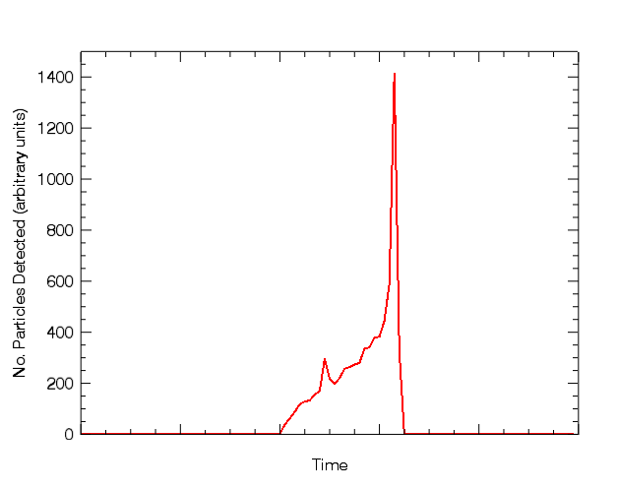
Fast Amplifier Measurements:
Multiple Time Peaks
Time structure in simulation matched the shape and timings of the first two peaks.
Initial thought: 1st and 2nd peak contain true profile data. Later peaks are noise from the downstream neutron target.
However, test measurement where one pulse deliberately missed the target still showed the same 5 peaks.
All 5 peaks must be related to the beam.
~150 ns
Channeltron Current
Time
Simulated time structure of a single bunch. In this result the residual gas was modelled as 100% hydrogen.
Typical time structure from the benchmark IPM containing 5 peaks, seen when a fast amplifier is used for measurement

Slide 23
Fast Amplifier Measurements:
Multiple Time Peaks
Individually, each of the 5 peaks produce similar profile data.
Additionally, the peak times increase if drift field strength is decreased.
All 5 peaks likely to be caused by residual gas ions created by the beam.
Each peak could contain valid profile information, can we prove what causes them?
If they each contain true profiles, we can set the IPM up to use specific peaks only for measurement.
With a lower Channeltron bias, the strong peaks do not saturate but the 1st and 2nd peaks are too weak to take a measurement from.

Slide 24
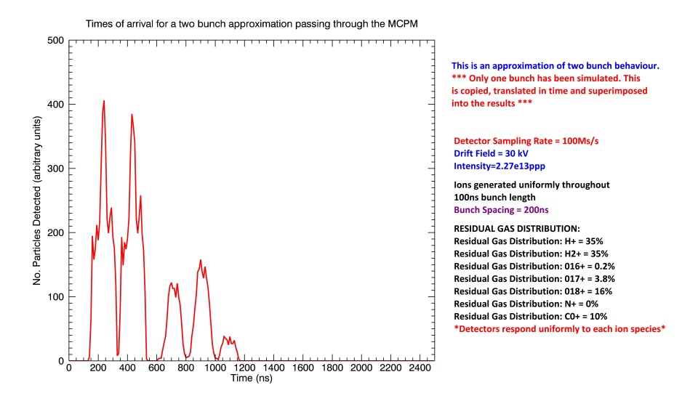
Simulation:
Multiple Residual Ion Species
We now suspect the 5 peaks are caused by different residual gas ion species.
Old mass spectrometer measurement of beam vacuum suggests a strong O and CO (or N₂) presence.
Adding these different ions to the simulation generates the 5-peak time structure (approximately), but the different peak heights vary significantly.
This is a work in progress, accurate residual gas distribution not yet known.
Probabilities of ionisation of each species also unknown.
Detection efficiency variation of Channeltrons for different ion masses also needs to be measured.
Comparison of measured time structure (left) and simulated time structure (right). The peak heights are not yet modelled accurately in the simulation.

Slide 25
Future Work
Initial tests in vacuum tank showed that an argon ion beam was detected at ~60% efficiency of a helium ion beam.
Need more complete experiment results.
What is the probability of ionisation for each residual gas species?
Further comprehensive Channeltron characterisation experiments planned.
Detection efficiency against varying Channeltron bias and ion energy
Future monitor design can take into account what we are learning.

Slide 26
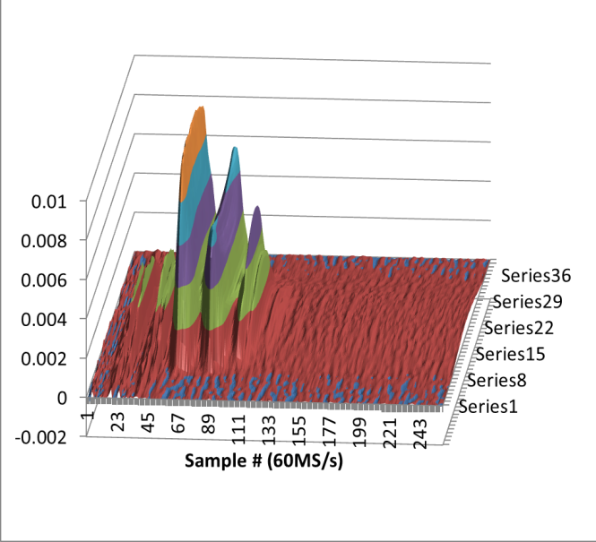
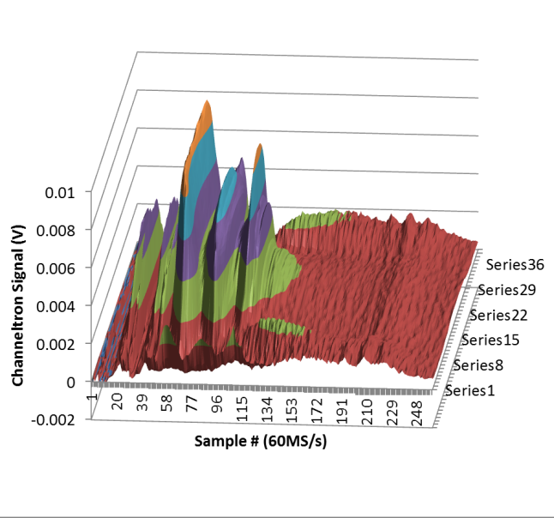
Future Work
Can we operate the IPM with the compensating field off permanently?
With the compensating field on, the time structure has additional features:
Recent fast amplifier measurements on a synchrotron ring IPM give the same time peak structure, but only at extraction.
Why? Further studies required.
Compensating Field Off
Compensating Field On
Fast amplifier measurements of beam profile, showing extra detail when the compensating field is switched on.

Slide 27
Thank you for your time
Compensating Field Off
Compensating Field On
Questions?

Slide 28
Additional Slides

Slide 29
C++ Particle Tracker:
Equations Used to Calculate Ion Motion
Lorentz force acting on each ion
$$F_{LORENTZ}=q\left(\vec{E}+\vec{v} × \vec{B}\right)$$
$$a_{x}=\frac{qE_{x}}{m}$$
$$F_{x}=qE_{x}=ma_{x}$$
$Inside the monitor: \vec{B}$= 0
Ion velocity change over 1 time step
v = final velocity, u = initial velocity
$$v_{x}=u_{x}+\frac{{qE}_{x}t}{m}$$
$$v_{x}=u_{x}+a_{x}t$$
Ion position change over 1 time step
x = final position, x₀ = initial position
$$x=x_{0}+\frac{(u_{x}+v_{x}\text{)}\text{t}}{2}$$
$$x=x_{0}+u_{x}t+\frac{{qE}_{x}t^{2}}{2m}$$
Final time step length when ions reach the detector
The final y-position is known (the detector position), so the ion is tracked over a smaller final time step, t_{f} . This give a precise ion position and velocity as it reaches the detector.
$$y={y_{0}+u}_{y}t_{f}+\frac{{qE}_{y}}{2m}t_{f}^{2}$$
Solve as a quadratic of t_{f} .
Use the +ve solution as the final time step length. Recalculate final velocity and position in each plane using the new time step.

Slide 30
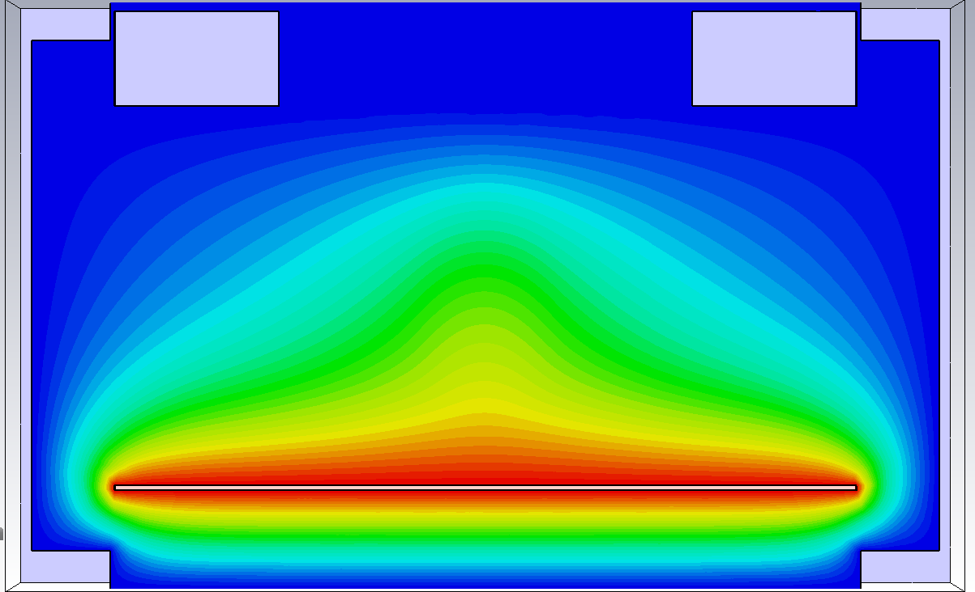
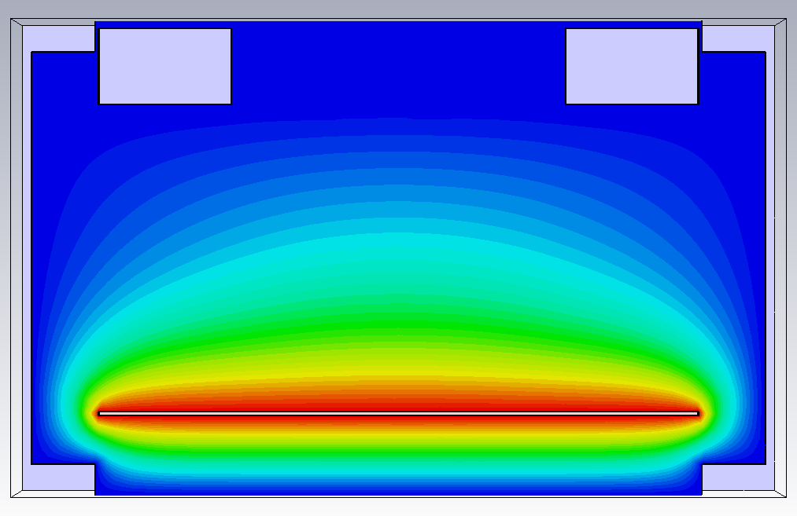
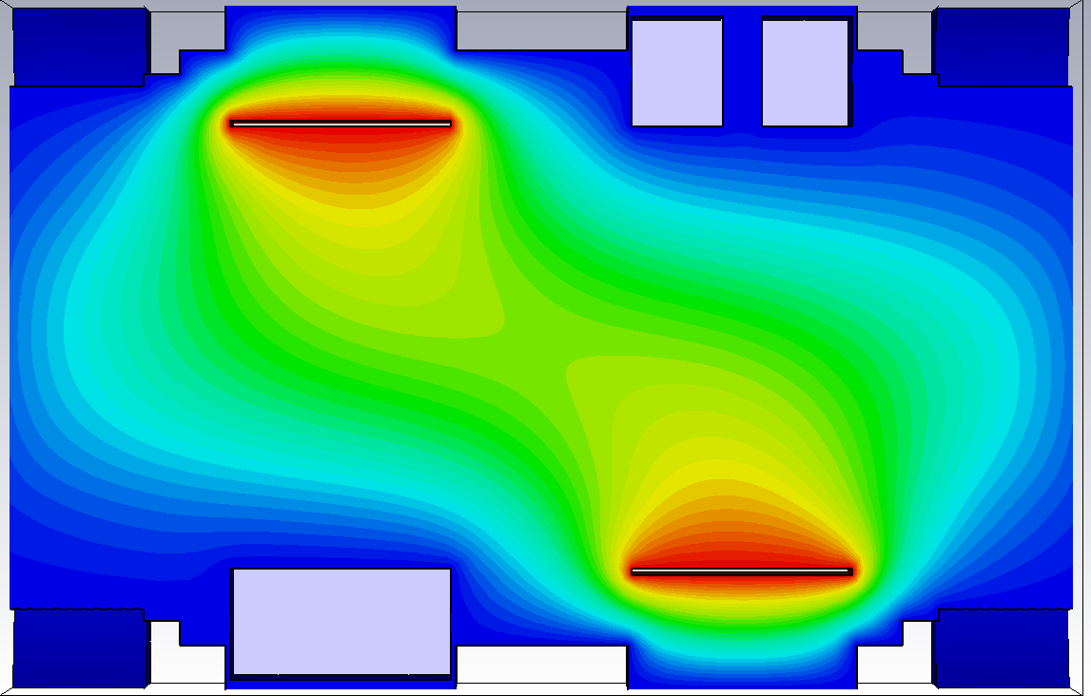
Effect of beam on IPM E-Fields
Transverse potential distribution with the beam present in the monitor
Transverse potential distribution once the beam has left the monitor
Longitudinal potential distribution with the beam present in the monitor
Longitudinal potential distribution once the beam has left the monitor

Slide 31
Experimental Fast Amplifier Data
Data showing a sweep across different channeltron bias voltages, causing changes to time structure peak heights.

Slide 32
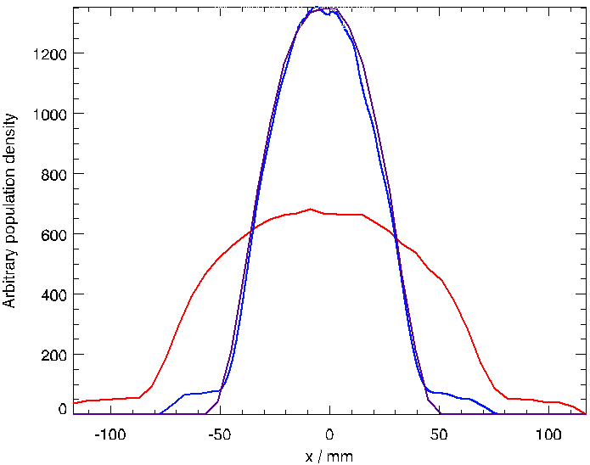
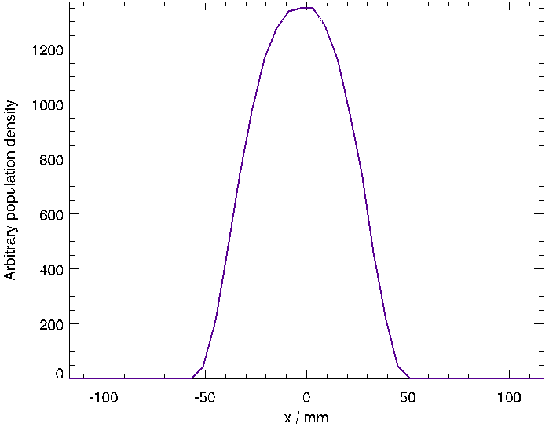
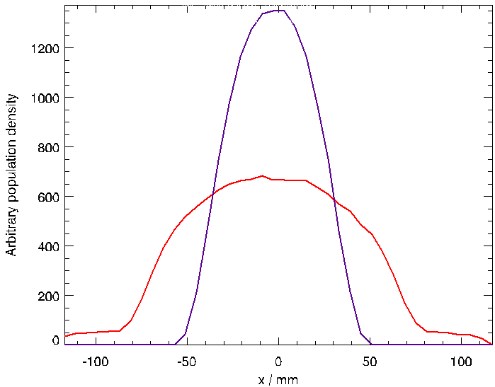
Profile Correction Scheme
Drift field correction
Space charge correction
Beam intensity
$$w_{m,p}=k_{d}w_{t,p}+\frac{k_{sc}pγI}{V}$$
R. Williamson
EPAC ‘08
Relativistic gamma
Drift field voltage
Ionisation monitor measured width and true beam width at percentage p
Derived from combination of simulation and measurements
Correct synchrotron profiles to within 6 mm
Profile tails
Simulated data
Ideal profile (purple)
Simulated profile (red)
Corrected profile (blue)

Slide 33
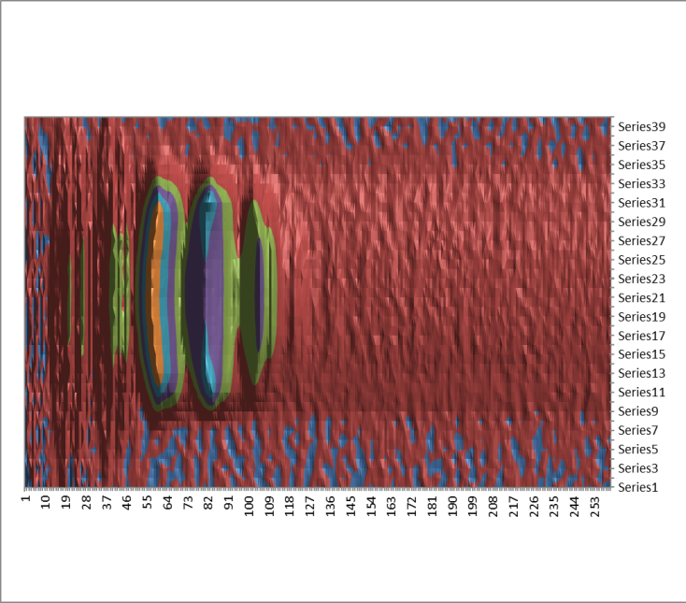
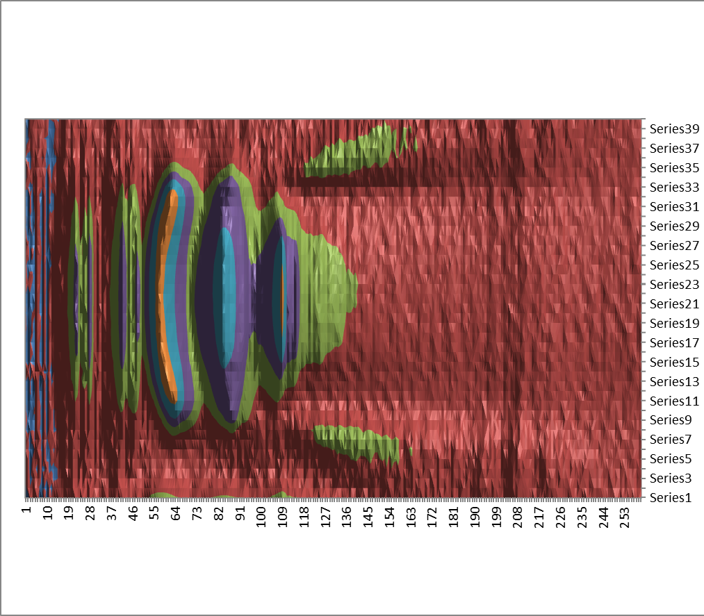
Time Structure: Compensating Field Off vs. Compensating Field On
Comp. Field On
Comp. Field On

Slide 34
Comparison With Other Codes
3D
From “Ionization Profile Monitor Simulations – Status and Future Plans” M. Sapinski et al., IBIC2016

Slide 35
Ion Gun Specs
HIDEN Analytical
IG20 Oxygen/Gas Gun

Slide 36
Profile Simulator Workflow: Setup
Inputs
(Data from ISIS machine run)
Beam profile information from 2D SEM grid
Horizontal & vertical radii, positions.
Beam intensity
IPM Drift Field Strength
3D E-Field
Calculation
(CST EMS)
CST EM Studio IPM Models – Calculate E-Fields within monitor
2 CST IPM models are used for time dependence approximation:
1 model with beam inside monitor, 1 model without beam
Export E-Fields as 3D grids with data point spacing of 2mm in each plane
Data point spacing <1% of IPM detector width (240mm).
Ion Tracking Setup
(C++)
C++ Tracking Code Setup
Import E-Field values from the CST model with beam inside the monitor.
User Inputs
Beam radii & position
Residual gas ion mass & charge
Tracking region boundaries (detector & monitor wall positions).
Create uniformly spaced ion distribution, of various masses, within beam volume then randomise initial positions
Initial ion velocities are set to 0.
Begin tracking loop

Slide 37
Profile Simulator
Workflow: Ion Tracker
Ion Tracking Loop
(C++)
t=t+Δt
Loop for each time step (t) until all ions have left tracking region
Time step size, Δt = 1 ns
i=i+1
Loop for each ion in the distribution (i)
Calculate nearest E-Field matrix point and retrieve field values
No interpolation of E-Field used as point spacing <1% of detector width.
Calculate ion motion during time step
New position and velocity calculated using initial position, initial velocity and Lorentz force applied by E-Field.
*The user defines the “tracking region” during setup. The tracking region represents the volume inside the monitor, with boundaries on the ion detectors and the monitor walls.
Has ion
left tracking region*?
Calculate final time step size, Δt_{f}
If the ion reached the detector, calculate exact time of arrival (<1ns). Use this new time step to recalculate exact position & velocity at contact with detector.
Yes
No
Have all ions been tracked in current time step?
No
Exclude ion from further tracking loops
Yes
If t=200 ns, load the beam independent E-Field matrix
Replace the initial E-Field matrix, calculated with the beam inside the monitor, with the E-Field from the CST model with no beam present.

Slide 38
Profile Simulator Workflow:
Post Processing
Simulation Post Processing
Code
(IDL)
Load ion motion tracks calculated in C++ ion tracker code
Create simulated profile measurement from each ion that has a final position on the detector face
Measured profile consists of a histogram with 40 bins, each with a width of 6mm. Each bin represents one channeltron detector.
Apply an elliptical weighting to the measured profile, using the initial (ionisation) positions of each ion
The ion tracker created a uniform distribution of ions within the beam volume, but in reality the ion creation will more concentrated in the beam centre.
Beam distribution weighting
Apply a weighting to simulate the behaviour of the channeltron detection behaviour
The channeltron detection efficiency decreases as the angle of incidence increases. It also varies with the energy of the incoming ion.
Weighting to simulate detector behaviour
Apply space charge and drift field correction
The profile data without this correction applied should match the IPM measured profile.
The profile data with this correction applied should match the SEM grip measured profile.
Calculate & output results

