Slide 1
Ion Profile Monitors _ 2017
Jim Zagel
GSI - IPM17 Workshop
21-24 May 2017

Slide 3
Fermilab Campus
Main Injector and Recycler IPM’s
Booster IPM’s

Slide 4
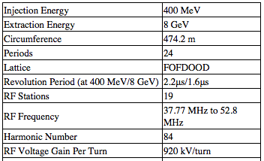
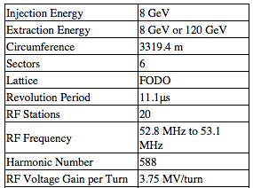
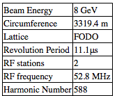
Accelerators at Fermilab
Booster
Main Injector
Recycler

Slide 5
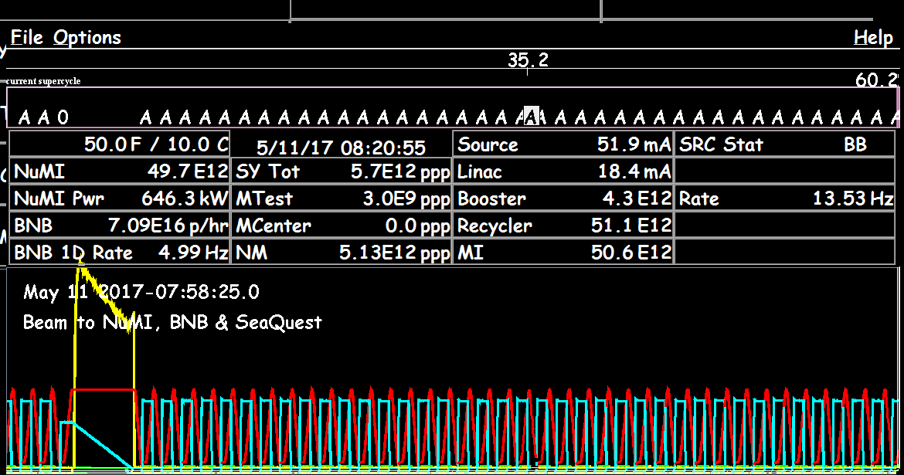
Beam On Display

Slide 6
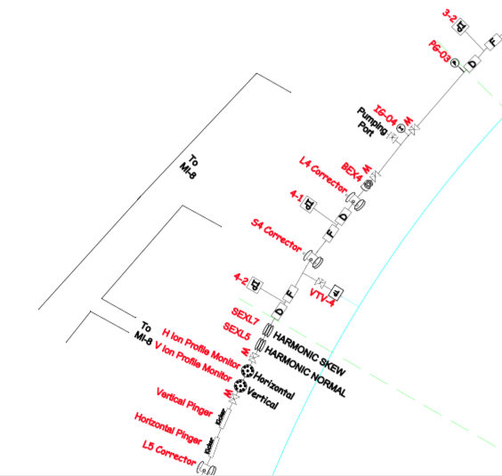
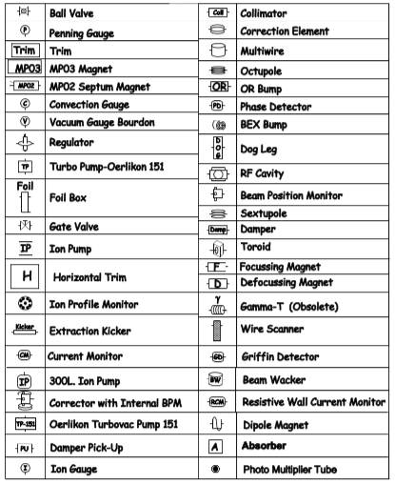
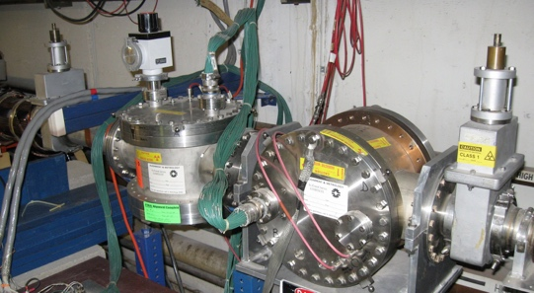
Booster IPM Location
New Booster IPM Installation this summer
Existing Booster IPM Installation
Booster Layout PDF
http://www-bd.fnal.gov/proton/booster/BoosterLayout.pdf

Slide 7
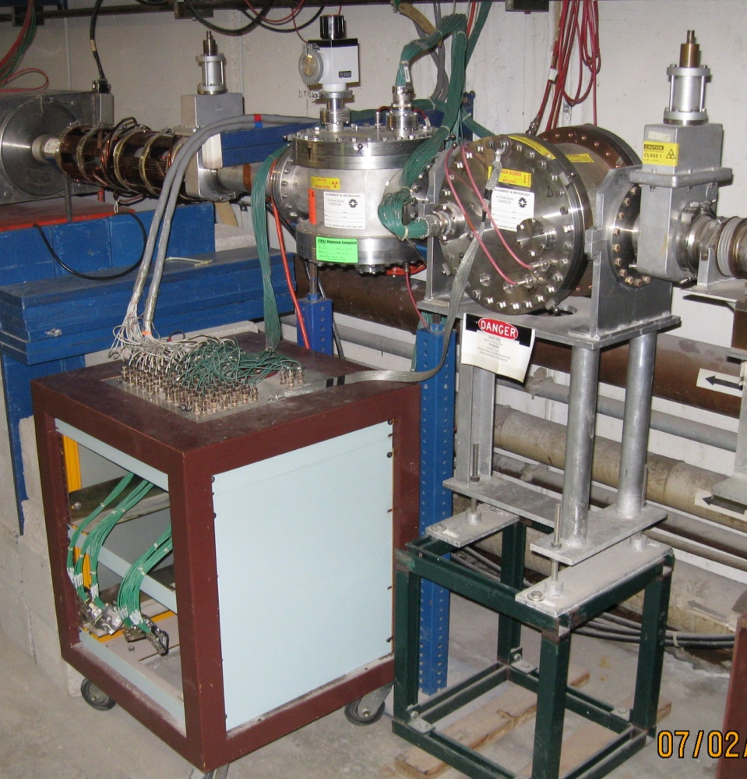
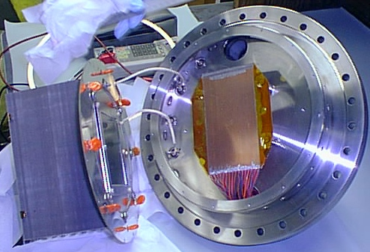
Existing Booster IPM
Originally installed ~1990’s in Booster as W Graves PHD project.
8KV Clearing Field
7

Slide 8
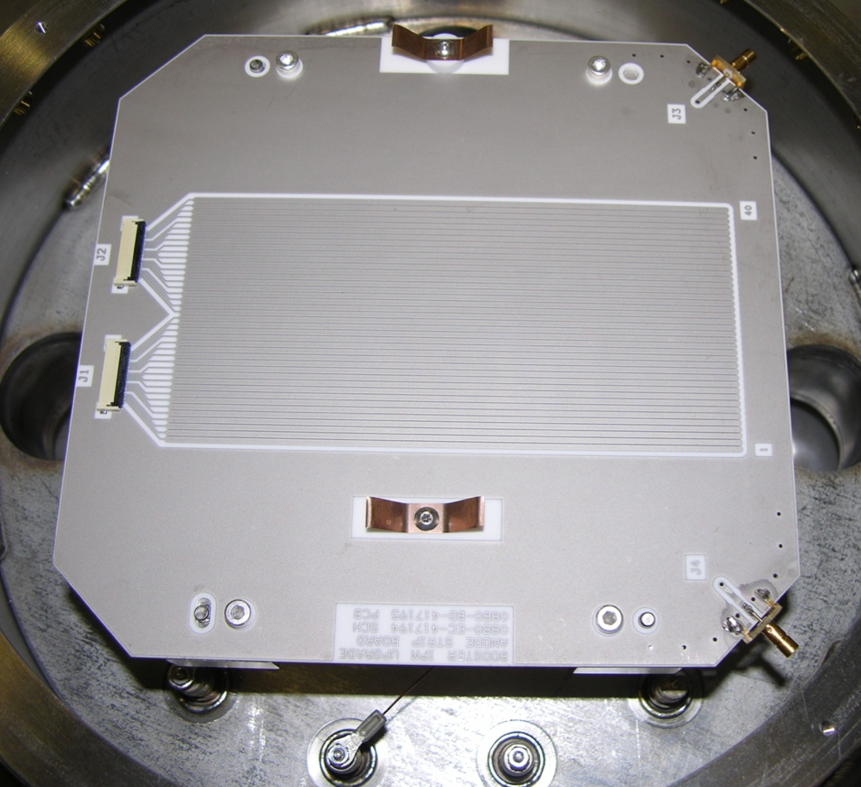
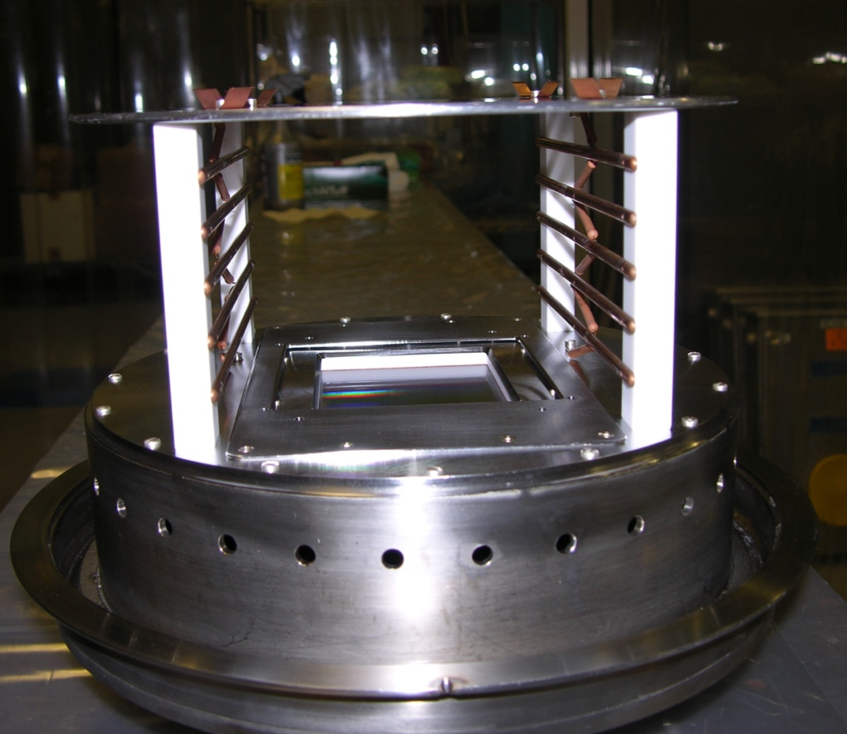
New Booster IPM Can Assembly for Long 4
Main Ring IPMs were reconfigured to use in Booster.
30KV designed to give a good measurement over entire Booster cycle
Will be installed this shutdown.
40 Strips spaced at 1.5mm pitch
Flash Test Strip added
Large Aperture

Slide 9
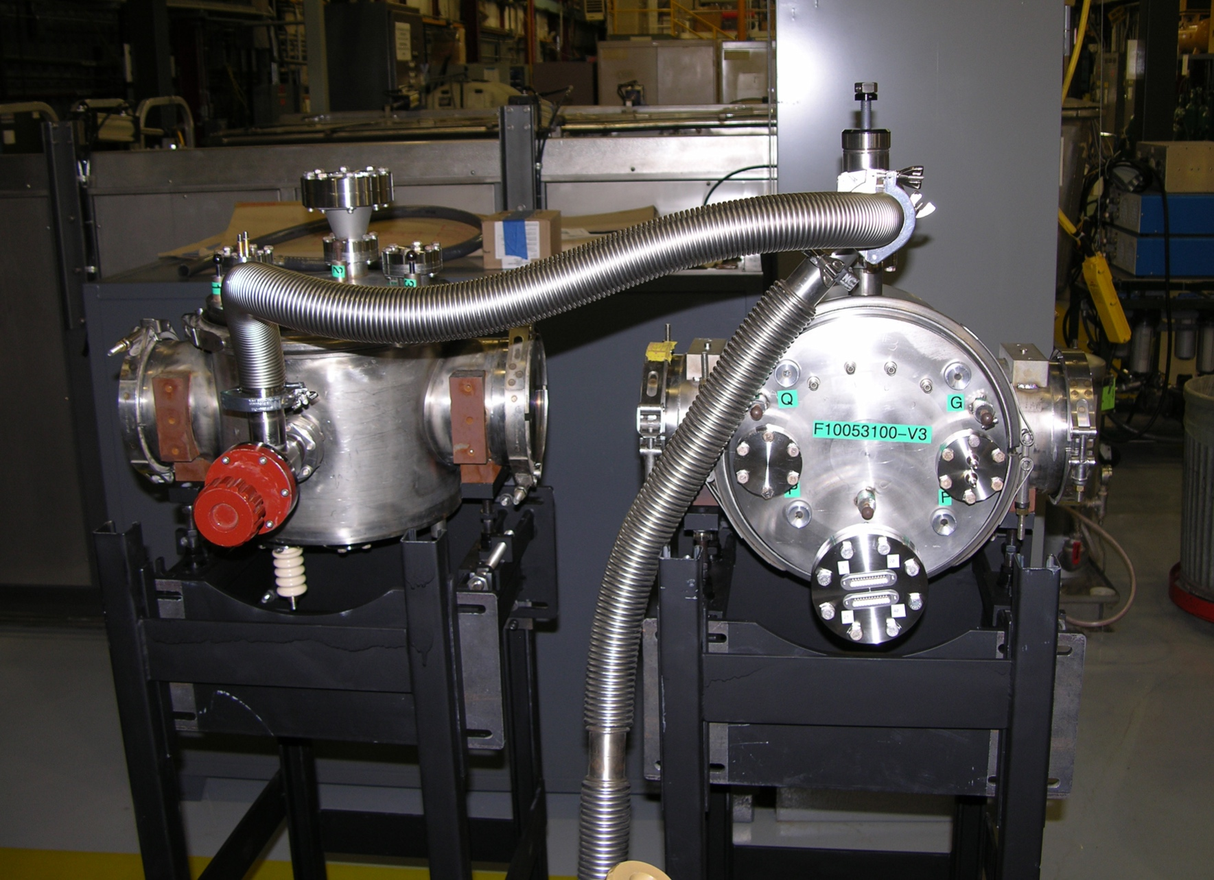
New Booster IPM Can Assembly Vacuum Certified Awaiting Installation this summer

Slide 10
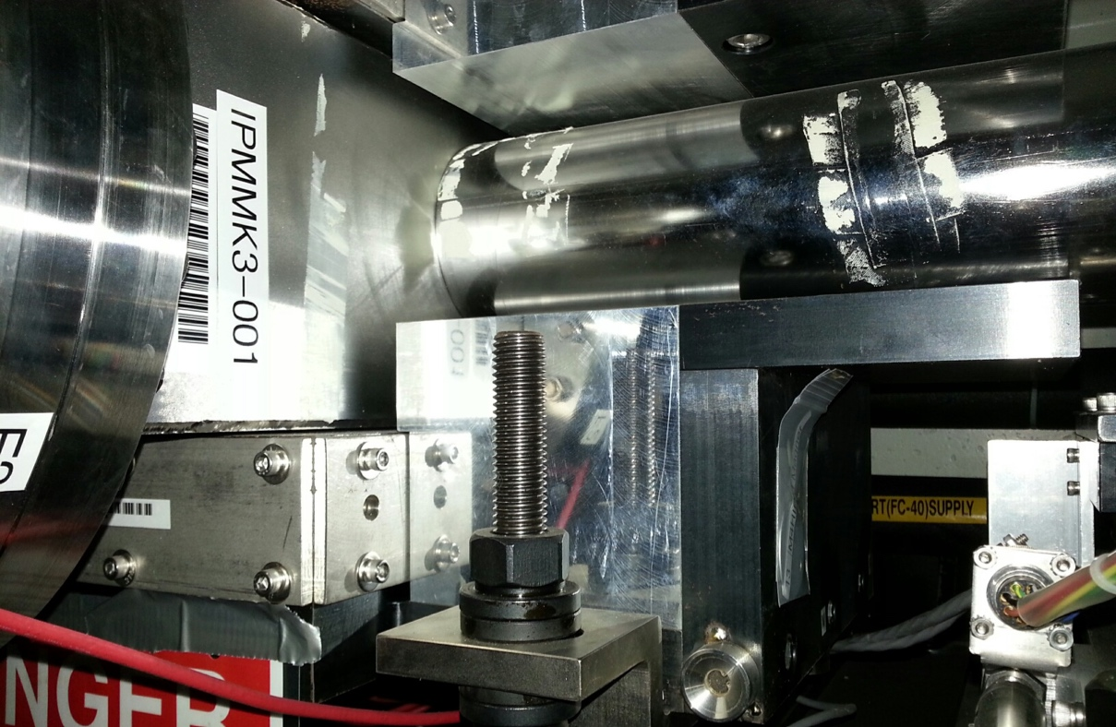
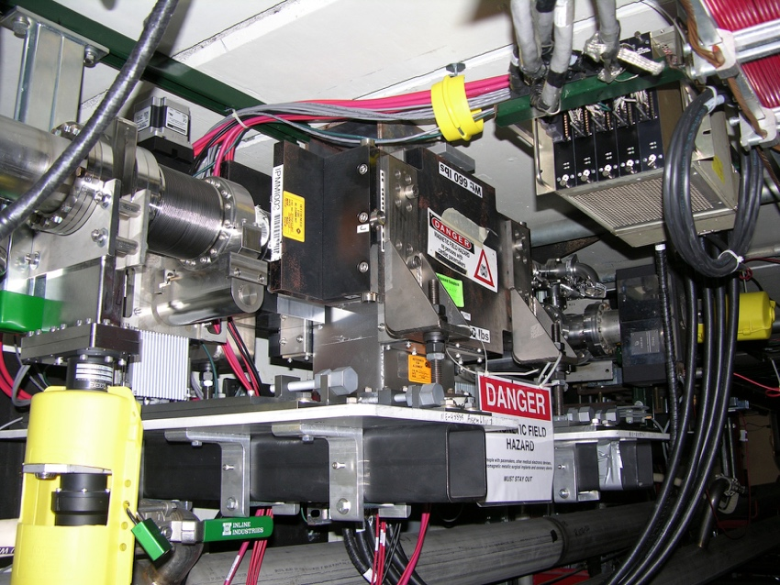
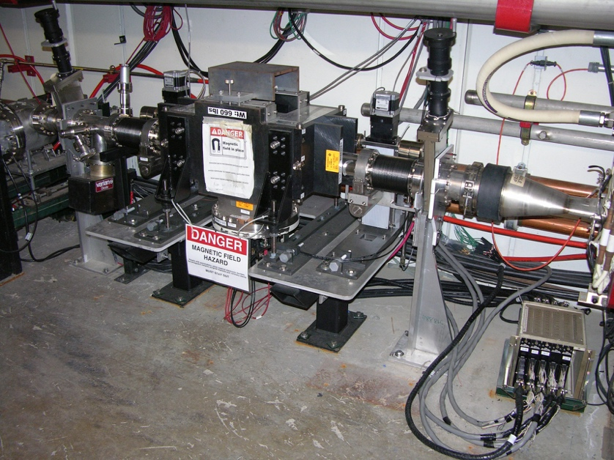
IPM Installations
Recycler Vertical at Q103
Recycler Horizontal At Q105
Main Injector Horizontal at Q104
Main Injector Vertical at Q103
10
Jim Zagel | GSI

Slide 11
Tevatron IPM
Used to measure 36 Proton and 36 Anti-Proton bunches per turn using QIE Chips in tunnel.
Horizontal Detector
Horizontal Correction Magnet

Slide 12
Main Injector IPM Discoloration
Some time after installation, with lots of beam having been exposed, we notice some slight discoloration on the supporting structures and on the beam side of the MCP.

Slide 13
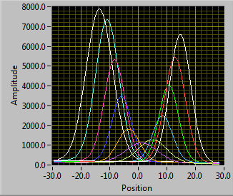
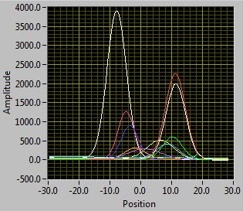
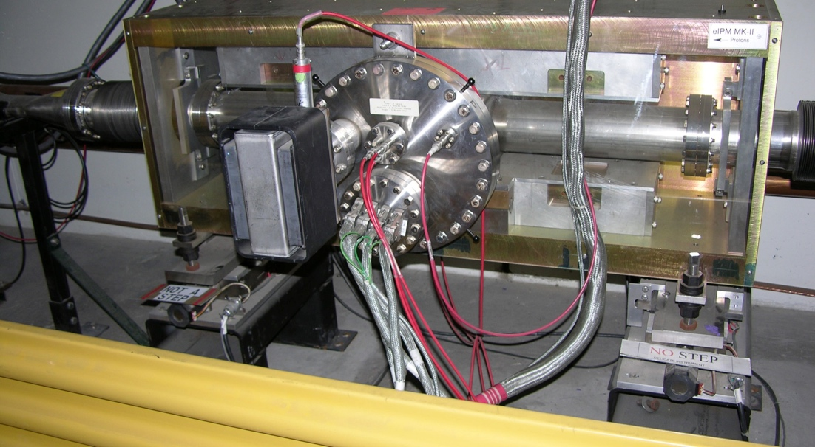
IPM MCP Scan
June 2016 Scan
Independent up and downstream +/- 25mm in horizontal plane for alignment and MCP Exposure.
Allows us to maximize MCP Life.
March 2017 Scan
Upstream Slide is binding as we approach 300mils off center.
We will replace both slides with a more robust/rad-hard version this summer.

Slide 14
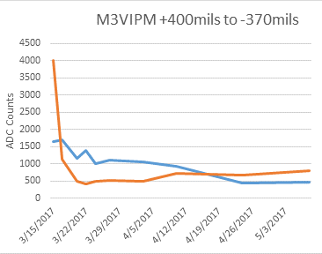
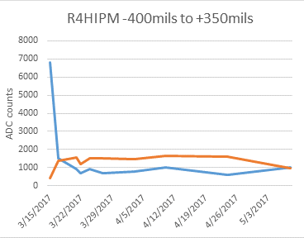
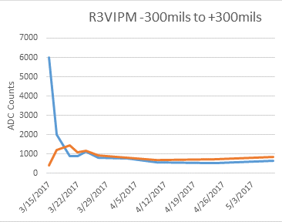
IPM Scan Plots After Move

Slide 15
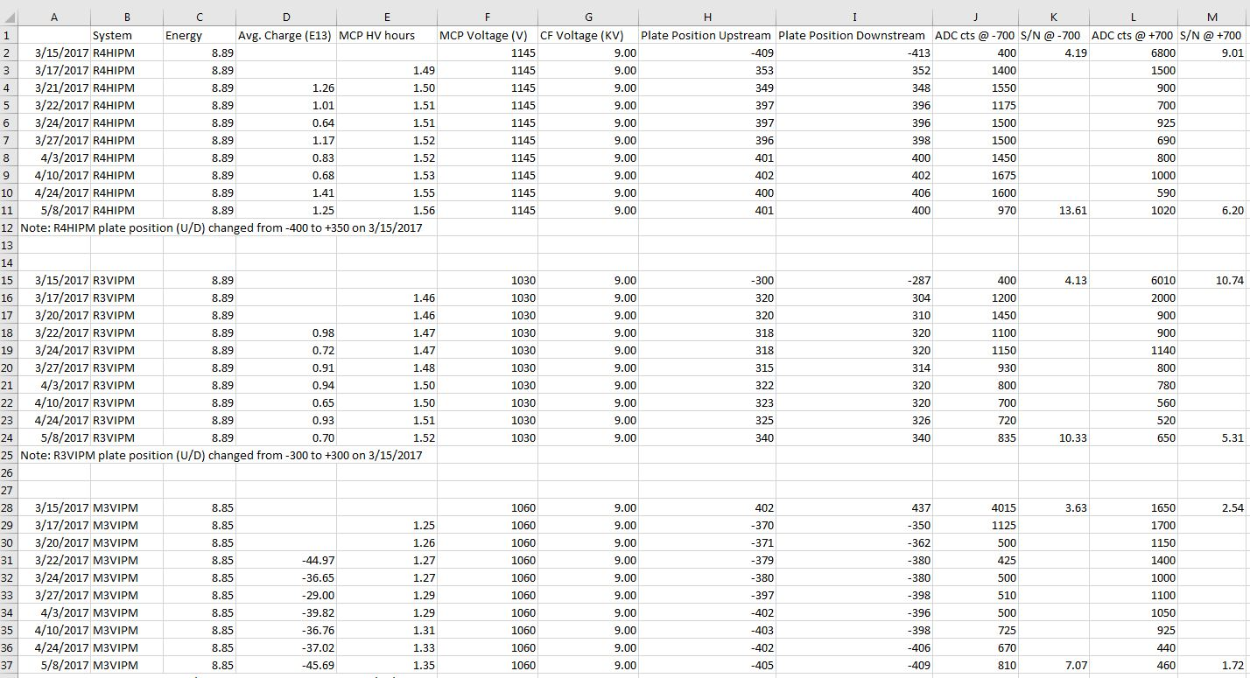
IPM Scan Data Yields Relative S/N

Slide 16
Main Injector IPM Control Grid

Slide 17
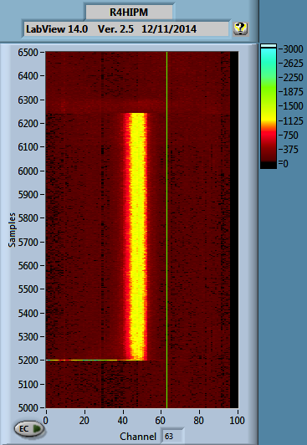
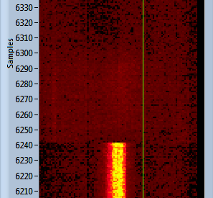
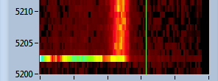
Control Grid Demonstration Test R4H
Control of electrons allowed to hit MCP.
Turn off
Turn on

Slide 18
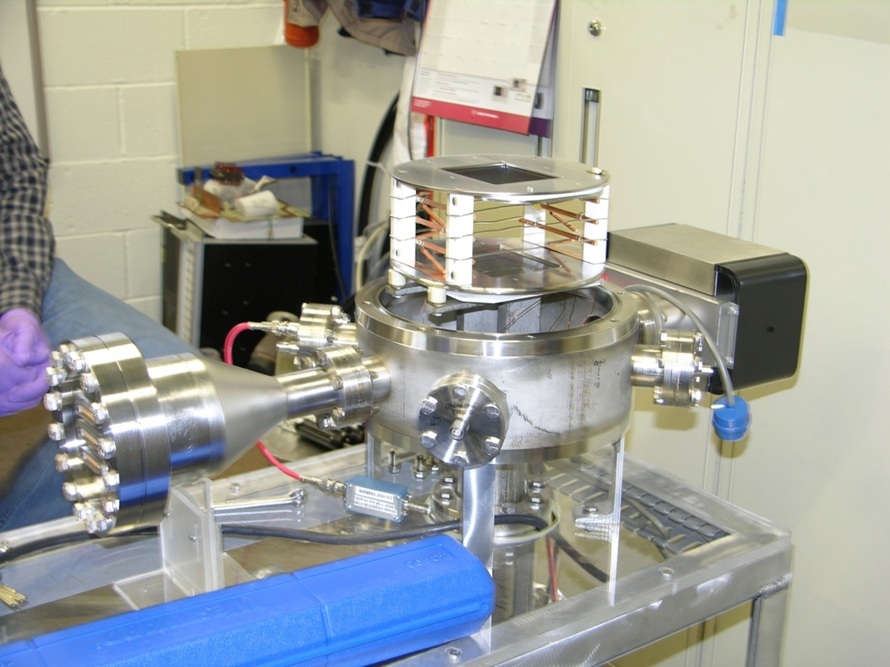
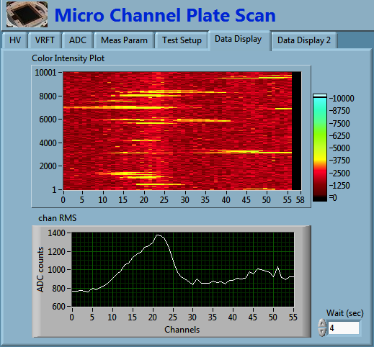
MCP Test Chamber
Facility to scan MCPs for suitability and look at areas of reduced gain
EGN Scan
Using an Electron Generator to provide a uniform signal for testing MCP’s.
Unfortunately the EGN is anything but uniform. Lots of shot noise over time

Slide 19
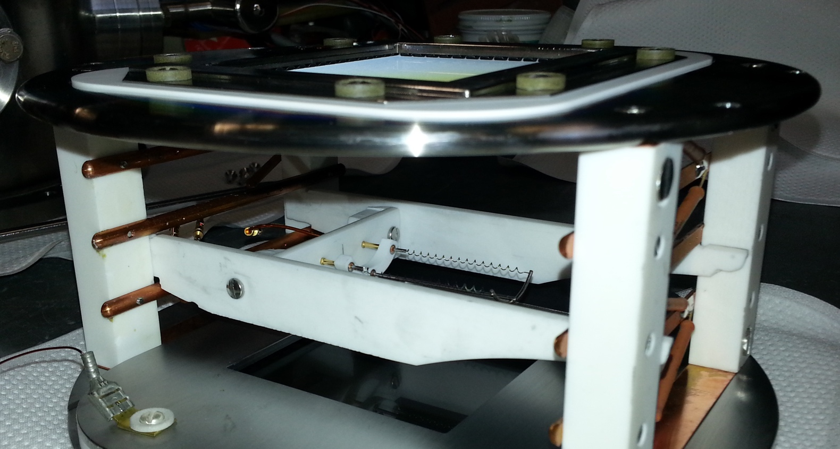
MCP Test Chamber
Using a Nude Ion Gauge filament to provide a steady controllable source of electrons
New 3” Filament
1.5” Filament Installed

Slide 20
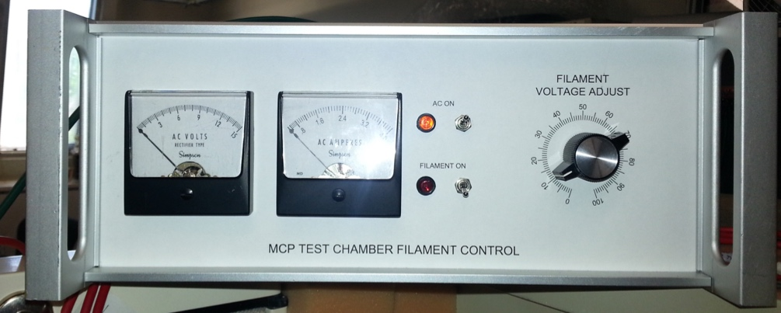
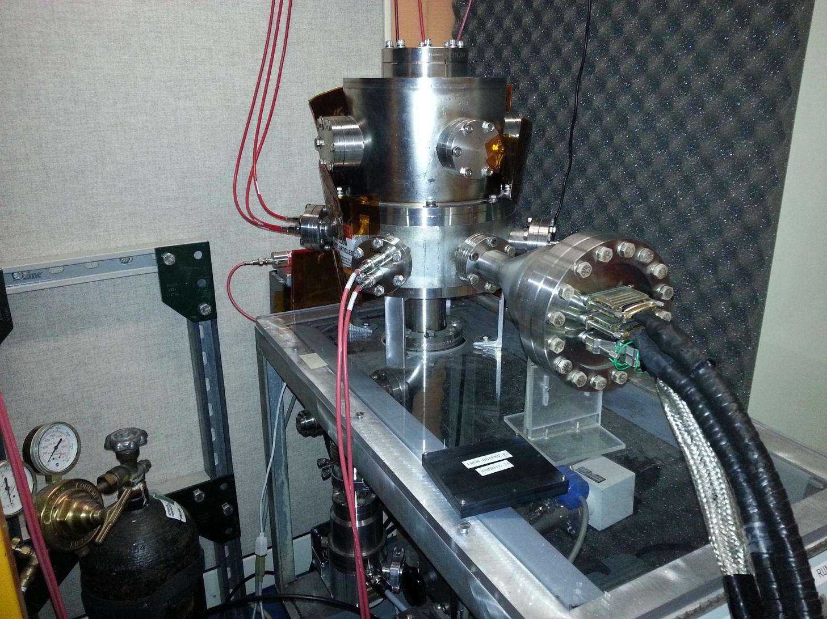
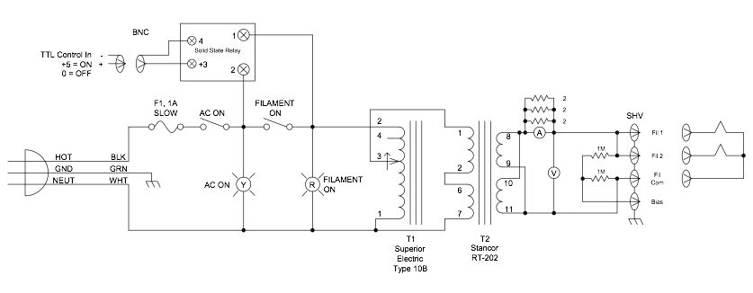
MCP Test Chamber Work Continues
Test Chamber
Filament Controller

Slide 21
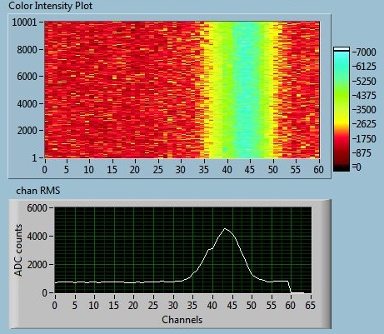
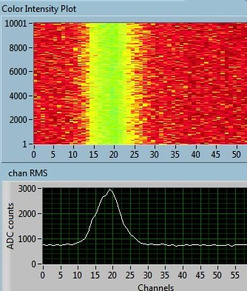
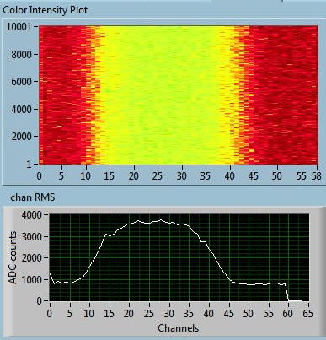
MCP Test Chamber
Filament Scan
Using a Nude Ion Gauge filament to provide a steady source of electrons
First test mounting filaments parallel to pick-up strips for proof of principle
Bottom Right, filament perpendicular to pickup strips
Filament 2 Parallel
Filament 1 Parallel
1.5” Filament 90º
Notes:
Strips at 1mm pitch filament measures approximately .8” = 20.32mm

Slide 22
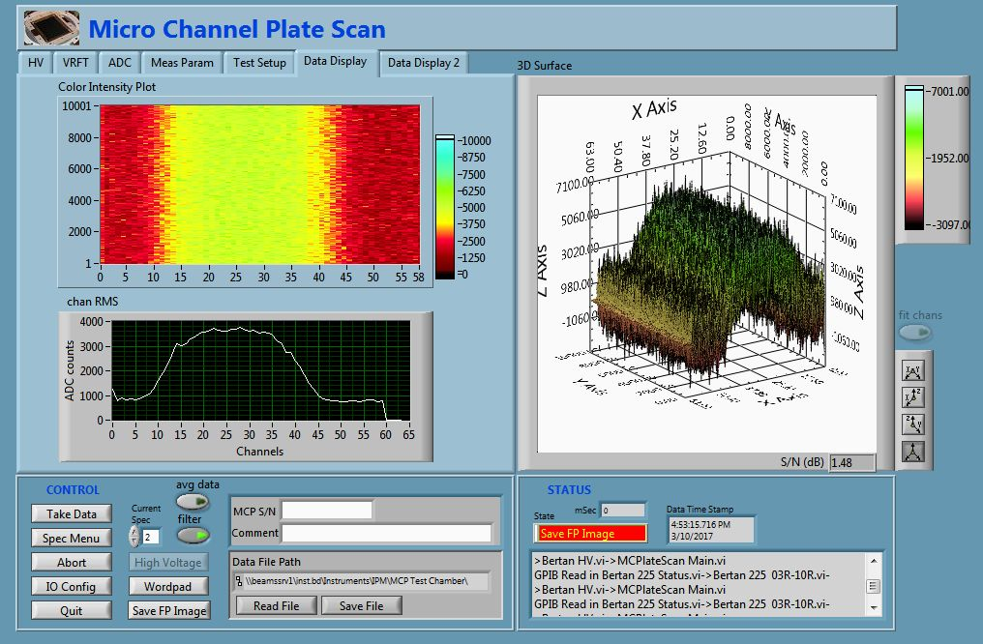
MCP Test Chamber
1.5” Filament Scan
Using 1.5” Nude Ion Gauge filament to provide a steady source of electrons
Filament perpendicular to pickup strips

Slide 23
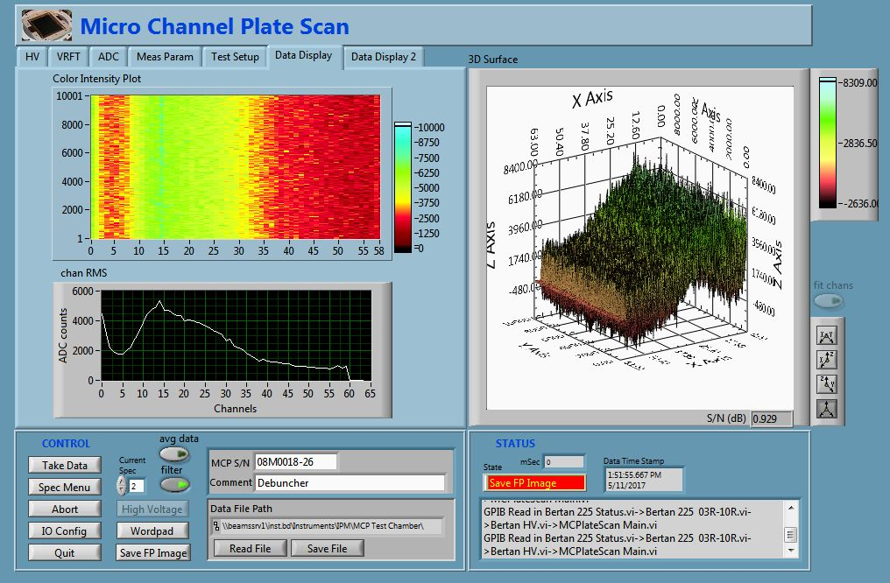
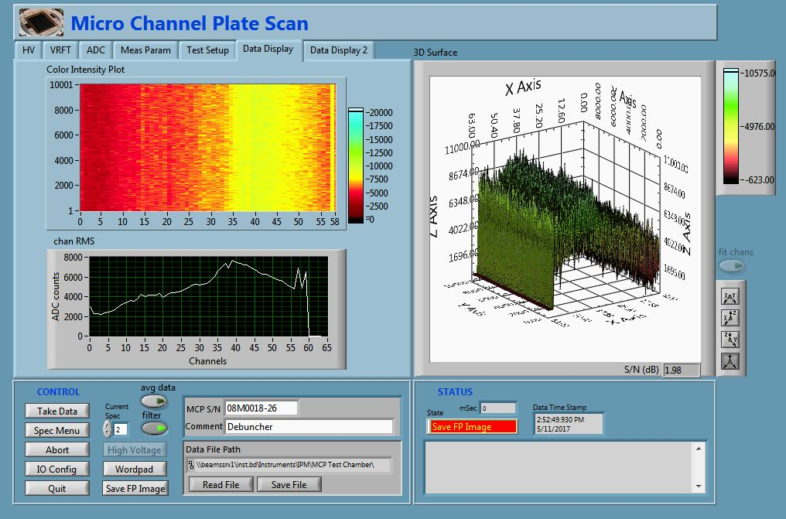
MCP Test Chamber
3” Filament Scan
Filament perpendicular to pickup strips
Magnet Compensation
Initial Signal

Slide 24
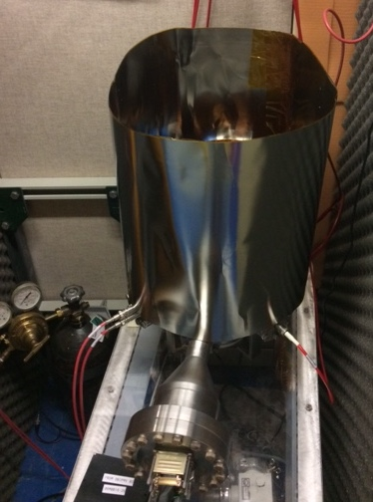
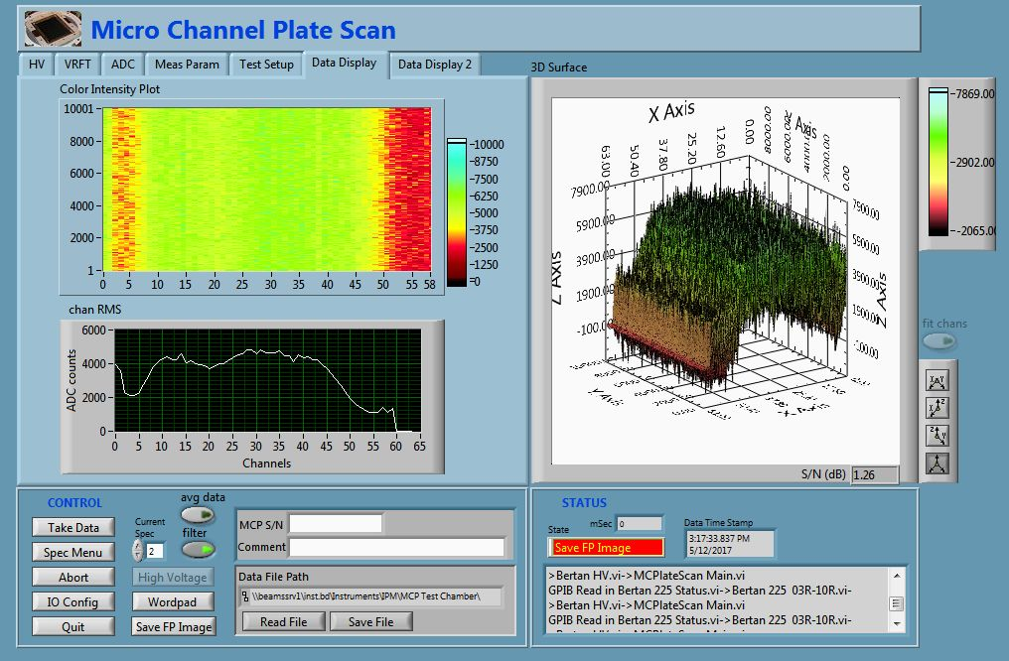
MCP Test Chamber
3” Filament Scan
With Mu Metal Shielding

Slide 25
That’s All Folks
That is all for now
Thank you for your attention

Slide 26
Extra Material
Beyond here, there be Dragons!

Slide 27
Recent References
Dirk Bartkoski, PhD Dissertation:
Analysis, Prototyping, and Design of an Ionization Profile Monitor for the Spallation Neutron Source Accumulator Ring, December 2013
https://www.researchgate.net/publication/269393015
Nuclear Instruments and Methods in Physics Research Section A Accelerators Spectrometers Detectors and Associated Equipment 11/2014; 767:379–384. DOI:10.1016/j.nima.2014.09.020
9th Ditanet Topical Workshop on Non-Invasive Beam Size Measurement
for High Brightness Proton and Heavy Ion Accelerators, April 2013
https://indico.cern.ch/event/229959/
International Beam Instrumentation Conference (IBIC):
September 2015-Melbourne, Australia: http://www.ibic2015.org
September 2014-Monterey, California: https://conf-slac.stanford.edu/ibic-2014/
September 2016-Barcelona, Spain: http://www.ibic2016.org/
NEXT: International Beam Instrumentation Conference (IBIC):
August 2017-Grand Rapids Michigan: http://www.ibic2017.org/
Note: IBIC of interest is not the INTERNATIONAL CONFERENCE ON INDUSTRIAL BIOTECHNOLOGY

Slide 28
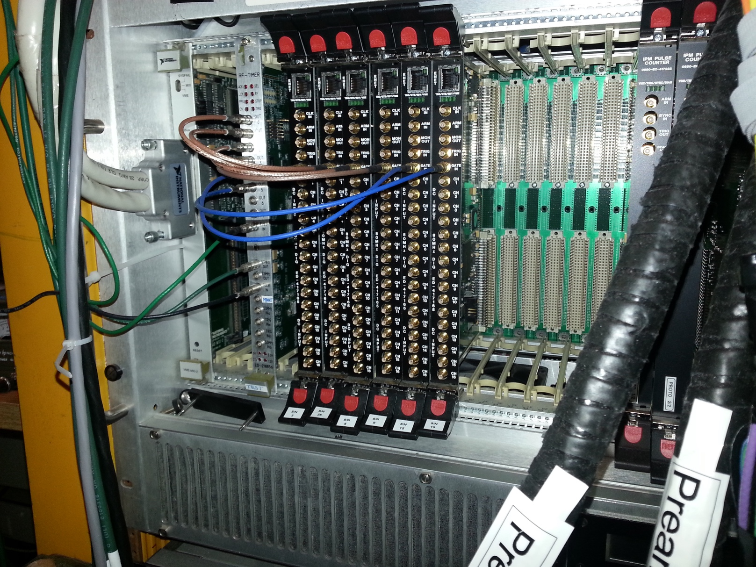
High Speed Digitizers
IPM VME Crate

Slide 29
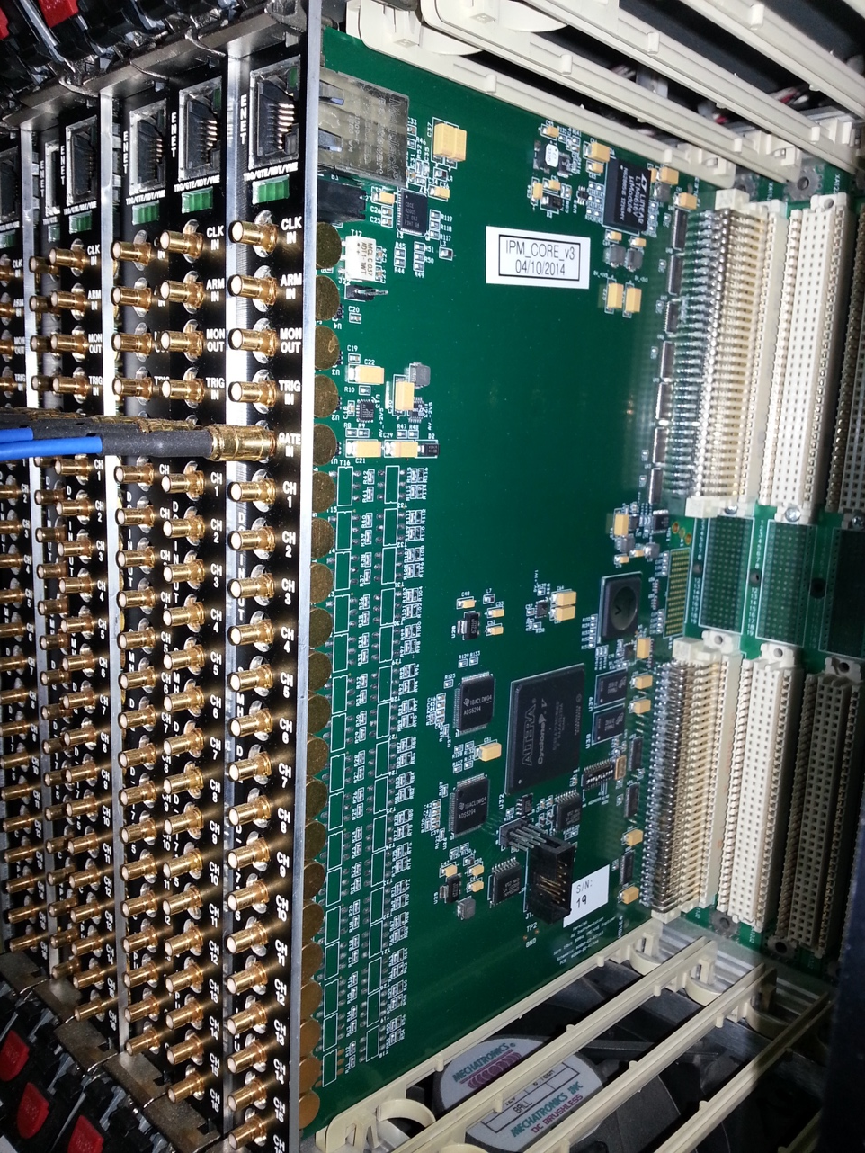
High Speed Digitizers
Alexei Semenov has designed a series of VME digitizers that are the root of most new instrumentation at Fermilab.
Channels | Bits | Frequency | Used on
16 | 14 | 80 MHz | IPM, LCLS
8 | 14 | 125 MHz | ATF, General
12 | 14 | 250 MHz | Booster BPM
8 | 16 | 250 MHz | New Booster BPM
Channels | Bits | Frequency | Used on
16 ADC | 14 | 80 MHz | IPM, LCLS
8 ADC | 14 | 125 MHz | ATF, General
12 ADC | 14 | 250 MHz | Booster BPM
8 ADC | 16 | 250 MHz | New Booster BPM
Feedback System
4 ADC + 4 DAC | 16 | 250MHz | DCCT, Longitudinal Damper

Slide 30
Ionization Profile Monitors

Slide 31
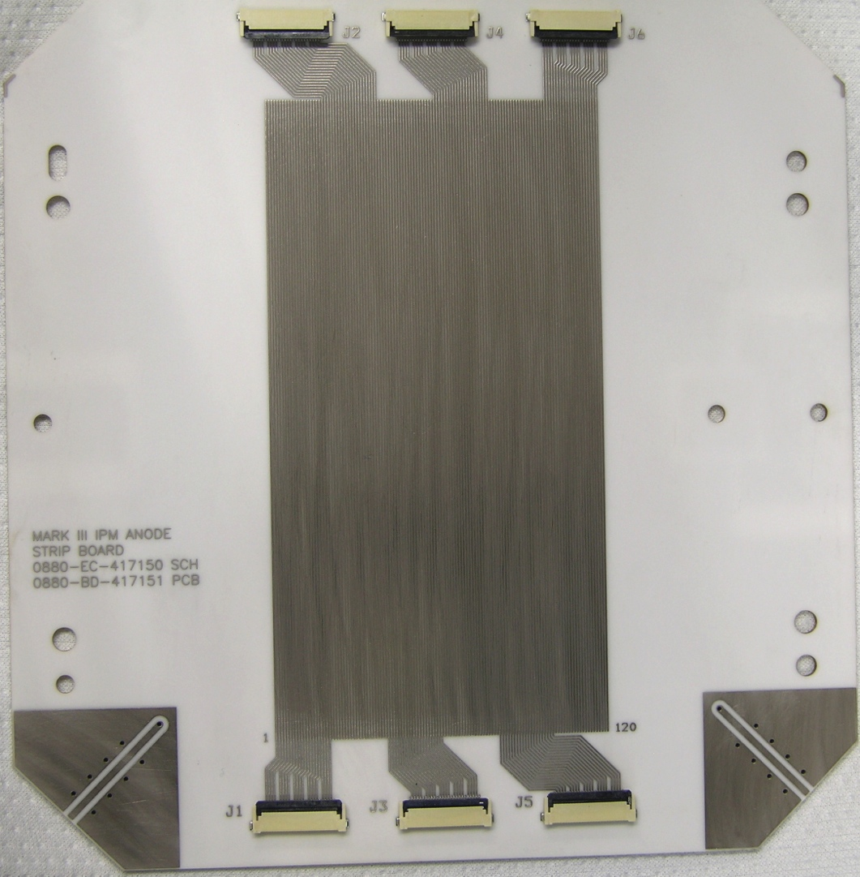
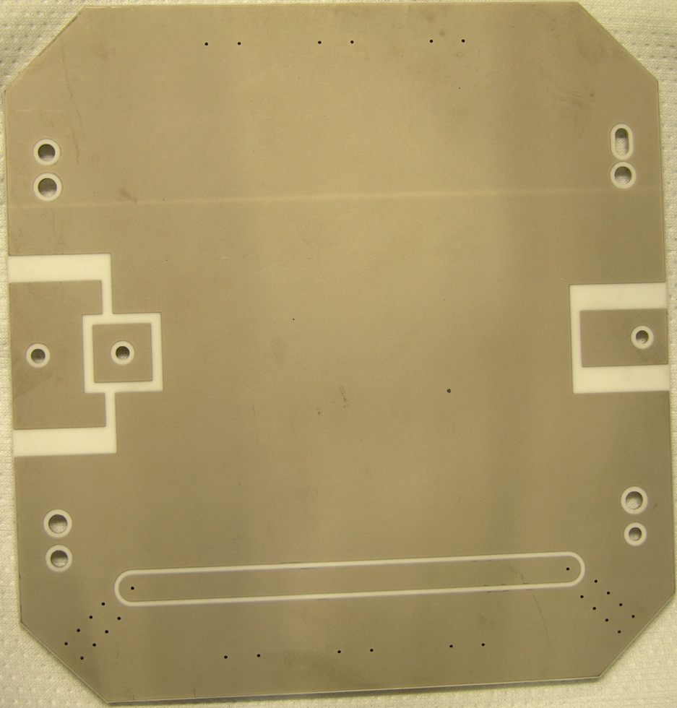
Anode Strip Board
Main Injector/Recycler Details
Ceramic
Mass terminated connectors.
80% copper, 20% space.
MCP Power Pads
50Ω Flash Test Strip

Slide 32
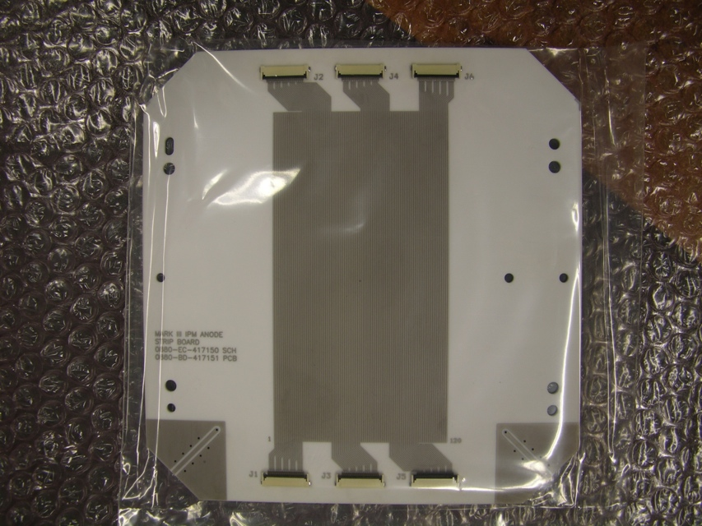
Anode Strip Board cont’d
Beam Size determines # of Strips and Pitch
Booster
Beam sigma 4.5 mm
48 Strips at 1.5 mm Pitch
1.2E12 to 4.5E12 protons
Main Injector/Recycler
Beam sigma 4.5 - 1.5 mm
120 Strips at 0.5 mm pitch
MI up to 6 booster batches
RR slip stack up to 12 batches
RR max intensity 5E13

